Slide 1
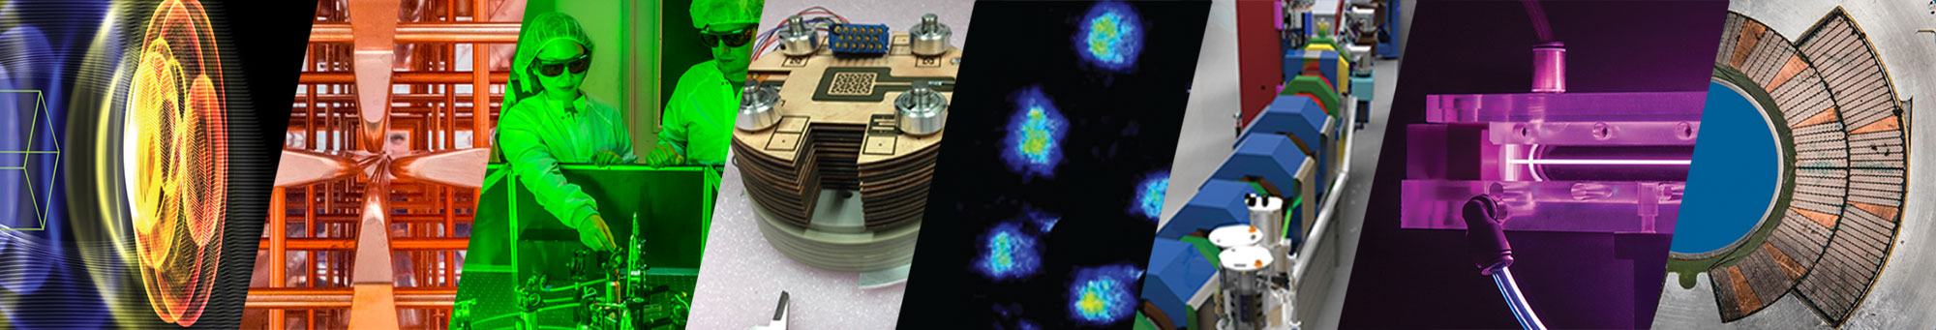
Chad Mitchell, Lawrence Berkeley National Laboratory
Tools for Modeling Beam Dynamics in Rings Based on
Nonlinear Integrable Optics
14th International Computational Accelerator Physics Conference
October 2-5, 2024
Advanced Modeling Program

Slide 2
Acknowledgements
Thanks to the organizing committee and to collaborators, including especially:
Kilean Hwang (MSU) and Rob Ryne (LBNL affiliate)
Sasha Valishev, Sasha Romanov, Jeff Eldred (FNAL)
David Bruhwiler, Chris Hall, Nathan Cook (RadiaSoft)
Finn O’Shea (formerly RadiaBeam)
Yongjun Li, Sergei Nagaitsev (Brookhaven)
This work was supported by the DOE Office of Science, Office of High Energy Physics, and made use of computing resources at the National Energy Research Scientific Computing Center.

Slide 3

Outline
Nonlinear integrable beam optics in rings
Computational and theoretical tools
  single-particle dynamics – tracking, analytical methods
  collective effects – space charge, matching, relaxation
  numerical diagnostics – chaos, filamentation, losses
Optimization for halo suppression
Conclusions

Slide 4
Nonlinear Integrable Beam Optics in Rings

Slide 5
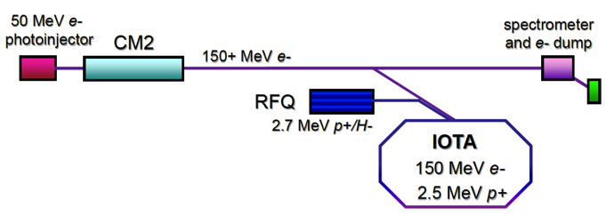
The IOTA storage ring : an accelerator R&D test facility with a focus
on strategies to mitigate space charge-induced beam halo.
Possible solutions: electron lenses and columns, nonlinear integrable lattices
Integrable Optics Test Accelerator (IOTA)
- Novel accelerator physics: strongly nonlinear design
- Experimental test bed for space charge mitigation
- Run first with electrons, then low-energy protons
Fermilab
halo
Webb et al¹
halo
using conventional linear design
using nonlinear integrable design
nonlinear magnetic insert
Nonlinearity tune spread “washes out” instabilities, core-halo resonances
Integrability ensures orbits are regular and remain bounded (no chaos)
S. Danilov, S. Nagaitsev, PRAB 13, 084002 (2010)
S. Antipov et al, JINST 12, T03002 (2017)
¹S. Webb et al, p. 2961, IPAC 2012

Slide 6
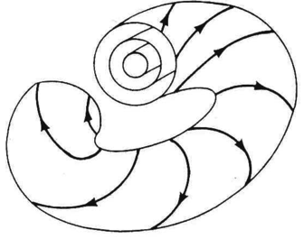
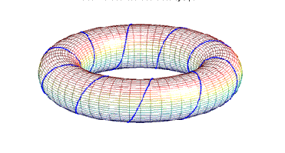
Integrability = the single-particle orbits are confined to level sets defined by invariants
of motion motion with stable frequencies (tunes)
Liouville-Arnold Theorem
Suppose H is a time-independent Hamiltonian for an n degree-of-freedom system,
and H = f₁, f₂, ..., f_{n} are n smooth functions on the phase space M such that:
invariants
1)
are linearly independent
(the f_{j} are independent)
2)
(the f_{j} are in involution)
level sets
The motion is confined to a set .
If M_{z} is compact and connected, then M_{z} is diffeomorphic to the n-torus.
Examples:
- stable linear motion
- nonlinear pendulum
- 2-body Keplerian motion
Similar definitions apply
to symplectic maps.
linear
flow
smooth coordinate
transformation
original
variables
action-angle
variables

Slide 7
Fermilab’s IOTA Ring: Nonlinear Integrable Optics Lattice Configuration
Two invariants of the transverse motion*.
H - single-particle Hamiltonian
I – second invariant
drift space for
nonlinear insert
Equivalent to
integrable
motion in a
2D nonlinear
potential
β_{x} = β_{y} , D = 0 across the nonlinear drift space
nπ phase advance from nonlinear drift space
exit to nonlinear drift space entrance
impacted by space charge
IOTA’s experimental program also includes:
use of electron lenses and columns
optical stochastic cooling
single-electron quantum science
*S. Danilov and S. Nagaitsev, PRAB 13, 084002 (2010).
S. Antipov et al, JINST 12, T03002 (2017)

Slide 8
R&D Areas: Long-Time Beam Prediction at the Interface Between Nonlinear Dynamics and High Intensity
Advanced Algorithm Development (Goals: improved speed and fidelity of modeling on long time scales.)
Fast symplectic tracking in nonlinear applied fields/fringe fields (non-split Hamiltonians)
Improved integration of realistic 3D Maxwellian RF and magnet models with tracking tools
Structure-preserving space charge modeling to ensure phase space preservation
Improved integration of space charge with s-based tracking (e.g., long, bunched beams, dipoles)
Efficient space charge modeling at high resolution (adaptive mesh refinement, higher-order particle shapes)
Addressing computational bottlenecks (eg., fast in-situ numerical phase space diagnostics to reduce I/O)
Mathematical and Theoretical Methods (Goals: validation and physics understanding for effective design.)
Nonlinear methods (e.g. Lie methods, near-integrable dynamical systems) – dynamic aperture
Self-consistent beam equilibria and stability with nonlinear focusing – matching
Understanding numerical artifacts (particle noise) associated with long-term simulation
Theoretical models of space-charge-induced beam halo formation with nonlinear focusing
Theoretical models of collective instabilities and nonlinear decoherence (Landau damping)

Slide 9
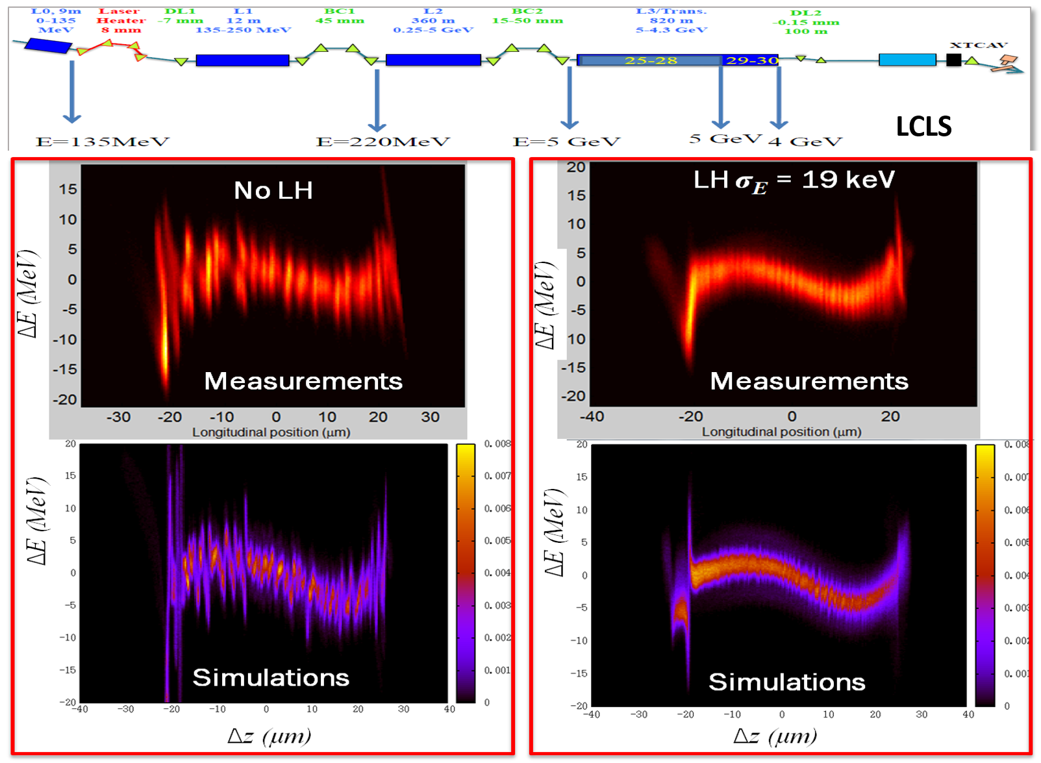
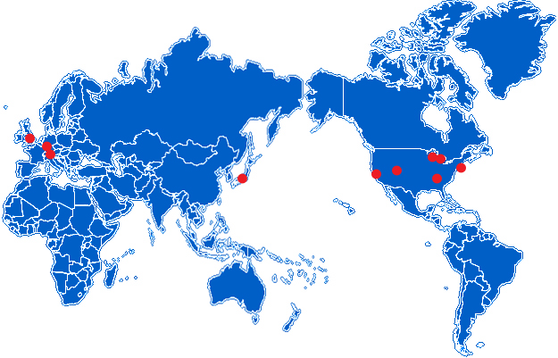

IMPACT: Multi-Physics High-Intensity and High Brightness Beam Dynamics Code Suite
Key features include:
  time-dependent and position dependent PICs
  serial and massive parallelization
  detailed 3D RF accelerating and focusing model
  standard elements: dipole, solenoid, multipole, etc.
  multiple charge states, multiple bunches
  3D space charge effects
  structure and resistive wall wakefields
  coherent synchrotron radiation (CSR)
  incoherent synchrotron radiation (ISR)
  photo-electron emission
  machine errors and steering
The IMPACT code suite is used by > 40
institutes worldwide
  successfully applied to both electron & proton
  machines:
    CERN PS2 ring, SNS linac, ...
    LCLS-II linac
  microbunching simulated using 2B macroparticles
Start-to-end simulation of the Linac Coherent Light Source
J. Qiang et al., Phys. Rev. Accel. Beams 20, 054402 (2017).
https://blast.lbl.gov/
Notes:
IMPACT is well known to the accelerator modeling community.
Contains time-based code IMPACT-T for modeling low-energy injectors, and s-based code iMPACT-Z for modeling linacs and rings at higher energy.
Well-tested models of standard accelerator elements, with detailed models of RF cavities and a variety of collective effects.

Slide 10
Single-particle dynamics

Slide 11
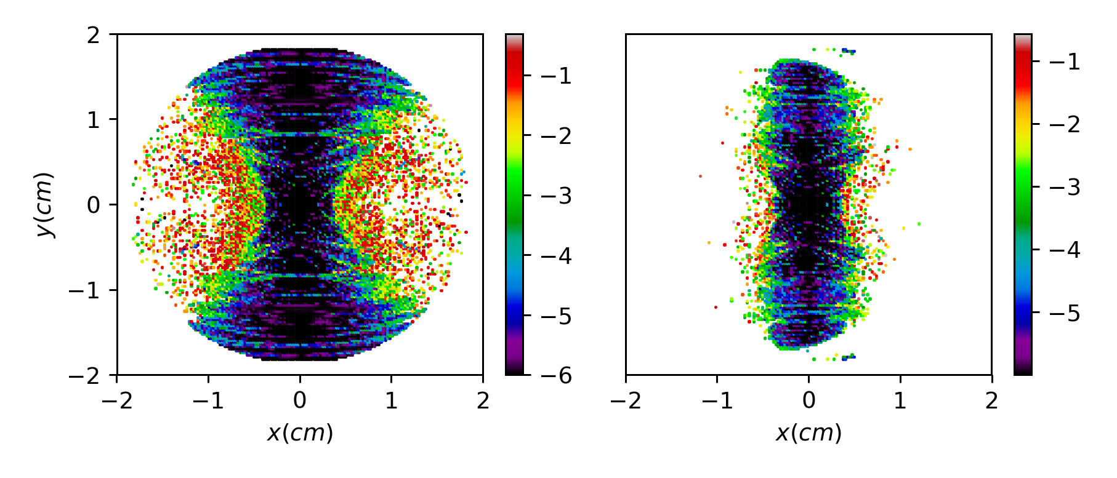
New algorithms and numerical capabilities added to IMPACT-Z to address challenges of modeling nonlinear integrable dynamics.
Implementation of the nonlinear magnetic insert using a symplectic integrator
Field lines of the nonlinear insert in the
transverse plane
Concise, complex representation of the nonlinear integrable potential.
Uses a 2nd order symplectic integrator to perform s-dependent tracking.
Avoids instability of previous integrators due to vanishing denominators in equations of motion.
Additional tools for soft-edge fringe fields.
Longitudinal variation of quadrupole gradient
1.8 m
z (segment)
Nonlinear quadrupole fringe field effects
QFF off
QFF on
The map for a single numerical step of size h:
Other new capabilities implemented in IMPACT-Z
Map for a single longitudinal step of size h:
Python interface and postprocessing control using Jupyter.
Implementation of quadrupole and dipole nonlinear fringe field
models relevant for modeling proton rings at low-moderate energy.
Additional Poisson solvers and diagnostics capabilities (discussed later).
C. Mitchell, in Proceedings NOCE 2017, and IPAC 2018, and arXiv:1908.00036

Slide 12
Geometric methods in nonlinear dynamics provide a foundation for the analysis of single-particle optics in integrable accelerator lattices.
Need: To understand the global single-particle dynamics accessible in accelerator designs (such as IOTA) based on nonlinear integrable optics.
Problem: Standard approaches to nonlinear dynamics in the accelerator community are perturbative, neglect fully 4D or 6D coupling, or require a clever choice of coordinates.
Solution: Geometric methods from the theory of integrable Hamiltonian systems may be applied to locate fixed points, periodic orbits, dynamical bifurcations, and determine frequencies of motion (tunes), using knowledge only of the invariants of motion.
Critical initial conditions at
nominal IOTA insert strength
p_{x}=p_{y}=0
separatrix
stable
periodic
Reveals new operating points for the IOTA ring and guidance for future accelerator designs.
fixed point
Bifurcations of dynamical fixed points
in IOTA vs. magnetic insert strength
C. Mitchell et al,
Phys. Rev. E 103,
062216 (2021)
Structure of
invariant level
sets near the
separatrix
τ=-1/2 bifurcation observed
during IOTA experimental run
red – unstable
black - stable
C. Mitchell, K. Hwang, R. Ryne,
Phys. Rev. Accel. Beams 23,
064002 (2020)

Slide 13
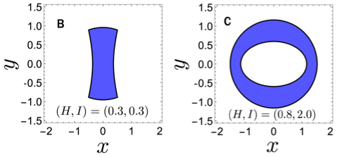
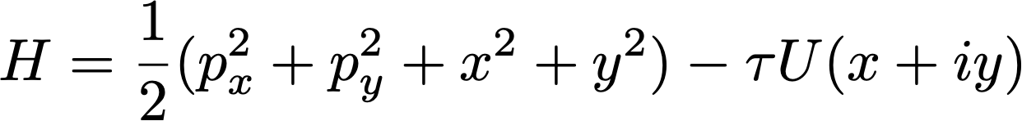
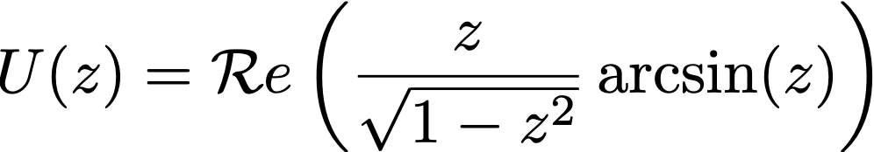
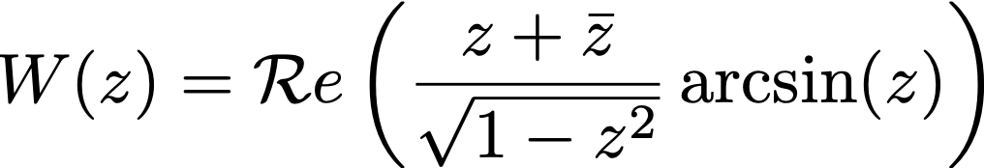
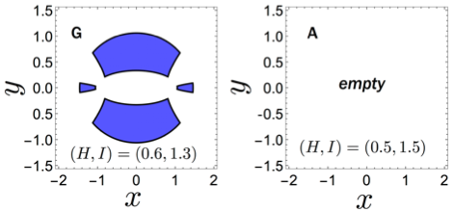
Example: Bifurcation diagram for nominal single-particle dynamics in IOTA
Examples: level sets (projected onto the x-y plane)
Bifurcation diagram showing critical values of (H,I)
Invariants of single-particle motion
nominal
Critical points occur where:
Curves parameterizing the critical values can be determined exactly using symbolic methods eg, Mathematica.
Distinct regions of the diagram correspond to dynamics with qualitatively distinct single-particle orbits.

Slide 14
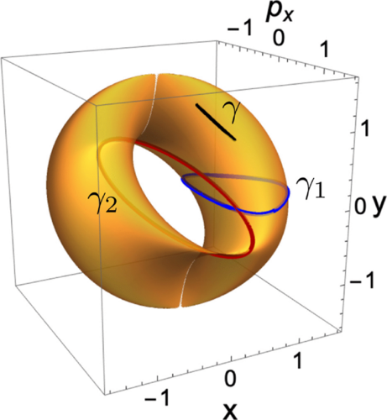
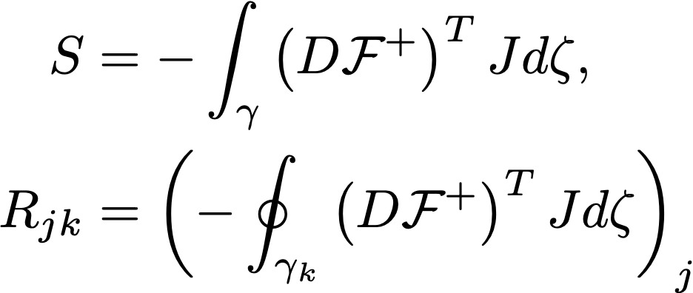

Analytical method for extracting nonlinear tunes of integrable symplectic maps developed and applied to the IOTA ring
Need: To understand analytically the frequency content of orbits
in accelerator lattices based on nonlinear integrable optics, and
to use this information in accelerator design (to control tune spread).
Problem: Traditional method for analysis of integrable systems
relies on action-angle coordinates, which are difficult to obtain
in explicit form, and which break down near critical phase space
structures (eg, separatrices).
Solution: A semi-analytical method to extract dynamical tunes of an integrable symplectic map from its invariants of motion, without the
need for tracking, using path integrals in the invariant level sets.
C. Mitchell et al,
Phys. Rev. E 103,
062216 (2021)
Extracting frequencies
of the 4D McMillan mapping
from its 2 invariants of motion
Extracting tunes for orbits in IOTA for comparison with tracking using NAFF
Reveals the link between frequencies and geometry of level sets.
Can aid in design of future nonlinear integrable lattices.
solution by quadrature
result from tracking (NAFF)
relative difference
≤ 10⁻³
vector of tunes

Slide 15
Collective effects

Slide 16
Implementation of a gridless symplectic space charge solver to enable
long-term Hamiltonian tracking of high intensity beams
Need: Avoid numerical artifacts due to space charge that break the geometric Hamiltonian structure, necessary to ensure reliability on long time scales.
Problem: Most PIC methods result in a particle push that is not symplectic
on the phase space due, e.g. due to interpolation and finite differencing.
Solution: A 2D gridless symplectic space charge solver (J. Qiang, 2017)
was implemented in IMPACT-Z to enable robust long-term tracking with
space charge. Each step is a map that is symplectic on the collective
N-body phase space of the simulated particles.
Evolution of the N-particle Hamiltonian
125 SC kicks
× 4.00
Relative change in H × 10⁶
Evolution of H for a
cylindrical proton
beam expanding to
twice its initial radius
250 SC kicks
500 SC kicks
Avoids the destruction of integrability due to non-symplectic artifacts.
y
decomposition into 2D Fourier modes
kick is a function of the N_{p} particle
coordinates, derived from
a Hamiltonian H
(0, b.)
x
Computational complexity
J. Qiang, Phys. Rev. ST Accel.
Beams 20, 014203 (2017)
(0,0)
16
(a , 0)

Slide 17
New PDE solver enables the study of intense beam equilibria in strongly nonlinear lattices and relaxation to equilibrium
Need: To understand 4D beam Vlasov equilibria for intense beams in constant focusing channels with strongly nonlinear transverse focusing.
Problem: Existing theories of beam equilibria were developed assuming
linear external focusing. Few analytical models in the nonlinear case.
Solution: A spectral Galerkin solver was developed to solve a nonlinear PDE for the equilibrium space charge potential. The new solver was applied to study intense beam equilibria in a nonlinear constant-focusing model of IOTA.
Reveals the expected structure of high intensity stable beams in IOTA.
Equilibrium beam, IOTA
nonlinear channel, 60 mA
Non-equilibrium beam, IOTA
nonlinear channel, 60 mA
Contours illustrating
equilibrium beam
density in the x-y
plane for increasing
value of beam current
Guidance for matching injected
beams using phase space painting.
17
C. Mitchell, R. Ryne, K. Hwang
Phys. Rev. E 100, 053308 (2020)
C. Mitchell, K. Hwang, R. Ryne
J. Instrum. 15, P07019 (2020)

Slide 18
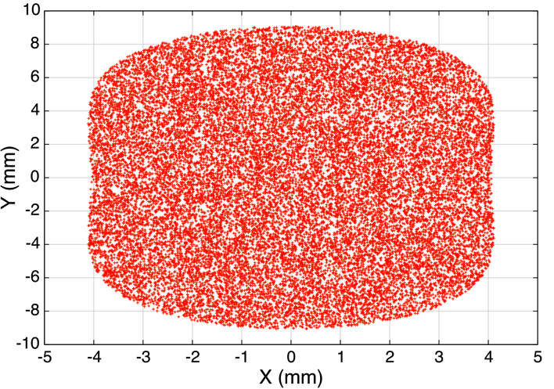
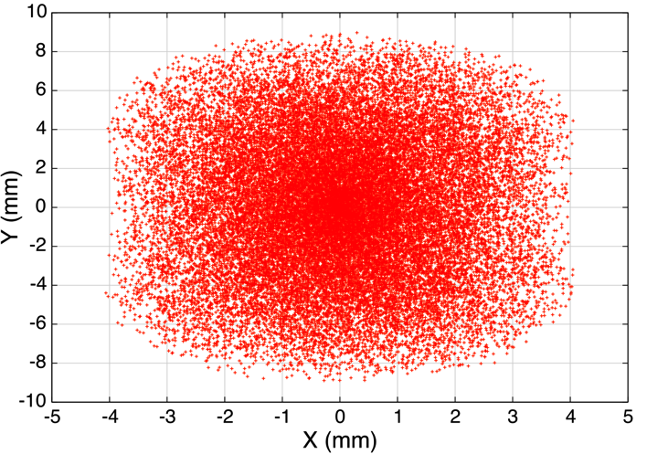
General procedure for the generation of an initial beam distribution matched to the periodic nonlinear lattice
Beam is matched to the nonlinear lattice at the NLI midpoint.
With space charge, adiabatic
ramping of beam current
normalized phase space
variables (x_{N} , p_{xN} , y_{N} , p_{yN})
physical phase space variables (x, p_{x}, y, p_{y})
Vertical
profile
“nonlinear KV distribution” [1]
Courant-Snyder
transformation
- Hamiltonian is s-dependent
- distribution varies periodically in s
- parameter ε₀ plays the role of emittance
“nonlinear waterbag distribution”
- Hamiltonian is s-independent
- distribution function is stationary
Ramping 0-8 mA over 100 turns.
Distribution at nominal 8 mA
current is visibly well-matched.
High-intensity matched beam
exhibits features similar to
the equilibrium in a CF channel.
Nonlinear KV
ε₀ = 8 mm-mrad
Nonlinear waterbag
ε₀ = 8 mm-mrad
boundary = equipotential curve
of the nonlinear potential
[1] S. Webb et al, p. 3099, IPAC 2013.

Slide 19
Numerical diagnostics

Slide 20
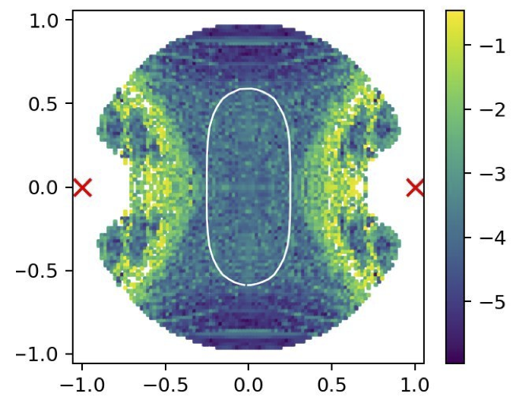
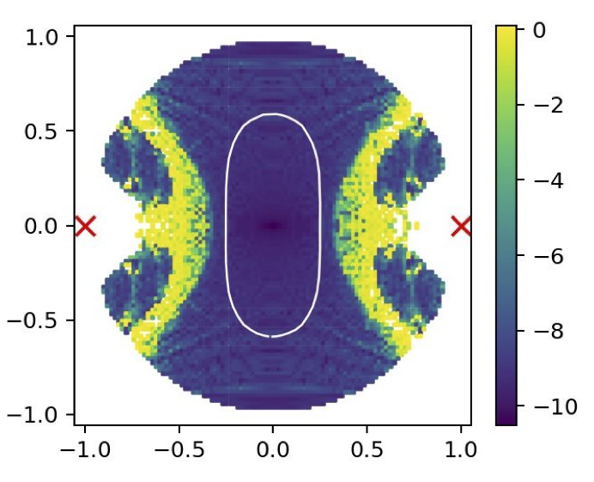
Efficient numerical algorithms reveal the boundary between chaos and integrability in nonlinear integrable lattices with space charge
Need: Accurate tools to distinguish between regular and chaotic motion that do not require long computing times.
Problem: Standard chaos indicators (NAFF) require long time series, and space charge introduces spurious frequency drift and numerical noise.
Solution: Use symplectic and time-reversible tracking algorithms and an efficient chaos indicator using forward-backward integration. Self-consistent tracking and idealized models of space charge reveal similar structure.
Nonlinear resonance lines in IOTA
model with space charge tune shift
beam
beam
y
Reveals phase space regions for IOTA that are sensitive to chaos and to be avoided.
Frequency Map Analysis
Forward-Backward Integration
chaotic
Stable aperture for
halo particles
surrounding
a proton beam
in IOTA
x
y
y
K. Hwang, C. Mitchell, R. Ryne,
Phys. Rev. Accel. Beams 23,
0846021 (2020)
regular
x
x

Slide 21
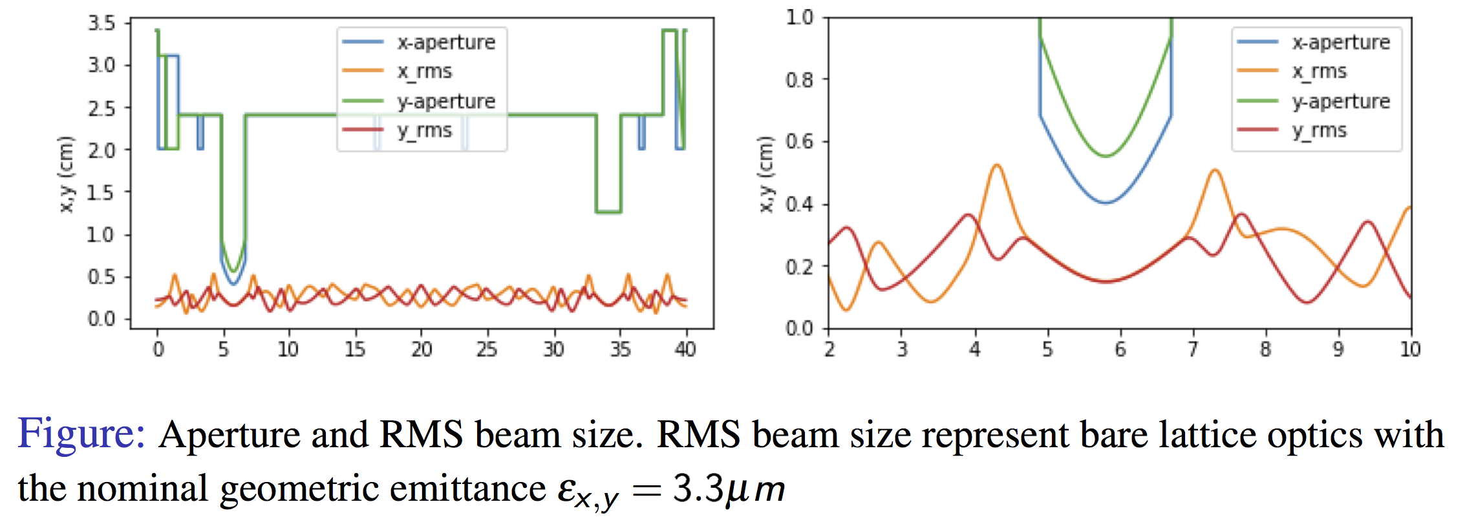
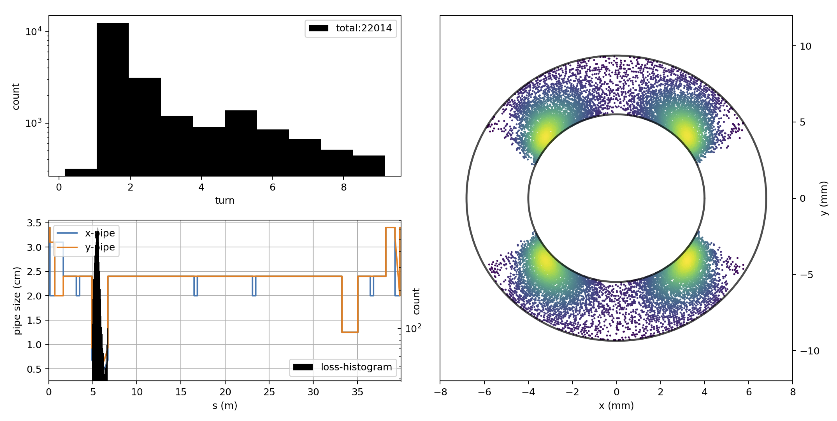
Numerical Tools in IMPACT-Z for Improved Characterization and Visualization of Proton Beam Losses in IOTA
Characterization and Visualization of Proton Losses in IOTA
Physical aperture in the IOTA ring
Need: To characterize problematic locations for losses to aid in
design of diagnostics for early-stage proton operation, and to aid in
selecting location/design of collimation scheme from the RFQ.
Problem: Previous tracking tools available in IMPACT-Z allowed
only circular/rectangular aperture, specified by element; only number
of lost particles per turn was stored, without phase space information.
Solution: Symplectic space charge tracking algorithm was updated
to allow variable particle number; elliptical and fully s-dependent
aperture capability was implemented; phase space information for
all lost particles is now stored and visualized via Python interface.
Outcome: Tools for visualizing proton losses were applied to
compare methods for truncating the beam distribution in IOTA at
the nominal emittance out of the RFQ, studying importance of
mismatch, magnetic insert strength, and distribution type.
Visualization of beam loss for an uncollimated beam with mismatch
from Kilean Hwang

Slide 22
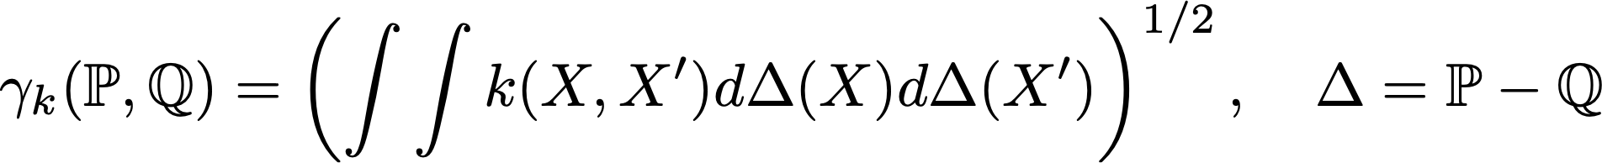
Numerical diagnostics using statistical distance (distribution “proximity”) implemented to characterize a beam’s relaxation to a stationary state
Need: To numerically characterize “proximity” and relaxation processes for beams in
the presence of high intensity or strong nonlinear focusing.
Problem: Diagnostics using low-order (eg, 2nd) beam moments are insufficient to characterize “proximity” of distributions in the presence of strong nonlinear effects.
Solution: Implement two-sample measures of statistical distance such as Maximum Mean Discrepancy, effectively embedding each distribution into a linear Hilbert space.
Distance to equilibirium as characterized
by Maximum Mean Discrepancy
C. Mitchell et al,
Phys. Rev. E 106,
065302 (2022)
Filamentation of a beam kicked off-axis in a nonlinear focusing system
Computed with complexity O(n)
for translation-invariant kernels
(e.g., Gaussian)
n = number of simulated particles
Provides a quantitative metric for numerical studies of relaxation.

Slide 23
Optimization for halo suppression

Slide 24
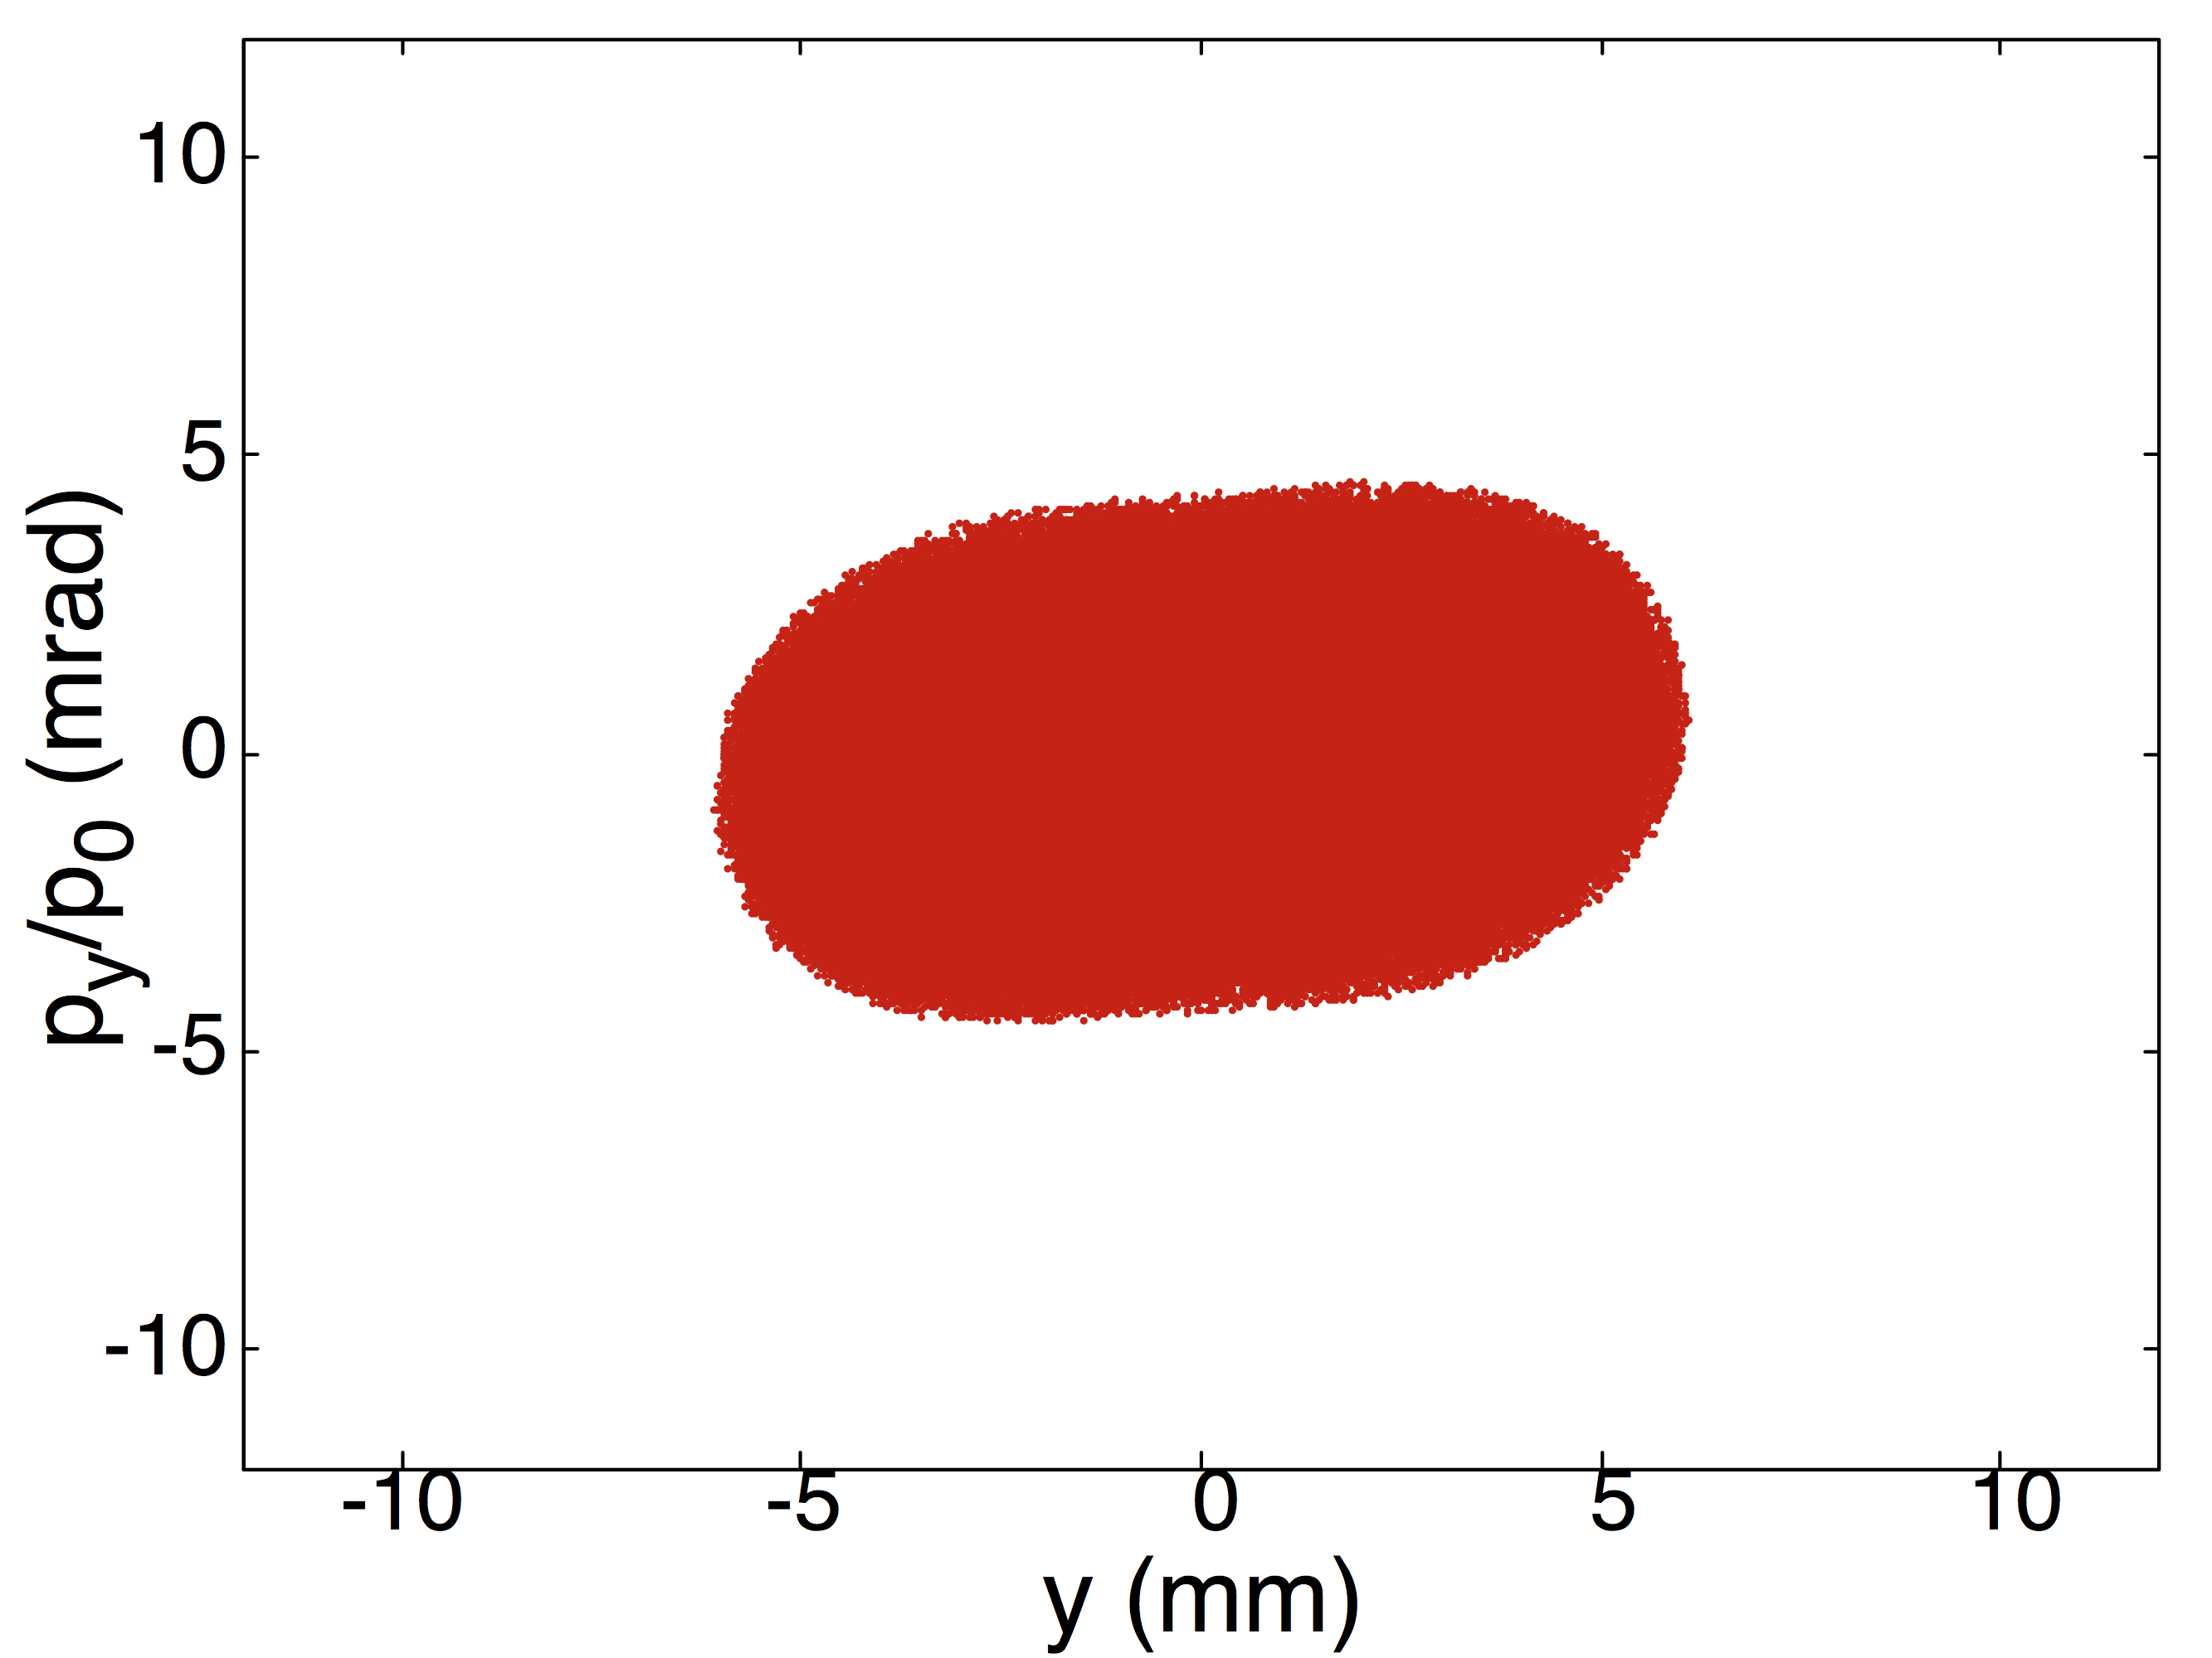
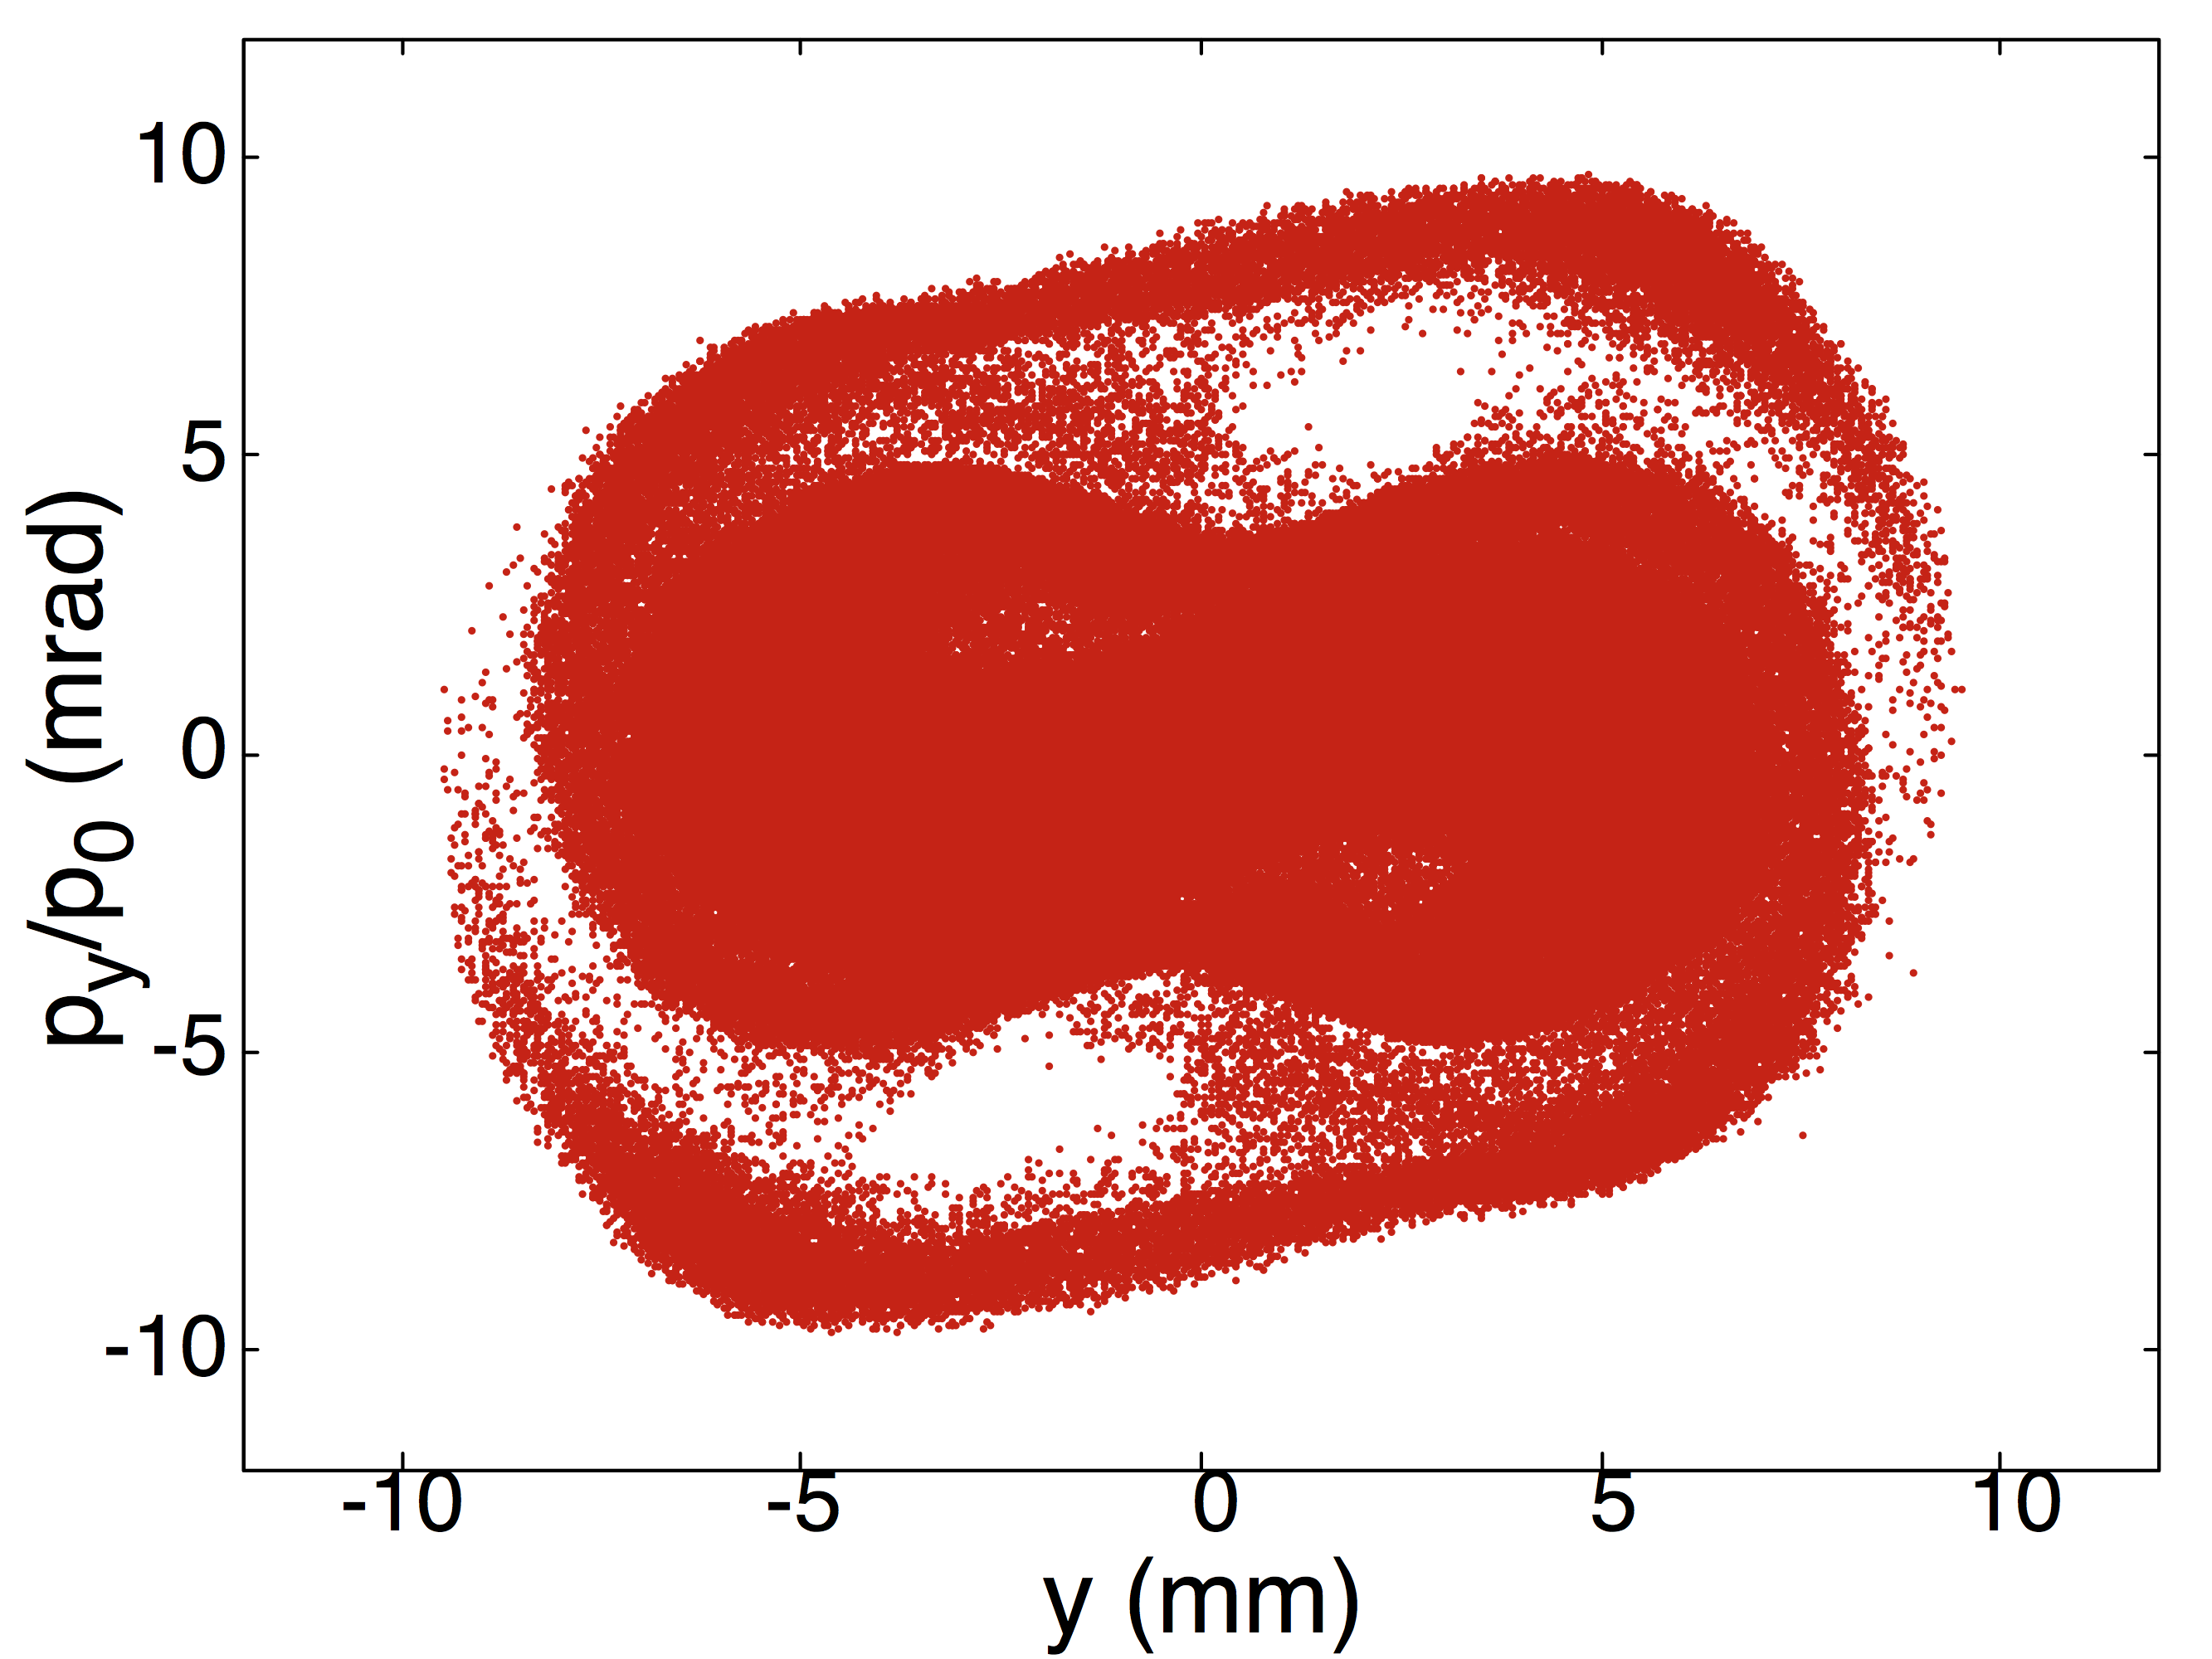
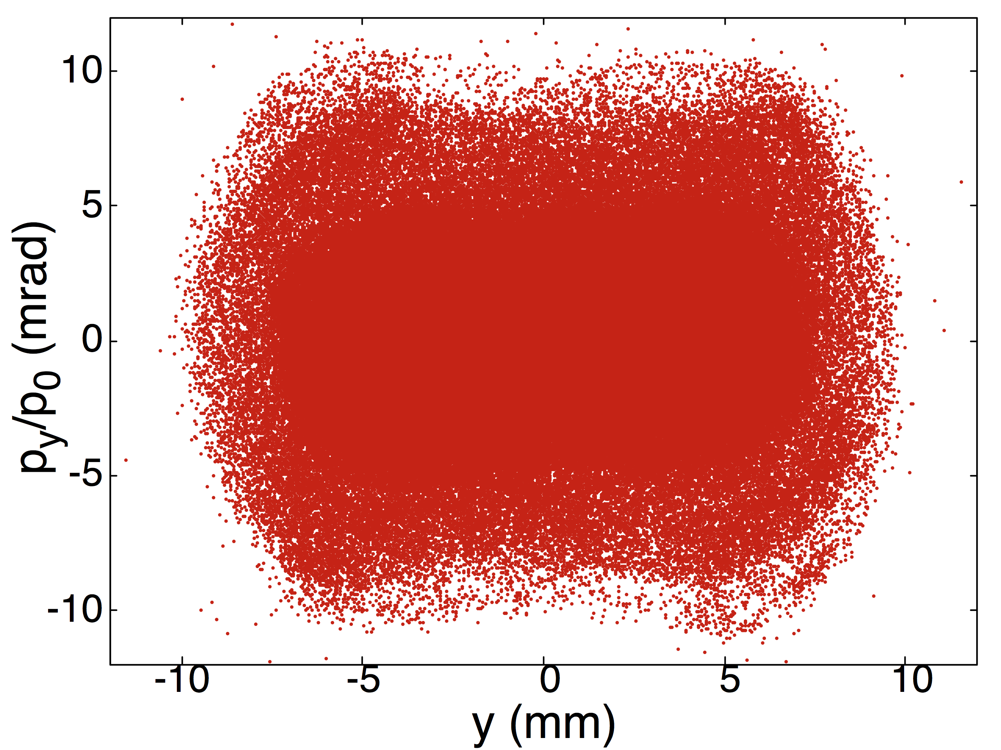
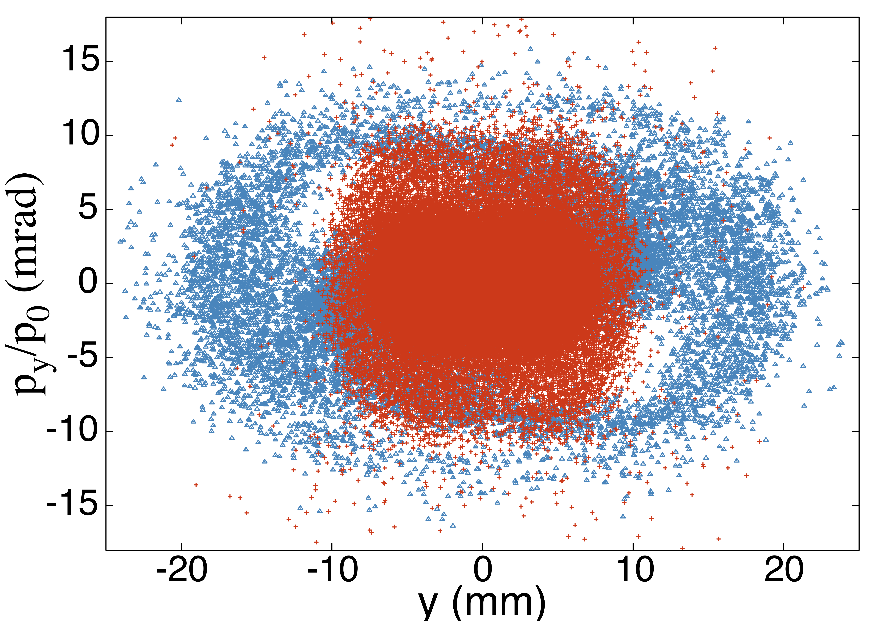
High-resolution modeling studies proton beam filamentation, halo, and losses in the IOTA ring and how these can be mitigated.
Impact of magnetic c-parameter on halo
Intense 8 mA proton beam in IOTA (vertical phase space)
c = 0.014 m^{1/2}
Halo formation occurs on a time scale of 200-300 turns (at 5-8 mA).
Due to chaos induced when particles cross a separatrix-like structure in the phase space.
Increasing c-parameter of the
nonlinear magnet moves the
problematic separatrix farther
from the beam.
1 turn
10 turns
c = 0.01 m^{1/2}
halo
50 turns
300 turns
c = 0.014 m^{1/2}
Design with increased c-parameter is being explored with the vendor.
Shows existing integrable optics designs can be improved!
nonlinear
linearized
suppressed
IOTA shows less halo formation than a linear design in this
regime, but results are sensitive to parameters and to the
choice of linear design (mixed).

Slide 25
Conclusions
Accelerator designs based on nonlinear integrable optics have the potential to provide strong damping of instabilities (decoherence), but require a new toolkit of techniques for analysis and modeling.
Analytical and semi-analytical methods for dynamical systems play an important role.
For the case of the IOTA storage ring, theory and modeling reveal an unexpectedly rich single-particle dynamics, with several distinct operating regimes. Modeling reveals a mixture of regular and chaotic orbits at high intensity. Beam halo mechanisms need to be better understood, and room remains for optimization.
Studies motivated the implementation of new tools in IMPACT-Z, including improved tracking and fringe field models (e.g., for dipoles), nonlinear magnet element types, new space charge models, new beam diagnostics, and a workflow for optimization and postprocessing using Jupyter.
Exploring the space of possible integrable focusing lattice schemes could have a major impact on beam performance in future high intensity machines.

Slide 26
Backup material

Slide 27
Integrability holds for (single-particle) motion of on-energy particles in the transverse degrees of freedom
Dynamics inside the nonlinear magnetic insert:
first invariant
Courant-Snyder transformation, scaling
D&N give in [1] a realizable potential U
such that H_{N} admits a second invariant I_{N} :
.
drift space for
nonlinear insert
Dynamics in the arc external to the nonlinear magnetic insert:
β_{x} = β_{y} , D = 0 across the nonlinear drift space
nπ phase advance from nonlinear drift space
exit to nonlinear drift space entrance
Assumed linear with a map R_{N} given by:
Thus, the phase advance must be nπ.
(4x4 identity)
impacted by space charge
H_{N}, I_{N} are invariant under the one-turn map.
¹V. Danilov and S. Nagaitsev, Phys Rev Accel Beams 13, 084002 (2010)

Slide 28
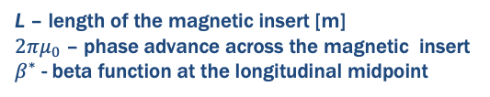
Magnetic Vector Potential and Magnetic Field within the IOTA Nonlinear Magnetic Insert
Magnetic field lines in the transverse plane
The ideal 2D magnetic field within the nonlinear insert at location s is given
by , where the potentials are given in terms of
dimensionless quantities:
Singular points in the
transverse plane:
Field lines of the nonlinear insert in the
transverse plane (blue)
using the complex function:
.
τ – dimensionless insert strength
c – transverse scale parameter [m^{1/2}]
Bρ – magnetic rigidity [T-m]
β – betatron amplitude [m]
The transverse focusing fields vary longitudinally with s.
Longitudinal variation of the quadrupole gradient
L – length of the magnetic insert [m]
$2πμ_{0}$ – phase advance across the magnetic insert
$β^{∗}$ - beta function at the longitudinal midpoint

Slide 29
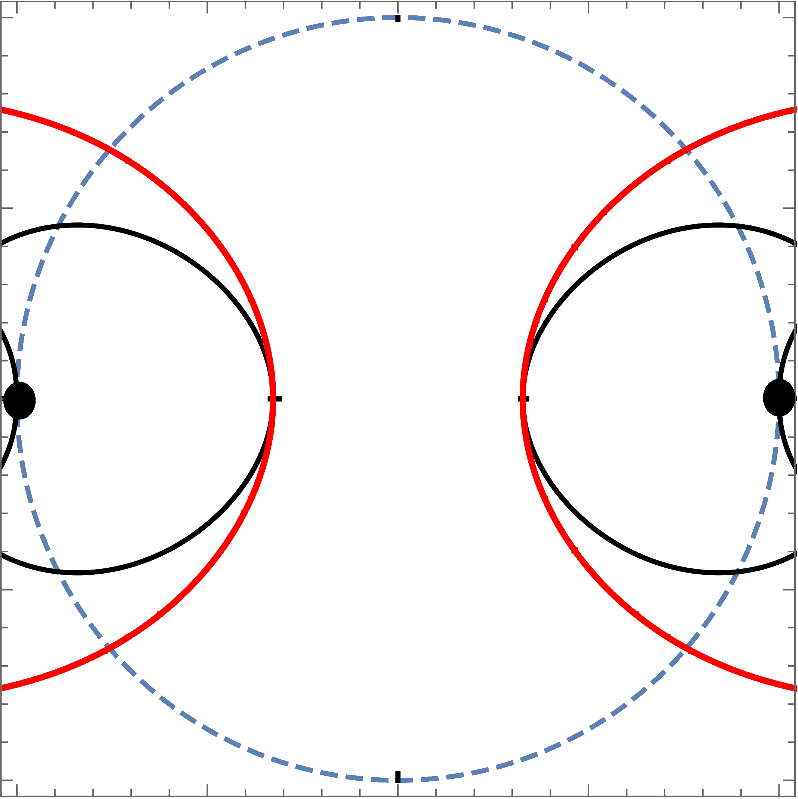
Critical and resonance structures in the single-particle phase space (zero current integrable motion)
Critical structures:
Red curve: primary separatrix-like structure
Black curve: I.C.s for unstable periodic orbits
Separate regions of distinct orbit behavior
A matched beam at 0 mA with the nominal emittance lies within the primary separatrix
Resonance structures:
Resonant contour lines are shown
High density of resonances outside the
primary separatrix
Color: measure of chaos when phase advance is perturbed (blue = regular)
When the phase advance is depressed, chaos develops first in the region outside the primary separatrix.
K. Hwang et al, Phys. Rev. Accel. Beams 23, 084602 (2020)
C. Mitchell et al, Phys. Rev. Accel. Beams 23, 064002 (2020)

Slide 30
Surface Methods Provide a Robust Method for Tracking in the IOTA Nonlinear Magnetic Insert with Realistic 3D Fringe Fields
Need: Accurate symplectic tracking algorithm for modeling
the IOTA nonlinear magnetic insert with realistic fringe fields.
Problem: The standard idealized model of the IOTA
insert is non-Maxwellian, and neglects fringe field
effects. 3D magnetic field data inherently noisy.
Solution: Use surface methods to extract a smooth
vector potential from 3D magnetic field data.
Outcome: Tracking with quadrupole and octupole fringe
field corrections shows evidence of perturbed invariants,
with little evidence of enhanced losses (10K turns).
30
C. Mitchell, Proc IPAC2018, Vancouver, THPAK036 (2018).

Slide 31
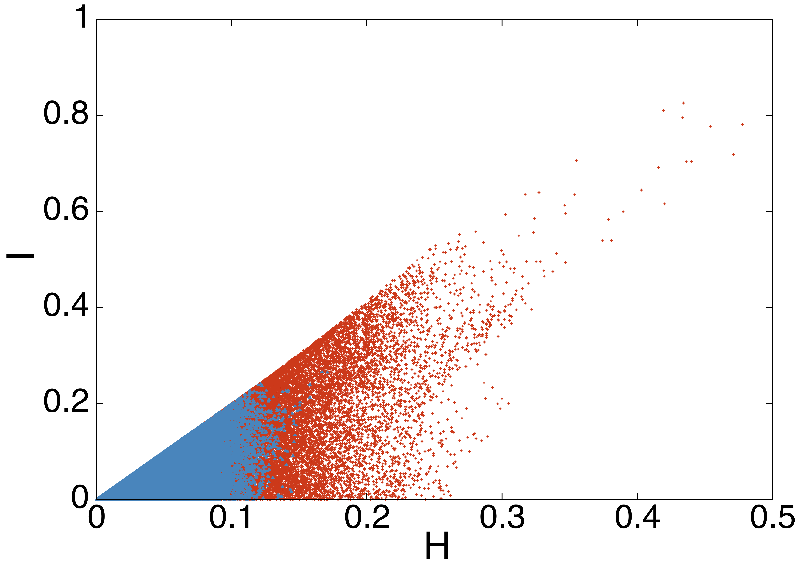
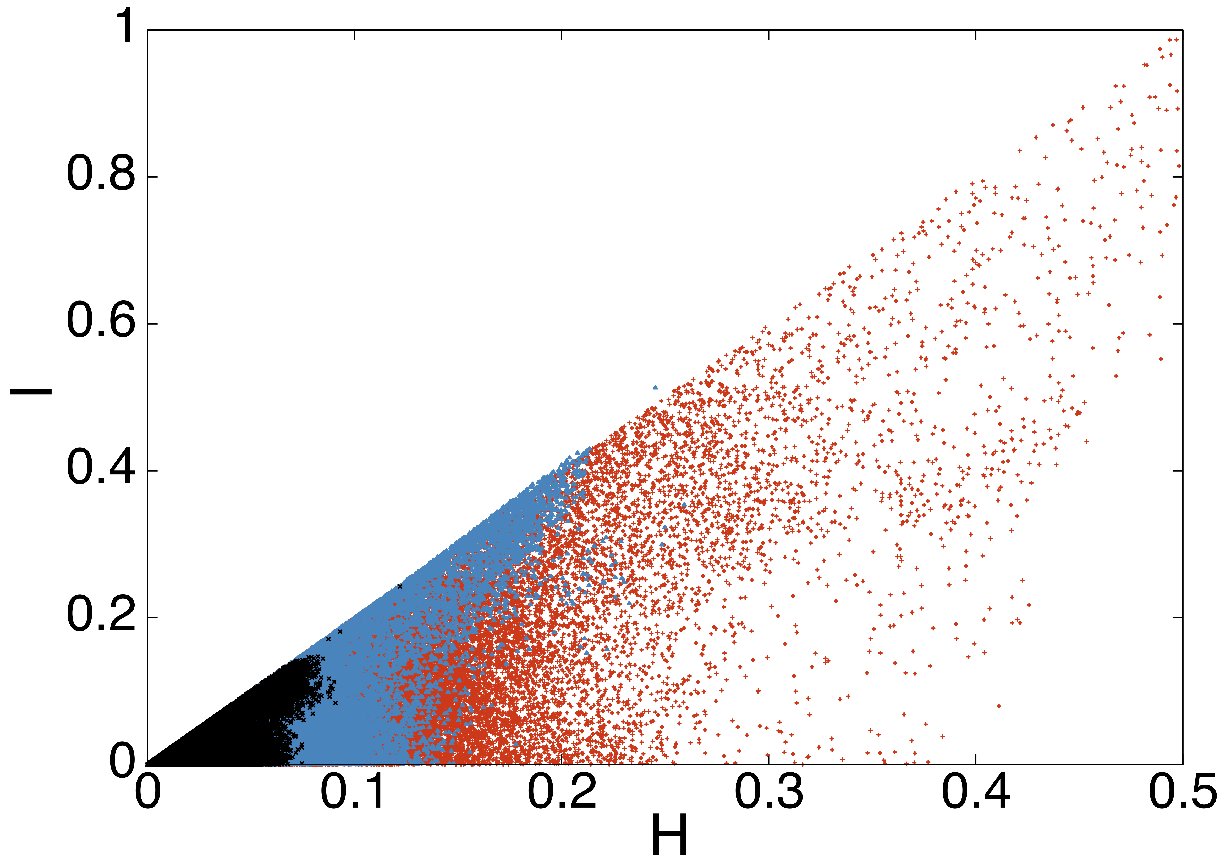
Effect of the Increasing the c Value on the Matched
Beam Distribution in Invariant Space
5 mA, nominal emittance
(matched distribution for several c)
8 mA, nominal emittance
(matched distribution for several c)
c = 0.010 m^{-1/2}
c = 0.014 m^{-1/2}
c = 0.010 m^{-1/2}
c = 0.014 m^{-1/2}
c = 0.020 m^{-1/2}
primary separatrix
primary separatrix
(H,I) = (0.1,0.2)
(H,I) = (0.1,0.2)
Increasing the c value leads the beam footprint to shrink in invariant space.
The primary separatrix begins at (H,I)=(0.1,0.2) and extends along the ray I = 2H
For sufficiently large c, the beam can be confined away from the primary separatrix.

Slide 32
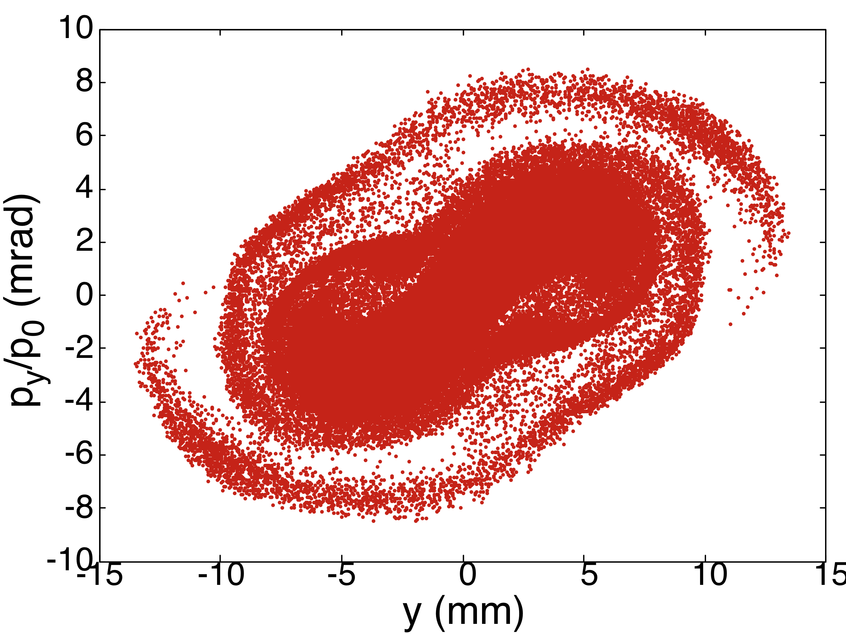
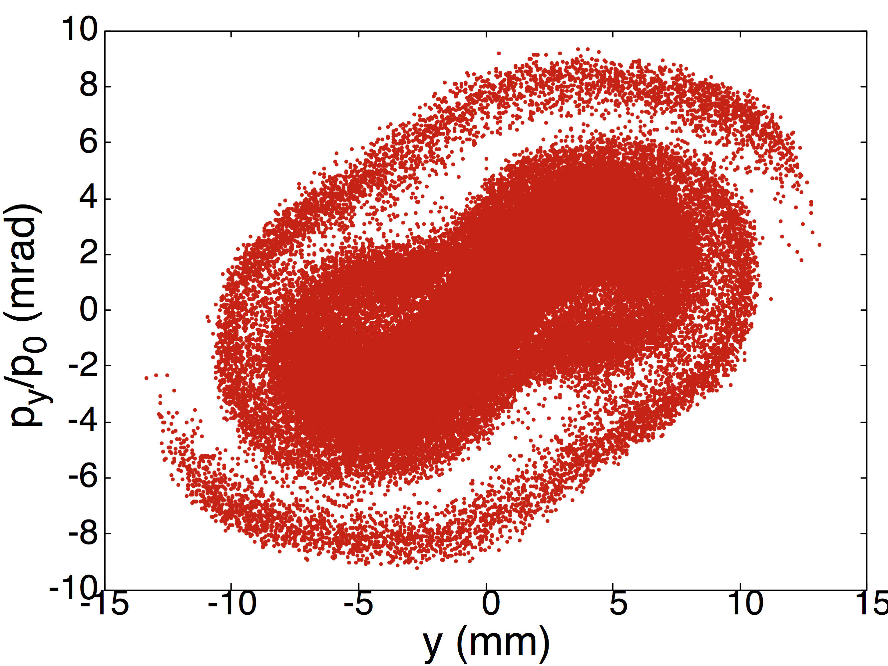
Understanding Proton Beam Dynamics at High Space Charge Intensity: An Example of Code Benchmarking (IMPACT-Z & MaryLie/IMPACT)
Goal: Study relaxation of a beam in IOTA to near-equilibrium at high intensity, to compare with halo formation in a standard linear lattice.
Physical IOTA lattice, 2.5 MeV proton beam with nominal emittance and energy spread.
8 mA beam current (ΔQ_{y} ≈-0.6, ΔQ_{x}≈-0.9) – near maximum for expected IOTA operation.
Comparing beam size over turn 10
Comparing beam after 10 turns
Impact-Z
ML/I
Reasonable agreement between two codes using
different space charge algorithms (spectral, PIC).
Numerical convergence tests: # modes/grid points,
# particles, location of Poisson boundary, # sc kicks.

Slide 33
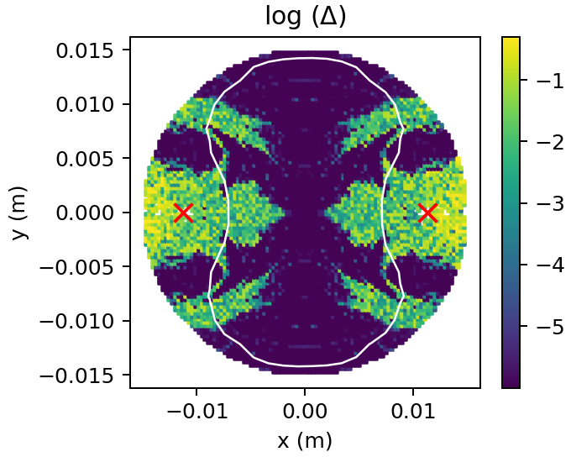
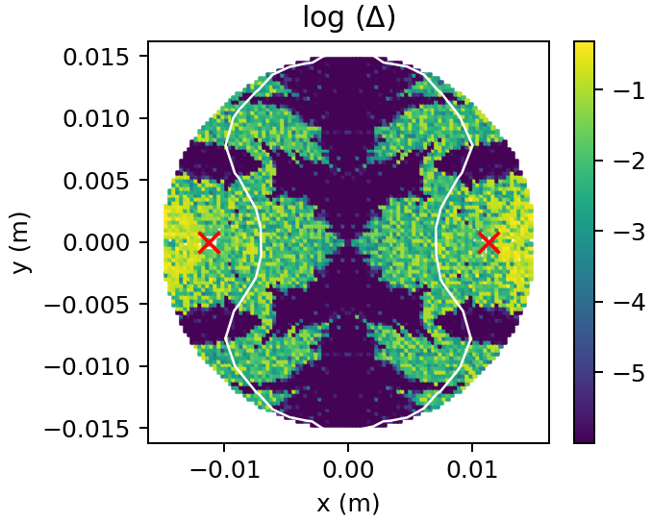
Frequency map analysis of orbits in the total potential (space charge + focusing) for a stationary beam in a nonlinear constant focusing channel.
Extreme current (space charge tune shift >1 near the origin), shown for illustration purposes only.
8K distinct initial conditions (x,0,y,0) in a disk.
Orbits are tracked in the sum of the external potential and the equilibrium space charge potential (using 15x15 modes) for 2048 x 1.8 m distance through the nonlinear constant focusing section.
Singular points of
the NL potential at:
60 mA Beam (Λ=5)
120 mA Beam (Λ=10)
Motion is
bounded due to
H conservation.
Integrable region
shrinks with
increasing current.
y (m)
tune diffusion
y (m)
tune diffusion
beam
boundary
chaotic
region
Self-consistent
thermal beam
integrable
region

