Slide 1
SciBmad: A full-featured ecosystem for modern, differentiable accelerator physics simulations
Matt Signorelli, David Sagan
14th International Computational Accelerator Physics Conference
Germany, October 2-5, 2024

Slide 2
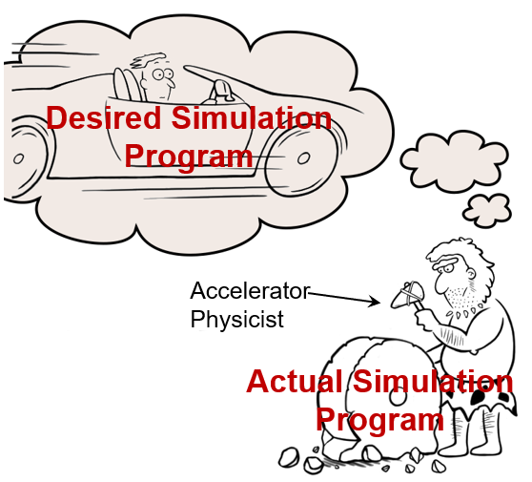
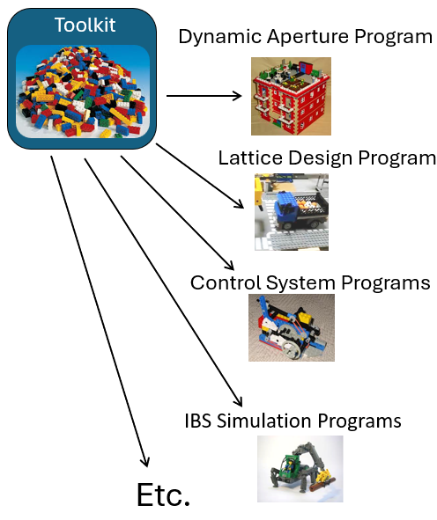
Accelerator Software Wish-List
Modularity!!
Maximal code re-use, minimal reinventing the wheel
Plug-and-play different optimizers, symplectic integrators, tracking methods, etc. with ease
Runs optimally on all architectures, with CPU & GPU parallelization
Easy to use and integrate with other programs/tools
Fully differentiable using automatic differentiation
Fast, accurate calculation of gradients for optimizations and machine learning using forward and backward differentiation
Full featured accelerator software toolkit
Linear and nonlinear tracking, nonlinear parametric normal forms including spin, Bmad’s advanced lattice design tools (e.g. superposition, multipass), etc
Can we have all of this? Enter: SciBmad
Notes:
Modularity
In Julia we get JIT-ted functions to use with other itnegrators and optimizers without having to abide by any rules/use tensors
Easy to use; Julia is easy to use, but we will have a full-featured python interface (like wrapping C code in python)
GPU and CPU parallelization we automatically get for free by using Julia
Programs/tools: all of Julia’s plotters at your service lattice “parsing” in Julia language itself

Slide 3
SciBmad: What it is (and isn’t)
SciBmad (formerly called Bmad-Julia) is NOT
A rewrite of the current Bmad in a different programming language. No Fortran code in SciBmad
An interface to the current Bmad. Lattice translation between the two will exist though!
The end of the current Bmad. Maintenance development of the current Bmad will continue
SciBmad is
Inspired by the experience (both good and bad) with developing the current Bmad
A new software ecosystem for modern, differentiable accelerator physics simulations
Written fully in the programming language
By leveraging the programming language, SciBmad will achieve all points on the wish-list!

Slide 4
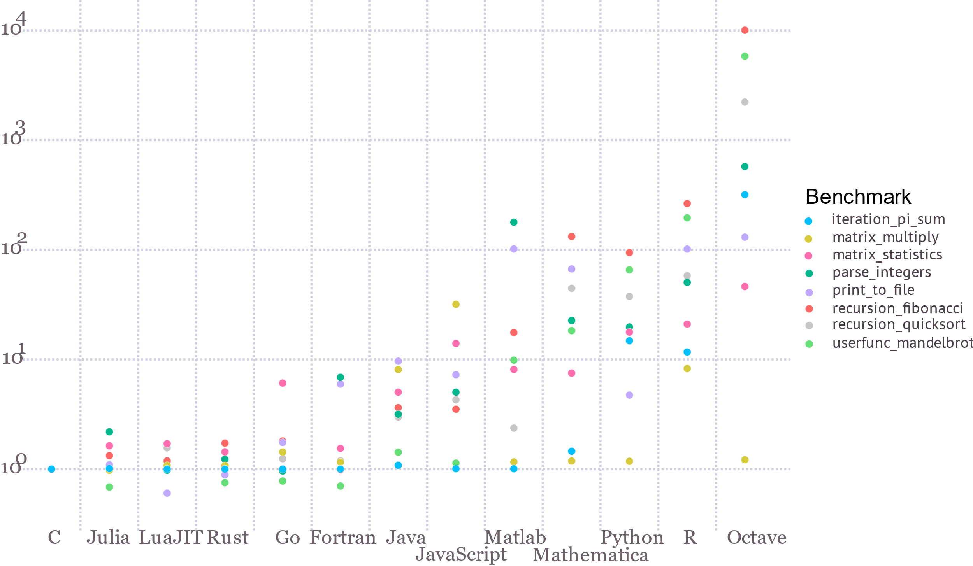
? What’s that?
Julia is a high-level, HPC language that “walks like Python, runs like C”
As simple as Python, but as fast as C
Adopts multiple dispatch and just-in-time (JIT) compilation as central paradigms
Where types are inferable at compile-time, it will be compiled (using LLVM toolkit), else dynamically-dispatched with runtime type
Features a powerful type system for highly-polymorphic code
Notes:
Rapidly growing ecosystem filled with plotting, optimizers, AD and ML packages, etc

Slide 5
The Power of Multiple Dispatch and JIT
Universal polymorphism in Julia is easy and fast! Consider the function:
Generally pass:
z0 = Vector{Float64}(...)
track_drift(z0, L)
function track_drift(z0, L)
zf = similar(z0)
zf[1] = z0[1]+z0[2]*L/(1.0+z0[6])
zf[2] = z0[2]
zf[3] = z0[3]+z0[4]*L/(1.0+z0[6])
zf[4] = z0[4]
zf[5] = z0[5]-L*((z0[2]^2)+(z0[4]^2))/(1.0+z0[6])^2/2.0
zf[6] = z0[6]
return zf
end
However, say we’d instead like to track a Taylor map of Truncated Power Series (TPS) defined in some other package. Just pass:
In fact, we can use types from any Julia (AD) package
z0 = Vector{TPS64}(...)
track_drift(z0, L)
That’s it!
JIT compiled $→$ fast!
E.g. Dual numbers and “tapes” in ForwardDiff.jl, ReverseDiff.jl, Enzyme.jl, Zygote.jl, etc etc.
For fun, we can even use Symbolics.jl (compiled!):
using Symbolics
@variables z0[1:6] L # creates symbolic vars
track_drift(z0, L)
Multiple dispatch and JIT compilation enable massive composability of packages
Plug-and-play (and differentiate) to your heart’s desire!
Notes:
Because this is ICAP, we can get into more technical details. Composability of packages and optimizers!

Slide 6
SciBmad: Because we are lazy!
We just showed how easy it is in Julia to use any ‘number’ type defined by any package
In fact, we also can use any optimizer, any (symplectic) integrator, plotting package, architecture-specific parallelization, etc. written by other people in Julia with minimal effort!
SciBmad offloads the work from the accelerator physicists to other experts
E.g. suppose you have a tracking function, and you want the closed orbit:
We can use any optimizer, written by other people, immediately. E.g. Optim:
Or NLSolve, etc.
This will be JIT compiled + fast too!
function track(ring, z0) ...
return zf # Final phase space position
end
using Optim
optimize(z->norm(z-track(ring, z)), [0,0,0,0,0,0])
using NLsolve
nlsolve(z->norm(z-track(ring, z)), [0,0,0,0,0,0])
Notes:
Because this is ICAP, we can get into more technical details. Composability of packages and optimizers!

Slide 7
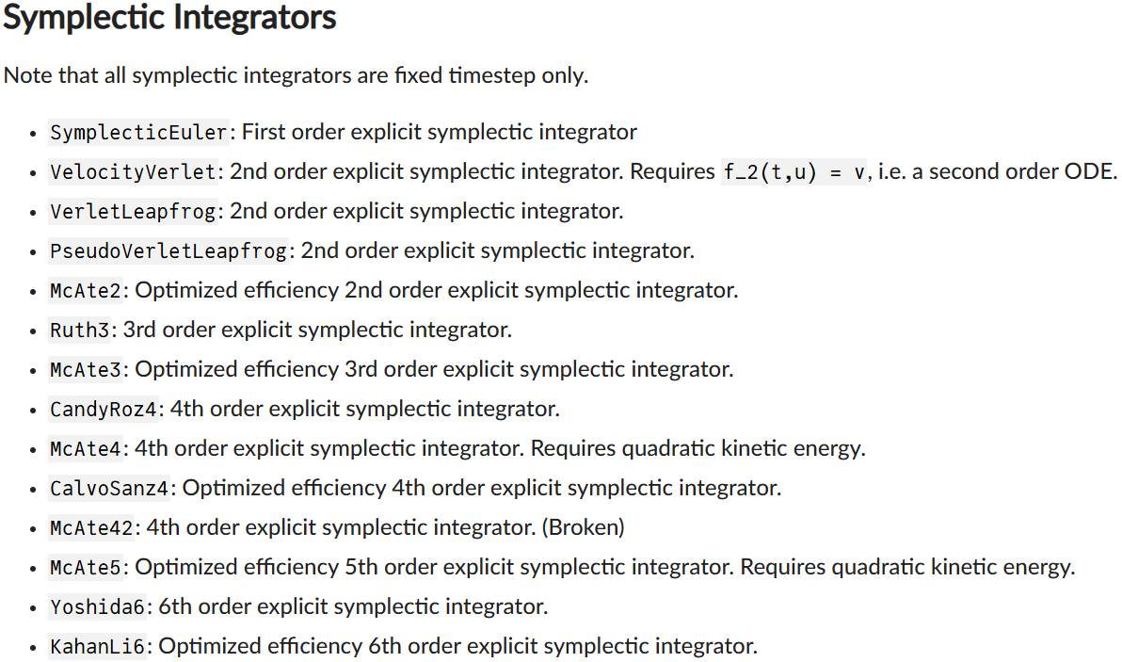
SciBmad: Because we are lazy!
Many forward/backward autodiff packages available
ForwardDiff.jl, ReverseDiff.jl, Enzyme.jl, Zygote.jl
Our ecosystem will be compatible with all such
We also don’t need to write any symplectic integrators DifferentialEquations.jl already has many differentiable ones:
All of Julia’s plotting packages at one’s fingertips
Makie.jl, Plots.jl, PyPlot.jl, etc
Powerful scientific ML tools: https://sciml.ai/
GPU parallelization using CUDA.jl type CuArray (so long as structure-of-arrays used on CPU)
Universally polymorphic functions that work on both CPU and GPU!
Lattice definition itself in the Julia programming language
Notes:
Because this is ICAP, we can get into more technical details. Composability of packages and optimizers!

Slide 8
But I love Python and refuse to learn Julia!
That’s ok: we will have a full-featured Python interface to the (fast) SciBmad Julia ecosystem
Gradients output for use with PyTorch and Xopt will be simple
All other features will also be available, except the lattice definition will always be in Julia (with translators from other formats available)
For Julia users, the experience will be fantastic. For Python users, it will be as good as the usual two-language experience: fast underlying library, with a full-featured Python wrapper for ease of use
Notes:
Because this is ICAP, we can get into more technical details. Composability of packages and optimizers!

Slide 9
Current SciBmad Ecosystem Status
Stable, officially-registered, ready for use:
GTPSA.jl: Julia interface to L. Deniau’s Generalised Truncated Power Series Algebra library
In development:
AcceleratorLattice.jl: Accelerator lattice definition/manipulation
NonlinearNormalForm.jl: Parametric nonlinear normal forms and analysis of DA maps including spin using Lie algebraic methods
AtomicAndPhysicalConstants.jl: Atomic/subatomic particle properties and other physical constants for simulations
Starting development:
BeamTracking.jl: CPU/GPU particle tracking methods/interfaces
Notes:
Because this is ICAP, we can get into more technical details. Composability of packages and optimizers!

Slide 10
AcceleratorLattice.jl
Accelerator lattice construction and manipulation is done using the Julia language itself:
using AcceleratorLattice
# Returns a FODO cell with specified quad strength
function FODO(k1)
@eles begin
qf = Quadrupole(L = 0.6, Kn1 = k1)
d = Drift(L = 0.4)
qd = Quadrupole(L = -0.6, Kn1 = -k1)
end
return BeamLine([qf, d, qd, d])
end
@ele begin0 = BeginningEle(pc_ref = 1e7, species_ref = Species("electron"))
# Construct a BeamLine using Julia functions!
my_beamline = BeamLine([begin0, FODO(0.36), FODO(0.30)])
my_lat = Lat([my_beamline])

Slide 11
AcceleratorLattice.jl
Fully-featured lattice elements:
julia> show(lat["qf"][1])
Ele: "qf" (b1>>2) Quadrupole
AlignmentGroup:
offset [0.0, 0.0, 0.0] m offset_tot [0.0, 0.0, 0.0] m
x_rot 0 rad x_rot_tot 0 rad
y_rot 0 rad y_rot_tot 0 rad
tilt 0 rad tilt_tot 0 rad
BMultipoleGroup:
Order Integrated Tilt (rad)
1 false 0.0 0.34 Kn1 0.0 Ks1 (1/m^2)
-0.011341179236737171 Bn1 -0.0 Bs1 (T/m^1)
FloorPositionGroup:
r (r_floor) [0.0, 0.0, 0.0] m
q (q_floor) 1.0 + 0.0⋅i + 0.0⋅j + 0.0⋅k
theta (theta_floor) 0.0 rad
phi (phi_floor) 0.0 rad psi (psi_floor) 0.0 rad
LengthGroup:
L 0.6 m orientation 1
s 0.0 m s_downstream 0.6 m
ReferenceGroup:
species_ref Species("electron") species_ref_exit Species("electron")
pc_ref 1.0e7 eV pc_ref_exit 1.0e7 eV
E_tot_ref 1.000000005e7 eV E_tot_ref_exit 1.000000005e7 eV
... Etc ...

Slide 12
NonlinearNormalForm.jl
Real and complex parametric DAMaps including spin and coasting beam, for example:
julia> m # Variable m is a map which has 6 variables and 2 parameters in this case
DAMap{Vector{ComplexF64}, Vector{ComplexTPS64}, Quaternion{ComplexTPS64}, Nothing, Bool}:
-----------------------
# Variables: 6
Maximum order: 3
# Parameters: 2
Parameter order: 3
-----------------------
Reference Orbit Vector{ComplexF64}:
1: 0.0 + 0.0im
2: 0.0 + 0.0im
3: 0.0 + 0.0im
4: 0.0 + 0.0im
5: 0.0 + 0.0im
6: 0.0 + 0.0im
Last plane is coasting: variable #6 is constant
Orbital Ray Vector{ComplexTPS64}:
Out Real Imag Order Exponent
------------------------------------------------------------------------------------------------------
1: 1.0016106150325099e+00 0.0000000000000000e+00 1 1 0 0 0 0 0 | 0 0
1: 7.9725998724008134e-03 0.0000000000000000e+00 1 0 1 0 0 0 0 | 0 0
⋮ ⋮ ⋮ ⋮ ⋮ ⋮ ⋮ ⋮ ⋮ ⋮ ⋮ ⋮ ⋮ ⋮ ⋮
596 rows omitted
Full customizable # variables and # parameters
Spin!
Coasting beam supported if wanted
Variables
Parameters

Slide 13
NonlinearNormalForm.jl
All the following tools are implemented already:
julia> m_lin = cutord(m, 2); # extract the linear part in orbital
julia> m_nonlinear = inv(m_lin) ∘ m; # remove the linear part
julia> F = log(m_nonlinear); # Get the Lie operator (including quaternion) generating nonlinear part
julia> m = m_lin ∘ exp(F); # Reconstruct same map using Lie exponent and linear part separately
julia> a = normal(m); # Calculate the nonlinear (parametric) normalizing canonical transformation
julia> R_z = inv(a) ∘ m ∘ a; # Nonlinear amplitude-dependent rotation in regular phase space (x, px, …)
julia> c = to_phasor(m); # Get the transform to phasors basis √(J)*exp(±im*ϕ)
julia> R_J = inv(c) ∘ R_z ∘ c; # Nonlinear amplitude-dependent rotation in phasors basis
julia> a_spin, a0, a1, a2 = factorize(a); # Spin part, nonlinear parameter-dependent fixed point, a1, a2
julia> Σ = equilibrium_moments(m, a); # Calculate equilibrium sigma matrix when fluctuation-dissipation
julia> a = normal(m, m=[0; 1], m_spin=[-1]); # Leaving in a Q_y - Q_spin resonance

Slide 14
Conclusions
SciBmad is a modern accelerator physics ecosystem which will provide:
Modularity!!
Maximal code re-use, minimal reinventing the wheel
Plug-and-play different optimizers, symplectic integrators, tracking methods, etc. with ease
Runs optimally on all architectures, with CPU & GPU parallelization
Easy to use and integrate with other programs/tools
Fully differentiable using automatic differentiation
Fast, accurate calculation of gradients for optimizations and machine learning using forward and backward differentiation
Full featured accelerator software toolkit
Linear and nonlinear tracking, nonlinear parametric normal forms including spin, Bmad’s advanced lattice design tools (e.g. superposition, multipass), etc
Goal: first accelerator simulations by end of year
✔
✔
✔
✔
✔
Notes:
Modularity
In Julia we get JIT-ted functions to use with other itnegrators and optimizers without having to abide by any rules/use tensors
Easy to use; Julia is easy to use, but we will have a full-featured python interface (like wrapping C code in python)
GPU and CPU parallelization we automatically get for free by using Julia
Programs/tools: all of Julia’s plotters at your service lattice “parsing” in Julia language itself

Slide 15
Contributors and Thank You!
Development of SciBmad is currently in full-gear, and would not be this far along without the help of many
Open to more collaborators!
Dan Abell (BeamTracking.jl and AtomicAndPhysicalConstants.jl)
J. Scott Berg
Oleksii Beznozov (BeamTracking.jl - GPU)
Alex Coxe (AtomicAndPhysicalConstants.jl)
Laurent Deniau
Auralee Edelen
Etienne Forest (significant help with NonlinearNormalForm.jl)
Juan-Pablo Gonzalez
Georg Hoffstaetter de Torquat
Gavin Hunsche (BeamTracking.jl)
Lixing Li (AtomicAndPhysicalConstants.jl)
Chris Mayes
Ryan Roussel
David Sagan (AcceleratorLattice.jl)
Matt Signorelli (NonlinearNormalForm.jl and GTPSA.jl)
Sophia Yang (BeamTracking.jl)

Slide 16
Thank you! Questions?

Slide 17
Backup Slides

Slide 18
C++: Single Dispatch
class A { };
class B : public A { };
class C : public A { };
class Foo {
virtual void my_fun(A* arg1, A* arg2) { std::println("A,A"); }
virtual void my_fun(B* arg1, B* arg2) { std::println("B,B"); }
virtual void my_fun(C* arg1, B* arg2) { std::println("C,B"); }
virtual void my_fun(B* arg1, C* arg2) { std::println("B,C"); }
virtual void my_fun(C* arg1, C* arg2) { std::println("C,C"); }
};
void call_my_fun(A* arg1, A* arg2) {
Foo *pFoo = new Foo;
pFoo->my_fun(arg1, arg2); // SINGLE DISPATCH: prints “A,A”
}
int main() {
A* arg1 = new B();
A* arg2 = new C();
call_my_fun(arg1, arg2); // prints “A,A”
return 0;
}
C++ only uses single dispatch, so this will print “A,A” even though both are B,C

Slide 19
Julia: Multiple Dispatch
abstract type A end
struct B <: A end
struct C <: A end
my_fun(arg1::A, arg2::A) = println("A,A")
my_fun(arg1::B, arg2::B) = println("B,B")
my_fun(arg1::C, arg2::B) = println("C,B")
my_fun(arg1::B, arg2::C) = println("B,C")
my_fun(arg1::C, arg2::C) = println("C,C")
function call_my_fun(arg1::A, arg2::A)
return my_fun(arg1, arg2)
end
arg1 = B()
arg2 = C()
call_my_fun(arg1, arg2) # prints B,C
Julia will dynamically-dispatch based on the runtime types
Call to my_fun done by going to method lookup table using runtime types, and JIT-compiling my_fun if not already compiled

