Slide 1
Beam-cavity interactions in the rapid cycling synchrotron chain of the future muon collider
Leonard Thiele (University of Rostock, CERN)
S. Albright, F. Batsch, R. Calaga, H. Damerau, A. Grudiev, I. Karpov, S.-A. Udongwo, U. van Rienen

Slide 2
Outline
Why collide muons?
Muon collider facility
Radiofrequency (RF) system of the rapid cycling synchrotron (RCS) chain
Interaction of induced voltages for counter-rotating beams
Transient beam loading
Conclusion

Slide 3
Why collide muons?
In comparison with electrons or protons, muons offer different advantages for colliders at the energy frontier:
Larger mass than electrons suppresses synchrotron radiation by orders of magnitude.
Point-like structure:
Ensures that the kinetic energy is entirely used in the collision.
No low-energy background data is produced.
BUT: Muons are unstable, with a lifetime of :
$$τ_{μ}=γ∗ 2.2μs$$
Continuous muon decay needs to be delayed by time dilation.
Luminosity requirement must be reached in collider.
Muons need to be generated with a reasonable beam quality → no “simple” source is available.

Slide 4
The muon collider facility
Two main drivers behind the design of a muon collider facility:
Maximise average acceleration gradient → to preserve muon lifetime.
Preservation of beam size → to maximise the number of collisions.
Initial low energy acceleration to 60 GeV is performed with linear accelerators (LINACs) and recirculating LINACs.
In the high energy acceleration, rapid cycling synchrotrons (RCS) are preferred to optimise the usage of the RF cavities → multi-pass.

Slide 5
The RF system of the RCS chain
RF system requirements in the RCS chain: combination of requirements from LINACs and circular accelerators:
LINACs:
Usually pulsed with a high instantaneous but low average load.
Voltage only needs to be supplied during very short time (pulsed).
Circular Accelerators:
Compensation of beam loading in the steady state is vital → constant cavity voltage.
Instantaneous load significantly lower but supplied for a longer time.
Challenge in the MuCol → because of the fast acceleration and only two far-spaced bunches, no steady state in the cavity voltage.
Voltage needs to be stable enough during the acceleration.
Sufficient time dilation.
Analysis of transient beam loading is necessary.

Slide 6
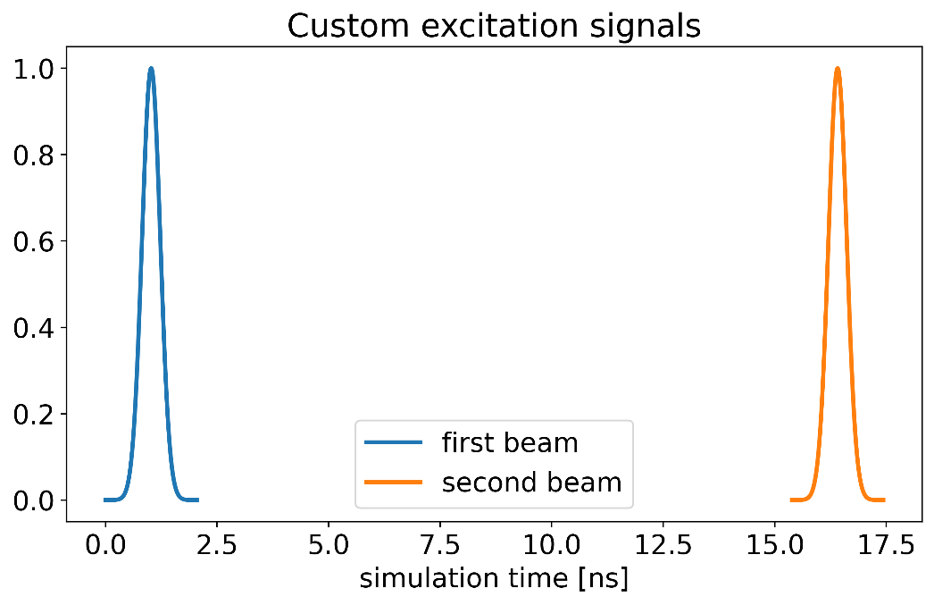
Interaction of counter-rotating beams – simulation setup
TESLA cavity is used as baseline in RCS studies.
Couplers have been assembled by S.-A. Udongwo.
To verify fundamental mode (FM) interactions:
Performed CST® wakefield solver simulation with one beam going in +z and one beam in –z direction.
Custom excitation signals → ensure a changeable time delay on the beam signal.
Long bunch length was chosen → only FM excited.

Slide 7
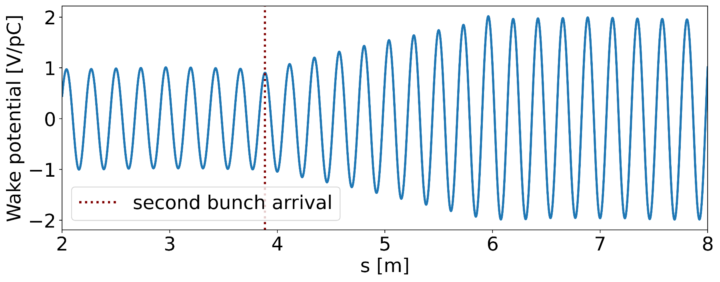
Interaction of counter-rotating beams – fundamental mode
Arrival time of the is defined by the acceleration requirement (synchronous phase $Φ_{s}$).
Counter-rotating $μ^{+}$ and $μ^{−}$beams get accelerated by the same RF cavities.
Opposite charge + opposite direction → same requirement for $Φ_{s}$ in both beams.
Induced voltages in the fundamental mode will add up.
Bunch on the next turn will encounter a higher remaining induced voltage.

Slide 8
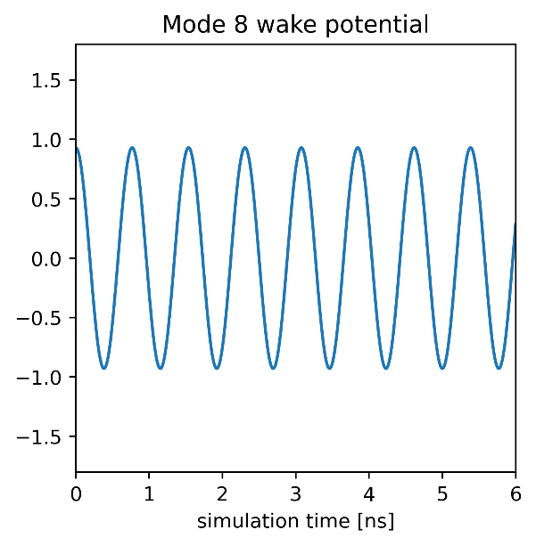
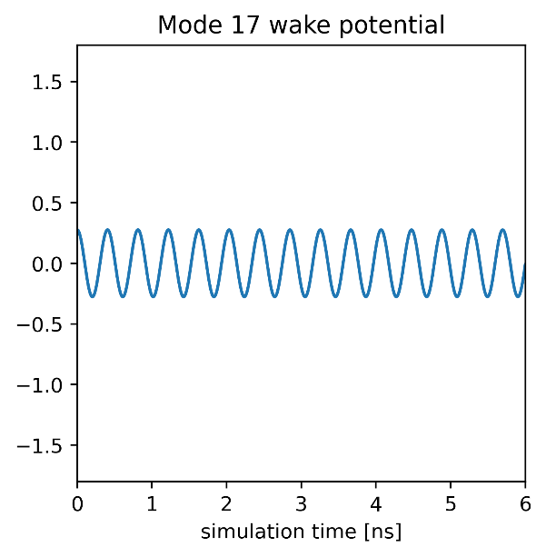
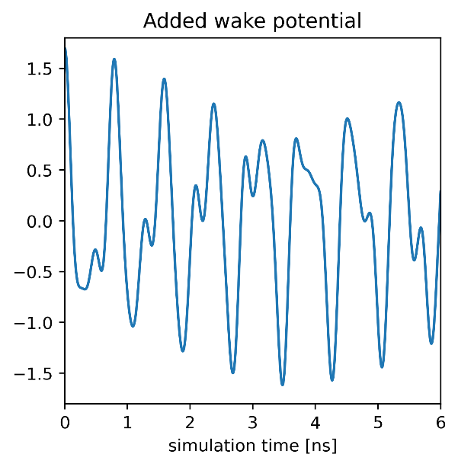
Interaction of counter-rotating beams – simulation setup II
Wakefield solver simulation not feasible for HOM interactions due to high quality factor of modes → very long simulation run times.
RLC Circuit-based model to calculate wake potential of individual modes.
Potentials of all monopole modes obtained from CST® Eigenmode simulation are added, according to their shunt impedance, quality factor and frequency.
To generate multi-bunch potential → add and shift existing potential.

Slide 9
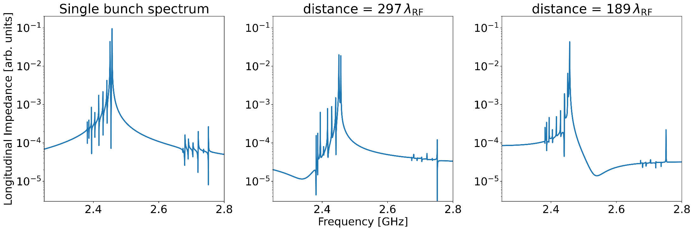
Interaction of counter-rotating beams – higher order modes
Wavelength of each higher-order mode (HOM) is different.
For HOM interactions, the exact arrival time difference is relevant.
RCS chain: RF system is split and distributed into multiple stations around the ring.
Depending on cavity position: constructive or destructive interaction.

Slide 10
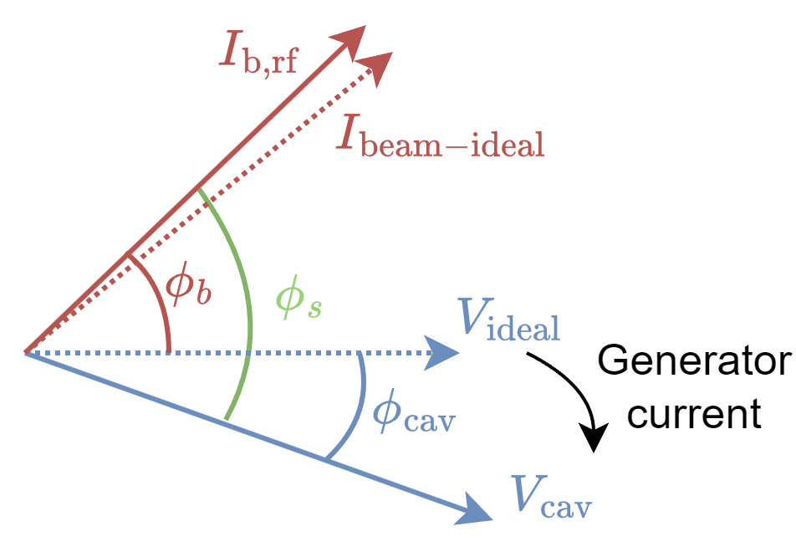
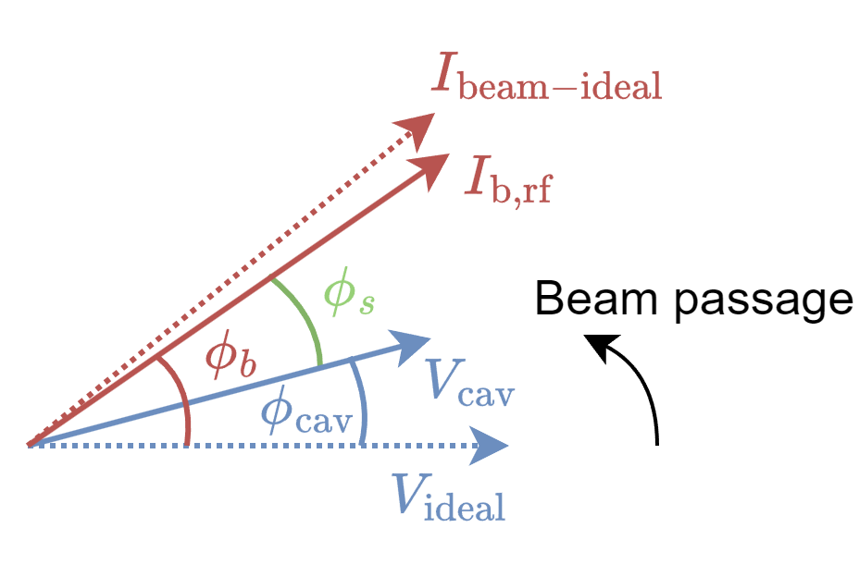
Transient beam loading in the muon collider
Assumptions to model transient beam loading in the fundamental mode:
Both phase and amplitude of the cavity voltage will be affected by the beam.
Constant generator current in phase and amplitude.
Formulas for the implementation follow [1]

Slide 11
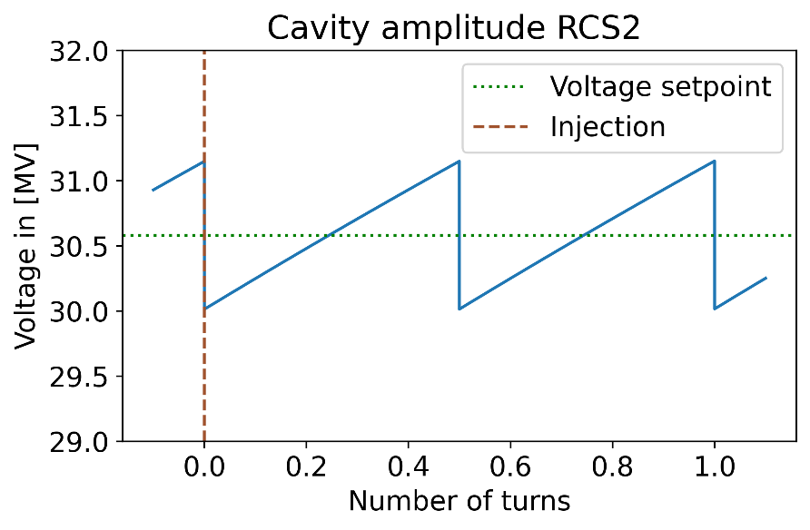
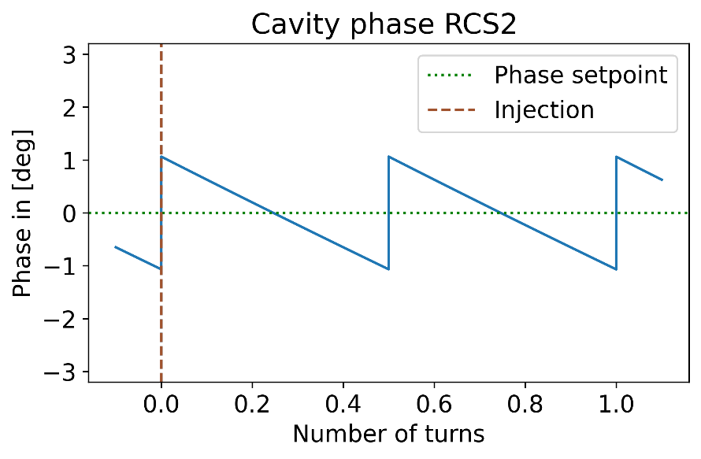
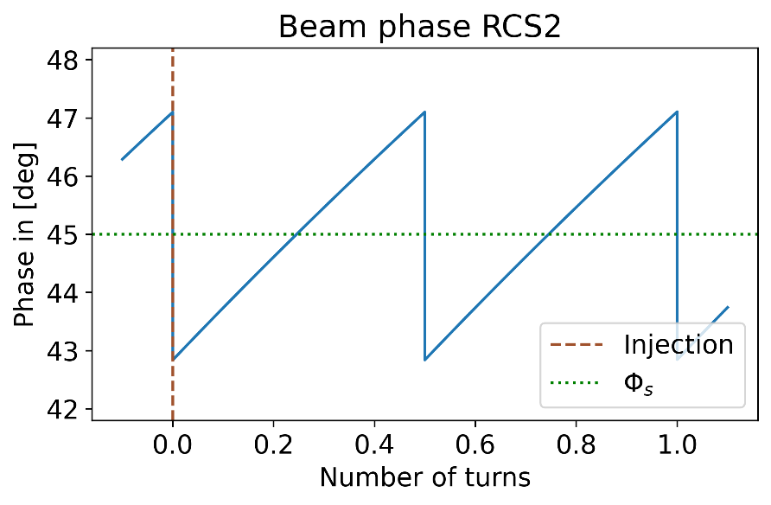
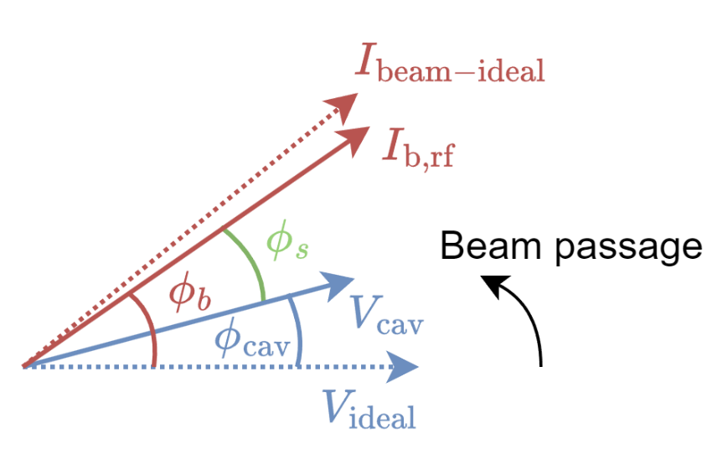
Changing cavity voltage during acceleration
In order to achieve the same energy gain, a change in the beam phase is necessary:
$$Φ_{b}(t)=\arccos\left(\frac{ΔE}{V_{cav}\left(t\right)}\right)+Φ_{cav}\left(t\right)$$

Slide 12
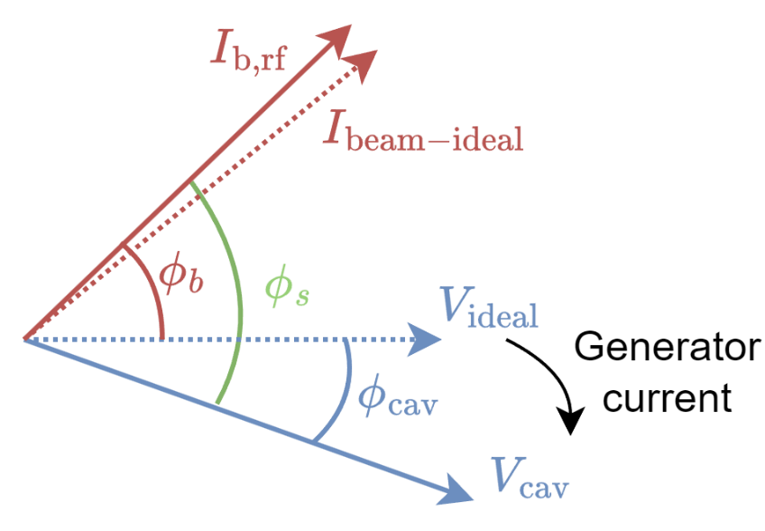
Changing cavity voltage during acceleration
In order to achieve the same energy gain, a change in the beam phase is necessary:
$$Φ_{b}(t)=\arccos\left(\frac{ΔE}{V_{cav}\left(t\right)}\right)+Φ_{cav}\left(t\right)$$

Slide 13
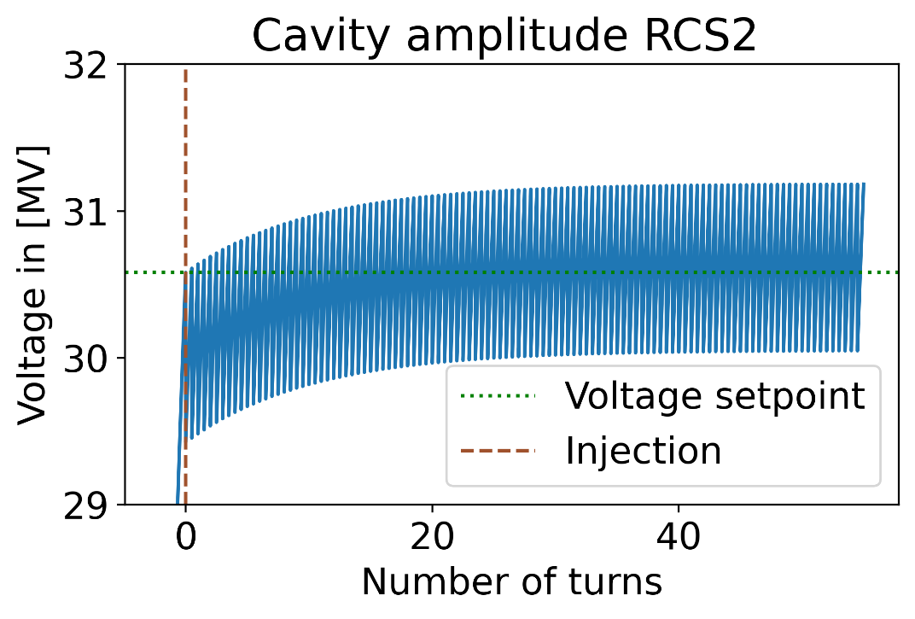
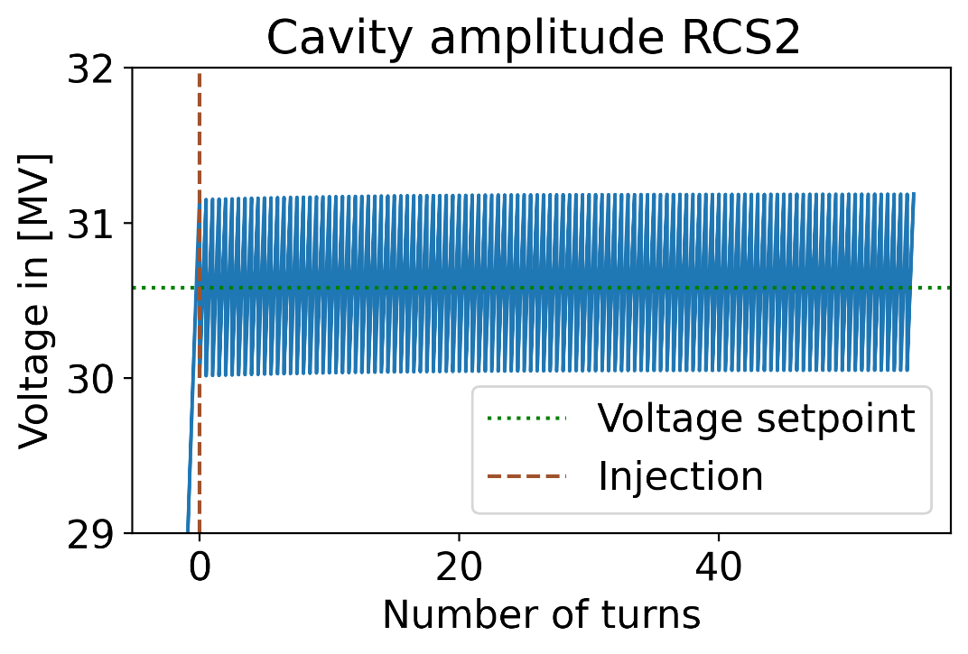
Transient beam loading simulation calculation of initial conditions
When simulating the cavity amplitude and phase, correct initial conditions for both need to be set.
The values are dependent on the length of the gap between two turns, the detuning and the generator current.
If the initial conditions are not correctly chosen, a transient behaviour will occur.
With corrected initial conditions

Slide 14
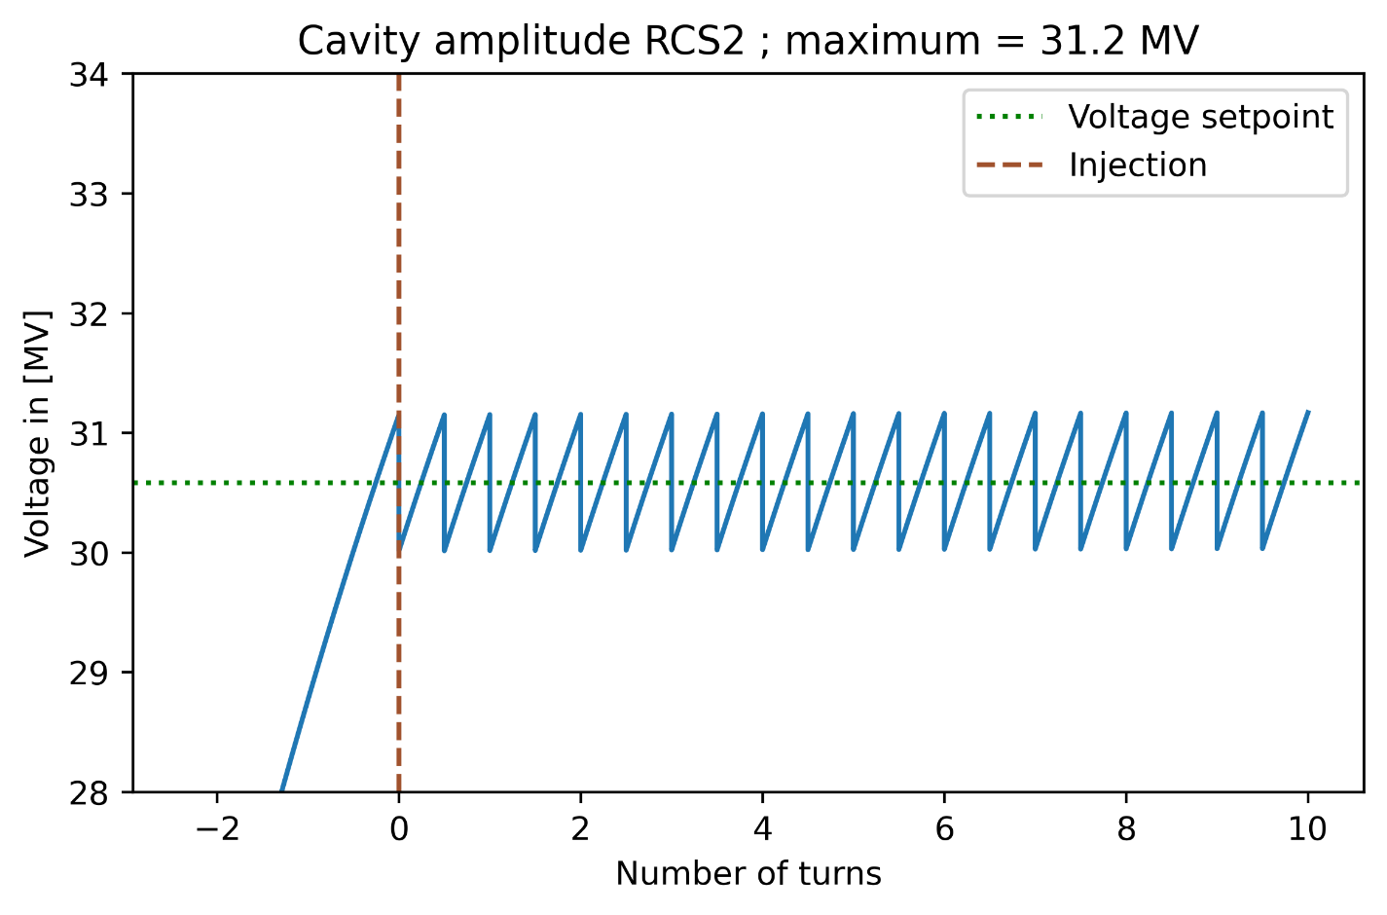
Cavity voltage amplitude in RCS2 Muon collider beam
Arrival time difference of the bunches is exactly ½ turn → amplitude and phase oscillate around their setpoints.
Excursion of the voltage from equilibrium → requires a setpoint reduction to avoid a voltage breakdown inside the cavity.

Slide 15
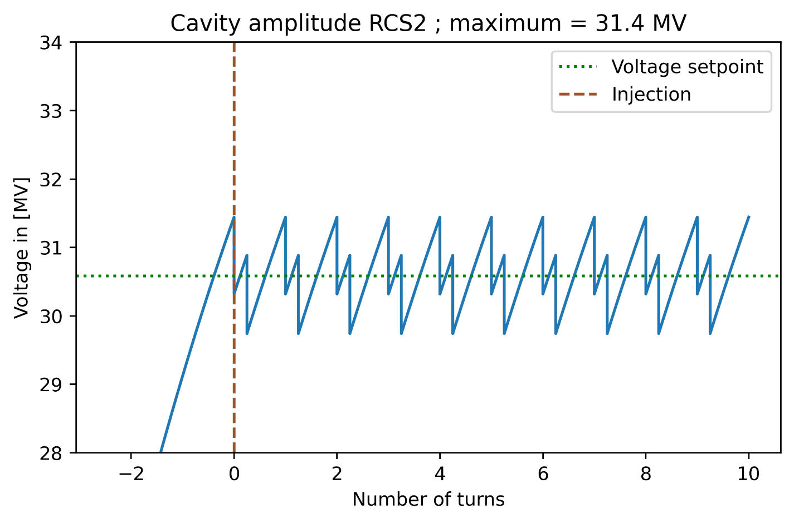
Cavity voltage amplitude in RCS2 Non-equidistant bunch spacing
Extremely high synchrotron tune ($Q_{s}≈1$) → RF system needs to be split into multiple stations.
Bunch-distance is not ½ turn → further disturbance of the cavity voltage → situation in most RF stations.
$μ^{+}$ and $μ^{−}$ bunches will encounter different voltages and phases.
Effects need to be studied with beam dynamics simulations in BLonD.

Slide 16
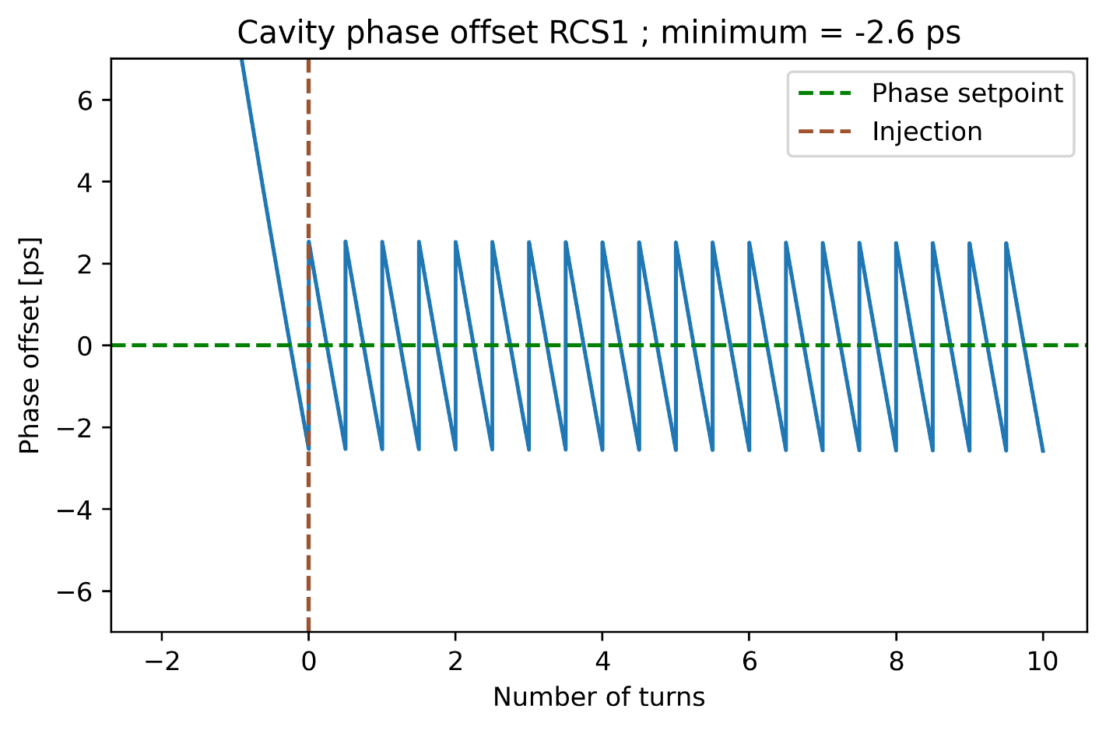
Cavity voltage in the RCS chain Dephasing in RCS1 and RCS4
Cavity dephasing is more significant, the closer the bunches are together.
Will be most pronounced in RCS1 and RCS2 → shortest accelerators in the RCS chain.

Slide 17
Conclusion
Muon colliders offer an elegant approach to enable research in the TeV collision-energy range.
Accelerator design mainly limited by muon lifetime of $τ_{μ}=γ∗2.2 μs$ → fast acceleration to profit from time dilation.
Synchronous phases, at which $μ^{+}$ and $μ^{−}$ need to be accelerated are identical → addition of their induced voltages.
Passage of bunches will alter both phase and amplitude of the cavity voltage.
Proper initial values must be chosen for the phase and the amplitude → no initial transient behaviour.
Performed simulations indicate that the cavity voltage oscillates stably around the setpoint → stabilising loop primarily necessary to ensure initial parameters.
Amplitude excursion from its setpoint is significant → useable voltage needs to be lowered to avoid voltage breakdowns.
Implications of the changing voltage on the beam dynamics will be investigated with dedicated simulations in BLonD.

Slide 19
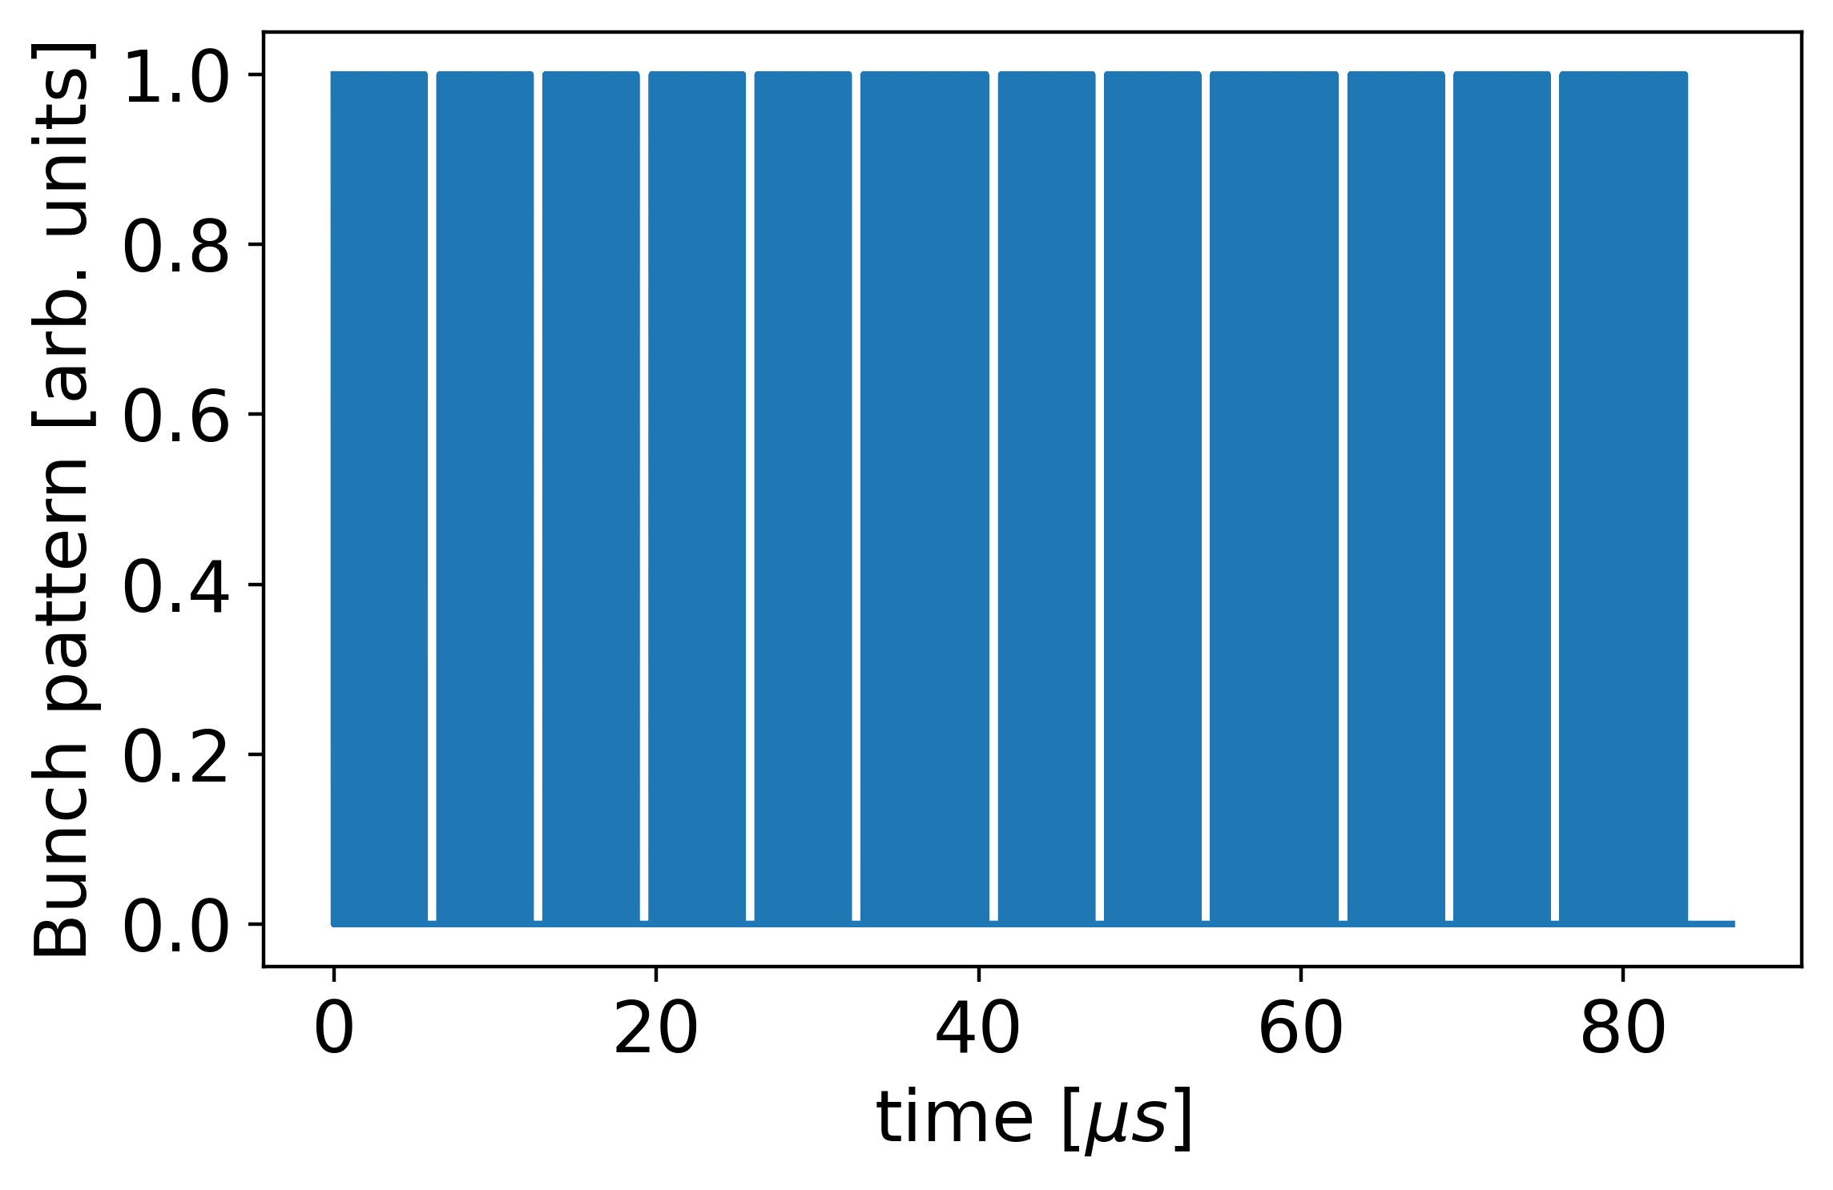
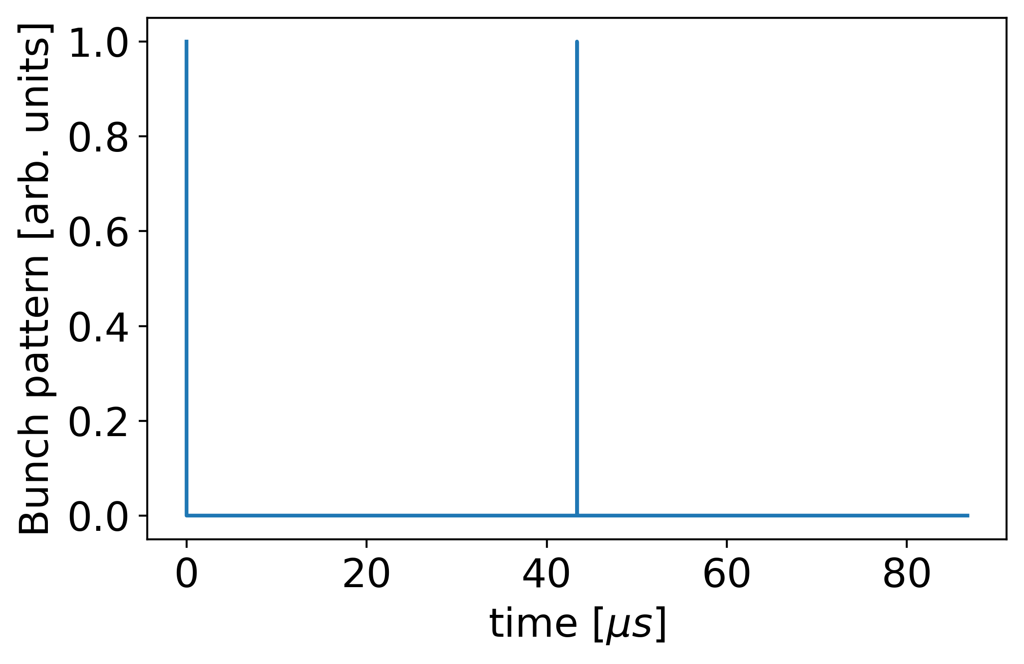
Transient beam loading in the muon collider
In the Muon Collider, the beam charge is concentrated in one bunch per direction and charge.
Beam dynamics simulations generally assume that the cavity voltage stays constant.
The generator can usually compensate for the energy taken from the cavity and the induced voltage by the beam passage.
This assumption is not realistic with only two highly populated bunches.
The voltage will, therefore, vary during the acceleration and affect the beam dynamics.
Transient beam loading needs to be simulated to quantify the effect.
← LHC-like bunch pattern over one turn
MuCol bunch pattern →

Slide 20
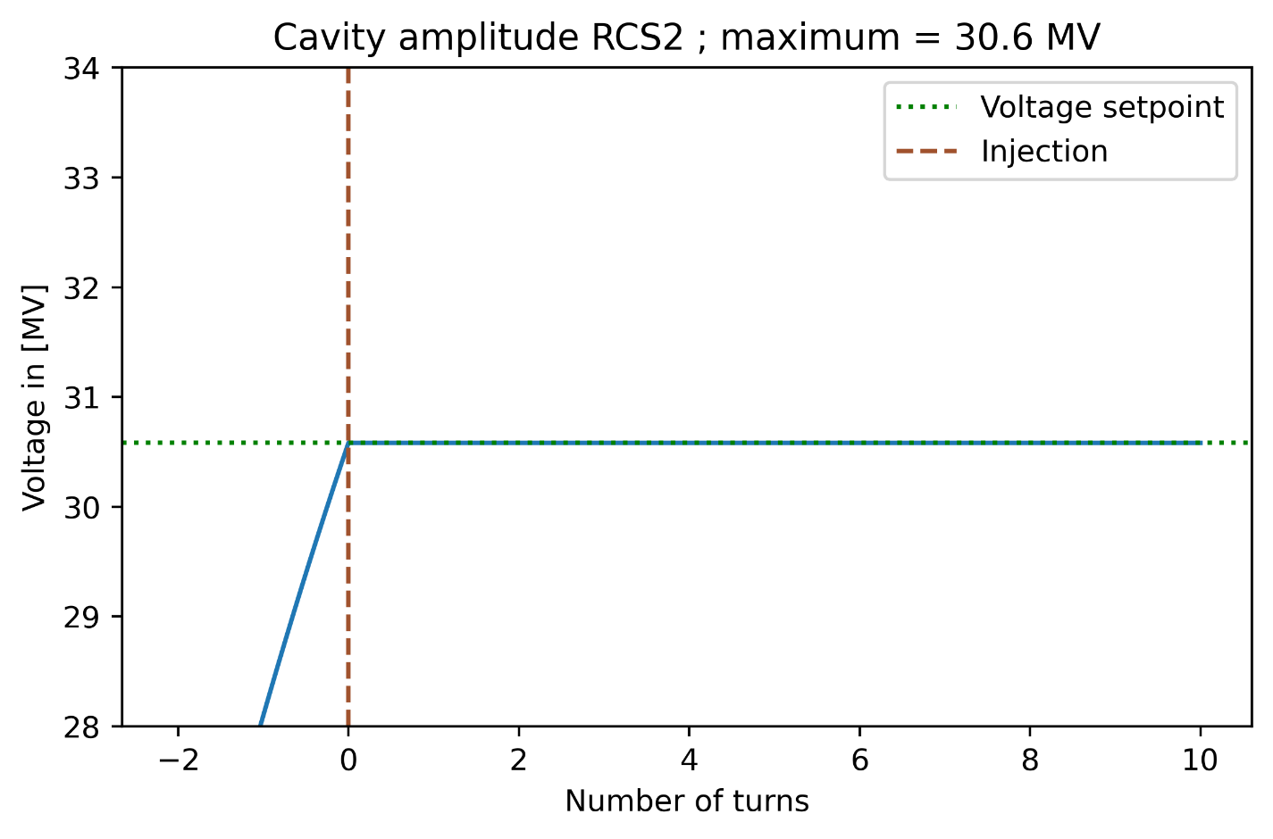
Cavity voltage amplitude in RCS2 Equally distributed beam
If the beam is equally distributed over the circumference of the accelerator, the voltage and the phase are both exactly at the setpoint voltage.
The formulas which are used follow [2].
Notes:
Eräutern, was mit setpoint gemeint ist.

Slide 21
Why collide muons?
Proton | Electron | Muon
Composite particle large amount of background data collision energy gets split | Point-like particle almost no background data collision energy is concentrated | Point-like particle almost no background data collision energy is concentrated
High beam-quality particle sources available | High beam-quality particle sources available | Particles need to be produced by proton collisions
Stable | Stable | Unstable: lifetime of $τ_{μ}=γ∗2.2 μs$ → Decay also creates background-data in the detector
Mainly limited by the bending strength of the dipole magnets | Mainly limited by synchrotron radiation energy loss due to low mass (power consuming replenishment by radio-frequency system necessary) | Mainly limited by muon lifetime and beam quality coming from the particle "source"

Slide 22
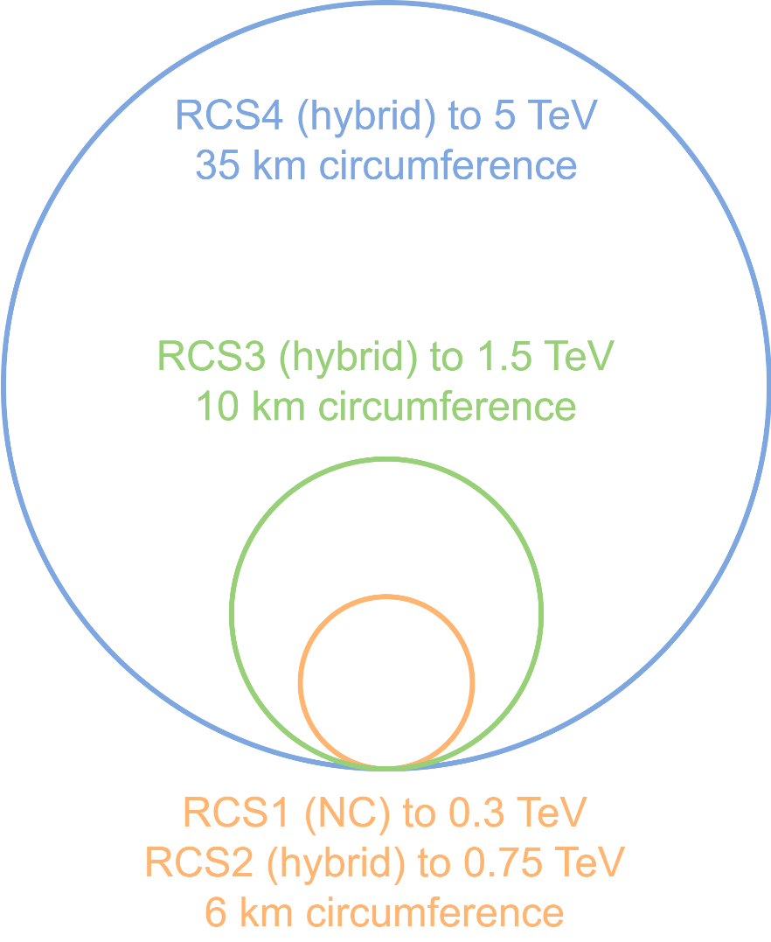
The muon collider RCS chain
The survival rate dictates the time that each particle can stay within a ring (~10s of turns).
The high energy gain per turn requires a large number of RF cavities and also magnets, which can follow the energy ramp.
Low-temperature superconducting (SC) magnets are ramping too slowly to be used in this context.
On the other hand, fast ramping normalconducting (NC) magnets do not provide a high bending field.
To limit the machine size, a possible solution is a hybrid magnet layout, in which normal- and superconducting dipole magnets coexist in the same ring.
Multiple RCSs are used to reach a high average bending field, limiting the total tunnel length.
One challenge for the RF system is the large voltage, which needs to be maintained with beam loading present.

Slide 23
Beam loading compensation
The passage of the beam induces a voltage, which detunes the cavity.
The cavity frequency must then be altered to make it an integer multiple of the revolution frequency again.
To reach optimum power efficiency of the RF system, two parameters can be adjusted:
Loaded quality factor $Q_{L}$ and cavity detuning $Δω$
BUT: the optimum of $Q_{L}$ is dependent on the chosen $Δω$ (if $Δω≠Δω_{opt}$).
Since the $Δω$ will be altered from the optimum value to ensure a stable acceleration, the $Q_{L}$ must also be adjusted.
${Δω}_{opt}=ω_{rf}\frac{\left(R/Q\right)\left|F_{b}\right|I_{b,DC}\cos\left(Φ_{s}\right)}{V_{cav}}$
$$Q_{L, opt}=\frac{V_{cav}}{2\left(R/Q\right)\left|F_{b}\right|I_{b,DC}\sin\left(Φ_{s}\right)}$$

Slide 24
Optimum cavity parameters
$$I_{g}=\left[\frac{V}{2\left(R/Q\right)Q_{L}}+I_{b,DC}F_{b}\sin\left(φ_{s}\right)\right]+i\left[I_{b,DC}F_{b}\cos\left(φ_{s}\right)−\frac{VΔω}{ω\left(R/Q\right)}\right]$$
$$I_{r}=\left[\frac{V}{2\left(R/Q\right)Q_{L}}−I_{b,DC}F_{b}\sin\left(φ_{s}\right)\right]−i\left[I_{b,DC}F_{b}\cos\left(φ_{s}\right)−\frac{VΔω}{ω\left(R/Q\right)}\right]$$
${Δω}_{opt}=ω_{rf}\frac{\left(R/Q\right)\left|F_{b}\right|I_{b,DC}\cos\left(Φ_{s}\right)}{V_{cav}}(12)$
$$Q_{L, opt}=\frac{V_{cav}}{2\left(R/Q\right)\left|F_{b}\right|I_{b,DC}sin⁡(Φ_{s})} (13)$$

Slide 25
Formula collection
$$I_{g}e^{iΦ_{L}}=\frac{V_{cav}}{2\left(R/Q\right)}\left(\frac{1}{Q_{L}}−2i\frac{Δω}{ω_{rf}}\right)+ \frac{<I_{b,rf}>}{2}$$
$$Q_{L, opt}=\frac{V_{cav}}{R/Q{\sqrt{(\left|F_{b}\right|I_{b,dc}\cos{{\left(Φ_{s}\right))}^{2}}+{\left(\left|F_{b}\right|I_{b,DC}\sin\left(Φ_{s}\right)+ \frac{V_{cav} 2Δω}{ωR/Q}\right)}^{2}}}^{.}}$$
${Δω}_{opt}=−ω_{rf}\frac{\left(R/Q\right)\left|F_{b}\right|I_{b,dc}\sin\left(Φ_{s}\right)}{2V_{cav}}$
Initial voltage for transient case
$$V_{init}=\left(\frac{V_{cav}}{τ}+R/Qω_{RF}I_{g}\cos\left(Φ_{L}\right)\right)∗t_{gap}$$
$$Φ_{s}=\arccos\left(\frac{ΔE}{A\left(t\right)}\right)$$
https://journals.aps.org/prab/abstract/10.1103/PhysRevAccelBeams.22.081002
$$Φ_{b}=\arccos\left(\frac{ΔE}{A\left(t\right)}\right)+Φ\left(t\right)$$

Slide 26
References
[1]: I. Karpov, Transient beam loading and rf power evaluation for future circular collider: https://journals.aps.org/prab/abstract/10.1103/PhysRevAccelBeams.22.081002

Slide 27
High energy acceleration parameters

