Slide 1
Numerical Simulation of a laser plasma driven HGHG FEL
S.Y. Teng^{1,2}, S.W. Chou¹, S.H. Chen¹
W.Y. Chiang², W.K. Lau²
¹Department of Physics, NCU, Taoyuan, Taiwan
²National Synchrotron Radiation Research Center , Hsinchu ,Taiwan
ICAP 2024
October 3, 2024

Slide 2
Outline
Introduction
Simulation results with a simple beam transport system
Decompressor for larger energy spread
Summary

Slide 3
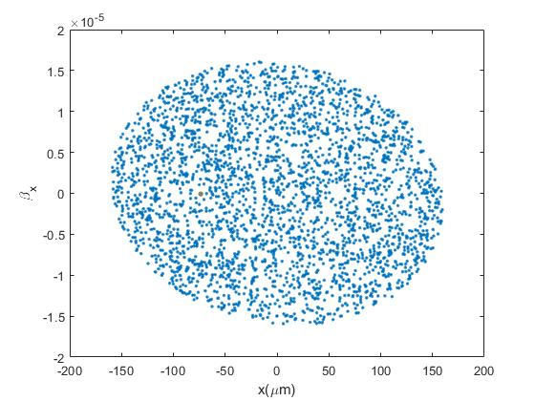
Free electron laser
A Free electron laser is an accelerator based light source that can generate intense radiation from a relativistic electron beam in a periodic magnetic field
Basic components
Relativistic electron beam
Energy ($γ$)
Current (I)
Emittance ($ε$)
Energy spread ($Δγ$)
Undulator : periodic magnetic field
Undulator period ($λ_{u}$)
Undulator parameter (K)
Undulator length (L)
Electromagnetic field : propagating with electron beam and getting amplified.
Resonant wavelength ($λ$)
Saturation power (P)
Resonant condition $λ=\frac{λ_{u}}{2γ^{2}}(1+\frac{K^{2}}{2})$

Slide 4
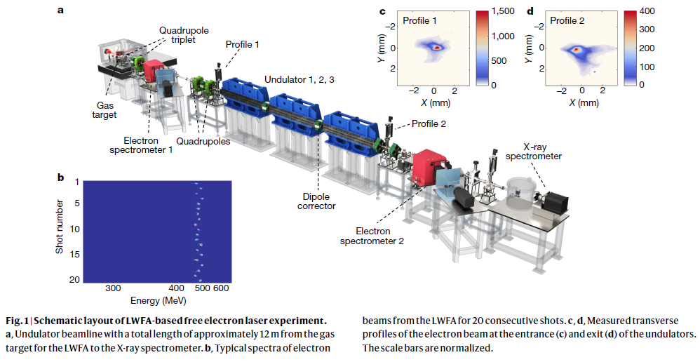
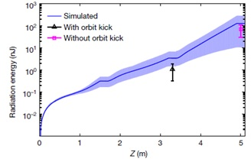
LWFA-based FEL
In 2021, The first experiment of LWFA based FEL was accomplished in Shanghai Institute of Optics and Fine Mechanics (SIOM)
Ultra-short bunch length and sub microradian emittance
Transportation and FEL gain of the high divergence /energy spread electron beam
Nature volume 595, pages516-520 (2021)

Slide 5
Structure of the proposed NCU LWFA beamline
TW laser system
Undulator
LWFA source
Transport to undulator
e-beam conditioning
NCU high field laboratory LWFA FEL
The baseline design of the proposed facility is a HGHG free electron laser driven by a 250 MeV high brightness electron beam from the laser plasma accelerator.
A 12-periods planar undulator with period length of 35 mm will be used for laser beam energy modulation. Followed by a radiator with period length of 20mm aimed at the 4th harmonic of 266nm seed laser
Schematic layout of NCU LWFA FEL experiment

Slide 6
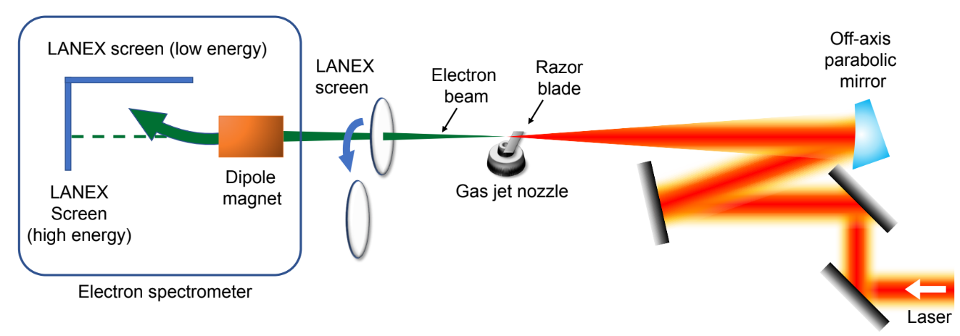
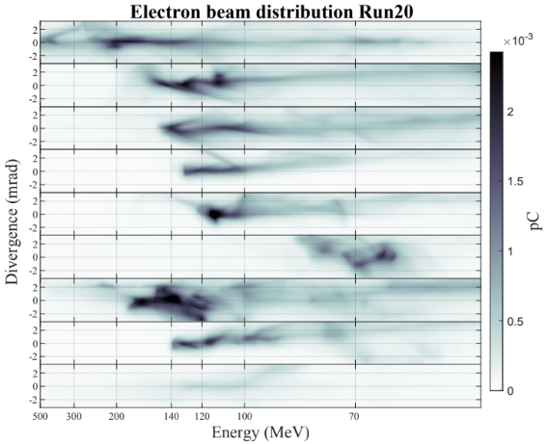
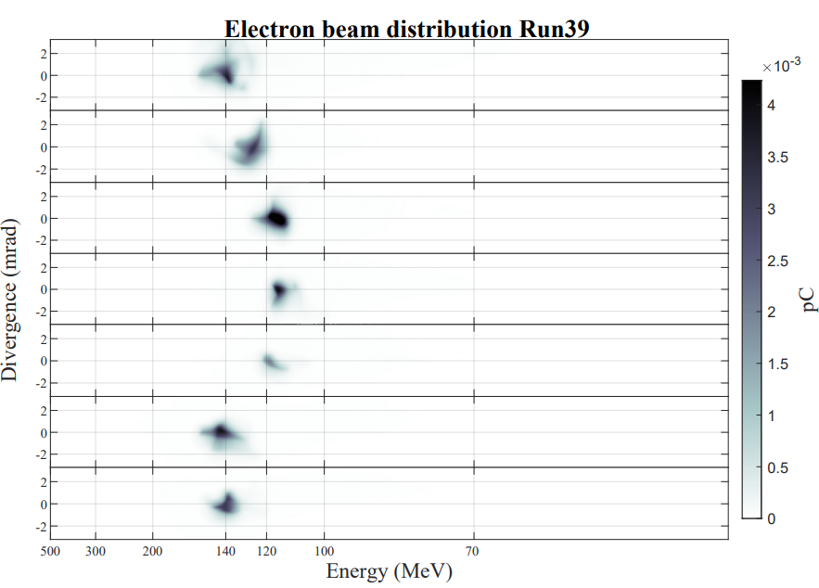
Layout and current results of LWFA beam
Consecutive shots of self injection and shock front injection scheme

Slide 7
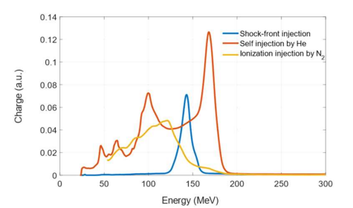
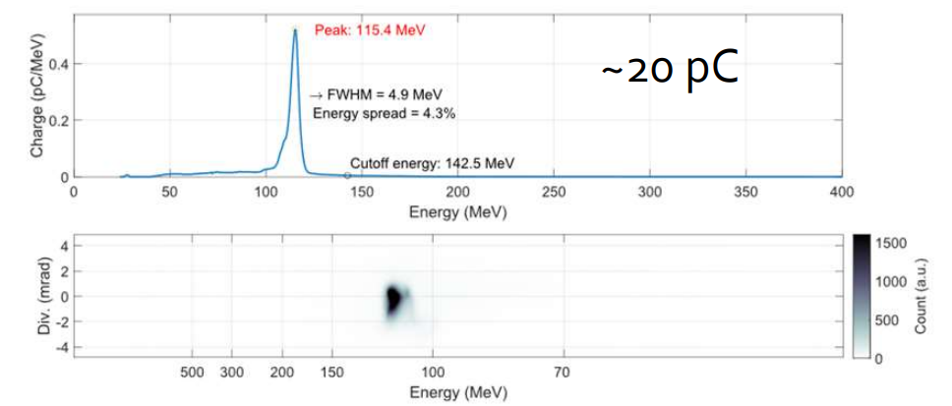
Layout and current results of LPA beam

Slide 8
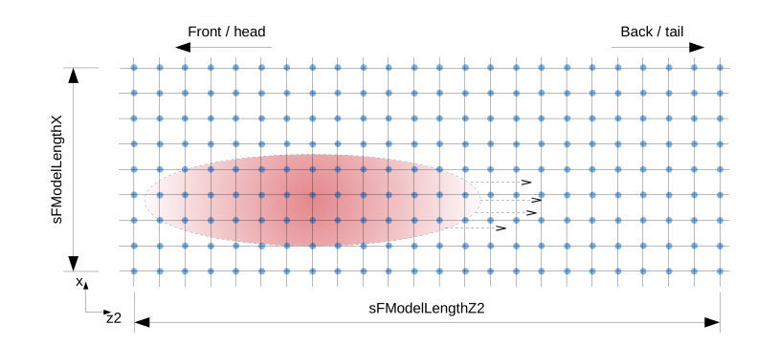
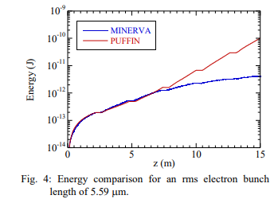
Simulation tools
IMPACT : A three dimensional parallel PIC code
PUFFIN : A three dimensional unaverage FEL code
IMPACT-T is a parallelized full 3D space charge tracking program which take short-range wakefields and CSR into account
For ultra-short bunch length generated from the LWFA. A strong transverse space charge need to be considered during the transportation
The full, broad bandwidth frequency spectrum, limited only by the Niquist frequency of the mesh
Transport of ultra-short / large energy spread beams through the undulator, and the radiation emitted from these beams
(https://github.com/impact-lbl/IMPACT-T )
L.T. Cambell. ANALYSIS OF ULTRA-SHORT BUNCHES IN FREE-ELECTRON LASERS (2020).

Slide 9
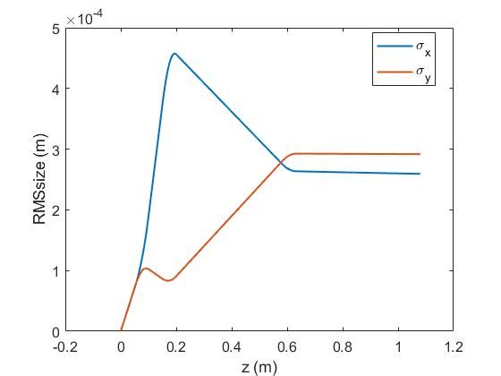
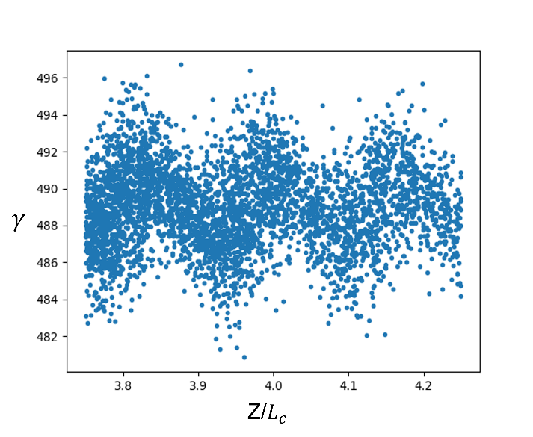
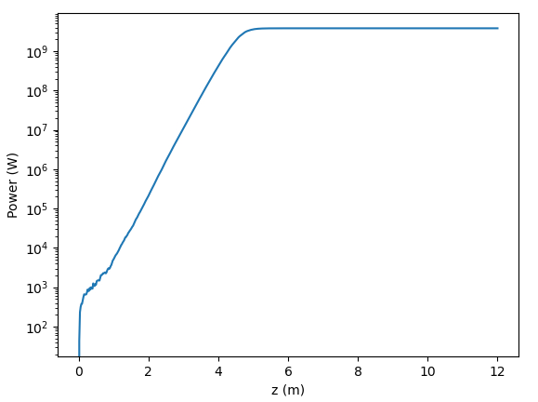
Simulation framework with Impact & Puffin
IMPACT-T
Objective optimization
Beam size evolution along transport line
Beam transport line for NCU LPA source
PUFFIN
modulator
radiator
4th harmonic HGHG FEL
Electron phase space distribution after modulator
Radiation power growth along radiator (1D example)

Slide 10
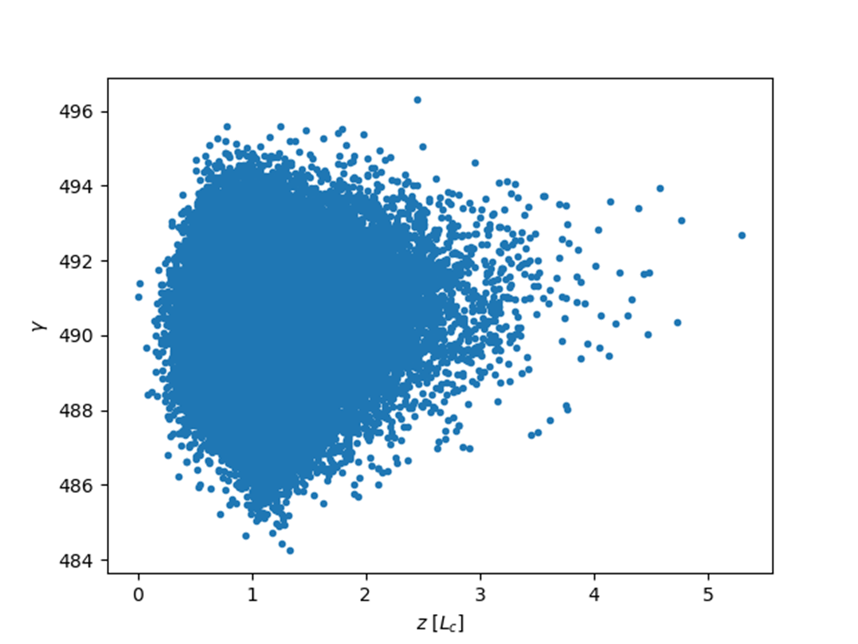
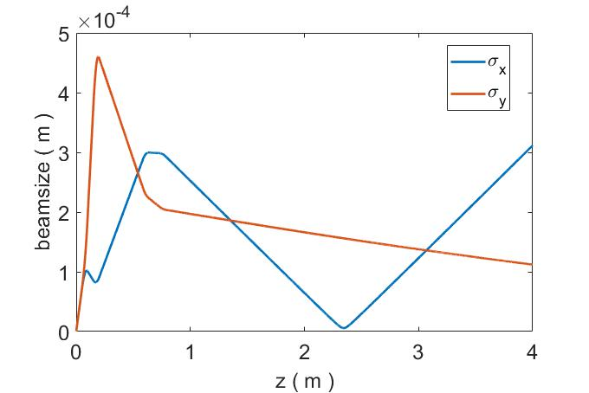
Beam transport simulation
Beam size evolution along transport line
Longitudinal phase space distribution at the entrance of modulator
LWFA Beam Parameters | Value
Beam energy [MeV] Bunch charge [pC] Bunch duration [fsec] Normalized emittance [μm] Initial beam size [μm] Initial beam divergence [mrad] Energy spread [%] | 250 20 2.12 0.5 0.72 1.4 0.1-0.5
A pair of high gradient permanent quadrupole magnets are placed right after the LWFA to limit rapid growth of beam size due to large initial divergence.

Slide 11
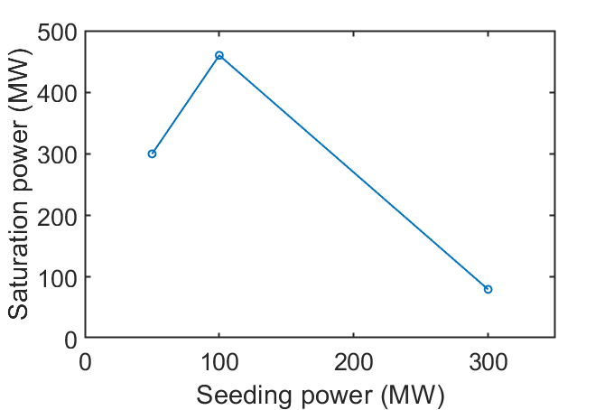
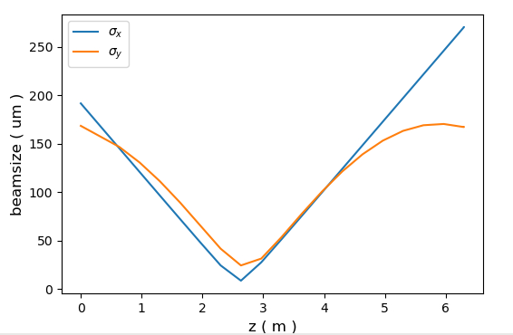
HGHG FEL optimization
HGHG FEL Parameters | Value
Seed laser wavelength [nm] Seed laser power [MW] Modulator period [mm] Modulator length [m] Chicane R56 [mm] Radiator period [mm] Resonant wavelength [nm] | 267 50-300 35 0.5 0.033 20 66.5
z (m)
Scan the seed laser power and fix chicane to optimize the saturation power
Optimize the quadrupole strength to fit the undulator focusing in the y direction

Slide 12
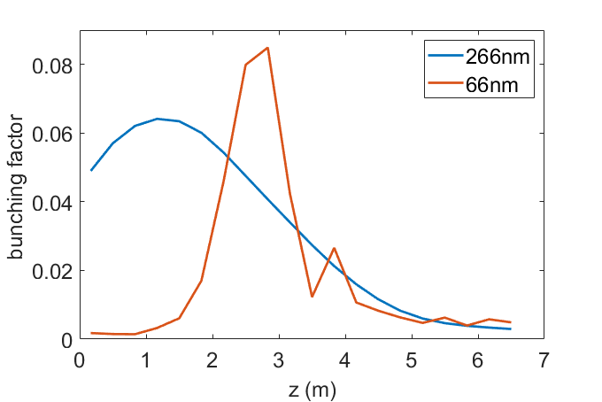
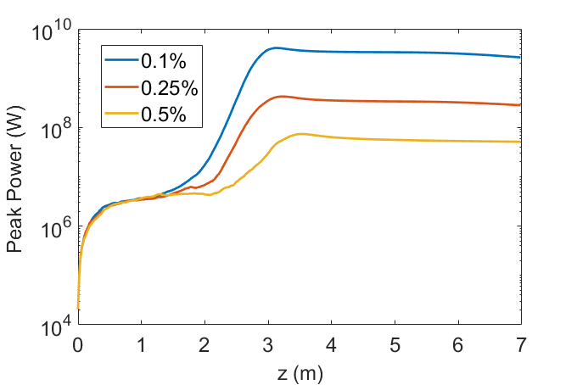
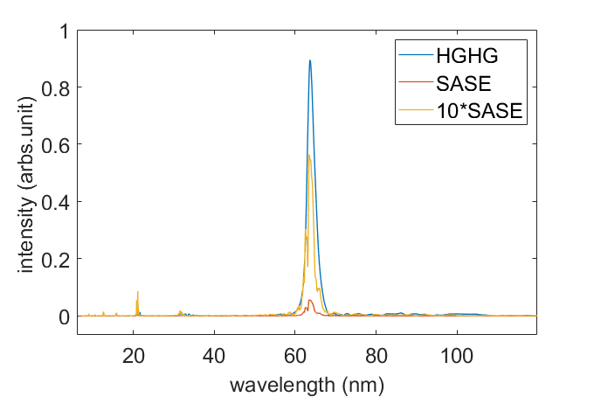
Radiator simulation results
Evolution of bunching factors at 266nm and 66nm in the radiator illustrate the effects of the beam energy modulation and the way of power gain in the 4th harmonic.
FEL gain can be observed with beam energy spread up to 0.5%. However, we can not get any FEL gain from 1% energy spread

Slide 13
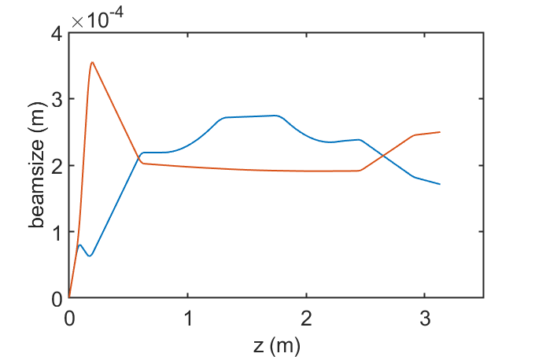
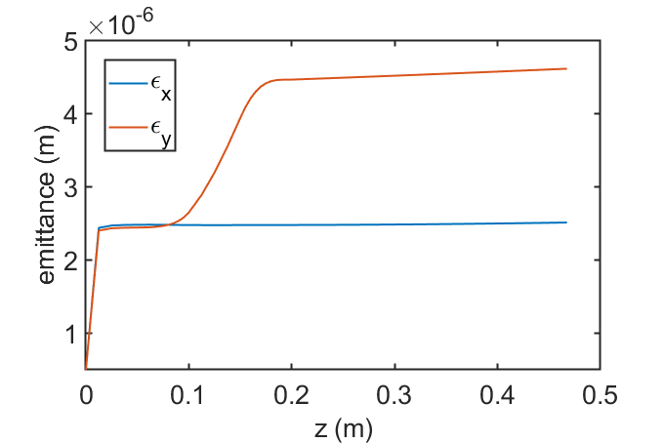
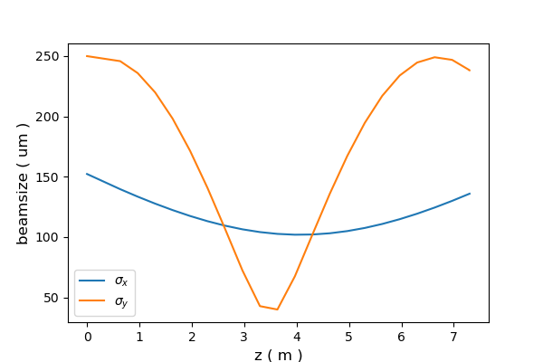
Decompressor for larger energy spread
Electron beam
U20 undulator
Seed
laser
TW laser
Quadrupole doublet
4-dipole decompressor
Quadrupole triplet
U35 undulator
4-dipole chicane
LWFA Beam Parameters | Value
Beam energy [MeV] Bunch charge [pC] Bunch duration [fsec] Normalized emittance [μm] Initial beam size [μm] Initial beam divergence [mrad] Energy spread [%] | 250 50 2.12 0.5 0.72 1.4 1
Emittance growth in the beginning of beam transportation
Focused electron beam size in the radiator
Beam size evolution along beam transportation

Slide 14
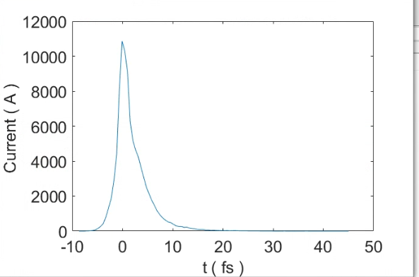
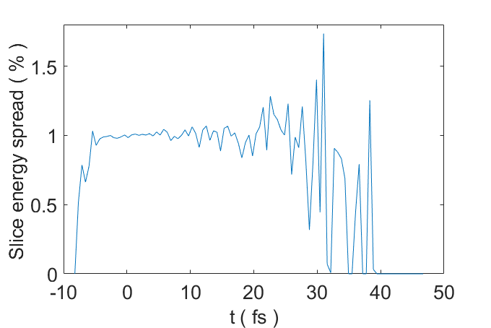
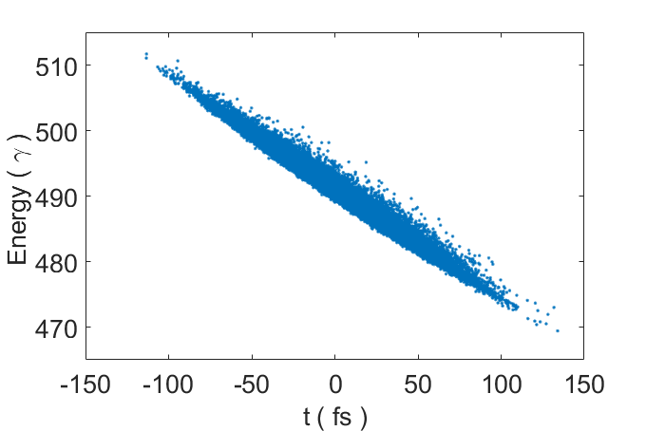
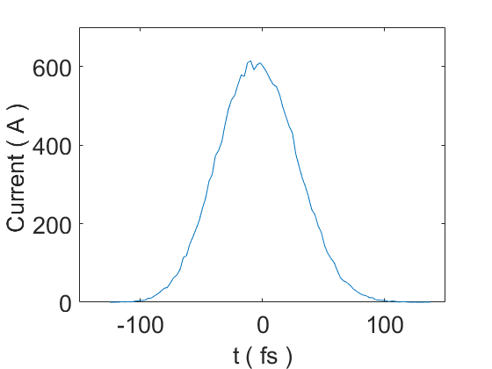
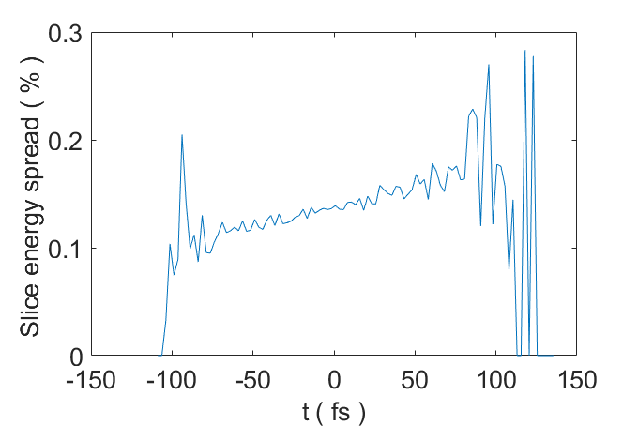
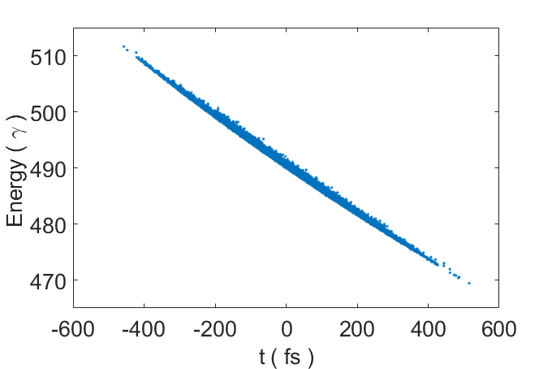
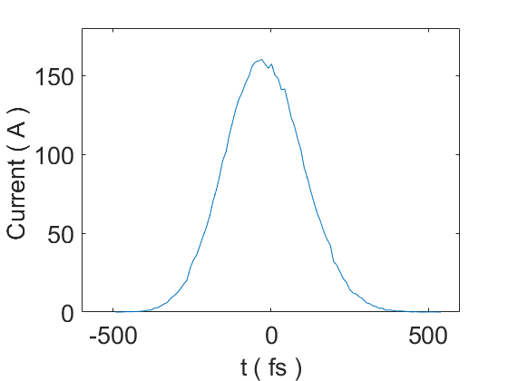
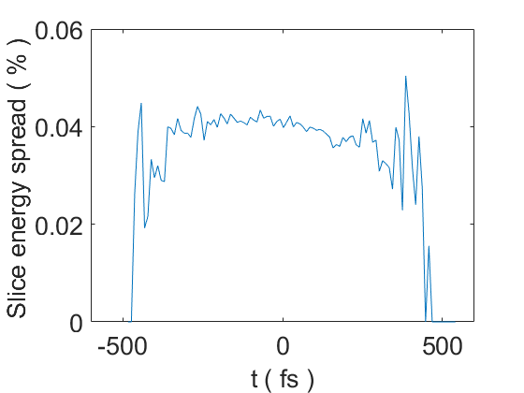
Beam distribution at entrance / exit of decompressor
Longitudinal phase space distribution
Current profile
Slice energy spread
Rms bunch length : 4.76fs
Rms bunch length : 29fs
Decompressor R56 = 1.7mm
Rms bunch length : 114fs
Decompressor R56 = 3.4mm

Slide 15
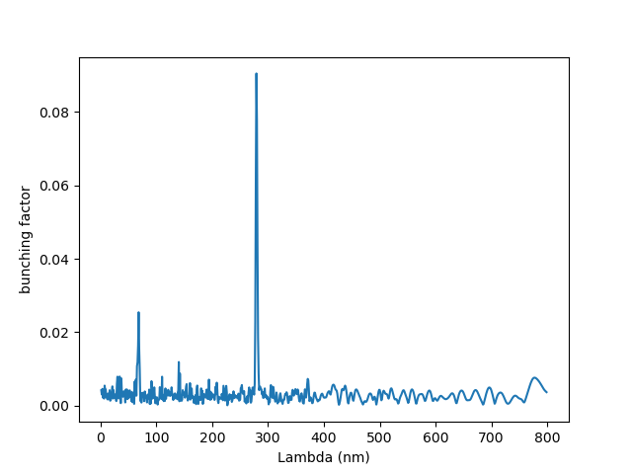
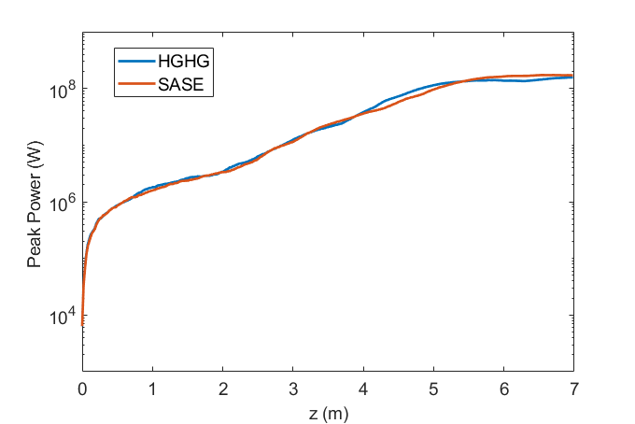
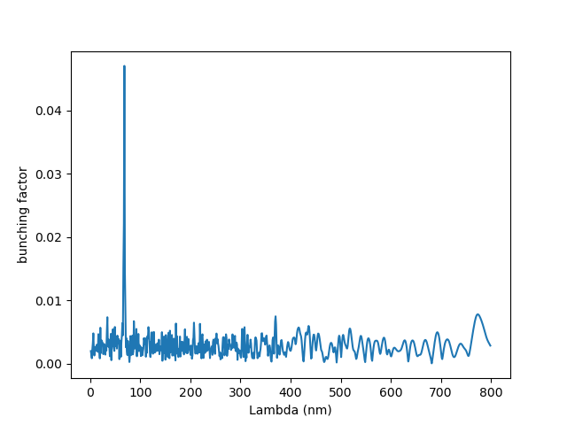
Radiator simulation for decompressed beam
Seed:
300MW
The power gain behave more similar to the SASE scheme even with 300MW seeding power
The effects of seed laser seems not working for a decompressed beam. This might because of the correlated energy spread

Slide 16
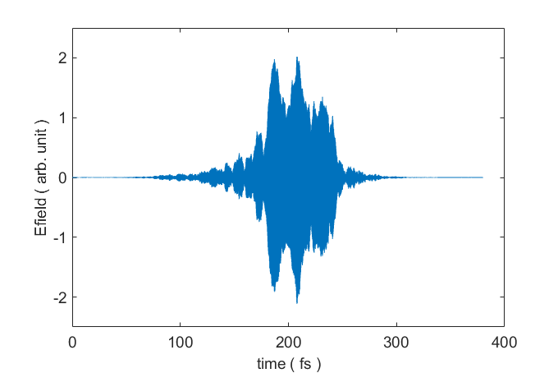
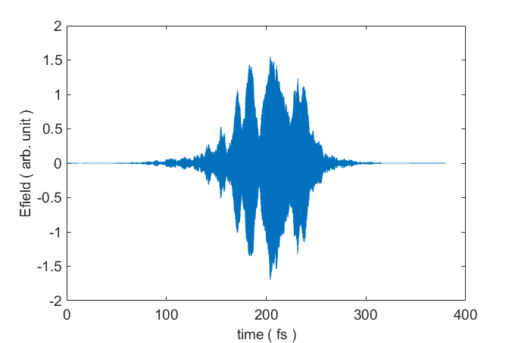
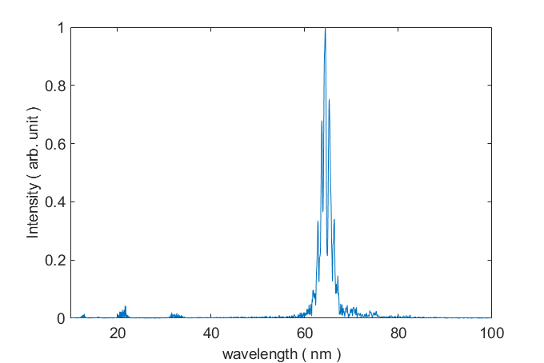
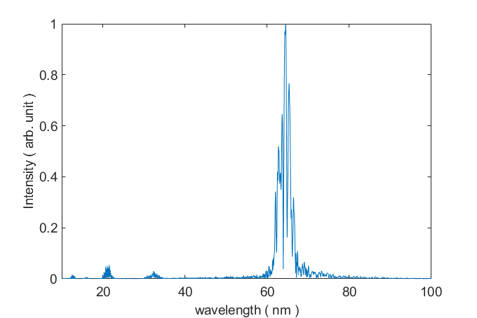
Radiation profile and spectrum of SASE / HGHG scheme
Not only the power growth , the radiation spectrum of HGHG scheme is also similar to the SASE case.
Applying a dechirper might be one of the solutions to reduce the correlated energy spread. This can be our future simulation plan.
On-axis electric field and the spectrum of the SASE scheme (left side) and the HGHG (right side) scheme

Slide 17
Summary
Simulation study of a LPA-driven HGHG FEL with a simple BTS has been done at various energy spreads. The results are promising for energy spread lower than 0.5% for a non decompressed beam.
The effects of short bunch length is significant!! Very high initial CUR, reduce radiator length to about 3m. However, this might have some reduction in pulse energy due to fewer microbunches.
With 4-dipole decompressor, we're able to further reduce slice energy spread to ~ 0.1% this helps to improve the FEL performace with 1% rms energy spread significantly.
The HGHG scheme seems not working for a decompressed beam, the reason might because of correlated energy spread. We’ll consider a dechirper for our future work

Slide 19
Thanks for your attention!

Slide 20
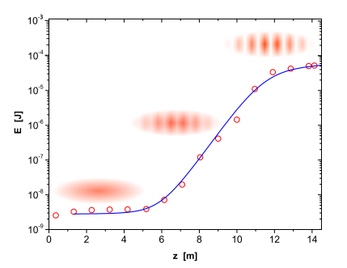
Common parameters for FEL
Saturation power and gain length
Saturation power
For a FEL amplifier, the growth and saturation of radiation can be described by:
Pierce parameter
$$L_{g(1D)}={λ_{u}}/{4π\sqrt{3}ρ}$$
Radiation power growth in undulator
$ρ$, L_{g} , L_{sat} and P_{sat} are the major performance parameters for a high gain FEL amplifier.
Ref: FLASH, Oleg Kornilov

Slide 21
Common parameters for FEL
Pierce parameter
Saturation power P_{sat}:
Pierce parameter ρ :
$$L_{g(1D)}={λ_{u}}/{4π\sqrt{3}ρ}$$
e-beam peak current
Undulator paramter
Alfven current = 17kA
Rms beam size
$σ_{δ}<ρ$: electron relative energy spread $σ_{δ}$should be a bit smaller than $ρ$
For NCU paramters : $ρ \sim 0.0029$ for 170um beamsize $ρ \sim 0.002$ for 300um beamsize

Slide 22
PUFFIN : A three dimensional unaverage FEL code
The full, broad bandwidth frequency spectrum, limited only by the Niquist frequency of the mesh
Full electron beam transport
Transport of large energy spread beams through the undulator, and the radiation emitted from these beams
L.T. Cambell. ANALYSIS OF ULTRA-SHORT BUNCHES IN FREE-ELECTRON LASERS (2020).

Slide 23
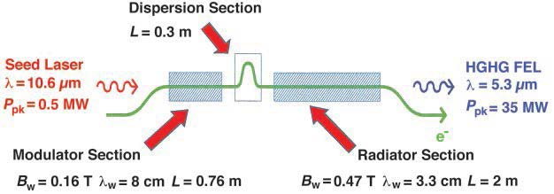
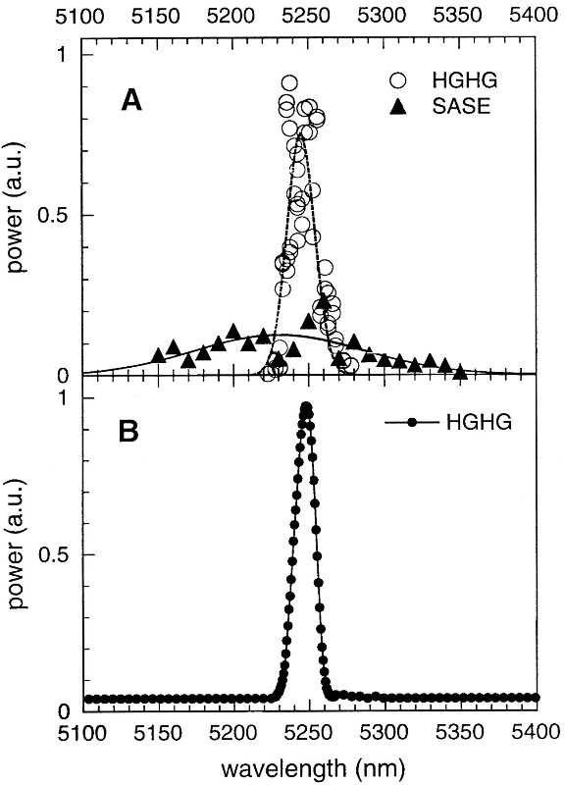
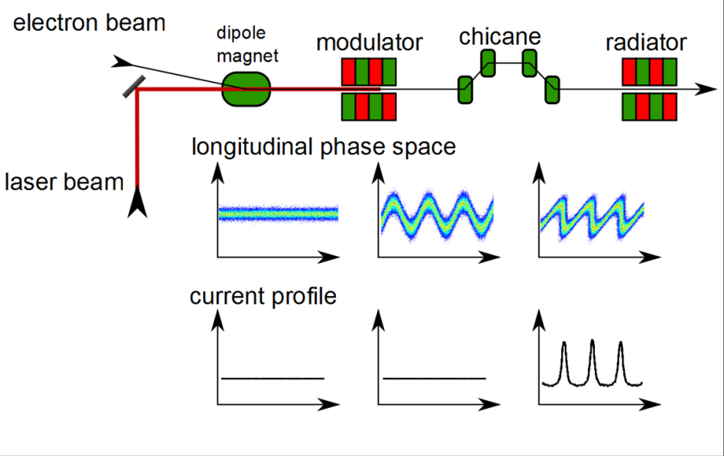
First HGHG Expt. @ Brookhaven National Lab
L.-H. Yu, et al. “High-Gain Harmonic-Generation Free-Electron Laser.” Science, vol. 289, no. 5481, 2000, pp. 932–34. JSTOR,

Slide 24
Structure of the proposed NCU LWFA beamline
The beamline simulation was done using Impact code by Dr. Ji Qiang which includes both 3D space charge and CSR effects.
LWFA Beam Parameters | Value
Beam energy [MeV] Bunch charge [pC] Bunch duration [fsec] Normalized emittance [μm] Initial beam size [μm] Initial beam divergence [mrad] Energy spread [%] | 250 20 2.12 0.5 0.72 1.4 0.1-1

