Slide 1
Benchmark of Linac Model and Phase Space Measurements at the SNS Beam Test Facility
Kiersten Ruisard
Oak Ridge National Laboratory
10/3/24 ICAP’24

Slide 2
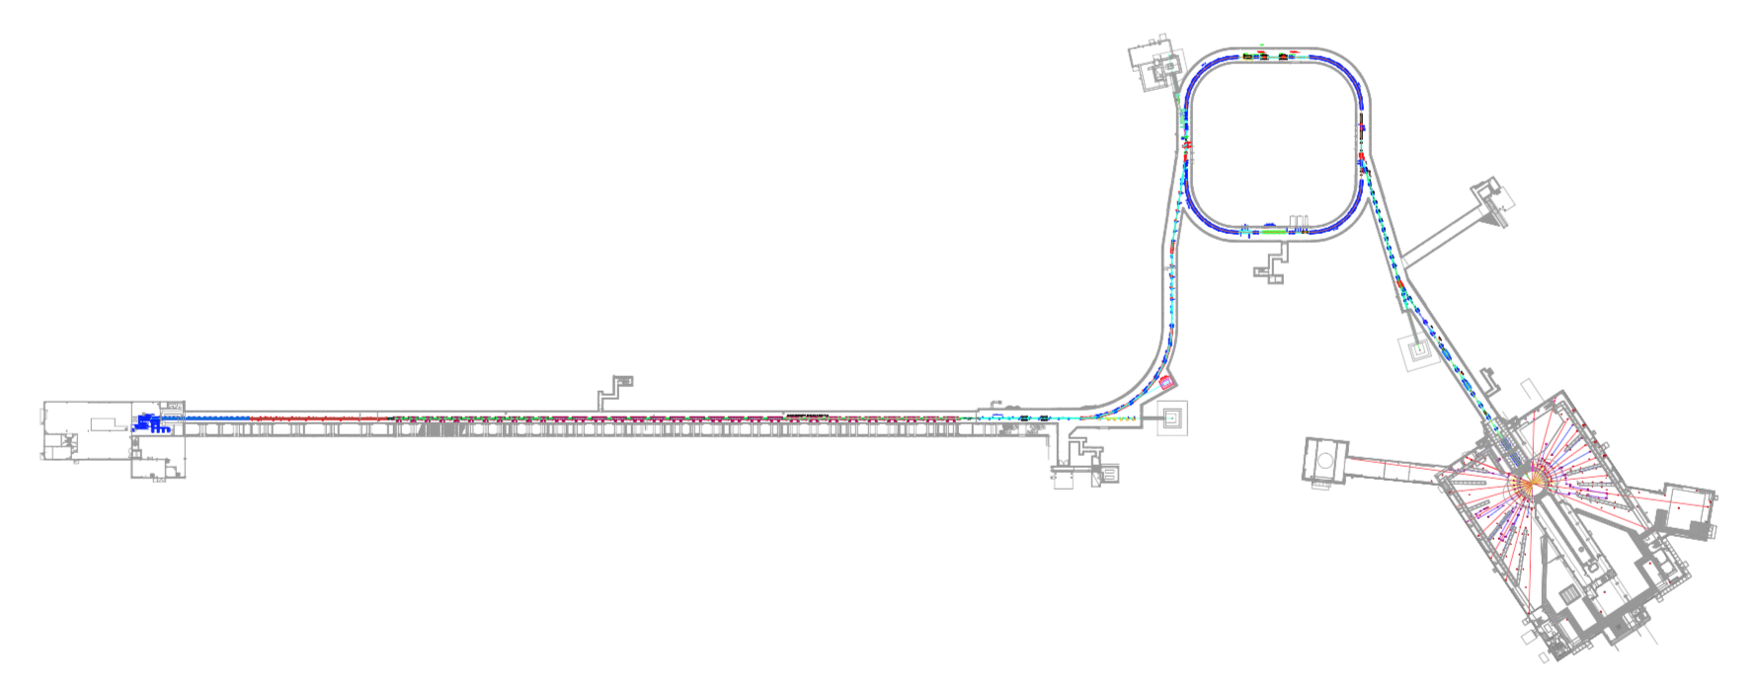
Beam loss, an operational challenge for SNS and other high-power ion accelerator
Beam loss at SNS (<0.001% of the beam) causes radioactivation in tunnels
Simulation models cannot predict losses
Excess beam loss can limit high power linac operation
SNS Accelerator Complex:
MEBT: 2.5 MeV
1.3 GeV
335 meters
Lost ions at high energy cause radioactivation
Complex nonlinear dynamics complicate ion trajectories
SNS Beam test facility:
2.5 MeV beam transport
Ion source
RFQ
13 meters

Slide 3
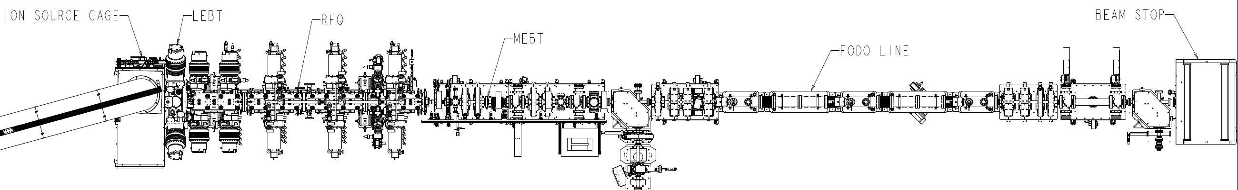
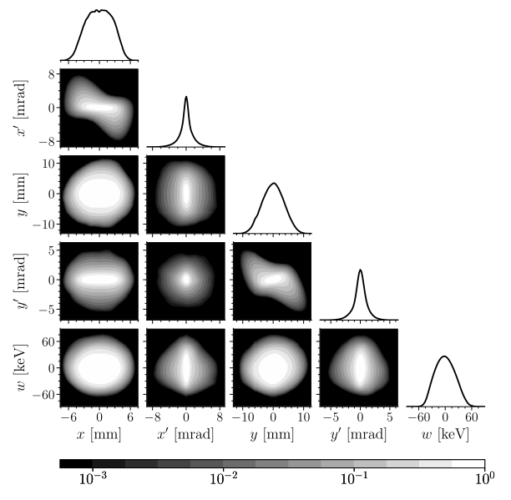
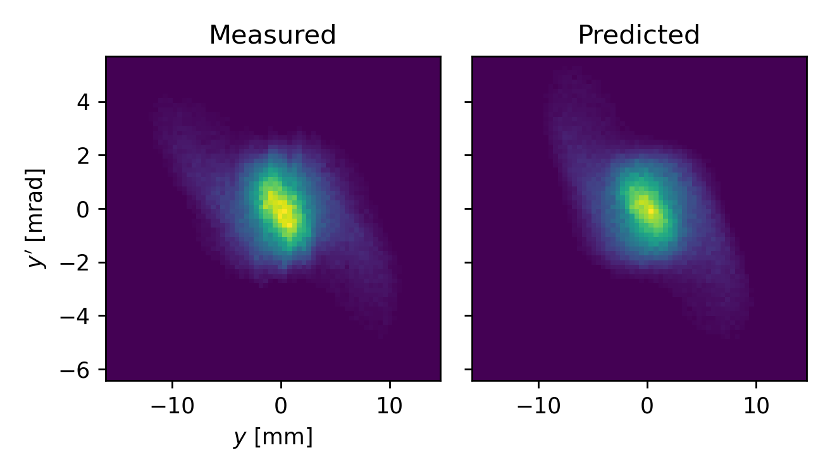
Scope of BTF project is to accurately model halo development over short, 2.5 MeV transport line
“input bunch”
“output bunch”
2D high dynamic range
Up to 6D phase space
2D phase space
Up to 5D phase space
5D measurement of initial bunch
2D phase space measurement vs model
(Linear scale, dynamic range of 10²)
Hoover et. al (2023).
PRAB 26, 064202

Slide 4
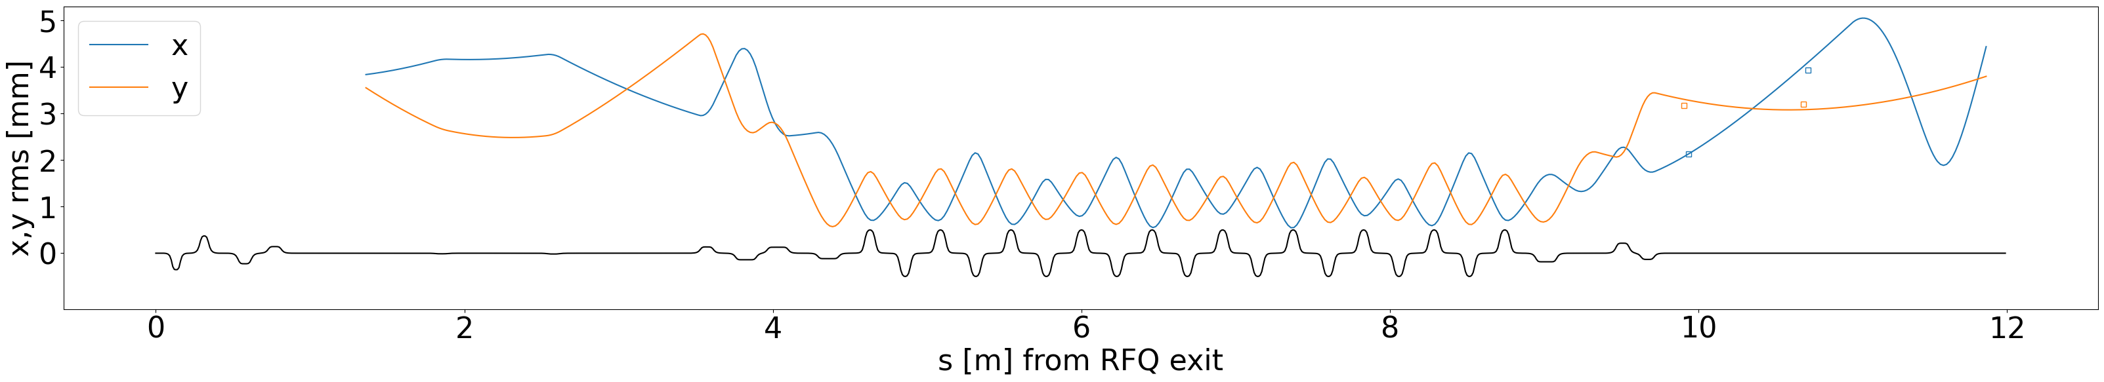
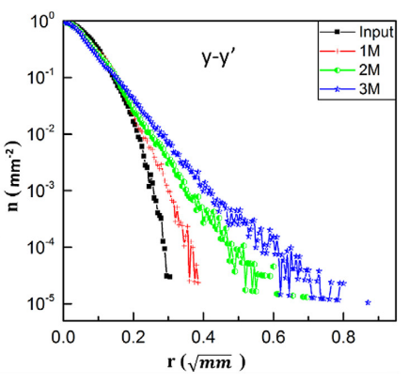
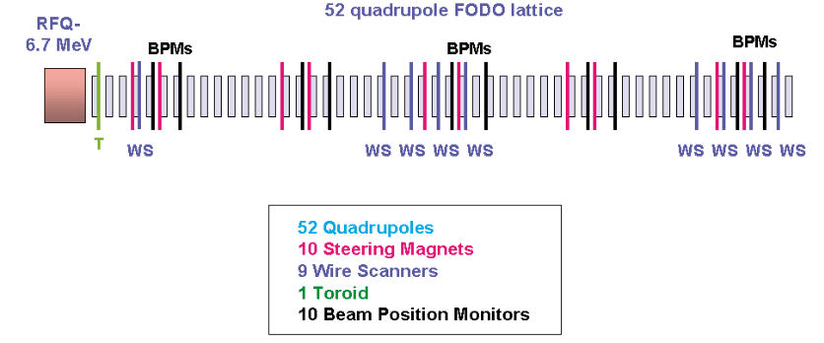
Scope of BTF project is to accurately model halo development over short, 2.5 MeV transport line
“input bunch”
“output bunch”
Relatively strong-focusing FODO line:
9.5 cells
105 degrees per cell
Permanent magnet quadrupoles
Zhang, Z., et. al (2020).
NIM-A, 949, 162826.
Qiang, J., et. al (2002).
PRSTAB, 5(12), 124201.

Slide 5










Beam Test Facility is equipped for thorough measurement of the bunch distribution
2D high dynamic range
Up to 6D phase space
2D phase space
Up to 5D phase space
2D high-dynamic-range (10⁶) phase space measurement
6D phase space measurement
slit 1 $=x$
slit 3 $\sim x′$
slit 1 $=x$
slit 2 $\sim x′$
slit $2=y$
H⁺
H⁻ beam
${90}^{∘}$dipole
${90}^{∘}$dipole
H⁻ beam
slit 4 $\sim ΔE$
0.95 m
wire $\sim y′$
RF
2-camera system
secondary e⁻
$f(φ$)

Slide 6
Recent operation and results, benchmark status
What matters? Model parameters and constraints
  Input bunch
  Quadrupole field model
  Longitudinal and space charge dynamics
3. Outlook and next steps

Slide 7
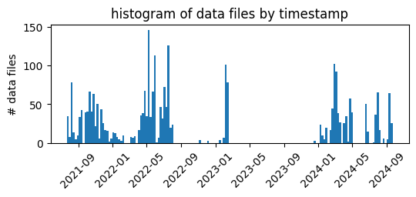
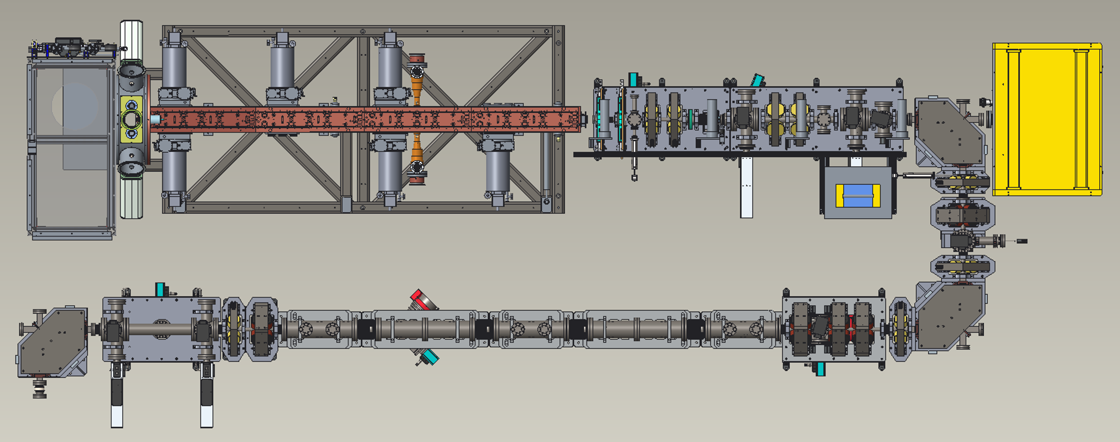
Operational notes from 2024 BTF experiments
2018 - 2022
New high-current ion source with wide aperture delivers 52 mA at RFQ output
New-to-BTF RFQ for 2024 run
Long shutdown for most of 2023
Full-6D measurement
High-dynamic range measurement
Re-commissioned in early 2024:
5D-capable diagnostics
Ion Source
0.06 - 2.5 MeV acceleration (RFQ)
Periodic focusing
Notes:
Operation

Slide 8

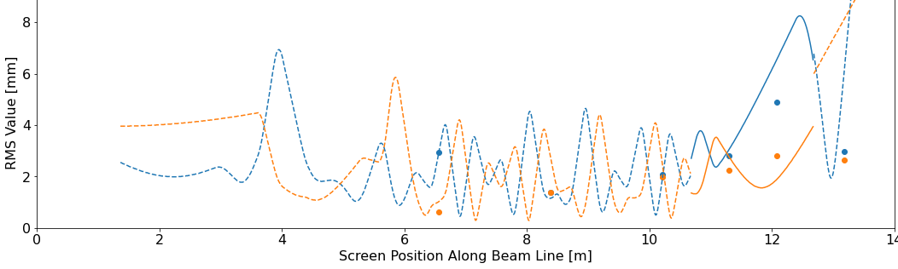
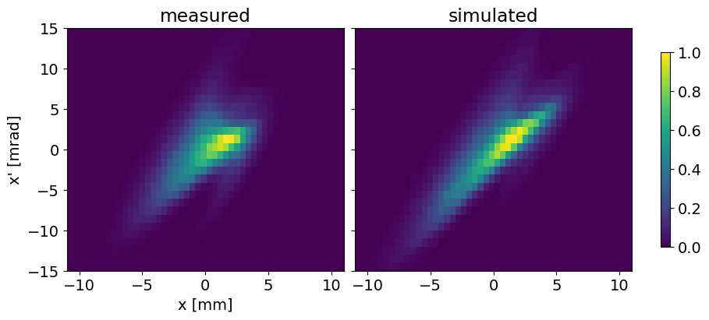
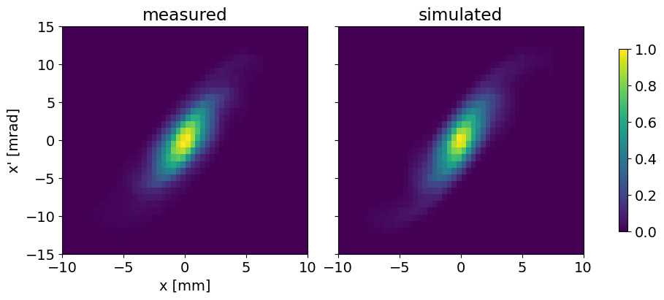
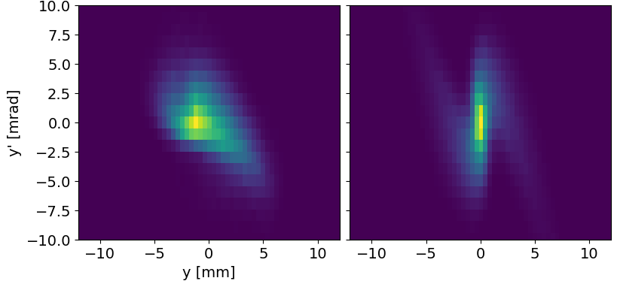
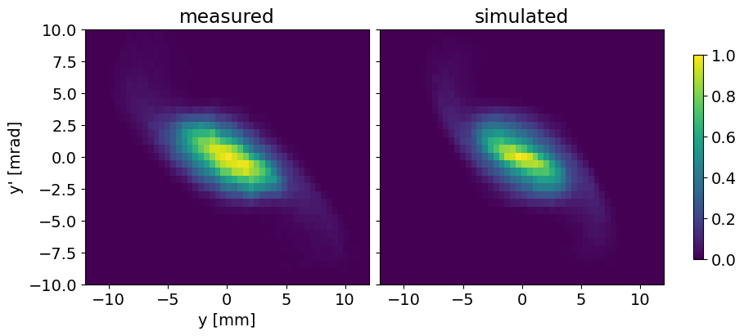
Recent reconfiguration of the BTF beamline has simplified beamline and improved benchmark
X rms, Y rms
Initial beam
Measured | Simulated
Measured | Simulated
X
Y
X
Y

Slide 9
Recent benchmark for 52 mA output bunch
Measured | Simulated
X
Y
200k particles
input bunch measured with 10² dynamic range
Notes:
Appeal to join us! Test code with our results

Slide 10
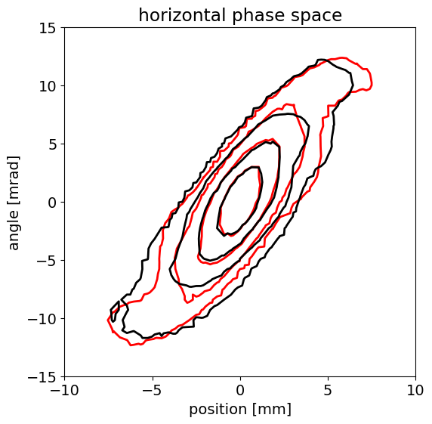
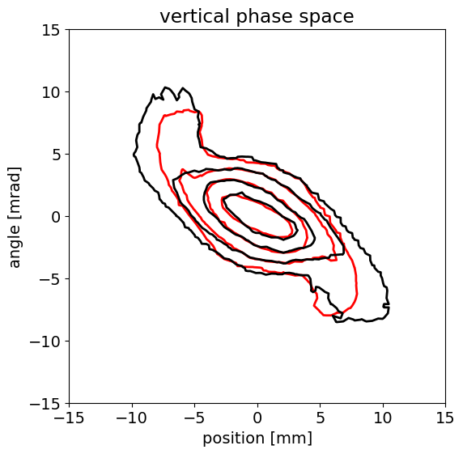
Recent benchmark for 52 mA bunch
X |  | Y
Red: simulation model
Black: measurement
99%
90%
67%
33%
33%
67%
90%
99%
Notes:
Appeal to join us! Test code with our results

Slide 11
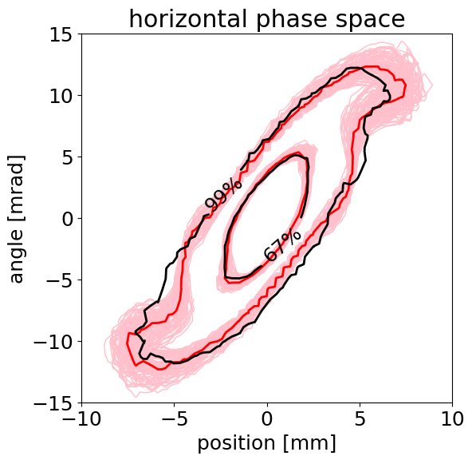
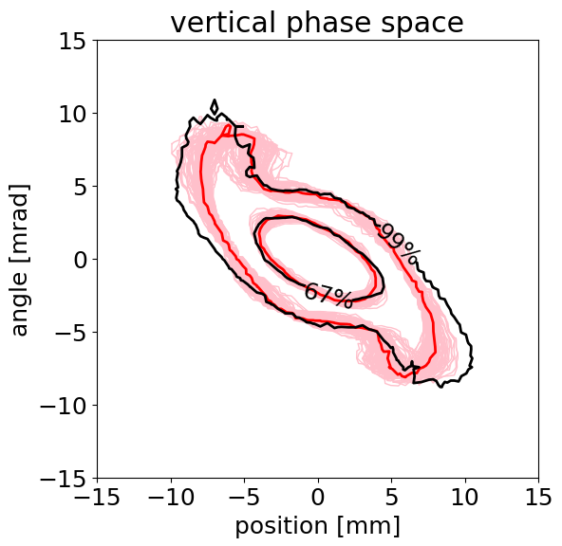
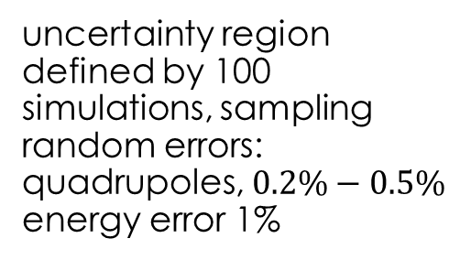
Recent benchmark for 52 mA bunch
All simulations in PyORBIT!
X |  | Y
Red: simulation model
Black: measurement
Pink: simulation uncertainty
uncertainty region defined by 100 simulations, sampling random errors:
quadrupoles, $0.2\%−0.5\%$
energy error 1%
Notes:
Appeal to join us! Test code with our results

Slide 12
Recent operation and results, benchmark status
What matters? Model parameters and constraints
  Defining of input bunch
  Quadrupole fields
  Longitudinal and space charge dynamics
3. Outlook and next steps

Slide 13
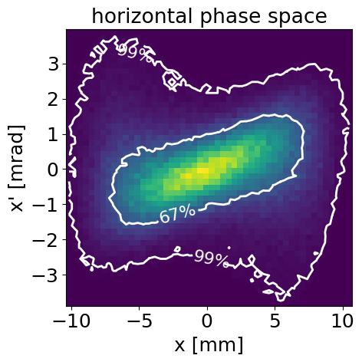
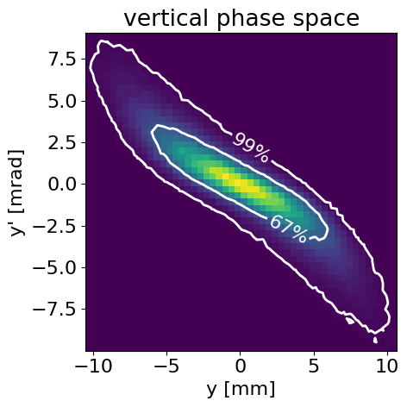
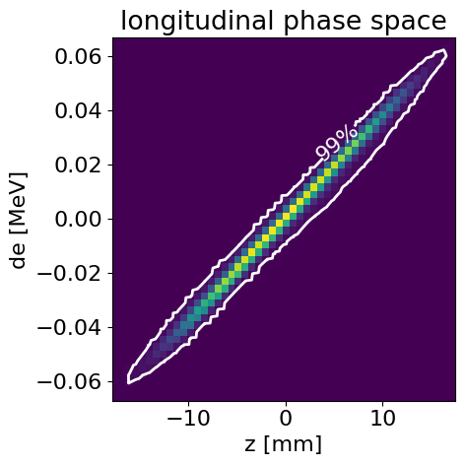
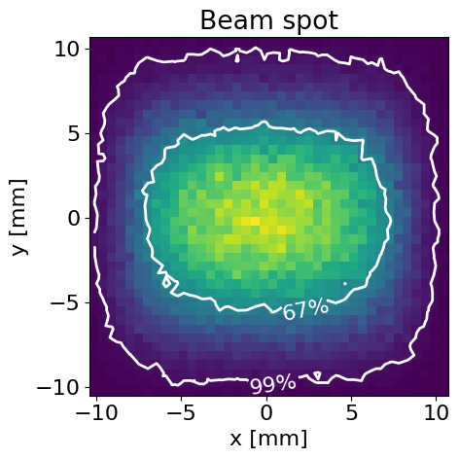
To define input bunch, sampling of 3 2D phase space measurements is sufficient (for now)
Initial bunch
Quadrupoles
Dynamics
Initial bunch typically has 200k particles

Slide 14
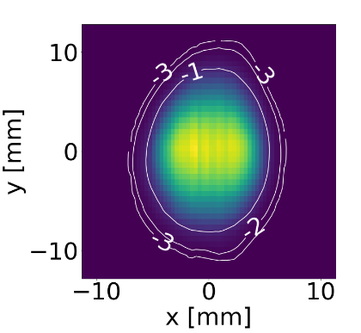
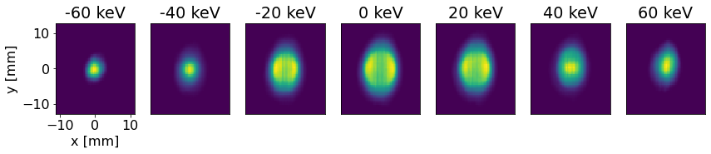

6D bunch predicted to have small effect
Initial bunch
Quadrupoles
There are measurable differences between $f(x,x’,y,y’,z,φ)$and $f\left(x,x’\right)⋅f\left(y,y^{′}\right)⋅f(z,φ)$
Dynamics
Integrated f(x,y) (measured)
Slice f(x,y) vs longitudinal energy
y
x
$$ΔE$$

Slide 15
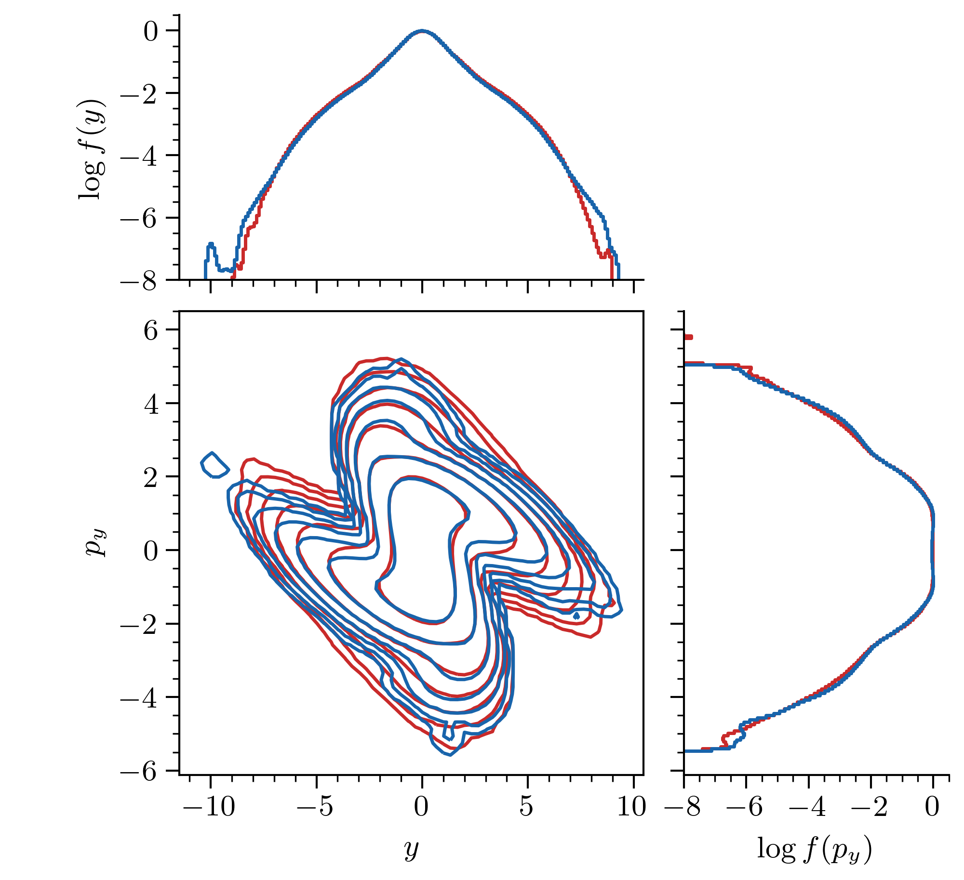
6D bunch predicted to have small effect
Initial bunch
Quadrupoles
As inferred from simulations with PARMTEQ initial bunch. We have never tracked a bunch based on full-and-direct 6D measurement!
Dynamics
Beam distribution (1D profiles) evolving with/without full 6D beam (simulated):
10⁻²
(~99%)
10⁻⁷ (~99.99999%)
Hoover et al, High Brightness Workshop, CERN (Oct 2023)

Slide 16
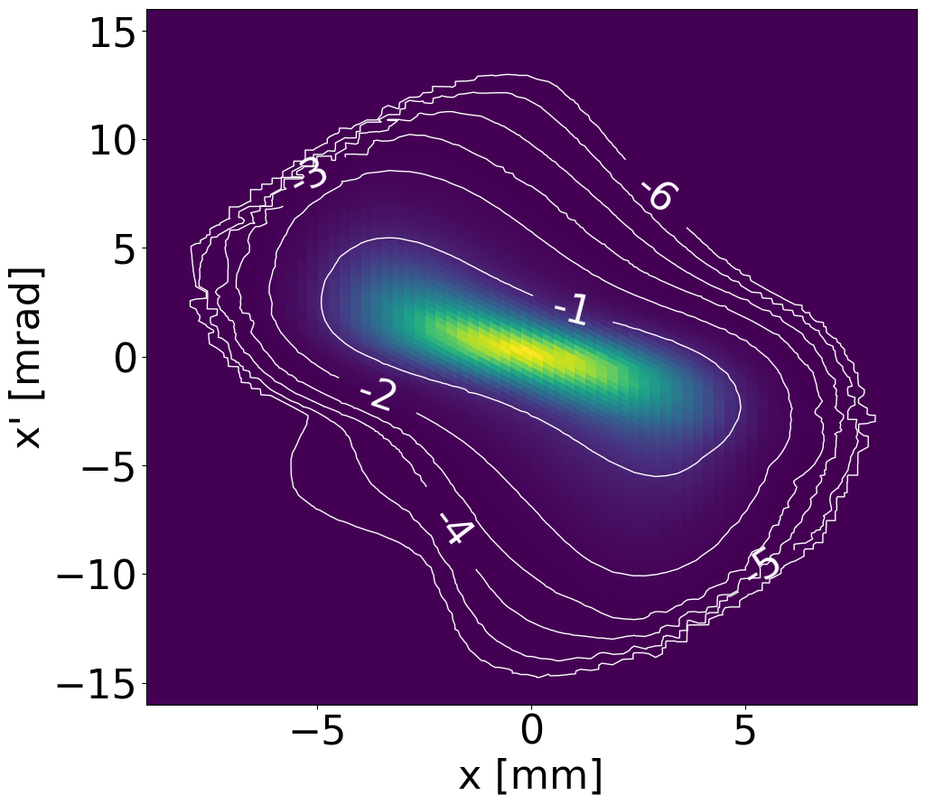
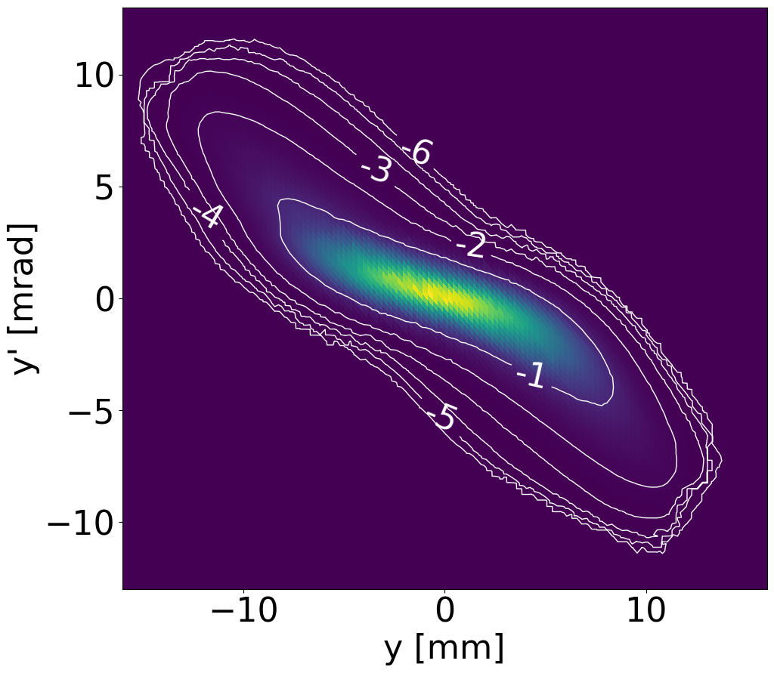
Initial bunch out of RFQ shows little halo
Initial bunch
Quadrupoles
Initial bunches used for benchmark based on low-dynamic-range measurements
Dynamics
Linear color scale, logarithmic contours

Slide 17
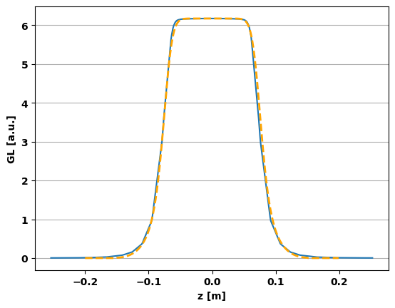
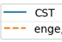
Iron-core quadrupole model
Initial bunch
Quadrupoles
No gridded 3D fields!
Pure quadrupole field
Soft-edged profile modeled with Enge function
Gradient/current curves from rotating coil measurements
Dynamics
Notes:
We’re uncovered errors amounting to 5-10% gradient errors by re-checking old data

Slide 18
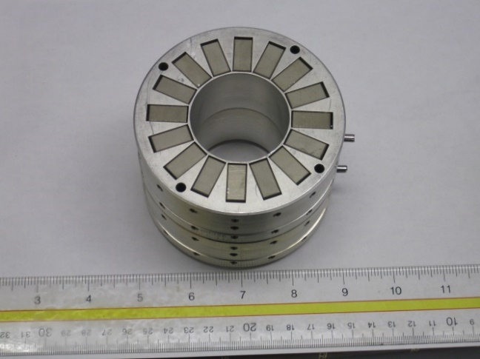
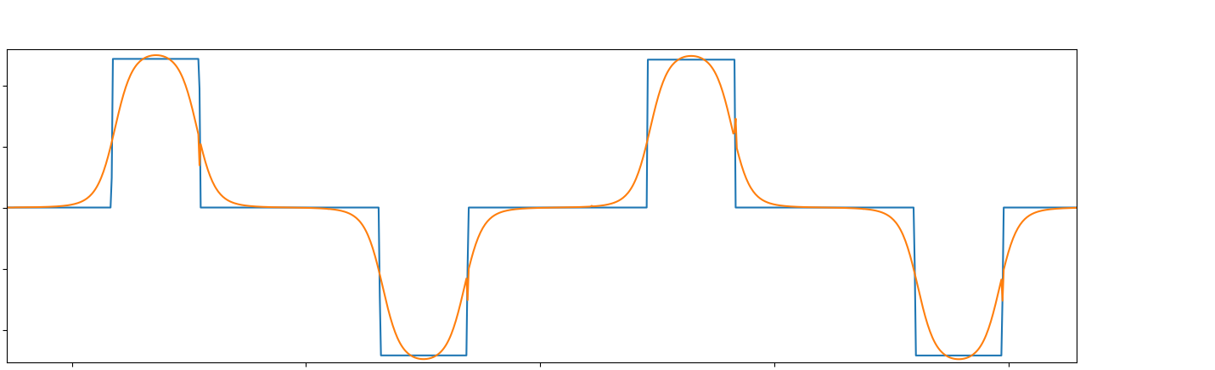
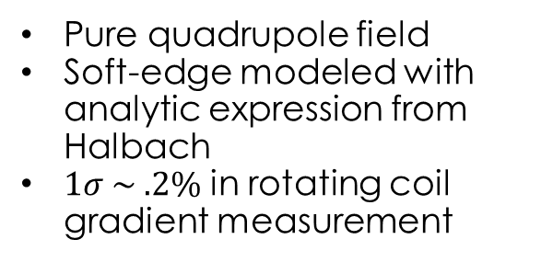
Permanent magnet quadrupoles
Initial bunch
Quadrupoles
Dynamics
Pure quadrupole field
Soft-edge modeled with analytic expression from Halbach
$1σ \sim .2\%$ in rotating coil gradient measurement
Halbach permanent magnet quad
9”

Slide 19
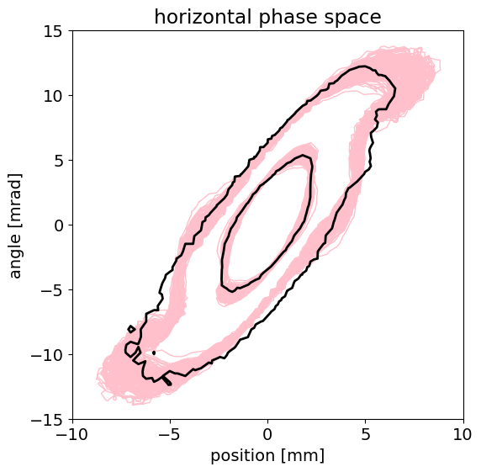
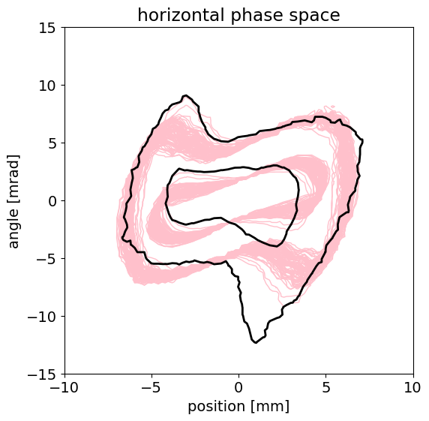
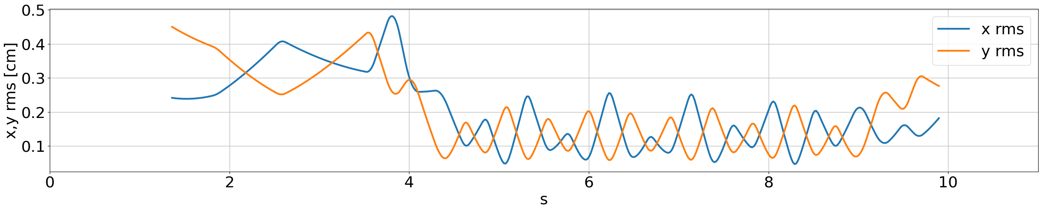
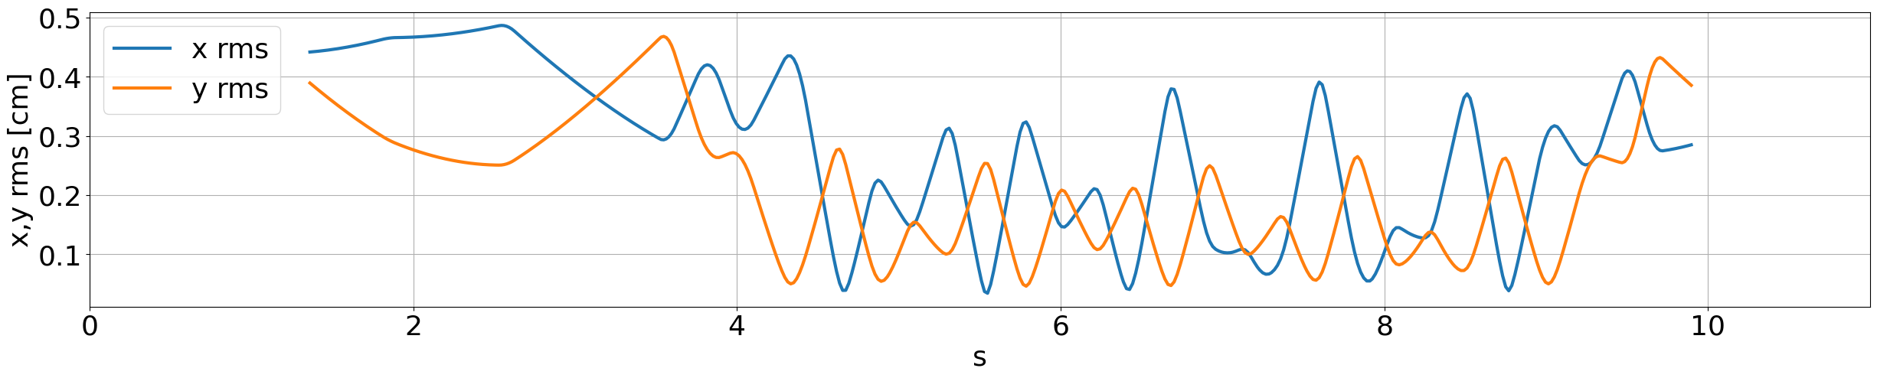
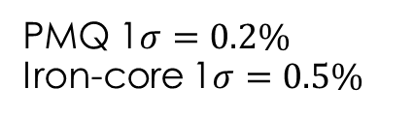
Sensitivity to quadrupole gradient errors
Initial bunch
Quadrupoles
Case 1:
Case 2:
Dynamics
PMQ 1$σ=0.2\%$
Iron-core 1$σ=0.5\%$
Black: measurement
Pink: simulation with uncertainty
Case 1:
Case 2:

Slide 20
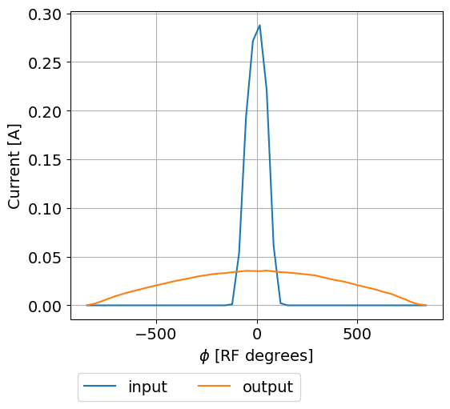
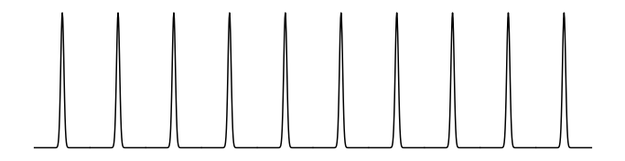
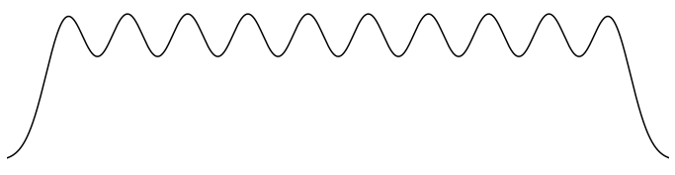
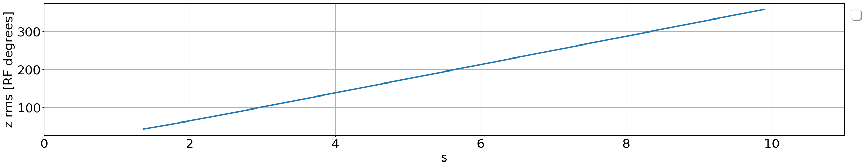

BTF has no RF past RFQ, debunching occurs rapidly
Initial bunch
Quadrupoles
Dynamics
402.5 MHz, $τ=$ 2.48 ns
Bunch train formed by RFQ fields (s=0)
Bunches start to overlap in beginning of FODO section

Slide 21
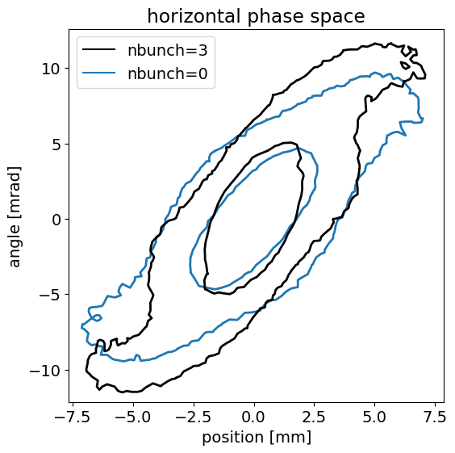
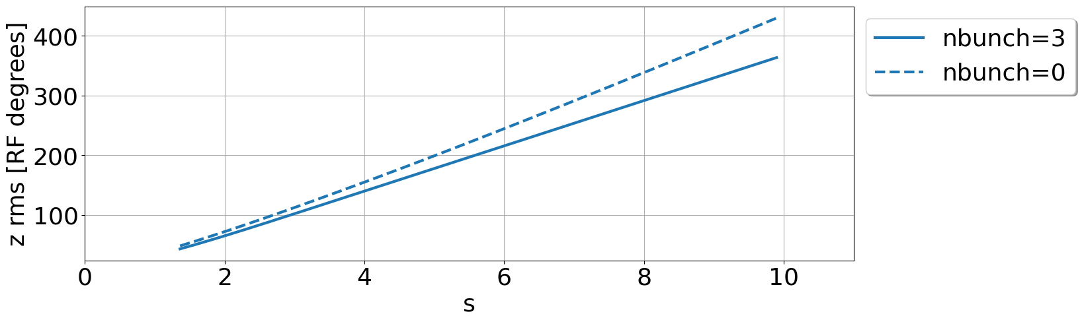

PyORBIT has multi-bunch field solver
Initial bunch
Quadrupoles
$$l_{s}{>360}^{∘}$$
Dynamics
Poisson solver :
3D FFT
nx,ny,nz = 64
n_particles = 200k
stepsize <= 0.01 m
n_bunches = 3
Notes:
This is a limitation for testing codes

Slide 22
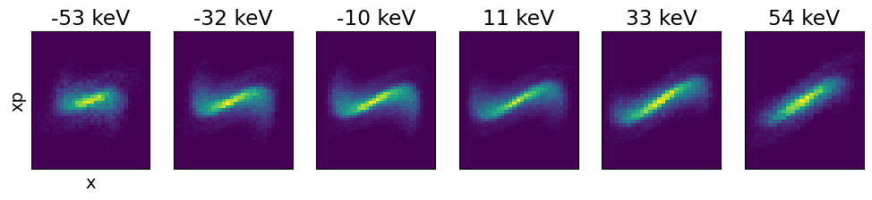
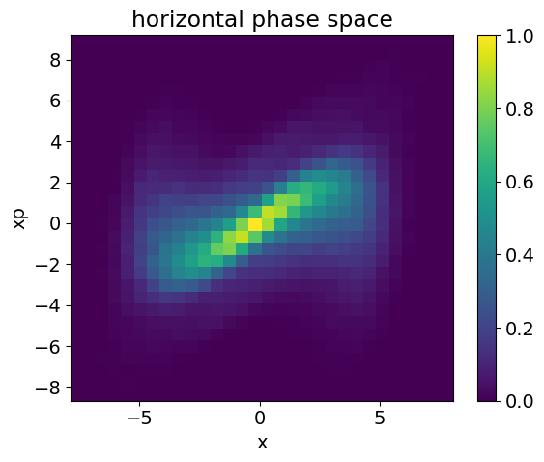
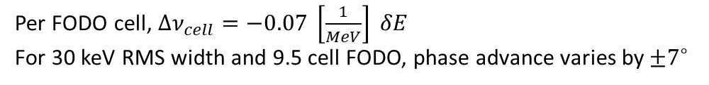
Large energy spread and longitudinal correlation means large chromaticity
Initial bunch
Quadrupoles
Dynamics
Per FODO cell, $Δν_{cell}=−0.07 \left[\frac{1}{MeV}\right] δE$
For 30 keV RMS width and 9.5 cell FODO, phase advance varies by${±7}^{∘}$
Full projection phase spaces:
Phase space for different energy slices:
tail
head
Notes:
This is an effect that is particular to BTF beamline
Two fold effect: energy kick

Slide 23
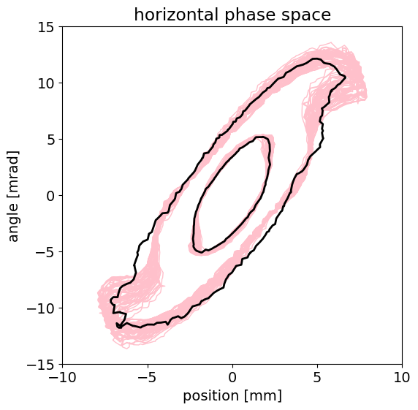
Uncertainty from central energy
Initial bunch
Quadrupoles
Time-of-flight measurements $T=2.5±0.02 MeV$
Dynamics
Uncertainty from 1% energy error
Uncertainty from .5% quadrupole gradient errors

Slide 24
Recent operation and results, benchmark status
What matters? Model parameters and constraints
  Input bunch
  Quadrupole fields
  Longitudinal and space charge dynamics
3. Outlook and next steps

Slide 25
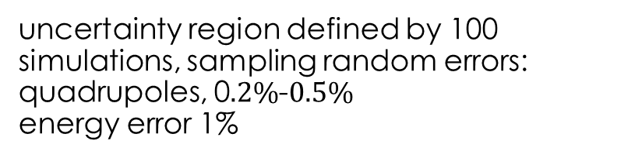
Current benchmark status:
Good agreement for core
Fair agreement for 10⁻² tails
Larger disagreement for mismatch indicates linear focusing error
Divergence of tails indicates nonlinear error
“Halo benchmark” not started yet
Red: simulation model
Black: measurement
Pink: simulation uncertainty
uncertainty region defined by 100 simulations, sampling random errors:
quadrupoles, 0$.2\%$-$0.5\%$
energy error 1%
X |  | Y

Slide 26
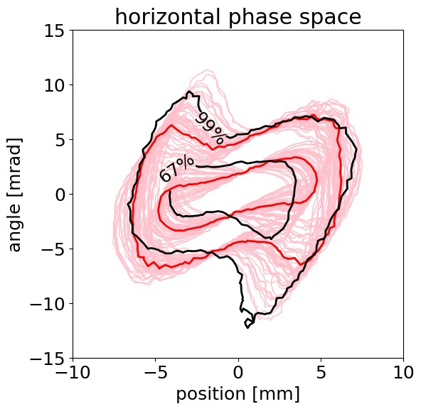

Current benchmark status:
Good agreement for core
Fair agreement for 10⁻² tails
Larger disagreement for mismatch indicates linear focusing error
Divergence of tails indicates nonlinear error
“Halo benchmark” not started yet
Red: simulation model
Black: measurement
Pink: simulation uncertainty
uncertainty region defined by 100 simulations, sampling random errors:
quadrupoles, 0$.2\%$-$0.5\%$
energy error 1%
X |  | Y

Slide 27

52 mA output distribution at high-dynamic-range and large mismatch oscillation

Slide 28

52 mA output distribution at high-dynamic-range and large mismatch oscillation

Slide 29
Backup material

Slide 30




Self consistent model of PMQs has little effect on dynamics
Initial bunch
Quadrupoles
Dynamics
$Δν=0.03$ for a single particle at maximum acceptance:
unnormalized coordinates
normalized coordinates
Thompson, Gorlov, et al, High Brightness Workshop, CERN (Oct 2023)

Slide 31




All benchmark cases
 | Matching strategy A, 52 mA | Matching strategy B, 52 mA | Mismatched, 52 mA | Matching strategy B, 30 mA
x
y
Contours at 33%, 67%, 90%, 99% contained

Slide 32

Measured 0-current matrix elements compared to simulation:

Slide 33
Large losses and steering kicks
Initial bunch
Quadrupoles
Losing a least 5% of 52 mA beam by end of beamline
Dynamics
Apertures
Existing correctors
Measure centroid to be as much as 0.5 cm offset in this area
Aperture r=4 cm, x,y rms ~ 0.5 cm
Notes:
What is precision?

Slide 34

Large energy spread and longitudinal correlation means large chromaticity
Initial bunch
Quadrupoles
Dynamics
Per FODO cell, $Δν_{cell}=−0.07 \left[\frac{1}{MeV}\right] δE$
For 30 keV RMS width and 9.5 cell FODO, phase advance varies by${±7}^{∘}$
Full projection phase spaces:
Phase space for different energy slices:
Notes:
This is an effect that is particular to BTF beamline
Two fold effect: energy kick (add plot?)

