Slide 1
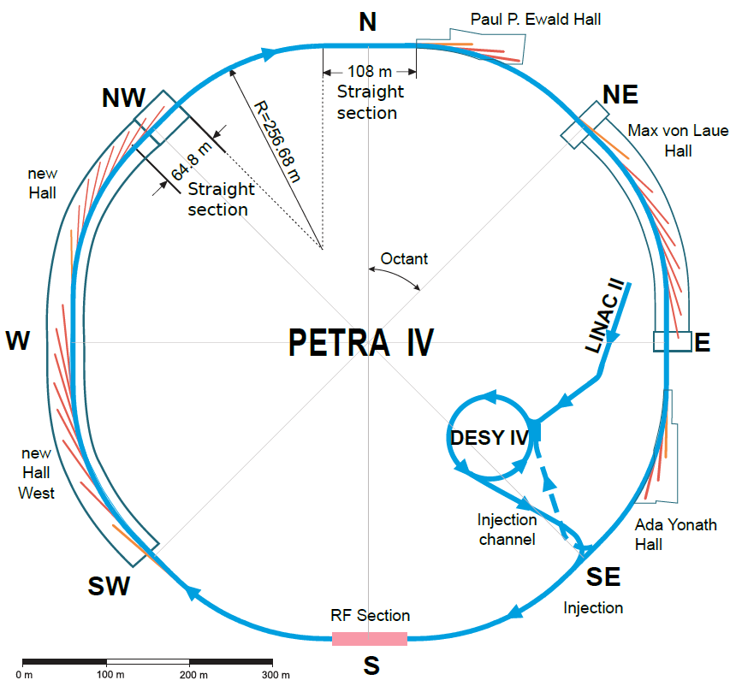
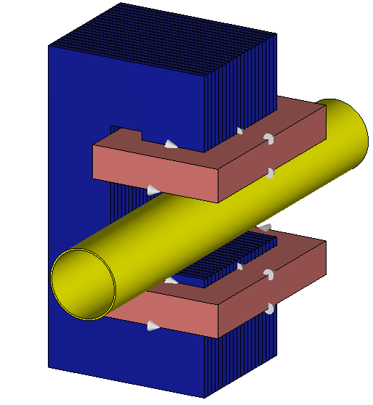
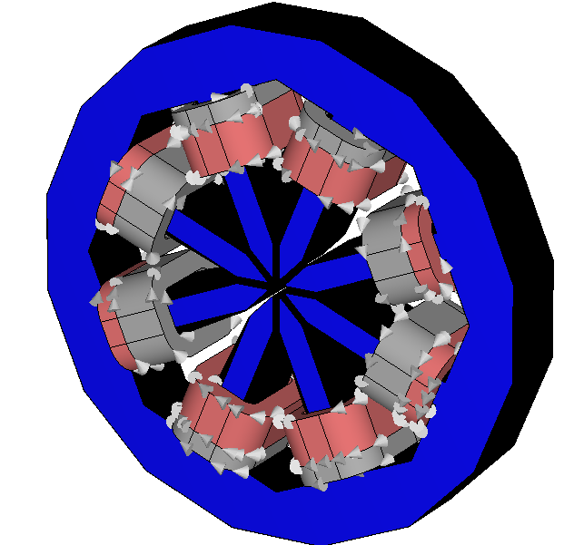
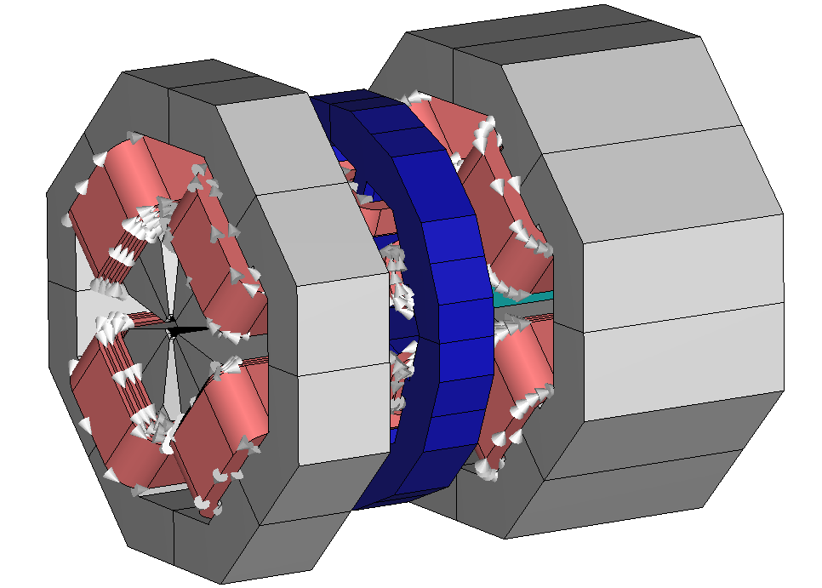
Efficient nonlinear Simulations Of Fast Corrector Magnets
J. Christmann, L. A. M. D’Angelo, and H. De Gersem
Institute for Accelerator Science and Electromagnetic Fields, TU Darmstadt
PETRA IV Conceptual Design Report
Notes:
.

Slide 2
Contents
1
Introduction
2
Homogenization Technique
3
Linear Corrector Magnet Simulations
4
Nonlinear Simulations
5
Conclusion/Outlook

Slide 3
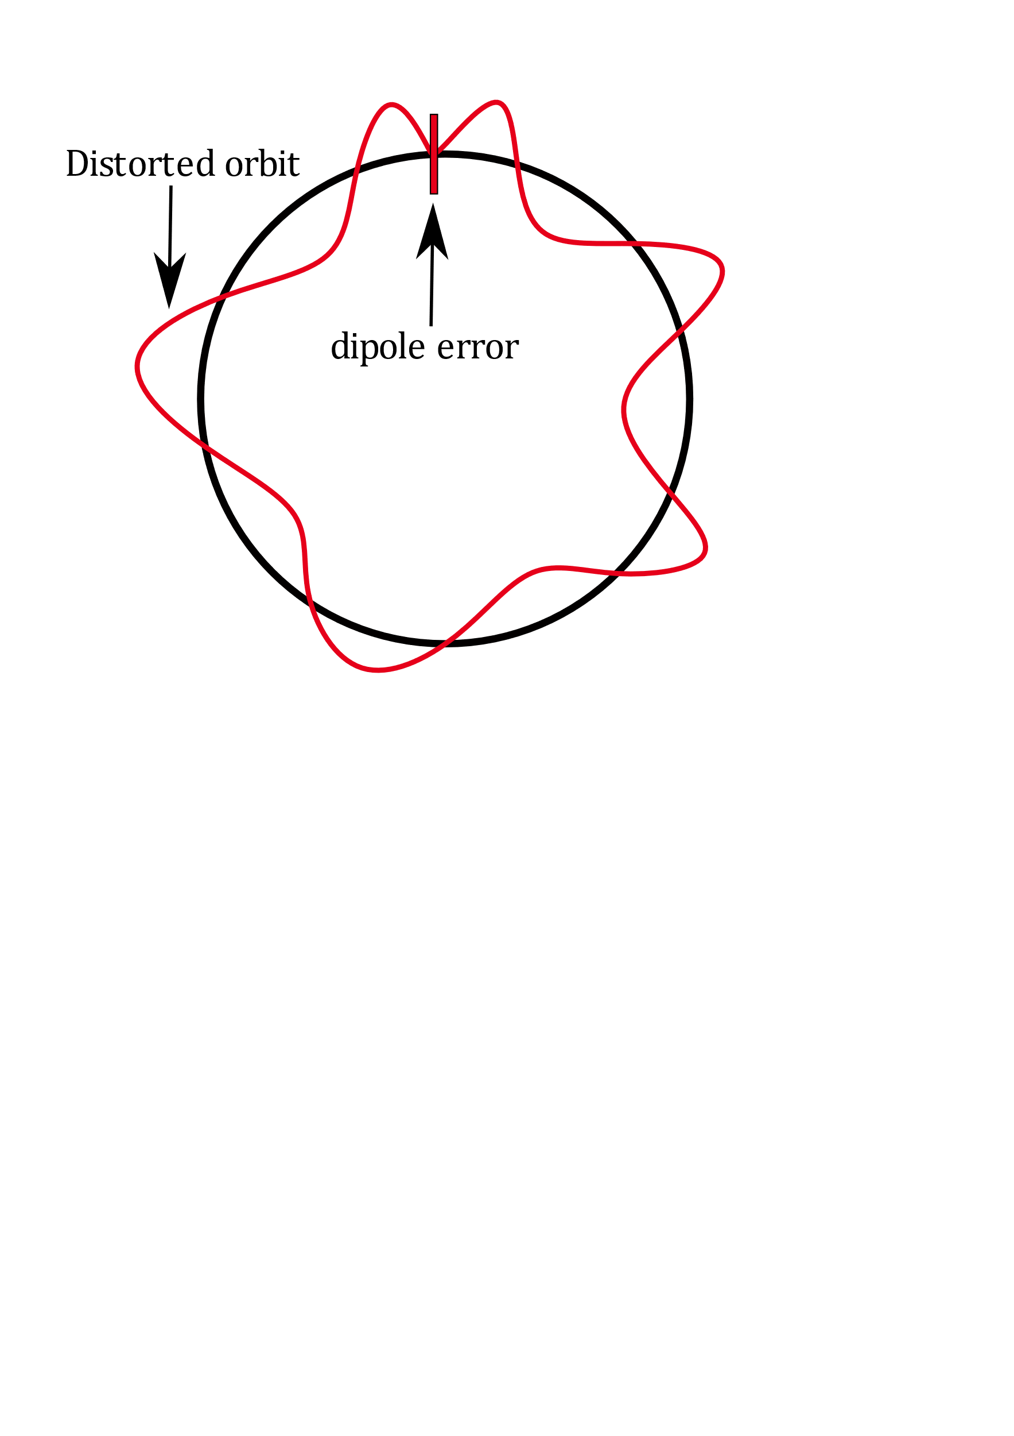
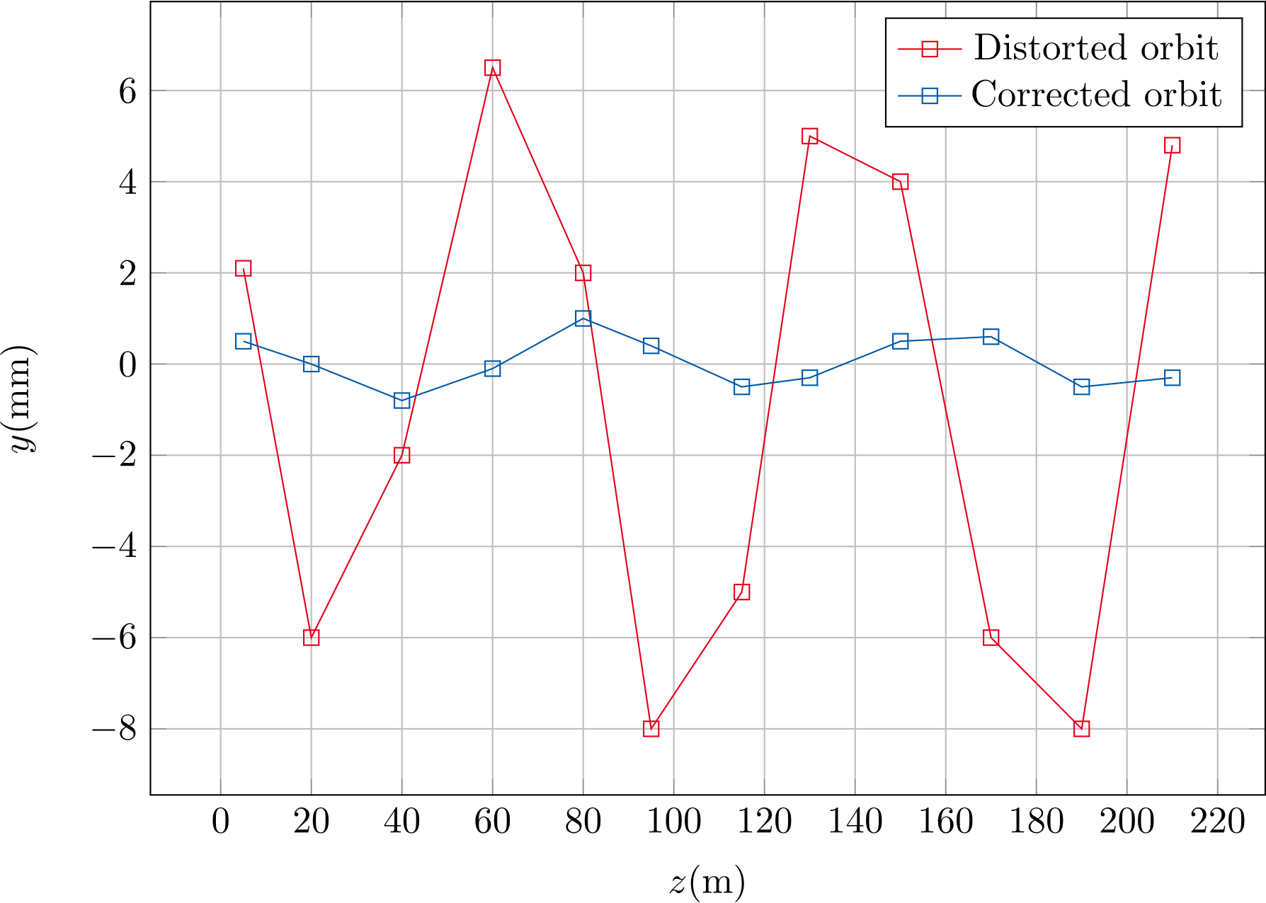
Introduction
Introduction
Circular accelerators need dipole magnets to correct orbit distortions
PETRA IV: ultra-low emittance synchrotron radiation source
Fast orbit feedback system, corrector magnets with frequencies in kHz range
Strong eddy currents ➔ power losses, time delay, and field distortion
Simulation challenging due to small skin depths and laminated yoke
➔ Need for technique to simplify simulations

Slide 4
Contents
1
Introduction
2
Homogenization Technique
3
Linear Corrector Magnet Simulations
4
Nonlinear Simulations
5
Conclusion/Outlook

Slide 5
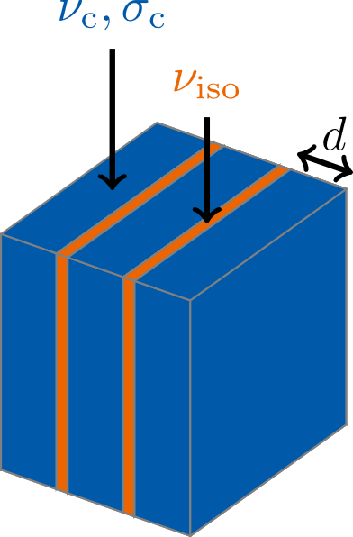
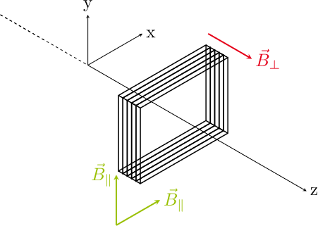
Homogenization Technique
THeory
Magnetoquasistatic PDE: $∇×\underset{ }{(ν(}\vec{r} )∇×\underline{\vec{A}} \left(\vec{r}\right))+jωσ(\vec{r})\underline{\vec{A}}(\vec{r})= {\vec{\underline{J}}}_{s}(\vec{r})$
Replace reluctivity $ν(\vec{r})$ and conductivity $σ(\vec{r})$ in the laminated yoke with spatially constant tensors
$$ν(\vec{r})→\overset{̿}{\underline{ν}}=\frac{1}{8}σ_{c}dδω\left(1+j\right)\frac{\sinh{(\left(1+j\right)δ^{−1}d)} }{\sinh^{2}\left(\left(1+j\right)δ^{−1}d/2\right) }\left[\begin{matrix}1 & 0 & 0 \\ 0 & 1 & 0 \\ 0 & 0 & 0\end{matrix}\right]+ν_{c}\left[\begin{matrix}0 & 0 & 0 \\ 0 & 0 & 0 \\ 0 & 0 & 1\end{matrix}\right]$$
$$σ(\vec{r})→\overset{̿}{σ}=γσ_{c}\left[\begin{matrix}1 & 0 & 0 \\ 0 & 1 & 0 \\ 0 & 0 & 0\end{matrix}\right]$$
Skin depth $δ= \sqrt{2/{ωσ_{c}μ_{c}}}$
Stacking factor $γ= \frac{V_{c}}{V_{Yoke}}$
P. Dular et al., 2003
L. Krählenbühl et al., 2004
H. De Gersem et al., 2012

Slide 6
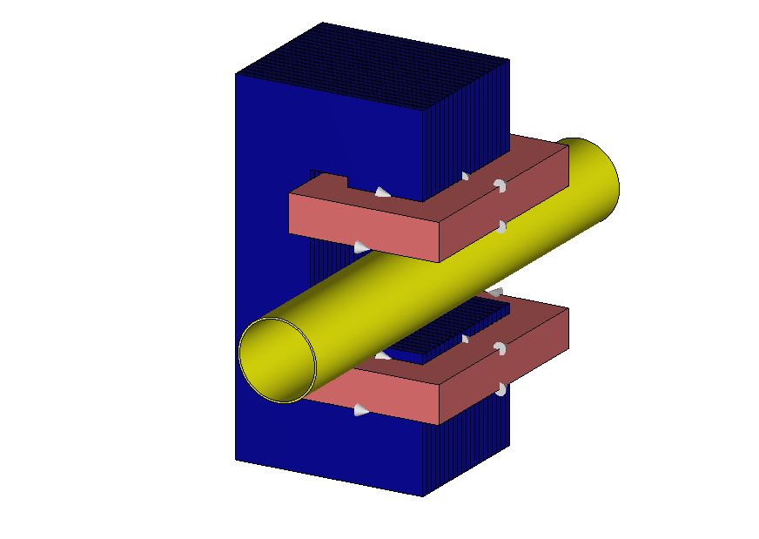
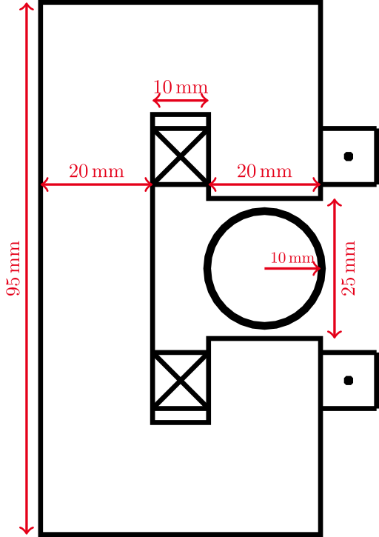
Homogenization Technique
Verification
Model specifics:
Iron yoke: length = 40 mm, lamination thickness = 1.83 mm
Copper beam pipe: thickness = 0.5 mm, length = 140 mm
Coils: current = 10 A (peak), # turns = 250
Frequency domain simulation via ${\text{CST} \text{Studio} \text{Suite}}^{\text{® }}$

Slide 7
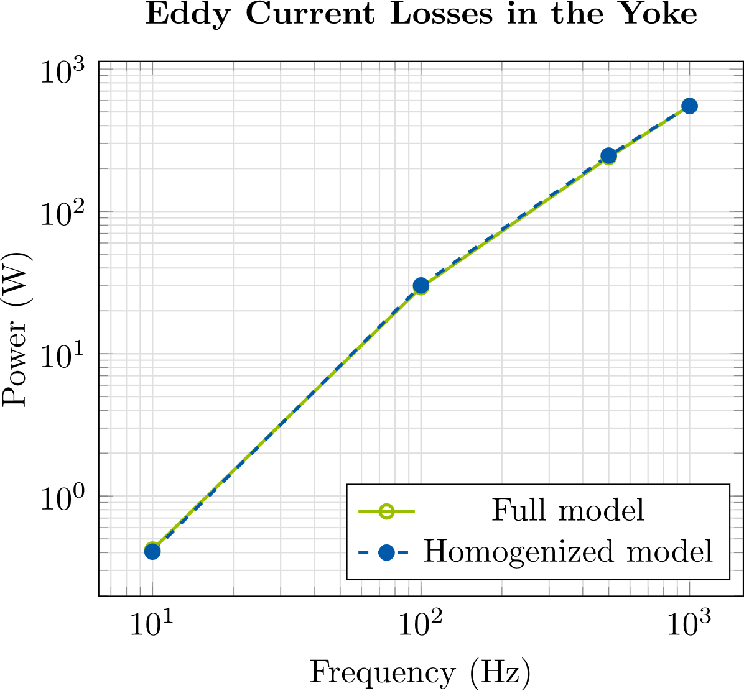
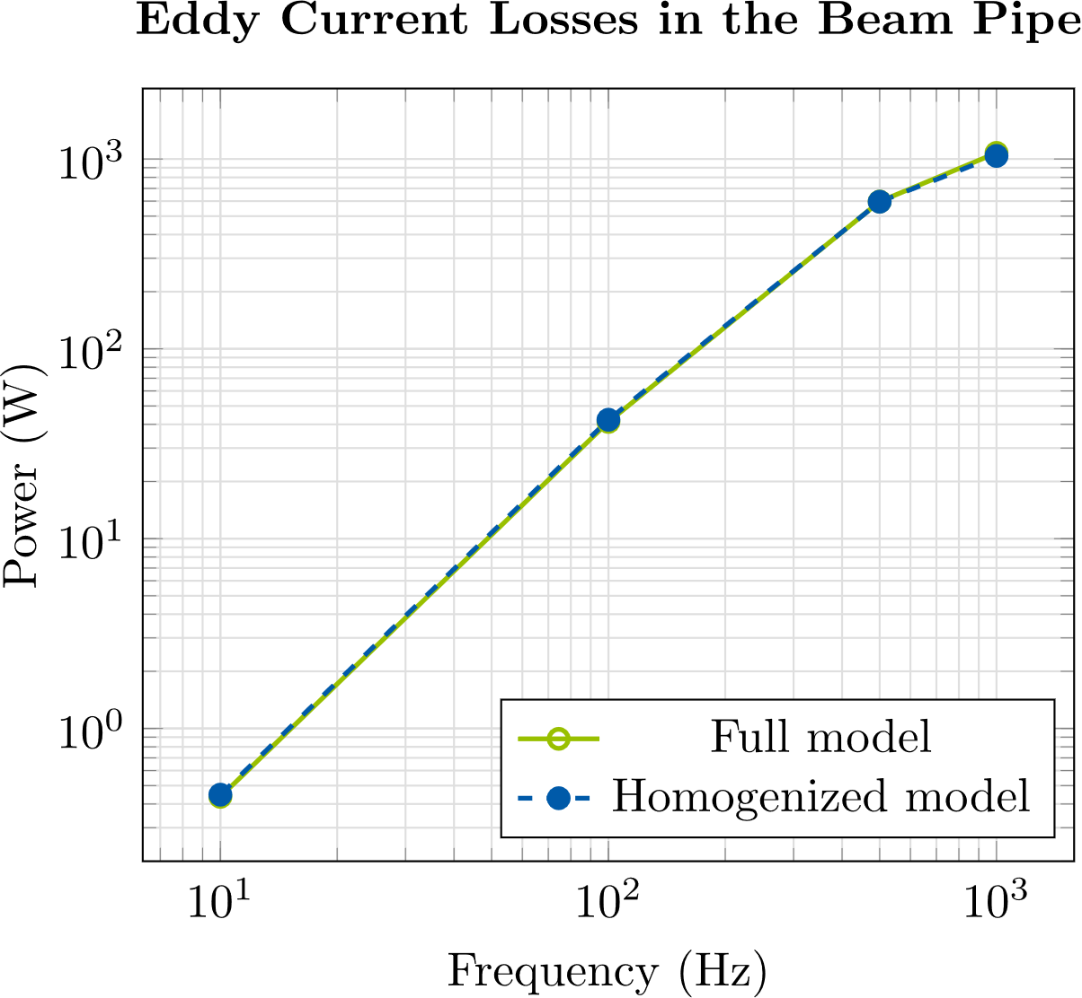
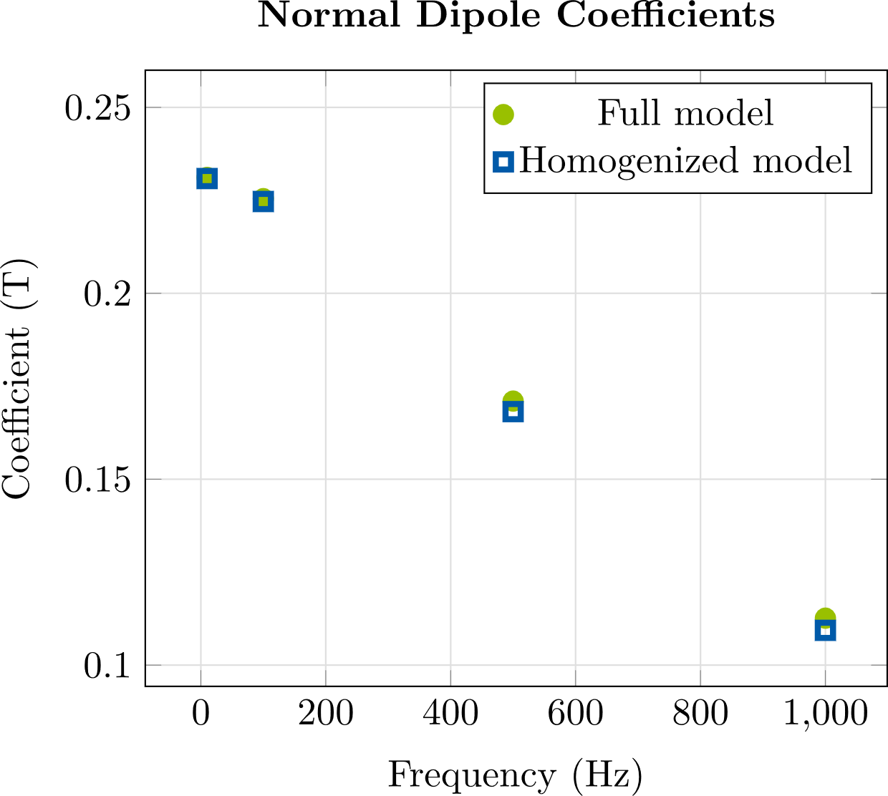
Homogenization technique
VErification
Eddy current losses
Multipole Coefficients
Multipole coeff. | Average rel. error
Dipole | $$1 \%$$
Quadrupole | $$5 \%$$
Sextupole | $$2 \%$$
Eddy current losses well approximated
Aperture field well approximated
Simulation time is reduced from several hours to just a few minutes!
➔ After comparing to other techniques, we decided to use this technique to simulate the corrector magnets

Slide 8
Contents
1
Introduction
2
Homogenization Technique
3
Linear Corrector Magnet Simulations
4
Nonlinear Simulations
5
Conclusion/Outlook

Slide 9
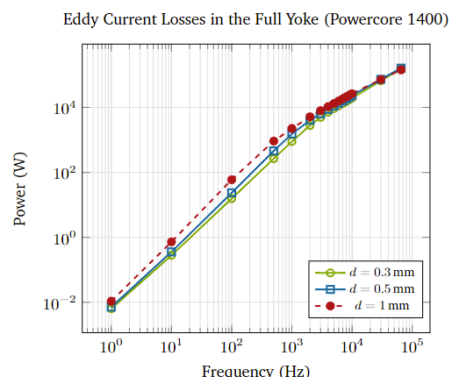
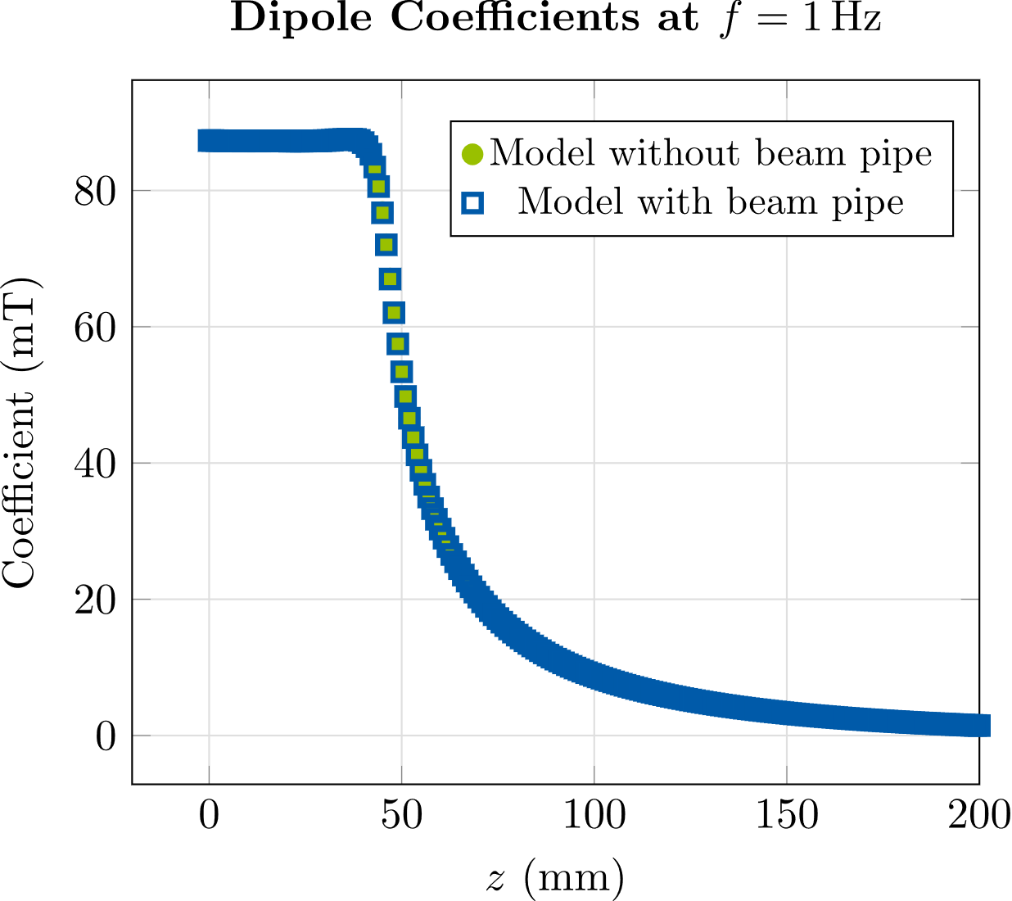
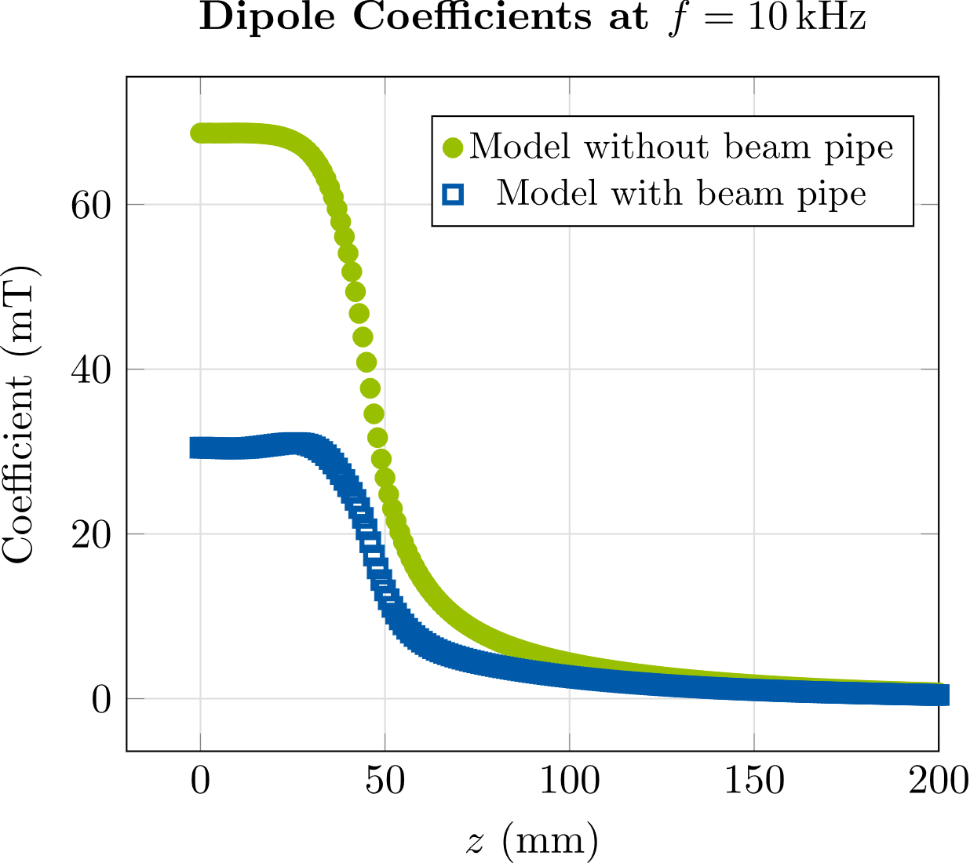
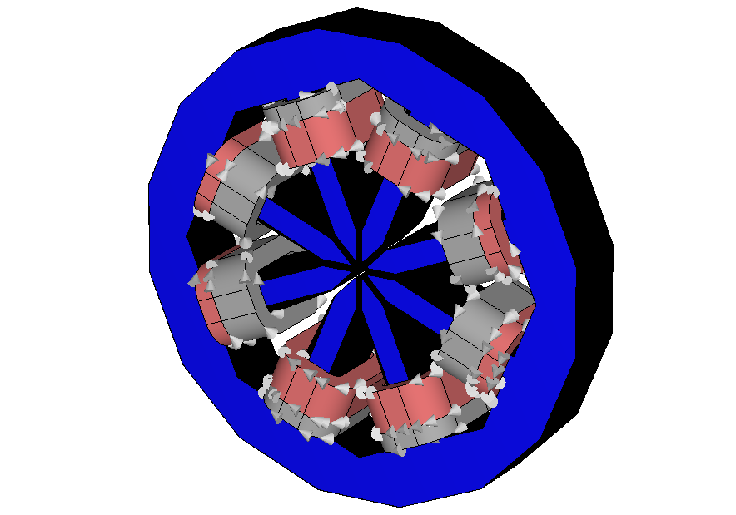
Linear Corrector magnet Simulations
Eddy Current losses & Multipole Coefficients
At lower frequencies: $P_{eddy} α f^{2}$, as expected from theory*
Lamination thickness only important at frequencies $≤1 kHz$
Dipole field is attenuated due to eddy currents
Beam pipe ➔ stronger attenuation at higher frequencies
* R. L. Stoll, The Analysis of Eddy Currents. 1974.
J. Lammeraner and M. Štafl, Eddy Currents. 1966.

Slide 10
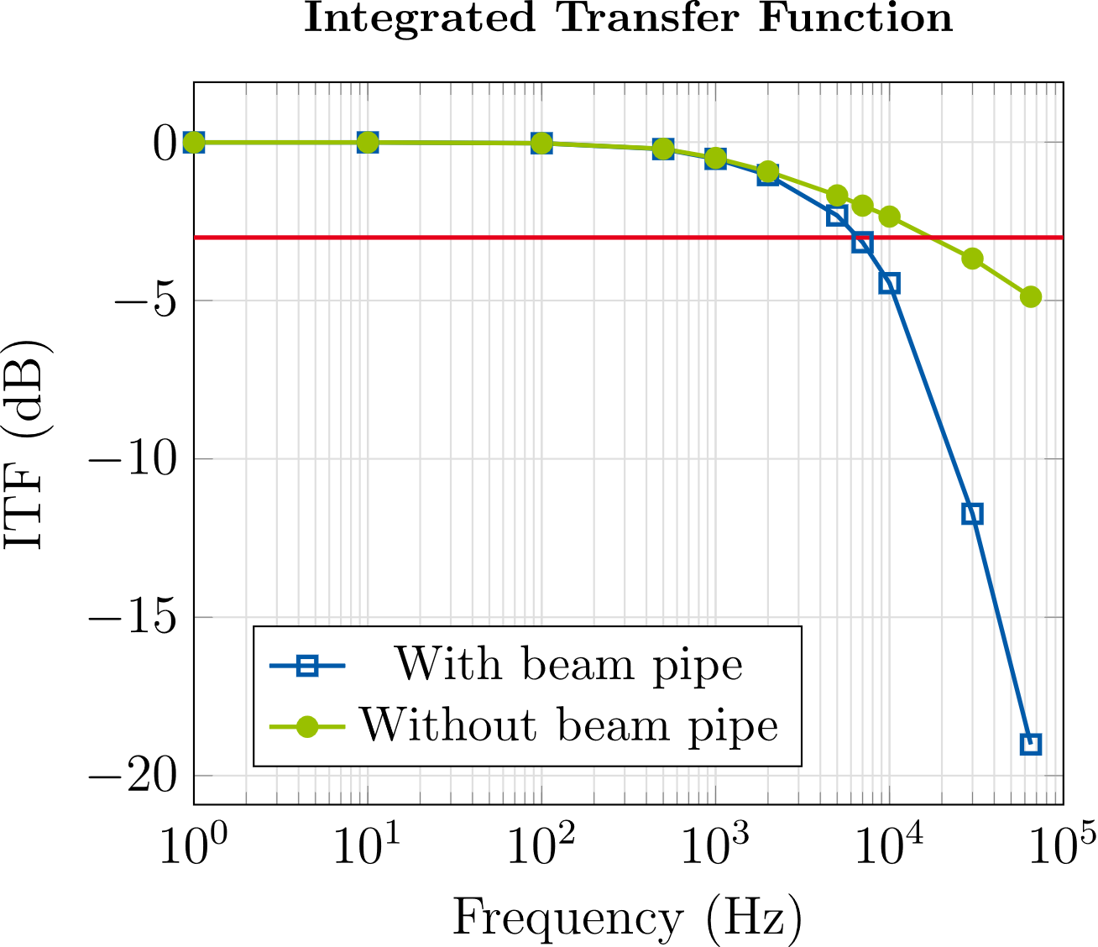
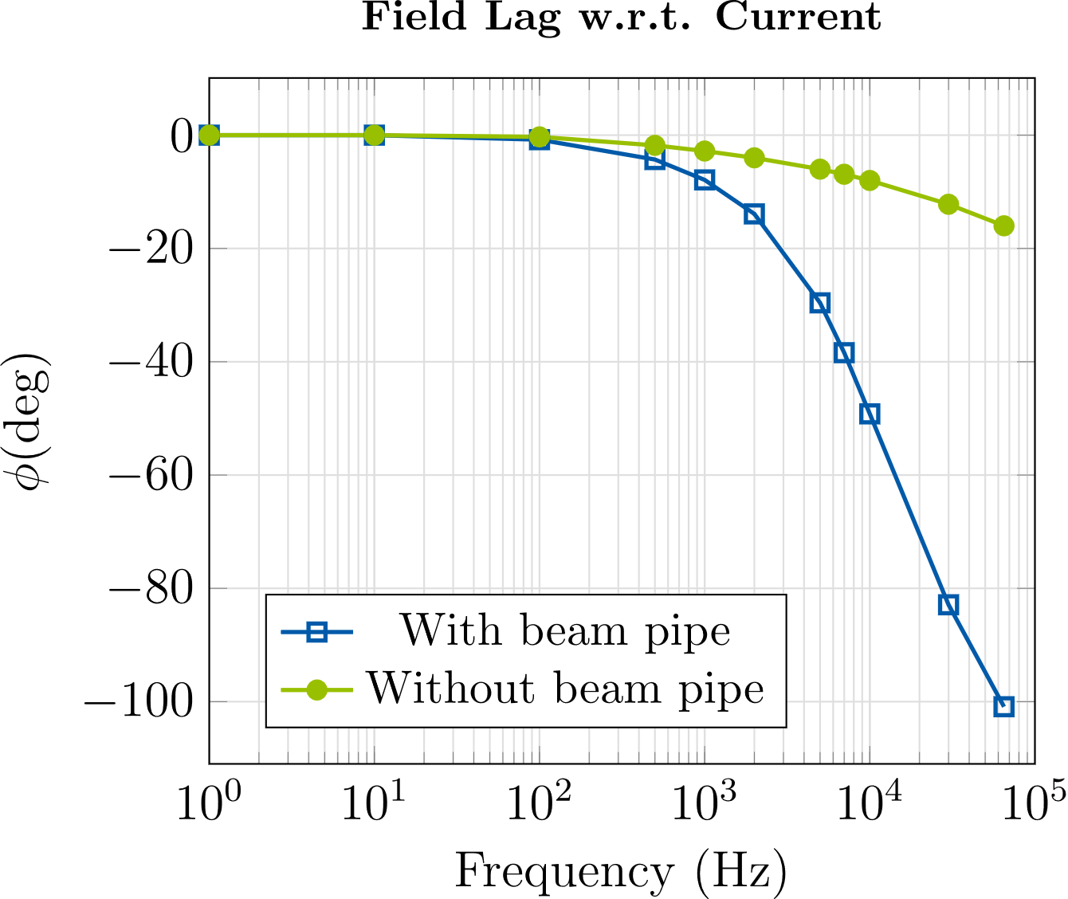
Linear Corrector magnet Simulations
Integrated Transfer function & Field Lag
$$ITF(f)= \frac{\int_{l}{B_{1}(z,f)}dz}{\int_{l}{B_{1,DC}(z)}dz}$$
Integrated transfer function and field lag (phase difference between current and aperture field) are of high interest for design of feedback control
We compute both from our simulations for different yoke materials, different lamination thicknesses, etc.

Slide 11
Contents
1
Introduction
2
Homogenization Technique
3
Linear Corrector Magnet Simulations
4
Nonlinear Simulations
5
Conclusion/Outlook
Notes:
Ok and now we want to move on to nonlinear simulations.

Slide 12
Nonlinear Simulations
without DC Bias - Theory
To incorporate non-linear $BH$-curves into simulations: combine homogenization technique and harmonic balance FEM (HBFEM)
HBFEM is a technique to approximate periodic solutions of nonlinear transient PDEs in frequency domain
Example: excitation current with 1st and 3rd harmonic, include field quantities up to 3rd harmonic
$$∇×\underset{ }{(ν(}t)∇×\vec{A}\left(t\right))+σ\frac{∂\vec{A}(t)}{∂t}= {\vec{J}}_{s}(t)$$
$$∇×( \underline{ν}(ω)⊛∇×\underline{\vec{A}} \left(ω\right))+jωσ\underline{\vec{A}}(ω)= {\vec{\underline{J}}}_{s}(ω)$$
$$\left[\begin{matrix}{K_{{\overset{̿}{\underline{ν}}}_{0}({3ω}_{f})}+3jω_{f}M_{\overset{̿}{σ}}}_{ } & K_{{\underline{ν}}_{2}} & 0 & 0 \\ K_{{\underline{ν}}_{−2}} & K_{{\overset{̿}{\underline{ν}}}_{0}(ω_{f})}+ jω_{f}M_{\overset{̿}{σ}} & K_{{\underline{ν}}_{2}} & 0 \\ 0 & K_{{\underline{ν}}_{−2}} & K_{{\overset{̿}{\underline{ν}}}_{0}(ω_{f})}−jω_{f}M_{\overset{̿}{σ}} & K_{{\underline{ν}}_{2}} \\ 0 & 0 & K_{{\underline{ν}}_{−2}} & K_{{\overset{̿}{\underline{ν}}}_{0}({3ω}_{f})}−3jω_{f}M_{\overset{̿}{σ}}\end{matrix}\right] \left[\begin{aligned}{\underline{a}}_{3} \\ {\underline{a}}_{1} \\ {\underline{a}}_{−1} \\ {\underline{a}}_{−3}\end{aligned}\right]= \left[\begin{aligned}{\underline{j}}_{3} \\ {\underline{j}}_{1} \\ {\underline{j}}_{−1} \\ {\underline{j}}_{−3}\end{aligned}\right]$$
+ Homogenization
S. Yamada and K. Bessho (1988)
H. De Gersem, H. Vande Sande, K. Hameyer (2001)

Slide 13
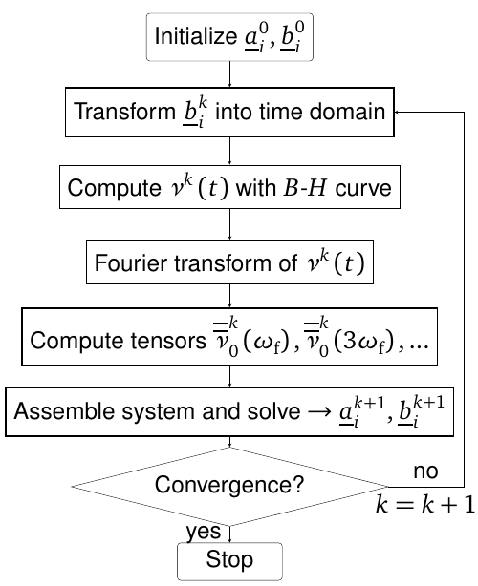
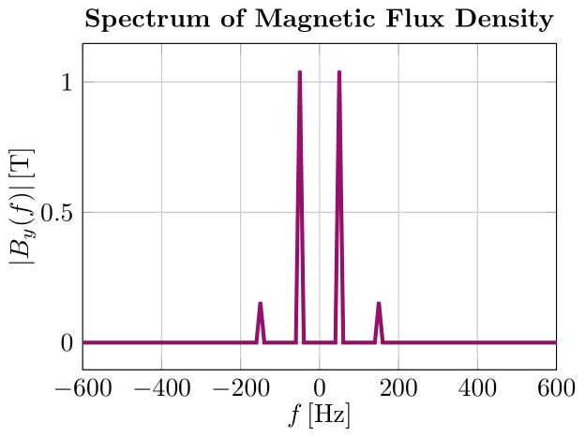
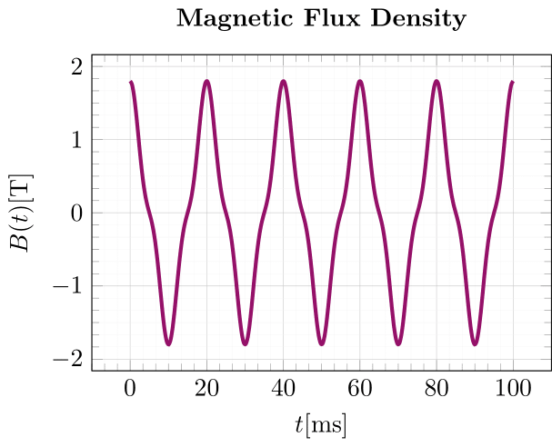
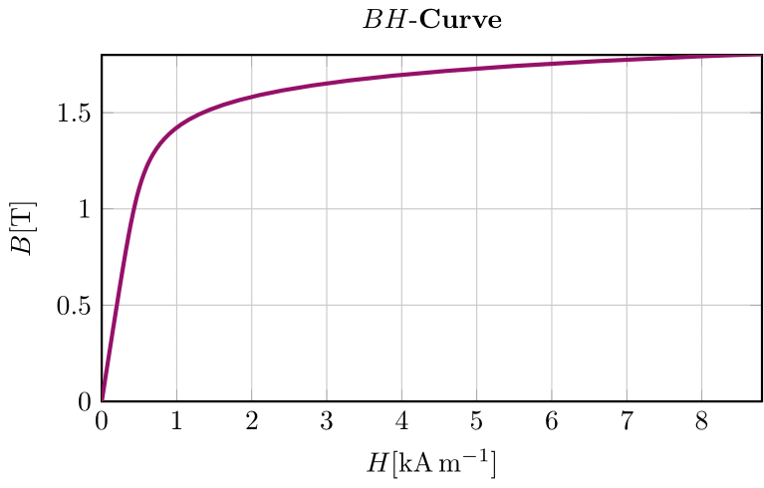
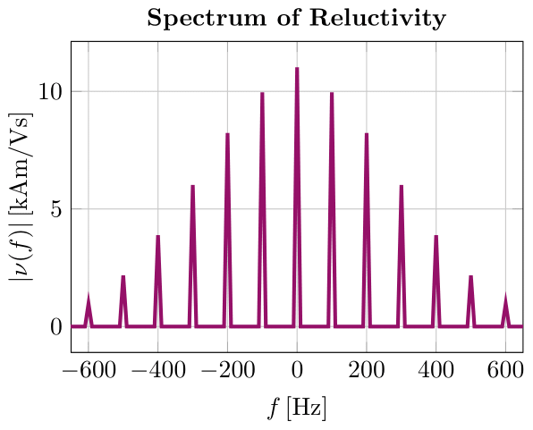
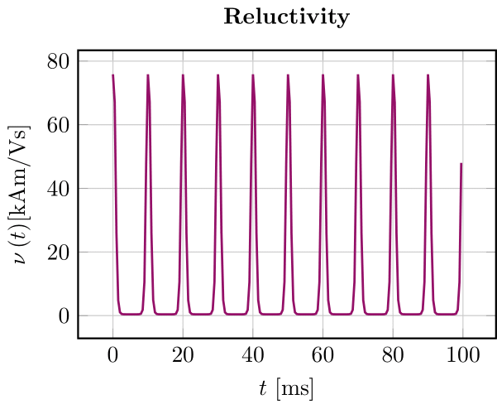
Nonlinear SimulationS
without DC Bias - Theory
$$\left[\begin{matrix}{K_{{\overset{̿}{\underline{ν}}}_{0}({3ω}_{f})}+3jω_{f}M_{\overset{̿}{σ}}}_{ } & 0 & 0 & 0 \\ 0 & K_{{\overset{̿}{\underline{ν}}}_{0}(ω_{f})}+ jω_{f}M_{\overset{̿}{σ}} & 0 & 0 \\ 0 & 0 & K_{{\overset{̿}{\underline{ν}}}_{0}(ω_{f})}−jω_{f}M_{\overset{̿}{σ}} & 0 \\ 0 & 0 & 0 & K_{{\overset{̿}{\underline{ν}}}_{0}({3ω}_{f})}−3jω_{f}M_{\overset{̿}{σ}}\end{matrix}\right] \left[\begin{aligned}{\underline{a}}_{3} \\ {\underline{a}}_{1} \\ {\underline{a}}_{−1} \\ {\underline{a}}_{−3}\end{aligned}\right]= \left[\begin{aligned}{\underline{j}}_{3}−K_{{\underline{ν}}_{2}}{\underline{a}}_{1} \\ {\underline{j}}_{1}−K_{{\underline{ν}}_{−2}}{\underline{a}}_{3}−K_{{\underline{ν}}_{2}}{\underline{a}}_{−1} \\ {\underline{j}}_{−1}−K_{{\underline{ν}}_{−2}}{\underline{a}}_{1}−K_{{\underline{ν}}_{2}}{\underline{a}}_{−3} \\ {\underline{j}}_{−3}−K_{{\underline{ν}}_{−2}}{\underline{a}}_{−1}\end{aligned}\right]$$

Slide 14
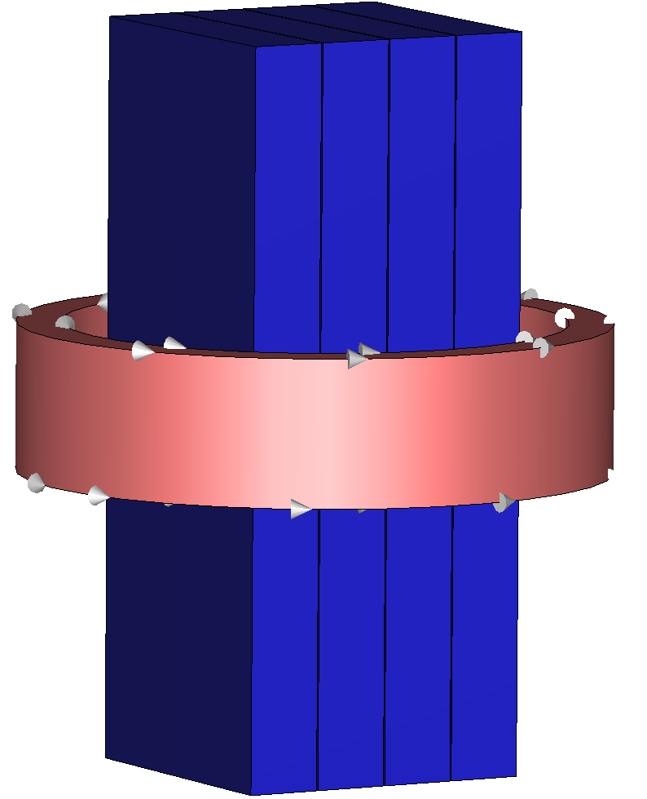
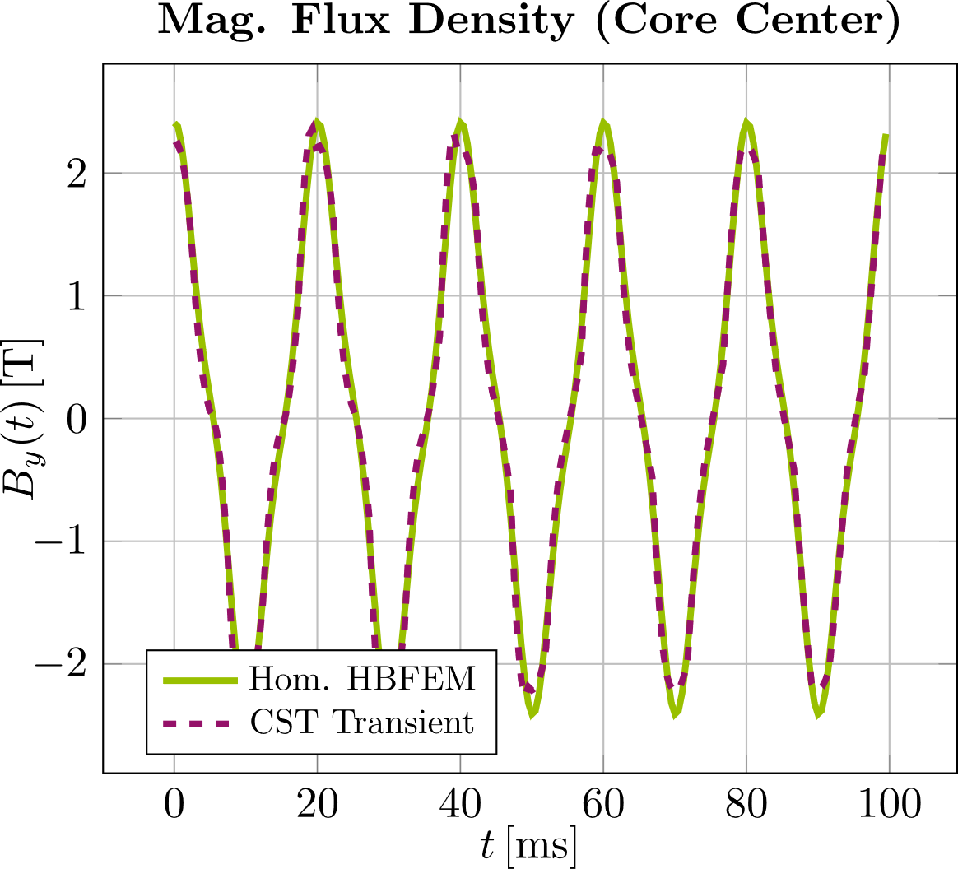
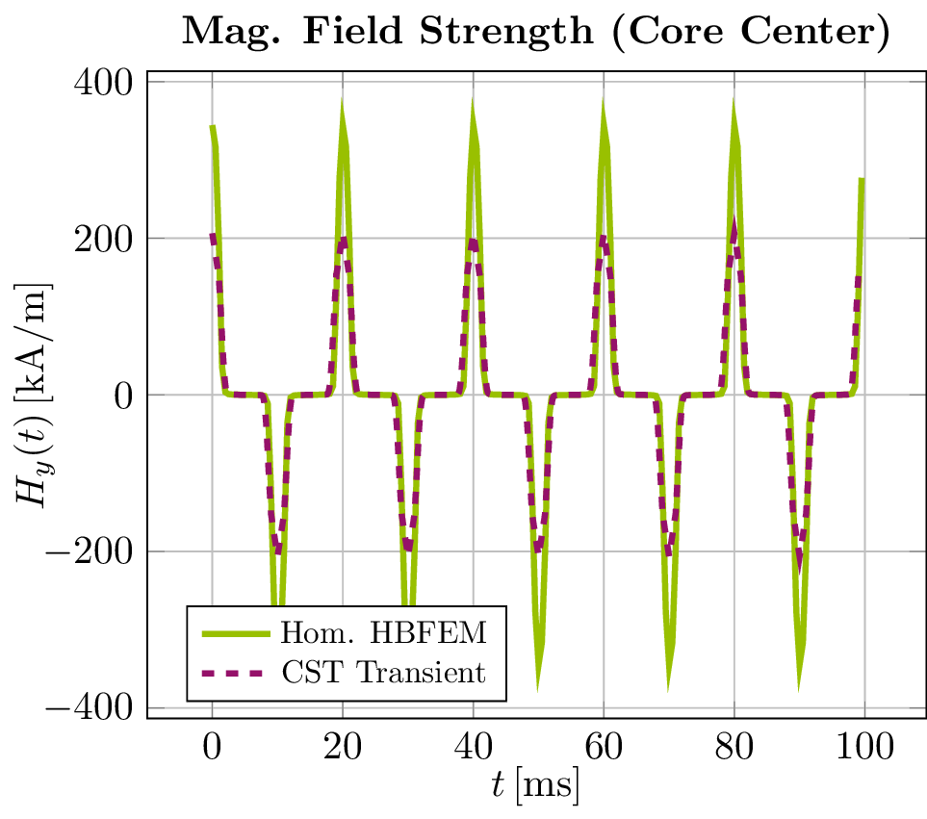
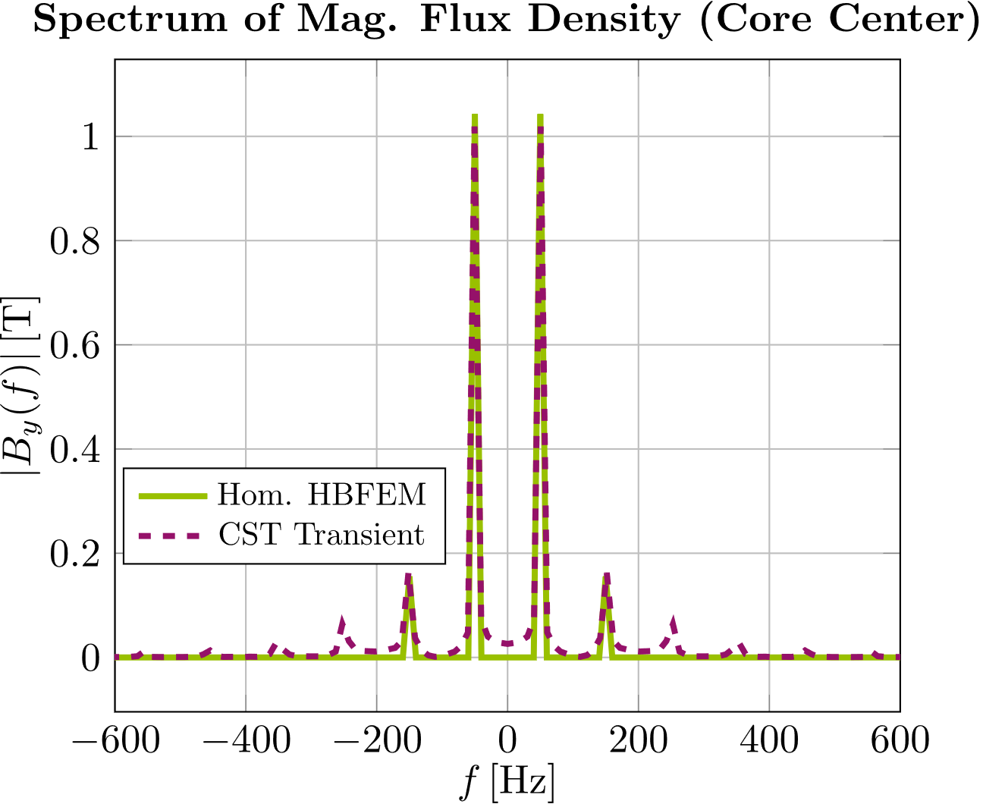
Nonlinear Simulations
Without DC Bias - Verification
Simple inductor with laminated core, excitation current: $I_{s}(t)=1.5 kA\cos\left(2π50Hz t\right)+0.24 kA\cos\left(2π150Hz t\right)$
Compare results of HBFEM + homogenization (GetDP + Python) to transient CST simulation with individually resolved laminations
➔ Good agreement in magnetic flux density
➔ Larger differences in magnetic field strength
➔ Suspicion: differences in magnetic field strength are due to not having included enough harmonics

Slide 15
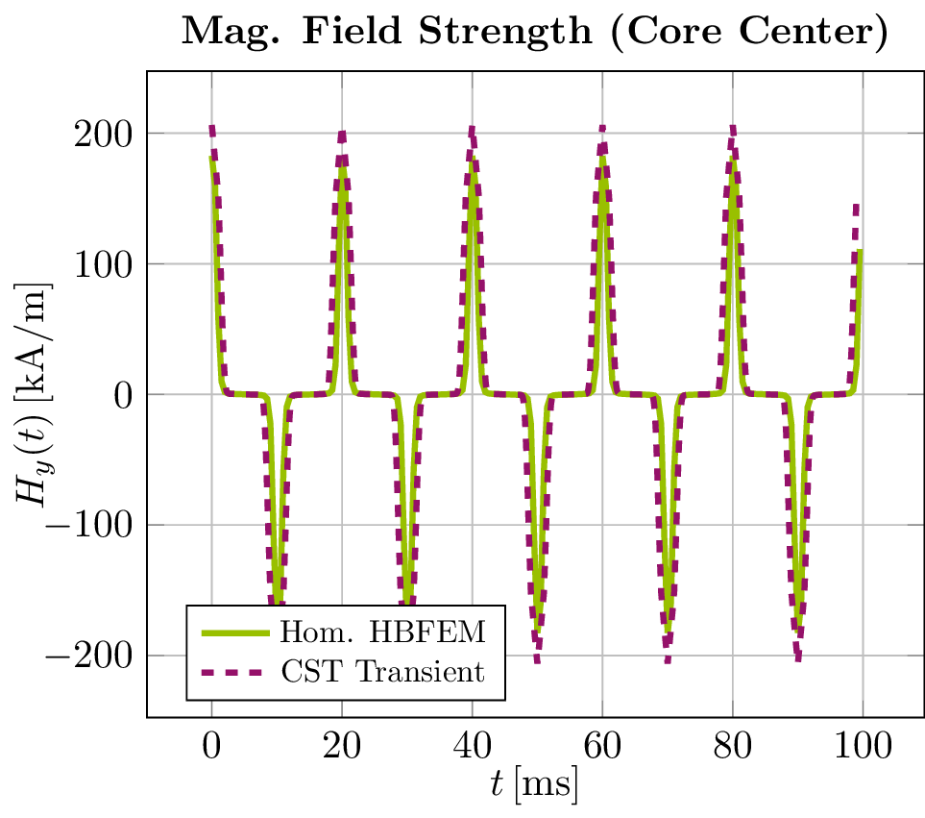
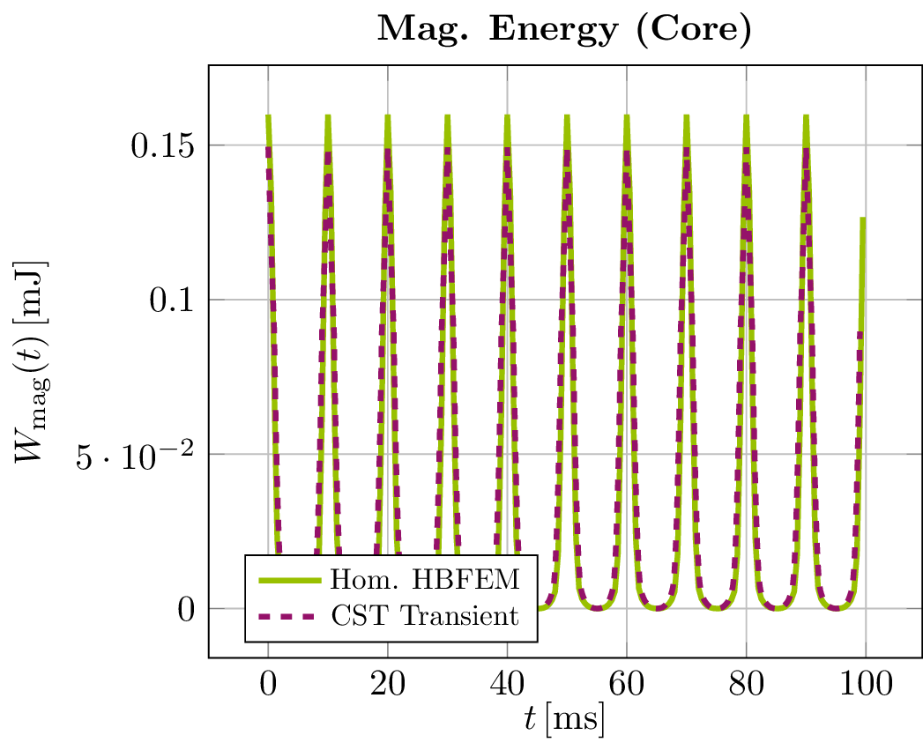
Nonlinear Simulations
Without DC Bias - Verification
Include 5th harmonic in the analysis
➔ Still good agreement in magnetic flux density, large differences in magnetic field strength vanish
➔ Decent agreement in magnetic energy

Slide 16
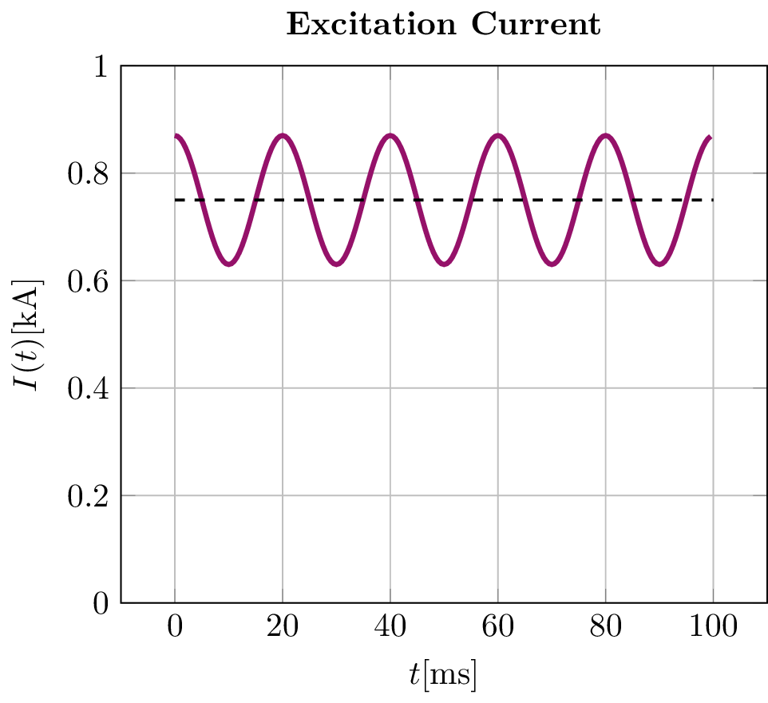
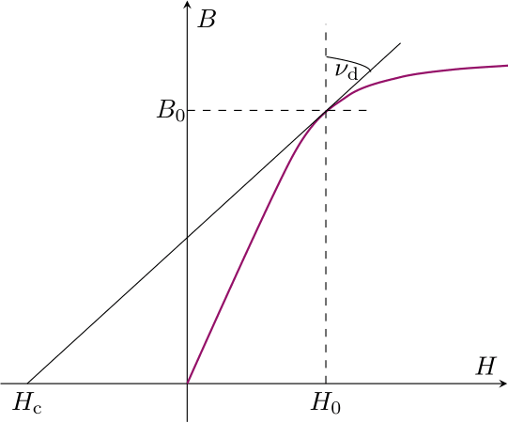
Nonlinear Simulations
With DC BIas - Theory
Current signal of corrector magnet: DC current + oscillations ➔ modify HBFEM method to include DC bias
Again, we combine HBFEM with a homogenization technique
$$∇×\left( \underline{ν}\left(ω\right)⊛∇×\underline{\vec{A}} \left(ω\right)\right)+jωσ\underline{\vec{A}}\left(ω\right)= {\vec{\underline{J}}}_{s}\left(ω\right) ⇒ ∇×\left( {\underline{ν}}_{d}\left(ω\right)⊛∇×\underline{\vec{A}} \left(ω\right)\right)+jωσ\underline{\vec{A}}\left(ω\right)= {\vec{\underline{J}}}_{s}\left(ω\right)−∇×{\underline{\vec{H}}}_{c} (ω)$$
chord reluctivity
differential reluctivity
magnetizing field strength
Homogenization
$$∇×\left(\overset{̿}{ν}∇×\vec{A}\right)+∇×\left(\overset{̿}{ξ}∇×\frac{∂\vec{A}}{∂t}\right)+\overset{̿}{σ}\frac{∂\vec{A}}{∂t}={\vec{J}}_{s}$$
$$\overset{̿}{ν}= \frac{1}{\frac{γ}{ν_{Fe}}+\frac{1−γ}{ν_{Iso}}}\left[\begin{matrix}1 & 0 & 0 \\ 0 & 1 & 0 \\ 0 & 0 & 0\end{matrix}\right]+\left(ν_{Fe}γ+ν_{Iso}(1−γ)\right)\left[\begin{matrix}0 & 0 & 0 \\ 0 & 0 & 0 \\ 0 & 0 & 1\end{matrix}\right]$$
$$\overset{̿}{ξ}= \frac{1}{12}σ_{Fe}d^{2}\left[\begin{matrix}1 & 0 & 0 \\ 0 & 1 & 0 \\ 0 & 0 & 0\end{matrix}\right]$$
J. Gyselinck et al., 1999

Slide 17
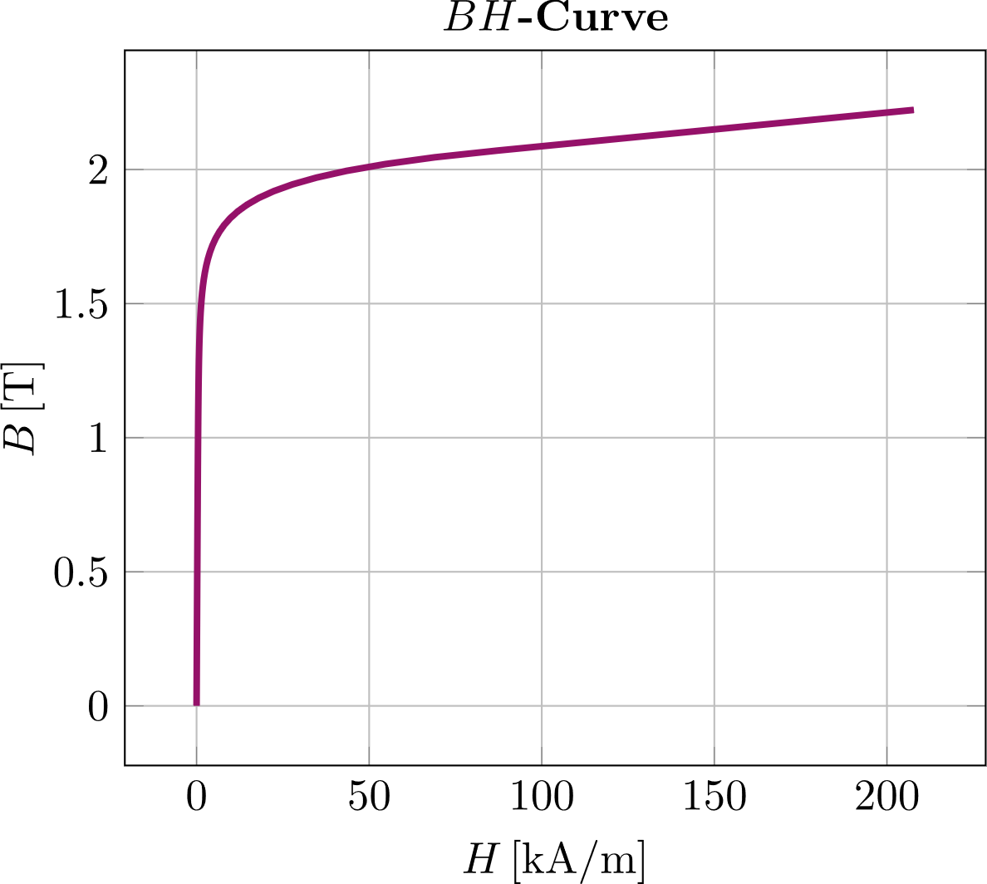
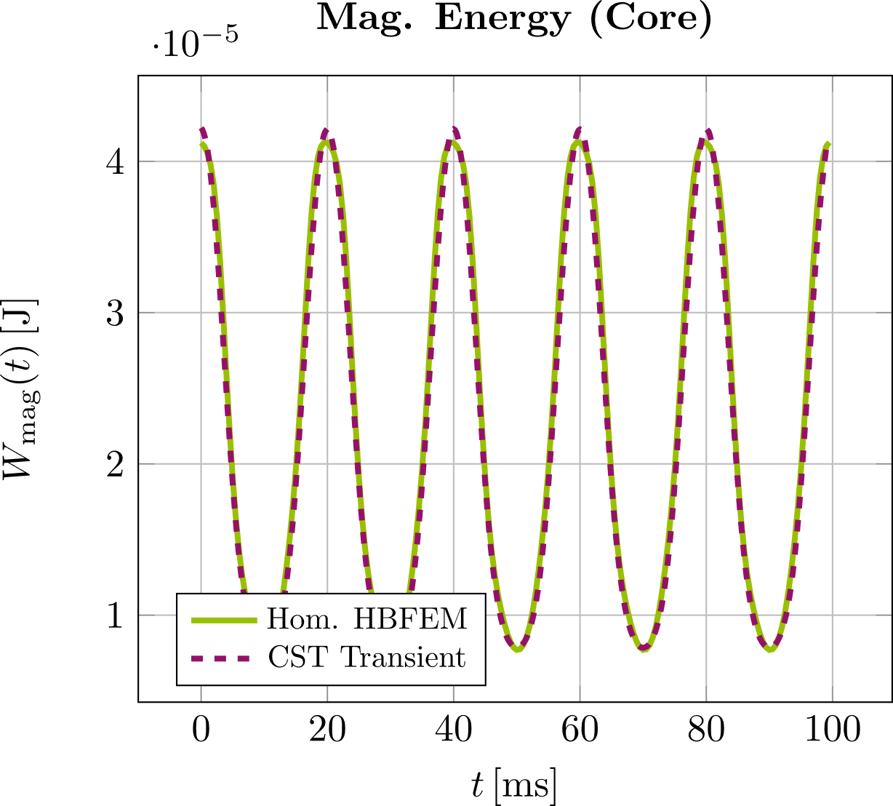
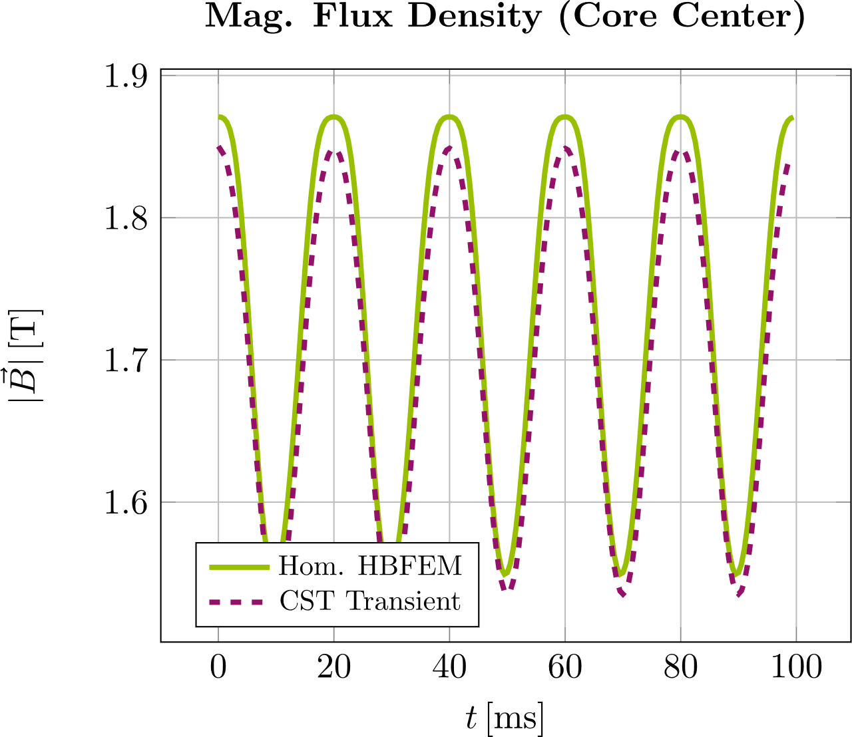
Nonlinear Simulations
With DC Bias - verification
Excitation current: $I_{s}\left(t\right)=750A+120A\cos\left(2π50Hz t\right)$
Comparison to transient CST simulation of toy model:
Very good agreement in magnetic energy in the core
Decent agreement in magnetic flux densities at individual points inside the core (average rel. error $3.7 \%)$

Slide 18
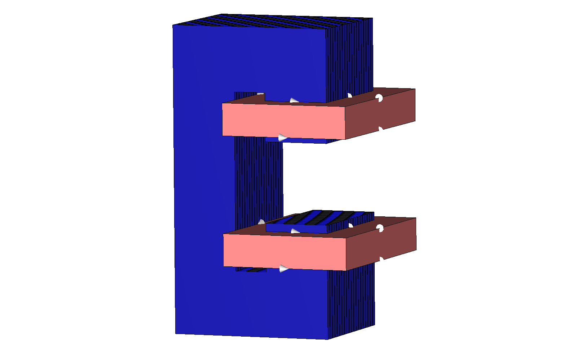
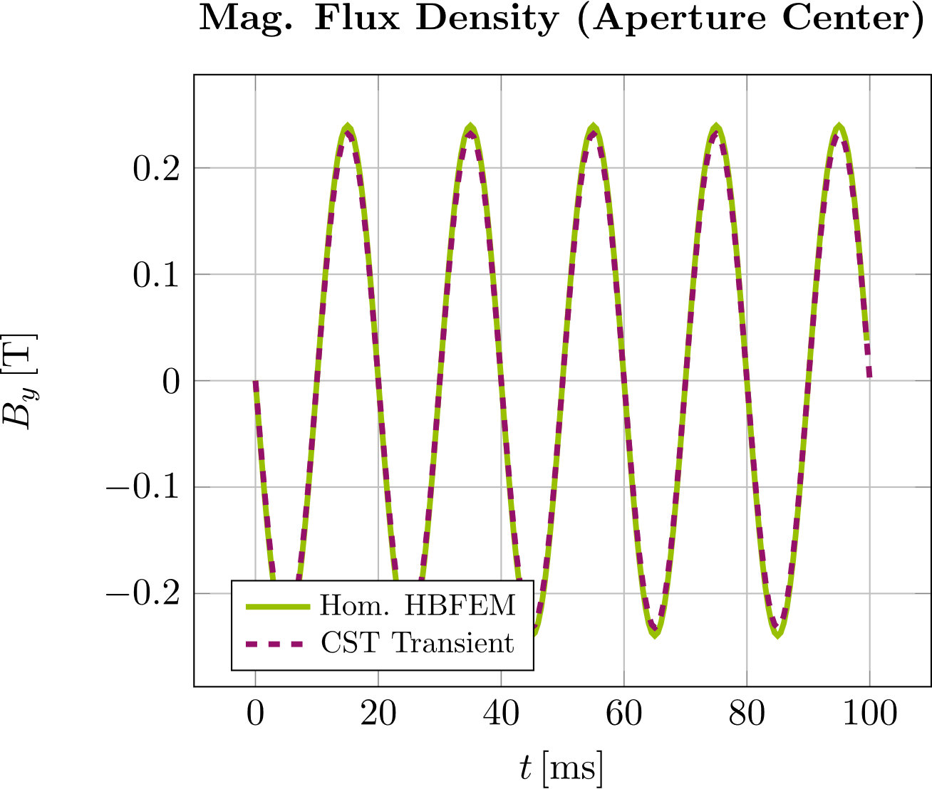
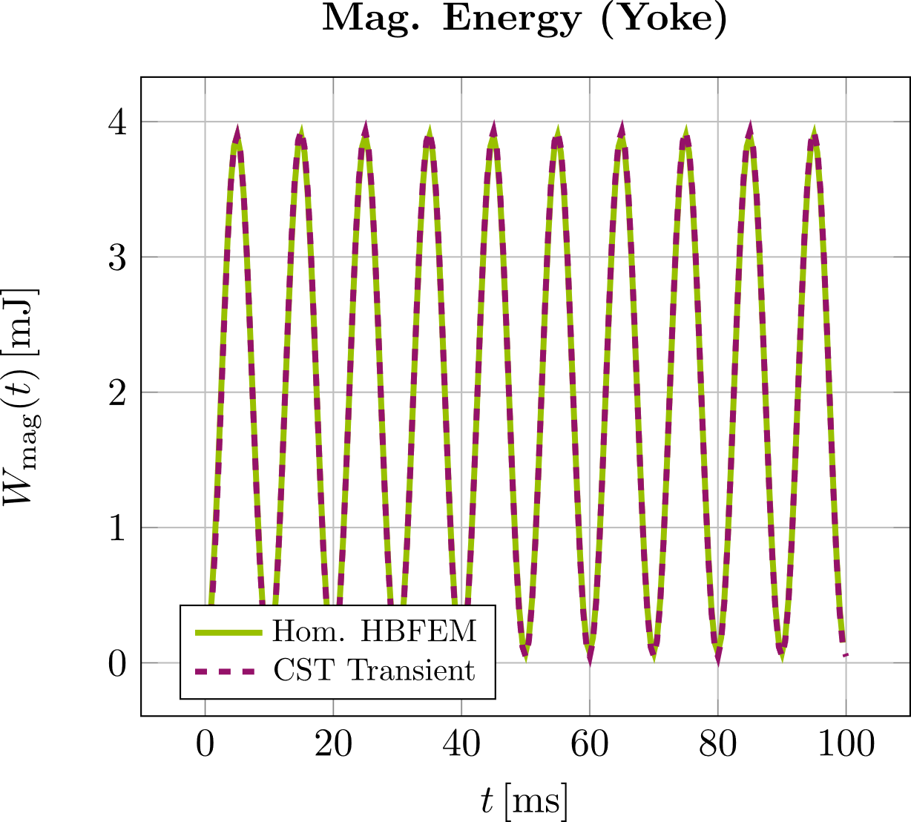
Nonlinear Simulations
Application To C-Dipole
Same magnet as before, lam. thickness $d=0.5 mm$
Excitation current for both coils: ${ I}_{s}(t)=2.5 kA\cos\left(2π50Hz t\right)$
Agreement in aperture field and magnetic energy in the yoke
Eddy current losses well approximated: $1.36 W$ with Hom. HBFEM vs. 1.32 W with CST ➔ $3 \%$ relative error
Higher order finite elements* to achieve good approximation of losses and energy
*J.P. Webb and B. Forghani, “Hierarchal Scalar and Vector Tetrahedra“, 1993

Slide 19
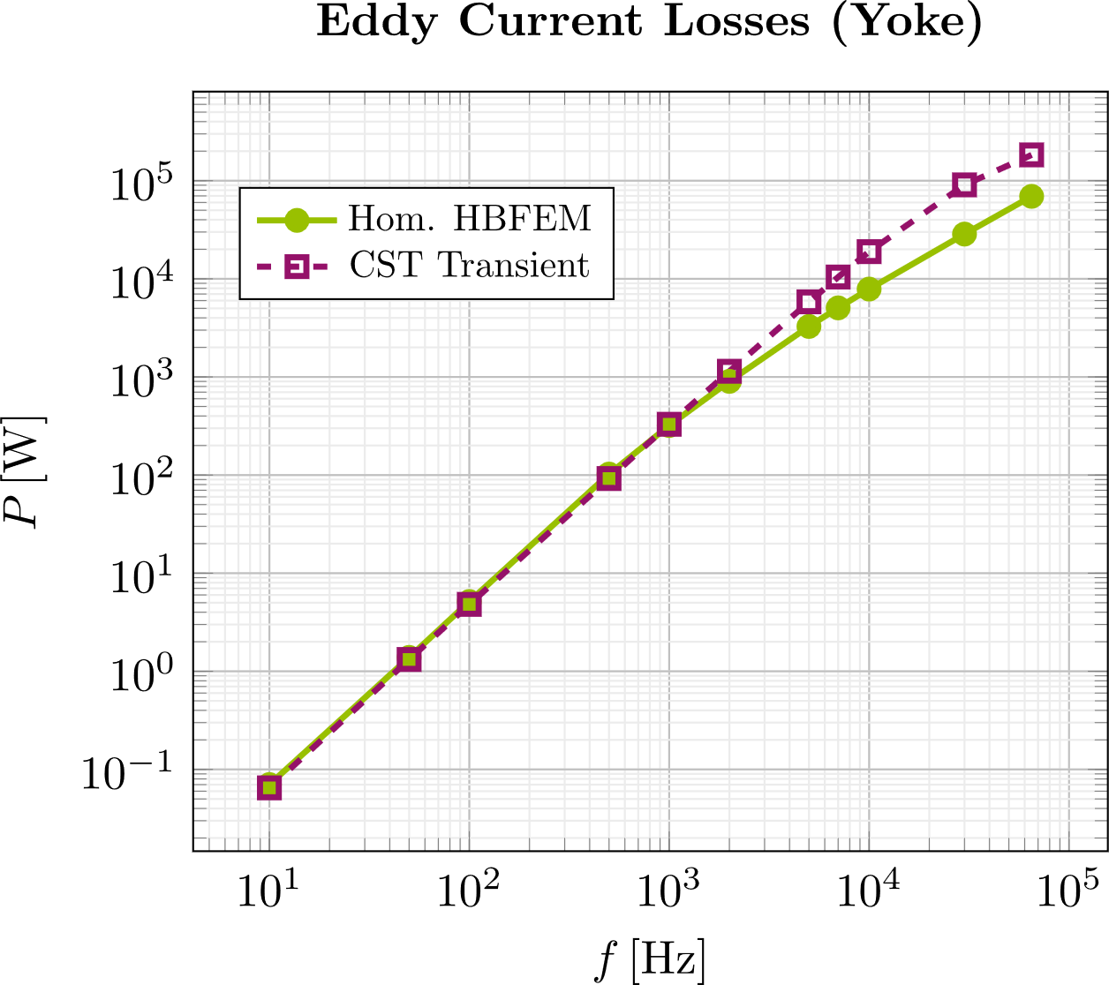
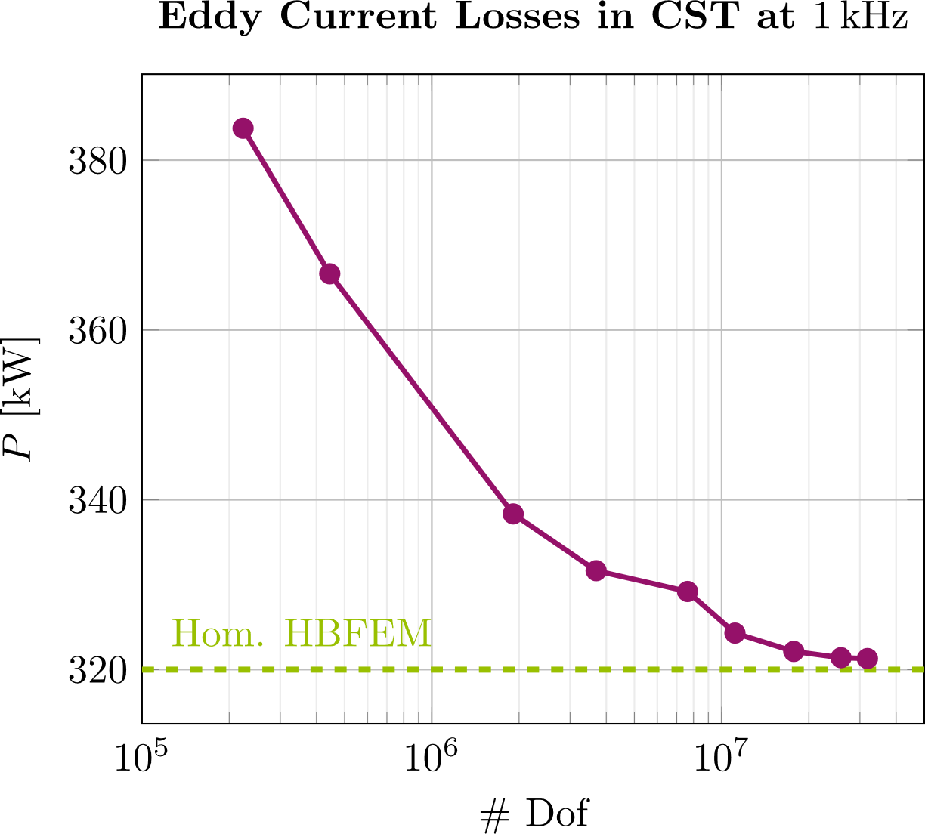
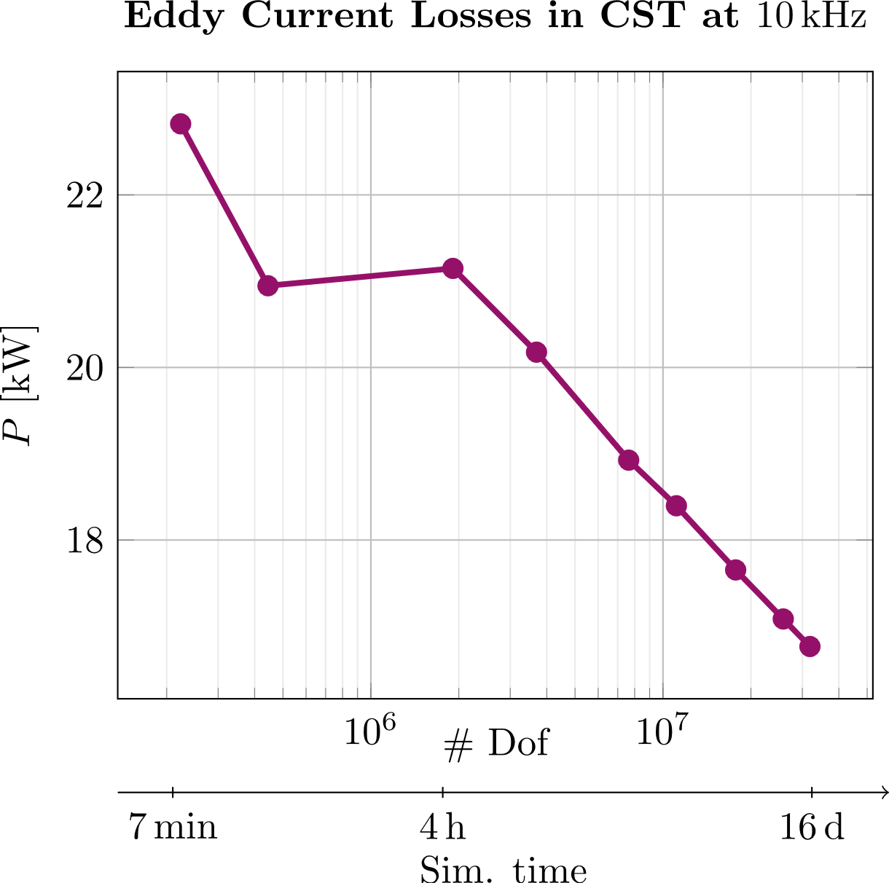
Nonlinear Simulations
Application to C-Dipole
Compute eddy current losses up to $f=65 kHz$ ➔ Scaling behavior as expected from theory*
➔ Good agreement with CST results up to $f≈1 kHz$
Reason for differences between Hom. HBFEM and CST: At higher frequencies, CST results are mesh-dependent, Hom. HBFEM results are stable
Hom. HBFEM reduces simulation time for nonlinear simulations in kilohertz range from days to hours
Hom. HBFEM Eddy Current Losses at $10 kHz$
$$\# Dof$$ | P (kW)
$$2.4⋅{10}^{4}$$ | $$7.38$$
$$5.6⋅{10}^{4}$$ | $$7.31$$
$$1.1⋅{10}^{5}$$ | $$7.38$$
* R. L. Stoll, The Analysis of Eddy Currents. 1974.
J. Lammeraner and M. Štafl, Eddy Currents. 1966.

Slide 20
Contents
1
Introduction
2
Homogenization Technique
3
Linear Corrector Magnet Simulations
4
Nonlinear Simulations
5
Conclusion/Outlook

Slide 21
Conclusion/Outlook
Conclusion/Outlook
Verification of Homogenization
Good approximation of multipoles & power losses
Simulation time for linear simulations reduced from hours to minutes
2. Application of Homogenization to Corrector
Power losses, multipoles along axis
Integrated transfer function & field lag
Cross-talk with neighboring magnets
Beam pipe material transition
3. Implementation & Verification of Hom. HBFEM
Toy model with and without DC bias
C-Dipole without DC bias up to 65 kHz
Simulation time for nonlinear simulations reduced from days to hours
Application of Hom. HBFEM to Corrector

Slide 22
references
References
[1] PETRA IV Conceptual Design Report.
[2] K. Wille, Physik der Teilchenbeschleuniger und Synchrotronstrahlungsquellen. Stuttgart, Germany: Teubner, 1992.
[3] P. Dular et al., “A 3-D Magnetic Vector Potential Formulation Taking Eddy Currents in Lamination Stacks Into Account,” IEEE Trans. Magn., vol. 39, no. 3, pp. 1424-1427, May 2003.
[4] L. Krähenbühl et al., “Homogenization of Lamination Stacks in Linear Magnetodynamics,” IEEE Trans. Magn., vol. 40, no. 2, pp. 912 - 915 Mar. 2004.
[5] H. De Gersem, S. Vanaverbeke, and G. Samaey, “Three-Dimensional-Two-Dimensional Coupled Model for Eddy Currents in Laminated Iron Cores,” IEEE. Trans. Magn., vol. 48, no. 2, pp.815 – 818, Feb. 2012.
[6] B. Podobedov et al., “Eddy Current Shielding by Electrically Thick Vacuum Chambers,” Proceedings of PAC09, Vancouver, BC, Canada, 2009.
[7] S. Yamada and K. Bessho, “Harmonic Field Calculation by the Combination of Finite Element Analysis and Harmonic Balance Method,” in IEEE Trans. Mag., vol.24, no. 6, pp. 2588-2590, Nov. 1988.
[8] H. De Gersem, H. Vande Sande, and K. Hameyer, “Strong Coupled Multi-Harmonic Finite Element Simulation Package”, COMPEL, vol. 20, no.2, pp. 335-546, June 2001.
[9] J. Gyselinck, L. Vandevelde, and J. Melebeek, “Calculation of Eddy Currents and Associated Losses in Electrical Steel Laminations,” in IEEE Trans. Mag., vol. 35, n. 3, May 1999
[10] J. P. Webb and B. Forghani, "Hierarchal scalar and vector tetrahedra," IEEE Trans. Magn., vol. 29, no. 2, pp. 1495-1498, Mar. 1993, doi: 10.1109/20.250686.
[11] R. L. Stoll, The Analysis of Eddy Currents. Oxford, U. K., Clarendon Press, 1974.
[12] J. Lammeraner and M. Štafl, Eddy Currents. Iliffe books, 1966.

