Slide 1
Simulation of quench protection systems of next‑generation superconducting magnets
M. Wozniak, J. Dular, E. Schnaubelt, E. Ravaioli and A. Verweij
CERN, Switzerland
3rd October 2024

Slide 2
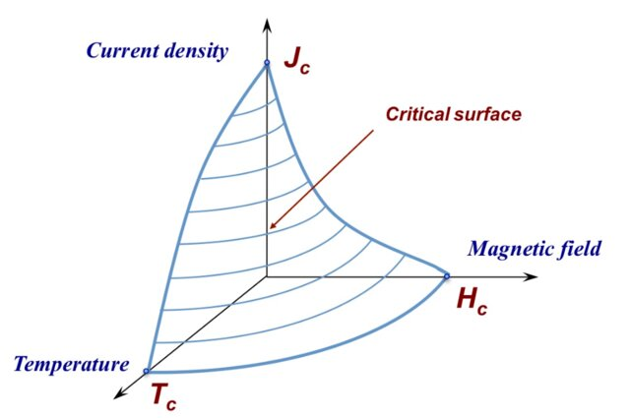
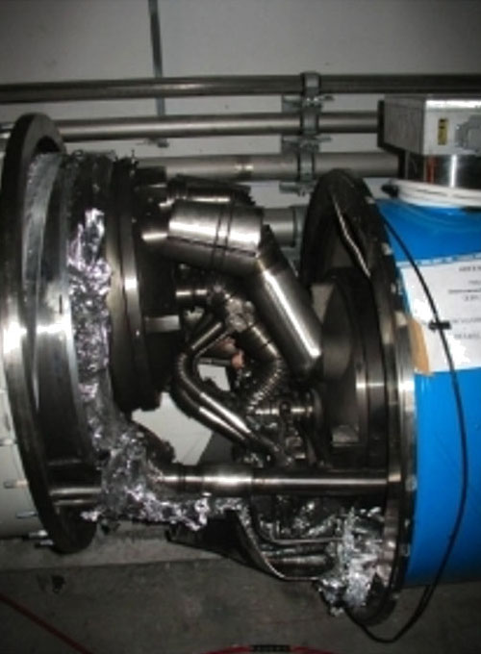
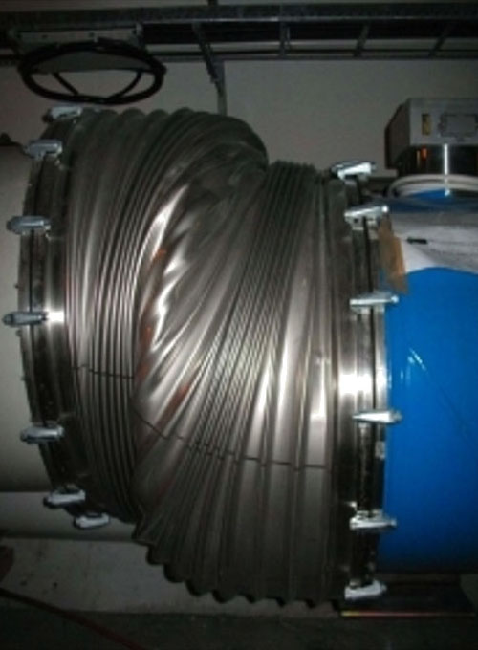
Motivation: quench of superconducting magnets
  Stored energy in each main dipole circuit of the LHC
  ~ 1 GJ = 250 kg of TNT
R. Navarro, “Hundred years of Superconducting Materials”, Second International Conference of Energy Engineering (2010)
Quench: loss of superconductivity leads to thermal runaway
  Violent process: high voltage, temperature and thermal stress
  Usually accompanied by dissipation in the coolant of stored magnetic energy (→ rapid boil-off)
M. Bajko, et al., “Report of the task force on the incident of 19th September 2008 at the LHC” . Technical report, CERN (2009). https://cds.cern.ch/record/1168025

Slide 3
Quench simulation
Key Facts and Requirements
Multi-physics, -rate and –scale problem
  Interaction: circuit, power convert., leads, magnets, protection…
  Today: coupling of thermodynamics (heat diffusion equation) and magnetics (magneto[quasi]statics)
Highly nonlinear with sharp (~ discont.) transitions
Local phenomenon → true 3D simulations or clever reduced order models required
Inherently transient effect
Accelerator magnet projects often run over decades
  How to ensure reproducible and traceable simulations?
L. Bortot et al., "STEAM: A Hierarchical Cosimulation Framework for Superconducting Accelerator Magnet Circuits," in IEEE Trans. Appl. Supercond. (2018).

Slide 4
Table of Contents
Finite Element Quench Simulator (FiQuS)
Integration of FiQuS into STEAM framework
  Parametric analysis
  Co-simulation with other tools of the STEAM framework
Reduced order models
(Outlook on) high-performance computing
Summary

Slide 5
Table of Contents
Finite Element Quench Simulator (FiQuS)
Integration of FiQuS into STEAM framework
  Parametric analysis
  Co-simulation with other tools of the STEAM framework
Reduced order models
(Outlook on) high-performance computing
Summary

Slide 6

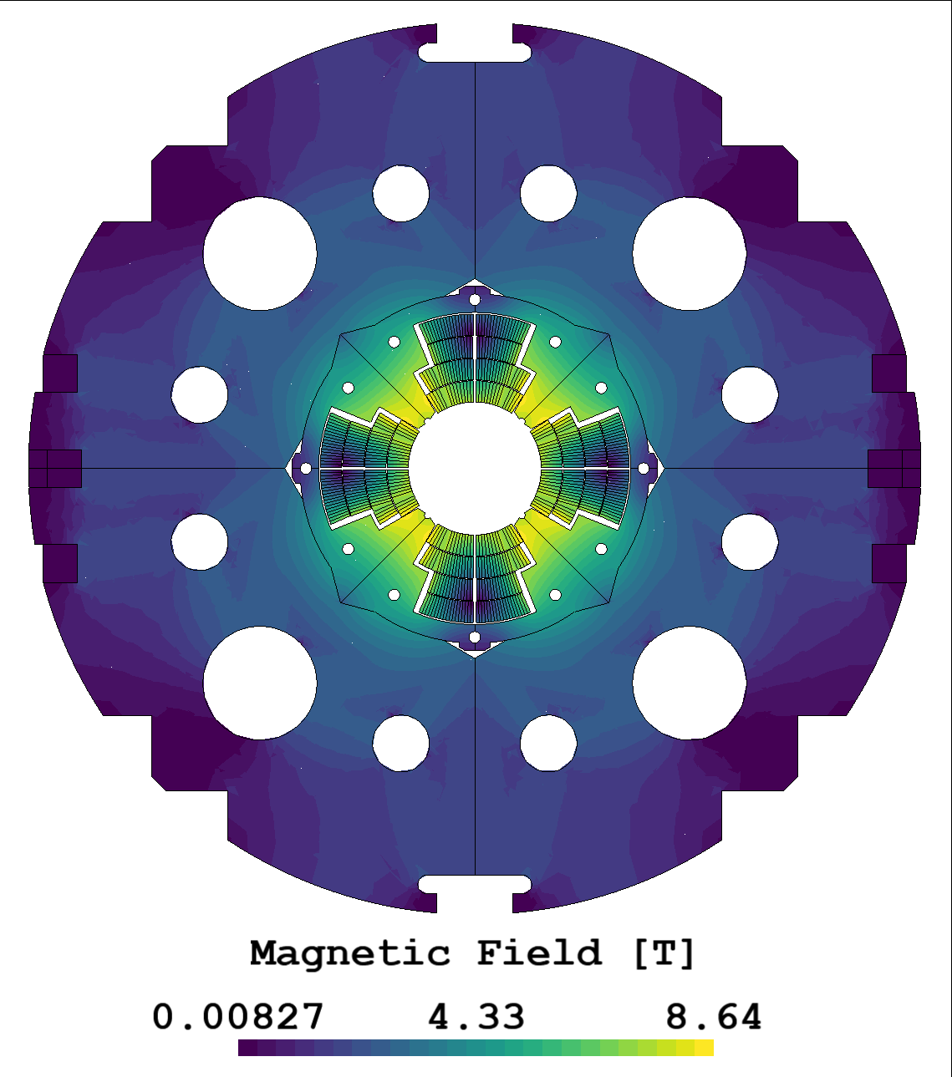
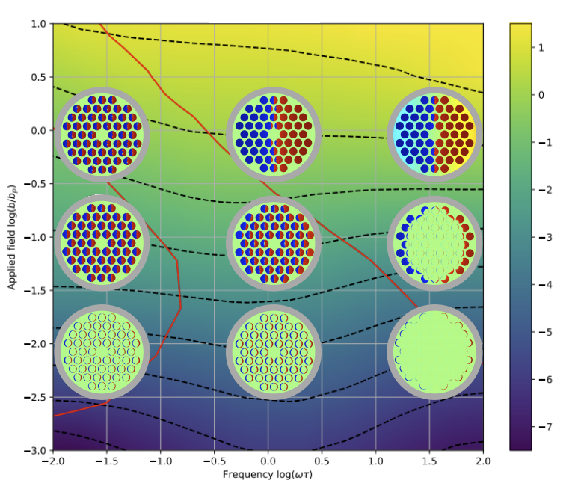
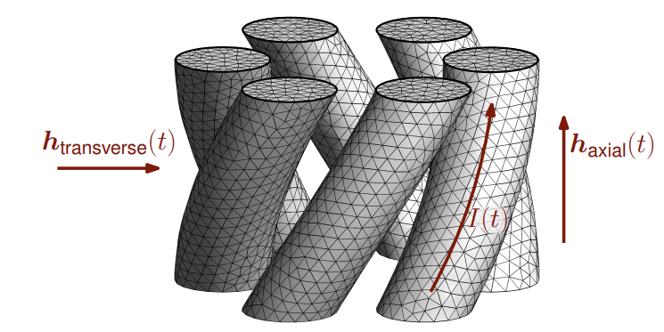
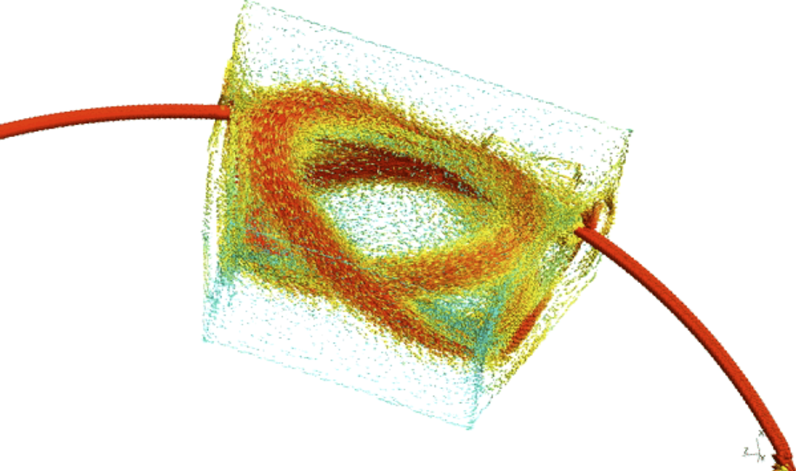
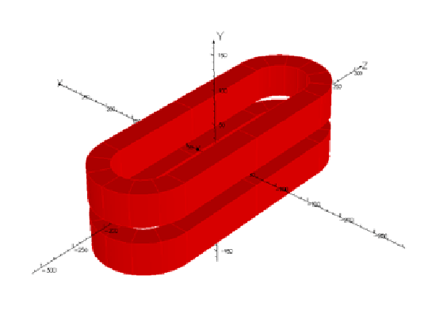
Finite Element Quench Simulator
2D Example for quadrupole MQXA
2D AC loss map of LTS strand
2D Reduced Magnetic Vector Potential Formulation
3D Example of a SC filaments
3D Example of a NI HTS coil
3D Example of a CCT magnet
3D Racetrack coils (HTS and LTS)

Slide 7




FiQuS as a tool
FiQuS is developed at CERN in TE-MPE-PE
FiQuS is part of software framework for STEAM
FiQuS is coded in Python and uses its libraries
FiQuS is based on Gmsh and GetDP
onelab.info

Slide 8
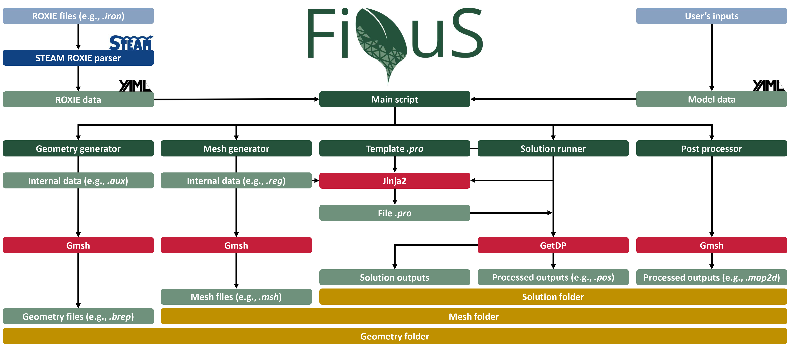
FiQuS code structure
A. Vitrano et al., "An Open-Source Finite Element Quench Simulation Tool for Superconducting Magnets,“ IEEE Trans. Appl. (2023)

Slide 9

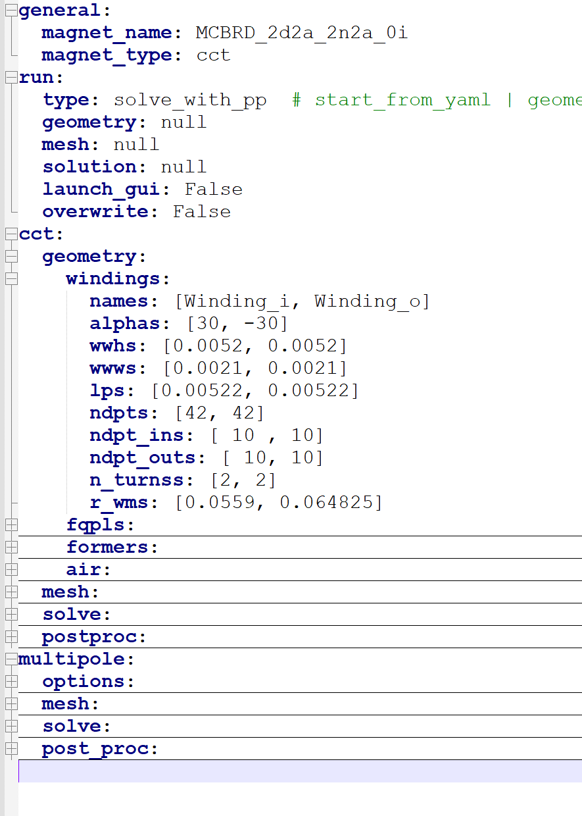
FiQuS input file and run types
FiQuS uses a yaml based input file
  Tree structure of lists, lists of lists, dictionaries etc.
There are some common parts (general, run) and geometry specific sections (CCT, multipole, ...)
This file can also be generated from a dedicated model library via STEAM SDK (see later)
Follows typical FE steps: geometry, mesh, solve
And a run type entry: “run” → “type” that can be:
‘start_from_yaml’
‘geometry_only’
‘mesh_and_solve_with_pp’
‘mesh_only’
‘solve_with_pp‘
‘solve_only’
‘pp_only’

Slide 10

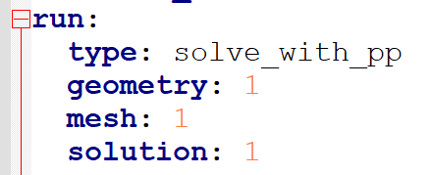
FiQuS folder structure
After completing each of 3 basic steps (geometry, mesh, solve), FiQuS saves its ‘state’ to files so a number of subsequent steps can be started from that point
‘start_from_yaml’
‘geometry_only’
‘mesh_and_solve_with_pp’
‘mesh_only’
‘solve_with_pp‘
‘solve_only’
‘pp_only’
Geometry_1
Mesh_1
Solution_1
Solution_2
Mesh_2
From Geometry_1 a few meshes can be created (useful for mesh sensitivity) and for each mesh many solutions performed (e.g., with changed excitation).
Solution_1

Slide 11
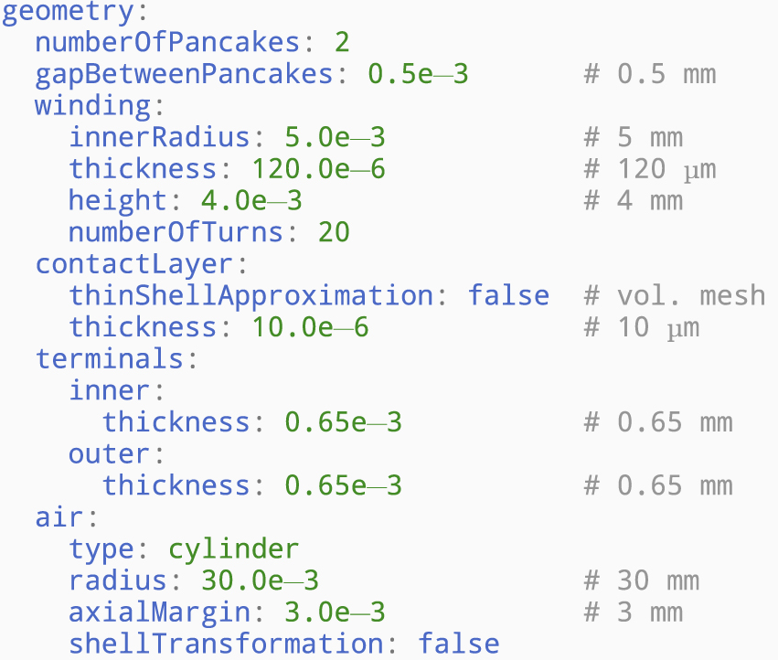

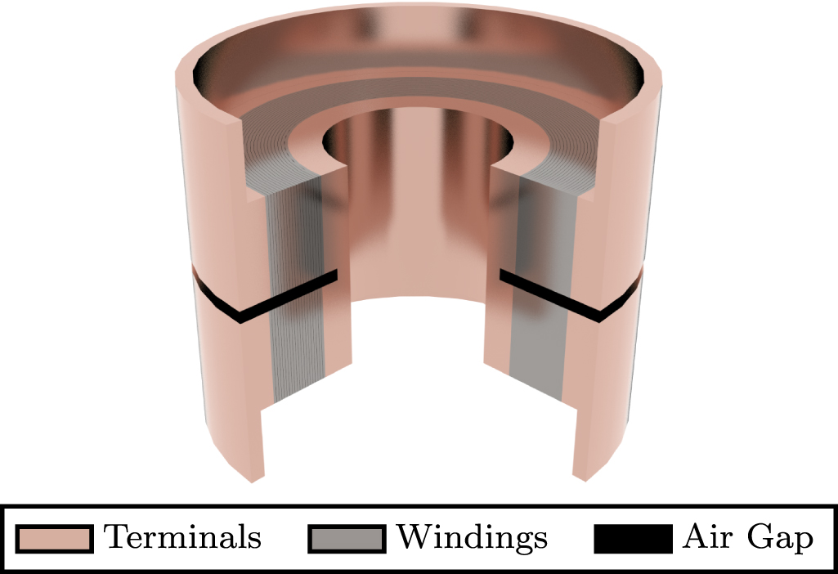


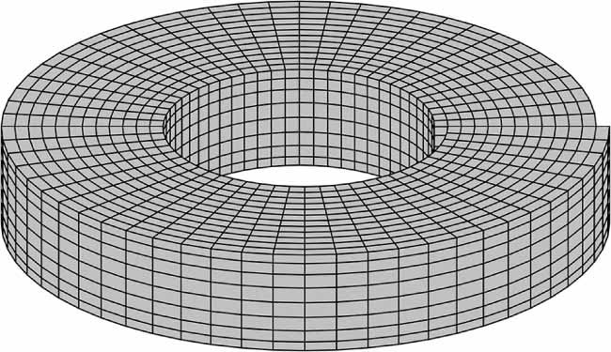
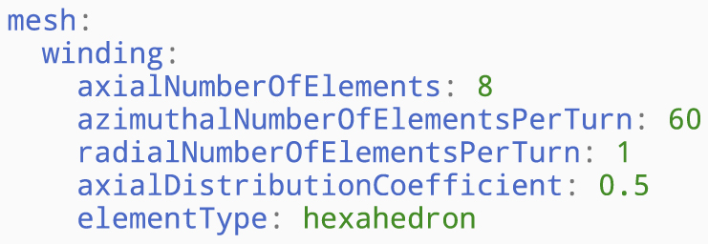
FiQuS geometry and mesh generation via Gmsh API
API
API
Examples from S. Atalay et al., "An open-source 3D FE quench simulation tool for no-insulation HTS pancake coils," Supercond. Sci. Technol. (2018)

Slide 12
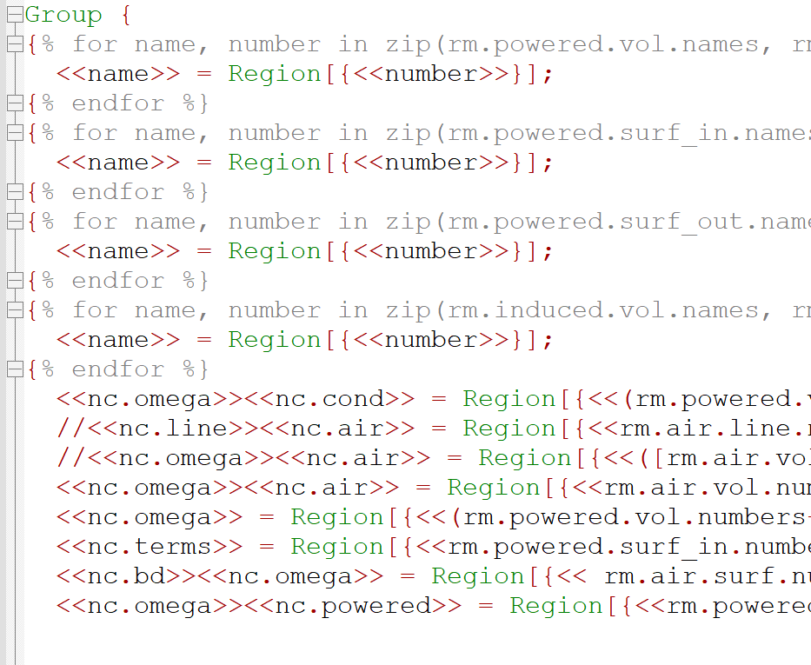
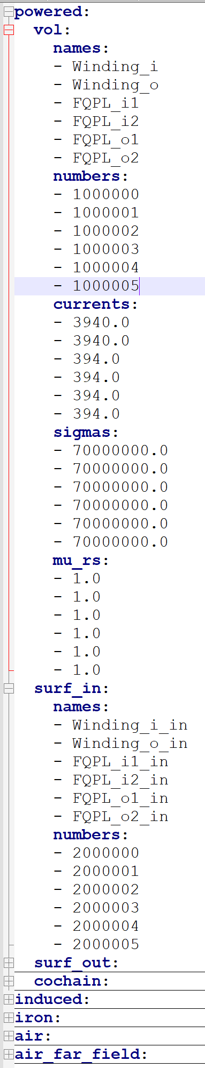
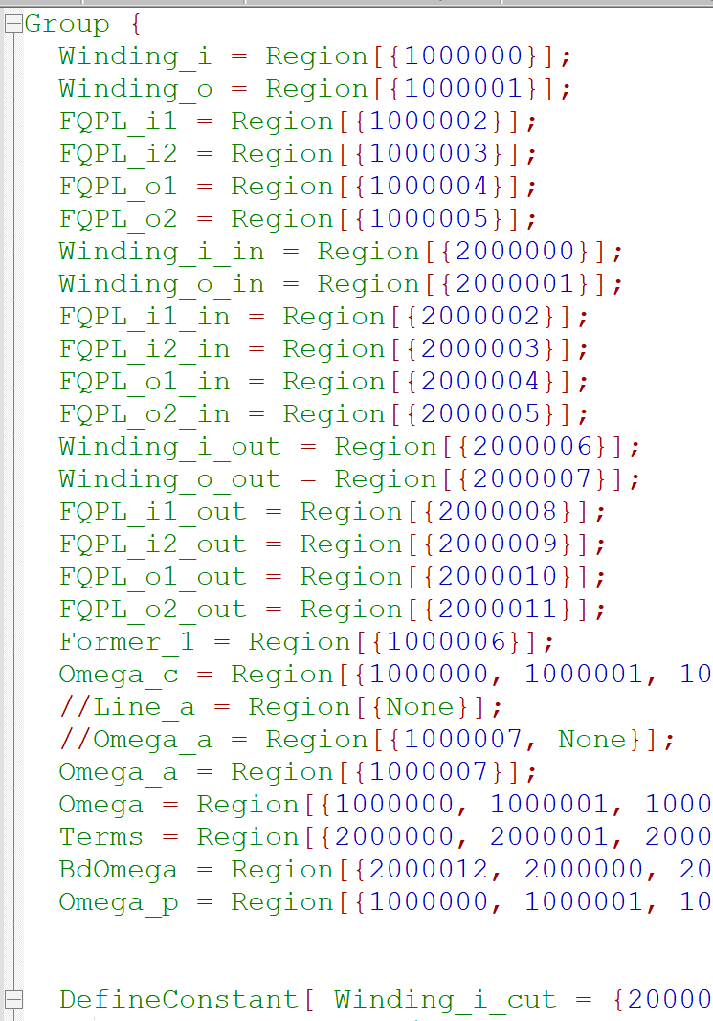
FiQuS programmatic generation of .pro
FiQuS uses templating engine (Jinja2 for Python) and .pro template and .regions file to generate .pro files for GetDP
.pro template
FiQuS
code
    .yaml input file
FiQuS
code
    .regions file
    (yaml based)
Jinja2 engine
geometry generation logic
pass through materials and BC
info
tags numbering logic
  .pro for GetDP
Variables in <<…>> get replaced with data from .regions file

Slide 13
Table of Contents
Finite Element Quench Simulator (FiQuS)
Integration of FiQuS into STEAM framework
  Parametric analysis
  Co-simulation with other tools of the STEAM framework
Reduced order models
(Outlook on) high-performance computing
Summary

Slide 14
FiQuS does not stand alone – the STEAM framework
Input files
Input files
Conductor
Conductor
Magnet
Magnet
Circuit
Circuit
Consecutive analysis
Consecutive analysis
Parametric analysis
Parametric analysis
Comparison to
measurements
Comparison to
measurements
Conductor
Conductor
FiQuS
FiQuS
STEAM SDK
STEAM SDK
STEAM SDK
STEAM SDK
STEAM SDK
LEDET
STEAM SDK
LEDET
XYCE
XYCE***
PyBBQ
PyBBQ
LEDET
LEDET
Dakota
Magnet
Dakota***
Magnet
ProteCCT
Circuit
FiQuS
ProteCCT
Circuit
PSPICE
CHALLENGES
Commercial software is not easily available to all users and expensive
BBQ
PSPICE**
BBQ*
SIGMA
Co-sim.
NICQS
Co-sim.
Analysis
Materials properties
SIGMA*
Component library
Analysis
Parametric
Materials properties
Component library
Parametric
Co-operative simulation
Meas. config
Meas. config
Co-operative simulation
COSIM
STEAM SDK
Meas. data
Meas. data
COSIM
STEAM SDK
STEAM SDK
STEAM SDK
*COMSOL license needed. **Commercial circuit solver from Cadence Design Systems. ***Free tools from Sandia Labs.
Some functionality is under active development
Software in green boxes is free to use

Slide 15
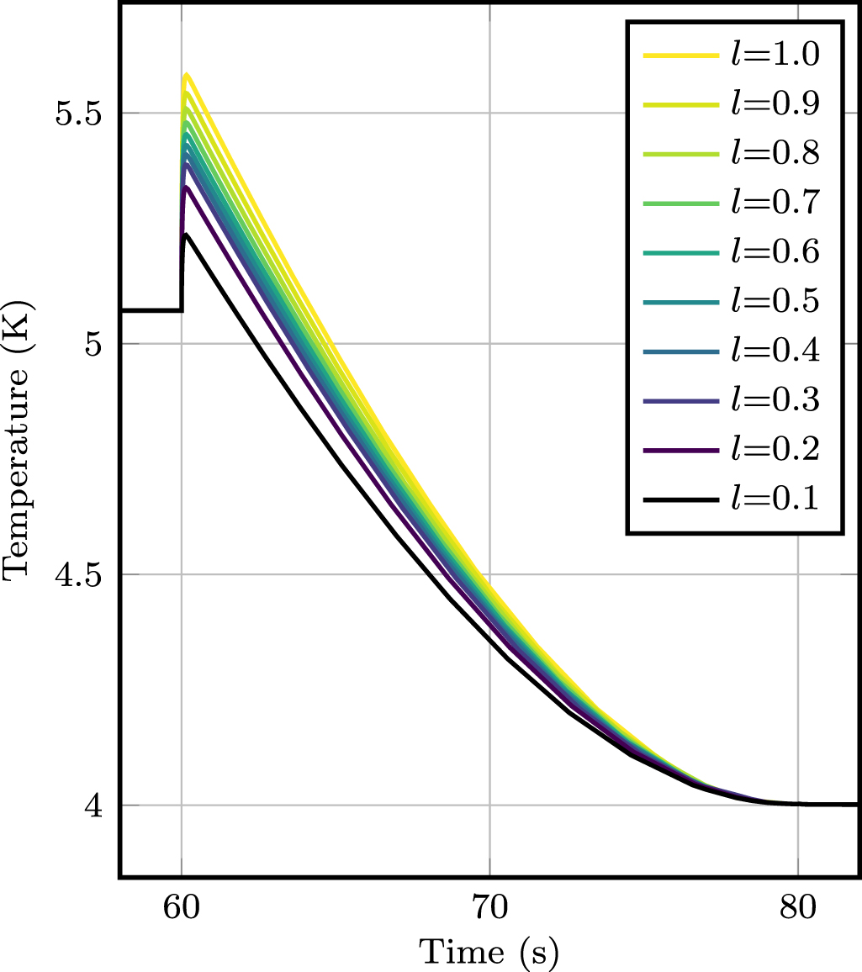
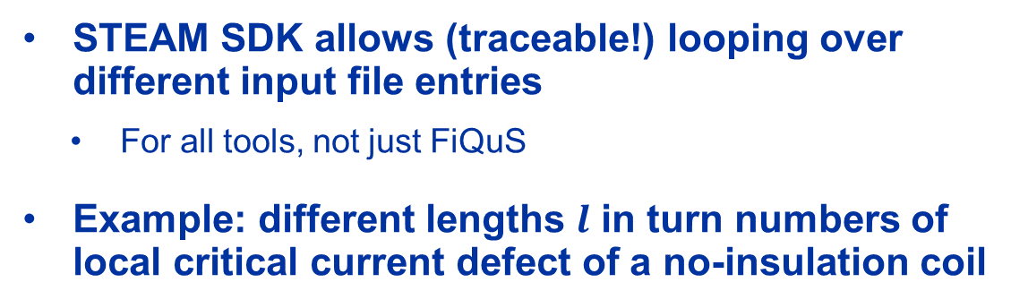
Parametric Analysis via STEAM SDK
STEAM SDK allows (traceable!) looping over different input file entries
  For all tools, not just FiQuS
Example: different lengths $l$ in turn numbers of local critical current defect of a no-insulation coil
simulation_number | ... | Options_FiQuS.Pancake3D.solve.localDefects.jCritical.defectLength
1 | ... | 10.1
2 | ... | 10.2
3 | ... | 10.3
4 | ... | 10.4
5 | ... | 10.5
6 | ... | 10.6
7 | ... | 10.7
8 | ... | 10.8
9 | ... | 10.9
10 | ... | 11
STEAM
SDK
Example from S. Atalay et al., "An open-source 3D FE quench simulation tool for no-insulation HTS pancake coils," Supercond. Sci. Technol. (2018)

Slide 16


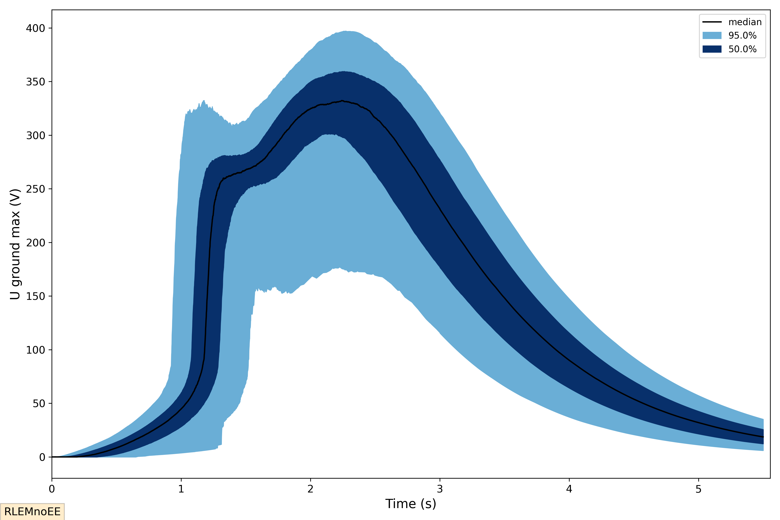
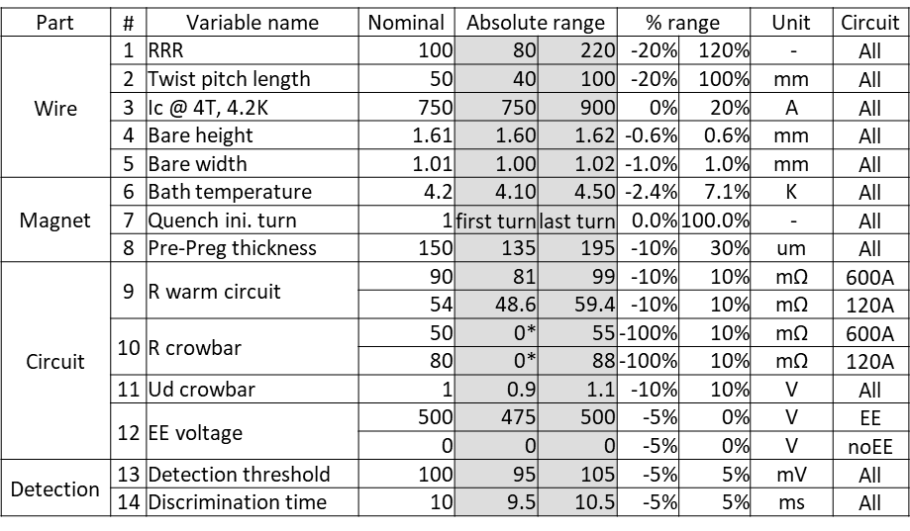
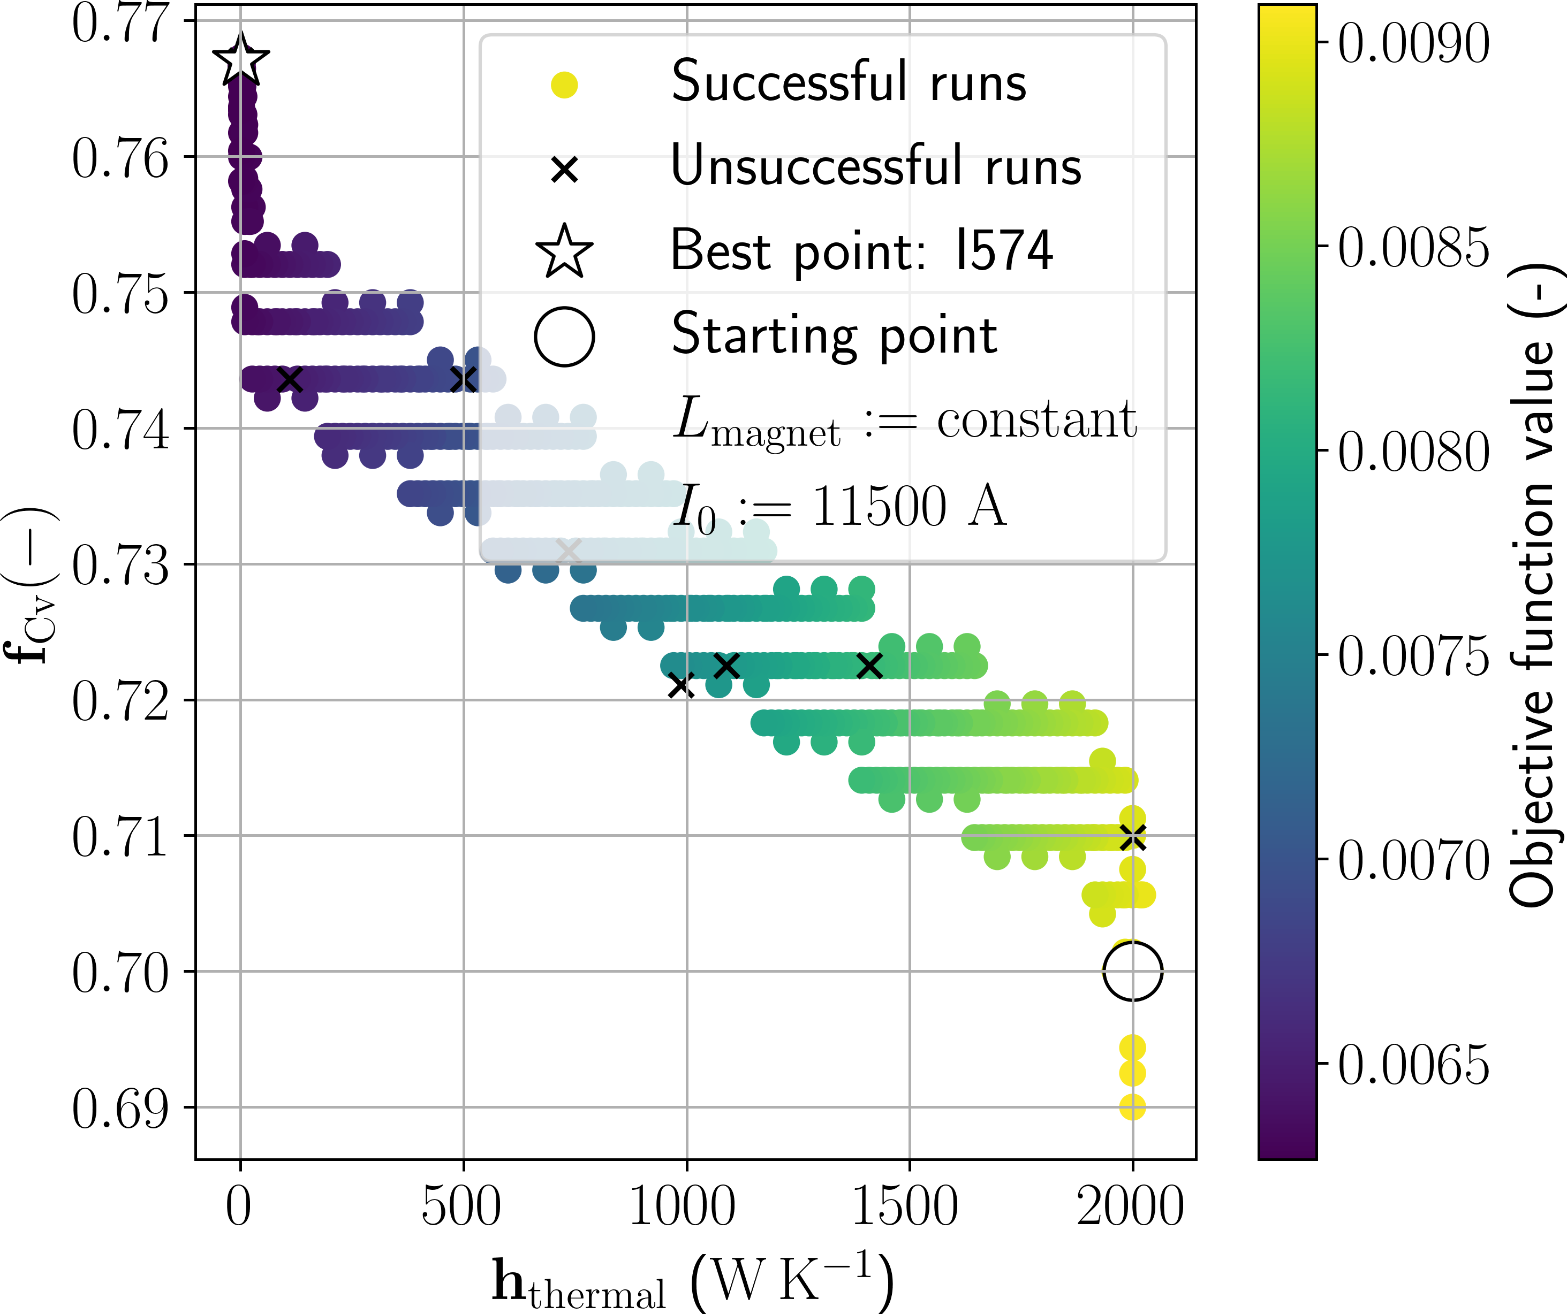
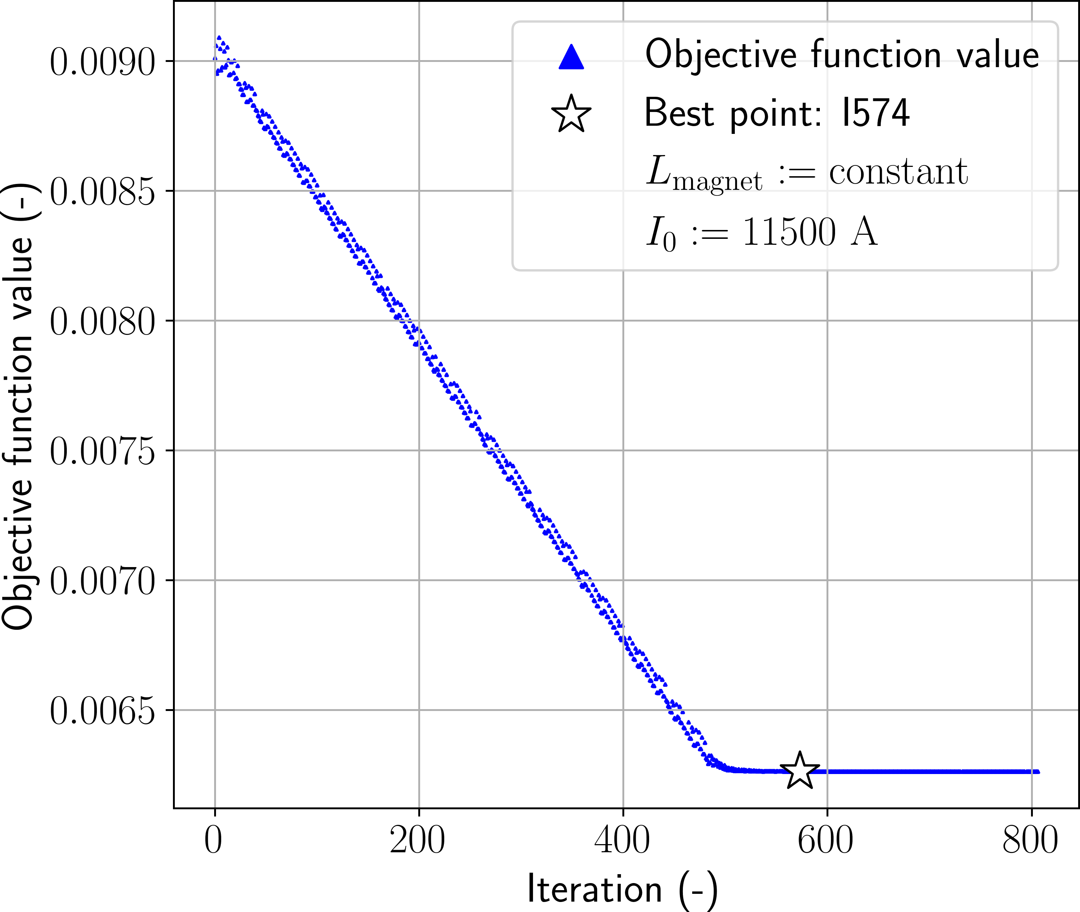
STEAM SDK coupling to DAKOTA
UQ
UQ
M. Wozniak et al., "Quench Protection of the HL-LHC Hollow Electron Lens Superconducting Solenoid Magnets," IEEE Trans. Appl. (2022)
Multivariate Closed-Loop Optimization
M. Gorenflo, "Closed-Loop Optimization of a Lumped Model of the Main Dipole Circuit’s Energy Extraction Resistor," Master’s Thesis Philipps-University Marburg (2024)
→ Coupling to Dakota benefits from text-based input files for models, virtually any input can be changed

Slide 17
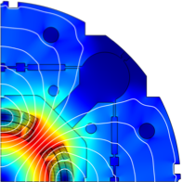


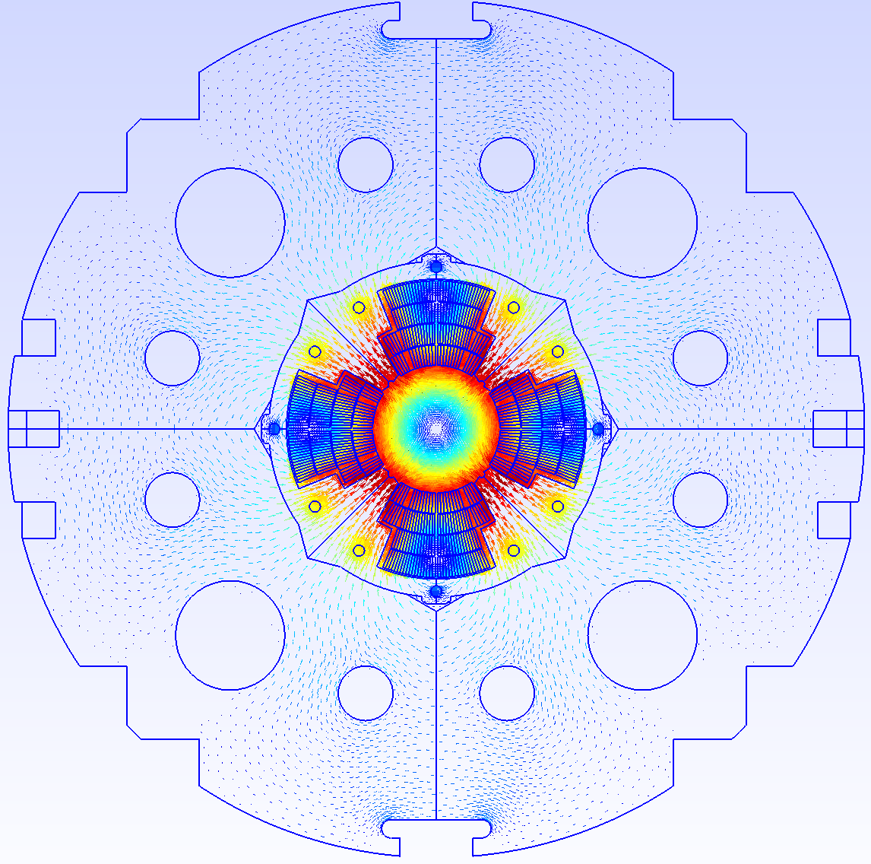
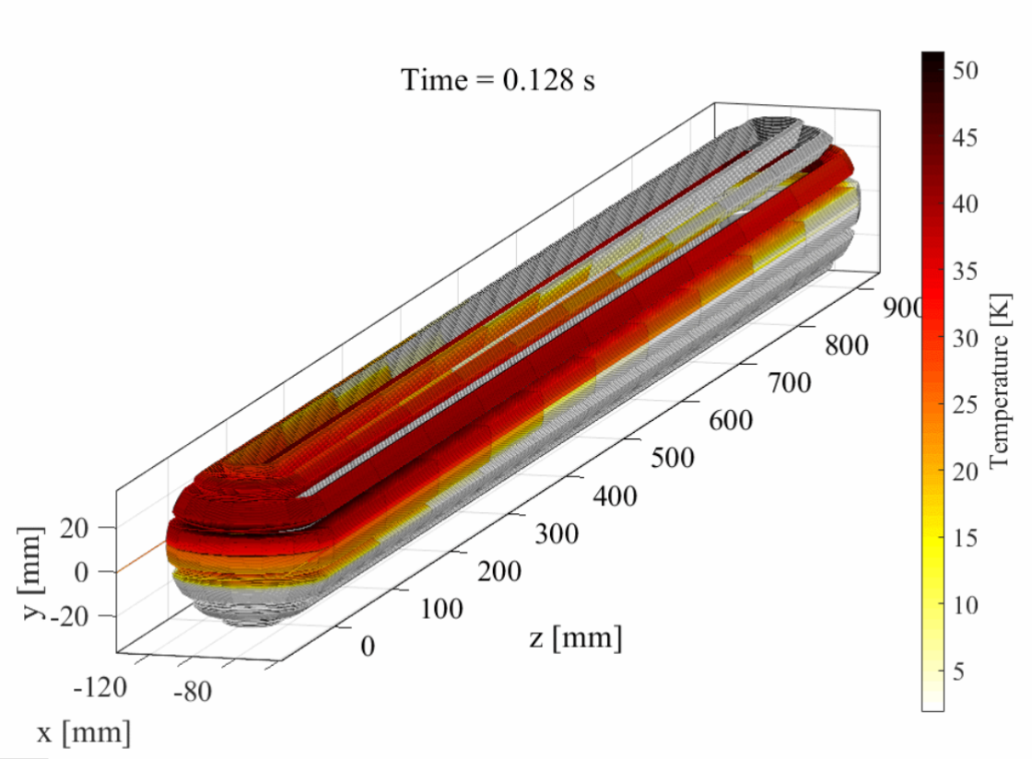

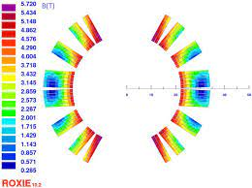
Comsol model
Integration of STEAM tools,
example for multipole magnet
Comsol
compiler
STEAM SDK
ROXIE files
COMSOL
.data
ROXIE
files parser
Conductor,
Geometry,
Circuit,
Mesh,
Solution,
Options,
data
SIGMA
SIGMA model
Java script
.iron
FiQuS input file
FiQuS
Magnet input file (model data)
FiQuS*
.mod
Gmsh API
+ GetDP
.cadata
LEDET input file
LEDET
.bhdata
LEDET
.map2d
ROXIE

Slide 18

Cooperative simulation (co-simulation)
part 1 of
complex
simulation
part 2 of
complex
simulation
Why?
Cooperative simulation are used when the needs of complex simulation exceed the capabilities of one software tool.
How?
Co-simulations are performed with at least two tools and data exchange between them. Typically, iterations are needed to converge on a final solution.
Software tool 1
Data exchange
Software tool 2
Cooperative simulation
Which tools can be used?
Data exchange, consistency and iterations are performed by:
STEAM SDK – Python Based Tool: cern.ch/steam
FiQuS – Finite Elements Tool: cern.ch/FiQuS
LEDET – Finite Difference Tool: cern.ch/LEDET

Slide 19
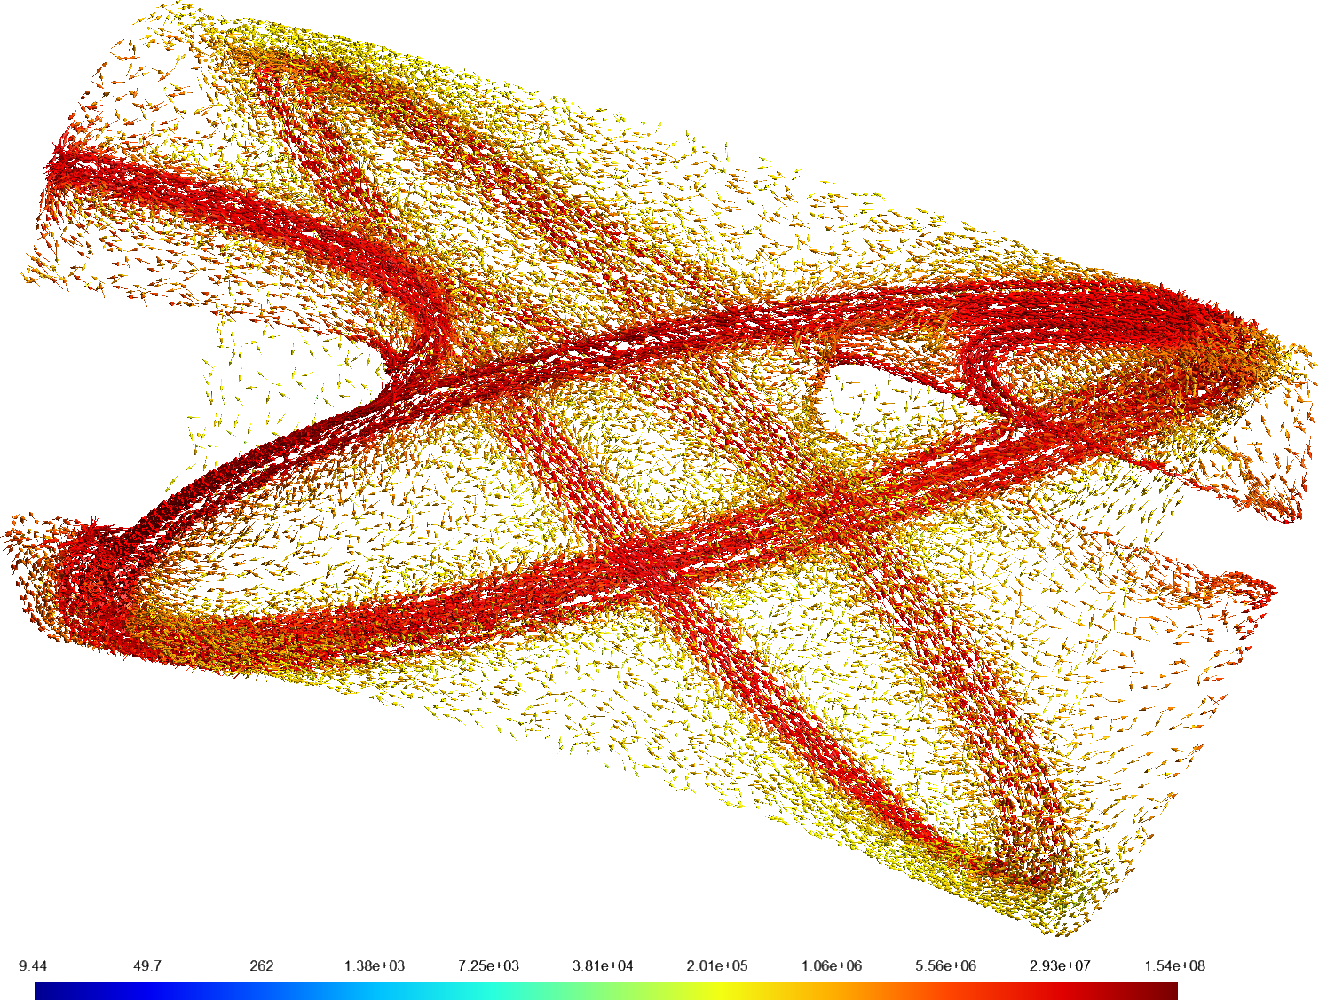
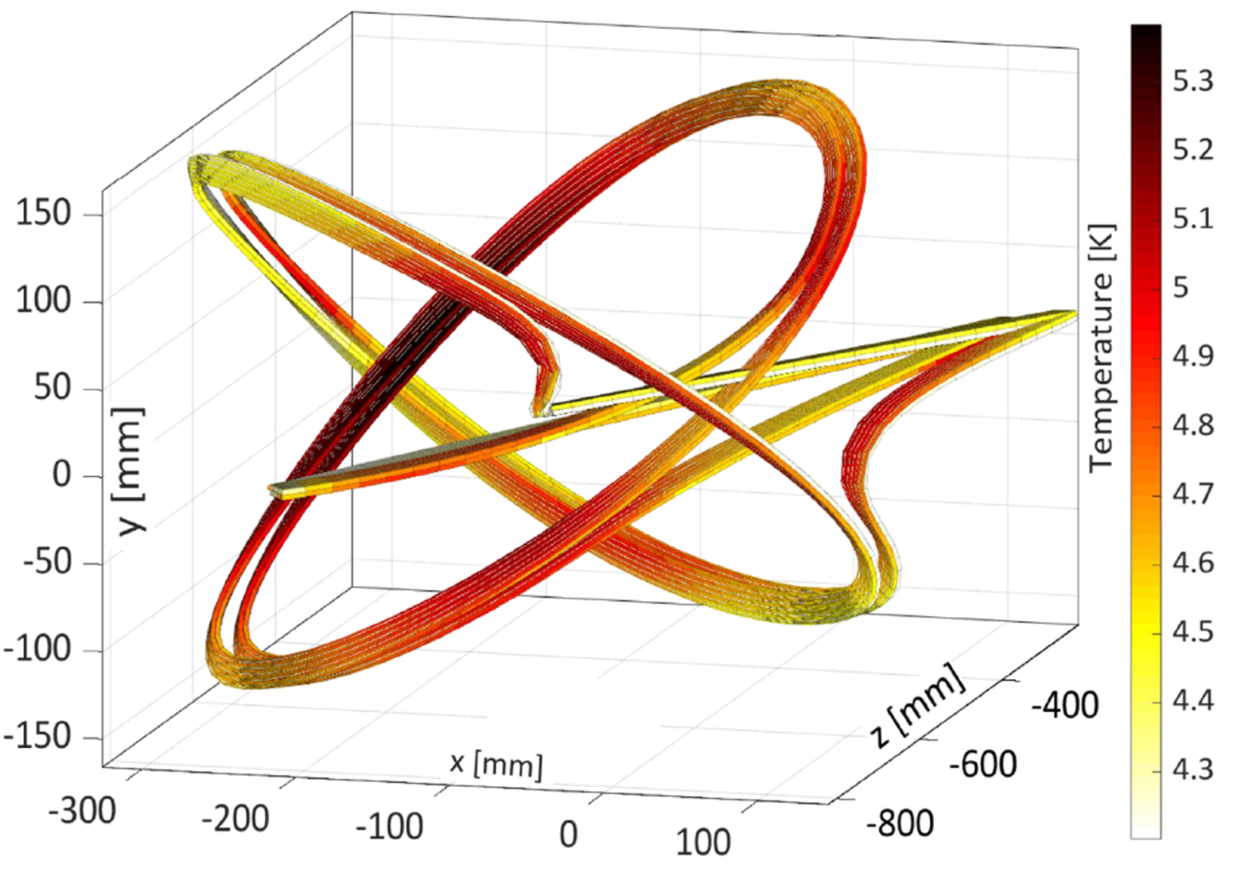


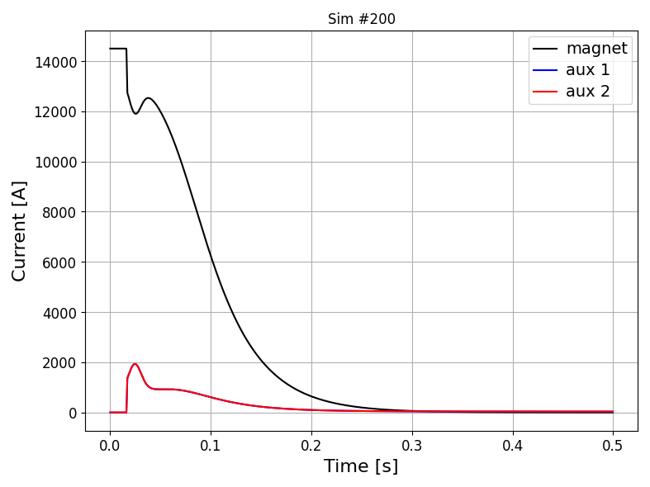
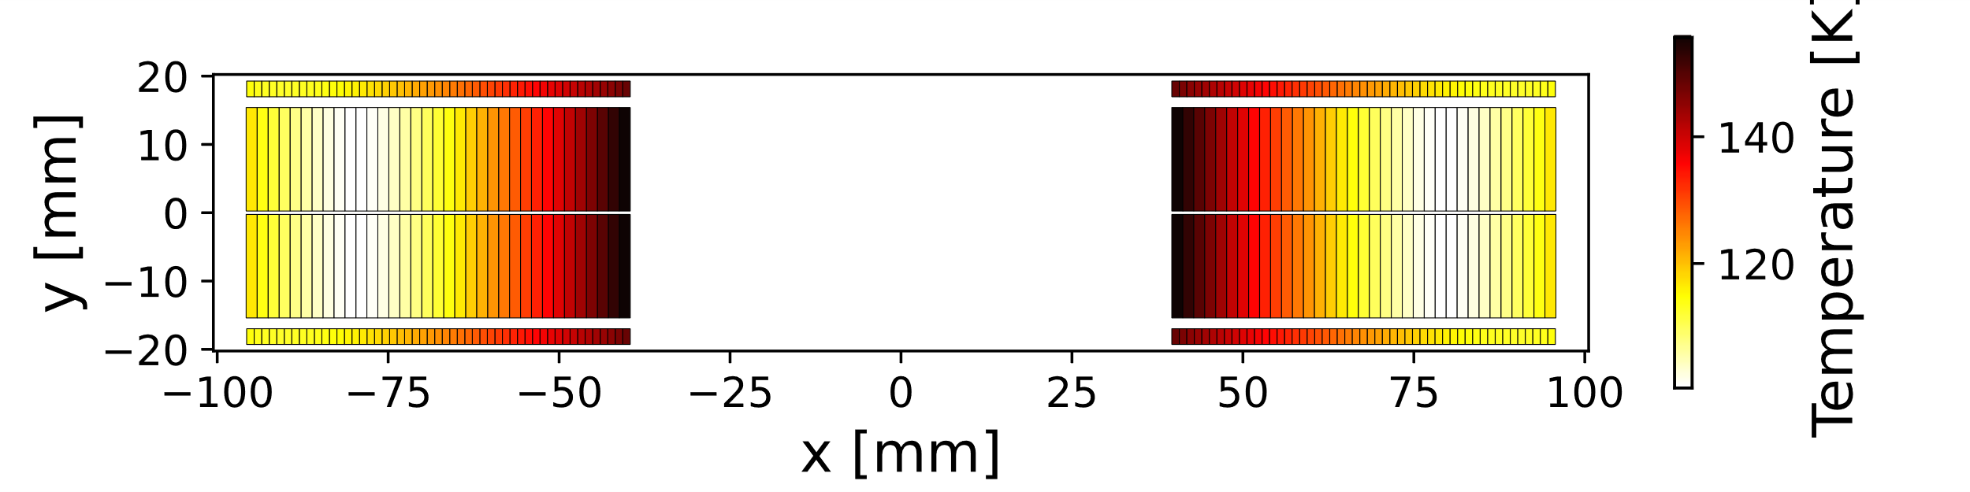
COSIM: Flexibility to deal with special geometries or scenarios
CCT magnet: FiQuS + LEDET
Magnet design courtesy
of Fusillo design team at CERN
ESC transient: PSPICE + LEDET

Slide 20
Table of Contents
Finite Element Quench Simulator (FiQuS)
Integration of FiQuS into STEAM framework
  Parametric analysis
  Co-simulation with other tools of the STEAM framework
Reduced order models
(Outlook on) high-performance computing
Summary

Slide 21
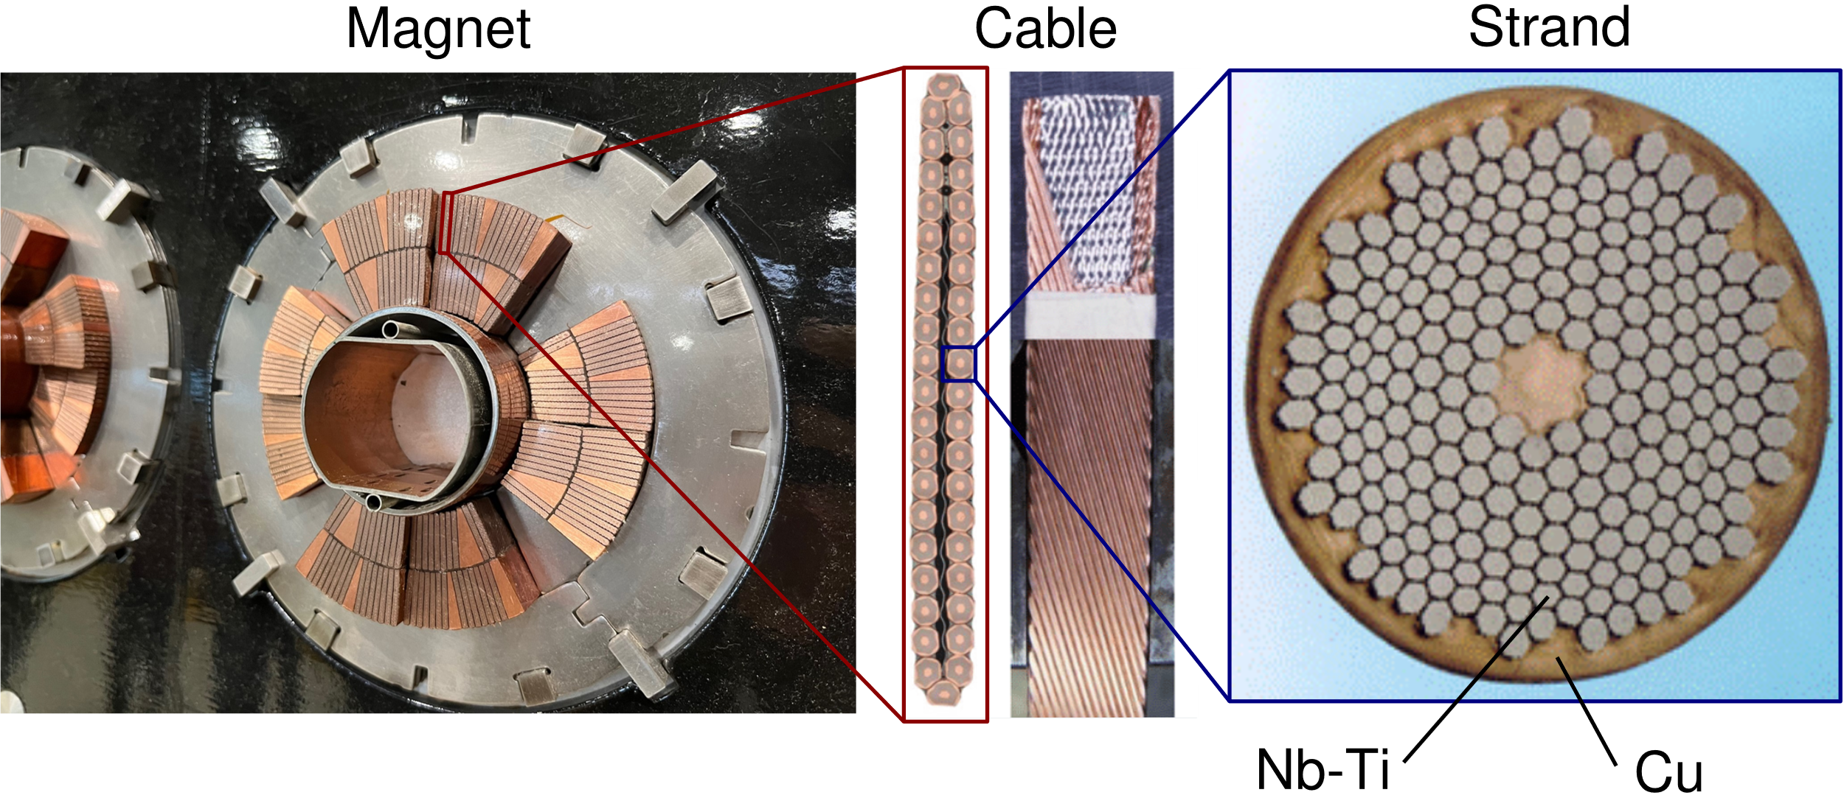
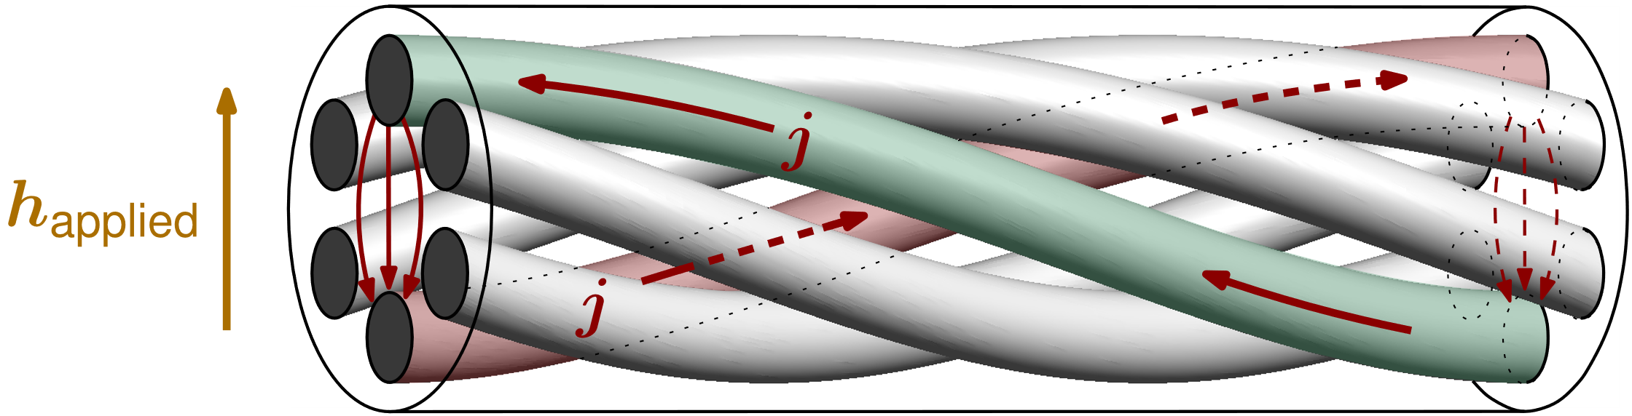
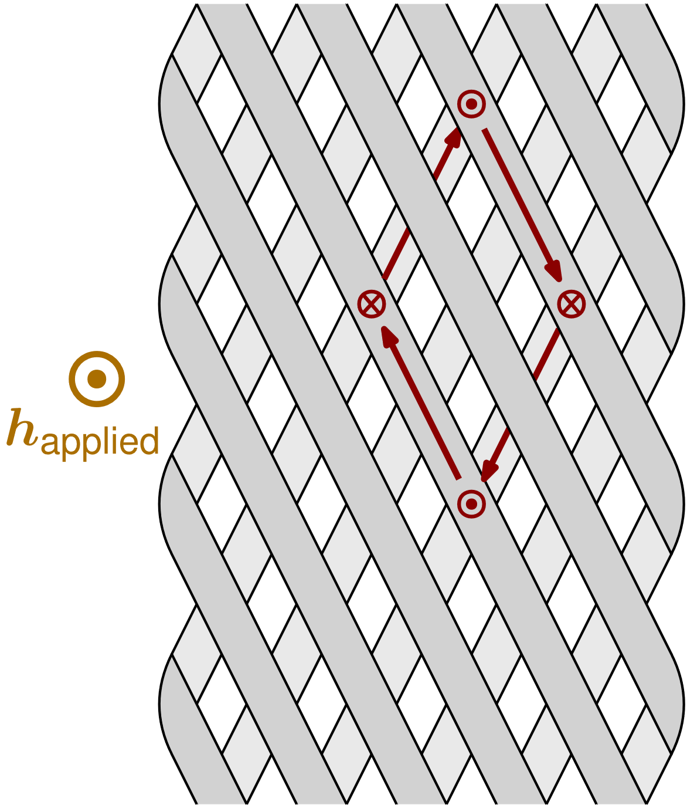
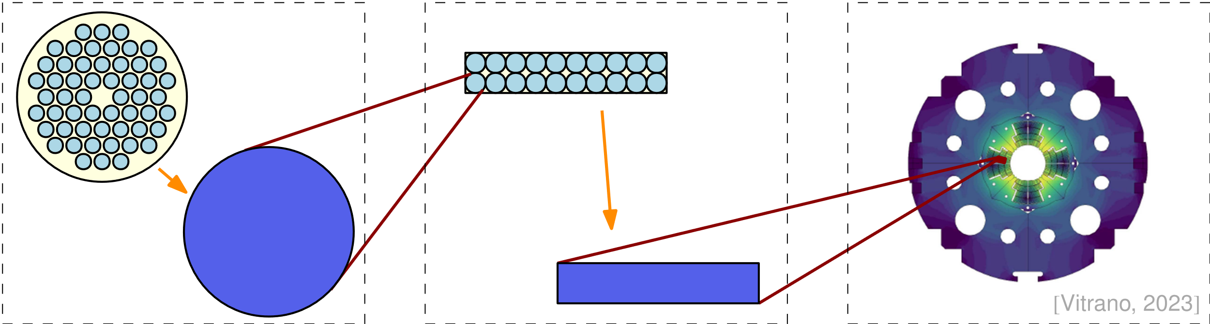
Reduced Order Modelling of Superconducting Magnets
Magnets are multi-scale structures.
Magnetization and AC loss depends on currents at the small scales, which must be resolved accurately.
Detailed magnet models are however too computationally expensive.
Solution: Reduced Order Modelling, with homogenization.
Examples:
Interfilament coupling currents in strands.
Interstrand coupling currents in cables.

Slide 22
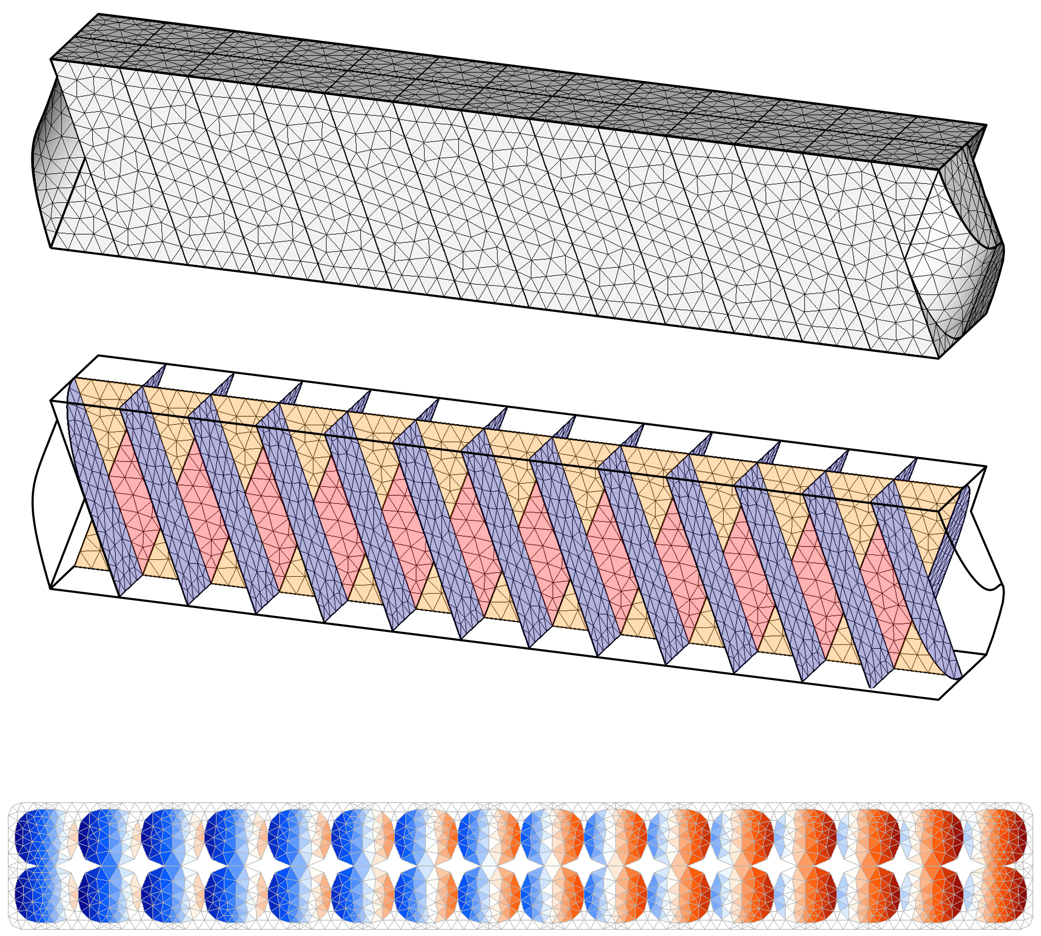
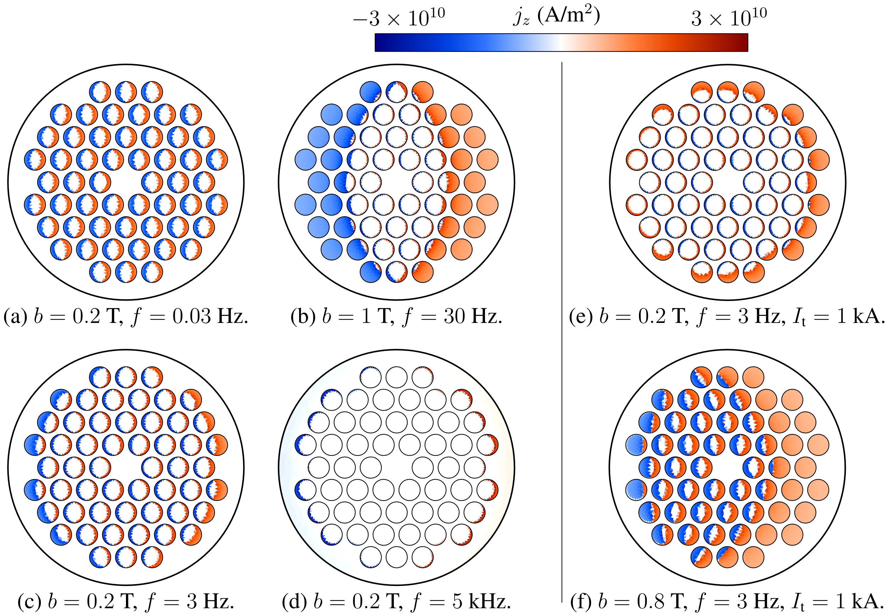
Reduced Order Modelling of Superconducting Magnets
Phase 1 – Detailed model:
  Multifilamentary superconducting strand and cable models in transient conditions.
  Coupled Axial and Transverse currents (CATI) method:
    2D finite element model: fast and accurate.
    Relies on periodicity, not symmetry, and hence applies to deformed geometries.
    Implemented in , user-friendly interface with small input file.
    3D composite strand
    2D CATI method solutions
3D Rutherford cable
2D CATI solution
Next steps:
Rutherford cable model with homogenized parameters from strand resolution (see Phase 2 next slide).
Extract impedance from transport current excitations, and its coupling with external field.
[1] J. Dular et al., “Coupled Axial and Transverse Currents Method for Finite Element Modelling of Periodic Superconductors”, SUST (2024).

Slide 23
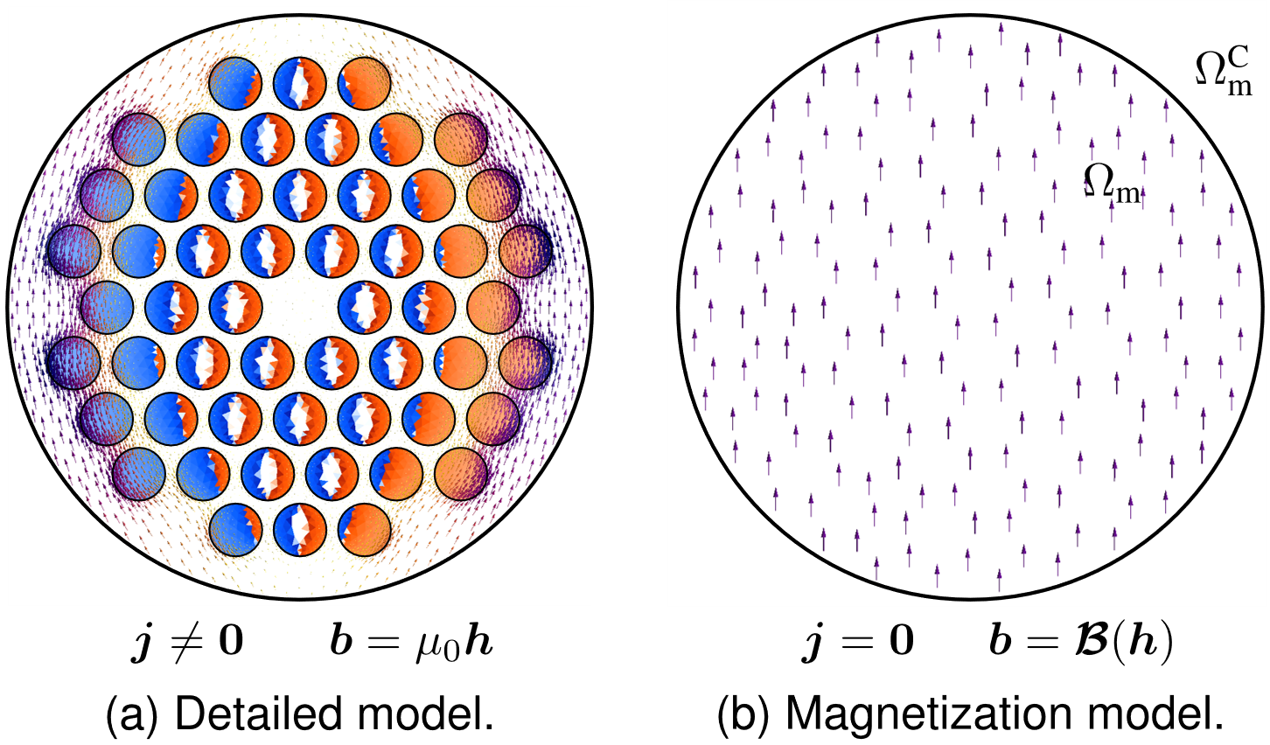
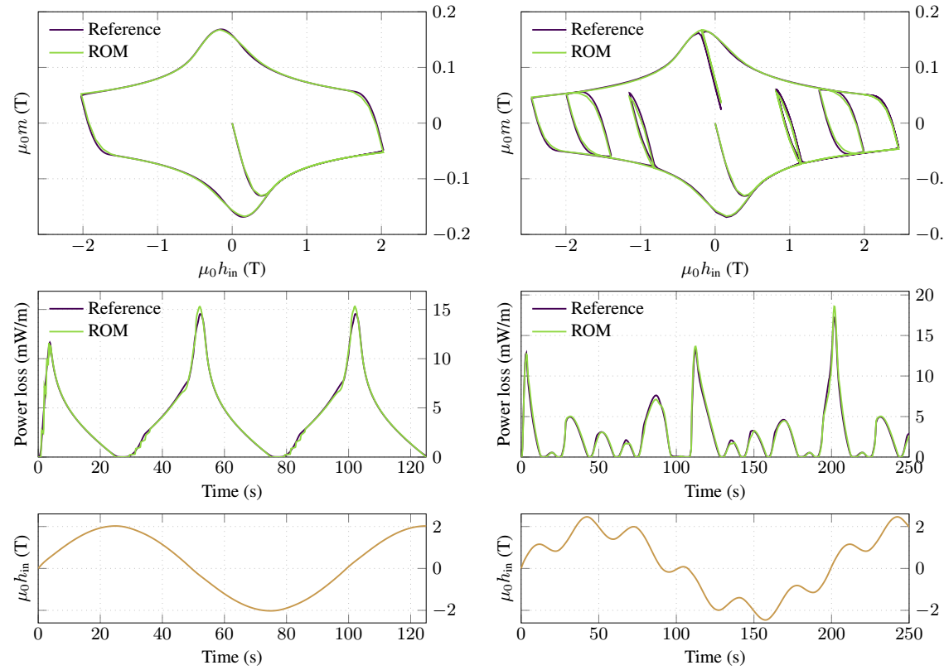
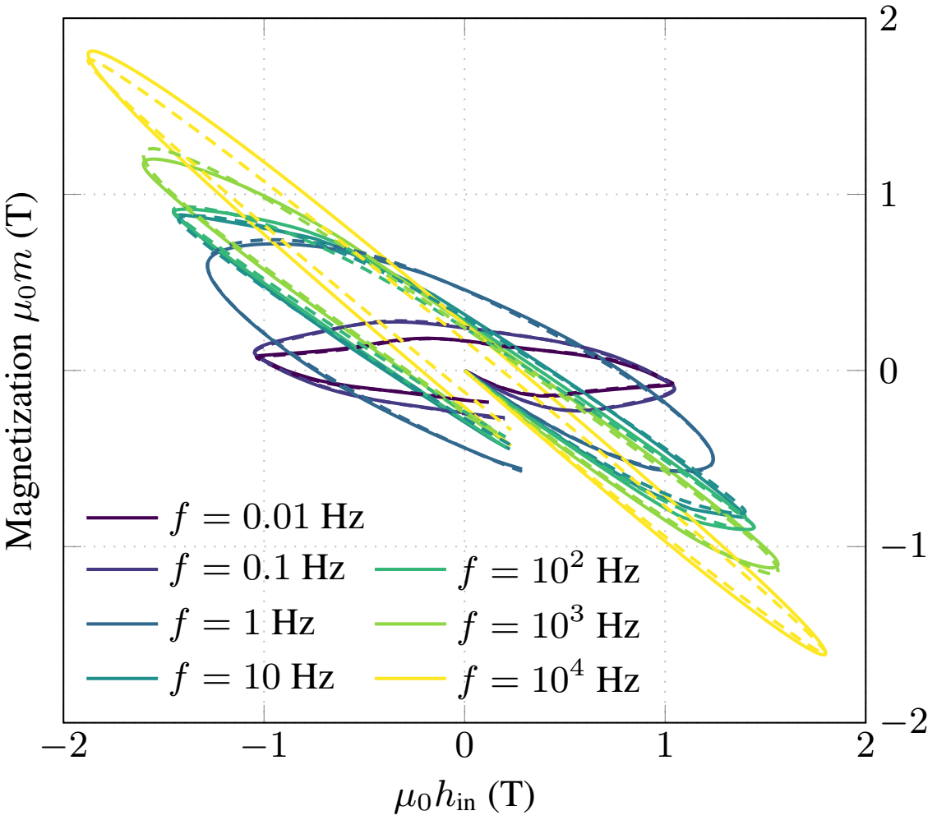
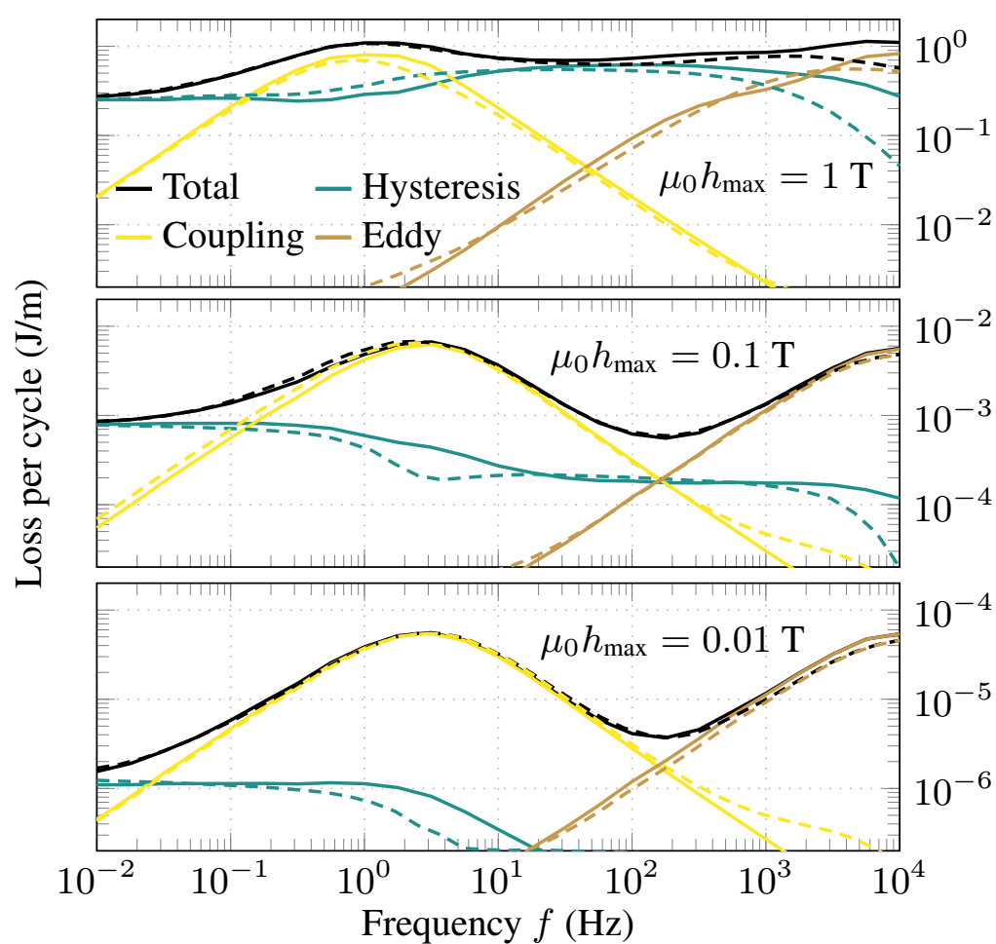
Reduced Order Modelling of Superconducting Magnets
Phase 2 – Homogenized model:
  Reduced Order Hysteretic Magnetization (ROHM) model:
    Describes AC loss and magnetization of a strand or cable subject to external field.
    Inspired by the ferromagnetic hysteresis models [1], [2] and extended (for eddy and coupling currents).
[1] Bergqvist, 1997. [2] Henrotte, 2006.
Rate-independent case
Rate-dependent case
Next steps:
Automate the parameter identification procedure.
Coupling with transport current excitations, and definition of homogenized impedance.
[3] J. Dular et al., “Reduced Order Hysteretic Magnetization Model for Composite Superconductors”, https://arxiv.org/abs/2409.13653

Slide 24
Table of Contents
Finite Element Quench Simulator (FiQuS)
Integration of FiQuS into STEAM framework
  Parametric analysis
  Co-simulation with other tools of the STEAM framework
Reduced order models
(Outlook on) high-performance computing
Summary

Slide 25
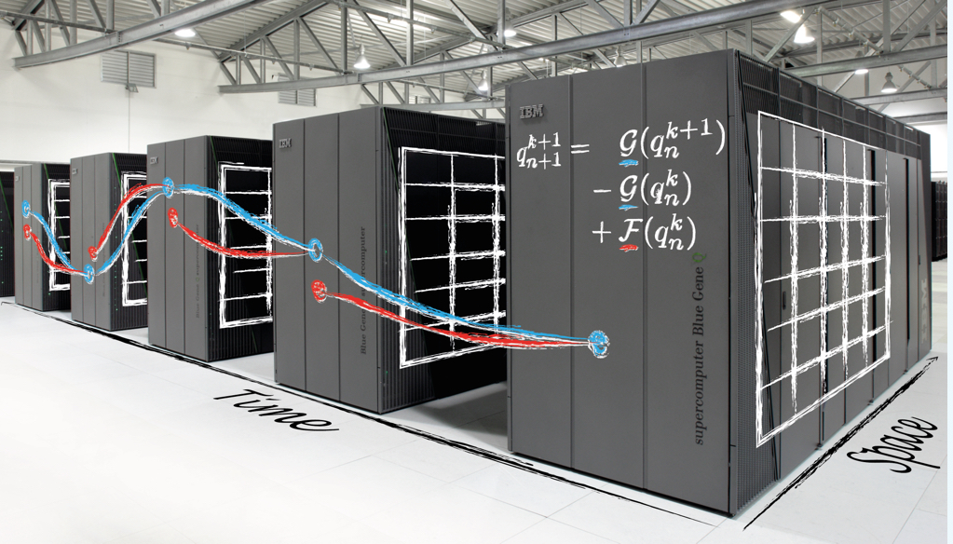


HPC for speeding up FiQuS and STEAM
Despite efficient modelling, quench simulation stays very computationally demanding
Further reduction of computational time to practical times is needed → HPC!
We consider(ed) domain decomposition....
in space on algebraic level allowing for black-box usage
in time
(PinT)
HPDDM: high-performance unified framework for domain decomposition methods
Portable, Extensible Toolkit for Scientific Computation
https://parallel-in-time.org

Slide 26
Some HPC-related results
PinT: adapted Parareal for transients in NI coils yields only speed-up of around 2 times [1]
  More intricate methods promise to perform better but require more fundamental numerical research [2]
[1] E. Schnaubelt et al., “Parallel-in-Time Integration of Transient Phenomena in No-Insulation Superconducting Coils Using Parareal”, SCEE’24 proceedings, accepted
[2] T. Baumann et al., “Adaptive time step selection for Spectral Deferred Correction”, Springer Numerical Algorithms, submitted
FE solver GetDP comes with (limited) MPI parallelization → speed-up around 8 times
  Limited parallel system assembly, parallel solution using MPI-parallel PETSc
  Scalability not ideal → next step: employ domain decomposition methods via PETSc/HPDDM
  Non-linear material fitting functions are expensive to assemble → (precompute) look-up table and interpolate?
Requirement: algorithms must be useable by non-experts in a (quasi-)black-box fashion!

Slide 27
Table of Contents
Finite Element Quench Simulator (FiQuS)
Integration of FiQuS into STEAM framework
  Parametric analysis
  Co-simulation with other tools of the STEAM framework
Reduced order models
(Outlook on) high-performance computing
Summary

Slide 28
Summary
Transient simulation tools are developed in the STEAM framework
Python is used as a ‘glue’ language in the tools and between them
Simple text files (YAML) are used as input files (with other files, CAD)
Text files simplify parametric simulation setup
Co-simulation is used with file-based data exchange
FiQuS code structure allows for modularity and repeatability
FiQuS is based on components capable of HPC, which is future work
Many developed features need validation with measurements

Slide 29
Thank you for your attention

Slide 30










CERNGetDP: Software Toolchain
Dependencies
STEAM Material Lib.
Linux binaries
Basic Linear Algebra Subprograms
(vector addition, dot product, ...)
Windows executables
Vanilla GetDP
CERNGetDP
getdp.info
cern.ch/cerngetdp
Message Passing Interface
(standard for parallel computing)
Docker containers (fully functional & portable computing environment)
Portable, Extensible Toolkit for Scientific Computation
(linear system solver)
⋮
FiQuS C++ Functions
Singularity containers (easy & efficient deployment on HPC/HTC)
Usage of sophisticated open-source (FE) tools requires non-trivial computing environment.
  All fully automated on CERN IT-provided runners and FiQuS-managed VMs via CERN Openstack.
  This way, we can run FiQuS easily on any computing infrastructure we have to (including HPC/HTC).

