Slide 1


Data-driven model predictive control for automated optimization of injection into the SIS18 synchrotron
S. Appel, Nico Madysa (GSI)
S. Hirländer (Paris Lodron Universität Salzburg)
Seeheim, October 2024

Slide 2

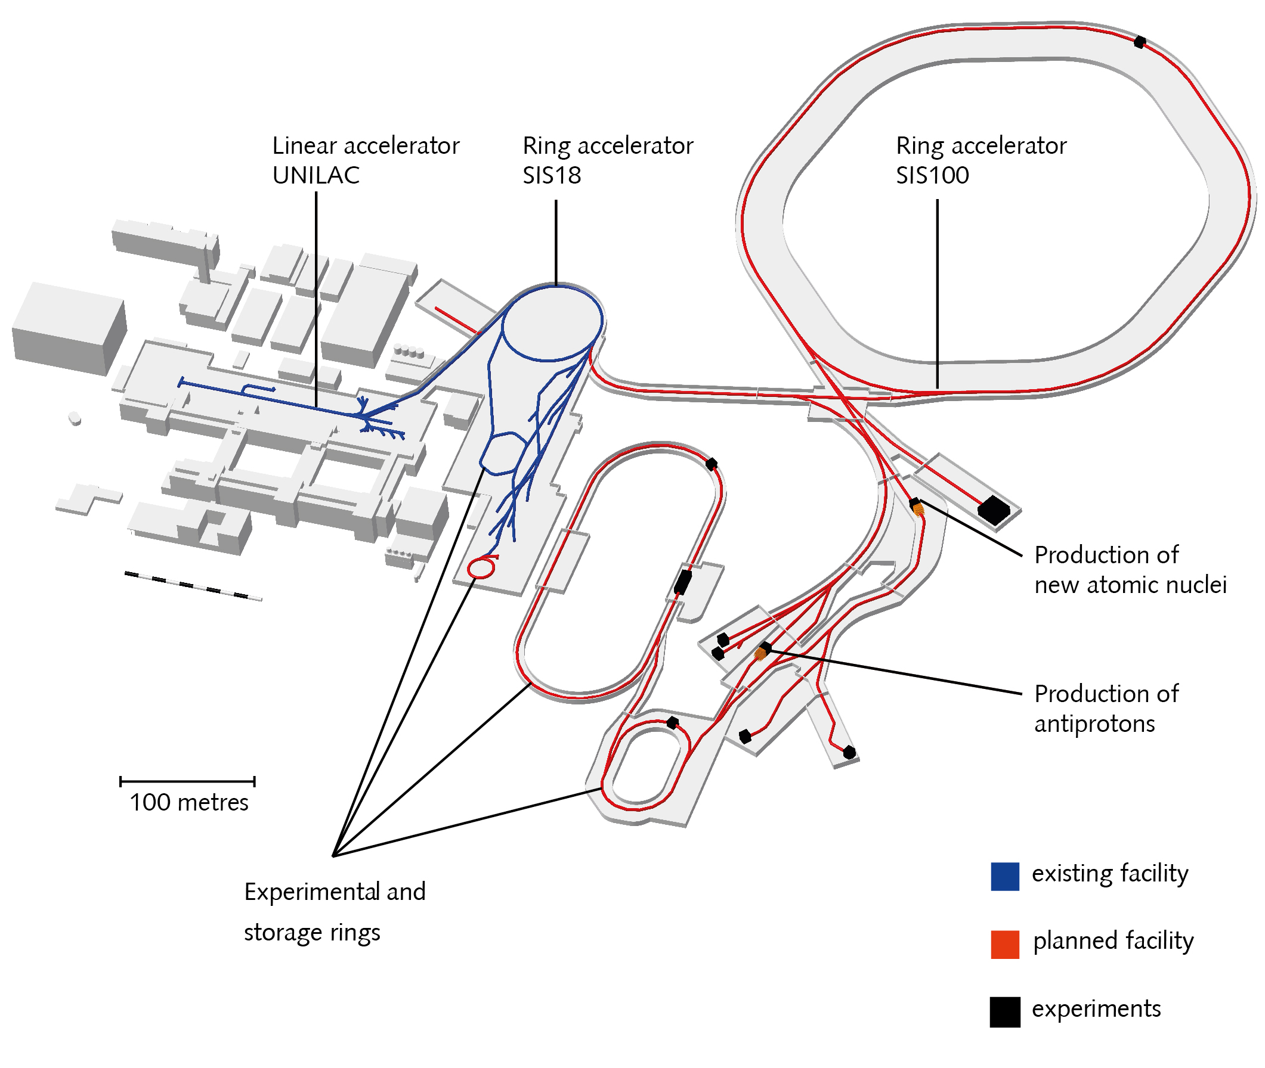
FAIR/GSI
Automation and optimization with Python:
Multi-turn injection loss minimization (SIS18)
Beam steering (TK)
Closed-orbit correction for non-standard optics (SIS18)
Slow extraction loss minimization (SIS18)
Beam steering and focusing (FRS)
Methods of interests of automation:
BOBYQA + Bayesian optimization (BO)
Physics-information Bayesian optimization
Multi-objective optimization with BO
Data-driven model predictive control
Reinforcement learning
EURO-LABS finances a scientific staff member for three years (in APH)
Several TUDa master and PhD students (with TUDa funding)
One master student from Paris Lodron Universität Salzburg
S. Appel - APH
2
Notes:
V. Isensee, Kazinova

Slide 3
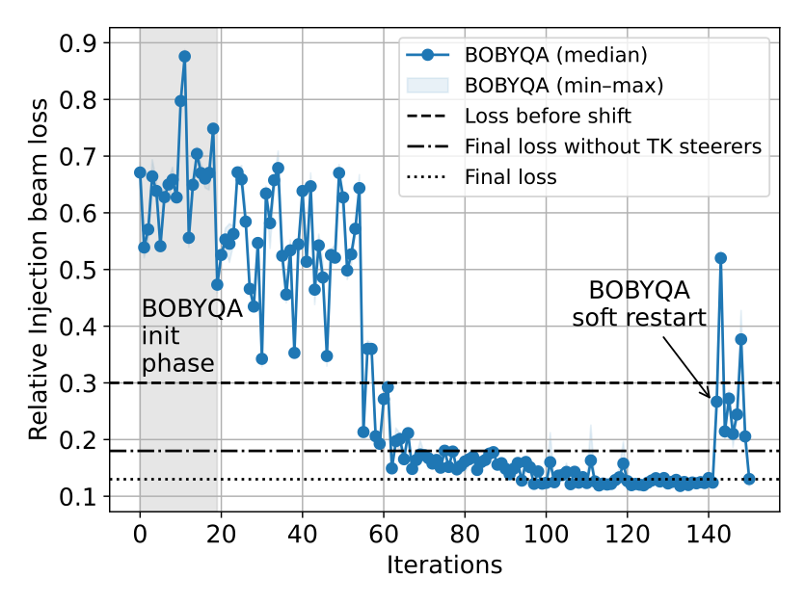
Control and optimization of particle accelerators
In accelerator labs such as GSI / FAIR, automating complex systems is the key to maximize the time spent on physics experiments.
Classical numerical optimizers like BOBYQA provide robust and fast results
Successfully implemented
  but typically lack state information
  learn the problem from scratch each time
  no safety mechanisms except parameter bounds
Reinforcement learning (RL) and Bayesian Optimization (BO) build reusable models
and can take safety concerns into account
Notes:
*better statement

Slide 4
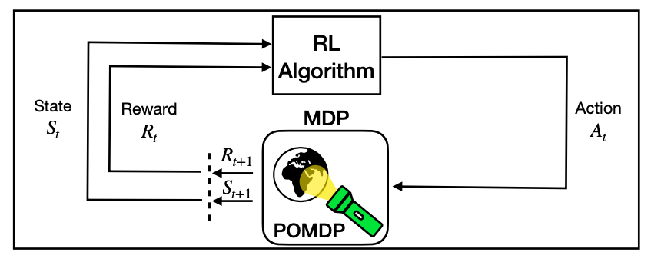
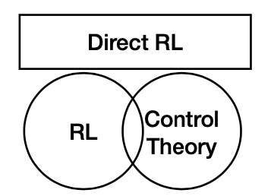
Reinforcement learning
Why are RL applications rare in controlling accelerators?
  Sample efficiency
  State space observability
  Safety constraints
  Non-stationarity
RL towards control theory
(leverage concepts from control theory)
“The Bayesian optimization of RL”
(based on Gaussian processes)
Possible solution:
Simulation- based RL
Model-based RL

Slide 5
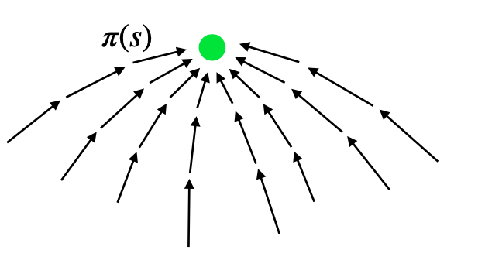
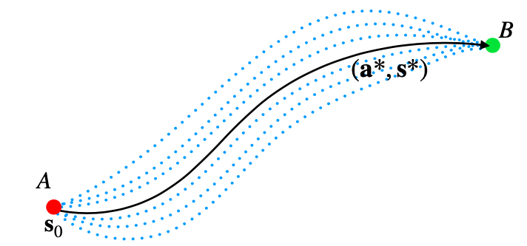
RL / control theory
RL
Control theory
Find solution from every point in phase space

Slide 6
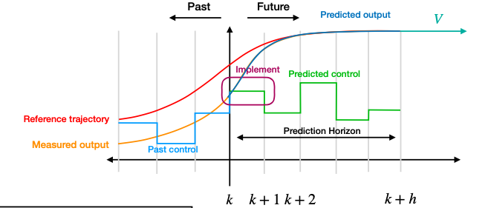
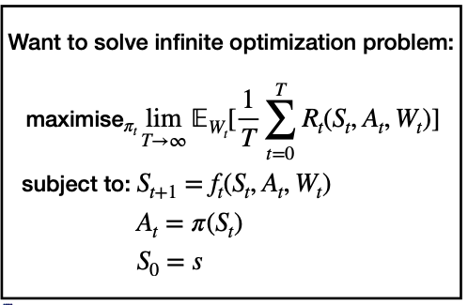
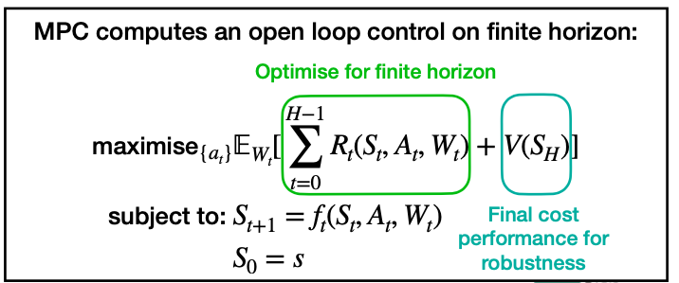
Data-Driven Model Predictive Control (MPC)
Intersection of model-based RL and control theory.
Solves a finite-horizon optimization problem
Uses uncertainty information from GP
Balances exploration and exploitation
Addresses delays and safety concerns (Horizon)
Better performance, avoids high-uncertainty regions
Effective policy after fewer environment
interactions
S. Kamthe, arXiv:1706.06491 (2018)
S. Hirlaender, et al. THPL038, IPAC 2023 and TUPS59, IPAC 2024

Slide 7
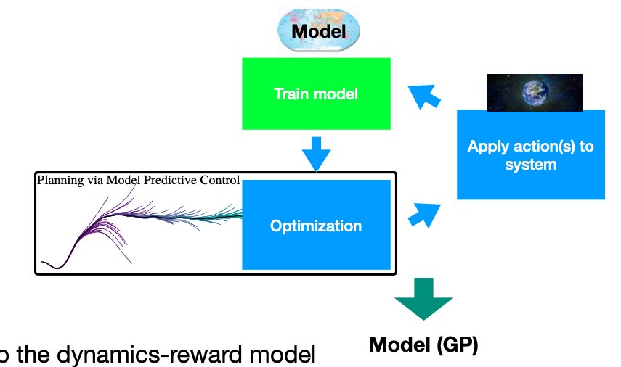
GP-MPC the BO of RL
Setup the dynamics-reward model
Use PMP to obtain sparse optimization
with gradient information
Choose optimization algorithm
Consider safety (constraints)
Set up training

Slide 8

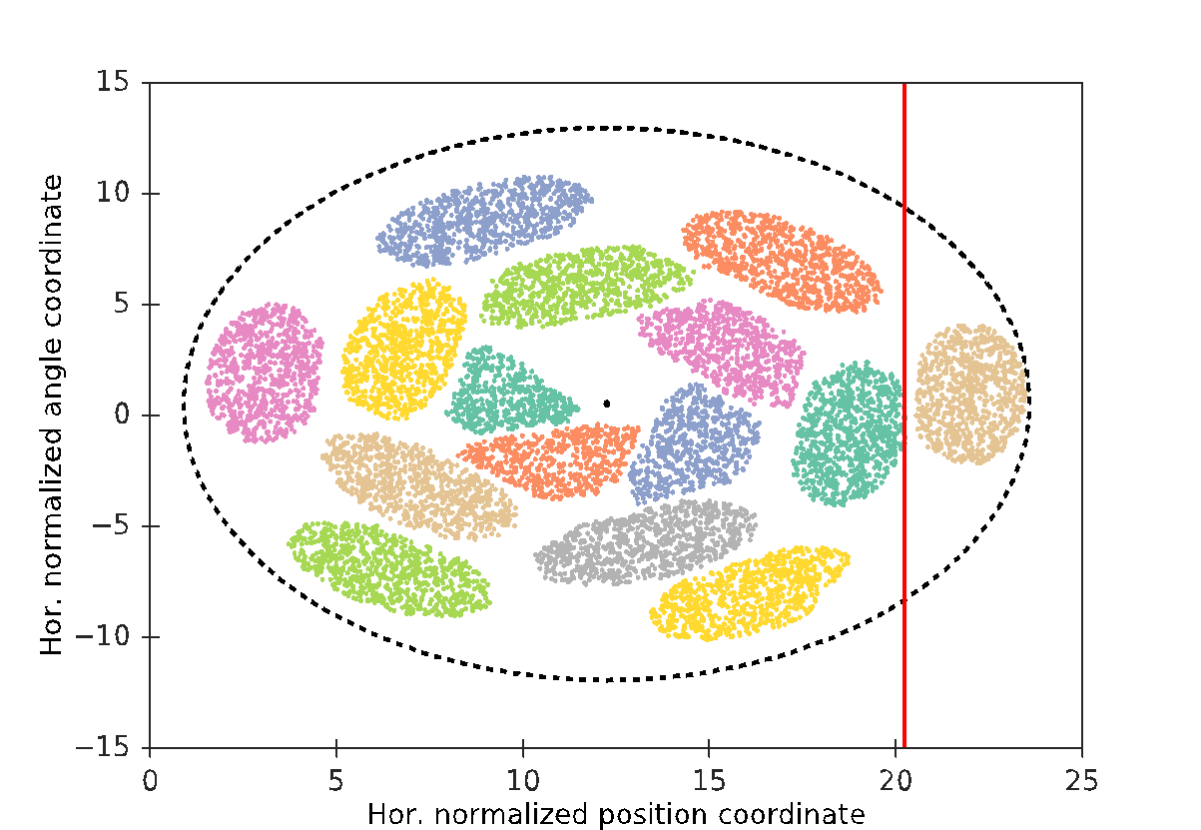
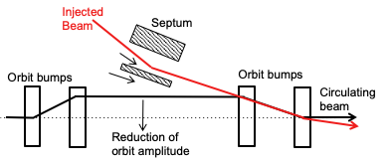
Multi-Turn-Injection
SIS18 can handle broad range of ion species
Liouville's theorem: can only inject into free phase space
Gain factor should be as high as possible to reach the space charge limit
Injection loss should be as low as possible to avoid loss-induced vacuum degradation
Competing: Maximize number of injection and minimize loss
Model in simulation code Xsuite, pyORBIT and benchmark with experiments¹
SIS18 electrostatic injection septum
Cathode
300 kV
Anode
¹S. Appel et al: Injection optimization through generation of flat ion beams, Nucl. Instr. and Meth. A 866, 36-39 (2017), DOI: 10.1016/j.nima.2017.05.041

Slide 9
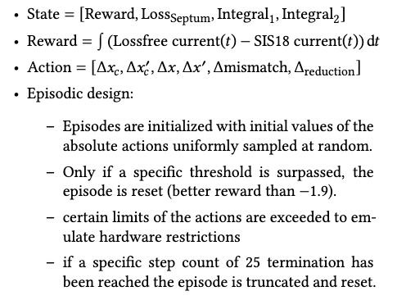
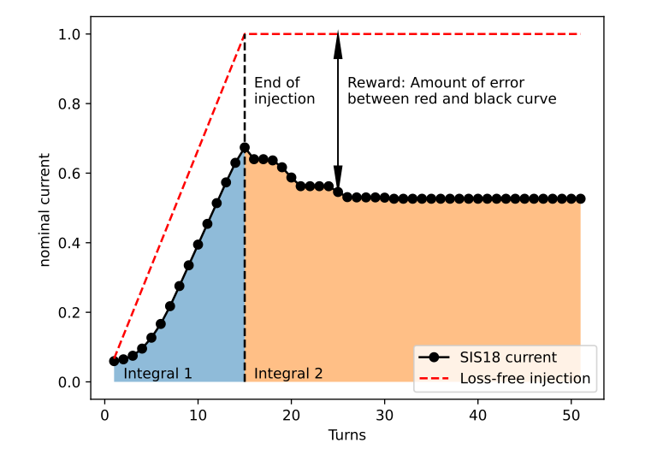
Markov decision process (MDP)
State: [Reward, Loss at septum, Integral₁, Integral₂]
Action: [Position of inj. beam, Hor. Angle of inj. beam,
Orbit bump amplitude, Hor. angle of orbit bump, Lattice mismatch, Orbit bump reduction]
Reward:
Episodic design:
Initialized Episodes with initial values
of the absolute actions uniformly sampled at random.
Successful termination if reward is above -1.9
Failure if certain actions are exceeded
(emulates hardware restrictions)
Truncation after 25 steps
Septum

Slide 10
MPC optimization of MTI
Episodes conclude successfully

Slide 11
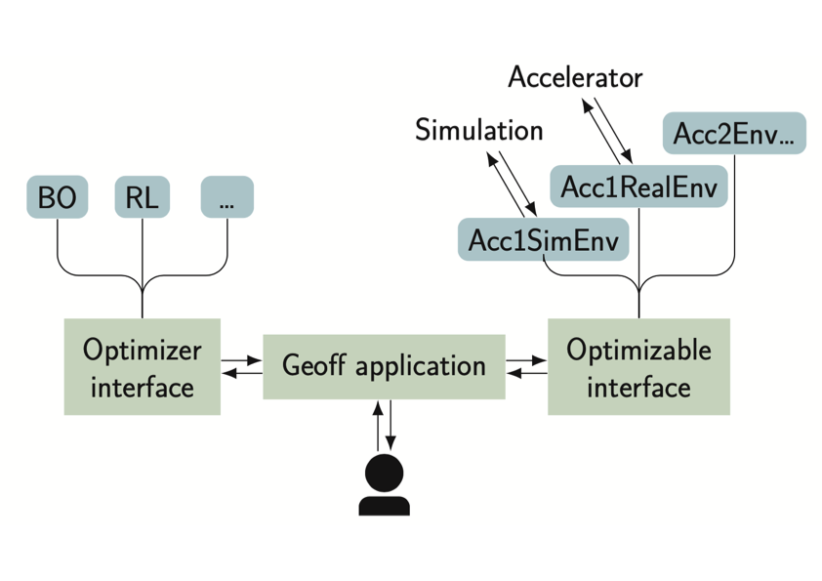
Summary and Outlook
Data-Driven Model Predictive Control (MPC)
has demonstrated to solve the MTI problem in simulation
Next steps:
Demonstration in the GSI control room with Geoff
GeOFF (Generic Optimization Frontend & Framework)
is a widely used framework for deploying automation
at CERN and GSI

Slide 12
Thank you for your attention

