Slide 1
PyORBIT as an Online Model and Virtual Accelerator at SNS
Brandon Cathey, David Brown, Carrie Elliot, Armen Kasparian, Andrei Shishlo, Alexander Zhukov
14th International Computational Accelerator Physics Conference, Seeheim-Jugenheim, Germany
October 3, 2024

Slide 2
Outline
PyORBIT
Particle-in-Cell
RF Cavities
Virac: the Virtual Accelerator
PyORBIT Model
Custom Devices
Current implementations
Current applications
Personnel training
Application development
Machine learning
Future goals

Slide 3
PyORBIT
A simulation tool for particle accelerators
descendant of ORBIT code
Two-language structure: Python with C++ underneath.
Use three main components.
The Bunch: the container of particles
The Lattice: the layout of the accelerator
Tracking: uses TEAPOT style tracking
Physics Features:
Particle-in-Cell tracking
Space-Charge calculators
Longitudinal dynamics

Slide 4
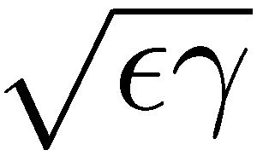
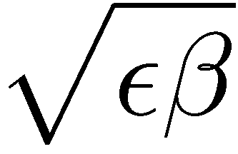
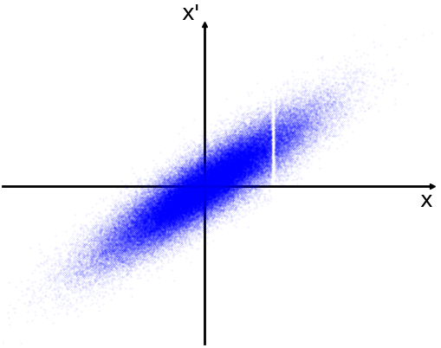
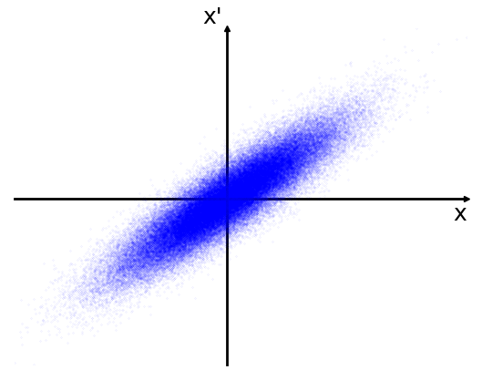
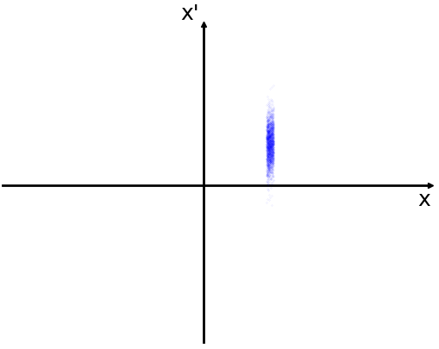
Particle-in-Cell (PIC)
x’
Envelope
Tracks individual particles
Each particle is tracked in all 6 dimensions: x, x’, y, y’, z, ΔE
Each particle represent a grouping of real particles to calculate space-charge.
Bunch: the collection of particles in PyORBIT
Advantages:
Can track losses.
Can track through non-linear elements.
x
Wire
Bunch
Slit

Slide 5
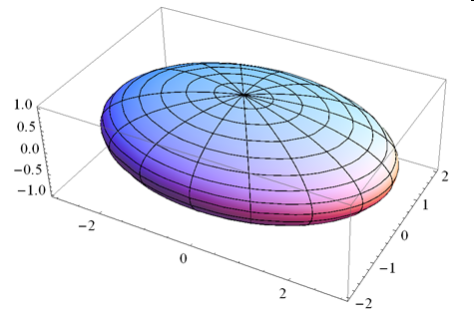
Space-Charge Calculators
3D Electric Field of Uniformly Charged Ellipsoid
Short, symmetrical bunches
Doesn’t need many particles
3D FFT Poisson Solver
Asymmetrical bunches
2.5D Space Charge Solver
Long bunches

Slide 6
Lattice
The Lattice
Bunch
Node 1
Node 2
Node 3
Node 4
Child
Child 1
Child 2
The Lattice contains a mapping of nodes.
Each node contains the tracking code for an element of the accelerator (Quadrupoles, correctors, RF gaps, etc.)
Each node can have children nodes attached to it.
Allows for extra tracking outside or inside the parent node (fringe fields, etc.)

Slide 7
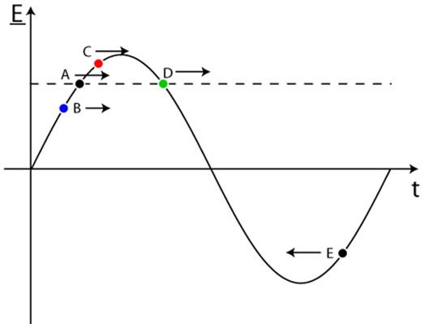
Linac RF Cavities
RF Gap #1
RF Gap #2
RF Gap #N
RF Cavity
…
RF Cavities are not nodes in PyORBIT
Each cavity keeps a reference to its associated RF gap nodes in the lattice.
Cavities supply their associated gaps with amplitude, initial phase of the 1st RF gap, and the design arrival time for all other RF gaps
PyORBIT accommodates changes in arrival time.
If an upstream cavity is altered, all downstream cavity phases are properly altered to imitate a real accelerator.
Multiple cavity models available
Simple cosine
Matrix
Transit-Time Factor
t=0

Slide 8
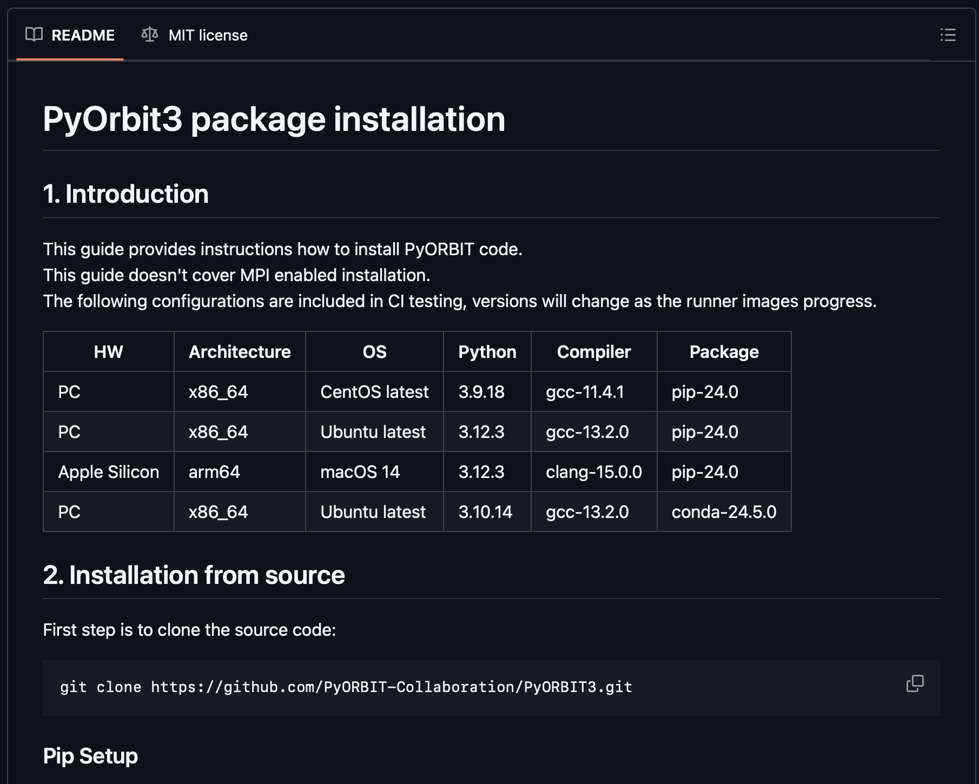
PyORBIT3
Now in Python 3: PyORBIT3
Huge thanks to ESS!
The old PyORBIT is no longer maintained.
New build system: Meson-python
Rebuilds C++ modules at import
Linac modules are ready. Ring modules are available but need testing.
MPI available but still has bugs.
PyORBIT-Collaboration: https://github.com/PyORBIT-Collaboration/PyORBIT3
Currently collaborating with ESS and LANL
Everyone is welcome to help!

Slide 9
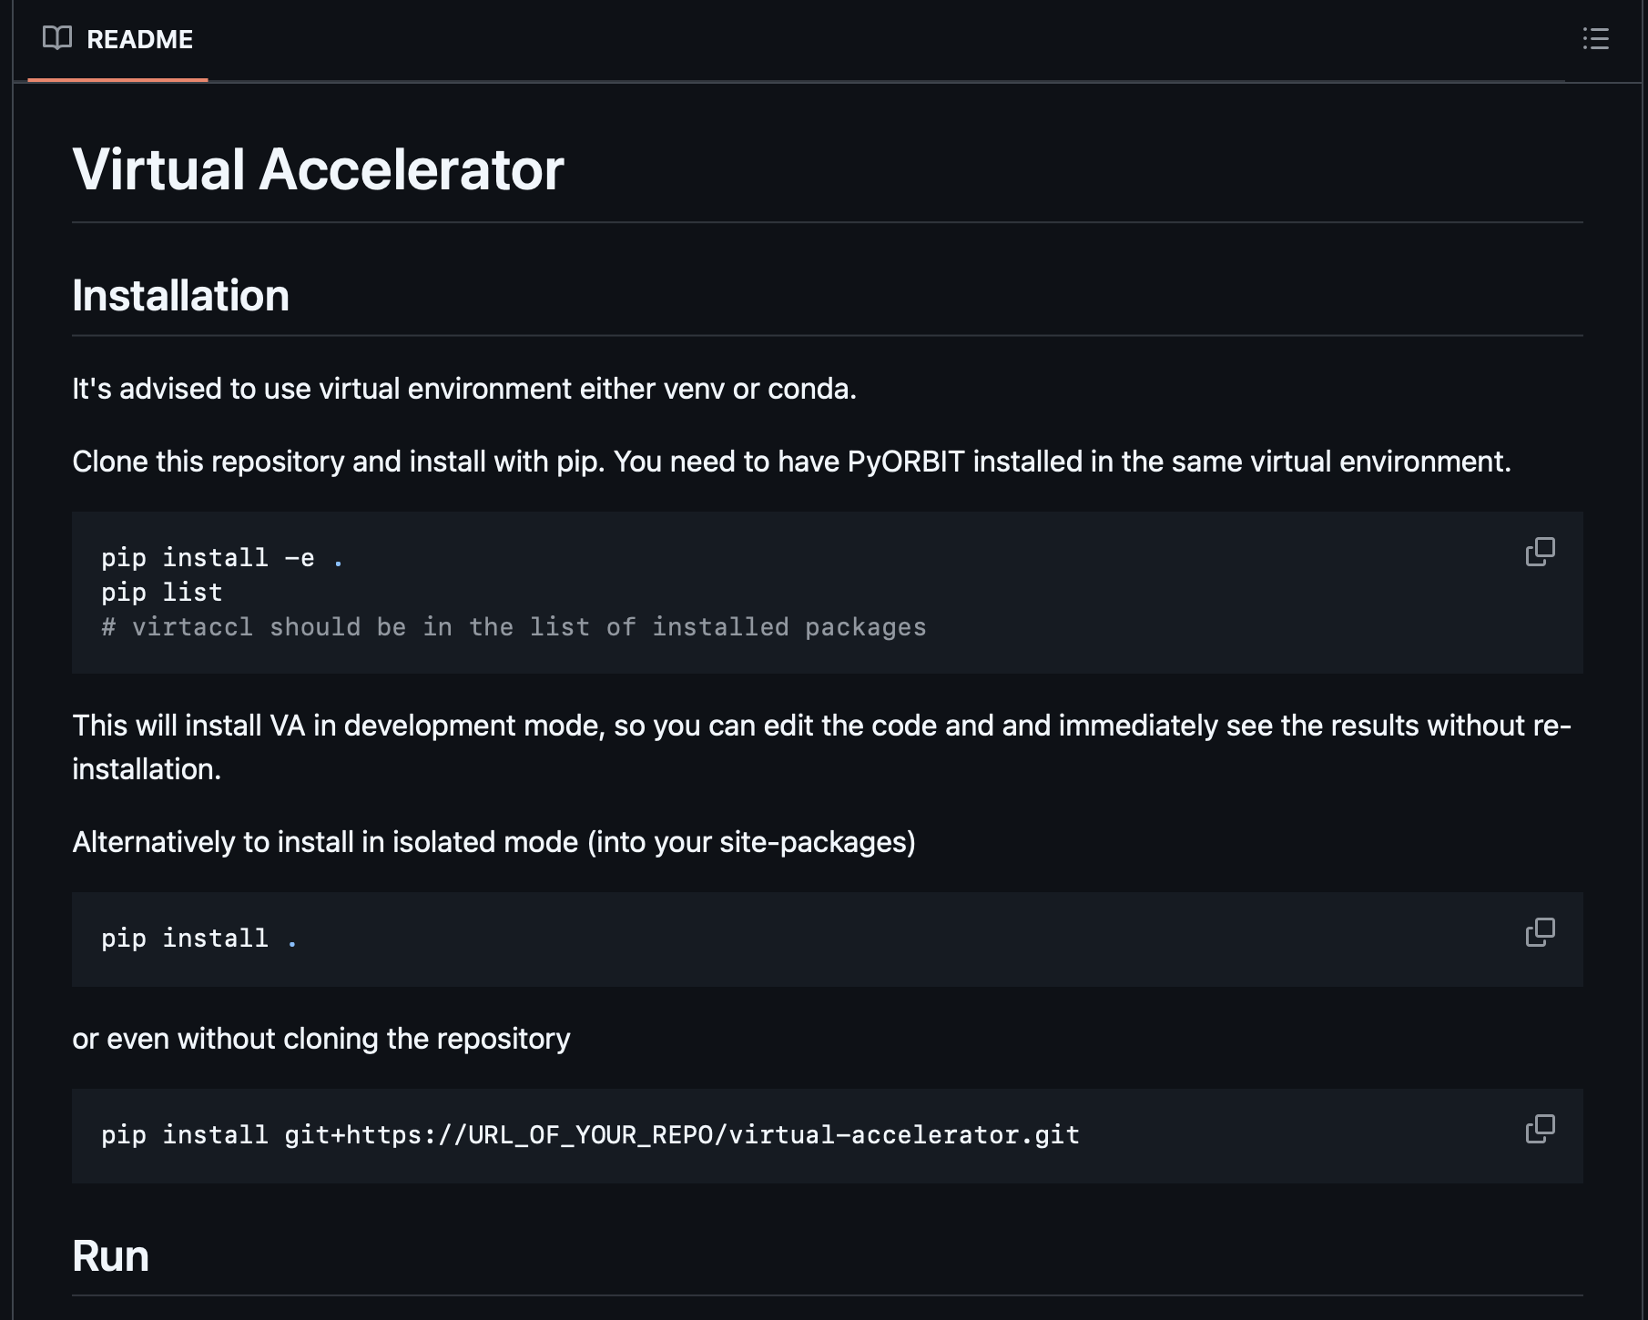
Virac: The PyORBIT3 Virtual Accelerator
Can be installed now:
PyORBIT-Collaboration Github: https://github.com/PyORBIT-Collaboration/virtual-accelerator
Uses Python 3.9 or higher
Requires PyORBIT3, numpy, scipy, and pcaspy packages.
Uses EPICS
Uses Sphinx to turn comments into documentation automatically.

Slide 10
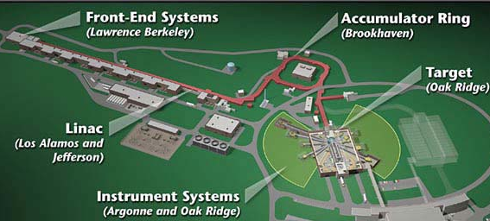
What is a Virtual Accelerator?
A virtual accelerator imitates working with an accelerator control system.
As communication is the most relevant part, this means anything can be behind curtain.
A random number generator
An accurate simulation of an accelerator (Virac)
Useful for
developing applications
Training personnel
Machine learning

Slide 11
Virac’s Structure
EPICS Process Variables
Server
Beam Line
Model Parameters
Model
There are three main components
The Model
The Server
The Beam Line
The beam line converts information between the server and model.
The virtual accelerator can be used with different models.

Slide 12
The Main loop
Update the server
Server
Get setting values from the server and send them to the model
new_optics = beam_line.get_model_optics()
model.update_optics(new_optics)
Update the model
model.track()
Get new measurements from the model and send them to the server
new_measurements = model.get_measurements()
beam_line.update_server(new_measurements)
Update the server PVs with new measurements and readbacks
server.update()
Sleep to maintain refresh rate
Update readbacks
Sleep
Beam Line
Get optics from the server
Send measurements to the Beam Line
Model Parameters
Model Parameters
Model
Get measurements from the model
Update the model with optics
Run the model

Slide 13
The Model
Tracking can be anything
A random number generator
An envelope simulation
A PIC simulation
Requires three functions
update_optics(new_optics): Gives the model updated setting values.
track(): The model generates new measured values.
get_measurements() -> new_measurements: The model returns measured values.
The Models receive and return dictionaries in the same format
All names are model specific. The model knows nothing about the server.
The dictionary is each element name in the model connected to that element’s parameter dictionary
example: {‘Quad01’: {‘dB/dr’: 6.01}, ‘Corrector01’: {‘B’: 0.005}, …}

Slide 14
PyORBIT Model
RF Cavity Controller
Lattice
Bunch
Lattice Node Controller
Model Parameters
Lattice Controller
Child Node Controller
The PyORBIT Model maintains a PyORBIT simulation for a given Lattice object and initial Bunch object.
model = OrbitModel(model_lattice, bunch_in)
Controller for different PyORBIT objects unify how inputs and outputs are handled.
Maintains a dictionary of saved bunches at each optic so that tracking only needs to occur from the most upstream change since the last track.

Slide 15
Beam Line
Model Parameters
Server
Server PVs
Beam Line
Model
Device 1
Device 2
Device 3
Device 4
Converts information between the model and the server.
Devices are hardware specific to accommodate different control schemes
PV names
Unit conversions
Shared power supplies
Functionality not in the model

Slide 16
Custom Devices
Individual PVs are registered with the Device at initiation
PVs are designated as a setting, measurement, or readback.
Setting values are automatically updated from the server by Beam Line.
Readbacks can be initialized with an associated setting.
Each PV can have functions attached to them
Noise, which is ignored by the model
Linear transformations, useful for units (degrees ↔ radians)
Devices have three functions that can be overwritten for custom functions.
get_model_optics() -> model_parameters: Return a parameter dictionary using the model’s keys associated with the registered settings.
update_measurements(parameter_dictionary): Update any PVs with information from the model.
update_readbacks(): Update readbacks from their associated settings.
If it has one, defaults to mirroring its associated setting.

Slide 17
Simple Example
{‘DCH:B_Set’: 0.05, ‘BPM:xAvg’: 0.1}
{‘cor’: {‘B’: 0.05}}
Server
Beam Line
Model
{‘DCH:B_Set’: 0.05}
{‘cor’: {‘B’: 0.05}}
Corrector
BPM
Simple virtual accelerator with just a corrector and BPM

Slide 18
Simple Example
{‘BPM:xAvg’: 0.1}
{‘bpm’: {‘x_avg’: 0.1}}
Server
Beam Line
Model
{‘bpm’: {‘x_avg’: 0.1}}
{‘BPM:xAvg’: 0.1}
Corrector
BPM
Simple virtual accelerator with just a corrector and BPM

Slide 19
The SNS Linac and Injection Dump Line
MEBT
HEBT
87 MeV
LDmp
RFQ
DTL
CCL
SCLMed
SCLHigh
Working Devices
Quadrupoles
Shared Power Supplies
Quadrupole Power Shunts
Correctors
Corrector Power Supplies
RF Cavities
Wire Scanners
Screens
BPMs
SNS Linac
Simulates from MEBT entrance through either the HEBT or Linac Dump
Injection Dump

Slide 20
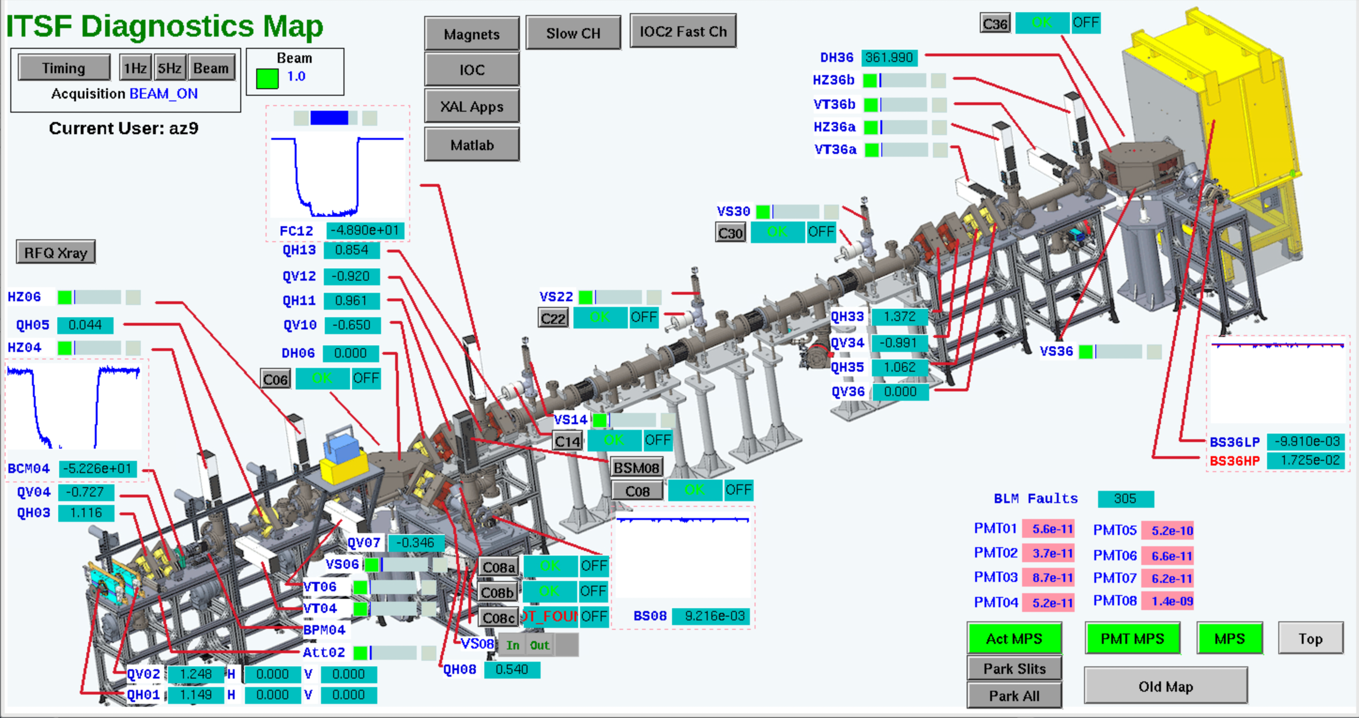
The Beam Test Facility
Simulates from RFQ to the end of either stop.
Model includes slits.
Working devices
Quadrupoles
Quadrupole Power Supplies
Correctors
Corrector Power Supplies
BPM
BCMs
Faraday Cups
Actuators (slits and cup)

Slide 21
US Particle Accelerator School
Successfully used in the Control Room Accelerator Physics class
16 students
No unexpected issues were encountered
Students were able to develop and run tools using the virtual accelerator
Quadrupole scan
Orbit correction
Energy restoration
Longitudinal emittance measurement

Slide 22
Spallation Neutron Source Applications
The SNS recently re-commissioned after completing the Proton Power Upgrade
~9 Months of downtime
Added 28 SC cavities to the linac
Virac was used to:
Train operators on applications (Wizards) before they had to use them.
Test the new Injection Dump Wizard before it was needed.
The following examples use real applications in the control.
Virac is running in the background for each application.
They were not modified in any way from their control room installations.

Slide 23
Operations Training: SCL Wizard
Application for tuning the SCL cavities in the control room.
In use for operations training.

Slide 24
Operations Training: Orbit Correction
Application for orbit correction
In use for operations training

Slide 25
Application Development: Injection Dump Wizard
Application for steering beam into the injection dump.
The injection dump is for beam that doesn’t enter the ring.
Rebuilt after injection line upgrades
Now in Python
Successfully tested with Virac before use during commissioning.

Slide 26
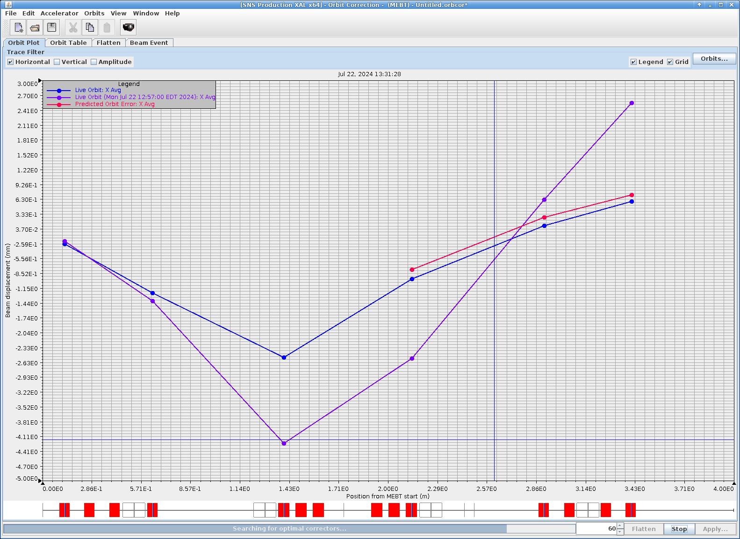
Machine Learning
The virtual accelerator is being used for AI training.
Successful orbit correction of the SNS MEBT.
Currently training for BTF transmission
Will be used for training on beam loss optimization.
Helping with proxy sever development.
Proxy
Guard Server
Control policy
SciOptControlToolKit
Virtual Accelerator

Slide 27
Future Work
Add ring functionality to Virac
Update current physics applications
Switch from Java to Python
Switch from XAL to PyORBIT
Add Beam Loss Monitor model for Beam Loss Optimization

Slide 28
Thank you

Slide 29
Making a BPM
Start by defining the defining the PV and PyORBIT parameter names
# EPICS PV names x_pv = 'xAvg' # [mm] y_pv = 'yAvg' # [mm] xy_noise = 1e-8 # [mm] # PyORBIT parameter keys x_key = 'x_avg' # [m] y_key = 'y_avg' # [m]
Needs the name of the device on EPICS, the name of the node in the model
def __init__(self, name, model_name):
Create a noise function and a transform function to convert to millimeters
xy_noise = AbsNoise(noise=BPM.xy_noise) milli_units = LinearTInv(scaler=1e3)
Define the PVs
self.register_measurement(BPM.x_pv, noise=xy_noise, transform=milli_units) self.register_measurement(BPM.y_pv, noise=xy_noise, transform=milli_units)

Slide 30
Making a BPM
”update_measurements()” is the the function used to convert information from the model into the information going to EPICS
def update_measurements(self, new_params): bpm_params = new_params[self.model_name] x_pos = bpm_params[BPM.x_key] self.update_measurement(BPM.x_pv, x_pos) y_pos = bpm_params[BPM.y_key] self.update_measurement(BPM.y_pv, y_pos)
This is where the PV and PyORBIT parameter names are correlated
This can be as simple or complicated as needed

Slide 31
Making a Quadrupole
Start by defining the defining the PV and PyORBIT parameter names
# EPICS PV names field_set_pv = 'B_Set' # [T/m] field_readback_pv = 'B' # [T/m] field_noise = 1e-6 # [T/m] # PyORBIT parameter keys field_key = 'dB/dr' # [T/m]
Needs the name of the device on EPICS, the name of the node in the model
def __init__(self, name, model_name):
Create a noise function and a transform function to convert to millimeters
field_noise = AbsNoise(noise=Quadrupole.field_noise)
Define the PVs
field_param = self.register_setting(Quadrupole.field_set_pv, default=initial_field) self.register_readback(Quadrupole.field_readback_pv, field_param, noise=field_noise)

Slide 32
Making a Quadrupole
”get_model_optics()” is the the function used to give the model the correct info
def get_settings(self): new_field = self.settings[Quadrupole.field_set_pv].get_param() params_dict = {Quadrupole.field_key: new_field} model_dict = {self.model_name: params_dict} return model_dict
This is where the PV and PyORBIT parameter names are correlated
This can be as simple or complicated as needed

Slide 33
SCL Wizard: Initialization
Application for tuning the SCL cavities in the control room.
In use for operations training.

Slide 34
SCL Wizard: Phase Scans

Slide 35
Orbit Correction: Original Orbit
Application for orbit correction
In use for operations training

Slide 36
Orbit Correction: Original Orbit
Application for orbit correction
In use for operations training

Slide 37
Orbit Correction: Original Orbit
Application for orbit correction
In use for operations training

Slide 38
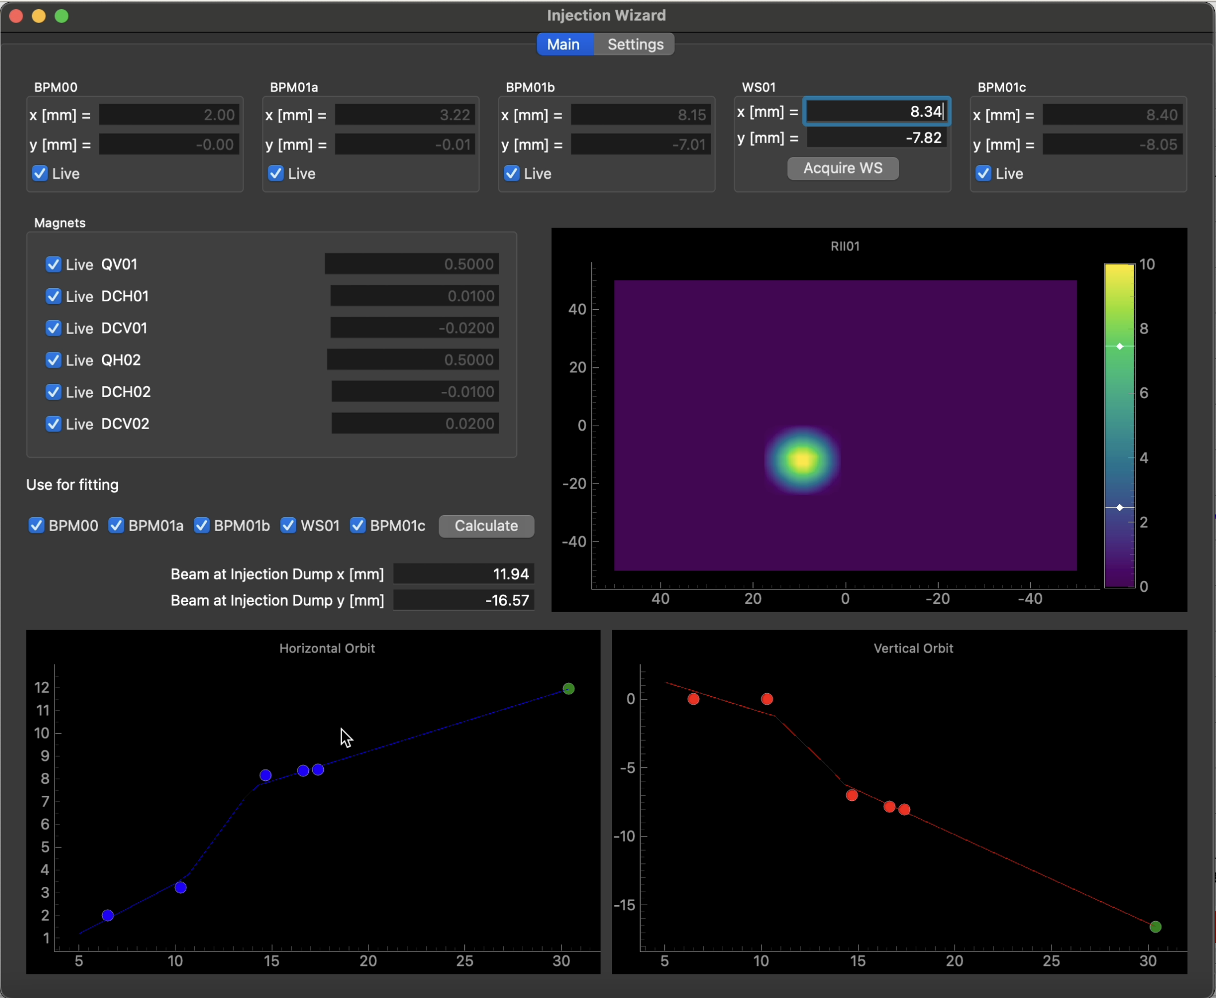
Application Development: Injection Dump Wizard
Application for steering beam into the injection dump.
The injection dump is for beam that doesn’t enter the ring.
Rebuilt after injection line upgrades
Now in Python
Successfully tested with Virac before use during commissioning.

