Slide 1
Machine learning and advanced accelerator optimization at GSI/FAIR
Sabrina Appel, Erika Kazantsea, Nico Madysa,
Stephane Pietri, Helmut Weick (GSI),
Christoph Reinwald, Daniel Kallendorf (TUDa)
Seeheim, October 2024

Slide 2

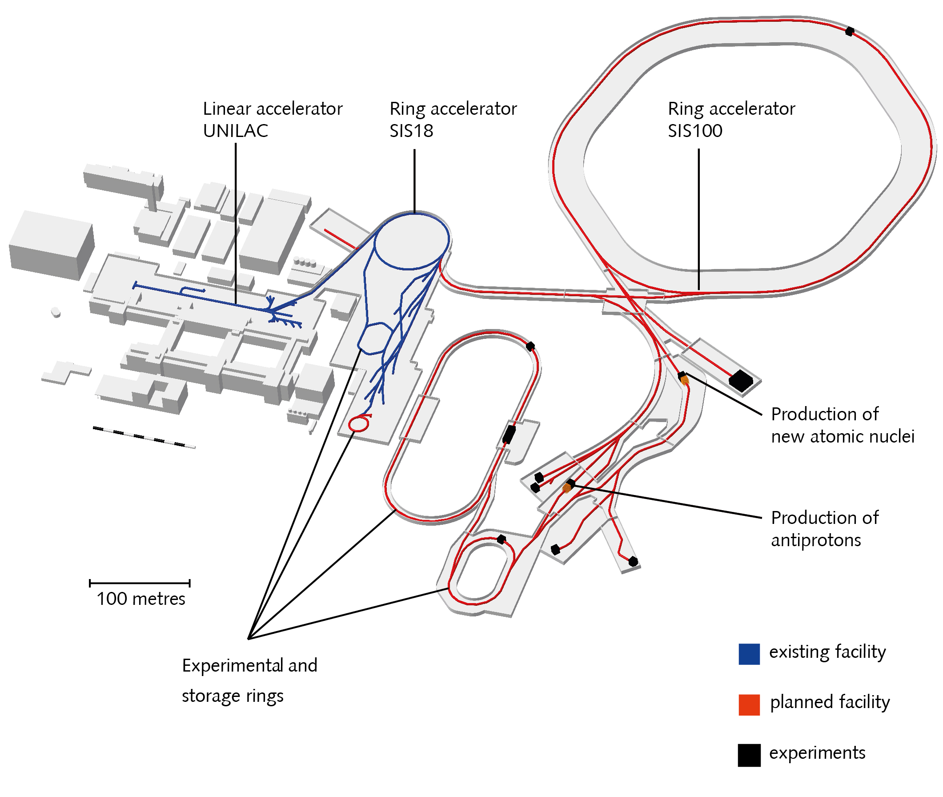
FAIR/GSI
Automation and optimization with Python:
Multi-turn injection loss minimization (SIS18)
Beam steering (TK)
Closed-orbit correction for non-standard optics (SIS18)
Slow extraction loss minimization (SIS18)
Beam steering and focusing (FRS)
Methods of interests of automation:
BOBYQA + Bayesian optimization (BO)
Physics-information Bayesian optimization
Multi-objective optimization with BO
Data-driven model predictive control
Reinforcement learning
EURO-LABS finances a scientific staff member for three years (in APH)
Several TUDa master and PhD students (with TUDa funding)
One master student from Paris Lodron Universität Salzburg
S. Appel - APH
2
Notes:
V. Isensee, Kazinova

Slide 3
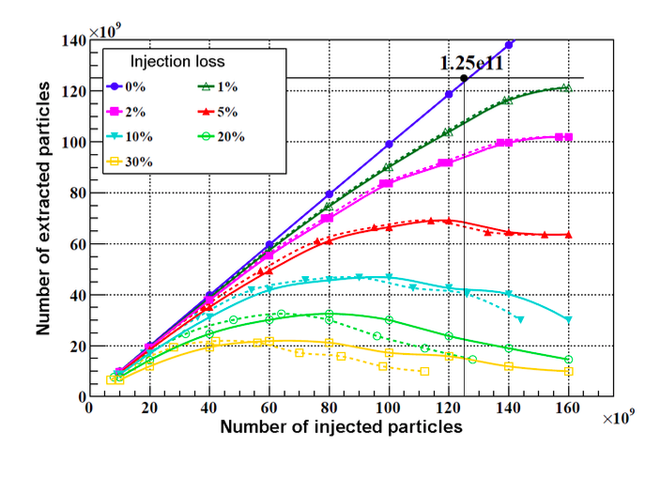
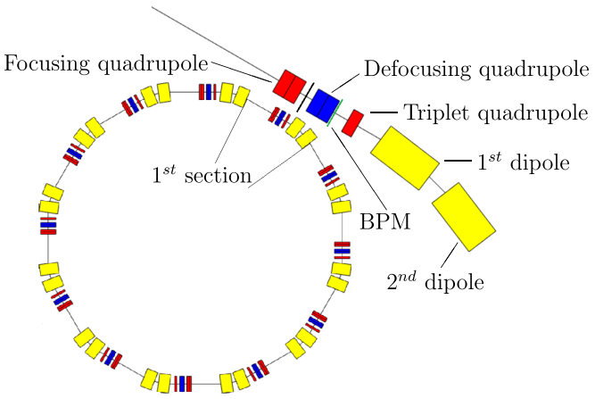
SIS18 (SchwerIonenSynchrotron)
Booster for FAIR SIS100 synchrotron
Offers fast and slow extraction to experiments and subsequent accelerators.
Main bottleneck for intense FAIR beams: multi-turn injection into SIS18
Main limiting effect: (incoherent) transverse space charge force
Also important limiting effect: loss-induced vacuum degradation for intermediate charge state ions
Beam Energy | U : 50-1000 MeV/u Ne: 50-2000 MeV/u p : 4,5 GeV
Particle Number Per Cycle | 10¹⁰ (U⁷³) – 10¹²(p)
Typical Cycle | 3 s (FAIR 2.7 Hz)
Extraction | fast: 1 μs with compression: 200 ns slow: 10-8000 ms

Slide 4
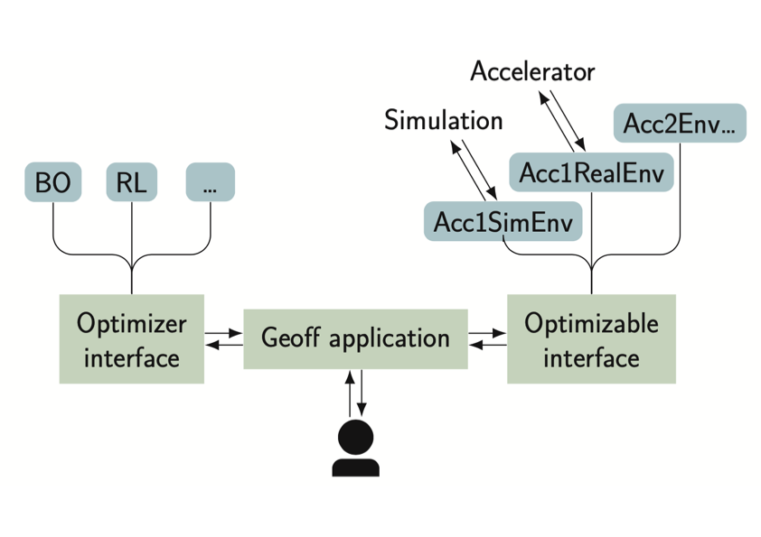
GeOFF at GSI
GeOFF (Generic Optimization Frontend & Framework) is a widely used framework for deploying automation at CERN
Python-based framework
lists, configures and runs optimization problems
standardized interfaces and adapters for various packages via Common Optimization Interfaces
Optimization problems formulated as classes
Class contains logic for live plotting, data logging, and communication with LSA, FESA and the Device Access system
Quick adaptation of code and on-the-fly during shifts: This is made easy due to flexibility of the framework.
GeOFF Development/Distribution/Maintenance (N. Madysa, APH, EU funded)

Slide 5

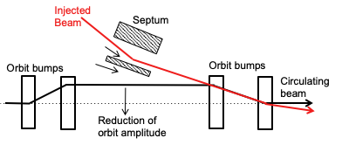
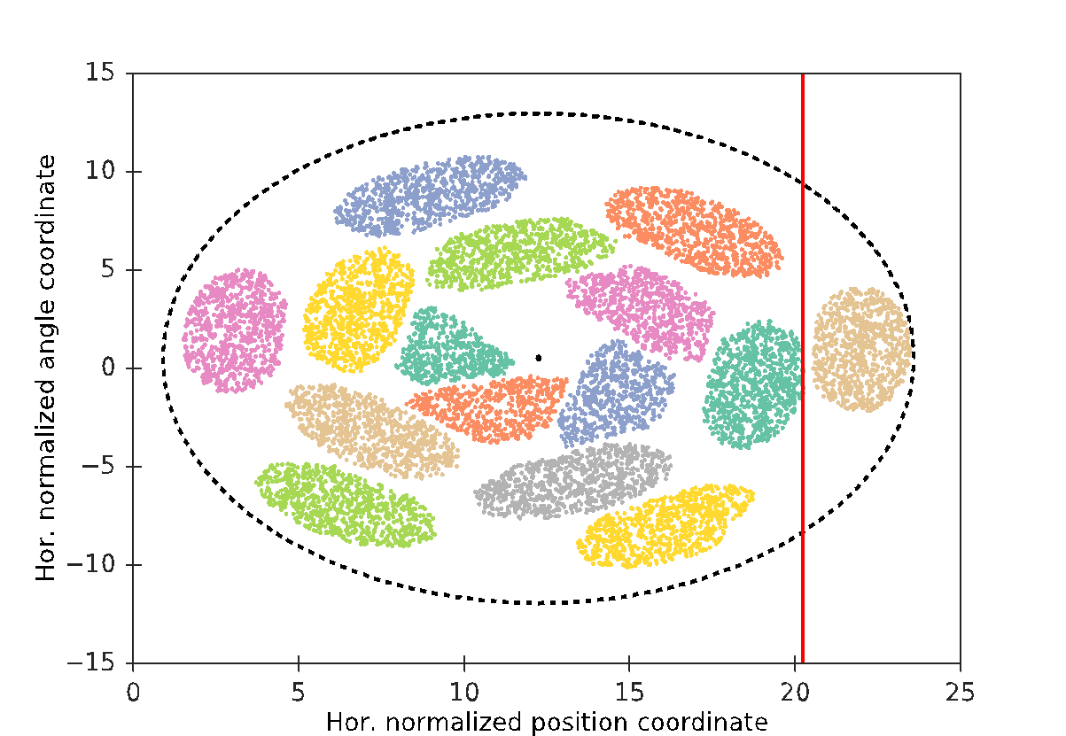
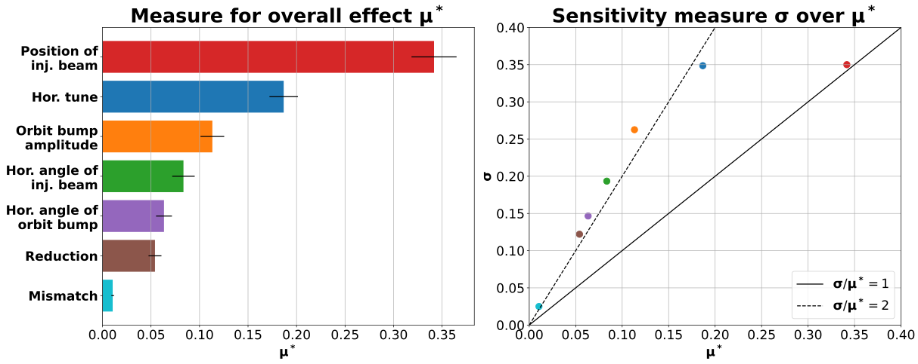
Multi-Turn-Injection
MTI has to respect Liouville’s theorem: Injected beams only in free space
Gain factor should be as high as possible to reach the space charge limit
Injection loss should be as low as possible to avoid loss-induced vacuum degradation
Competing goals: Maximize number of injection and minimize loss
MTI model has been implemented in Xsuite¹ for fast tracking
Christoph Reinwald, Master's thesis
σ: Estimates the second- and higher-order effects of one input on the output
Especially important: Injected beam position and tune!
Higher order dynamics for all parameters according to the ratio σ/μ∗
μ∗ : Estimates the overall effect of one input on the output
¹https://xsuite.readthedocs.io/en/latest/

Slide 6
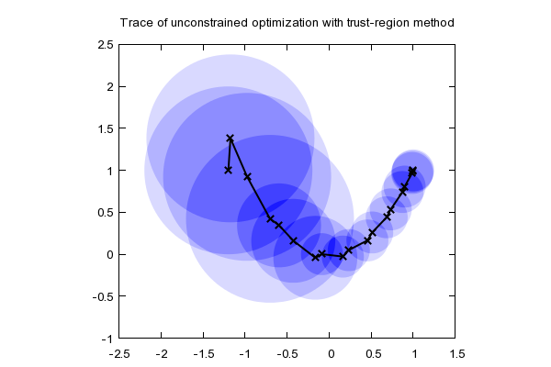
Bound Optimization BY Quadratic Approximation
Developed by Michael J. D. Powell in 2009.
sequential trust–region algorithm
quadratic approximations of objective function ^{[1]}
Updates to the model and trust radius on each iteration.
Py-BOBYQA^{[2]}: adds global optimization
and robustness against noise
by Ralf Juengling - 2008
[1] M. J. D Powell, technical report DAMTP 2009/NA06, Cambridge (2009),
[2] C. Cartis, arXiv:1804.00154, (2018), https://pypi.org/project/Py-BOBYQA

Slide 7
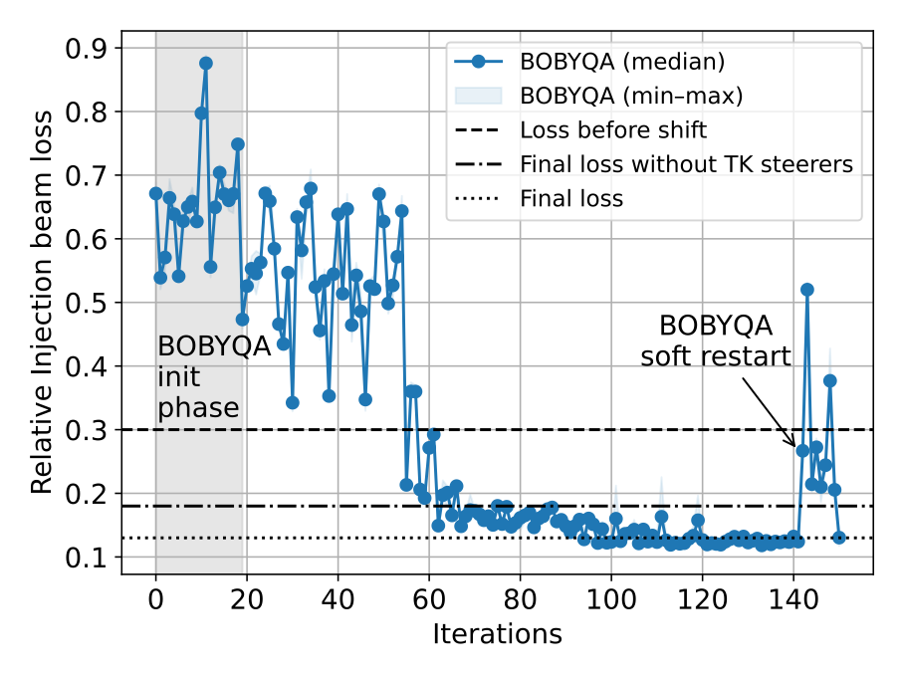
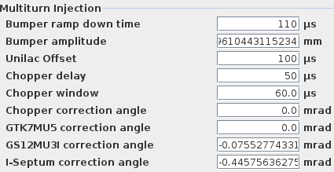
Automation of Multi-Turn Injection
Usually, MTI is optimized manually, with varying success
Using nine optimization parameters.
1
2
3
+ 4 TK Steers
4
5
150 iterations required, which took about 30 minutes.
1 iteration = median of 3 evaluations (to reduce variance)
gray area = initialization phase of algorithm.
Loss could be reduced from 30 % to 12 %.
(correction of loss calculation to earlier publications)
successful use of BOBYQA
algorithm's internal model not reusable

Slide 8
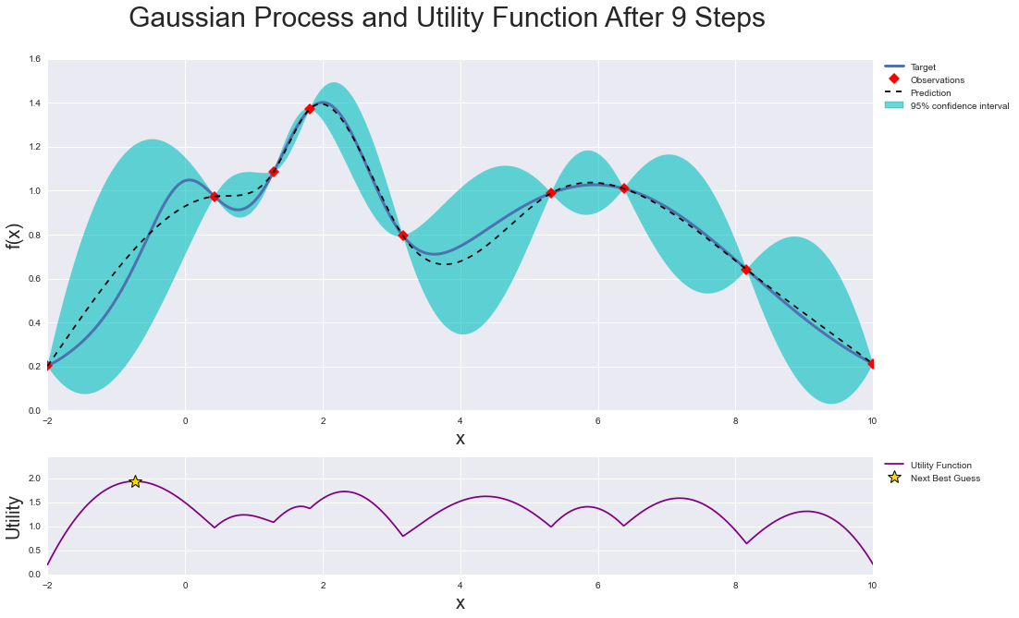
Bayesian optimization
Constructs probabilistic model of objective
Gaussian process prior express assumption
about objective function (mean function)
Kernel function k(x, x′) describes correlation
in phase space
Acquisition function use model to decide
where to evaluate function next
Choice of kernel and acquisition function essential
Extension: Multi-objective Bayesian optimization (https://ax.dev/tutorials/multiobjective_optimization.html)
Target
Observations
Prediction
95% confidence interval
Next Best Guess
Utility Function

Slide 9
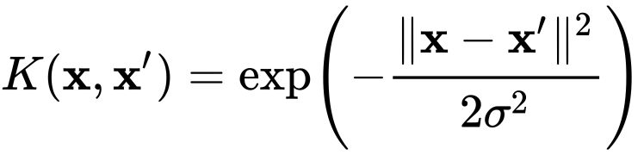
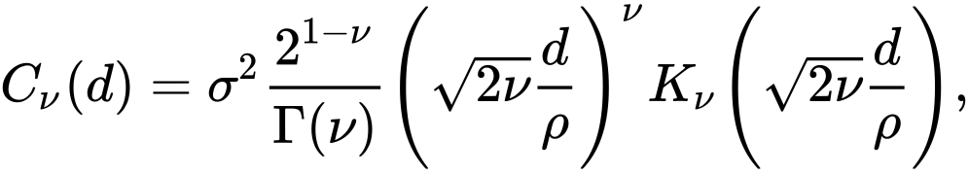
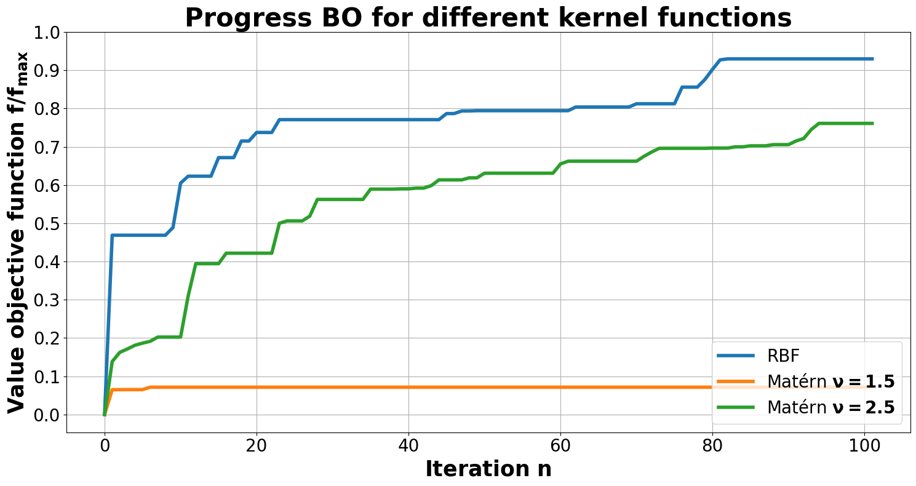
BO - Different kernel functions
Christoph Reinwald, Master's thesis
  Radial basis function kernel (RBF), with standard parameter
  and Matern kernel
RBF: Smaller mean as Matern kernel, overall it is better
f_{max} = Loss-free injection (ideal current)

Slide 10

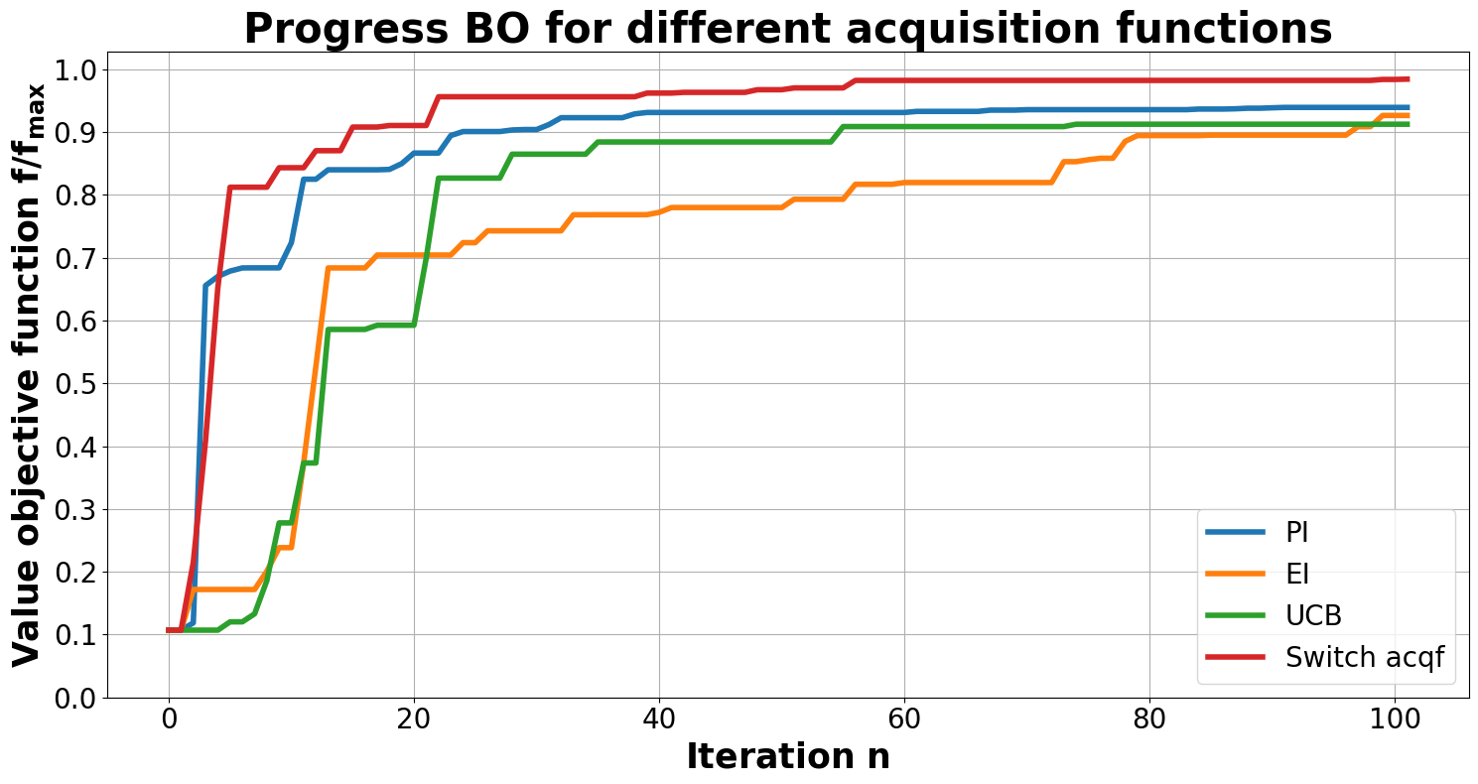
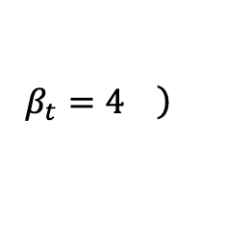
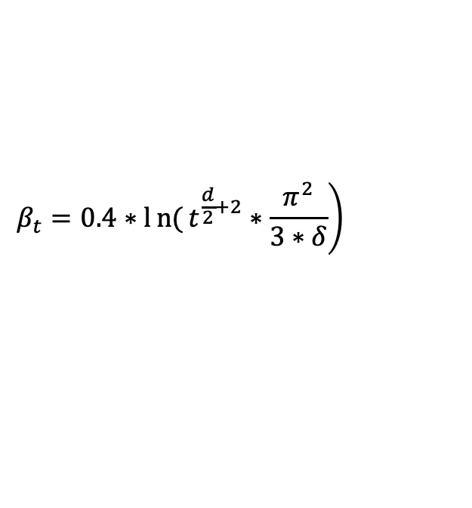
BO - Different acquisition functions
Christoph Reinwald, Master's thesis
Probability of improvement (PI): Sample points which are likely to be greater than best point so far (greedy)
Expected improvement (EI): Sample points which are likely to have a high improvement
Upper confidence bound* (UCB):
Hedging (portfolio of acqf) -> Switch acqf: Rotation of UCB -> EI -> PI in this order
*N. Srinivas, arXiv:0912.3995v4, 2010
$$\left.β_{t}=0.4∗ln{(}t^{\frac{d}{2}+2}∗\frac{π^{2}}{3∗δ}\right)$$
$$\left.β_{t}=4 \right)$$
has a weaker performance compared to dynamic beta
UCB + switch acqf returns the best results

Slide 11
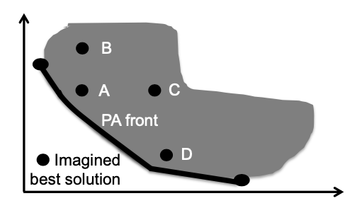
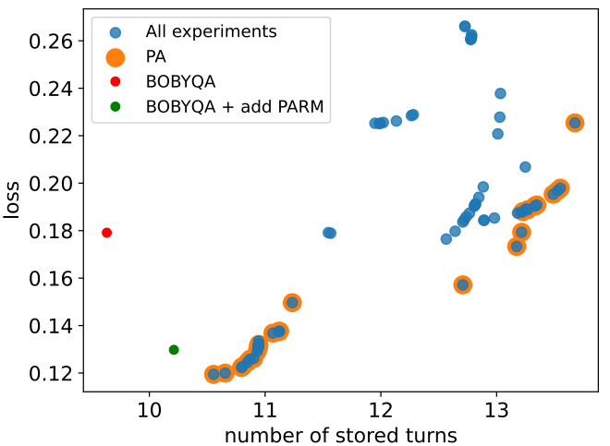
Multi-objective optimization with BO
Competing: Maximize number of injection and minimize loss
Pareto front: Find set of optimal solutions instead of single one
Simulation with Genetic algorithms has been performed a while ago
Measurements
Simulation with Genetic algorithms
Optimization of injector beam line is missing

Slide 12
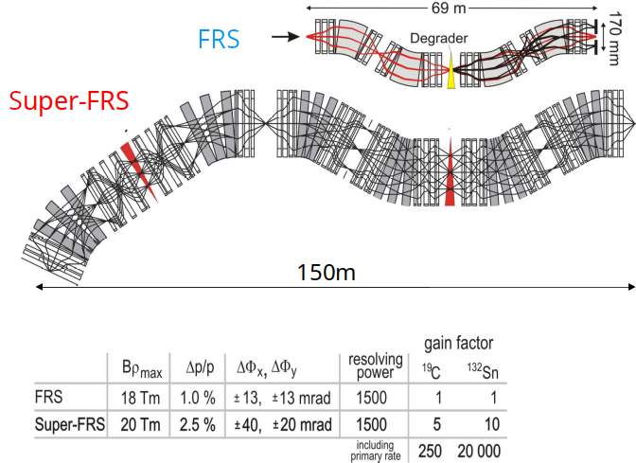
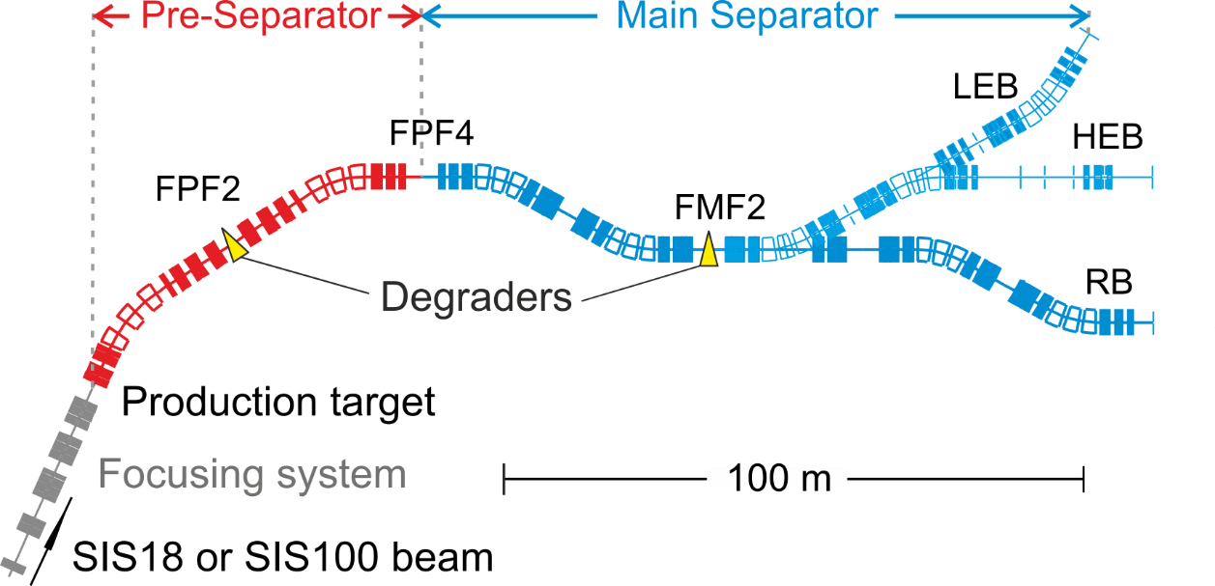
FRS (FRagment Separator) and Super-FRS
Production and investigation of nuclear structure of exotic nuclei
Exotic nuclei can be produced, separated, identified and eventually stored in a storage ring
"Super-FRS: higher acceptance, more complex (4×more magnets), gain factors between 1000 (¹²C) and 7500 (¹³²Sn)¹.
Automation of operational tasks essential
Super-FRS layout:
¹H. Simon et al., EMIS XVIII workshop, 2018.

Slide 13
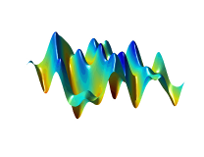

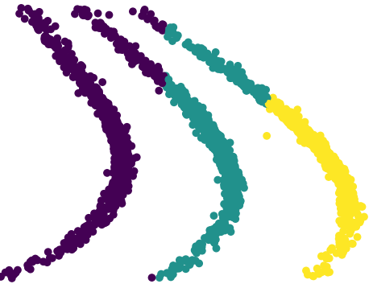
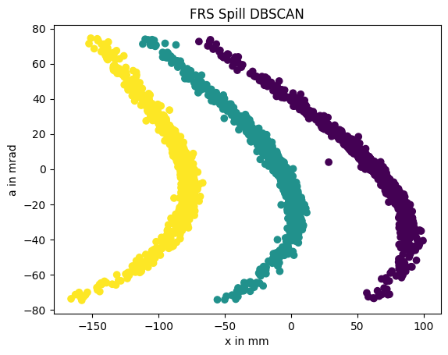
Automatization of FRS & Super-FRS: sub-goals
Why?
Manual setup is too time consuming
Increased complexity: different experiments
will demand many different optical modes
Scaling for same optics but different Brho not accurate enough
Goals of optimization loops:
0th order: center the beam – vertical steerers, main dipoles (Brho scaling for particular case mater calibration)
1st order: set focus, dispersion - quadrupoles
2nd order: minimize aberrations - sextupoles
3rd order: minimize aberrations – octupoles (S-FRS only)
Preparation:
FRS simulation model in COSY Infinity
optimization and data analysis in Python
Observables:
Histograms from current grid detectors /
phase space spectra from tracking detectors
Device—Interface:
LSA (trim steerers + magnets),
FESA (SIS18 monitoring),
Experiment instrumentation (TPC via Go4 server, current grids)
Classification
(simulation with disabled sextupoles)
K-Means
DBSCAN
Daniel Kallendorf, Master's thesis
Notes:
Density-Based Spatial Clustering of Applications with Noise

Slide 14
Optimization of separator optics with primary beam
Individual particle tracking detectors + charge states:
-> Lots of information from x-x’ spectra at dispersive focal plane
Central spot:
  x-Twiss parameters
  Non-dispersive 1st order x-transfer matrix
Charge states after target (outer spots):
  Dispersive transfer matrix elements
  of 1st and 2nd order
Goal: Bring the spectra as close as possible to desired 1st order parameters
Using charge states = more deduced optical properties
Optimize direct observables instead of individual matrix elements
TPC Data analysis
U⁹²⁺
U⁹¹⁺
U⁹⁰⁺
Dispersion
Different distance:
focus tilt
Different heights
Different tilt,
a_center ≠ 0:
Twiss parameters → 1st order transfer matrix
2nd order deformations → sextupole errors

Slide 15
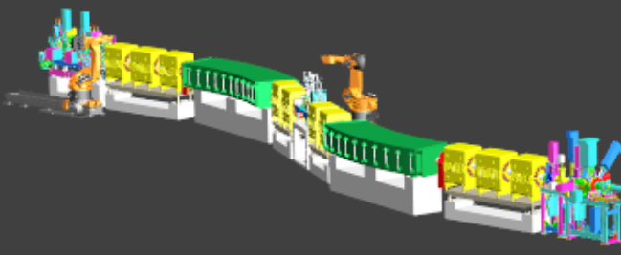
FRS 1st order: tune quadrupoles
Schematic illustration of FRS Dispersive Focus area
Proof of principle:
Steer beams at the target
Tune quadrupoles to focus the beam (central spot upright)
Tune sextupoles to remove focal plane tilt and “banana”-deformation
Change quadrupole strengths
Next step:
Use other observables to tune the entire 1st order optics (including dispersion)
TPC Data analysis
U⁹⁰⁺
U⁹¹⁺
U⁹²⁺
Evaluation of beam spot slope

Slide 16
Outlook
Towards more comprehensive accelerator models (with the most relevant parameters)
Optimization of total SIS production cycles (performance on target)
Control room integration of GeOFF GUI at GSI
More advanced ML algorithms, adaptation to GSI
  student-driven
  examples: physics-informed BO, data-driven MPC
EURO-LABS: generalization + maintenance
  Prove portability of GeOFF through use at GANIL
  continued collaboration with CERN on upgrades
Presented results
U⁹⁰⁺
U⁹¹⁺
U⁹²⁺

