Slide 1
CAV-SIM-2D: A Simulation and Analysis Tool for 2D Axisymmetric Accelerator Cavity Geometries
Sosoho-Abasi Udongwo, Ursula van Rienen

Slide 2
Content
Introduction
Motivation
Code architecture and capabilities
Examples
Outlook

Slide 3
Introduction
cavsim2d: A collection of `Python` scripts and executables
Focused on the design and optimisation of axisymmetric radio-frequency (RF) cavity geometries
It is open source (most of it currently, at least)

Slide 4
Motivation
Quick and easy design and analysis of cavity geometries
Streamlined management of results from various analysis types
Development of open-source tools for cavity design, optimisation and analysis

Slide 5
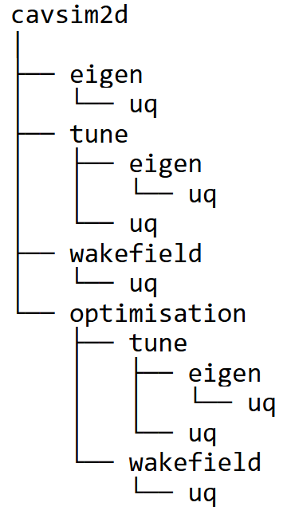
Code Architecture and Capabilities
*
*uncertainty quantification

Slide 6
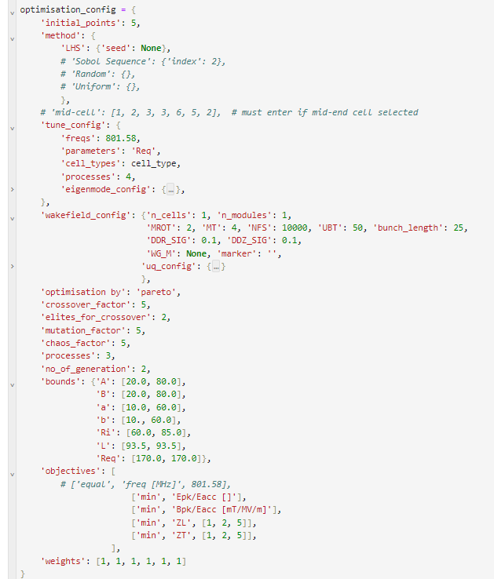
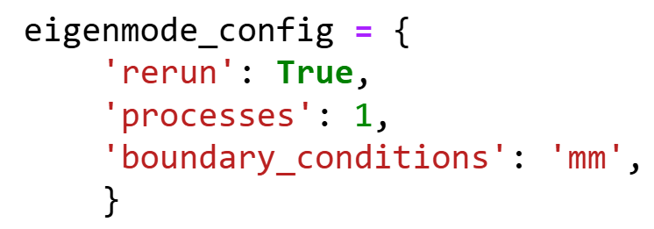
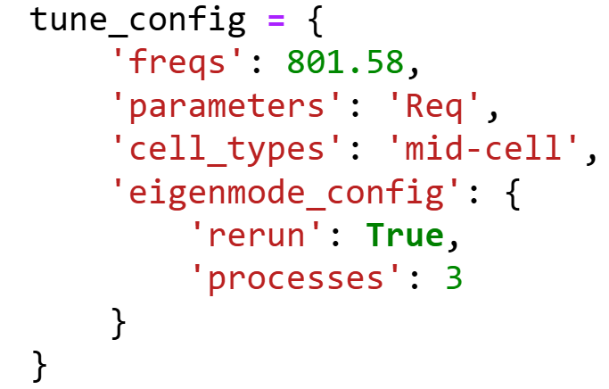
Input data

Slide 7
Examples
TESLA cavity geometry [1]
Reentrant cavity geometry
Aune, Bernard, et al. "Superconducting TESLA cavities." Physical Review special topics-accelerators and beams 3.9 (2000): 092001.

Slide 8
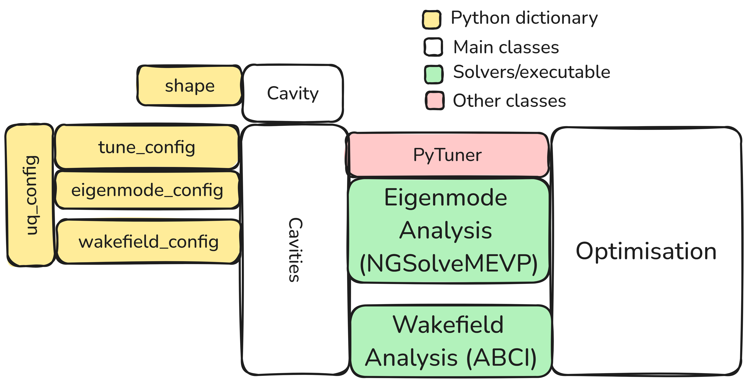
Eigenmode Analysis
Eigenmode solver implemented in NGSolve [*]
[*] Schöberl, Joachim. "C++ 11 implementation of finite elements in NGSolve." Institute for analysis and scientific computing, Vienna University of Technology 30 (2014).

Slide 9
Eigenmode Analysis

Slide 10
Eigenmode Analysis

Slide 11
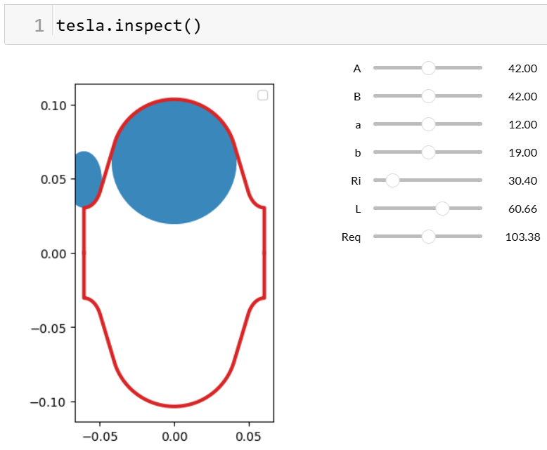
Eigenmode Analysis

Slide 12
Eigenmode Analysis

Slide 13
Eigenmode Analysis

Slide 14
Eigenmode Analysis

Slide 15
Eigenmode Analysis

Slide 16
Eigenmode Analysis

Slide 17
Eigenmode Analysis

Slide 18
Eigenmode Analysis

Slide 19
Eigenmode Analysis

Slide 20
Tuning

Slide 21
Tuning

Slide 22
Tuning

Slide 23
Tuning

Slide 24
Wakefield Analysis
cavsim2d interfaces with ABCI [2]
[2] Chin, Yong Ho (2005). User's guide for ABCI version 94 (azimuthal beam cavity interaction) and introducing the ABCI windows application package (KEK--2005-6). Japan

Slide 25
Wakefield Analysis

Slide 26
Wakefield Analysis

Slide 27
Wakefield Analysis

Slide 28
Wakefield Analysis

Slide 29
Multiobjective Optimisation

Slide 30
Multiobjective Optimisation

Slide 31
Uncertainty Quantification

Slide 32
Example – Uncertainty Quantification

Slide 33
Example – Uncertainty Quantification

Slide 34
Summary and Outlook
In this talk
Introduced cavsim2d, a collection of `Python` scripts and executables focused on the design and optimisation of axisymmetric radio-frequency RF cavities
Showed some examples
It can be found at https://github.com/Dark-Elektron/cavsim2d
Future work
Extension to other axisymmetric structures
Enhancing program modularity for improved flexibility and maintainability
Integration of 2D multipacting analysis code
Interface to other software e.g. CST

