Slide 1
Schwarz Domain Decomposition with the Modal Transmission Condition Applied to an In-Vacuum Undulator at PETRA III, DESY
Frederik Quetscher, Erion Gjonaj, Herbert De Gersem

Slide 2
Content
Introduction
Absorbing boundary conditions
Schwarz method
Convergence factor
Hybrid transmission condition
Application

Slide 3
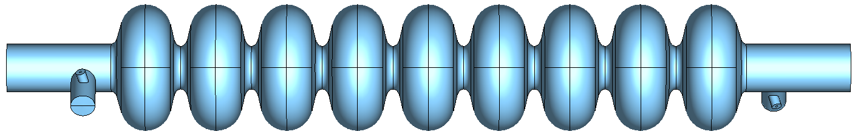

Introduction problem statement
Weak formulation: find $E∈H(curl)$ such that $∀v∈H(curl)$:
$\int_{Ω}{μ^{−1} ∇×E∙∇×v dV}−ω^{2}\int_{Ω}{ε E∙v dV}=$
$−jω\int_{Ω}{J∙v dV}−\int_{Σ_{SI}}{μ^{−1}\left[n× ∇×E\right]∙v dS}−\int_{Σ_{WG}}{μ^{−1}\left[n× ∇×E\right]∙v dS}$
Resistive wall BC: $μ^{−1}n×∇×E=jωY(ω)n×n×E$
Waveguide BC: $μ^{−1}n×∇×E=μ^{−1}n×∇×E^{Inc}−jω\sum_{m=1}^{∞}{Y_{m}^{TX}(ω)a_{m}(E−E^{Inc}) e_{m}^{TX})}$
Current excitation
Resistive wall
Waveguides

Slide 4
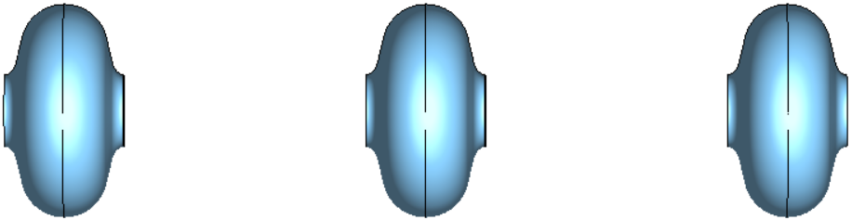
Introduction
Schwarz Domain Decomposition
Transmission condition
Transmission condition
Cut model into pieces
Apply a transmission condition at the interfaces
  Essentially absorbing boundary conditions (ABCs)
  Additionally exchange outgoing waves as excitations
Enables to solve each subproblem individually
  On different nodes of HPC cluster → parallelization

Slide 5

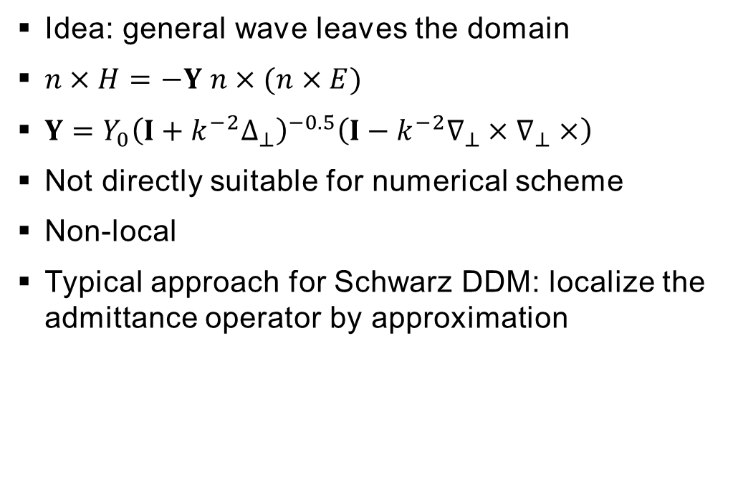




Absorbing Boundary Conditions
Exact
Idea: general wave leaves the domain
$n×H=−Y n×(n×E)$
$Y=Y_{0}{\left(I+k^{−2}Δ_{⊥}\right)}^{−0.5}\left(I−k^{−2}∇_{⊥}×∇_{⊥}×\right)$
Not directly suitable for numerical scheme
Non-local
Typical approach for Schwarz DDM: localize the admittance operator by approximation
Model domain $Ω$
$$n$$
$$E,H$$
$$Σ_{ABC}$$
$$Σ_{PEC}$$
(Trace operators omitted)
[M. El Bouajaji, X. Antoine, C. Geuzaine, Approximate local magnetic-to-electric surface operators for time-harmonic Maxwell's equations, 2014]

Slide 6
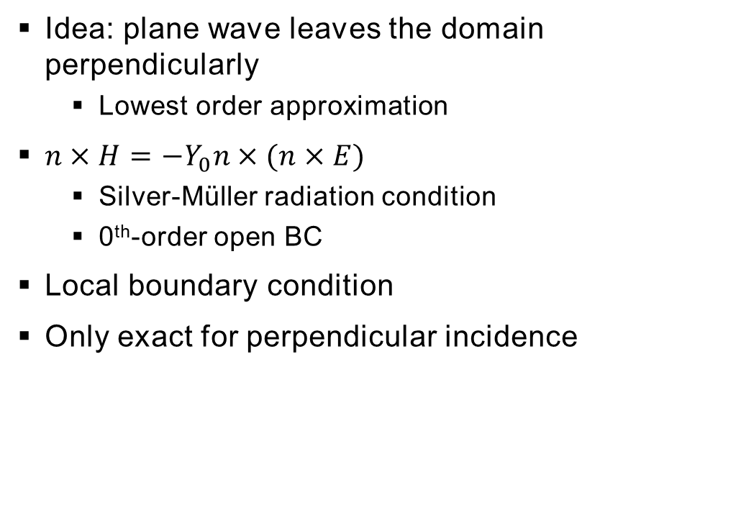
Absorbing Boundary Conditions
Free SpacE
Idea: plane wave leaves the domain perpendicularly
  Lowest order approximation
$n×H=−Y_{0}n×(n×E)$
  Silver-Müller radiation condition
  0th-order open BC
Local boundary condition
Only exact for perpendicular incidence
Model domain $Ω$
$$n$$
$$E,H$$
$$Σ_{ABC}$$
$$Σ_{PEC}$$
(Trace operators omitted)

Slide 7
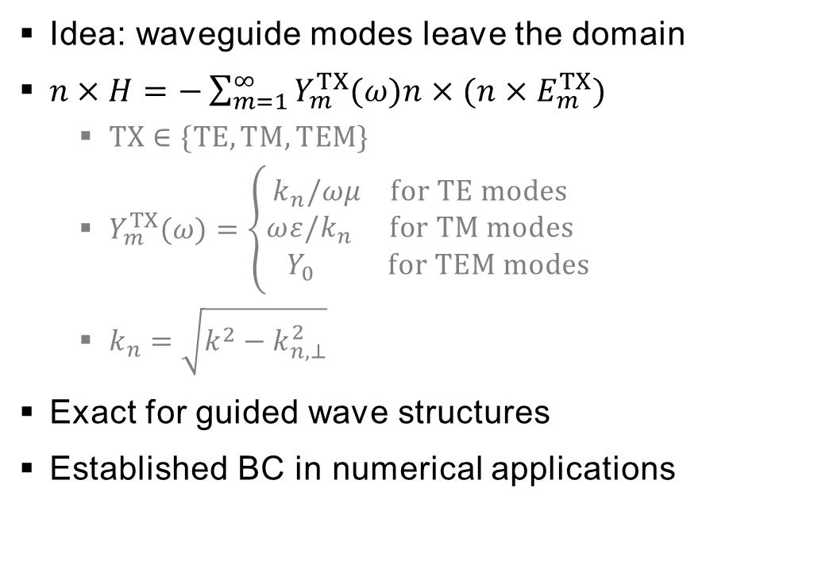
Absorbing Boundary Conditions
Modal
Idea: waveguide modes leave the domain
$n×H=−\sum_{m=1}^{∞}{Y_{m}^{TX}(ω)n×(n×E_{m}^{TX}) }$
  $TX∈\{TE,TM,TEM\}$
  $Y_{m}^{TX}(ω)=\left\{\begin{aligned}k_{n}/ωμ for TE modes \\ ωε/k_{n} for TM modes \\ Y_{0} for TEM modes\end{aligned}\right.$
  $k_{n}=\sqrt{k^{2}−k_{n,⊥}^{2}}$
Exact for guided wave structures
Established BC in numerical applications
Model domain $Ω$
$$n$$
$$E,H$$
$$Σ_{ABC}$$
$$Σ_{PEC}$$
(Trace operators omitted)

Slide 8
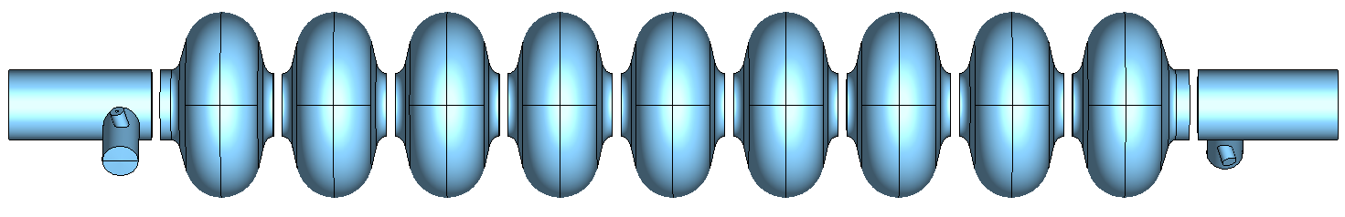
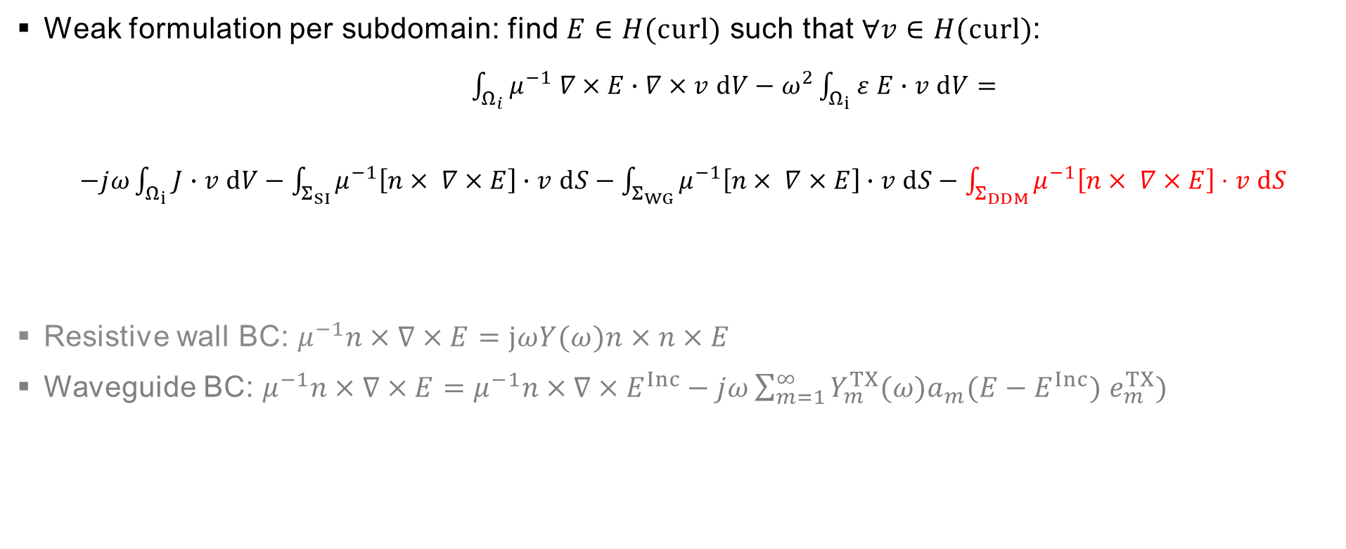
Domain decomposition problem statement
Weak formulation per subdomain: find $E∈H(curl)$ such that $∀v∈H(curl)$:
$\int_{Ω_{i}}{μ^{−1} ∇×E∙∇×v dV}−ω^{2}\int_{Ω_{i}}{ε E∙v dV}=$
$−jω\int_{Ω_{i}}{J∙v dV}−\int_{Σ_{SI}}{μ^{−1}\left[n× ∇×E\right]∙v dS}−\int_{Σ_{WG}}{μ^{−1}\left[n× ∇×E\right]∙v dS}−\int_{Σ_{DDM}}{μ^{−1}\left[n× ∇×E\right]⋅v dS}$
Resistive wall BC: $μ^{−1}n×∇×E=jωY(ω)n×n×E$
Waveguide BC: $μ^{−1}n×∇×E=μ^{−1}n×∇×E^{Inc}−jω\sum_{m=1}^{∞}{Y_{m}^{TX}(ω)a_{m}(E−E^{Inc}) e_{m}^{TX})}$
Current excitation
Resistive wall
Waveguides
DDM interface

Slide 9
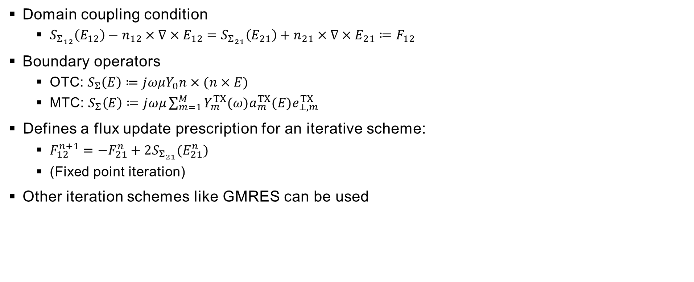
Domain decomposition
Domain Coupling
Domain coupling condition
  $S_{Σ_{12}}\left(E_{12}\right)−n_{12}×∇×E_{12}=S_{Σ_{21}}\left(E_{21}\right)+n_{21}×∇×E_{21}≔F_{12}$
Boundary operators
  OTC: $S_{Σ}\left(E\right)≔jωμY_{0}n×(n×E)$
  MTC: $S_{Σ}\left(E\right)≔jωμ\sum_{m=1}^{M}{Y_{m}^{TX}(ω)a_{m}^{TX}(E)e_{⊥,m}^{TX}}$
​Defines a flux update prescription for an iterative scheme:
  $F_{12}^{n+1}=−F_{21}^{n}+2S_{Σ_{21}}(E_{21}^{n})$
  (Fixed point iteration)
Other iteration schemes like GMRES can be used

Slide 10
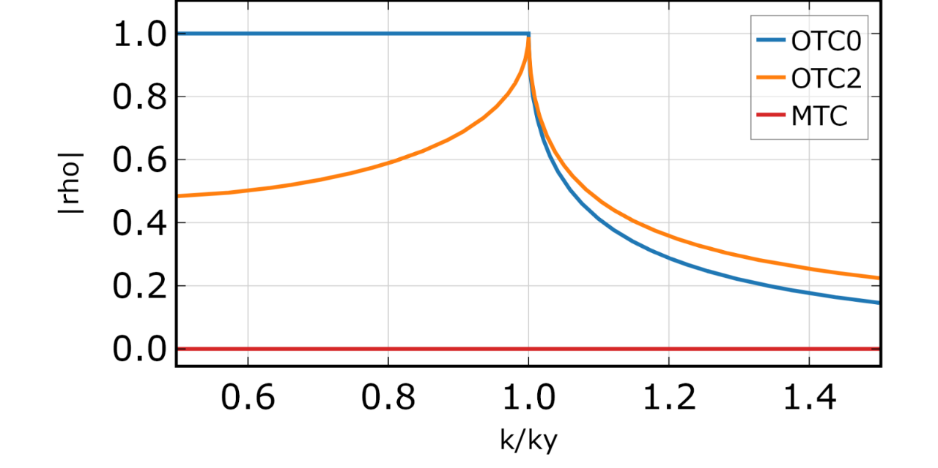

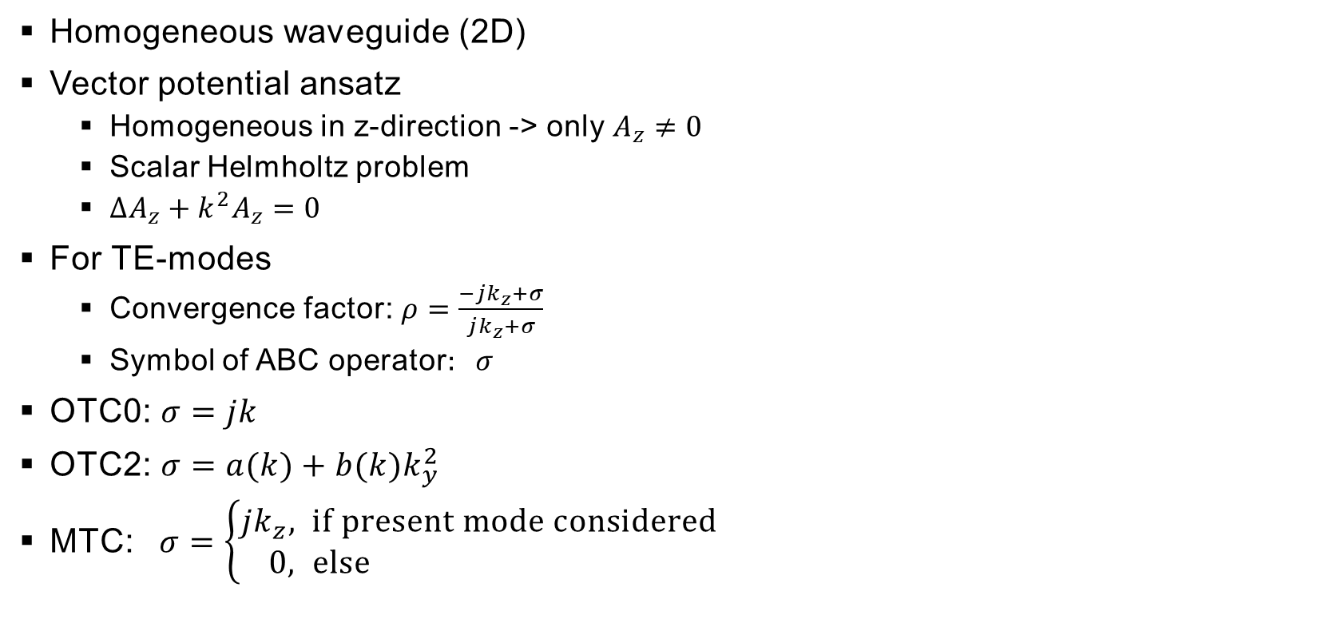







Convergence Factor
Homogeneous waveguide (2D)
Vector potential ansatz
  Homogeneous in z-direction -> only $A_{z}≠0$
  Scalar Helmholtz problem
  $ΔA_{z}+k^{2}A_{z}=0$
For TE-modes
  Convergence factor: $ρ=\frac{−jk_{z}+σ}{jk_{z}+σ}$
  Symbol of ABC operator$: σ$
OTC0: $σ=jk$
OTC2: $σ=a(k)+b(k)k_{y}^{2}$
MTC: $σ=\left\{\begin{aligned}{jk}_{z}, if present mode considered \\ 0, else \end{aligned}\right.$
$$y$$
$$h$$
$$n$$
Waves
Waves
$$Ω_{1}$$
$$Σ$$
$$Ω_{2}$$
$$0$$
$$z$$

Slide 11
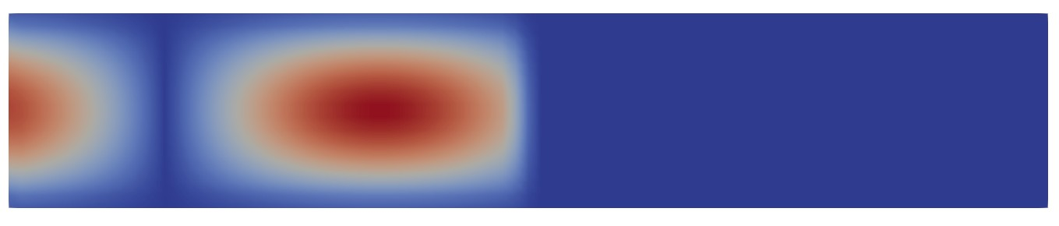
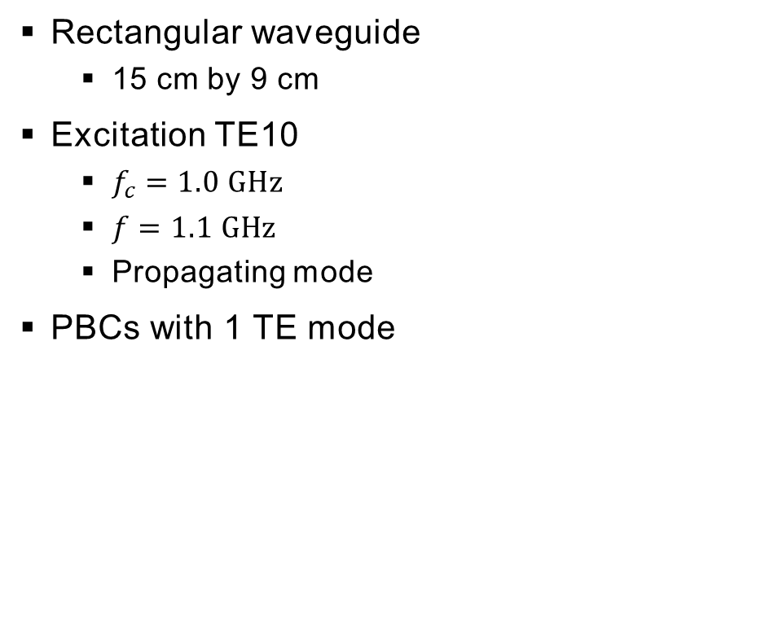

Convergence Factor
Rectangular waveguide
  15 cm by 9 cm
Excitation TE10
  $f_{c}=1.0 GHz$
  $f=1.1 GHz$
  Propagating mode
PBCs with 1 TE mode
${\left\|Re\left(E\right)\right\|}_{2}$, Iteration 1
OTC0
MTC
Interface
Direction of propagation

Slide 12
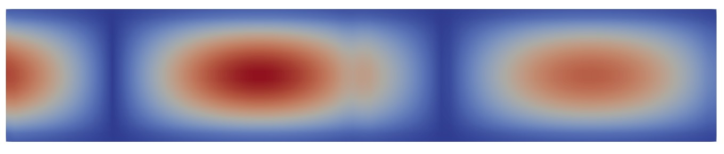
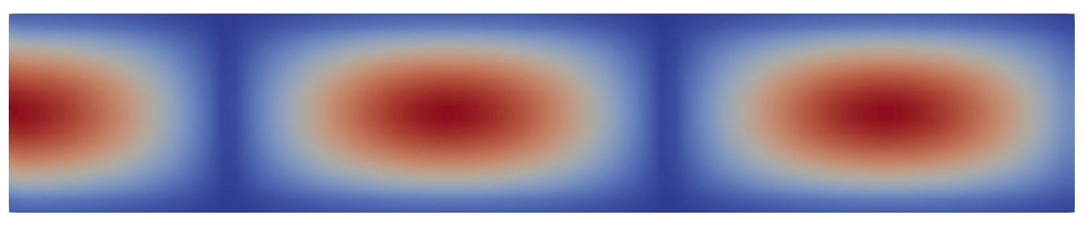

Convergence Factor
Rectangular waveguide
  15 cm by 9 cm
Excitation TE10
  $f_{c}=1.0 GHz$
  $f=1.1 GHz$
  Propagating mode
PBCs with 1 TE mode
${\left\|Re\left(E\right)\right\|}_{2}$, Iteration 2
OTC0
MTC
Interface
Direction of propagation

Slide 13
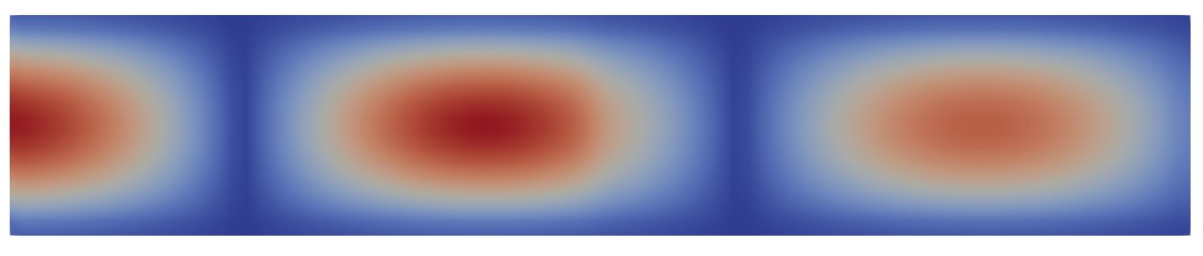


Convergence Factor
Rectangular waveguide
  15 cm by 9 cm
Excitation TE10
  $f_{c}=1.0 GHz$
  $f=1.1 GHz$
  Propagating mode
PBCs with 1 TE mode
${\left\|Re\left(E\right)\right\|}_{2}$, Iteration 3
OTC0
MTC
Interface
Direction of propagation

Slide 14
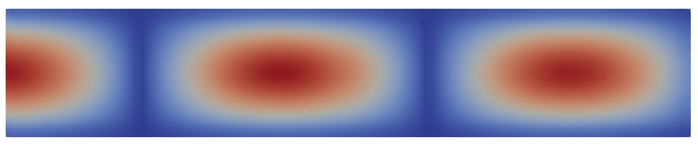

Convergence Factor
Rectangular waveguide
  15 cm by 9 cm
Excitation TE10
  $f_{c}=1.0 GHz$
  $f=1.1 GHz$
  Propagating mode
PBCs with 1 TE mode
${\left\|Re\left(E\right)\right\|}_{2}$, Iteration 4
OTC0
MTC
Interface
Direction of propagation

Slide 15
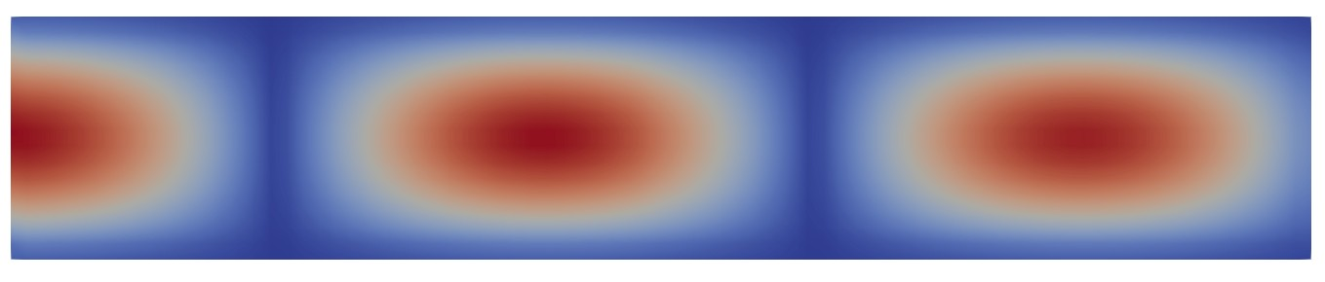

Convergence Factor
Rectangular waveguide
  15 cm by 9 cm
Excitation TE10
  $f_{c}=1.0 GHz$
  $f=1.1 GHz$
  Propagating mode
PBCs with 1 TE mode
${\left\|Re\left(E\right)\right\|}_{2}$, Iteration 5
OTC0
MTC
Interface
Direction of propagation

Slide 16
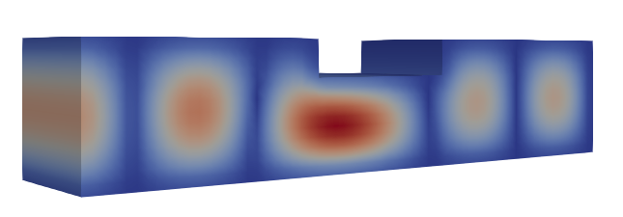
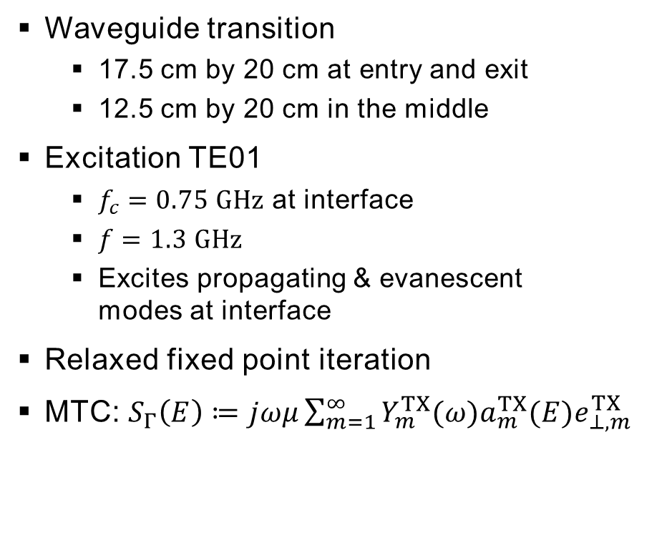
Convergence Factor
Waveguide transition
  17.5 cm by 20 cm at entry and exit
  12.5 cm by 20 cm in the middle
Excitation TE01
  $f_{c}=0.75 GHz$ at interface
  $f=1.3 GHz$
  Excites propagating & evanescent
  modes at interface
Relaxed fixed point iteration
MTC: $S_{Γ}\left(E\right)≔jωμ\sum_{m=1}^{∞}{Y_{m}^{TX}(ω)a_{m}^{TX}(E)e_{⊥,m}^{TX}}$
Direction of propagation

Slide 17
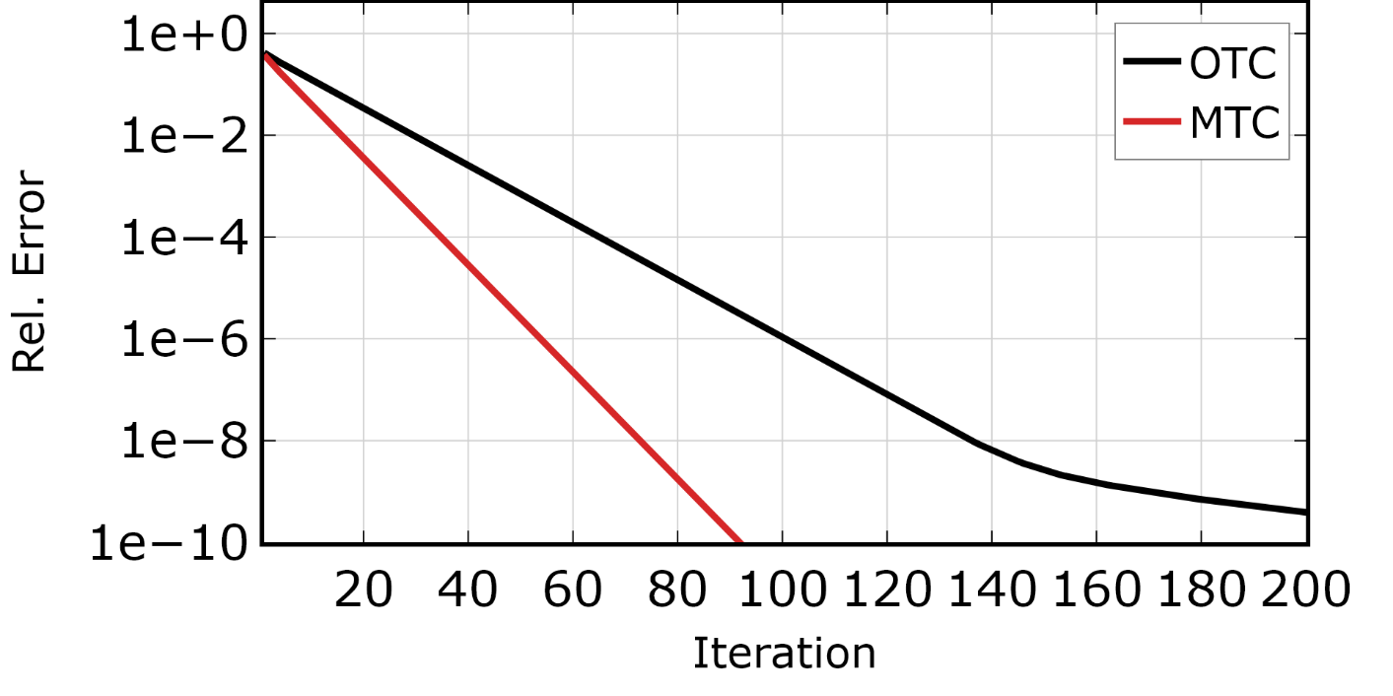
Convergence Factor
Waveguide transition
  17.5 cm by 20 cm at entry and exit
  12.5 cm by 20 cm in the middle
Excitation TE01
  $f_{c}=0.75 GHz$ at interface
  $f=1.3 GHz$
  Excites propagating & evanescent
  modes at interface
Relaxed fixed point iteration
MTC: $S_{Γ}\left(E\right)≔jωμ\sum_{m=1}^{∞}{Y_{m}^{TX}(ω)a_{m}^{TX}(E)e_{⊥,m}^{TX}}$

Slide 18
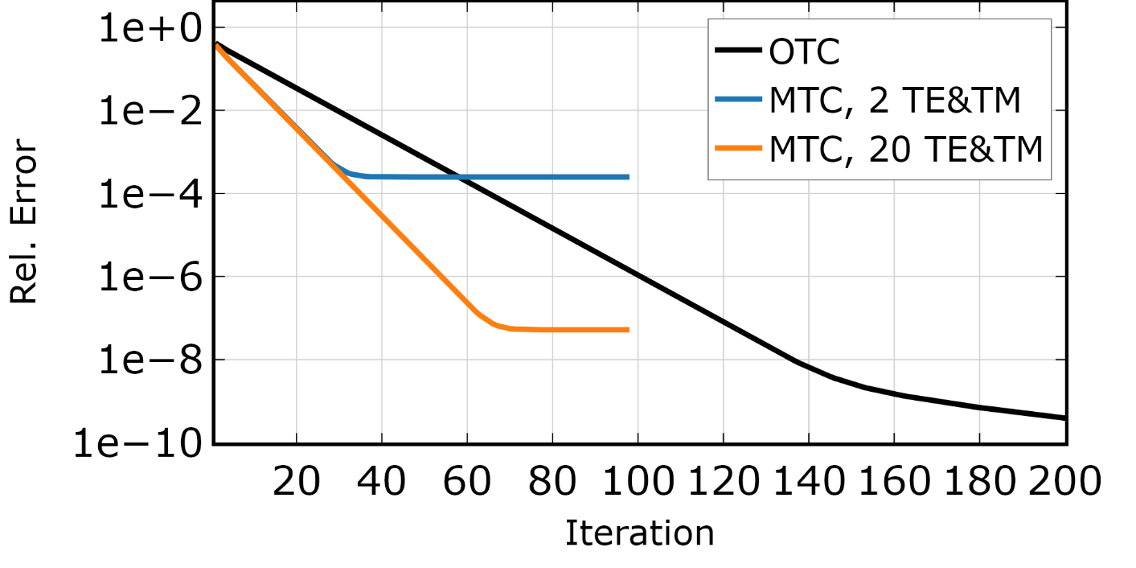
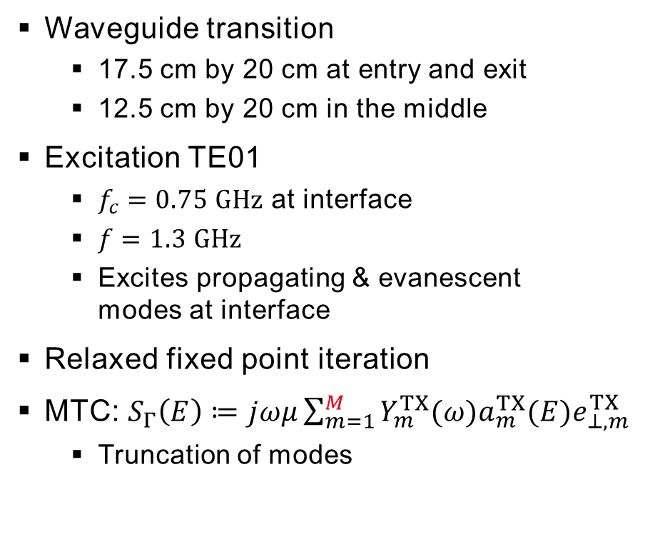
Convergence Factor
Waveguide transition
  17.5 cm by 20 cm at entry and exit
  12.5 cm by 20 cm in the middle
Excitation TE01
  $f_{c}=0.75 GHz$ at interface
  $f=1.3 GHz$
  Excites propagating & evanescent
  modes at interface
Relaxed fixed point iteration
MTC: $S_{Γ}\left(E\right)≔jωμ\sum_{m=1}^{M}{Y_{m}^{TX}(ω)a_{m}^{TX}(E)e_{⊥,m}^{TX}}$
  Truncation of modes

Slide 19
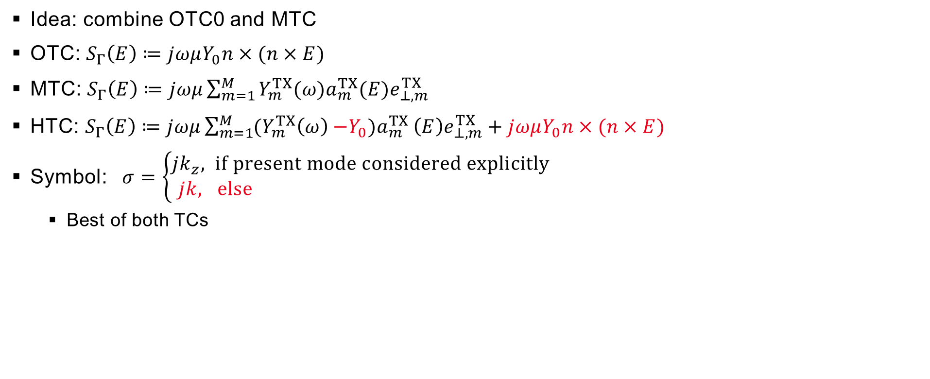
Hybrid Transmission Condition
Idea: combine OTC0 and MTC
OTC: $S_{Γ}\left(E\right)≔jωμY_{0}n×(n×E)$
MTC: $S_{Γ}\left(E\right)≔jωμ\sum_{m=1}^{M}{Y_{m}^{TX}(ω)a_{m}^{TX}(E)e_{⊥,m}^{TX}}$
HTC: $S_{Γ}\left(E\right)≔jωμ\sum_{m=1}^{M}{{(Y}_{m}^{TX}\left(ω\right){−Y_{0})a}_{m}^{TX}\left(E\right)e_{⊥,m}^{TX}}+jωμY_{0}n×(n×E)$
Symbol: $σ=\left\{\begin{aligned}{jk}_{z}, if present mode considered explicitly \\ jk, else \end{aligned}\right.$
  Best of both TCs

Slide 20
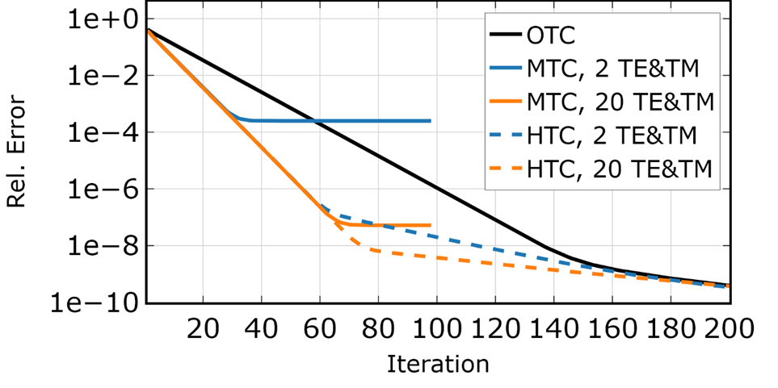
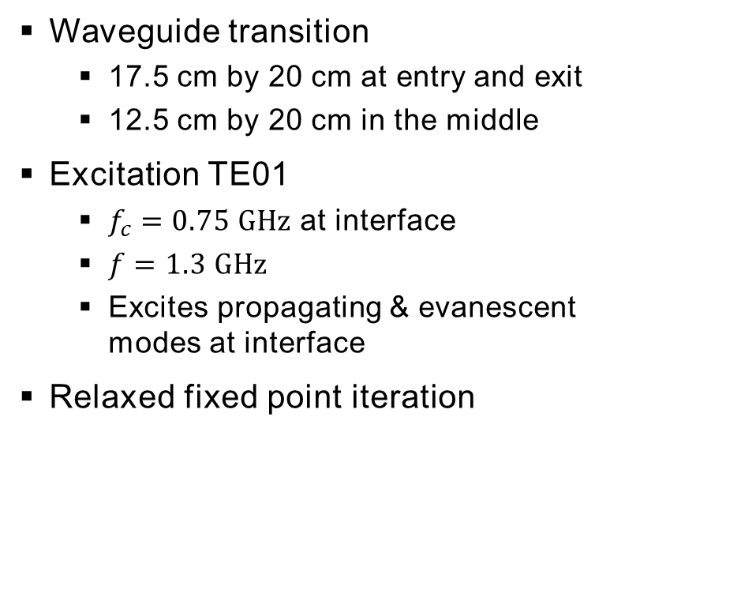
Hybrid Transmission Condition
Waveguide transition
  17.5 cm by 20 cm at entry and exit
  12.5 cm by 20 cm in the middle
Excitation TE01
  $f_{c}=0.75 GHz$ at interface
  $f=1.3 GHz$
  Excites propagating & evanescent
  modes at interface
Relaxed fixed point iteration

Slide 21
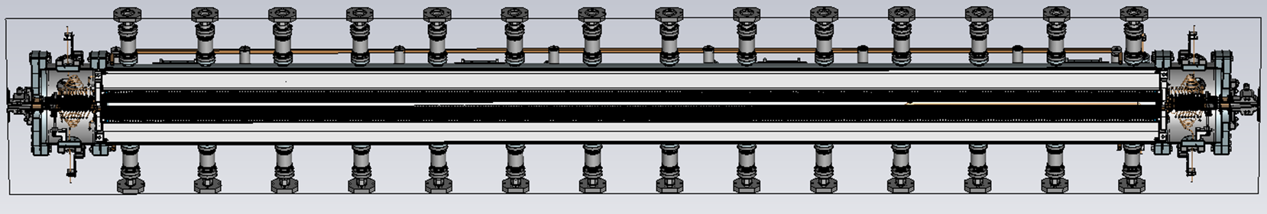
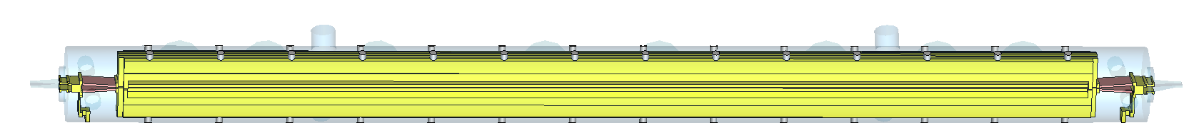
Application
In-Vacuum Undulator At Petra, Desy
Vacuum chamber
Magnet arrays
e beam
Flexible taper
4.6 m length
Flexible taper
Notes:
TE1 at 6 GHz
TE2 at 9 GHz
TE3 fc at 11GHz
TE4 fc at 12GHz
TE5 fc at 15GHz

Slide 22
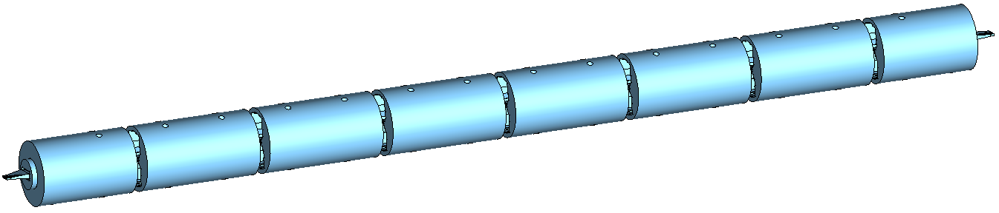
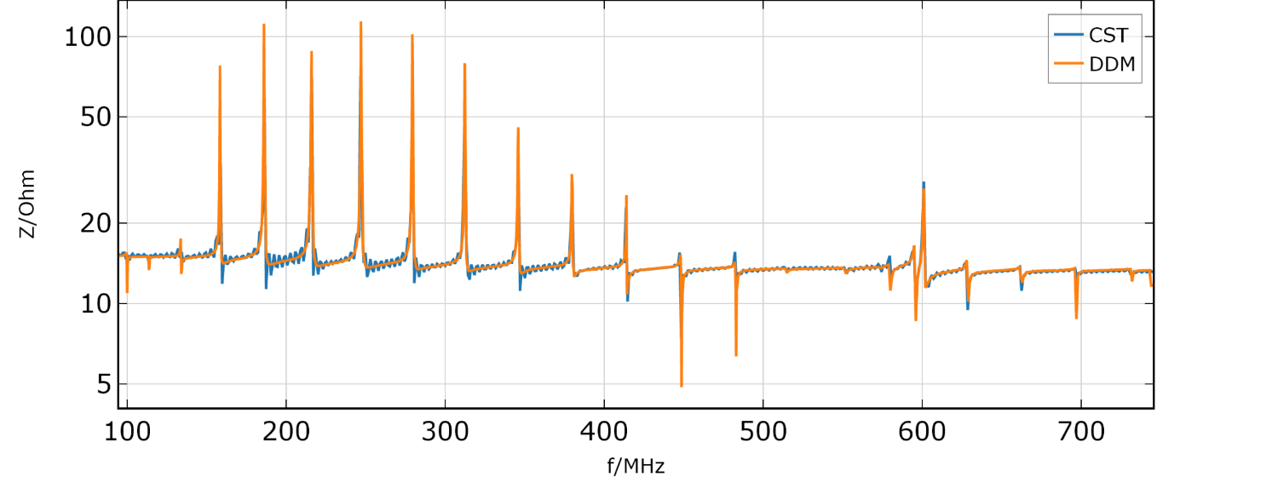
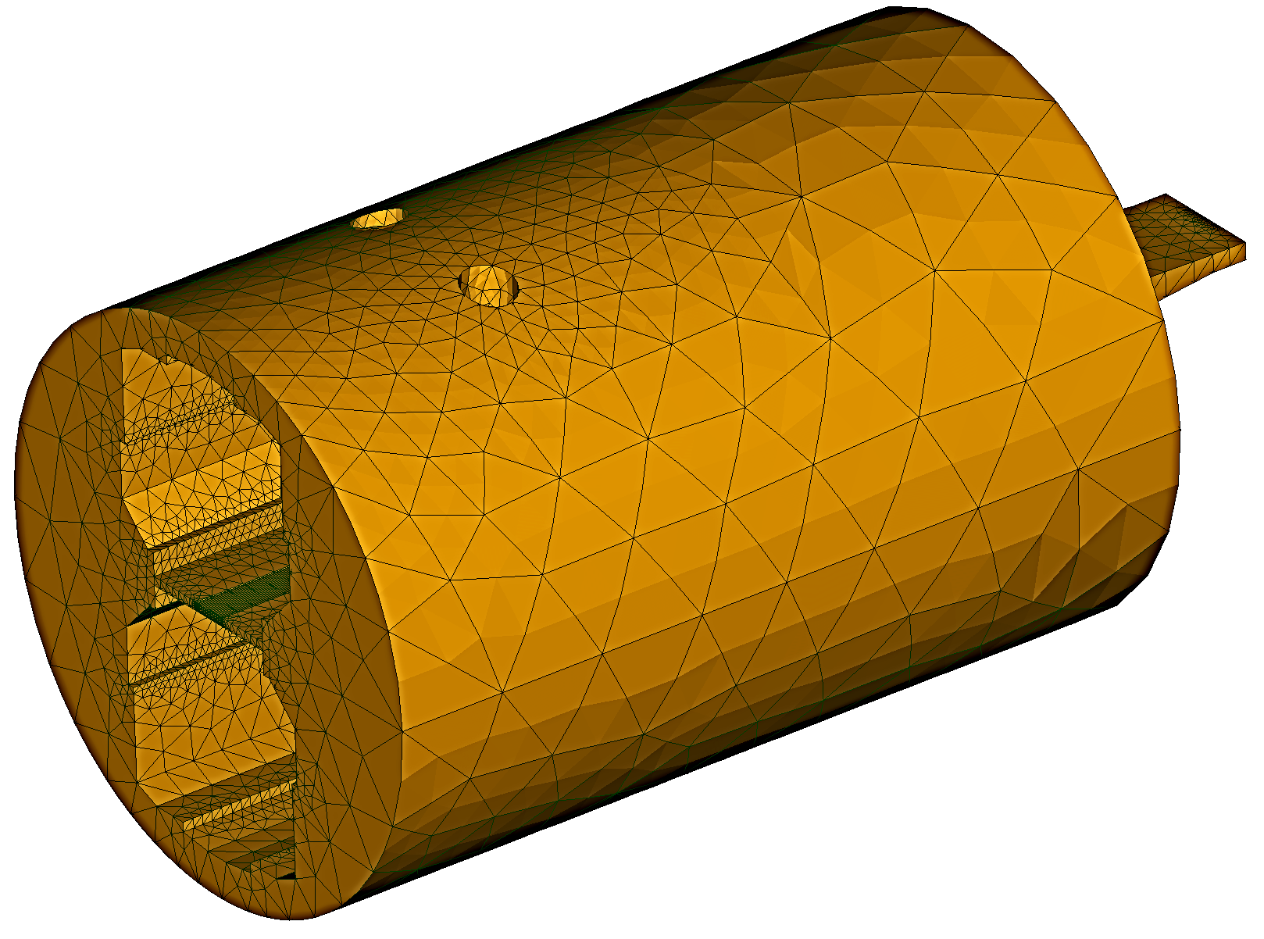
Application
In-Vacuum Undulator At Petra, Desy
8-domain decomposition
e beam
~700.000 vol. elements
2 TEM modes at DDM interfaces

Slide 23
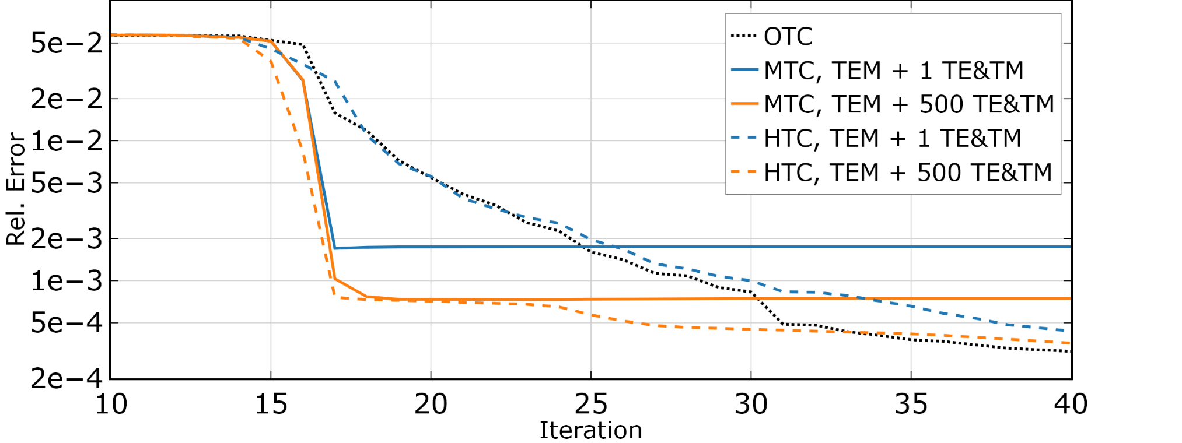
Application
In-Vacuum Undulator At Petra, Desy
GMRES iteration scheme
Rapid initial convergence for MTC
Improved convergence for HTC with many modes

Slide 24
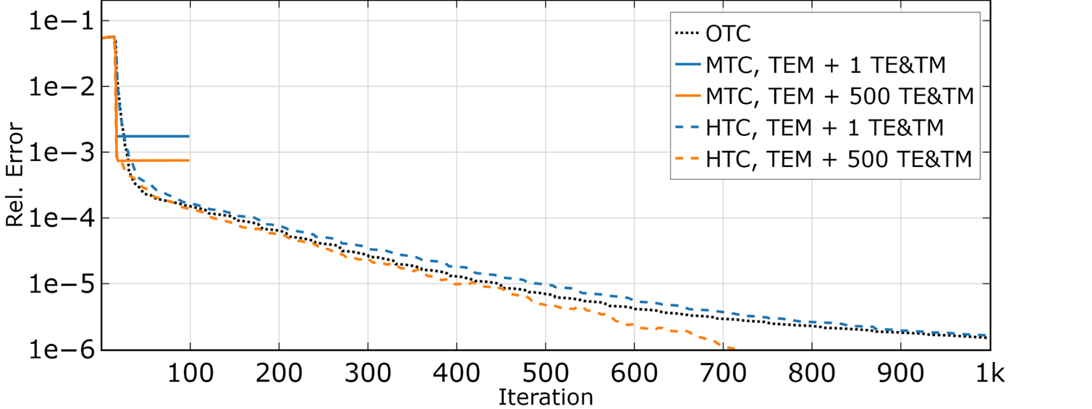
Application
In-Vacuum Undulator At Petra, Desy
GMRES iteration scheme
Rapid initial convergence for MTC
Improved convergence for HTC with many modes
Wall time on workstation
  OTC: 742 s
  HTC: 561 s

Slide 25
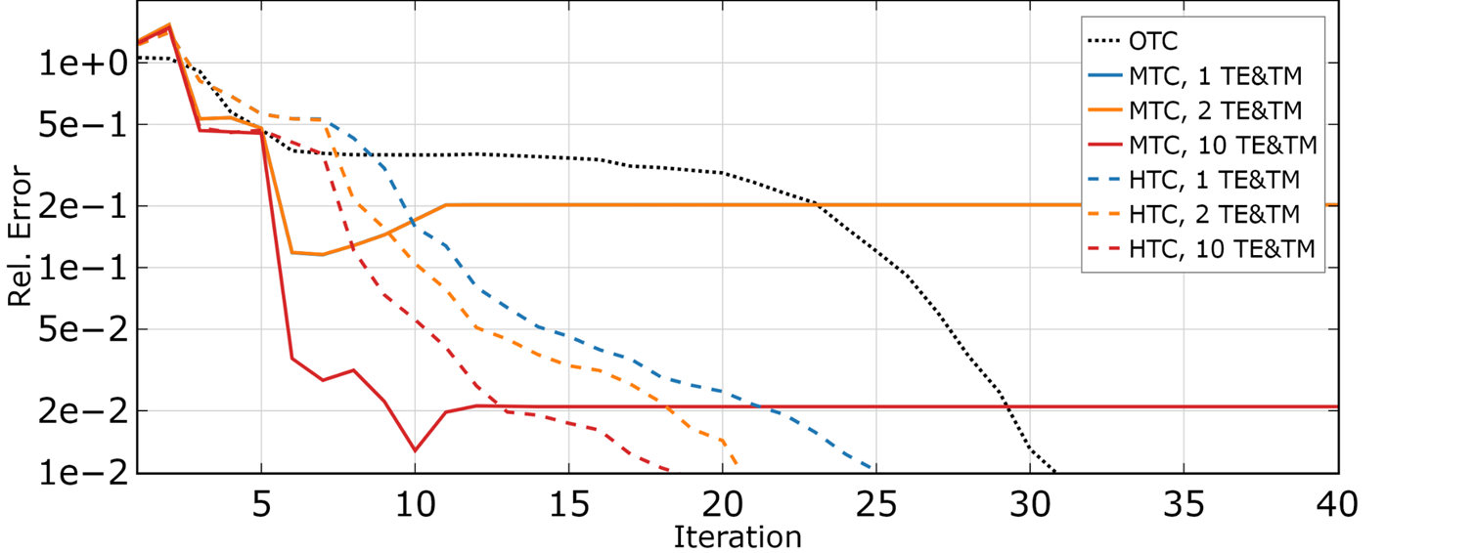
Application
Tesla Cavity
GMRES iteration scheme
Rapid initial convergence for MTC
Significantly improved convergence for HTC compared to OTC

Slide 26
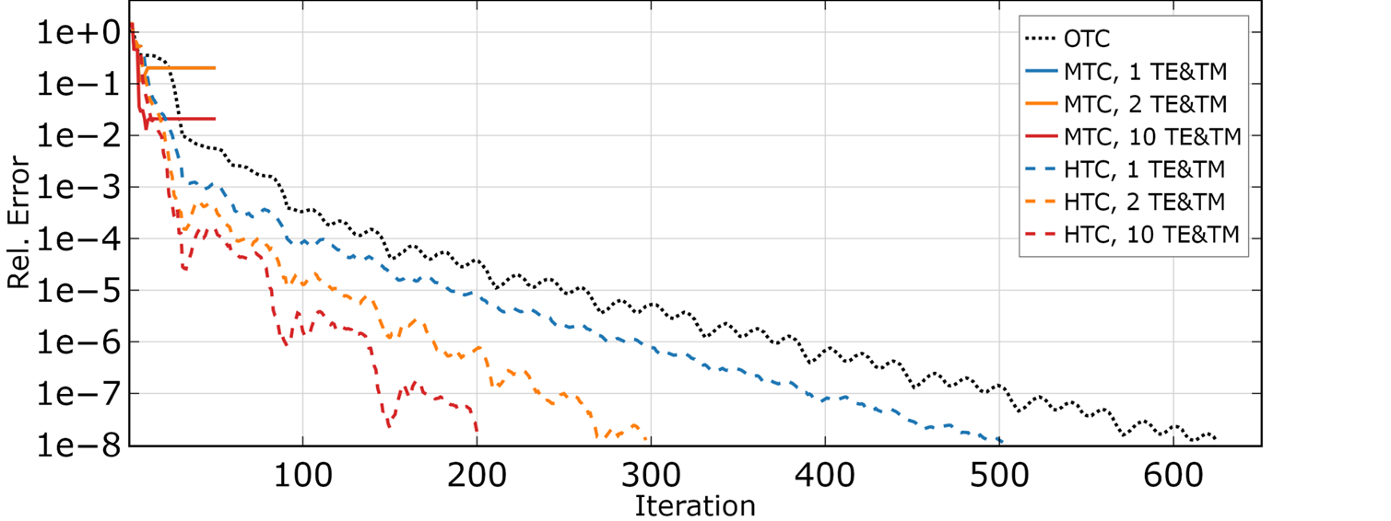
Application
Tesla Cavity
GMRES iteration scheme
Rapid initial convergence for MTC
Significantly improved convergence for HTC compared to OTC

Slide 27
Conclusion
Introduced two new transmission conditions (TC) for the Schwarz method
Modal TC (MTC)
  Rapid convergence
  Needs to be truncated in practice
    Small error remains
Hybrid TC (HTC)
  Allows to combine the MTC with the OTC
  In theory combines the advantages of both TCs
Application to undulator
  Small improvement compared to the OTC
Application to Tesla cavity
  Major improvement compared to the OTC

