Slide 1
Green's Function-based Methods for Modeling Electromagnetic Interaction Between RF Accelerator Cavity and Electron Bunch
Yang Liu
Lawrence Berkeley National Laboratory
Email: liuyangzhuan@lbl.gov
Joint work with Tianhuan Luo, Ji Qiang, Xiaoye Sherry Li, Yikai Kan,
Mustafa Rahman, Hengrui Luo, Aman Rani

Slide 2
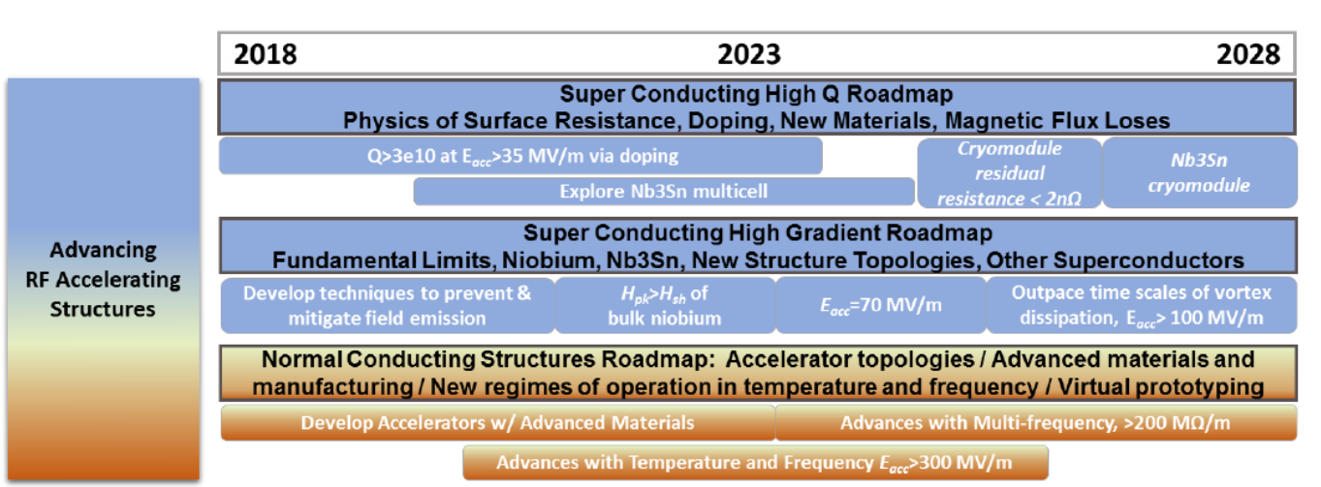
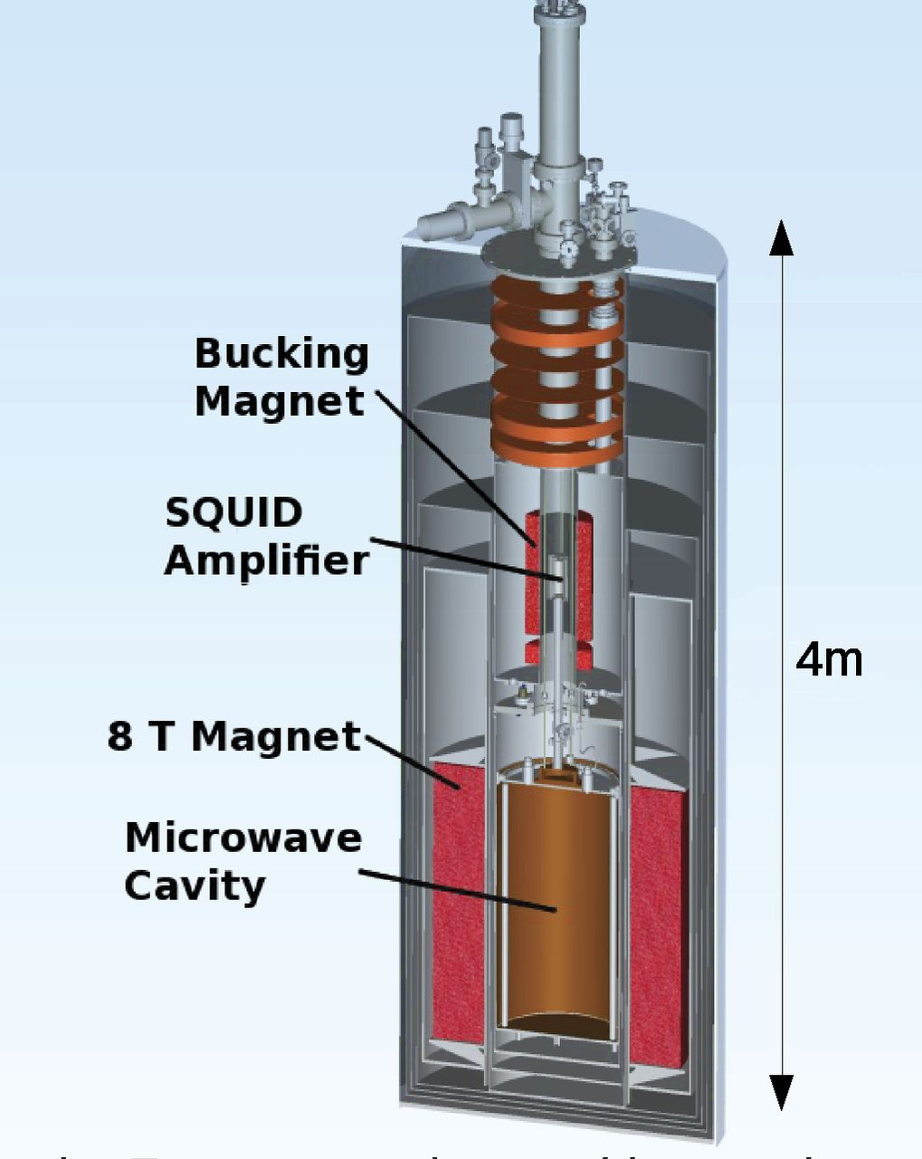
Radio-Frequency Cavity for Energy Research
Radio-frequency (RF) cavity: a metallic container of EM field
High-quality RF cavities are key components for high energy particle accelerators, synchrotron light sources, dark matter searches, quantum computing, etc.
DOE 10-year GARD-RF Roadmap on Improving Accelerating Structures
Dark-matter QCD-axion searches, Leslie J Rosenberg.
Superconducting 3D quantum computers, Hanhee Paik et al.
2

Slide 3
Outline
Frequency-domain Simulation
  Characterization of resonance/eigen modes of a RF cavity
  Forward simulation needed in cavity design
  Existing Tools (FD/FEM): Omega3P, CST, etc.
  Our work: frequency-domain integral equation (FD-IE) formulations
Time-domain Simulation
  Modeling electromagnetic interaction between a RF cavity and a relativistic electron bunch (rigid model or beam dynamics-based)
  Wake-field modeling, multi-pacting, etc.
  Existing tools (FD/FEM): ACE3P, CST, etc.
  Our work: time-domain integral equation (TD-IE) formulations
3

Slide 4
Eigen Solver for Cavity Modeling: IE or FEM?
FEM method
  Search for the resonance frequency which is the eigenvalue of the FEM system
  No frequency sweeping
  Nonlinear eigen problem with waveguide ports
  Accuracy for modes near cutoff frequencies
  Volume discretization, numerical dispersion
IE method
  Search for the resonance frequency at which the system matrix’s smallest eigenvalue is close to 0
  Linear eigen problem with waveguide ports for a given frequency
  Surface discretization, no numerical dispersion
  System matrix is ill-conditioned near resonance
  Expensive frequency sweeping
[1] J. M. Jin, John Wiley & Sons, 2002
[2] L.-Q. Lee, Z. Li, C. Ng, and K. Ko, Tech. Rep. 2009
[3] V. Catina, Ph.D thesis, 2010
[4] Q. I. Dai, J. Wu, H. Gan, Q. S. Liu, W. C. Chew and W. E. I. Sha, IEEE TAP, 2016
[5] R. Van Beeumen, O. Marques, E.G. Ng, C. Yang, Z. Bai, L. Ge, O. Kononenko, Z. Li, C.-K. Ng, L. Xiao, J. of Comp. Physics, 2018.
[6] L. Xiao, L. Ge, Z. Li, and C.-K. Ng, JMMCT, 2019
4

Slide 5
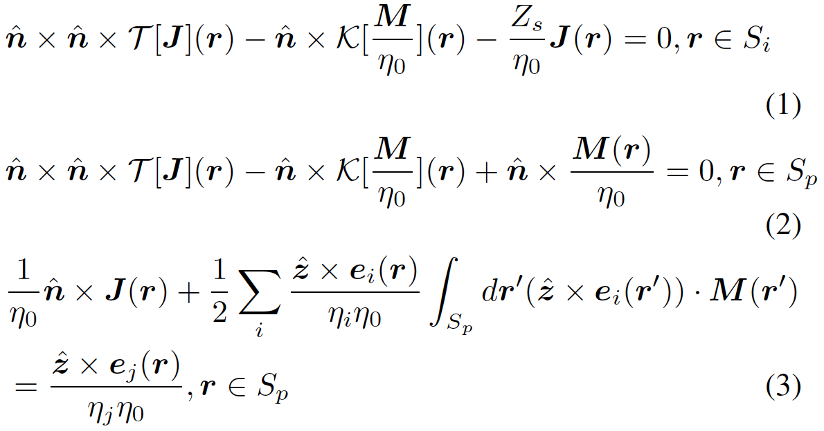
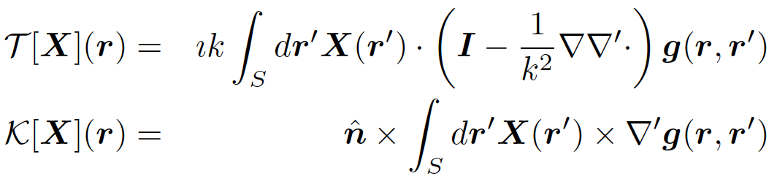
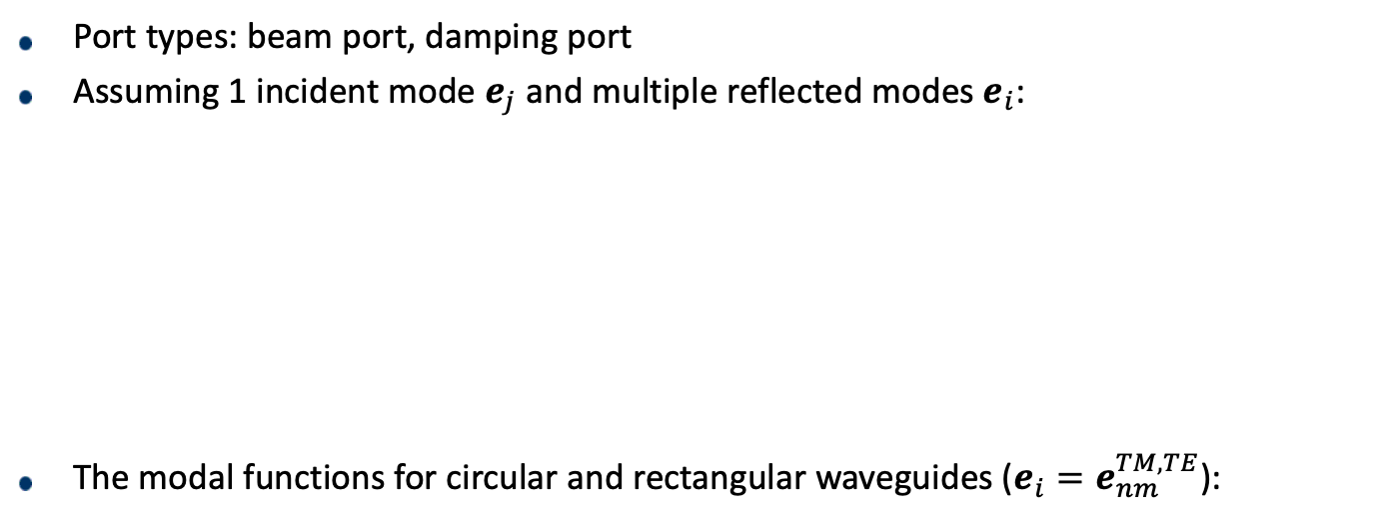
Formulation: IE for Cavities with Waveguide Ports
Port types: beam port, damping port
Assuming 1 incident mode $e_{j}$ and multiple reflected modes $e_{i}$:
The modal functions for circular and rectangular waveguides ($e_{i}=e_{nm}^{TM,TE}$):
Green’s function
rectangular
circular
5

Slide 6
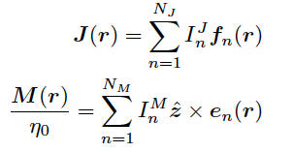
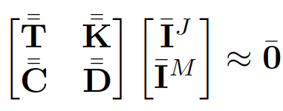
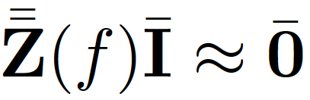
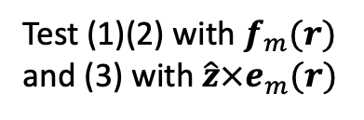
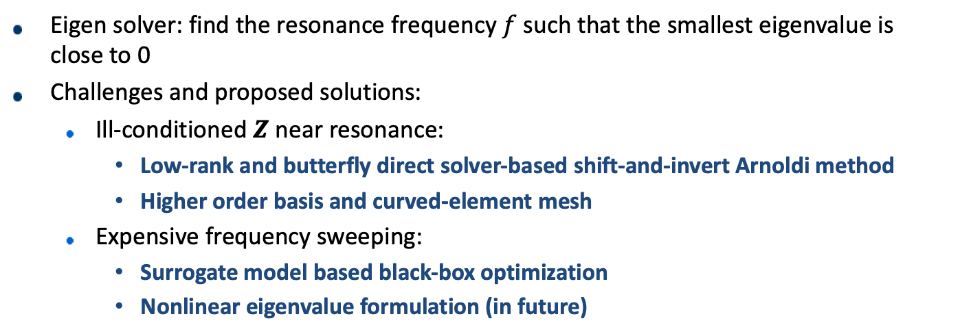
Formulation: IE for Cavities with Waveguide Ports
GWP basis and mode basis
Test (1)(2) with $f_{m}(r)$
and (3) with $\hat{z}×e_{m}(r)$
Eigen solver: find the resonance frequency $f$ such that the smallest eigenvalue is close to 0
Challenges and proposed solutions:
  Ill-conditioned $Z$ near resonance:
    Low-rank and butterfly direct solver-based shift-and-invert Arnoldi method
    Higher order basis and curved-element mesh
  Expensive frequency sweeping:
    Surrogate model based black-box optimization
    Nonlinear eigenvalue formulation (in future)
6

Slide 7
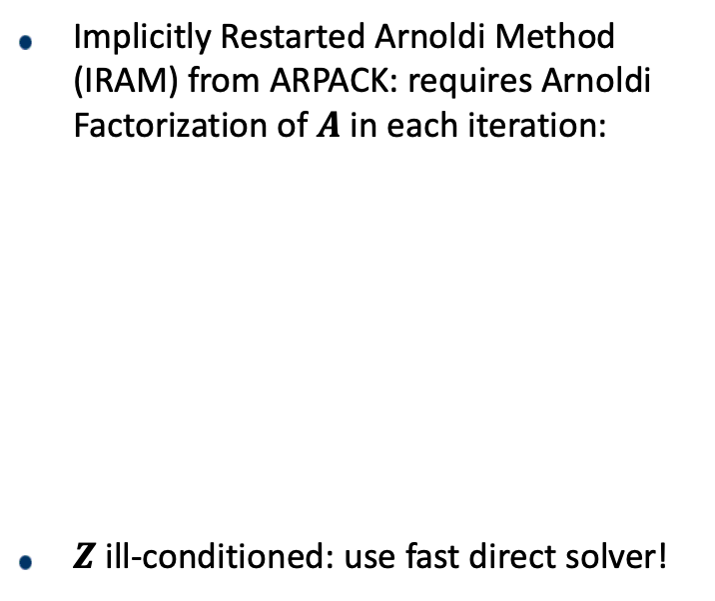
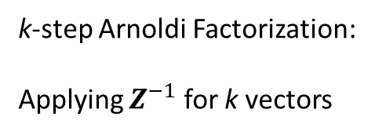
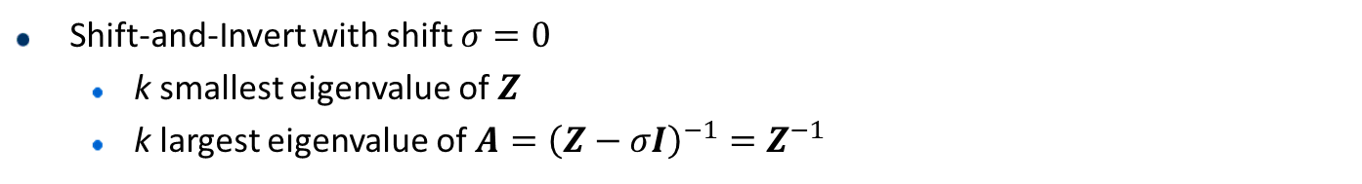
Shift-and-Invert Implicitly Restarted Arnoldi Method
Shift-and-Invert with shift $σ=0$
  k smallest eigenvalue of $Z$
  k largest eigenvalue of ${A=\left(Z−σI\right)}^{−1}=Z^{−1}$
Implicitly Restarted Arnoldi Method (IRAM) from ARPACK: requires Arnoldi Factorization of $A$in each iteration:
$Z$ ill-conditioned: use fast direct solver!
k-step Arnoldi Factorization:
Applying $Z^{−1}$ for k vectors
[1] R. B. Lehoucq , D. C. Sorensen, and C. Yang, 1998
7

Slide 8
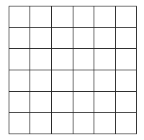



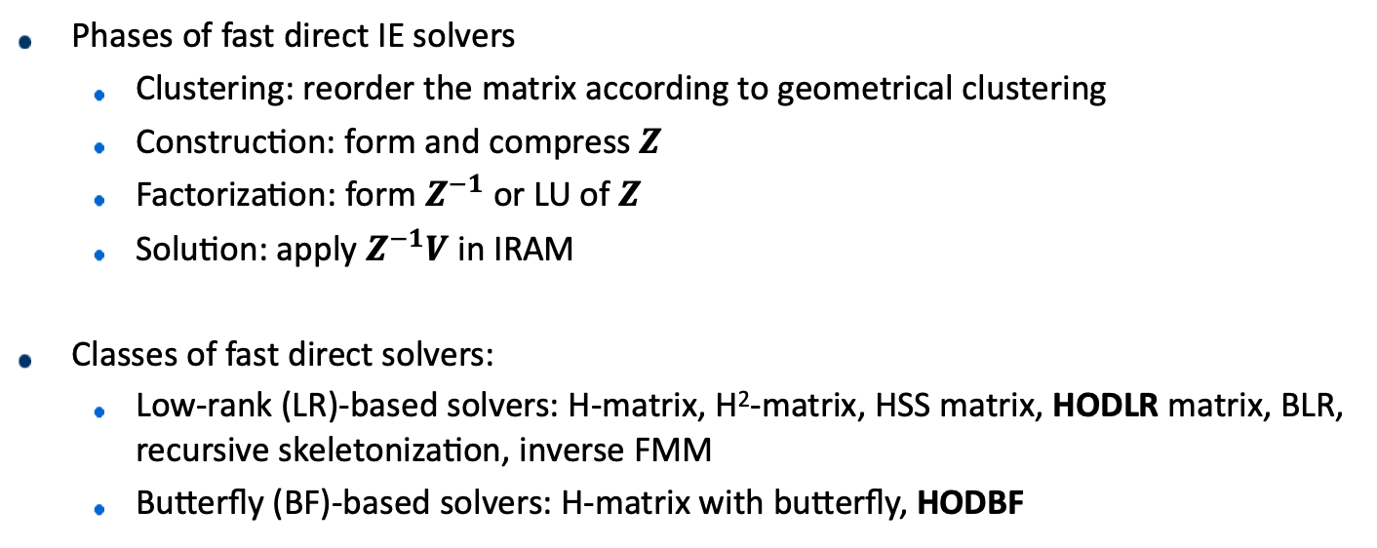
Fast direct IE solvers
Phases of fast direct IE solvers
  Clustering: reorder the matrix according to geometrical clustering
  Construction: form and compress $Z$
  Factorization: form $Z^{−1}$ or LU of $Z$
  Solution: apply $Z^{−1}V$ in IRAM
Classes of fast direct solvers:
  Low-rank (LR)-based solvers: H-matrix, H²-matrix, HSS matrix, HODLR matrix, BLR, recursive skeletonization, inverse FMM
  Butterfly (BF)-based solvers: H-matrix with butterfly, HODBF
Geometry partitioning
$Z^{}$
$Z^{−1}$
Mem ${≪N}^{2}$
8

Slide 9
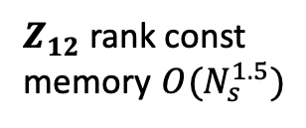


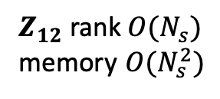


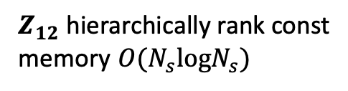
HODLR and HODBF Solvers
Focused solvers: Hierarchical off-diagonal low-rank (HODLR) and hierarchical off-diagonal butterfly (HODBF).
Low-freq regime (fundamental mode): blocks of $Z$ allow low-rank (LR) compression
High-freq regime (very high order mode): blocks of $Z$ allow butterfly (BF) compression
$Z_{12}$ rank const
memory $O(N_{s}^{1.5})$
$Z_{12}$ rank $O(N_{s})$
memory $O(N_{s}^{2})$
$Z$: low-freq
$Z$: high-freq
$Z_{12}$ hierarchically rank const
memory $O(N_{s}logN_{s})$
$Z$: high-freq

Slide 10
HODLR and HODBF Inversion
Factorization with exact or approximate inversion
Randomized butterfly operations:
or LR operations:
LR or BF
LR or BF
LR or BF
SMW formula
[1] A. Aminfar, S. Ambikasaran, and E. Darve, JCP, 2016
[2] Y. Liu, H. Guo, and E. Michielssen, IEEE AWPL., 2017
[3] Y. Liu, P. Ghysels, L. Claus, and X. S. Li, SISC, 2021

Slide 11
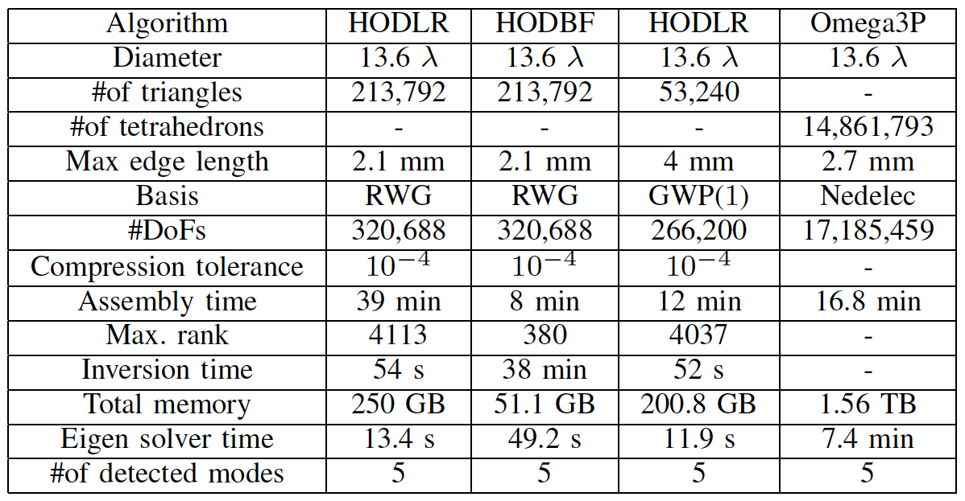
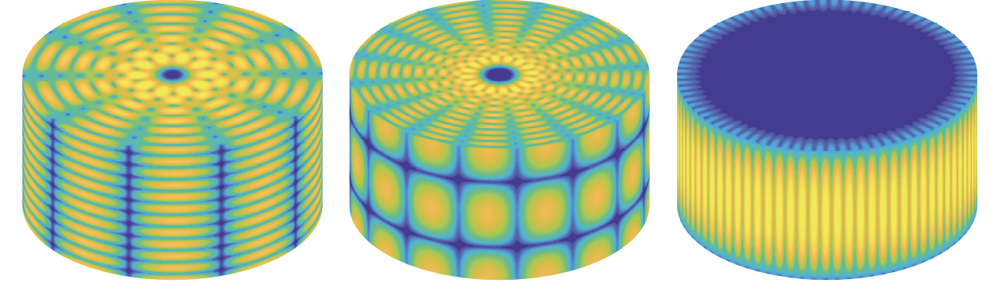
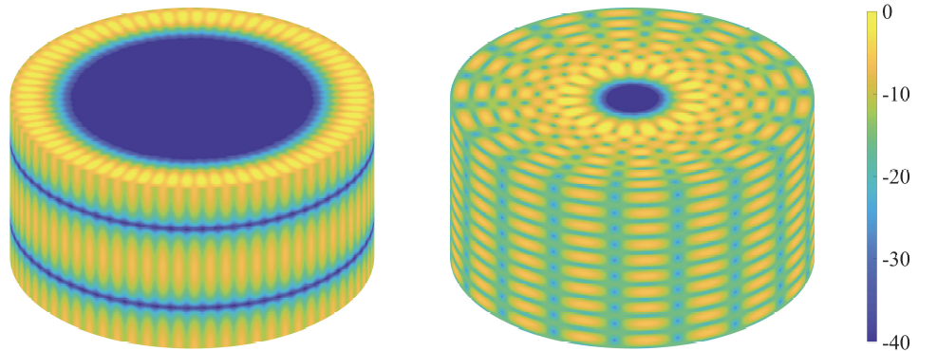


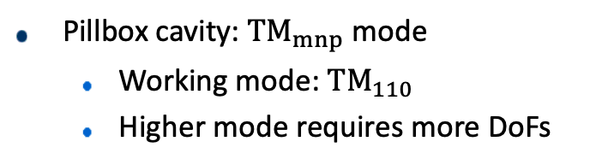

Pillbox Cavity (No Port)
Pillbox cavity: ${TM}_{mnp}$ mode
  Working mode: ${TM}_{110}$
  Higher mode requires more DoFs
$$f_{mnp}=\frac{c}{2π} \text{((}\frac{\text{BesselJZero}\text{[}n, m\text{]}}{R}{\text{)}}^{2} \text{+(}\frac{pπ}{La}{\text{)}}^{2}{\text{)}}^{0.5}$$
$f=20.472 GHz$, 16 Cori nodes
$\left|J\right|$ (in dB) for 5 detected modes at $20.472 GHz$

Slide 12
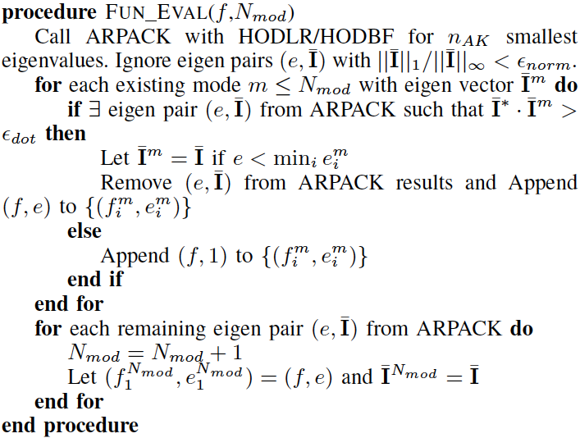
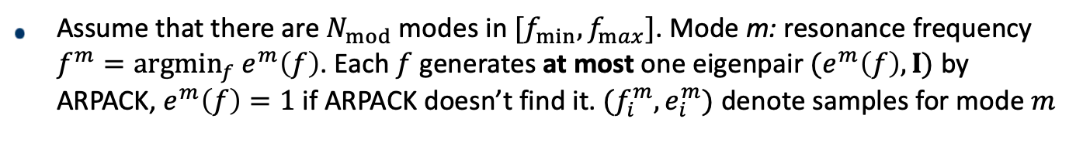
Augmented Bayesian Optimization for Frequency Sampling
Assume that there are $N_{mod}$ modes in $[f_{min},f_{max}]$. Mode m: resonance frequency $f^{m}=argmin_{f} e^{m}\left(f\right)$. Each $f$ generates at most one eigenpair $(e^{m}\left(f\right),I)$ by ARPACK, $e^{m}\left(f\right)=1$ if ARPACK doesn’t find it. $(f_{i}^{m},e_{i}^{m})$ denote samples for mode $m$
12

Slide 13
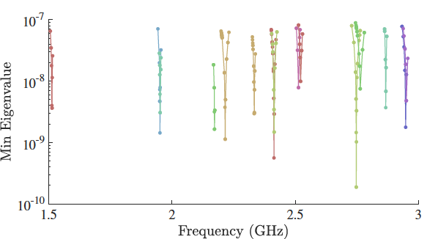
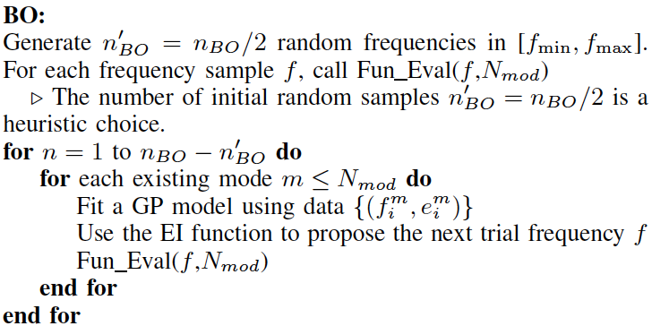
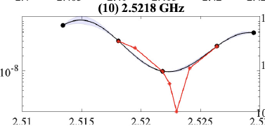
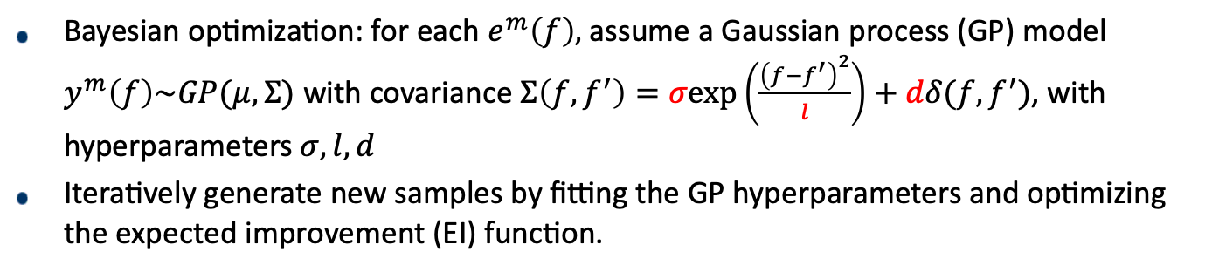

Bayesian Optimization (BO)
Assume that there are $N_{mod}$ modes in $[f_{min},f_{max}]$. Mode m: resonance frequency $f^{m}=argmin_{f} e^{m}\left(f\right)$. Each $f$ generates at most one eigenpair $(e^{m}\left(f\right),I)$ by ARPACK, $e^{m}\left(f\right)=1$ if ARPACK doesn’t find it. $(f_{i}^{m},e_{i}^{m})$ denote samples for mode $m$
Bayesian optimization: for each $e^{m}\left(f\right),$assume a Gaussian process (GP) model $y^{m}\left(f\right)\sim GP(μ,Σ)$ with covariance $Σ\left(f,f^{′}\right)=σexp\left(\frac{{\left(f−f^{′}\right)}^{2}}{l}\right)+dδ(f,f^{′})$, with hyperparameters $σ, l, d$
Iteratively generate new samples by fitting the GP hyperparameters and optimizing the expected improvement (EI) function.
BO samples are further refined by Nelder–Mead
13

Slide 14
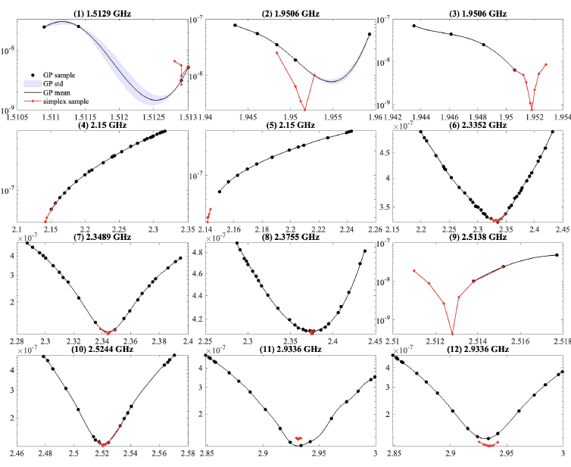
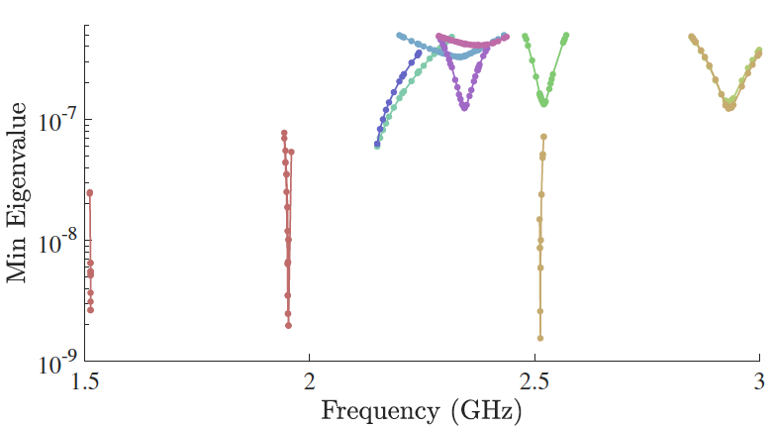
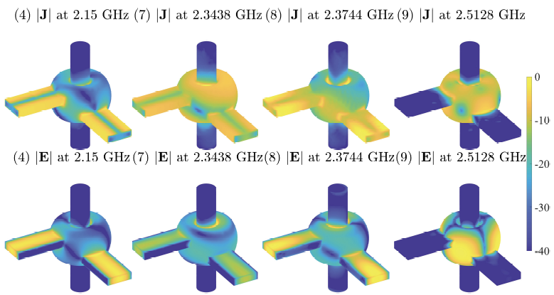
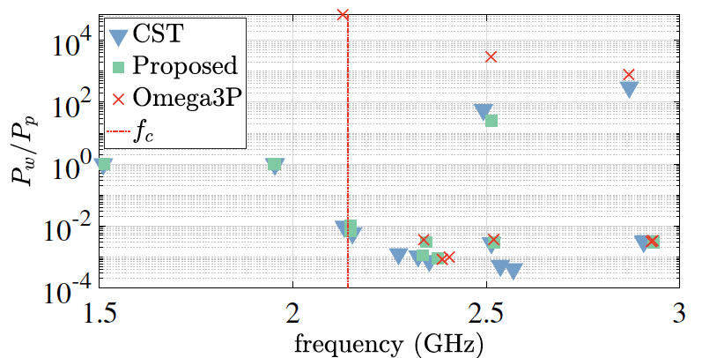

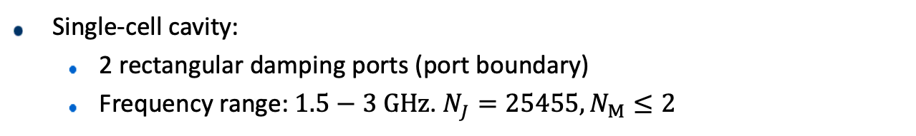
Single-Cell Cavity with Waveguide Boundaries
Single-cell cavity:
  2 rectangular damping ports (port boundary)
  Frequency range: $1.5−3 GHz$. $N_{J}=25455, N_{M}≤2$
working freq
All frequency samples
Zoomed-view of all frequency samples
$\left|J\right|$ and $\left|E\right|$ (in dB) for 5 selected modes
Ratio between dissipated and damped powers

Slide 15
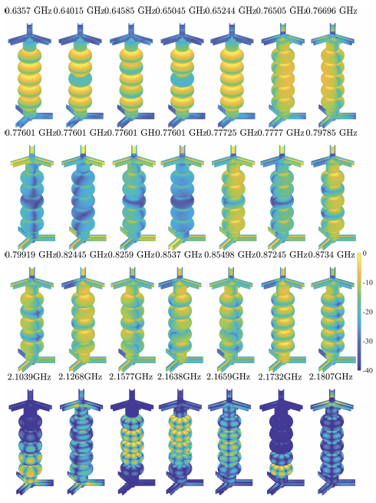
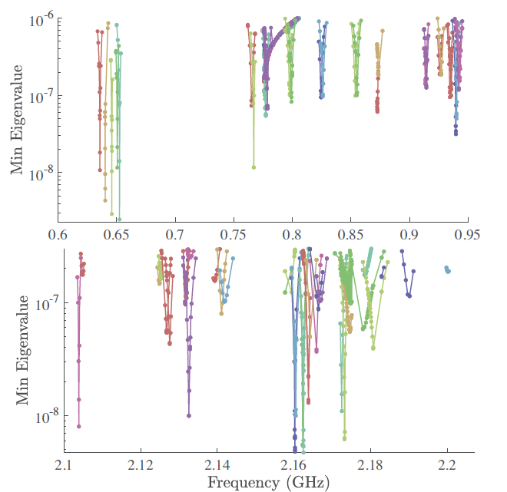

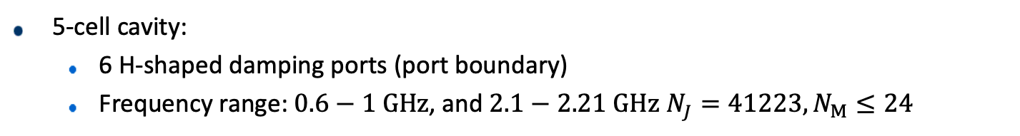
5-Cell Cavity with H-Shaped Waveguide Ports
5-cell cavity:
  6 H-shaped damping ports (port boundary)
  Frequency range: $0.6−1 GHz$, and $2.1−2.21 GHz$ $N_{J}=41223, N_{M}≤24$
working freq
All frequency samples
Surface $\left|E\right|$ (in dB) for 21 selected modes

Slide 16
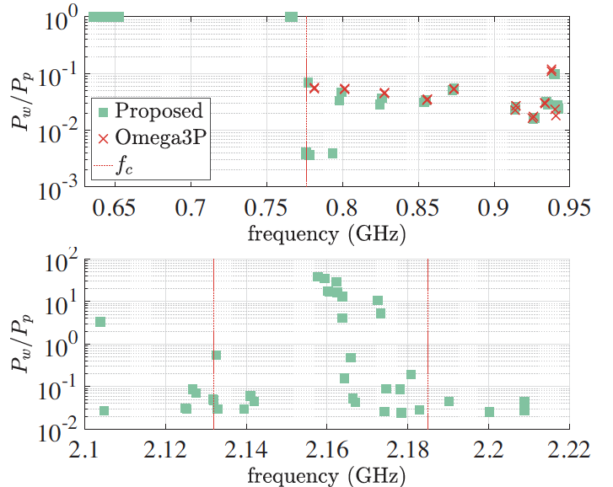
5-Cell Cavity with H-Shaped Waveguide Ports
5-cell cavity:
  6 H-shaped damping ports (port boundary)
  Frequency range: $0.6−1 GHz$, and $2.1−2.21 GHz$ $N_{J}=41223, N_{M}≤24$
Ratio between dissipated and damped powers
[1] Y. Liu, T. Luo, A. Rani, H. Luo, and X. Li, “Detecting resonance of radio-frequency cavities using fast direct integral equation solvers and augmented Bayesian optimization,” IEEE JMMCT, 2023.

Slide 17
Outline
Frequency-domain Simulation
  Characterization of resonance modes of a RF cavity
  Forward simulation needed in cavity design
  Existing Tools (FD/FEM): Omega3P, CST, etc.
  Our work: frequency-domain integral equation (FD-IE) formulations
Time-domain Simulation
  Modeling electromagnetic interaction between a RF cavity and a relativistic electron bunch (rigid model or beam dynamics-based)
  Wake-field modeling, multi-pacting, etc.
  Existing tools (FD/FEM): ACE3P, CST, etc.
  Our work: time-domain integral equation (TD-IE) formulations
17

Slide 18
TDIE Formulation
Electric field TDIE (TD-EFIE)
PEC
vector potential
scalar potential
Expand current as
DoF:
Notes:
First, I will review the standard TD-SIE formulations. Suppose we have incident field Ei Hi illuminating on a PEC surface. The incident field is bandlimited to wmax and the simulation time is from 0 to capital T. The electrical field TDIE can be formulated by enforcing Boundary conditions require the tangential scattered electric fields due to surface current J must cancel out tangential incident fields on the surface. Here Le is the EFIE operator that involves a vector and scalar potential contributions

Slide 19
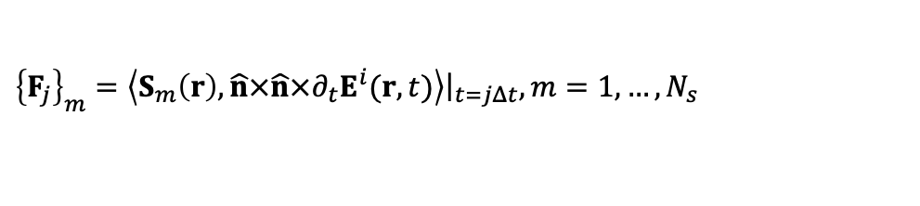
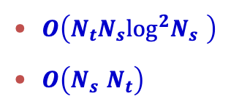

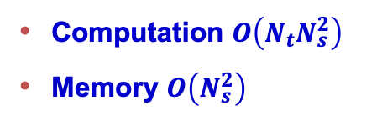
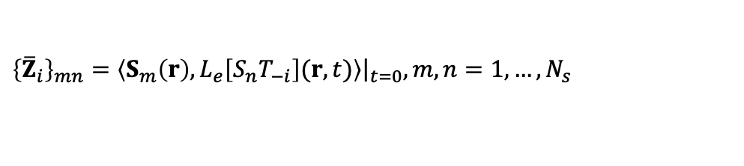
TDIE Solution
Enforce TD-EFIE at
${\left\{{\overline{Z}}_{i}\right\}}_{mn}=\left\langle S_{m}\left(r\right),L_{e}\left[S_{n}T_{−i}\right](r,t)\right\rangle {\left.​\right|}_{t=0},m,n=1,…,N_{s}$
${\left\{I_{j}\right\}}_{n}=I_{n,j},n=1,…,N_{s}$
${\left\{F_{j}\right\}}_{m}=\left\langle S_{m}\left(r\right),\hat{n}×\hat{n}×∂_{t}E^{i}(r,t)\right\rangle {\left.​\right|}_{t=jΔt},m=1,…,N_{s}$
immediate interactions
unknowns
tested incident field
delayed interactions
previously computed
Cost:
  Computation $O\left({N_{t}N}_{s}^{2}\right)$
  Memory $O\left(N_{s}^{2}\right)$
Fast algorithms^{[1][2]}
  $O\left({N_{t}N_{s}\log^{2}N}_{s}^{}\right)$
  $O\left(N_{s}^{}N_{t}\right)$
[1] Y. Liu, A. C. Yücel, H. Bağcı, and E. Michielssen, “A scalable parallel PWTD-accelerated SIE solver for analyzing transient scattering from electrically large objects”, IEEE TAP, 2015.
[2] Y. Liu, A. C. Yücel, H. Bağcı, A. C. Gilbert, and E. Michielssen, “A wavelet-enhanced PWTD-accelerated time-domain integral equation solver for analysis of transient scattering from electrically large conducting objects”, IEEE TAP, 2018.
Notes:
Now, we use galerkin method in space and point matching in time, for every time step, we get a matrix equation. Let me immediately interpret the equation for you. Here Fj is the tested incident field at time step j, Ij is the collections of expansion coefficients, which is really a snapshot of the current at time step j. At every time step, the tested scattered field from unknown current coefficient Ij at time step j plus tested scattered field from past current must cancel the tested incident field at time step j. After solving Ij, we move it to the RHS and then go to next time step. This implicit scheme is so called marching on in time or MOT. The computation bottleneck of this direct scheme is to calculate the scattered field from past current, the computational complexity is NtNs^2 and memory is Ns^2.

Slide 20

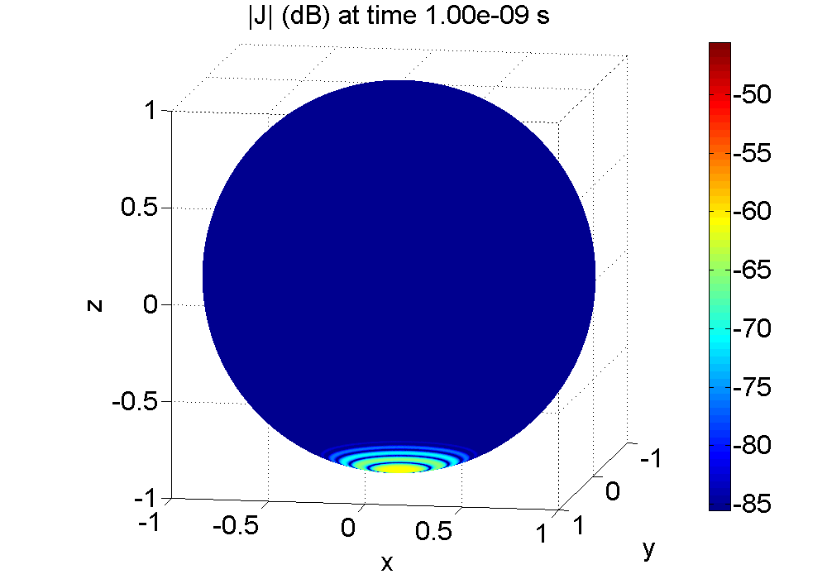
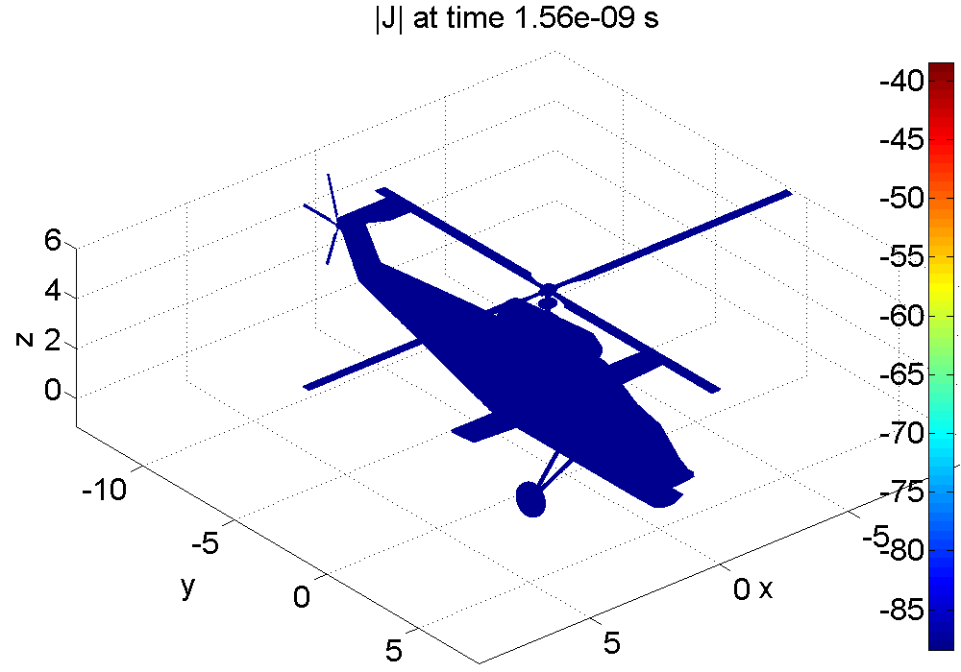
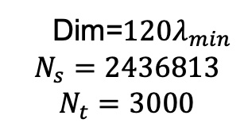
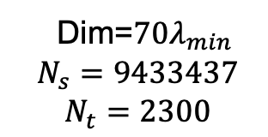
Large-Scale TDIE Results (Plane Wave Excitation)
Dim=$120λ_{min}$
$$N_{s}=2436813$$
$$N_{t}=3000$$
Dim=$70λ_{min}$
$$N_{s}=9433437$$
$$N_{t}=2300$$
[1] Y. Liu, A. C. Yücel, H. Bağcı, and E. Michielssen, “A scalable parallel PWTD-accelerated SIE solver for analyzing transient scattering from electrically large objects”, IEEE TAP, 2015.
[2] Y. Liu, A. C. Yücel, H. Bağcı, A. C. Gilbert, and E. Michielssen, “A wavelet-enhanced PWTD-accelerated time-domain integral equation solver for analysis of transient scattering from electrically large conducting objects”, IEEE TAP, 2018.

Slide 21
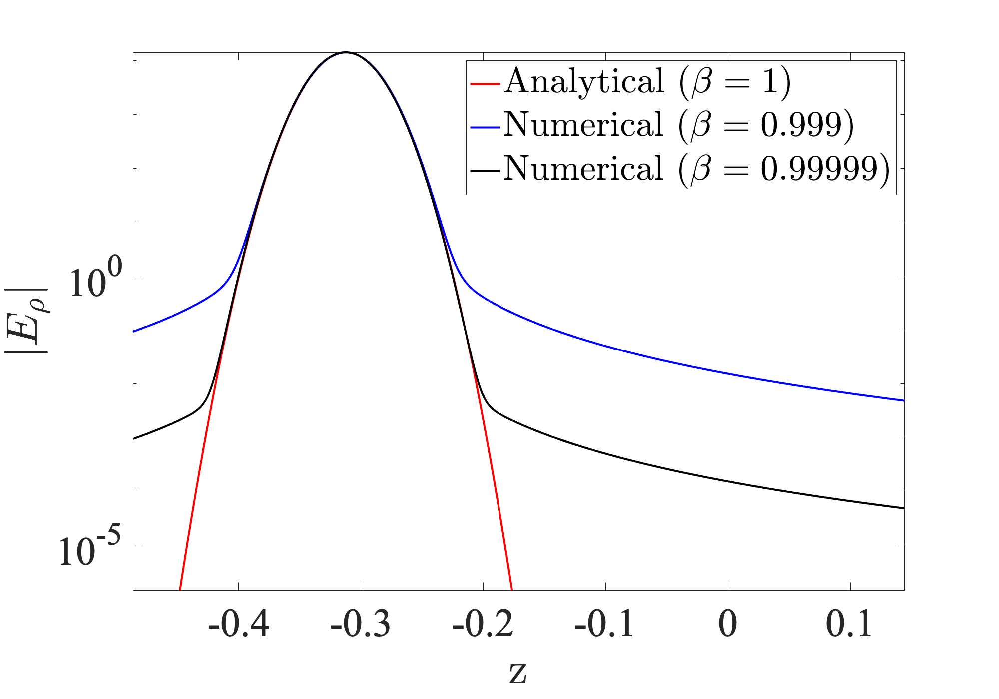
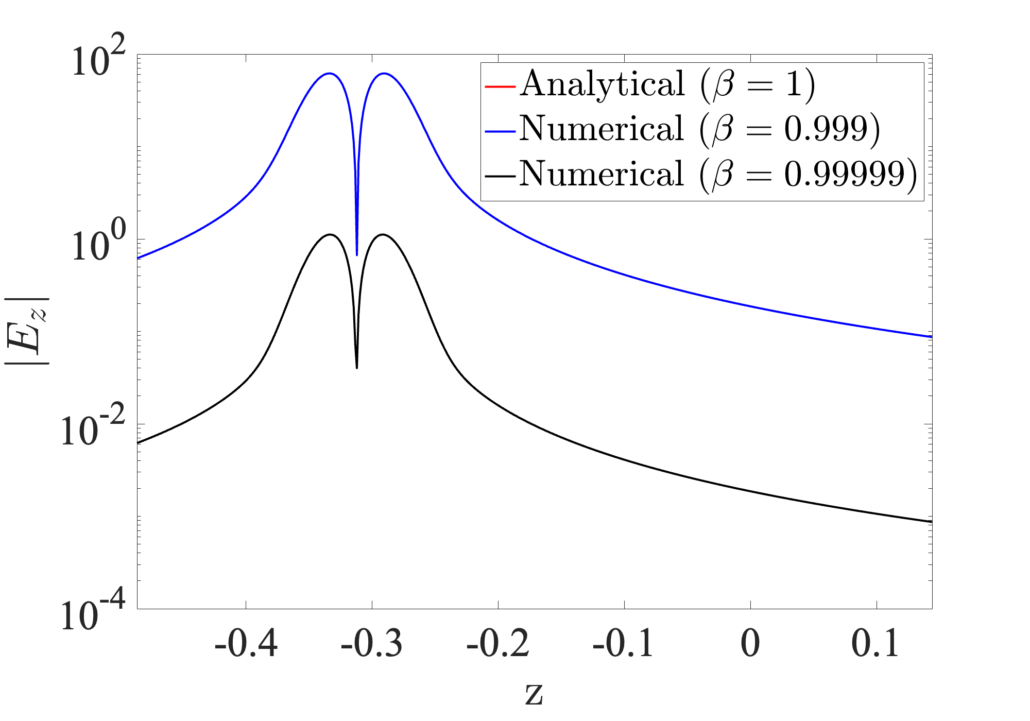
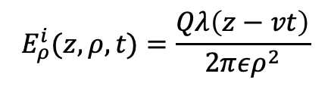


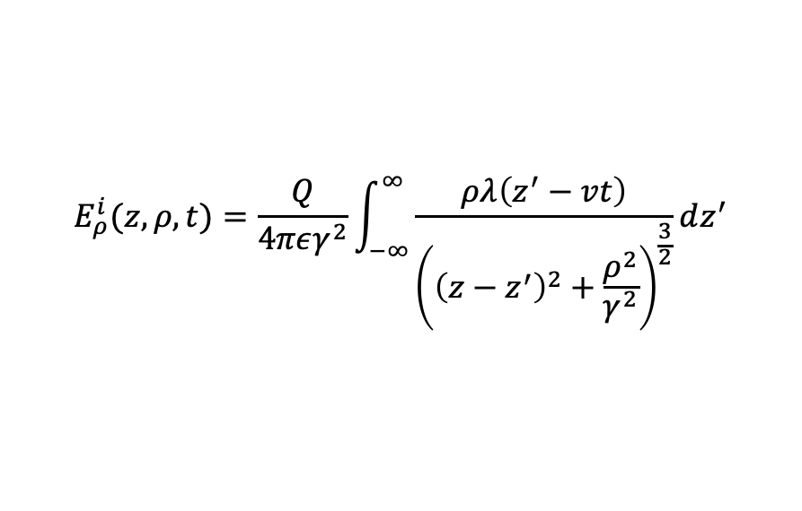




Electron Bunch Excitation: ${\left\{F_{j}\right\}}_{m}=\left\langle S_{m}\left(r\right),\hat{n}×\hat{n}×∂_{t}E^{i}(r,t)\right\rangle {\left.​\right|}_{t=jΔt}$
$$z=z_{0}$$
$$z=0$$
Analytical ($β=1$)
Numerical integration ($β<1$)
$$z$$
$$v$$
$$E_{ρ}^{i}(z,ρ,t)=\frac{Qλ\left(z−vt\right)}{2περ^{2}}$$
  $$E_{z}^{i}(z,ρ,t)=0$$
$$λ\left(z\right)=\frac{1}{\sqrt{2π}σ}e^{−\frac{{(z−z_{0}) }^{2}}{2σ^{2}}}$$
Charge density
$$E_{ρ}^{i}(z,ρ,t)=\frac{Q}{4πεγ^{2}}\int_{−∞}^{∞}{\frac{ρλ\left(z^{′}−vt\right)}{{\left({\left(z−z^{′}\right)}^{2}+\frac{ρ^{2}}{γ^{2}}\right)}^{\frac{3}{2}}}}dz^{′}$$
  $$E_{z}^{i}(z,ρ,t)=\frac{Q}{4πεγ^{2}}\int_{−∞}^{∞}{\frac{\left(z−z^{′}\right)λ\left(z^{′}−vt\right)}{{\left({\left(z−z^{′}\right)}^{2}+\frac{ρ^{2}}{γ^{2}}\right)}^{\frac{3}{2}}}}dz^{′}$$
$$ρ=0.025,t=0$$

Slide 22




TDIE Results
$$z=z_{0}$$
$$z=0$$
Bunch speedup: $β=1,$ $γ=∞$
Bunch length: $σ=0.02$
#unknowns $N_{s}=24665$
$$z$$
$$v$$
$$λ\left(z\right)=\frac{1}{\sqrt{2π}σ}e^{−\frac{{(z−z_{0}) }^{2}}{2σ^{2}}}$$
Charge density
$E^{s}$ at the cavity center

Slide 23



TDIE Results
$$z=z_{0}$$
$$z=0$$
Bunch speedup: $β=0.99,$ $γ=7.0888$
Bunch length: $σ=0.02$
#unknowns $N_{s}=24665$
$$z$$
$$v$$
$$λ\left(z\right)=\frac{1}{\sqrt{2π}σ}e^{−\frac{{(z−z_{0}) }^{2}}{2σ^{2}}}$$
Charge density
$E^{s}$ at the cavity center

Slide 24



TDIE Results
$$z=z_{0}$$
$$z=0$$
Bunch speedup: $β=0.99,$ $γ=7.0888$
Bunch length: $σ=0.005$
#unknowns $N_{s}=24665$
$$z$$
$$v$$
$$λ\left(z\right)=\frac{1}{\sqrt{2π}σ}e^{−\frac{{(z−z_{0}) }^{2}}{2σ^{2}}}$$
Charge density
$E^{s}$ at the cavity center

Slide 25

Summary
FDIE method
  Search for the resonance frequency at which the system matrix’s smallest eigenvalue is close to 0
  Linear eigen problem with waveguide ports for a given frequency
  Surface discretization, no numerical dispersion
  Accurate modeling above and below cutoff frequencies
  System matrix is ill-conditioned near resonance -> fast direct solvers
  Expensive frequency sweeping -> augmented BO
TDIE Method
  Excitation $E^{i}(r,t)$ at each time step from rigid bunch models or particle-based codes.
  Surface discretization, no numerical dispersion
  Fast algorithms for the TDIE code handling interaction among surface unknowns.
  Rigid bunch: one-way coupling: $E^{i}(r,t)$ by numerical integration.
  Particle codes: two-way coupling: How about fast algorithms for computing $E^{i}(r,t)$ and $E^{s}(r_{p},t)$ ?
25

Slide 26



Acknowledgement
Exascale Computing Project (17-SC-20-SC)
Scientific Discovery through Advanced Computing (SciDAC) program through the FASTMath Institute under Contract No. DE-AC02-05CH11231.
Laboratory Directed Research and Development Program of Lawrence Berkeley National Laboratory under U.S. Department of Energy Contract No. DE-AC02-05CH11231

