Slide 1
Automation and AI integration at the CERN injectors
A. Huschauer, V. Kain, M. Schenk, F. Velotti on behalf of the CERN accelerator community
14th International Computational Accelerator Physics Conference Lufthansa Seeheim Conference Hotel 02. October 2024

Slide 2
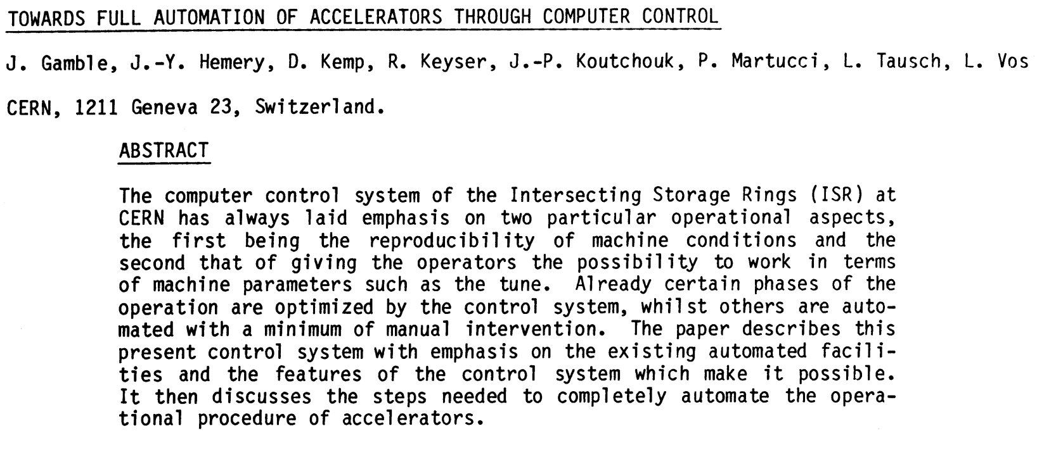
40+ years ago at the CERN ISR …
J. Gamble et al., 11th International Conference on High-Energy Accelerators, CERN, Geneva, July 1980

Slide 3
40+ years ago at the CERN ISR …
J. Gamble et al., 11th International Conference on High-Energy Accelerators, CERN, Geneva, July 1980
Have come a long way
Advanced analysis, modelling, algorithms (& computing libraries)
Flexibility of DAQ, real-time processing, control system
Improved BI & logging: observables, amount of data / bandwidths
Computing power
Some things have largely remained the same
Need for automation: complex interlinked systems, maximising machine availability and beam quality, reducing beam setup times
Reproducibility challenges: magnetic hysteresis and eddy-current effects, external factors beyond our control
Challenge of convincing ourselves of need and feasibility for automation

Slide 4
Introduction
Accelerator automation history (at CERN)
Closing the loop: continuous control or auto-launch
Infrastructure: server-based solutions
Equipment: predictive maintenance, fault analysis, …
Classical automation
Reduce complexity through models high-level parameter models with hierarchies, settings generation
Sequencers, watchdogs & SW interlocks, classic control
Adding AI / ML
High-level parameter control
Hierarchical structures
Conditional sequencing of actions
1980
2018
systematic exploitation of ML & AI
2006
2021 -
Optimisers, ML, …
Typically on-demand
Learn models if not available
Infrastructure: Python & frameworks
Notes:
Recent years: addition of AI / ML to control room. However, not yet in a systematic manner. → EPA

Slide 5
Contents
Introduction
Efficient Particle Accelerators
Infrastructure
Specific WPs
Final remarks

Slide 6
Contents
Introduction
Efficient Particle Accelerators
Infrastructure
Specific WPs
Final remarks

Slide 7
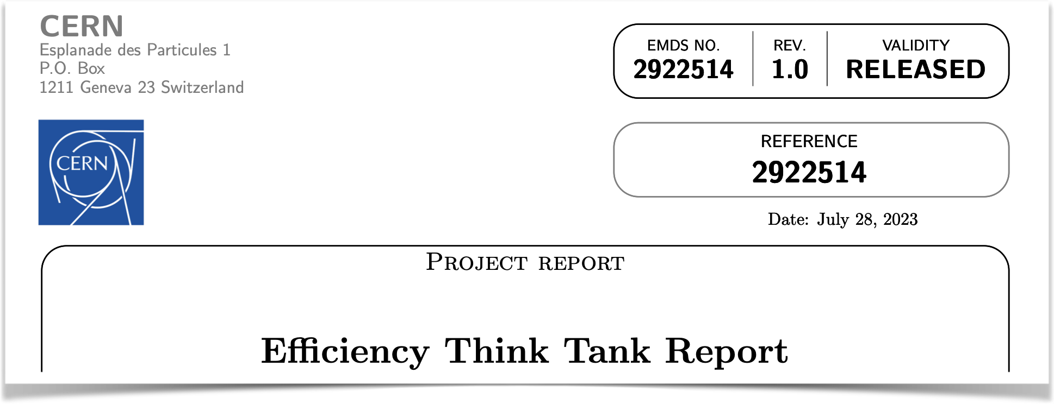
Efficient Particle Accelerators project
Efficiency Think Tank
Question coming up repeatedly at CERN end-of-year workshops ‘21 & ‘22
How to better exploit the accelerator complex? in terms of efficiency, reproducibility, flexibility, and performance
Efficiency Think Tank (ETT) in 2023
7 strategic recommendations

Slide 8
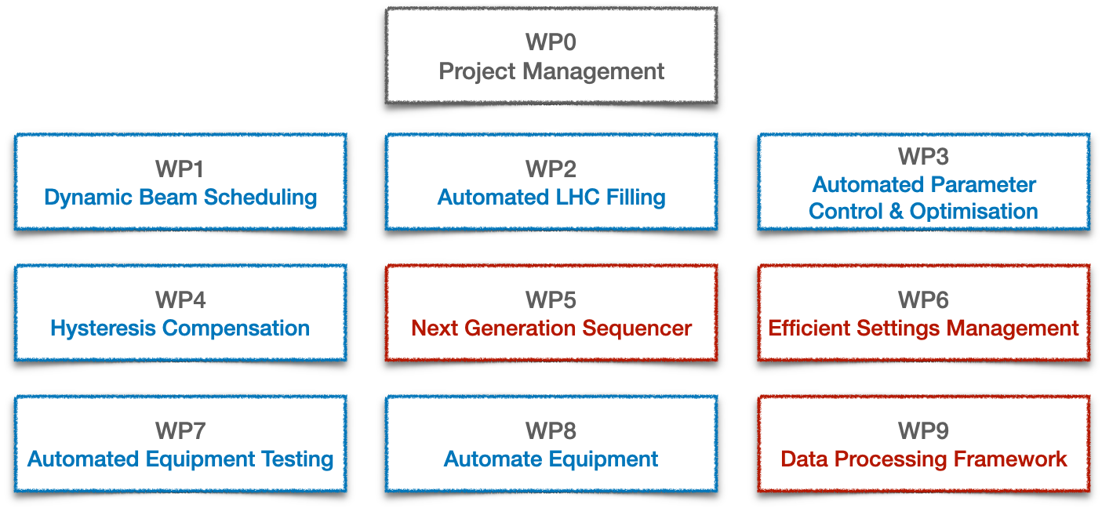
Efficient Particle Accelerators project
From think-tank to project
Think tank Efficient Particle Accelerators (EPA) project
Approved in 2023 for a 5-year period
9 interlinked work packages (WP)
Think tank recommendations
Infrastructure evolution

Slide 9
Efficient Particle Accelerators project
From think-tank to project
Think tank Efficient Particle Accelerators (EPA) project
Approved in 2023 for a 5-year period
9 interlinked work packages (WP)
Evolving infrastructure is key to bringing AI / ML into operations
Think tank recommendations
Infrastructure evolution

Slide 10
Contents
Introduction
Efficient Particle Accelerators
Infrastructure
Specific WPs
Final remarks

Slide 11
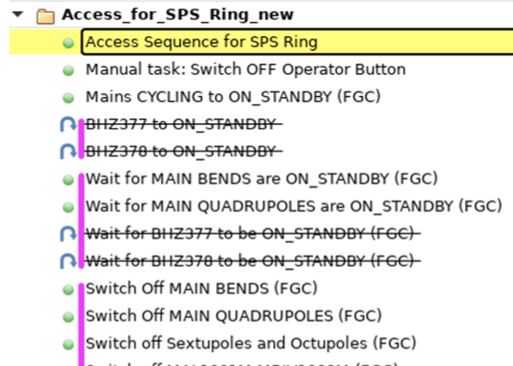
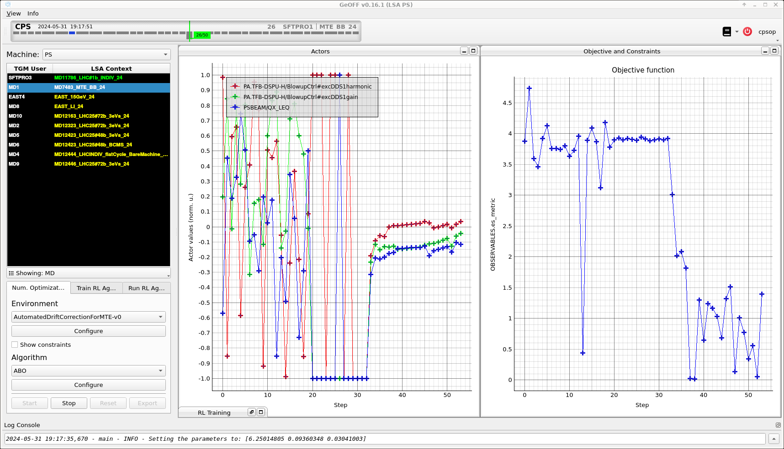
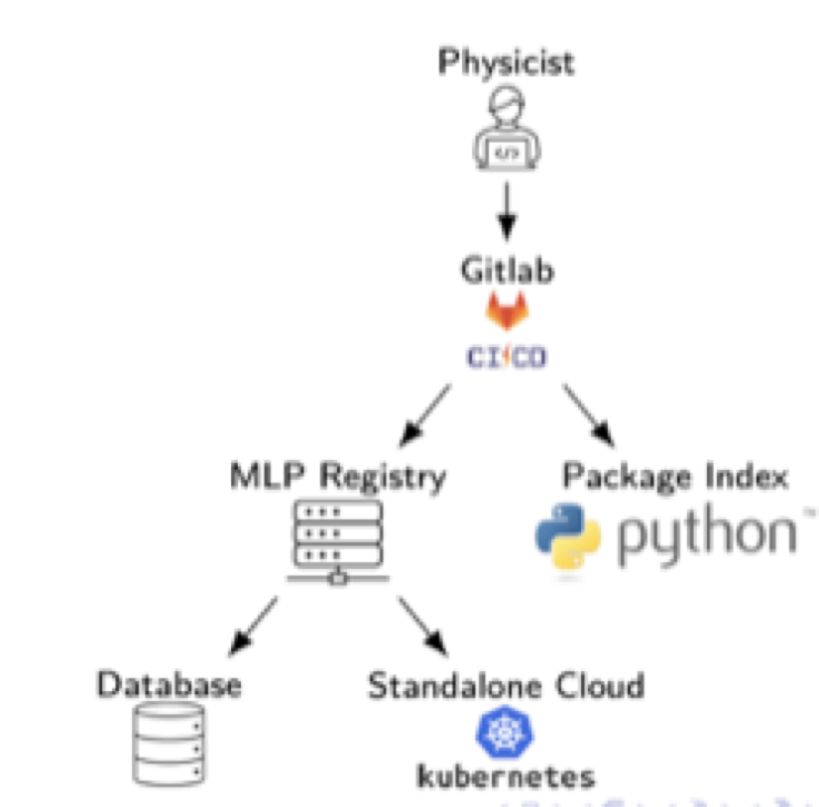
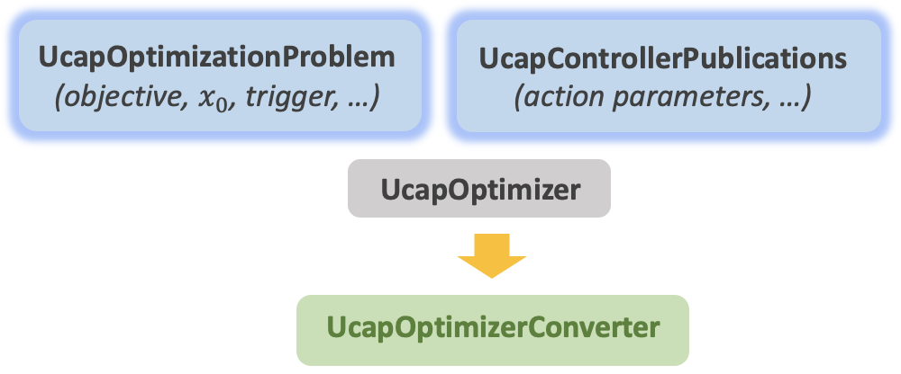
Infrastructure
Frameworks & building blocks
Acc-Py “accelerating Python”
Full integration of Python with control system
Online data acquisition, equipment access (set / get), app development, …
Python package index
Classical automation concepts
UCAP Unified Controls Acquisition & Processing
Sequencer: programmatic execution of tasks
High-level parameter models
AccTesting
Virtual device service
Event-based, online data transformations
Further evolution with EPA
EPA: sequencer 2.0, equipment testing, settings management
Enabling automation with AI / ML
Auto-pilots & optimisers
GeOFF Generic Optimisation Framework and Frontend
Machine Learning Platform Deployment & inference of (ML) models
Facilitate implementation of automatic control
Exploit & expose features of control architecture
Maintain uniformity across complex
Service to store & share ML models with VC
Language agnostic
Available in control room
geoff4ucap Framework for optimisation & control via UCAP

Slide 12
Infrastructure
UCAP: Unified Controls Acquisition & Processing
Framework & service to implement and run online data processing pipelines
Pipelines can be chained and structured into hierarchies
Can combine data from (almost) any source
Plays a key role in realising various EPA objectives
Acquire
Transform
Publish
Subscribe to data sources
Group incoming data via EventBuilder (e.g. cycle stamp)
Can be specific cycle(s) or all
Process incoming data
Java or Python
GPU support
Publish results
Can be hardware “sets”
Can be stored in logging database

Slide 13
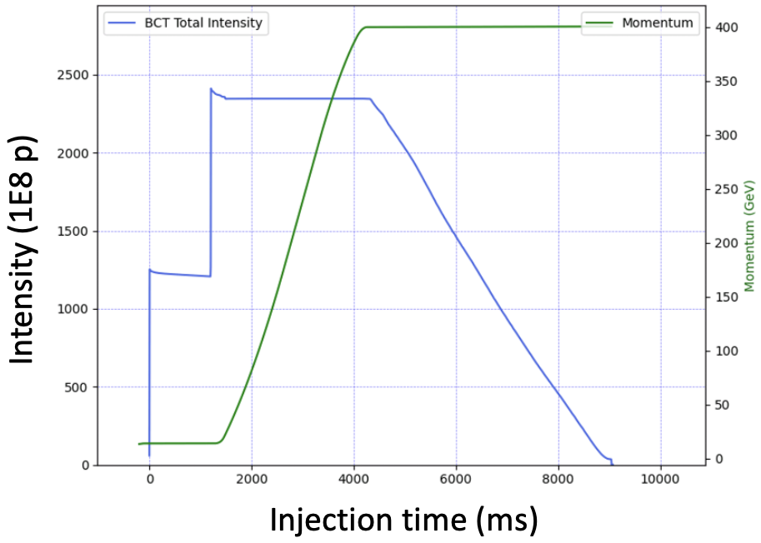
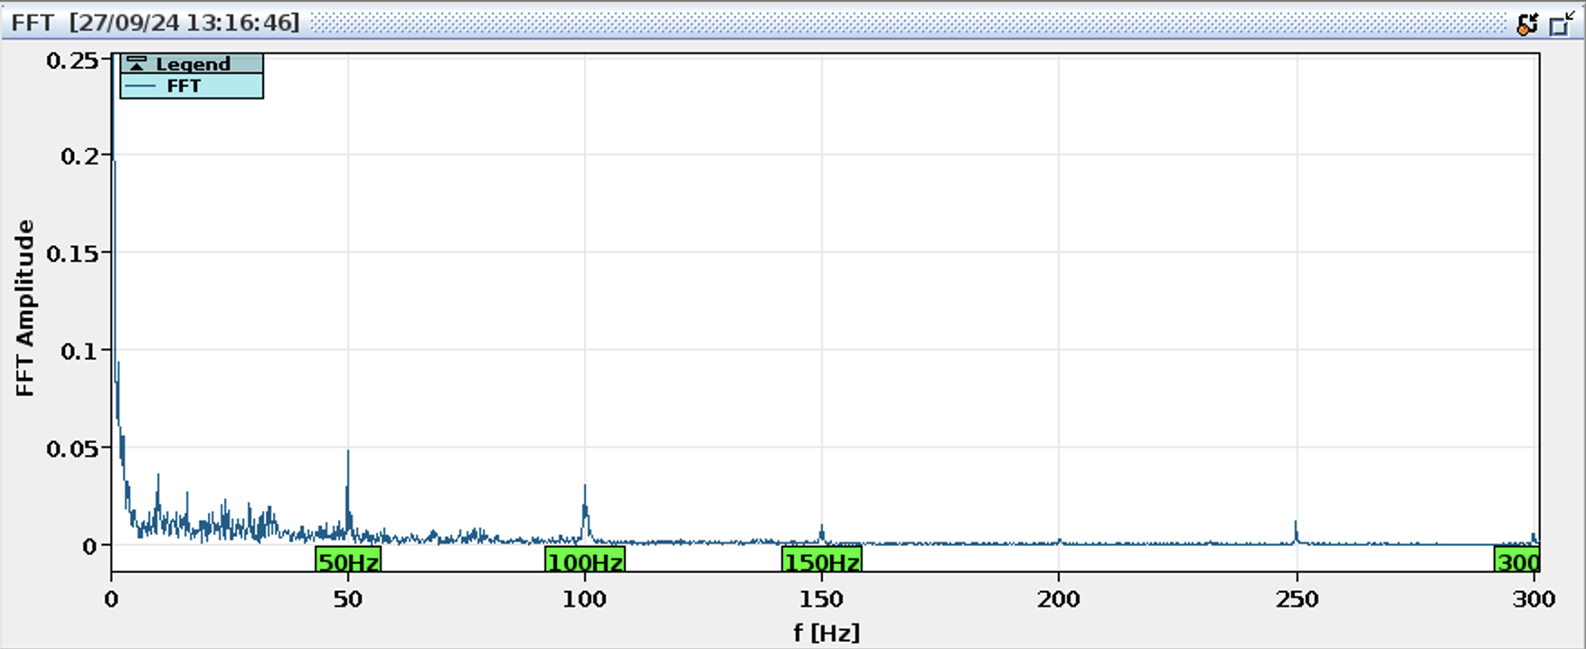
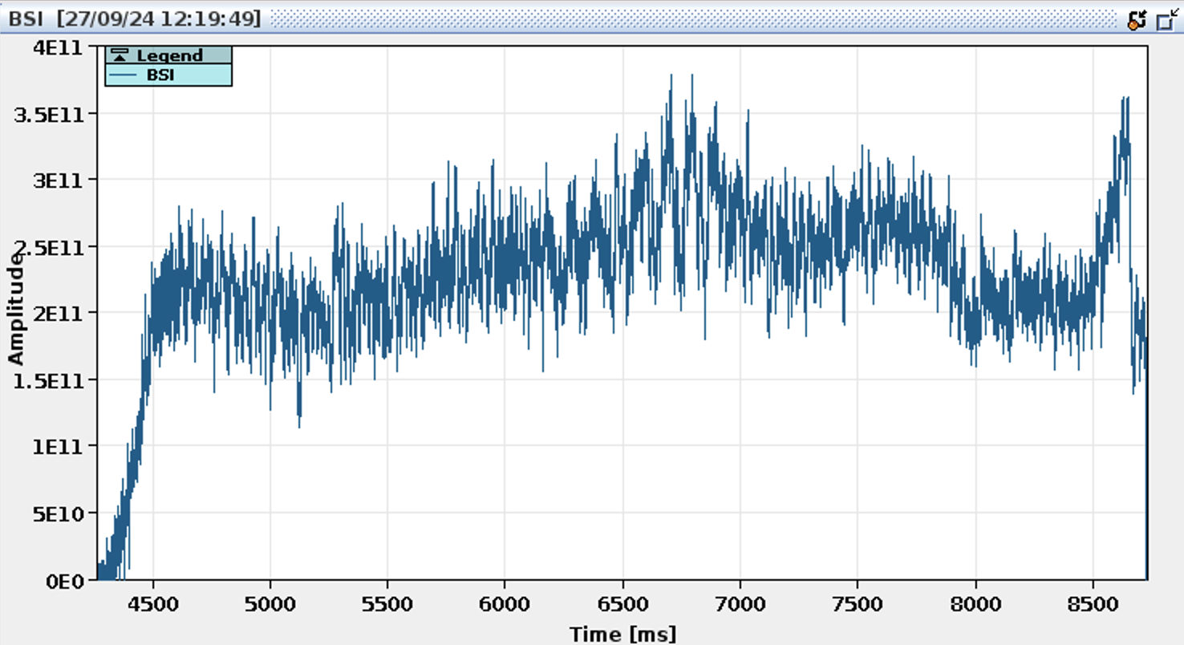
Infrastructure
UCAP: Unified Controls Acquisition & Processing
Example UCAP hierarchy: active noise cancellation on the SPS slow-extracted spill
Beams affected by noise introduced through power converter ripple (50 Hz and harmonics)
…
UCAP BCT concentrator
Intensity performance analysis
Dump time
Extracted intensity
SX spill analysis
Noise cancellation controller (GP model, GPU)
…
Noise spectrum
gain & phase (hardware “sets”)
Metadata
BSI signal (intensity during SX)
Other input
Data
Model

Slide 14
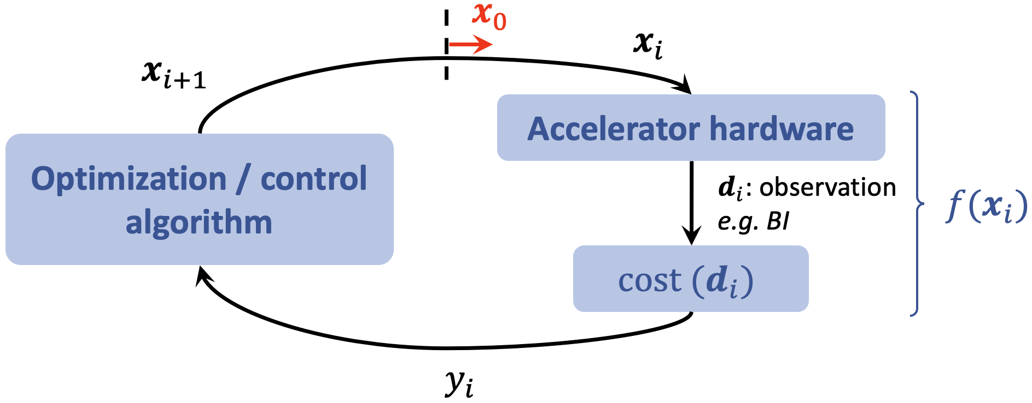
Infrastructure
GeOFF & geoff4ucap
Parameter optimisation & drift compensation problems are being tackled across the injector complex
Generic Optimisation Framework & Frontend (GeOFF)
Python framework to unify optimisation approaches
Standardised interfaces, tools for developers & docs
GUI application that wraps everything together
“Facilitate implementation of parameter optimisation task with primary focus on problem itself”
Initiated at CERN and since 2022 under development in collaboration with GSI
Since 2023 similar framework adopted for UCAP
Server-based GeOFF
Cover need for continuous controllers
or simulation …

Slide 15
Contents
Introduction
Efficient Particle Accelerators
Infrastructure
Specific WPs
Final remarks

Slide 16
Efficient Particle Accelerators project
From think-tank to project
Think tank Efficient Particle Accelerators (EPA) project
Approved in 2023 for a 5-year period
9 interlinked work packages (WP)
Evolving infrastructure is key to bringing AI / ML into operations
Think tank recommendations
Infrastructure evolution

Slide 17
Efficient Particle Accelerators project
Overview
Remove fixed supercycles by dynamically & algorithmically scheduling beams
Deterministic magnetic field control Will have positive impact on reproducibility for almost all beam dynamics processes
Automate & standardise beam preparation in injectors for LHC fills; Reduce impact on fixed target users and LHC turn-around time.
Automate parameter optimisation & compensate drifts
Automatic testing for “all” equipment to speed up hardware commissioning
Automation of equipment setup, fault analysis, and recovery; preparing the grounds for preventive maintenance

Slide 18
Efficient Particle Accelerators project
Overview
Remove fixed supercycles by dynamically & algorithmically scheduling beams
Deterministic magnetic field control Will have positive impact on reproducibility for almost all beam dynamics processes
Automate & standardise beam preparation in injectors for LHC fills; Reduce impact on fixed target users and LHC turn-around time.
Automate parameter optimisation & compensate drifts
Automatic testing for “all” equipment to speed up hardware commissioning
Automation of equipment setup, fault analysis, and recovery; preparing the grounds for preventive maintenance

Slide 19
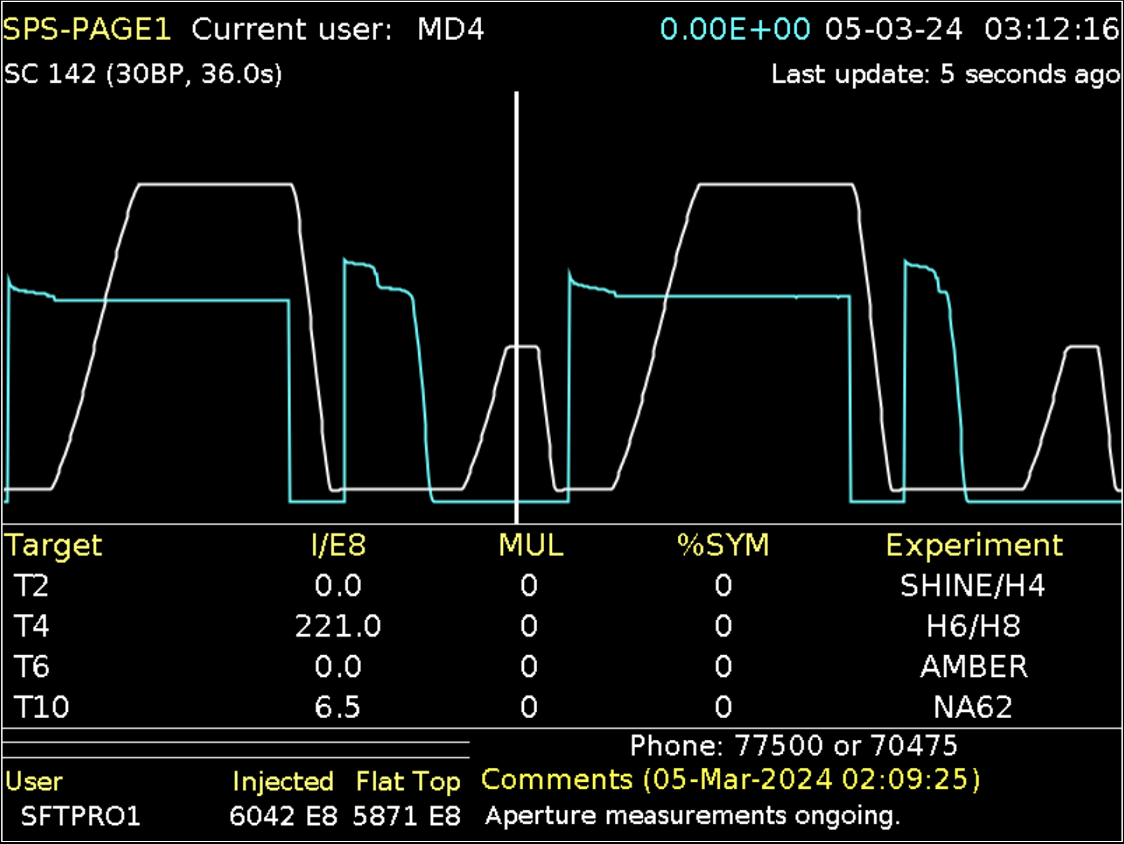
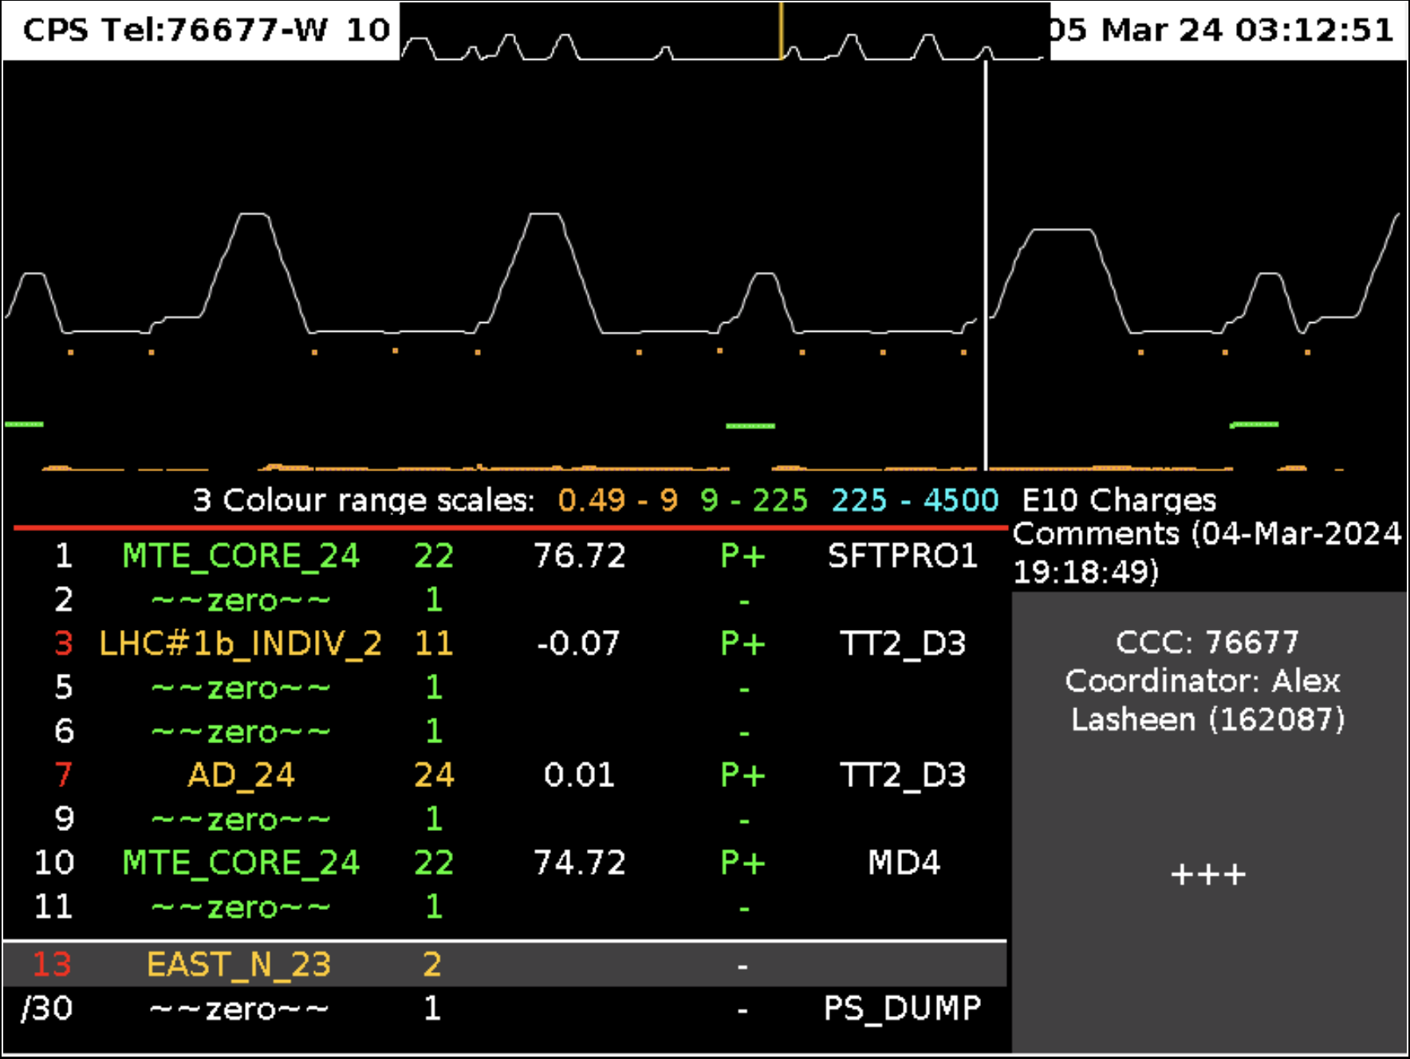
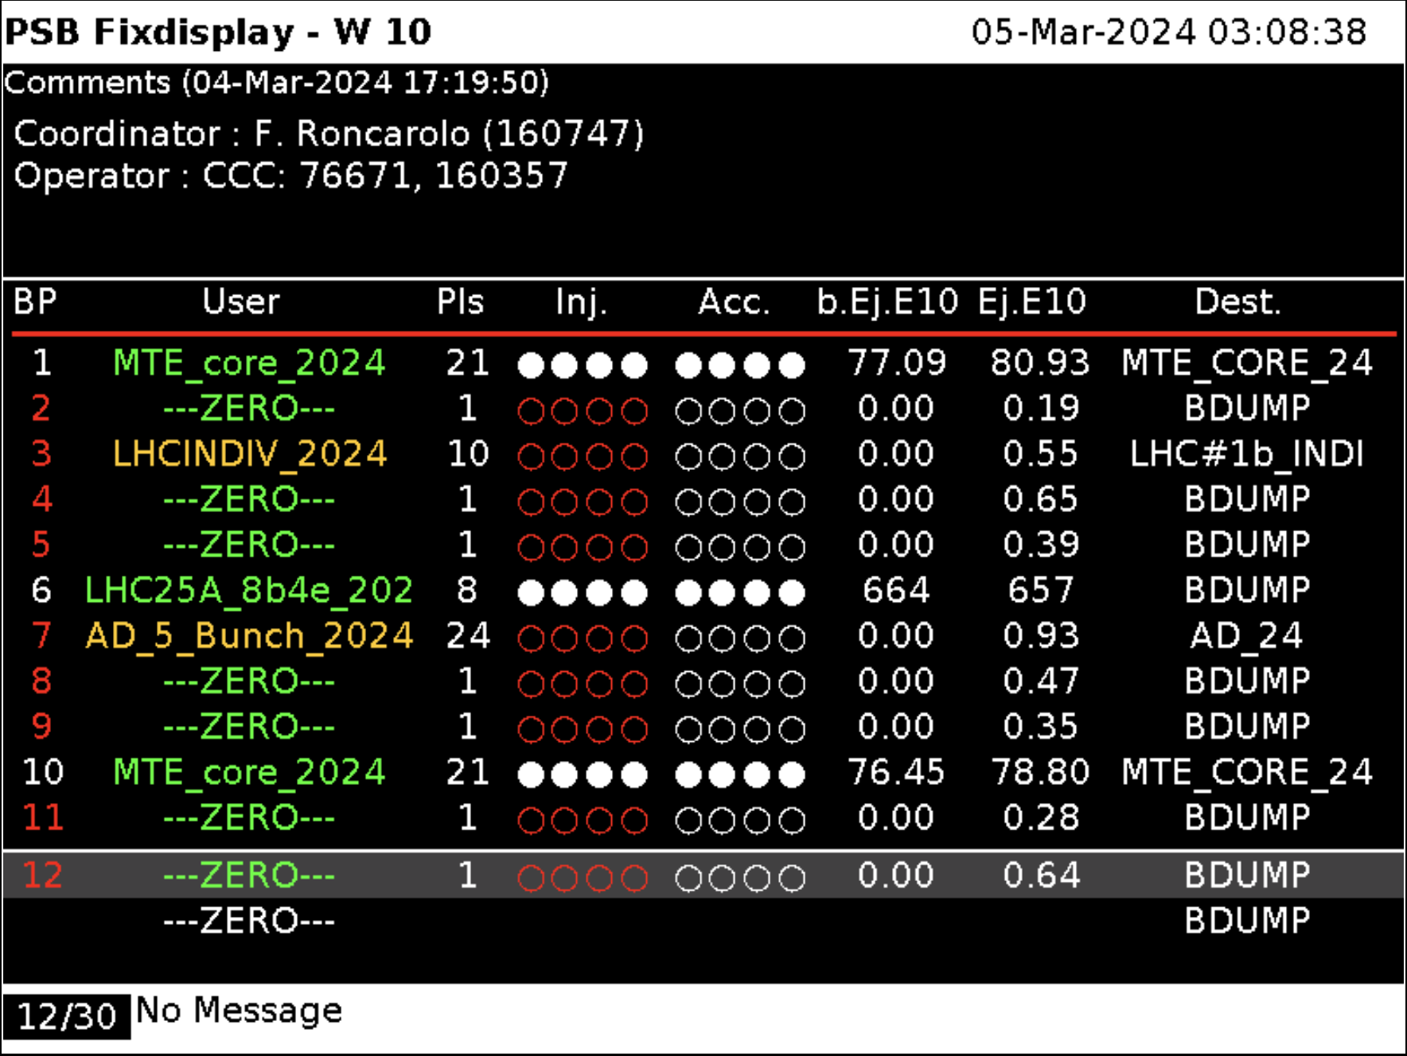
EPA: specific WPs
Dynamic beam scheduling
Supercycle (SC): sequence of beam types / cycles played over and over
Programming SC is a constrained scheduling problem and impacts efficiency & OP resources Constraints: some beams cannot be adjacent, respect priorities, etc. Stats: SC change takes 2 - 25 min; 40 - 60 x / 24 h
Goal: schedule beams live and automatically based on user requests
First version of scheduling algorithm ready to “fill-in the gaps”
Operational test before end of Run 2024
Fully dynamic scheduling requires compensation of magnetic hysteresis and eddy-current effects
SPS
PS
PSB
Notes:
multi-destination machines

Slide 20
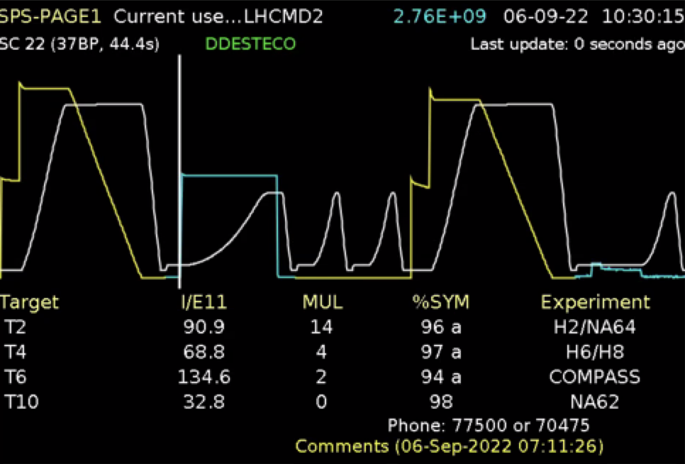
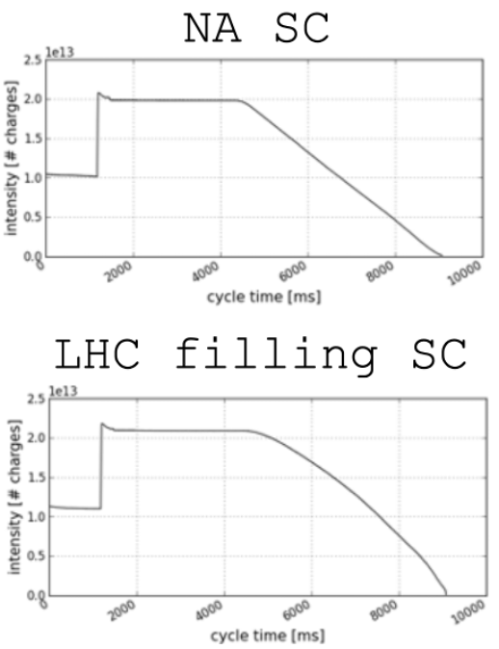
EPA: specific WPs
Hysteresis & eddy-current compensation
MD1 cycles
Feed-forward correction to provide reproducible magnetic fields
Saving cost, energy, time ”MD1 de-Gauss” cycle, 3.6 s, 5 kWh, ~10⁶ year ⁻¹
Reproducible conditions (orbit, tunes, etc.)
Flexibility: dynamic beam scheduling
PoC for main dipoles at SPS since 2023
To be extended to other multipoles and injectors (LEIR, PSB, PS)

Slide 21
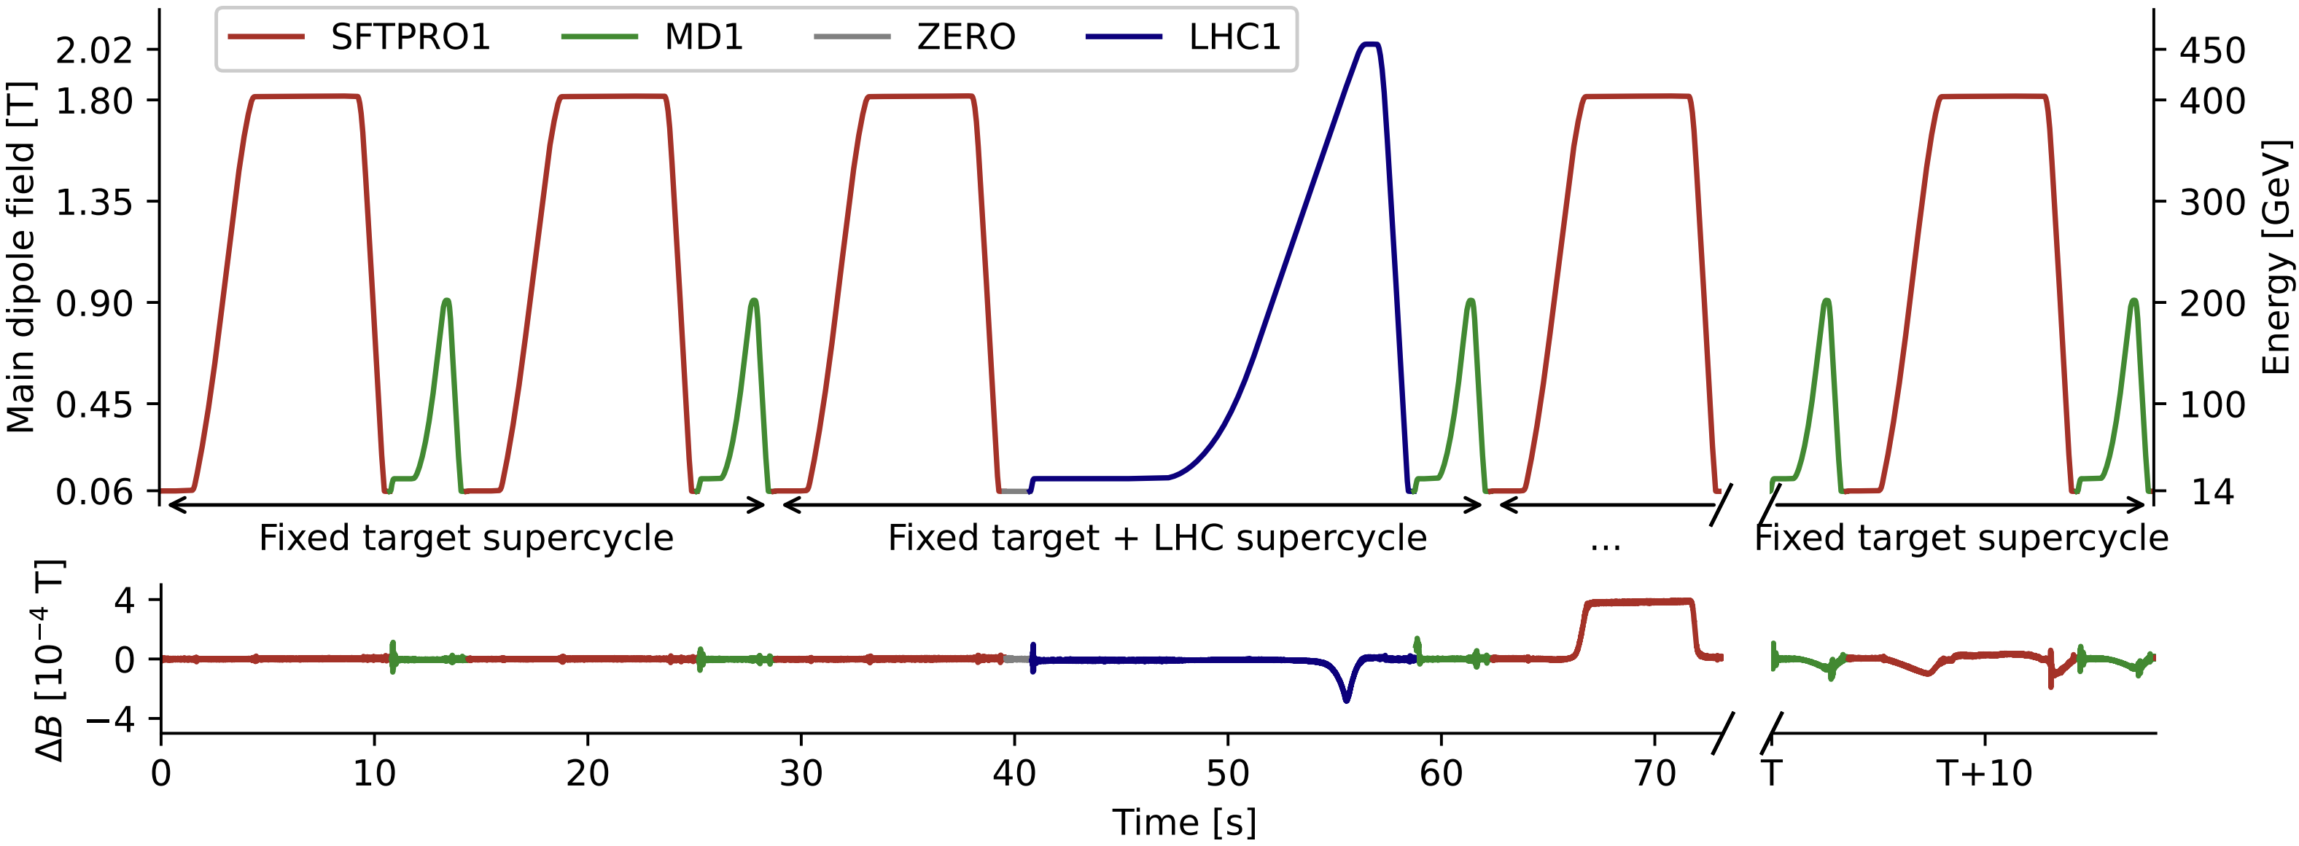
EPA: specific WPs
Hysteresis & eddy-current compensation
“B-Train” Online B-field measurement for SPS
Parasitic to OP: abundant, but lacking variability
Dedicated: explore different supercycle variations
Lab
More flexibility in data collection
“Sensor fusion”: combining Hall probes & flux meter
Challenges
Securing adequate data variability
Measurement accuracy, baseline drift, and noise
Data source
Model
Integration
Supercycle changes

Slide 22
EPA: specific WPs
Hysteresis & eddy-current compensation
Data source
Predict future $B$ based on past $I_{meas}, B_{meas (pred)}$ and future $I_{prog}$
Two types of time-series models under study
Physics-inspired models (e.g. PhyLSTM)
Temporal Fusion Transformer Powerful, but data hungry and compute-intensive training
Auto-regressive mode using past $B_{pred}$ also under exploration important for multipoles where no online measurement available
Challenges
Achieving sub-Gauss accuracy: crucial at low beam energies
Generalisability: capturing transitions between unseen cycles
Data quality (e.g. noise)
Model
Integration

Slide 23
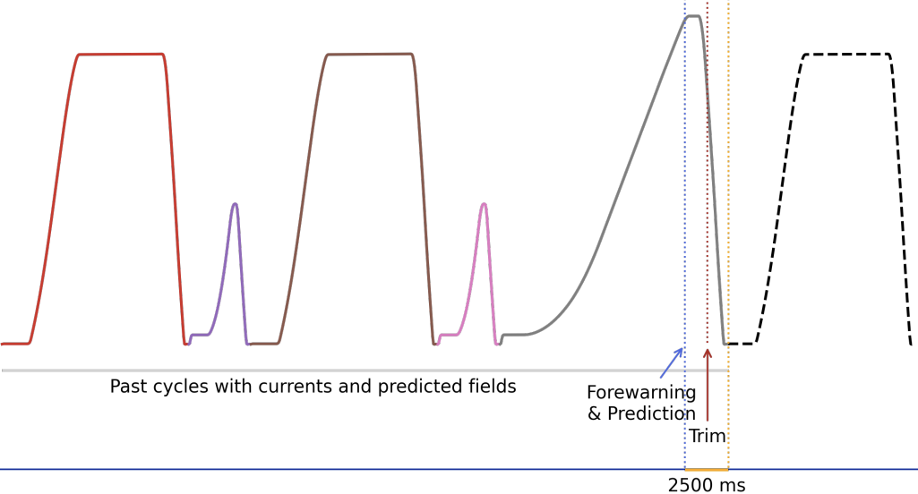
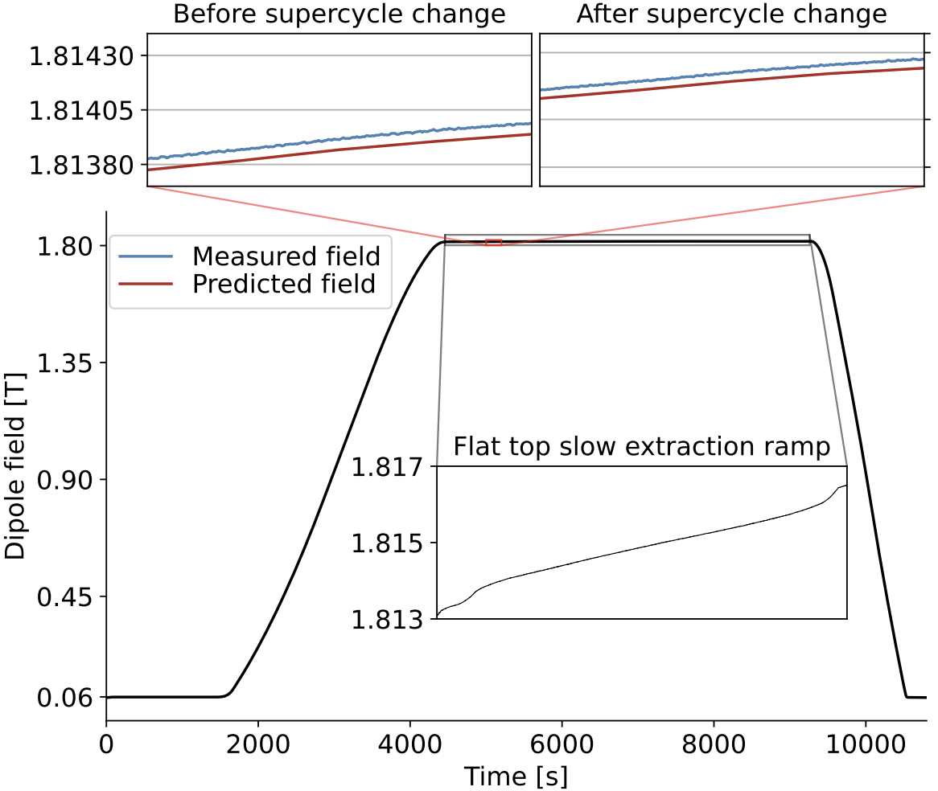
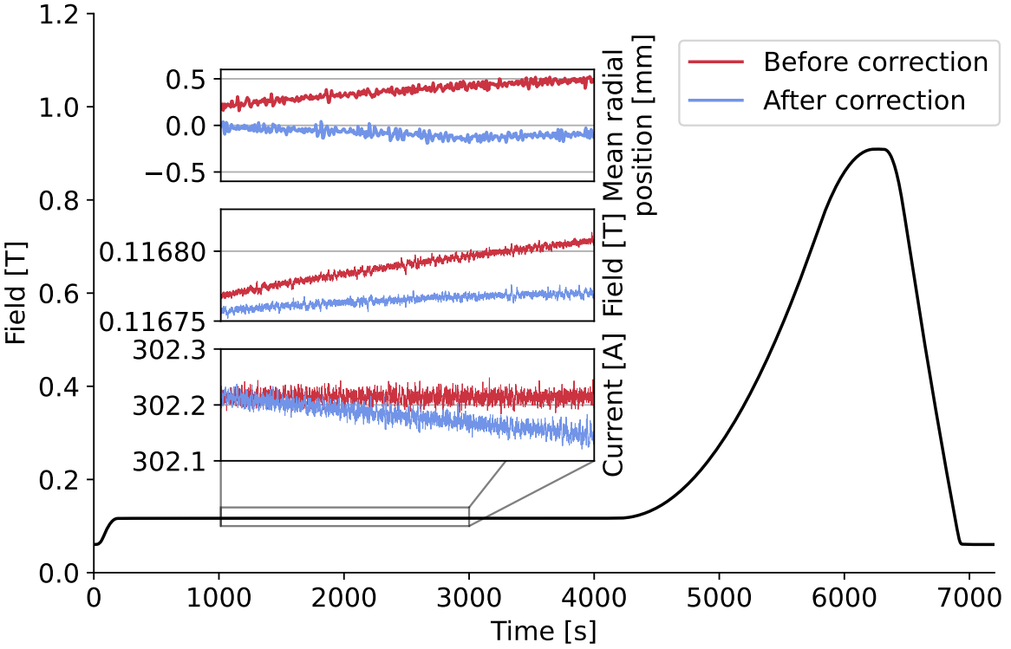
EPA: specific WPs
2.5 s to calculate & apply $ΔB$ correction (effectively: 800 ms for acquisition, prediction, postprocessing)
Hysteresis & eddy-current compensation
Data source
Model deployment, integration with controls infrastructure, and tests with beam
MD results
Promising real-time corrections for eddy-current compensation (“orbit flattening”) and hysteresis at high energy (SX beam)
Low-energy hysteresis corrections limited by data / prediction accuracy
Model
Prediction at high energy (SX beam)
Integration
Eddy-current compensation

Slide 24
Efficient Particle Accelerators project
Overview
Remove fixed supercycles by dynamically & algorithmically scheduling beams
Deterministic magnetic field control Will have positive impact on reproducibility for almost all beam dynamics processes
Automate & standardise beam preparation in injectors for LHC fills; Reduce impact on fixed target users and LHC turn-around time.
Automate parameter optimisation & compensate drifts
Automatic testing for “all” equipment to speed up hardware commissioning
Automation of equipment setup, fault analysis, and recovery; preparing the grounds for preventive maintenance

Slide 25
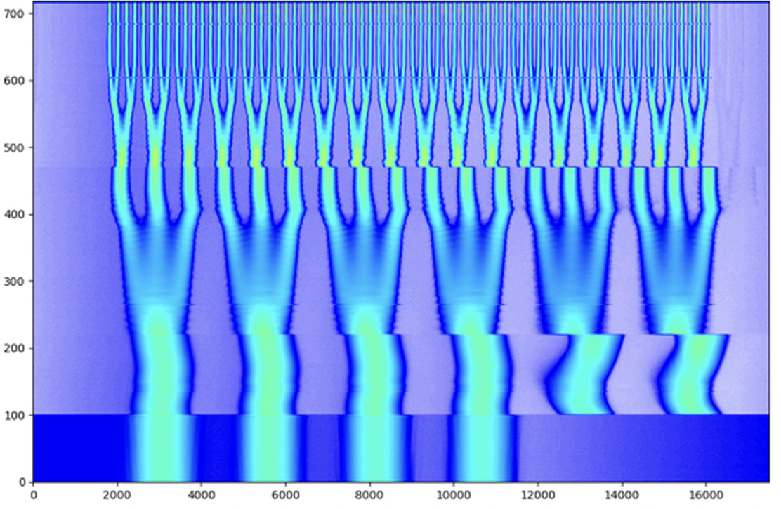
EPA: specific WPs
Automated LHC beam preparation
Goal: standardise LHC beam preparation and automate filling procedure
Produce beams according to clearly defined specs
Reduce turn-around: LHC fills vs fixed-target physics
First test before end of Run 2024
Full implementation during LS3 (2026 – 2029)
Key components
Orchestration of tasks and execution of sequences across complex
Continuous monitoring and quality assessment e.g. now in place for triple & double splittings
Automatic parameter optimisation (if needed)
UCAP and sequencer play major role
PS double splitting Intensity vs phase

Slide 26
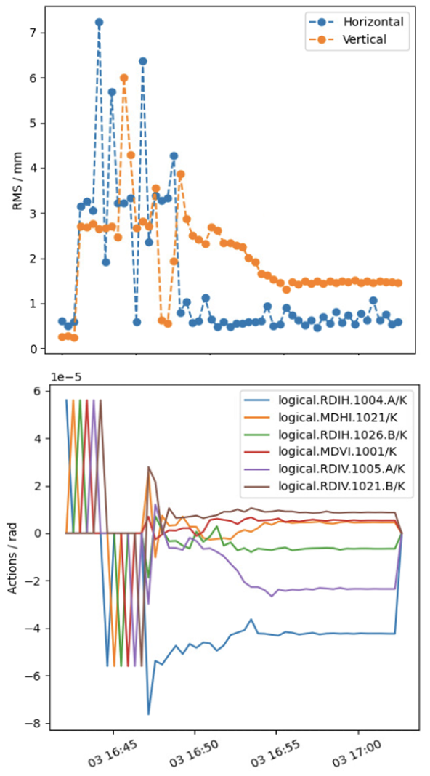
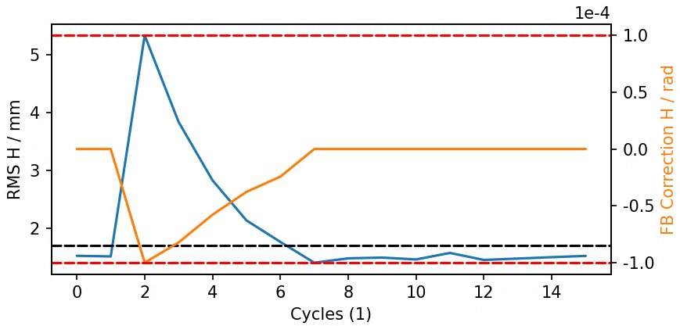
EPA: specific WPs
Continuous trajectory corrections
Auto-steering framework
Goal: continuous transfer line trajectory corrections multiplexed, between machines & to experimental targets
Classical methods and numerical optimisers combined objective with e.g. beam loss, position, etc.
Based on UCAP and interfacing geoff4ucap
PS n-TOF
P2SPS
Various steering controllers in place
SPS NA target intensity sharing and symmetries
PS EAST & AD target steering
Testing phase: PS n-TOF, PS2SPS
Next: SPS2LHC, PS injection
PS EAST
SPS NA

Slide 27
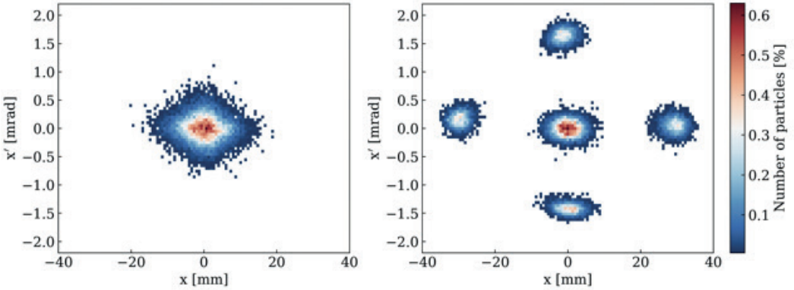
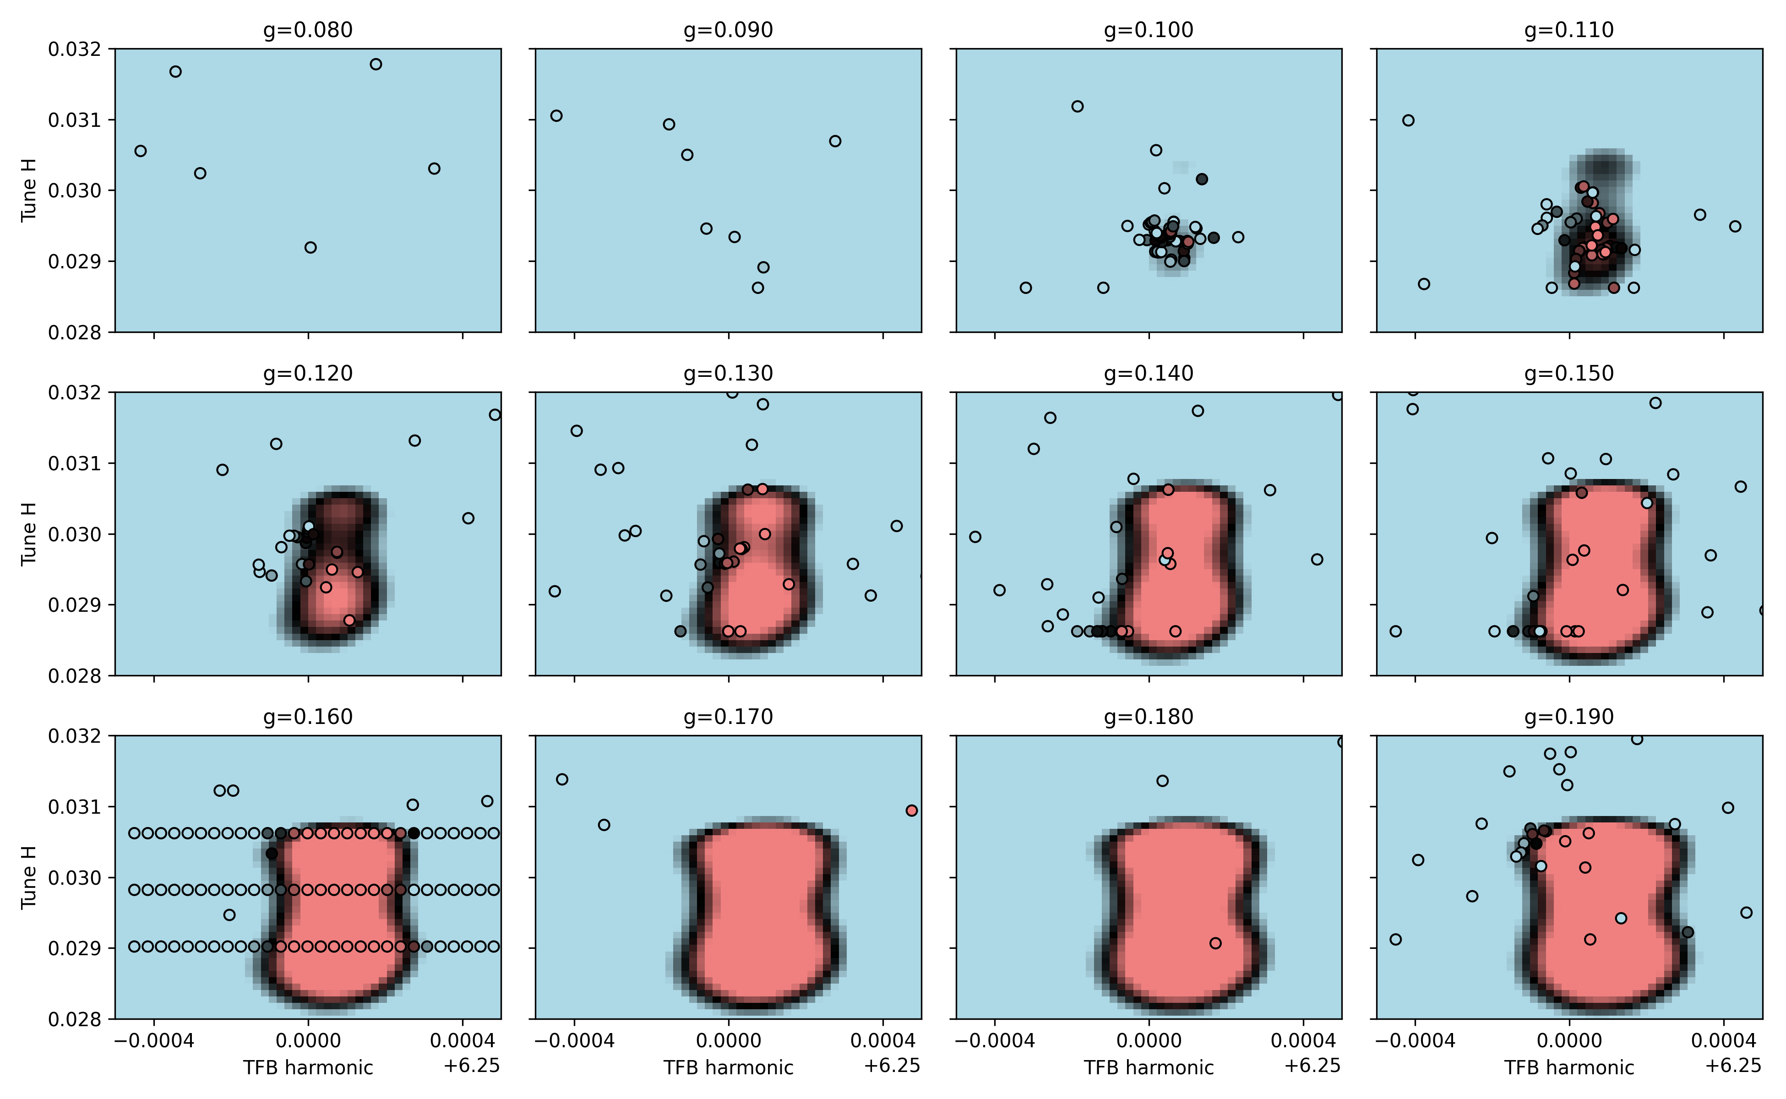
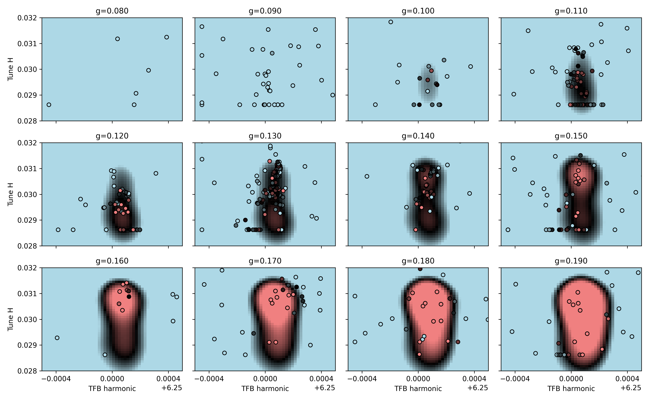
EPA: specific WPs
Lessons learnt: MTE beam optimisation
4th order resonant excitation and extraction over 5 consecutive turns
PS multi-turn extraction optimisation
Goal: uniform intensity across beamlets
3 parameters: TFB_{harmonic}, TFB_{gain}, Q_{H}
Issues
Slow drifts: relatively easy to handle e.g. using Extremum Seeking (ES) or adaptive Bayesian optimisation
Abrupt changes: supercycle switch a.o. hysteresis: generally big impact on reproducibility
Some challenges and transferable lessons
Develop understanding of problem dynamics (MDs, simulations) reduce from 3D to 2D problem, build knowledge into model if possible
Test prototypes in MDs, but move to operational conditions early on some issues only appear over longer time-scales…
External factors and time dependencies can make it difficult to incorporate historical data
Hyperparameter tuning particularly: exploration / exploitation during operations
Sanity checks for controller inputs & provide monitoring
following TOF & EAST
following two MTEs

Slide 28
Efficient Particle Accelerators project
Overview
Remove fixed supercycles by dynamically & algorithmically scheduling beams
Deterministic magnetic field control Will have positive impact on reproducibility for almost all beam dynamics processes
Automate & standardise beam preparation in injectors for LHC fills; Reduce impact on fixed target users and LHC turn-around time.
Automate parameter optimisation & compensate drifts
Automatic testing for “all” equipment to speed up hardware commissioning
Automation of equipment setup, fault analysis, and recovery; preparing the grounds for preventive maintenance

Slide 29
EPA: specific WPs
Equipment automation
Smart equipment with context-awareness: beam parameters, machine state, etc.
Automate setup, fault analysis, and recovery
Pave the way towards preventive maintenance
Plans 2024 – 2026
Pilot implementations of parts of a new equipment automation framework
Examples
Controlled SPS kicker vacuum interlock auto-resets
Convolutional auto-encoder for SPS beam dump anomaly detection
Kicker temperature forecasting
Main implementation: during LS3 (2026 – 2029)

Slide 30
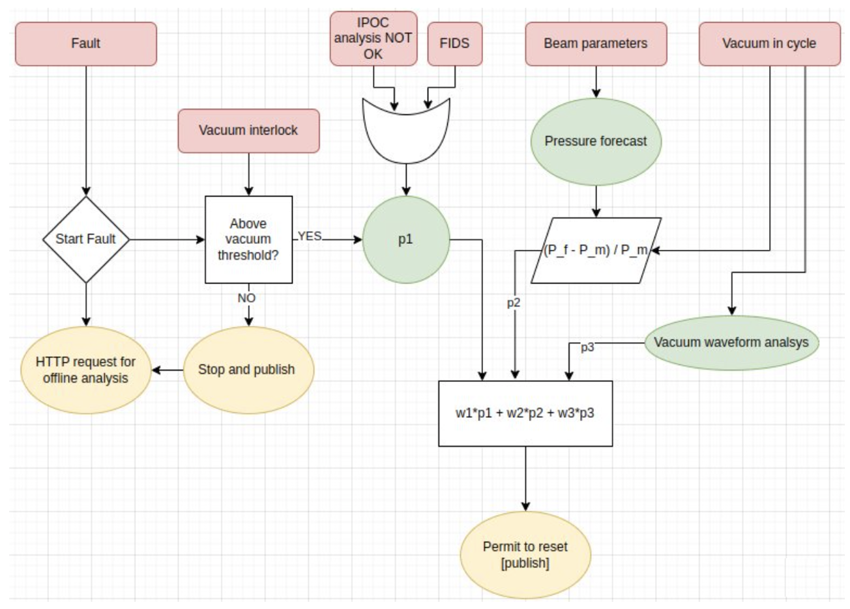
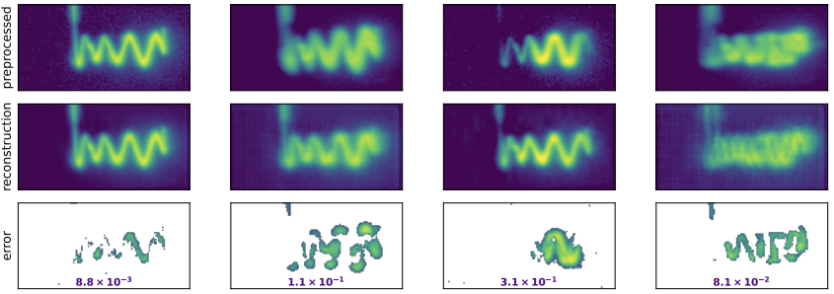
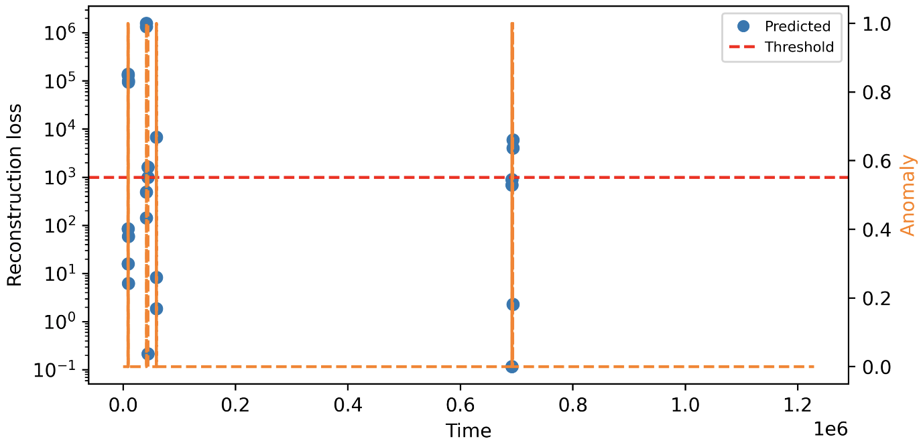
EPA: specific WPs
Equipment: anomalies and auto-resets
Auto-reset of SPS kicker following vacuum interlock
Goal: correctly classify vacuum “spikes” to avoid unnecessary downtime
Method: VAE trained on historical time-series data
Auto-reset and automatic e-mail with diagnostics plots to experts
Detect anomalous SPS beam dump patterns
Convolutional AE: use reconstruction loss to identify anomalies (5 – 20 x higher)
Fault diagnostics: localisation of error
Potential early detection of kicker issues
normal
anomalous
VAE for anomaly detection from vaccum pressure data
“unseen” MKDH failures

Slide 31
Contents
Introduction
Efficient Particle Accelerators
Infrastructure
Specific WPs
Final remarks

Slide 32
Final remarks
Automation of accelerator operation has come in stages over the past decades
Next push thanks to technological advances
Efficient Particle Accelerators project in place to
transform how we run the existing accelerator complex
gain experience how to design and run future machines
Infrastructure plays a crucial role (Python, UCAP, optimisation frameworks, MLP, …)
Exciting undertaking and rewarding investment
Thank you

Slide 33
References
A. Huschauer, V. Kain, K. Papastergiou, F. Velotti, ETT report, 2023.
CERN Joint Accelerator Performance Workshop, Montreux, Switzerland, 2023.
CERN LHC Performance Workshop, Chamonix, France, 2024.
D. Anderson et al., “The AccTesting Framework: an extensible framework for accelerator commissioning and systematic testing”, ICALEPCS’13, California, 2013.
L. Cseppento, M. Buttner, “UCAP: A FRAMEWORK FOR ACCELERATOR CONTROLS DATA PROCESSING @ CERN”, ICALEPCS’21, China, 2021.
A. G. Wilson and R. P. Adams, “Gaussian Process Kernels for Pattern Discovery and Extrapolation”, PMLR 28(3):1067-1075, Georgia, 2013.
K. Iliakis et al., Longitudinal Beam Diagnostics and Phase Space Reconstruction in the LHC Using ML, 6th Inter-Experiment Machine Learning Workshop, CERN, Geneva, Switzerland, 2024.
HL-LHC commissioning long-term plan, Mar 2024.
A. Lu et al., First operational experience with data-driven hystersis compensation for the main dipole magnets of the CERN SPS, IPAC’24, Nashville, TN.

Slide 34
Backup

Slide 35
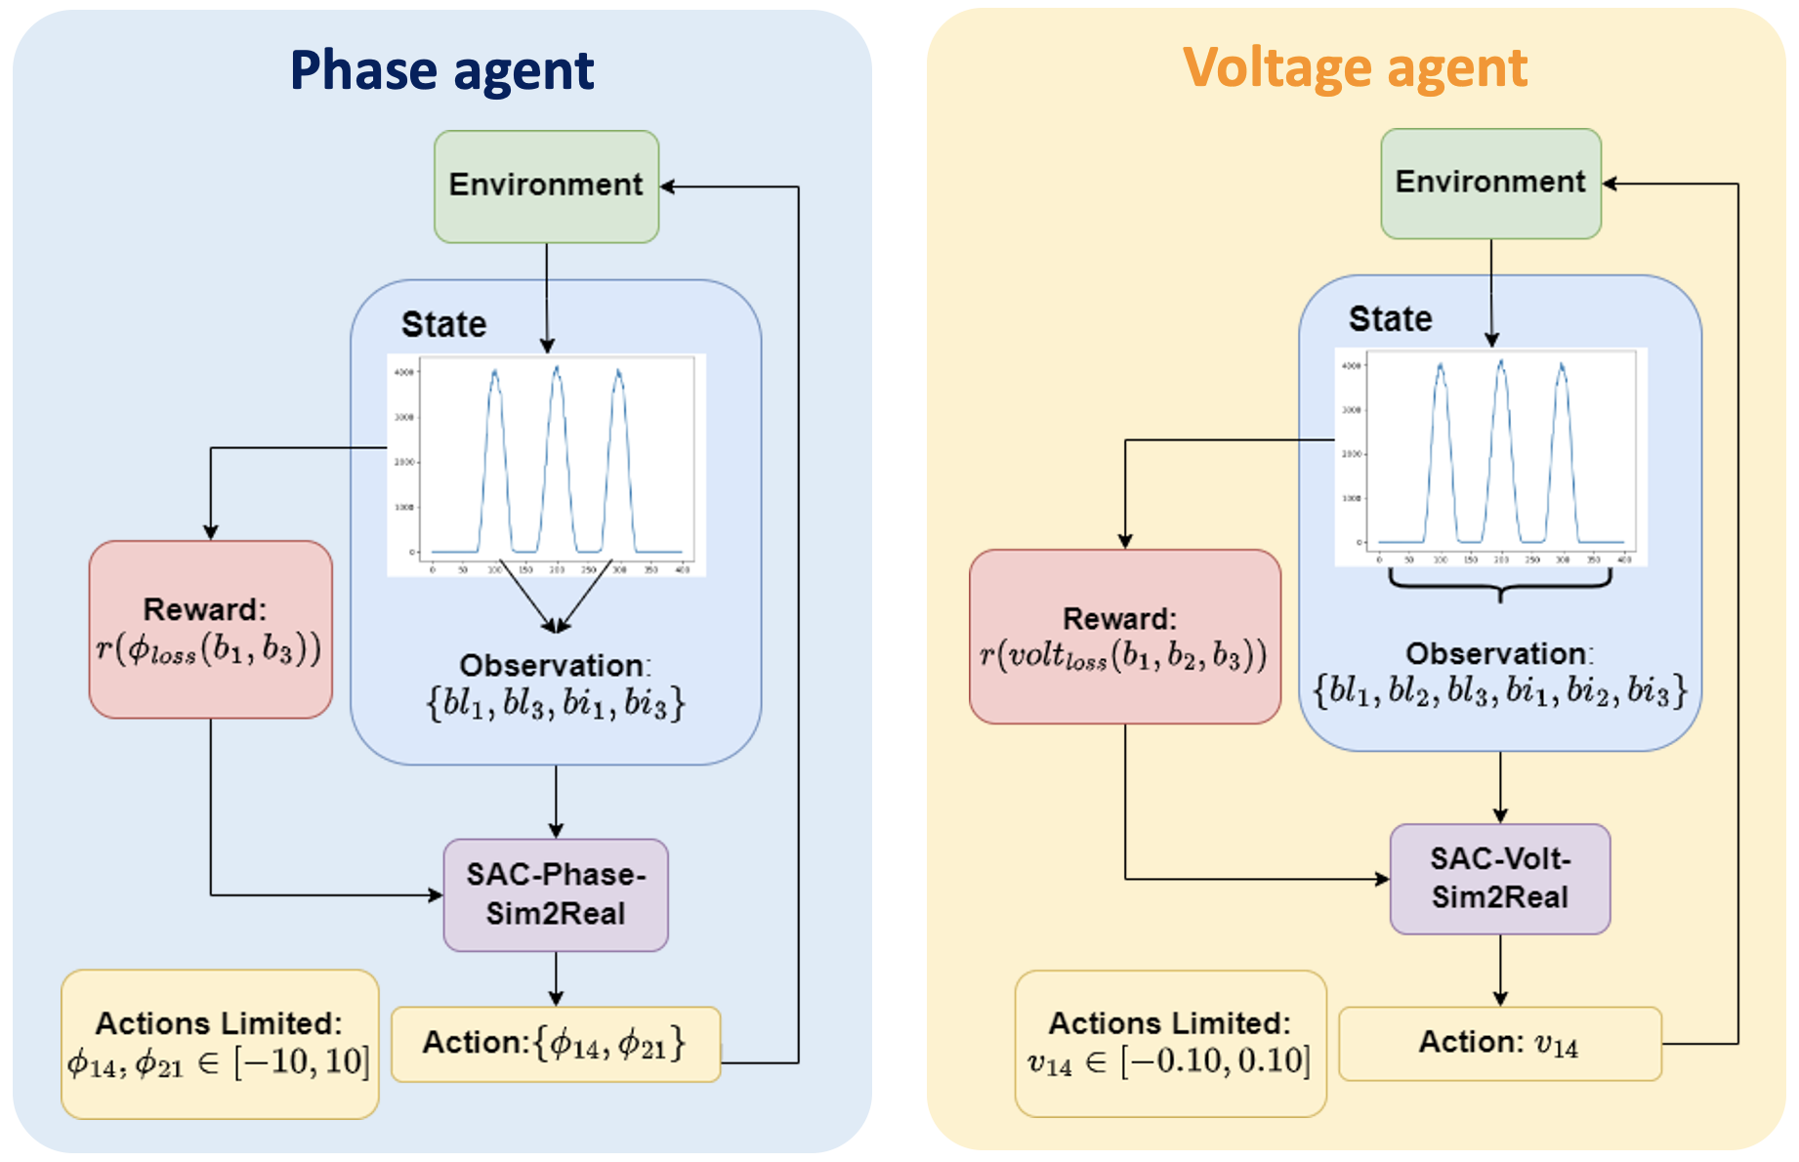
EPA: specific WPs
Continuous monitoring
LHC beam preparation in the PS
Mainly: triple and double splittings
Continuous longitudinal beam monitoring
… and evaluation of splitting qualities now in place
Launch parameter optimisation according to beam quality requirements
Triple splitting
3 parameter problem
CNN + RL agents
Double splittings
Linear relation between intensity and cavity phase
Solved with a PI controller
Challenges: different dynamics along bunch train (beam loading) and for consecutive cycles
Double splitting Intensity vs phase
Triple splitting RL agents

Slide 36
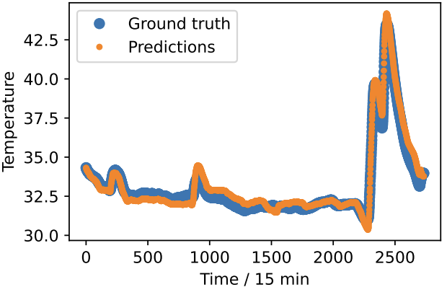
EPA: specific WPs
Equipment anomalies and resets
Kicker magnet temperature forecasting
Kicker temperatures limit SPS high-intensity operation (beam-induced heating)
Goal: create temperature forecast using online measurement, current machine operation and future planning
Method: Light Gradient Boosting Machine and using beam-induced heating equation

Slide 37
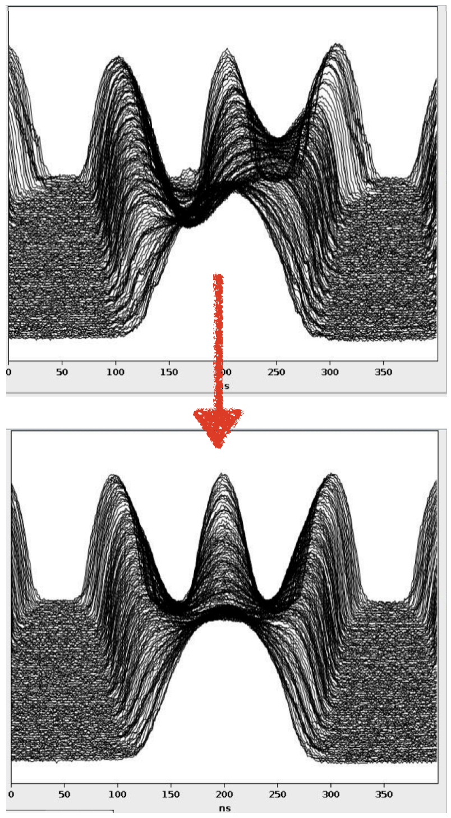
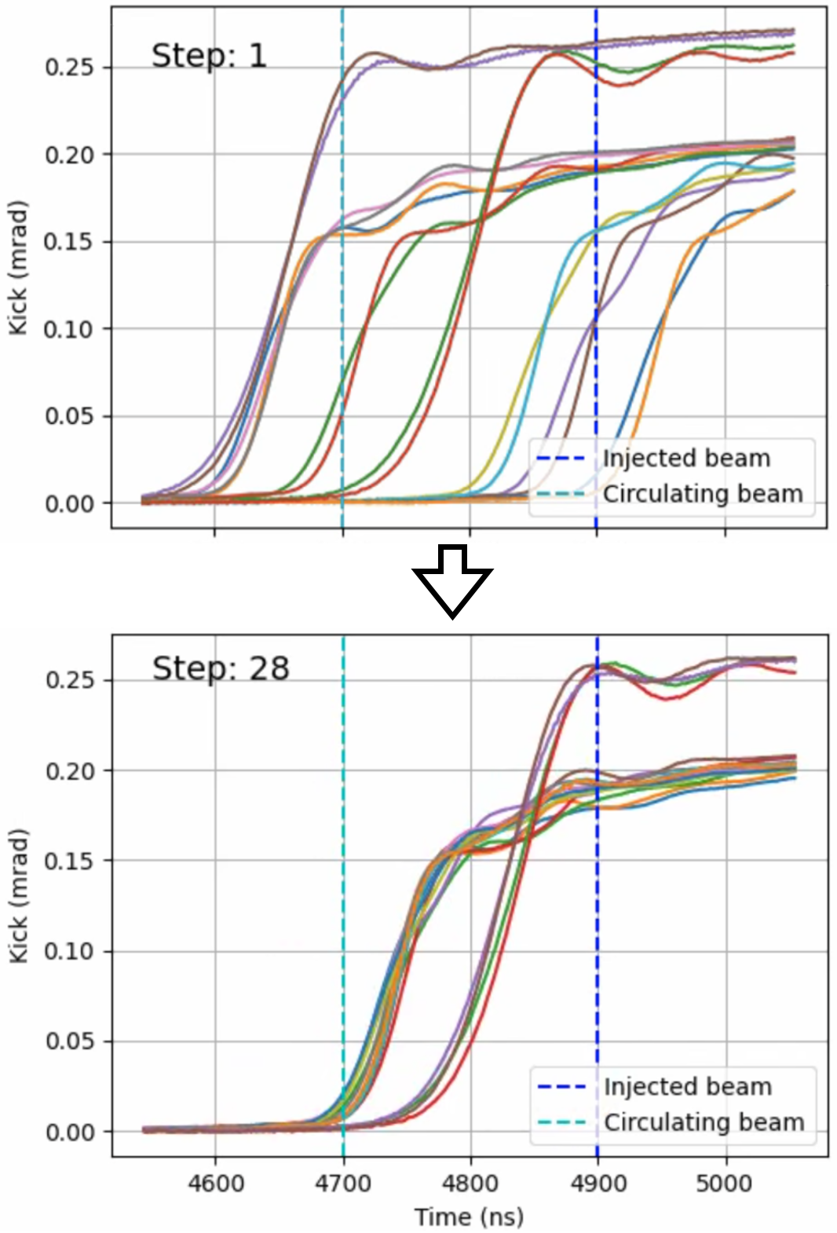
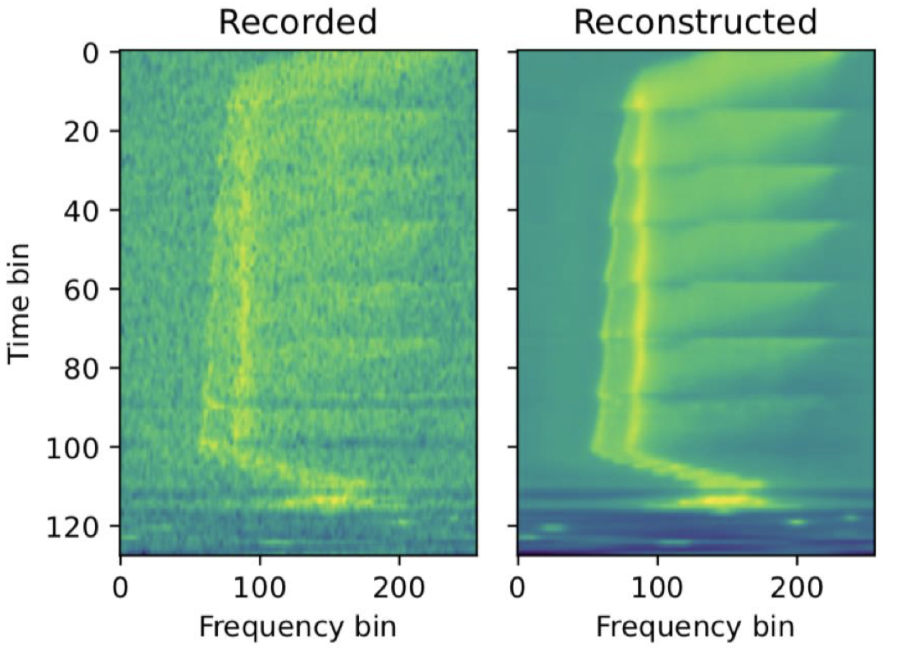
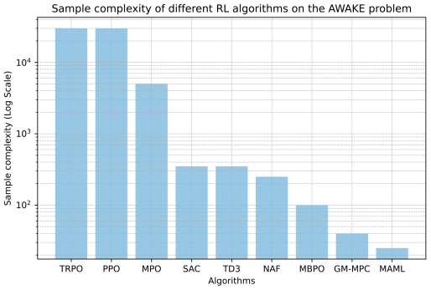
Examples using RL
PS
PS to SPS
Correct RF phase & voltage for uniform bunch splitting (LHC beams)
Multi-agent (SAC) & CNN for initial guess
Successful sim2real transfer
If things go wrong: degraded beam
Adjust fine delays of SPS injection kicker
RL agent (PPO) trained on data-driven dynamics model
If things go wrong: beam loss, activation
A. Lasheen, J. Wulff
M. Remta, F. Velotti
LINAC3 / LEIR
AWAKE
Achieve optimal injection into LEIR
RL state based on β-VAE-encoded Schottky spectra
Agent trained on data-driven dynamics model
If things go wrong: beam loss, activation, equipment trips
Steer electron beam in AWAKE line
Test-bed for different RL algorithms & sim2real transfer
Large improvements in sample efficiency (Meta RL)
If things go wrong: not critical
V. Kain, N. Madysa, B. Rodriguez
S. Hirlaender, V. Kain

Slide 38
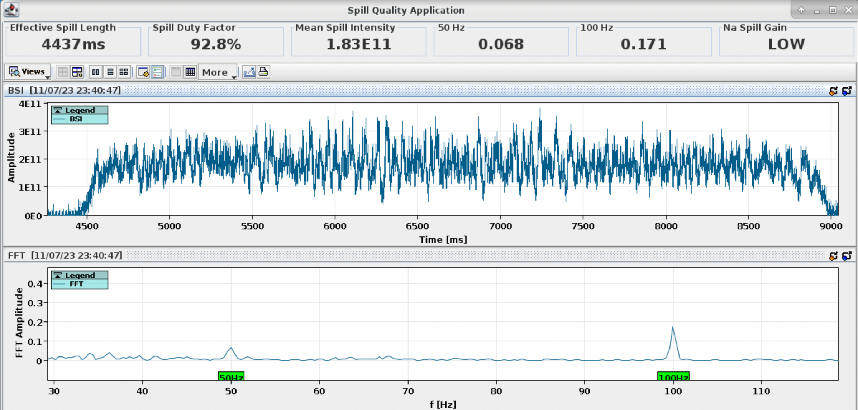
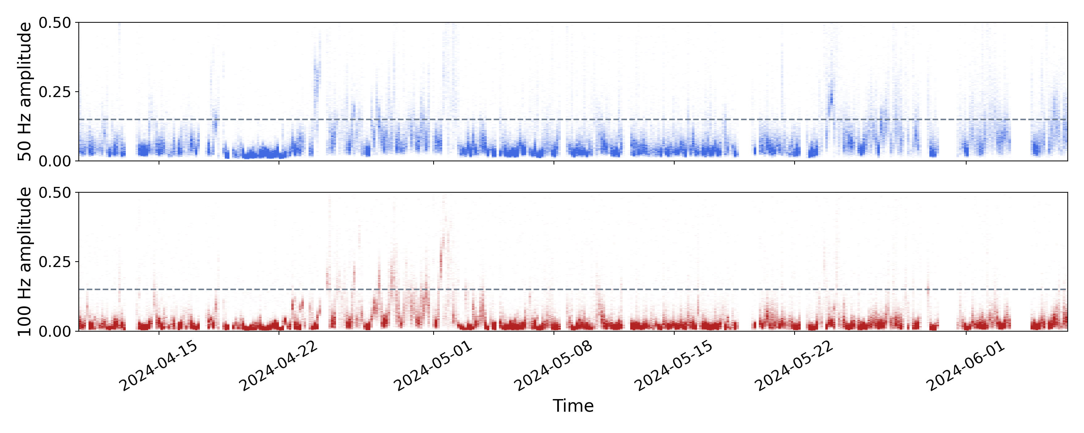
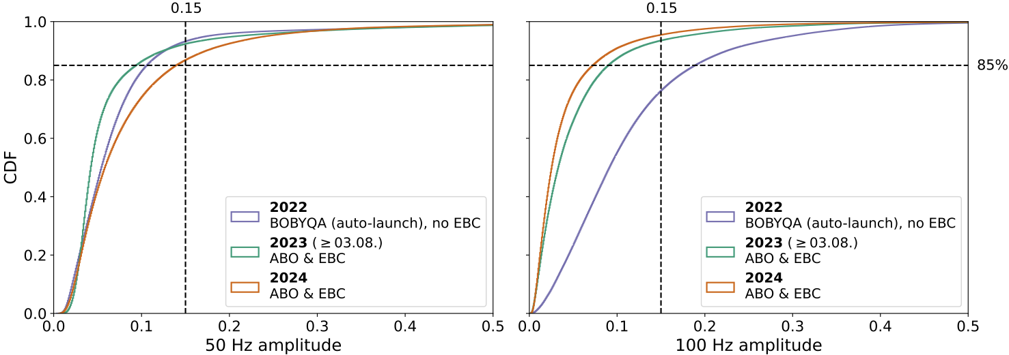
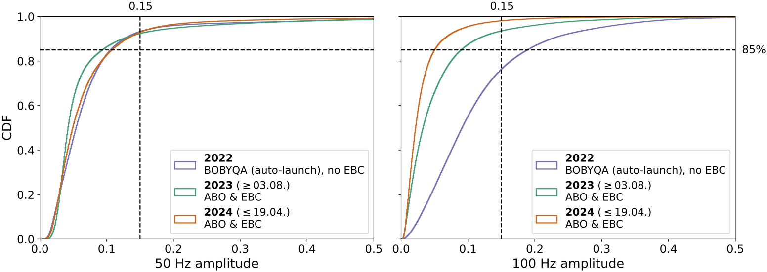
Other optimisation examples
SPS: spill noise compensation
Slow-extracted beam has 50 Hz & 100 Hz noise originating from quadrupole power converter ripple discussed at IPP, 17.11.23
Continuous controller & empty bucket channeling (EBC) find more details here
Adaptive Bayesian optimisation (ABO) spatio-temporal Gaussian Process model
Running on UCAP since start of physics ‘24 essential: UCAP node with GPU & Python
Still ironing out a few issues bugs that only became apparent longer-term, EBC adjustments, strong cycle-by-cycle variations
Interesting case to study algorithm improvements proximal biasing to reduce exploration spikes

Slide 39
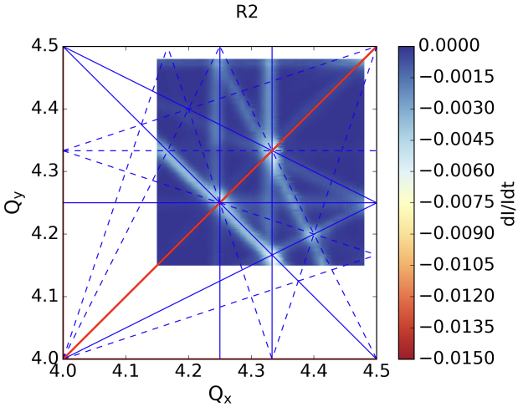
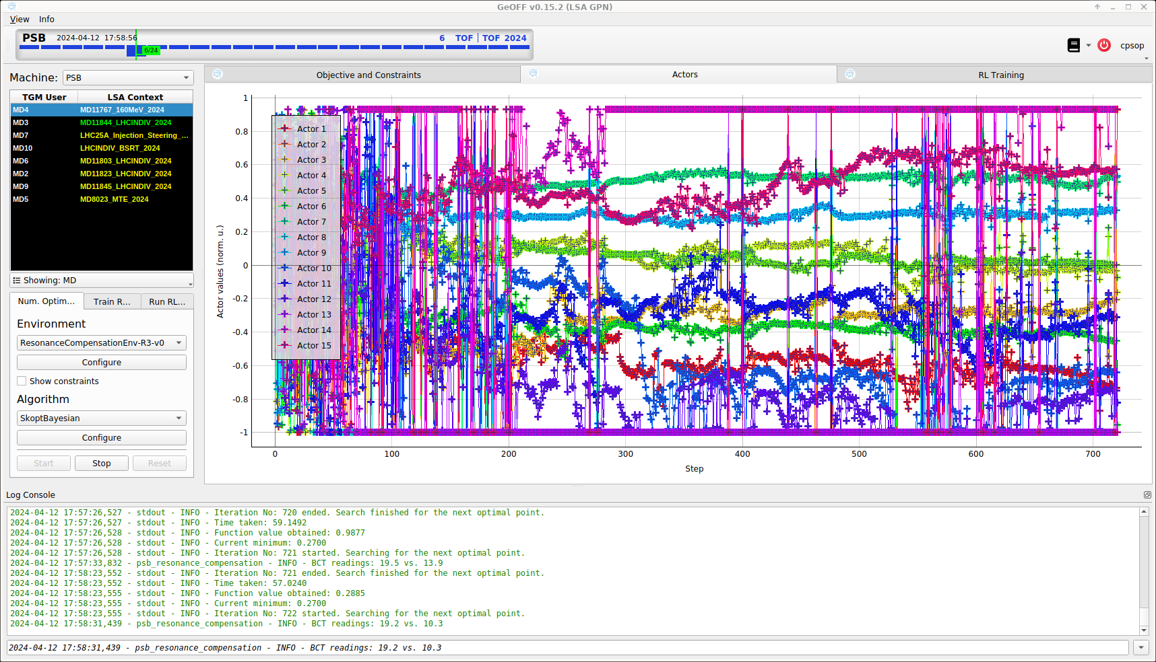
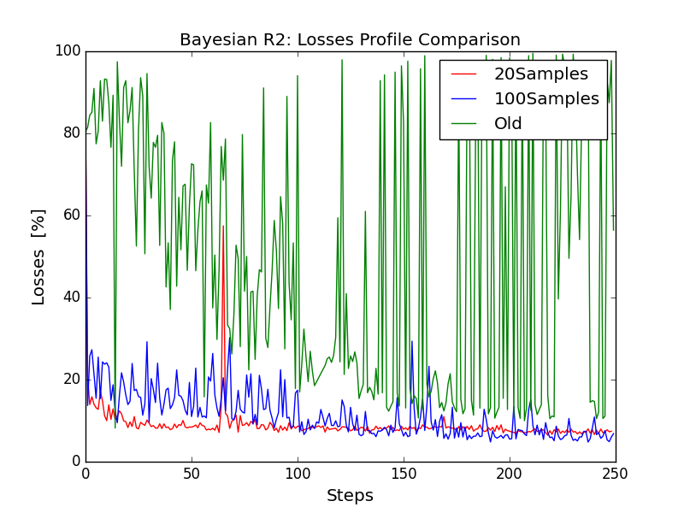
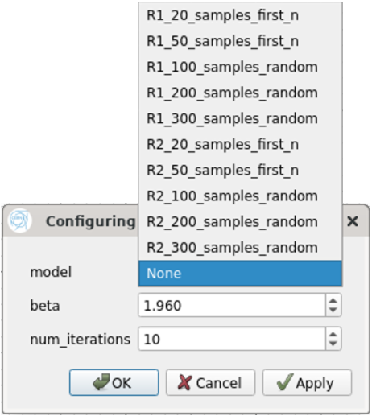
Other optimisation examples
PSB: resonance compensation
Goal: tune sextupole & octupole currents to minimise impact of resonances
Generic SkoptBayesian not flexible enough and performance bottleneck given # samples and no GPU
Use custom optimisers newly supported by GeOFF Bayesian optimisation implemented with BoTorch
Pre-conditioned model based on historical data
Use prior knowledge to improve sample efficiency
Next
Additional machine studies
Year-to-year transfer?
F. Asvesta, T. Prebibaj, G. Tangari
39

