Slide 1
Weak-strong simulations of electron cloud effects from
the Inner Triplets of the Large Hadron Collider
Konstantinos Paraschou, Giovanni Iadarola, Lotta Mether
CERN, Geneva, Switzerland
Many thanks to: G. Rumolo, H. Bartosik, Y. Papaphilippou, F. Van der Veken
14th International Computational Accelerator Physics Conference 2nd October 2024

Slide 2
Outline
Introduction and motivation
Description of simulation method
Simulation results:
Validation
Frequency map analysis
Dynamic aperture

Slide 3
Outline
Introduction and motivation
Description of simulation method
Simulation results:
Validation
Frequency map analysis
Dynamic aperture

Slide 4
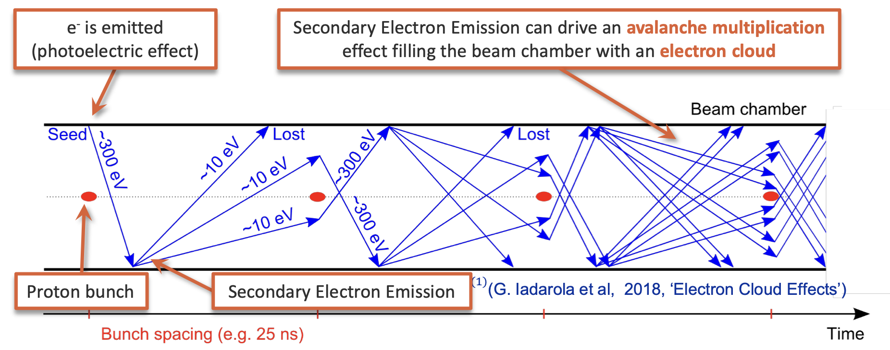
Electron clouds
Quadrupole:
Electrons are introduced into the chamber (residual gas ionization / synchr. rad. + photoelectric effect)
Electrons are accelerated by passing bunches and impact on beam chamber, emitting more electrons.
If conditions allow, electrons multiply
exponentially!
[PyECLOUD simulation]

Slide 5
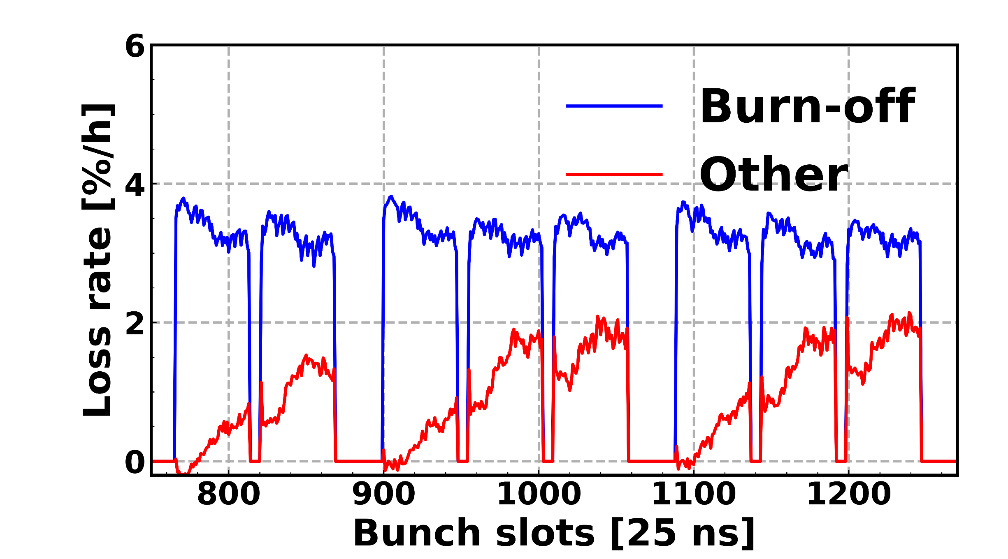
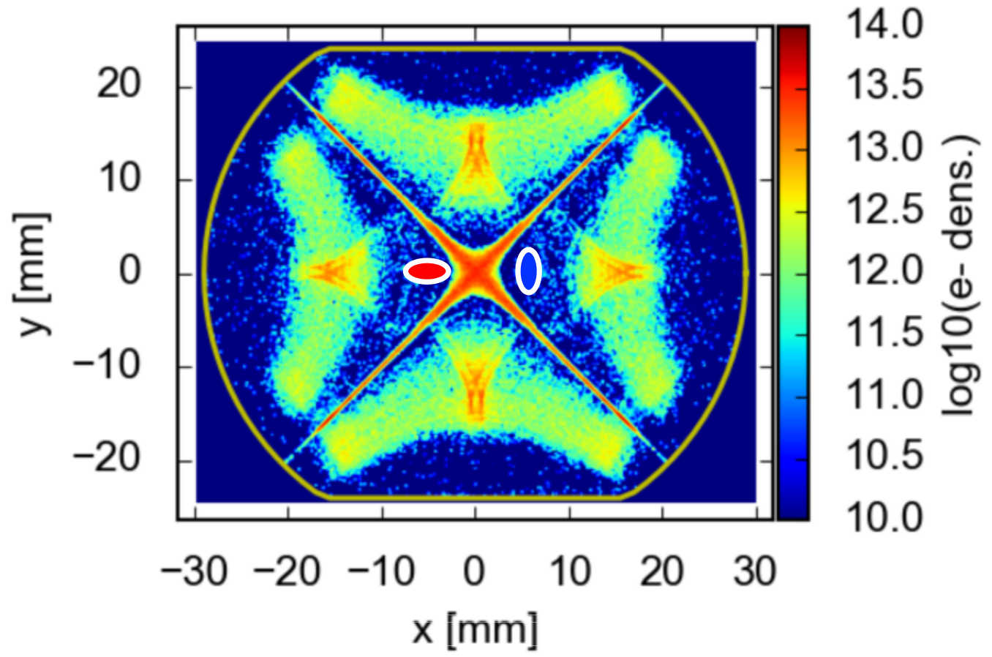
Motivation
Slow proton beam loss comes from:
Luminosity burn-off (inelastic p-p collisions).
Additional losses (Beam dynamics).
Luminosity (ATLAS + CMS)
Total loss rate (Fast Beam Current Transformer)
Several configurations were tested. All observations point to the e-cloud forming in the Inner Triplet quadrupoles. (Final focusing quadrupoles)
Good news: HL-LHC Inner Triplet will have a-C coating to suppress e-cloud formation.
Can we simulate these losses?
(By looking for a reduction of dynamic aperture in particle tracking simulations)

Slide 6
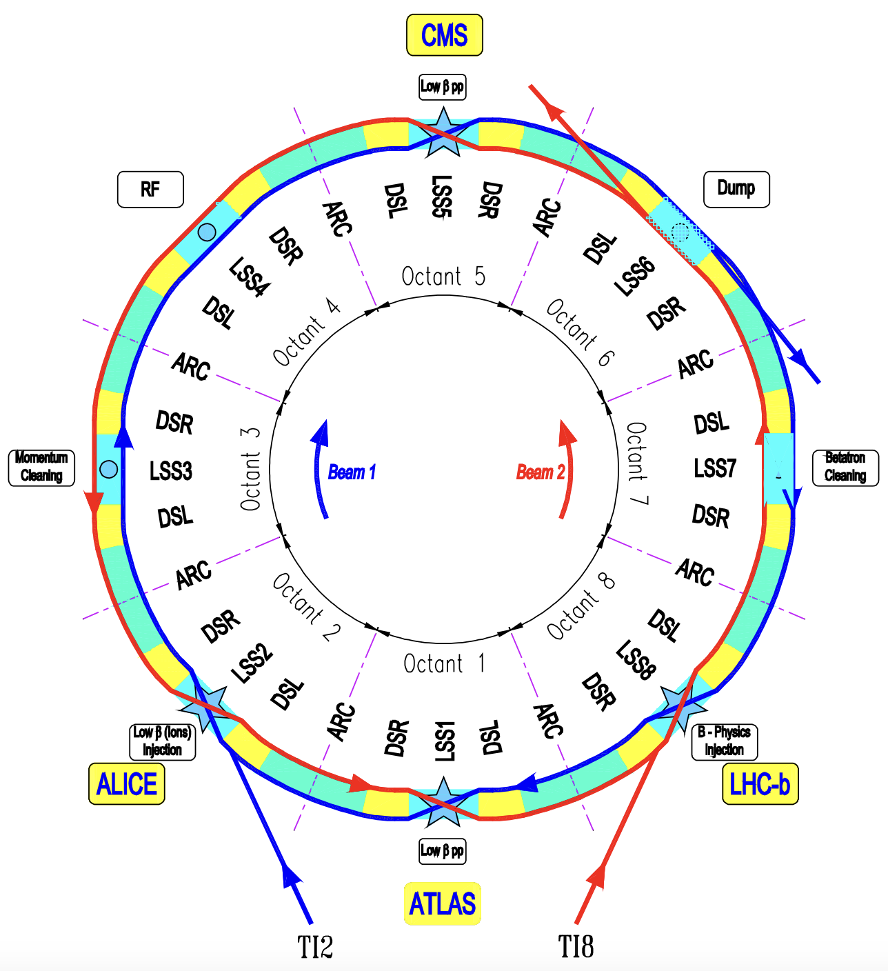
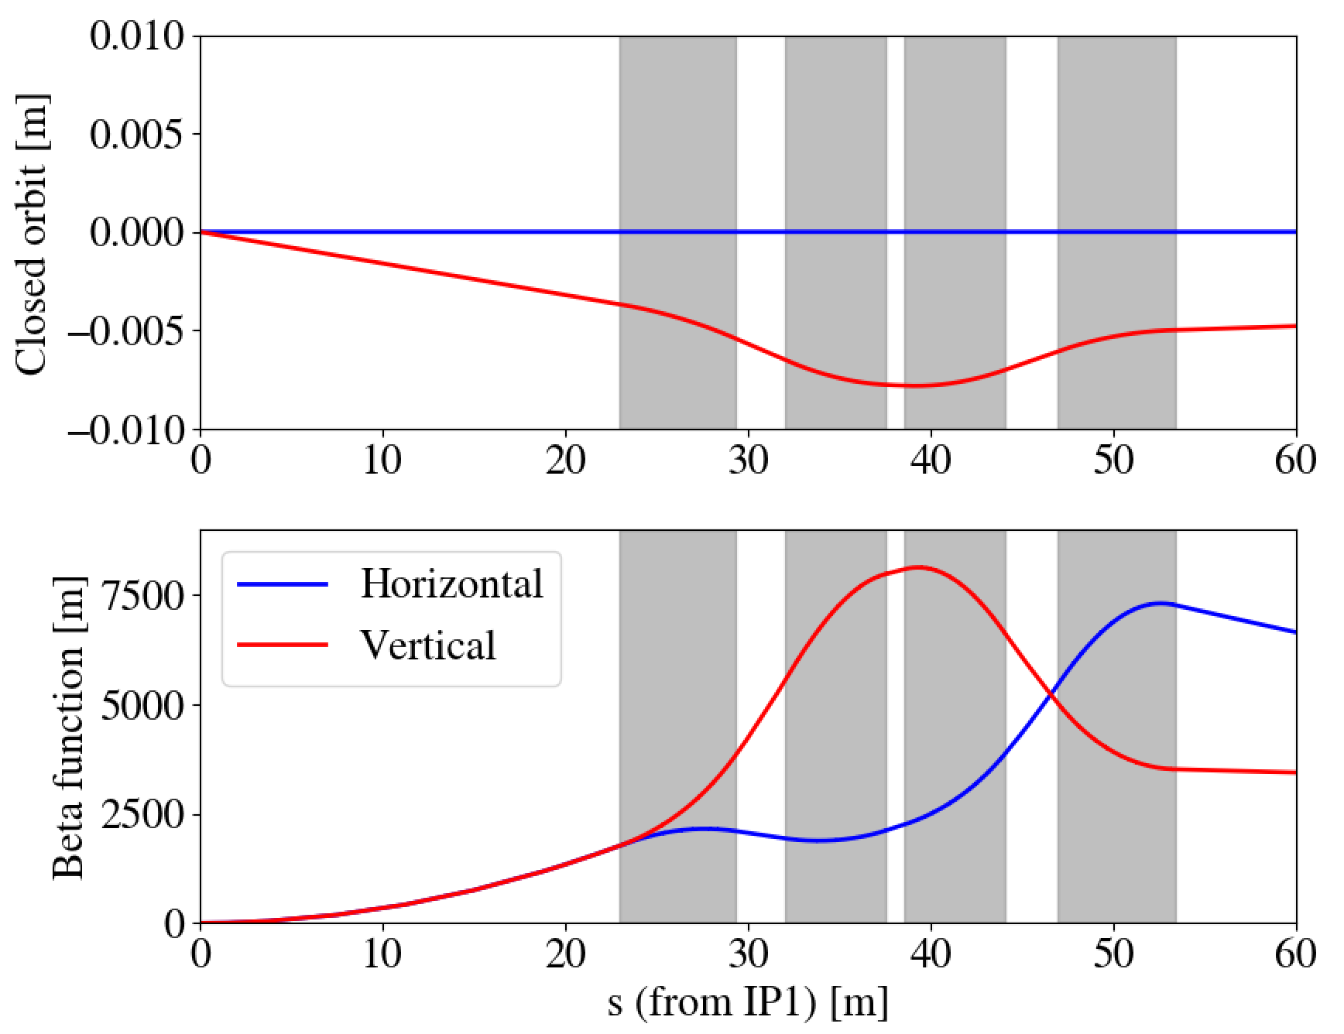
The Inner Triplet
Q2A
Q3
Q1
Q2B
Large Hadron
Collider
The Inner Triplets are complex and in ≈ 30 m :
Two beams present arriving at different times at each slice (w.r.t. to each other).
Rapidly changing closed orbit.
Rapidly changing betatron functions.
Many slices are necessary.

Slide 7
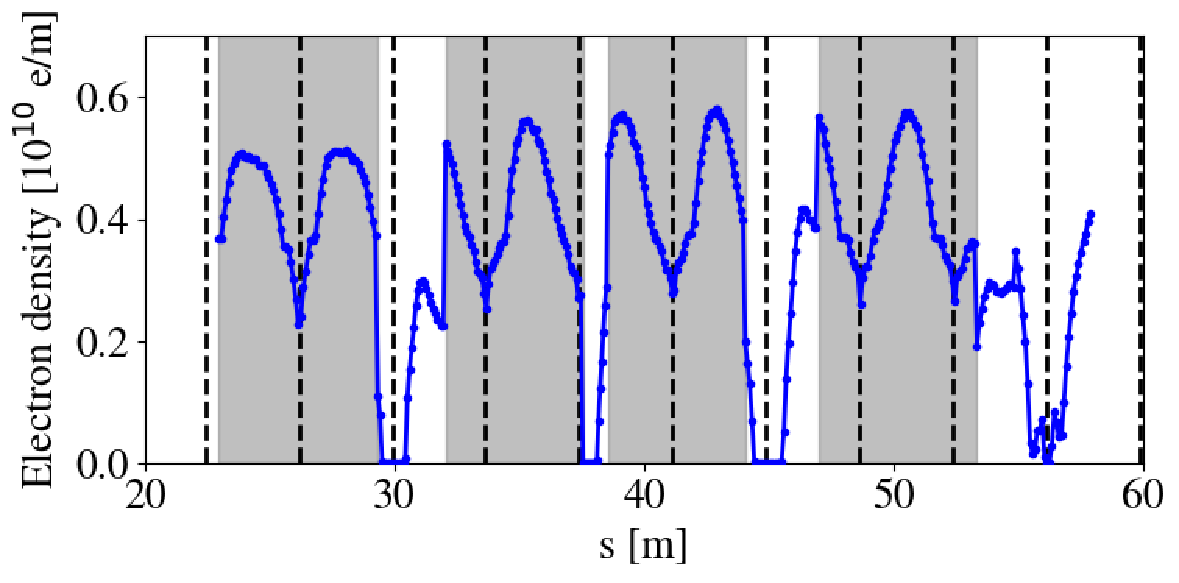
The computational problem
Q1
Q2A
Q2B
Q3
E-cloud strongly depends on delay between two beams:
Less e-cloud at locations of beam-beam long-range interactions
Less e-cloud in drift spaces.
384 slices per triplet → 4 triplets, 1536 slices.
≈ 4GB per slice → ≈ 6 TB

Slide 8
Outline
Introduction and motivation
Description of simulation method
Simulation results:
Validation
Frequency map analysis
Dynamic aperture

Slide 9
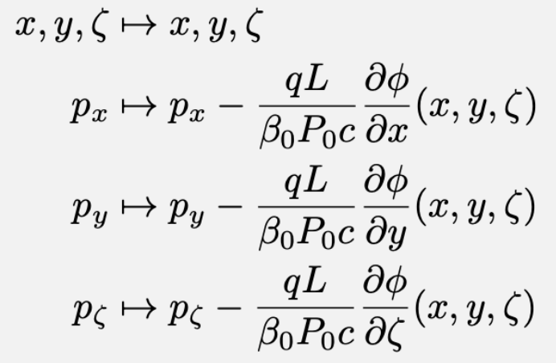
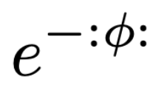
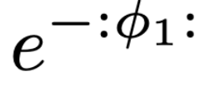
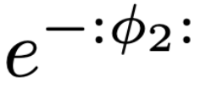
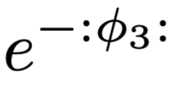
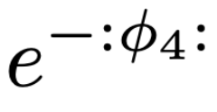
Strategy
[G. Iadarola, CERN-ACC-NOTE-2019-0033]
An e-cloud slice can be described by a scalar potential ϕ(x, y, ζ) in a thin-lens formalism.
Transport slices to same location.
Slices commute (only depend on x, y, ζ). They can be summed.
Transport through
e-cloud slice
i
1
2
3
4
k
Transport through
segment
...
ζ refers to s – β₀ct, the longitudinal distance from the reference particle

Slide 10
Approximations
i
1
2
3
4
k
Effective (lumped) e-cloud:
...
(1st approximation):
Courant-Snyder parameterization
Combines all slices into one scalar potential.
Equation can be evaluated on a 3D grid, and treated as a single slice.
i
k
(2nd approximation):
Constant phase advance
(3rd approximation):
No longitudinal motion

Slide 11
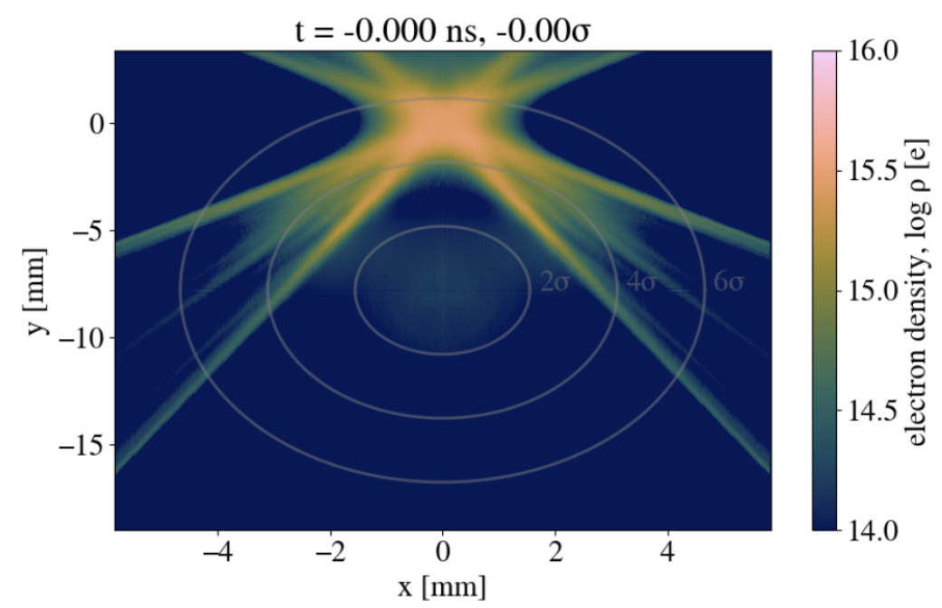
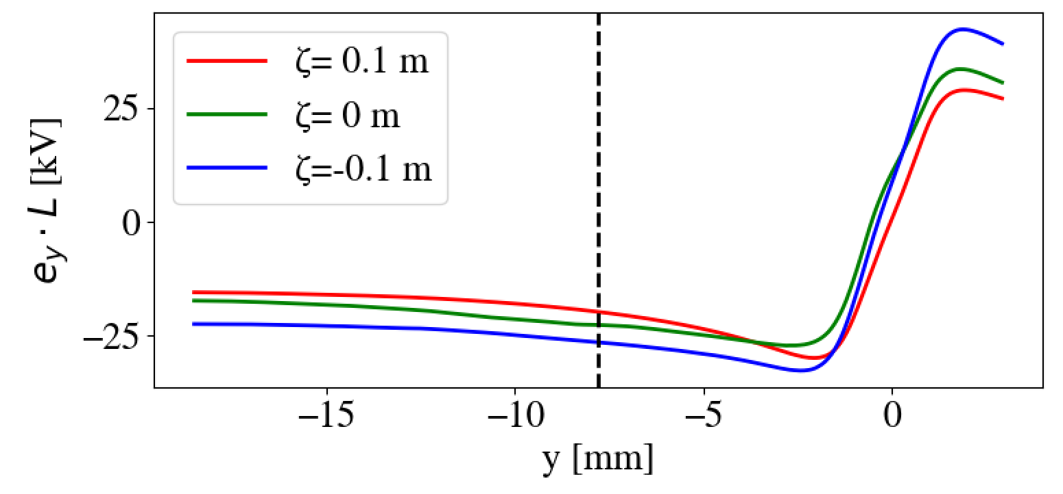
Effective e-cloud
Non-linear time-dependent forces.
Forces become exceedingly non-linear at large amplitudes of oscillation.
Weak-strong simulations:
Assume e-cloud is in a steady state.
Map is constructed once in a “pre-processing stage”, and re-used during particle tracking.

Slide 12
Simulation flow
Pre-processing stage (weak-strong)
Particle tracking stage
PyECLOUD simulations (CPU)
Xsuite simulations (GPU)
~ 8 CPU hours per slice, easy to parallelize
Frequency map
analysis
1st slice
2nd slice
Dynamic aperture
3rd slice
Triplet Maps
Emittance growth
reduction from ~ TB to ~ GB in required memory per triplet
N^{th} slice
Tracking time for 1 000 000 turns, 20 000 particles in A100 GPU:
LHC lattice : 5.7 hours
LHC lattice + beam-beam : 6.1 hours
LHC lattice + beam-beam + e-cloud : 7.0 hours

Slide 13
Outline
Introduction and motivation
Description of simulation method
Simulation results:
Validation
Frequency map analysis
Dynamic aperture

Slide 14
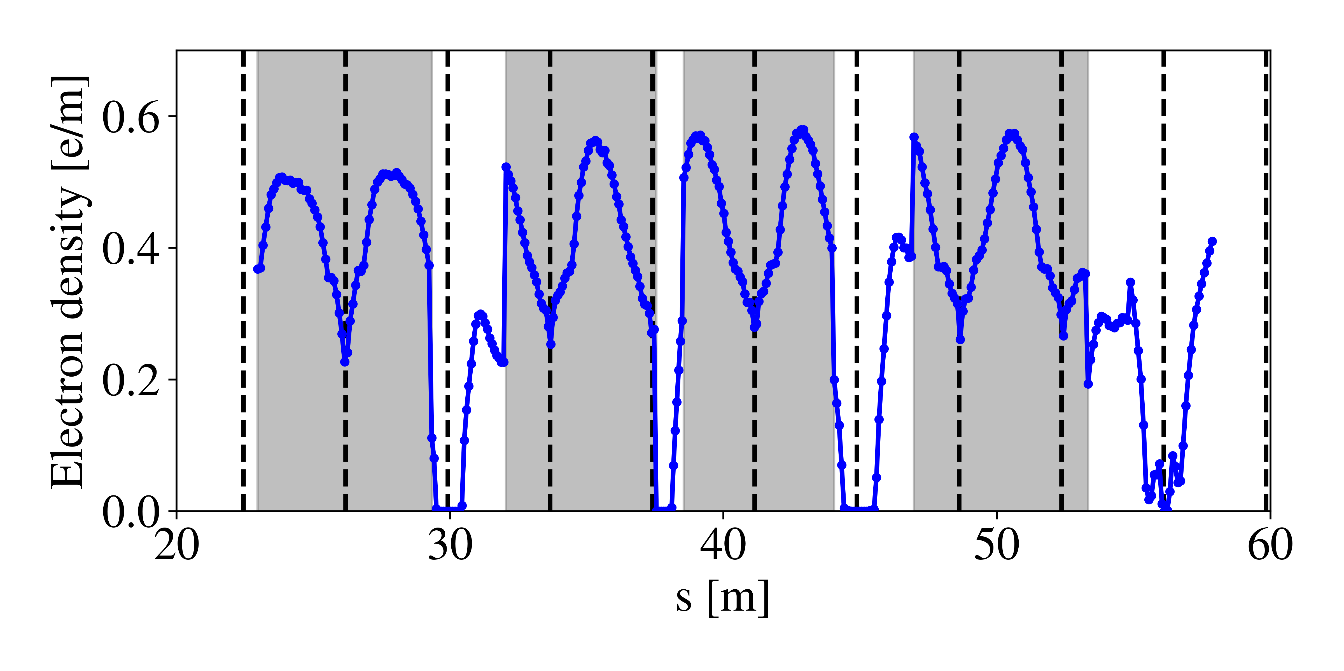
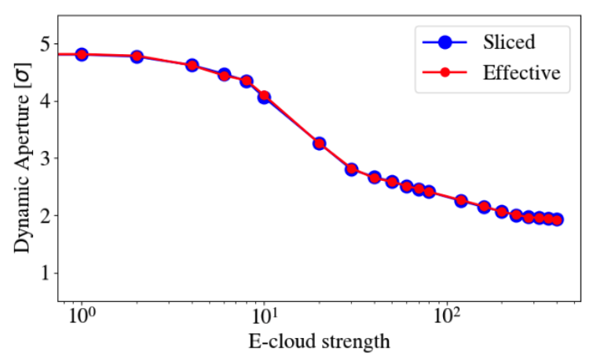
Validation
Q1
Q2A
Q2B
Q3
Focus on Q3 quadrupole (right of interaction point 1): Q3R1.
64 slices, can fit in 1TB RAM computers.
Dynamic aperture simulations to test previous equation.
Good agreement.

Slide 15
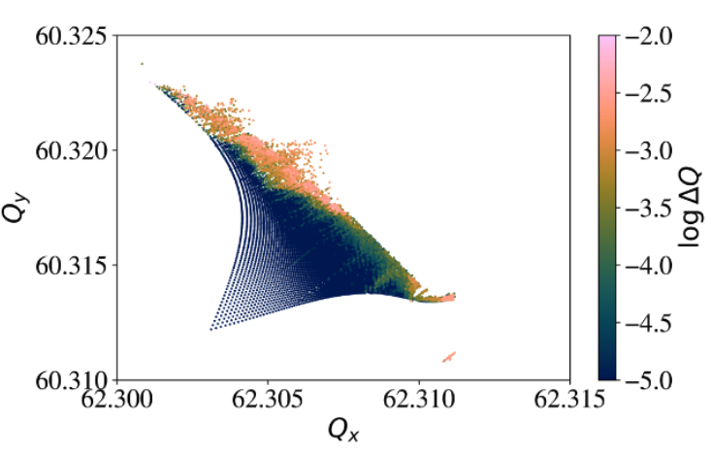
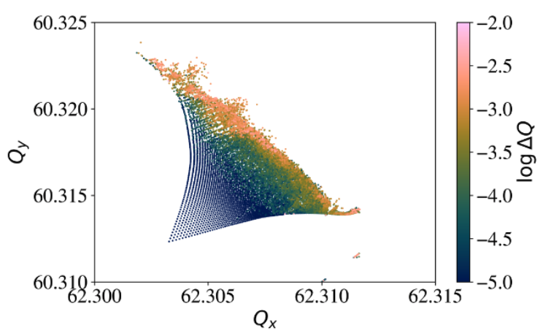
Frequency Map Analysis
Beam-beam effects &
e-cloud (in 4 Inner Triplets)
Beam-beam effects
Tracking over 100 000 turns, tune evaluated over:
First 50 000 turns,
Last 50 000 turns.
Difference in tune → tune is not constant and so trajectory is chaotic.
E-cloud doesn’t cause a significant tune-shift (compared to beam-beam effects)
Visible effect of e-cloud → increase of non-linearities.

Slide 16
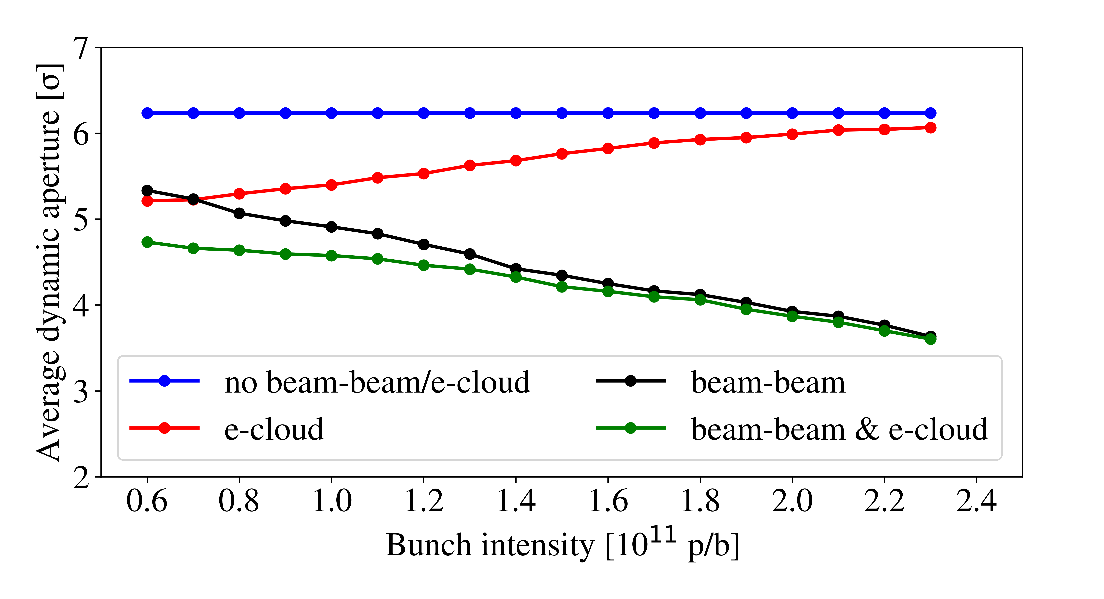
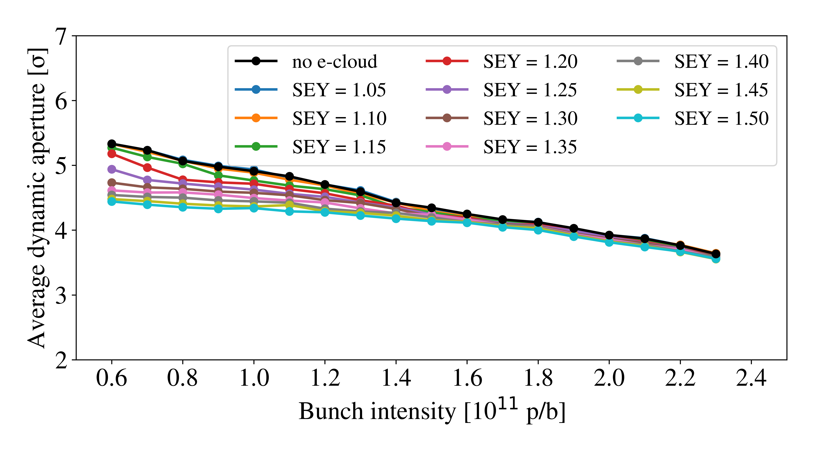
Dynamic aperture
Dynamic aperture over 1 000 000 turns, including the e-clouds in the 4 inner triplets (left and right of i.p. 1 and 5).
E-cloud in triplet scales favorably with higher intensity.
E-cloud effects can become as strong as beam-beam effects at low bunch intensities.
E-clouds are worse with larger Secondary Emission Yield (SEY).
SEY < 1.10 will be enough to mitigate the effect of e-cloud in the triplets.

Slide 17
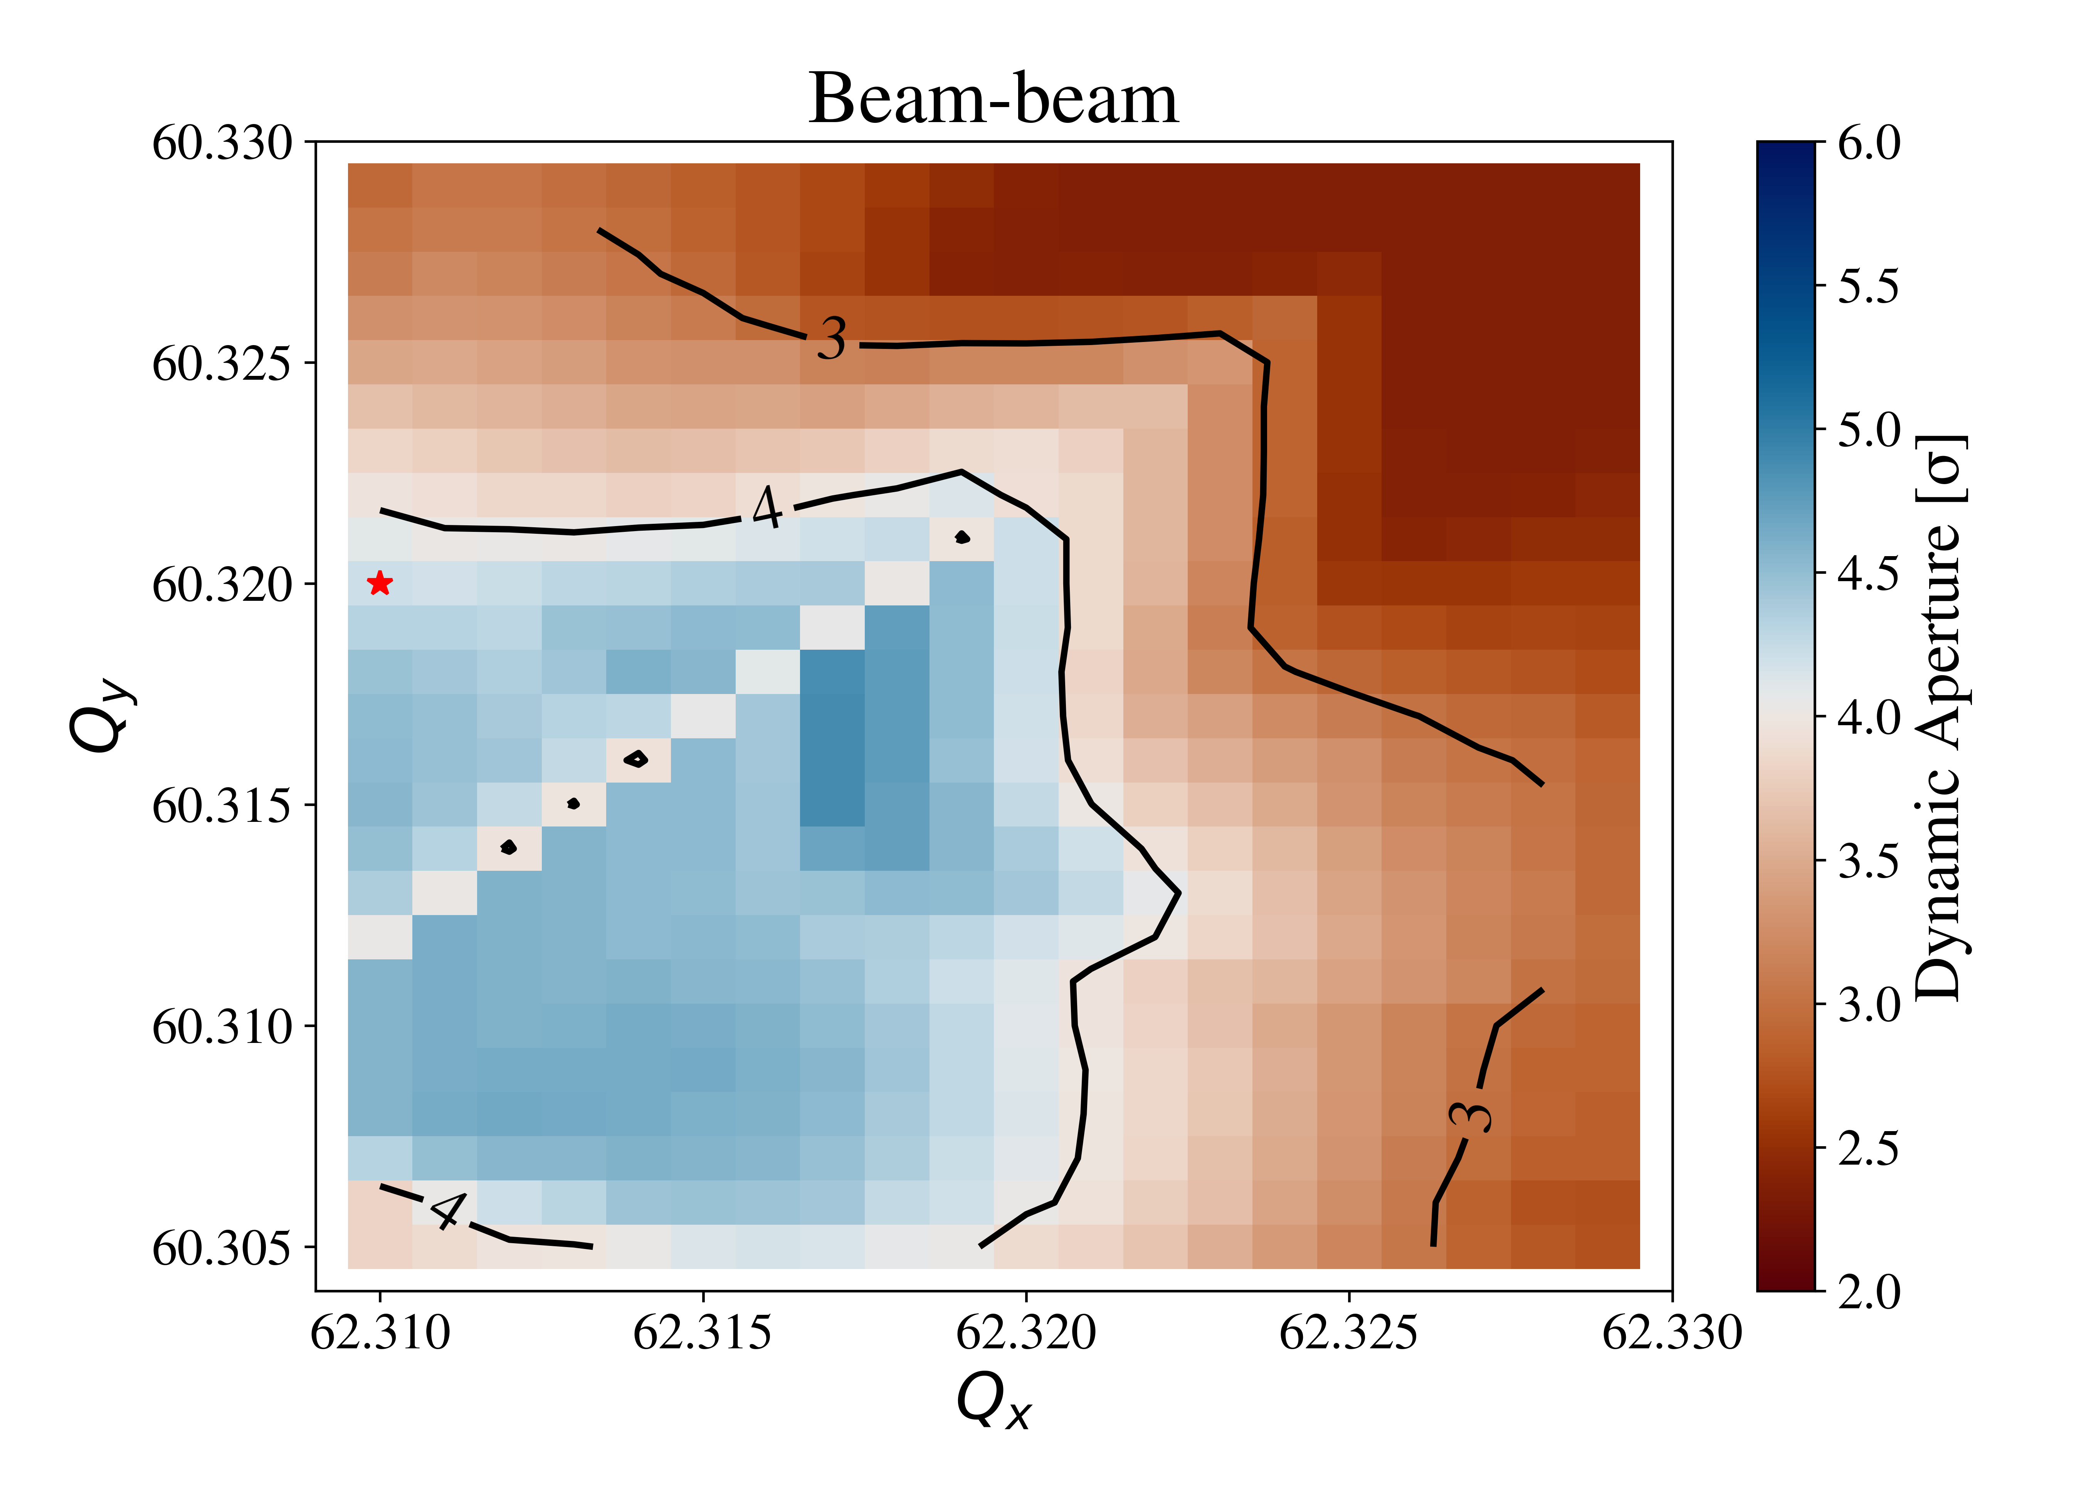
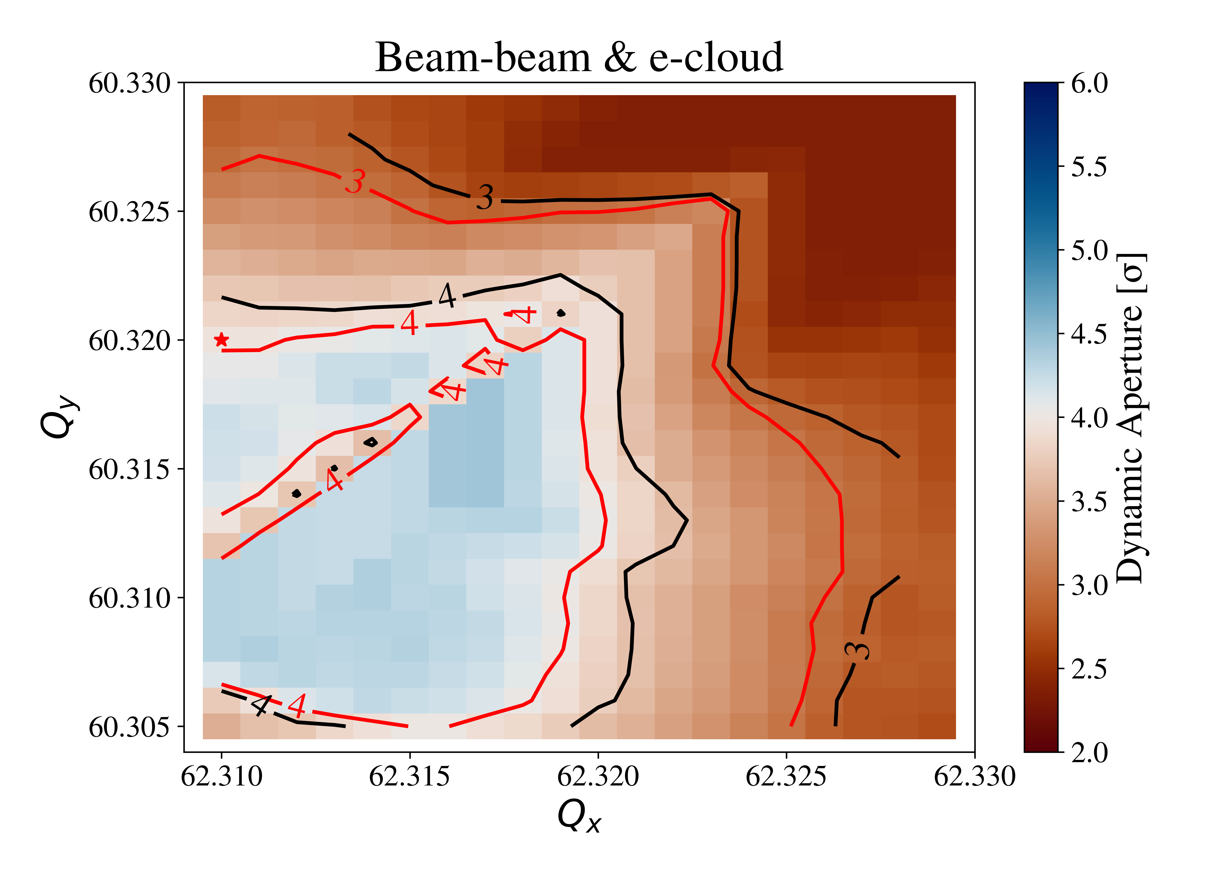
Dynamic aperture
Tune scan
Dynamic aperture over 1 000 000 turns,
including the e-clouds in the 4 inner triplets (left and right of i.p. 1 and 5). Simulations varying the working point.
E-cloud effects cause a reduction of dynamic aperture for all tunes.
The optimal working point remains similar.
Simulation parameters:
Bunch intensity = 1.2 10¹¹ p/b
SEY = 1.30

Slide 18
Conclusions
Region around Inner Triplets is complicated.
Electron cloud effects from the inner triplets in the LHC can be simulated.
Method was developed and benchmarked to be able to simulate effects in a sustainable manner, by reducing memory consumption.
Frequency Map Analysis:
Increased chaoticity that goes deeper into the distribution of particles.
No significant tune-shift effects
Dynamic aperture studies:
Effect that can be at least as strong as beam-beam effects at low bunch intensities.
Cannot be mitigated with a change in working point.
Strategy of HL-LHC upgrade project to coat the new inner triplets with amorphous carbon remains a good solution.
Thank you for your attention!
Konstantinos Paraschou

Slide 19
Backup slides

Slide 20
Simulation parameters
Beam parameters:
Bunch intensity = 1.2 10¹¹ p/b
norm. emittance = 2 μm
r.m.s. bunch length = 0.09 m
Energy = 6.8 TeV
Surface parameters:
SEY = 1.30
2023 Optics with β* = 30 cm
Half-crossing angle : 160 μrad
Working point: Qx = 62.31
Qy = 60.32
Non-linearities to mitigate coherent instabilities: Q’ = 20
I_MO = 300 A
Residual uncorrected global linear coupling:
Re[C⁻] = 0.001

Slide 21
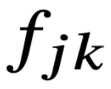
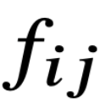
Lie tranformations
Lie transformations are operators that describe the solution of Hamiltonian systems:
where
is the Poisson bracket.
Example:
Transport through element with Hamiltonian
Transport through element with Hamiltonian
Transport through element with Hamiltonian

Slide 22
Lie transformations
i
j
k
: Hamiltonian of e-cloud
interaction for one slice
at location j
: Hamiltonian of transport
between location i and j
: Hamiltonian of transport
between location j and k
Step 1: use property

Slide 23
Lie transformations
i
j
k
We have transported the e-cloud slice (without approximation).
We need to simplify
Step 2: use property

Slide 24
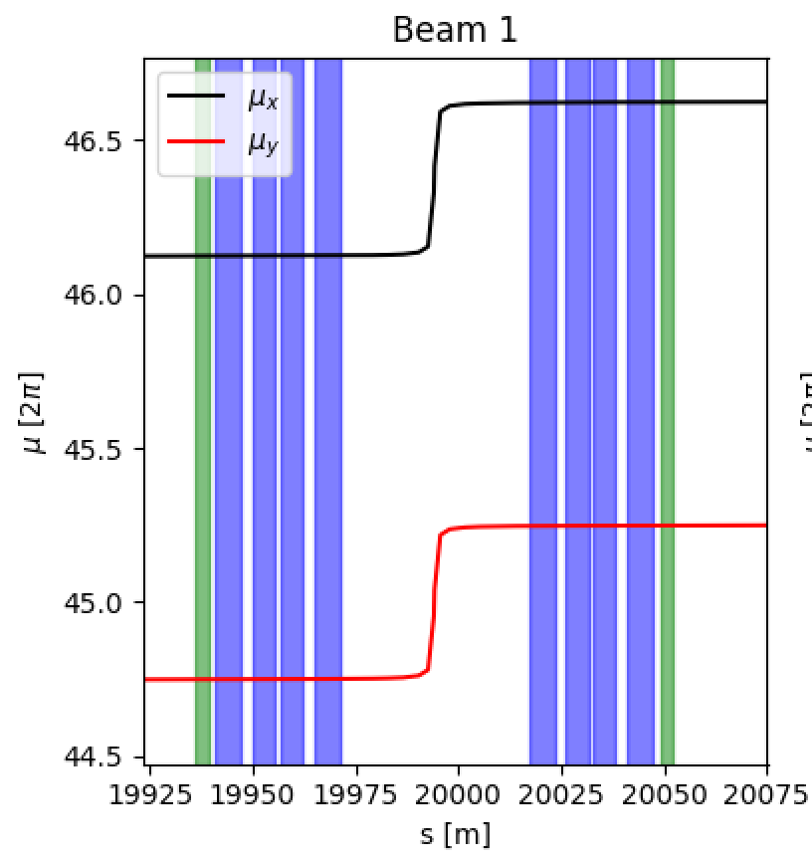
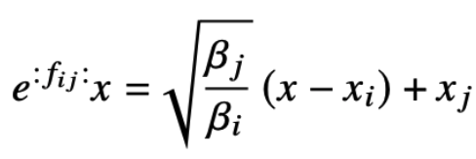
Lie transformations – Courant-Snyder parameterization
Courant-Snyder parameterization (first approximation):
Constant phase advance (second approximation):
Transformation becomes:
Third approximation: longitudinal coordinate doesn’t change.

Slide 25
Effective e-cloud
Equation is manageable in this form.
is defined on a 3D grid, we just need to reinterpolate based on the above equation.
i
1
2
3
4
k
...
1536 simulations each to:
Do electron cloud buildup,
Detailed bunch passage “pinch”.
Combine on-the-fly to same 4 files.

