Slide 1


Longitudinal beam dynamics simulations for the CERN accelerators
Simon Albright, Theodoros Argyropoulos, Fabian Batsch, Heiko Damerau,
Niki Gallou, Konstantinos Iliakis, Leandro Intelisano, Birk Emil Karlsen-Baeck,
Ivan Karpov, Alexandre Lasheen, Mariangela Marchi, Luis Medina, Oleksandr Naumenko,
Danilo Quartullo, Joel Repond, Alice Lucie Vanel, Juan Esteban Müller, Markus Schwarz,
Helga Timko, Leonard Thiele, Panagiotis Tsapatsaris, Georgios Typaldos, Michail Zampetakis
14th International Computational Accelerator Physics Conference, 2-5 October 2024

Slide 2
Outline
BLonD simulation framework and its features
CERN accelerator complex and main projects
Simulation examples
Future work
Based on the recent publication:
H. Timko et al., Beam longitudinal dynamics simulation studies, PRAB, 2023

Slide 3

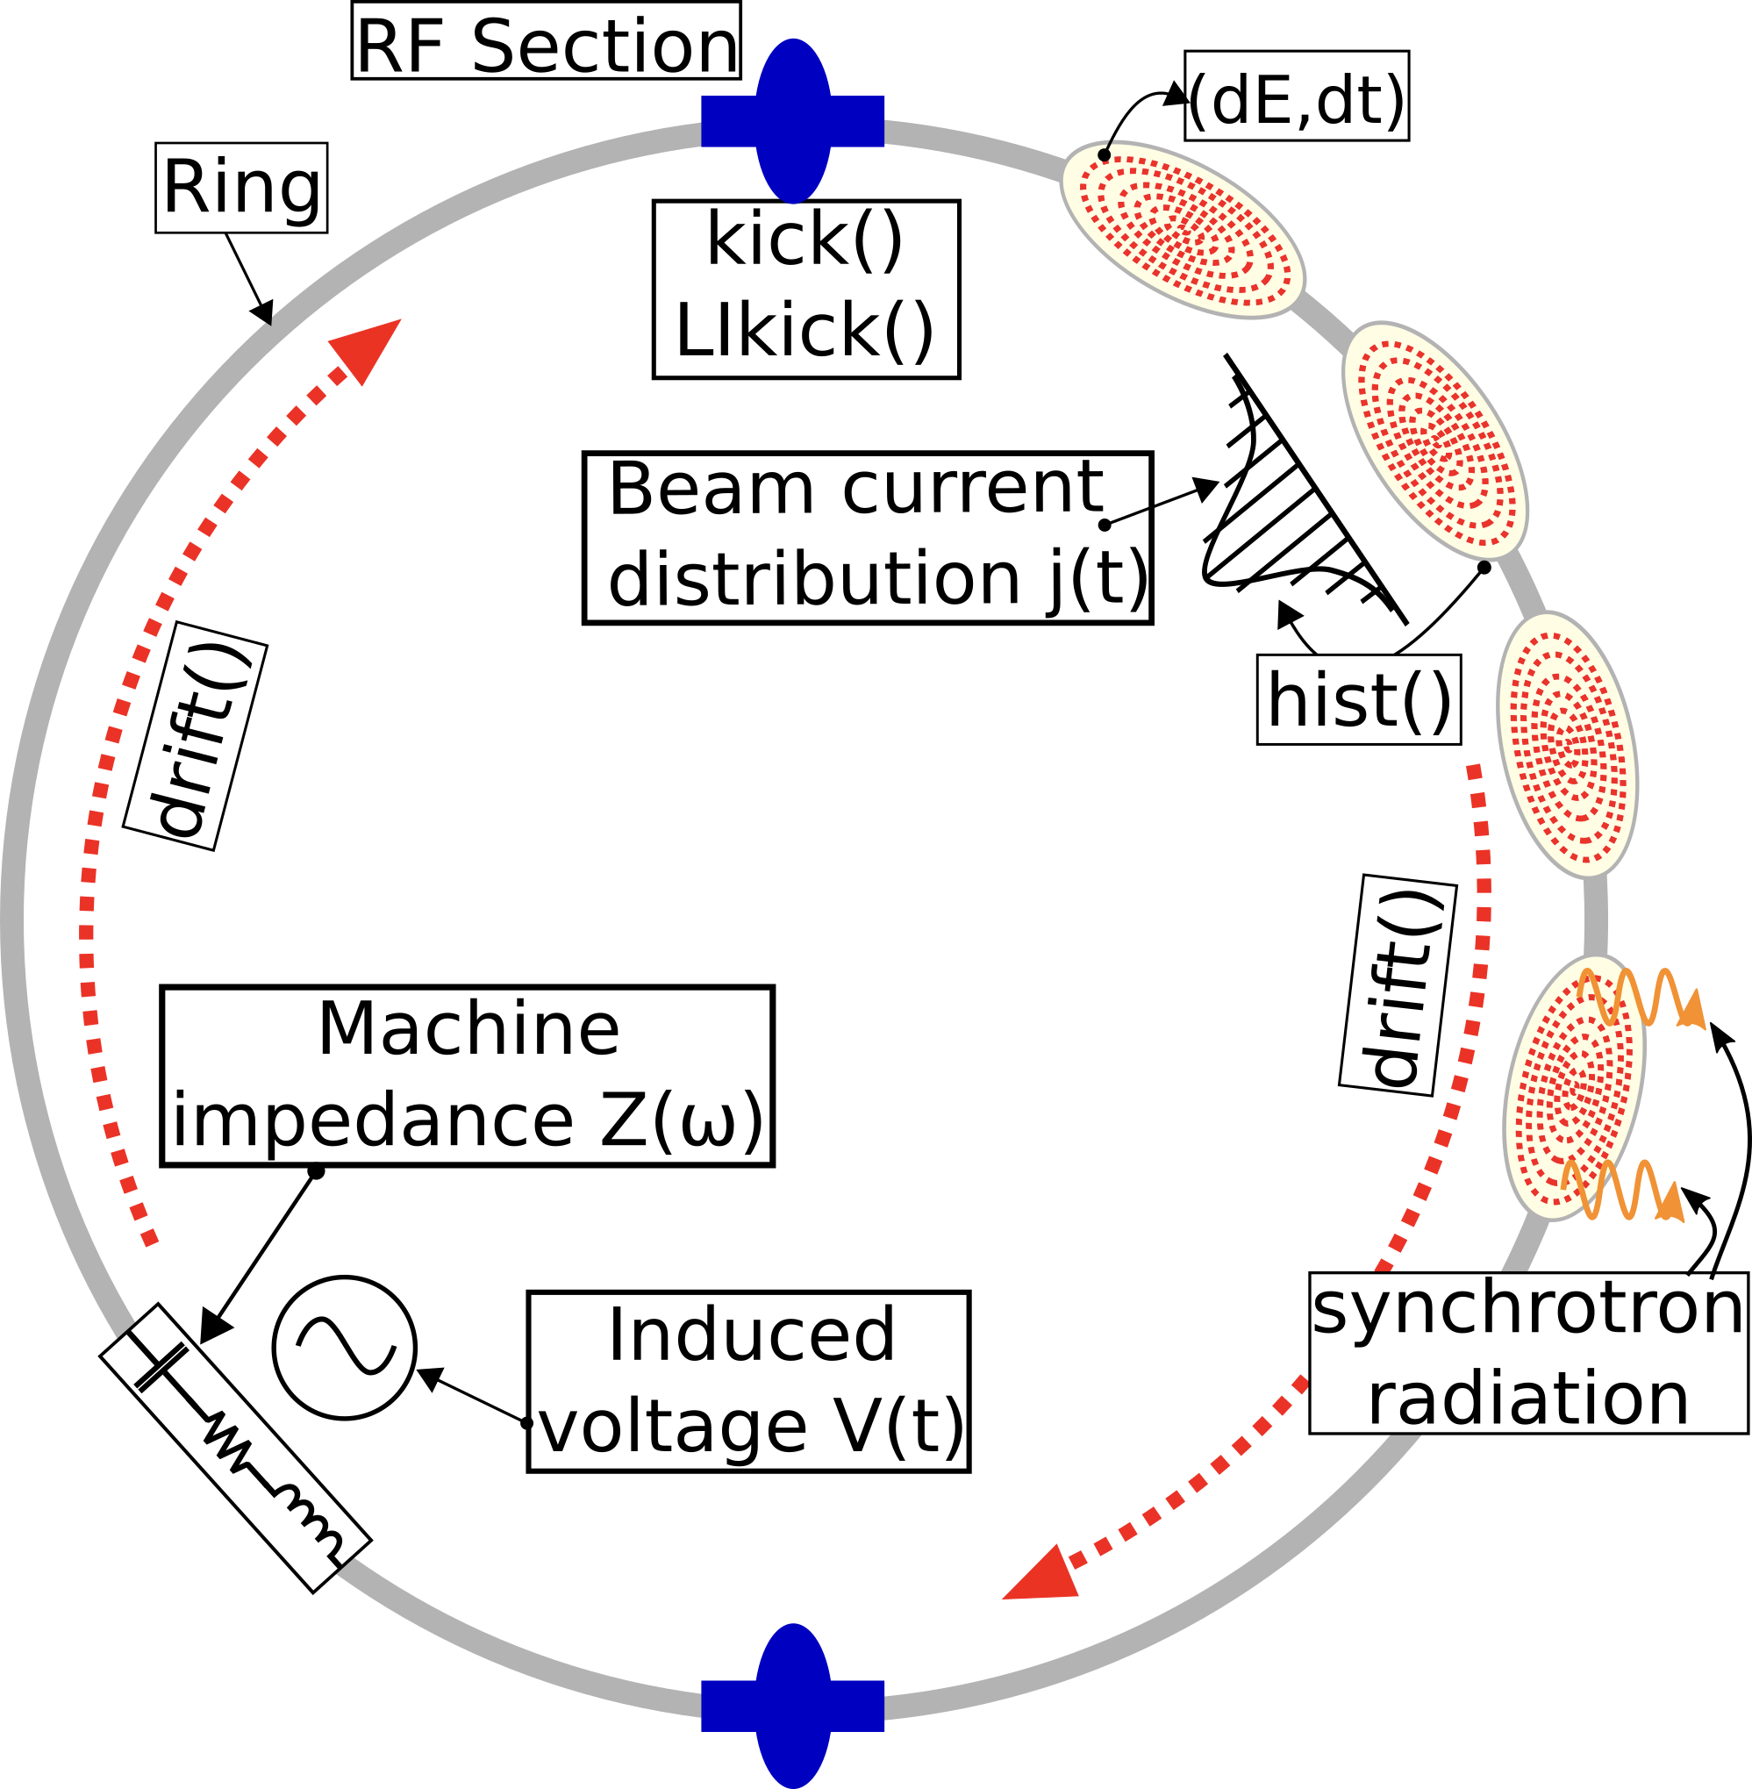
The BLonD simulation suite
Beam Longitudinal Dynamics (BLonD)
(H. Timko et al., PRAB, 2023):
Is developed in CERN RF group since 2014
Models longitudinal beam motion in synchrotrons
Includes RF-related items:
  Longitudinal coupling impedance
  Multi-station and multi-harmonic RF systems
  RF manipulations
  RF noise/excitation
  Low-Level RF loops
  Synchrotron radiation
  Intra-beam scattering
Is applied for various beam dynamics studies at CERN and other laboratories (GSI, KIT, KEK, J-PARC, HIAF, Fermilab, Jefferson Lab, …)
Code repositories with installation instructions
Main - https://gitlab.cern.ch/blond/BLonD
    Mirror - https://github.com/blond-admin/BLonD
  Documentation
  https://blond-code.docs.cern.ch/

Slide 4
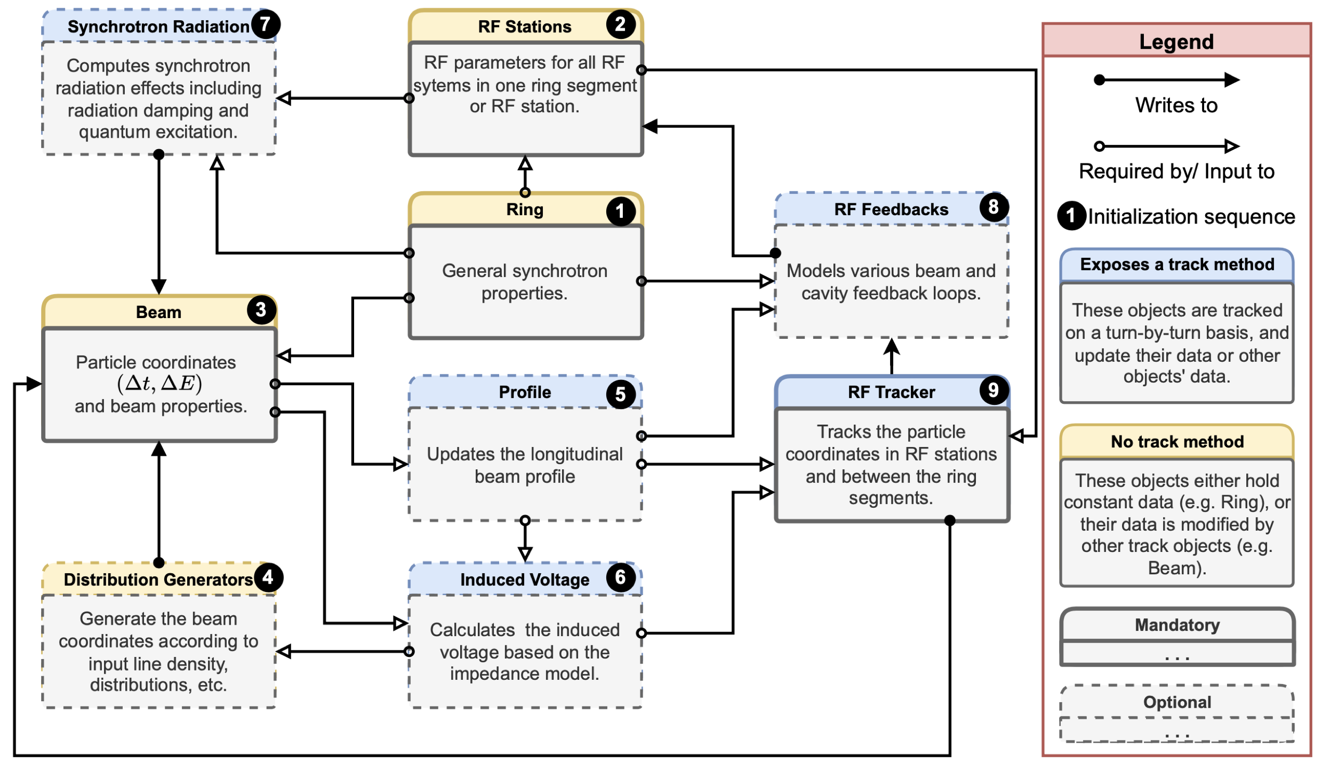
Code structure
BLonD code structure with mandatory (solid line)
and optional (dashed line) objects
  Object-oriented Python code with C++/CUDA computational kernels
    Optional usage of most modules, defined by the user in their input file

Slide 5
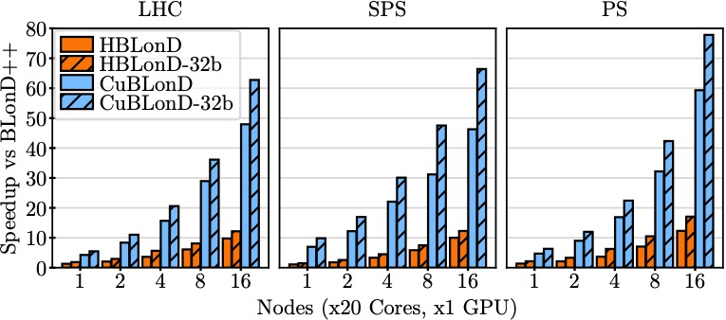
Performance optimizations
BLonD applies high-performance computing methods (K. Iliakis, PhD thesis, 2022)
  BLonD (Python only) → BLonD++
      Move computational core to C++
      Optimise time-consuming code regions
        Use of highly efficient libraries (e.g. sine function)
      Runtime reduction: 1 day → 80 minutes
  BLonD++ → HBLonD (x10 speed-up)
      From single-core to distributed version
      Using the Message Passing Interface (MPI)
      High-performance computing techniques
        Dynamic load balancing, data- and task parallelism
  BLonD++ → CuBLonD (x10-17 speed-up)
      GPU-accelerated version
      CUDA and CuPy versions available

Slide 6
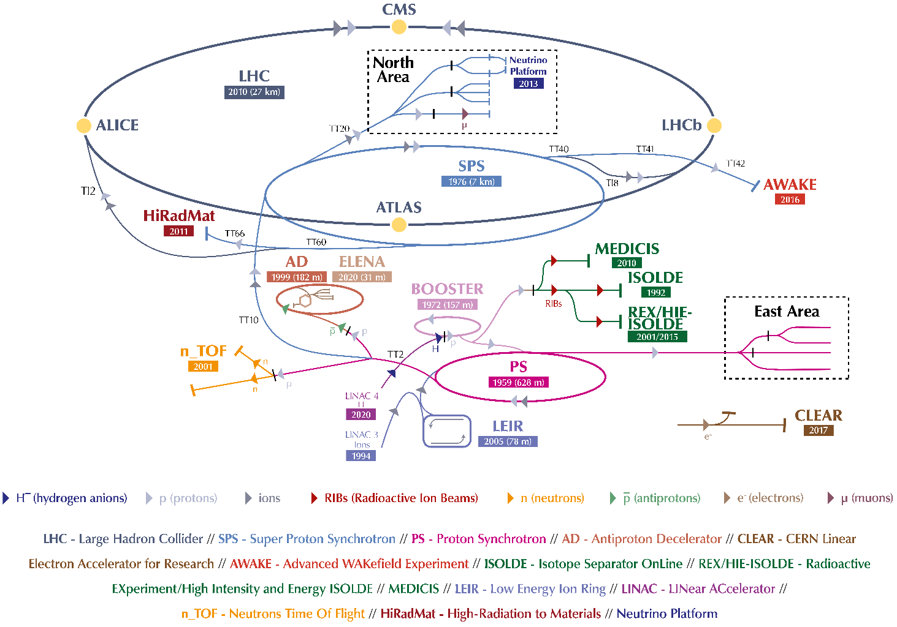





CERN accelerator complex and main projects

Slide 7
CERN accelerator complex and main projects
A small subset of studies will be presented

Slide 8
Proton Synchrotron Booster (PSB)

Slide 9
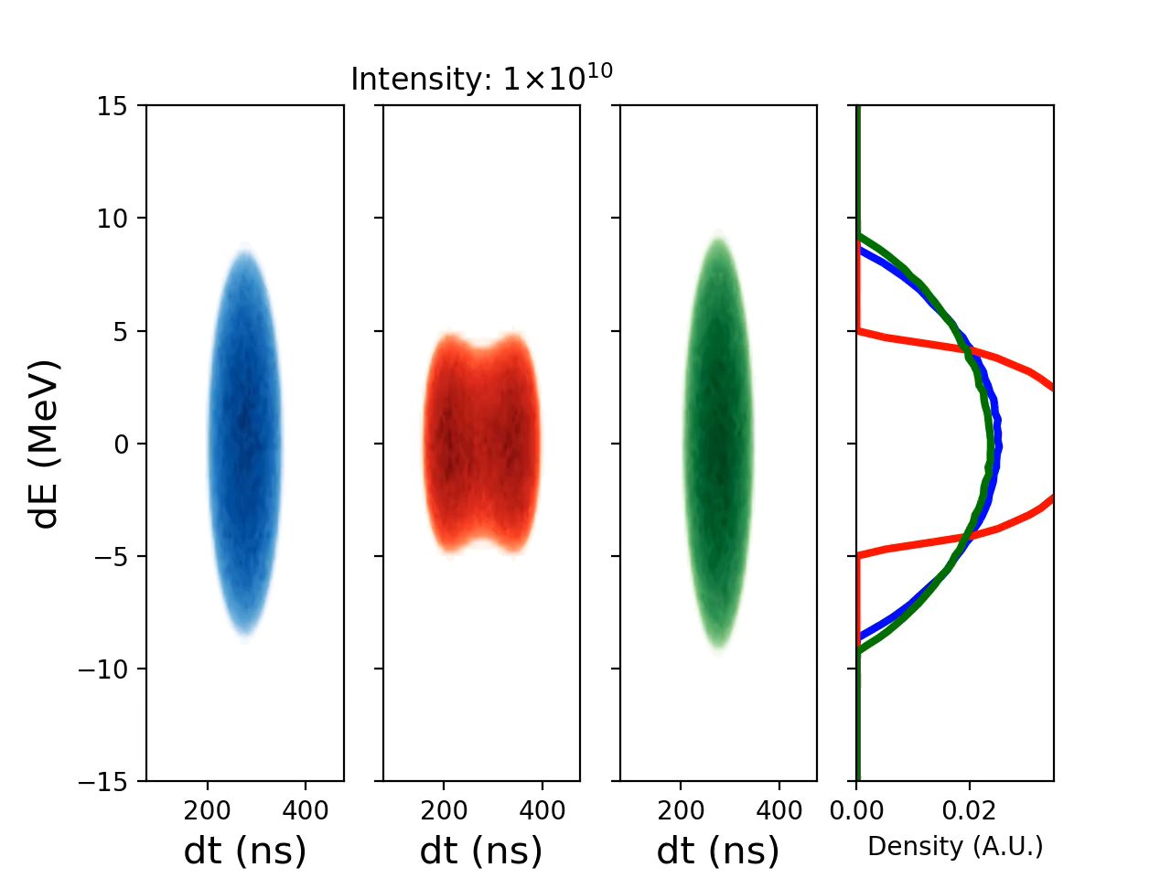
PSB: beam stability with double-harmonic RF system
Single-harmonic
RF
Bunch-lengthening mode
Bunch-Shortening mode
LIU target longitudinal beam parameters are far from limitations due to collective effects
Probing of intensity limits is driven by the PBC project
To understand instability mechanisms, good knowledge of the impedance model and implementation of feedback loop in BLonD is crucial

Slide 10
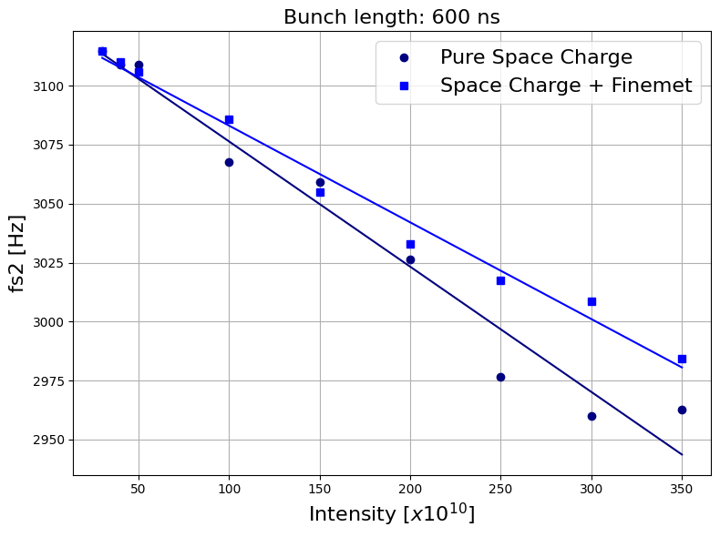
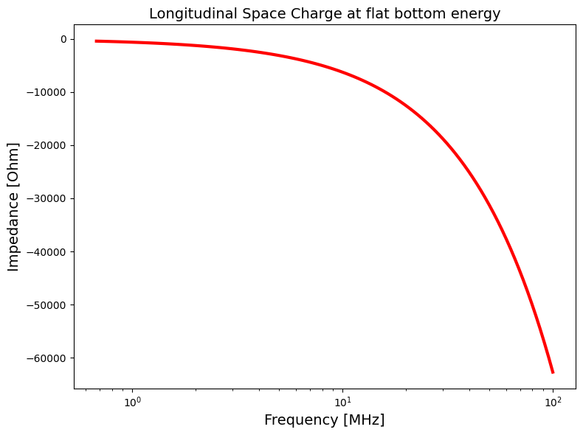
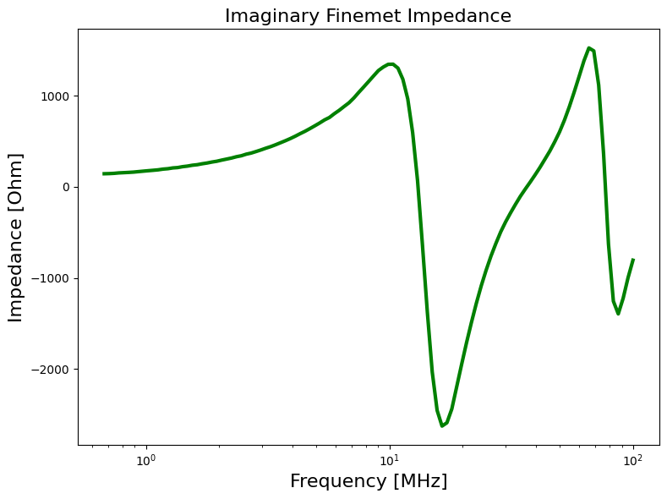
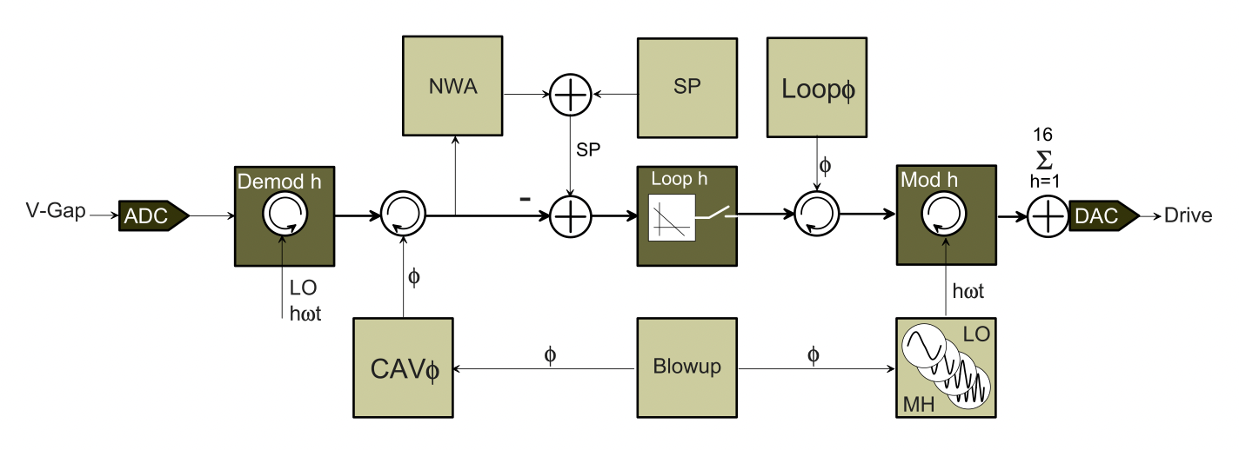
PSB: probing longitudinal impedance
Dominant sources of PSB longitudinal impedance
PSB multi-harmonic digital feedback system
Impedance of FinemetTM cavities partially compensates the space charge
Quadrupole oscillations and their frequency shifts vs intensity allow probing the imaginary part of the broad-band impedance
Multi-harmonic feedback actively suppresses FinemetTM impedance at multiples of revolution harmonics (up to h = 16)
D. Barrientos et al., IPAC’22, 2022

Slide 11
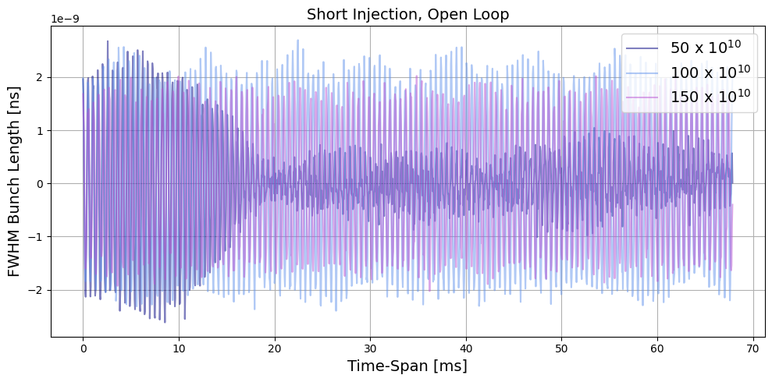
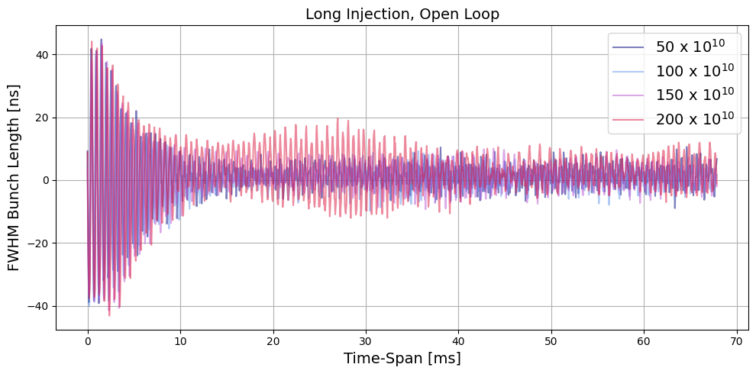
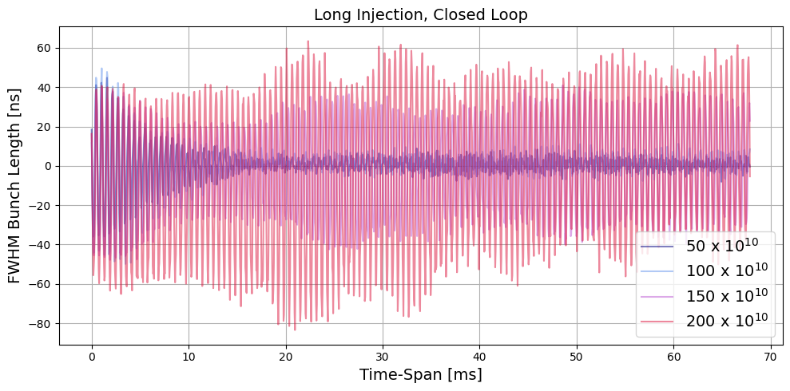
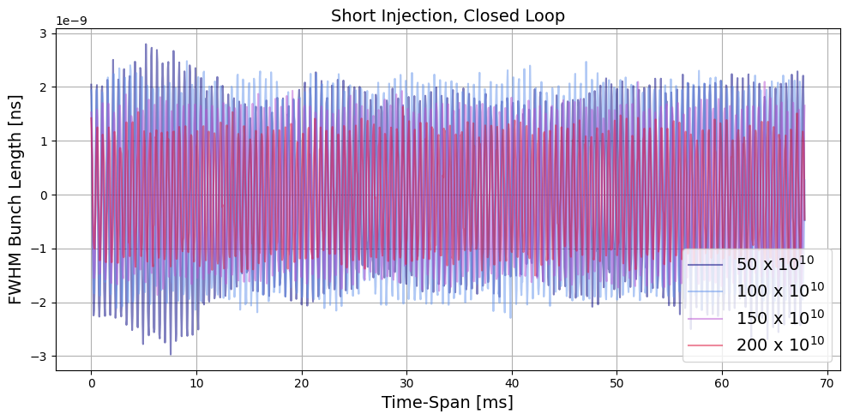
PSB: first comparisons with measurements
Evolution of bunch length oscillation amplitude (M. Marchi and S. Albright, SC workshop, 2024)
MHFB off
MHFB off
Measurements (380 ns)
Simulation (350 ns)
MHFB on
MHFB on
$→$ Clear signs of the modified effective impedance in measurements
$→$ Detailed comparisons are ongoing

Slide 12
Proton Synchrotron (PS)

Slide 13
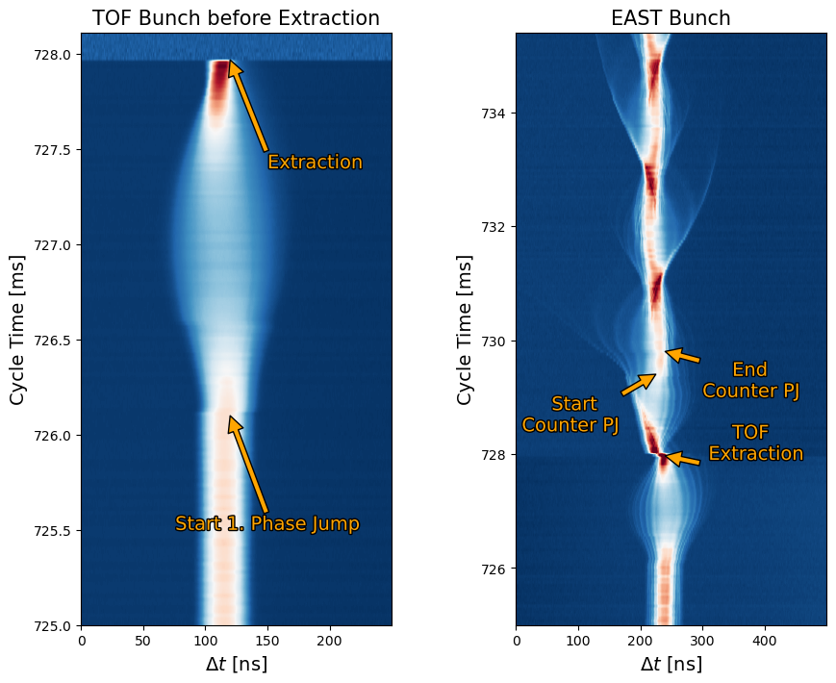
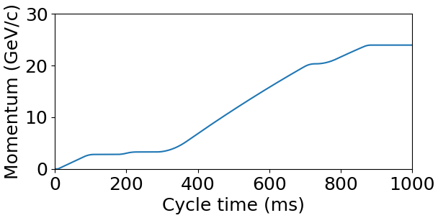
PS: TOF EAST bunch rotation
2 Bunches: TOF and EAST
TOF 10x more intense than EAST (350e10 and 35e10 protons)
Extracted at different energies and times
Both extracted with phase jumps
  Short TOF Bunch Length
  Large momentum spread for EAST
3rd phase jump to counter-rotate EAST
Extraction TOF
Extraction EAST

Slide 14
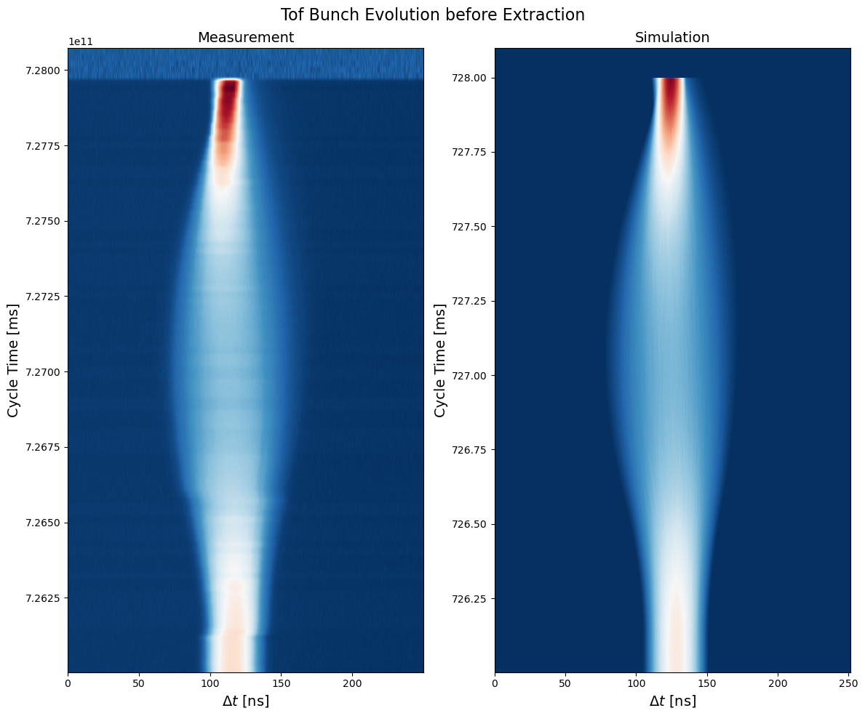
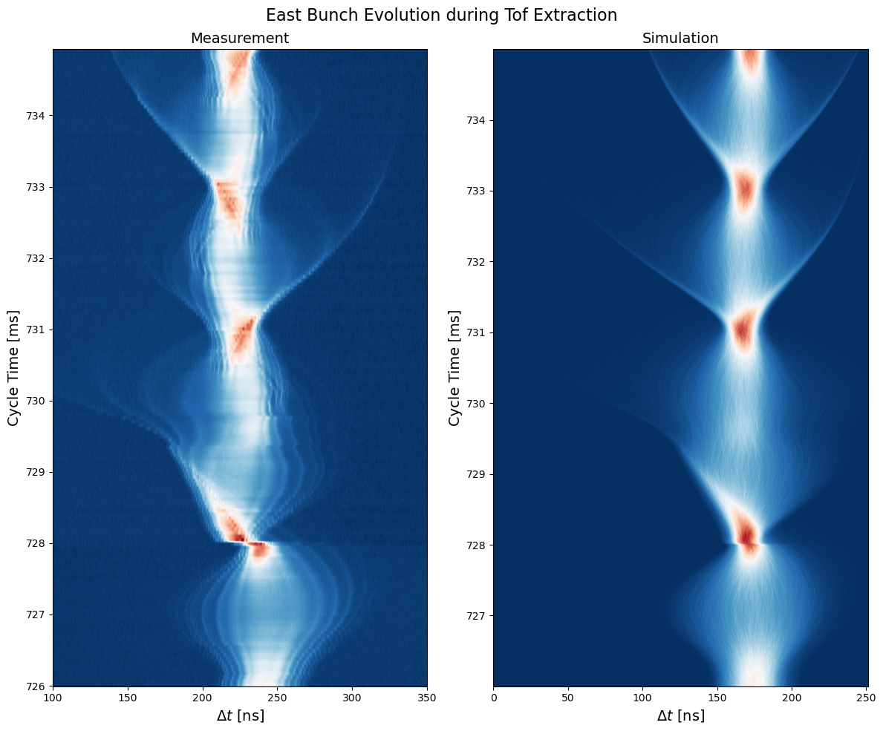
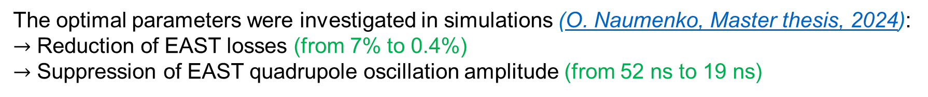
PS: benchmark and optimization
The optimal parameters were investigated in simulations (O. Naumenko, Master thesis, 2024):
$→$ Reduction of EAST losses (from 7% to 0.4%)
$→$ Suppression of EAST quadrupole oscillation amplitude (from 52 ns to 19 ns)

Slide 15
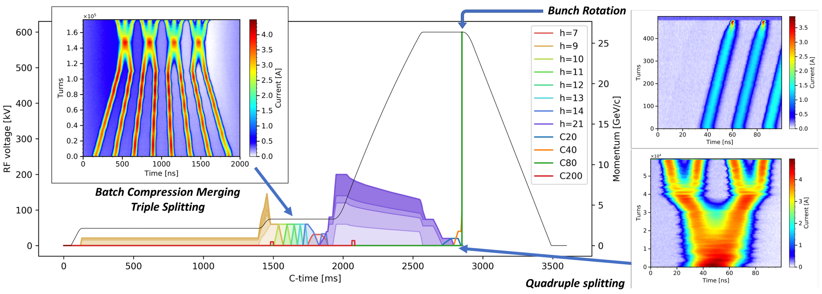
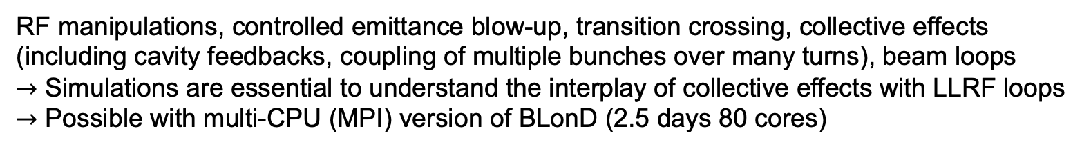
PS: end-to-end simulation for LHC-type beam
PS momentum and voltage programs for the BCMS cycle, with the bunch profile evolution as simulated in BLonD (A. Lasheen et al., HB2021)
RF manipulations, controlled emittance blow-up, transition crossing, collective effects (including cavity feedbacks, coupling of multiple bunches over many turns), beam loops
$→$ Simulations are essential to understand the interplay of collective effects with LLRF loops
$→$ Possible with multi-CPU (MPI) version of BLonD (2.5 days 80 cores)

Slide 16
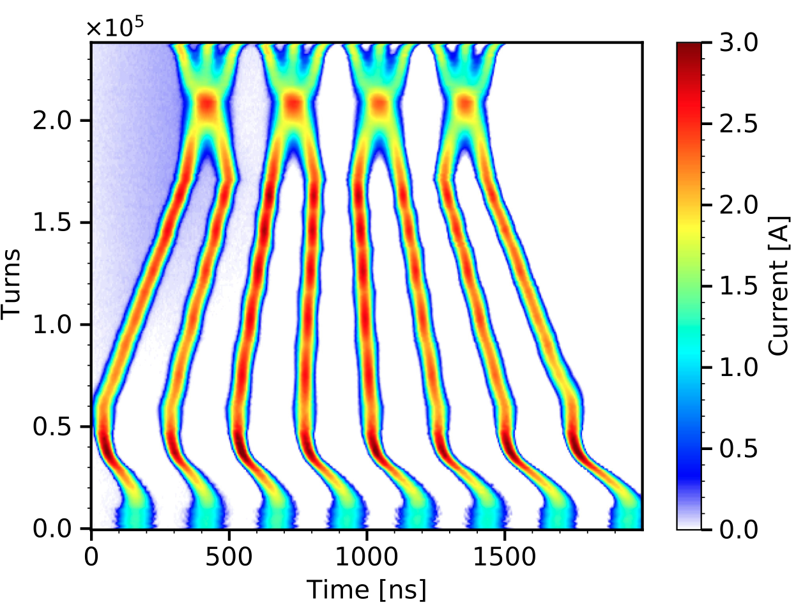
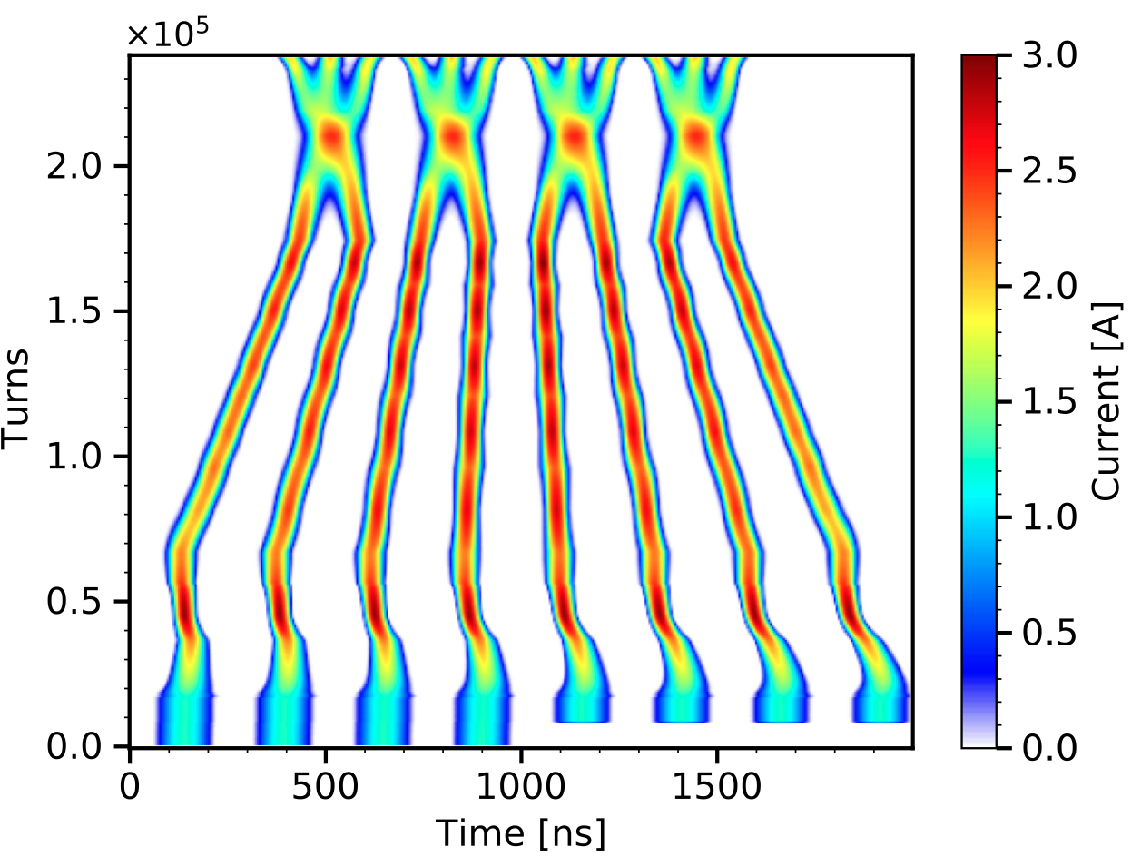
PS: end-to-end simulation for LHC-type beam
Measurements
Simulations

Slide 17
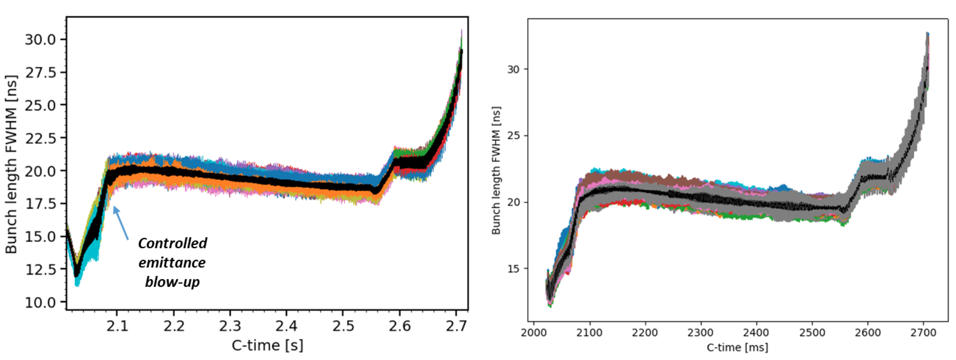
PS: end-to-end simulation for LHC-type beam
Bunch lengths along the acceleration ramp starting right before transition crossing until the double splittings at flat top energy.
Simulations
Measurements
All parameters are the same as in measurements except for the doubled amplitude of controlled emittance blow-up (under investigation).

Slide 18
Super Proton Synchrotron (SPS)

Slide 19
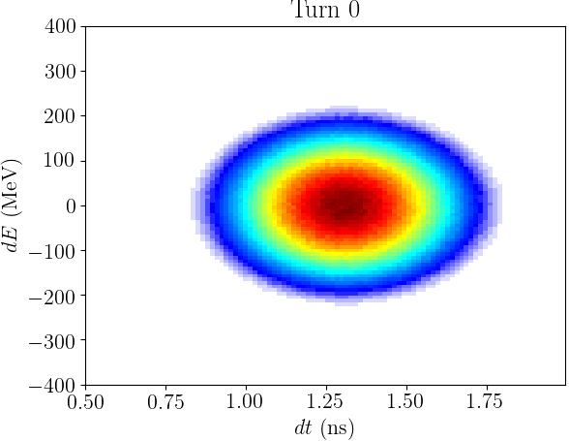
SPS: loss of Landau damping
Dominant inductive impedance above transition
Longitudinal phase space
Discrete mode
Loss of
Landau damping
Loss of Landau damping (LLD) occurs when a coherent mode is outside of the frequency band
LLD plays a crucial role in multi-bunch stability (IK, E. Shaposhnikova, PRAB, 2024)

Slide 20
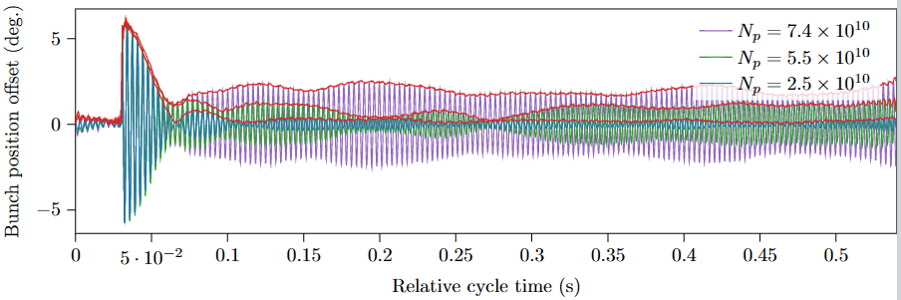
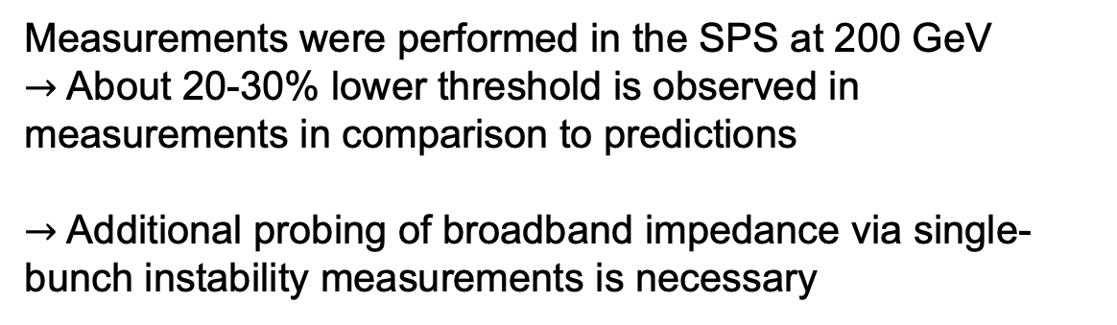
SPS: loss of Landau damping
Phase kick
Measurement technique
Amplitude evolution after a kick
Measurements
L. Intelisano et al, IPAC’23, 2023
Measurements were performed in the SPS at 200 GeV
$→$ About 20-30% lower threshold is observed in measurements in comparison to predictions
$→$ Additional probing of broadband impedance via single-bunch instability measurements is necessary
Predicted
LLD threshold
Simulations

Slide 21
Large Hadron Collider (LHC)

Slide 22
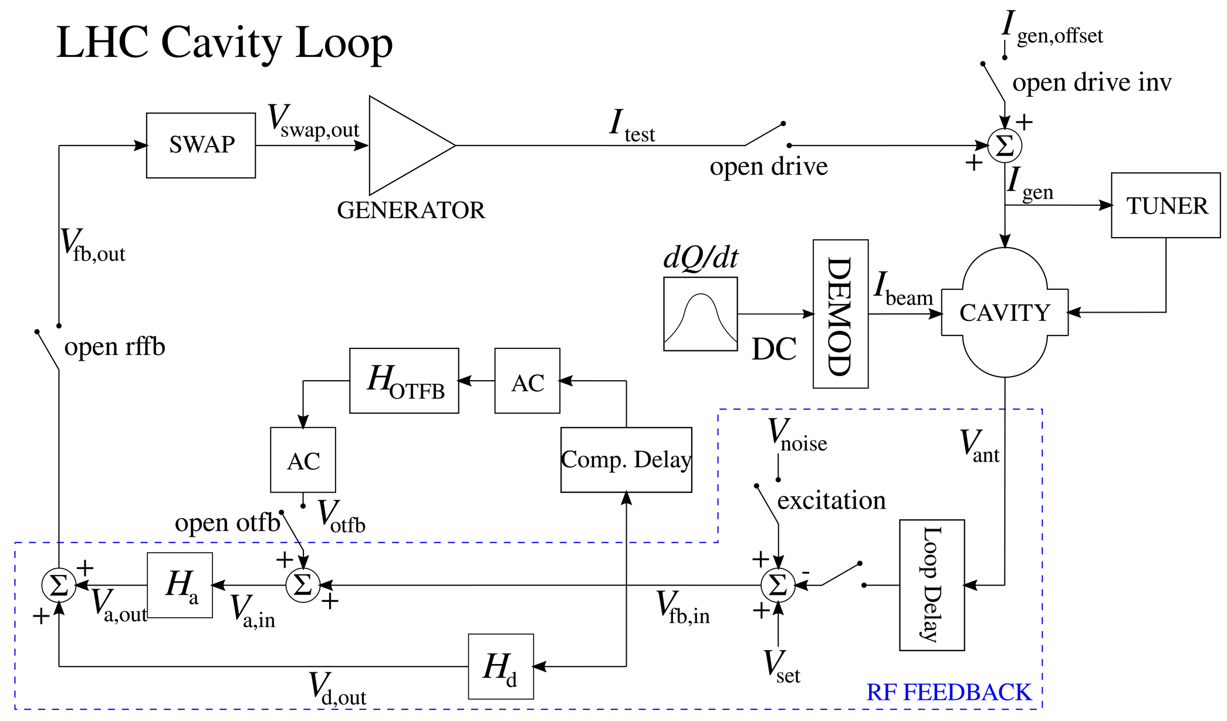
LHC: RF power limitations and losses
BLonD models of the SPS and LHC LLRF
  Power transients are studied in simulation for HL-LHC beam current
    Possible power limitations for the main RF system
    Missing RF voltage can lead to significant losses
  The study requires (B. Karlsen-Baeck, Master thesis, 2022)
    Modeling the extracted beam distribution from the SPS with collective effects and cavity feedback
    Modeling the LHC injection with collective effects, cavity feedback, and beam-based loops

Slide 23
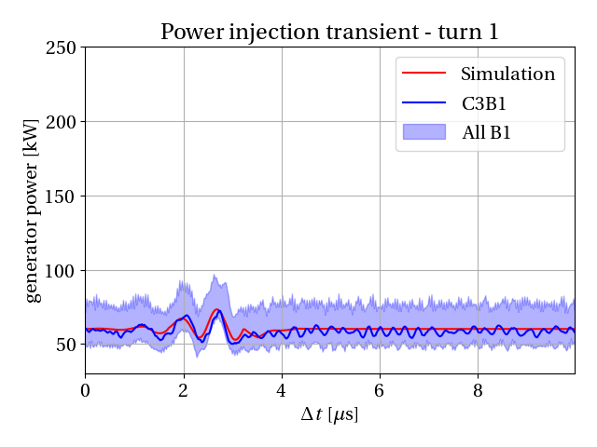
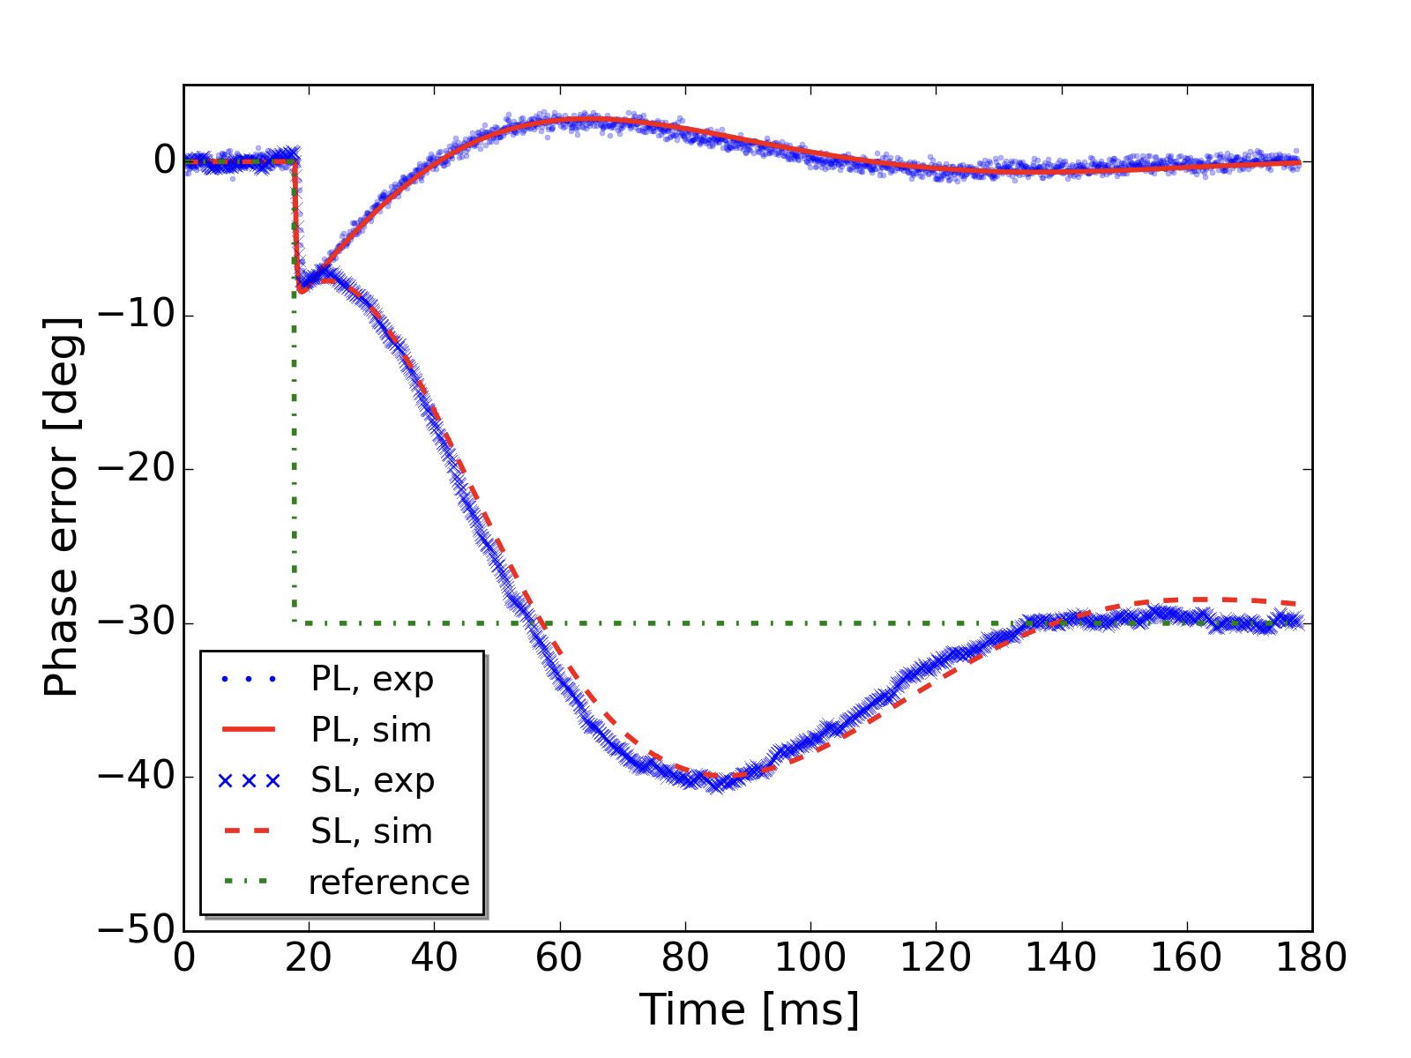
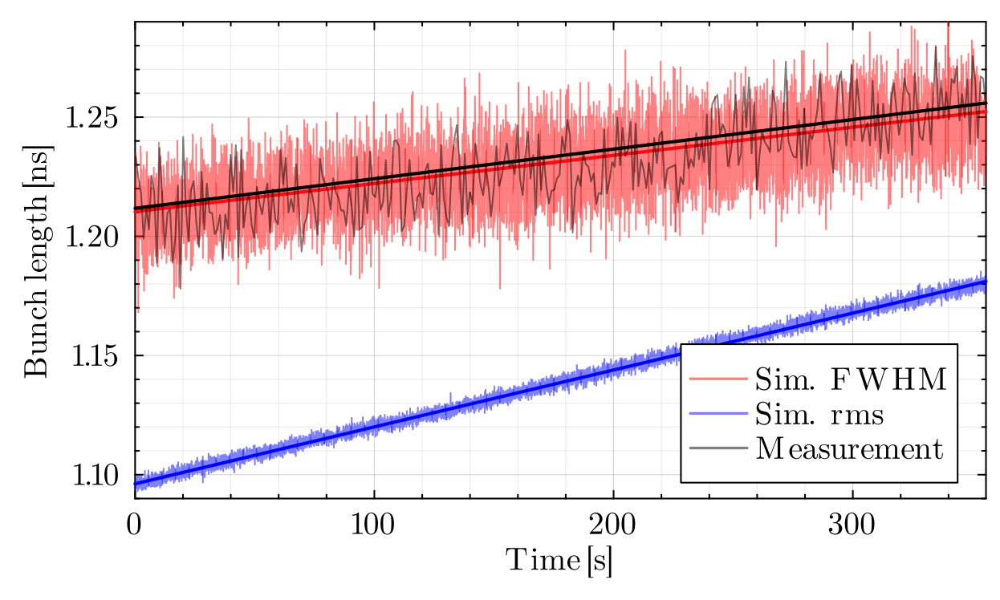
LHC: RF power limitations and losses
Step response of beam phase and synchro loops:
Measured (blue) vs simulated (red) phase error
Injection transients with a 36-bunch batch of 1.8x10¹¹ p/b
- Coupling of local and global control loops allow for accurate predictions of RF power transients at injection and capture losses
- Intra-beam scattering model is ready to study the long-term evolution of losses
M. Zampetakis et al., IPAC, 2024

Slide 24
Muon collider

Slide 25
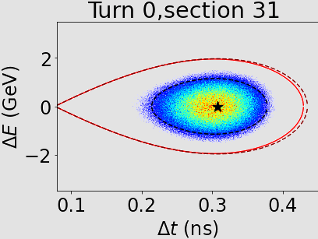
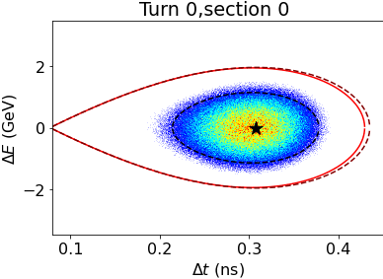


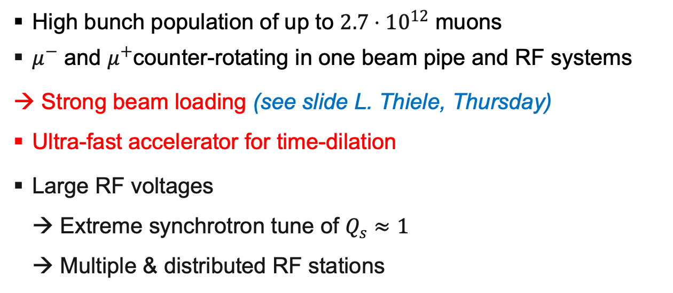
Muon collider: counter-rotating beams
High bunch population of up to $2.7⋅10^{12}$ muons
$μ^{−}$ and $μ^{+}$counter-rotating in one beam pipe and RF systems
→ Strong beam loading (see slide L. Thiele, Thursday)
Ultra-fast accelerator for time-dilation
Large RF voltages
→ Extreme synchrotron tune of $Q_{s}≈1$
→ Multiple & distributed RF stations
Sketch of RCS with 8 RF stations
5
crossing point
6
4
7
Example with 8 RF stations
3
$μ^{−}$
$$μ^{+}$$
8
2
crossing point
1

Slide 26
Summary and future work
Ten years of BLonD
  Reliable simulator used for a huge number of studies at CERN
    Simulations results were and are being used for: operation, LIU design, HL-LHC, FCC, muon collider…
  There is a growing user community outside CERN
    GSI, KIT, KEK, J-PARC, HIAF, Fermilab, Jefferson Lab, …
Future work
  Automatic assembler of tracking methods
  Advanced schemes for collective effects
    Non-uniform grid, space slicing, or compressed convolution
  Stochastic cooling
  BLonD-Xsuite coupling for full 6D simulations

Slide 27
Thank you for your attention!

Slide 28
Backup slides

Slide 29
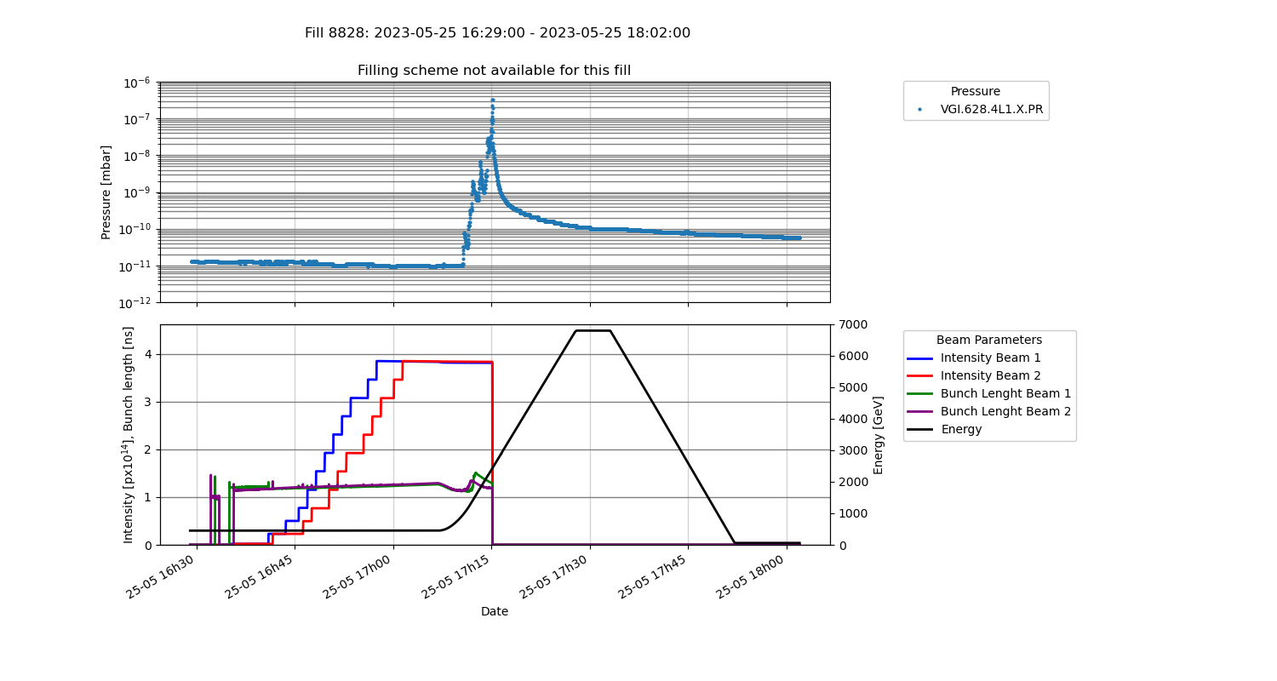
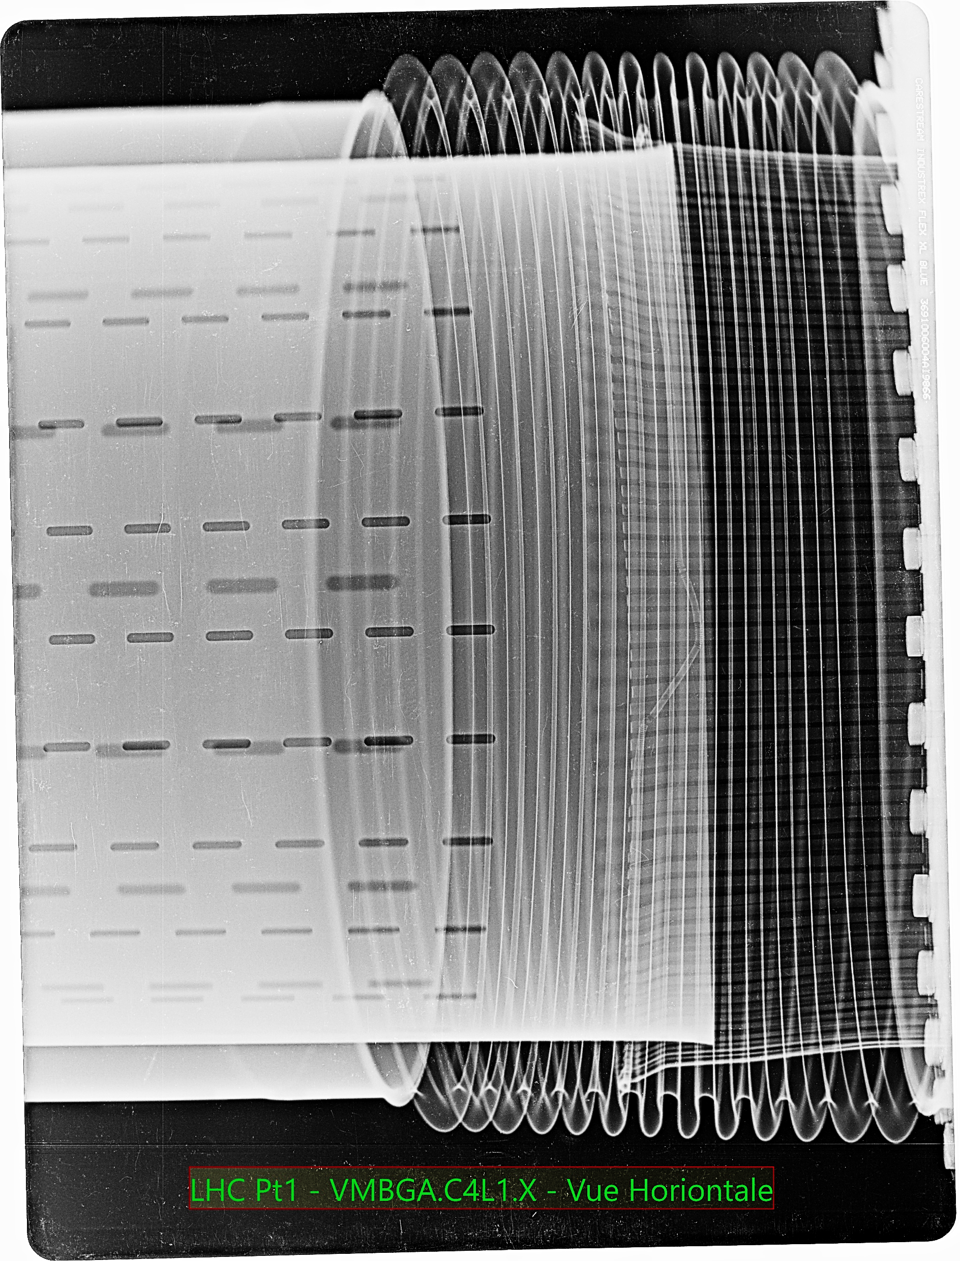
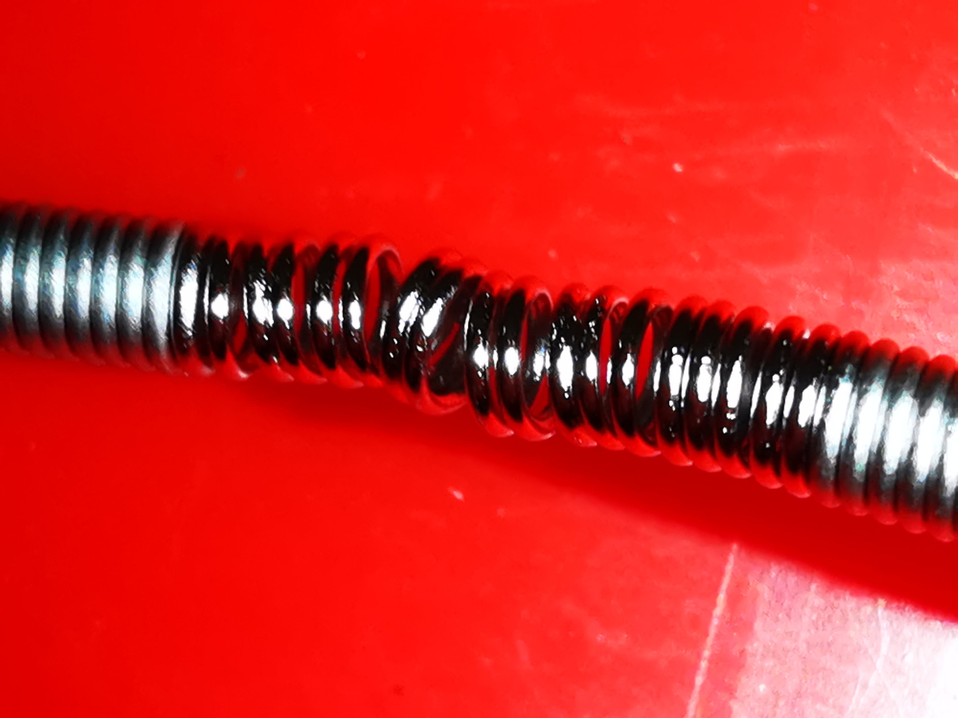
LHC: limitations on bunch length
Failure of warm modules due to localized heating on spring compatible with the estimated beam-induced power
C. Zannini et al. – LBOC, 2024
Restrictions on beam parameters, e.g., for OP beams:
- 1.8e11 p/b possible if bunch length ≥ 1.3 ns along the whole cycle

Slide 30
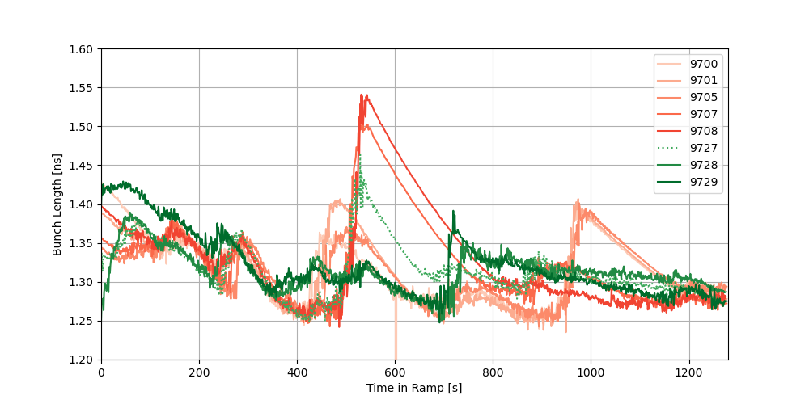
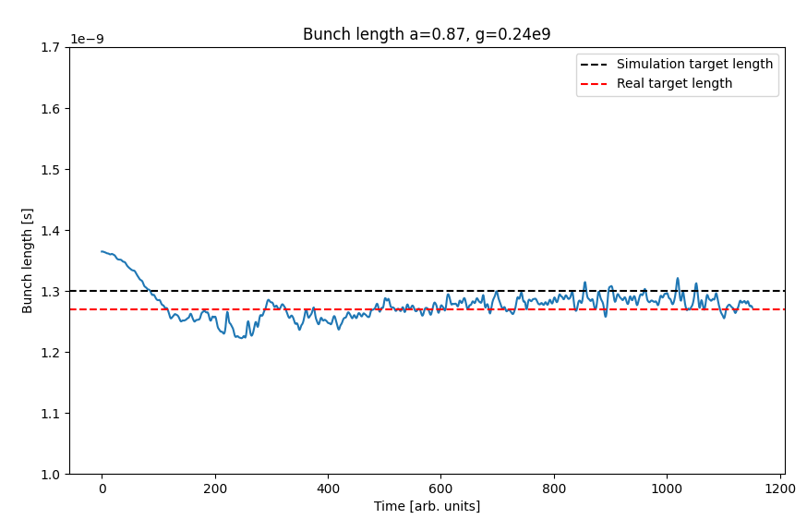
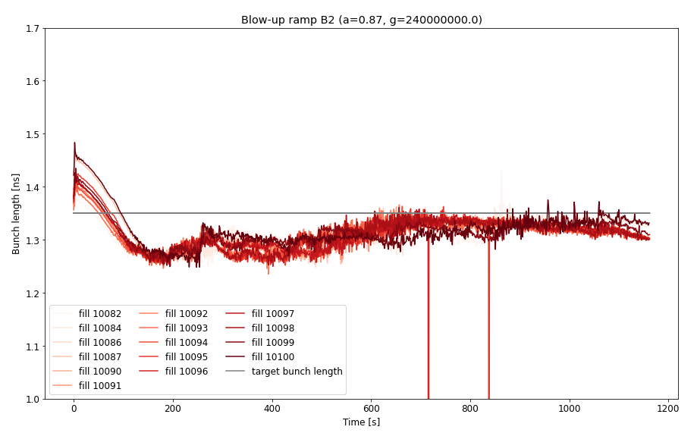
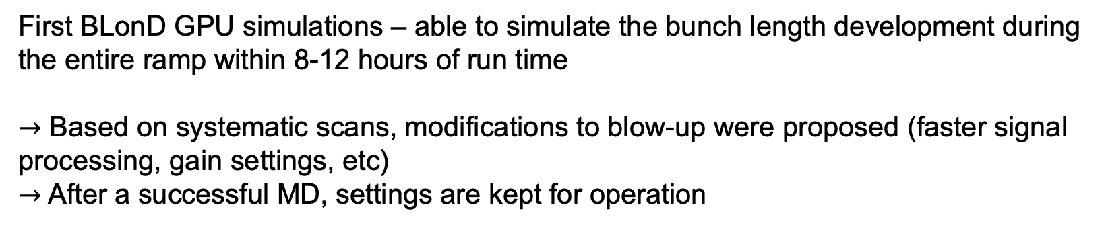
LHC: controlled emittance blow-up
Beam 2:
First BLonD GPU simulations – able to simulate the bunch length development during the entire ramp within 8-12 hours of run time
$→$ Based on systematic scans, modifications to blow-up were proposed (faster signal processing, gain settings, etc)
$→$After a successful MD, settings are kept for operation

Slide 31
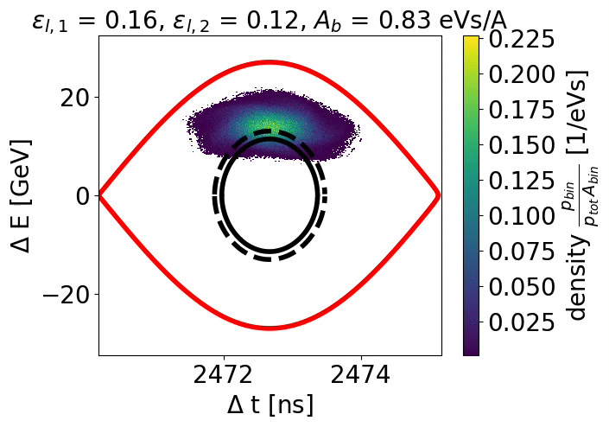
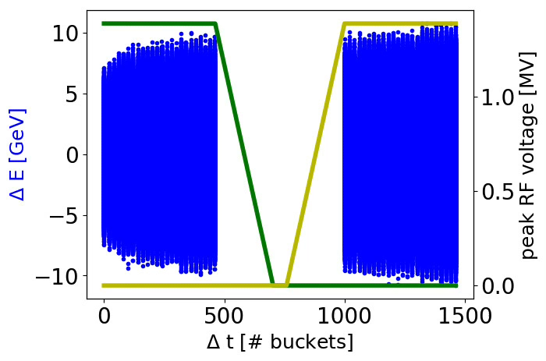
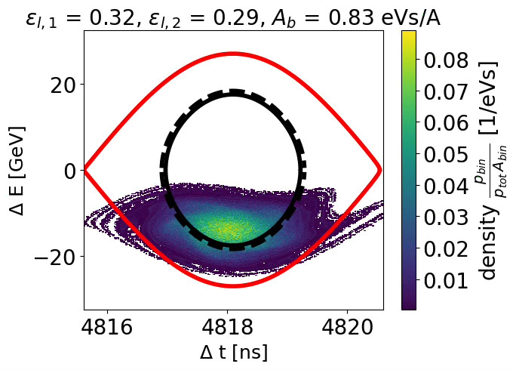
SPS: ion beam slip stacking
Slip stacking for ion beams in SPS in simulations
(D. Quartullo, PhD thesis, 2019)

Slide 32
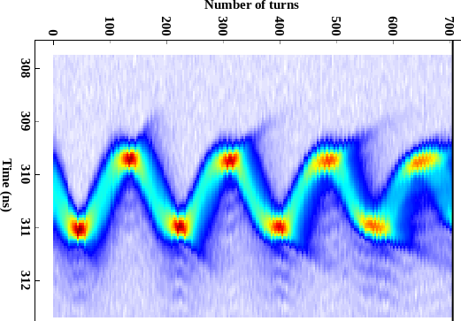
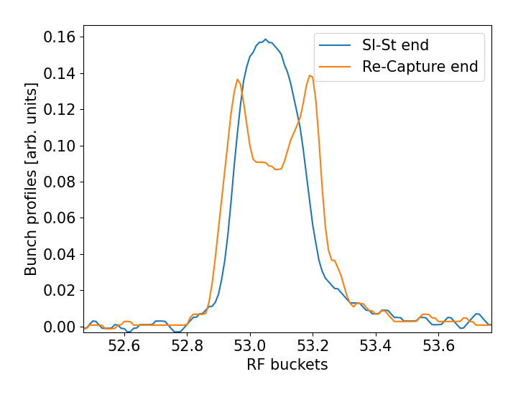
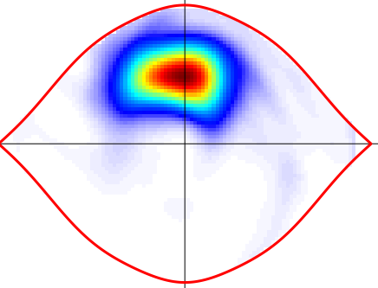
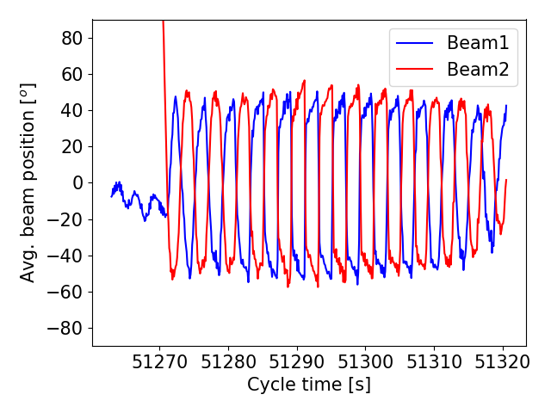
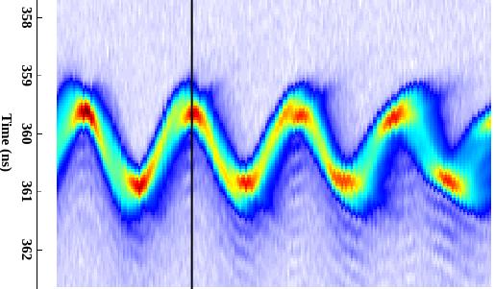
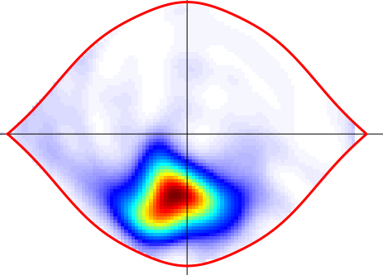
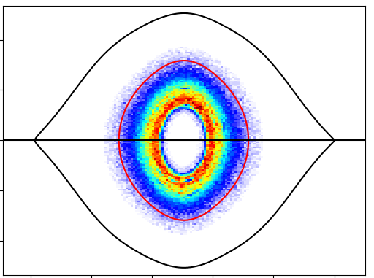

SPS: ion beam slip stacking
Non-adiabatic voltage jump at 8MV: all cavities at same frequency
Beams 180$°$ out of phase → Phase-loop inactive → Strong dipole oscillations
Hollow bunches generated → small long emittance and some bunches can become unstable
  Switch on the 800MHz RF at the same time with voltage ratio, $V_{r}=0.1$
  Switch on PL after filamentation → bunch center is repopulated
Hollow bunches
Beam1 – bunch1
Dipole oscillations
Tomography
Measurements
Beam2 – bunch1
Simulation
T. Argyropoulos, IPP, 2023

