Slide 1
Amplitude analysis Bound and virtual states Triangles
Alessandro Pilloni
Modern Techniques in Hadron Spectroscopy, Bochum, July 26th, 2024

Slide 2
Bound and virtual states
Decreasing the potential strength, the pole reaches threshold
The pole jumps on the 2nd sheet (dineutron), it becomes a virtual state
Example from $pn$ scattering Bound state on the real axis 1st sheet (deuteron)
$$V(r)$$
$$\text{Im} E$$
$$r$$
$$V$$
Deuteron
$$\text{Re} E$$
$${}_{}^{1}S$$
Deuteron pole
Dineutron pole
$${}_{}^{3}S$$
A. Pilloni – Amplitude analysis
Notes:
Controlla la parte su Regge

Slide 3
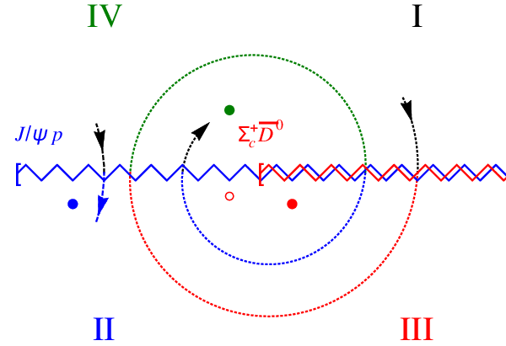
Bound and virtual states
The situation is more complicated when more channels are open
Virtual state
Bound state
Resonance
A. Pilloni – Amplitude analysis
Notes:
Controlla la parte su Regge

Slide 4
New pentaquarks discovered
The lowest $P_{c}(4312)$ appears as an isolated peak at the $Σ_{c}^{+}{\overline{D}}^{0}$ threshold
A detailed study of the lineshape provides insight on its nature
Bottom-up: DON’T YOU DARE describing everything!!! Focus on the peak region
A. Pilloni – Amplitude analysis
Notes:
Controlla la parte su Regge

Slide 5
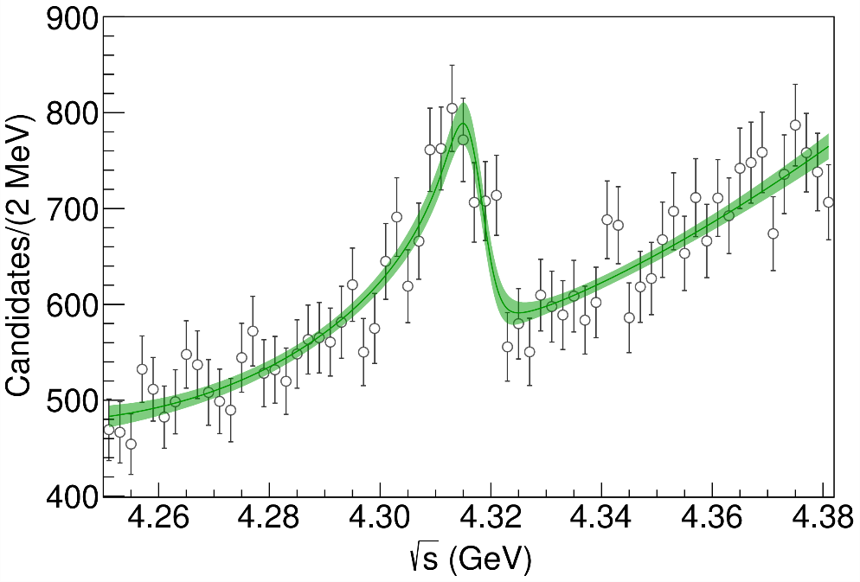
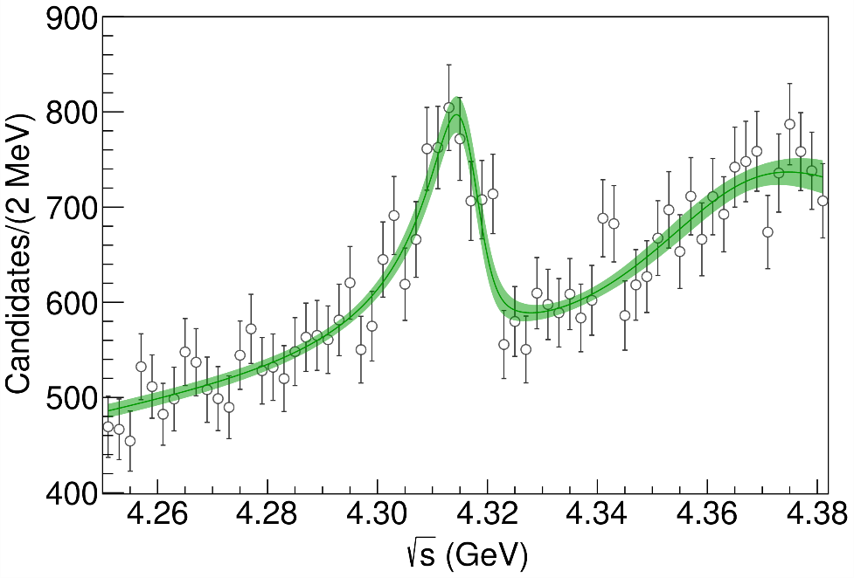
Minimal(istic) model for $P_{c}(4312)$
( data)
Fernandez-Ramirez, AP et al. (JPAC), PRL 123, 092001
Effective range expansion We can set $c_{ii}=0$ to reduce to the scattering length approximation
$$c_{ii}=0$$
Finite $c_{ii}$
A. Pilloni – Amplitude analysis
Notes:
2 slides su Zc, a Bes e a Belle
2 slide su tetraquark model: dall’hamiltoniana di Jaffe al calcolo delle masse
1 slide su molecular models, dove sono i carichi? (non in Tornqvist, si in Hanhart, vedere Braaten, citare Nefediev)
2 slides su decay channels, dove si dovrebbe vedere, e a seconda del modello, vedere qualche plot
1 slide su Y(4260), tetraquark? C’è lo strano (si vede la f0)
1 slide su Zc a cleo (anche il neutro)

Slide 6
Minimal(istic) model for $P_{c}(4312)$
Effective range expansion We can set $c_{ii}=0$ to reduce to the scattering length approximation
$$c_{ii}=0$$
Finite $c_{ii}$
A. Pilloni – Amplitude analysis
Notes:
2 slides su Zc, a Bes e a Belle
2 slide su tetraquark model: dall’hamiltoniana di Jaffe al calcolo delle masse
1 slide su molecular models, dove sono i carichi? (non in Tornqvist, si in Hanhart, vedere Braaten, citare Nefediev)
2 slides su decay channels, dove si dovrebbe vedere, e a seconda del modello, vedere qualche plot
1 slide su Y(4260), tetraquark? C’è lo strano (si vede la f0)
1 slide su Zc a cleo (anche il neutro)

Slide 7
Minimal(istic) model for $P_{c}(4312)$
Effective range expansion We can set $c_{ii}=0$ to reduce to the scattering length approximation
Points to a virtual state
$$c_{ii}=0$$
Finite $c_{ii}$
A. Pilloni – Amplitude analysis
Notes:
2 slides su Zc, a Bes e a Belle
2 slide su tetraquark model: dall’hamiltoniana di Jaffe al calcolo delle masse
1 slide su molecular models, dove sono i carichi? (non in Tornqvist, si in Hanhart, vedere Braaten, citare Nefediev)
2 slides su decay channels, dove si dovrebbe vedere, e a seconda del modello, vedere qualche plot
1 slide su Y(4260), tetraquark? C’è lo strano (si vede la f0)
1 slide su Zc a cleo (anche il neutro)

Slide 8
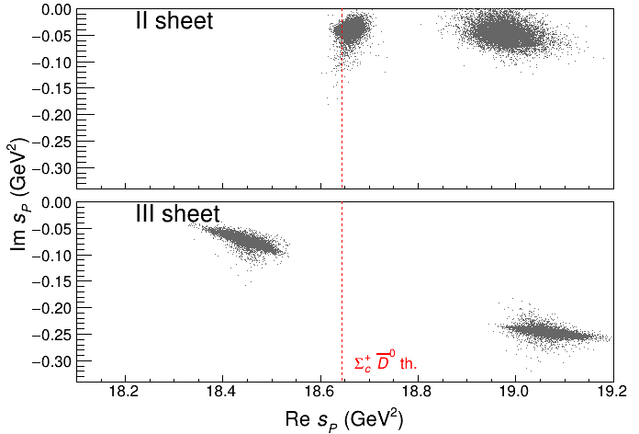
Minimal(istic) model for $P_{c}(4312)$
Effective range expansion We can set $c_{ii}=0$ to reduce to the scattering length approximation
Points to a virtual state
Doesn’t point to a resonance
$$c_{ii}=0$$
Finite $c_{ii}$
A. Pilloni – Amplitude analysis
Notes:
2 slides su Zc, a Bes e a Belle
2 slide su tetraquark model: dall’hamiltoniana di Jaffe al calcolo delle masse
1 slide su molecular models, dove sono i carichi? (non in Tornqvist, si in Hanhart, vedere Braaten, citare Nefediev)
2 slides su decay channels, dove si dovrebbe vedere, e a seconda del modello, vedere qualche plot
1 slide su Y(4260), tetraquark? C’è lo strano (si vede la f0)
1 slide su Zc a cleo (anche il neutro)

Slide 9
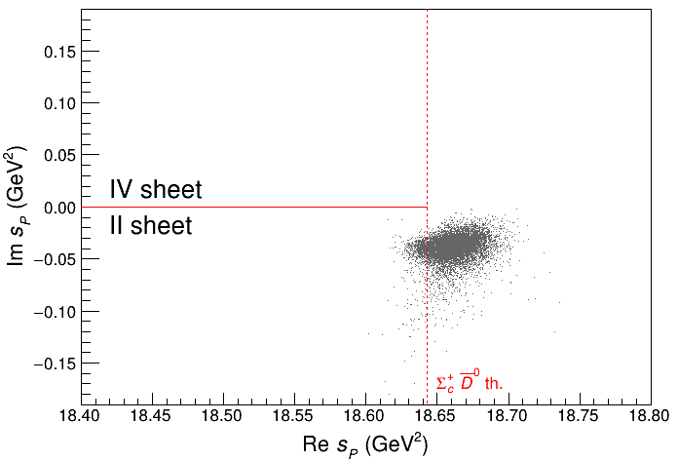
Minimal(istic) model for $P_{c}(4312)$
Effective range expansion We can set $c_{ii}=0$ to reduce to the scattering length approximation
Points to a virtual state
Doesn’t point to a resonance
$$c_{ii}=0$$
Finite $c_{ii}$
A. Pilloni – Amplitude analysis
Notes:
2 slides su Zc, a Bes e a Belle
2 slide su tetraquark model: dall’hamiltoniana di Jaffe al calcolo delle masse
1 slide su molecular models, dove sono i carichi? (non in Tornqvist, si in Hanhart, vedere Braaten, citare Nefediev)
2 slides su decay channels, dove si dovrebbe vedere, e a seconda del modello, vedere qualche plot
1 slide su Y(4260), tetraquark? C’è lo strano (si vede la f0)
1 slide su Zc a cleo (anche il neutro)

Slide 10
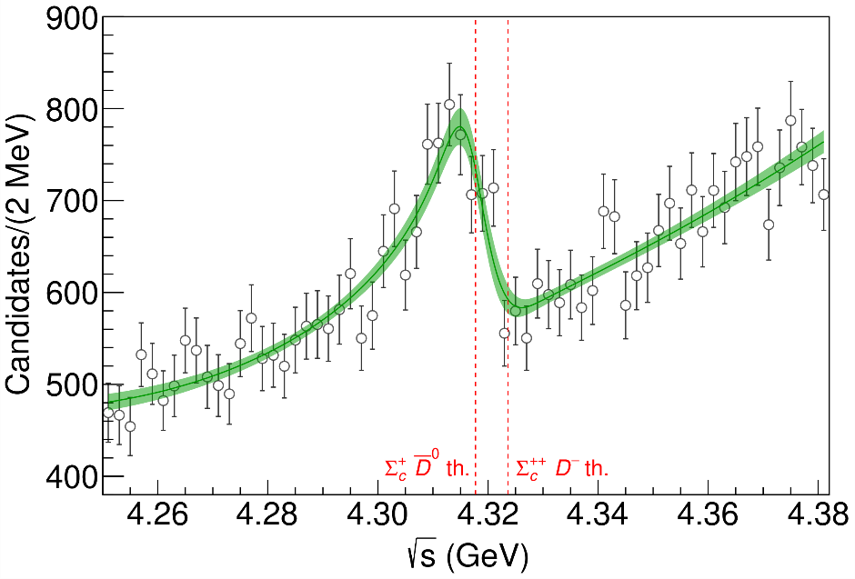
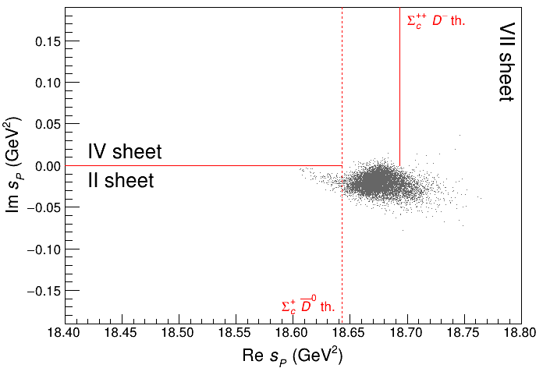
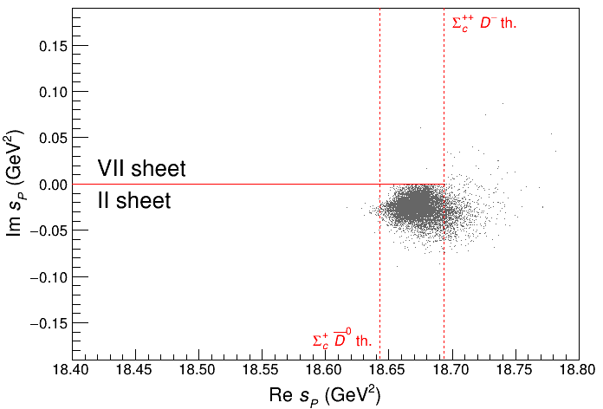
3 channels
A. Pilloni – Amplitude analysis
Notes:
2 slides su Zc, a Bes e a Belle
2 slide su tetraquark model: dall’hamiltoniana di Jaffe al calcolo delle masse
1 slide su molecular models, dove sono i carichi? (non in Tornqvist, si in Hanhart, vedere Braaten, citare Nefediev)
2 slides su decay channels, dove si dovrebbe vedere, e a seconda del modello, vedere qualche plot
1 slide su Y(4260), tetraquark? C’è lo strano (si vede la f0)
1 slide su Zc a cleo (anche il neutro)

Slide 11
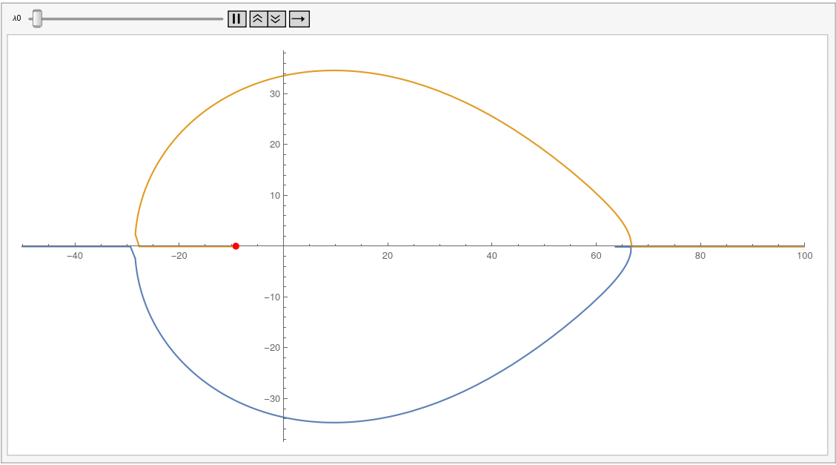
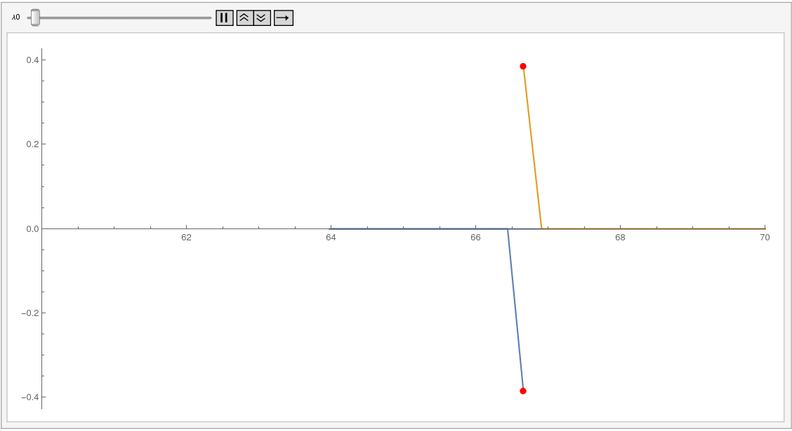
Triangle singularity
A. Pilloni – Amplitude analysis
Notes:
2 slides su Zc, a Bes e a Belle
2 slide su tetraquark model: dall’hamiltoniana di Jaffe al calcolo delle masse
1 slide su molecular models, dove sono i carichi? (non in Tornqvist, si in Hanhart, vedere Braaten, citare Nefediev)
2 slides su decay channels, dove si dovrebbe vedere, e a seconda del modello, vedere qualche plot
1 slide su Y(4260), tetraquark? C’è lo strano (si vede la f0)
1 slide su Zc a cleo (anche il neutro)

Slide 12
Weinberg’s criterion and lineshapes
Let us imagine to have a theory with a bound state with a binding momentum much smaller than the inverse of the range of the potential
The potential is just a delta function, we calculate the $2→2$ scattering amplitude
+
+
+ …
$$A(E)=\frac{1}{1/a−i\sqrt{2μE}}$$
This has a pole at $E_{B}=−\frac{1}{2μa^{2}}$ and residue $g^{2}=\sqrt{\frac{2B}{μ}}$
A. Pilloni – Amplitude analysis
Notes:
Controlla la parte su Regge

Slide 13
Weinberg’s criterion and lineshapes
Now let us consider the propagation of a bare intermediate state
+
+
+ …
$$A\left(E\right)=\frac{g_{0}^{2}}{E_{0}−E−ig_{0}^{2}\sqrt{2μE}}=\frac{g_{0}^{2}}{{−E}_{B}−E−ig_{0}^{2}\sqrt{2μE}−g_{0}^{2}\sqrt{2μE_{B}}}$$
This has a pole at $E_{B}$ and residue $g^{2}=\sqrt{\frac{2B}{μ}}\left(1−Z\right)$ where $Z$ is the w.f. renormalization, $Z={\left(1+g_{0}^{2}\sqrt{\frac{μ}{2B}}\right)}^{−1}$= overlap between the bare state and the continuum
A. Pilloni – Amplitude analysis
Notes:
Controlla la parte su Regge

Slide 14
Weinberg’s criterion and lineshapes
The amplitude can be rewritten as
$$A\left(E\right)=\frac{1}{\frac{1}{a}+\frac{1}{2}r_{0}k^{2}−ik}$$
Thus identifying $a=−2 \frac{1−Z}{2−Z}\frac{1}{\sqrt{2μE_{B}}}$, $r_{0}=−\frac{Z}{1−Z}\frac{1}{\sqrt{2μE_{B}}}$
So a negative $r_{0}$ points to a short range component in the wave function
This is true up to corrections of the order of the range of the potential, which btw are positive under general assumptions
Esposito, Maiani, Pilloni, Polosa, Riquer, 105 (2022) 3, L031503
A. Pilloni – Amplitude analysis
Notes:
Controlla la parte su Regge

Slide 15
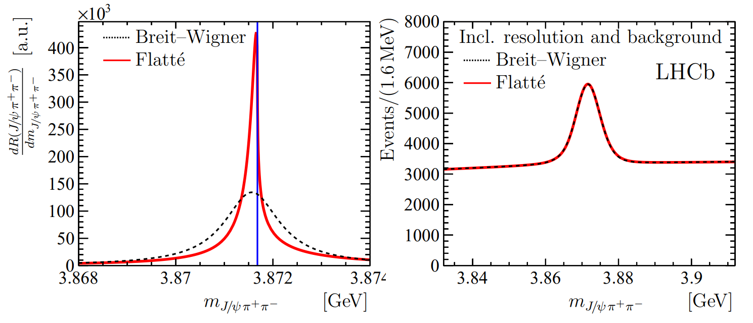
The lineshape of the $X(3872)$
Blue line is $D^{0}\overline{D^{∗0}}$,
$D^{+}D^{∗−}$ is $δ=8.2 \text{MeV}$
heavier
Because of experimental resolution, different lineshapes are indistinguishable
Unitary parametrizations tend to be narrower, $Γ_{BW}=1.39±0.24±0.10 \text{MeV}$, $Γ_{fl}={0.22}_{−0.06−0.13}^{+0.07+0.11} \text{MeV}$
A. Pilloni – Amplitude analysis
Notes:
Controlla la parte su Regge

Slide 16
The lineshape of the $X(3872)$
Esposito, Maiani, AP, Polosa, Riquer, PRD 105 (2022) 3, L031503
LHCb data is fitted with the Flatte’ parametrization
The $D^{0}\overline{D^{∗0}}$ threshold
Two options: a) I set $δ=0$ b) I expand at threshold
The $D^{+}D^{∗−}$ threshold
The $J/ψ ρ,ω,$ and other unknown channels
This considers coupled channel, but Weinberg’s criterion applies to single channel bound states only
A. Pilloni – Amplitude analysis
Notes:
Controlla la parte su Regge

Slide 17
The lineshape of the $X(3872)$
Esposito, Maiani, AP, Polosa, Riquer, PRD 105 (2022) 3, L031503
Option b)
Option a)
According to Weinberg’s, the first result points to a sizeable short-range structure of the X(3872)
Still disagreement on how to perform the extraction though
A. Pilloni – Amplitude analysis
Notes:
Controlla la parte su Regge

Slide 18
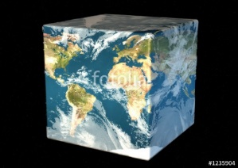
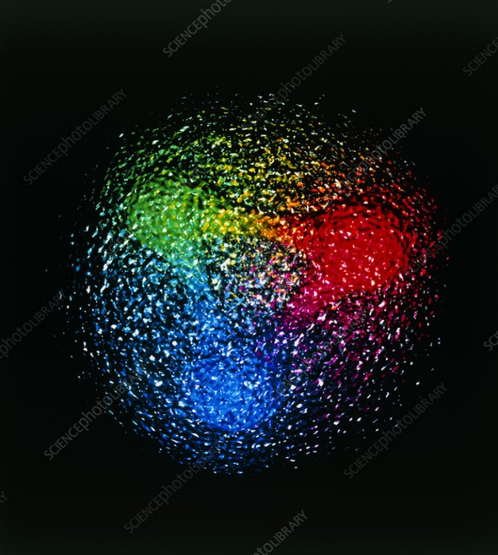
Exo(tic) Had(ron) TC
Funded in 2023 by DoE as a Topical Collaboration in Nuclear Physics
S-Matrix Principles
Dispersion relations
Spin and 3-body decays
Regge theory
Lineshapes and parametrizations
Effective field theories
Many body physics
Quark models
Functional methods
Hybrids from Scattering
Form factors
Lattice QCD
Aims at exploring all aspects of exotics (= hybrids at GlueX)
Quark level calculations
Lessons from EFTs
QCD
Discretization
Algorithms for sampling
Cubic group and subduction
The GEVP
Luscher formula
Studying details of production mechanisms of exotics at GlueX
Finite energy sum rules
Amplitude Analysis
Phenomenology
A. Pilloni – Amplitude analysis
Notes:
Controlla la parte su Regge

Slide 19
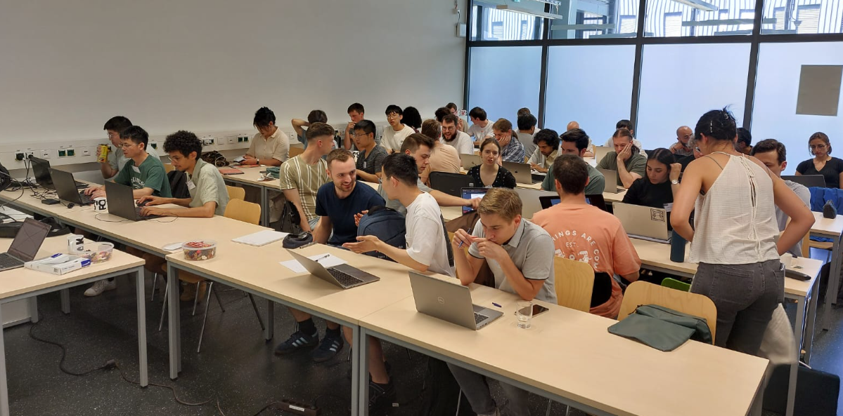
Thank you to:
Herzallah Alharazin
Nadine Hammoud
Gloria Montana
Ilya Segal
Vanamali Shastry
Daniel Winney
A. Pilloni – Amplitude analysis
Notes:
Controlla la parte su Regge

Slide 20
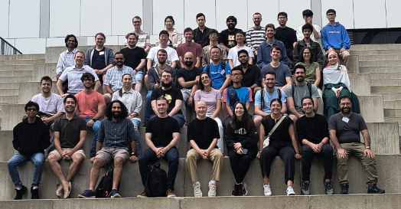
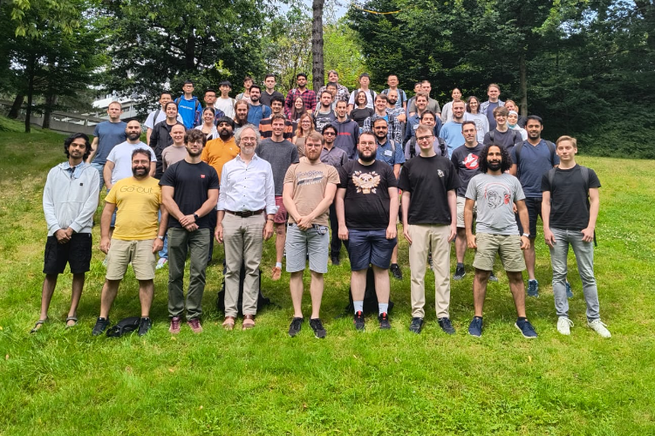
A. Pilloni – Amplitude analysis
Notes:
Controlla la parte su Regge

Slide 21
Logos are not clickable
A. Pilloni – Amplitude analysis
Notes:
Controlla la parte su Regge

Slide 22
Logos are not clickable
A. Pilloni – Amplitude analysis
Notes:
Controlla la parte su Regge

Slide 23
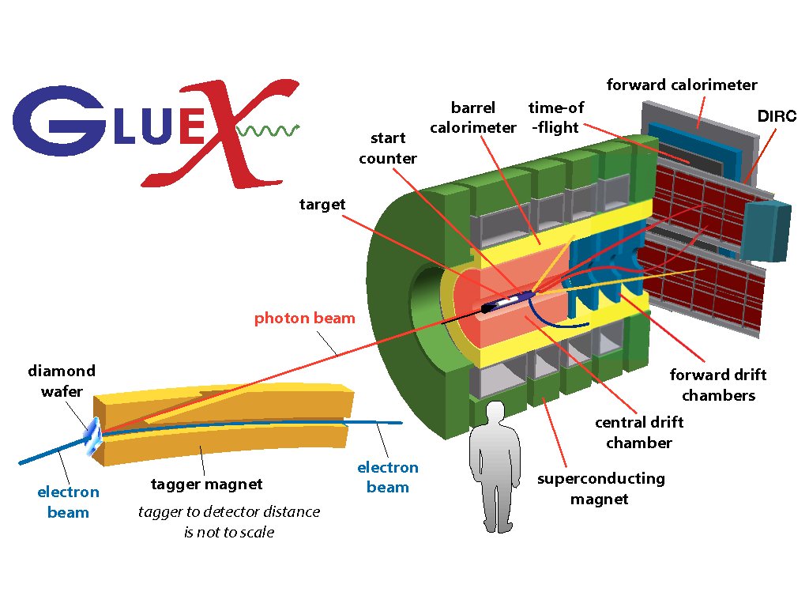
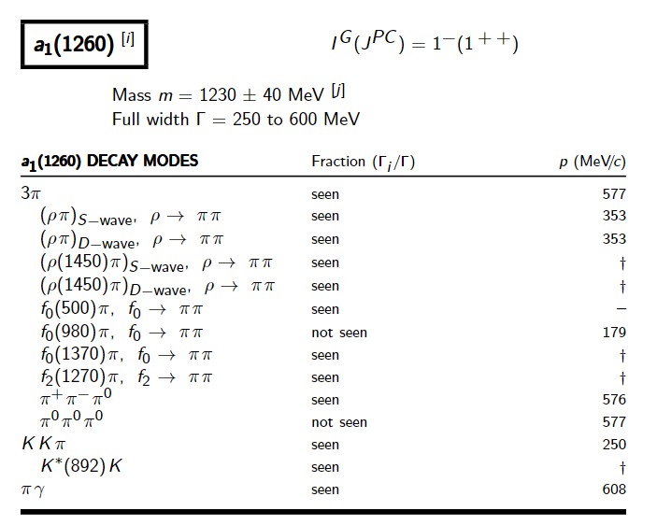
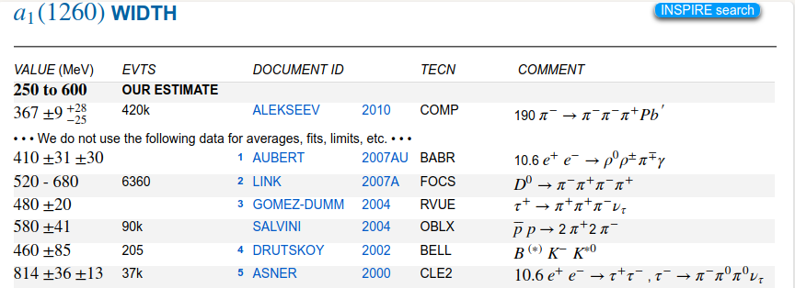
How theorists think of experiments
All the information about hadrons is collected by the Particle Data Group
$$G$$
Changing beam and target, you can change the font
P
D
What theorists see…
What experimentalists present…
A. Pilloni – Amplitude analysis

Slide 24
Real(istic) conversations between theorists and experimentalists
T: How could you not find the XXX quantum numbers?
E: Well, you know, 5D fit, O(100) parameters, local minima, systematics…
T: You are not that good, are you?
T: You shouldn’t use Breit Wigners!
E: Gimme some better
T: I have an analytic unitary parametrization, but it works in a given mass window and only knows about energy dependence, you can’t add background terms to it…
E: Breit Wigners.
T: Stop using complex couplings!
E: HAHAHAHHAHAHAHAHAHHHAHAHAHA
A. Pilloni – Amplitude analysis
Notes:
2 slides su Zc, a Bes e a Belle
2 slide su tetraquark model: dall’hamiltoniana di Jaffe al calcolo delle masse
1 slide su molecular models, dove sono i carichi? (non in Tornqvist, si in Hanhart, vedere Braaten, citare Nefediev)
2 slides su decay channels, dove si dovrebbe vedere, e a seconda del modello, vedere qualche plot
1 slide su Y(4260), tetraquark? C’è lo strano (si vede la f0)
1 slide su Zc a cleo (anche il neutro)

Slide 25
Backup

Slide 26
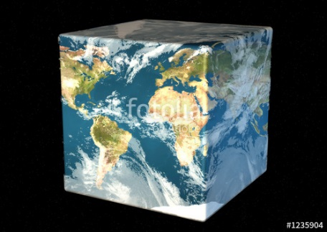
The Richness of the Spectrum
Meson
Baryon
Glueball
Hybrids
Tetraquark
Molecule
Experiment
Data
Amplitude analysis
QCD
Lattice QCD
With great statistics comes great responsibility!
Peter Parker, PhD
For theorists, this is an experimental business
For experimentalists, this is grandma’s recipe
A. Pilloni – Amplitude analysis

Slide 27
Definition of exotics
Despite it’s wrong, the vaste majority of hadrons obeys QM
Whatever is beyond $q\overline{q}$ for mesons and $qqq$ for baryons is exotic
Flavor exotics: e.g. doubly charged meson, baryon with positive strangeness Ex.: $T_{cc}^{+}$ ; if OZI rule enforced, $Z_{c,b}$, $P_{c}$…
Spin exotics: $J^{PC}$ not allowed in QM Ex.: $π_{1}(1600)$
Criptoexotics: $J^{PC}$ allowed, but properties not compatible with QM expectations Ex.: $Y(4260)$, $Λ(1405)$, hybrid baryons, $X(3872)$
Unjustified personal explanation: QM-allowed signatures can be written as leading-twist quark bilinears
Ex.: $\overline{ψ} \left(γ_{μ} \overset{⃡}{D_{ν}}+γ_{ν}\overset{⃡}{D_{μ}}\right)ψ$ is $2^{++}$
Ex.: $\overline{ψ}\left(γ^{μ} D_{μ}D_{ν}−γ^{μ}D_{ν}D_{μ}\right)ψ=i\overline{ψ} γ^{μ} F_{μν}ψ$ is $1^{−+}$
A. Pilloni – Amplitude analysis
Notes:
2 slides su Zc, a Bes e a Belle
2 slide su tetraquark model: dall’hamiltoniana di Jaffe al calcolo delle masse
1 slide su molecular models, dove sono i carichi? (non in Tornqvist, si in Hanhart, vedere Braaten, citare Nefediev)
2 slides su decay channels, dove si dovrebbe vedere, e a seconda del modello, vedere qualche plot
1 slide su Y(4260), tetraquark? C’è lo strano (si vede la f0)
1 slide su Zc a cleo (anche il neutro)

Slide 28
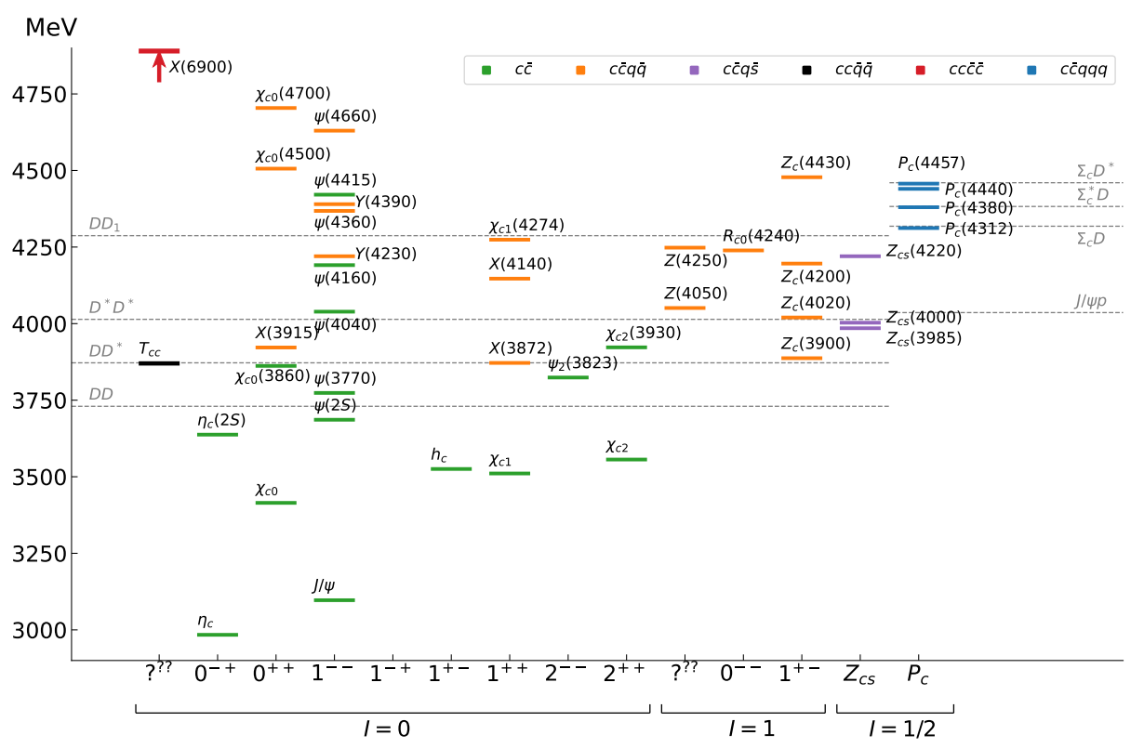
Exotic landscape in $c\overline{c}$
Esposito, AP, Polosa, Phys.Rept. 668
JPAC, arXiv:2112.13436
A host of unexpected resonances have appeared
decaying mostly into charmonium + light Hardly reconciled with usual $q\overline{q}$ pheno
A. Pilloni – Amplitude analysis
Notes:
2 slides su Zc, a Bes e a Belle
2 slide su tetraquark model: dall’hamiltoniana di Jaffe al calcolo delle masse
1 slide su molecular models, dove sono i carichi? (non in Tornqvist, si in Hanhart, vedere Braaten, citare Nefediev)
2 slides su decay channels, dove si dovrebbe vedere, e a seconda del modello, vedere qualche plot
1 slide su Y(4260), tetraquark? C’è lo strano (si vede la f0)
1 slide su Zc a cleo (anche il neutro)

Slide 29
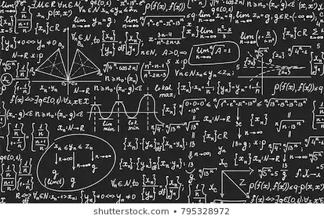
Bottom-up approach
Less predictive power ✗
Some physical interpretation ✗ Minimally biased ✓
You extract physics
You choose a set of generic amplitudes at the hadron level
You start with data
A. Pilloni – Amplitude analysis

Slide 30
Life is not easy...
A. Pilloni – Amplitude analysis
Notes:
2 slides su Zc, a Bes e a Belle
2 slide su tetraquark model: dall’hamiltoniana di Jaffe al calcolo delle masse
1 slide su molecular models, dove sono i carichi? (non in Tornqvist, si in Hanhart, vedere Braaten, citare Nefediev)
2 slides su decay channels, dove si dovrebbe vedere, e a seconda del modello, vedere qualche plot
1 slide su Y(4260), tetraquark? C’è lo strano (si vede la f0)
1 slide su Zc a cleo (anche il neutro)

Slide 31
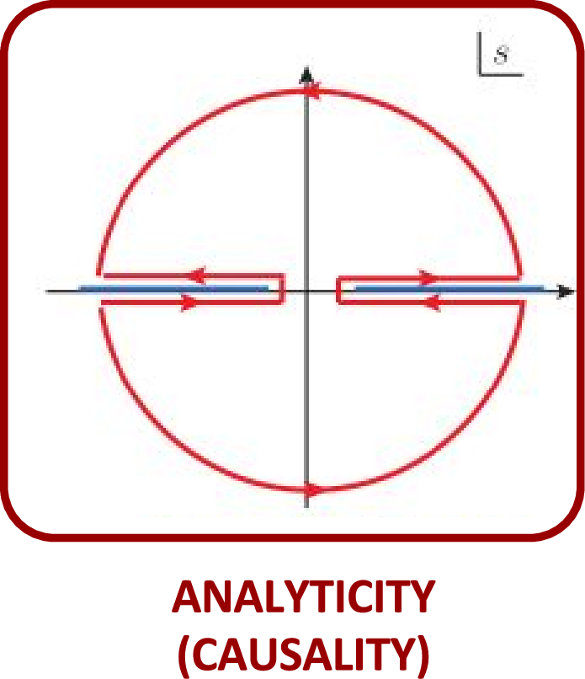
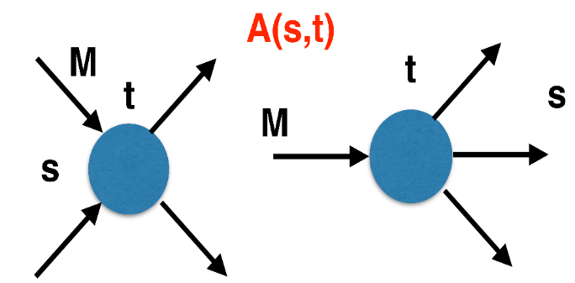
The S-Matrix principles
Future cannot change the past
100%, something will happen
The anti-particle is an anti-particle and not just a different particle
(analyticity)
(unitarity)
(crossing symmetry)
Sherlock Holmes, QFT
Analyticity
Unitarity
Crossing
Parametrize your ignorance.
Build a model.
Fit data.
Have fun.
A. Pilloni – Amplitude analysis

Slide 32
$S$-Matrix principles
$$t_{l}\left(s\right)=\lim_{ε→0}t_{l}(s+iε)⁡$$
Analyticity
$$\text{Im} t_{l}=ρ_{l}{\left|t_{l}\right|}^{2} ⁡$$
These are constraints the amplitudes have to satisfy, but do not fix the dynamics
They can be imposed with an increasing amount of rigor, to extract robust physics information
The «background» phenomena can be effectively parameterized in a controlled way
+ Lorentz, discrete & global symmetries
A. Pilloni – Amplitude analysis
Notes:
Controlla la parte su Regge

Slide 33
Basics of $2→2$ elastic scattering
Let us consider the elastic scattering of two equal mass spinless particles
$s={\left(p_{1}+p_{2}\right)}^{2}=$ energy squared
$t={\left(p_{1}−p_{3}\right)}^{2}∝\cos{θ}=$ momentum transferred
$$3$$
$$1$$
$$θ$$
$$2$$
$$4$$
Legendre polynomial
$$A\left(s,t\right)=\sum_{l}{A_{l}\left(s\right)P_{l}(\cos{θ})}$$
$$\text{Im} A_{l}\left(s\right)=ρ\left(s\right){\left|A_{l}\left(s\right)\right|}^{2}$$
Phase space (known)
Partial wave
Partial waves diagonalize unitarity: each one statisfy a separate equation Each partial wave has definite orbital angular momentum = spin
Remember: I can only measure cross section (amplitude squared)
A. Pilloni – Amplitude analysis

Slide 34
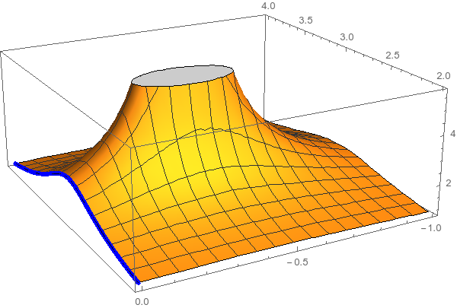
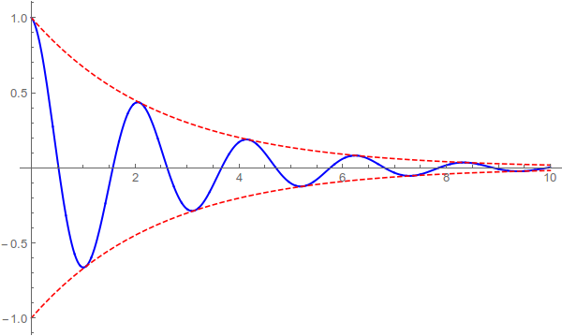
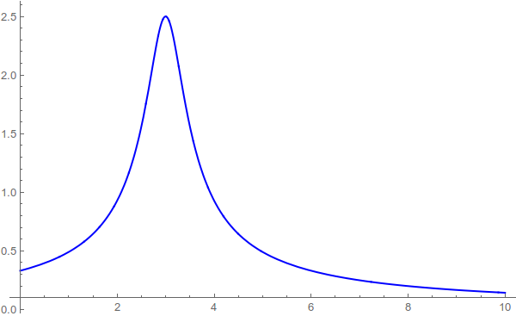
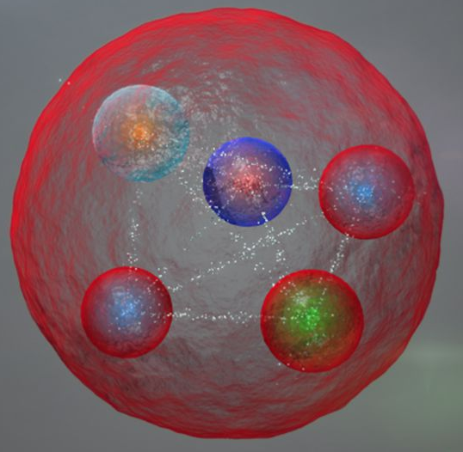
Resonances = Unstable states
$$ψ(t)=e^{−i E_{0} t} e^{− \frac{Γ}{2} t }$$
$$ψ(E)=\frac{1}{E−E_{0}+i\frac{Γ}{2}}$$
The function explodes for value of energy $E=E_{0}−i\frac{Γ}{2}$
Resonances are poles in the complex energy plane
Excited states are unstable
They manifest as resonant peaks
A. Pilloni – Amplitude analysis

Slide 35
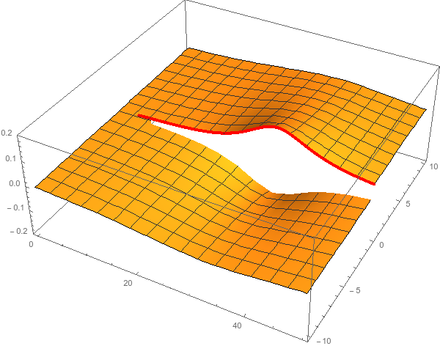
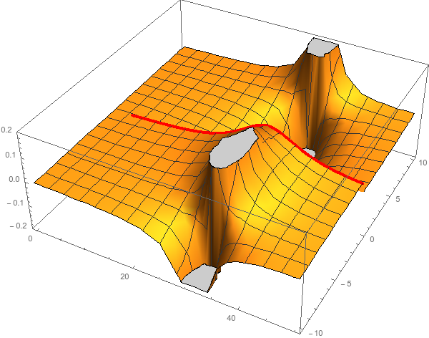
Unitarity & Pole hunting
Unitarity creates a branch cut on the real axis, two sheets continuosly connected
I sheet
II sheet
Finding resonances means writing analytic amplitude, and hunting for poles in the complex plane
A. Pilloni – Amplitude analysis
Notes:
Controlla la parte su Regge

Slide 36
You shall not sum!
The simplest ansatz for a PW amplitude is the Breit-Wigner
What if I have two resonances? Can I add two BWs?
$$A_{l}\left(s\right)=\frac{g^{2}}{m^{2}−s−i g^{2}ρ(s)}$$
$$A_{l}\left(s\right)=\frac{g_{1}^{2}}{m_{1}^{2}−s−i g_{1}^{2}ρ(s)}+\frac{g_{2}^{2} e^{iα}}{m_{2}^{2}−s−i g_{2}^{2}ρ(s)}$$
Unitarity is broken, $\text{Im} A_{l}\left(s\right)≠ρ\left(s\right){\left|A_{l}\left(s\right)\right|}^{2}$
Unitarity is saturated, $\text{Im} A_{l}\left(s\right)=\text{Im}\frac{m^{2}−s+i g^{2}ρ(s)}{{\left|m^{2}−s−i g^{2}ρ\left(s\right)\right|}^{2}}=ρ\left(s\right){\left|A_{l}\left(s\right)\right|}^{2}$
But that’s precisely what experimentalists do!
Phases take partially into account the modifications of unitarity due to inelastic channels. However, when we shoot for precision, we need better ansätze (will show examples in the next lectures)
Of course they are not stupid, this works if the two resonances are well isolated. Unfortunately we have no simple alternative solution that can work in all situation, we have to proceed case by case and we live on different timescales
A. Pilloni – Amplitude analysis
Notes:
Controlla la parte su Regge

Slide 37
L. Maiani
A. Pilloni – Amplitude analysis
Notes:
Controlla la parte su Regge

Slide 38
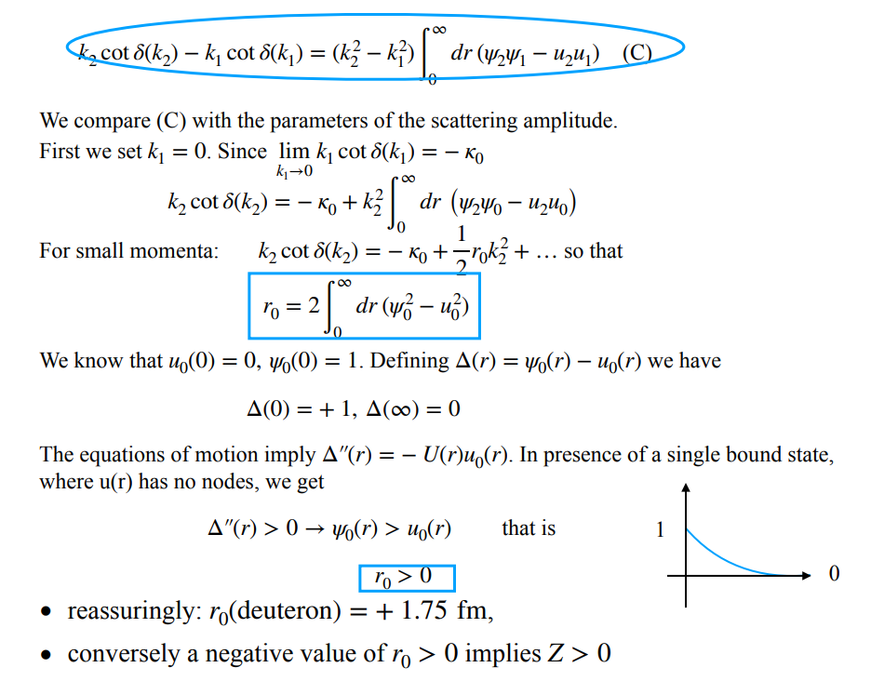
L. Maiani
A. Pilloni – Amplitude analysis
Notes:
Controlla la parte su Regge

Slide 39
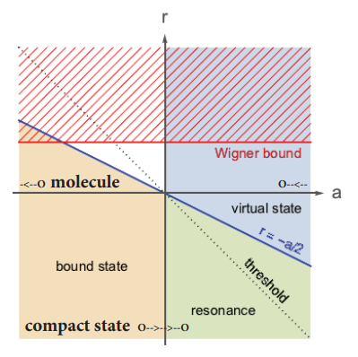
Bound and virtual states
The amplitude close to threshold can be expanded as
$$A\left(E\right)=\frac{1}{\frac{1}{a}+\frac{1}{2}r_{0}k^{2}−ik+O\left(k^{4}\right)}$$
$a$ is the scattering length
$r_{0}$is the effective range
The sign of $a$ controls whether we have a bound or virtual state
A. Pilloni – Amplitude analysis
Notes:
Controlla la parte su Regge

