Slide 1
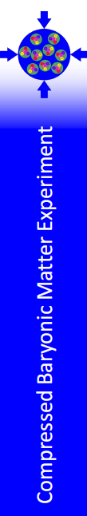






CBM detector system
Conceptual overview
Requirements of the CBM experiment
  Status of the detector systems
    Summary
Tomas Balog
FAIRNESS, Berlin, 19.09.2013

Slide 2
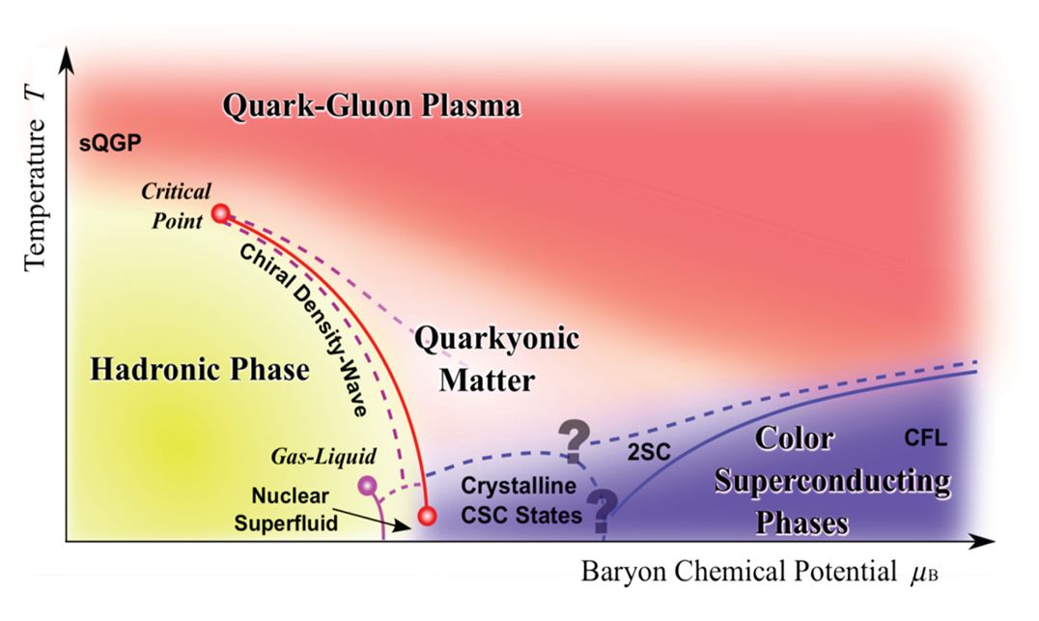
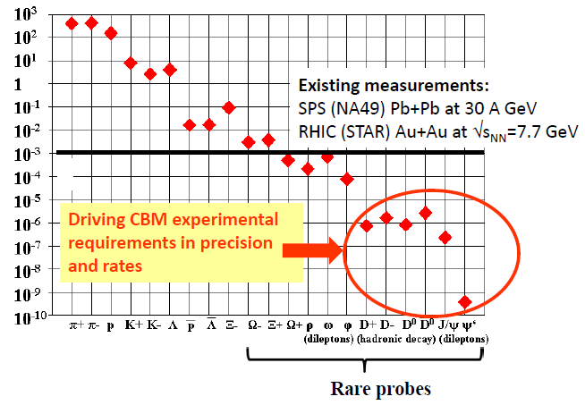
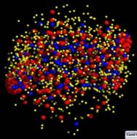


QCD phase diagram and probes
Experiment | Energy range (Au/Pb beams) | Reaction rates Hz | Observables, √s_{NN}= 8 GeV
 |  |  | hadrons | flow, fluct., correl. | dileptons di-e/di-µ | charm
STAR@RHIC BNL | √s_{NN} = 7 – 200 GeV | 1 – 800 (limit luminosity) | yes | yes | no | no
NA61@SPS CERN | E_{kin}= 20 – 160 AGeV √s_{NN}= 6.4 – 17.4 GeV | 80 (limit detector) | yes | yes | no | no
MPD@NICA Dubna | √s_{NN}= 4.0 – 11.0 GeV | ~1000 (at design luminosity ) | yes | yes | no | no
CBM@FAIR Darmstadt | E_{kin}= 2.0 – 35 AGeV √s_{NN}= 2.7 – 8.3 GeV | 10⁵ – 10⁷ (limit detector) | yes | yes | yes | yes
K, π, Λ, η
D⁰, D⁺, D_{s}⁺ , Λ_{c}
Φ, Ξ, Ω

Slide 3
Experimental challenge
Central Au+Au collision at 25 AGeV (UrQMD + GEANT4):
160 p 400 π⁻ 400 π⁺ 44 K⁺ 13 K⁻
High acceptance including forward and mid rapidities
(2.5° < Θ < 25°, φ within 2π )
➢ 10⁵ - 10⁷ Au+Au reactions/sec
➢ determination of (displaced) vertices (σ ≈ 50 μm)
➢ identification of leptons and hadrons
➢ fast and radiation hard detectors
➢ free-streaming readout electronics
high speed data acquisition and high performance computer farm for online event selection
➢ 4-D event reconstruction

Slide 4
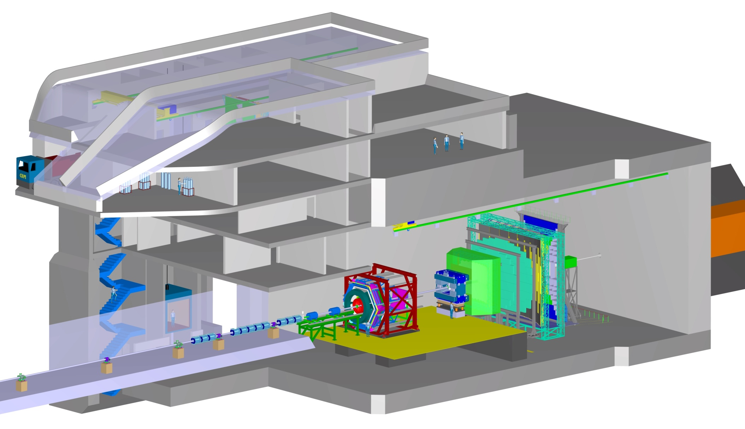
Cave for nucleus-nucleus collision experiments

Slide 5
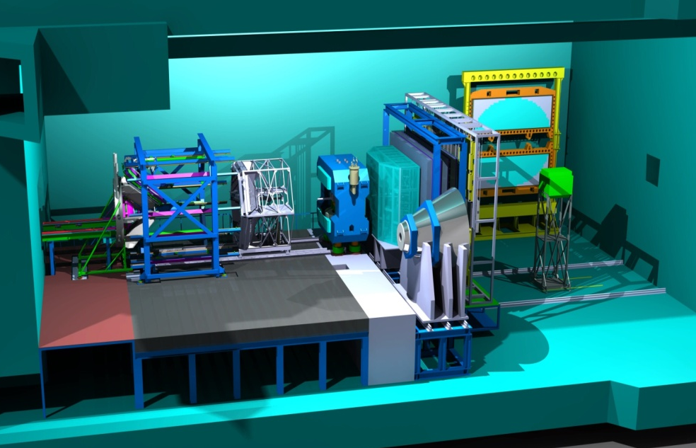
Cave for nucleus-nucleus collision experiments

Slide 6
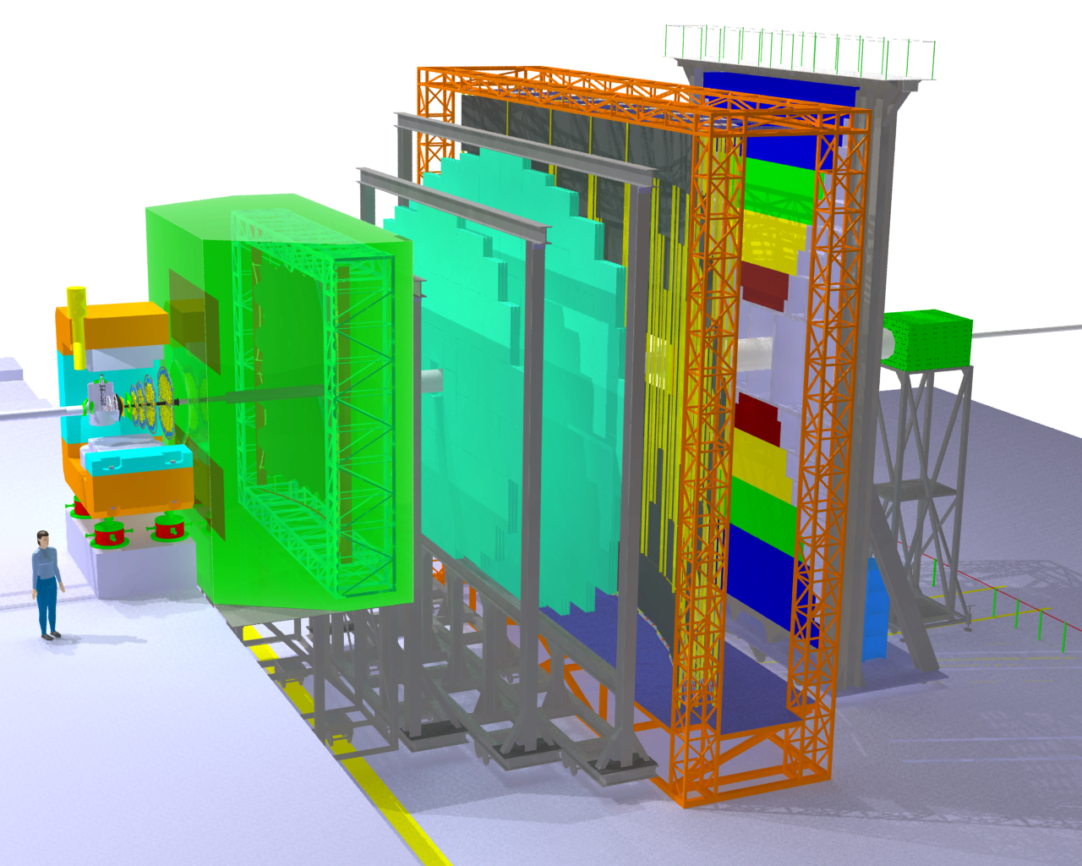
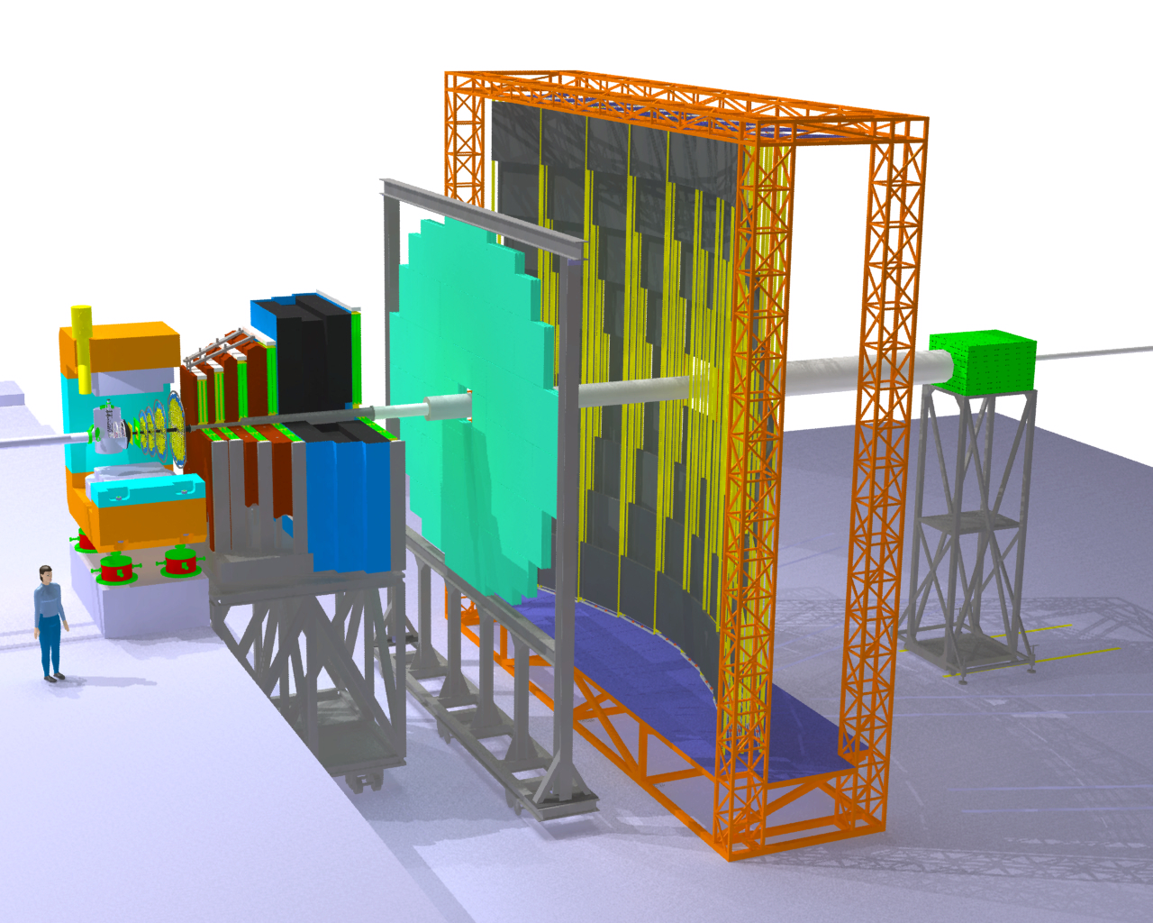
The Compressed Baryonic Matter Experiment
Transition
Radiation
Detectors
Tracking
Detector
Muon
detection
System
Electro-
magnetic
Calorimeter
Ring Imaging
Cherenkov
Detector
Silicon
Tracking
Stations
Micro-
Vertex
Detector
Projectile
Spectator
Detector
(Calorimeter)
Dipol
magnet
Resistive
Plate
Chambers
(TOF)
CBM aims to measure vector mesons via e+/e- AND µ+/µ-
in SEPARATE runs => control systematics

Slide 7
The CBM Modular Start Version (SIS100)
HADES:
Electrons and hadrons
in Au+Au collisions
up to 4 A GeV.
CBM:
hadrons, charm, and hypernuclei in Au+Au collisions up to 11 A GeV
(high densities)
CBM components:
Dipole Magnet
Micro-Vertex-Detector
Silicon Tracking System
Time-of-Flight wall
PSD (calorimeter)
DAQ
FLES (CPU/GPU farm)
HADES:
Electrons and hadrons
in Au+Au collisions
up to 4 A GeV.
CBM:
hadrons, charm, hypernuclei, electrons, gammas in Au+Au collisions up to 11 A GeV
(high densities)
CBM components:
Dipole Magnet
Micro-vertex-Detector
Silicon Tracking System
Time-of-Flight wall
PSD (calorimeter)
DAQ /FLES
RICH (electrons)
TDR (electrons)
ECAL (gammas)
HADES:
Electrons and hadrons
in Au+Au collisions
up to 4 A GeV.
CBM:
hadrons, charm, hypernuclei, electrons, gammas, muons (charmonium) in Au+Au collisions up to 11 A GeV (high densities)
CBM components:
Dipole Magnet
Micro-Vetex-Detector
Silicon Tracking System
Time-of-Flight wall
PSD (calorimeter) DAQ
FLES (CPU/GPU farm)
RICH (electrons)
ECAL (gammas)
MuCh (muons)
CBM
Magnet
STS
TOF
HADES
PSD
TRD
ECAL
RICH
MuCh

Slide 8
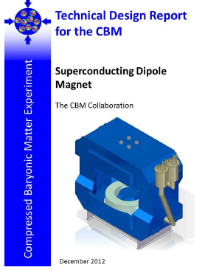
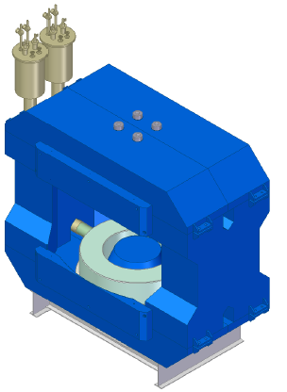
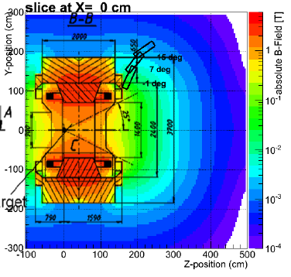
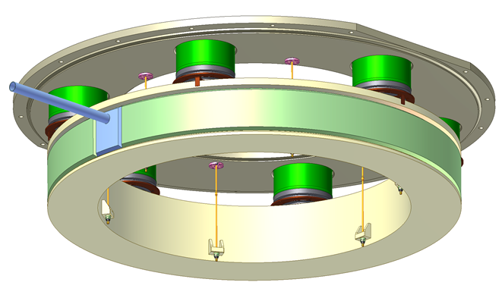
Dipole magnet
H-type
  Circular coils with
  1749 turns per coil
Superconducting
  Cooled by liquid He
Aperture ± 25°
Field integral – 1 Tm
Total weight 160 tons

Slide 9
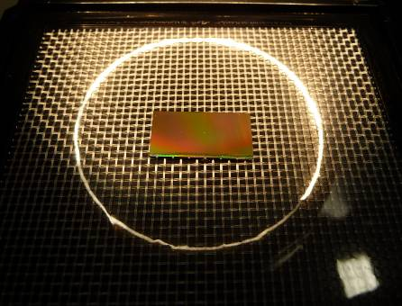
Micro-vertex Detector (MVD)
z
Determination of the decay vertices of
open charm particles
Monolithic Active Pixel Sensors (MAPS)
A position resolution of σ = 3.5 - 6 μm
(depending on the pixel size - 18 x 18 μm²
and 20 x 40 μm²)
Total thickness of about 300 - 500 μm
silicon equivalent for sensors
and support structures
3 MAPS layers located at 5, 10, and 15 cm
downstream of the target in the vacuum
Determine the secondary decay vertex
of a D-meson with a resolution of about
50-100 μm along the beam axis
Target
(Gold)
Detector2
Detector 1
Primary Beam: 25 AGeV Au Ions (up to 10⁹/s)
Primary
vertex
Secondary
vertex
Short lived particle
D⁰ (cτ = ~ 120 µm)
Reconstruction concept for open charm

Slide 10
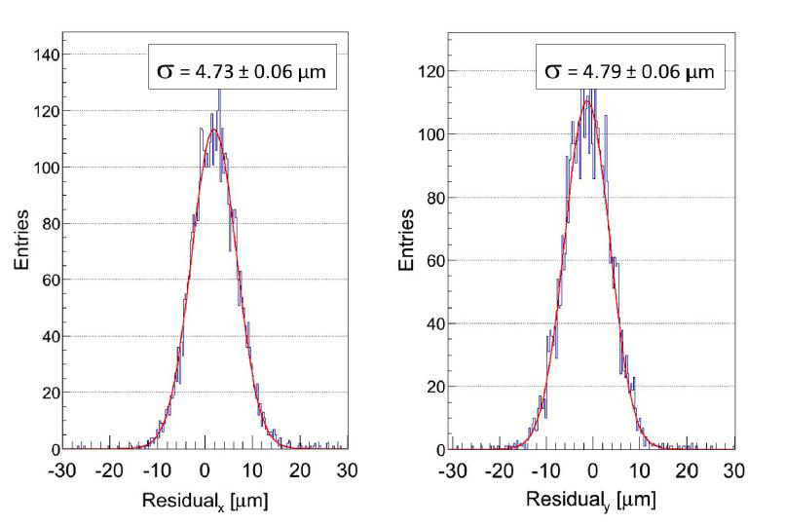

Micro-vertex Detector (MVD)
Requirements by CBM experiment
 | CBM SIS300
Single point res. | ~ 5 µm
Material budget* | < 0.3% X₀
Rad. hard. non-io. | >10¹³ n_{eq}
Rad. hard. io | > 3 Mrad
Time resolution | < 30 µs
MIMOSA-26 Binary, 0
4 µm
~ 0.3% X₀
>10¹³ n_{eq}
> 500 krad
110 µs

Slide 11
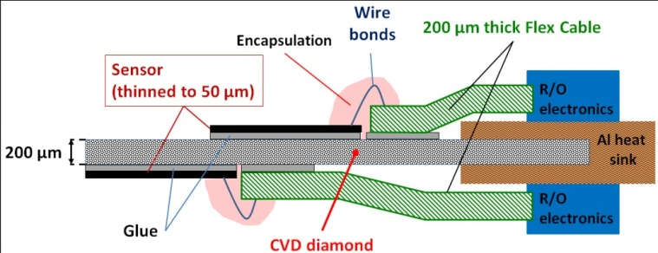
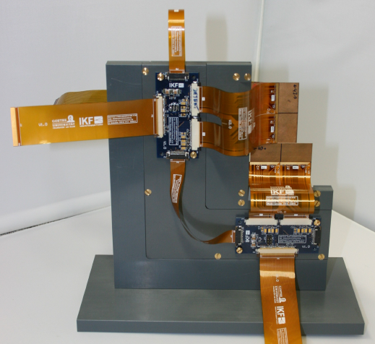
Micro-vertex Detector (MVD)

Slide 12
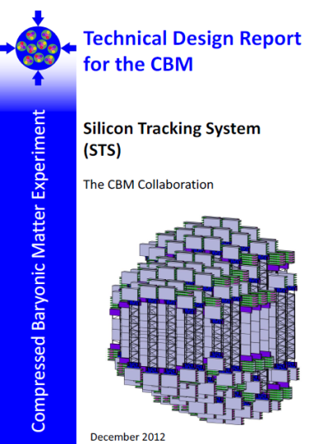
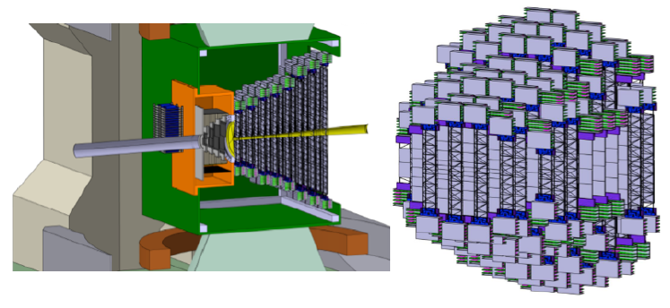
Silicon Tracking System (STS)
track reconstruction and momentum determination of charged particles
the multiplicity of charged particles is up to 700 per event within the detector acceptance
8 tracking layers of silicon detectors - distances between 30 cm and 100 cm inside the magnetic dipole field
momentum resolution is of the order of Δp/p = 1%
an ultra-low material budget of the stations
Sensors: double-sided with a stereo angle of 7.5°, a strip pitch of 58 μm, strip lengths between 20 and 60 mm, and a thickness of 300 μm of silicon

Slide 13
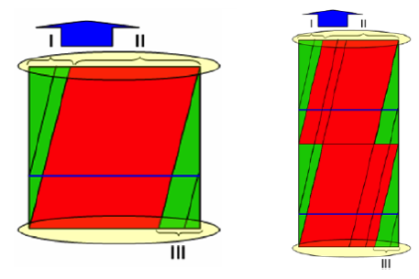
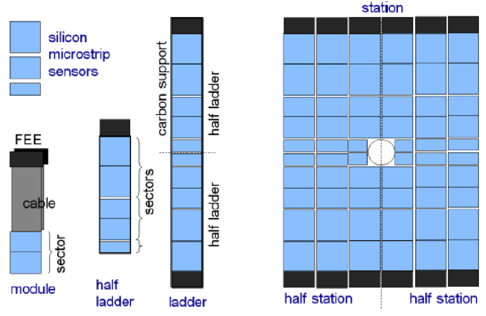
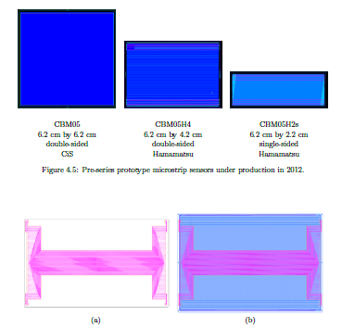
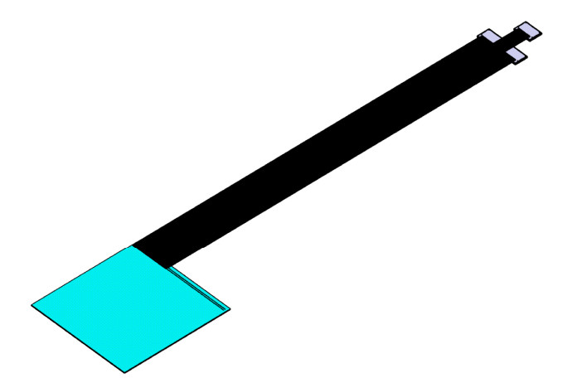
Silicon Tracking System (STS)

Slide 14
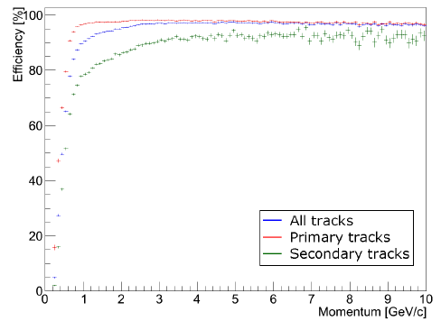
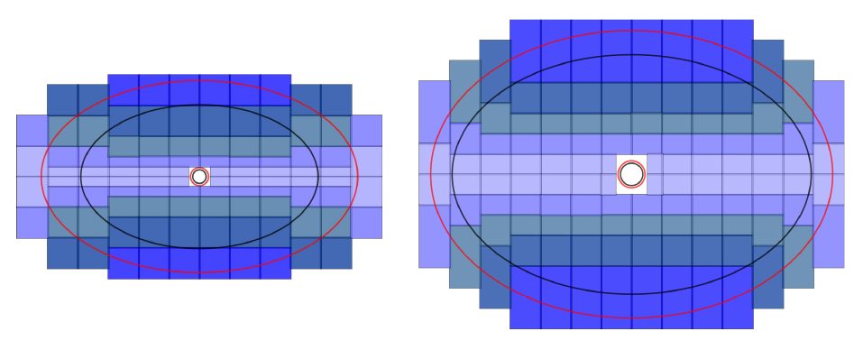
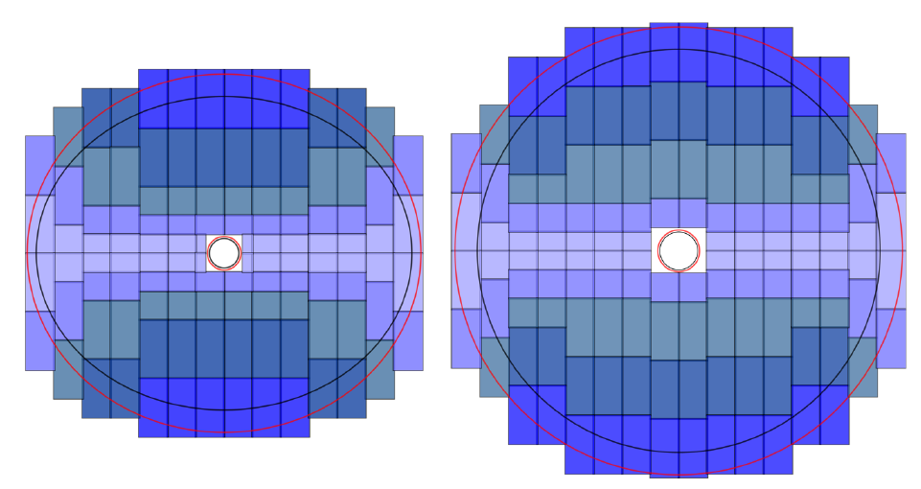
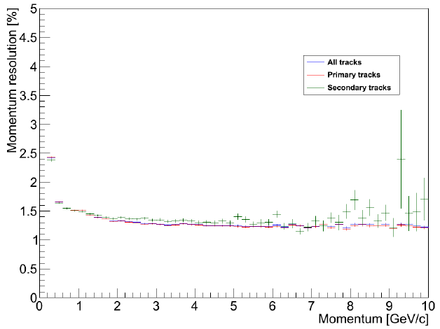
Silicon Tracking System (STS)

Slide 15
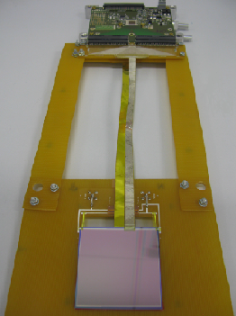
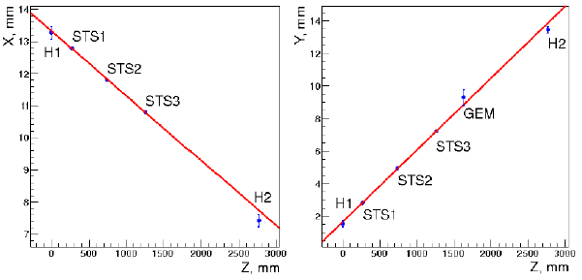
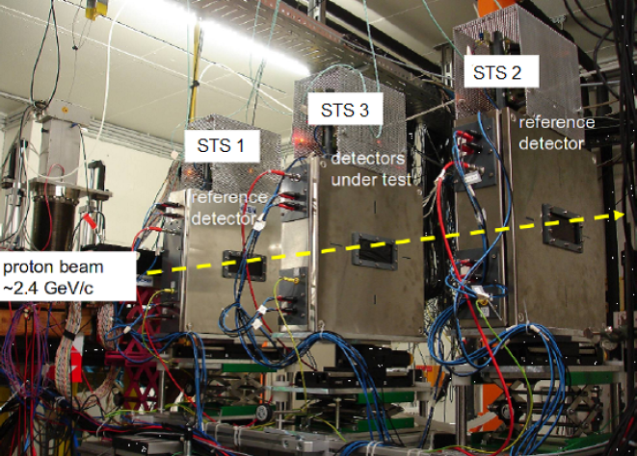
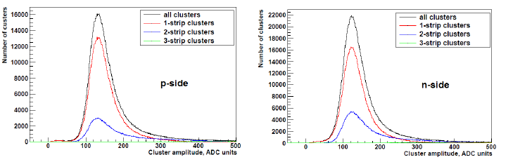
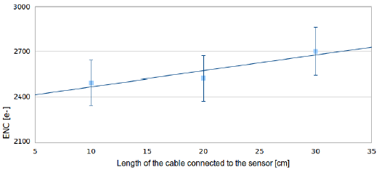
Silicon Tracking System (STS)

Slide 16
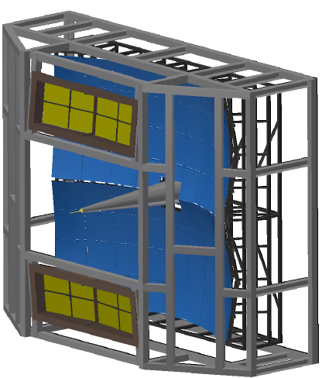
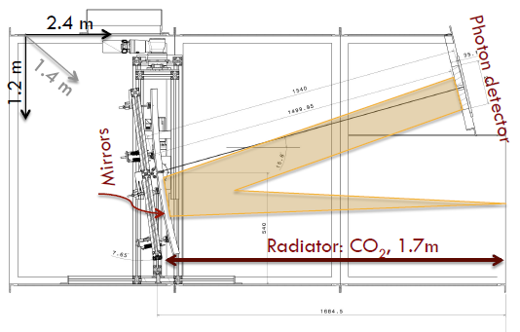

Ring Imaging Cherenkov Detector (RICH)
identification of electrons and suppression of
the pions in momentum range below 10 GeV/c
gas radiator (length 1.7 m) - CO2 - the pion
threshold for Cherenkov - 4.65 GeV/c
mirror plane built out of 72 mirror tiles
curvature of 3 m radius - Al+MgF2 reflective coating
two arrays each with area 4m x 1.5m
photo detector plane –
Photo Multiplier Tubes (MAPMT)
shielded by the yoke
of the magnet

Slide 17
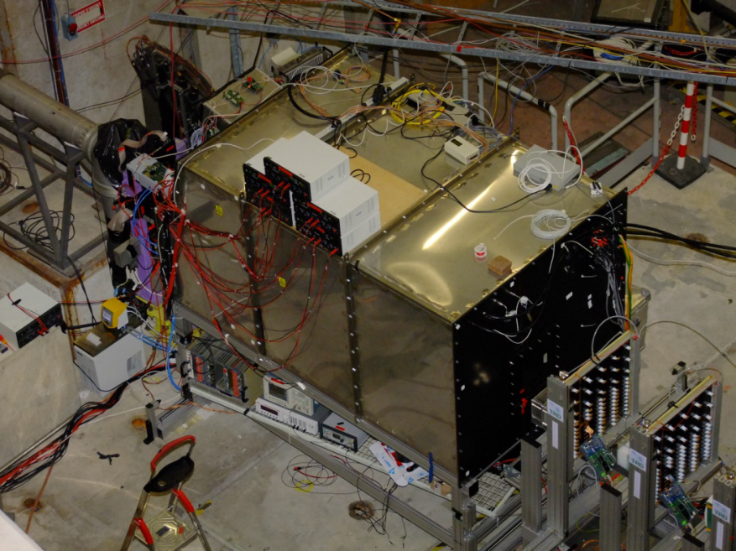
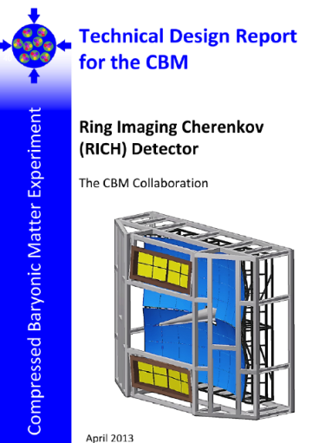
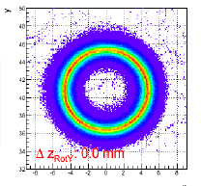
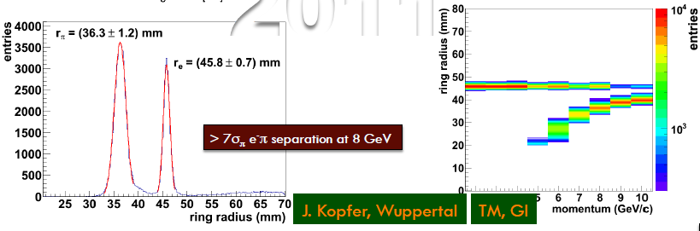
Ring Imaging Cherenkov Detector (RICH)

Slide 18
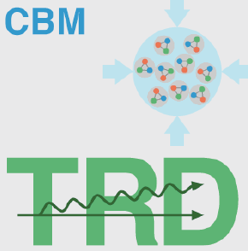
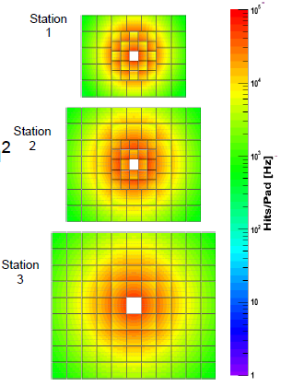
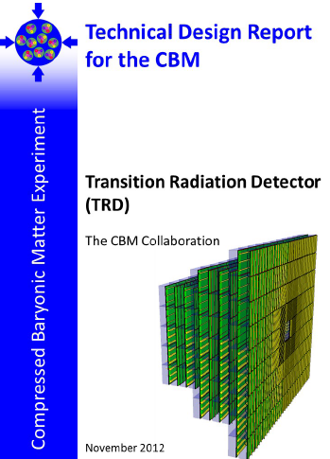
Transition Radiation Detector (TRD)
for identification of the electrons and positrons wih p > 1.5 GeV/c
three transition radiation detector stations
location of the stations :
5 m, 7.2 m and 9.5 m downstream the target
rectangular pads - resolution of 300 - 500 μm
across and 3 - 30 mm along the pad
pion suppression factor obtained
with 10 TRD layers - well above
100 at an electron efficiency 90%
at SIS100 only one station with
3 detector layers will be used
- intermediate tracker
between the STS and Time-of-Flight
TRD requirements: 100 kHz/cm², 700 m²

Slide 19
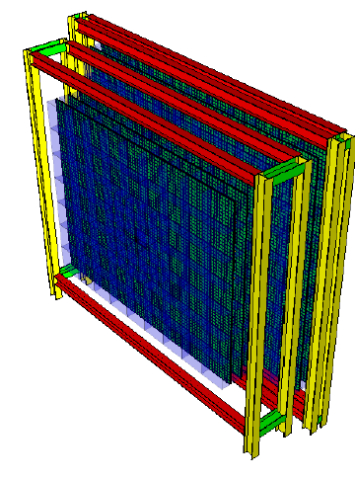
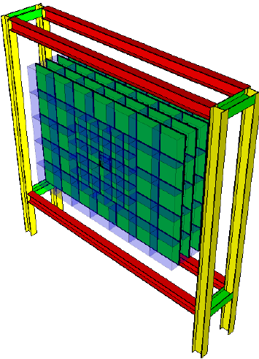
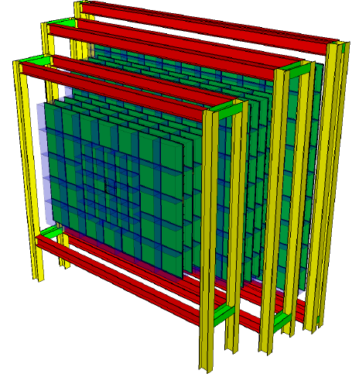
Transition Radiation Detector (TRD)
SIS300
μ-setup
(used as tracking
station after MUCH)
SIS100 version
(TRD station 1 for SIS300)
SIS300
e-setup

Slide 20
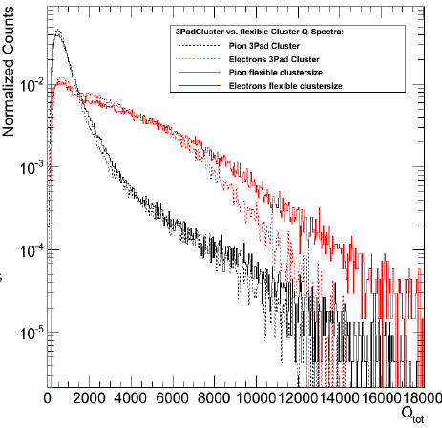
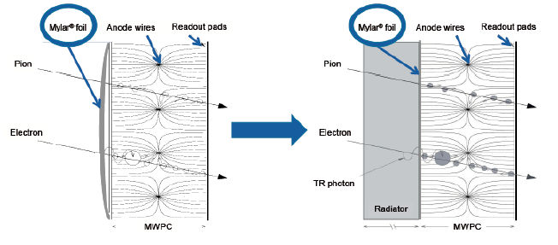
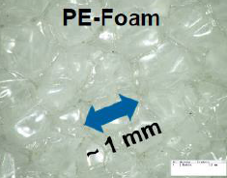
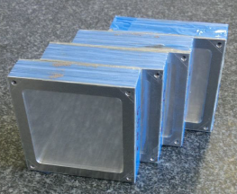
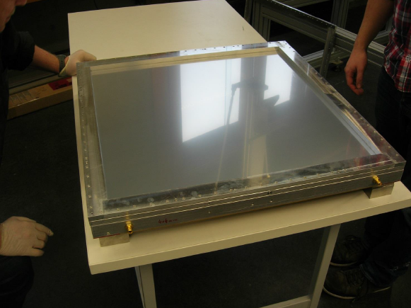


Transition Radiation Detector (TRD)
Different radiators under investigation

Slide 21
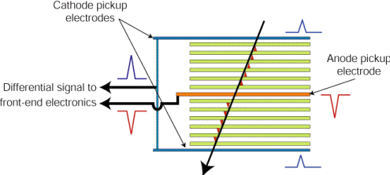
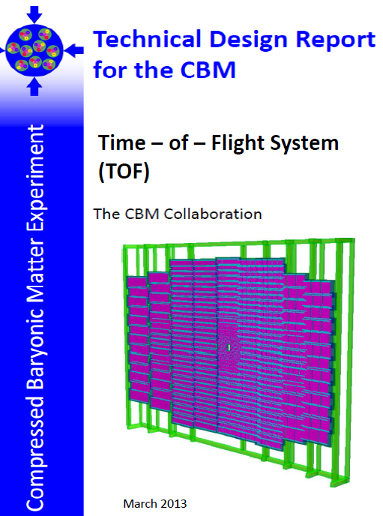
Time-of-flight Wall (TOF) a.k.a. Timing Multi-gap Resistive Plate Chamber (MRPC)
array of Resistive Plate Chambers
used for hadron identification via
time-of-flight measurements
inner section rates 10 – 25 kHz/cm²
outer section rates 2 – 10 kHz/cm²
The MRPC is a stack of resistive glass plates.
A high voltage is applied to the external surfaces of the stack.
Further out there are pickup electrodes.
A charged particle ionizes the gas and the high
electric field amplifies this ionization by an electron avalanche.
The resistive plates stop the avalanche development in each gap;
they are however transparent to the fast signal induced on the pickup
electrodes by the movement of the electrons.
So the total signal is the sum of the signals from all gaps
(the reason for many gaps is to achieve high efficiency),
whereas the time jitter of the signal depends on the individual gap width
(the reason for narrow gaps is to achieve good time resolution).

Slide 22



Time-of-flight Wall (TOF) a.k.a. Timing Multi-gap Resistive Plate Chamber (MRPC)
Two structures under investigation
  Pad for the inner areas (high rate)
  Strips for outer areas (low rate)
pads
strips

Slide 23




Electromagnetic Calorimeter (ECAL)
Measure direct photons and neutral
mesons (π0;η) decaying into photons
“Shashlik” structured
Tiles build out of lead absorbers
and scintillators
Modules with cell sizes of 3 cm x 3 cm,
6 cm x 6 cm and 12 cm x 12 cm each
consisting out of 140 layers of 1 mm lead
and 1 mm scintillator
J/ψ
Reconstructed
using ECAL
Moveable 4 cell section
1144 modules (4576 ch)
Less than 30 tons
Flexible and universal

Slide 24




Projectile Spectator Detector (PSD)
The PSD provides measurement
of centrality and reaction plane at the CBM
Designed to measure the number of
non-interacting nucleons from a projectile
nucleus in nucleus-nucleus collisions
Lead-scintillator calorimeter - provides very good
and uniform energy resolution
45 individual modules, each consisting of 60 lead/scintillator layers with a surface of 20 cm x 20 cm

Slide 25


Muon Chamber System (MUCH)
detect muons from J/ψ and light vector mesons in an environment of high particle densities
hit rate of 3 MHz/cm² (in first detector triplet)
compact absorbers - suppress background from hadrons
prototype chambers based on GEM technology – operated successfully
at SIS100 a MUCH start version with 3 chamber triplets is sufficient
cathode
SIS-100 version
10 A GeV
Iron absorber: 20+70+135 cm
3 detector triplets:
GEM + GEM + straw tubes/TRD
mesh
anode
MICROMEGAS + GEM prototype (MG):
■ readout pad – 4x4 mm²
■ drift gap – 4 mm
■ transfer gap – 1mm
■ anode-mesh gap – 70 μ
SIS300 version
25 A GeV
Iron absorber: 3x20+30+35+100 cm
6 detector triplets:
4 GEM+2 straw tubes/TRD

Slide 26



Muon Chamber System (MUCH)

Slide 27

The CBM Physics Book
Foreword by Frank Wilczek
Springer Series:
Lecture Notes in Physics, Vol. 814
1st Edition., 2011, 960 p., Hardcover
ISBN: 978-3-642-13292-6
Electronic Authors version:
http://www.gsi.de/documents/DOC-2009-Sep-120-1.pdf

Slide 28

FAIR construction site today (19.09.2013 at 11:09 CET)
CBM will be
somewhere here

Slide 29
Summary and conclusion
CBM searches for first order phase transition, critical point …
CBM is to measure the widest possible range of observables
Building CBM is a challenge BUT
The R&D is supported by helpful trends in industry:
      Multicore and GPGPU computing
      New chip manufacturing processes
      High bandwidth data network technologies
Detector prototypes are being build and tested in beam,
writing TDR is envisaged for 2013-2014
The construction of FAIR has started, expect beam on target 2018

Slide 30
Backup

Slide 31
Operation principle of MAPS
+3.3V
Output
Source Follower
SiO₂
P-Well
Diode
P+
N+
Epitaxial Layer
P-
P+

Slide 32
Leakage current
+3.3V
Reset
+3.3V
Output
SiO₂
Positive Charge
SiO₂
-
-
-
N++
N++
N+
P+
-
-
P-
-
-
-
P+
Leakage current generated by defects of the irradiation is collected
=> Noise generated

Slide 33


Classes of radiation damage
To be investigated and improved: Radiation hardness against…
… non-ionizing radiation:
Energy deposited into the crystal lattice
Atoms are displaced
Caused by heavy (fast leptons, hadrons),
charged and neutral particles
Farnan I, HM Cho, WJ Weber, 2007. "Quantification of Actinide α-Radiation
Damage in Minerals and Ceramics." Nature 445(7124):190-193.
… ionizing radiation:
Energy deposited into the electron cloud
Can ionize atoms and destroy molecules
Caused by charged particles and photons

Slide 34
Non-ionizing radiation damage effect
Diode
Epitaxial Layer
e-
Defects due to
radiation
Particle
Charge losses due to recombination at radiation-induced defects

Slide 35
Influence of radiation damage and pixel pitch
Large pixel pitch
Large pixel pitch
Diode
Epitaxial Layer
e-
Defects
due to radiation
Small pixel pitch
Small pixel pitch
Diode
Epitaxial Layer
e-

Slide 36
Operation principle
SiO₂
P-Well
N+
Sensing diode
N+
P+
e-
P-
Epitaxial Layer
e-
Substrate
P+
Particle

Slide 37
Non-ionizing radiation effects:
Leakage current/Noise
SiO₂
P-Well
N+
Sensing diode
N+
P+
Defects
Epitaxial Layer
-
P-
-
Substrate
P+

Slide 38
High-resistivity
High-resistivity: Decrease of doping concentration in epitaxial layer.
Low-resistivity High-resistivity
SiO₂
P-Well
Sensing diode
N+
P+
P-
depleted volume
Epitaxial Layer
Substrate
P+
Larger depleted volumes ⇒ guided charge collection
⇒ Improved charge collection efficiency (CCE)

Slide 39
Non-ionizing radiation effects:
Signal response
SiO₂
P-Well
N+
Sensing diode
N+
P+
Defects
e-
Epitaxial Layer
P-
Substrate
P+

