Slide 1
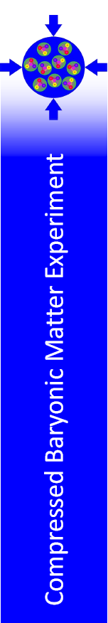

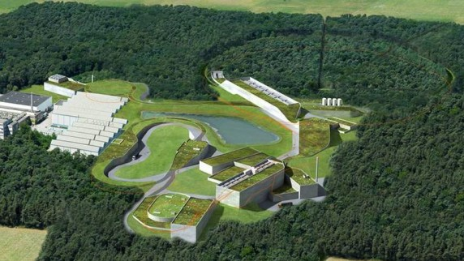




Track measurements in the high multiplicity environment at the CBM experiment
Many thanks to
Dr. Johann Heuser and others for providing slides
Pradeep Ghosh
(for the CBM Collaboration)
Institut für Kernphysik, Goethe-Universität, Frankfurt am Main
GSI Helmholtzzentrum für Schwerionenforschung, Darmstadt

Slide 2
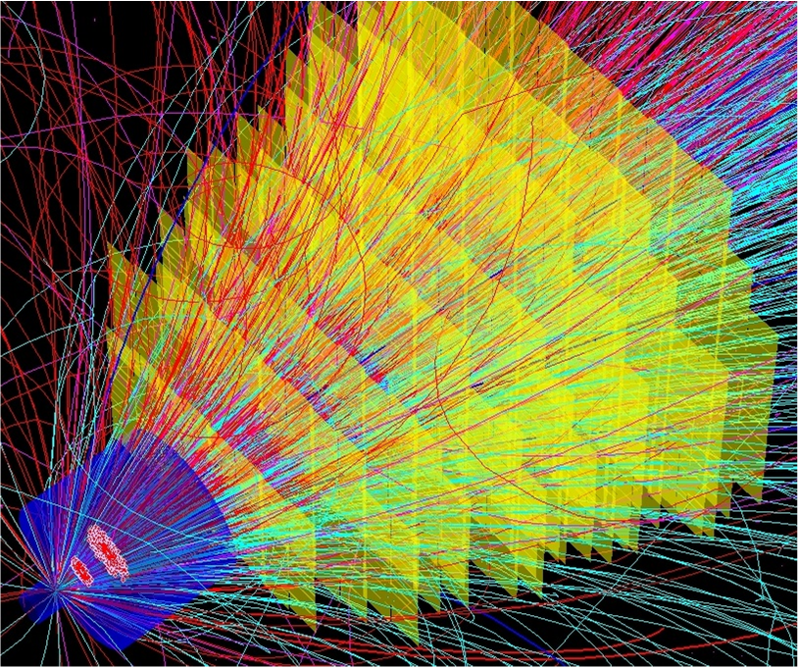
Outline
CBM Experiment
Silicon Tracker
Assessment of STS
Technical details
Timeline/updates
Summary

Slide 3
CBM Experiment
CBM detector setup
Tracking challenges at SIS100/300
Track matching

Slide 4
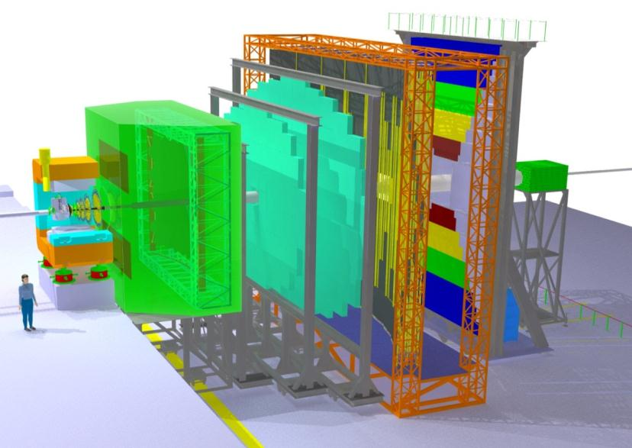
The CBM Experiment at FAIR
RICH – identify
“slow” electrons
RPC (TOF) – identify
“slow” hadrons
ρ,ω,φ …=> e+/e-
Major cut = Particle ID
Remaining background = γ => e+/e-
ECAL – measure
gammas
STS – measure
momentum
TRD – identify
fast electrons
MVD – find
decay vertex
MVD, γ=> e+/e-
rejection
PSD – measure
event plane
Target
J/Ψ …=> e+/e-
Major cut = Particle ID, p_{t} > 1.2 GeV

Slide 5
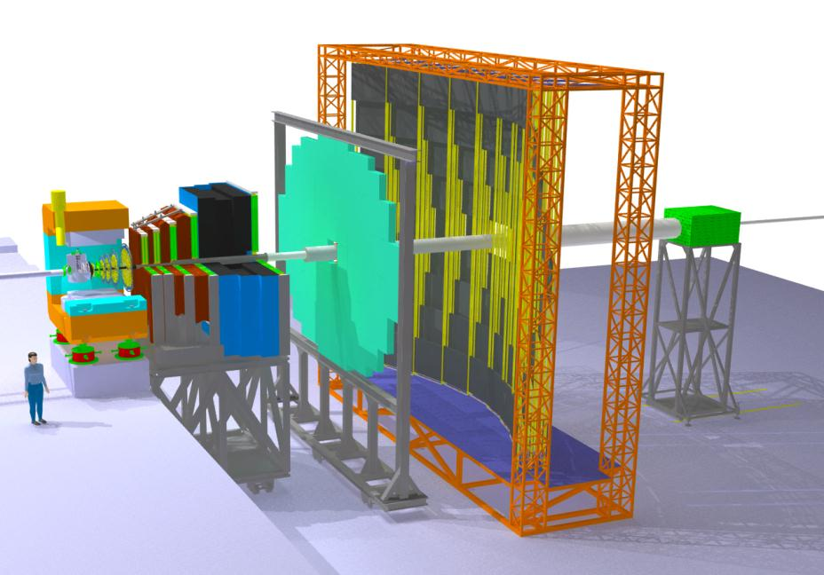
The CBM Experiment at FAIR
ω,ρ,φ ,J/Ψ …=> µ+/µ-
Major cut = Particle ID
Remaining background = π => μ + X
RICH – slow e ID
ECAL
TRD – tracking
MVD
Much – Active
Muon absorber
RPC (TOF) – hadron suppr.
STS - Momentum
PSD – Event
plane
CBM aims to measure vector mesons via e+/e- AND µ+/µ-
in SEPARATE runs => control systematics

Slide 6
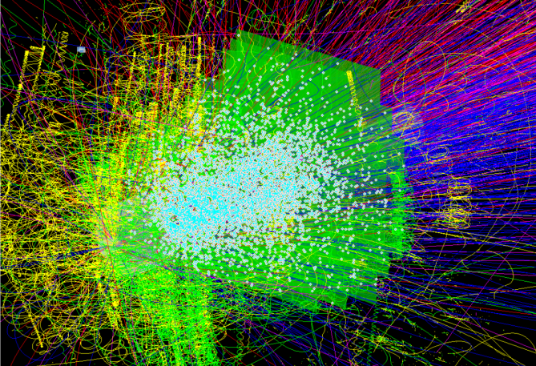
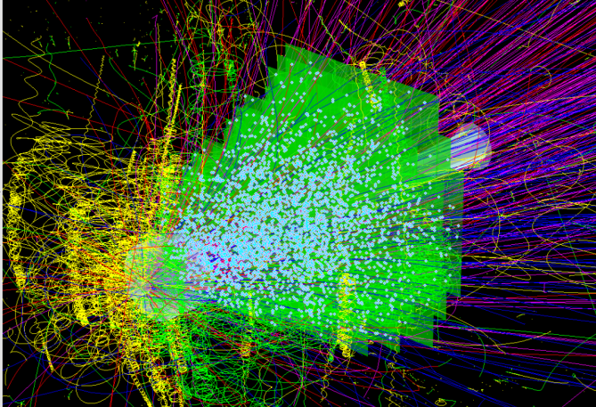
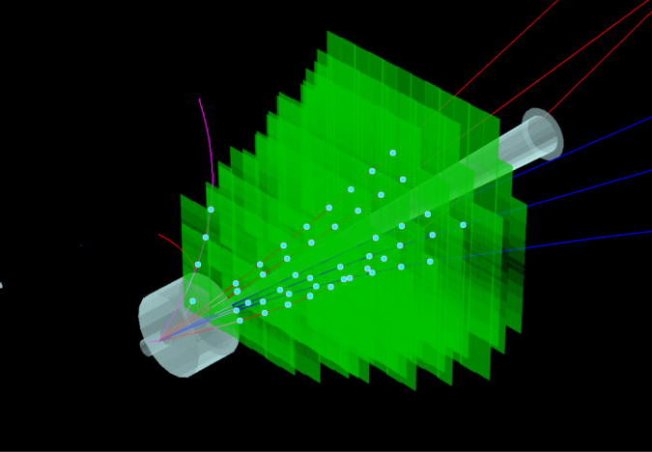
Tracking challenges at SIS-100/300
central Au+Au, 25 AGeV
central Au+Au, 8 AGeV
p+C, 30 GeV
~700 charged particles
~350 charged particles
few charged particles
high-rate experiment
10⁵ -10⁷ interactions/sec
hit rates 3-20 MHz/cm²
  fast free-streaming readout
  online event selection
  radiation hard sensors
low mass large-area detector
  high-resolution momentum determination
track matching
  into MVD and RICH/MUCH

Slide 7
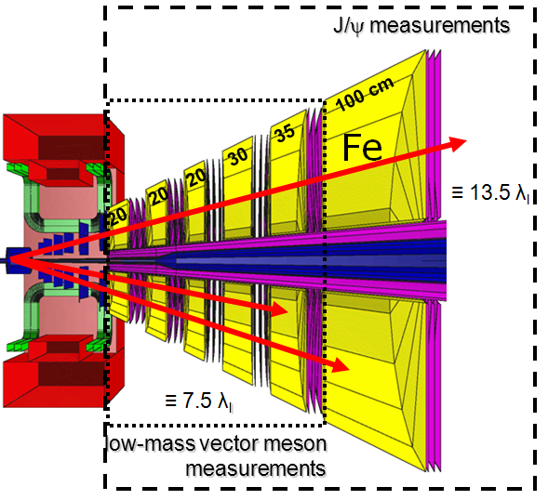
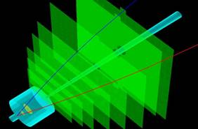
Track matching
upstream into Vertex Detector
downstream into MUCH (or RICH)
e.g. signal D⁰→K⁻π⁺
K⁻
π⁺
MVD 2
v₂₁
MVD 1
v₂₂
v₁₁
z= 5 cm
z= 10 cm

Slide 8
Silicon Tracking System
Design constraints
Design constituents
STS model in CBMRoot

Slide 9
STS Design Constraints
Coverage
rapidities from center-of mass
to close to beam
aperture 2.5° < Θ < 25°
Minimum granularity
(@ hit rates < 20 MHz/cm²)
maximum strip length compatible with
hit occupancy and S/N performance
largest read-out pitch compatible with the required spatial resolution
Momentum resolution
δp/p ≅ 1%
field integral 1 Tm, 8 tracking stations
25 µm single-hit spatial resolution
material budget/station ~1% X₀
Radiation hard sensors
(compatible with the CBM physics prog.)
Maximum of 1 × 10¹³ n_{eq}/cm² (SIS100)
Maximum of 1 × 10¹⁴ n_{eq}/cm² (SIS300)
(only at the innermost sensors)
  No event pile-up
10 MHz interaction rates
self-triggering read-out
signal shaping time < 20 ns
Integration, operation, maintenance
compatible with the confined space in the dipole magnet
efficient cooling for
  silicon sensors
  front end electronics
maintenance friendly structures
Hit & track reconstruction
close to 100% hit efficiency
> 95% track eff. for momenta >1 GeV/c

Slide 10
STS Design constituents
station
silicon microstrip detectors, 3 sizes
carbon support
half ladder
FEE
sectors
cable
half ladder
sector
module
half ladder
ladder
half station
half station

Slide 11
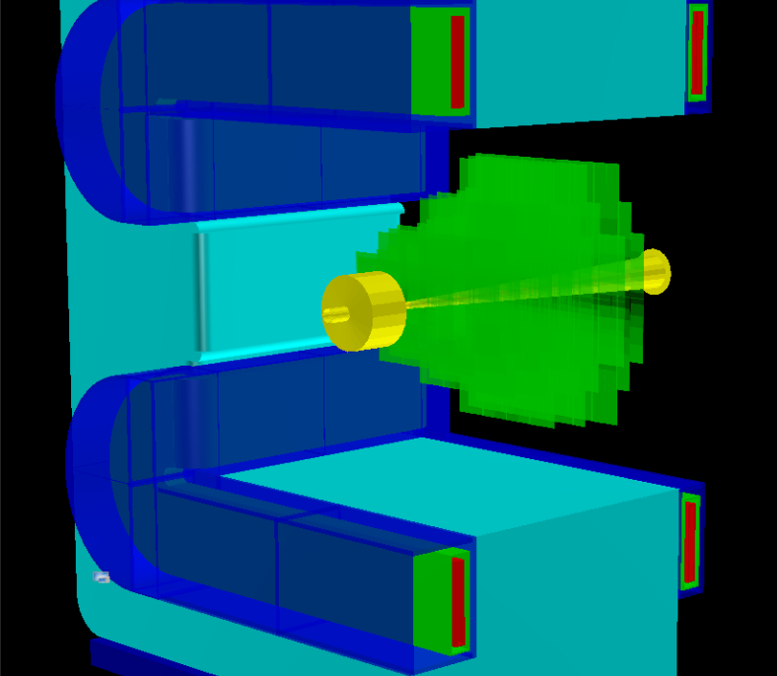
STS model in CBMRoot
stations
1220 sensors in 3 sizes
8 stations
z = 30, 40, 50, 60, 70, 80, 90, 100 cm
2.5 < Θ < 25°– 38°
total area > 4 m²
14336 readout ASICs
1760 front-end electronics boards
1.835 M r/o channels
ladders
106 ladders in 8 types,
built from those modules on carbon fiber supports
modules
896 modules in 25 types, differing in numbers and size of sensors, and cable lengths.

Slide 12
Assessment of performance
Material budget
Sensor occupancy
Hit multiplicity
Hit clusters
Track reconstruction performance
Kinematic distribution
Physics performance
Radiation environment at SIS100/300

Slide 13
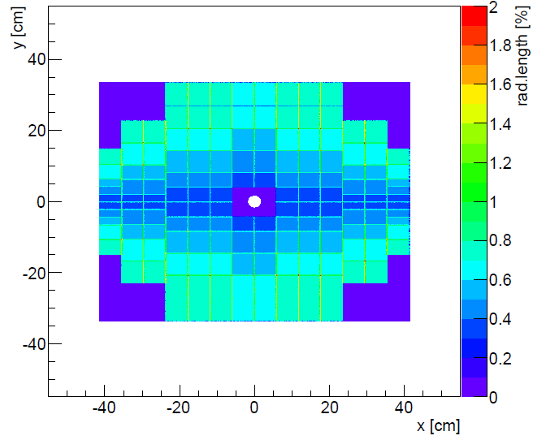
Assessment – material budget
station 4
electronics
sensor: 0.3% X₀
r/o cables: 2×0.11% X₀
front view
side view

Slide 14
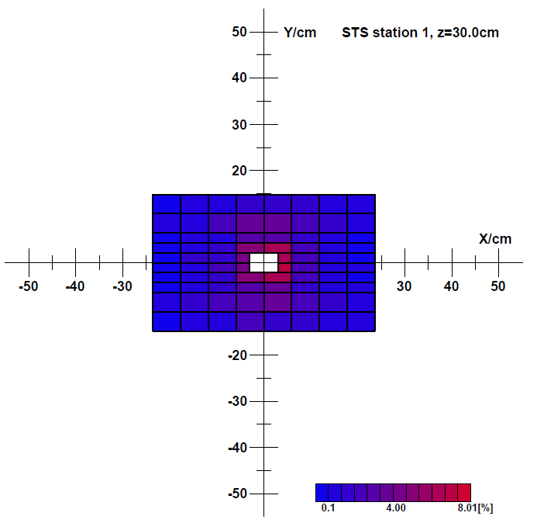
Assessment – sensor occupancy
sensor occupancy := ratio “nb. of hit strips : nb . of all strips“ in a sensor
station 1
Y/cm

Slide 15
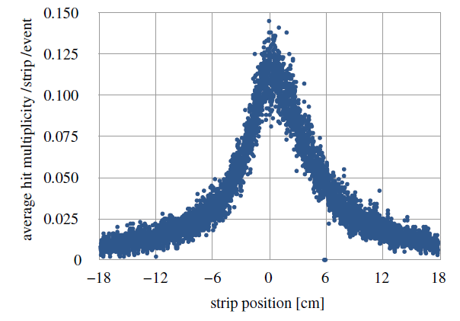
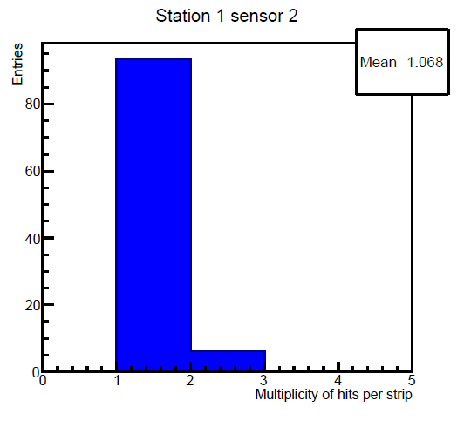
Assessment – hit multiplicities
in the most exposed sensors of station 1
particle hits per strip and event
particle hits per hit strip
Mean 1.07

Slide 16
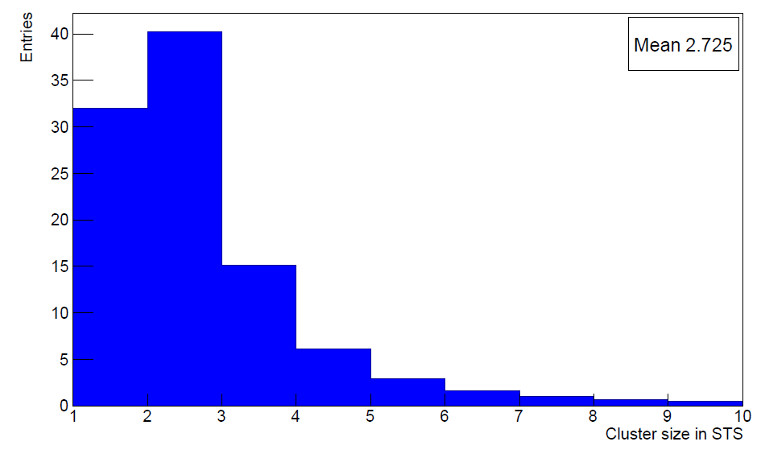
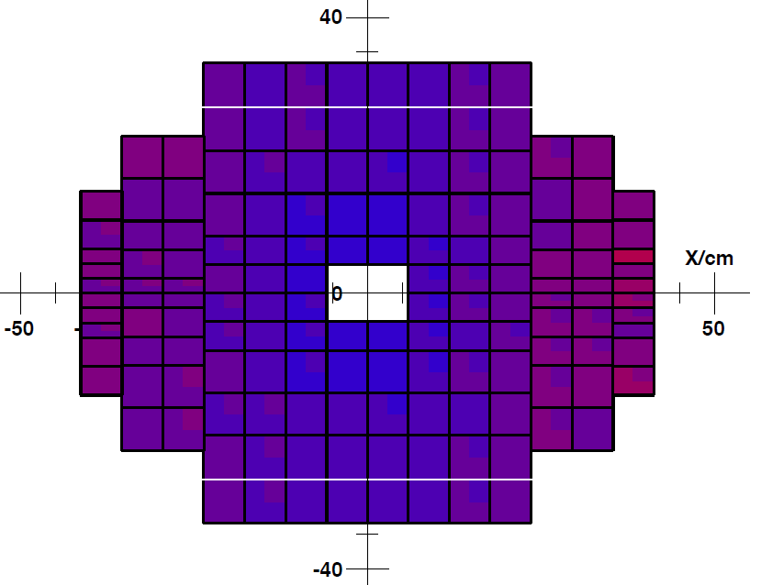
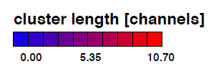
Assessment – hit cluster size
cluster of strips := number of adjacent strips in a sensor that fire simultaneously
distribution for full STS
in station 4
mean: 2.7

Slide 17
Track reconstruction performance
Cellular Automaton and Kalman Filter:
76 ms per event on a single core CPU;
event level parallelization, many-core platforms:
2500 min. bias events/s on 80 core server
primary vertex reconstruction
σ_{x} = 7.4 µm
σ_{y} = 14.1 µm
σ_{z} = 50.7 µm
Example: a central Au+Au collision, 25 AGeV
(STS + MVD: ~ 10 times better)
xz projection
yz projection
xy projection

Slide 18
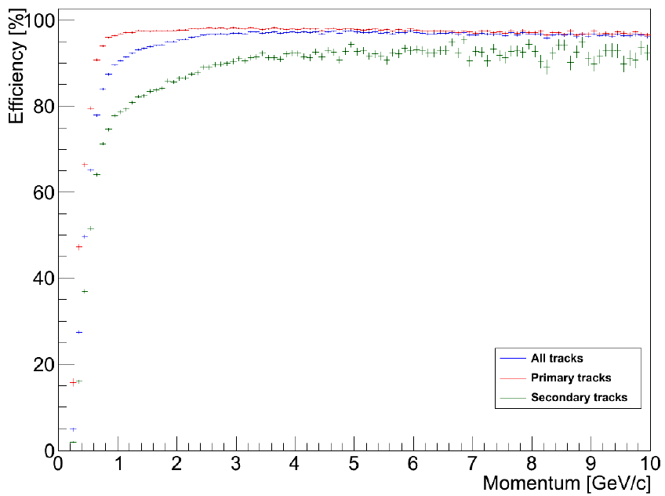
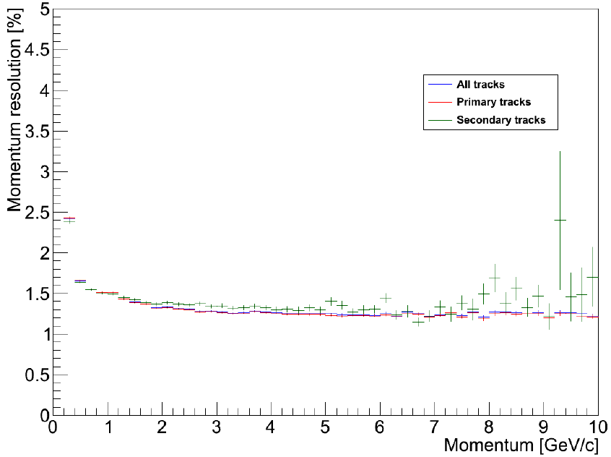
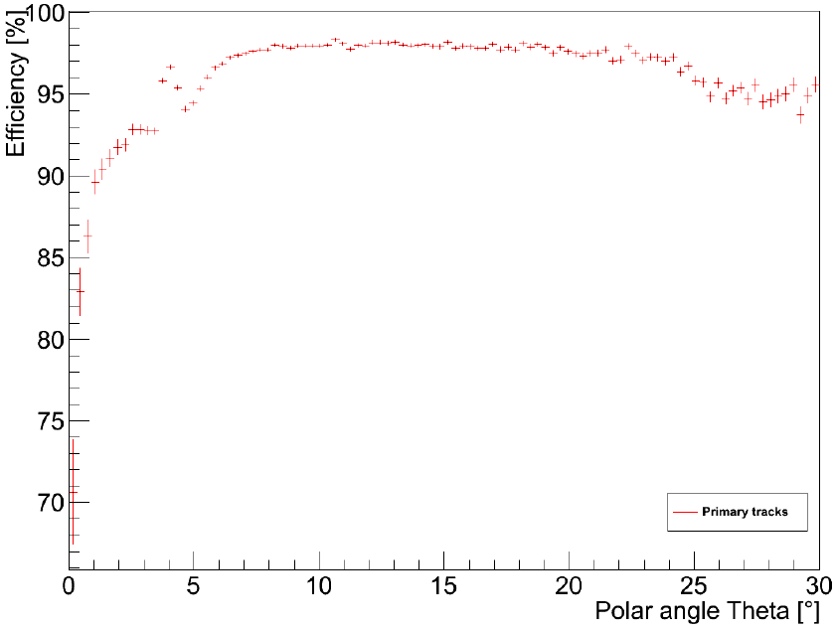
Track reconstruction performance
track reconstruction efficiency
momentum resolution
25 AGeV Au+Au central
⇒ Ongoing layout improvements:
aperture improvements to be done
in some of the stations: better coverage around beam pipe
optimize number and type of modules and their deployment in the stations

Slide 19
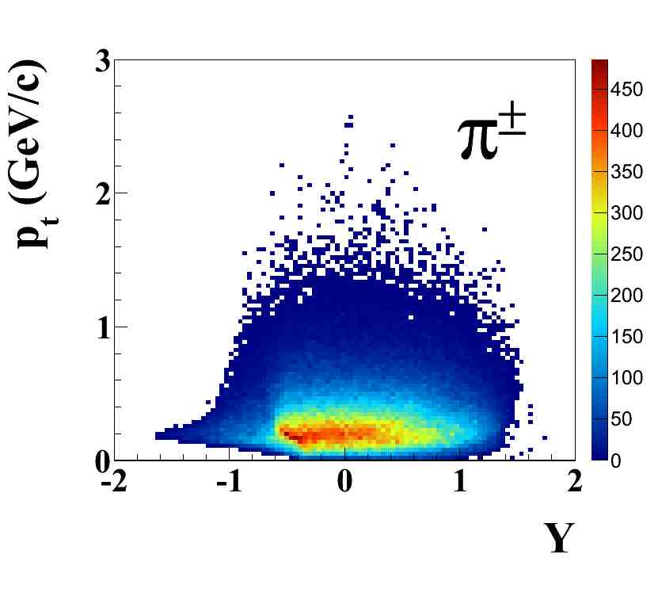
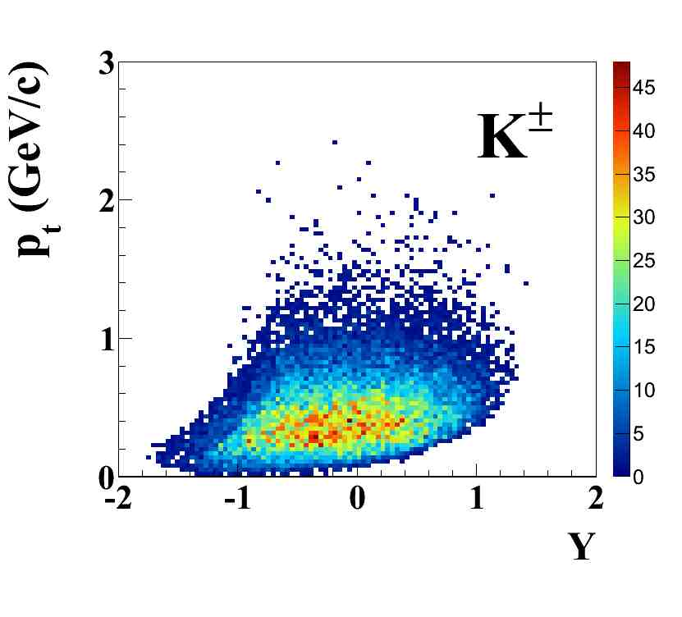
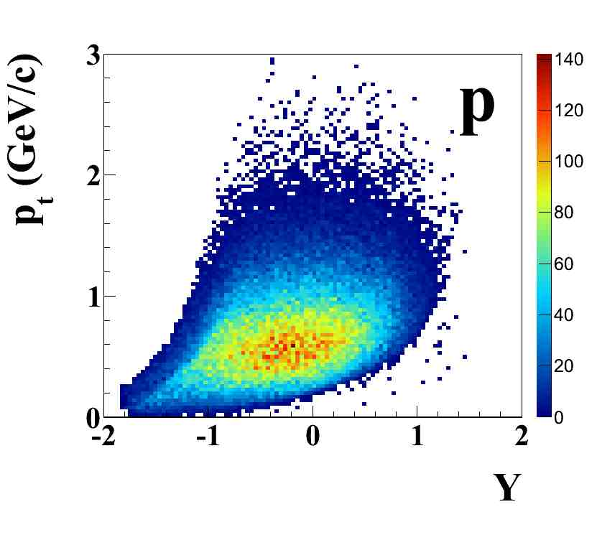
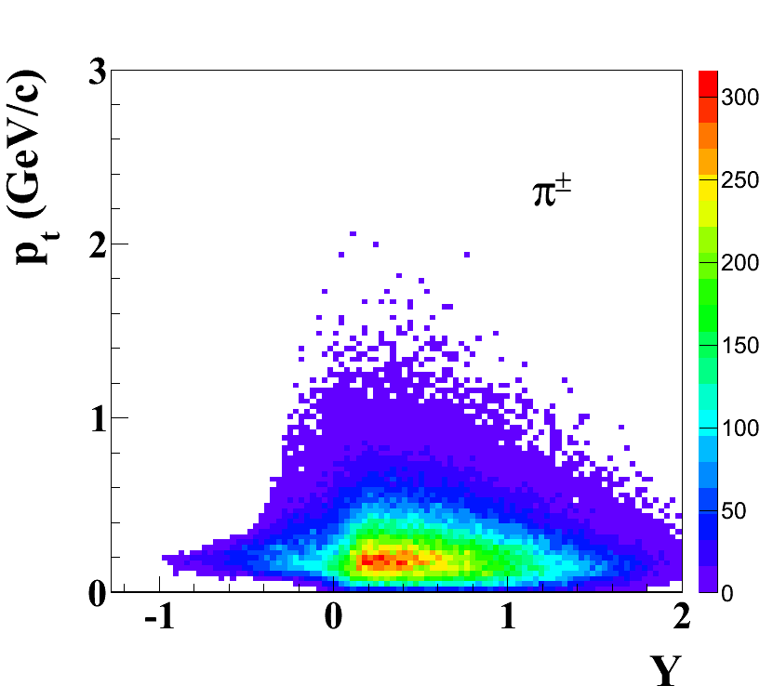
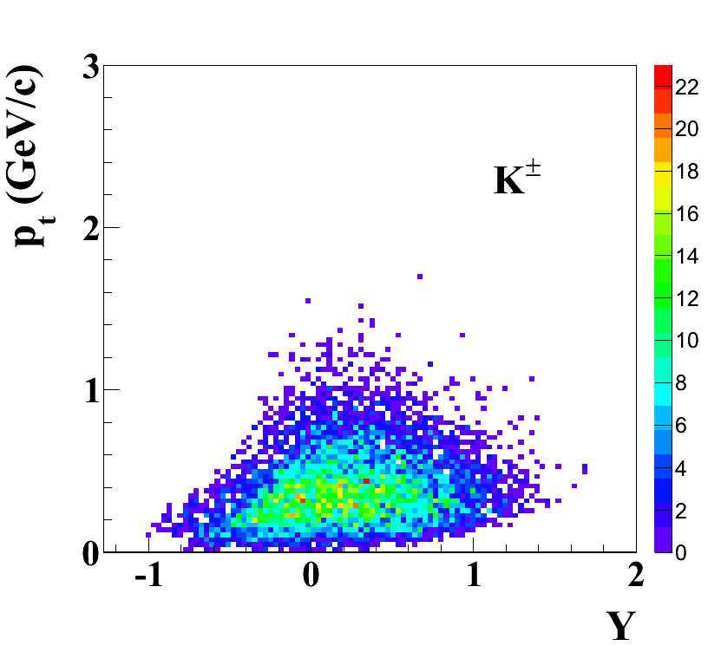
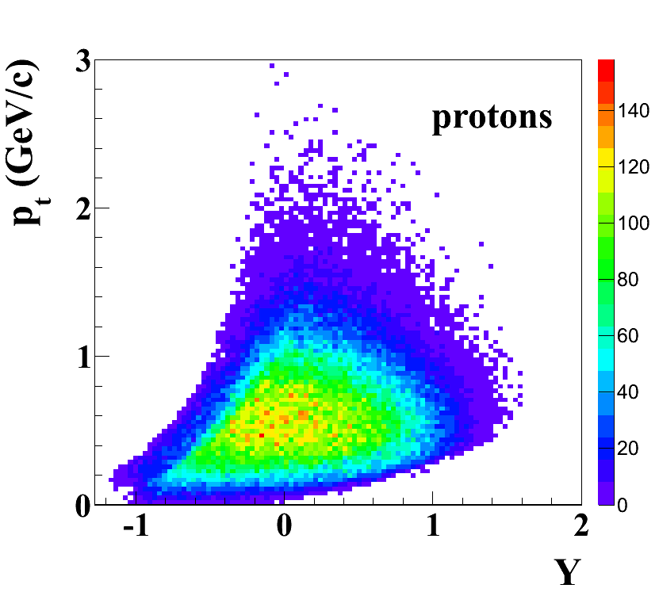


Kinematic distributions of charged hadrons
Au+Au collisions, 25 AGeV
STS + TOF
Au+Au collisions, 6 AGeV

Slide 20
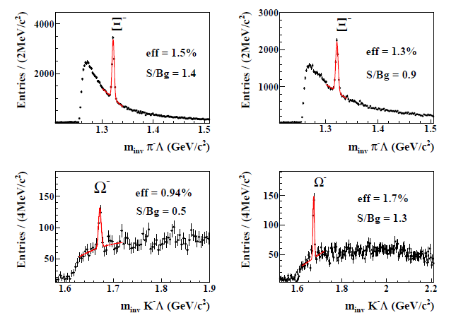
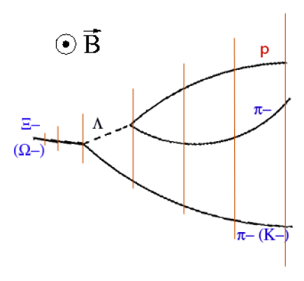
Physics performance studies – hyperons
Au+Au, 8 AGeV
Au+Au, 25 AGeV
cτ several cm,
decays just before/
within STS

Slide 21
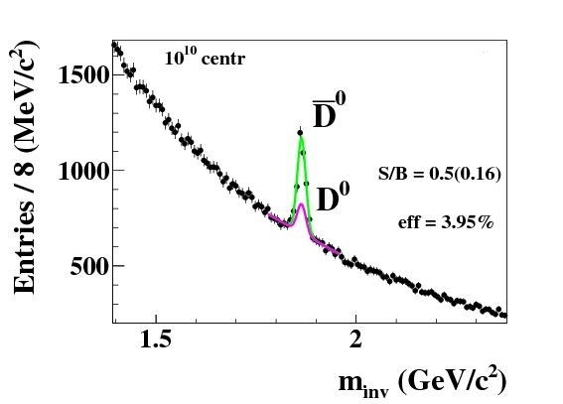
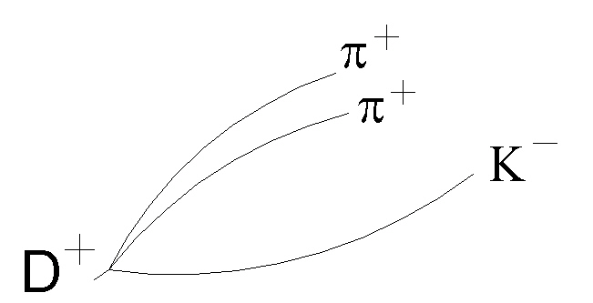
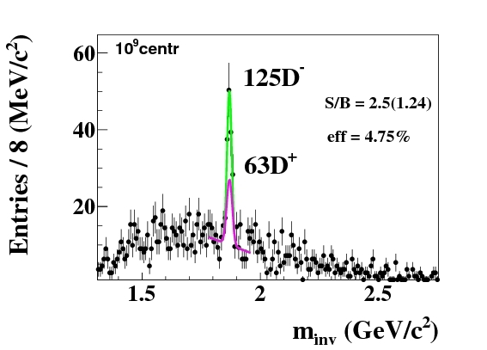
Physics performance studies – open charm
Au+Au, 25 AGeV
cτ few hundred µm,
decay just downstream of target, in front of MVD and STS

Slide 22
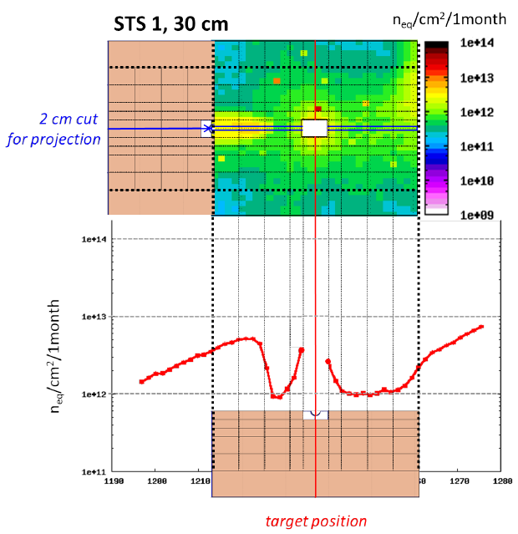
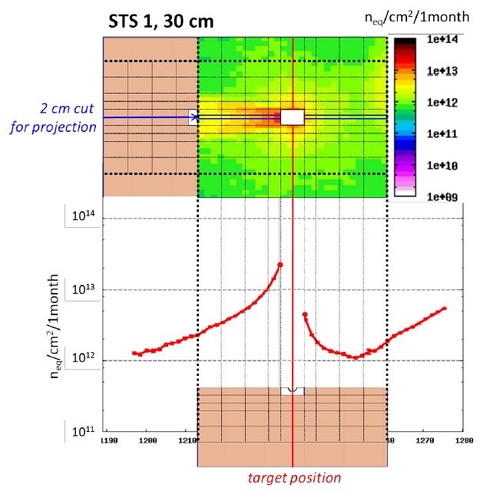
Radiation environment – SIS100 / SIS300
Au+Au, 10 AGeV
Au+Au, 35 AGeV
FLUKA, non-ionizing dose at STS station 1, 1 month 10⁹ ions/s on target

Slide 23
Technical details
Microstrip sensors
Prototyping
Sensor module
Tests of prototypes
Engineering design for integration
CO2 cooling for STS

Slide 24
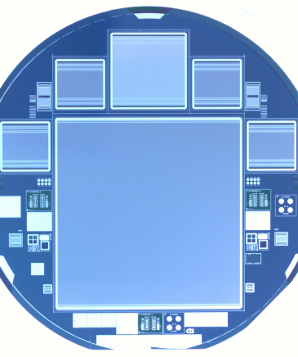
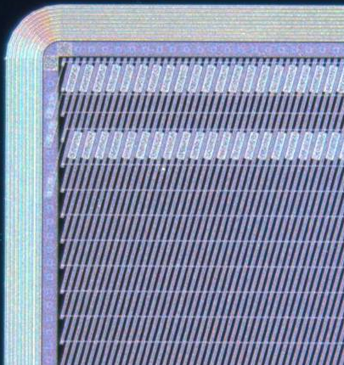
Microstrip sensors
double-sided, p-n-n structure
width: 6.2 cm
1024 strips at 58 μm pitch
three types, strip lengths: 2, 4, 6 cm, 4 cm
stereo angle front-back-sides 7.5°
integrated AC-coupled read-out
double metal interconnects on p-side, or replacement with an external micro cable
operation voltage up to few hundred volts
radiation hardness up to 1 × 10¹⁴ n_{eq}/cm²
4” and 6” wafers, 300 µm thick
test and full-size sensors

Slide 25
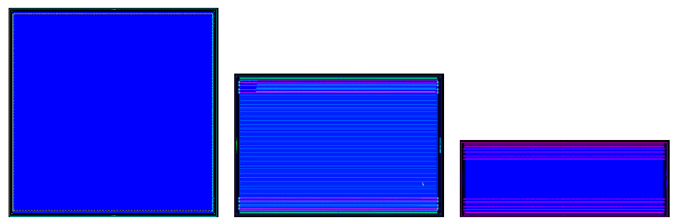
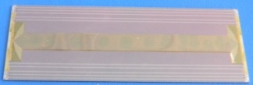
Prototype microstrip sensors
Prototype | Year | Vendor | Processing | Size [cm²] | Description
CBM01 | 2007 | CiS | double-sided | 5.5 × 5.5 | ±7.5 deg
CBM03 | 2010 | CiS | double-sided | 6.2 × 6.2 | ±7.5 deg
CBM03’ | 2011 | CiS | Single/CBM03 | 6.2 × 6.2 | test for CBM05
CBM05 | 2013 | CiS | double-sided | 6.2 × 6.2 | 7.5/0 deg full-size
CBM05H4 | 2013 | Hamamatsu | double-sided | 6.2 × 4.2 | 7.5/0 deg full-size
CBM05H2 | 2013 | Hamamatsu | single-sided | 6.2 × 2.2 | 7.5/0 deg full-size
under study: replacement for integrated 2nd metal layer
external on-sensor cable
CBM05
CBM05H4
CBM05H2

Slide 26
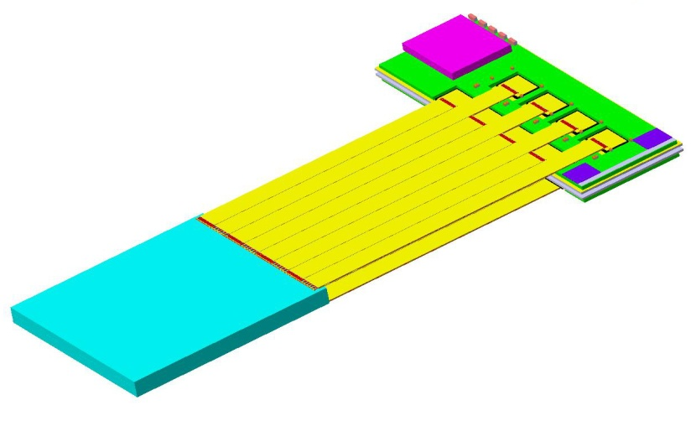
STS sensor module
module := building block of ladders
smallest assembled functional unit
front-end electronics board
read-out cables
sensor
10 – 50 cm
6 cm
2, 4, 6, (12) cm

Slide 27
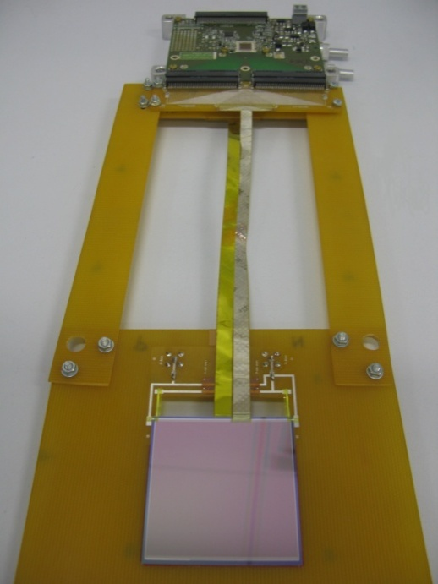
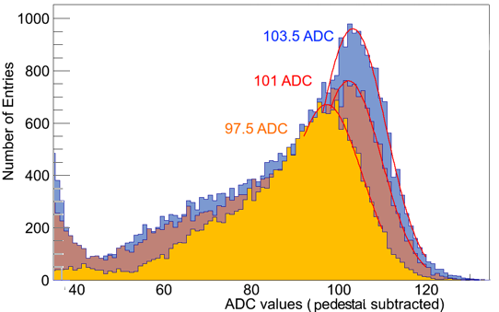
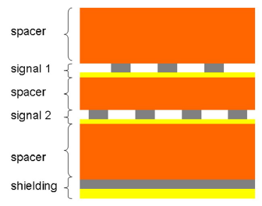
Test of first prototype modules
n-XYTER FEB
ADC spectrum, ²⁴¹Am source
59.5 keV
γ line
10 cm: 15.0 ke⁻
20 cm: 14.7 ke⁻ 30 cm: 14.1 ke⁻
10 cm
20 cm
30 cm
CBM01
S/N_{MIP} ~ 20
threshold @ 3σ noise
read-out cable,
Al-Polyamide thickness 0.1% X₀

Slide 28
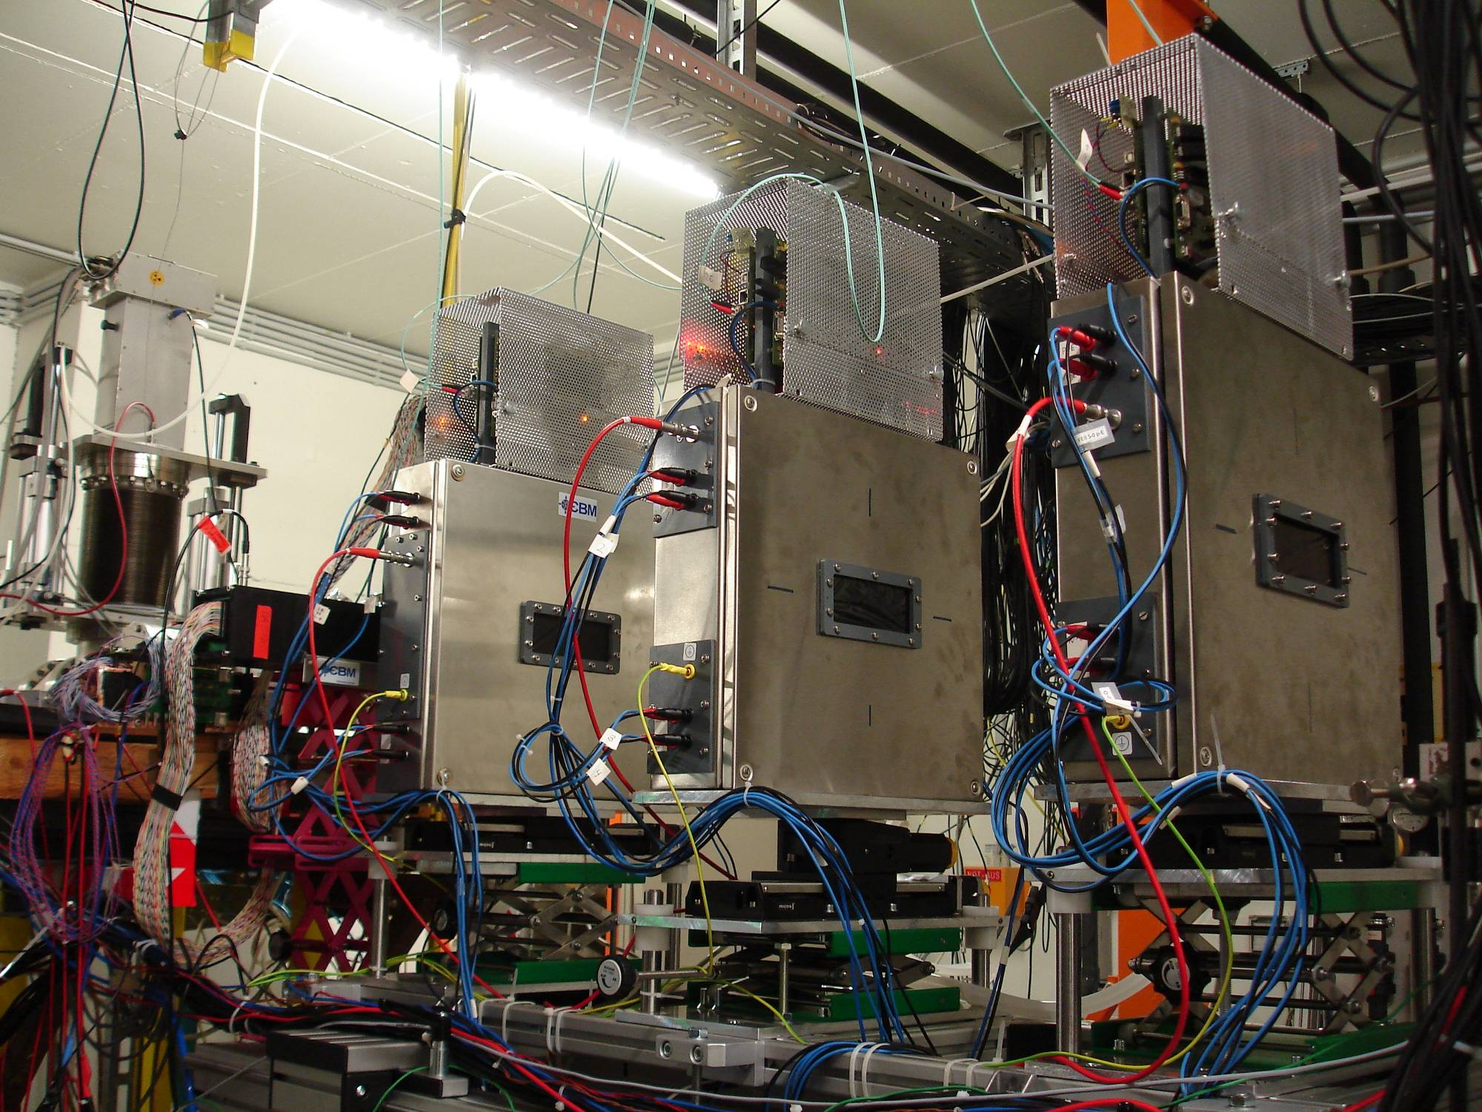
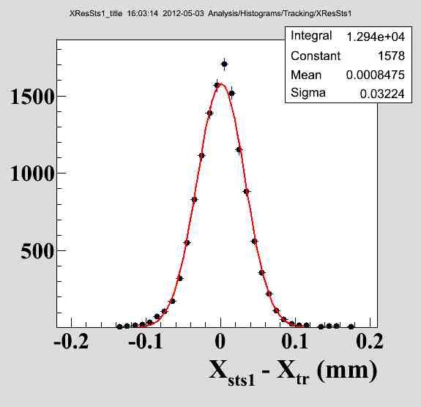
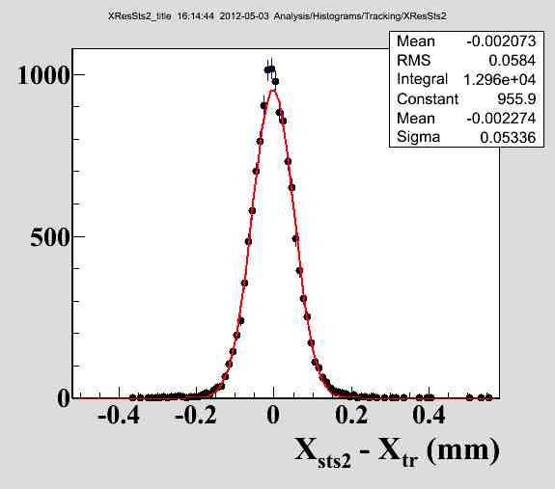
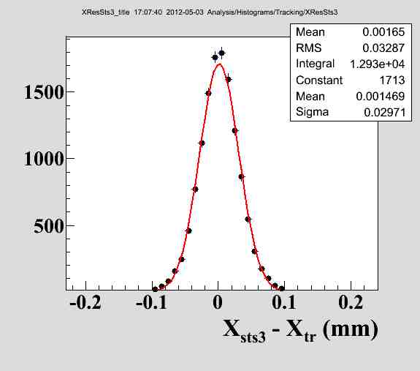
In-beam tests of prototype systems
silicon microstrip sensors
self-triggering front-end electronics
DAQ
DCS
online monitoring
tracking
2.4 GeV protons
neutron-irradiated sensor
σ =32 μm
σ =58 μm
σ =32 μm

Slide 29

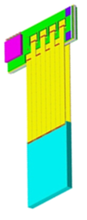
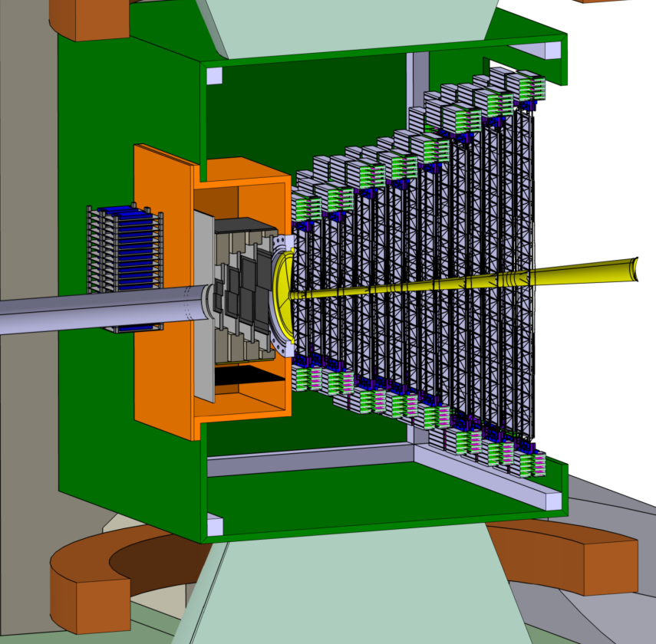
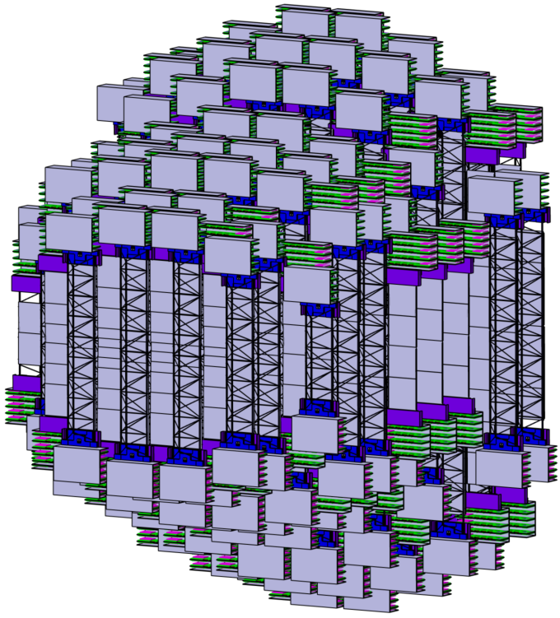
Engineering model of the STS for integration

Slide 30
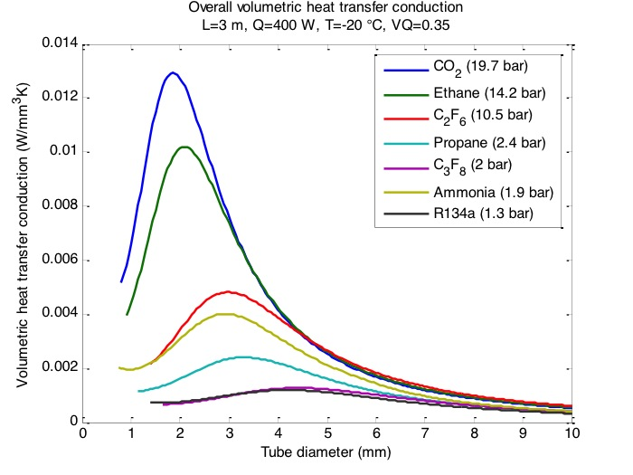
CO₂ cooling of the front-end electronics
Cooling requirements
200 W per front-end electronics box
42 kW for total STS
effective cooling, little space !
best cooling agent: CO₂
volumetric heat transfer vs. tube diameter
CERN COURIER May 31, 2012
in cooperation with CERN
(EU-FP7 CRISP):
realization of a 1 kW CO₂ test cooling unit TRACI-XL
electronics box with 8 FEBs
attached to a cooling plate
2 m long capillary of 1.6 mm diameter

Slide 31

CO₂ cooling
CO₂ cooling infrastructure in the proposed CBM building at FAIR
Underground hall:
Length: 37 m
Width: 22 m
Height: 17 m
gas storage
CO₂ plant
room height:
~ 3.70 m
CBM experiment
STS
accelerator tunnel
pipe length ~ 70 m

Slide 32
Timeline for STS
Until 2013
R&D and Prototyping
Technical Design Report approval
2013-2017
Pre-production (2013- 7/2015)
Mechanical freeze (2014)
2017-2018
Installation,
Engineering design of layout
Layout freeze (2013)
Beam time test 2013/2014
Production Readiness Review 7/2015 and
Series production (2015 - 6/2017)
Commissioning and
Beginning of operation

Slide 33




Participating institutes in STS
From Germany, Poland, Russia and Ukraine
Darmstadt, Germany, GSI Helmholtz Center for Heavy Ion Research GmbH
Dubna, Russia, Joint Institute for Nuclear Research (JINR)
Katowice, Poland, University of Silesia
Kharkov, Ukraine, State Enterprise (SE SRTIIE) ^{* Partner} ^{Institut}
Kiev, Ukraine, Kiev Institute for Nuclear Research (KINR)
Krakow, Poland, AGH University of Science and Technology
Krakow, Poland, Jagiellonian University
Moscow, Russia, Institute for Theoretical and Experimental Physics (ITEP)
Moscow, Russia, Moscow State University
Protvino, Russia, Institute for High Energy Physics (IHEP)
St. Petersburg, Russia, Ioffe Physical-Technical Institute
St. Petersburg, Russia, Khlopin Radium Institute (KRI)
St. Petersburg, Russia, St. Petersburg State University
Tübingen, Germany, Eberhard Karls University

Slide 34

Technical Design Report
Submitted to FAIR in December 2012;
Comments received by June 2013
Accepted by FAIR Expert Committee Experiments August 2013
Public Release next week in Collaboration Meeting, Dubna Russia.

Slide 35
Summary
Showed:
  Challenges for tracking, STS design constraints and constituents
  Assessment of the STS in terms of
    Material budget, sensor occupancy, hit multiplicity
    Clusters formation and reconstruction performance studies
    Physics performance studies
  Microstrip sensors, readout electronics, cooling and engineering models describing STS
  Prototype testing : Lab and In beam measurements
Update :
  Acceptance of TDR, geometry freeze and the project timeline
  Beamtime in12/2013 with new prototype demonstrator modules

Slide 36
Thank you for your attention !

