Slide 1
Mesons, PANDA and the Importance of Scalar Glueball
Institut für Theoretische Physik Technische Universität Wien
Denis Parganlija
Thanks to:
F. Giacosa, S. Janowski and D. H. Rischke (Frankfurt)
Gy. Wolf and P. Kovács (Budapest)
D. Bugg (London)

Slide 2
QCD and Its Degrees of Freedom

Slide 3
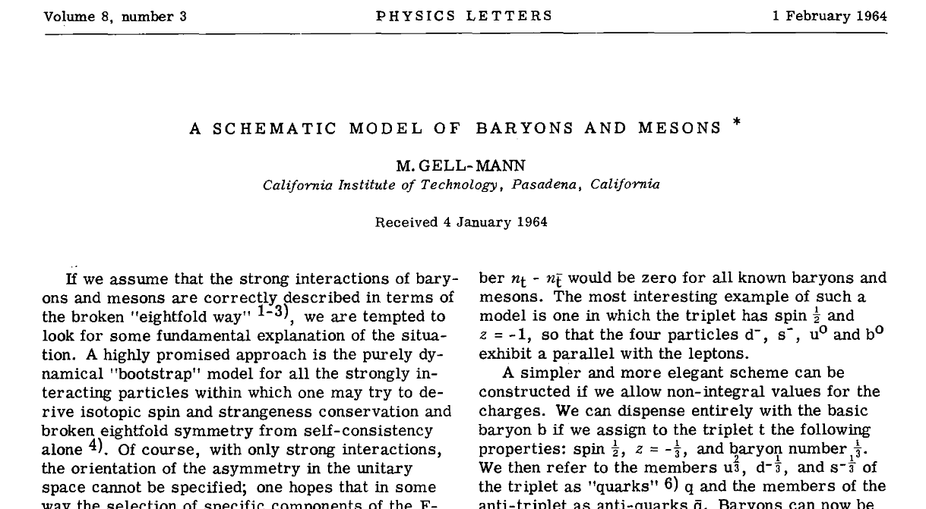
Introduction of Quarks

Slide 4
Quantum Chromodynamics
QCD Lagrangian:
Gluons are self-interacting!
Strong Coupling Energy-Dependent!
(Quarkonium)
Strongly Nonperturbative
Half-Integer Spin
Baryons
Integer Spin
Mesons
Hadrons Emerge

Slide 5
Glueballs
Gauge-boson self-interaction does not exist in QED:
QCD exhibits self-interaction of gauge bosons
Can bound states of gluons exist?
Glueballs!
→ Photons can at most interact via (suppressed) fermion loops

Slide 6
The Importance of Glueballs
Mass of, e.g., nucleons is generated by 1. Higgs mechanism (subdominant) 2. Strong interaction (predominant)
Glueball mass is generated only by the strong interaction
Glueballs must have integer spin → they are mesons
Meson spectrum is incomplete without glueballs
How do we produce mesons?

Slide 7
Mesons and Experiment

Slide 8
Production of Mesons
Main production channels for low-energy mesons:
Glueballs are • expected in • suppressed in γγ
What is the status in the scalar sector? And what is a scalar meson?
[Crystal Barrel; GAMS; OBELIX]
[Axial Field Spectrometer Collaboration; Ames-Bologna-CERN-Dortmund-Heidelberg-Warsaw Collaboration; GAMS; WA76; WA91; WA102]
[CMD-2; MARK-III; Crystal Ball; KLOE; BES; BES II; BES III]
[CERN-Cracow-Munich Collaboration; CERN-Munich Collaboration; E791; WA76; WA102; GAMS]

Slide 9
Meson Quantum Numbers
Quantum numbers: J^{PC}
Scalar mesons: J^{PC} = 0⁺⁺ [σ or f₀(500), a₀(980), a₀(1450)…]
Pseudoscalar mesons: J^{PC} = 0⁻⁺ [π, η, η´…]
Vector mesons: J^{PC} = 1⁻⁻ [ρ, ω, φ(1020)…]
Axial-Vector mesons: J^{PC} = 1⁺⁺ [a₁(1260), f₁(1285), …]
Total Spin
Parity
Charge Conjugation

Slide 10
Candidates for the Scalar Glueball
States up to 1.8 GeV (PDG)
State | Mass [MeV] | Width [MeV]
f₀(500) | 400 - 550 | 400 - 700
f₀(980) | 990 ± 20 | 40 - 100
f₀(1370) | 1200 - 1500 | 200 - 500
f₀(1500) | 1505 ± 6 | 109 ± 7
f₀(1710) | 1720 ± 6 | 135 ± 8
f₀(1790)

Slide 11
Scalar Ambiguities I
A new resonance was claimed by BES in 2004

Slide 12
Scalar Ambiguities II
Assume that they are the same resonance
[M. Ablikim et al. (BES II Collaboration), Phys. Lett. B 603, 138 (2004) and
Phys. Lett. B 607, 243 (2005)]

Slide 13
Candidates for the Scalar Glueball
States up to 1.8 GeV
State | Mass [MeV] | Width [MeV]
f₀(500) | 400 - 550 | 400 - 700
f₀(980) | 990 ± 20 | 40 - 100
f₀(1370) | 1200 - 1500 | 200 - 500
f₀(1500) | 1505 ± 6 | 109 ± 7
f₀(1710) | 1720 ± 6 | 135 ± 8
f₀(1790)…
… but ignored
by the PDG

Slide 14
Scalar Glueball and Theory

Slide 15
Two approaches to Low-Energy QCD
QCD
First principles:
Effective theories and models:
Lattice
[Wilson; Fodor, Katz, Dürr, Wagner, Gregory,
Irving, Prelovsek, Bali, Lang, Chen, Endrodi…]
Linear Sigma Model
scalars very broad,
extrapolation problems
Chiral Perturbation Theory
Based on QCD symmetries; may be based on constituent quarks
Bethe-Salpeter Equations
[Roberts, Nicmorus, Eichmann, Williams,
Fischer, Oset, …]
[Results from Extended Linear Sigma Model (eLSM) → talks by S. Janowski (Thursday) and P. Kovacs (Friday)]
have to be non-truncated
Lattice: m_{G} ~ 1.5 GeV
[Morningstar and Peardon (2004), pure YM]

Slide 16
Candidates for the Scalar Glueball
States up to 1.8 GeV
State | Mass [MeV] | Width [MeV]
f₀(500) | 400 - 550 | 400 - 700
f₀(980) | 990 ± 20 | 40 - 100
f₀(1370) | 1200 - 1500 | 200 - 500
f₀(1500) | 1505 ± 6 | 109 ± 7
f₀(1710) | 1720 ± 6 | 135 ± 8
f₀(1790)
… but f₀(1790)
ignored by the PDG

Slide 17
Points of Extreme Importance for PANDA
There can be no complete glueball spectrum without the scalar glueball
There will be no pure scalar glueball, but a predominantly glueball scalar state
A clear identification of this predominantly glueball state is only possible all f₀ states are known
f₀(1790) is exactly where lattice QCD predicts a scalar glueball
If f₀(1790) exists, virtually all we know about classification of f₀ states may change
Hence PANDA needs to look for f₀(1790)!

Slide 18
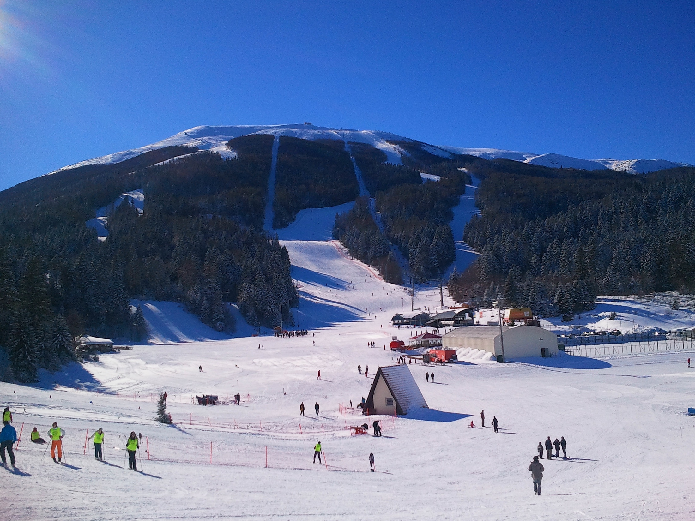
Excited QCD VI
Sarajevo, February 2 – 8, 2014
indico.cern.ch/e/exqcd2014

Slide 19
Spare Slides

Slide 20
Motivation: More Reasons to Consider Mesons
Nucleon-nucleon interaction modelled via exchange of a scalar isosinglet meson
Restoration of chiral invariance and decofinement ↔ Degeneration of chiral partners π and a scalar → that scalar has to be a quarkonium
Identify the scalar quarkonia
Note the same problem with ρ/a₁ and K*/K₁: order parameter sensitive to assignment of quarkonium

Slide 21
PANDA at FAIR

Slide 22
PANDA Experiment at FAIR
It is impossible to consider glueball only: f₀(1370), f₀(1500), f₀(1710) too close → mixing with quark-antiquark states
Additional complication: f₀(1790) would interfere… if it exists
Look for f₀(1790)!

Slide 23
Summary and Outlook
More scalar states than expected by the antiquark-quark picture: f₀(500), f₀(980), f₀(1370), f₀(1500), f₀(1710), f₀(1790)
Where is the quark-antiquark state?
What is the structure of other states?
Relevance for nucleon interaction and chiral restoration
Need one comprehensive approach containing 1) mixing of scalar states 2) interactions of scalars with other meson classes

