Slide 1





Strange and heavy mesons in hadronic matter: many-body and unitarity for a road to FAIR
Daniel Cabrera
ITP and FIAS, Goethe Universität
and
Universidad Complutense de Madrid

Slide 2
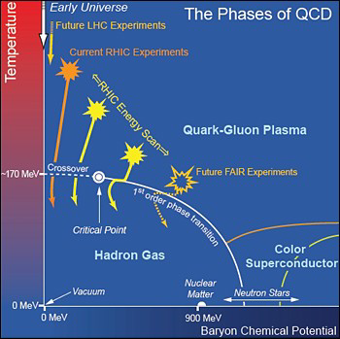
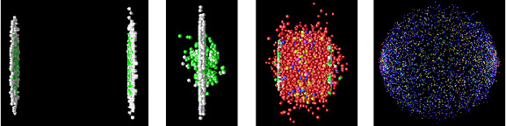
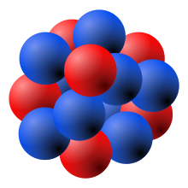
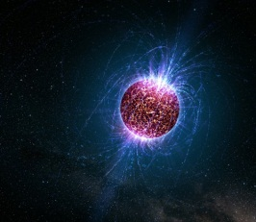
Introduction and motivation
The QCD phase diagram
Motivation: setup for strong interactions at extreme conditions
Understand (de-)confinement
Asymptotic freedom
Phenomenological variety: cold QGP, nuclear matter phases…

Slide 3
Introduction and motivation
The QCD phase diagram
Heavy-Ion Collisions
Production of hadrons in nuclei
Neutron stars
Facilities:
CERN (SPS, LHC), BNL (RHIC), GSI-FAIR, NICA-Dubna
Spring 8 – Osaka, J-PARC, KEK, JLAB, ELSA-Bonn

Slide 4
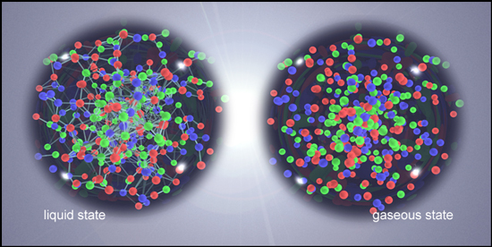
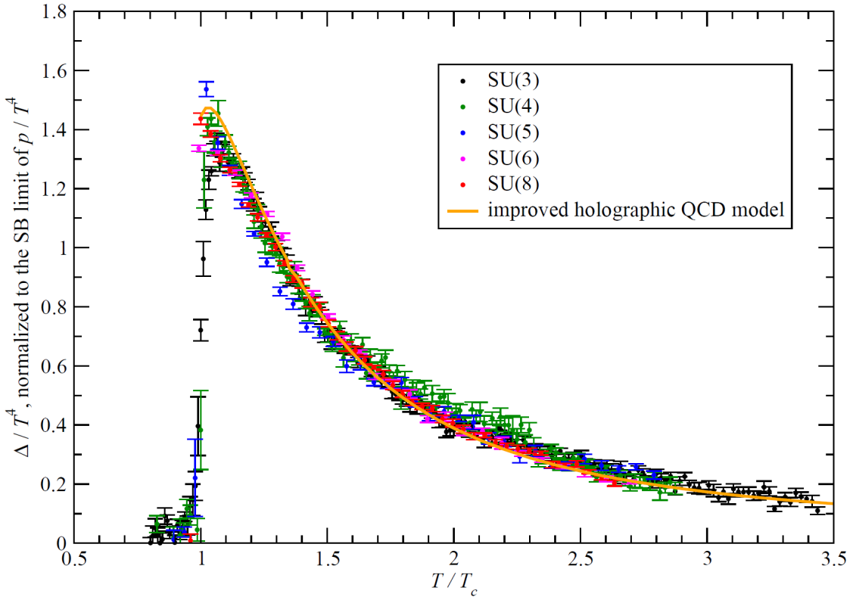
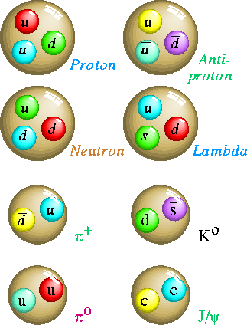
Introduction and motivation
Trace anomaly: (e-3p)
Thermodynamics of QCD
M. Panero, PRL 103, 232001 (2009)
Hadron gas
2-body corr.
Free gas
M. Panero, PRL 103, 232001 (2009)

Slide 5
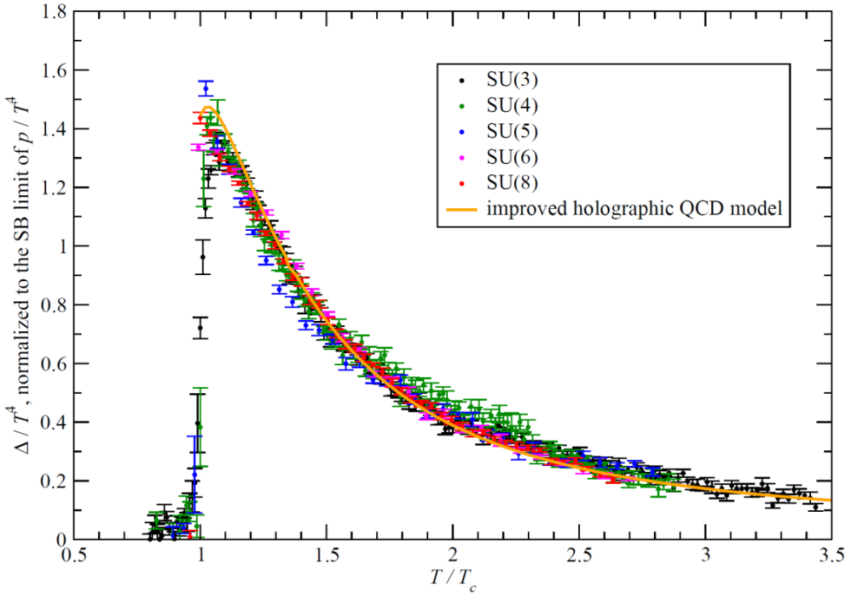
Introduction and motivation
Definitory properties of QCD under the test
M. Panero, PRL 103, 232001 (2009)
Confinement: “colored states are not observable”
(i.e. only color neutral particles exist: “color singlets”)
Asymptotic freedom: “strong coupling weakens at high energies”
(i.e. quarks and gluons propagate freely as ideal gas)
Hadron gas
2-body corr.
Free gas
New realm of a “colorful” spectroscopy of strong interactions
  Exotic hadronic states
  Glueballs (bound states of two gluons)

Slide 6

Introduction and motivation
Understand the properties of hadrons in dense matter
1. Linked to fundamental properties of QCD (e.g. ChSymmetry restoration)
2. Understand full history of collision (signatures of QGP)
3. Test the limits of nuclear many body methods.

Slide 7
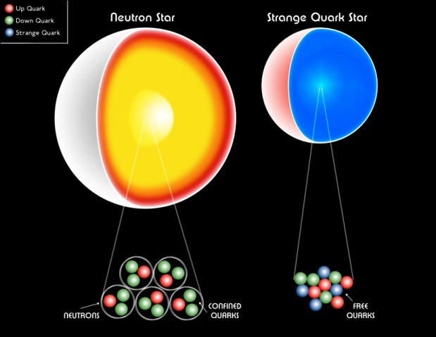
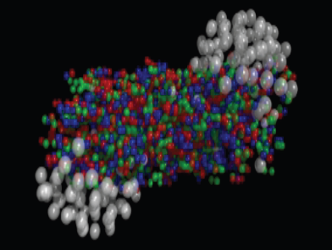
Introduction and motivation
Why strangeness in dense matter
Kaon condensation in neutron stars
Kaonic atoms (nuclear opt. potential)
Production (AND propagation) in HIC’s
  Understand data
  Learn about hadron nature and medium effects
FOPI , KAOS , HADES , NICA
Also RHIC low-energy program

Slide 8
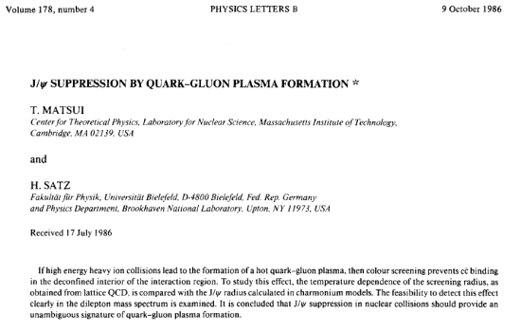
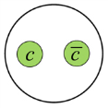
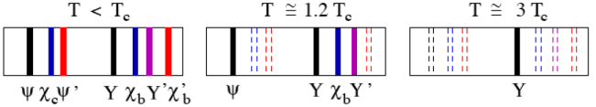
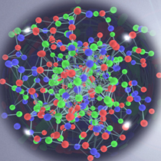
Introduction and motivation
Why charm in dense matter
Initial motivation: J/y suppression in HICs
Dynamics in hadronic phase relevant!
Sector not constrained by Ch.Symmetry
Heavy flavor relaxation in hadronic phase
D, B
CBM experiment

Slide 9
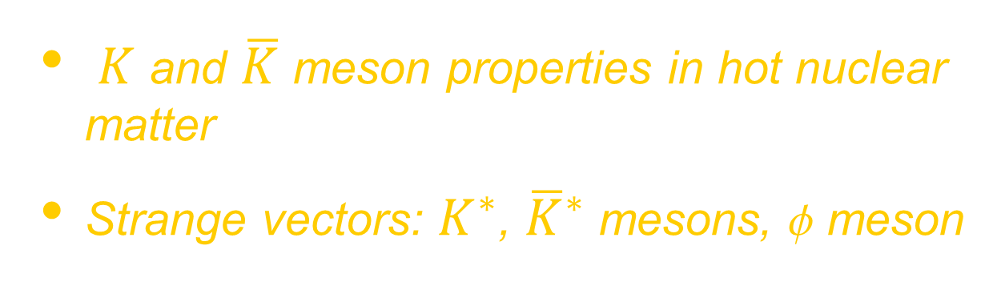
Part 1: Strange mesons
$K$ and $\overline{K}$ meson properties in hot nuclear matter
Strange vectors: $K^{∗}$, ${\overline{K}}^{∗}$ mesons, f meson

Slide 10
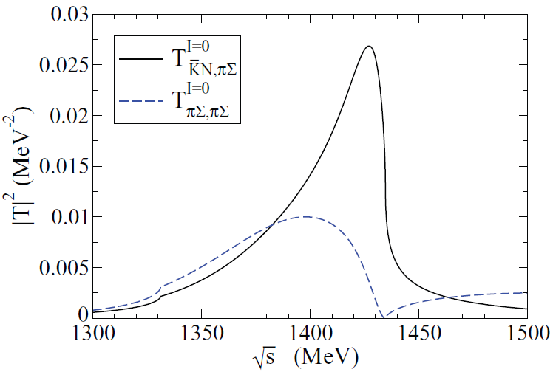
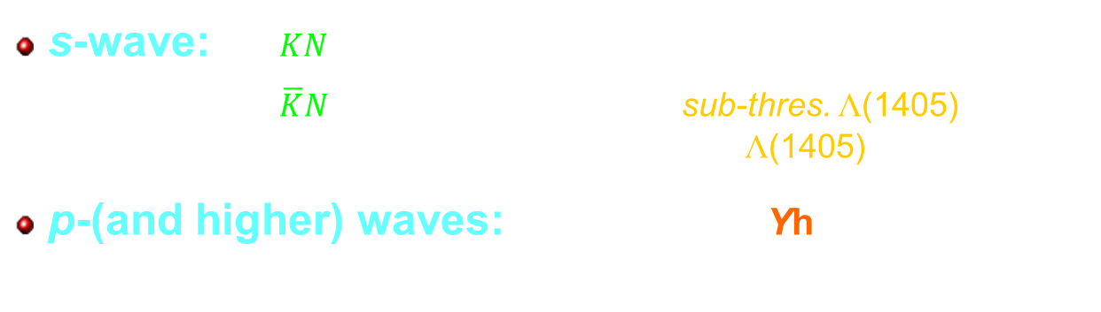
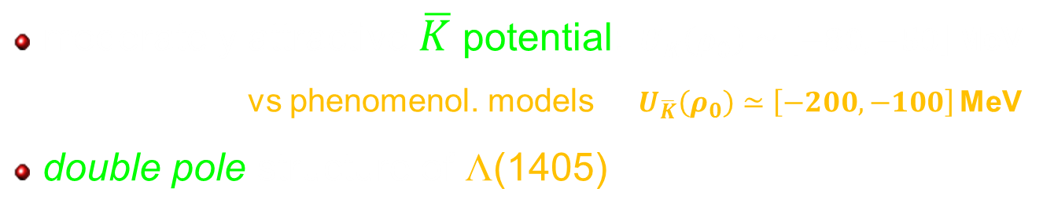
KN and KN scattering in hot nuclear medium
Modelling the (anti-)kaon nucleon interaction
s-wave: $KN$ smooth at low energies → mild repulsion (30 MeV)
$\overline{K}N$: strongly dominated by sub-thres. L(1405) → attraction due to in-med shift of L(1405) + broadening
p-(and higher) waves: populated by Yh excitations → relevant in HIC!
Some results from unitarized coupled-channel approaches
moderately attractive $\overline{K}$ potential:$U_{\overline{K}}\left(ρ_{0}\right)≃\left[−80,−50\right]$ MeV
vs phenomenol. models $U_{\overline{K}}\left(ρ_{0}\right)≃\left[−200,−100\right]$ MeV
double pole structure of L(1405)
Koch
Kaiser, Waas , Weise
Lutz, Kolomeitsev;
Schaffner-Bielich
Ramos, Oset, Tolos
Oller, Meissner
Hosaka, Jido
Nieves, Ruiz-Arriola
Cassing, Bratkovskaya, Tolos, Ramos
Roca, Oset, PRC87 (2013) 055201

Slide 11
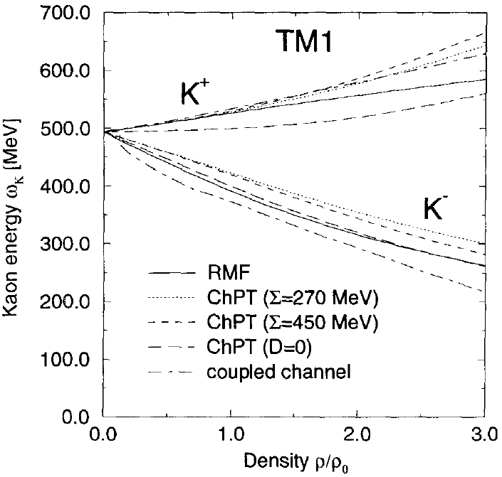
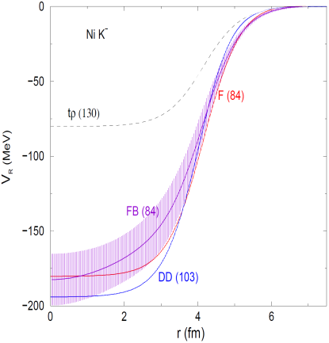
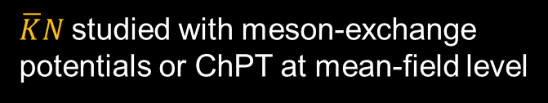

KN and KN scattering in hot nuclear medium
Other frameworks and approaches
Relativistic Mean-Field models (RMF)
Phenomenological approaches
$\overline{K}N$studied with meson-exchange potentials or ChPT at mean-field level
Schaffner-Bielich, Mishustin, Bondorf, NPA 625 (1997) 325
Empirical density-dependent potentials to describe kaonic atoms
Cieply, Friedman, Gal, Mares, NPA696 (2001) 173
$\overline{K}$-${}_{}^{58}{Ni}$
Friedman, Gal, Phys. Rept. 452, 89 (2007)

Slide 12
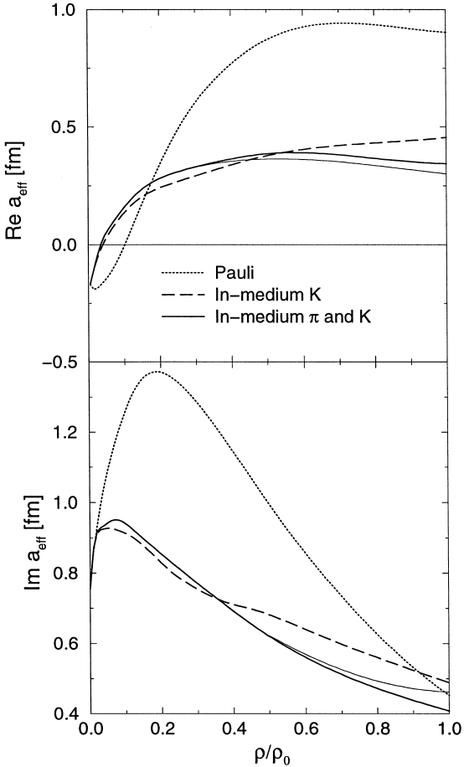
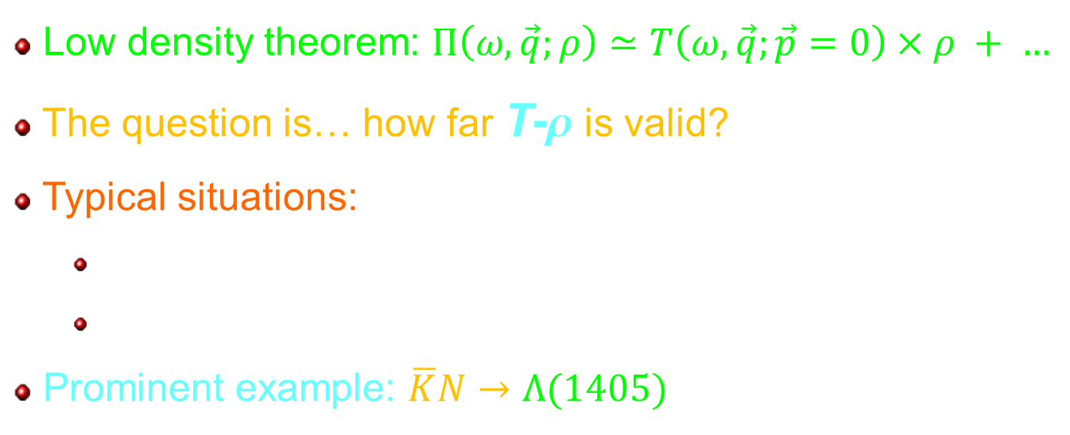
KN and KN scattering in hot nuclear medium
A basic result from many-body theory…
Low density theorem: $Π\left(ω,\vec{q};ρ\right)≃T\left(ω,\vec{q};\vec{p}=0\right)×ρ + …$
The question is… how far T-r is valid?
Typical situations:
  Resonances close to threshold
  Very narrow states
Prominent example: $\overline{K}N→Λ(1405)$
  Interaction turns rapidly from repulsive to attractive already from very low nuclear densities
Other systems: w, f, open charm
Oset, Ramos, NPA671 (2000) 481

Slide 13
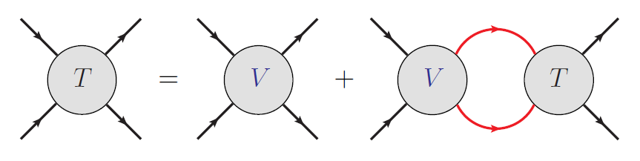

KN and KN scattering in hot nuclear medium
Selfconsistent and unitary coupled-channel approach
Vacuum
G
Baryons: Pauli blocking and potential dressing
$$𝒯_{ij} = V_{ij} + V_{il} G_{l} 𝒯_{lj}$$
Medium
G
$$𝒯_{ij}\left(ρ,T\right) = V_{ij} + V_{il} G_{l}\left(ρ,T\right) 𝒯_{lj}(ρ,T)$$
=
Meson selfenergy and spectral function
$$Π$$
T

Slide 14
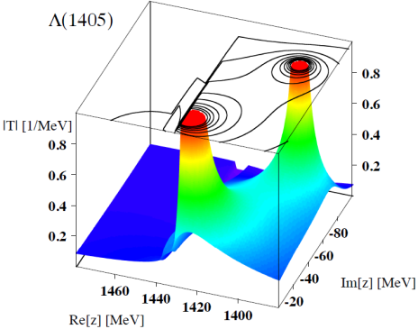
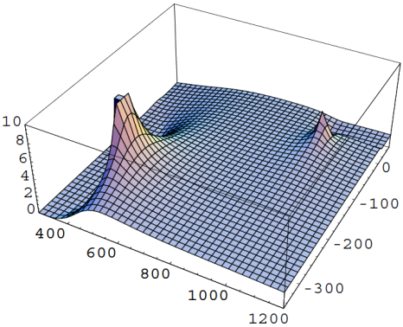
KN and KN scattering in hot nuclear medium
A word about Chiral Unitary Theory
M
M
  ChPT: amplitudes valid at low energies
  Resonances: singularities of T
  Restoring unitarization
    Reach higher energies and temperatures
    Dynamically generated resonances
    Few parameters (predictive!)
  Coupled channels!
W T
M’
B
L(1405)
Hyodo, Jido, Prog. Part. Nucl. Phys 67 (2012) 55
Unitarization schemes:
On-shell Bethe-Salpeter eq.
Inverse Amplitude Method
N/D method
Dispersion relations
s
f₀(980)
Ollet, Oset, Pelaez, Phys.Rev. D59 (1999) 074001; Phys. Rev. Lett. 80 (1998) 3452

Slide 15
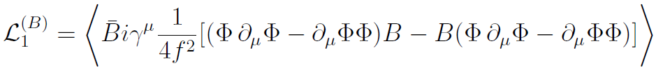
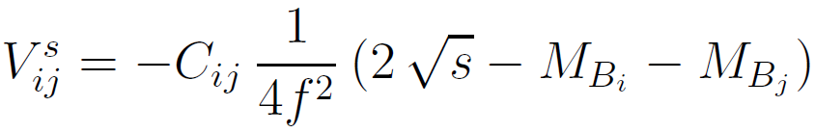


KN and KN scattering in hot nuclear medium
Particularly, for $\overline{K}N$, $KN$
S= -1: KN, pS, hL, KX (I=0); KN, pL, pS, hS, KX (I=1)
S=+1: KN (I=0,1)
Chiral SU(3) Lagrangian
S-wave meson-baryon potential
Bethe-Salpeter equation
Finite-temperature calculation: Imaginary Time Formalism (ITF)
L. Tolós, A. Ramos, A. Polls, PRC 65, 054907 (2002)
L. Tolós, A. Ramos, T. Mizutani, PRC 77, 015207 (2003)
L. Tolós, D.C., A. Ramos, PRC78, 045205 (2008)

Slide 16
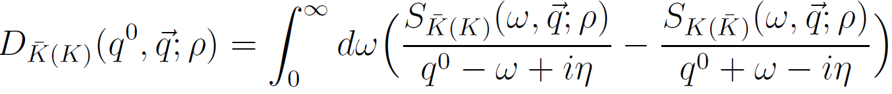
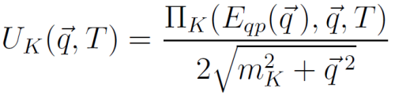
$K$, $\overline{K}$ and L(1405) in hot and dense matter
Reminder…
Spectral function:
Meson propagator [Källen-Lehmann spectral representation]:
Quasi-particle energy:
Nuclear optical potential:

Slide 17
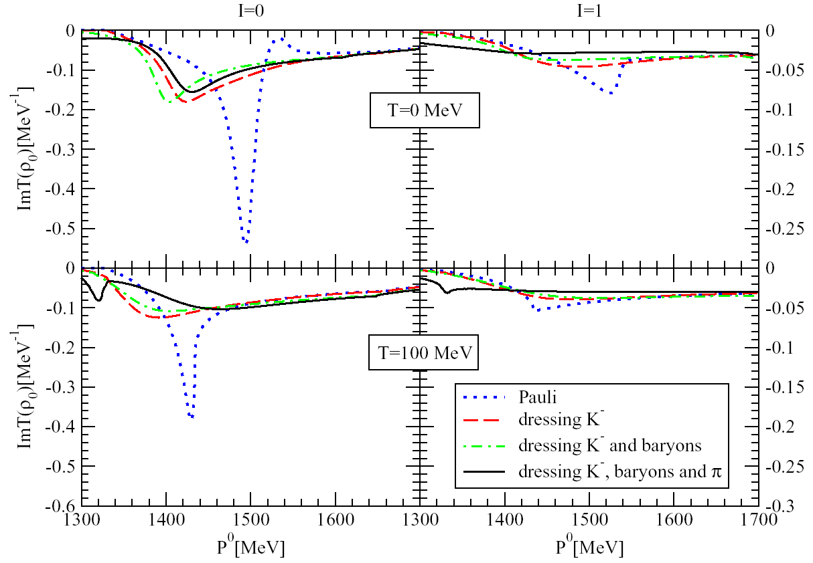
$K$, $\overline{K}$ and L(1405) in hot and dense matter
$\overline{K}N$: L(1405) dynamically generated and medium properties
T = 0
(vac)
L(1405)
T = 100 MeV
L. Tolós, D.C., A. Ramos, PRC78, 045205 (2008)

Slide 18
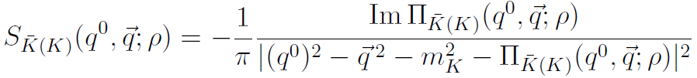
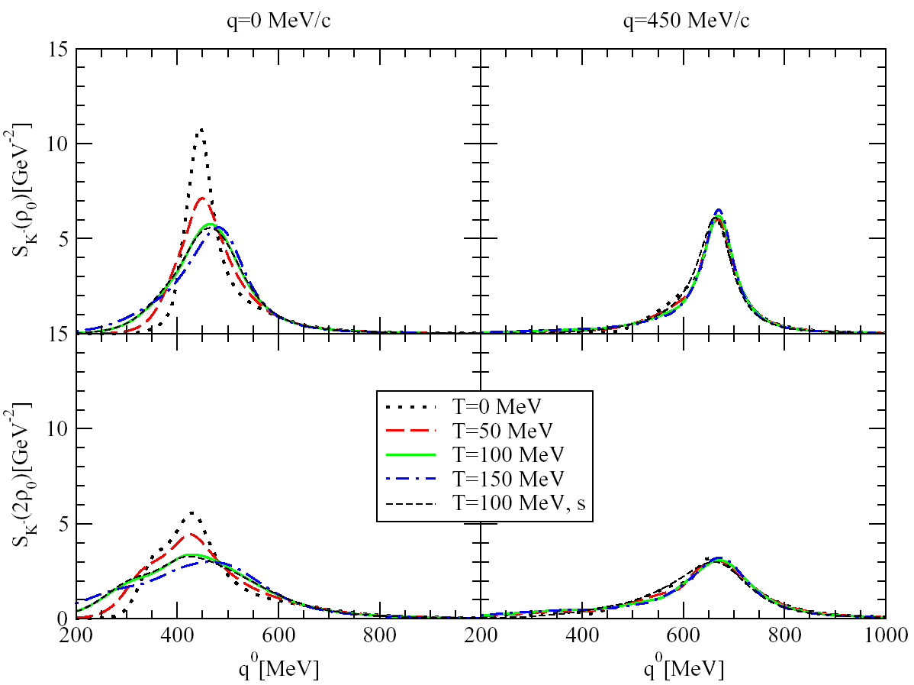
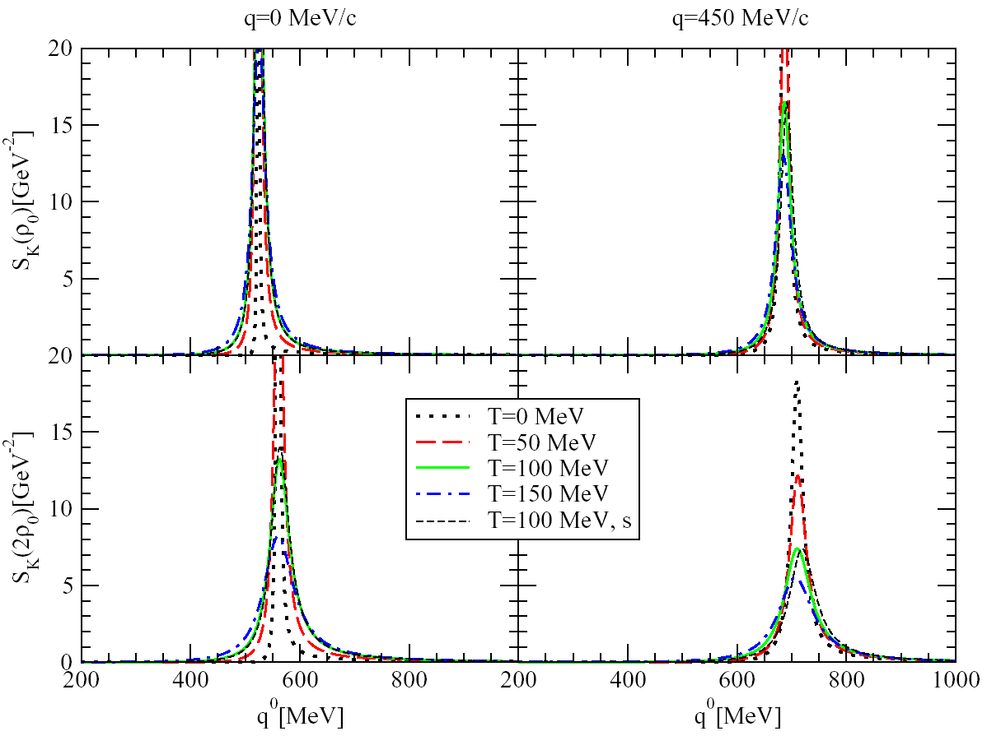

$K$, $\overline{K}$ and L(1405) in hot and dense matter
Anti-kaon and kaon spectral function
L. Tolós, D.C., A. Ramos, PRC78, 045205 (2008)
r₀
r₀
L(1405)h
qp
Yh
2r₀
2r₀
  Results from different groups agree (up to p-waves)
  E.g. Lutz, Korpa, Möller, Nucl.Phys. A808 (2008) 124
  Hadronic input for (off-shell) transport: strangeness in HICs!
See, e.g., Hartnack, Oeschler, Leifels, Bratkovskaya, Aichelin, Phys. Rept. 510 (2012) 119

Slide 19
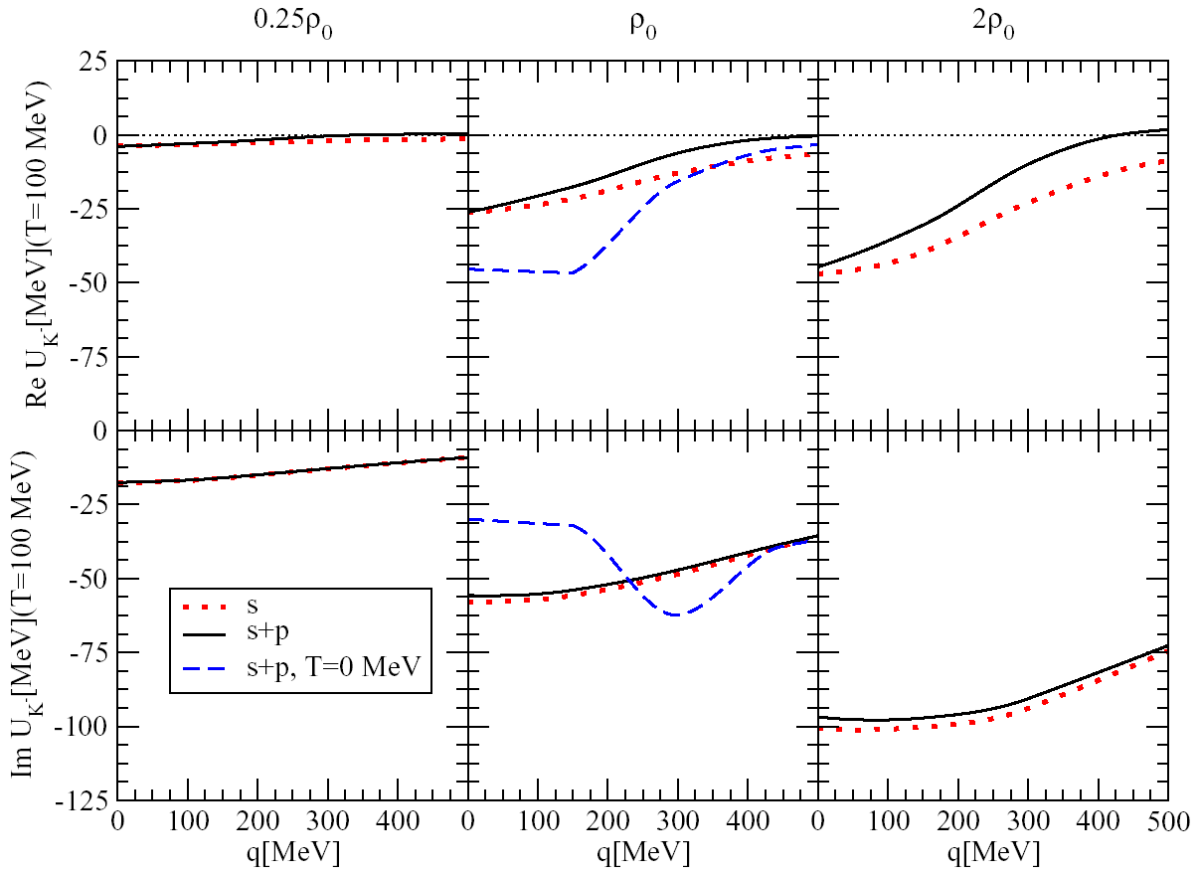
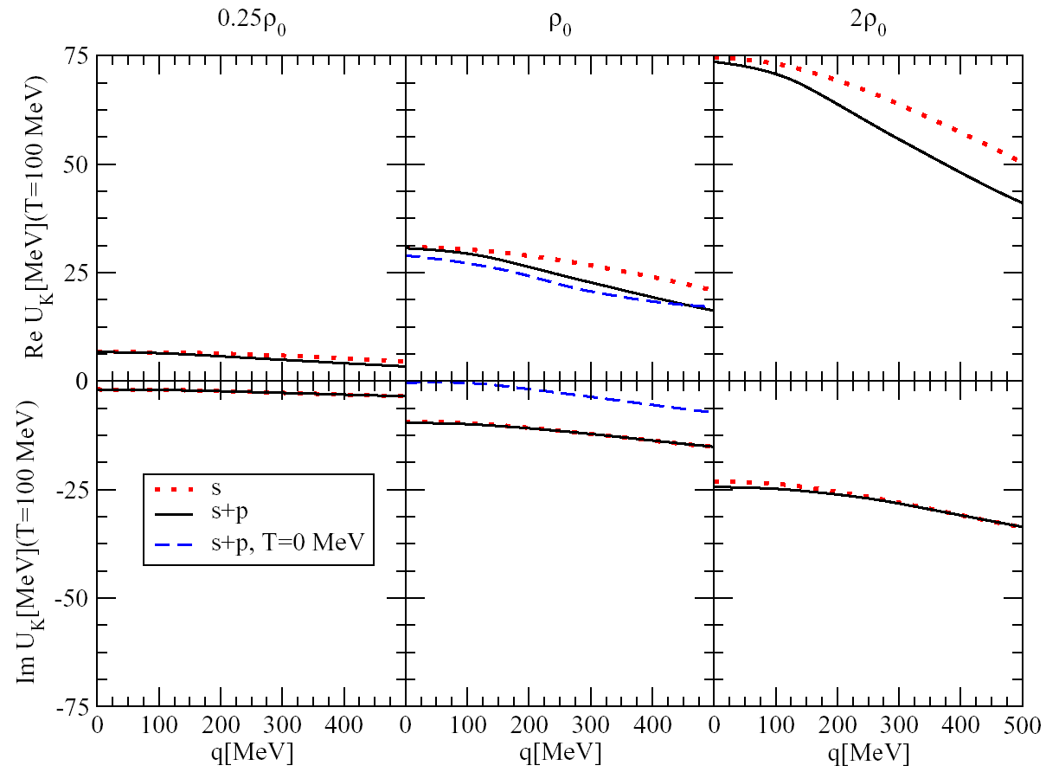
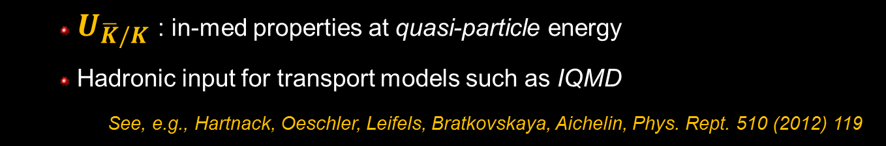
$K$, $\overline{K}$ and L(1405) in hot and dense matter
Anti-kaon and kaon nuclear optical potential
T = 100 MeV
T = 100 MeV
L. Tolós, D.C., A. Ramos, PRC78, 045205 (2008)
  $U_{\overline{K}/K}$ : in-med properties at quasi-particle energy
  Hadronic input for transport models such as IQMD
  See, e.g., Hartnack, Oeschler, Leifels, Bratkovskaya, Aichelin, Phys. Rept. 510 (2012) 119

Slide 20
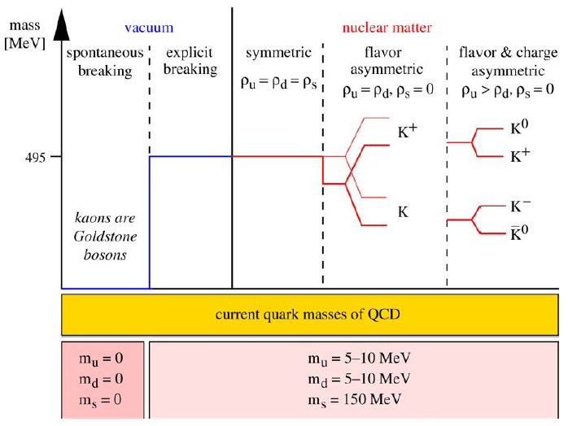



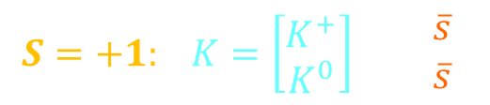
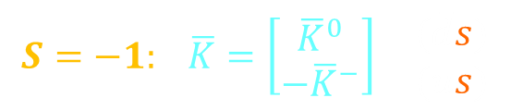

Strange vector mesons: $K^{∗}$, ${\overline{K}}^{∗}$, f
$K^{∗}≡$ $K^{∗}(892)$
$$S=−1: \overline{K}=\left[\begin{matrix}{\overline{K}}^{0} \\ {−\overline{K}}^{−}\end{matrix}\right] \begin{matrix}(\overline{d}s) \\ (\overline{u}s)\end{matrix}$$
$$S=+1: K=\left[\begin{matrix}K^{+} \\ K^{0}\end{matrix}\right] \begin{matrix}(u\overline{s}) \\ (d\overline{s})\end{matrix}$$
$\overline{K}$ / $K$: $I\left(J^{P}\right)=1/2(0^{−})$
f$(s\overline{s})$: $I\left(J^{P}\right)=0(1^{−})$
${\overline{K}}^{∗}$ / $K^{∗}$: $I\left(J^{P}\right)=1/2(1^{−})$
C. Fuchs, Prog. Part. Nucl. Phys. 56 (2006) 1

Slide 21
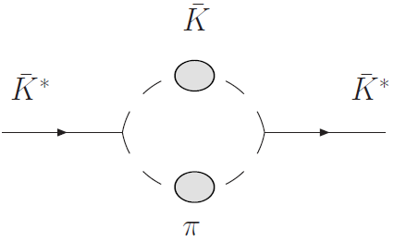
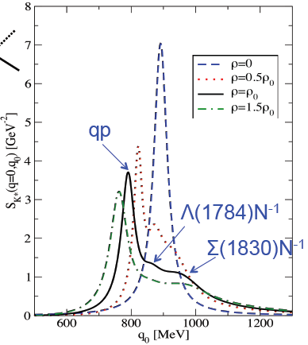
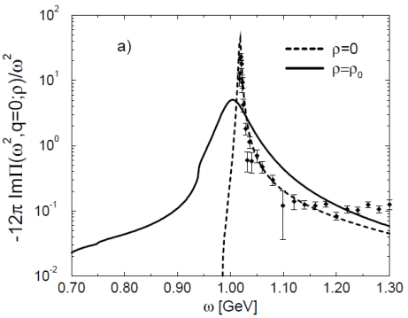


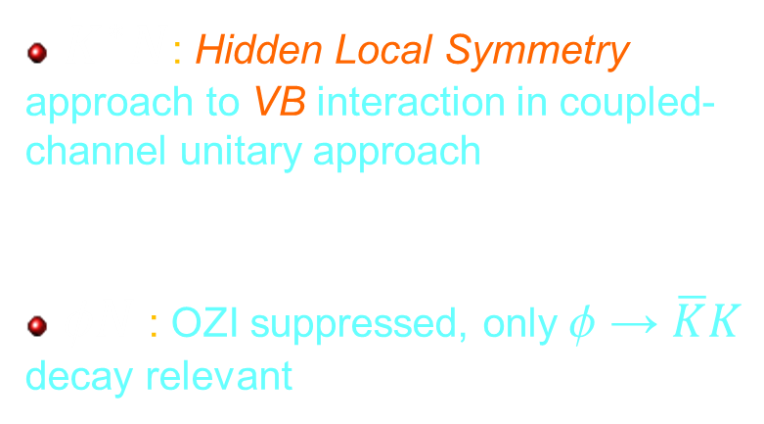

Strange vector mesons: $K^{∗}$, ${\overline{K}}^{∗}$, f
Collisional selfenergy plus in-medium decay
$$K^{∗}$$
+
T
$$N$$
${\overline{K}}^{∗}N$: Hidden Local Symmetry approach to VB interaction in coupled-channel unitary approach
f$N$ : OZI suppressed, only f → $\overline{K}K$ decay relevant
$${\overline{K}}^{∗}$$
Bando et al 1995; Harada and Yamawaki 2003; Meissner 1988
Tolos et al, PRC82 (2010)
f
Ko et al. PRC45 (1992) 1400
Klingl, Kaiser, Weise, NPA 624 (1997) 527
Oset, Ramos, Nucl.Phys. A679 (2001) 616
DC, Vicente-Vacas, Phys.Rev. C67 (2003) 045203
Klingl, Waas, Weise, PLB 431

Slide 22
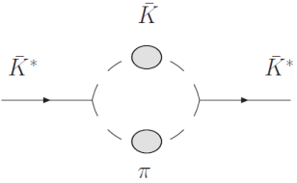
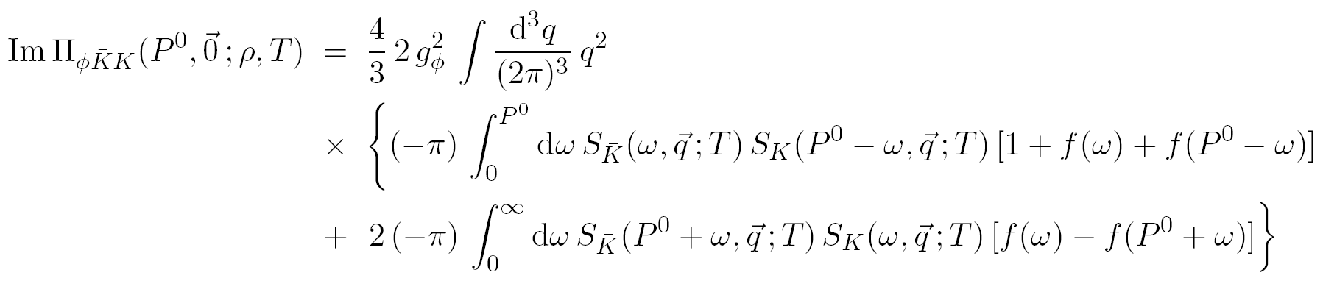
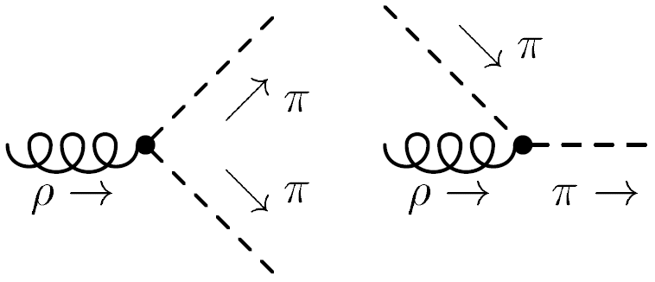
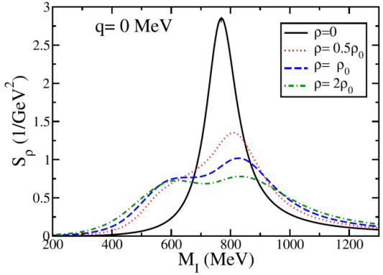




Strange vector mesons: $K^{∗}$, ${\overline{K}}^{∗}$, f
Medium effects in decay channel: the two-meson cloud
“Stimulated” (Bose enhanced) decay
Diffusion term (low energy)
$$\overline{K}$$
$$K$$
f
$$K$$
f
$$K$$
Pioneering work in hadronic many-body methods:
Chanfray, Schuck,NPA 555 (1993) 329
Herrmann, Friman, Nörenberg, NPA 560 (1993) 411
Urban, Buballa, Rapp, Wambach, Nucl.Phys. A641 (1998) 433
r
Riek, Rapp, Lee, Oh, PLB 677 (2009) 116

Slide 23
Strange vector mesons: $K^{∗}$, ${\overline{K}}^{∗}$, f
f meson width and spectral function in hot/dense matter
A. Ilner, D.C., L. Tolos, E. Bratkovskaya, work in progress
  In-medium open channels: fN → KL(1405); fN → KL, K S, K S*(1385)
  Broadening and sizable population of low energy region of spectral function at FAIR conditions

Slide 24
Strange vector mesons: $K^{∗}$, ${\overline{K}}^{∗}$, f
${\overline{K}}^{∗}$ meson selfenergy in hot/dense matter ($\overline{K}π$ decay)
A. Ilner, D.C., L. Tolos, E. Bratkovskaya, work in progress
  Vacuum width: $Γ_{K^{∗}}≃50$ MeV huge modification in hot medium

Slide 25


Strange vector mesons: $K^{∗}$, ${\overline{K}}^{∗}$, f
${\overline{K}}^{∗}$ vs $K^{∗}$ in hot/dense matter ($\overline{K}π$ vs $Kπ$ decay)
$${\overline{K}}^{∗}$$
$$K^{∗}$$
A. Ilner, D.C., L. Tolos, E. Bratkovskaya, work in progress
  Relatively smaller change of K* ⁰/⁺ , still quite broadened (factor ≈ 2 at r₀)
  Recent: deep sub-threshold K*(892)⁰ in Ar+KCl at 1.76 AGeV (HADES)
  Yield overestimated in transport calculations (UrQMD)
Agakishiev et al (HADES), Eur. Phys. J. A49 (2013) 34
Bass et al, Prog. Part. Nucl. Phys. 41 (1998) 255; Bleicher et al, J. Phys. G 25 (1999) 1859

Slide 26
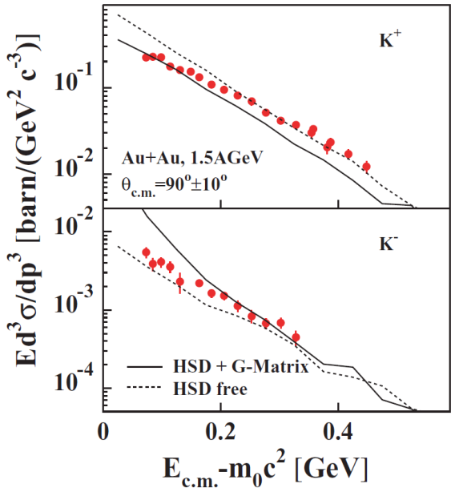
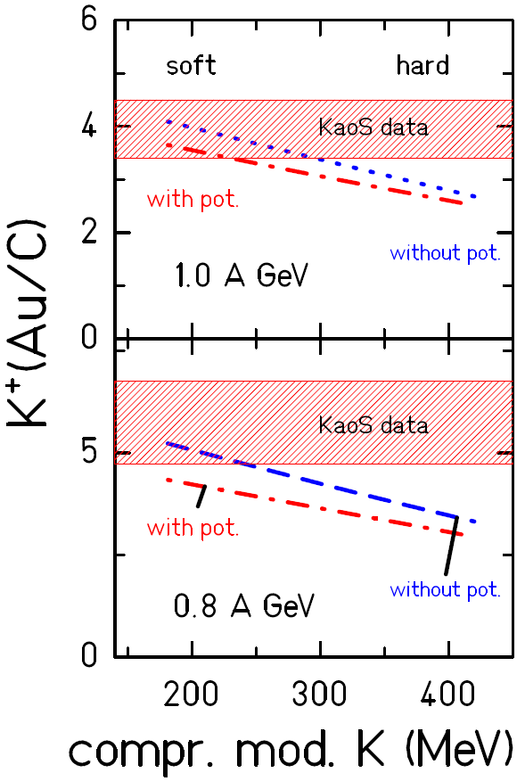

Strange mesons in HIC at GSI/SIS energies (KaoS)
Lessons from exp + transport theory
  K⁺ and K⁻ yields coupled by strangeness exchange reaction: $N↔NΔ↔K^{+}ΛN$ , $πY↔K^{−}N$
  Later emission of K⁻ vs K⁺ (diff. freeze-out conditions)
  K⁺ probes the EoS at high densities (soft)
Förster et al (KaoS), PRC75, 024906 (2007)
  Kaon production in BUU/HSD off-shell transport model within self-consistent coupled channel approach
      Not a complete description of all spectra
      Room for realistic model for kaon spectral function and (relevant) cross sections in hot and dense matter
Cassing, Tolos, Bratkovskaya, Ramos, NPA727 (2003) 59
Work in progress Frankfurt-Barcelona collab.
Hartnack et al, Phys. Rep. 510 (2012) 119

Slide 27
Part 2: Charmed mesons
D meson interaction in matter
D (and B) meson relaxation in hadronic gas

Slide 28



Modelling heavy-meson interactions in the hadron gas
Recent results from transport theory at FAIR: (UrQMD Hybrid)
Interaction:
Lang, van Hees, Steinheimer, Bleicher, arXiv:1305.1797
Heavy-light quark resonant interaction
“quark-hadron” duality

Slide 29

Modelling heavy-meson interactions in the hadron gas
Heavy mesons through hadronic matter
HEAVY MESON transport phenomena (diffusion)
  Produced in early stages: witness full evolution
D = (c $\overline{q}$)
B = (q $\overline{b}$)
  In the hadronic phase: cannot be thermally excited
  Interactions with medium can distort their properties
D, B

Slide 30

Modelling heavy-meson interactions in the hadron gas
QUESTION: how much “memory of the initial state” do heavy quarks loose in their way through the hadronic phase of a heavy-ion collision?
Or, in other words:
  How much do they “relax”, do they become “thermal”?
  What is their relaxation length / time?
  How quickly does their momentum distribution evolves towards that of a gas in thermal equilibrium?

Slide 31


Modelling heavy-meson interactions in the hadron gas
Two key points:
Realistic model for heavy-quark interactions with the hadronic gas constituents
Suitable transport theory approach for heavy-quark diffusion

Slide 32



Modelling heavy-meson interactions in the hadron gas
Set-up of the approach
  Hadronic phase of HIC $≈$ light hadron gas [mostly p’s, also K’s , h’s]
  Effective d.o.f.: HEAVY-FLAVORED MESONS → D, B
  Heavy – light meson interactions → eff. theories of QCD, models
  Propagate off-equilibrium → Transport approach
Legend:
light mesons (pions)
Heavy mesons (D, B)
D = (c $\overline{q}$)
M_{c} = 1.27 GeV ↔ M_{D} = 1.87 GeV
B = (q $\overline{b}$)
M_{b} = 4.67 GeV ↔ M_{B} = 5.28 GeV

Slide 33

Modelling heavy-meson interactions in the hadron gas
Two distinct scenarios…
  $μ_{B}≃0$RHIC, LHC conditions
    Hadronic phase of HIC $≈$ light meson gas [mostly p’s, also K’s , h’s]
  $μ_{B}≠0$ FAIR conditions, production reactions in nuclei
    Hadronic phase of HIC $≈$ hot nuclear matter [p’s… AND N, D, N*…]
Effect of baryons:
See Juan Torres’ talk

Slide 34


Modelling heavy-meson interactions in a hadron gas
D- and B-meson spectra
0⁺
1⁺
1⁺
2⁺
0⁺
1⁺
1⁺
2⁺
1⁻
0⁻
0⁻
1⁻
  D, D* and B, B* mesons as (stable) degrees of freedom
  HQ limit: 4 degenerate heavy-quark modes
  S-wave pion decays pD and pB interaction is RESONANT!!

Slide 35
Modelling heavy-meson interactions in a hadron gas
Models for D (and B) interaction with hadronic medium
Phenomenological approaches
Effective field theory: Heavy-meson ChPT Lutz, Soyeur, NPA813(2008)14; Guo, Hanhart, Meissner, EPJA 40 (2009) 171; Geng, Kaiser, Martin-Camalich, Weise, PRD82 (2010) 054022
    Perturbative expansion of amplitudes (NLO)
    Coupled-channel unitarized approach
He, Fries, Rapp, Phys. Lett. B 701, 445 (2001)
“empirical” scattering amplitudes of D/D* off $π, K, η, ρ, π, K^{∗}, N, Δ$
D/D* off ($π, K, η)$ SU(3) octet + constraints from HQ symmetry
Ghosh, Das, Sarkar, Alam, Phys. Rev D 84, 011503 (2011)
Das, Ghosh, Sarkar, Alam, Phys. Rev D 85, 074017 (2012)
Abreu, DC, Llanes-Estrada, Torres-Rincon, Ann. Phys. 326, 2737 (2011)
Abreu, DC, Torres-Rincon, Phys.Rev. D87 (2013) 3, 034019
See also: Fuchs, Martemyanov, Faessler, Krivoruchenko, PRC73, 035204 (2006)

Slide 36





Modelling heavy-meson interactions in a hadron gas
Role of unitarization
Abreu, DC, Llanes, Torres-Rincon, Annals Phys. 326 (2011) 2737-2772
Abreu, DC, Torres-Rincon, Phys.Rev. D87 (2013) 3, 034019
Dp
D*p
D₀(2400)
D₁(2427)
Bp
B*p
B₀(??)
B₁(??)
Kolomeitsev, Lutz, PLB 582, 39 (2004); Guo et al, PLB 641, 27 (2006); Flynn and Nieves, PRD 75 (2007) 074024

Slide 37

Heavy-meson transport coefficients in a hadron gas
Transport approach for heavy mesons:
  D/B distribution not in equilibrium with the hot hadron gas
  Relax via Boltzmann-Uehling-Uhlenbeck equation
  Small number of heavy mesons
  M_{D/B} >> m_{p}
Fokker-Planck equation
More details:
Juan Torres’ talk

Slide 38


Heavy-meson transport coefficients in a hadron gas
Fokker-Planck equation:
Momentum distribution function
Friction term (“drag force”)
Diffusion term
Collision rate:
  (and similarly for bottomed mesons and other species in the gas)
Isospin-averaged D/D* p amplitude

Slide 39




Heavy-meson transport coefficients in a hadron gas
Drag and Diffusion coefficients at $μ_{B}≃0$: charmed mesons
F
  Phenomenological (He, Fries, Rapp)
  Unitarized ChPT (Abreu, DC, Llanes, Torres)
  Perturbative ChPT (Ghosh, Das, Sarkar, Alam)
  Drag and diffusion strengthened in hotter stages
  Resonant interaction!
  Sizable momentum dependence of G₁ vs G₀
  Sensitivity of anisotropic observables (elliptic flow)
T = 150 MeV

Slide 40


Heavy-meson transport coefficients in a hadron gas
Heavy-quark relaxation lengths and energy loss in p gas
  l = 1 / F - dE/dx = F * p
  At p = 1 GeV/c , T = 150 MeV
State | l (fm) | - dp/dx (MeV/fm)
D | 40 | ≈ 50
B | 100 | ≈ 70
“It is reasonable to expect that the lifetime of the pion gas is smaller than the relaxation time of D and B mesons, meaning that heavy quarks DO NOT completely relax and will carry information from QGP”
“Thus, if the pion gas is in existence for, say, 4 fm, a D meson measured in the final state with a momentum of 800 MeV/c will have been emitted from the quark–gluon plasma phase with 1 GeV/c”

Slide 41



Heavy-meson transport coefficients in a hadron gas
Comparison to other approaches
Effect of baryons:
See Juan Torres’ talk
Resonant interactions!
  Bp total cross section
  B drag coef. F (static)
Unitarization rocks!

Slide 42
Summary
Strange and heavy mesons stand as unique probes for testing strong interactions at FAIR conditions, as long as we understand their dynamics in vacuum and in the hot and dense nuclear medium
A lot of theoretical work is required, within realistic approaches to interactions in the hadronic gas, in connection with experimental information
Transport simulations with the input of such realistic, in-medium interactions may help understand the production and propagation of strangeness and charm in HICs
It is a very exciting moment!

