Slide 1
Triplet Based Online Track Finding in the PANDA-STT

Slide 2
Outline
Introduction
PANDA Detector
Straw Tube Tracker (STT)
Operating Conditions
Online Tracking Scheme
Concept
Tracking Algorithms
Triplet Finder
Concept
Processing of Axial and Skewed Straws
Monte Carlo Benchmarking
Results
GPU Implementation
Summary

Slide 3
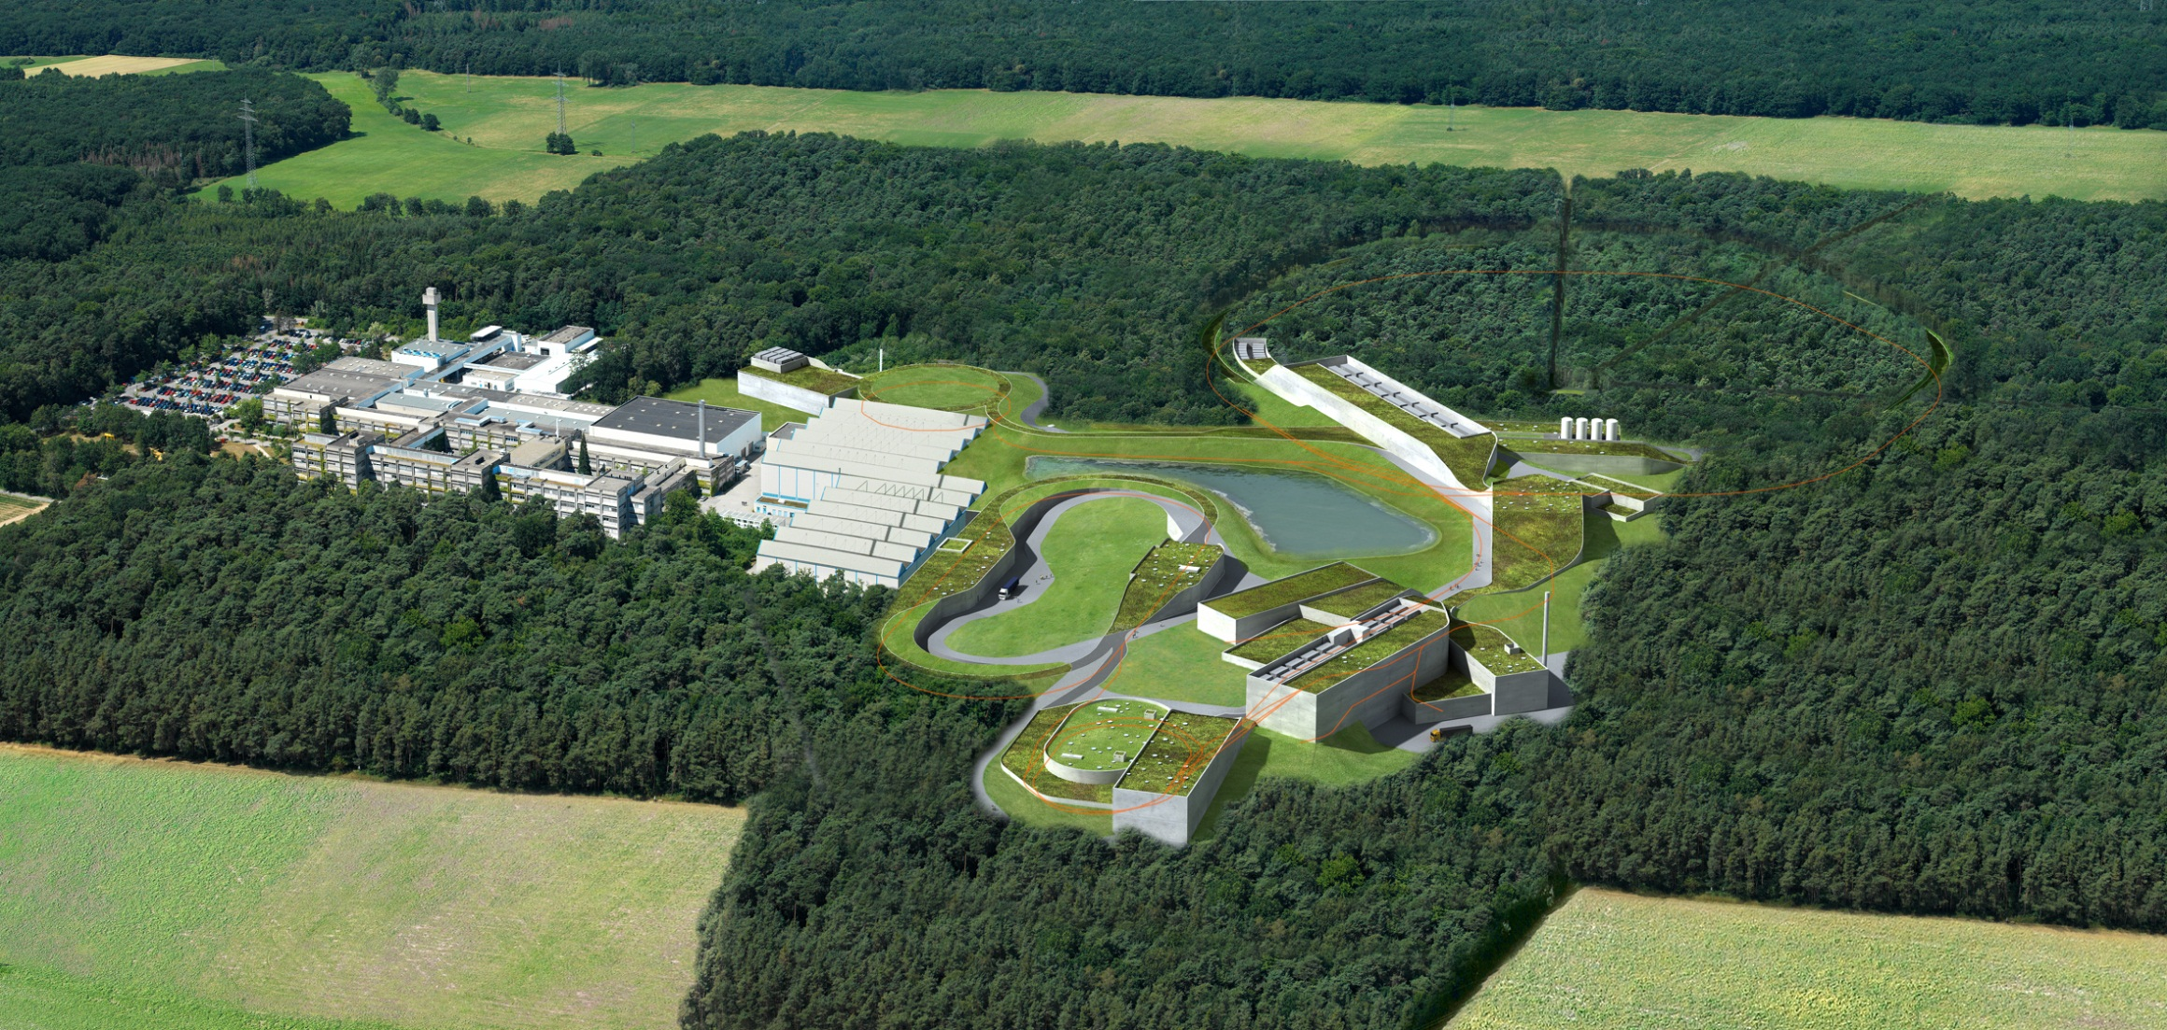
Future FAIR Facility in Darmstadt
PANDA
Antiproton – Proton fixed target experiment in the charm mass energy region

Slide 4
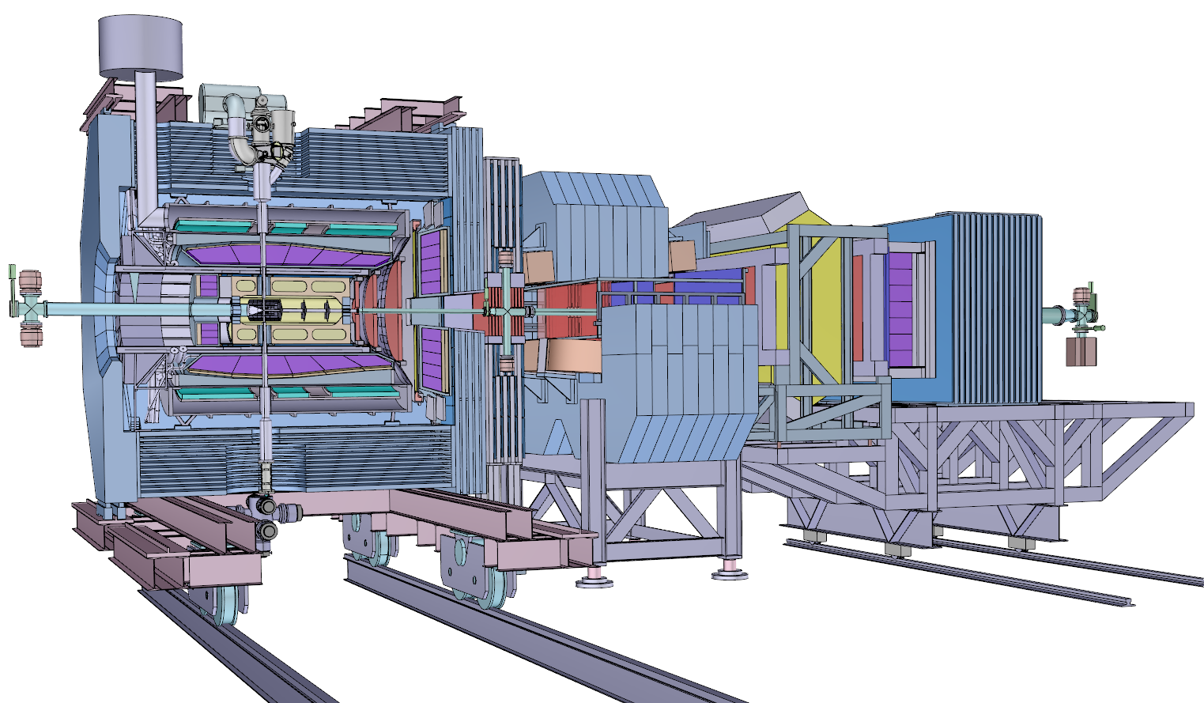
PANDA Detector
Fixed proton target:
Pellet or cluster jet
Interaction point
Antiproton beam
13 m

Slide 5
PANDA Detector
Micro Vertex Detector
Straw Tube Tracker
PANDA: Rare channels, high rates (2·10⁷ evts/s)
Similar topology of signal and background
No simple event selection criteria with high suppression potential
Online event filter instead of traditional trigger
Most signal channel selections require online tracking information
13 m

Slide 6
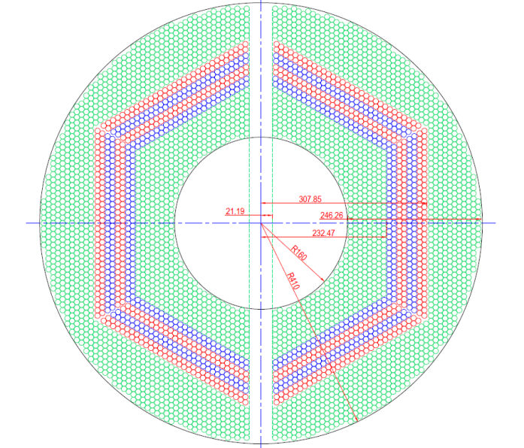
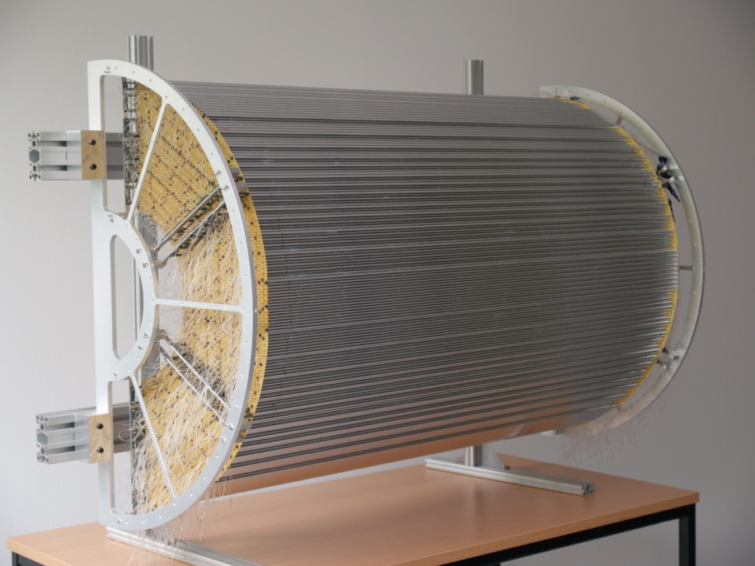
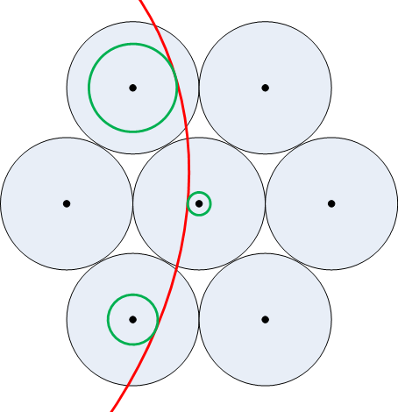
Straw Tube Tracker
Straw = cylindrical drift chamber
4636 straws in 20 – 27 layers
Close packed axial layers
Skewed layers (±3°) for z reconstruction
Total weight: 15 kg
Total radiation length: 1.2 %
84 cm
isochrones
t_{drift} = t_{hit} – t₀
1 cm
150 cm

Slide 7
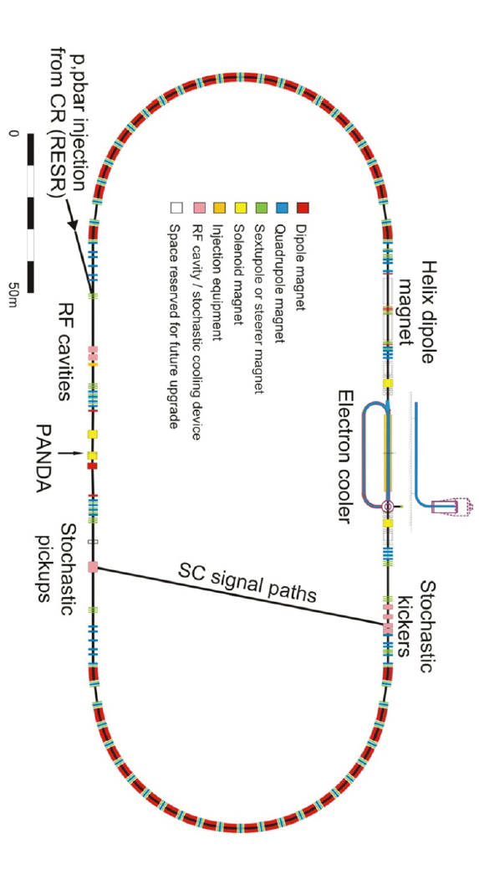
PANDA Operating Conditions
Gap estimate:
Barrier Bucket: 80% Filling
HESR length: 575 m
Antiproton velocity: ~c
Revolution time: 2000 ns
Gap: 400 ns
Fill/Gap ratio may vary
Events per revolution → Burst:
2·10⁷/s·2 µs = 40

Slide 8
Event Structure
2 · 10⁷ events/s
Blue: MVD Hits
Red: STT Hits
Time based simulation by T. Stockmanns

Slide 9
Online Tracking Scheme

Slide 10
Online Tracking
Detector Hits/Digis
Global scheme specifically designed for PANDA
Triplet Finder
Local Clustering
Calibration
Alignment
…
STT Tracking
Global Tracking
Online Tracking
Information Merging:
PID, etc
Tracks
Further Algorithms:
Hough transform,
Riemann tracker, …
Software Trigger

Slide 11
More (Online) Tracking Algorithms
Algorithm | Comments
Hough Transform, Yutie Liang | FPGA implementation
Hough Transform, Mohammad Al-Turany/Andreas Herten | GPU implementation
Non-Origin Trackfinder, Lia Lavezzi | Focused on offline, online application(?)
Triplet Finder, MCM | No isochrone info required, online
Track Segment Finder + Linker, Sean Dobbs | Template based
Fast Combinatorial Finder / Fitter, Sean Dobbs | Based on CLEO‘s SOLO
Forward Hough, Martin Galuska | Focused on offline, applicable for online
Riemann Tracker, Tobias Stockmanns | Focused on offline, online application(?)
Global Tracking in PandaRoot, Gianluigi Boca | Focused on offline
Neural networks pattern reco, Pablo Genova | Focused on offline, applicable for online
Riemann Tracker, Andreas Herten | GPU implementation
Triplet Finder, Andrew V. Adinetz | GPU implementation

Slide 12
Track Information Storage / Algorithm Interplay
Connection of hits to tracks
Ideal storage for these connections?
Desired parameters to store?
Override old values? Store list?
Parameters for assigned hits/tracks
Unassigned
Low quality – Veto value close to threshold
Mid quality
High quality – additional quality criterion passed
Multi algorithm confirmed quality

Slide 13
Triplet Finder

Slide 14
Triplet Finder Concept
Focus on mathematical simplicity → Fast and robust
No isochrone information used → Does not require t₀ or radius-drifttime calibration
Can provide t₀ seed for selected tracks (hit timestamp constraints, matching with other detectors)
Three step operation:
Identification of hit Triplets (or n-lets) around pivot straws
3 point circle calculation: Origin + 2 Triplets
Hit association via circle proximity

Slide 15
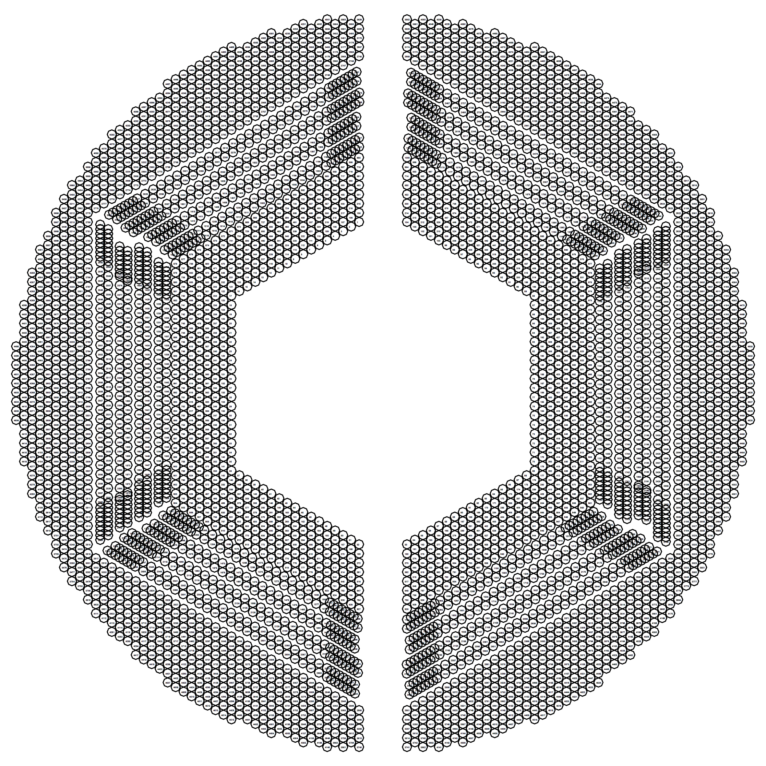
STT Geometry in PandaRoot
Axial pivot straws indicated
in one sector (red)
Skewlet layers indicated
in one sector (orange)
Axial Straws:
Triplets are generated around pivot straws
Skewed Straws:
Half-Skewlets are generated per skewed double layer (analog to Triplets in the axial layers)
Half-Skewlets of oppositely skewed double layers above and below Skewlet layer are combined to (full) Skewlets → 3D spatial information

Slide 16
Triplet Finding in Axial Straws
Pivot straw is checked for hit
Surrounding straws are checked for hits
Center of mass of fired straws is calculated (small number of combinations → suitable for lookup table)
Pivot straws

Slide 17
Event Time Constraining
t₀ constraining concept for Triplets and tracks:
Pivot straws
t₁
t₃
t₂
220 ns

Slide 18
Triplet Finding in Axial Straws
Once two triplets are found, calculate circle through origin
Associate nearby hits with track candidate
Track Verification:
Currently mix of curvature and number of associated hits
Lots of room for improvement
Further possibilites:
Distance sorting, Concurrent associations, Clutter veto, …
Missing straw compensation: Pivot straw triggered by neighbor straws
Weight hits within triplet according to timestamp
Pivot straws
Pivot straws
Interaction Point

Slide 19
Triplet Finding in Axial Straws
Once two triplets are found, calculate circle through origin
Associate nearby hits with track candidate
Track Verification:
Currently mix of curvature and number of associated hits
Lots of room for improvement
Further possibilites:
Distance sorting, Concurrent associations, Clutter veto, …
Missing straw compensation: Pivot straw triggered by neighbor straws
Weight hits within triplet according to timestamp
Pivot straws
Pivot straws
Interaction Point

Slide 20
Triplet Finding in Axial Straws
Once two triplets are found, calculate circle through origin
Associate nearby hits with track candidate
Track Verification:
Currently mix of curvature and number of associated hits
Lots of room for improvement
Further possibilites:
Distance sorting, Concurrent associations, Clutter veto, …
Missing straw compensation: Pivot straw triggered by neighbor straws
Weight hits within triplet according to timestamp
Pivot straws
Pivot straws
Interaction Point

Slide 21
Triplet Finding in Axial Straws
Once two triplets are found, calculate circle through origin
Associate nearby hits with track candidate
Track Verification:
Currently mix of curvature and number of associated hits
Lots of room for improvement
Further possibilites:
Distance sorting, Concurrent associations, Clutter veto, …
Missing straw compensation: Pivot straw triggered by neighbor straws
Weight hits within triplet according to timestamp
Pivot straws
Pivot straws
Interaction Point

Slide 22
Triplet Finding in Axial Straws
Once two triplets are found, calculate circle through origin
Associate nearby hits with track candidate
Track Verification:
Currently mix of curvature and number of associated hits
Lots of room for improvement
Further possibilites:
Distance sorting, Concurrent associations, Clutter veto, …
Missing straw compensation: Pivot straw triggered by neighbor straws
Weight hits within triplet according to timestamp
Pivot straws
Pivot straws
Interaction Point

Slide 23
Triplet Finding in Skewed Straws: Skewlets
Triplet search in individual skewed double layers
Combination of adjacent double layers‘ Triplets to Skewlets
Track matching in xy-projection
Extraction of z-information

Slide 24
Triplet Finding in Skewed Straws: Skewlets
Triplet search in individual skewed double layers
Combination of adjacent double layers‘ Triplets to Skewlets
Track matching in xy-projection
Extraction of z-information

Slide 25
Triplet Finding in Skewed Straws: Skewlets
Triplet search in individual skewed double layers
Combination of adjacent double layers‘ Triplets to Skewlets
Track matching in xy-projection
Extraction of z-information

Slide 26
Triplet Finding in Skewed Straws: Skewlets
Triplet search in individual skewed double layers
Combination of adjacent double layers‘ Triplets to Skewlets
Track matching in xy-projection
Extraction of z-information

Slide 27
Triplet Finding in Skewed Straws: Skewlets
Triplet search in individual skewed double layers
Combination of adjacent double layers‘ Triplets to Skewlets
Track matching in xy-projection
Extraction of z-information

Slide 28
Triplet Finding in Skewed Straws: Skewlets
Triplet search in individual skewed double layers
Combination of adjacent double layers‘ Triplets to Skewlets
Track matching in xy-projection
Extraction of z-information

Slide 29
Triplet Finding in Skewed Straws: Skewlets
Triplet search in individual skewed double layers
Combination of adjacent double layers‘ Triplets to Skewlets
Track matching in xy-projection
Extraction of z-information

Slide 30
Triplet Finding in Skewed Straws: Skewlets
Triplet search in individual skewed double layers
Combination of adjacent double layers‘ Triplets to Skewlets
Track matching in xy-projection
Extraction of z-information

Slide 31
Triplet Finding in Skewed Straws: Skewlets
Triplet search in individual skewed double layers
Combination of adjacent double layers‘ Triplets to Skewlets
Track matching in xy-projection
Extraction of z-information

Slide 32
Triplet Finding in Skewed Straws: Skewlets
Triplet search in individual skewed double layers
Combination of adjacent double layers‘ Triplets to Skewlets
Track matching in xy-projection
Extraction of z-information

Slide 33
Monte Carlo Simulation

Slide 34
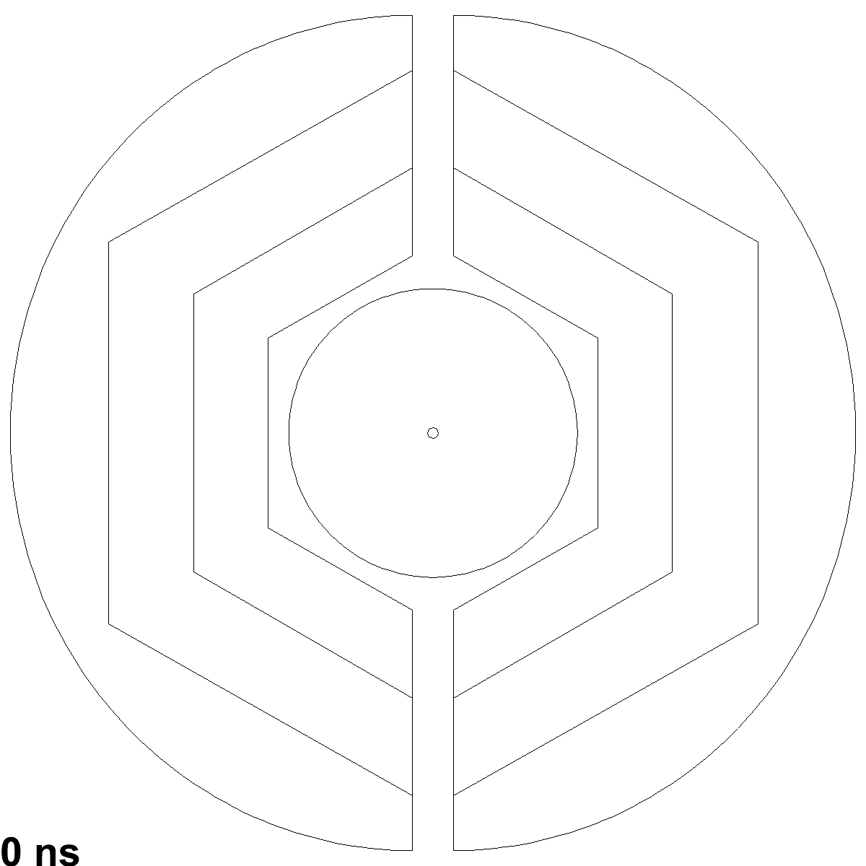
Hitstream Display: 15 GeV/c DPM, 50 ns Mean Time
XY-View
Dual Parton Model (DPM): Standard pp background generator
Black circles: Early isochrone
Blue circles: Early skewed isochrone
Green circles: Close isochrone
Red circles: Late isochrone
Black dots: MVD hits
Green dots: MVD hits r/z > 0.3
Black+Red dots: Triplets/Skewlets
Yellow tracks: Timed out track
Blue tracks: Current track
DPM Benchmark: Realistic event rate and structure, continuous operation

Slide 35
Monte Carlo Benchmarking
Efficiency: Ratio of correctly reconstructed tracks vs. simulated tracks
Purity: Quality of track finder output
Resolution: Deviation of reconstructed observables from MC input for selected tracks (of secondary interest for a track finder → defer to track fitter)

Slide 36
Monte Carlo Benchmarking
Time-based simulation with 50 ns mean time between events
Continuous stream of hits
Realistic event overlaps
Realistic selection of time windows for track finding
BUT: Lots of information which is trivial in event based simulations, is harder to obtain in time based simulations
Benchmark requires careful selection of „reconstructable“ events
Two directions of analysis:
Reconstructable Monte Carlo event input
Complete track finder output

Slide 37
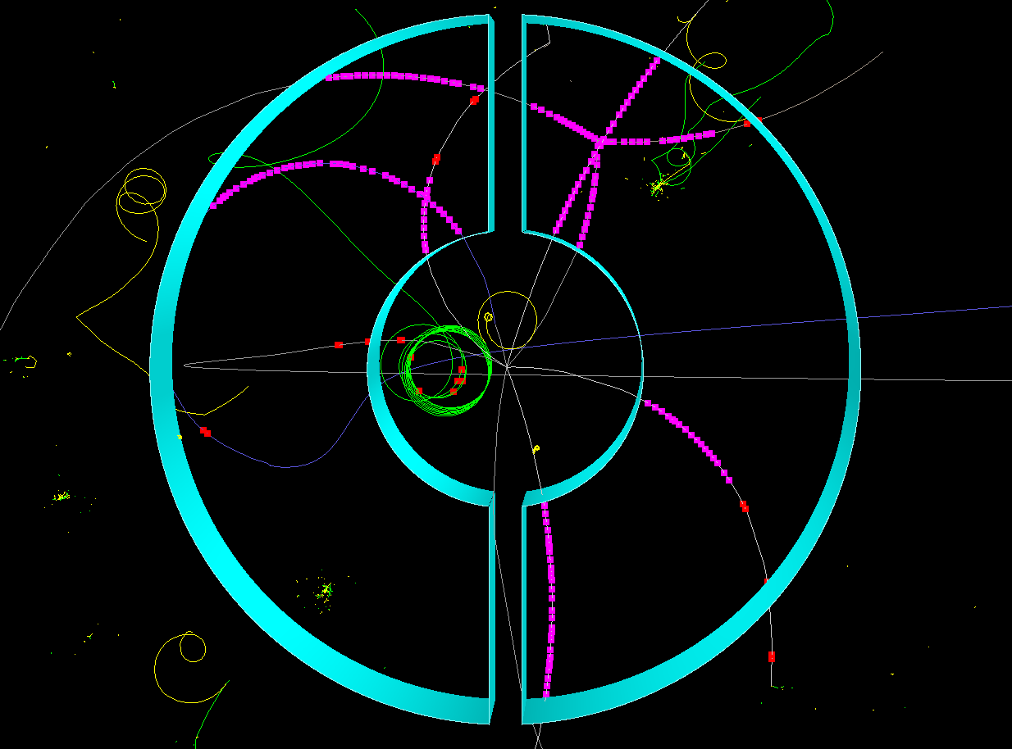

Slide 38
Reconstruction Run Statistics (200 µs of Data)
Total reconstructed track count: 38246
Reached MC ID: 3917
MC Track Grand Total: 1968001
MC Track PDG Code too large: 4987
MC Track Non Prime: 1910598
MC Track Low Momentum: 25341
MC Track Low Pt Hit: 2738
MC Track Low BetaGamma: 5508
Secondary Tracks: 3582
MC Track missed STT: 8822
MC Track to be recoed: 9163
MC Track recoed (all): 6778
MC Track recoed (90): 4787
MC Track recoed (80): 5581
MC Track recoed (bad): 3295
MC Track not recoed: 2385
MC Match Good 90: 15314
MC Match Good 80: 21008
MC Match Bad: 17177
MC Tracks with NULL pointers in Reco: 61
MC Tracks with NULL pointers: 0
Crashes PDG Library
Prime: MC ID -1 and 0
< 60 MeV/c
< 0.4
> 2 cm
Reconstructable MC Tracks
MC Tracks Found

Slide 39
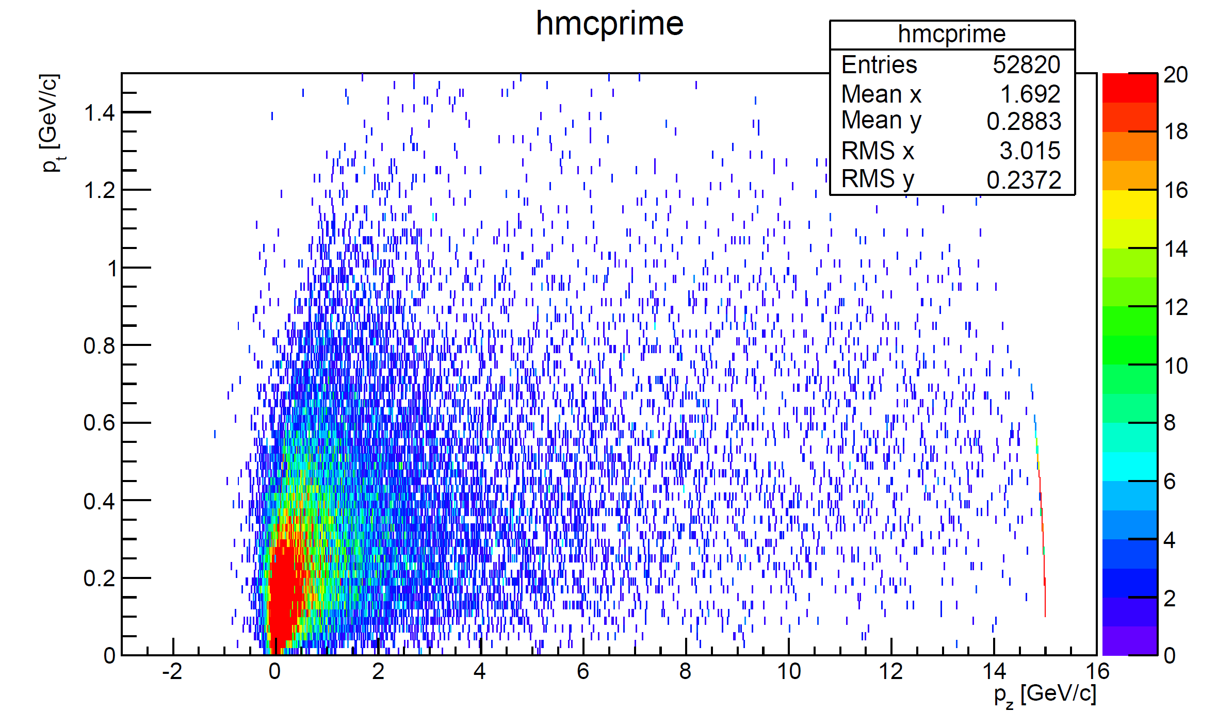
Momentum Distribution – MC „Primes“

Slide 40
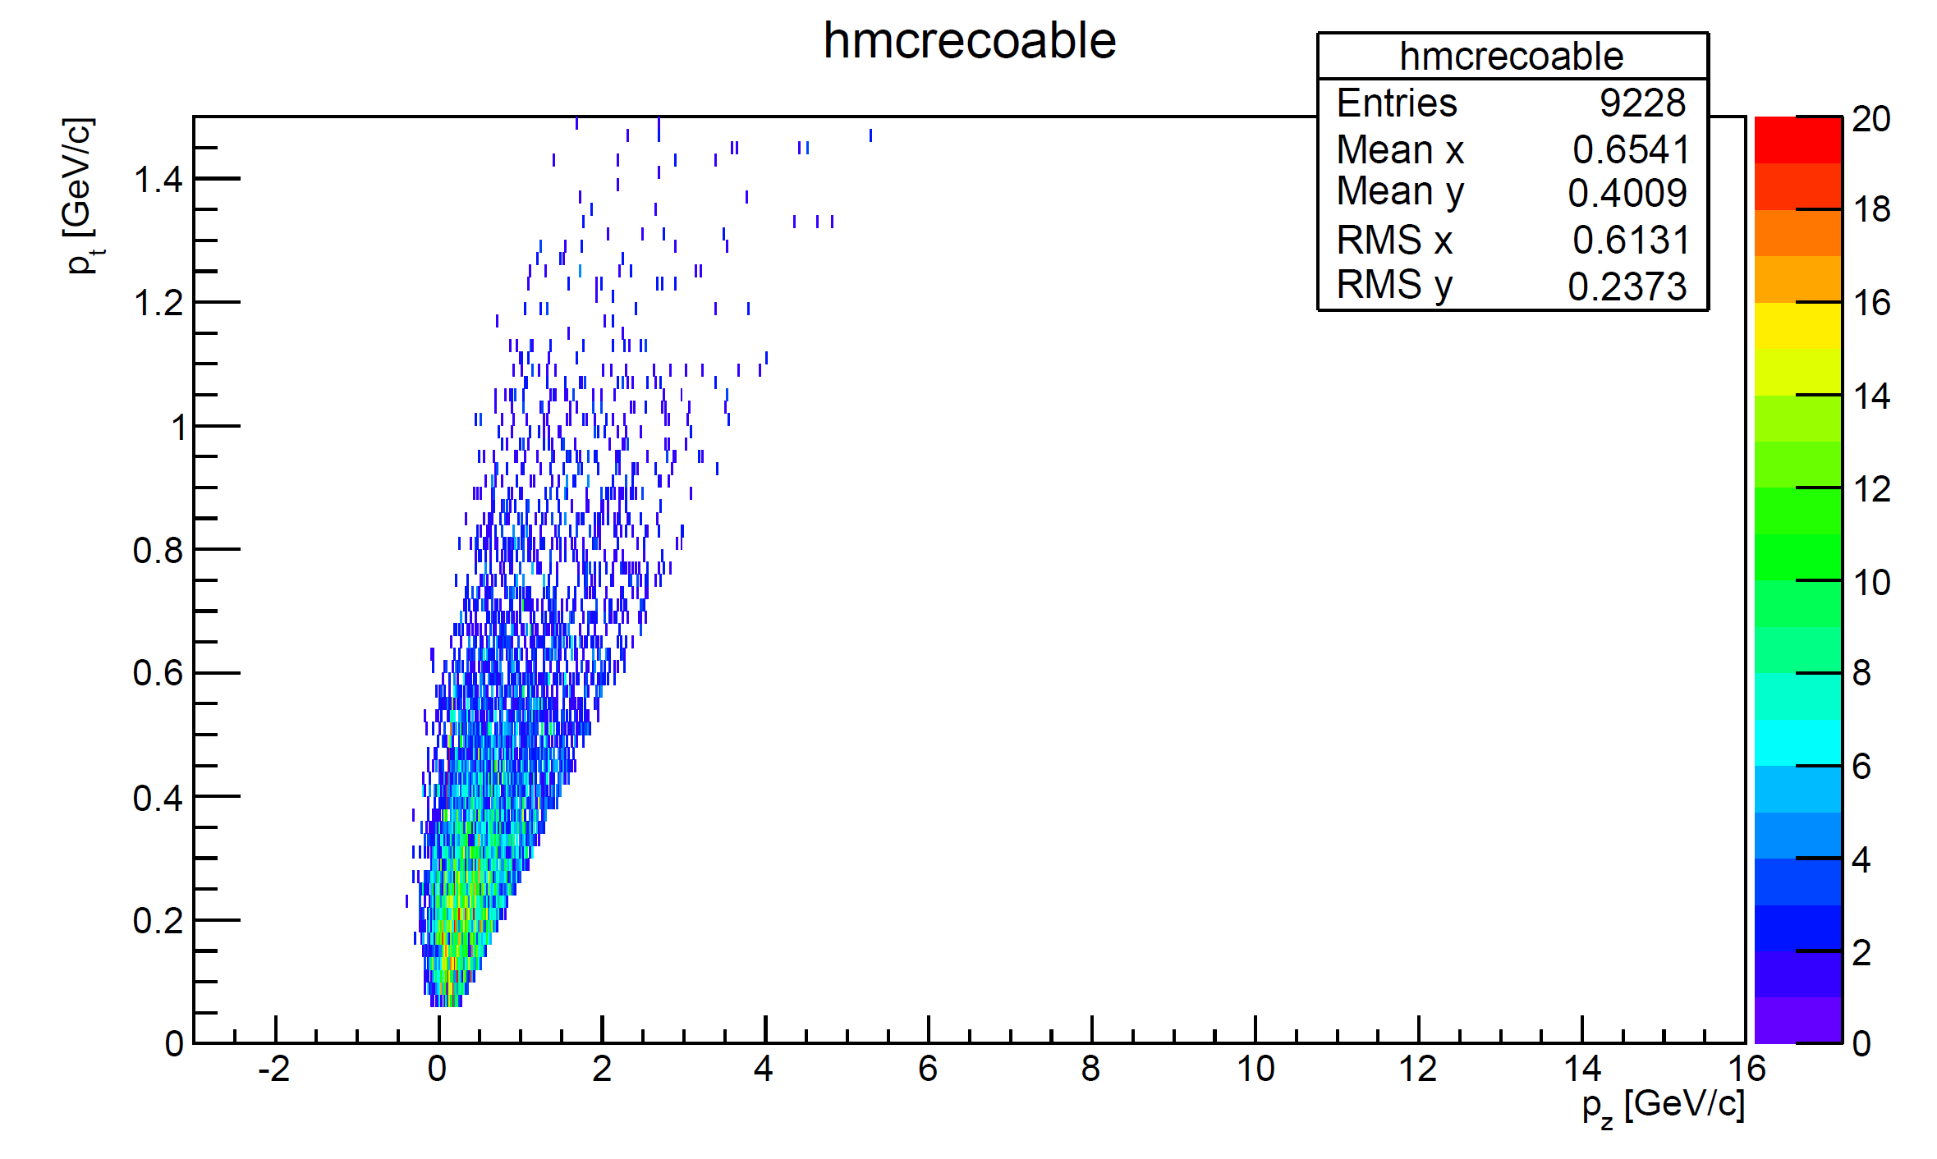
Momentum Distribution – Reconstructable Tracks

Slide 41
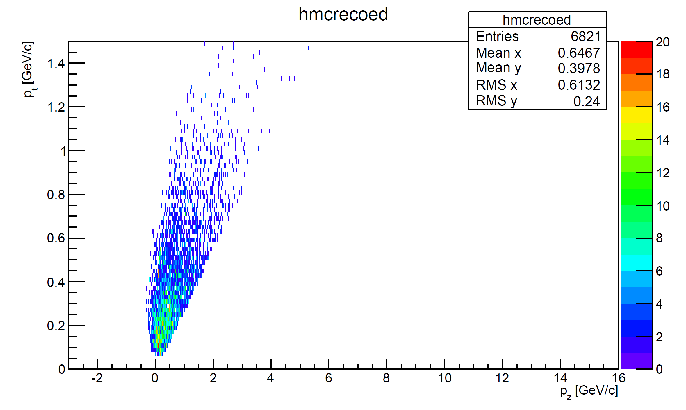
Momentum Distribution – Reconstructed Tracks

Slide 42
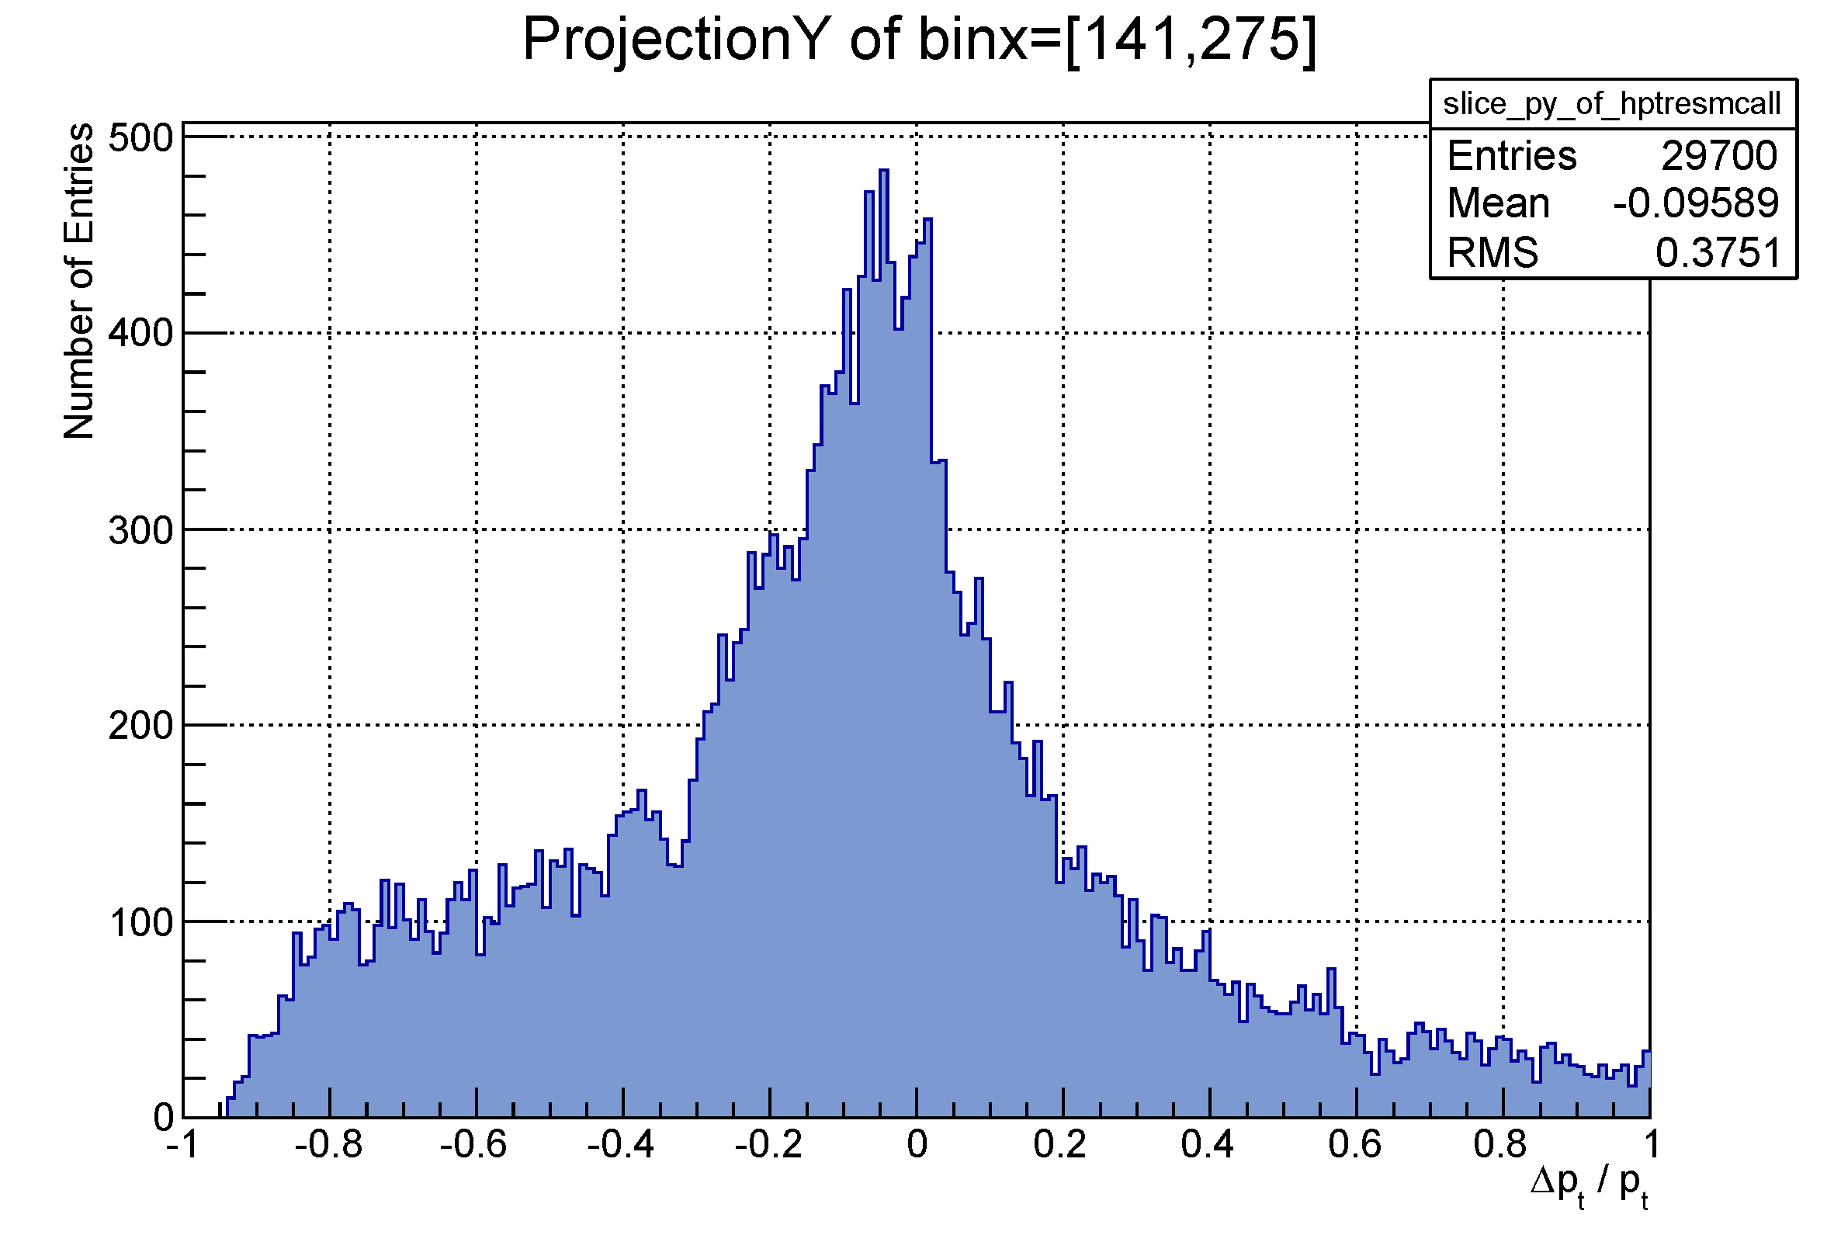
Results: Positive Particles‘ p_{t} (Full Output)
PRELIMINARY
Many low momentum recoil protons

Slide 43
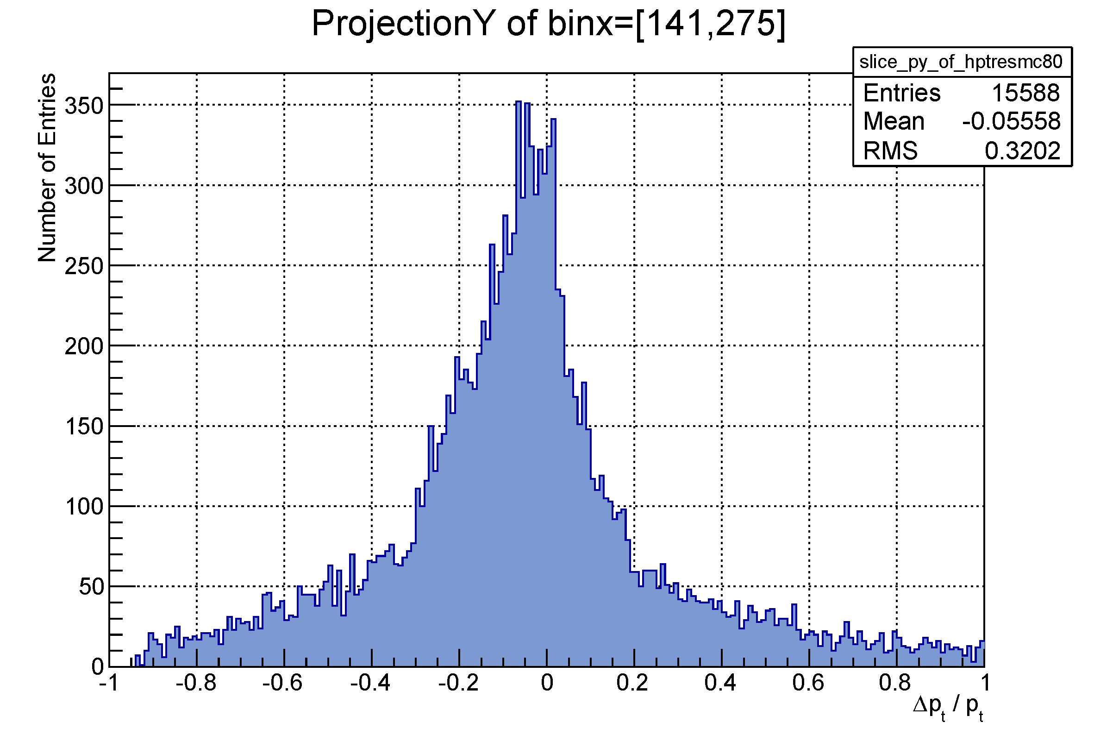
Results: Positive Particles‘ p_{t} (80% Correct Hits)
PRELIMINARY

Slide 44
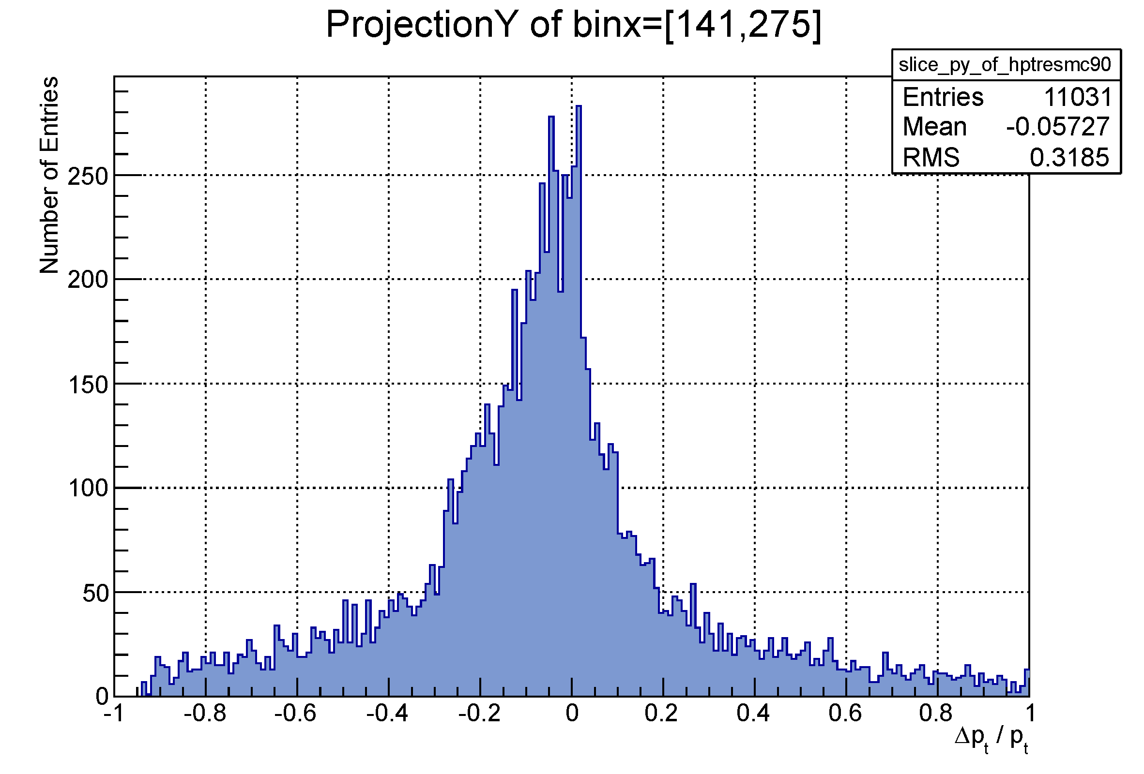
Results: Positive Particles‘ p_{t} (90% Correct Hits)
PRELIMINARY

Slide 45
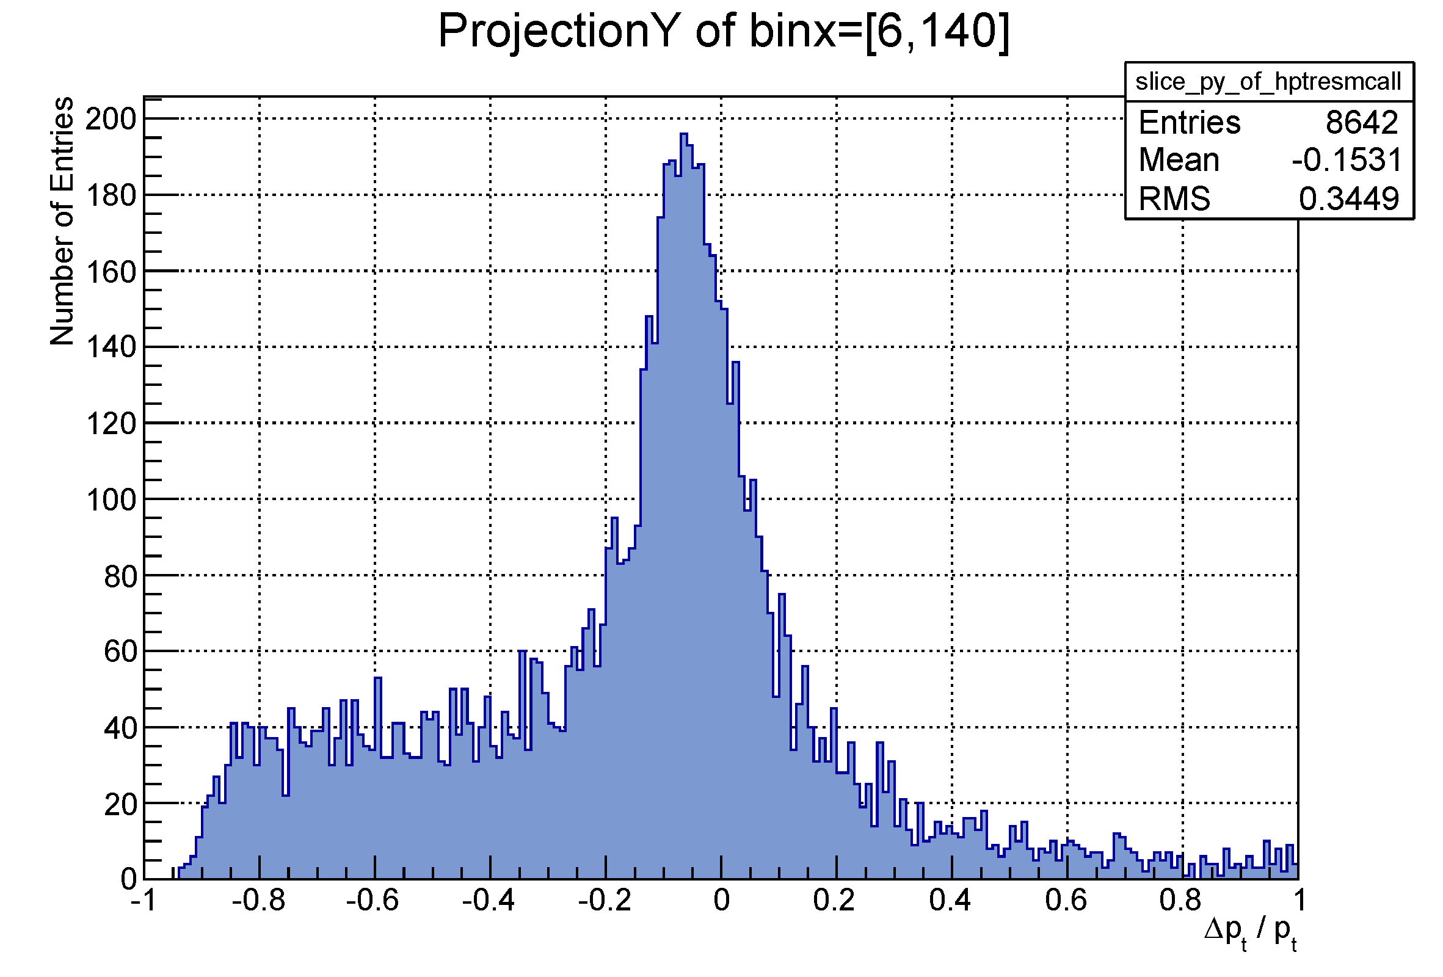
Results: Negative Particles‘ p_{t} (Full Output)
PRELIMINARY

Slide 46
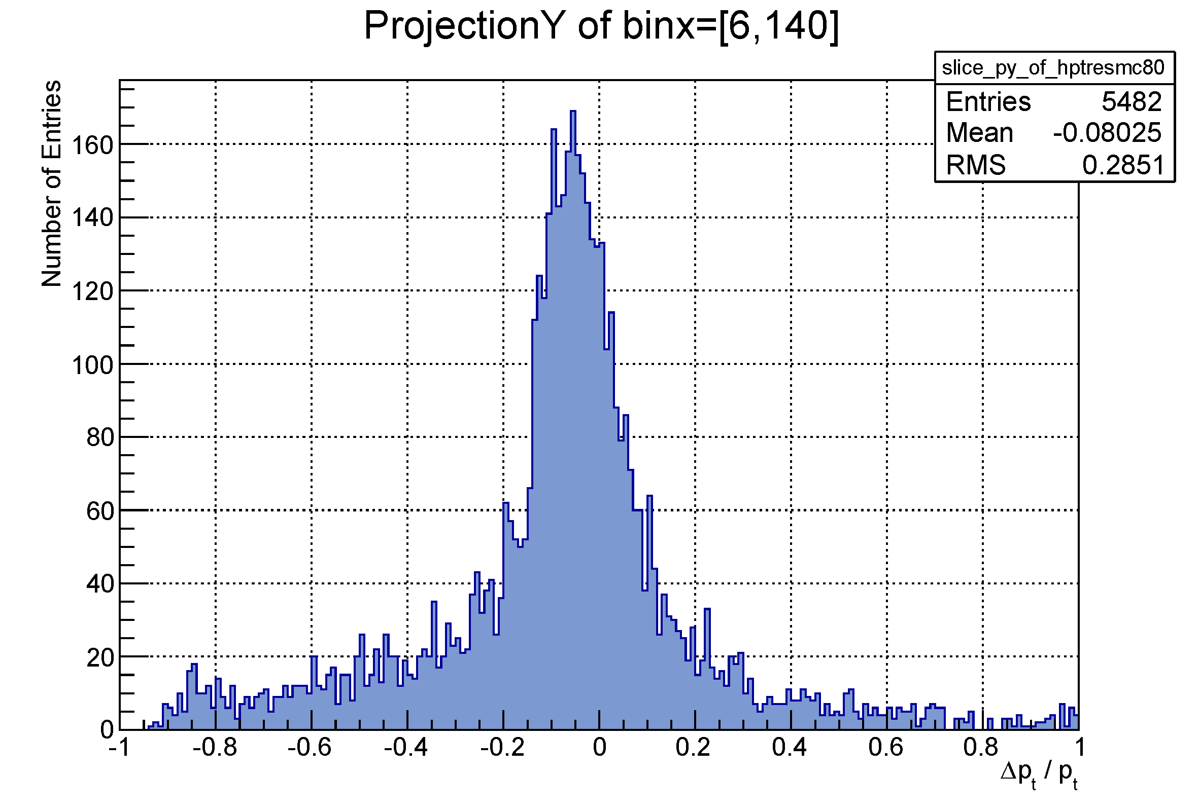
Results: Negative Particles‘ p_{t} (80% Correct Hits)
PRELIMINARY

Slide 47
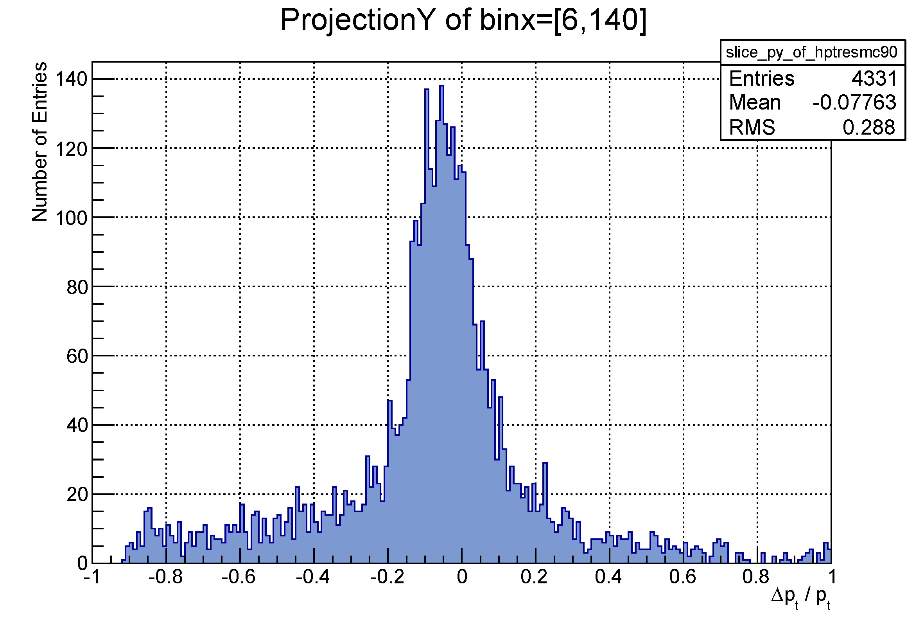
Results: Negative Particles‘ p_{t} (90% Correct Hits)
PRELIMINARY

Slide 48
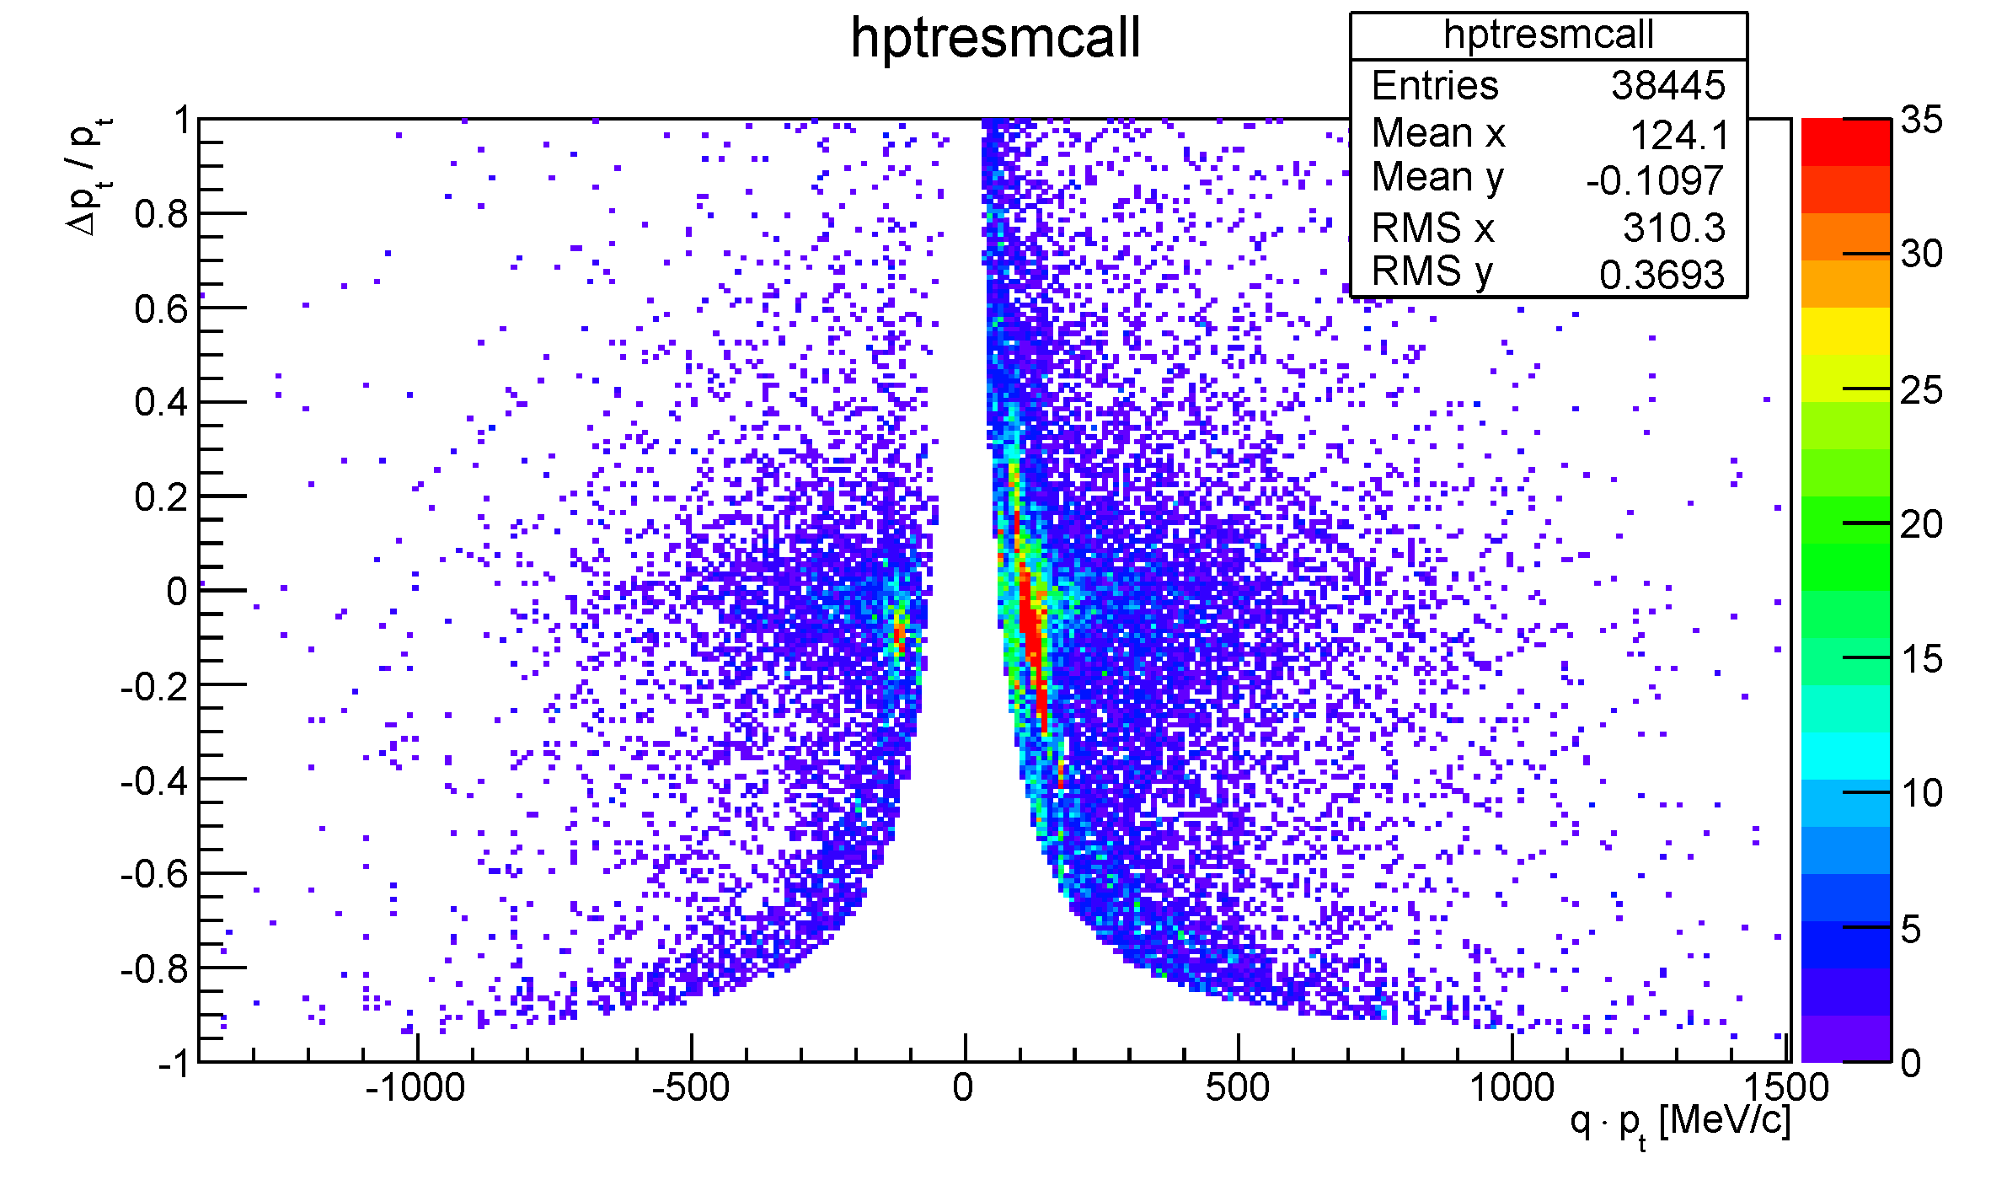
Results: p_{t} Resolution (Full Output)
PRELIMINARY

Slide 49
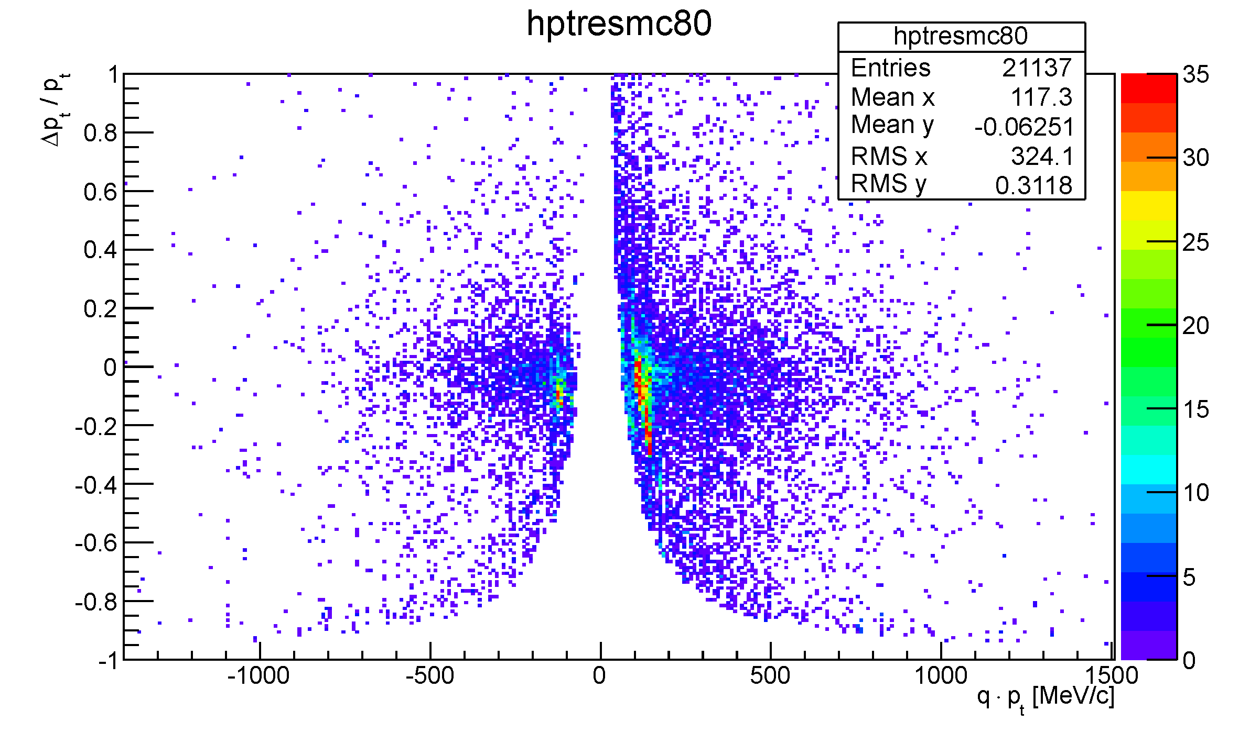
Results: p_{t} Resolution (80% Correct Hits)
PRELIMINARY

Slide 50
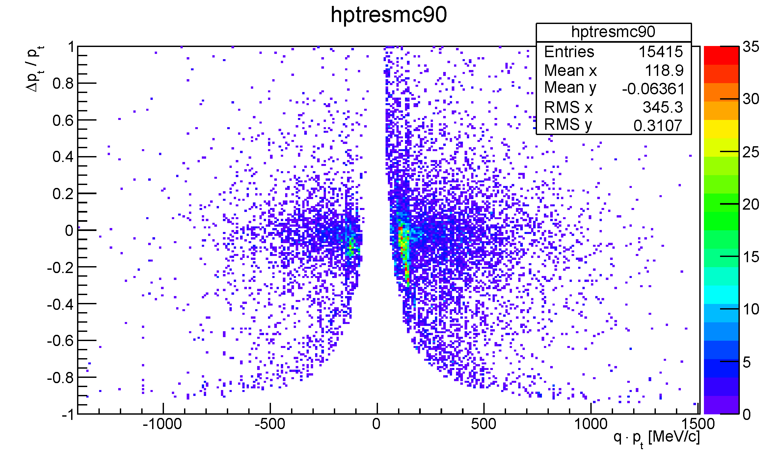
Results: p_{t} Resolution (90% Correct Hits)
PRELIMINARY

Slide 51
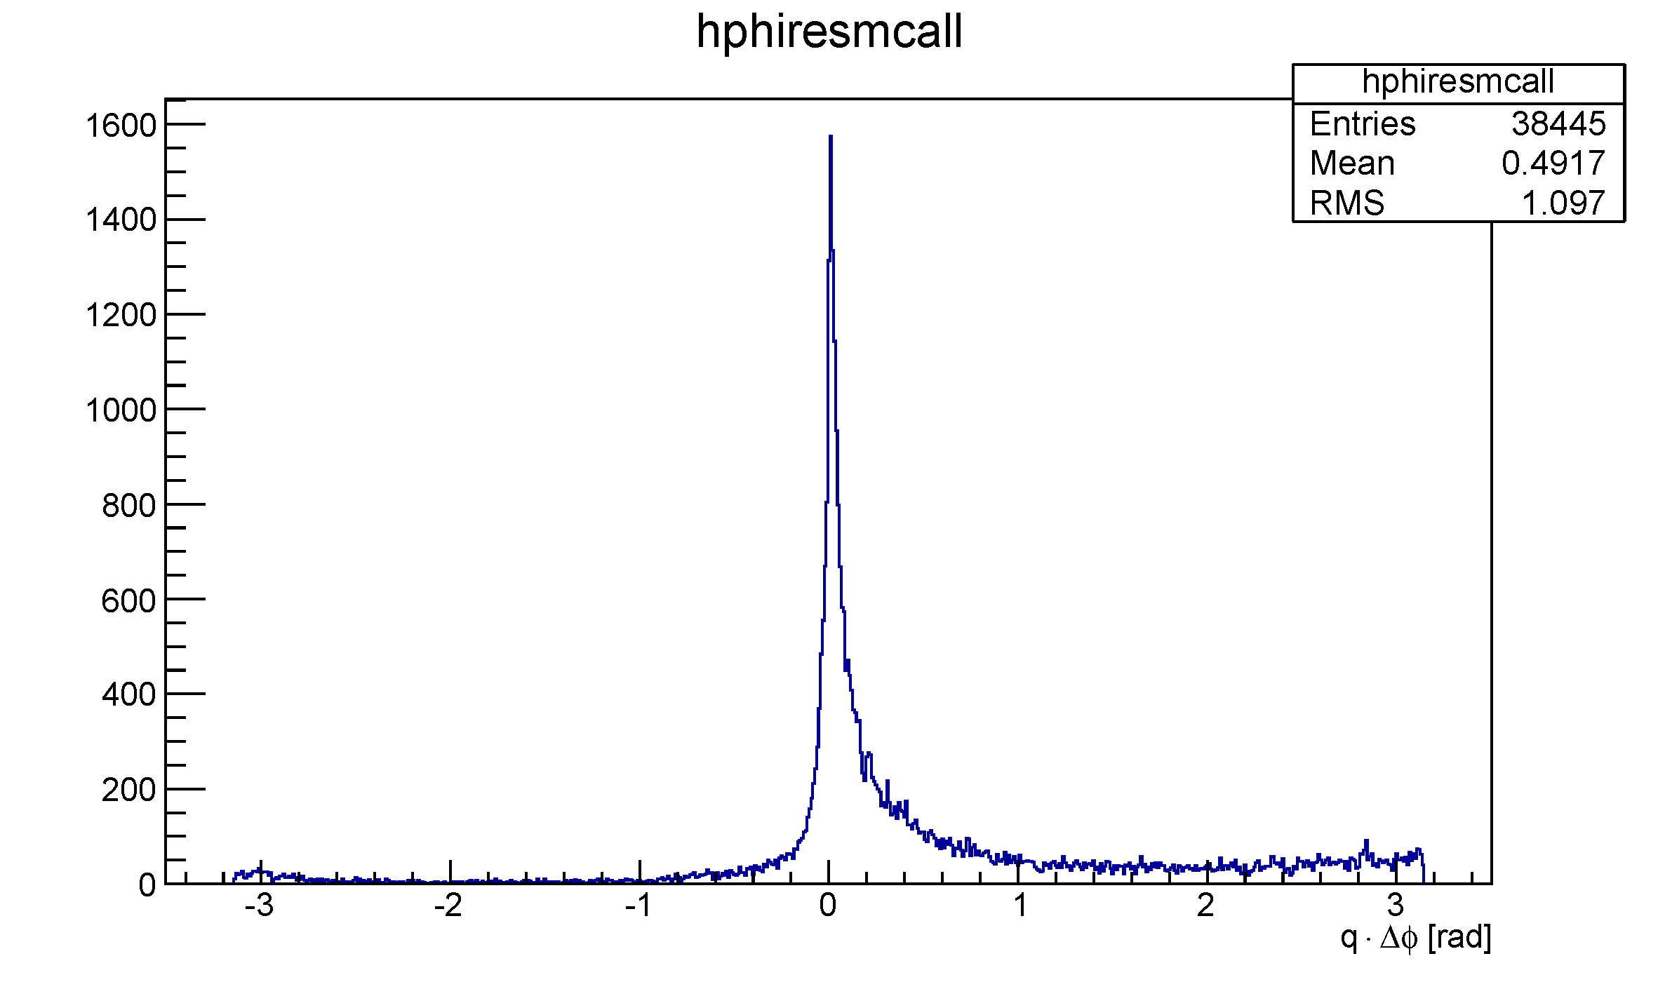
Results: φ Resolution (Full Output)
PRELIMINARY

Slide 52
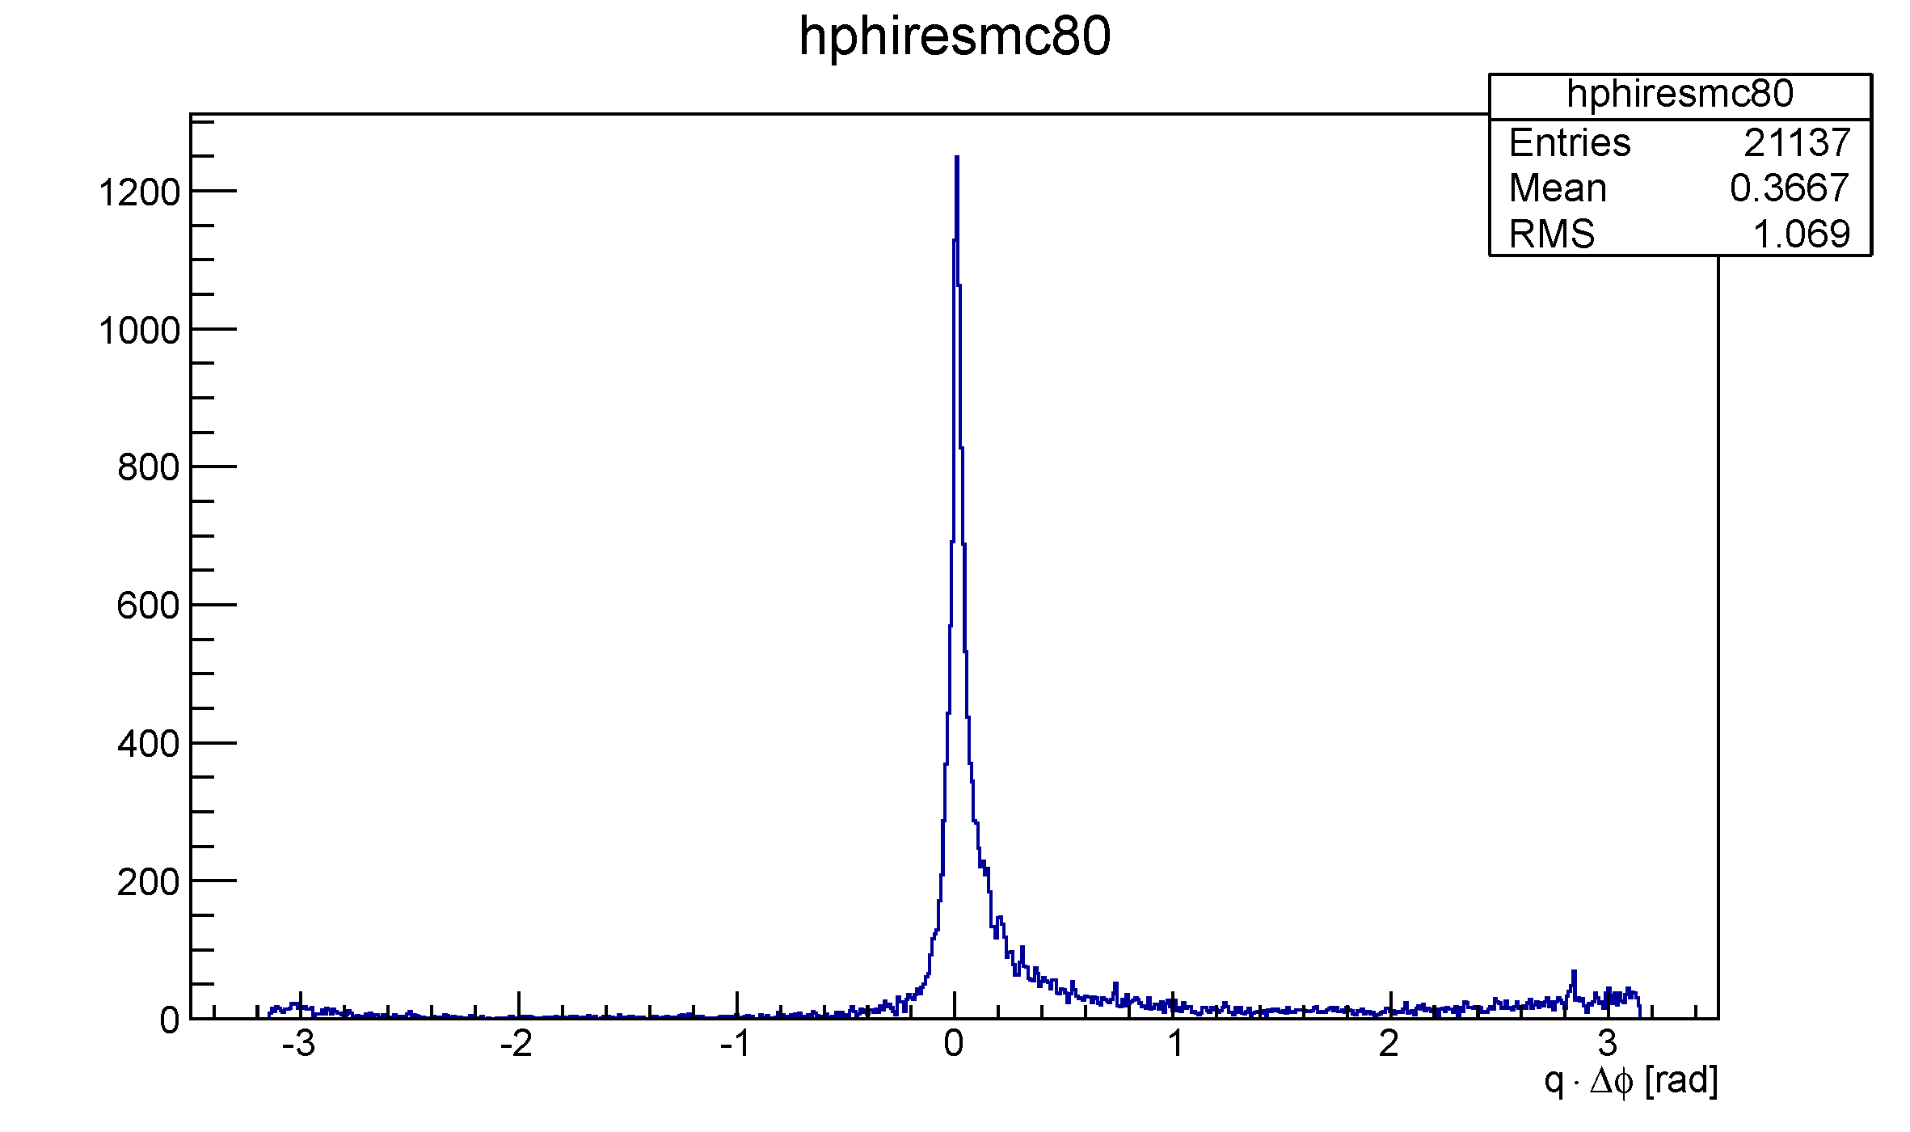
Results: φ Resolution (80% Correct Hits)
PRELIMINARY

Slide 53
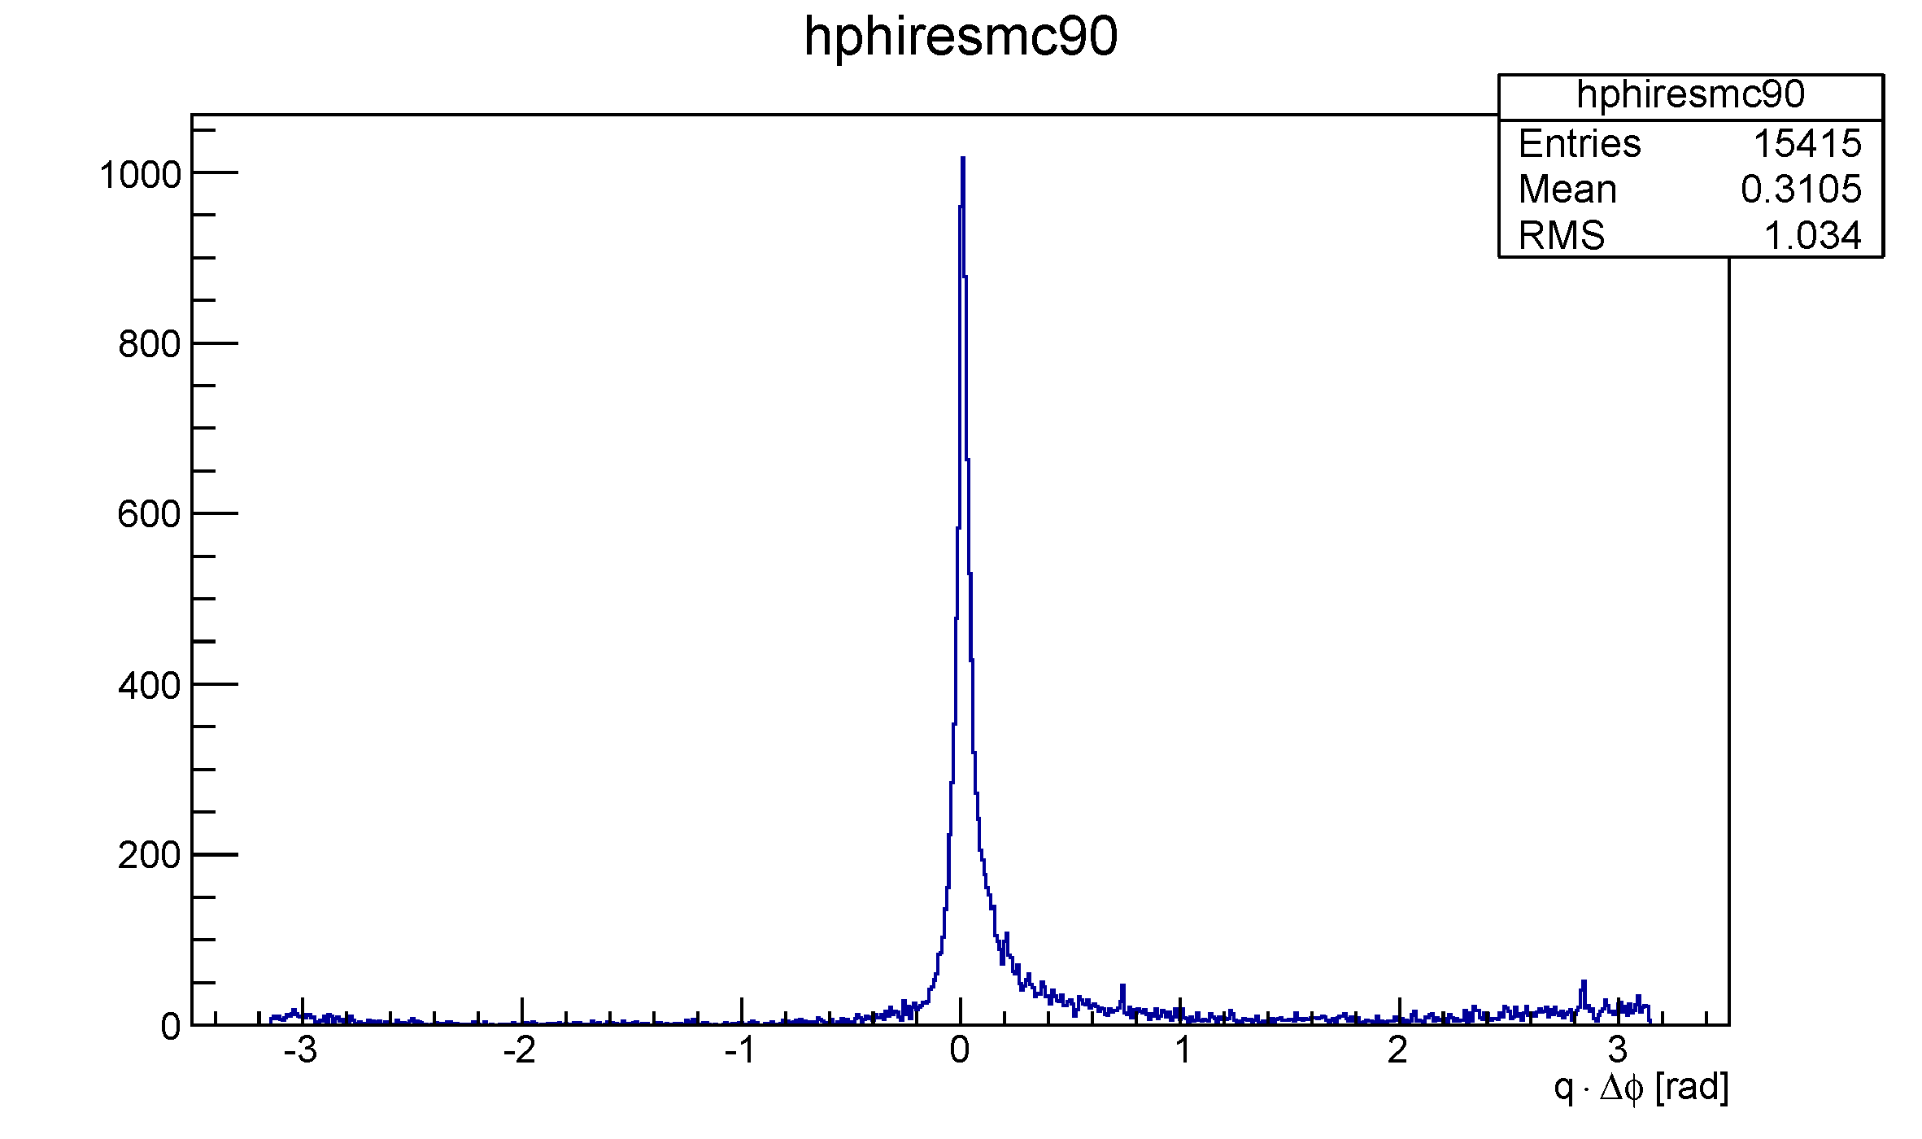
Results: φ Resolution (90% Correct Hits)
PRELIMINARY
Little Bumps

Slide 54
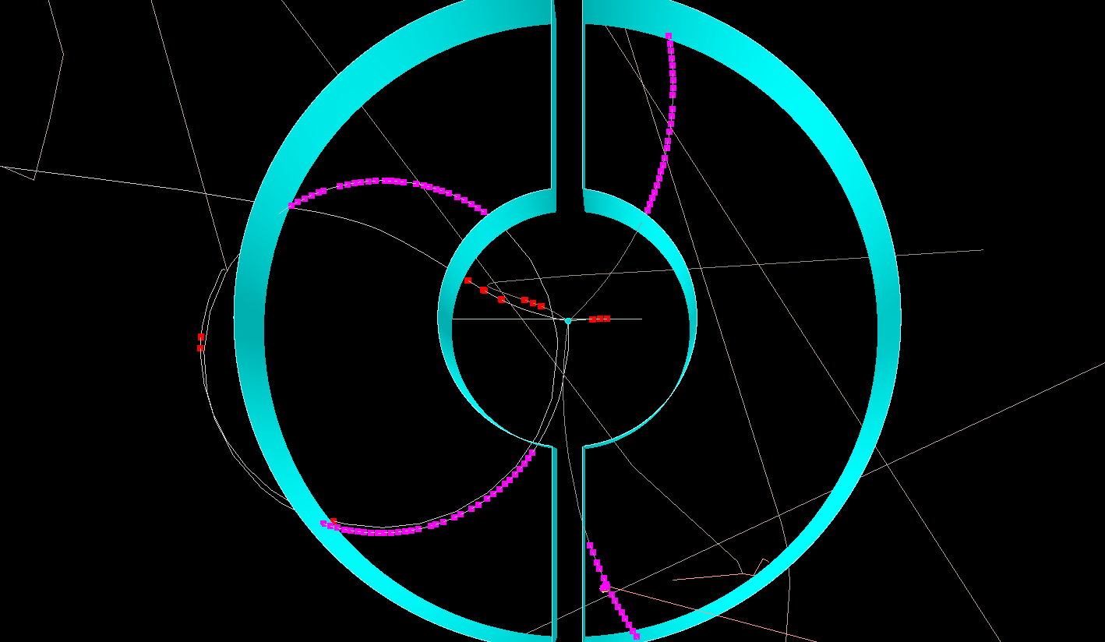
Bumps: Both Directions of Recurring Tracks

Slide 55
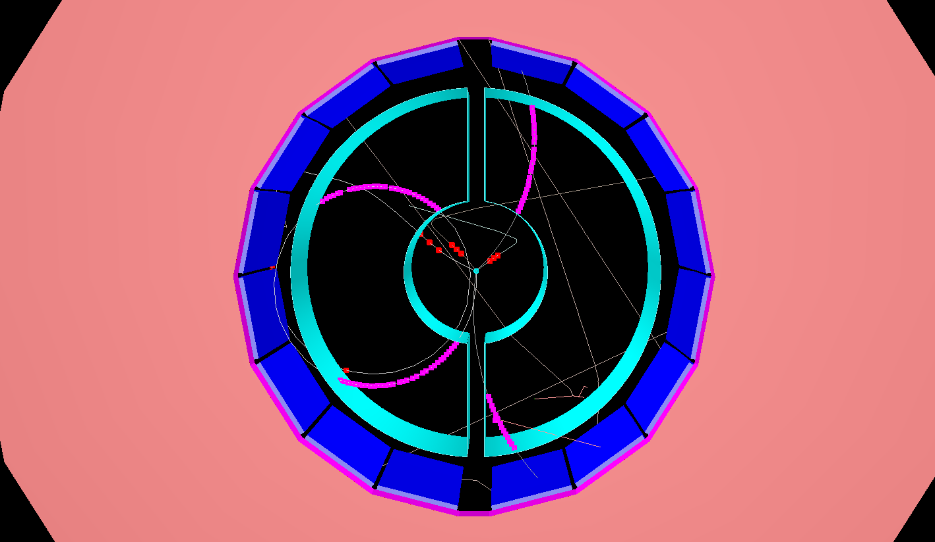
Bumps: Both Directions of Recurring Tracks

Slide 56
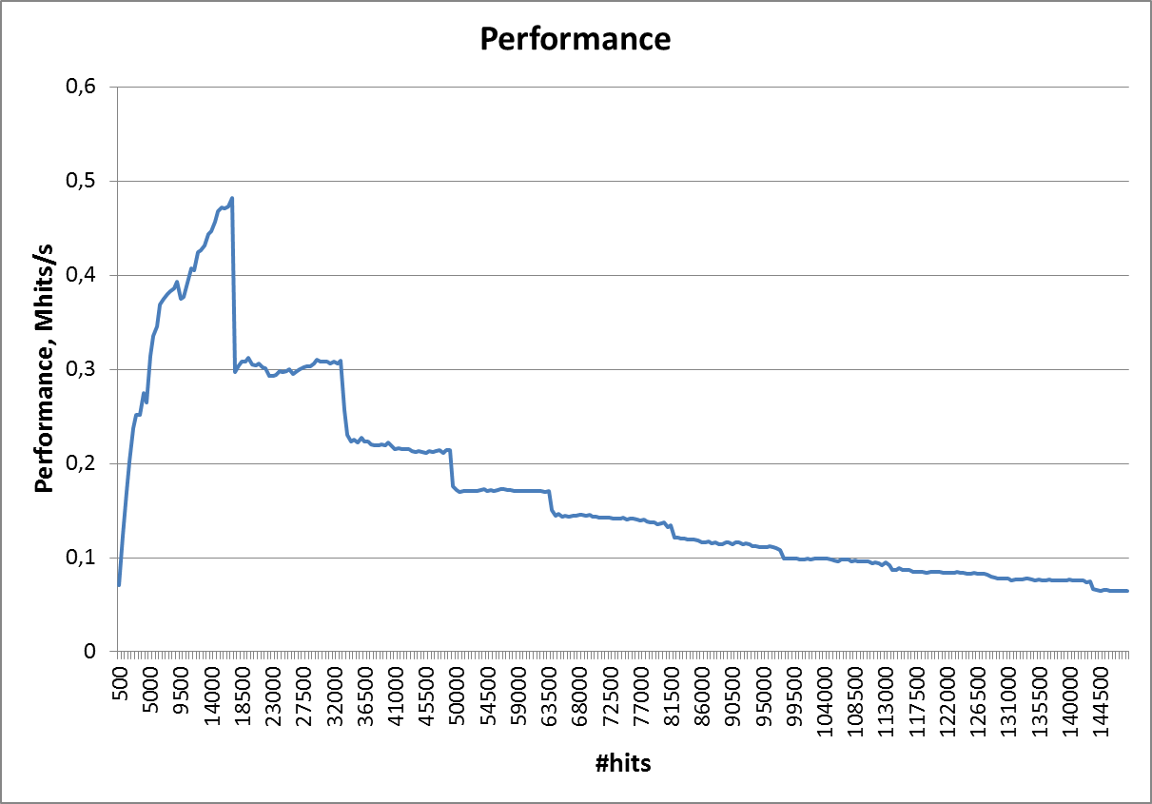
GPU Implementation
Max. Burst Size
Andrew V. Adinetz, NVIDIA Application Lab (www.fz-juelich.de/ias/jsc/nvlab)

Slide 57
Outlook
Triplet Finder
Further studies with actual signal instead of background → Efficiencies and purities (resolution interesting, but not primary figure of merit → Track fitter)
Online Tracking System
Investigate algorithm interplay
Investigate „special cases“ → Track flags, i.e. duplicate, curler, …
Investigate correlation between
Efficiency / Resolution
Track properties
Observables at reconstruction time
→ Online reconstruction quality control → Selection of best result from several algorithms
Requirements in PandaROOT
Burst simulation in digitization → Realistic burst structure in online reconstruction
Signal events embedded into background at selectable rates (e.g. minimum time between signal events)

Slide 58
Summary
Full online tracking system design/ideas/requirements advancing
Proof of concept Triplet Finder tested with DPM input in time based simulations at realistic event rates
Robust first-line algorithm independent of isochrone (t₀) information and drifttime calibration
First quantitative test results incoming
Many (straightforward) tuning possibilites affecting efficiency, purity and robustness to be studied
Future
Triplet Finder reconstruction tests with signal events
Investigation of interplay with other algorithms
Investigation of „special cases“ (e.g. duplicate, curler, kink tracks) → Flags useful?
More accurate simulation of PANDA‘s event structure required
Thank you for your attention

