Slide 1
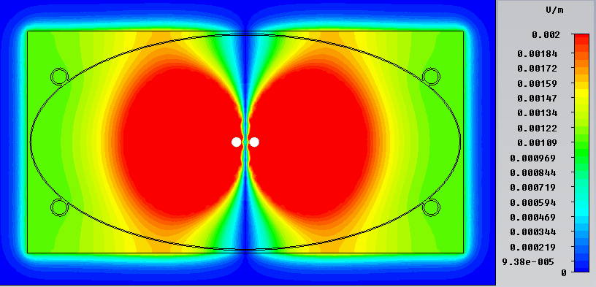
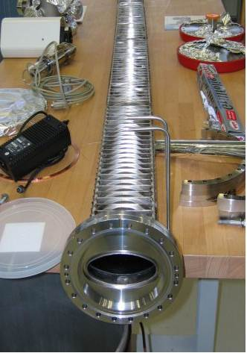

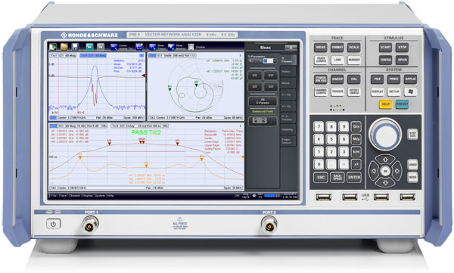
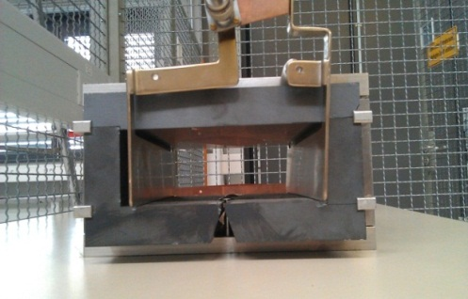
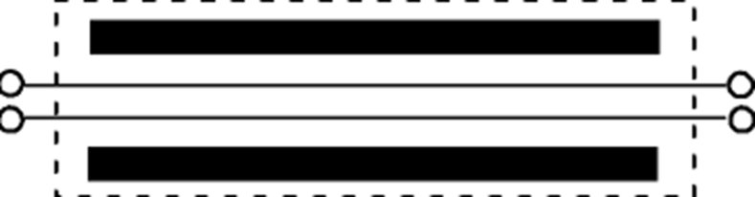
Impedance measurements and simulations of SIS-100 components
PhD project (2011-2014): Uwe Niedermayer
✓ Thin (0.3 mm) resistive beam pipe:
✓ Ferrite loaded kicker modules (with PFN):
U. Niedermayer, O. Boine-F.,
NIM A (2012)
CST simulation: EM fields
and image currents induced
by the beam in the pipe.
+ 3D frequency domain
impedance solver !
f=100 kHz
Next step:
bench
measurements
kicker magnet
180deg
Hybrid
Hybrid
180deg
0deg
0deg
PFN –
connection
DUT
Goal: - Detail comparison of bench measurement and EM simulations
- SIS-18/100 impedance library (10 kHz - 1 GHz)

Slide 2
Tune spectra and BTFs for intense bunches
PhD project (2011-2014): Paul Görgen
Collaboration with BNL (Wolfram Fischer)
Transverse tune spectra in SIS-18@GSI
Transverse BTFs in RHIC@BNL
Measurement
Simulation
Simulation replicates measurement
R. Singh, O. Boine-F., P. Forck, P. Kowina, et al., to be submitted.
P. Görgen, O. Boine-F., W. Fischer, Proc. ICAP 2012
Goals (using existing baseband tune and BTF equipment + simulation models):
-(Fast) characterization of beam and intensity parameters (e.g. tune shifts/spreads)
- Interplay of space charge, beam-beam, octupoles or other nonlinear elements.
- BTF of transverse head-tail modes and their stability !

Slide 3
New project: Feedback simulation modules
PhD project: NN (2012-2015)
PATRIC (O. Boine-F., V. Kornilov, et al.):
3D particle tracking with self-consistent 2.5D space charge solver, impedances, e-clouds.
MADX maps, arbitrary rf bucket forms
Implemented for multi-core CPUs using MPI.
Validated using SIS/CERN PSB experiments.
V. Kornilov, O. Boine-F., Head-tail instability and Landau damping in bunches with space charge, PRST-AB 2010
Transverse feedback in SIS-100:
- required to stabilize the proton
and ion bunches !
- frequency range (of the coherent
bunch oscillations): 50 kHz -200 MHz
Questions:
- required minimum band width
- required minimum gain
- resulting beam emittance growth
- interplay with other damping
mechanisms (e.g. octupoles, coupling)
Goal:
- Implementation of a transverse feedback module in PATRIC.
- Validation with SIS-18 experiments using the existing transverse damper.
- Study of the (long-term) interplay of feedback and collective effects in SIS-100.

Slide 4
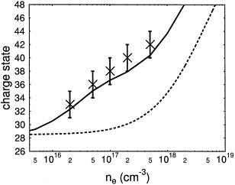
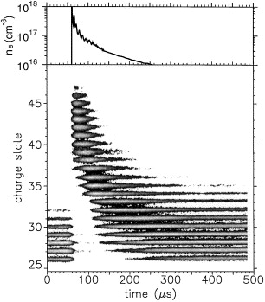
New project: Plasma stripper/stopper
PhD project (2012-2015): Peter Schmidt
With plasma strippers much
higher charge states can be
reached than with gas strippers.
A pinch device is presently
being installed at GSI
(with GU Frankfurt).
Goal:
- Plasma simulations and
beam interaction (VORPAL)
- Prediction of the charge state
distribution and energy loss
rate equation including
indirect projectile
ionization
(Pulsed) plasma discharge
devices:
binary
encounter
approxim.
Mean charge state of Au²⁸⁺ projectiles
as a function of the electron density of
the fully-ionized hydrogen plasma (l=20 cm)
compared to the calculated effective charge
states.
[1] C. Stöckl, O. Boine-Frankenheim, et al.
Interaction of heavy ion beams with dense plasmas
Laser and Part. Beams 14, 561 (1996)
[2] O. Boine-Frankenheim, Ch. Stöckl
Charge state and nonlinear stopping power of heavy ions in fully ionized plasmas
Laser and Particle Beams 14, 781 (1996)
[3] C. Stöckl, O. Boine-Frankenheim, et al.
Experiments on the Interaction of Heavy Ions with Dense Plasma at GSI
Nucl. Instr. Meth. A 415, 558 (1998)
Plasma density on the Z-pinch axis versus
time and charge state distribution of Au ions
at 8.6 MeV/u energy with an initial charge state
of 24+ passing a Z-pinch discharge.

Slide 5
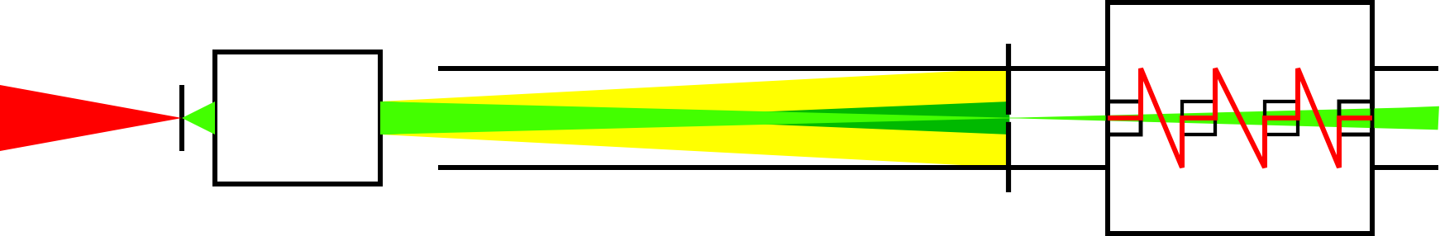
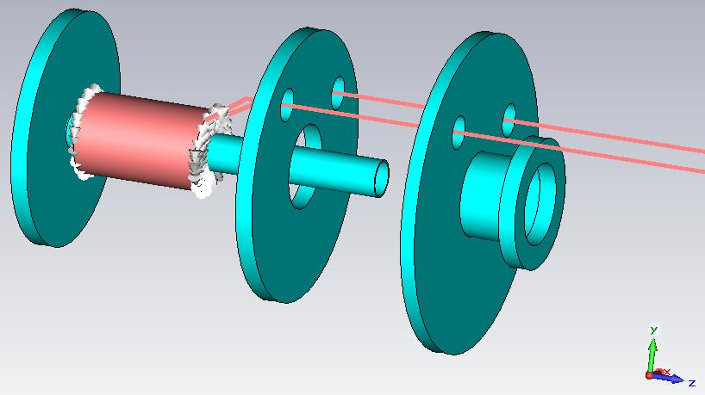
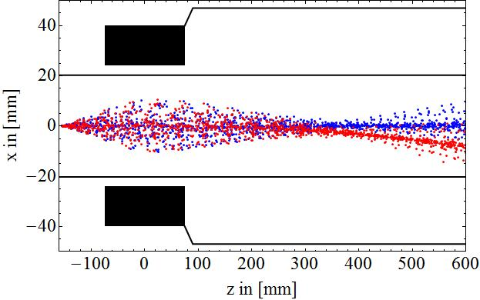
LIGHT: Laser Ion Generation, Handling and Transport
Demonstrator Project @ GSI (Coordinator: Markus Roth)
PhD project (2010-15): Zsolt Lecz, NN -> H4F
Goal: Simulation of the focusing and transport of laser-accelerated ion beam,
generated by the TNSA or RPA (Radiation Pressure) mechanisms.
Laser pulse
solenoid
TNSA setup
energy filter
target
(thin metal foil)
drift pipe
buncher cavity
2D/3D full EM PIC simulations
of TNSA with VORPAL
Simulation of the pulsed (9 T)
solenoid with CST
Beam neutralization
and transport simulations
Z.Lecz, P. Schmidt, O. Boine-F., V. Kornilov, Proc. ICAP 2012

