Slide 1
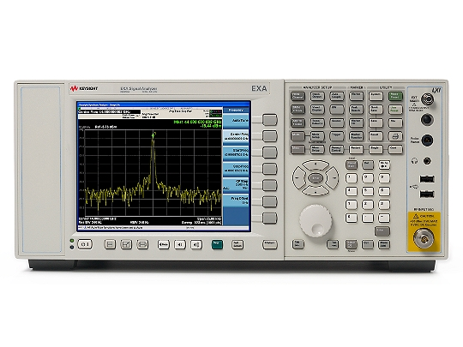
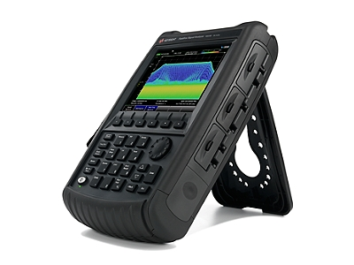
Introduction to Spectrum Analysis
Aufbau eines Spektrum-Analysators

Slide 2
Contents
Introduction
RF measurements (time and frequency domain)
Signals of bunched beam current
The super-heterodyne concept and its application(s)
Spectrum Analyzer
Build Your Own Spectrum Analyzer

Slide 3
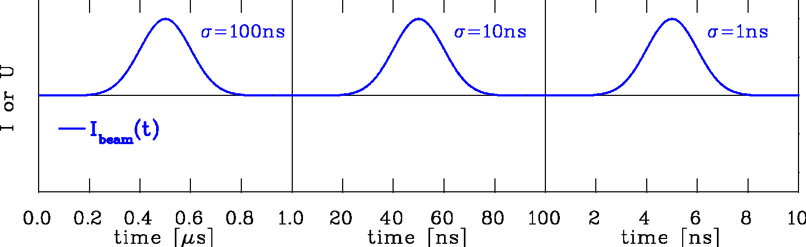
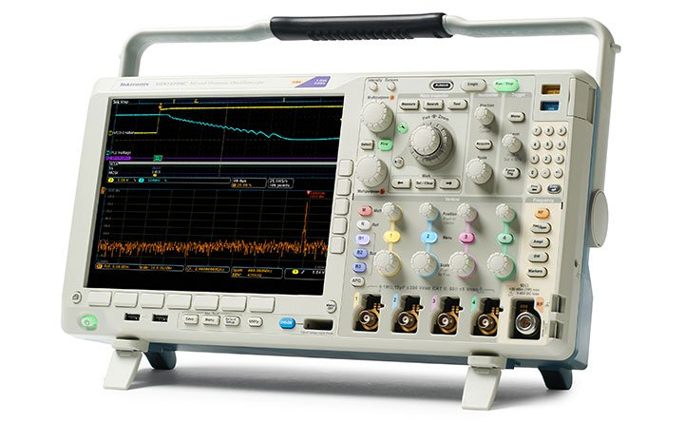
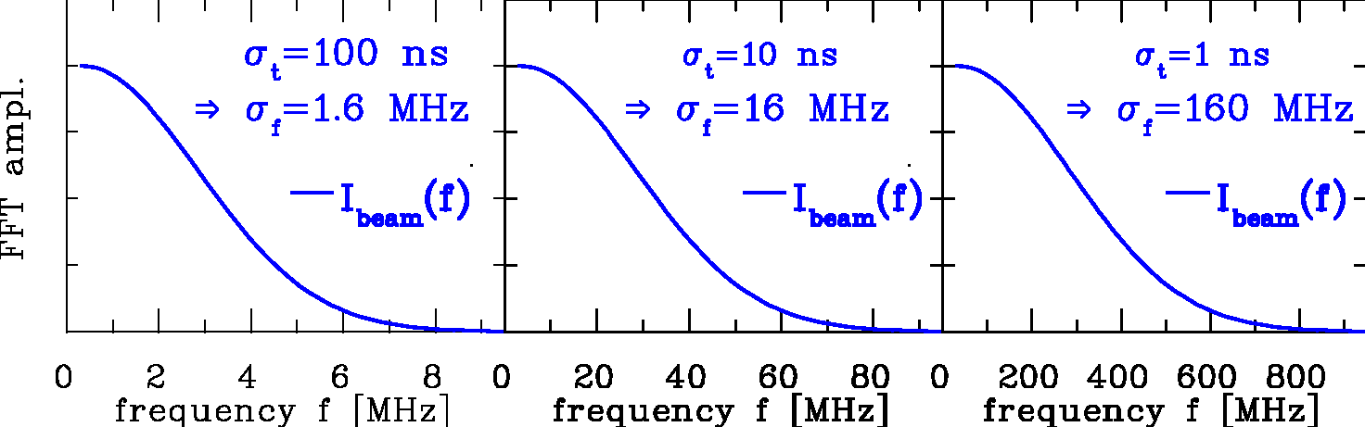
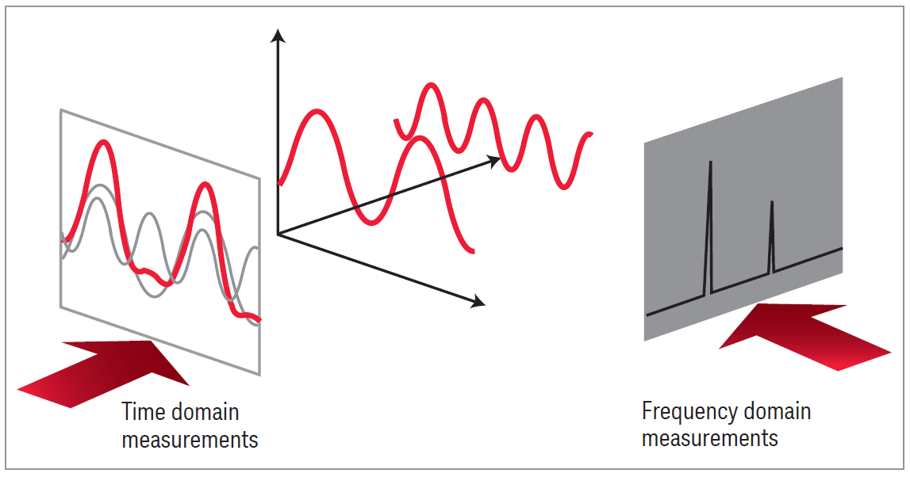
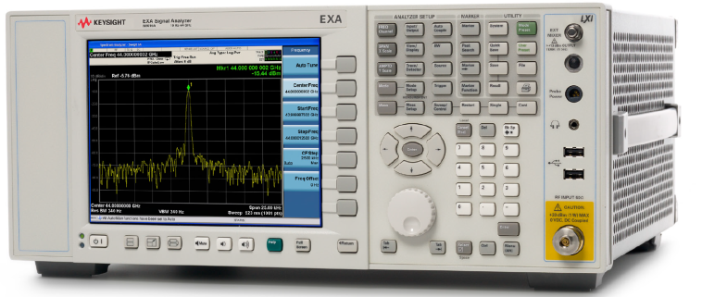
Time Domain ↔ Frequency Domain
Time domain: Recording of a voltage as a function of time:
Instrument: Oscilloscope
Fourier Transformation:
of time domain data
I_{beam}
Frequency domain: Displaying of voltage as a function of frequency:
Instrument:
Spectrum Analyzer
voltage
frequency
time
Care: Fourier transf. contains amplitude and phase
courtesy company Keysight

Slide 4
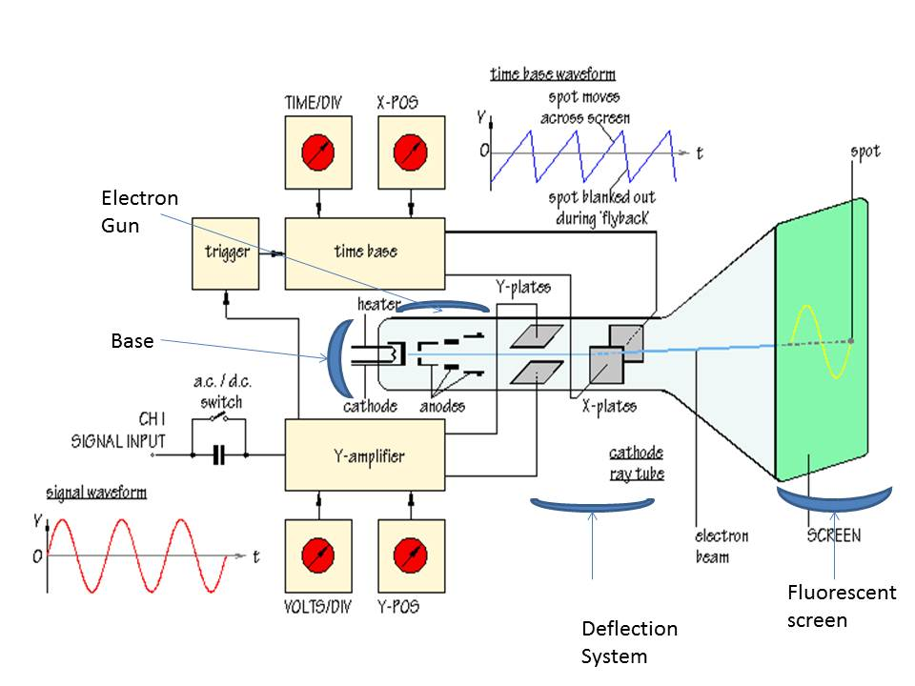
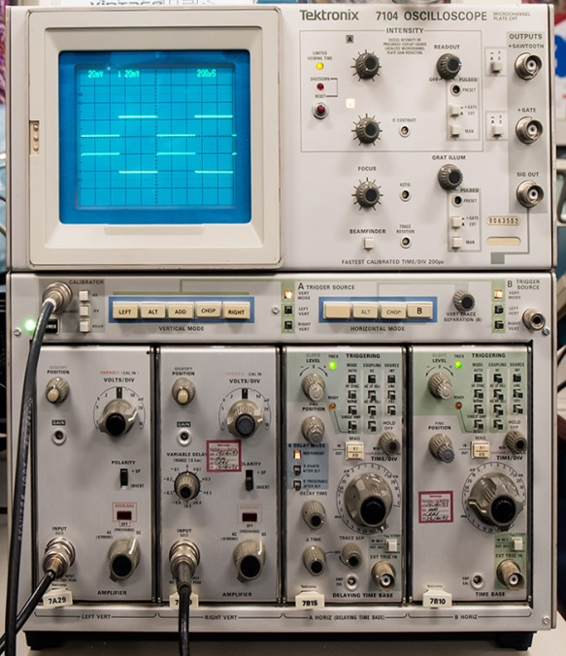
RF Measurements (Time Domain)
Oscilloscope: to observe signals in time domain
  periodic signals
  burst and transient signals with arbitrary waveforms
  application: direct observation of signals from a beam pick-up,
  from a test generator, or from other sources
  visualizes the shape of a waveform, etc.
  limited performance for the evaluation of non-linear effects.
http://semesters.in/basic-principle-of-the-oscilloscope-notes-for-electronics-engineering-1st-year/
Cathode Ray Tube (CRT) Oscilloscope

Slide 5
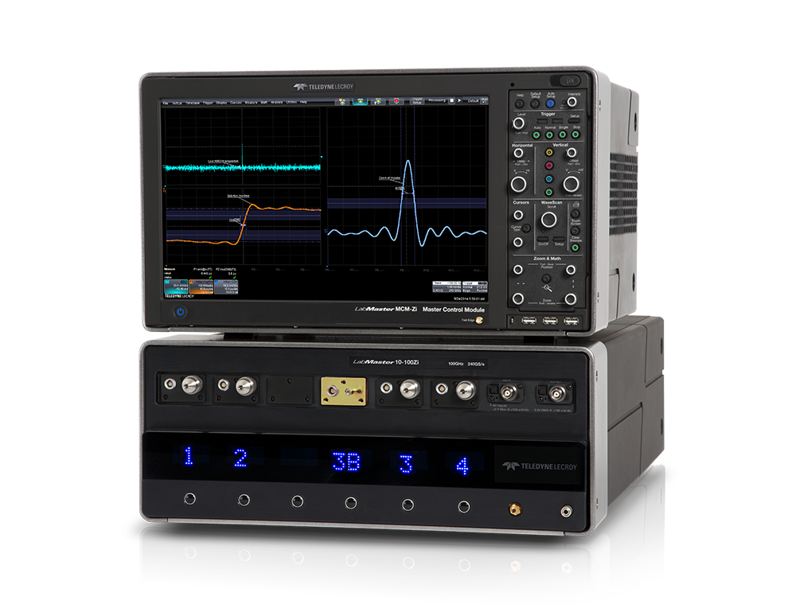
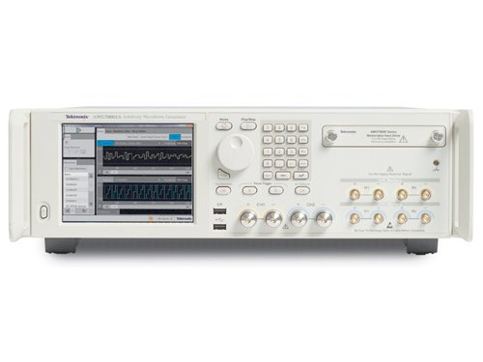
Digital Storage Oscilloscope (DSO)
100 GHz bandwidth
240 GS/s oscilloscope
(LeCroy)
…and digital signal generator
(AWG: arbitrary waveform generator)
Device Under Test (DUT)
50 GS/s, 10-bit AWG (Tektronix)
Signal processing based on fast ADCs and DACs
  Similar readout to an analog oscilloscopes, but better performance
    8…12-bit multi-GS/s ADCs, still, be aware of aliasing effects!
    Fast sampling oscilloscope require sufficient memory resources.
Typical time domain (TD) test setup: signal generator & digital oscilloscope:
  Device under test (DUT) characterization and trouble shooting
    Gaussian impulse, step, or arbitrary waveform (e.g. beam signal) as stimulus signal
    High impedance probe for measurements on the printed circuit board (PCB)

Slide 6
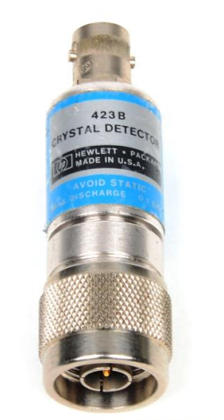
RF Measurements Methods
RF power detection: Cristal Detector (Schottky diode)
  Supplies a rectified (video) output signal proportional to the RF signal power
  Very broad frequency range few MHz to many GHz
  up to 90 dB dynamic range.
  Delivers no frequency nor phase information
Spectrum analyzer: to observe signals in frequency domain
  Sweeps in equidistant steps through a given frequency range
  application: observation of spectrum from the beam, or from a signal generator or RF source, or the spectrum emitted from an antenna to locate EMI issues in the accelerator tunnel, etc.
  Requires periodic signals
  Large dynamic range!
Vector signal analyzer (VSA), or FFT analyzer
  Acquires the signal, often after down-conversion,
  in time domain by fast sampling
  Further numerical treatment in digital signal processors (DSPs)
  Spectrum calculated using Fast Fourier Transform (FFT)
  Combines features of an oscilloscope and a spectrum analyzer:
  Signals can be observed directly in time or in frequency domain
  Contrary to the SA, also the spectrum of non-periodic signals and transients can be measured

Slide 7
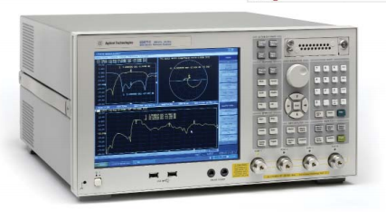
RF Measurements Methods
Vector Network Analyzer (VNA)
  Combines the functions of a vector spectrum analyzer (FFT analyzer),
  a RF sweep generator, and a S-parameter test set (directional coupler)
  Excites a Device Under Test (DUT, e.g. circuit, antenna, amplifier, etc.) network at a given Continuous Wave (CW) frequency, and measures the response in magnitude and phase => determines the S-parameters
  Covers a selectable frequency range by measuring step-by-step at subsequent frequency points (similar to the spectrum analyzer)
  Applications: characterization of passive and active RF components, Time Domain Reflectometry (TDR) by Fourier transformation of the reflection or transmission response, etc.
  The VNA is the most versatile and comprehensive tool in the RF laboratory!

Slide 8
A (too) Simple Radio Receiver
broadband
low-noise RF amp
e.g. 87-108 MHz
tunable
narrowband
band-pass filter
RF amp
demodulator
audio amp
Is this how does a ”traditional” analog radio works?
  It is, difficult to make precisely tunable narrowband, band-pass filters for high frequencies (~100 MHz)!!
  high frequency low-noise amplifiers are expensive!
  high frequency demodulators are not trivial.
    => direct detection of radio or RF signals is challenging!

Slide 9
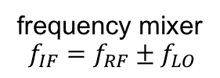




The Super-Het Receiver
frequency mixer
$$f_{IF}=f_{RF}±f_{LO}$$
audio amp
$$f_{RF}$$
$$f_{IF}$$
broadband
low-noise RF amp
e.g. 87-108 MHz
IF narrowband
band-pass filter
e.g. 10.7 MHz ± 90 kHz
$$f_{LO}$$
IF amp
demodulator,
e.g. FM PLL or
AM diode detector
tunable
local oscillator (LO)
e.g. 97.7-118.7 MHz
Introduce a non-linear element: the (frequency) mixer!
  ”down-convert” the RF band to a fixed ”intermediate” frequency (IF)
  requires a tunable local oscillator (LO)
  well manageable IF section:
    narrowband band-pass filter(s) (BPF) and amplifier(s)
  standards solution used in RF telecommunication
  Often multiple mixing stages are used in modern RF instruments (spectrum analyzer, vector network analyzer)
$$f_{IF}=f_{RF}±f_{LO}$$

Slide 10
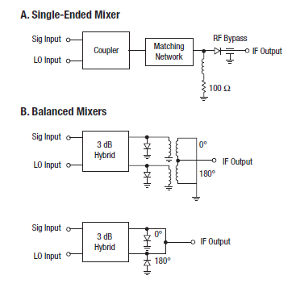
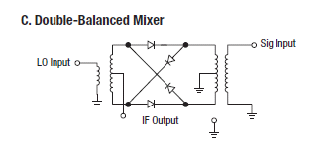
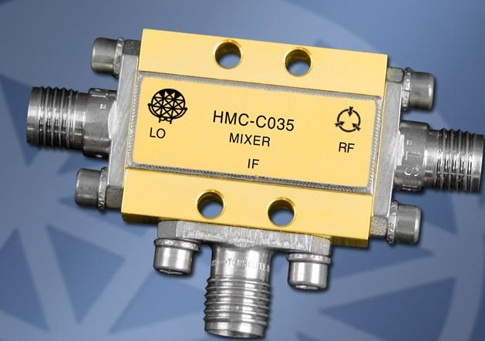
The RF mixer
Examples of different mixer configurations
A typical coaxial mixer (SMA connector)

Slide 11





Mixer response in time domain
frequency mixer
$$f_{IF}=f_{RF}±f_{LO}$$
$$f_{RF}$$
$$f_{IF}$$
$$f_{LO}$$
IF narrowband
band-pass filter
Input signals here:
LO = 10 MHz
RF = 8 MHz
For more info, go to:
http://www.microwaves101.com/encyclopedia/mixerwaveforms.cfm
$$f_{IF}=f_{RF}±f_{LO}$$

Slide 12
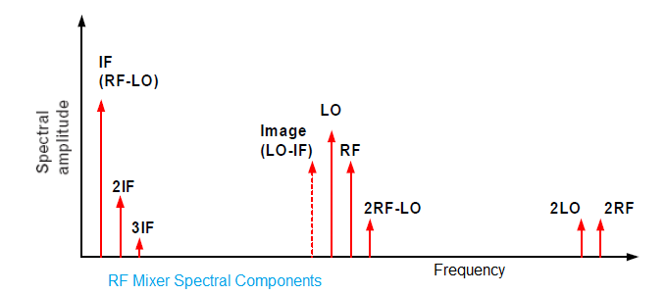





Mixer response in time and frequency domain
frequency mixer
$$f_{IF}=f_{RF}±f_{LO}$$
$$f_{RF}$$
$$f_{IF}$$
$$f_{LO}$$
IF narrowband
band-pass filter
Input signals here:
LO = 10 MHz
RF = 8 MHz
Mixing products at
2 and 18 MHz and
higher order terms at higher frequencies
$$f_{IF}=f_{RF}±f_{LO}$$

Slide 13





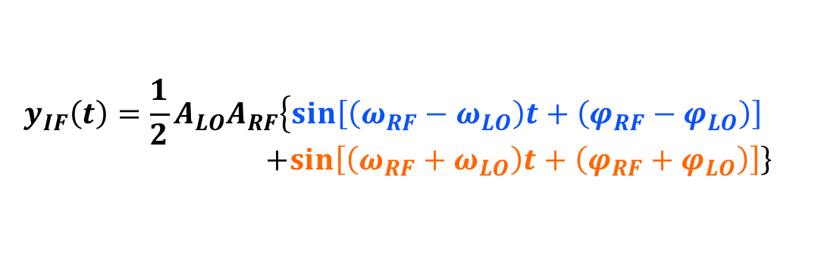

The RF Mixer as Downconverter
RF
IF
$$y_{RF}\left(t\right)=A_{RF}\sin\left(ω_{RF}t+φ_{RF}\right)$$
$$y_{IF}\left(t\right)=y_{RF}\left(t\right)y_{LO}\left(t\right)$$
LO
$$f_{IF}=f_{RF}±f_{LO}$$
Ideal mixer:
Frequency conversion
  f_{RF} ≠ f_{LO}: heterodyne receiver
  f_{RF} = f_{LO}: homodyne, demodulator
Real-world mixer:
  Image frequency:
$$y_{LO}\left(t\right)=A_{LO}\sin\left(ω_{LO}t+φ_{LO}\right)$$
$$y_{IF}\left(t\right)={\frac{1}{2}A}_{LO}A_{RF}\left\{\sin\left[\left(ω_{RF}−ω_{LO}\right)t+\left(φ_{RF}−φ_{LO}\right)\right]\right. \\ +\left.\sin\left[\left(ω_{RF}+ω_{LO}\right)t+\left(φ_{RF}+φ_{LO}\right)\right]\right\}$$
upper sideband
A
f_{lo}
lower sideband
f
f_{LO}-f_{RF}
f_{IM}
f_{RF}
f_{LO}+f_{RF}
$$f_{IF}={mf}_{RF}±{nf}_{LO}$$
$$f_{IM}=f_{LO}−f_{IF}$$

Slide 14
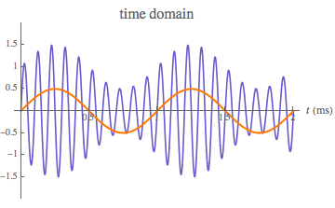
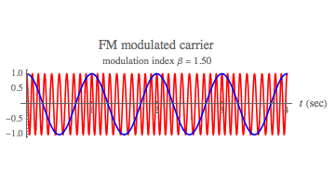
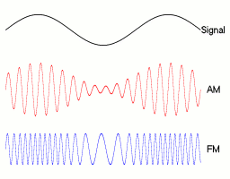
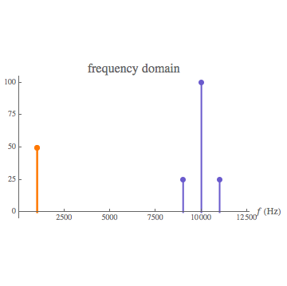
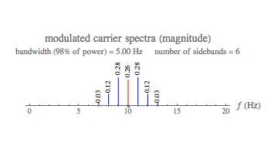
AM & FM Modulation
Beam current signals: transient (pulse-like) signals
RF signals: Sinusoidal signals (CW: continuous wave)
  High frequency carrier modulated with low frequency information
  In ring accelerators:
AM: Betatron oscillations
FM: Synchrotron oscillations

Slide 15
The Super-Het Receiver
frequency mixer
$$f_{IF}=f_{RF}±f_{LO}$$
audio amp
$$f_{RF}$$
$$f_{IF}$$
broadband
low-noise RF amp
e.g. 87-108 MHz
IF narrowband
band-pass filter
e.g. 10.7 MHz ± 90 kHz
$$f_{LO}$$
IF amp
demodulator,
e.g. FM PLL or
AM diode detector
tunable
local oscillator (LO)
e.g. 97.7-118.7 MHz
Introduce a non-linear element: the (frequency) mixer!
  ”down-convert” the RF band to a fixed ”intermediate” frequency (IF)
  requires a tunable local oscillator (LO)
  well manageable IF section:
    narrowband band-pass filter(s) (BPF) and amplifier(s)
  standards solution used in RF telecommunication
  Often multiple mixing stages are used in modern RF instruments (spectrum analyzer, vector network analyzer)
$$f_{IF}=f_{RF}±f_{LO}$$

Slide 16
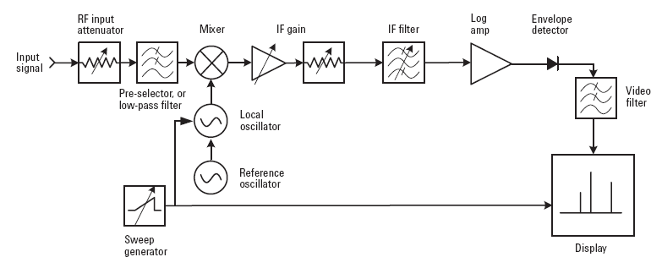
Simplified Spectrum Analyzer
based on the super-heterodyne principle
Switchable BW of the
IF filter and video BPF
(analog or digital)
allows to improve the
signal-to noise (S/N)-ratio

Slide 17
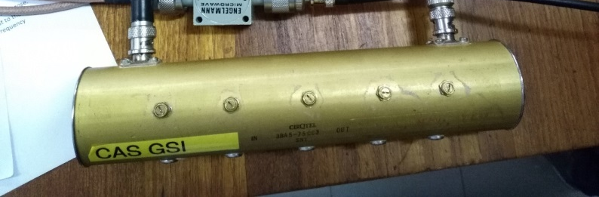
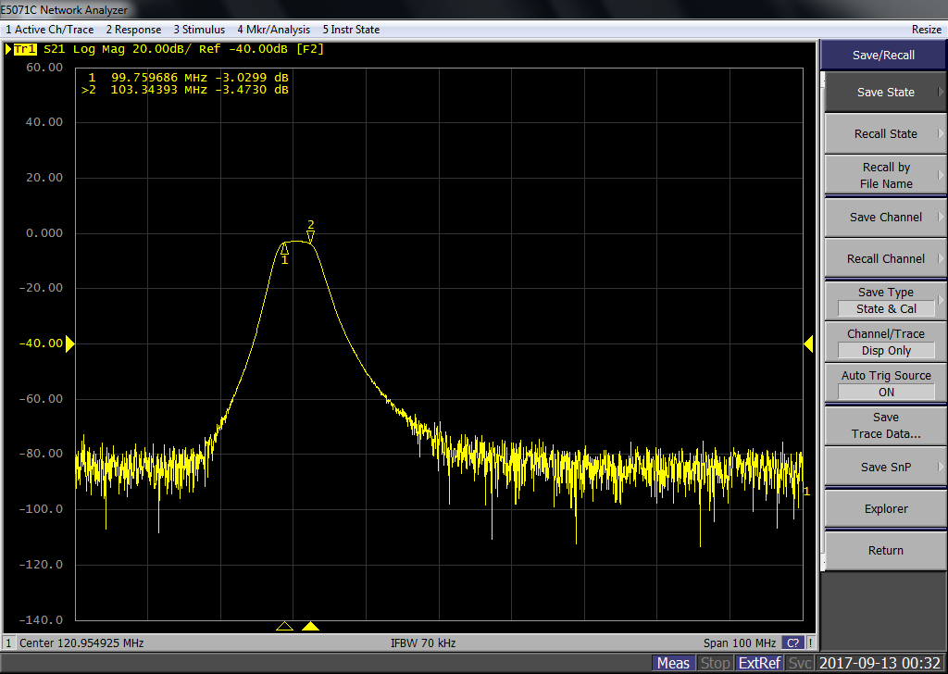
The Band Pass (IF) Filter
The IF filter has to be a band-pass filter with a narrow frequency band
On the spectrum analyzer bandwidth are tunable
IF filter (BPF) tested with a VNA:
  Cavity filter
  central frequency: 101.8MHz
  band-width 3MHz

Slide 18
Simplified Spectrum Analyzer
based on the super-heterodyne principle
Switchable BW of the
IF filter and video BPF
(analog or digital)
allows to improve the
signal-to noise (S/N)-ratio

Slide 19
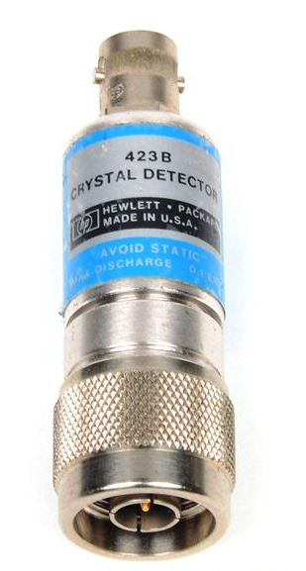
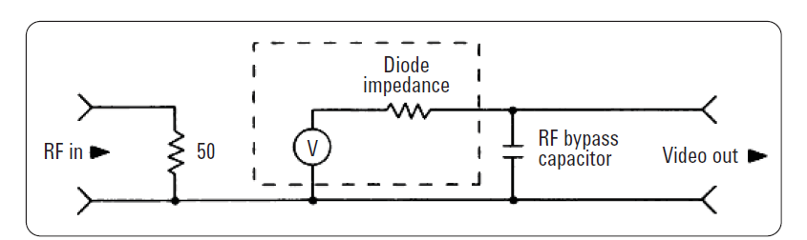
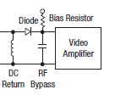
The RF diode
We are not discussing the generation of RF signals here, just the detection
Basic tool: fast RF* diode
(= Schottky diode)
In general, Schottky diodes are
fast but still have a voltage
dependent junction capacity
(metal – semi-conductor junction)
Equivalent circuit:
A typical RF detector diode
Try to guess from the type of the connector which side is the RF input and which is the output
Video output

Slide 20
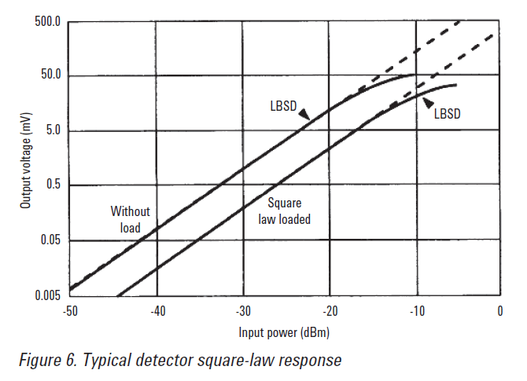
The RF diode
This diagram depicts the so called square-law region where the output voltage (V_{Video}) is proportional to the input power
The transition between the linear region and the square-law region is typically between -10 and -20 dBm RF power (see diagram).
Since the input power is proportional to the square of the input voltage (V_{RF}²) and the output signal is proportional to the input power, this region is called square- law region.
In other words:
V_{Video} ~ V_{RF}²
Linear Region
-20 dBm = 0.01 mW

Slide 21
Modern Spectrum Analyzer in SA mode
based on the super-heterodyne principle
Switchable BW of the
IF filter and video BPF
(analog or digital)
allows to improve the
signal-to noise (S/N)-ratio
Today, the IF, demodulation, video and display sections of a spectrum analyzer are realized digitally
  Requires an analog-digital converter (ADC) with sufficient dynamic range

Slide 22
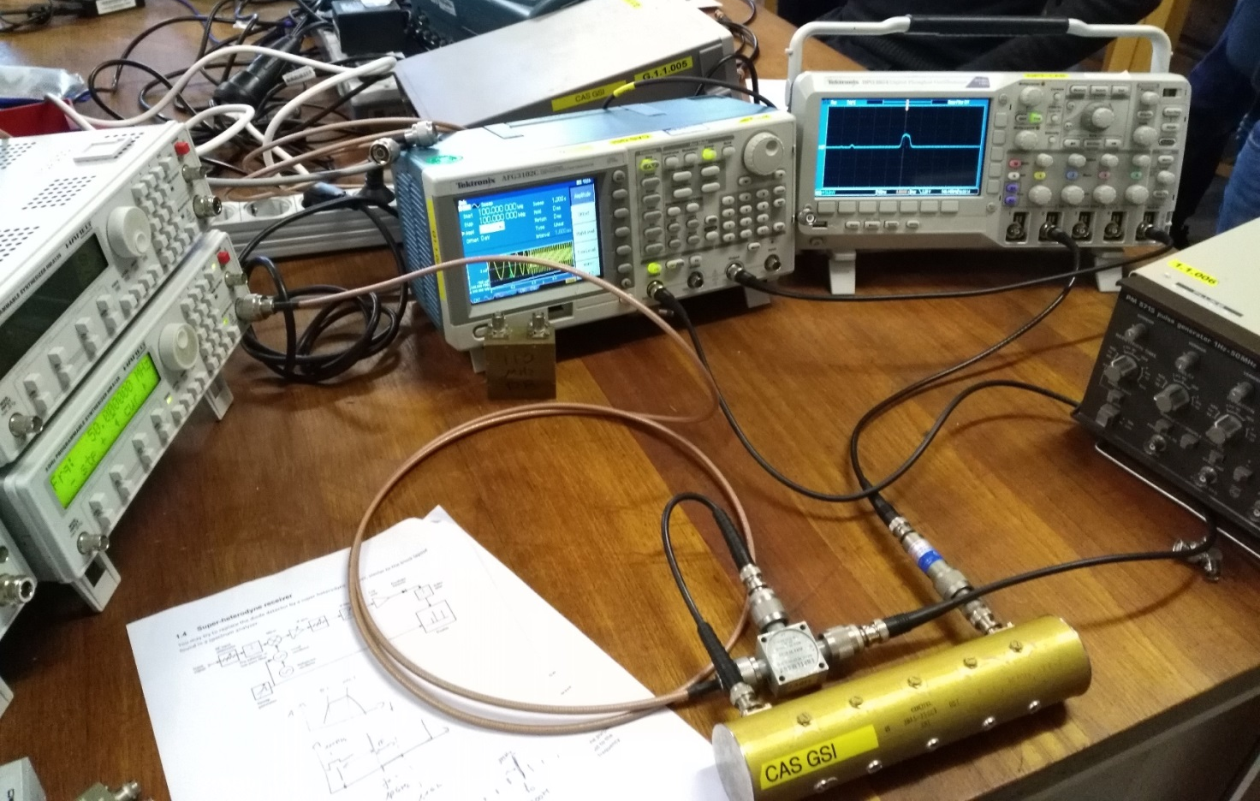

Slide 23
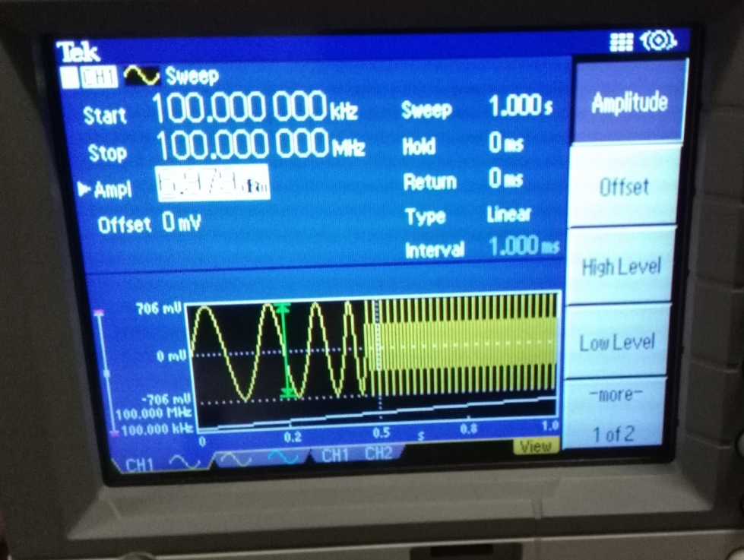
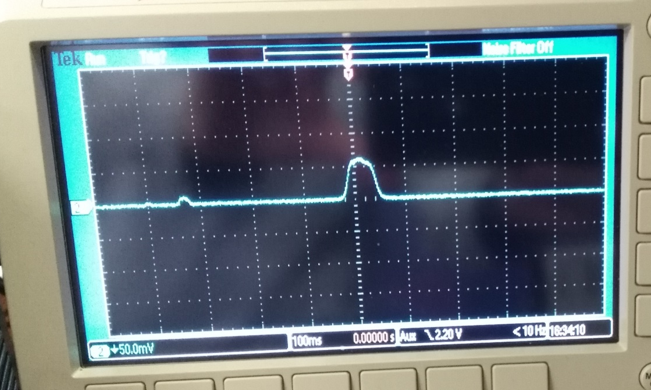
Simplified Spectrum Analyzer
Receiving a 150MHz RF-signal from Function Generator
Local oscillator signal
  Frequency sweep from 100kHz to 100MHz in 1s
Output display
  0.1s/div. time base i.e. time corresponing to the frequency sweep
3MHz
100kHz
100MHz
Output signal
Local oscillator signal

Slide 24
Further Reading
https://www.rohde-schwarz.com/de/applikationen/db-oder-nicht-db-educational-note_230850-15534.html
http://www.microwaves101.com/encyclopedia/mixerwaveforms.cfm
https://cds.cern.ch/record/1982420
https://cas.web.cern.ch/schools/tuusula-2018
https://cas.web.cern.ch/sites/cas.web.cern.ch/files/lectures/tuusula-2018/rfmeasurementstechniques.pdf
https://sites.google.com/view/uspas-dembd/home
https://indico.cern.ch/event/780638/timetable/#20190610

Slide 25
Thank you!
Notes:
25

Slide 26
Backup

Slide 27





“dB or not dB”, that it the question
dezi-Bel: 1 dB = 0.1 B (Bel)
  Logarithmic scaling to compare large,
  e.g. power ratios:
  or large ratios of other quantities, e.g.:
$$P_{dB}=10{ \text{log}}_{10}\left(\frac{P_{1}}{P_{2}}\right)$$
$$V_{dB}=20{ \text{log}}_{10}\left(\frac{V_{1}}{V_{2}}\right)$$
dB ratio | P₁/P₂ | V₁/V₂
n x 10 dB | 10^{n} | 10^{n/2}
40 dB | 10000 | 100
20 dB | 100 | 10
10 dB | 10 | ~3.16
6 dB | ~4 | ~2
3 dB | ~2 | ~1.41
0 dB | 1 | 1
-3 dB | ~0.5 | ~0.71
-20 dB | 0.01 | 0.1
$$I_{dB}=20{ \text{log}}_{10}\left(\frac{I_{1}}{I_{2}}\right)$$
$$\frac{P_{1}}{P_{2}}={10}^{\left(\frac{P_{dB}}{10}\right)}$$
$$\frac{V_{1}}{V_{2}}={10}^{\left(\frac{V_{dB}}{20}\right)}$$
The 3 dB ratio (half power) is a
common specification for the bandwidth
https://www.rohde-schwarz.com/de/applikationen/db-oder-nicht-db-educational-note_230850-15534.html

Slide 28




“dBm” vs. “dB”
dBm is a logarithmic power unit
  based on dB and P_{ref} = 1 mW
dBm can also be used as logarithmic voltage unit
  e.g. for Z₀ = 50 Ω: V_{ref} = 0.2236 V
$$P_{dBm}=10{ \text{log}}_{10}\left(\frac{P}{P_{ref}}\right)$$
$$V_{dBm}=20{ \text{log}}_{10}\left(\frac{V}{V_{ref}}\right)$$
dBm | P | V (RMS)
30 dBm | 1 W | 7.07 V
20 dBm | 100 mW | 2.24 V
10 dBm | 10 mW | 707 mV
6 dBm | 4.0 mW | 446 mV
0 dBm | 1.0 mW | 224 mV
-20 dBm | 10 μW | 22.4 mV
-60 dBm | 1.0 nW | 224 μV
-120 dBm | 1.0 fW | 224 nV
- 174 dBm | 4.0e-21 W | 0.446 nV
$$P={P_{ref}10}^{\left(\frac{P_{dBm}}{10}\right)}$$
$$V={V_{ref}10}^{\left(\frac{V_{dBm}}{20}\right)}$$
Noise power in a bandwidth B = 1 Hz
at room temperature

