Slide 1
GSI
Operating and Reliability
1

Slide 2
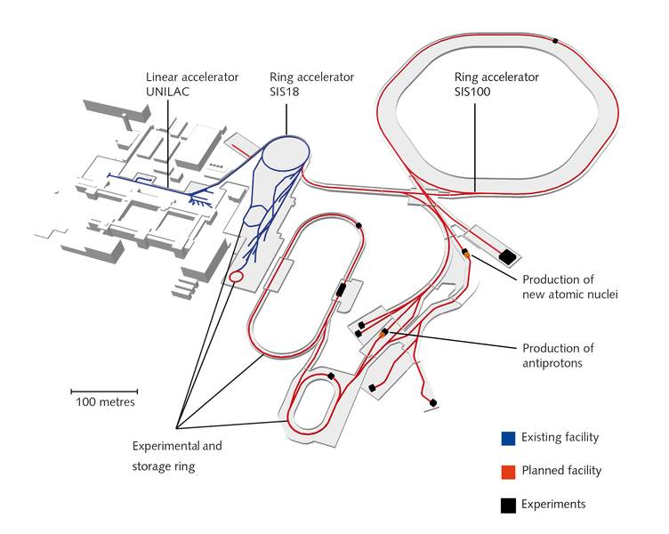
GSI & FAIR Overview
SIS100
super conducting 100 Tm synchrotron
→ 99% speed of light
Super FRS
super conducting fragment separator
Collector Ring
anti proton collection
HESR (high energy storage ring)
p-linac: dedicated linear accelerator for protons
Image: FAIR/GSI

Slide 3
GSI UNIversal Linear ACcelerator
HSI Injektor (1999)
HLI Injektor (1991)
Alvarez (1975)
Einzelresonatoren (1975)

Slide 4
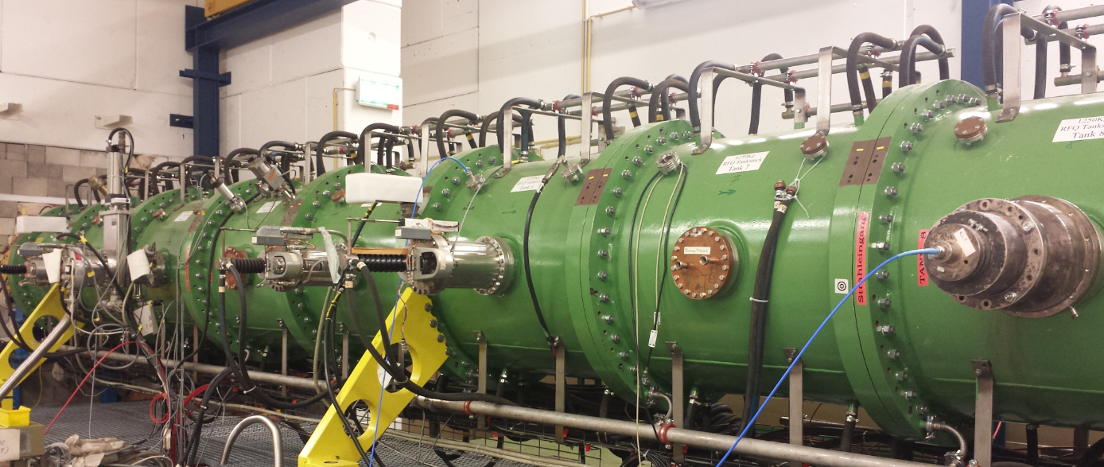
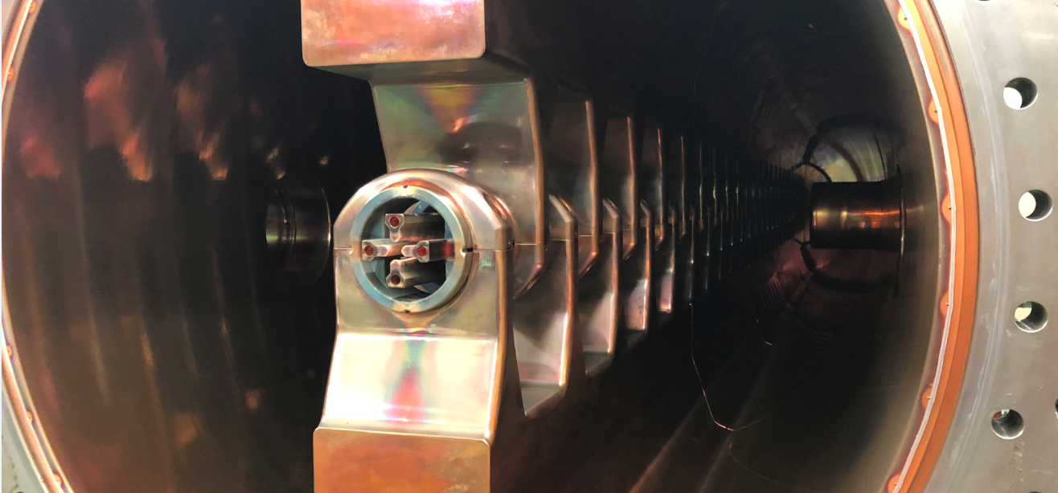
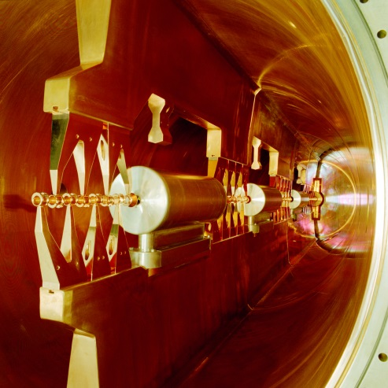
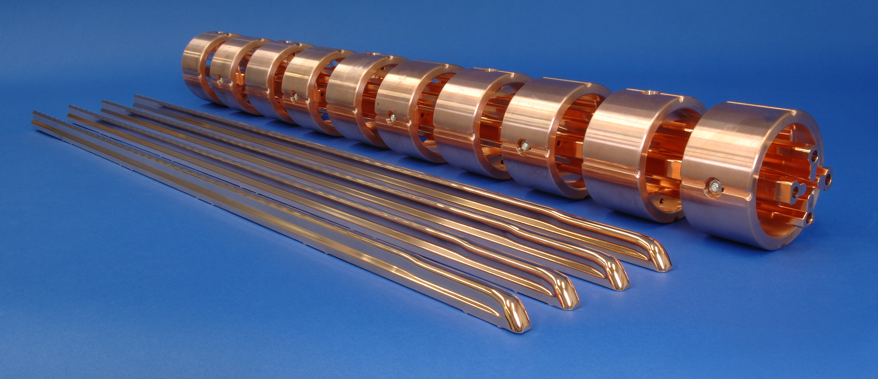
HSI (High Current Injector)
HSI Injector (1999)
36.136 MHz
1.4 MeV/u
50 Hz operation

Slide 5
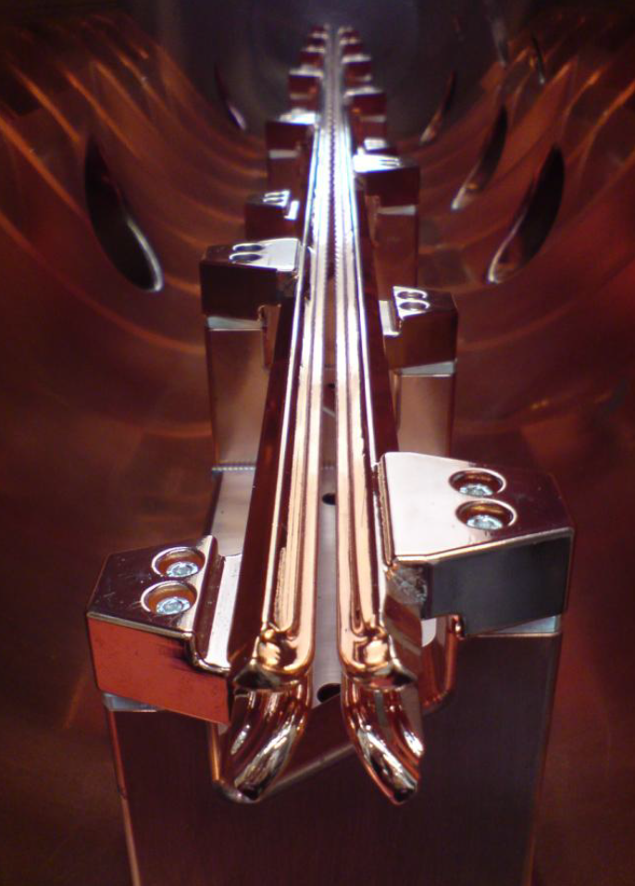
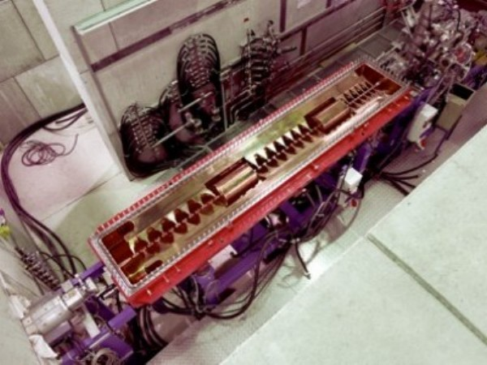
HLI (Hoch Charge State Injector)
HLI Injector (1991)
108.408 MHz
1.4 MeV/u
50 Hz operation

Slide 6
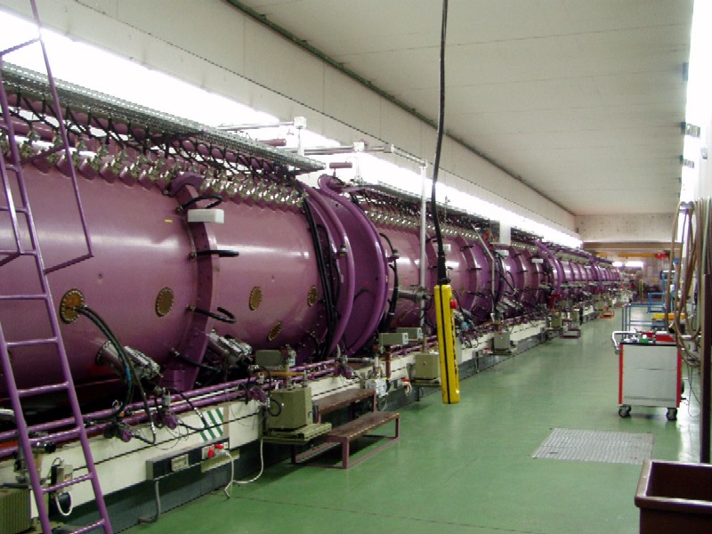
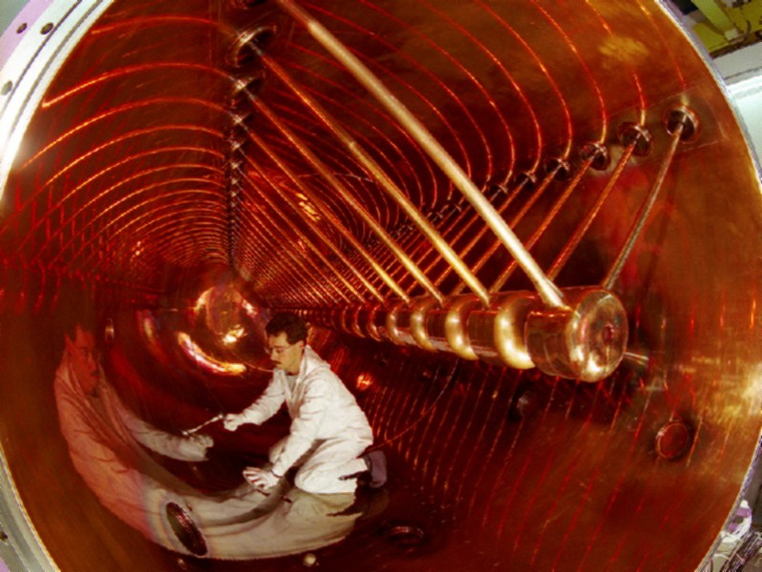
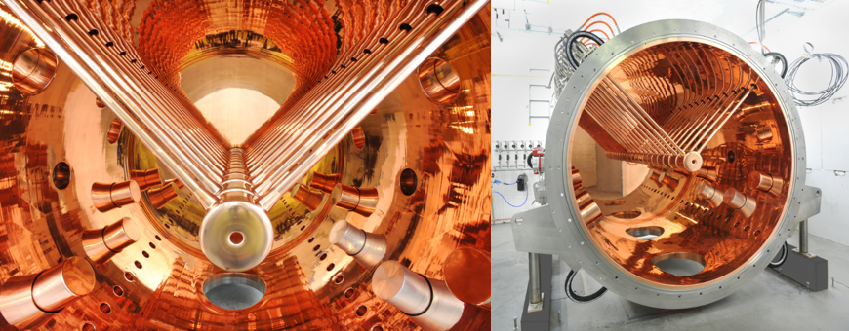
Alvarez
Alvarez (1975)
108,408 MHz
11,4 MeV/u
Avarez 4 only 10Hz operation

Slide 7
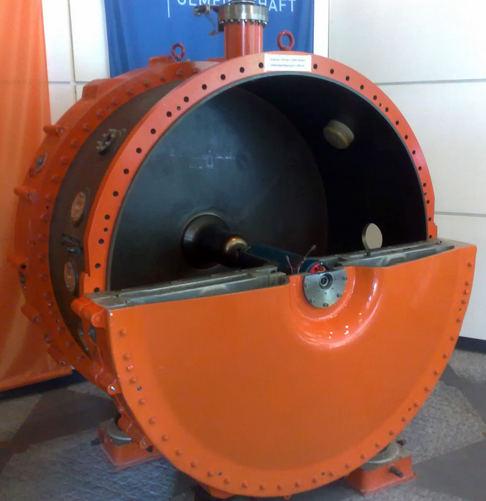
Single Gap Resonators (1975)

Slide 8
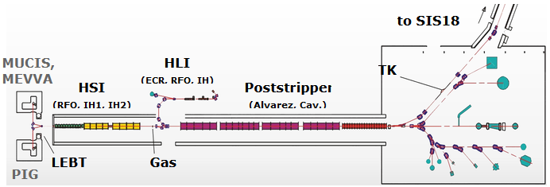
Unilac
Beamenergy
1.4 MeV/u
300 keV/u
+/- ca 1 MeV/u
120 keV/u
1,4 MeV/u
3,6 MeV/u
4,8 MeV/u
8,6 MeV/u
11,4 MeV/u
5,9 MeV/u

Slide 9
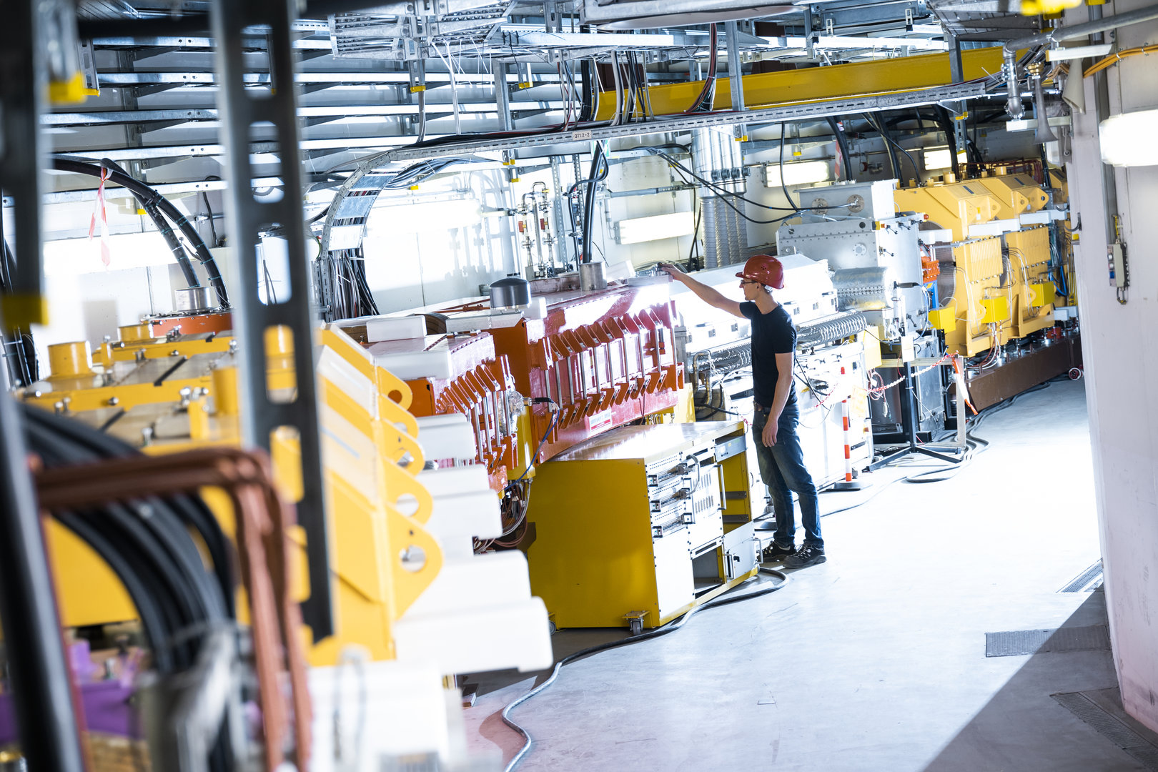
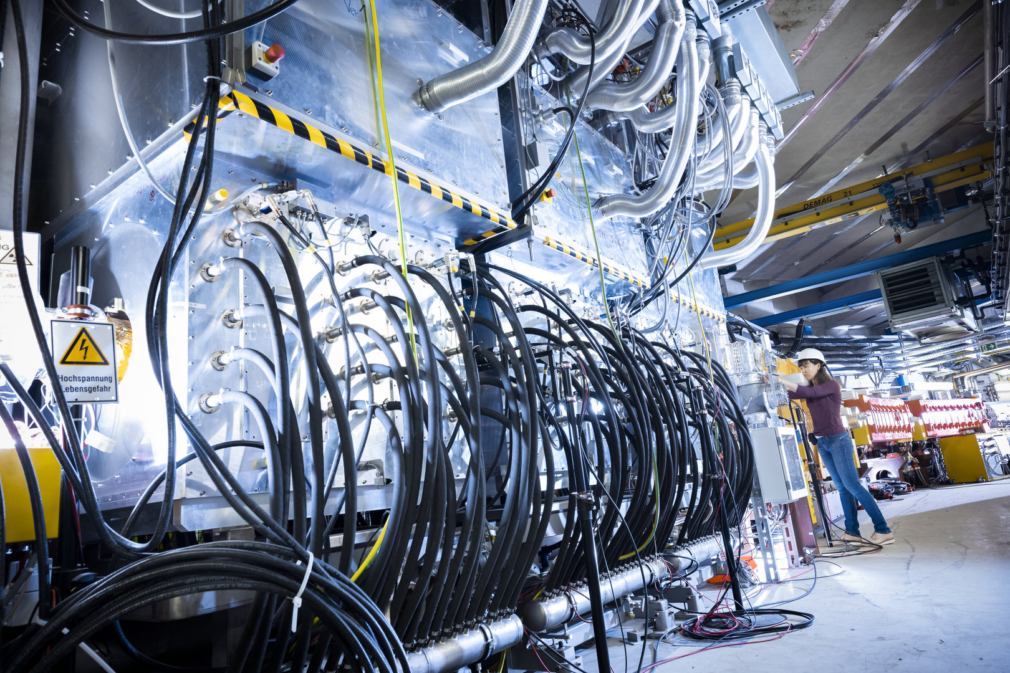
Synchrotron SIS18
216m circumference, 18 Tm, 10 T/s ramp rate
1 – 4 GeV/u

Slide 10
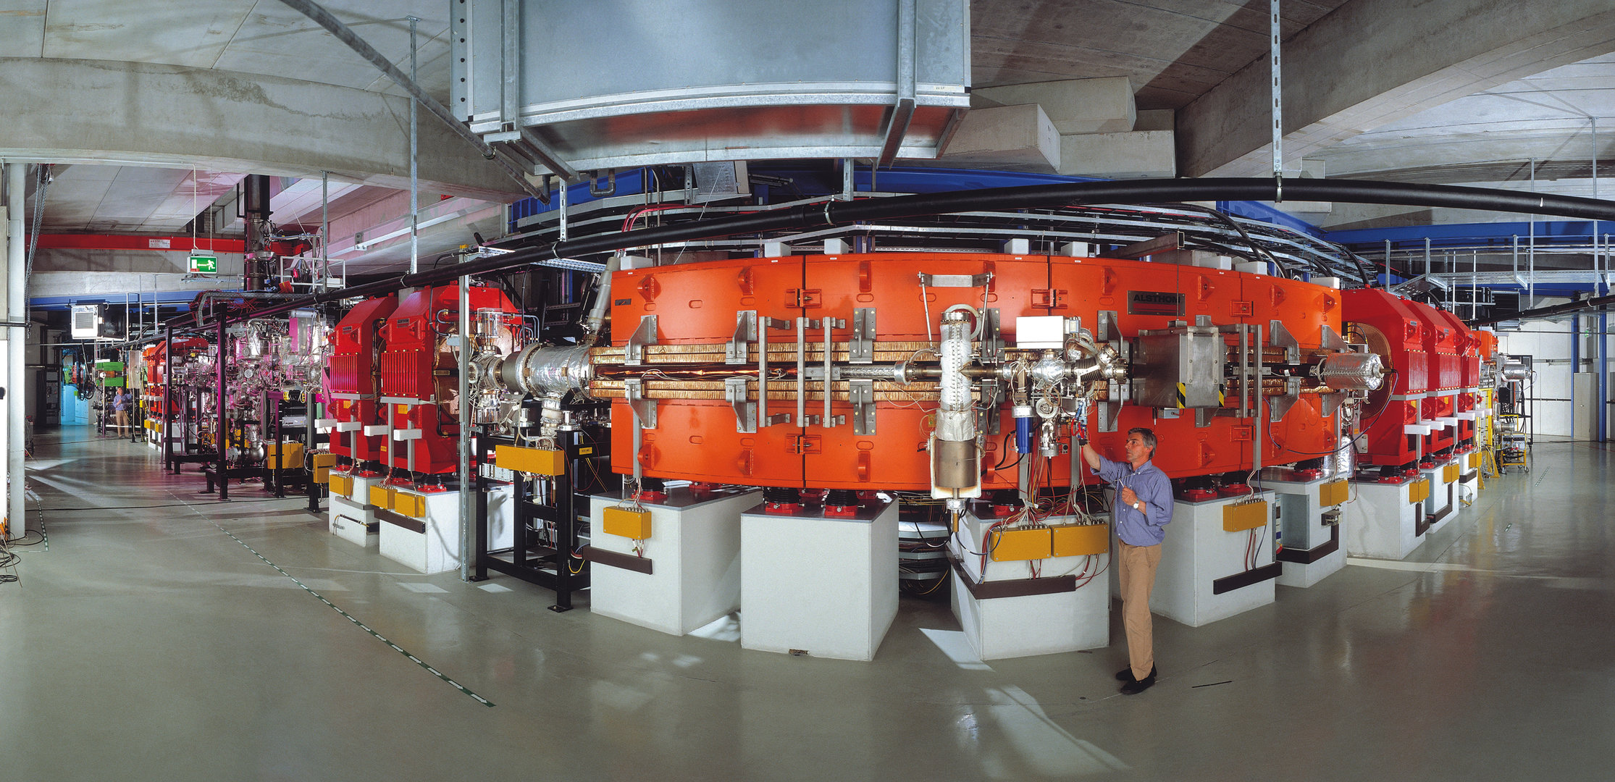
ESR: Experimental Storage Ring
ultra high vacuum, e-cooler, stochastic cooling

Slide 11
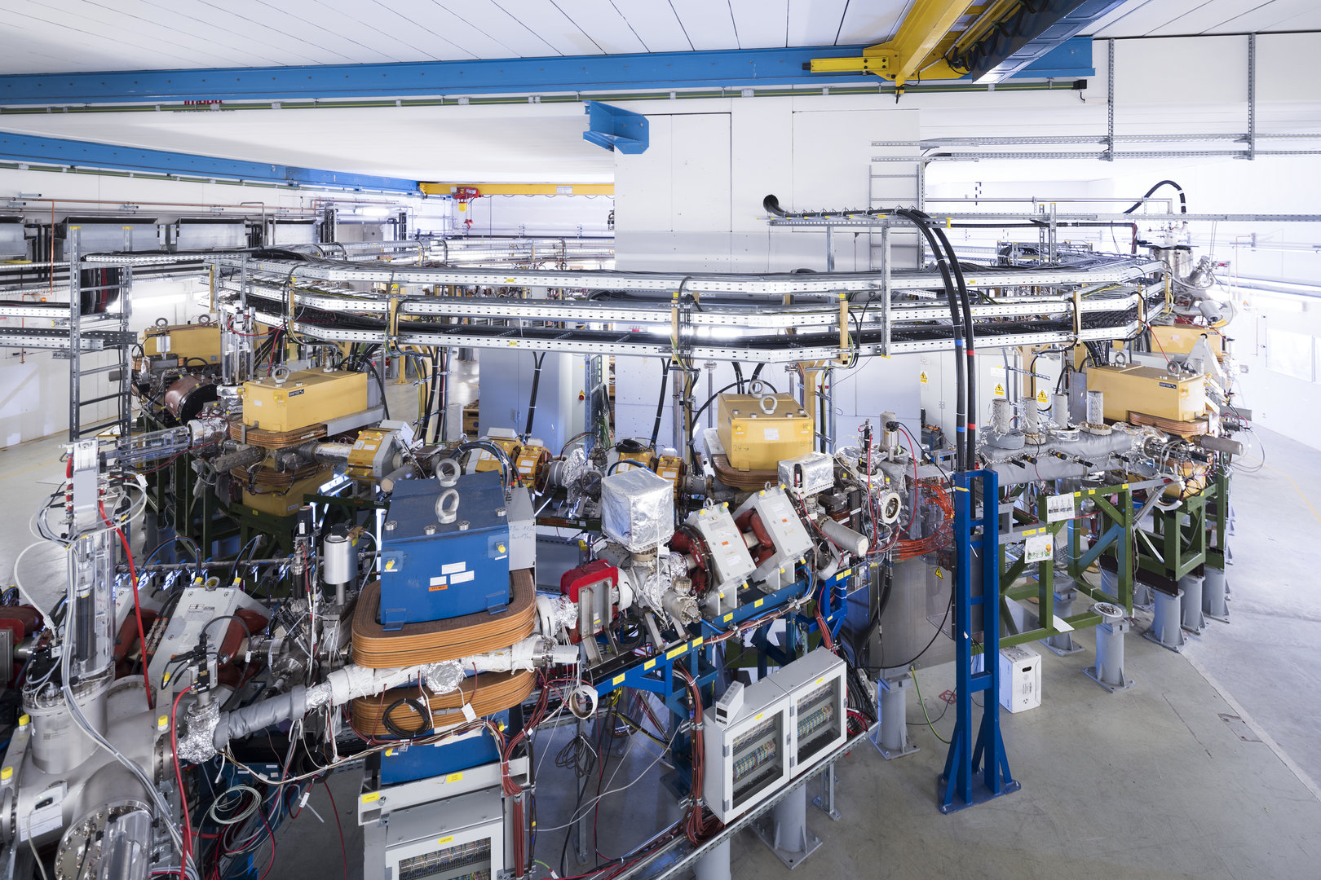
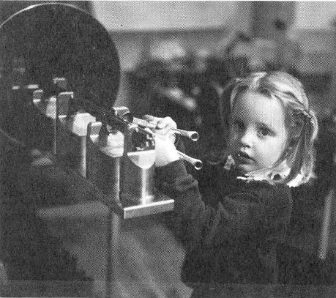
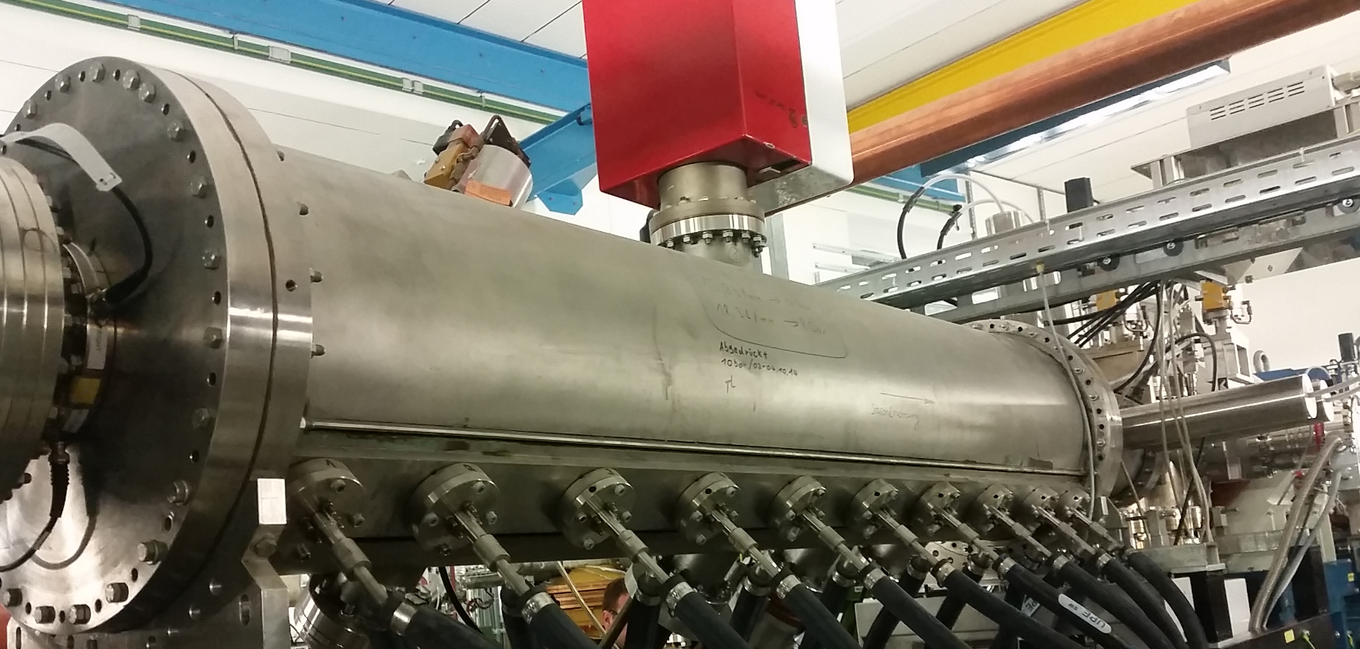
Cryring (low energy storage ring)

Slide 12
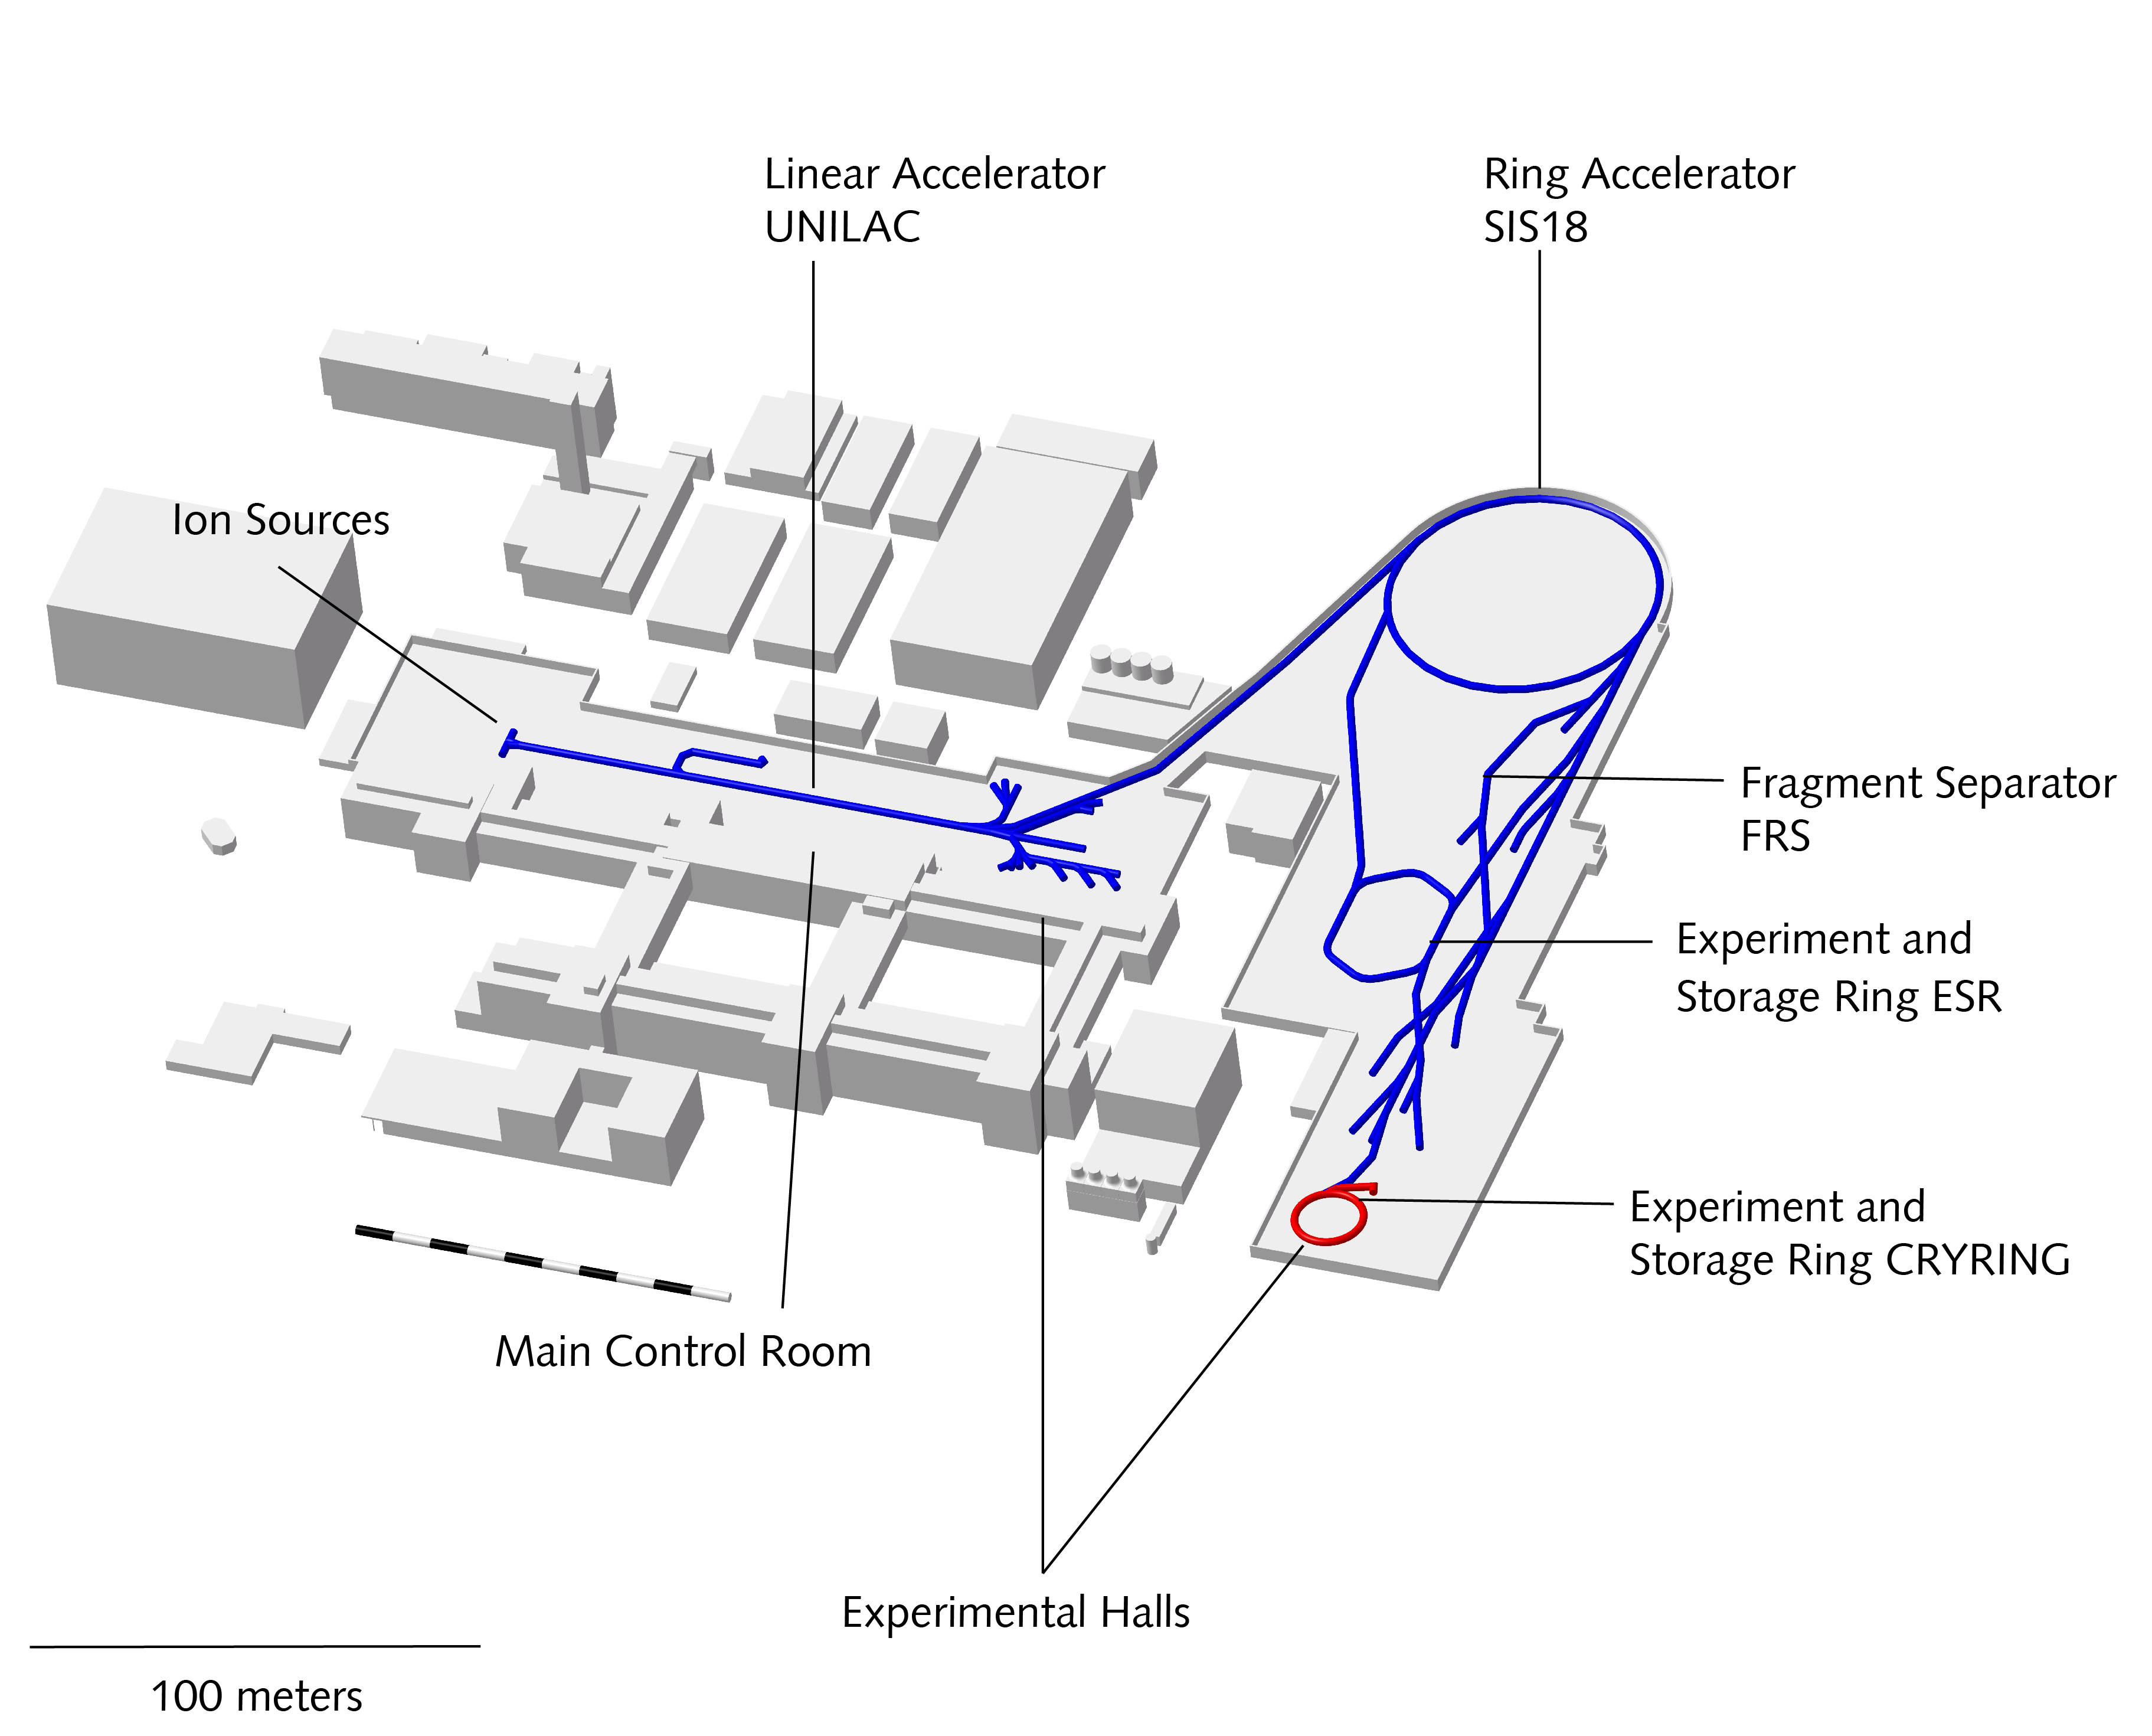
existing facility (GSI)
UNILAC
3 Ion sources @ 2 Injectors
11.4 MeV/u → 15% speed of light
SIS18
18 Tm, 90% speed of light
4.5 GeV (Protons), 1GeV/u (Uranium)
FRS (Fragment Separator)
Production and Separation of rare Isotopes
ESR (Experiment Storage Ring)
Cryring (Storage Ring for low Energys)
Image: FAIR/GSI

Slide 13
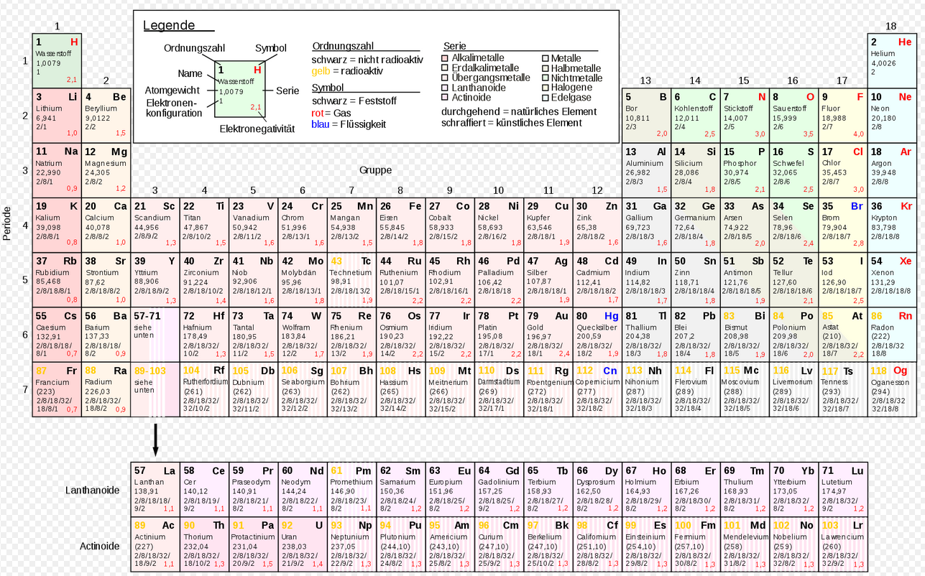
Accelerated elements
Within the last 5 years
in the current beam time
Accelerated ions: protons to uranium, also molecules such as CH3
Beam current: a few μA up to 2mA
Particles per bunch: up to 4x10¹¹
Energy: up to 11.4 MeV in Unilac, up to about 2 GeV in SIS18

Slide 14
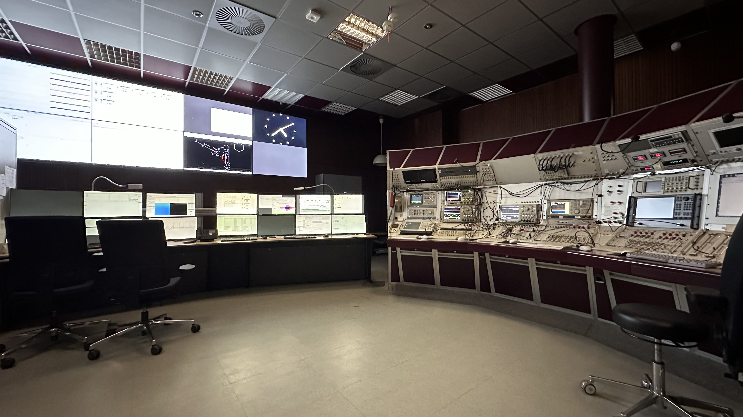
Operating
6 month (9 month) per year
24/7 operating
old vs. new control system

Slide 15
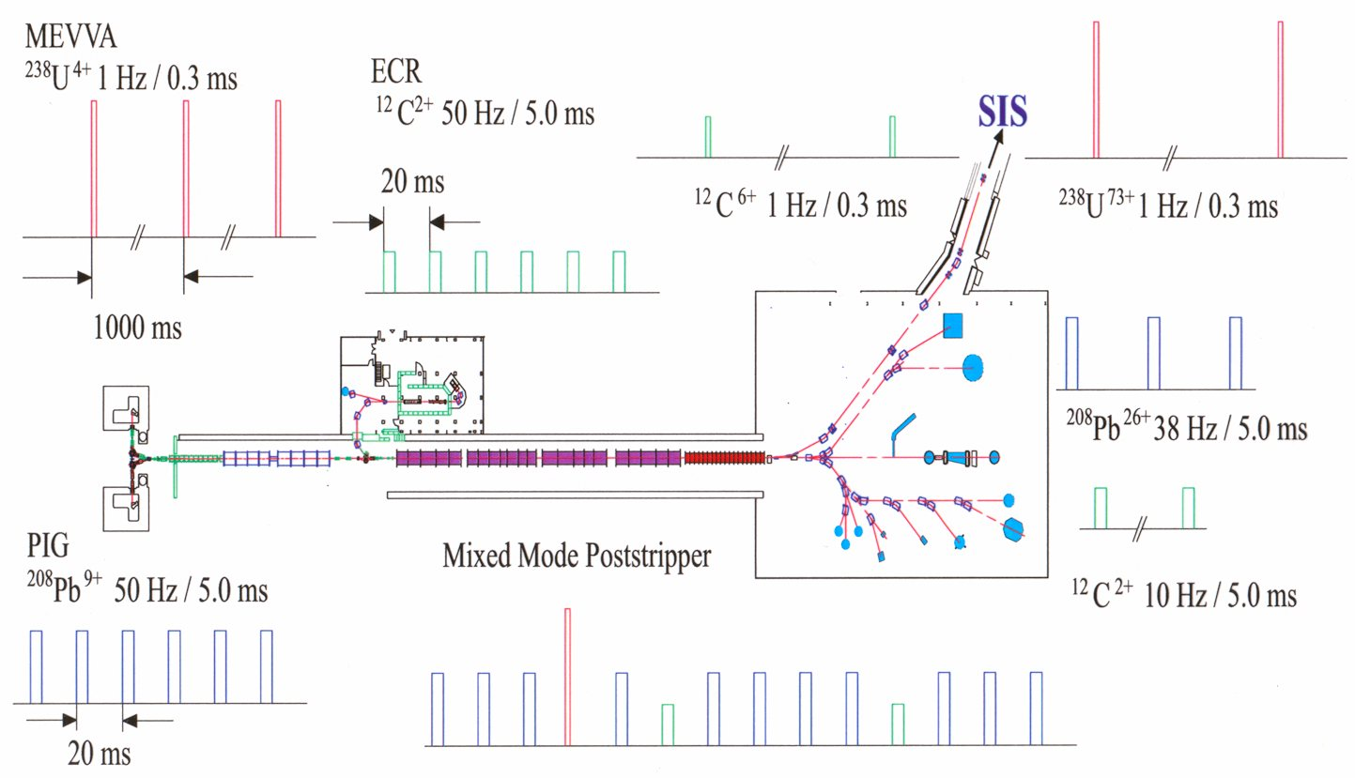
GSI accelerator system operation

Slide 16
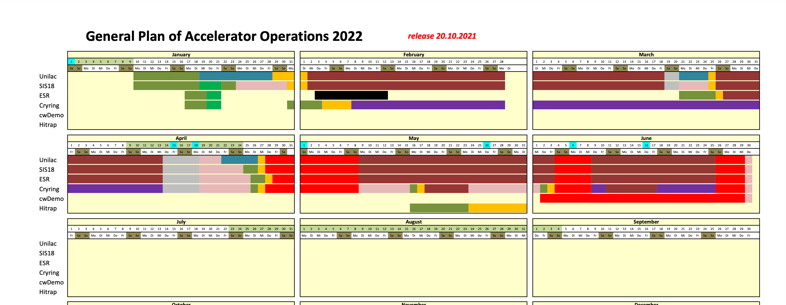
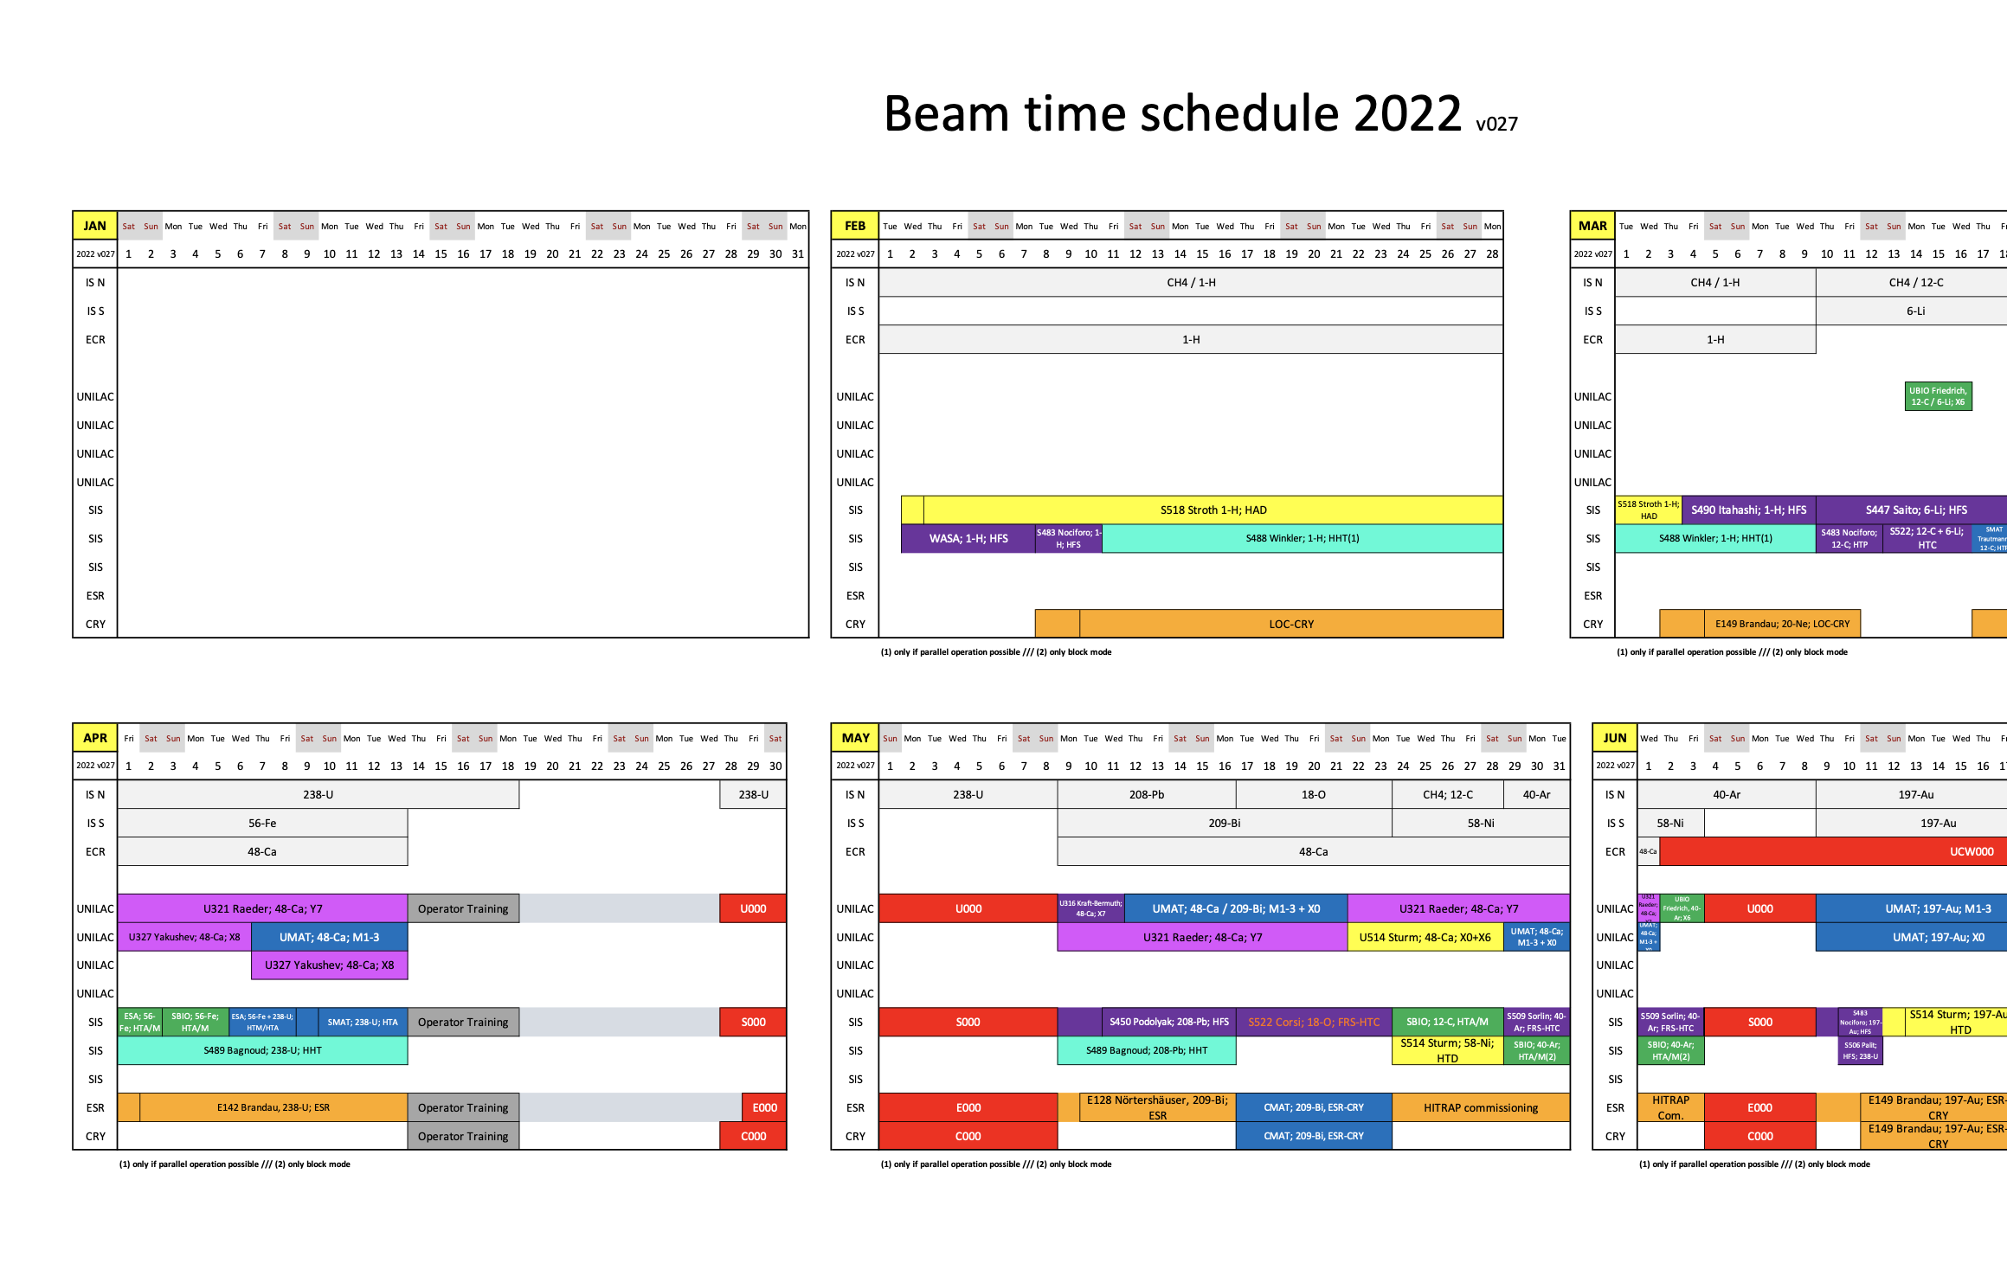
GSI (and soon FAIR) Operation Planning/Excution
Beschleunigerrahmenplan
Strahlzeitplan
gsi.de/work/beschleunigerbetrieb/betrieb/strahlzeiten
gsi.de/work/organisation/wissenschaftliche_gremien/user/beamtime

Slide 17
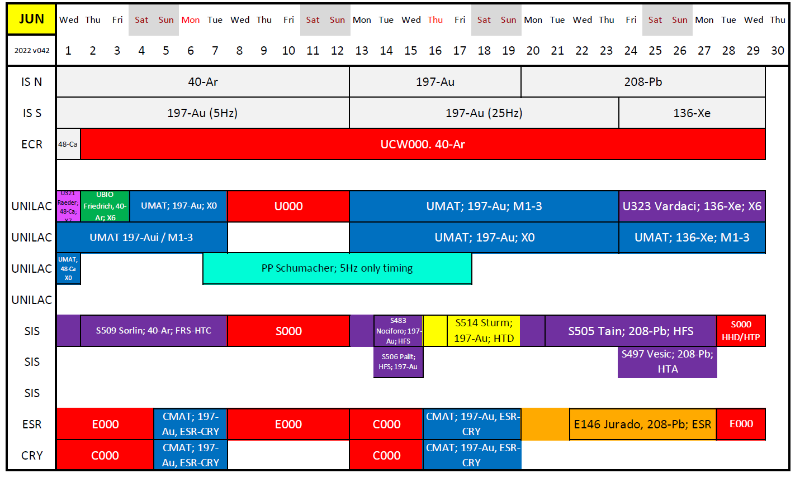
Beam Time Schedule

Slide 18
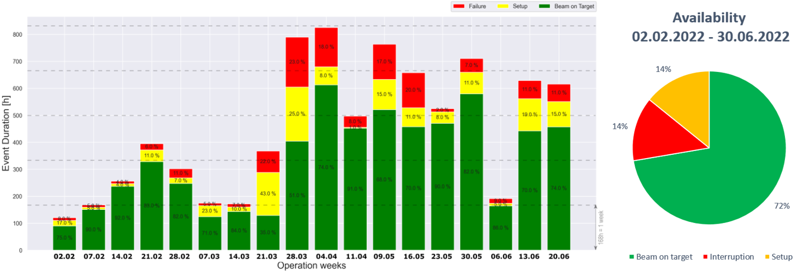
Availability

Slide 19
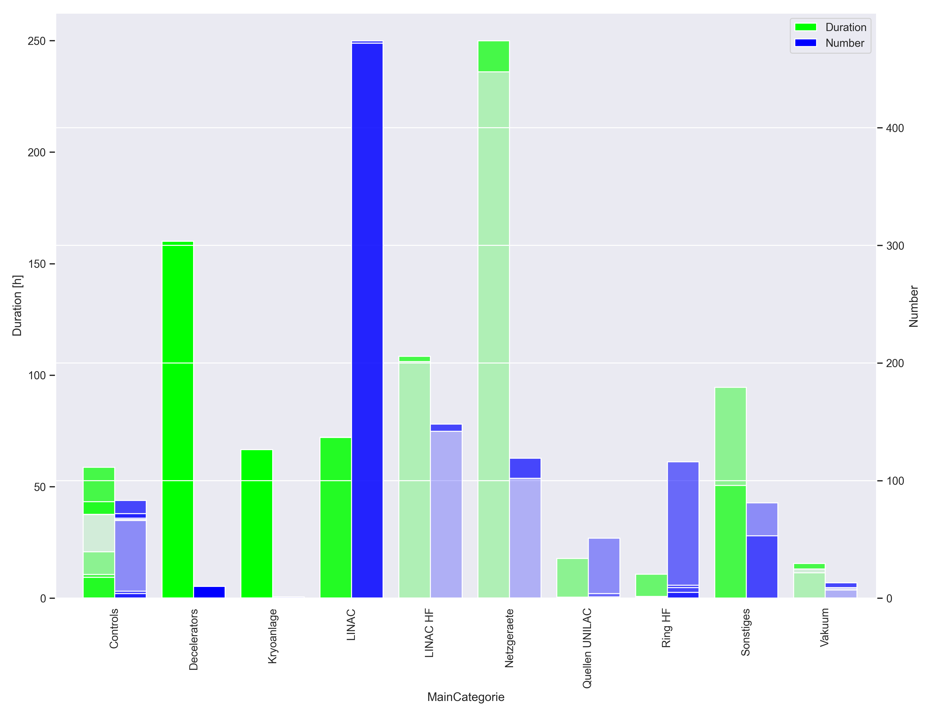
failures 2022

Slide 20
unexpected failures
aging of the machine
jumping RF phase axis
parallel operation
detect protons
uneven burning of the ion source
destroyed grids
weather events
inexperienced on-call participants
real time errors
failure of the single resonators
bad cathode quality

Slide 21
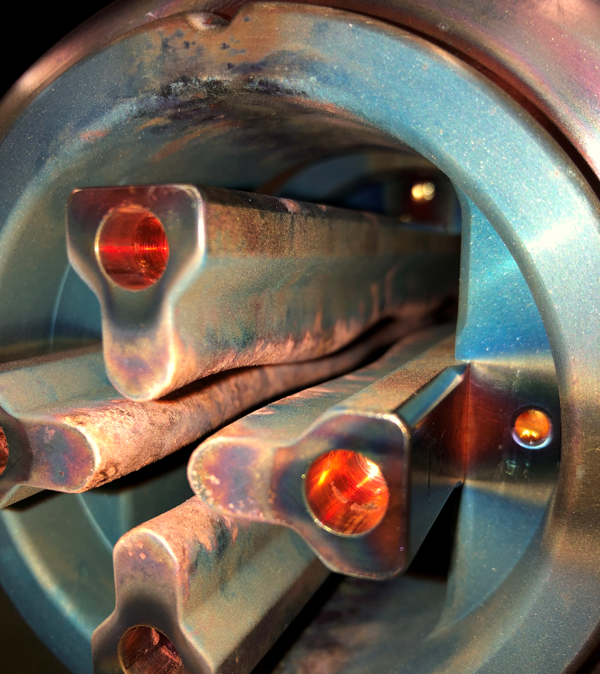
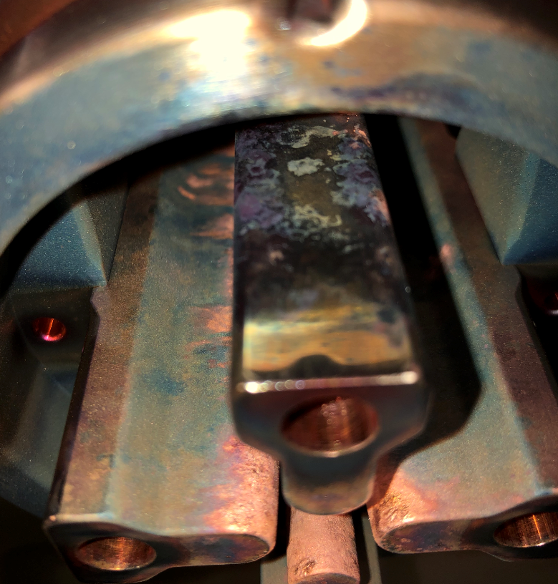
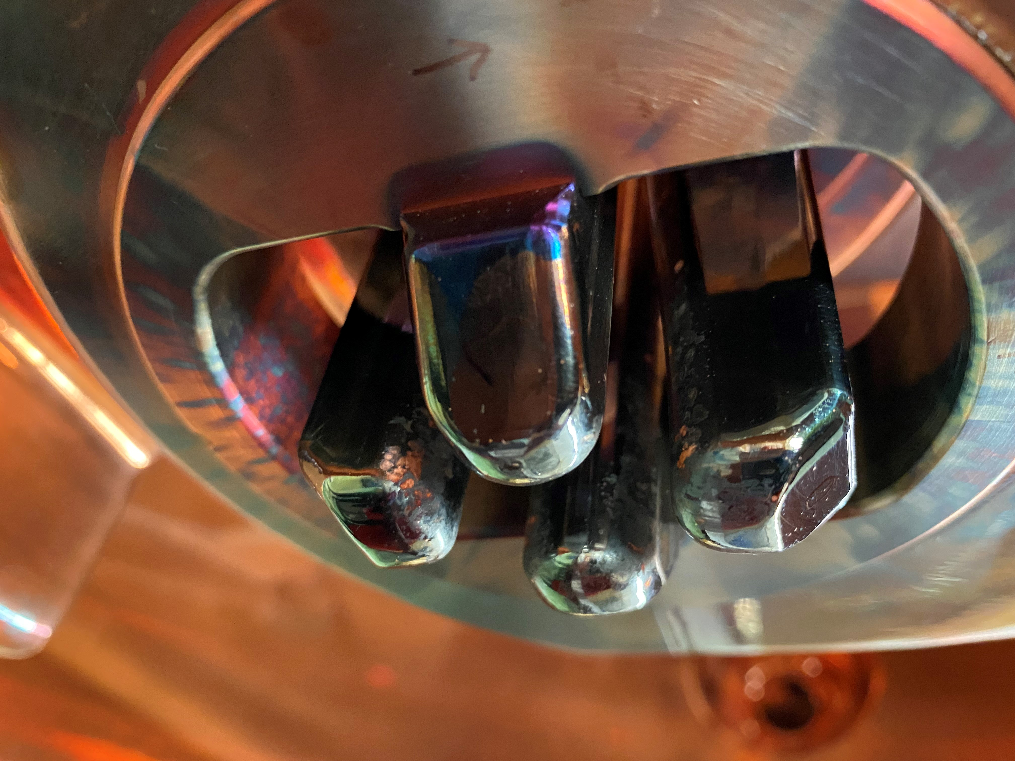
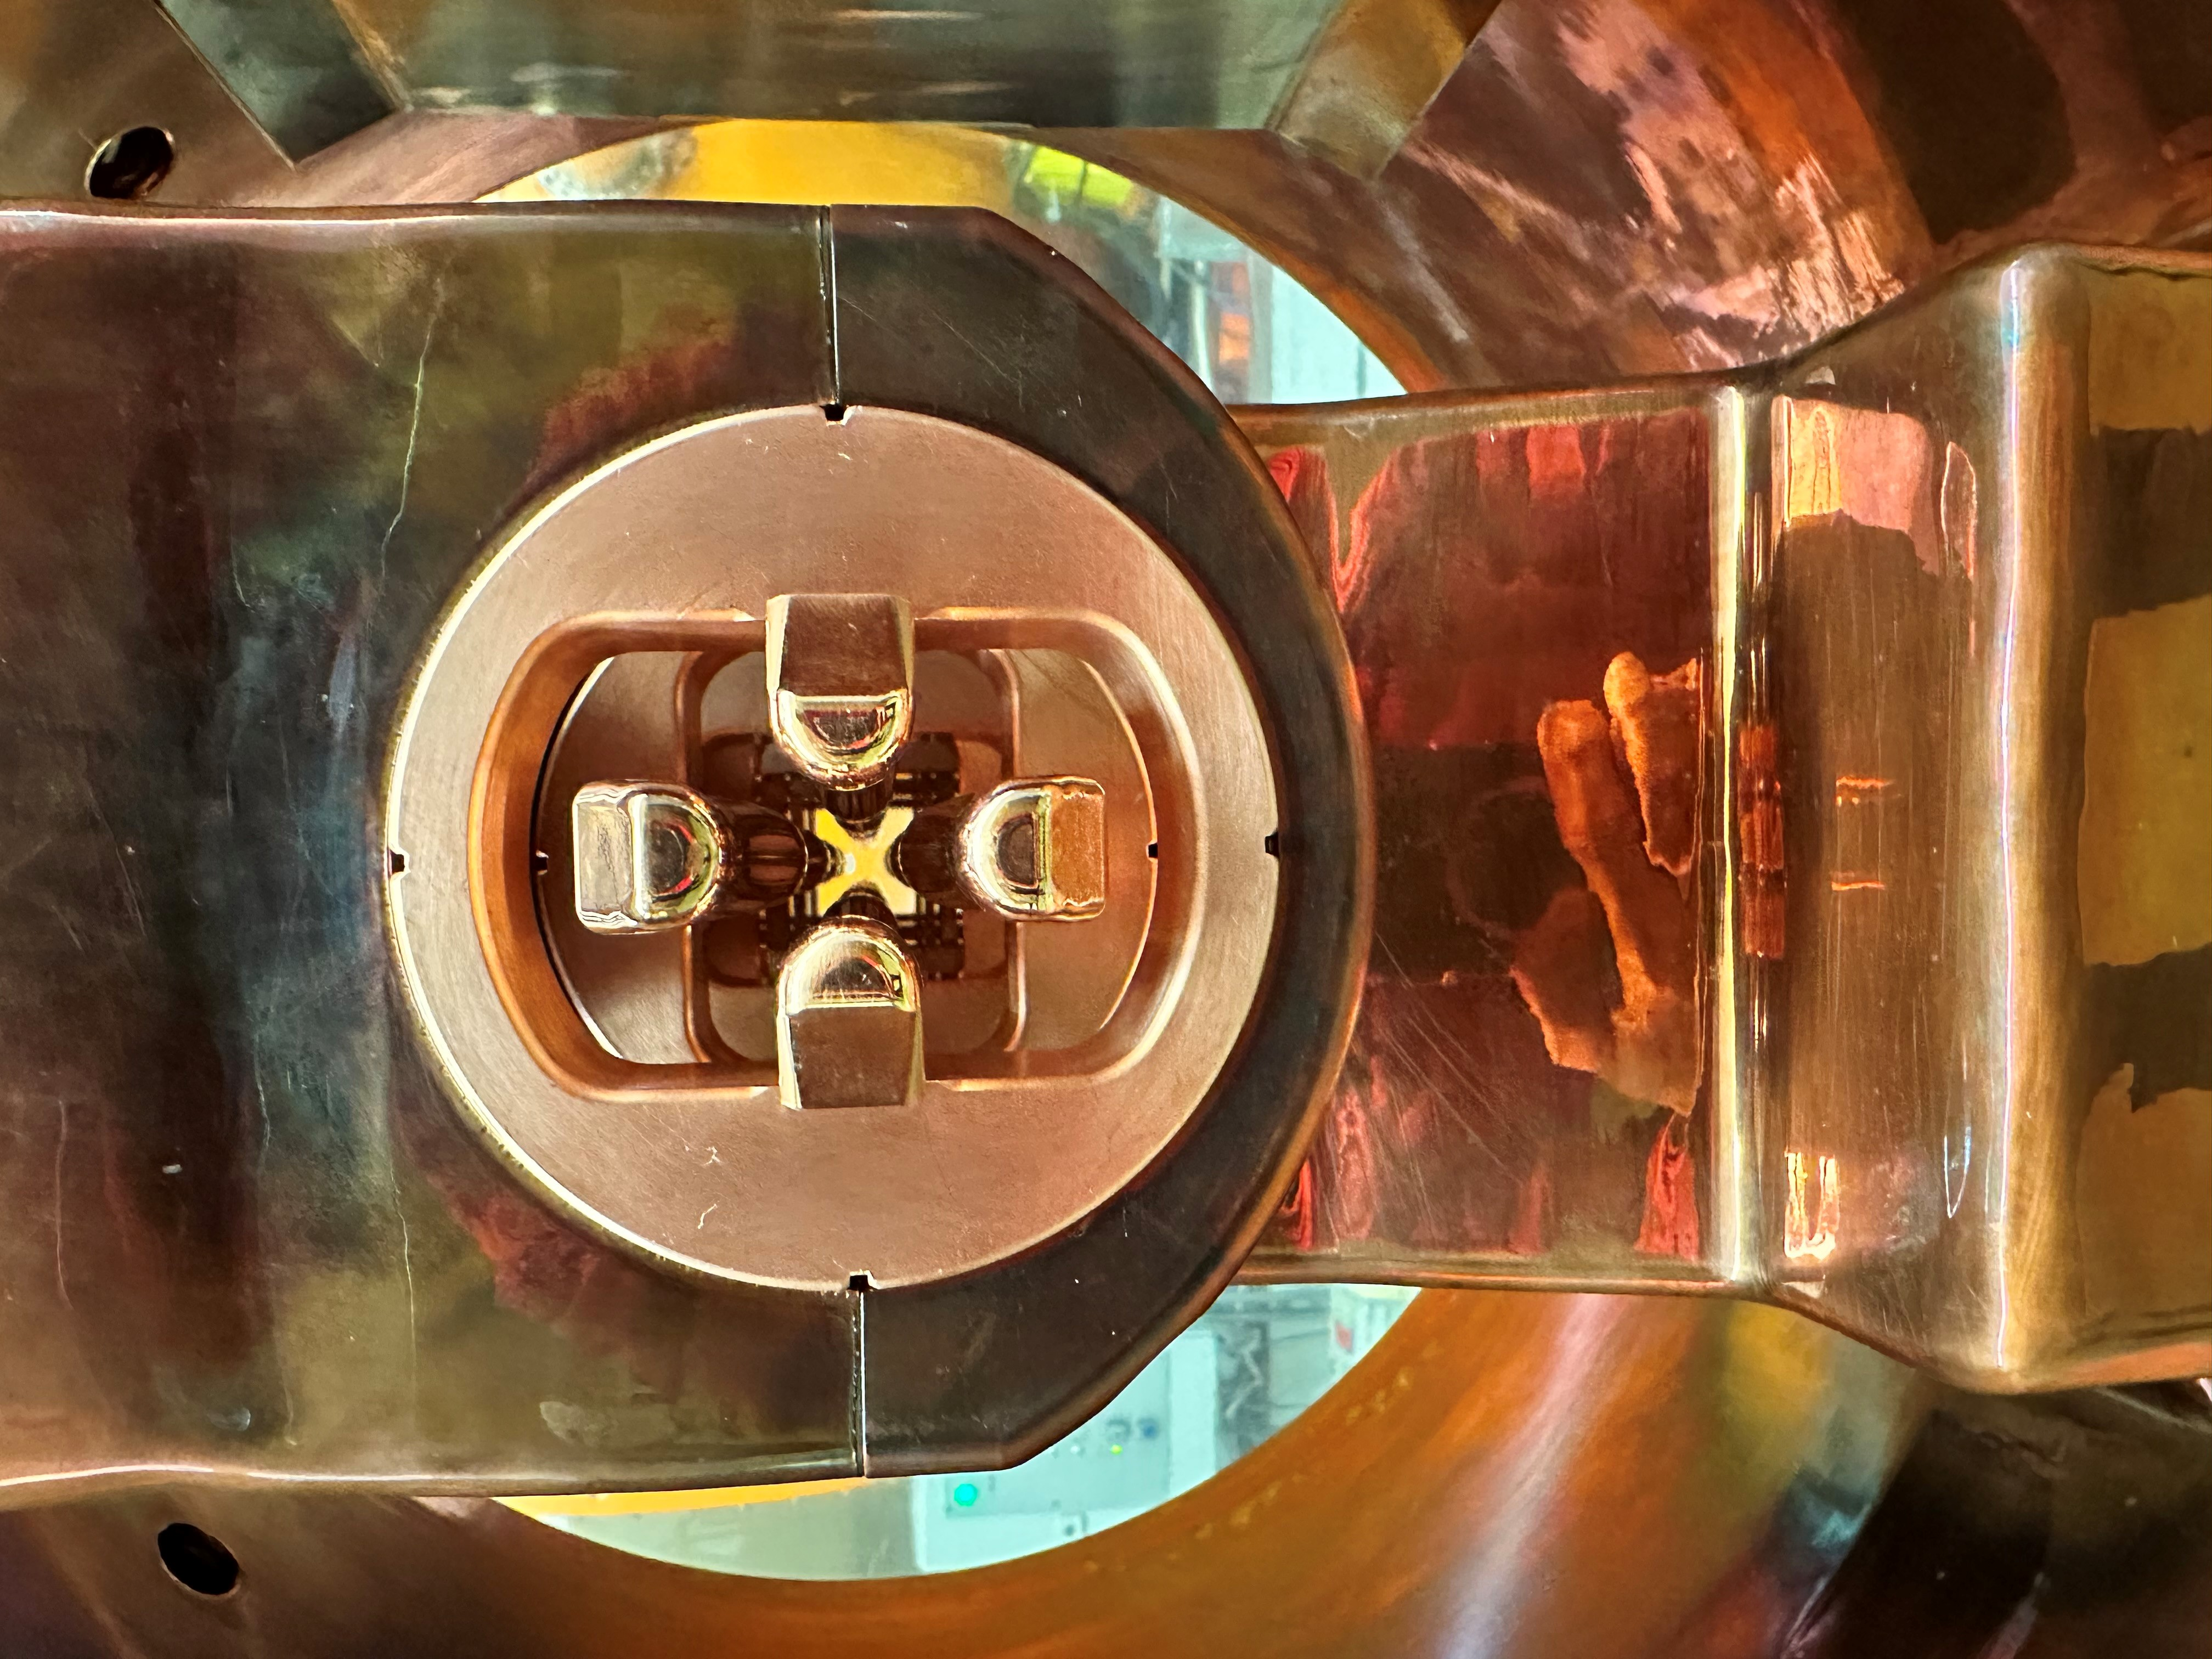
aging of the machine
bad and dirty surfaces
many electrical flashovers
short vacuum collapse
RF system must be reset (up to 40 times per shift)
in the case of heavy ions, a operator must take care of it permanently

Slide 22
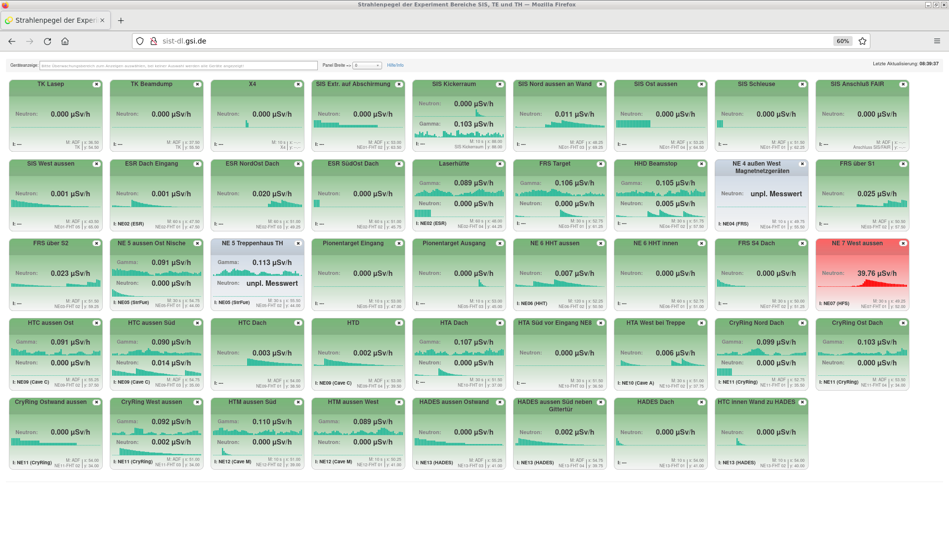
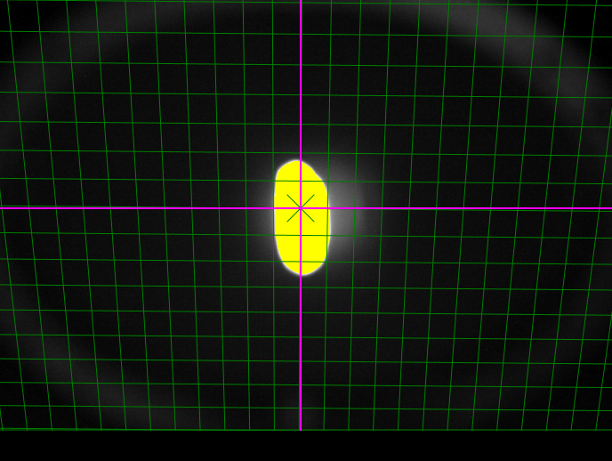
detect protons
Detect high energy protons
Beam diagnostics is designed for heavy ions
high beam intensities are necessary for fluorescence screens
high proton intensities often cause bio rems when adjusting
careful and slow adjustment is absolutely necessary
bio rems can cause longer failures

Slide 23
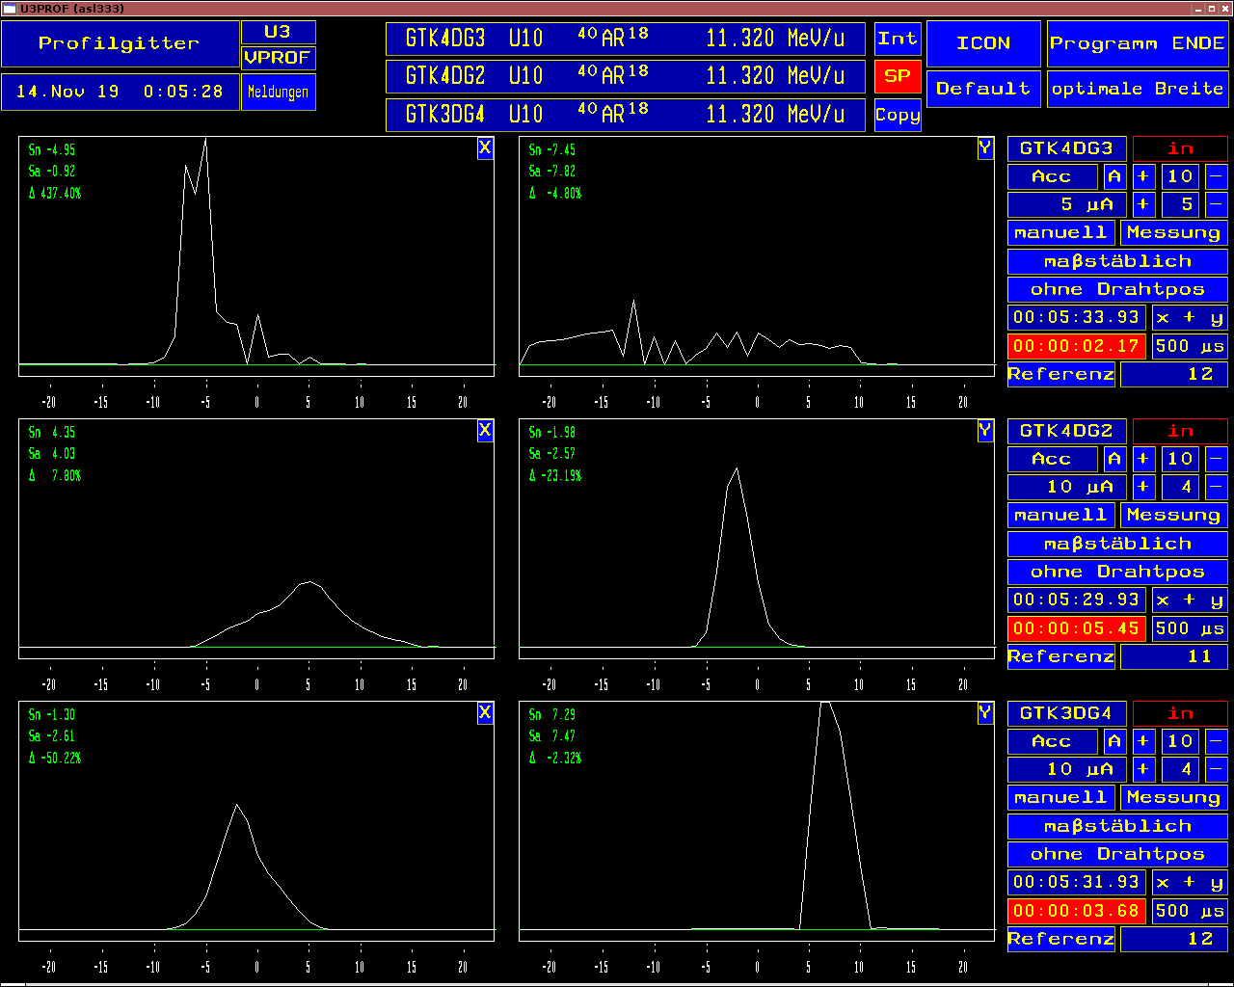
destroyed profile grids
grids were destroyed during a high-current campaign
control system error for the profile grid protection
inaccurate beam position in the settings
Beam adjustment are more difficult
significantly longer adjustment times are necessary

Slide 24
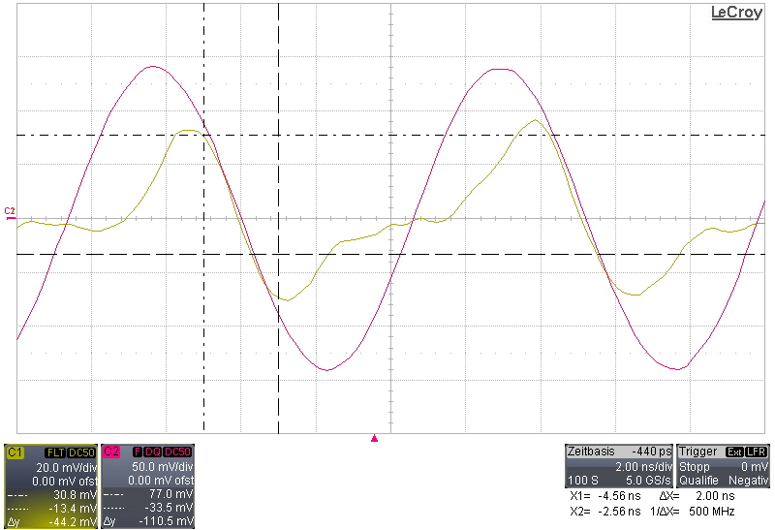
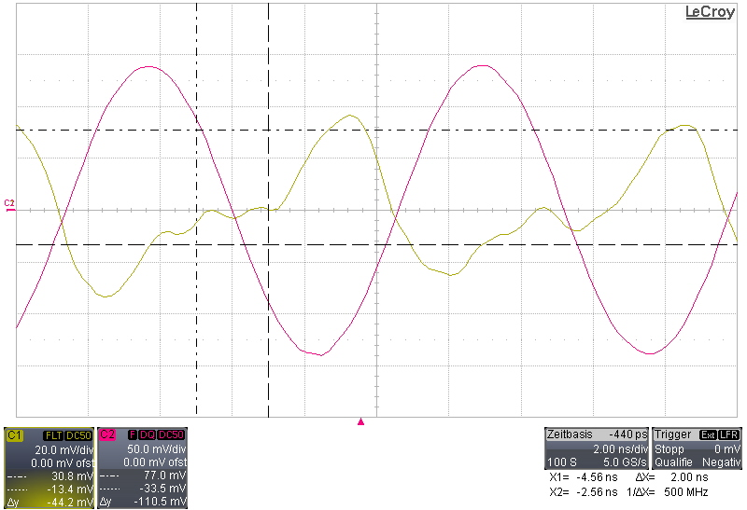
jumping RF phase axis
RF phase axis is not constantly monitored
the beam partially disappears completely
often the errors are not easy to find
complex timing system but few experts

Slide 25
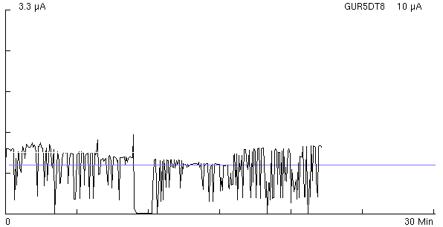
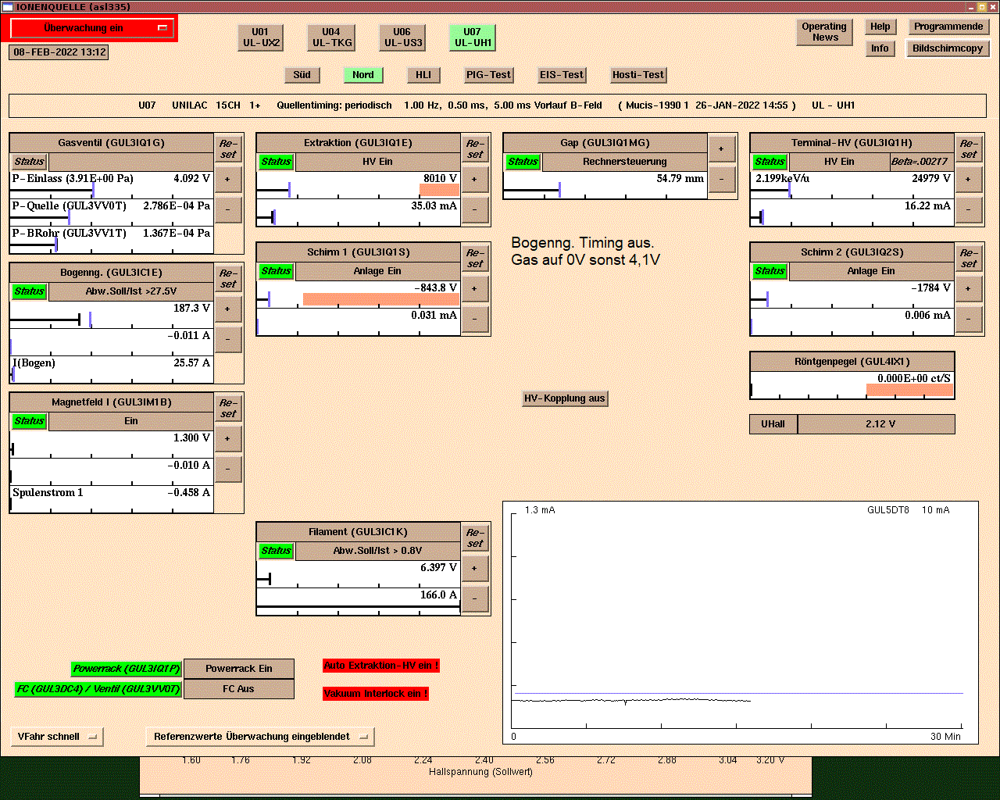
burning behavior of the ion source
burning behavior depends on type of ion
High current requirements are more difficult
stable beam for experiments not possible
constant monitoring and adjustment of the ion source

Slide 26
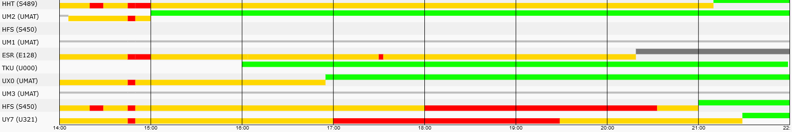
parallel operation
parallel setting disrupt ongoing experiments
adding/removing a pattern changes the position of the beam
many experiments require high rigidity and low energy. power supplies are not designed for this
frequent change of experiments
sometimes up to 5 experiments start on the same day

Slide 27

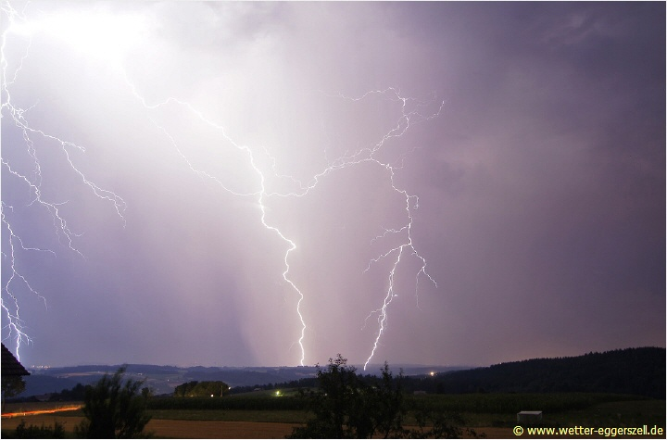
weather events
cooling water system is not sufficient
when it is hot, the cooling water is not sufficiently cooled down
causes failures in power supplies and accelerator systems
additional fans / opening the roof windows during the night are necessary
Windows must be closed by operators when it rains.
power outages due to lightning strikes
very critical for vacuum systems

Slide 28
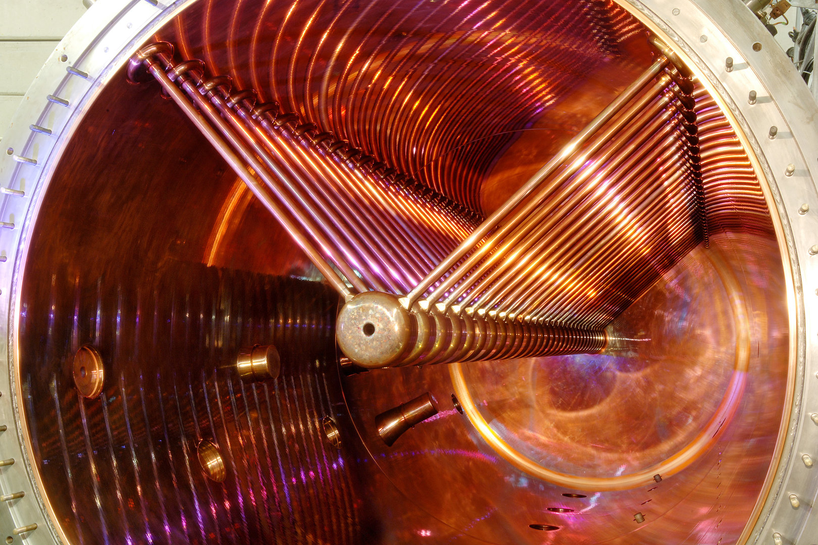
Thank you for your attention!

