Slide 1
Challenges and Activities at the GSI Accelerator Facility
HFHF-IAP Seminar, Sankt Michael im Lungau, Österreich
Ralph W. Aßmann
25.02.2024

Slide 2
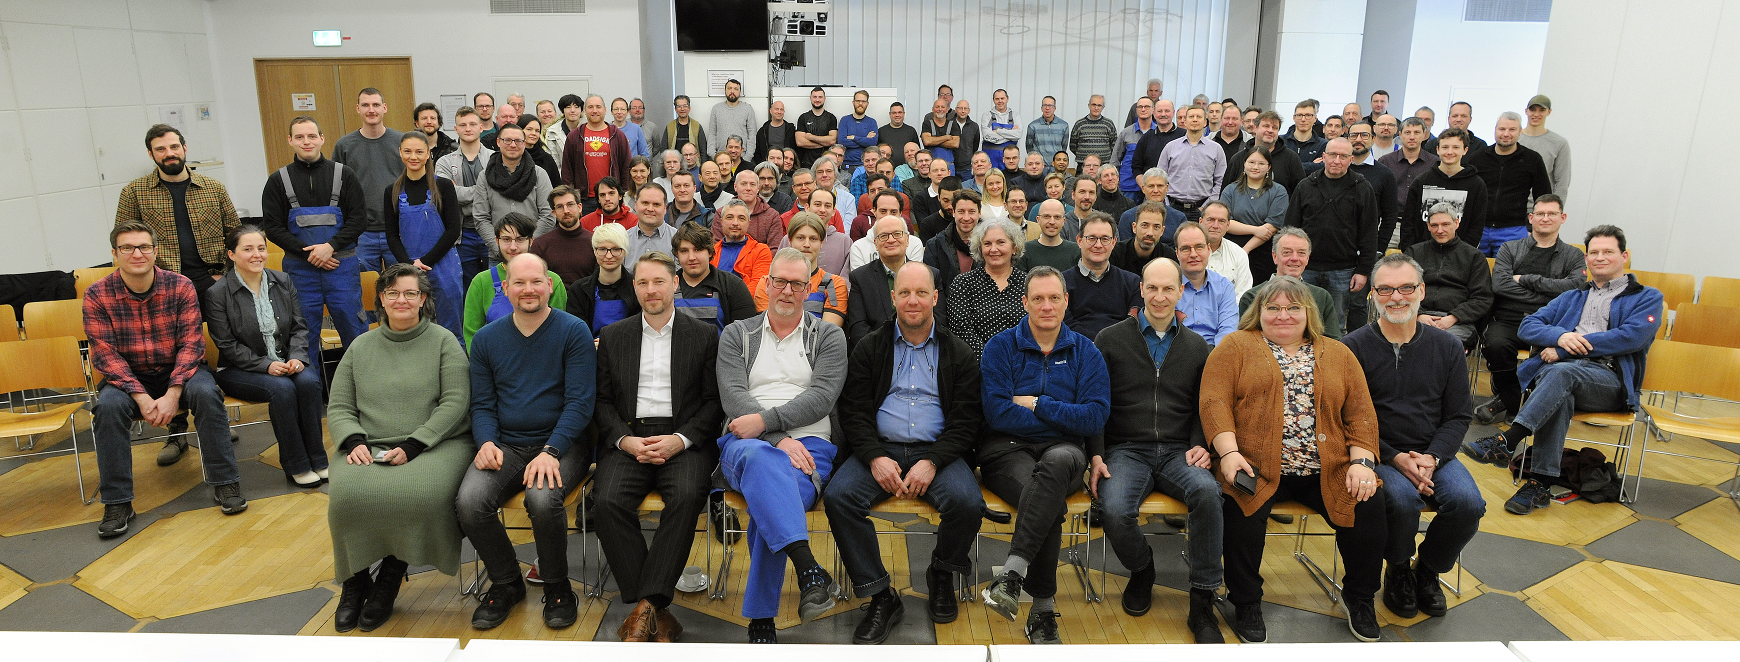
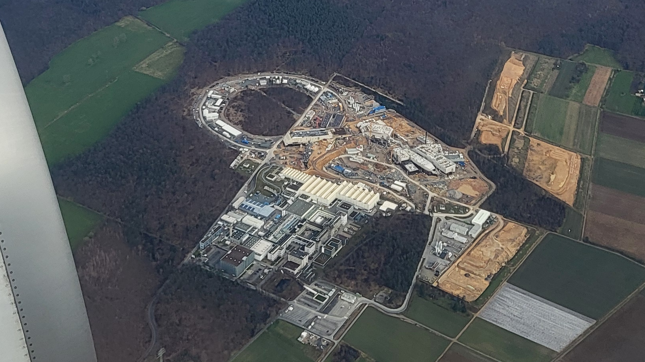
Mission “Accelerator Operations and Development”
Operation of GSI accelerators and delivering beams for world-class heavy ion research
Development of GSI accelerators and preparing them step-wise for the future
Supporting the FAIR project and its completion
Preparation and organization of FAIR accelerator commissioning
Operating costs working group lead
Merging of certain GSI/FAIR accelerator-related activities – work with regional universities and international labs
Leadership team (see photos) and young talents in depts → excellent options for future shaping of world-class GSI/FAIR accelerator area

Slide 3
Accelerator Operations & Development
At the moment: 153 Staff (front row and two right 2nd row: Leaders of Departments)
29.1.2024

Slide 4


GSI/FAIR Organisation – Technical
Sector
February 2024
ACC Operations & Development
FAIR
Project
2027
FAIR Early Science Completion
2028
FAIR First Science Completion
8 Departm.
Operations – De-celerators – Ion Sources – LINAC – LI-NAC RF – Storage Rings – Beam Cooling – UNILAC PSU
2 Departm.
Mechanics, Metal Working – Technology Lab.

Slide 5
Aerial View on 25 Feb 2024

Slide 6
Challenges for Acceleration Operations and Developments
2024 | 2025 | 2026 | 2027 | 2028 | 2029 | 2030 | 2031
Operation of existing GSI accelerators
Operation from Future Control Center FCC
Beam Comm./Op. SFRS (early science)
Beam Comm./Op. SIS-100 (first science)
FAIR planning status Feb 2024

Slide 7
Aerial View on 25 Feb 2024
Challenge: Operation of existing GSI accelerators

Slide 8
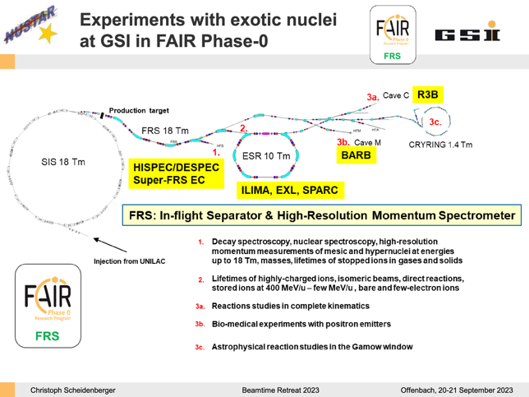
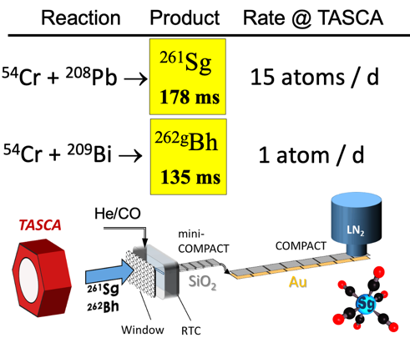
Wishes from the Experiments (SIS-18, UNILAC)
NUSTAR ("Nuclear Structure, Astrophysics and Reaction")
  Efficient use of beam-on-target time:
    Improved micro-spill and macro-spill structure
  Stay competitive on the world-wide scale:
    Higher beam intensity at 1GeV/u
  Increase duty cycle of slow-extracted SIS-18 beams:
    Many NUSTAR exp. run with 1…2 sec. extraction time: fast ramping up and down of SIS-18 will increase the duty factor
    factor 2(?) higher average beam intensity on target
SHE (”Super Heavy Elements”)
  Optimization beam transmission & material consumption:
  e.g. crucible lasts 4-5 days, service takes 2 days → 30% of beamtime lost
  Timely exchange of damaged triplet at (HLI) injector crucial!
  HELIAC: will deliver beams for SHE during PoF V → integration in planning for civil construction crucial!
Reference: Talks in Beam Retreat 2023

Slide 9
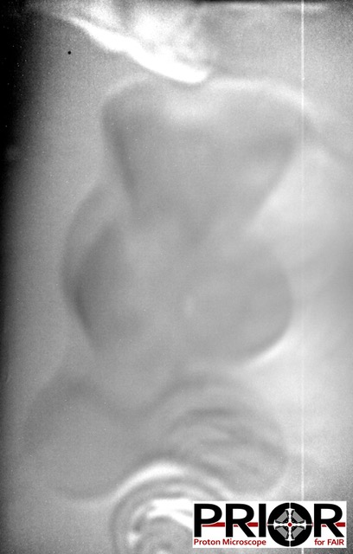
Wishes from the Experiments (UNILAC)
BIOPHYSICS
  Mixed He-C beam
  ∼10¹⁰ pps of ¹²C
  Midterm needed to produce competitive therapy research: active energy change (GSI invented)
    beam properties (energy, focus, intensity) requested from library
    changing possible from spill to spill
HiTRAP
  Decelerating from 4 MeV/u to 6 keV/u (goal 10⁵ ions).
  Solve transmission to experiment with 20% energy spread and 180 π mm mrad
  Around 7 days of further commissioning time with beams from ESR (commissioning blocks beginning of 2024&2025)
Reference: Talks in Beam Retreat 2023

Slide 10
Wishes from the Experiments (CRYRING, ESR)
SPARC
  Storage rings overbooked by factor 4.5
  Transmission: FRS → ESR, ESR → CRYRING, ESR → Cave A (new control system)
  Beryllium-like 197Au75+ ions (> 5 10⁶) from SIS → ESR → CRYRING
  Accumulation, purification, electron and stochastic cooling, new target in TE, lasers, gas-jet operation, windows and detectors
  ESR:
    Optimize deceleration capability (e.g. vacuum, power supply stabilization with drift tubes)
    accumulation of Li-like RIBs (Bi80+) with different method (ecool-stacking)
    Ultra-slow extraction
  CRYRING:
    optimize/increase the intensity of soft beams (e.g. Ne3+)
    new ion species (e.g. W14+)
  Most equipment is stored and maintained by university groups outside the campus of GSI/FAIR. For setup assembly and testing, a work area outside CRYRING@ESR is an absolute necessity.
Reference: Talks in Beam Retreat 2023

Slide 11
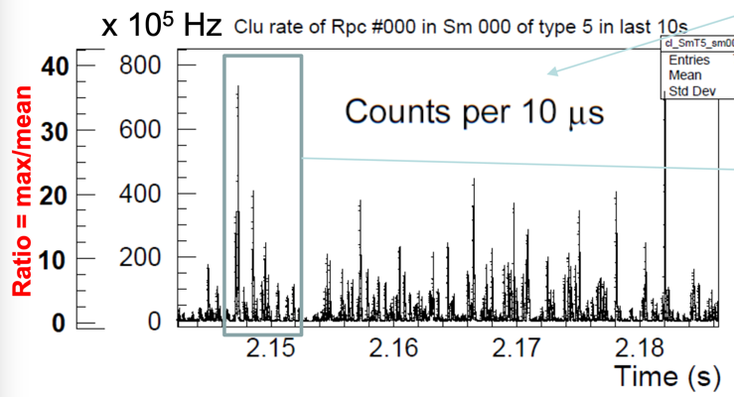
Wishes from the Experiments (SIS-18, HEST)
HADES (“High Acceptance Di-Electron Spektrometer“)
  G-22-00022 (C/Au beams)
    Stable, well focused beam on the HADES target, beam spot diameter < 2mm (+-3sigma, 99,73%), slow extraction
    Au ions: 0.8A – 0.2A GeV, 1.2*10⁶ ions/s (flat top)
    C ions: 0.8A–0.6A GeV, 3*10⁶ ions/s (flat top)
    Spill duration > 13 s to improve the duty factor
    Desired micro and macro time structure (Q<5)
    Beam Abort System (MP) installed & operational, reaction time ~100 ms
  G-22-00141 (Pion beam)
    Fully stripped N ions, 10¹¹ ions/s, 1.7 GeV/u, slow extraction, 1 s flat top, 80% extraction efficiency
    Extraction efficiency SIS18, enlarged apertures, improved radiation shielding
Plus wishes and requests from accelerator experts for improvements, reno-vations and upgrades!
Reference: Talks in Beam Retreat 2023

Slide 12
Beam Retreat Presentations are Partly Addressed
Of course, there is already a working improvement process in place.
Presentations at beam time retreat and discussions.
Actions by the responsible machine coordinators and facility divisions → improvements.
Works best for shorter term improvements.
Limited for long term actions and major investments, that require staged invests and major resource allocations → resource-loaded technical roadmap with full coherency over the full accelerator complex.
Also expected from us for Helmholtz POF5 review (→ funding).
Must include smaller and larger actions, ordered in time and with a basic plan until completion.

Slide 13
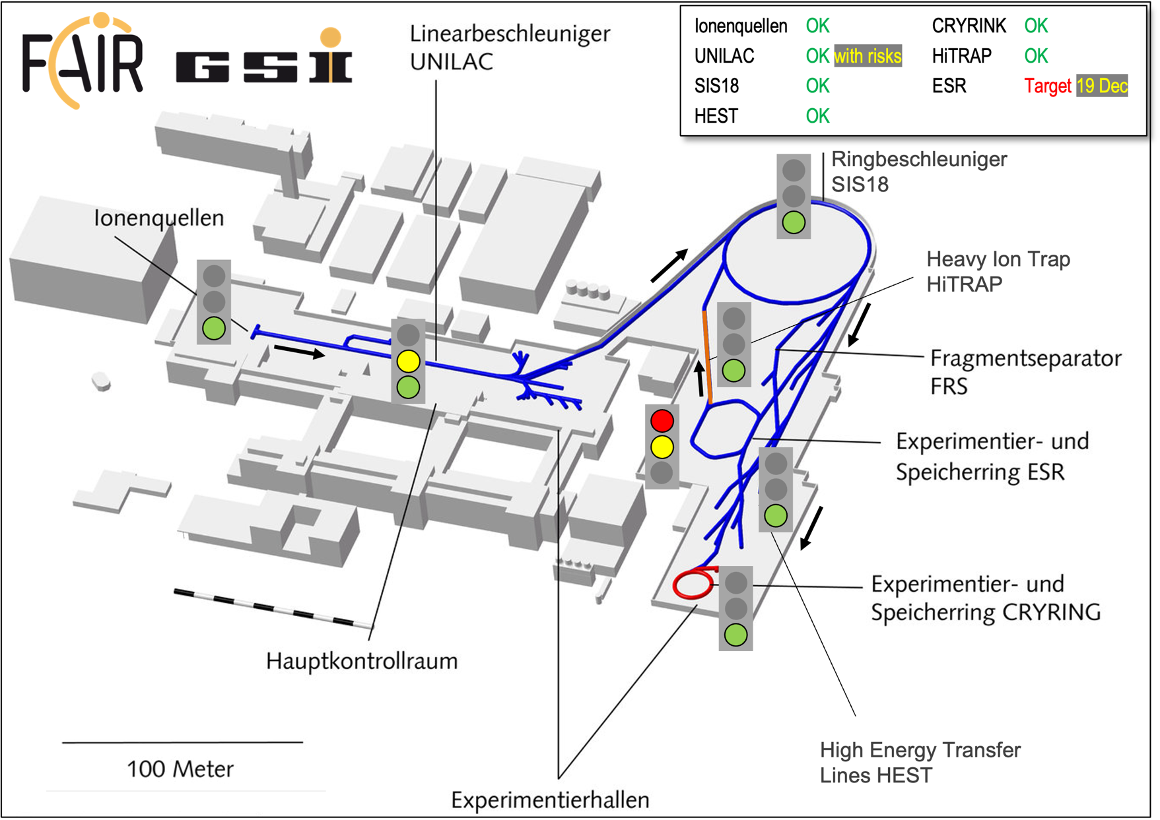
Example: N Beam for HADES
This particular delivery
process “tests” big parts
of the accelerator complex
and delivers beam for users
UNILAC: ¹⁴N⁷⁺ 5.4 emA @11.4 MeV/u (150% of UNILAC design limit)
  (N₂)⁺-acceleration at HSI to overcome space charge limitations
  Two stripping process for max. intensity in charge state 7+

Slide 14
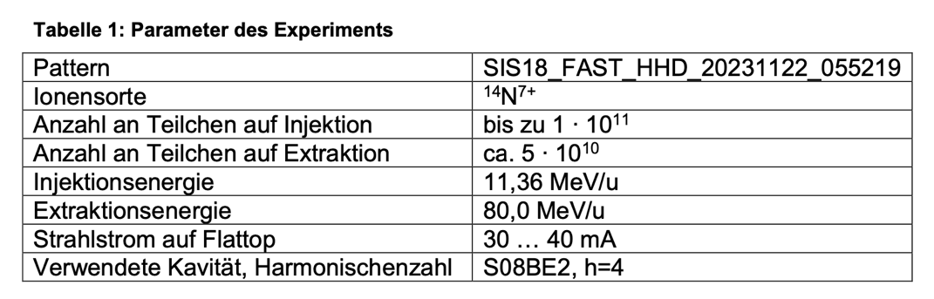
SIS18: Test N Beam Phase Regulation
D. Lens, B. Zipfel, et al
off
on
off
on

Slide 15
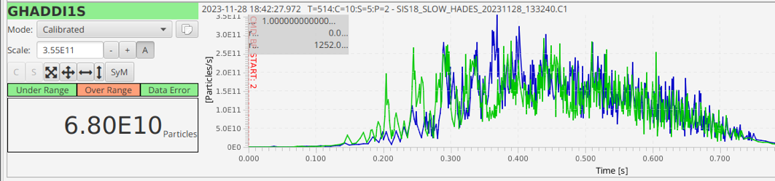
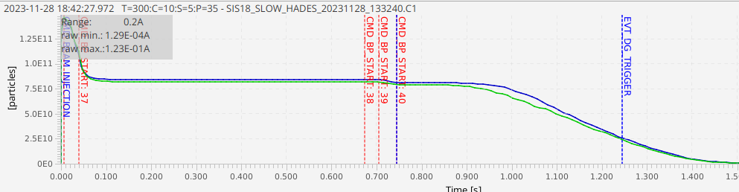
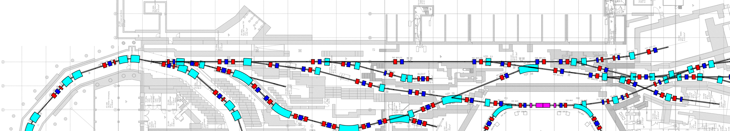
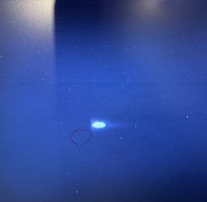
Courtesy C. Hessler et al
HEST: High-Current N Study for HADES Pion Run
During 2014 pion run the beam intensity had to be limited due to high radiation dose levels observed in the target hall, which were caused by beam losses in the extraction region and in HEST.
Improvements in HEST to overcome this issue:
  Quadrupole vacuum chambers with increased apertures
  Installation of BLMs
  New transfer line optics for pion production
During the high-current study the transmission from SIS18 to the pion production target could be significantly increased by a factor 3-4 to 80% (incl. extraction efficiency).
Analysis of radiation dose data is on-going.
@ pion target
8.5E10 ions in SIS18
pion
target
HADES
SIS18

Slide 16
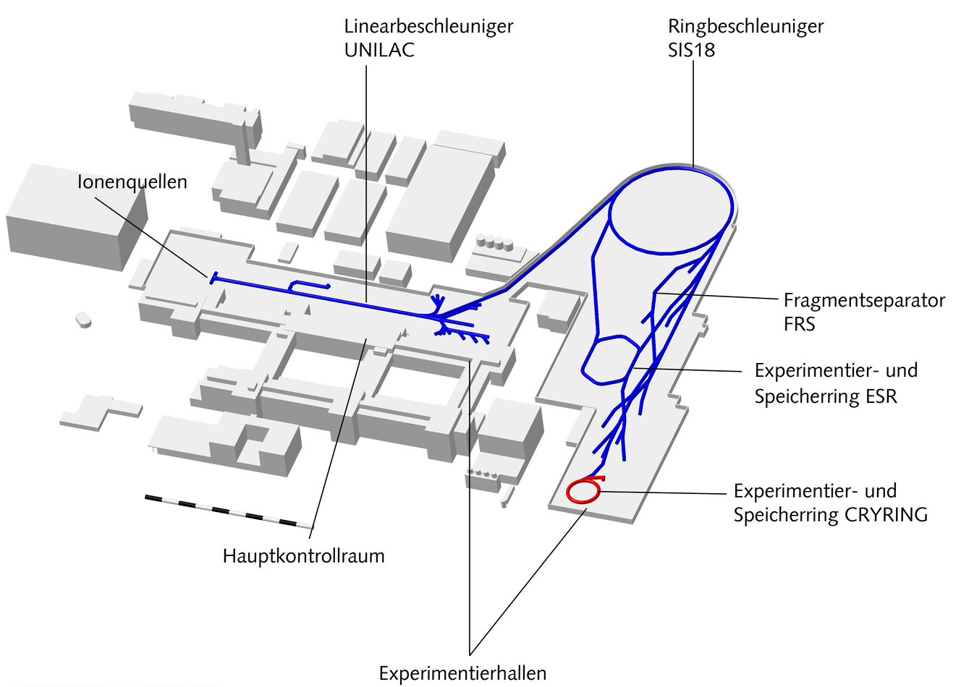

Status Accelerators
25 Feb 2024
Ionenquellen OK CRYRINK OK
UNILAC OK with risks HiTRAP OK
SIS18 OK ESR Target 19 Dec
HEST OK
19 Jan
Ringbeschleuniger
SIS18
Shutdown achievements:
Modernization, upgrades and repairs. Prepare for user run but also FAIR operation. Major works done, some the 1st time in decades (e.g. ESR).
Examples: Sources – new ion species prepared. UNILAC tunnel septum magnet improved → Z line can be served again after several years. Exchange of superlens electrodes → operation back with high performance. SIS18 new micro-spill cavity for smoother ion rate in slow extraction. HEST diagnostics modernized and digitized. CRYRING new experimental capabilities. HiTRAP RFQ tuned up to higher fields and software modernized to FAIR standard (ongoing). ESR cooling equipment repaired.
Heavy Ion Trap
HiTRAP
High Energy Transfer
Lines HEST

Slide 17
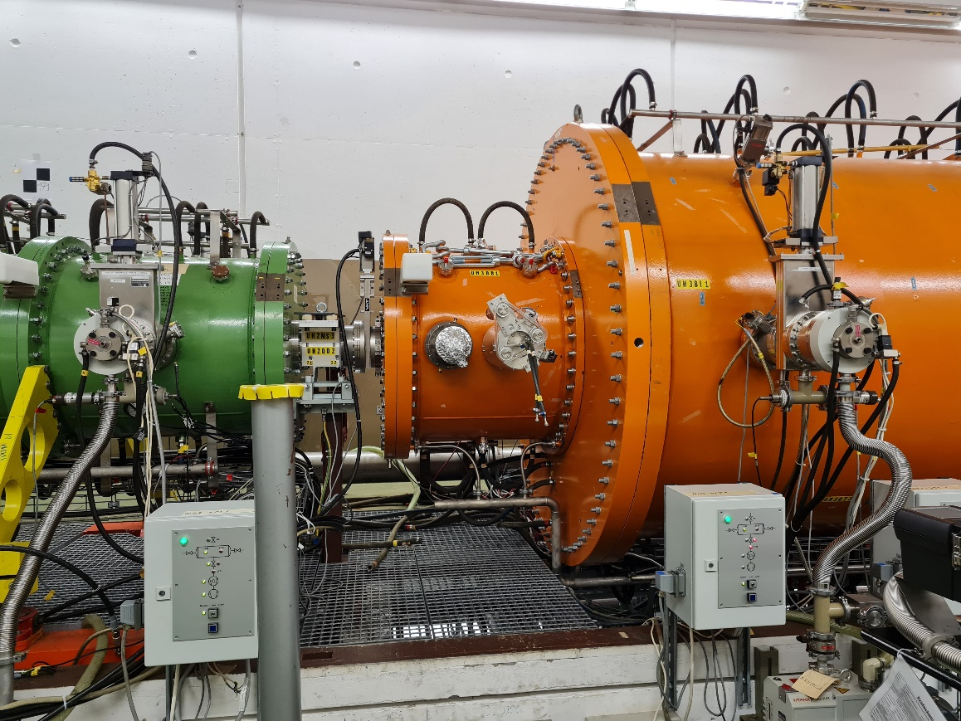
UNILAC – Superlens Repair & Upgrade (2022/23)
Courtesy W. Barth et al
Operating issues
Unacceptable beam losses
Performance degradation
Increased reflected power @high current operation
Measures
Replacing old rods
New rods
            massive copper
            galvanic copper coated
Advanced plunger design
            enlarged size
            closer positioned to the girders
            w/o tuner extensions
compensate (unwanted) shift of rf- frequency
IH-Tank 1
RFQ
Superlens

Slide 18
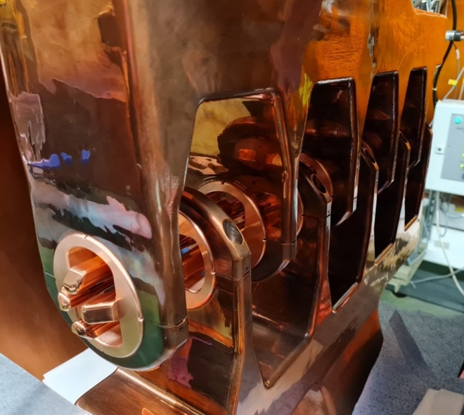
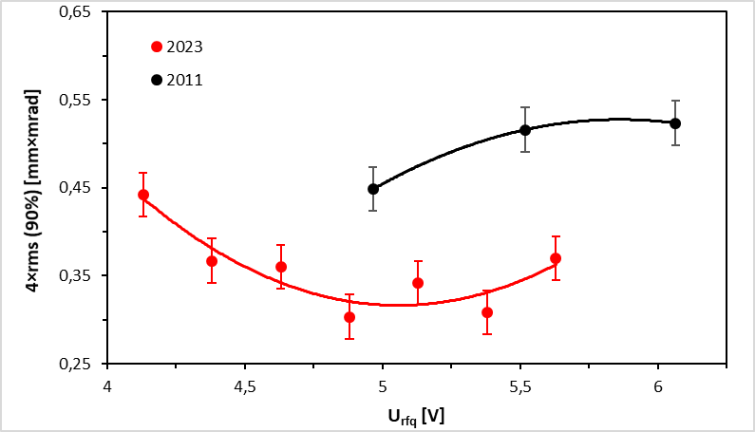
UNILAC – Superlens Repair & Upgrade (2022/23)
Successful rf-commissioning of SL
  Confirmed frequency compensation
  High power operation with advanced plunger design
  110% of nominal rf-level reached
⁴⁰Ar¹⁺-beam (MUCIS)
working area
50% reduction of beam emittance!
  Emittance measurement campaign behind RFQ
  → improved MEBT-emittance...
Courtesy W. Barth et al

Slide 19
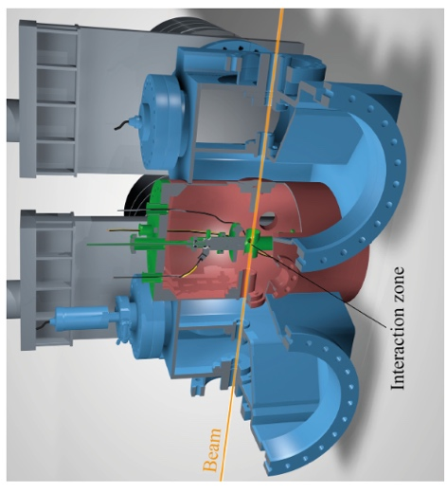
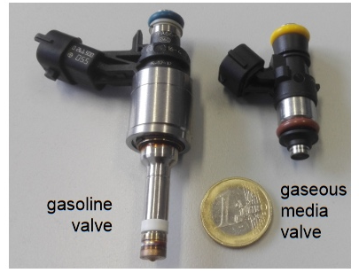
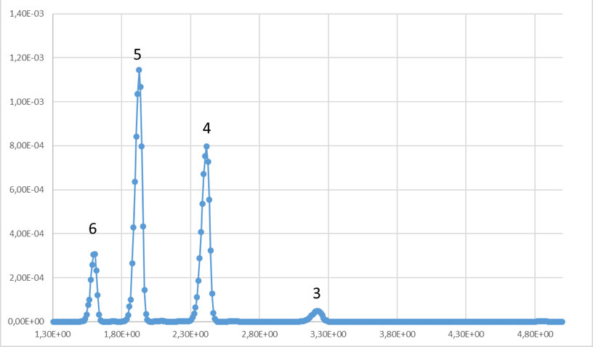
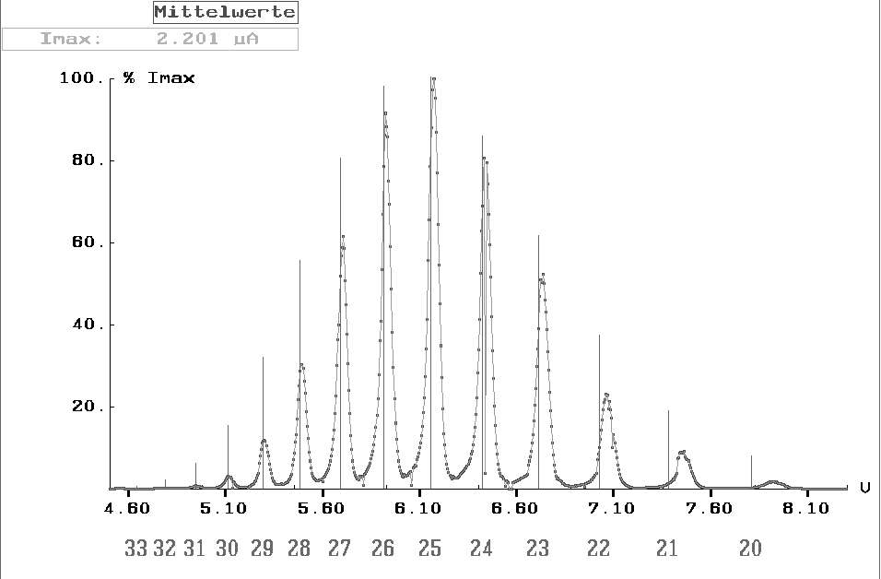
Pulsed Gaseous Stripper Operation (temporary)
Tests in Engineering Run 2023
Set-up operated in 2023 to collect more data on stripping of → by
[ CH₃, Ar, Fe, Au ] → [ N₂, H₂ ]
light, inter-mediate, heavy
eight scenarios, at different gas-pressures, pulse lengths, and repetition rates
U²⁸⁺ → H₂ operation for further beam time in 2023 / 24
C^{n+} after N₂ stripping
Au^{n+} after
H₂ stripping
Courtesy L. Gröning et al

Slide 20
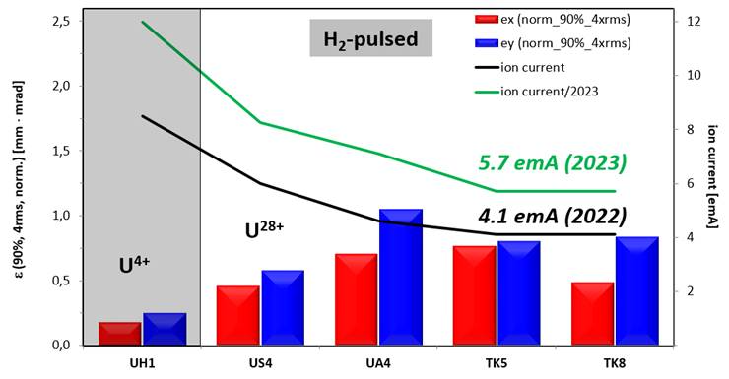
New U²⁸⁺ Record at End of UNILAC
W. Barth: „40% Stromerhöhung (TK-Ende) gegenüber 2022 dank Superlinsen-upgrade – das ist die bis dato höchste erzielte U28+-Intensität“
Courtesy W. Barth et al

Slide 21
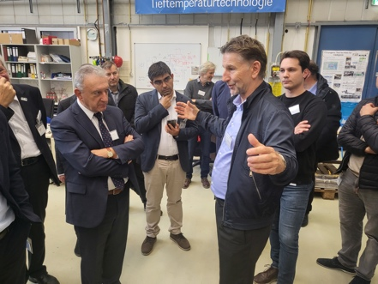
SIS18: Overall Status and Strategy
FAIR Phase 0 (present operation): Improvement of spill micro-structure with new RF structure
Improvement of shielding (esp. p and light ions), kicker area done
recently, compatibility with construction work
FAIR Phase 1 (booster operation): Development of further technologies to stabilize the dynamic vacuum,
esp. for U²⁸⁺ operation
Robustness of septum wires: Improve robustness by adding collimators. Worry of sparking at wires. MP
issues.
Making SIS18 fit for the future: Replacement of old UHV pumps (→ better vacuum).
Replacement of power supplies.
New beam-based feedbacks (profiting from completed
digitilization work).
Digital Schottky system enables active, automatic regulation of SIS18
RF frequency to measured UNILAC beam energy
Courtesy P. Spiller et al

Slide 22
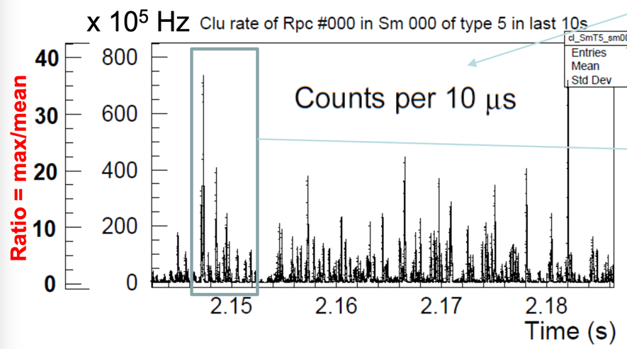
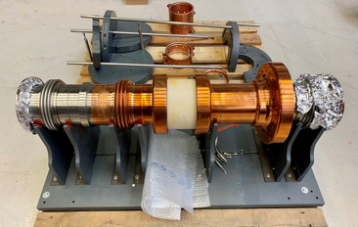
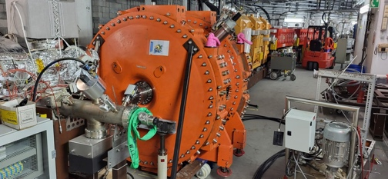
SIS18: μ-Spill Cavity for Spill Structure
Goal: Spill structure smoothing by VHF bunching
Proof of principle experiment:
  cavity most probably removed, depending on results
  If positive: low impedance cavity to be developed
Caveats:
  The cavity may have an impact on the U²⁸⁺ live time (will be measured).
  High shunt impedance: cavity op. may be limited to lower beam currents. Short cut during no-use.
  Cavity op. generates pressure bump around the Rf gap: cavity commissioned ½ day before beam time.
Beam time 2023:
  1st block: Commissioning by Rf dpt. and local control of Rf parameters (no integration into control system)
  2nd block: Measurement of beam micro structure (BI) with „pilot beam“ → promising results, more work needed
HADES collaboration
measurement, courtesy C. Sturm et al
Rf gap produced twice because of insufficient properties of gap ceramics (Rf energy dissipation)
Cavity at installation in SIS18
Courtesy P. Spiller et al

Slide 23
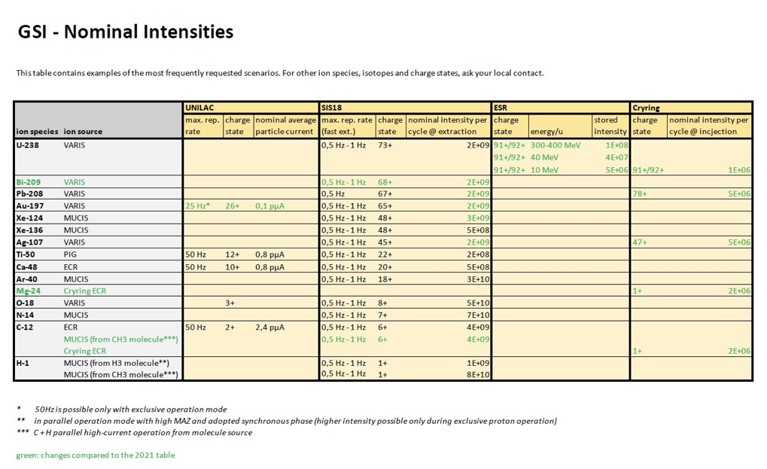
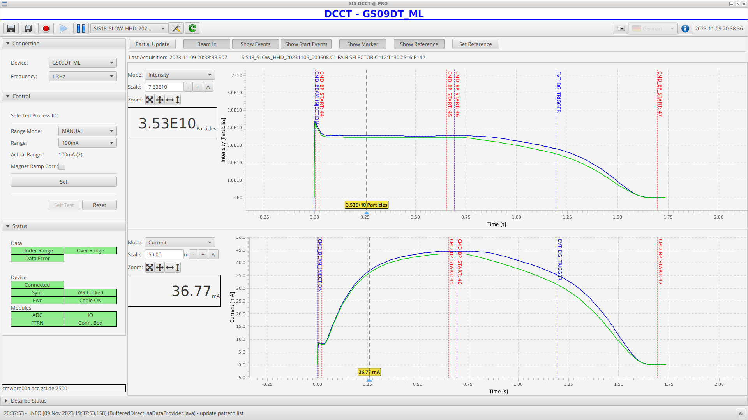
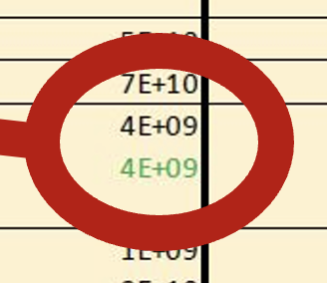
SIS18: Intensity C Beam for Users → Factor 10 Better
Vacuum Upgrade Program
Using the methane CH₄ source
Courtesy S. Reimann et al

Slide 24
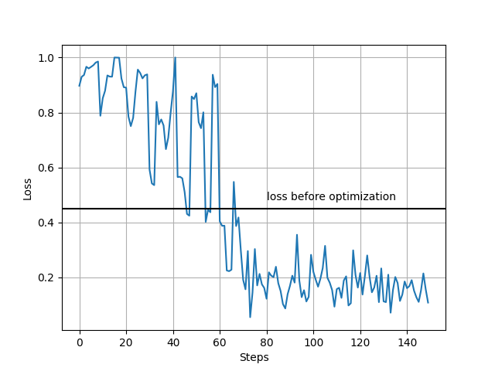
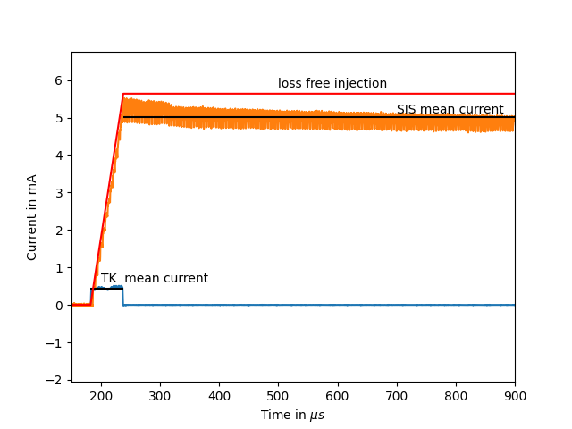
S. Appel, O. Boine-Frankenheim et al
First automated SIS18 injection optimization
With the python bridge fully automated multi-turn injection optimization can be performed in about 15-20 min
The loss could be reduced from 40% to 10% using five optimization parameter
Potentially further improvements using more optimization parameters and other optimization algorithms

Slide 25
19 Jan

Slide 26
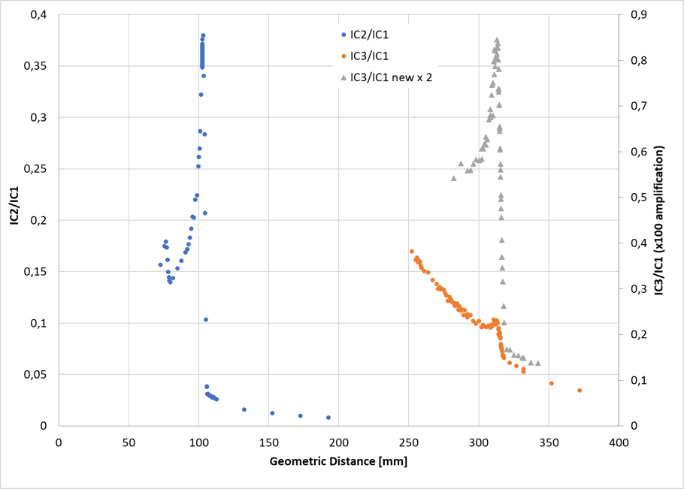
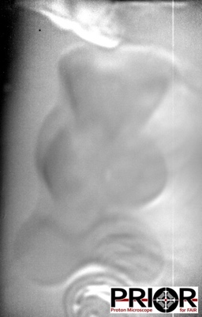
Courtesy F. Maimone et al
Dual Ion Beam for Tumor Therapy (world-wide first)
Carbon used for tumor irradiation. Helium penetrates through body and is used for real time imaging.
Integrals over one spill for the depth dose
Ion mass He + C ( 5-20% He)
Ion charges ⁴He⁺ und ¹²C³⁺ from CH₄
Energy 225 MeV/u
Beam intensity 10⁸, Slow extraction
Stability No variation of He, C and O
Contamination of ¹⁶O⁴⁺ As low as possible
O, C
20% He
Possible contrast at low-density differences
A gummy bear in addition to other density calibration targets in a gelatin block (edge length 6 cm), can be imaged exclusively with the helium portion of the beam.
Two ‘working points‘: 5% He and 20% He (relation to C), 7% O throughout
5% He
Measurements with a matrix IC detector (also time-resolved) and films providing location information collected as well.
- IC2: front chamber with O and C peak
- IC3 : back chamber with 5% He concentration
- IC3 : back chamber with 20% He concentration
Measured ion contributions to image:
12C⁶⁺: 0.167%
4He²⁺: 99.833%

Slide 27

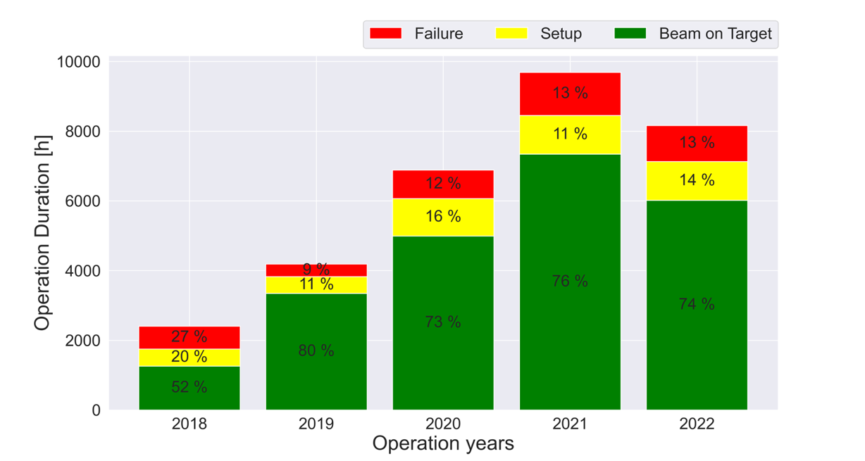
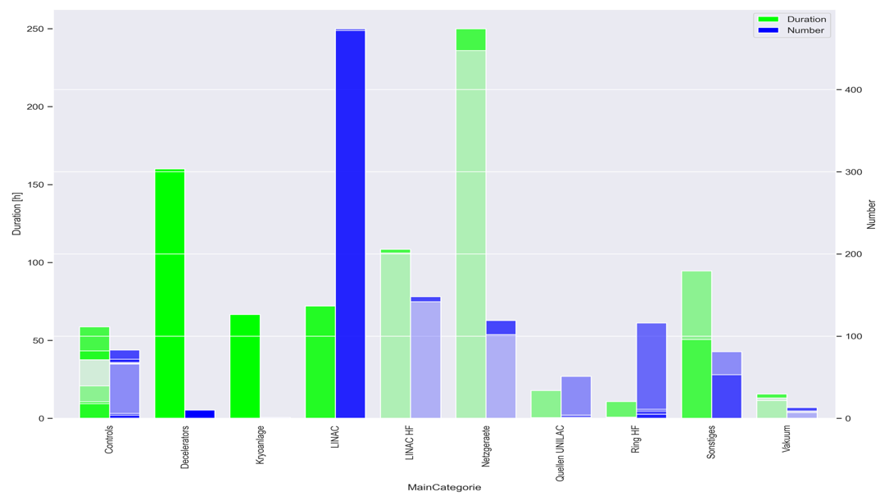
Courtesy O. Geithner et al
Availability 2018-2022 → 2023?
Numbers and statistics will guide our conclusions. We need to watch breakdown rates in ageing equipment closely to implement proactive counter-measures.
Performance committee will track accelerator performance and work out a coordinated technical roadmap / action plan across the accelerator complex
→ Oksana Geithner will act as committee manager
Notes:
2018
Stopped Beamtime due to the LinacHF fire exident. Too low Failure ‚cause we stopped counting
…
2019 – Just short beamtime UNILAC + SIS18. ENG RUN for ESR+CRYRING.
…
2020
…COVID; start of AWG regular Meetings
2021
Failure Glad magnet due to failed cryogenic compressor -> KS02 involved; Cooling towers maintenance this shutdown
High number of RealTimeErrors -> Much better in 2022
Failure due to missing set/actual value -> still not available?

Slide 28
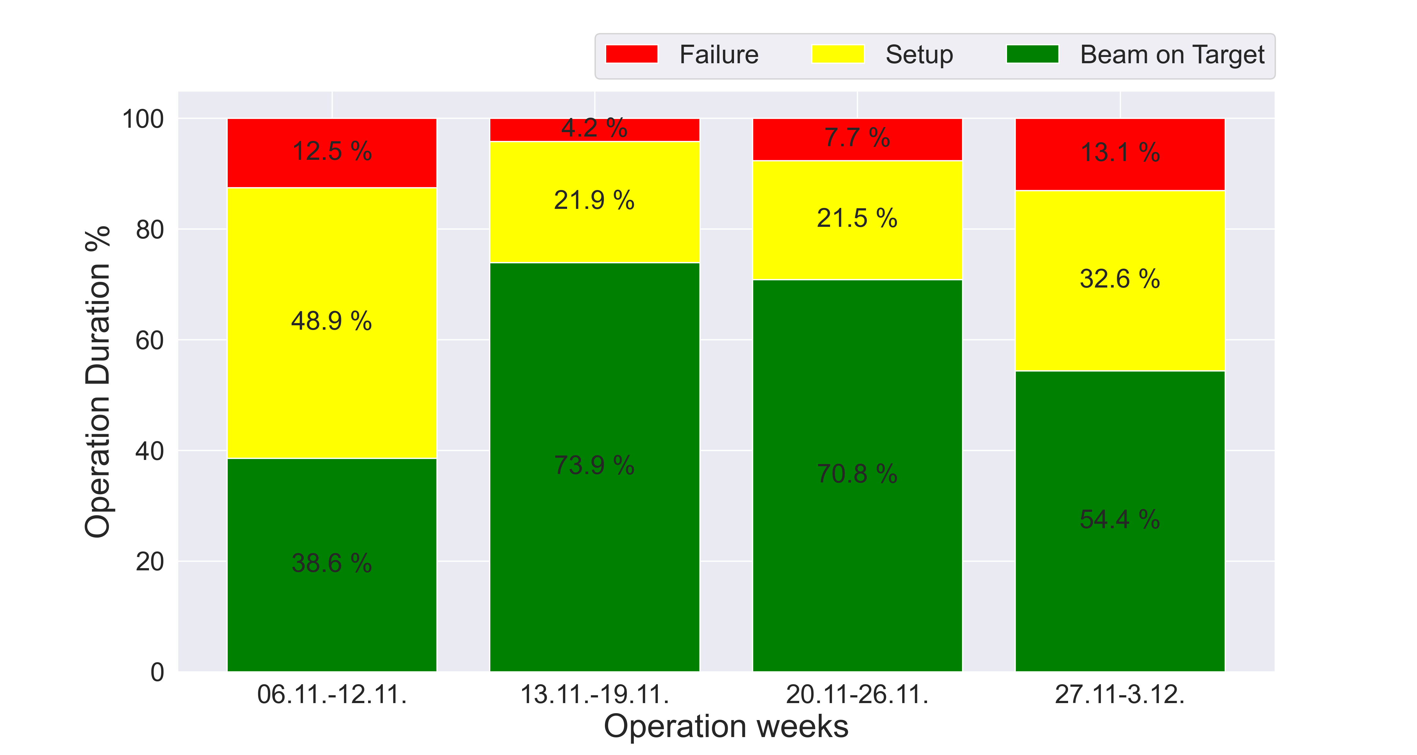
Overall Accelerator Chain Availability During Engineering-Run 2023 (first 4 weeks)
Courtesy O. Geithner et al
Availability Goal
(Setup + BoT) is
> 90% during half the run (so far)
So far very (exceptionally) good
* The distinction between setup and beam on target is rather arbitrary during an engineering run. The decisive factor is the failure rate.

Slide 29
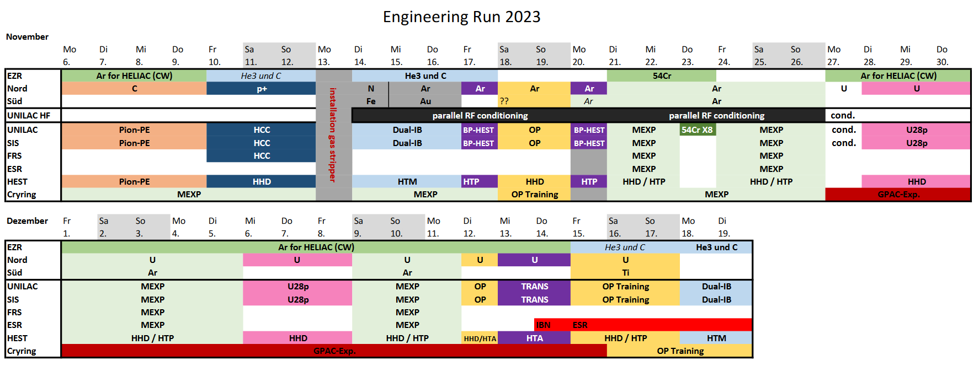
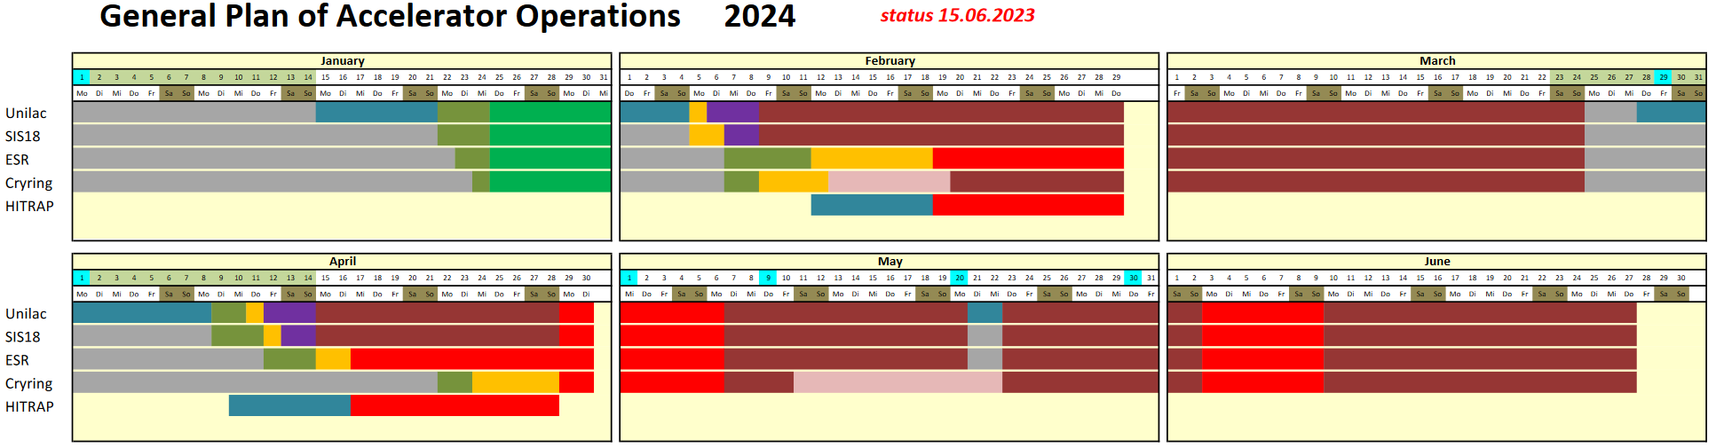
Ongoing: User Beam Time 2024
Engineering run (6 Nov – 19 Dec 2023):
  Recommissioning and performance testing to ensure operational capability
  5 campaigns for further development of operating modes for GSI/FAIR users
  78 registered proposals for machine studies & detector tests for FAIR and GSI
User beam time (9 Feb – 27 Jun 2024):
  102 days of physics beam time for GSI/FAIR users
  15 days for machine development
  22 days for HITRAP commissioning
Coordinated by S. Reimann

Slide 30
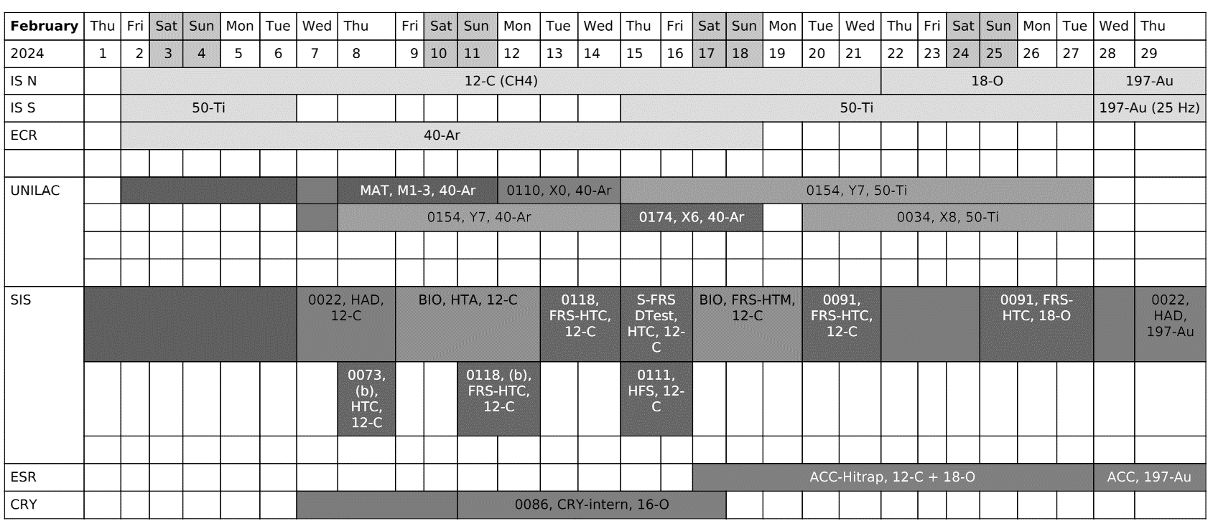
ü
experiment finished (>80% machine availability/performance = nominal) 8
experiment finished (>60% machine availability/performance = sufficient) 4
experiment failed or < 60% machine availability/performance = insufficient 0
S. Reimann
M. Vossberg
ü
x
Status 23.02.
ü
ü
x
ü
ü
ü
ü
ü
ü
ü
ü
ü
ü

Slide 31
Aerial View on 25 Feb 2024
Challenge: Beam Commissioning & Operation of FAIR

Slide 32
Timeline
2024 | 2025 | 2026 | 2027 | 2028 | 2029 | 2030 | 2031
Operation of existing GSI accelerators
Operation from Future Control Center FCC
Beam Comm./Op. SFRS (early science)
Beam Comm./Op. SIS-100 (first science)
FAIR planning status Feb 2024

Slide 33
Early Science, First Science, First Science +
# | From | To | Particles species | Rigidity range [Tm] | max. hor. acceptance [mm mrad] | max. vert. acceptance [mm mrad] | at momentum offset: [± ‰]
Early Science | SIS18 | SFRS Target | Ions | 9-18 | 45 | 23 | 3
First Science | SIS18 | SIS100 | Ions, protons | 9-18 | 90 | 42 | 3
 | SIS100 | SFRS Target | Ions | 27-100 | 43 | 30 | 10
Reference: "FAIR Operation Modes“, EDMS.
UNILAC U4+ is produced in the VARIS source
  U28+ is produced in the UNILAC gas stripper at 1.4 MeV/u
  Accelerated in UNILAC to 11.4 MeV/u
  4 pulses of uranium beam are produced in 1.11 s (2.7 Hz)
SIS18 Each pulse is accelerated at harmonic number h=2 to 200 MeV/u
  Acc. of 4x2 bunches requires 1.6 s in total including pre- and post-processing
SIS100 Duration of injection into SIS100 is 1.11 s
  Acceleration to 1.5 GeV/u

Slide 34
NUSTAR Requirements in LEB and HEB will receive the primary beam from
SIS100 with slow extraction
Requirements for the primary beam in front of the Super-FRS target
Requirement of NUSTAR Experiments in HEB and LEB
Beam Parameters | Ion type
 | Ref. Ion: U²⁸⁺ | Bi²⁶⁺ , Pb²⁶⁺, Au²⁵⁺ | Xe²¹⁺, Kr¹⁶⁺ | Ar¹⁰⁺ | p | Ref. Ion: U²⁸⁺ |  | Bi^{26+,} Pb²⁶⁺, Au²⁵⁺ | Xe²¹⁺, Kr¹⁶⁺ | Ar¹⁰⁺ | p
 | Commissioning |  |  |  |  | Operation in MSV
Spill length [s] | 1-10
Number of ions per cycle | 2 x 10¹⁰ | 3x10⁹ | 7x10⁹ | 8x10¹⁰ | 10¹¹ |  | 5x10¹¹ |  | 7x10¹¹ |  | 5x10¹²
Energy Range [GeV/u] | 0.4-2.7
Ref. energy [GeV/u] | 1.5 |  |  |  | 2.5 |  | 1.5 |  |  |  | 2.5
Momentum spread (2σ) | ≤10³
Transverse emittance (2σ) [mm mrad] | 2(h) x 5(v)
Beam spot radius on target [mm] | 1(h) x 2(v)
Reference: "FAIR Operation Modes“, EDMS.

Slide 35
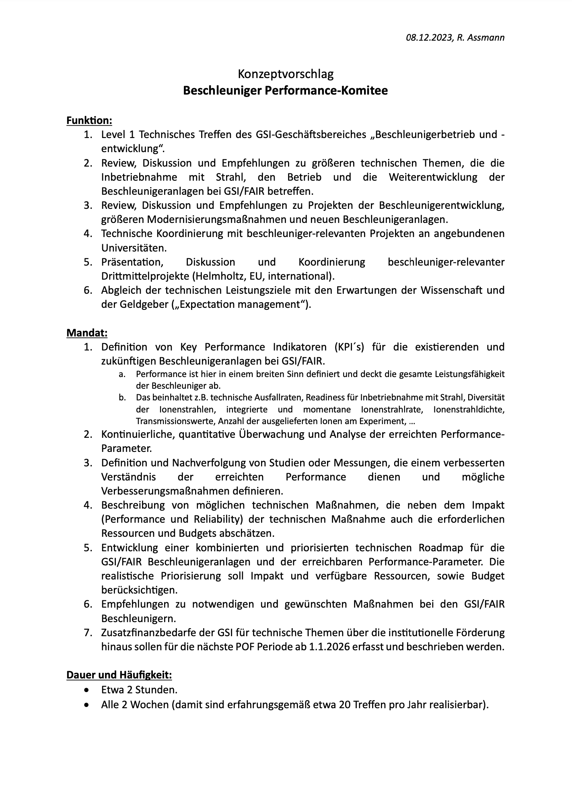
Performance Committee: Concept
Concept paper (3 pages) finalized and internally presented
Committee will bring together the leaders in accelerator science and technology across GSI and FAIR every 2 weeks
It will include representatives from collaborating universities and experiments
We will discuss and define together the GSI/FAIR technical roadmap with prioritization (taking into account performance, resources, budget):
  What performance when → expectation management of GSI/FAIR performance
  Common strategy and plan on improvements, upgrade and new facility projects in the accelerator domain
The committee complements line management that remains responsible for final decision, resources and implementation.

Slide 36
Performance Committee: Mandate
Definition OF Key Performance Indicators (KPI´s) for the existing and future accelerators at GSI/FAIR.
  Performance is defined in aborad sense and covers the full performance capability and issues of the accelerators
  This includes technical failure rates, readiness for beam commissioning, diversity of ion beams, integrated and peak ion delivery rates, density of ion beams (emittance), transmission rates, number ions delivered at various experiments, …
Continuous and quantitative surveillance of delivered KPI‘s
Definition and follow-up of studies, measurement campaigns and R&D efforts, that are required for an improved understanding of the obtained performance and for the definition of possible improvement measures
Description of possible technical measures, including impact (performance reliability), required resources and budget.
Development of a combined and prioritized technical roadmap for the GSI/FAIR accelerator complex and the realistically reachable performance indicators. The realistic prioritization shall include impact, available resources and budget.
Recommendations on necessary and favored actions on the GSI/FAIR accelerators.
Collection and description of additional financial needs at GSI for technical work during the next POF period, beyond the institutional funding from 1.1.2026 onwards.

Slide 37
Performance Committee: Milestones
01/2024 Kickoff meeting
03/2024 Definition of KPI´s
09/2024 Overview table on the present status and future expectations (goals)
10/2024 Preliminary list of additional financial needs at GSI for technical work
during the next POF period
12/2024 Combined and prioritized technical roadmap for the GSI/FAIR accelerator
complex and the realistically reachable performance indicators, including
a first estimate on resources and cost for eventual actions.

Slide 38
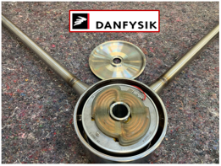
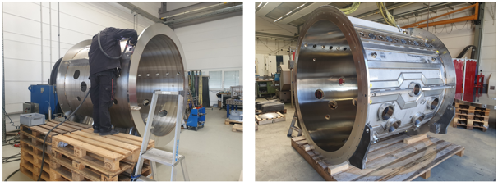
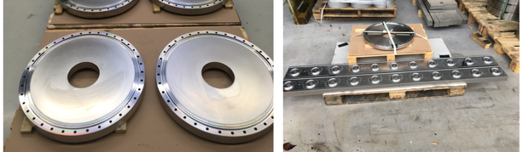
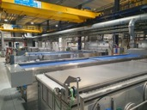
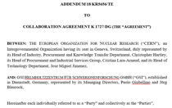
Future Upgrade: UNILAC Post-Stripper Upgrade
Cavity series production
Small parts series production
Drift tube production
  first prototype successfully tested
  tubes for first cavity ordered
  tubes for second cavity to be ordered in Dec.
  council recently approved the funding application for all tubes to be considered in 2024 council
Plating of 177 drift tubes → CERN
  CERN‘s new plating shop will be equipped with dedicated set-up for GSI
  Contract with CERN signed and in place (11 Dec).
Project on schedule and on budget
Courtesy L. Gröning et al

Slide 39
Collaboration & Scientific Exchange are Crucial
Thanks for organizing this – looking very much forward to our discussions on our fascinating accelerator science!

Slide 40
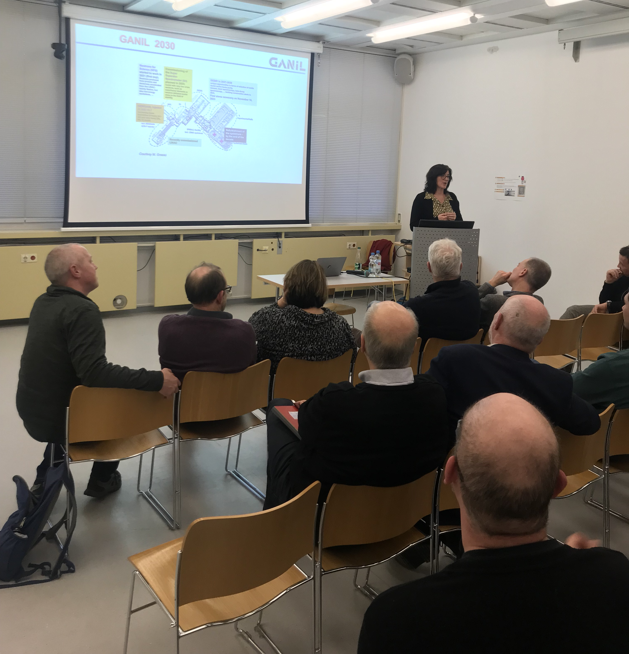
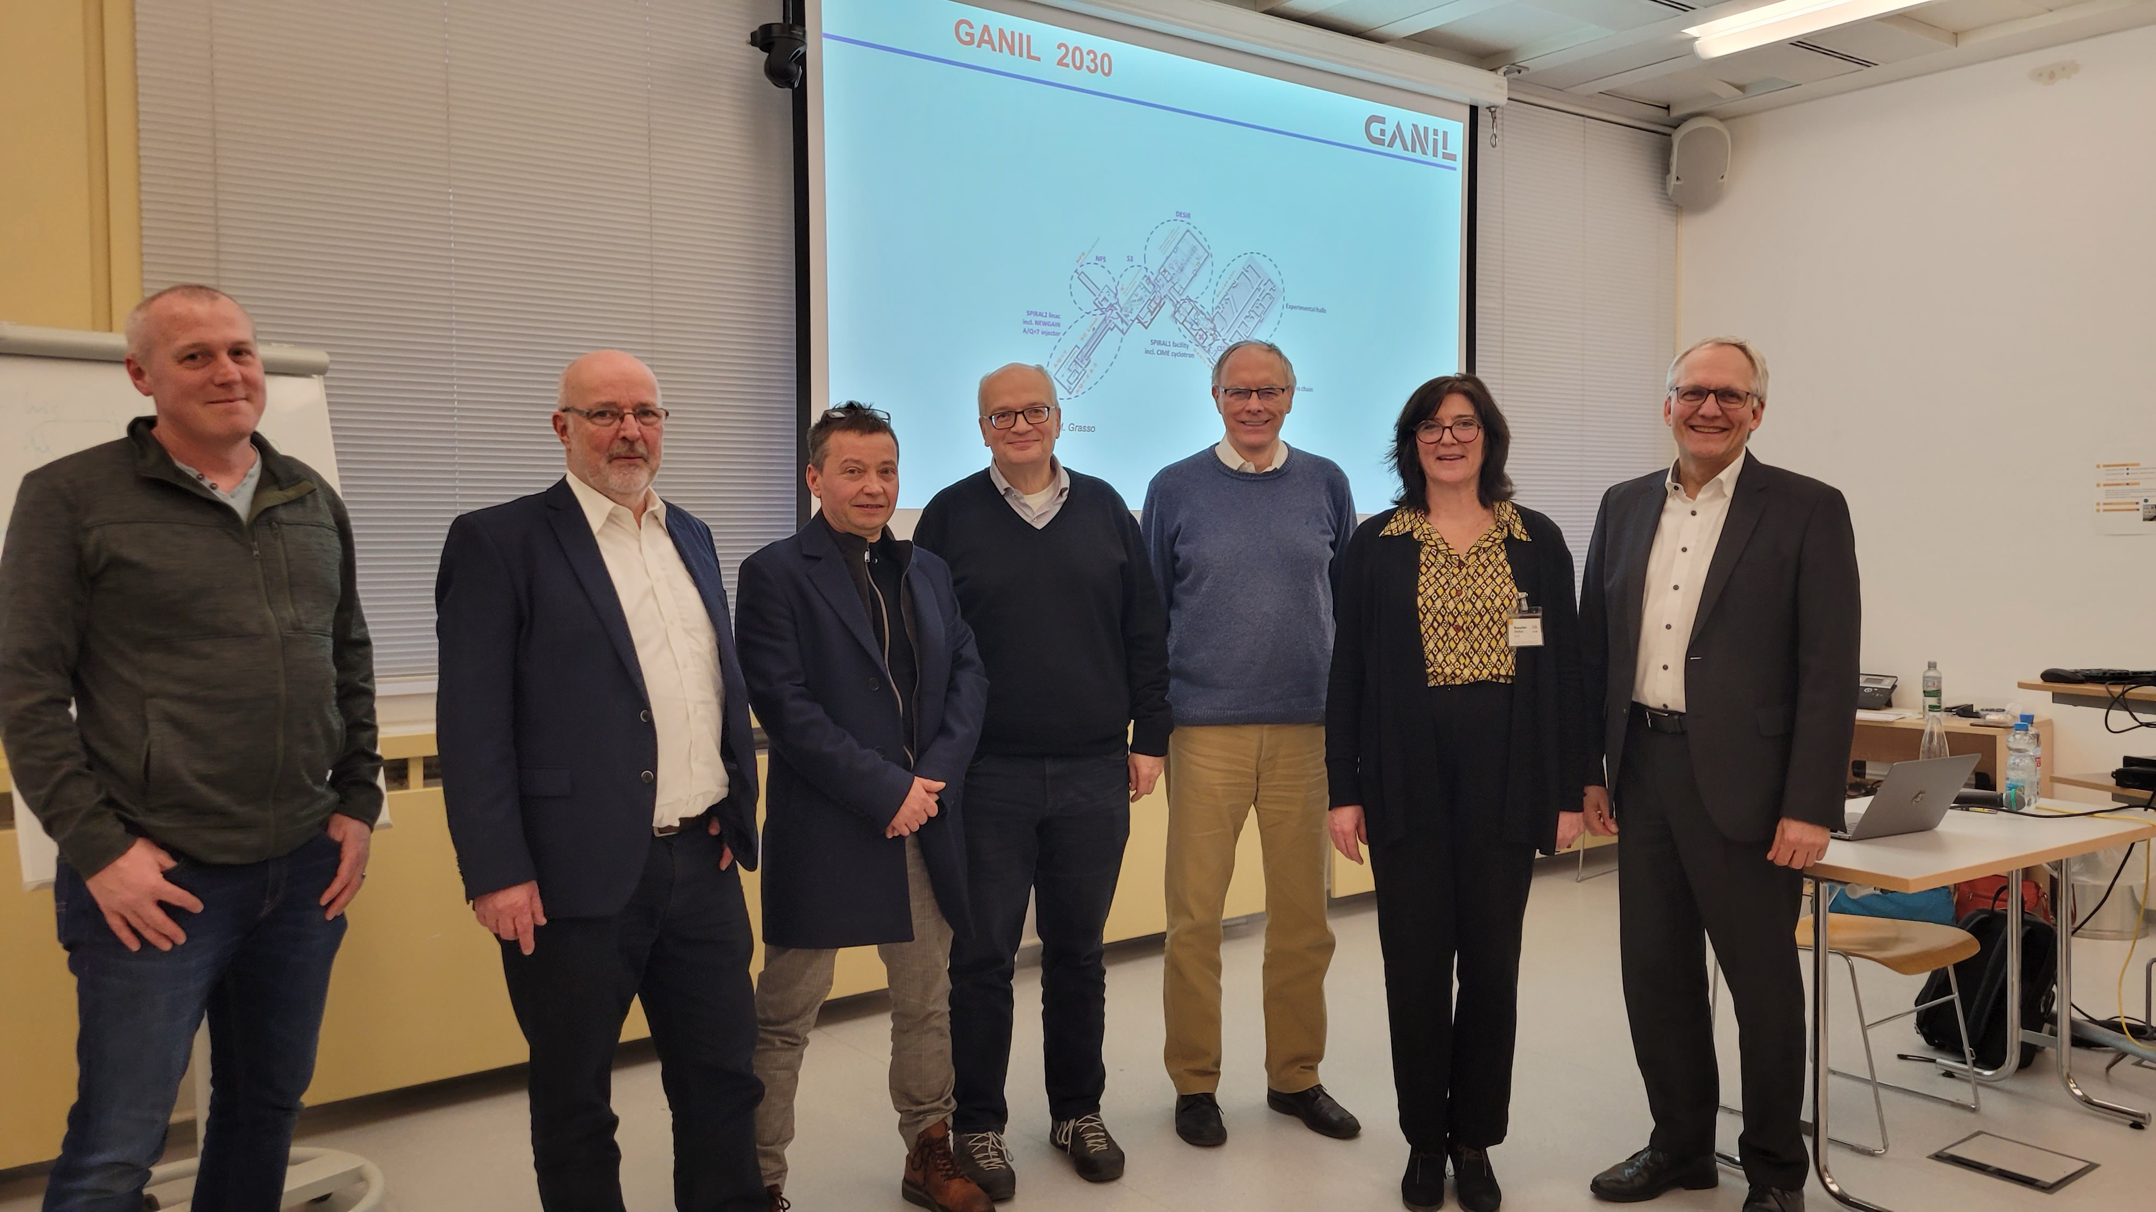
Collaboration & Scientific Exchange are Crucial
GSI Accelerator Seminar Series
Last week in person → 40– 50 participants
Budget reserved for this

Slide 41
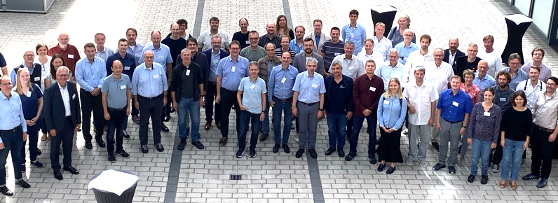
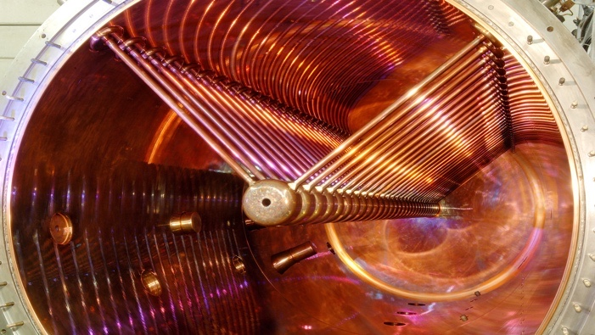
Conclusion and Outlook
Long shutdown 2022 → 2023: completed
Engineering run successful, now in physics run
Next years: about 6 months user runs and shorter yearly shutdowns (repairs, smaller upgrades) foreseen
FAIR installation and preparing FAIR operation:
  Hiring personnel with mixed GSI/FAIR duties in ACC
  Merging of some accelerator-related activities to be considered
Stronger links to universities & international labs
New committee will define performance indicators: prepare optimized accelerator actions across GSI/FAIR
GSI/FAIR technical roadmap with prioritization (taking into account performance, resources, budget) to be prepared together until 12/2024.

Slide 42
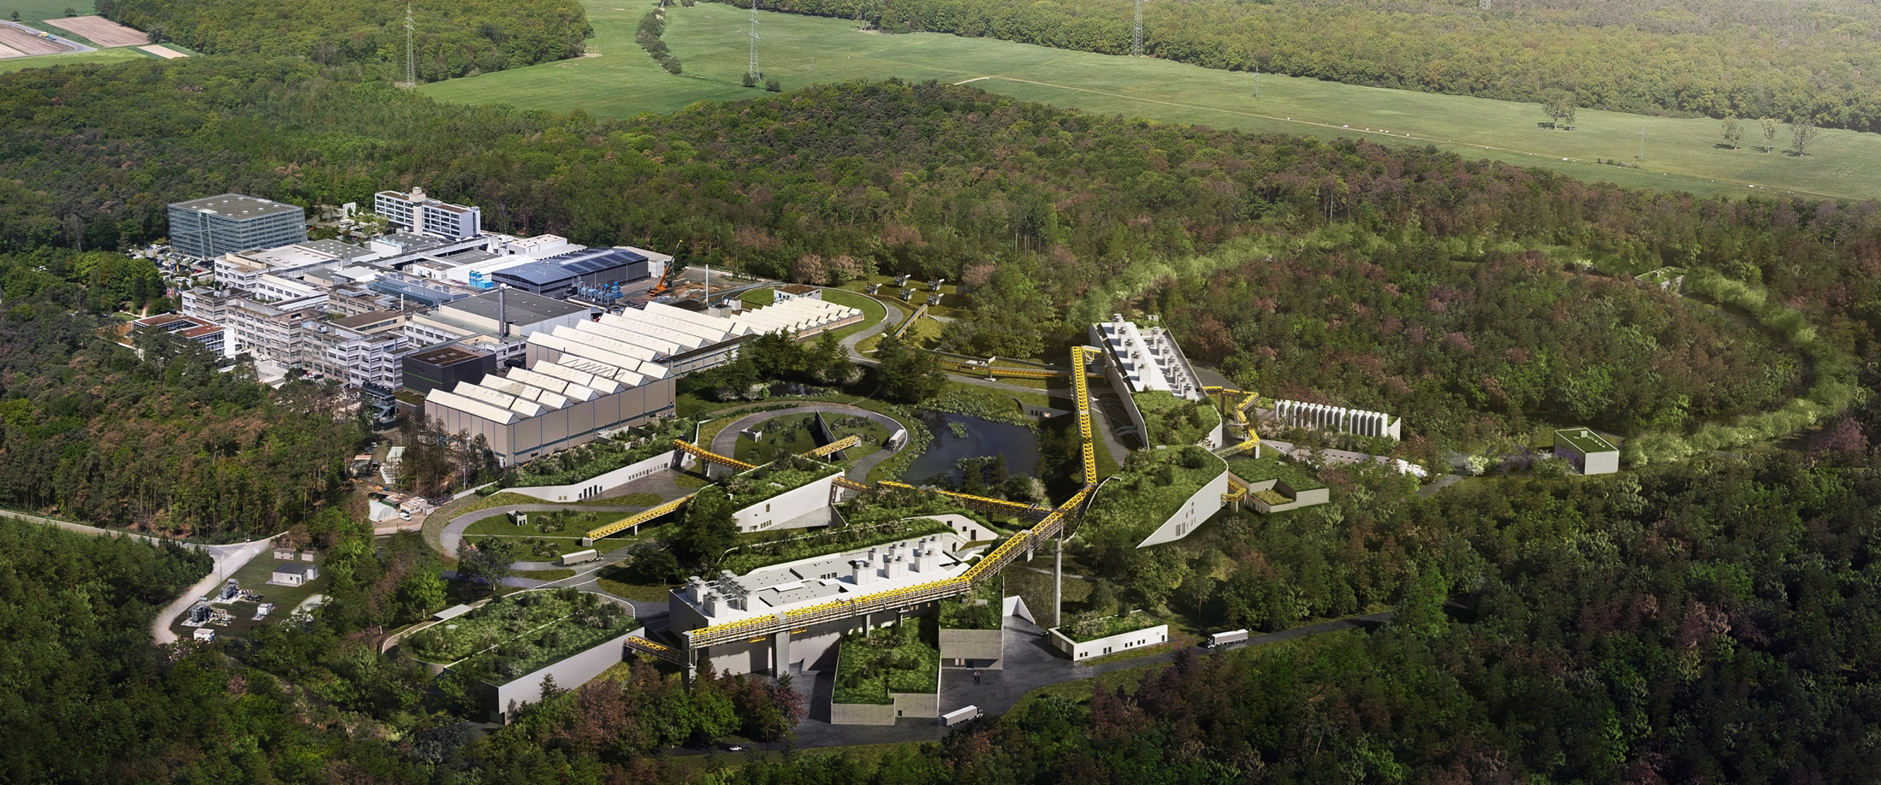
Thank You for Your Attention

Slide 43
FAIR/GSI Strategic Operation Scenario towards FS+
beam time
Acc. Operation total / days
134
44
140
Pre-paration works
EH
140+30
8 months
fire protection renovation
EH
140
10 months
fire protection renovation
EH
140
200
240
240
beam time
Physics beam time/ days
107
0
100
100+30
50
70
min. 120*
180
180
engineering-runs
Project phases (ES, FS, FS+)
FAIR Installation of Accelerator Components
FAIR Hardware Commissioning
FCC OP ready
UNILAC CS ready
DR
FAIR Beam Commissioning
PCP reached
Facility availability
early science (ES) →
SIS18 → SFRS → NUSTAR
still
missing
first science (FS) →
SIS100 → SFRS → NUSTAR
first science + (FS+) →
SIS100 –> CBM
UNILAC → EH, SIS18 → TH, EX, FRS, ESR → HITRAP, Cryring
2022
2023
2024
2025
2026
2027
2028
2029
2030
Courtesy S. Reimann, Beam Retreat 2023
FAIR Phase 0
Early Science
Early Science & First Science+
43

Slide 44
SIS18: UHV System Refurbishment
Courtesy P. Spiller et al
Baseline UHV puming system has an age of about 35 years!
  (Initial) static residual gas pressure especially important for U²⁸⁺ (booster) operation.
  High pumping power → stabilize dynamic vacuum under influence of ion induced gas desorption.
Actions 2022 - 2023:
  IZ pumps and NEG pumps procured for replacing part of the old pumps.
  Shut down, sector S03-S05: all IZ pumps renewed, all Ti-pumps exchanged by CapaciTorr-NEG pumps
Static UHV pressure has been improved in upgraded sections from 5 x 10¹¹ to 1 x 10¹¹.
U²⁸⁺ -operation:
  beam lifetime may be affected by each short section with poor pressure.
  Lifetime improvements with standard ions and U²⁸⁺ ions will be measured in 2023 beam time.
Outlook:
  In 2024, + vacuum sector S01 (S11-S02) will be opened for installation of first cryognic insert. Used for replacing all pumps in this sector. Urgent improvements needed in sector 5 and 6 incl. NEG activation.

