Slide 1
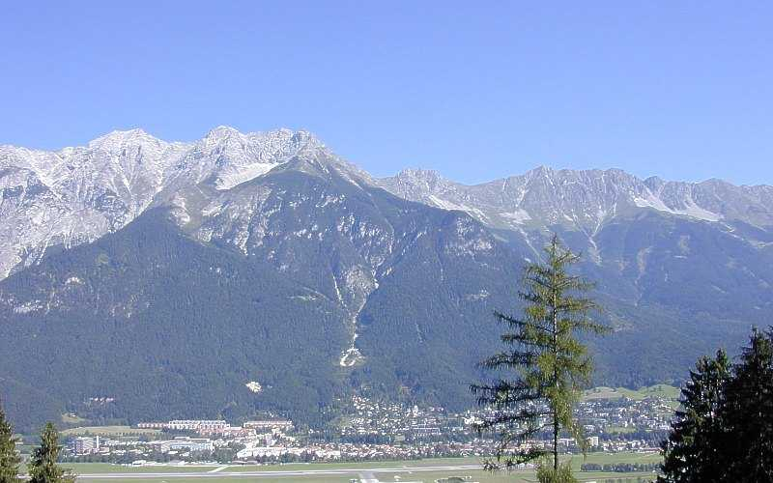


strongly interacting fermions:
from spin mixtures to mixed species
Rudolf Grimm
Center for Quantum Physics
Innsbruck
Austrian
Academy of Sciences
University

Slide 2
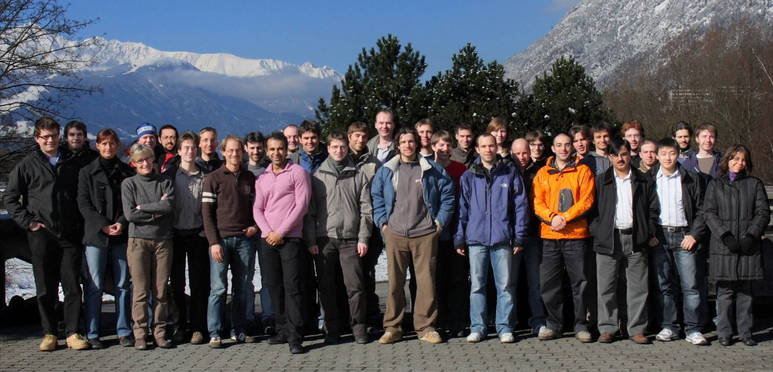
ultracold.atoms
Innsbruck
RG
JHD
FS
HCN
FF
Cs-Rb mixture (RG & HCN)
Ca⁺ Rb (JHD)
Cs few-body physics (RG & HCN)
⁶Li₂ (RG & JHD)
Cs III (HCN)
Li-K-Sr mixture (RG & FS)
Rb lattice (JHD & RG)
Sr BEC (FS)
Notes:
Put in subgroups

Slide 3
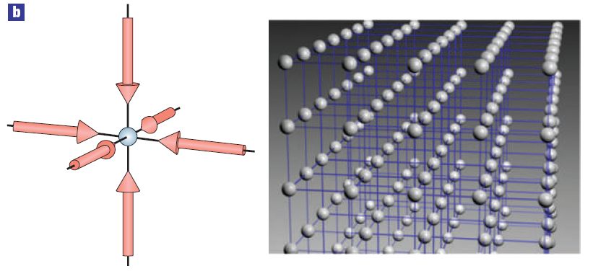
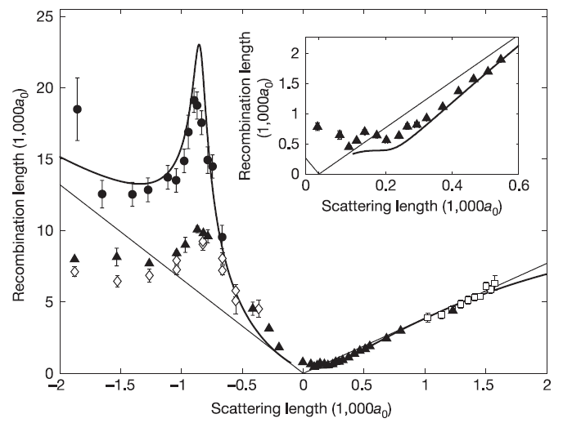
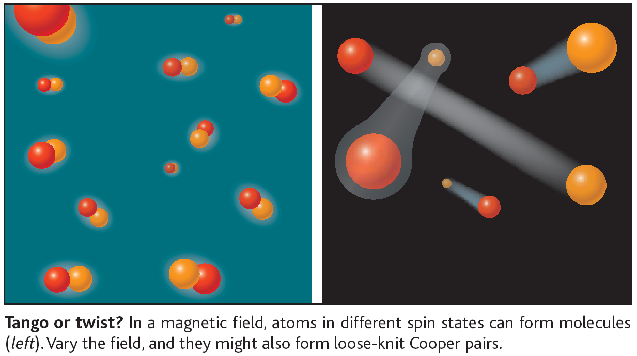
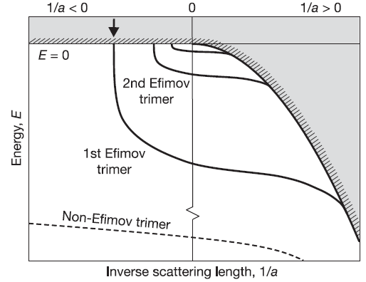
ultracold atoms: general research theme
model systems
to study complex
quantum phenomena
condensed-matter physics:
optical lattices
few-body physics: Efimov states
many-body physics:
BEC-BCS crossover

Slide 4
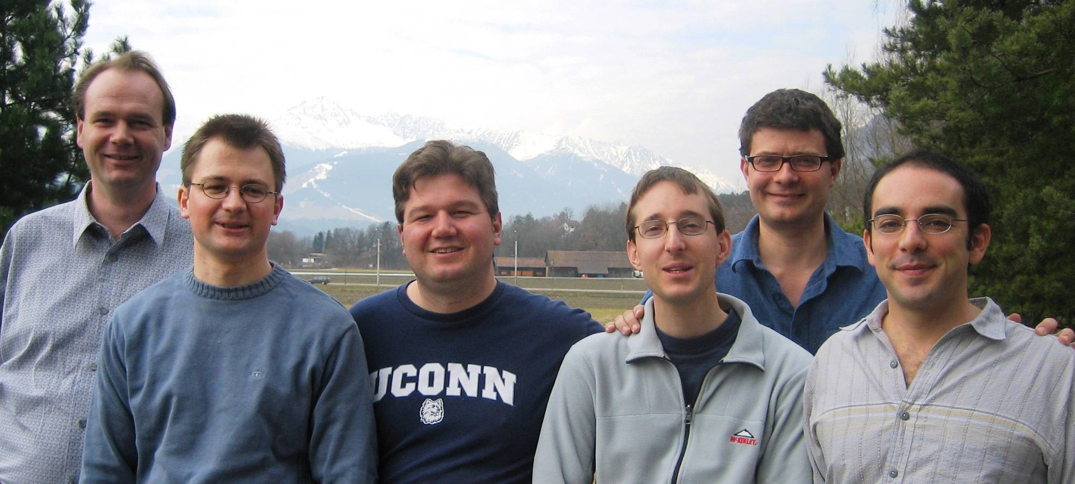
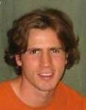
the ⁶Li team
Christoph
Kohstall
Johannes
Hecker
Denschlag
RG
(Alexander
Altmeyer)
(Matthew
Wright)
Stefan Riedl
Edmundo
Sanchez

Slide 5
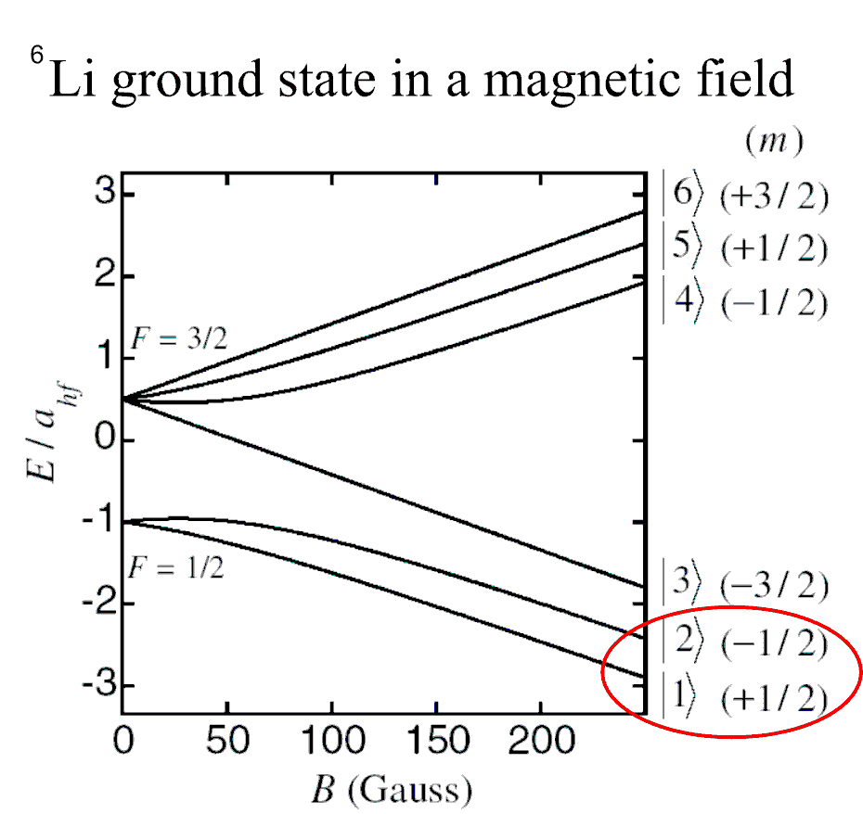

⁶Li spin mixture
Feshbach resonance
prediction: Houbiers et al., PRA 57,R1497 (1998)
precise characterization:
Bartenstein et al., PRL 94, 103201 (2005)
spin mixture of
two lowest states
stable against
two-body decay
BEC-BCS
control
knob

Slide 6
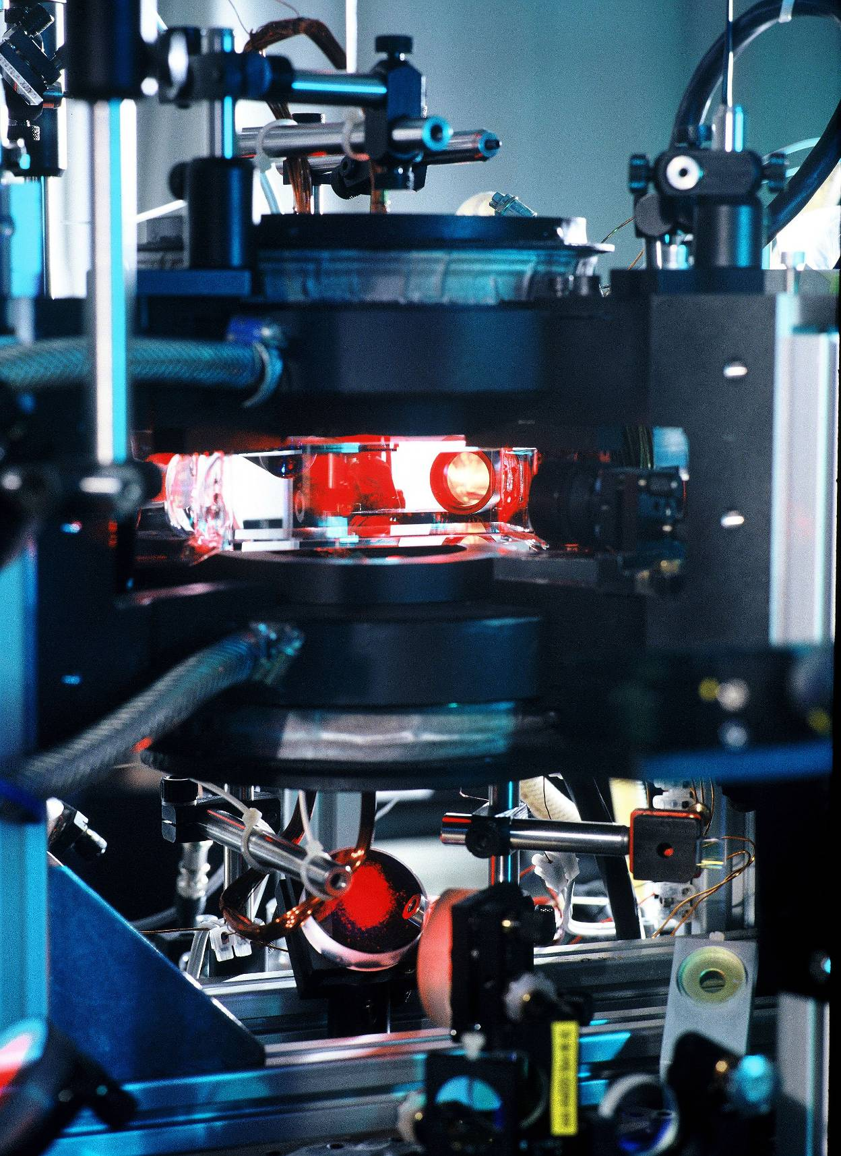
apparatus

Slide 7
optical trap for evaporative cooling
4x10⁵ atoms
at T<0.1T_{F}

Slide 8
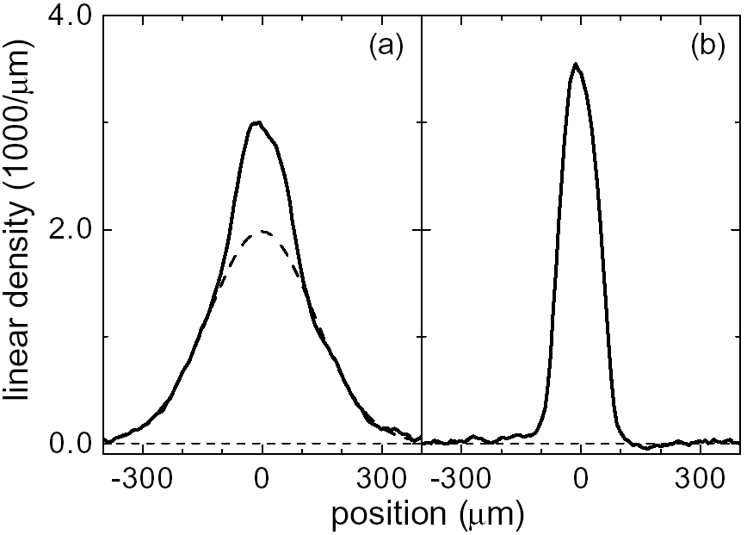
BEC of molecules
Jochim et al., Science (2003)
Bartenstein et al., PRL (2004)
partially
condensed
almost
pure
mBEC:
excellent starting point
for studies on
BEC-BCS crossover
final trap power 28mW 3.8mW
number of molecules 400.000 200.000
temperature 430nK few 10nK
condensate fraction ~20% >90%

Slide 9
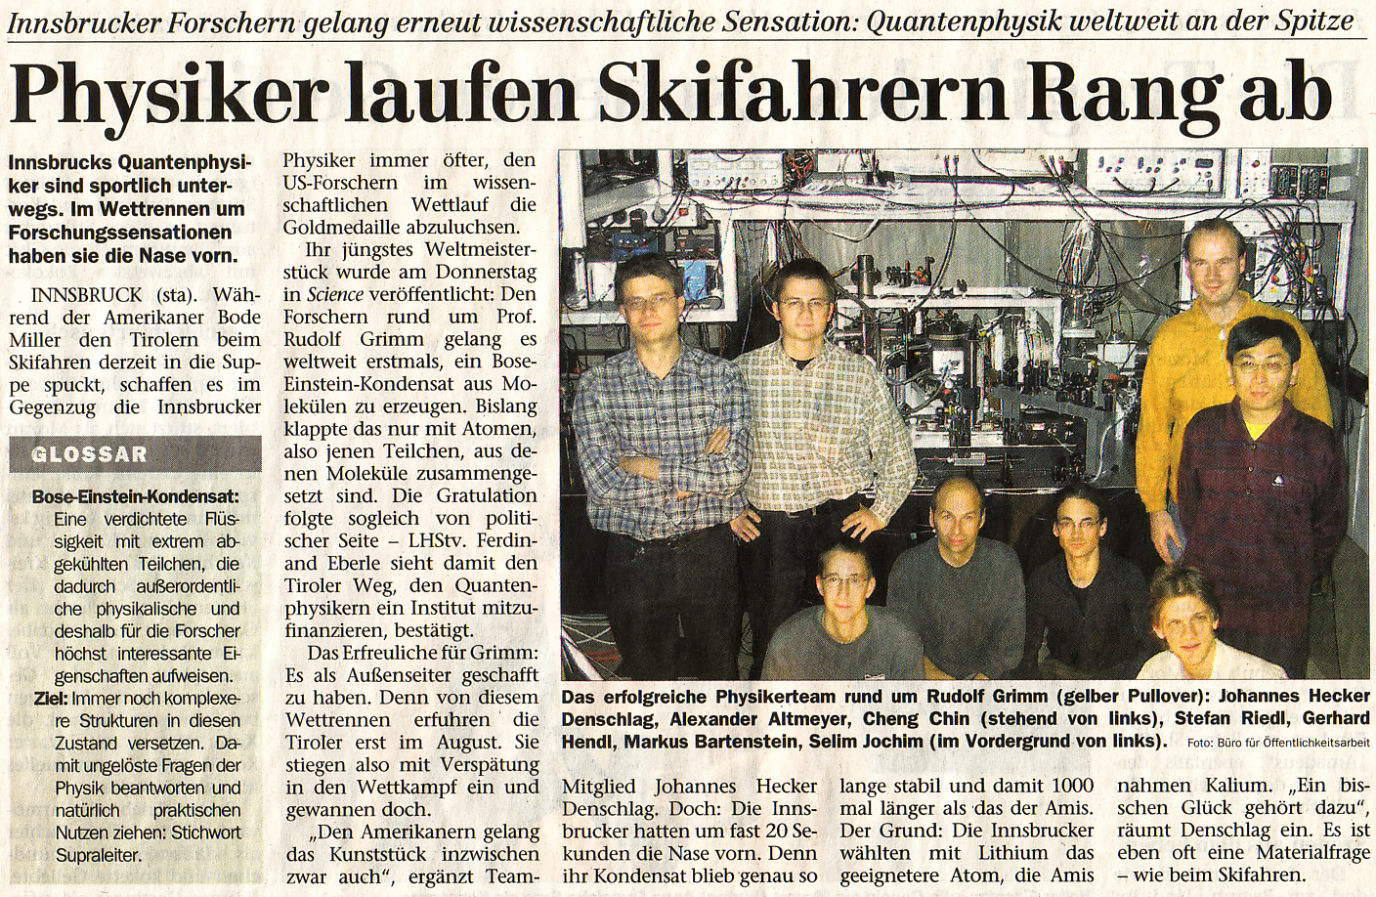
Tiroler Tageszeitung, 14.Nov.03

Slide 10
two classes
Bosons
integer spin
Fermions
half-integer spin
trapped atoms
at T=0
these two
worlds
are connected !
all in ground state:
Bose-Einstein condensate
only one particle per state:
degenerate Fermi gas

Slide 11
two classes
Bosons
integer spin
Fermions
half-integer spin
trapped atoms
at T=0
„pairing“
is the key
all in ground state:
Bose-Einstein condensate
only one particle per state:
degenerate Fermi gas

Slide 12
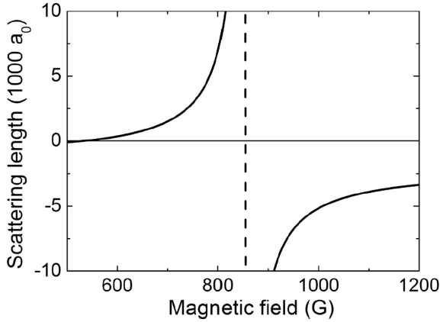
two classes
Bosons
integer spin
Fermions
half-integer spin
Feshbach
resonance
trapped atoms
at T=0
interaction
control !!!
all in ground state:
Bose-Einstein condensate
only one particle per state:
degenerate Fermi gas

Slide 13
two classes
Bosons
integer spin
Fermions
half-integer spin
universal !!!
trapped atoms
at T=0
interaction
control !!!
all in ground state:
Bose-Einstein condensate
only one particle per state:
degenerate Fermi gas

Slide 14
two classes
Bosons
integer spin
Fermions
half-integer spin
crossover gas
as a high-Tc
superfluid
all in ground state:
Bose-Einstein condensate
only one particle per state:
degenerate Fermi gas

Slide 15
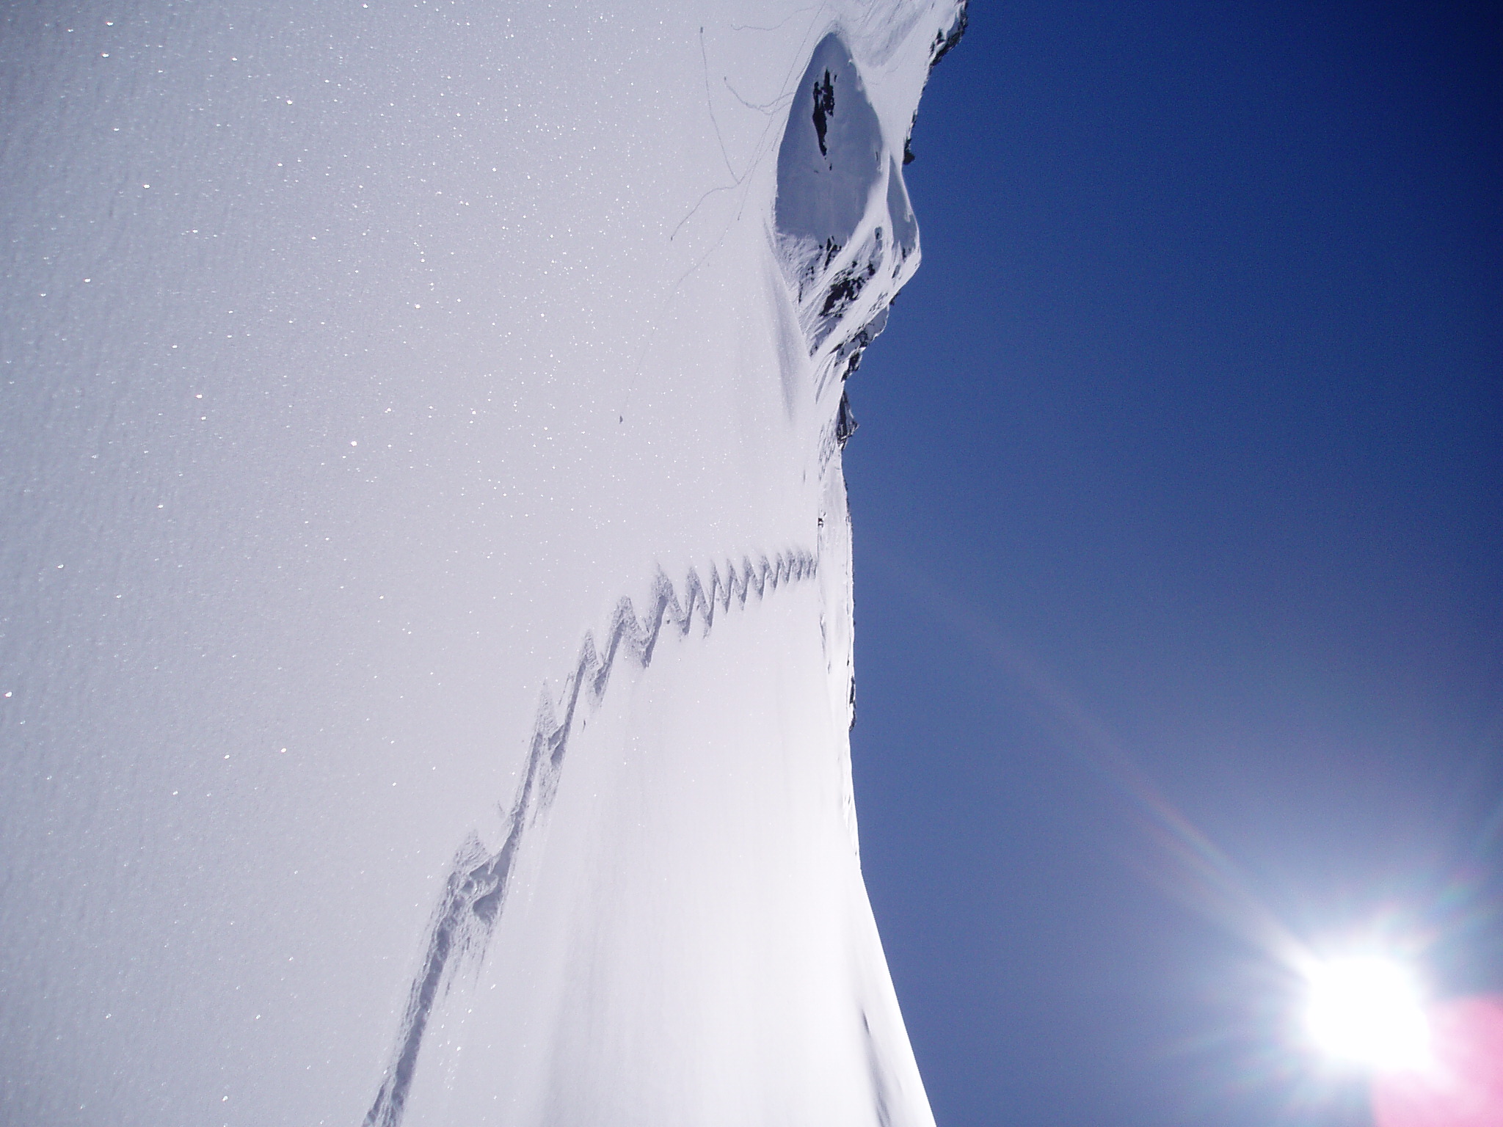
Cs
collective modes
Stringari, Europhys. Lett. 65, 749 (2004)
Hu, Minguzzi, Liu, Tosi, PRL 93, 190403 (2004)
Heiselberg, PRL 93, 040402 (2004)
Combescot, Leyronas, Europhys. Lett. 68, 762 (2005)
Manini, Salasnich, PRA 71, 033625 (2005)
Bulgac, Bertsch, PRL 94, 070401 (2005)
Kim, Zubarev, PRA 72, 011603(R) (2005)
Astrakharchik, Combescot, Leyronas, Stringari, PRL 95, 030404 (2005)
…
theory
and many more recent papers…
expt.
Duke Univ., J. Thomas group / Innsbruck

Slide 16
radial compression mode
Innsbruck
Duke
Bartenstein et al., PRL 92, 203201 (2004)
see also Altmeyer et al., cond-mat/0611285
Altmeyer et al., PRL 98, 0404401 (2007)
Kinast et al., PRL 92, 150402 (2004)
Kinast et al. PRA 70, 051401(R) (2004)
Kinast et al., PRL 94, 170404 (2005)
radial breathing mode
compression mode

Slide 17
radial compression mode
2004 data
frequency
(normalized
to sloshing
mode)
Bartenstein et al.,
PRL 92, 203201 (2004)
hydrodynamic
collisionless
damping
plausible explanation:
coupling of coll. osc.
to pairing gap
C. Chin et al.,
Science 305, 1128 (2004)

Slide 18
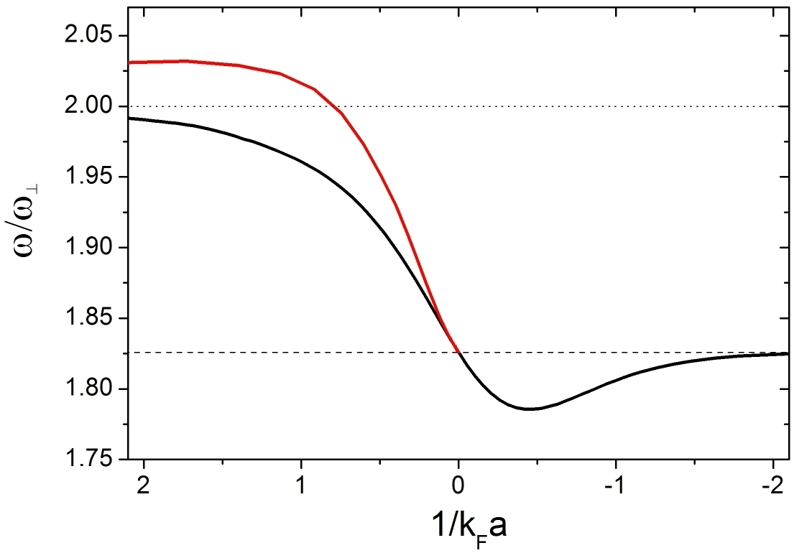
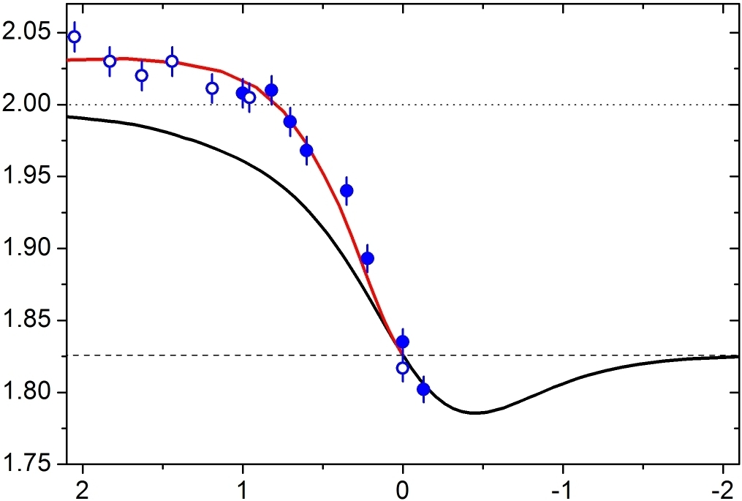
precision measurements
Altmeyer et al., PRL 98, 0404401 (2007)
quantum Monte carlo
Astrakharchik et al.,
PRL 95, 030404 (2005)
mean-field BCS
BEC
BCS
precision test of many-body theories !

Slide 19
Cs
surface modes

Slide 20
radial quadrupole mode
Altmeyer et al., PRA 76, 033610 (2007)
radial quadrupole mode
pure surface mode
pure test of hydrodynamics !
(mode freq. independent of eq. of state)
hydrodynamic freq. collisionless freq.

Slide 21
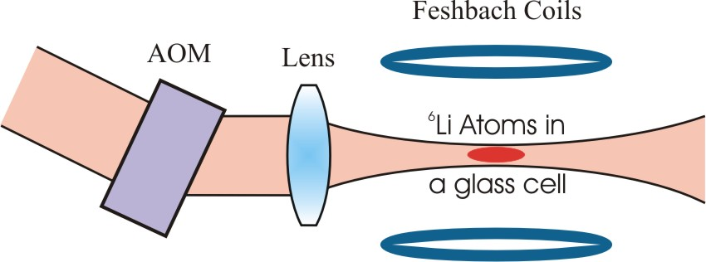
scanning the trap beam

Slide 22
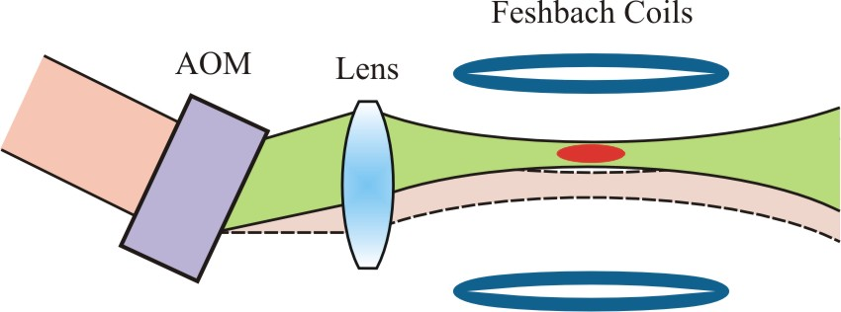
scanning the trap beam

Slide 23
scanning the trap beam
time-averaged potentials:
a powerful tool for controlled trap deformations

Slide 24
radial quadrupole mode: expectations
collisionless
?
frequency
hydrodynamic
ω_{q}/ω_{r}
0
BEC
-1/k_{F}a
BCS
how sharp is the transition ?
does it show any structure ?
smooth change between the two frequencies ?

Slide 25
results on radial quadrupole mode
930-960G
collisionless
frequency
hydrodynamic
huge
downshift !
1/k_{F}a

Slide 26
results on radial quadrupole mode
930-960G
collisionless
frequency
hydrodynamic
huge
downshift !
damping
rate

Slide 27
results on radial quadrupole mode
930-960G
collisionless
frequency
hydrodynamic
huge
downshift !
standard hydrodynamic theory breaks down !
coupling of oscillations to pairing gap ?
R. Combescot and X. Leyronas, PRL 93, 138901 (2005)
quasi-particle excitations
M. Urban, arXiv:0808:3719

Slide 28
Cs
role of temperature
in the crossover

Slide 29
scissors mode
break cylindrical
symmetry of trap !
atoms in elliptic potential
aspect ratio ~ 2
sudden change of angle
of the elliptic potential
angle of elliptic cloud
oscillates
cloud shape doesn‘t change
qualitative difference in the oscillation
for hydrodynamic and collisionless regime

Slide 30
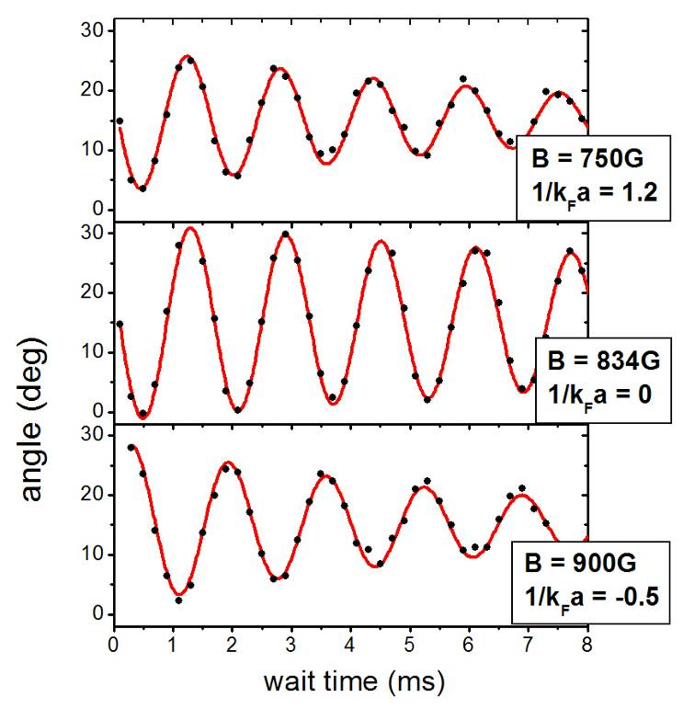
scissors oscillation at low T
hydrodynamic gas
single frequency oscillation

Slide 31
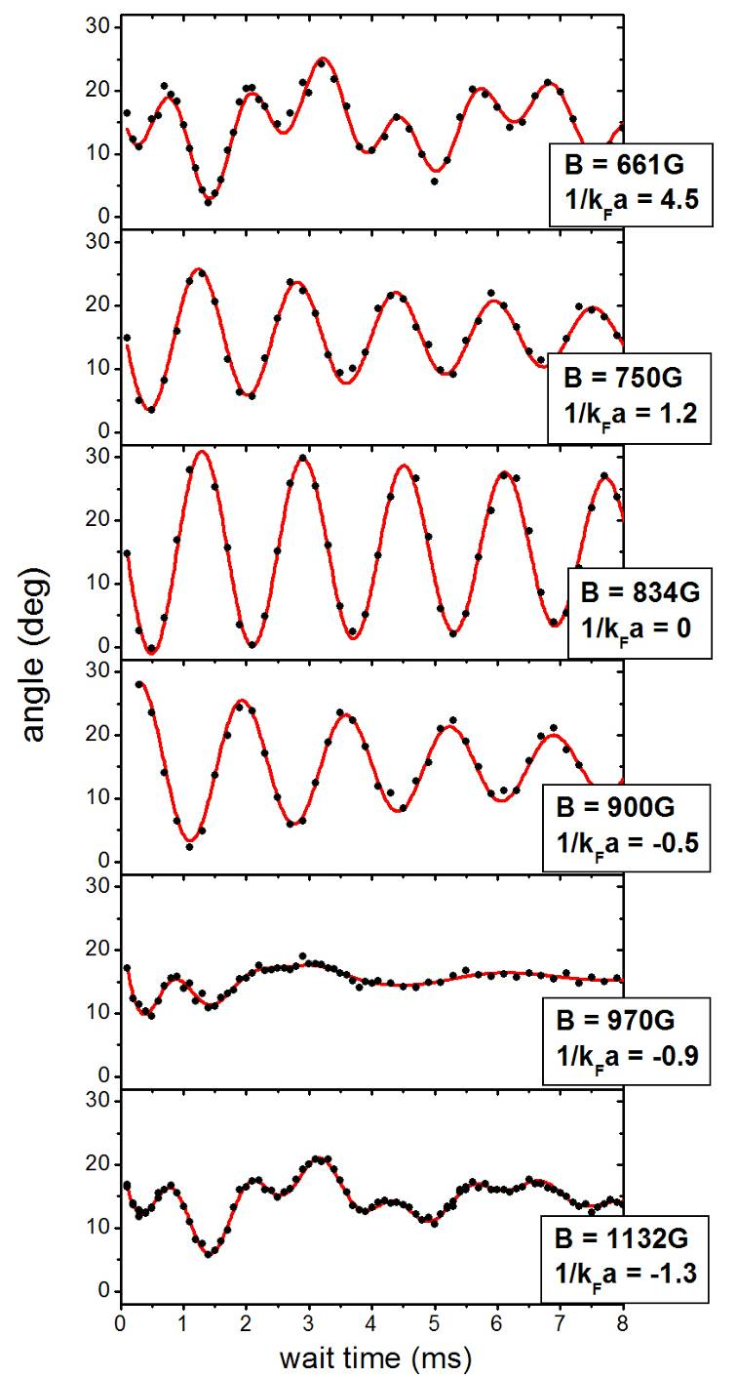
scissors oscillation at low T
hydrodynamic gas
single frequency oscillation
collisionless gas
oscillation with two frequencies

Slide 32
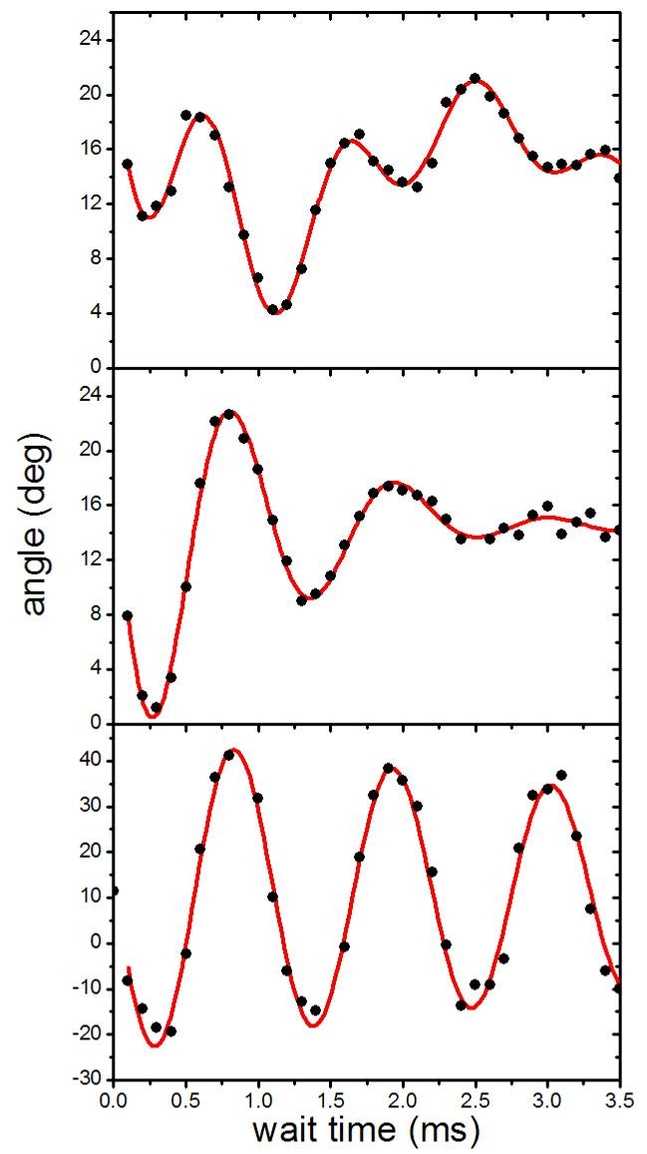
finite temperature
collisionless gas
T/T_{F} ~ 1.0
transition regime
(strong damping)
Temperature
T/T_{F} ~ 0.6
how does the transition temperature depend on the interaction strength ?
scissors mode excellent tool to probe this!
T/T_{F} ~ 0.1
hydrodynamic gas

Slide 33
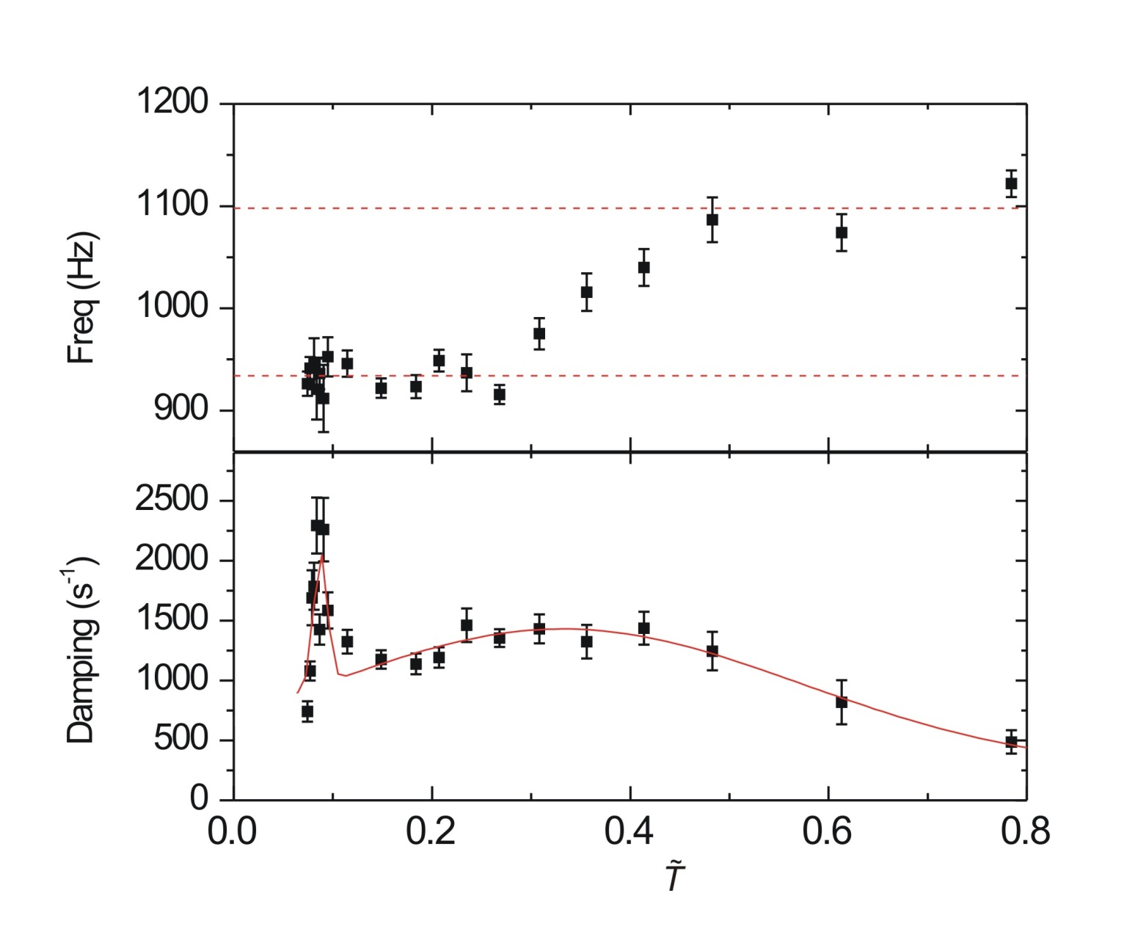
damping vs temperature
B = 905 G
collisionless
hydrodynamic
maximum damping
in transition region
temperature parameter à la J. Thomas measured on resonance

Slide 34
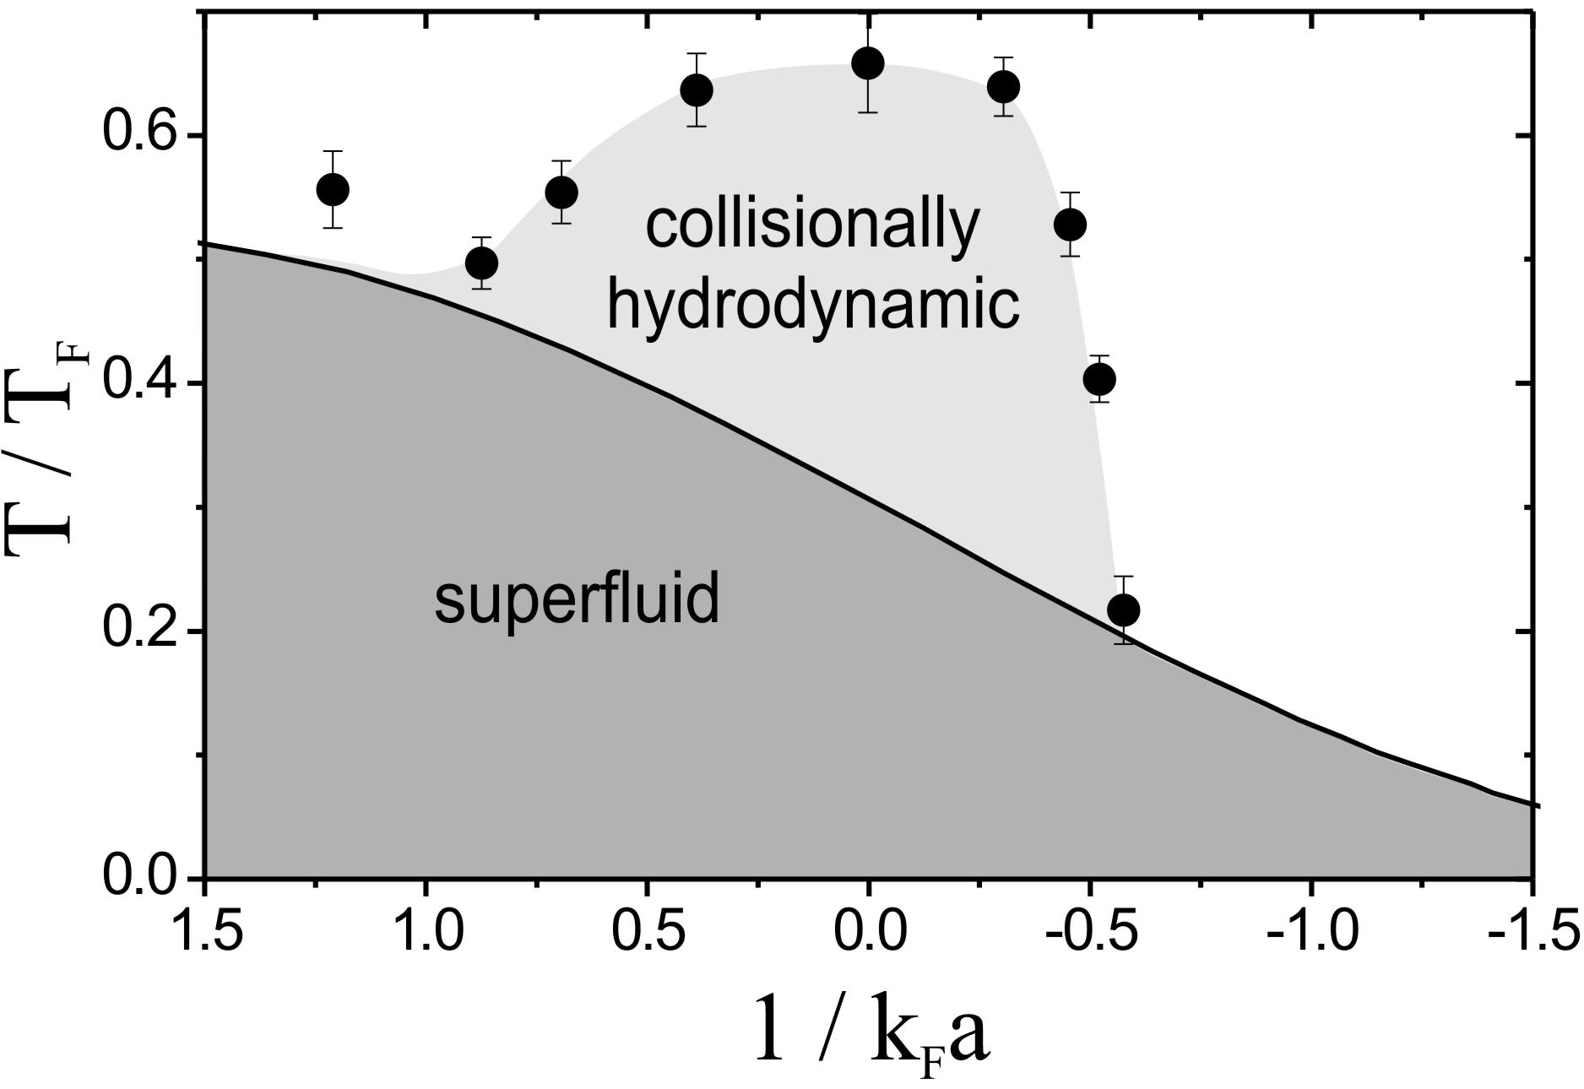
phase diagram
Wright et al., PRL 99, 150403 (2007)
T_{C} theory curve from Perali et al., PRL 92, 220404 (2004)

Slide 35
surprise
B = 895 G
maximum damping
hydrodyn. – c´less
temperature parameter à la J. Thomas measured on resonance

Slide 36
surprise
B = 895 G
!?
superfluid-to-normal
phase-transition ?
maximum damping
hydrodyn. – c´less
temperature parameter à la J. Thomas measured on resonance

Slide 37
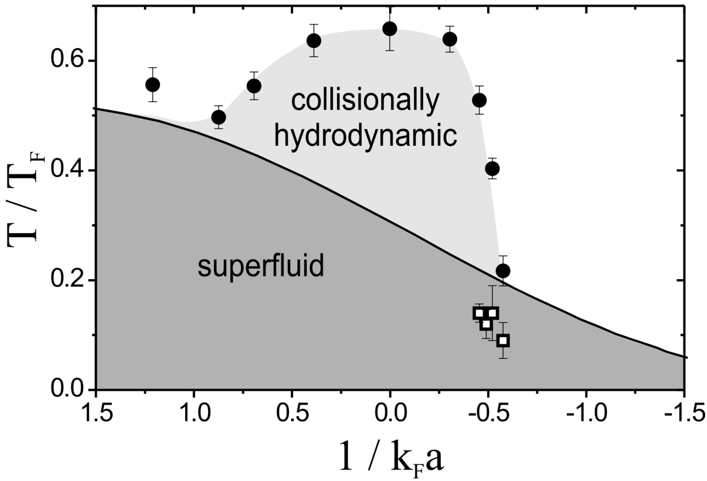
phase diagram
T_{C} theory curve from Perali et al., PRL 92, 220404 (2004)

Slide 38
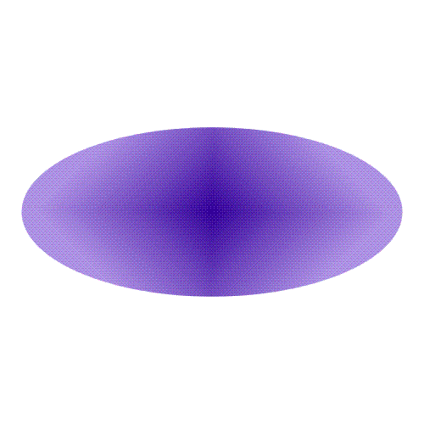

conclusion on surface modes
hydrodynamic-to-collisionless transition
with large change of frequency
striking frequency down-shift ?
temperature-induced transition:
phase diagram for hydrodynamic behavior in crossover
damping peak near superfluid
phase transition ?

Slide 39
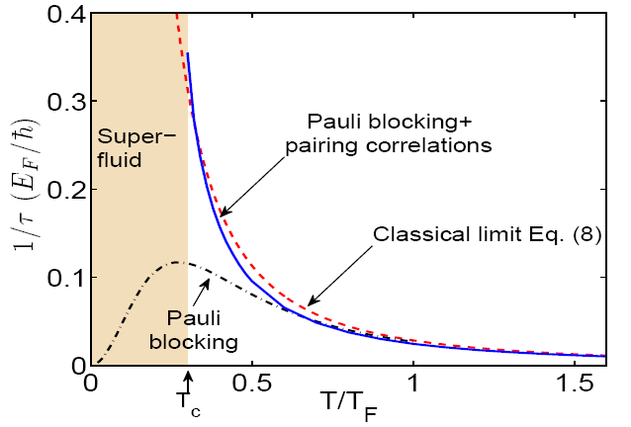
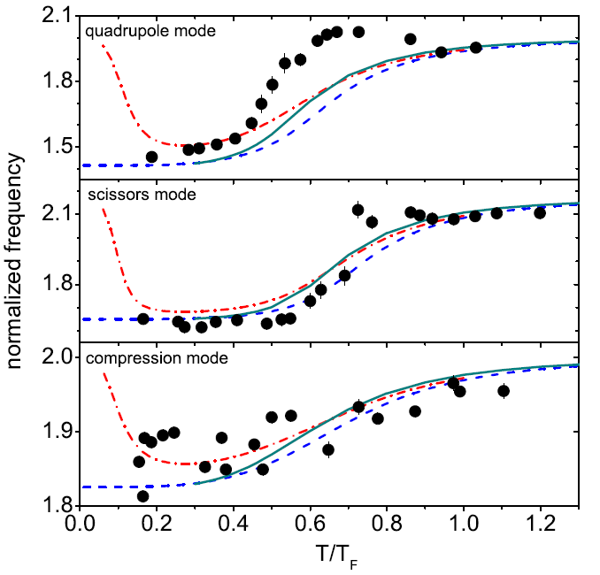
comparative study of collective modes
theory for T>Tc
(G. Bruun & H. Smith)
Riedl et al.
arXiv:0809.1814

Slide 40
rotating the trap
see poster presented by
Edmundo Sanchez and Christoph Kohstall

Slide 41
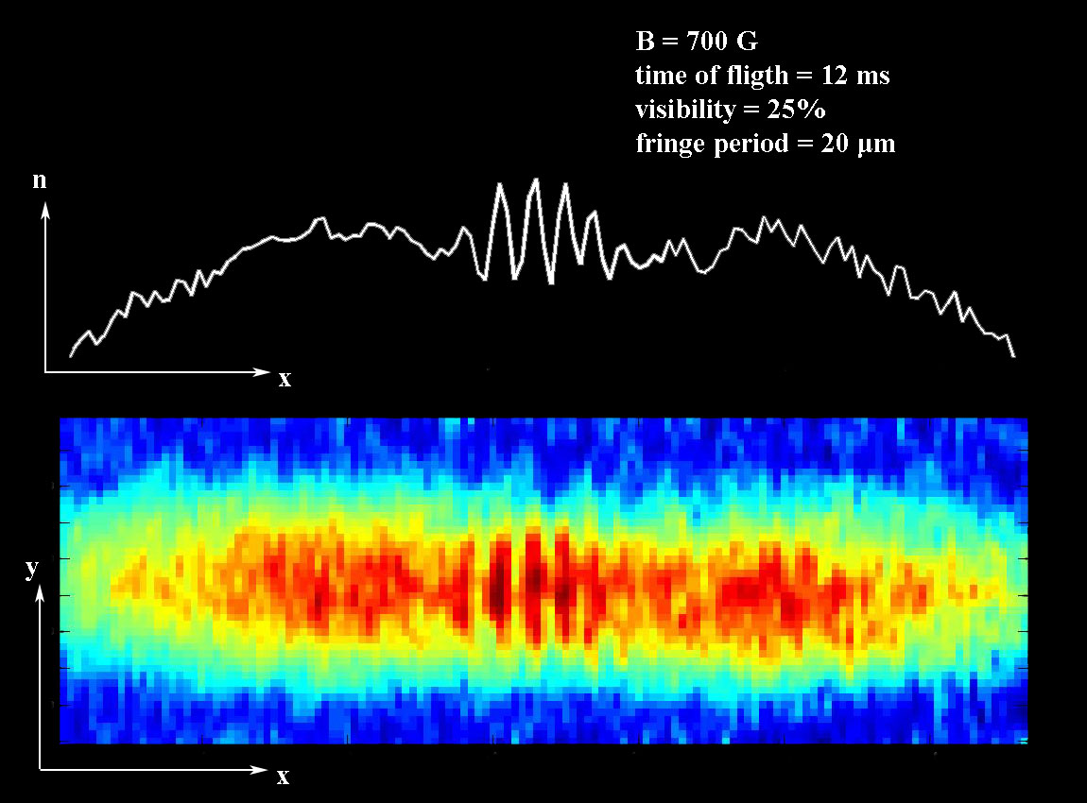
double well
interference between two mBECs
TOF 12ms
700G
100µm

