Slide 1
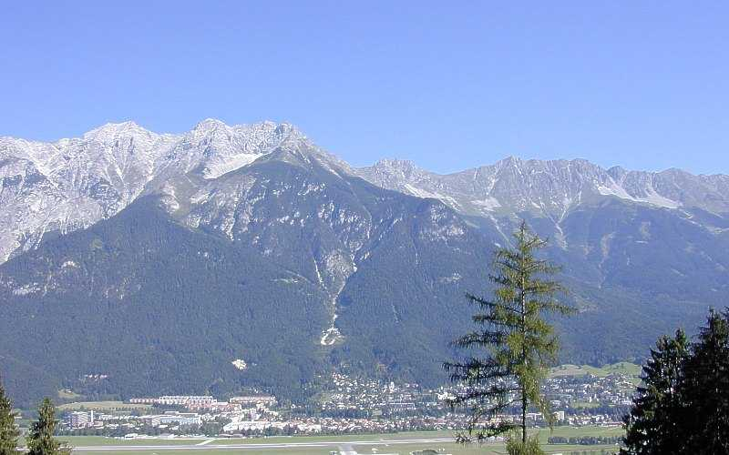


strongly interacting fermions:
… to mixed species
Rudolf Grimm
Center for Quantum Physics
Innsbruck
Austrian
Academy of Sciences
University

Slide 2
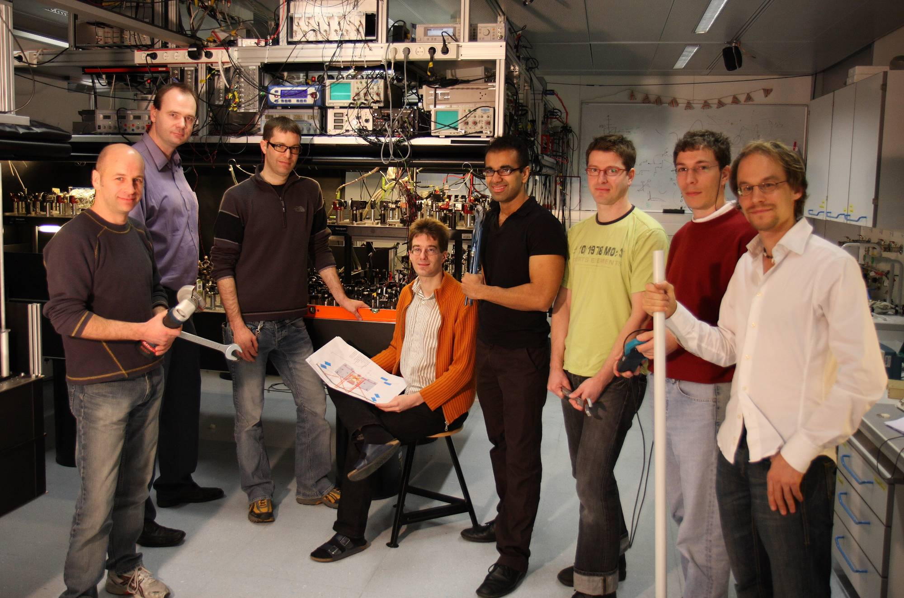
The team
Devang
Naik
Frederik
Spiegelhalder
Rudi
Grimm
Devang
Naik
(Gabriel
Kerner)
Eric
Wille
Gerhard
Hendl
Andreas
Trenkwalder
Florian
Schreck
Notes:
At the end, let me show you a foto of the people who have contributed to
the research.
And I would like to thank our sponsors. In addition to organizations
sponsoring IQOQI in general, we used a lot of Rudis Wittgenstein price money
and recently we obtained a EuroQuam grant. The grant selection process was
administerd by the european science foundation but the money is coming from
the national founding agencies, in our case the FWF.
Thank you for your attention!

Slide 3
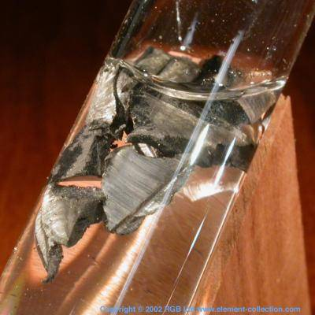
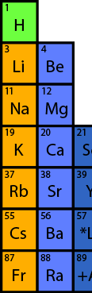
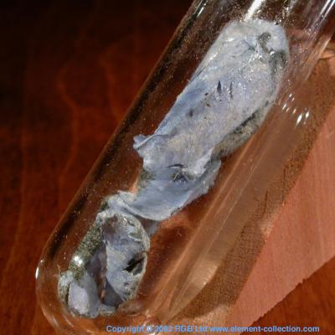
Ultracold alkali fermions
6
40
K
Li
last five years:
tremendous success in strongly interacting Fermi gases
with spin mixtures of ⁶Li and ⁴⁰K
molecular BEC, pair condensates, superfluidity,…

Slide 4
Ultracold alkali fermions
6
&
40
K
Li
let‘s go a big step further
pairing and superfluidity in a Fermi-Fermi mixture

Slide 5

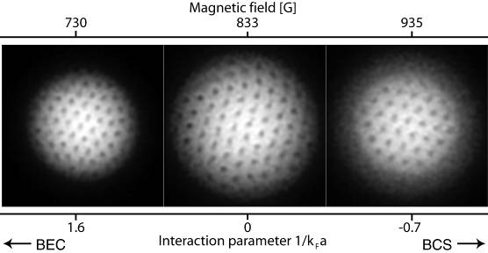
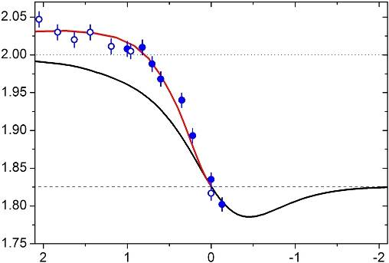
control knobs (single species)
BEC-BCS crossover physics
a
interaction strength
Innsbruck, JILA, MIT,
Duke, ENS, Rice
…
trap parameters:
anisotropy, ellipticity etc. (very flexible!)
physics of polarized Fermi gases
P
Rice
spin imbalance
MIT

Slide 6
new possibilities in FF mixtures
m₁/m₂
control of mass ratio
87/40 = 2.2
40/6 = 6.7
fermion pairing with unequal masses,
stable heteronuclear molecules,
novel quantum phases …
Li, K, Sr
87/6 = 14.5
m_{Sr}/m_{K} = 2.2
m_{K}/m_{Li} = 6.6
m_{Sr}/m_{Li} = 14.5
species #1
independent control of optical potentials
…
pairing with unequal Fermi surfaces
e.g., small trap of ⁴⁰K in a large trap of ⁶Li
or optical lattice for ⁸⁷Sr in a bath of ⁶Li …
species #2
…
molecules
Cooper pairs
+
dipolar
molecules
complex
molecules
Notes:
Alkaline – Alkaline Earth

Slide 7
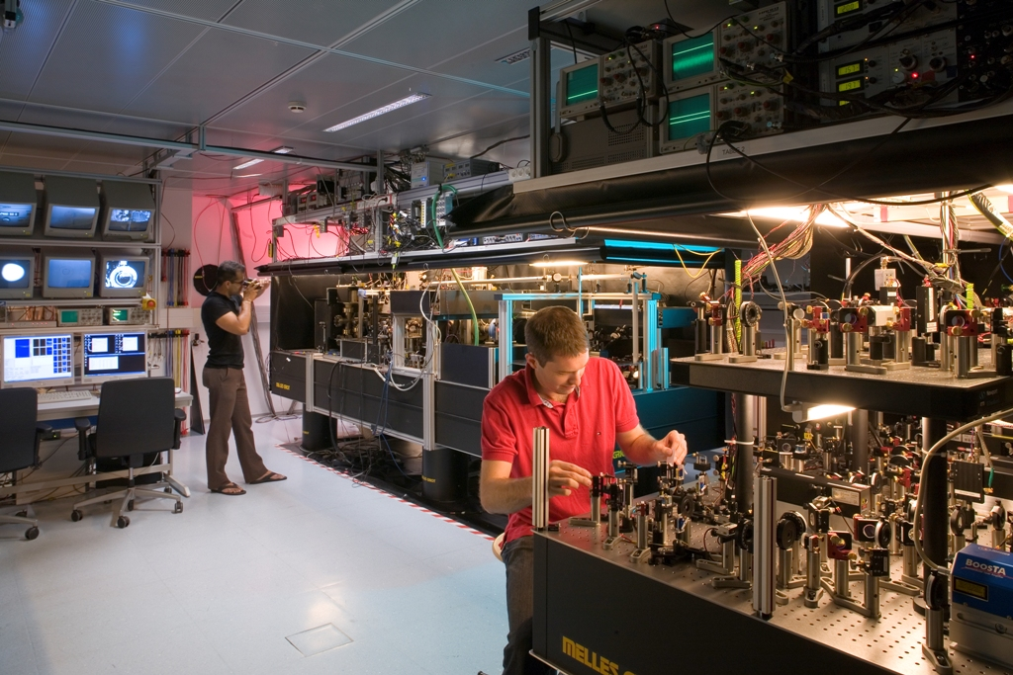
The machine

Slide 8
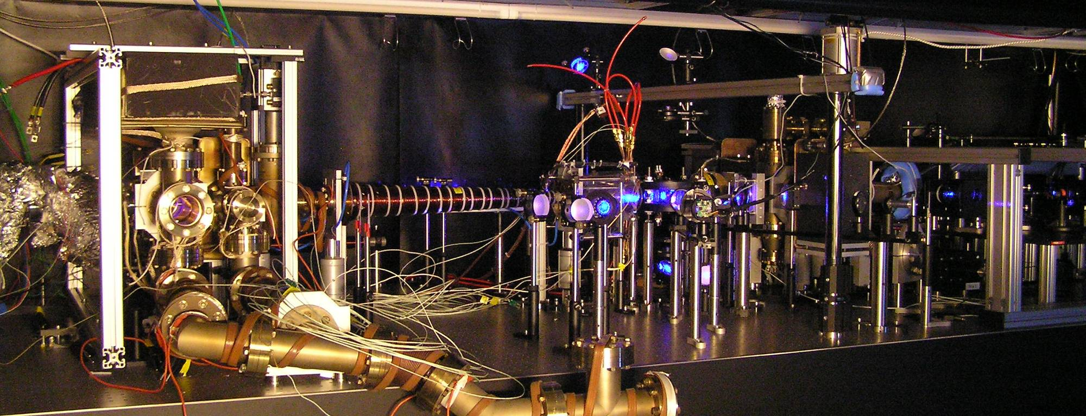
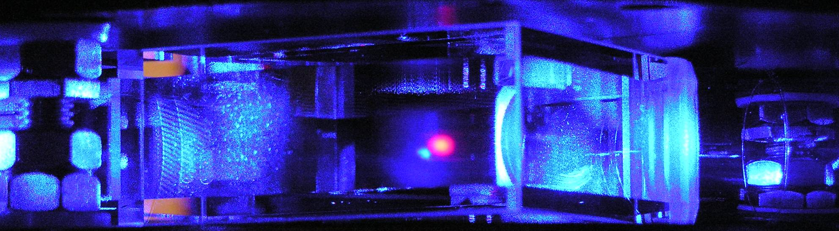
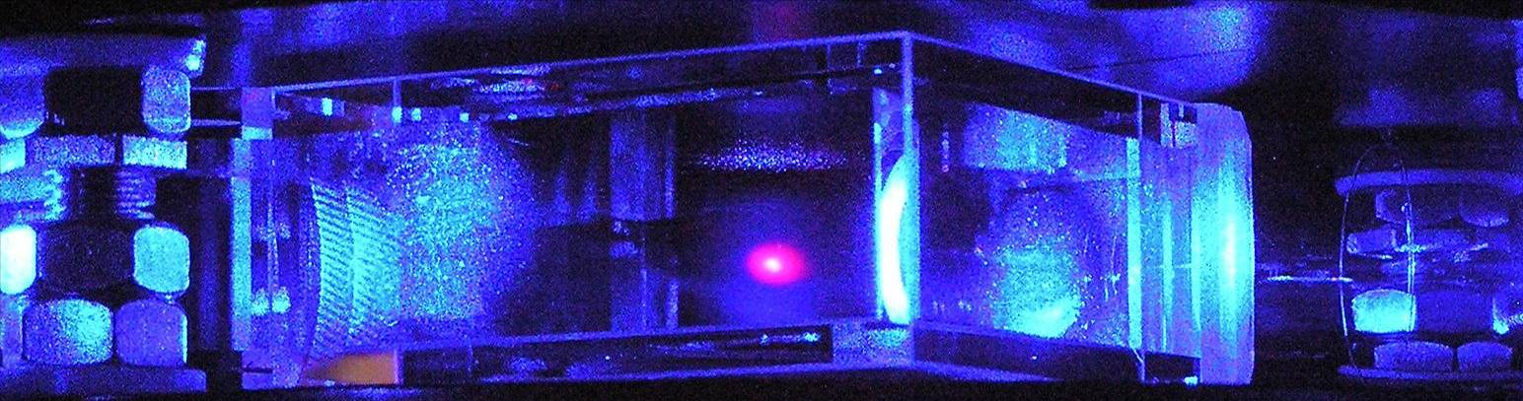
Lithium-Potassium-Strontium Machine

Slide 9
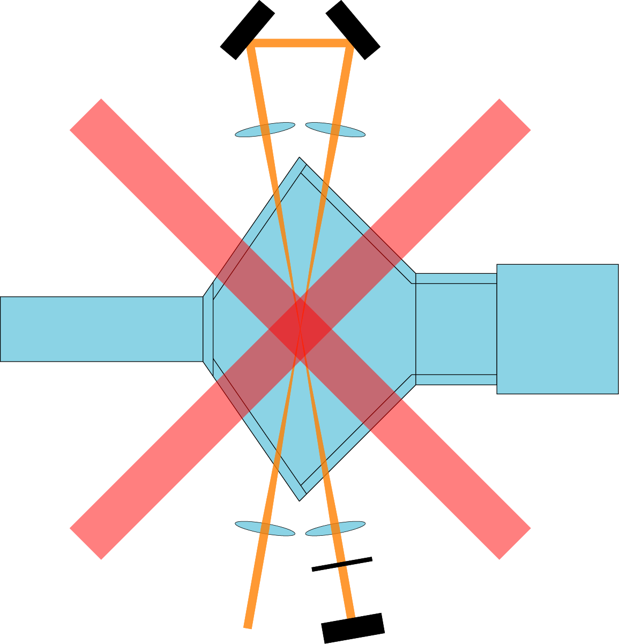
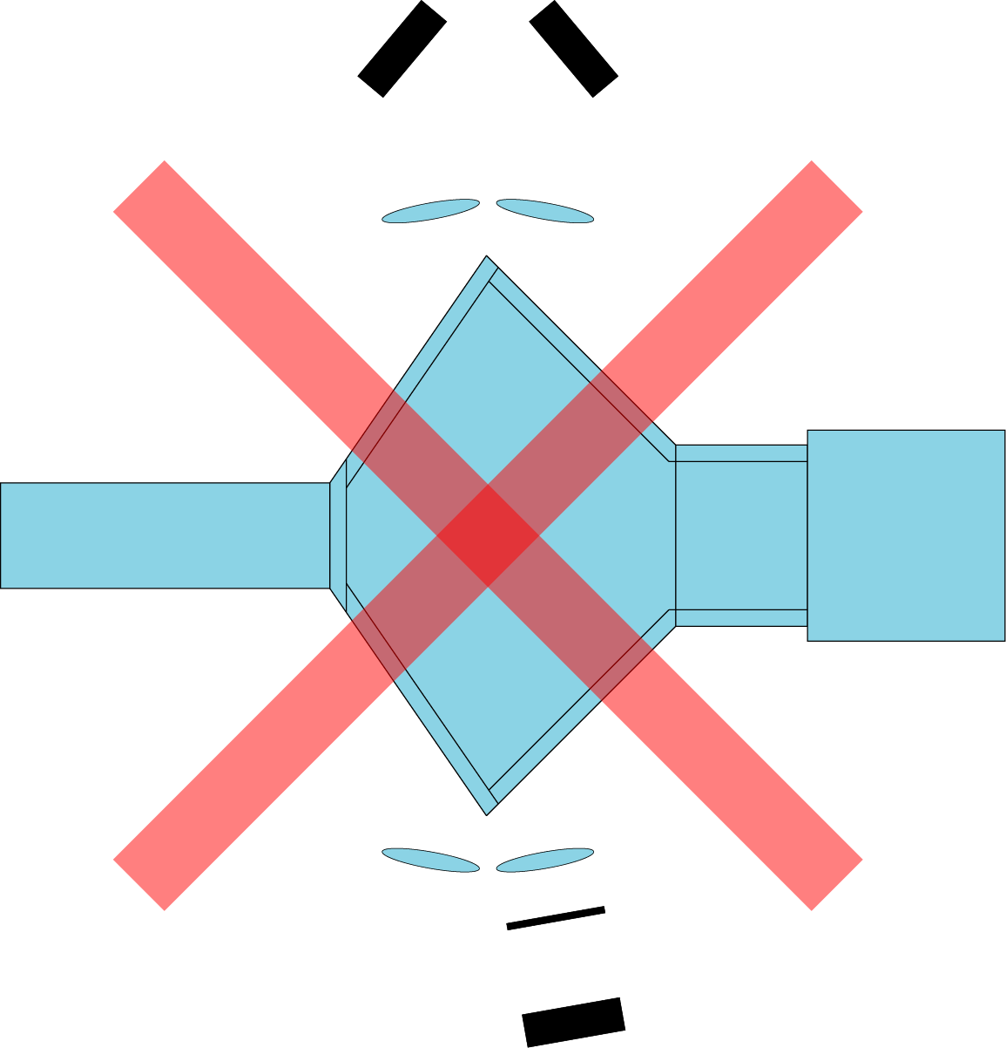
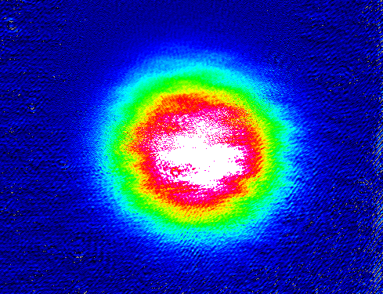
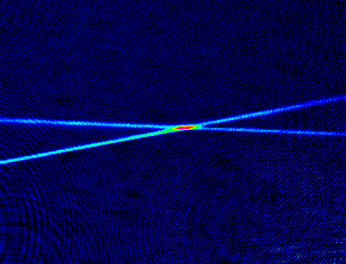
all-optical way
⁶Li MOT: N ~ 10⁹ T ~ 300µK
MOT
beams
MOT
beams
3 mm
dipole trap: N > 10⁶
λ/4
3 mm
dipole trap (100W 1075nm laser):
U ~ k_{B} 1 mK
w ~ 60 µm
Notes:
Good starting point for evaporative cooling!
Feshbach search!

Slide 10


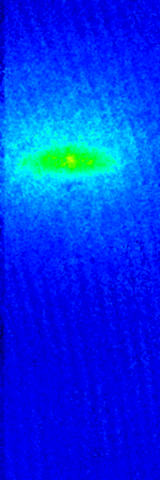
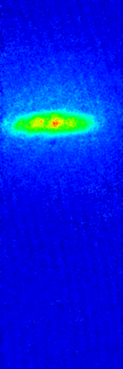
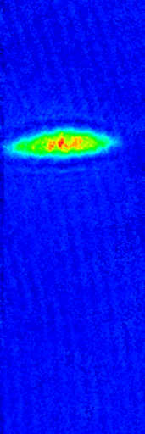
⁶Li₂ molecular Bose condensation
5.10⁵
molecules
in dipole trap
After 10ms time of flight:
PURE BEC!
4.3 sec evap
4.7 sec evap
4.8 sec evap
5.1 sec evap

Slide 11
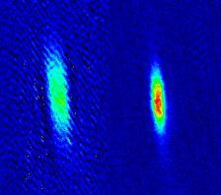
heteronuclear FF mixture !
absorption images of ⁶Li and ⁴⁰K atoms
after 3 s of forced evaporative cooling at 750G
⁶Li
⁴⁰K
26 µK trap depths 55 µK
temperature ~ 4µK
numbers ~ 10⁵
heteronuclear Fermi-Fermi mixture

Slide 12
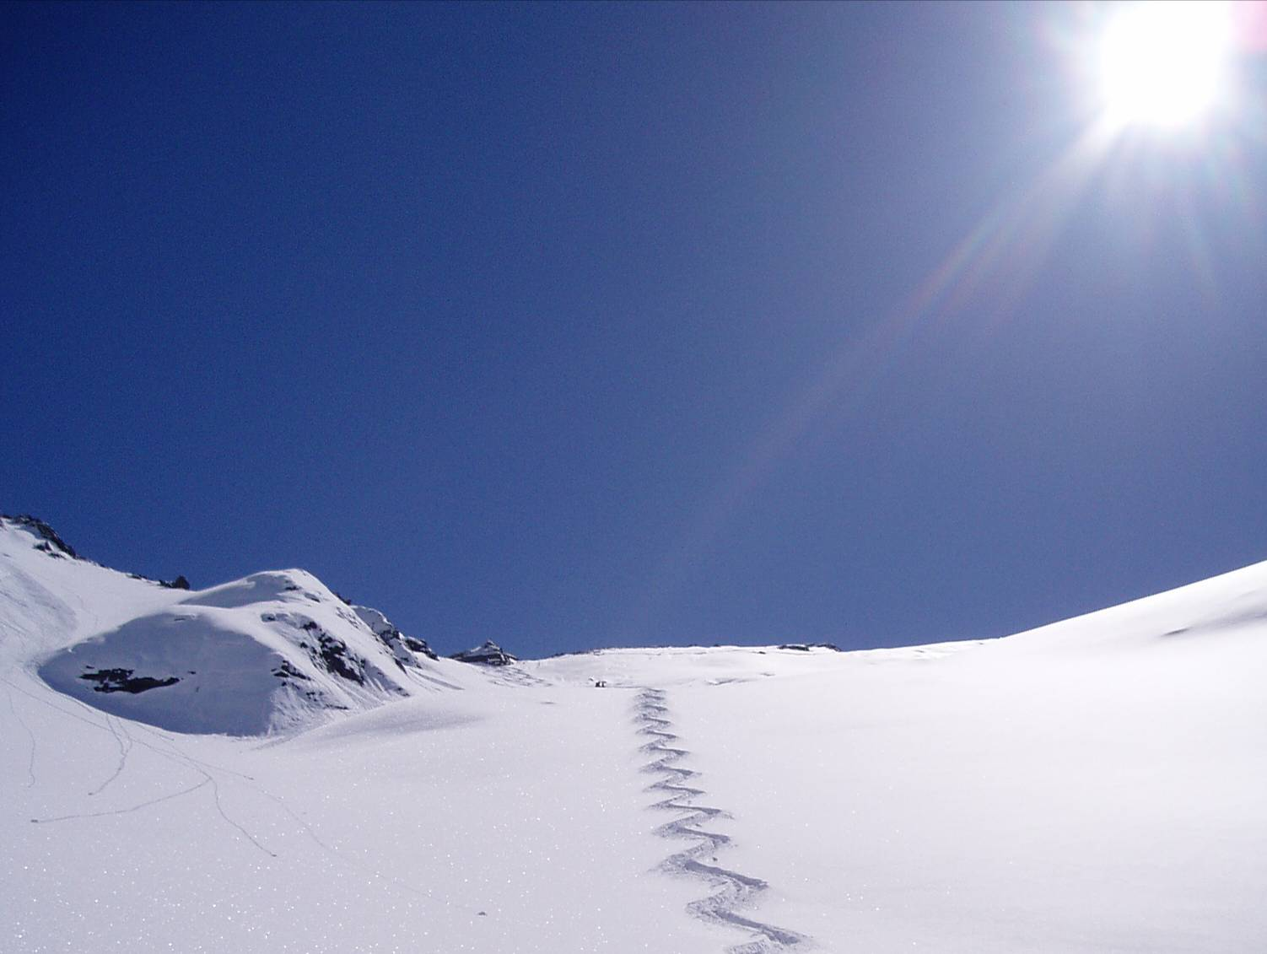
Cs
Feshbach resonances

Slide 13
Feshbach resonance
bound state
s­wave scattering length a
as a function of magnetic field B
U(r)
closed channel
coupling
a
incident channel
r
a_{bg}
magnetic moment of closed channel
differs from the magnetic moment
of the incident channel
B₀
B

Slide 14
coupling to molecular state
U(r)
bound state
Feshbach resonance
as entrance door into
the molecular world
coupling
production of molecules via
Feshbach resonances
T. Köhler, K. Goral, P. Julienne,
RMP 78, 1312 (2006)
r
enhanced three-body recombination near Feshbach resonance:
trap loss as a signature of a resonance

Slide 15
spin states
Energy [MHz]
Energy [MHz]
.
.
.
Li
K
B [T]
B [T]
.
.
.
Δm=+1
Δm= -1
Notes:
Could also show hyperfine pumping

Slide 16
spin relaxation
Energy [MHz]
Energy [MHz]
.
.
.
Li
K
stable mixtures can be created
if one of the species is in the lowest state !
B [T]
B [T]
.
.
.
Δm=+1
Δm= -1

Slide 17
spin states nomenclature
Energy [MHz]
Energy [MHz]
.
.
.
Li
K
B [T]
B [T]
|9>
|3>
.
.
.
.
.
.
|2>
|1>
|1>

Slide 18
initial spin state preparation
Energy [MHz]
Energy [MHz]
Li
K
B [T]
B [T]
|9>
|3>
.
.
.
|2>
resonant laser
removes Li|1>
|1>
Optical pumping to lower states
|1>
optical pumping to K|1>
RF transfer to K|2>

Slide 19

Feshbach spectroscopy
recapture to MOT
and observe remaining fluorescence
Prepare stable mixture
wait 10 s
prepare mixture of K|1> and Li |1,2> in IR trap
ramp to B field
evaporative cooling at 760 G
losses occur
Remove unwanted states
state change with RF
Li|1> + K|1>
Li|2> + K|1>
Li|3> + K|1>
Li|1> + K|2>
Li|1> + K|3>
.
.
.
RF sweep
resonant laser
B
760
B [G]

Slide 20
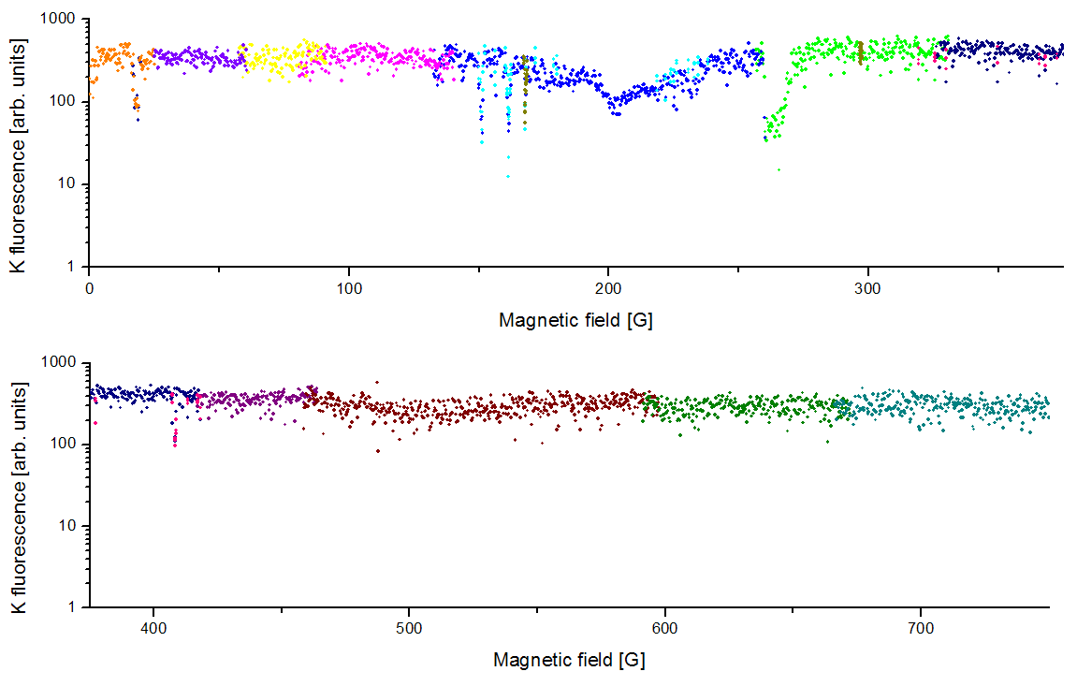
Li|1> K|2> scan
interspecies
K|2> only
Notes:
4 mixtures scanned
2601 measurement points per mixture
10404 experimental runs
174 hours

Slide 21
interspecies Feshbach resonances
B [G]
channel position [G] width [G]
Li|2> + K|1> 215.6 1.7
Li|1> + K|1> 157.6 1.7
Li|1> + K|1> 168.2 1.2
Li|1> + K|1> 249 11
Li|1> + K|2> 16.1 3.8
Li|1> + K|2> 149.2 1.2
Li|1> + K|2> 159.5 1.7
Li|1> + K|2> 165.9 0.6
Li|1> + K|2> 263 11
Li|1> + K|3> 141.7 1.4
Li|1> + K|3> 154.9 2.0
Li|1> + K|3> 162.7 1.7
Li|1> + K|3> 271 14

Slide 22
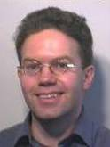
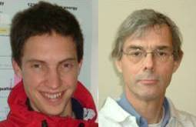
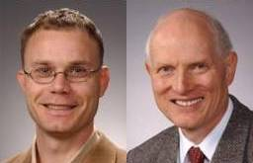
interspecies Feshbach resonances
B [G]
channel position [G] width [G]
Li|2> + K|1> 215.6 1.7
Li|1> + K|1> 157.6 1.7
Li|1> + K|1> 168.2 1.2
Li|1> + K|1> 249 11
Li|1> + K|2> 16.1 3.8
Li|1> + K|2> 149.2 1.2
Li|1> + K|2> 159.5 1.7
Li|1> + K|2> 165.9 0.6
Li|1> + K|2> 263 11
Li|1> + K|3> 141.7 1.4
Li|1> + K|3> 154.9 2.0
Li|1> + K|3> 162.7 1.7
Li|1> + K|3> 271 14
asymptotic
bound state moldel
coupled channels
calculation
S. Kokkelmans, T. Tiecke and J. Walraven, E. Tiesinga, P. Julienne did interpret data
Only two free parameters fit model to data:
position of last bound state in singlet and triplet potential (= a_{S} and a_{T})

Slide 23
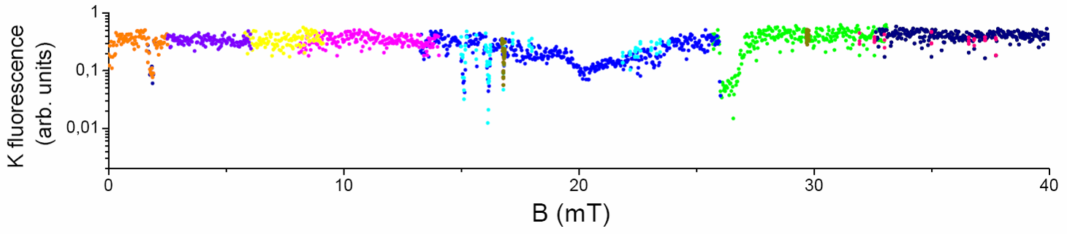
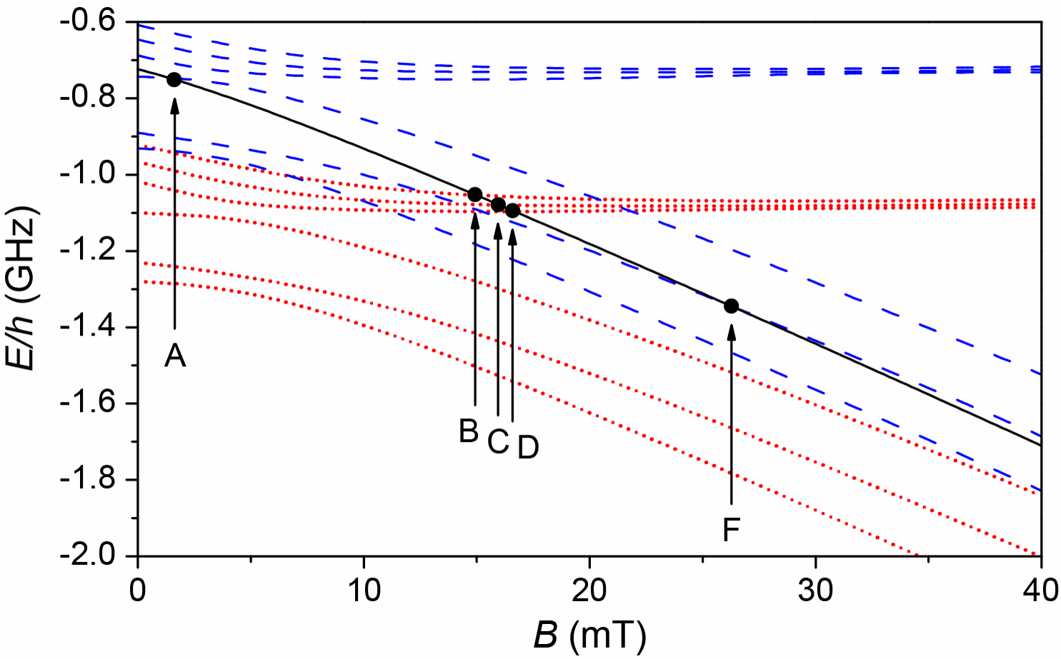
what do we learn?
U(r)
bound state
closed channel
coupling
incident channel
r
individual atoms
p-wave molecules
s-wave molecules

Slide 24
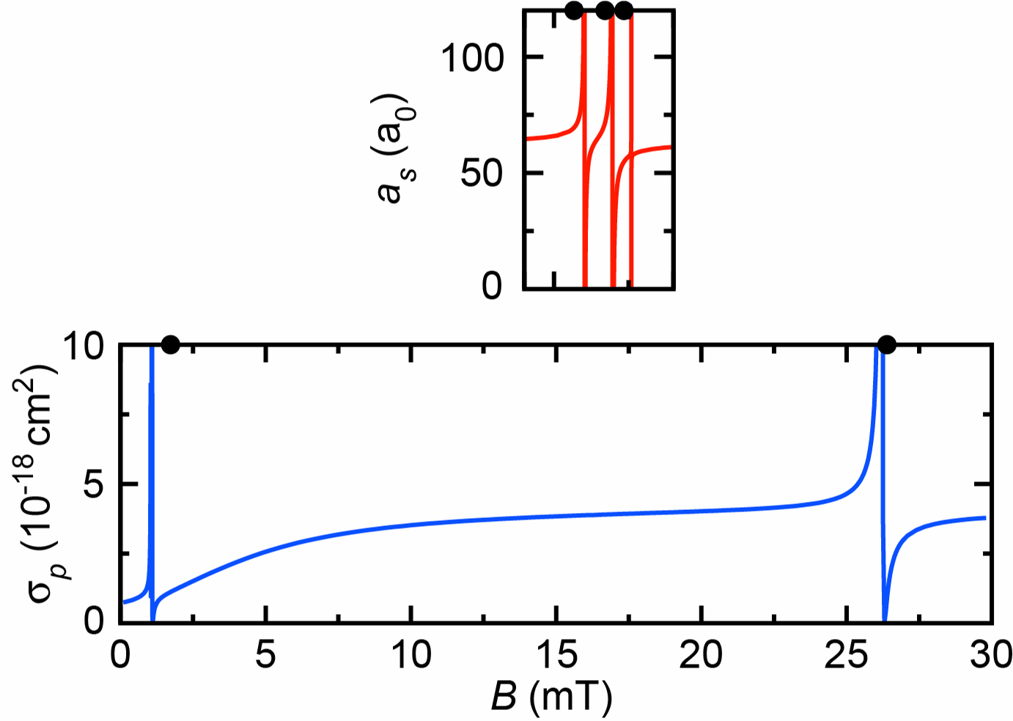
Li|1> K|2> scattering length
coupled channels calculation by
Eite Tiesinga and Paul Julienne
but, s-wave res.
all rather narrow !
interaction
tuning !
singlet sc. length a_{s} = 52.1 a₀
triplet sc. length a_{t} = 63.5 a₀

Slide 25
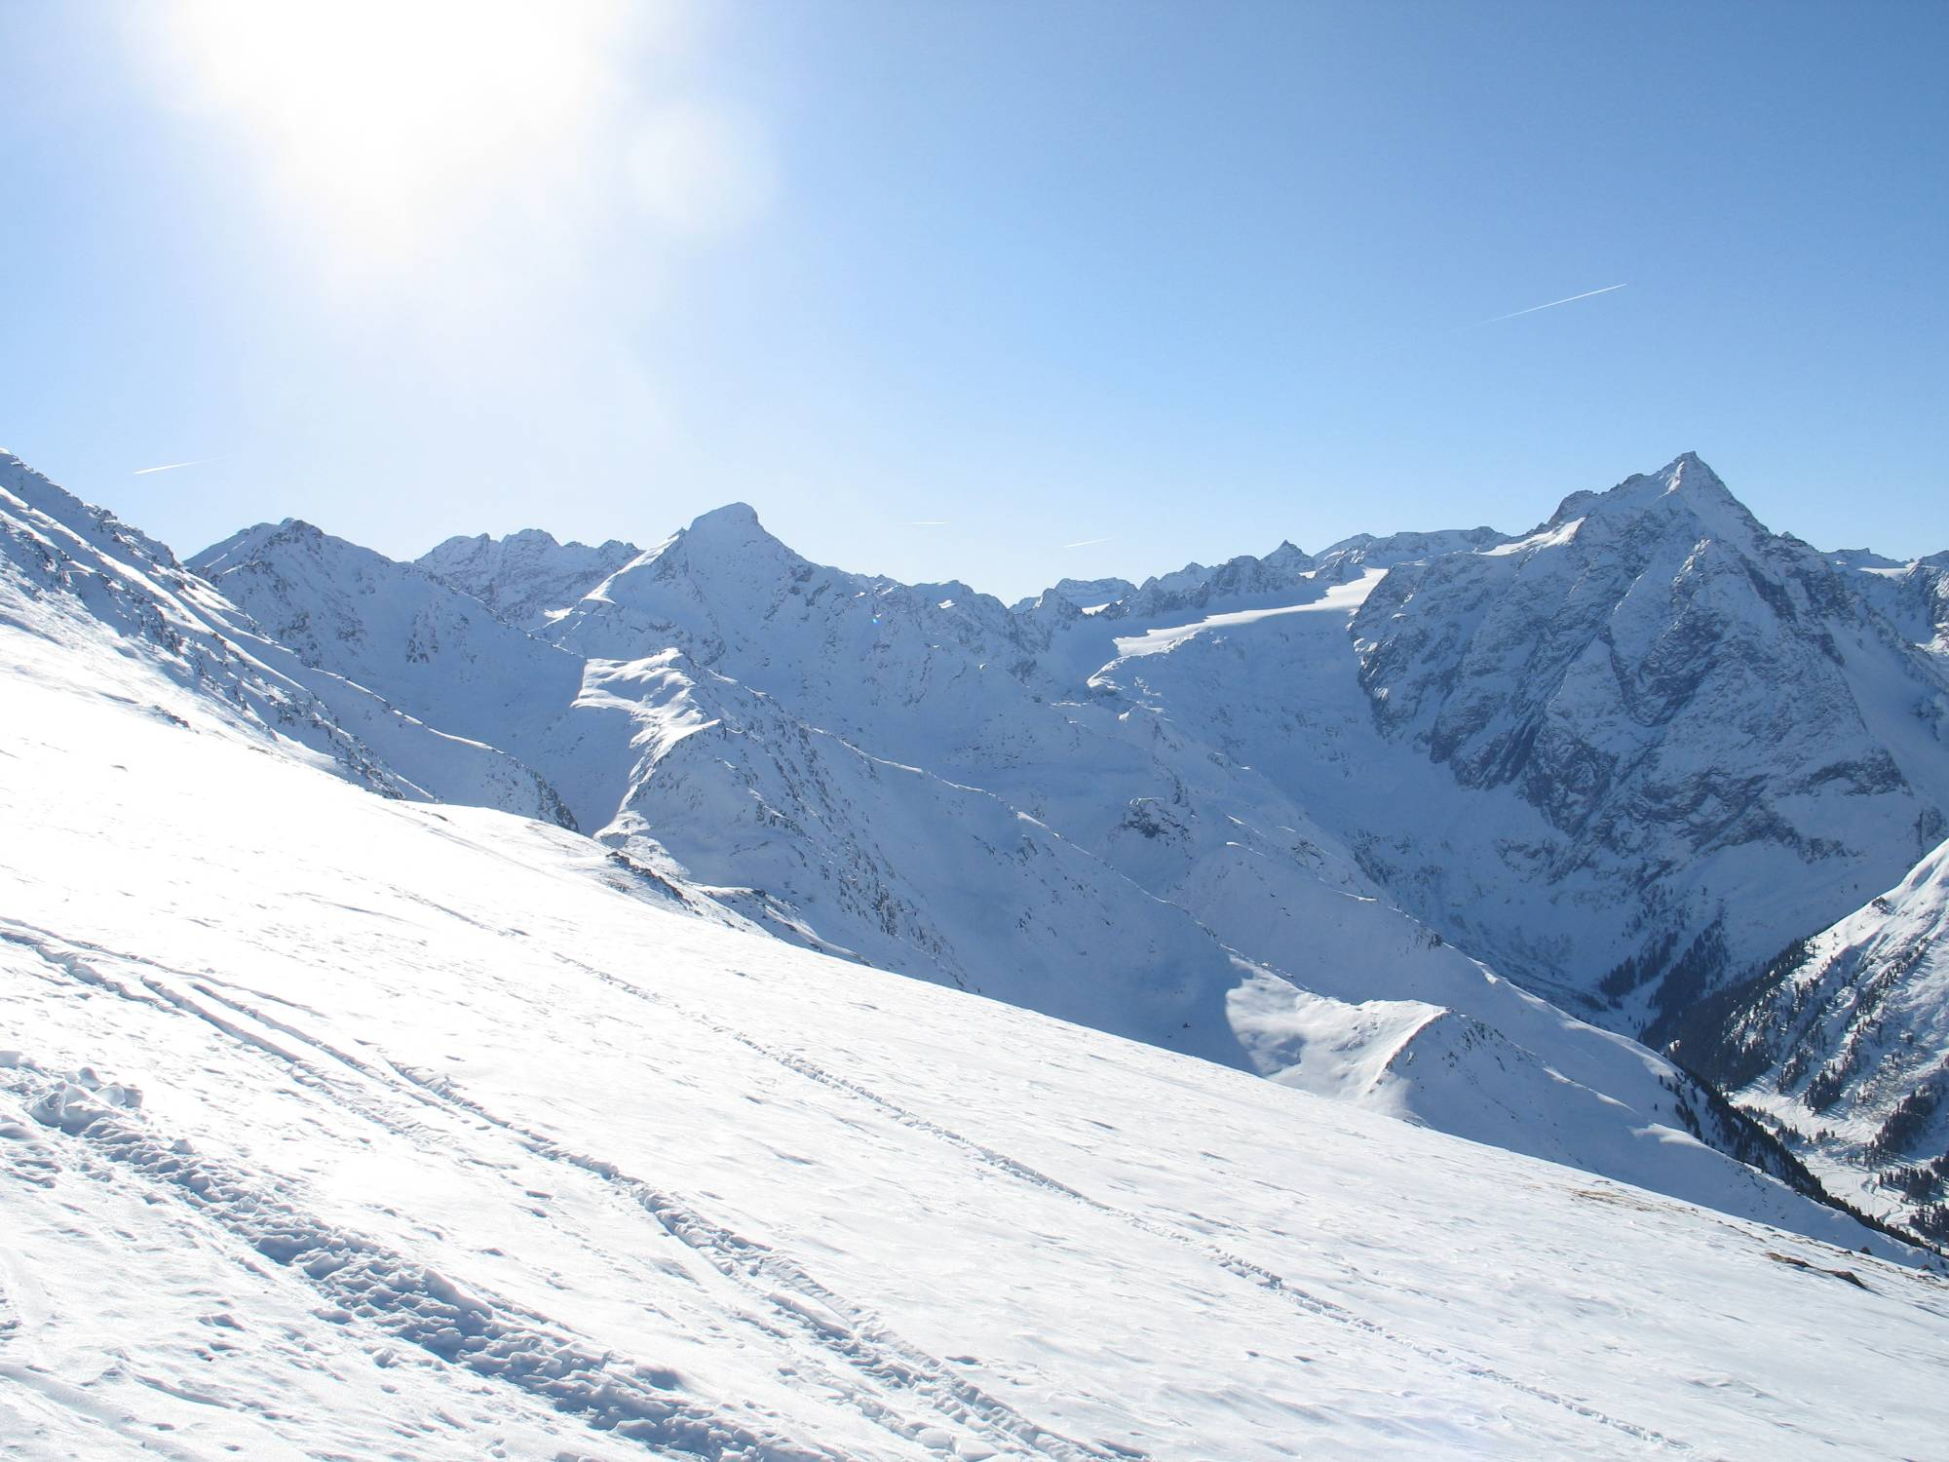
present experiments
optimum strategie for degeneracy
three-body physics (3 non-id. atoms)

Slide 26
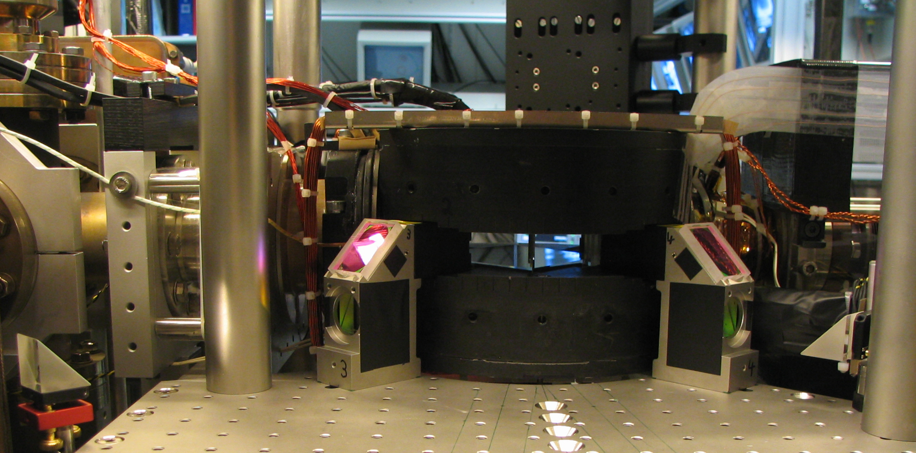
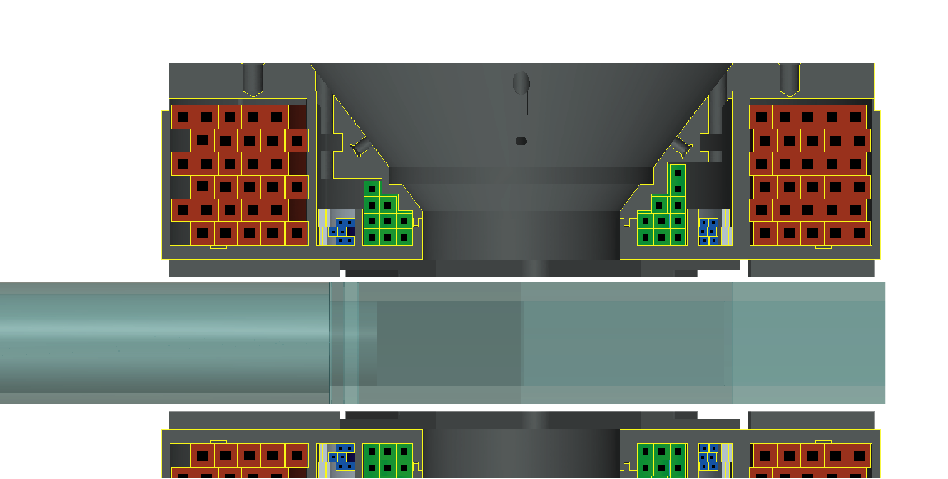
improved set-up
superb optical access (later applications like lattices)

Slide 27
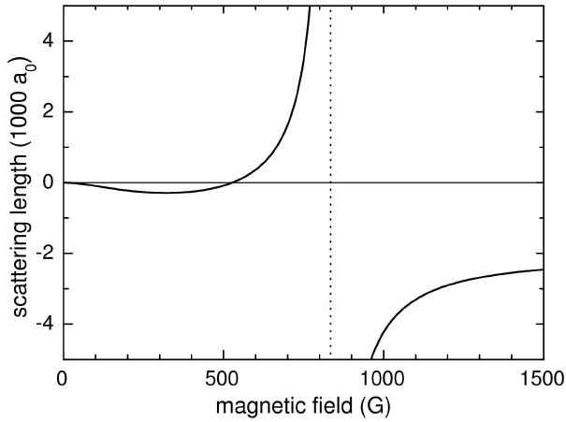
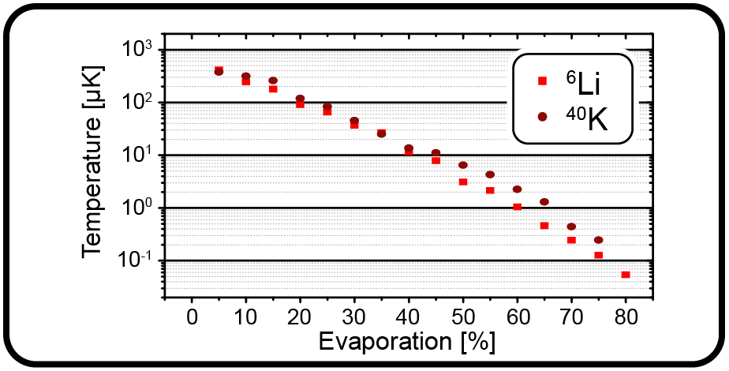
evaporative cooling
⁶Li spin mixture would be a
superb cooling agent
760 G
how well does sympathetic
cooling of ⁴⁰K work ?
preliminary
loss of ⁴⁰K atoms
molecules
mBEC

Slide 28
early stage of cooling: three-component atomic gas
three atoms with two identical ones
three-body recombination Pauli suppressed

Slide 29
early stage of cooling: three-component atomic gas
three atoms with two identical ones
three-body recombination Pauli suppressed

Slide 30
early stage of cooling: three-component atomic gas
three nonidentical atoms (one pair with large a)
three-body recombination without Pauli suppression

Slide 31
final stage of cooling: atom-dimer mixture
atom-dimer interaction (involving three atoms)
inelastic decay without Pauli suppression

Slide 32
three-body physics
this slide made in May 2008
?
three-body decay
(near-resonant pair of atoms)
our educated guess: moderate loss
atom-dimer decay
(weakly bound halo dimer)
?
our educated guess: strong loss
… but three-body physics is full of surprises,
e.g. „Efimov-type“ loss resonances, loss minima…

Slide 33
next experimental step
this slide made in May 2008
explore three-body decay and
sympathetic cooling
of ⁴⁰K immersed into a
near-resonant ⁶Li spin mixture
variable B-field
an important question awaiting experimental answer:
does a realistic scenario for a three-component Fermi gas
exist where at least two components are strongly interacting ?
or will future experiments on strongly interacting Fermi gases
be restricted to two-component gases ?

Slide 34
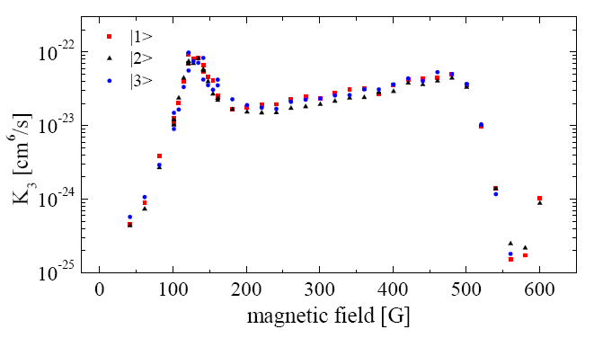
strong loss in a 3-comp. ⁶Li spin mixture
three-body recombination
with lowest three spin states of ⁶Li
extremely fast losses !
Ottenstein et al., arXiv:0809.0587 S. Jochim‘s group in Heidelberg

Slide 35
how about a ⁶Li – ⁴⁰K mixture?
two spin states of ⁶Li
+ one spin state of ⁴⁰K
non-resonant
stable
or not ?
Feshbach
resonance
non-resonant

Slide 36
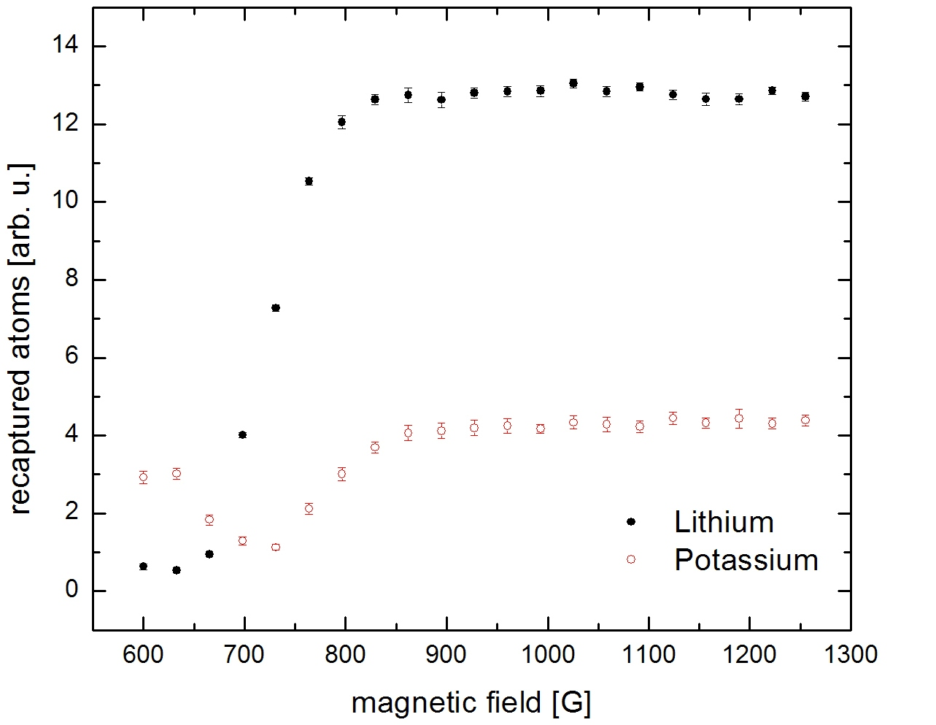
strongly interacting, degenerate spin mixture of ⁶Li
+ ⁴⁰K
a > 0
a < 0
after 1s
storage
resonance
high stability on top of the resonance
and its a<0-side
very good news !

Slide 37
The team
Fermi-Fermi mixture available in the lab!
Devang
Naik
several interspecies resonances observed!
scattering properties understood!
“friendly” three-body properties
Notes:
At the end, let me show you a foto of the people who have contributed to
the research.
And I would like to thank our sponsors. In addition to organizations
sponsoring IQOQI in general, we used a lot of Rudis Wittgenstein price money
and recently we obtained a EuroQuam grant. The grant selection process was
administerd by the european science foundation but the money is coming from
the national founding agencies, in our case the FWF.
Thank you for your attention!

