Slide 1
Summary of session 6
Seva Kamerdzhiev

Slide 2
Topics/talks in session 6
Shutdown Planning 2024
M. Klich
Integrated Campus Schedule
N. Winters
E. Rosi
Access Control System TVS, Status & Plans for access regulation in 2025
T. Radon
TVS - Upgrade
G. Walter

Slide 3
Shutdown Planning 2024
Clear shutdown planning implemented
new project planning tool (Planisware) implemented with the help of PMO
information distributed in the machine meeting
clear decision making process established
summary of various shutdown activities by accelerator area presented
TVS work is not yet planed

Slide 4
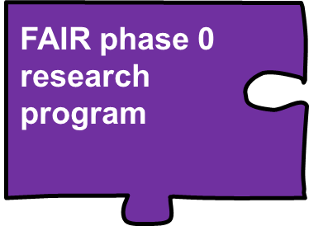
Integrated Campus Schedule
Integrated Campus Scheduling makes dependencies and effects visible and manageable
Create long term overview of main activities and projects covering all stratectic objectives of campus (FAIR & GSI)
Discuss interfaces, dependencies & new projects
Link plans and consolidate resources needs (TGF) to achieve our strategic goals on time
all new projects where interfaces are expected must be submitted to the ICS team for assessment in advance
information available https://www.gsi.de/work/gesamtprojektleitung_fair/project_management_office/integrated_campus_scheduling
Open points
Planning quality and completeness (FAIR Resources, GSI ACC planning activities & Procurement activities,)
Next steps
More efficient TGF resources management
Portofolio management improvement

Slide 5
Access Control System TVS, Status & Plans
TVS operational for about 25 years
system found to be not fail safe
2-stage plan for 2024-2025 agreed upon
stage 1 completed
meeting with authorities envisaged for operation in 2025
active cooperation with FZJ colleages
new system to be operational before beam time 2026
power outage issues yet to be coordinated with CAM

