Slide 1
UNILAC Controls Upgrade 2025
Part of Injector Controls Upgrade
Peter Gerhard/PSU on behalf of ACO a.o.

Slide 2
Outline
Introduction
  Motivation and approach
  Retrospect: Beam time retreat 2023
  General UNILAC control system strategy towards 2026
Injector Controls Upgrade
  Secure UNILAC beam operation through 2025
  Project planning, organization and scope
  Intermediate UNILAC emergency control system
  Short report from dry run
  Move to FCC: HKR modernization sub-project
  UNILAC production control system
  Further project planning
Summary and outlook

Slide 3
Motivation and Approach
Hard- and Software of existing UNILAC control system from the 1990s
  obsolete, outdated, deprecated, not maintainable anymore
  stuck with operating system running beyond extended support contract from 2024, leading to compatibility problems and security risks
  drain of expert knowledge due to retirement
  GSI can not maintain two separate control systems
  move to new FCC main control room requires upgrades of control system
Functionally, UNILAC would be able to serve FAIR today
  use existing legacy control system as template, no new features necessary
  integrate UNILAC into FAIR control system
  new developments only where necessary or high benefit can be achieved at low effort
  exploit new capabilities later

Slide 4
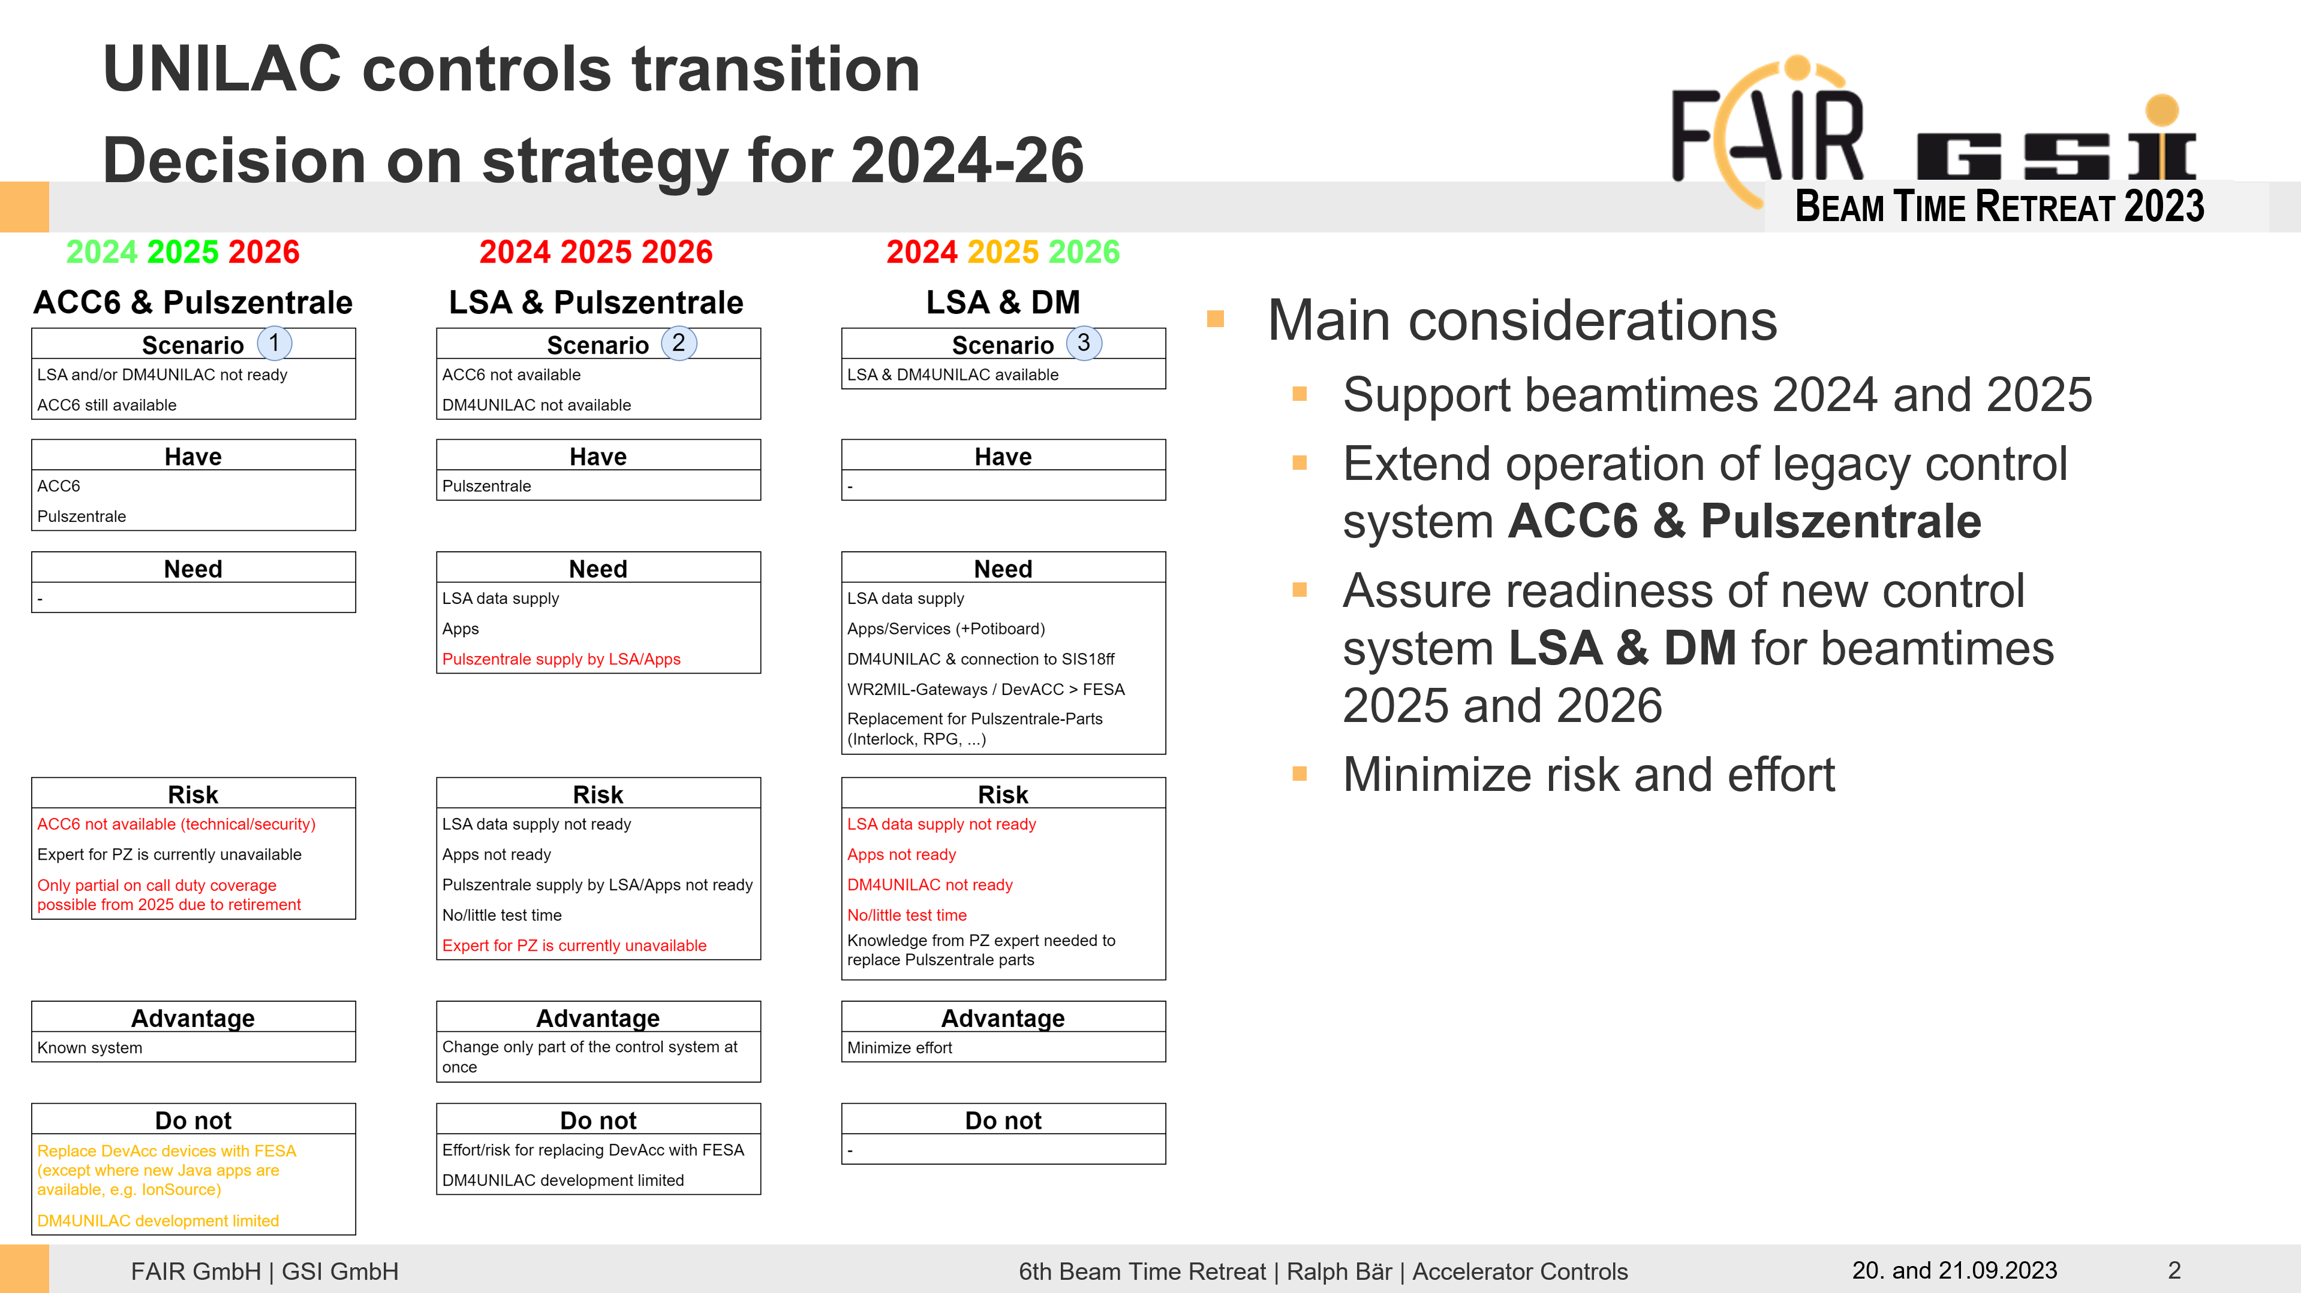
Retrospect: Beam Time Retreat 2023

Slide 5
General Strategy
Step 0: secure UNILAC beam operation through beamtime 2025
  replace existing operating cluster with virtual machines, replace terminals in MCR
  implement IT security measures for operation extension
Step 1: develop emergency control system
  first viable version of new control system with reduced and simplified feature set
  replace existing MIL timing system by White Rabbit-based system
  MCR modernization project: replace/upgrade hardware devices in control room
  serves as emergency backup for beamtime 2025
Step 2: develop production control system
  based on emergency control system
  replace simplifications made by fully fledged solutions, implement full feature set
  enhance operability and efficiency
Step 3: further development, include other linear accelerators

Slide 6
General Strategy
Step 0: secure UNILAC beam operation through beamtime 2025
  replace existing operating cluster with virtual machines, replace terminals in MCR
  implement IT security measures for operation extension
Step 1: develop emergency control system
  first viable version of new control system with reduced and simplified feature set
  replace existing MIL timing system by White Rabbit-based system
  MCR modernization project: replace/upgrade hardware devices in control room
  serves as emergency backup for beamtime 2025
Step 2: develop production control system
  based on emergency control system
  replace simplifications made by fully fledged solutions, implement full feature set
  enhance operability and efficiency
Step 3: further development, include other linear accelerators

Slide 7
Step 0: secure UNILAC beam operation through beamtime 2025 - milestones
⇒ UNILAC runs on legacy control system up to and including beamtime 2025
Get rid of old, outdated control system hardware
  change from server cluster to virtual machines
  exchange terminal consoles in MCR (and console monitors as a consequence)
Beamtime 2024
  operation with legacy control system on extended support
Dry Run 2024
  apply final updates, implement IT security measures
  verify operational readiness
Reverify operational readiness after application of other CS updates, (databases, services, ...) in August and December
Beamtime 2025
  final operation of user beam time with legacy control system beyond extended support
Final shut down and decommissioning of legacy control system

Slide 8
General Strategy
Step 0: secure UNILAC beam operation through beamtime 2025
  replace existing operating cluster with virtual machines, replace terminals in MCR
  implement IT security measures for operation extension
Step 1: develop emergency control system
  first viable version of new control system with reduced and simplified feature set
  replace existing MIL timing system by White Rabbit-based system
  MCR modernization project: replace/upgrade hardware devices in control room
  serves as emergency backup for beamtime 2025
Step 2: develop production control system
  based on emergency control system
  replace simplifications made by fully fledged solutions, implement full feature set
  enhance operability and efficiency
Step 3: further development, include other linear accelerators

Slide 9
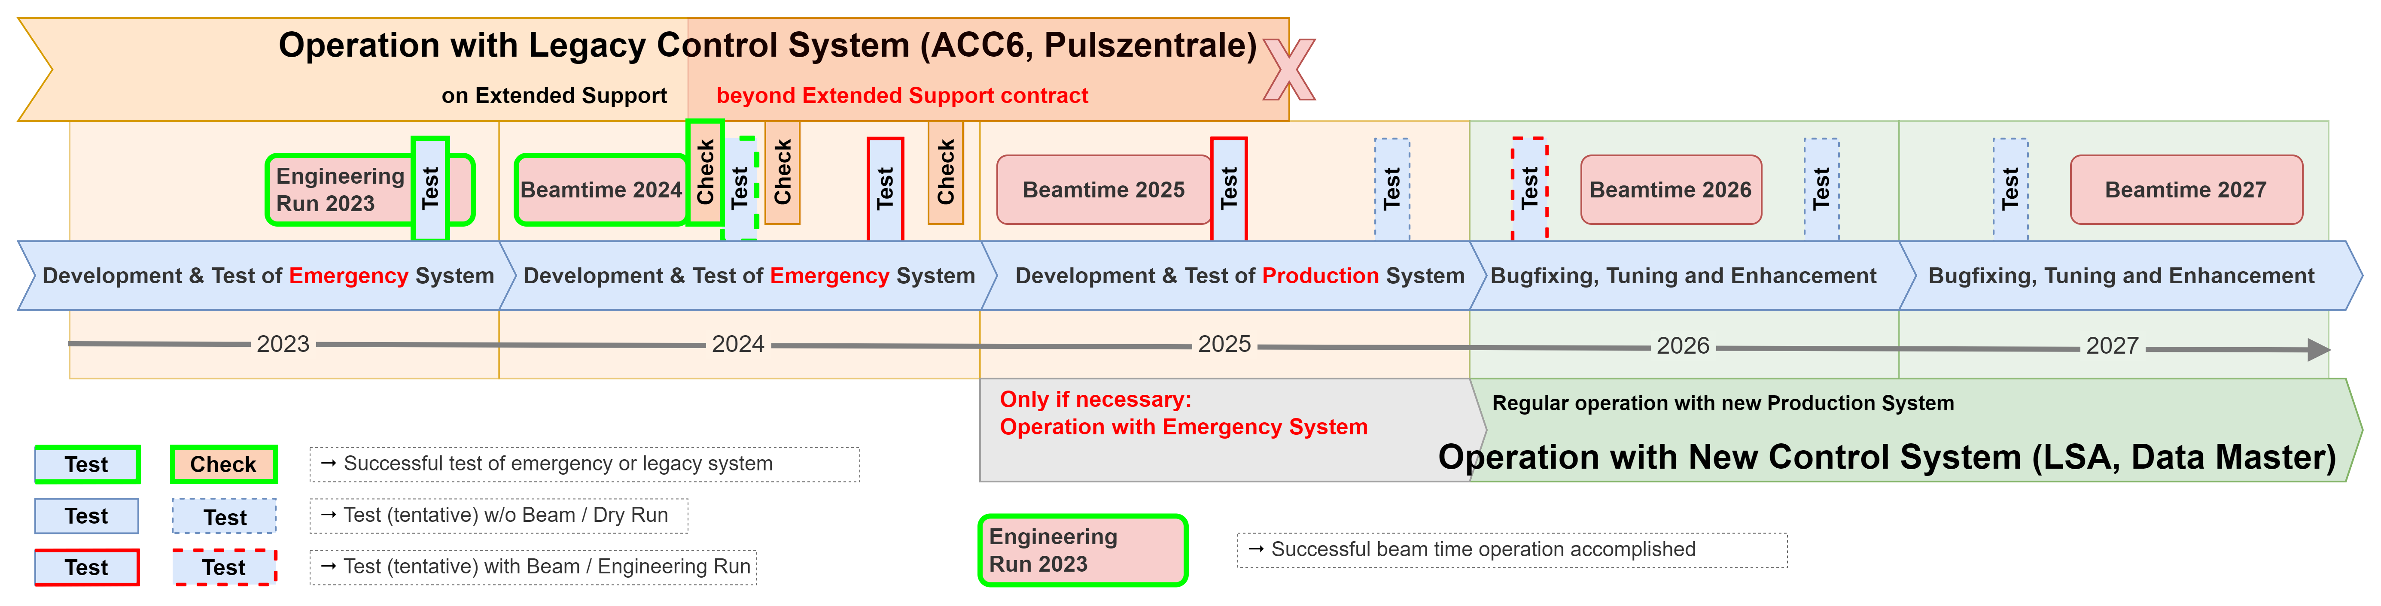
Timeline for Development and Test Strategy
Develop emergency control system as intermediate step until beamtime 2025
Regular operation with new control system from beamtime 2026
Interleave control system tests with already scheduled beam times and shutdowns

Slide 10
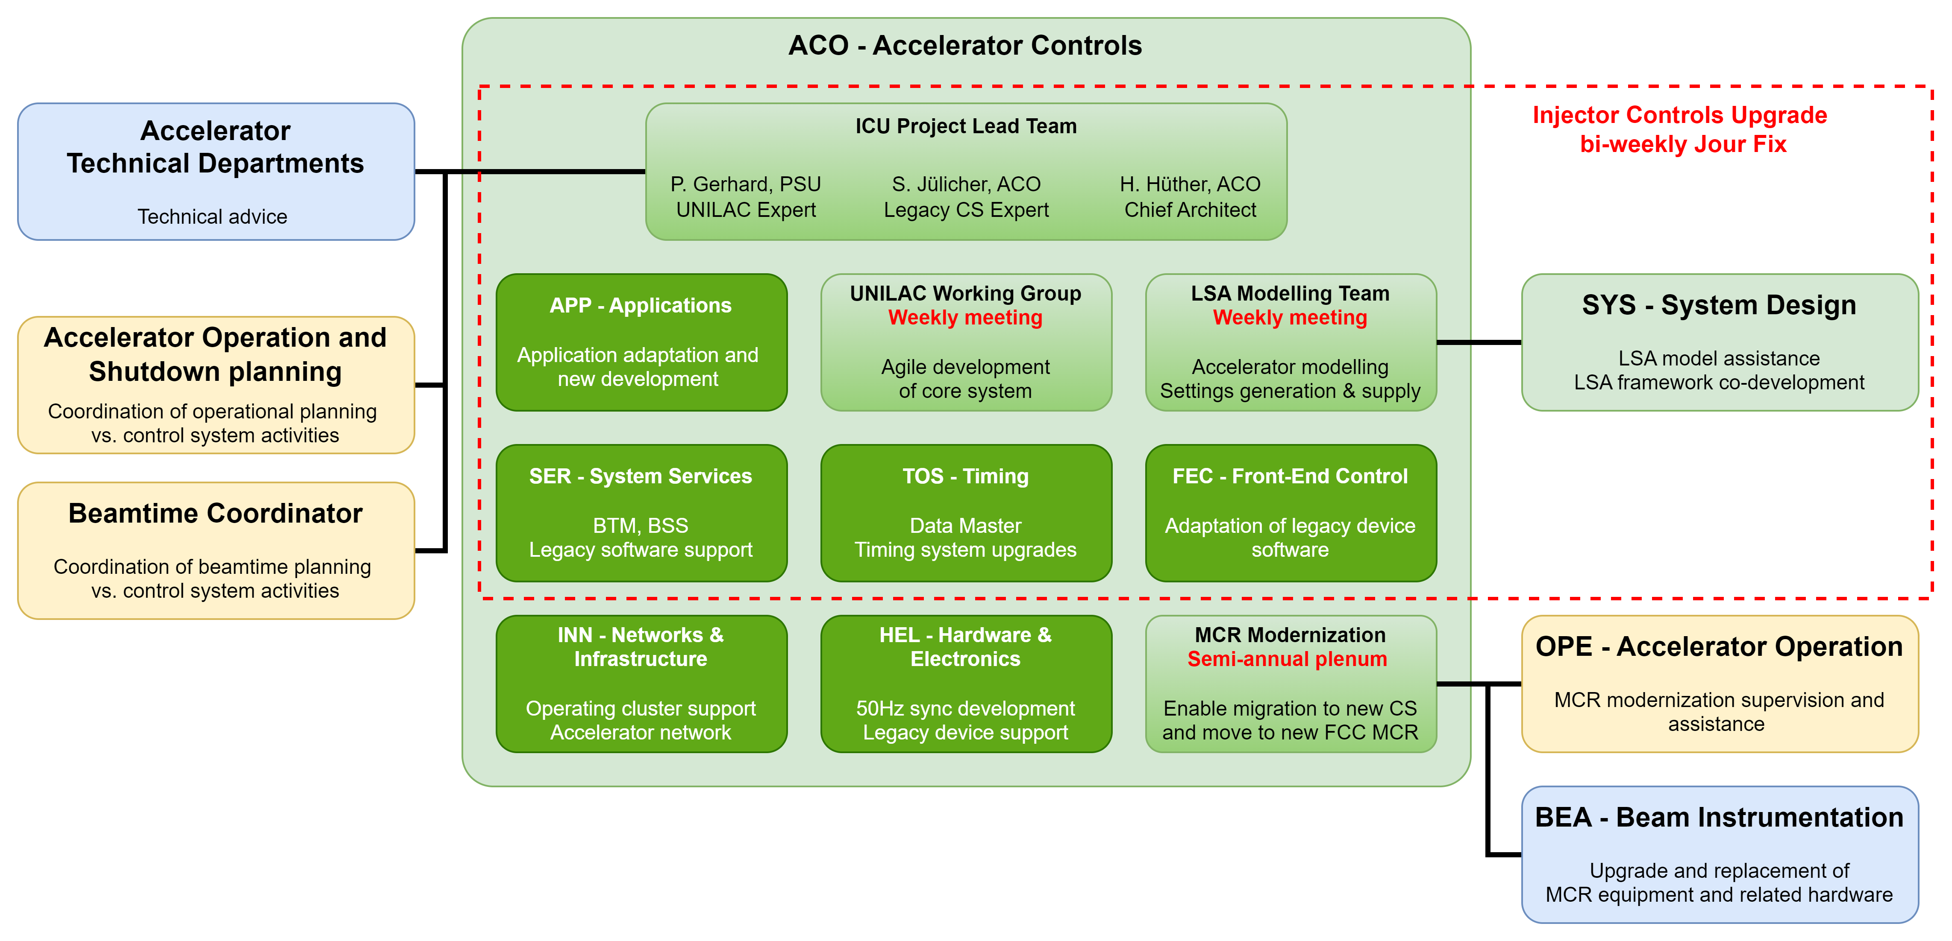
Project Organization

Slide 11
Project Planning 2024
Essential:
Dry run directly following the beam time
Engineering run only including UNILAC, not SIS18
Extremely dense shutdown

Slide 12
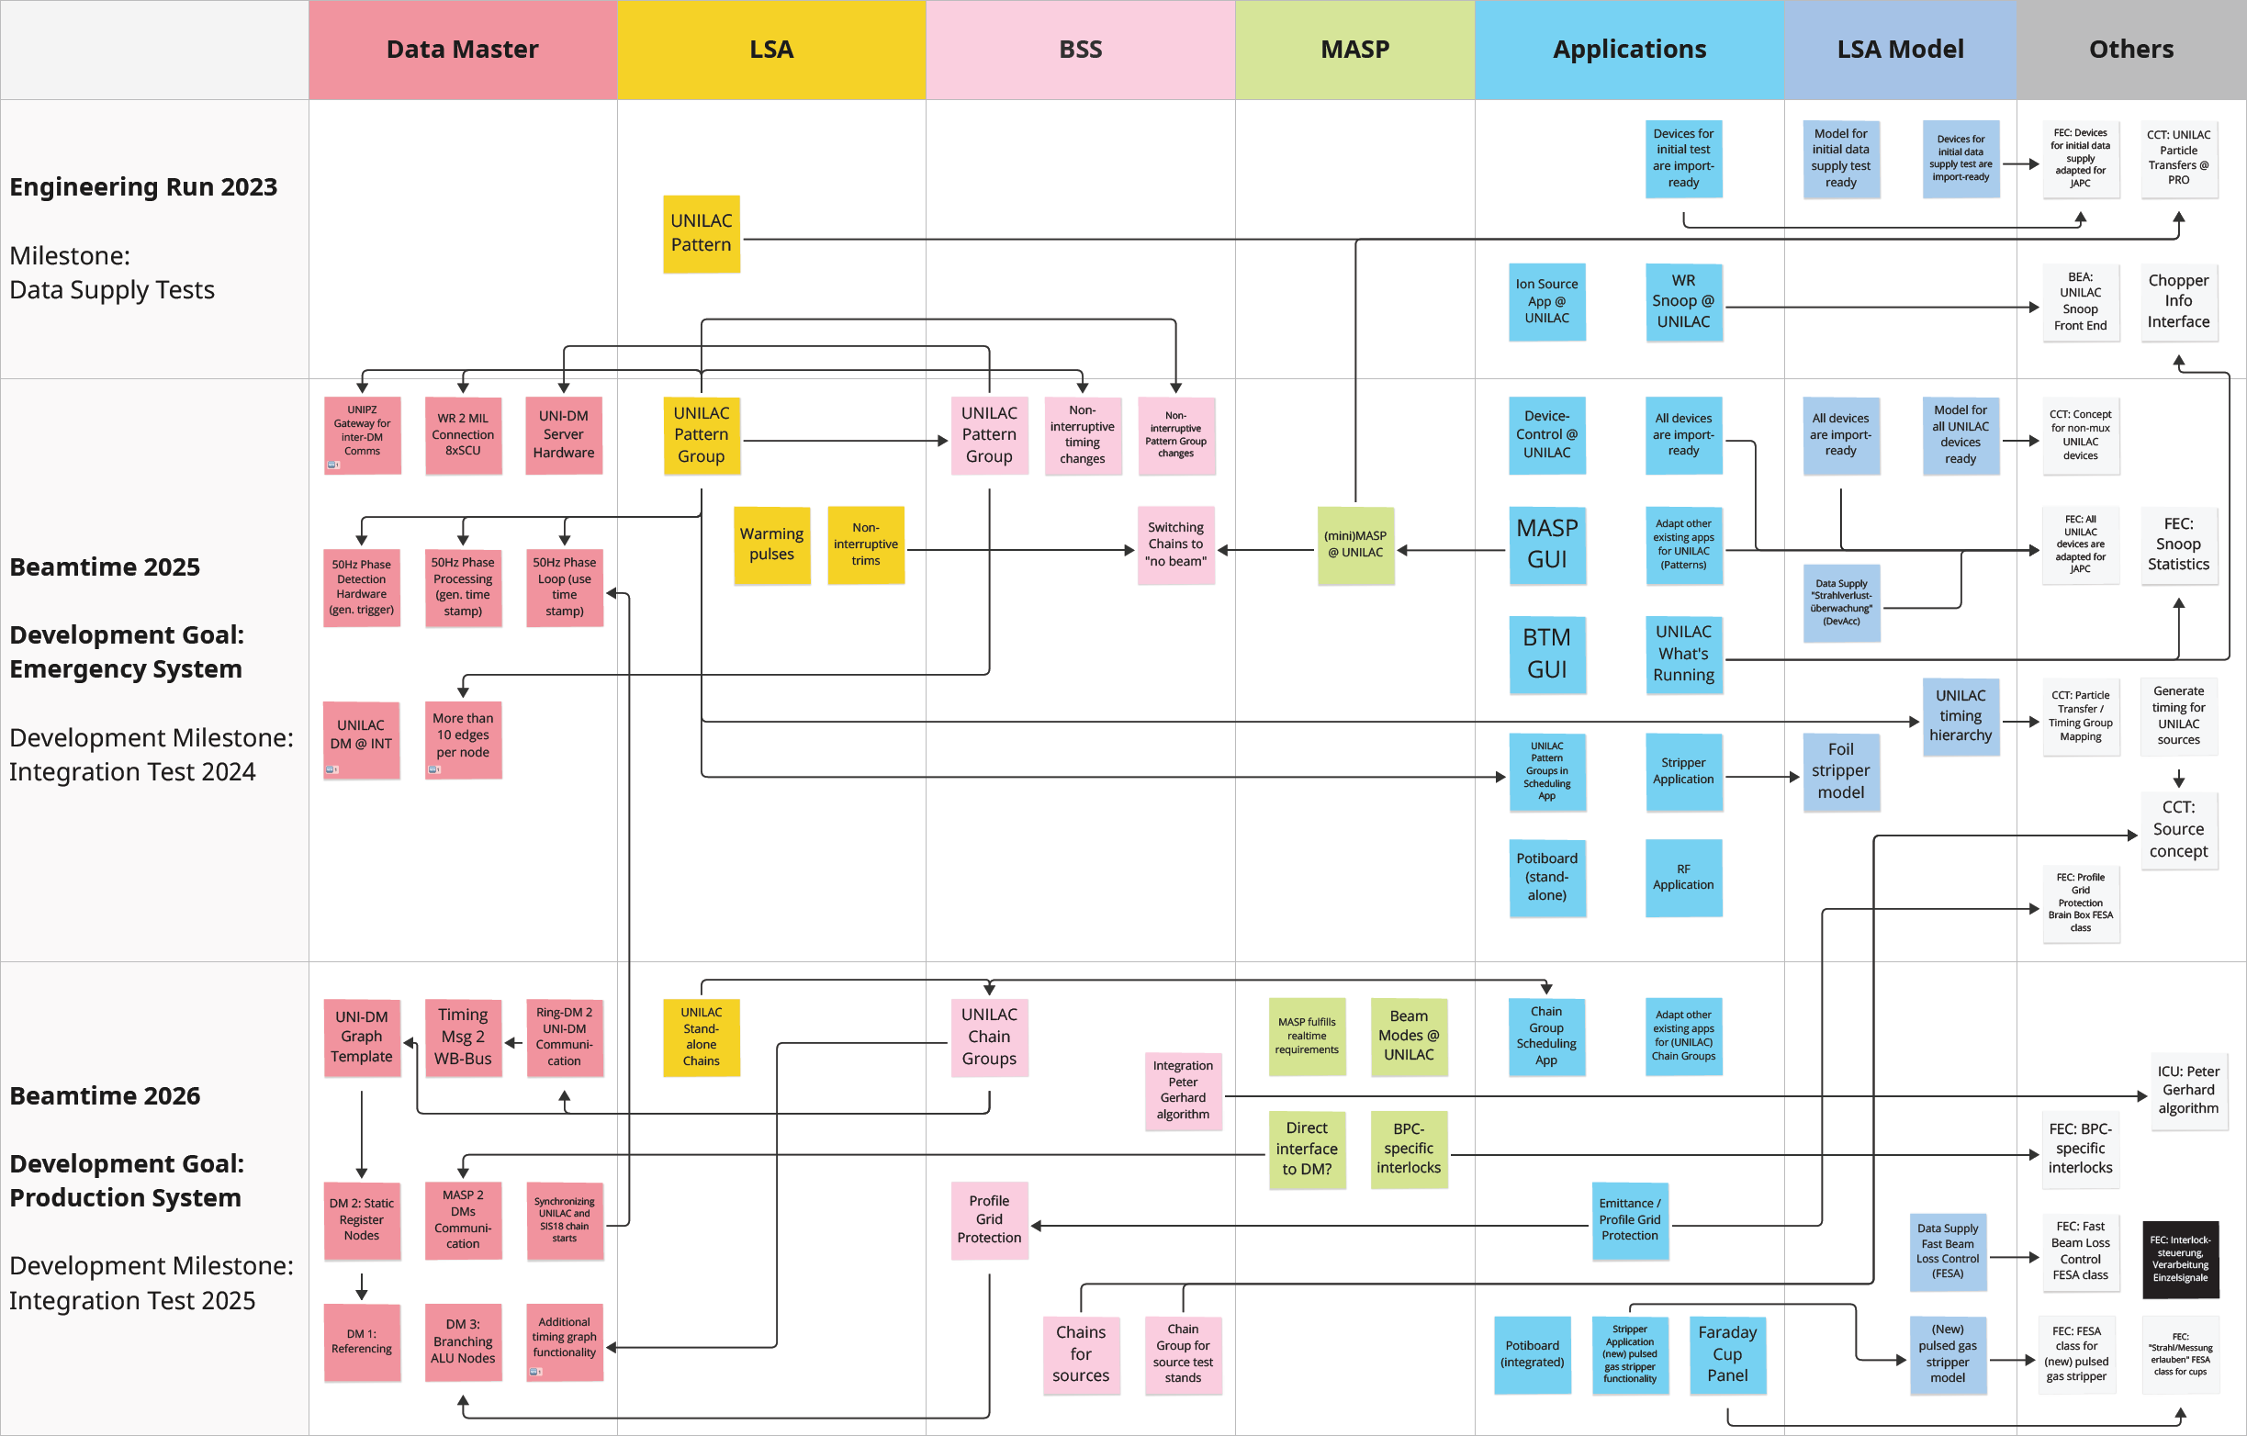
Integrated milestones and activities chart
✓
✓
✓
✓
✓
✓ achieved
✓
✓
⇒
✓
⌛
⇒ in progress
✓
✓
✓
✓
✓
✓
✓
⇒
⇒
⇒
✓
⌛ delayed
✓
✓
✓
✓
✓
⇒
⇒
✓
✓
✓
⇒
⌛
⌛
✓
⇒
✓
✓
⇒
⇒
⇒
⇒
(tagging w/o obligation)

Slide 13
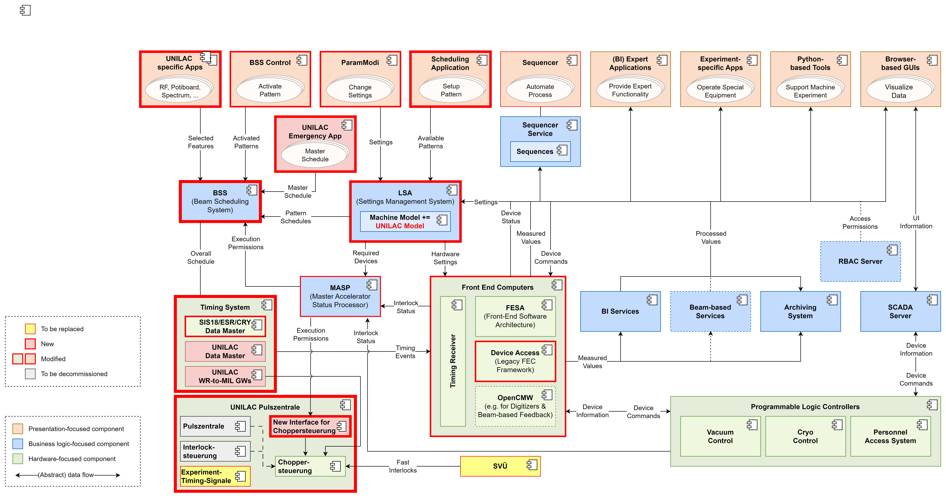
Control System Architecture Overview

Slide 14
Step 1: develop emergency control system -
milestones
Dry Run 2023
  first test of new control system components at UNILAC (settings generation and data supply)
  testing assisted by legacy control system
Implementation of new basic functionality
  Patterns/Chains at UNILAC, based on existing concept
  New timing generation and scheduling concept
  Non-Multiplexed contexts for DC devices
Dry Run 2024
  verify main capabilities of emergency control system
  core functionality complete, standalone testing possible
Engineering Run 2024
  test complete emergency control system with beam without SIS
  feature complete emergency control system
  Data Master: White Rabbit-based timing with some restrictions, interim pattern concept
  complete, simplified settings generation and data supply
  basic operating tools and applications, incl. most of MCR modernization
  overall reduced operating features and efficiency
Beamtime 2025
  only if necessary: operation with emergency control system

Slide 15
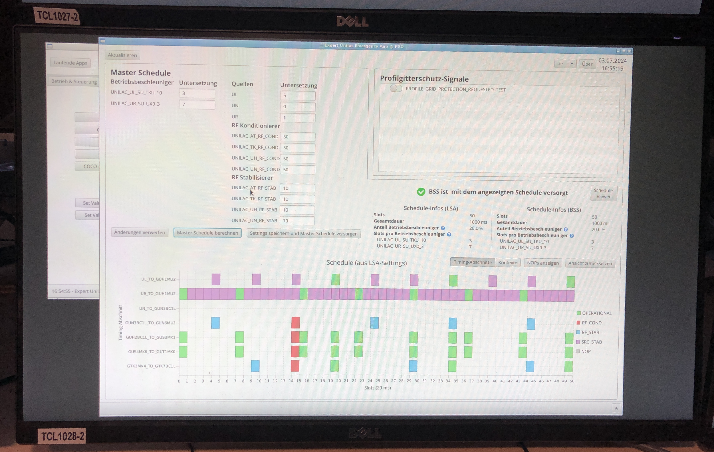
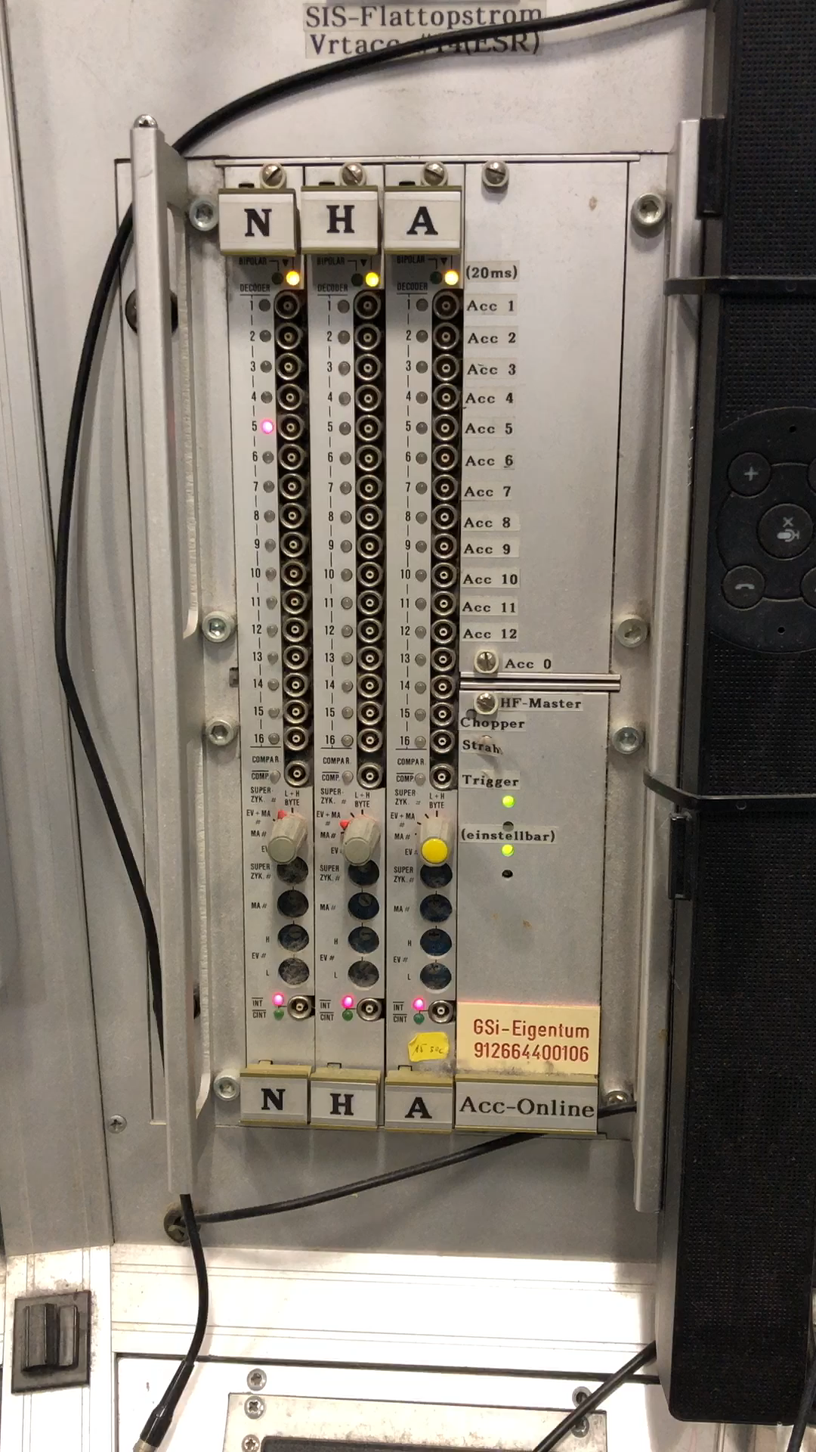
Dry Run 2024-2: Emergency App &
First Data Master Generated UNILAC Timing
taken 05.07.2024

Slide 16
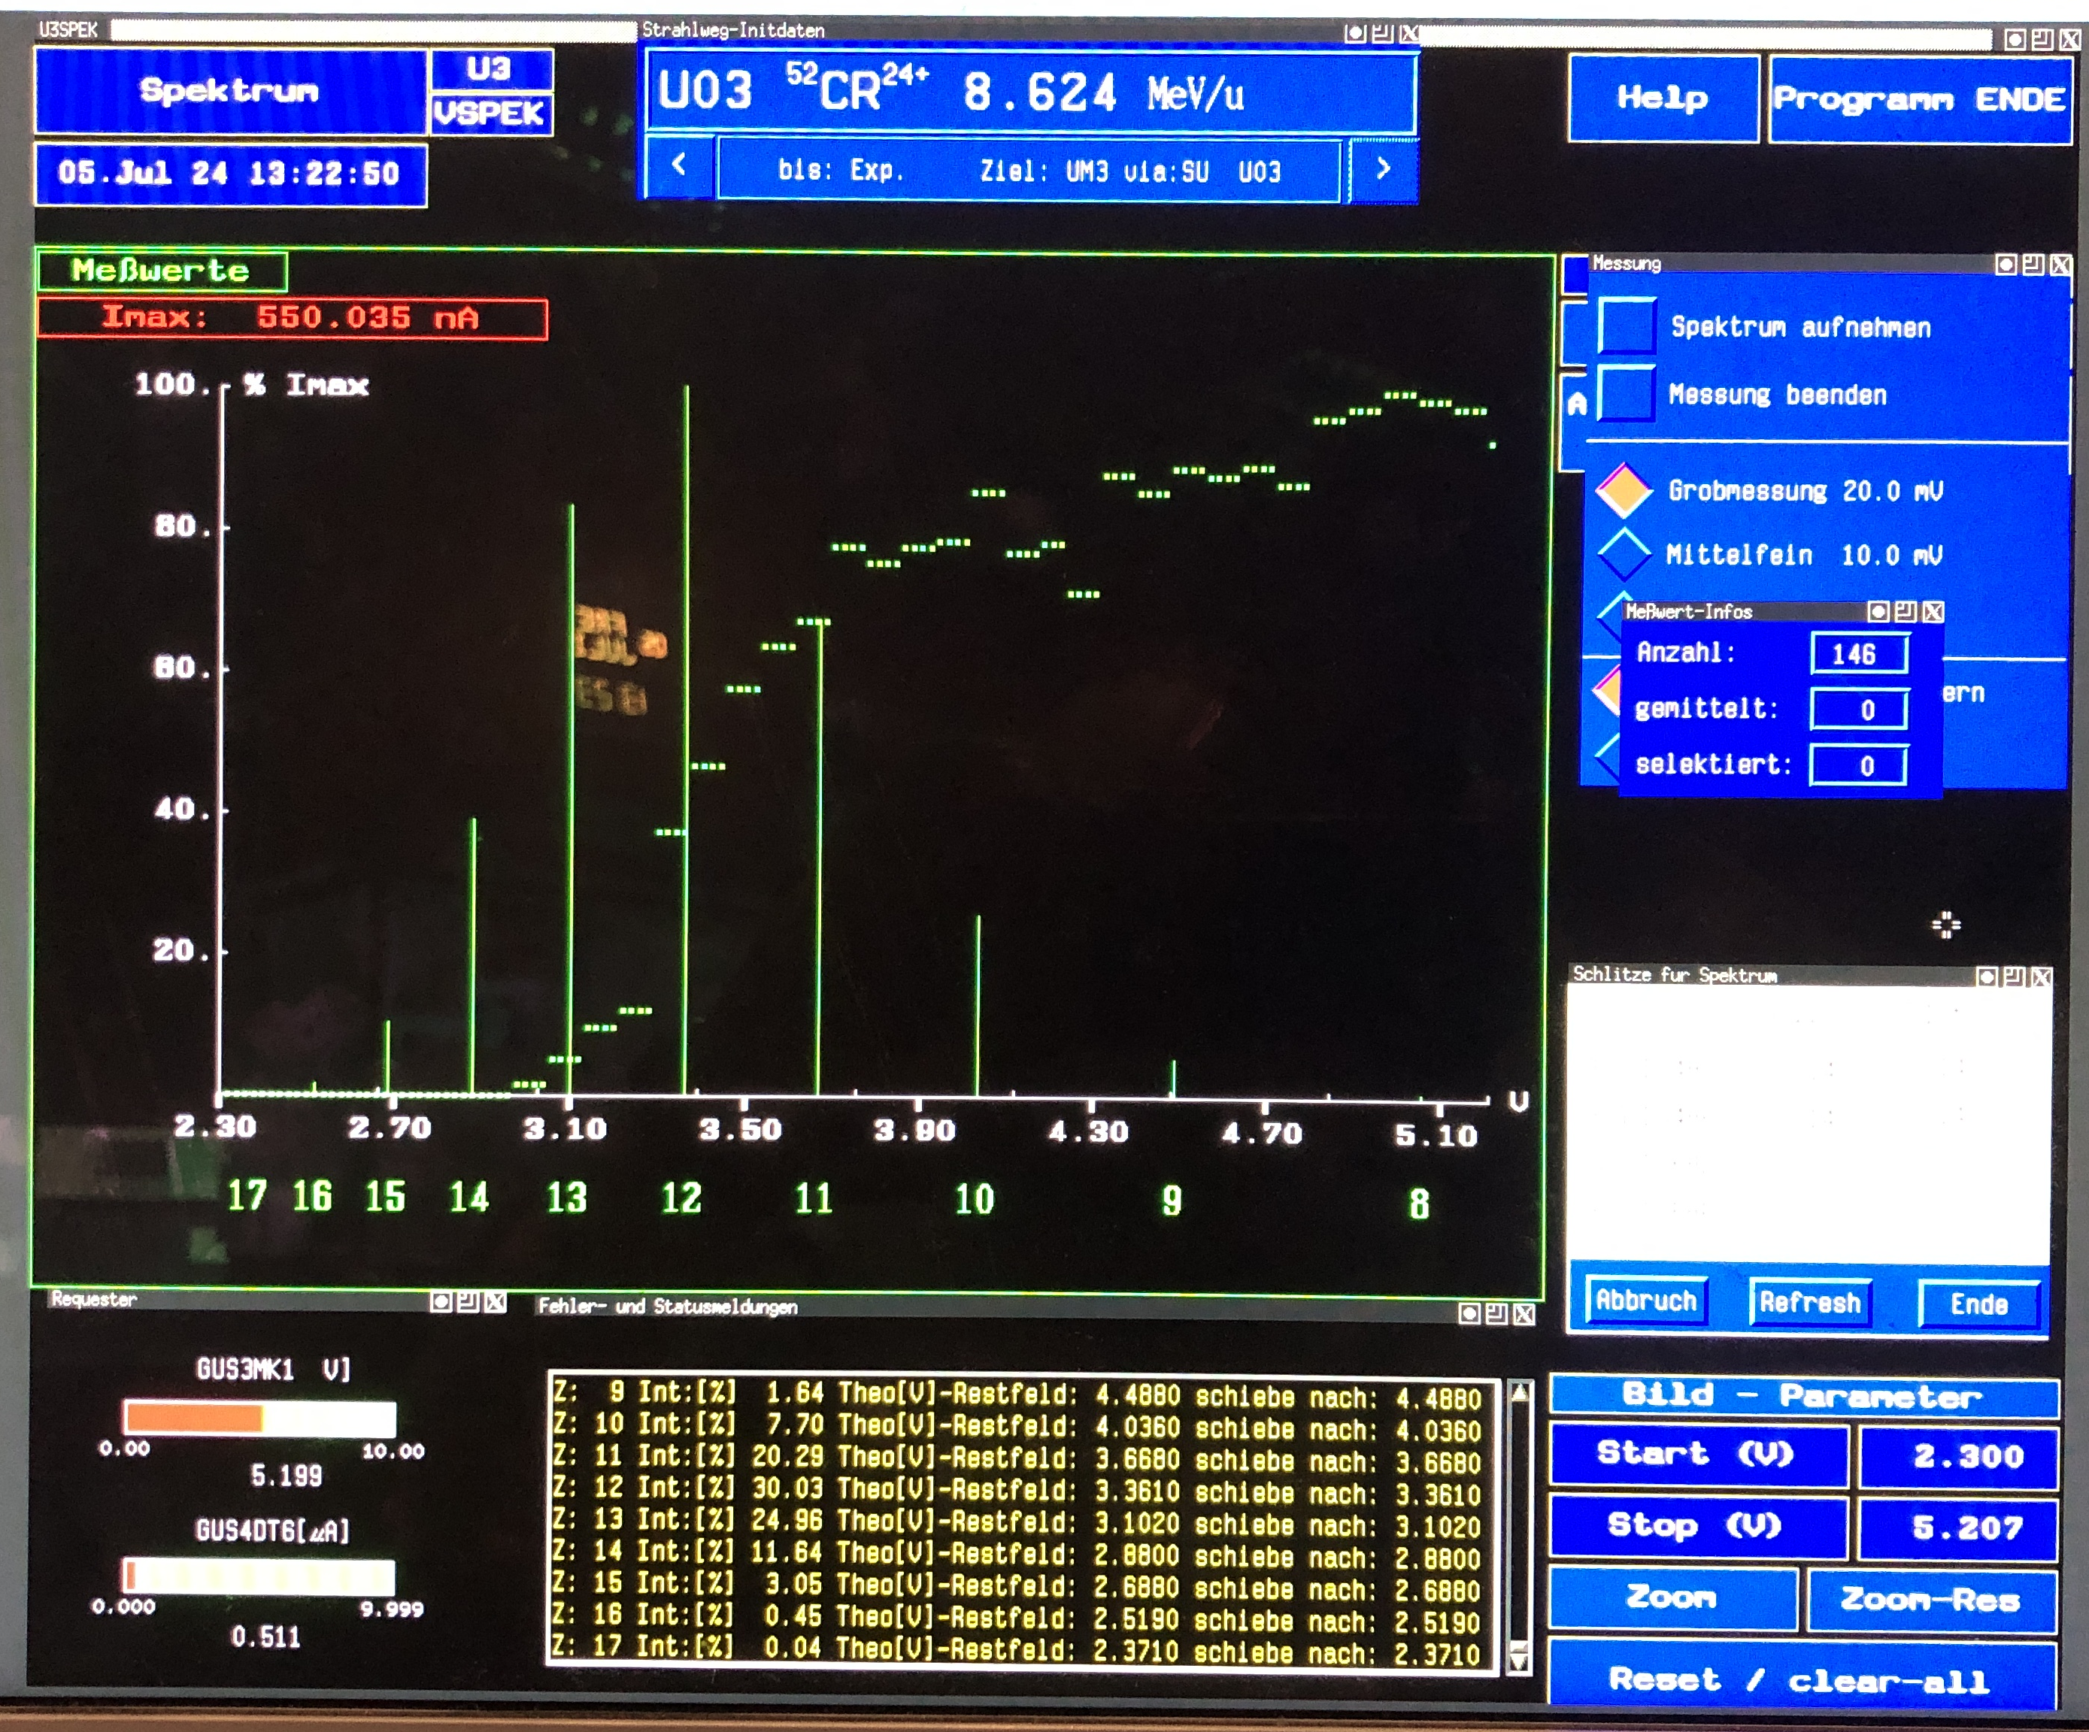
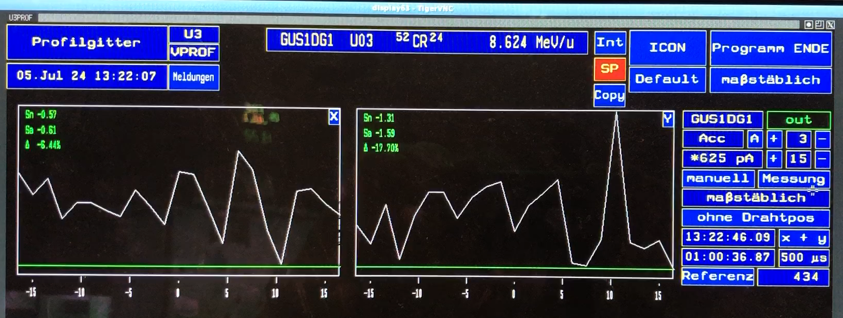
Dry Run 2024-2: First Measurements with original DM WR-to-MIL Timing at UNILAC
taken 05.07.2024

Slide 17
MCR Modernization Overview and Status
Work package | Dept. | Description | Status
MAPS | BEA | Beam current measurement and display | Commissioning
UNIMON | BEA | RF cavity display | Operational
PHAS | BEA | Phase probe control, bunch shape and energy measurement | In progress
Cupid | BEA | Integrated video monitoring system | Operational, full installation soon
UNIPOS | BEA | Beam position measurement and display | In progress
BIF | BEA | Beam Induced Fluorescence monitor | Operational, upgrade pending
Chopper display | ACO | Status display for beam chopper requests | In progress
PG/EMI protection | ACO | Control and status display for SEM grid protection | In progress
Cup control | ACO | Control and status display for faraday cups | In progress
Interlock/beamloss display | ACO | Interlock and beamloss status display | In progress
Experiment signal display | ACO | Display any detector feedback from beam users | Postponed
WR-Snoop@UNILAC | ACO | WR timing diagnostic tool | Operational, upgrade pending
BTM | ACO | Beam Transmission Monitoring | Pending
Experiment timing | ACO | Trigger, sync and gate signals for beam users | Pending
Gas stripper | PSU | Pulsed hydrogen gas stripper | In progress
Potiboard | ACO/OPE | Realtime accelerator (magnet) adjust | In progress
Oscilloscopes | ACO/IQU | Signal display for ion sources | Installation

Slide 18
General Strategy
Step 0: secure UNILAC beam operation through beamtime 2025
  replace existing operating cluster with virtual machines, replace terminals in MCR
  implement IT security measures for operation extension
Step 1: develop emergency control system
  first viable version of new control system with reduced and simplified feature set
  replace existing MIL timing system by White Rabbit-based system
  MCR modernization project: replace/upgrade hardware devices in control room
  serves as emergency backup for beamtime 2025
Step 2: develop production control system
  based on emergency control system
  replace simplifications made by fully fledged solutions, implement full feature set
  enhance operability and efficiency
Step 3: further development, include other linear accelerators

Slide 19
Step 2: develop production control system -
milestones
Complete and finalize implementation of initial production control system
  starting point: emergency system
  fully fledged White Rabbit-based timing system, new FAIR pattern scheduling concept
  enhanced settings generation and data supply
  full set of operating tools and applications
  bugfixes, essential tuning and necessary enhancements
Engineering Run 2025
  test initial production control system with beam
  first test of beam injection into SIS18 solely with new control system
Dry Run / Engineering Run 2025/26
  in between testing of further developments before first beamtime operation
Beamtime 2026
  initial production control system
  first regular operation with new control system
Beamtime 2027
  improved production control system
  first regular operation of user beam time with new control system

Slide 20
Timeline for Development and Test Strategy

Slide 21
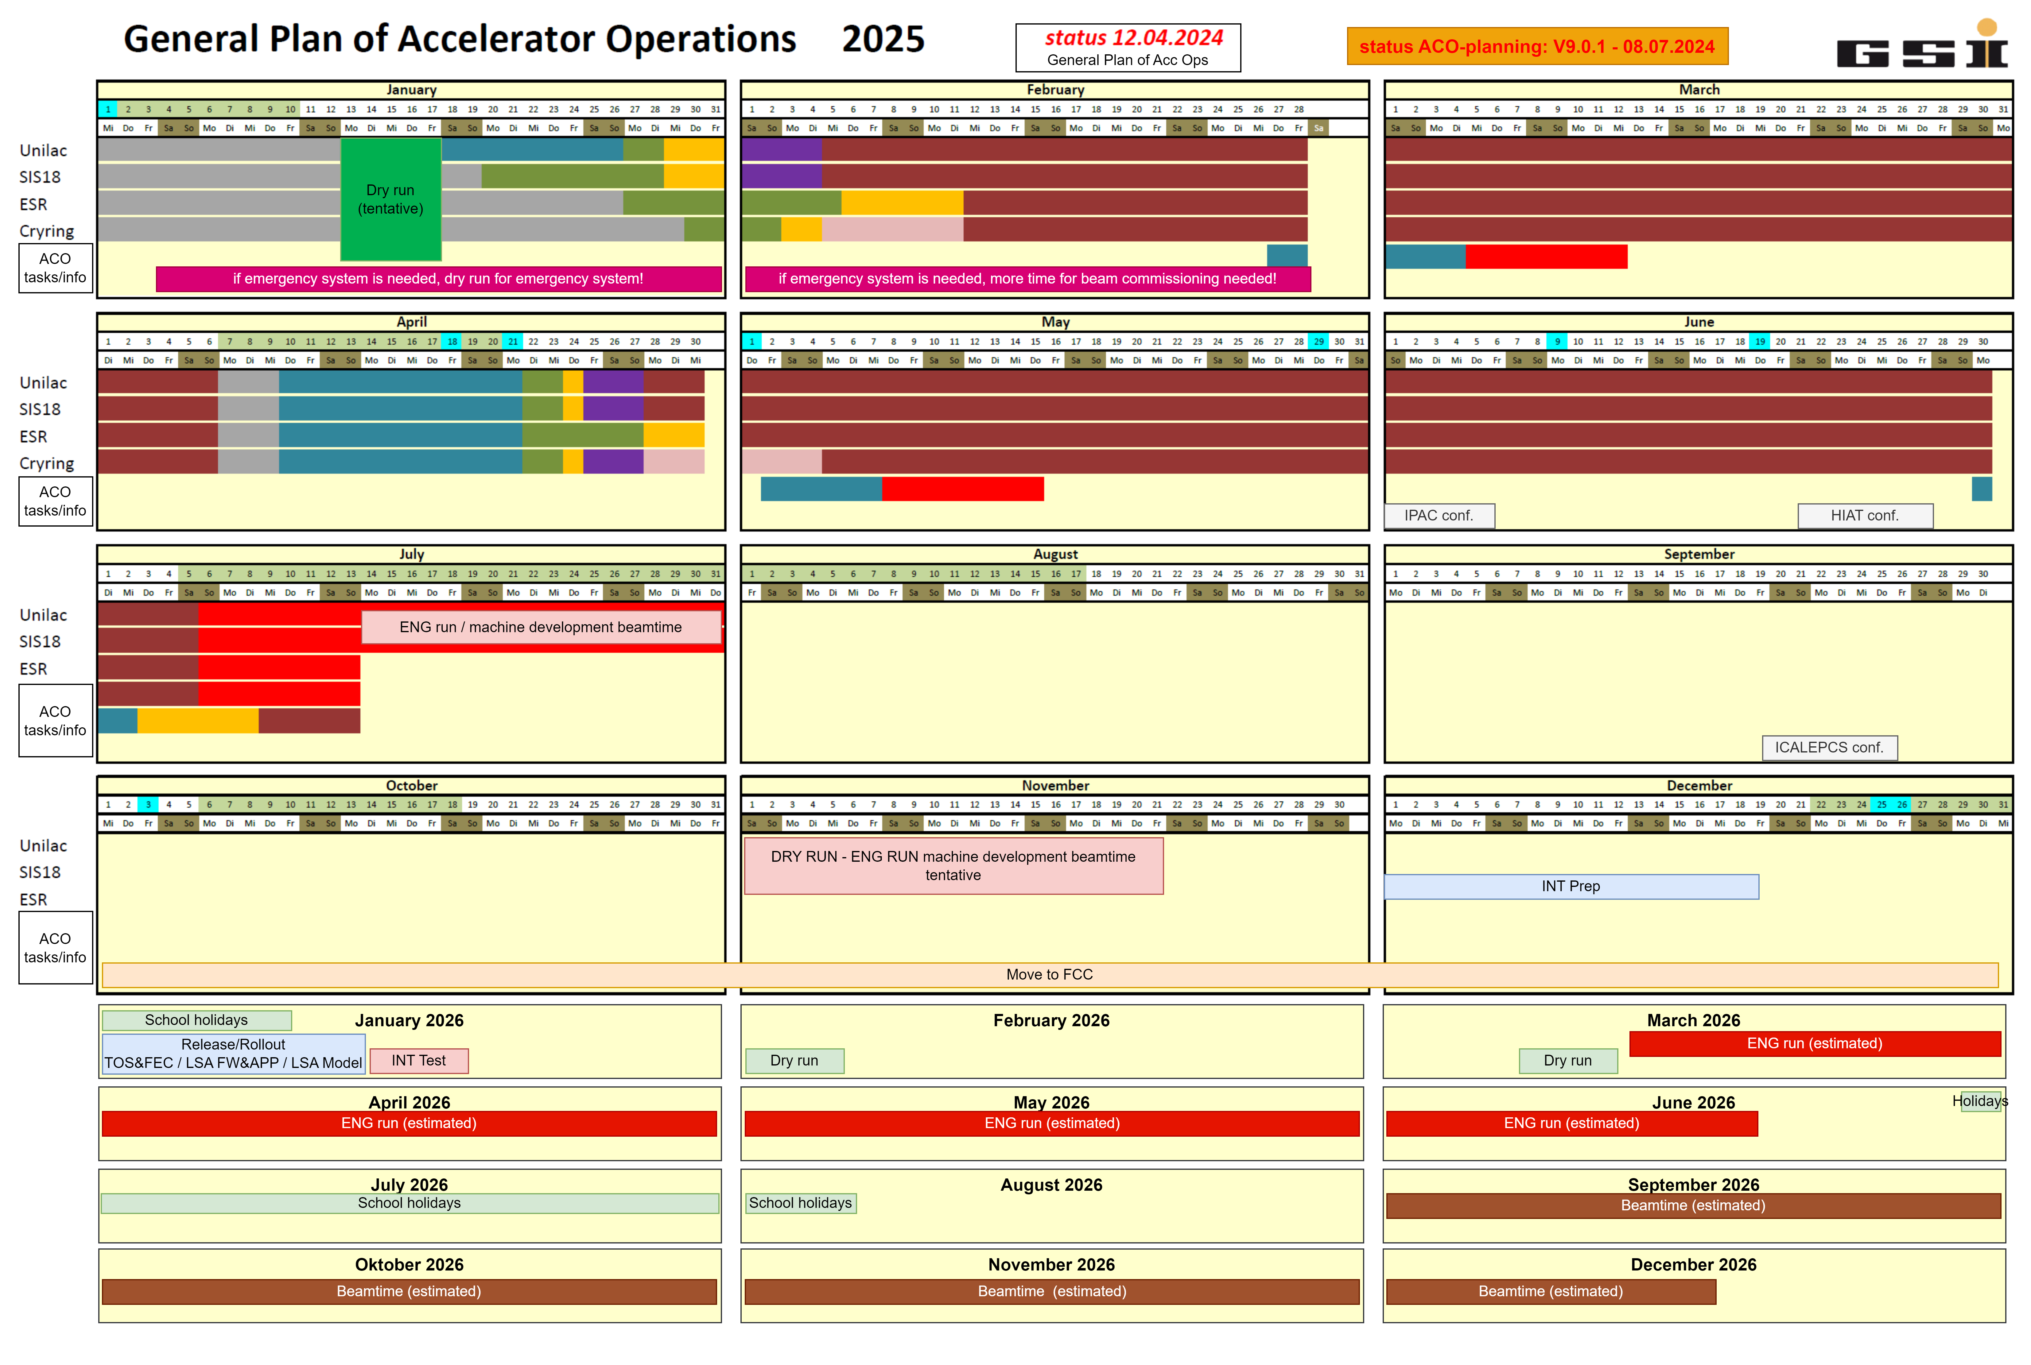
Project Planning 2025/26
Essential:
Engineering run 2025 directly following the beam time and including UNILAC and SIS18 already communicated and fixed

Slide 22
General Strategy
Step 0: secure UNILAC beam operation through beamtime 2025
  replace existing operating cluster with virtual machines, replace terminals in MCR
  implement IT security measures for operation extension
Step 1: develop emergency control system
  first viable version of new control system with reduced and simplified feature set
  replace existing MIL timing system by White Rabbit-based system
  MCR modernization project: replace/upgrade hardware devices in control room
  serves as emergency backup for beamtime 2025
Step 2: develop production control system
  based on emergency control system
  replace simplifications made by fully fledged solutions, implement full feature set
  enhance operability and efficiency
Step 3: further development, include other linear accelerators

Slide 23
Timeline for Development and Test Strategy
Step 2 (develop production control system) covers 2026 and 2027
Step 3 (further development, include other linear accelerators ) starts 2028
  transition to normal development and maintenance
  bugfixes, tuning and further enhancements ⇒ exploit new capabilities
  use CS basis created for UNILAC on other machines

Slide 24
Summary and Outlook
Injector controls upgrade - mission since 2020
  provide new, LSA based/FAIR standard control system for GSI linacs
  focus on FAIR injector UNILAC, use functionality as reference
  enable move to new FCC MCR
  secure operation of UNILAC through all planned and upcoming beamtimes
Project
  Planning, schedule and organization set up achieved
  First major milestones reached, project well on track
  Challenges and tight schedule ahead

Slide 25
Summary and Outlook
Legacy System 2024/25
  Beamtime 2024 served well
  Last actions executed, testing successfully completed
  Prepared for beamtime 2025
Emergency System 2025
  Dry Run 2023 successful, Dry Run 2024 promising, but still ongoing
  Introduction of new fundamental concepts (Non-mux context)
  Development largely on schedule
  Capabilities far better than anticipated
  Temporary solutions, drawbacks and limitations have to be accepted
    Intermediate use of existing pattern/chain-concept, will be exchanged by new FAIR concept (standalone-chains)
    Poor-man’s coupling of SIS18 to UNILAC
    Limited length of master schedule (super cycle) and number of chains (beams)
    simplified settings generation
  Complete replacement of UNILAC Pulszentrale remains as major challenge

Slide 26
Summary and Outlook
Move to FCC:
  Modernization project on track
    Most parts will be ready for emergency control system
  Development of initial production control system on time needed
  Emergency control system serves as backup

Slide 27
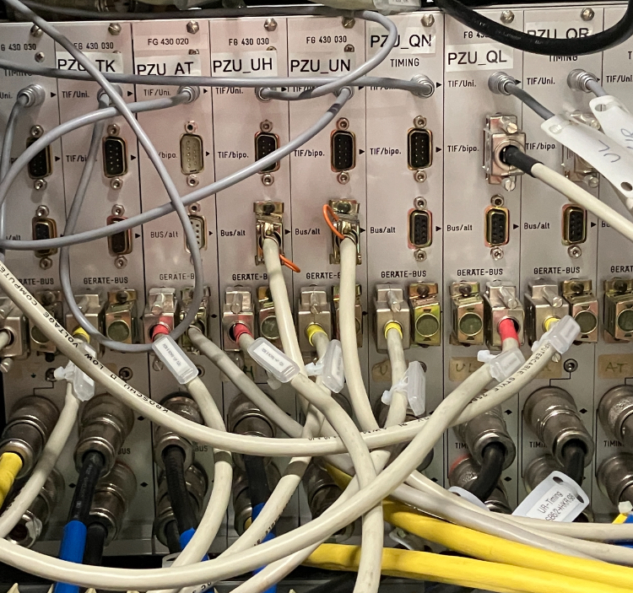
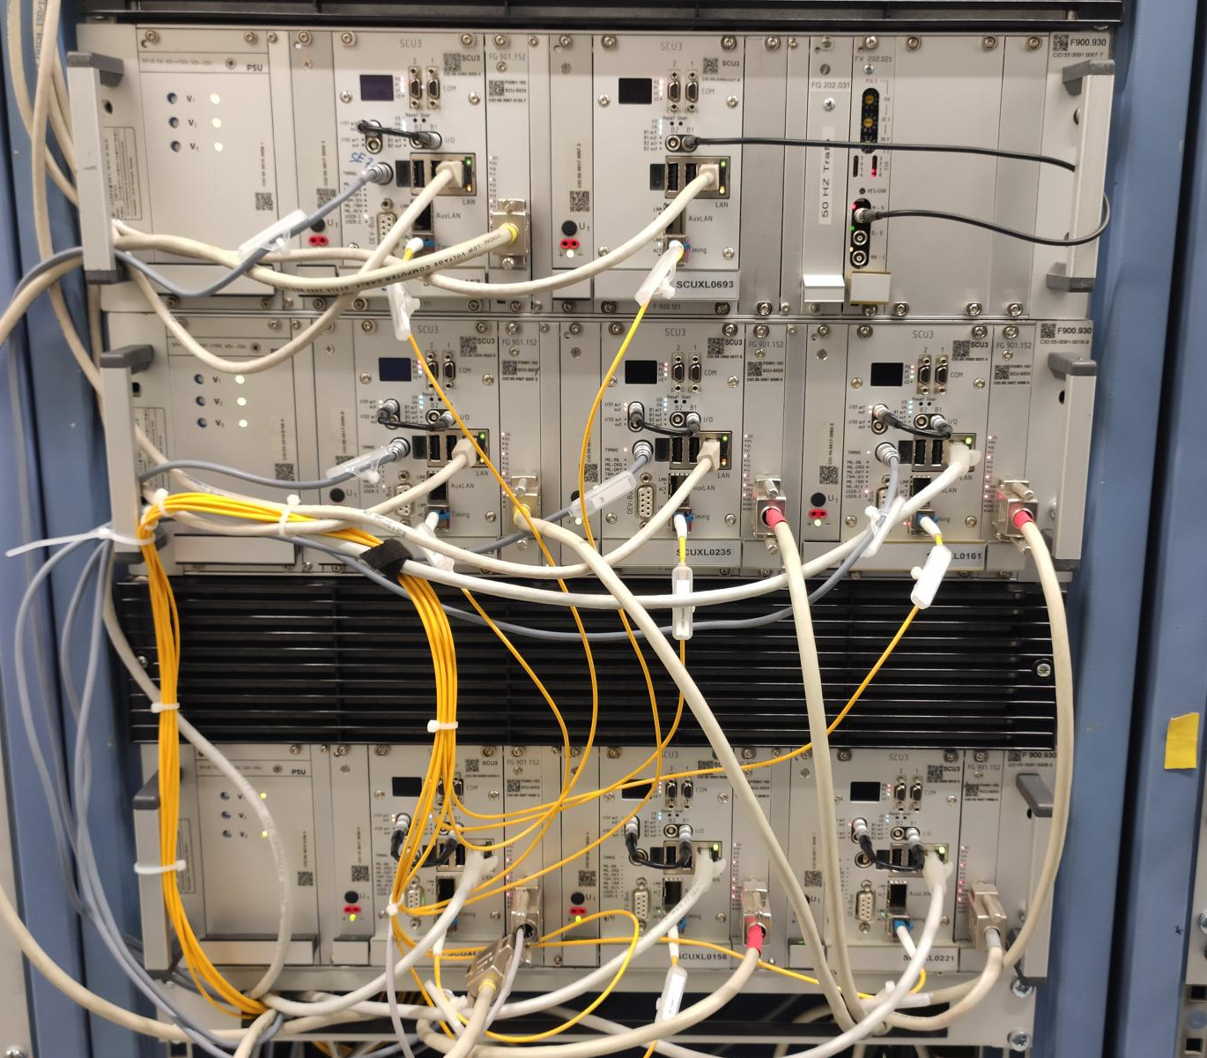
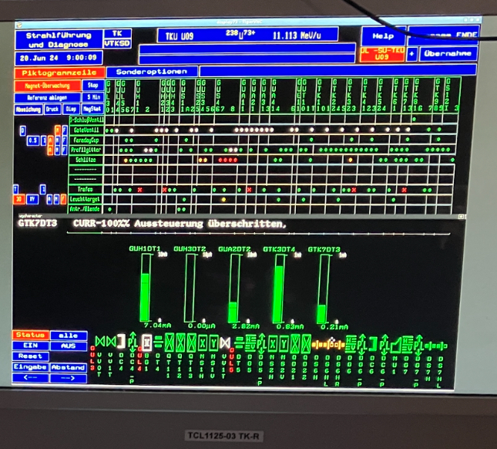
Thank you for your attention!
Timing system test on 28.06.24:
²³⁸U beam accelerated to SIS18
by use of WR-to-MIL Gateways

Slide 28
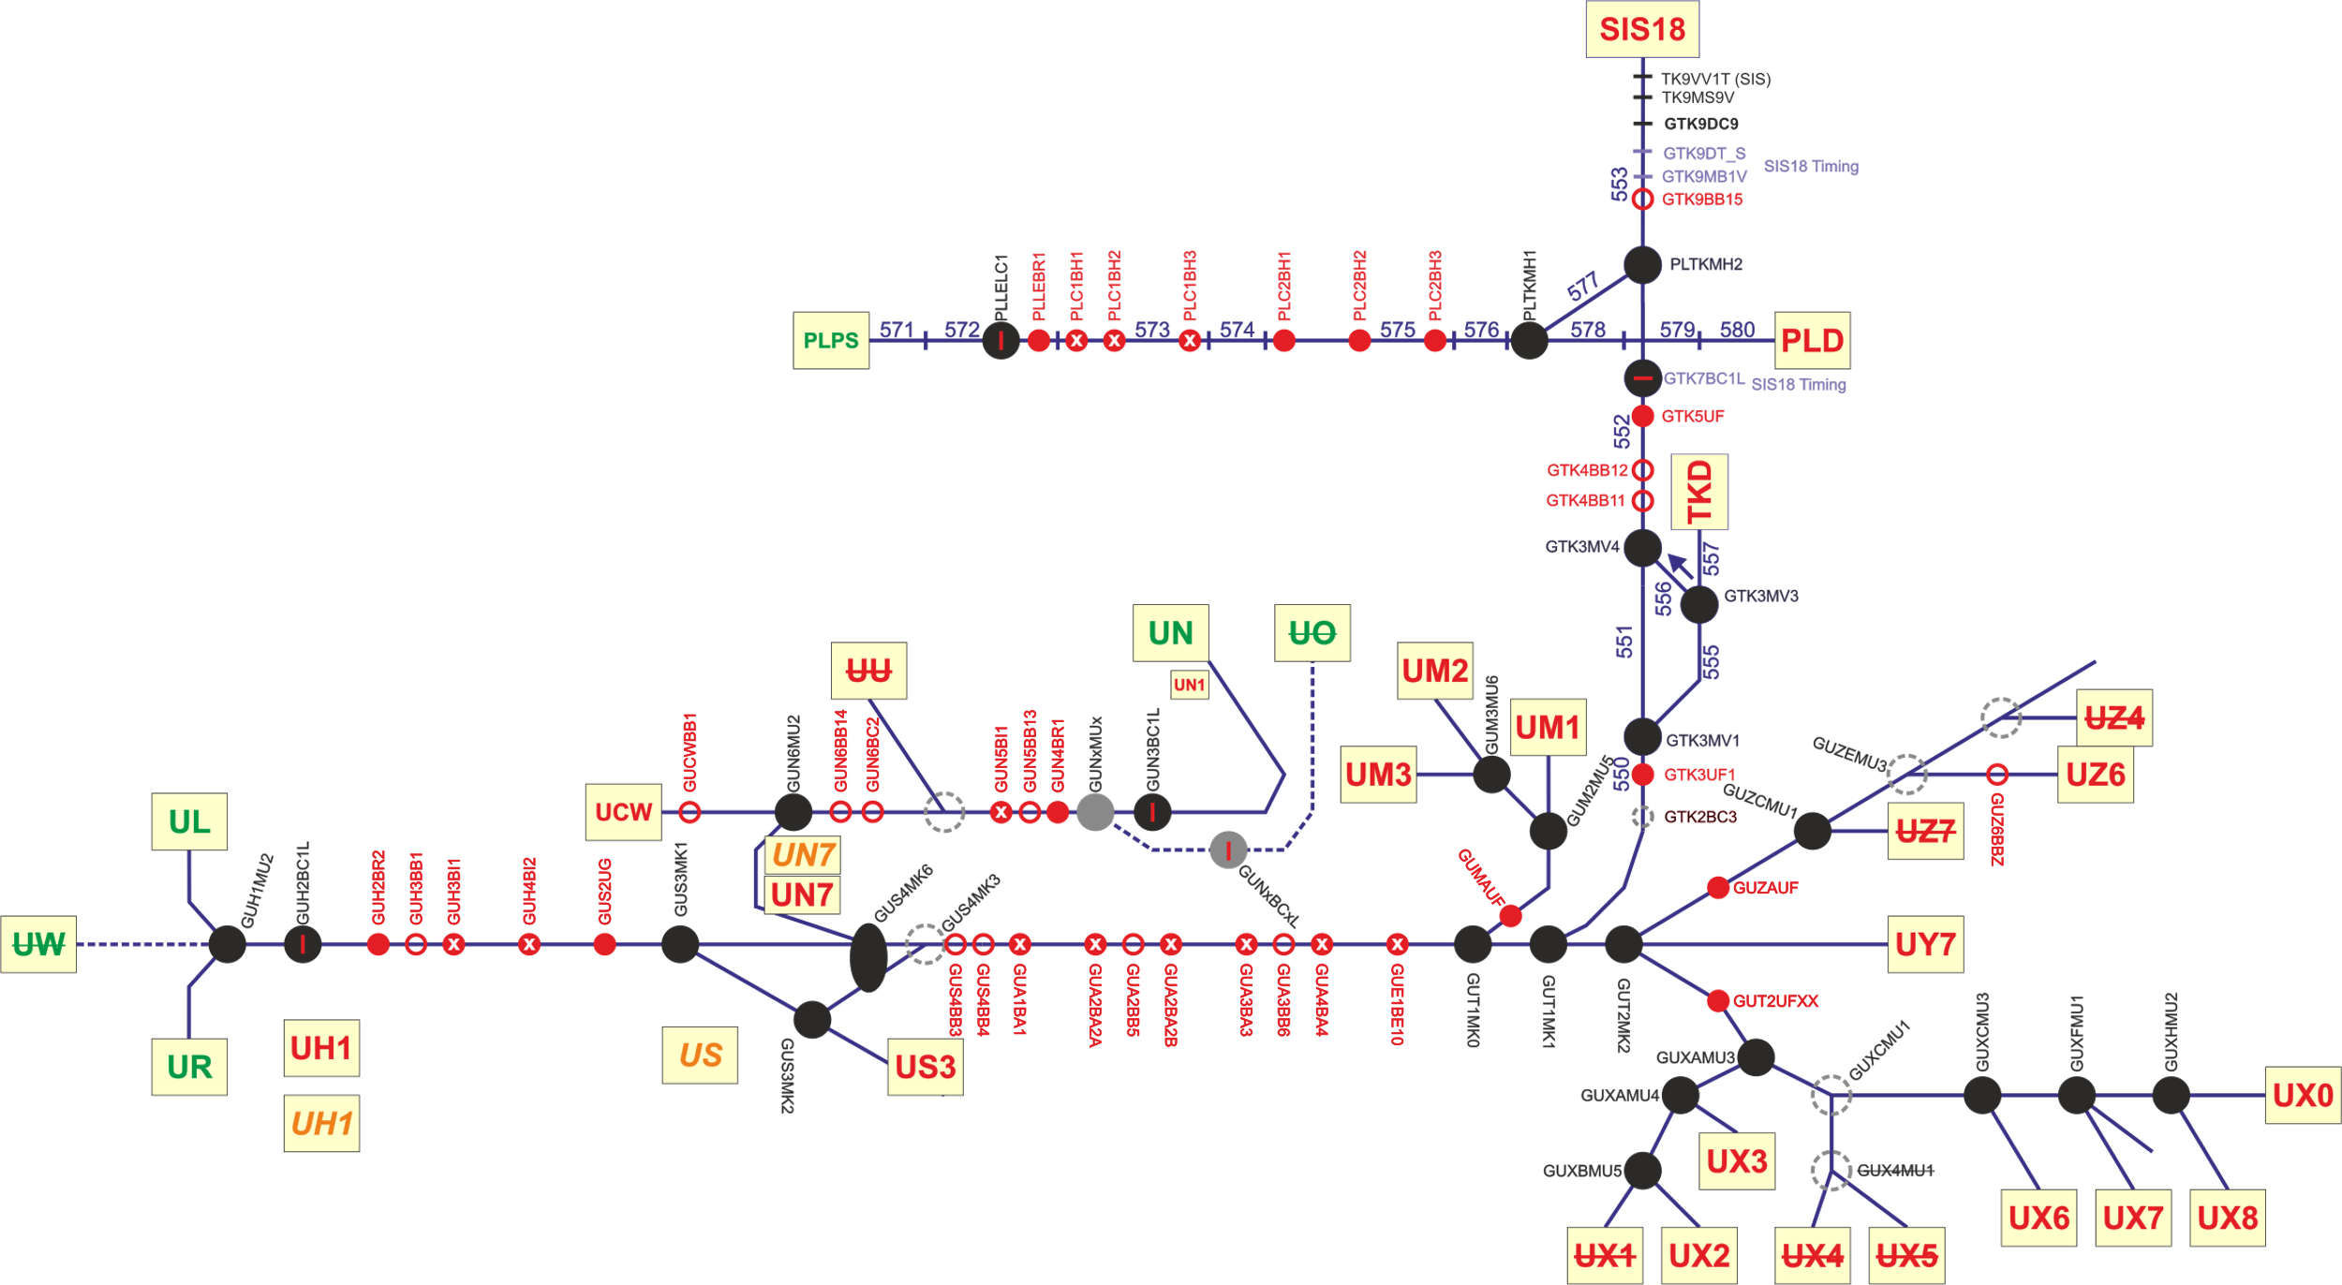
Topographic Control System View on UNILAC

Slide 29
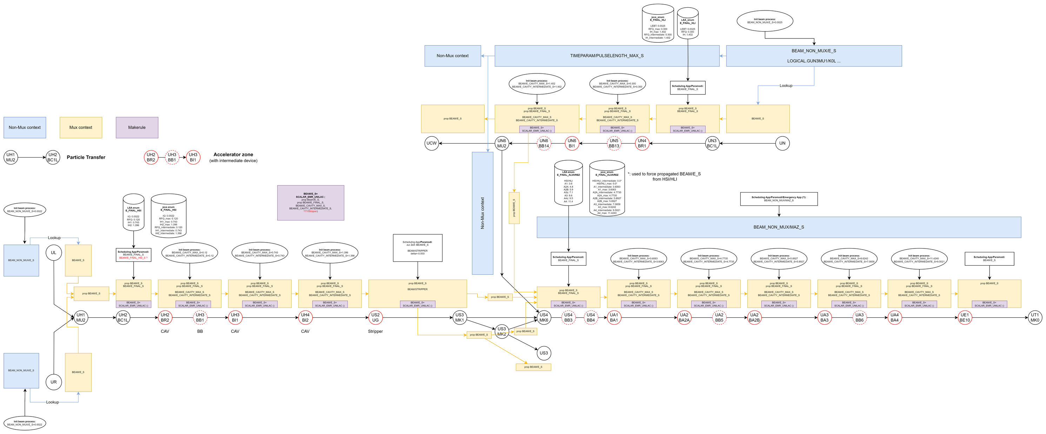
UNILAC LSA beam energy model

