Slide 1
7th Beam Time Retreat
Sustainability aspects at GSI/FAIR
J. Lindenberg – Sustainability Management
11th and 12th July 2024
@ Hotel Jagdschloss Kranichstein

Slide 2
Agenda
1. General information on sustainability management
  Main activities
  Example: Greenhouse gas accounting
  Example: Climate Adaption Act
2. Energy Management
  Market situation
  Energy consumption
  Demand planning 2024
  Beamtime 2024
  Energy efficiency measures

Slide 3


1. Sustainability management
Main activities
Supply Chain Due Diligence Act ( LkSG)
Corporate Sustainability Reporting Directive ( CSRD)
  Materiality analysis and sustainability strategy
Sustainable procurement pilot project
Energy management
  Demand planning in cooperation with operational planning and beamtime coordination
  Procurement/contract design and billing of energy (electricity and gas)
  Implementation of measures
  Development of a measurement network
  Energy Efficiency Act ( EnEfG)
    Introduction and certification of ISO 50001 until 2026
  Determining the potential of renewable energies on GSI/FAIR campus
Greenhouse gas accounting (preliminary results available)
Climate adaptation measures ( KAnG)
Sustainability and energy management @ GSI
four persons
  one human rights officer (LkSG)
  two working students
  one sustainability officer
Feedback and suggestions:
nachhaltigkeit@gsi.de

Slide 4
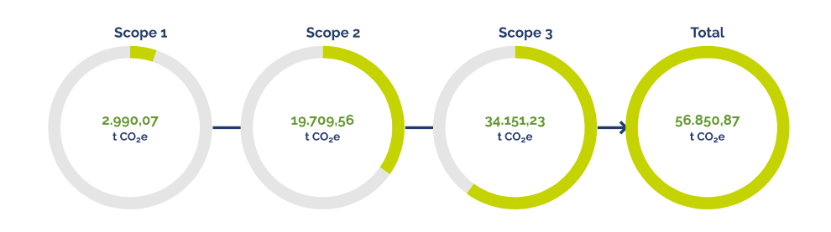
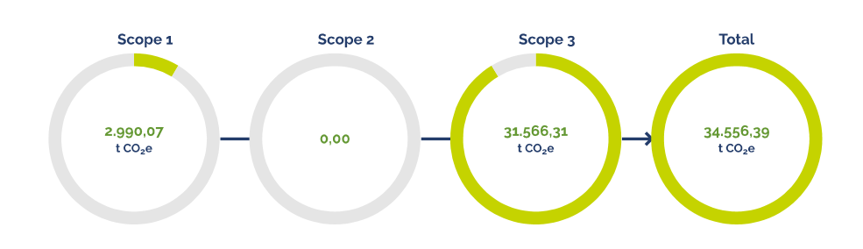
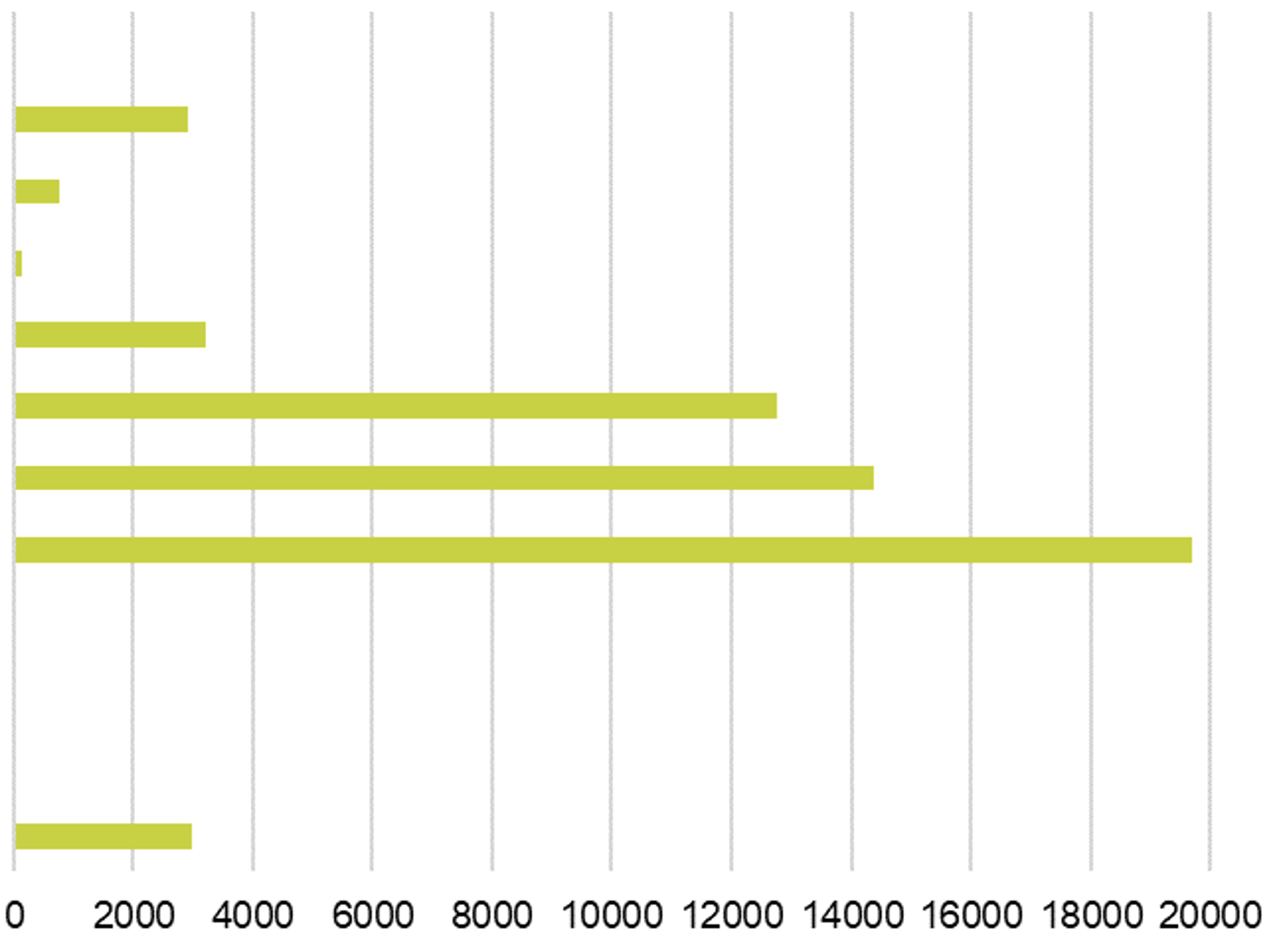
1. Sustainability management
Example: Greenhouse gas accounting
2018 snapshot
2018 snapshot with 2023 green electricity (zero Scope 2 emissions)
Greenhouse gas emissions (t CO₂e)
Scope 1, 2 and 3
Part of future sustainability reporting
based on the requirements of the internationally recognized standards of the Greenhouse Gas Protocol (GHG- Protocol)
reference year is 2018
  before pandemic and energy crisis
3.7 Commuting by employees
3.6 Business trips
3.5 Waste
3.3 Fuel and energy-related emissions
3.2 Capital goods
3.1 Purchased goods and services
2 Electricity
1.4 Industrial gases
1.3 Autogas (LPG)
1.2 Diesel (vehicle fleet)
1.1 Natural gas
Planned waste heat utilization in the operation of FAIR

Slide 5
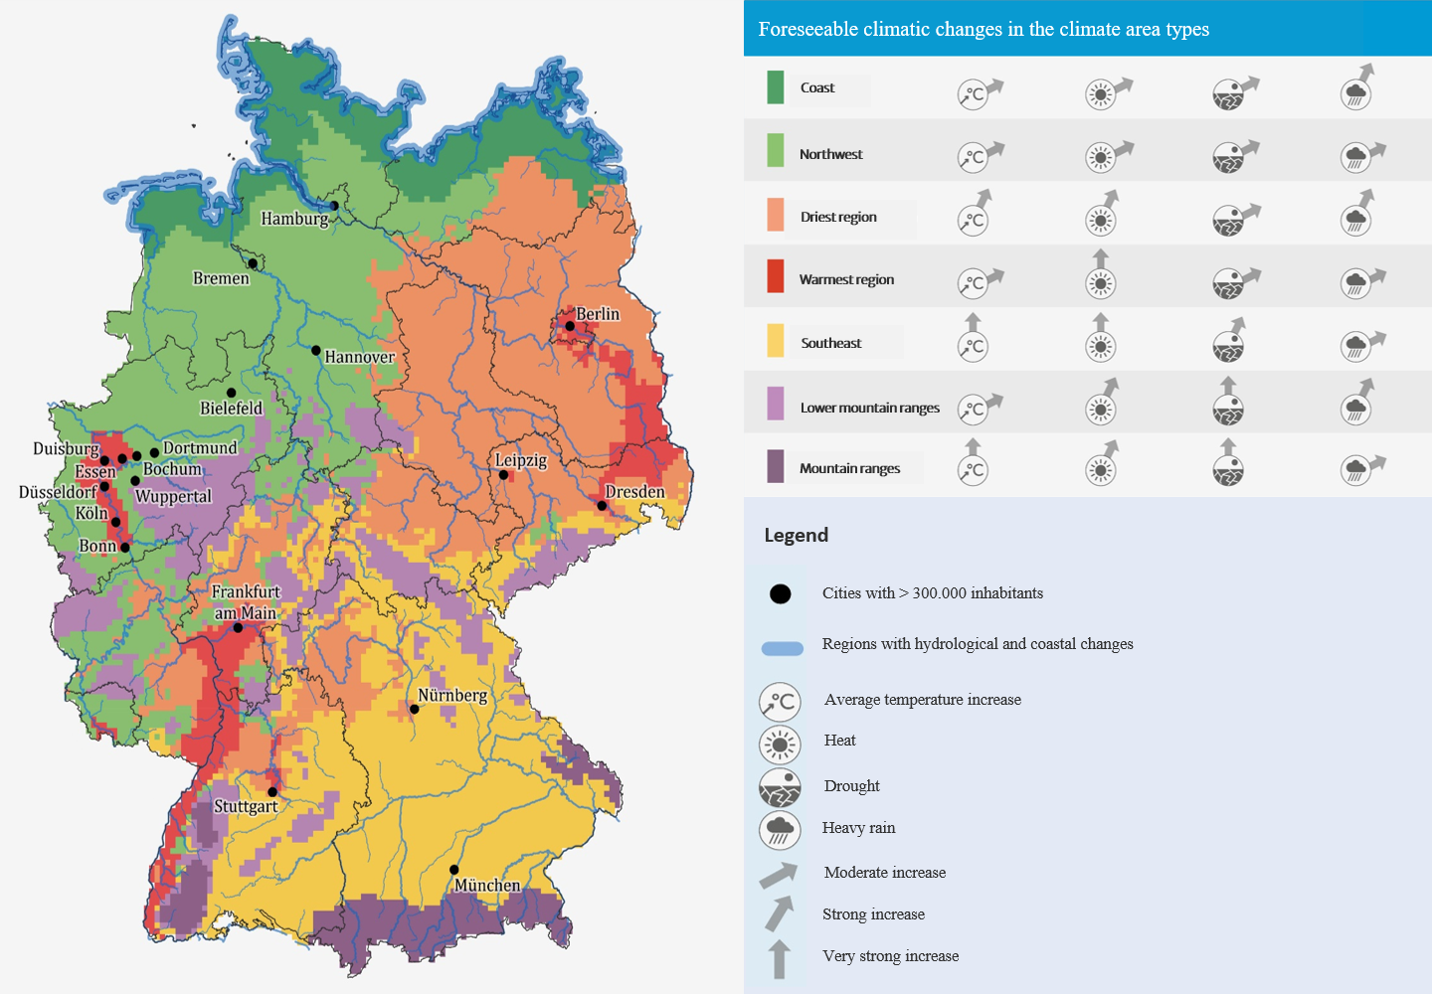

1. Sustainability management
Example: Climate Adaption
The Climate Adaptation Act (KAnG) has been in force since 01.06.2024
GSI is located in the warmest region in Germany, the Upper Rhine Plain
Examples of possible adaptation concepts and measures for climate-related impacts such as heavy rainfall, extreme heat, storms or forest fires:
  Heat protection measures for buildings
  Sustainable air conditioning
  Emergency scenarios to protect employees and facilities
Darmstadt
With this law, the German government aims to provide a binding framework for climate adaptation at federal, state and communal level.
Reporting obligations and evidence of measures are expected.
Climate area types and average change in selected climate parameters towards the middle of the century
Map basis: © GeoBasis-DE / BKG (2020), © EuroGeographics, Deutscher Wetterdienst, © European Union, Eurac Research
Source: KWRA 2021

Slide 6
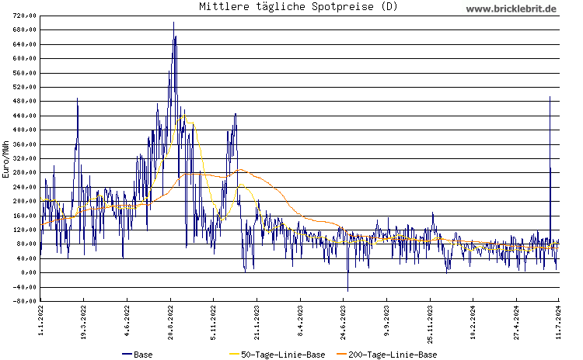
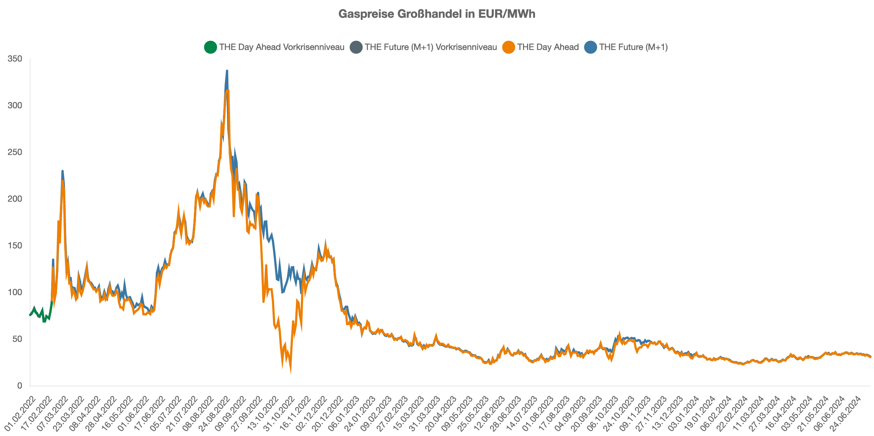
2. Energy management
Market situation
Euro/MWh
Spot market price (10.07.2024):
0,079 €/kWh, corresponds to an electricity price of approx. 0,164 €/kWh, including all fees and energy-related taxes and duties.
For comparison:
2023 average industry electricity price in Germany: 0,25 €/kWh
GSI 2023: 0,18 €/kWh
GSI 2013: 0,16 €/kWh
Spot market price (09.07.2024):
0,031 €/kWh, corresponds to a gas price of approx. 0,061 €/kWh, including all fees and energy-related taxes and duties.

Slide 7
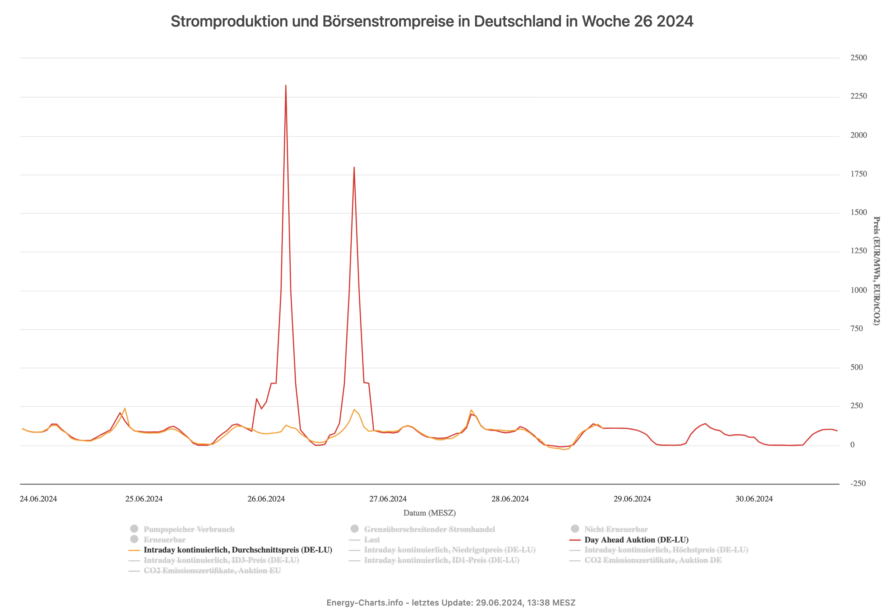
2. Energy management
Temporary decoupling of the energy markets
On 26.06.2024, there were two significant price distortions on the European Power Exchange EPEX.
Cause:
Technical disruption, decoupling of the submarkets
in accordance with the merit order principle, the most expensive power plant that is still needed to meet demand sets the price
Due to decoupling, there was no cross-border balancing (e.g. in the form of favorable overcapacities)
Effects for GSI:
According to initial findings, the damage across all grids is up to €80,000; a detailed statement will be requested from Enercity
Average power consumption during the period of the disruption at approx. 9.5 MW (in comparison: campus operation at approx. 3.5 MW)
Adjustment of the procurement model (futures market, PPAs, ...) would minimize the risk. Clarification with EKM.
06:00 - 07:00 Uhr: 2,33 €/kWh
20:00 - 21:00 Uhr: 1,80 €/kWh

Slide 8
2. Energy management
Energy consumption 2023
electric energy:
  approx. 40 GWh
heating oil:
  approx. 0,27 GWh
  for emergency operating only
natural gas:
  approx. 12 GWh
    95% heating and air conditioning
      buildings and halls on campus
      accelerator-related air conditioning
    5% hot water supply and dehumidification
comparison with previous years
Year | Electricity (GWh) | Natural gas (GWh)
2018 | 47 | 14
2019 | 48 | 14
2020 | 53 | 12
2021 | 62 | 15
2022 | 54 | 13
2023 | 40 | 12

Slide 9
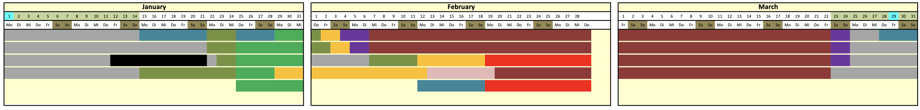
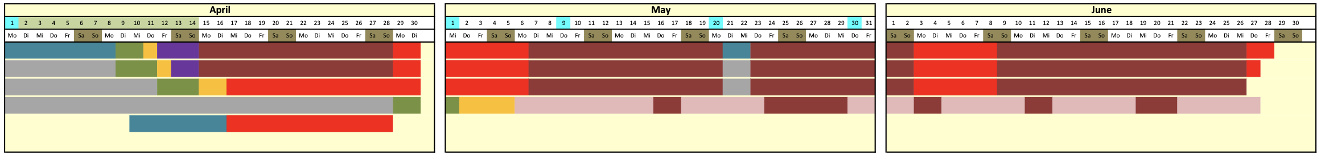
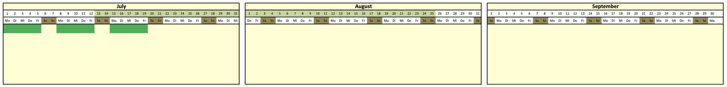
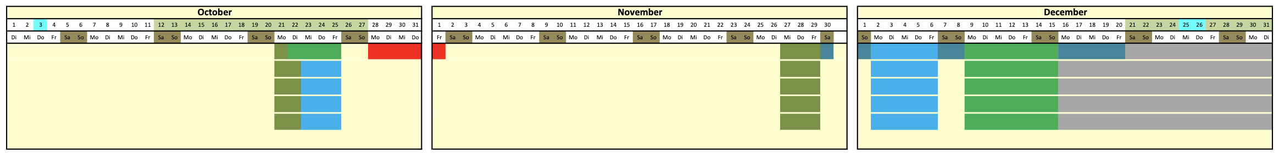
2. Energy management
Consumption and forecast 2024

Slide 10
2. Energy management
Demand planning 2024
  Simple but effective method
  predictions based on mean values from previous beam times
  Average values (kWh/d) for the C1, P1 and HPC grid are assigned to each operating mode
  Higher accuracy in future thanks to finer differentiation of operating modes, simple learner/predictor models (…)
  Average consumption of the 2024 beamtime approx. 6% higher than the engineering run in 2023
  Base load so far in 2024 approx. 30% higher than in the comparative period 2023 (-> early start of beam time)
  HPC share in 2024 approx. 15% higher than in 2023

Slide 11
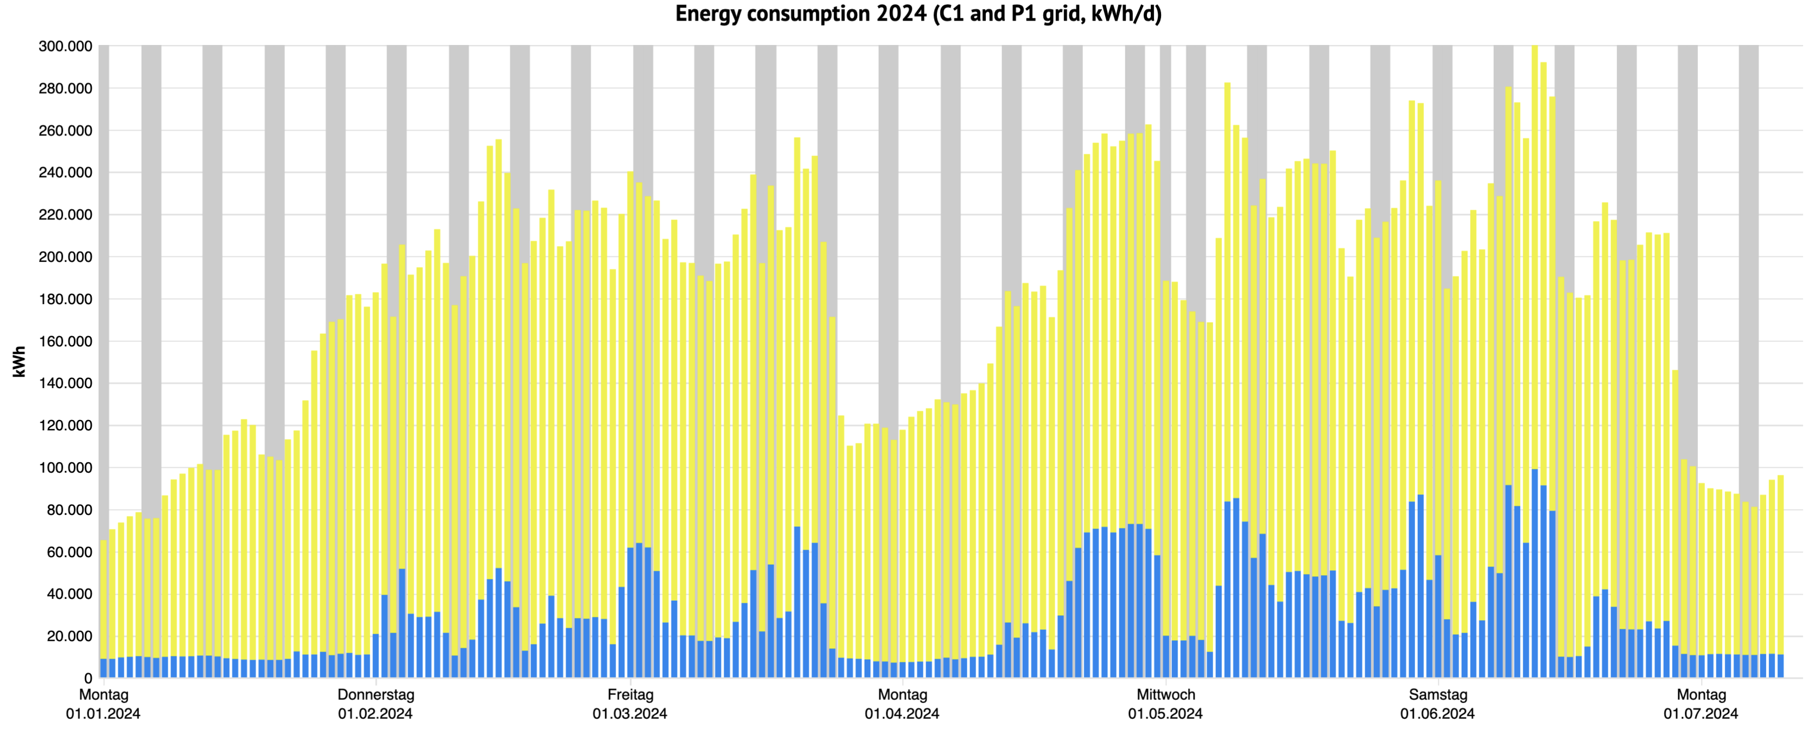
2. Energy management
Beamtime 2024 consumption – to be investigated
C1 grid (kWh)
P1 grid (kWh)
09.-15.06.
08.-10.05.
29.-30.05.
20.-22.03.
13.-16.02.
29.02.- 04.03.
20.-30.05.

Slide 12
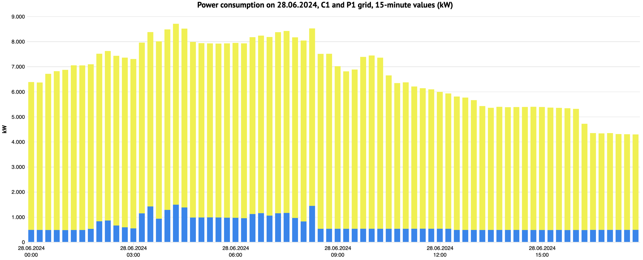
2. Energy management
Beamtime 2024 consumption – to be investigated
C1 grid (kW)
P1 grid (kW)
Interim conclusion:
The cooperation on various levels has been successful – for example, unwanted peak loads have been greatly reduced and demand planning is very effective. Cooperation should therefore be further expanded.

Slide 13
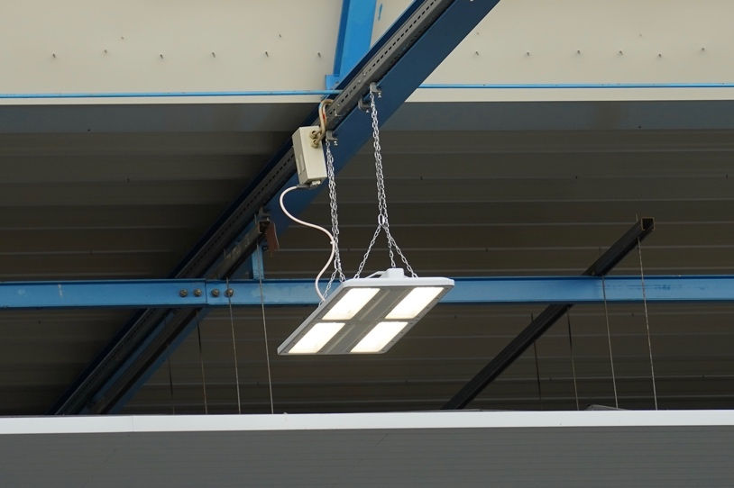
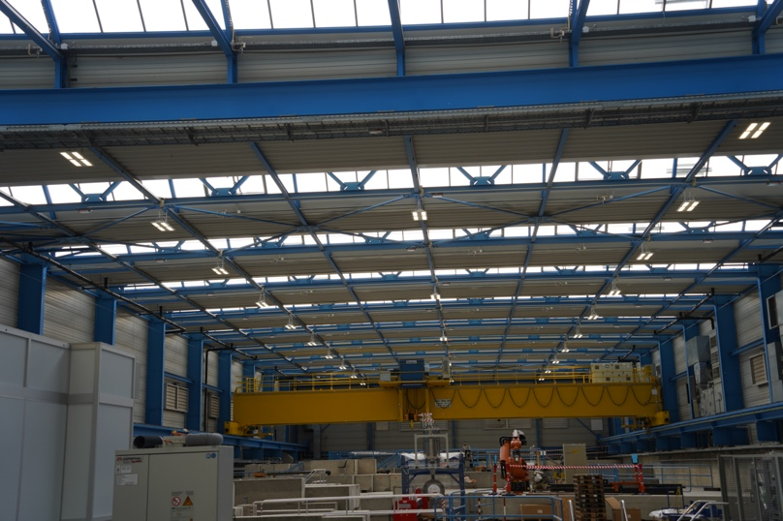
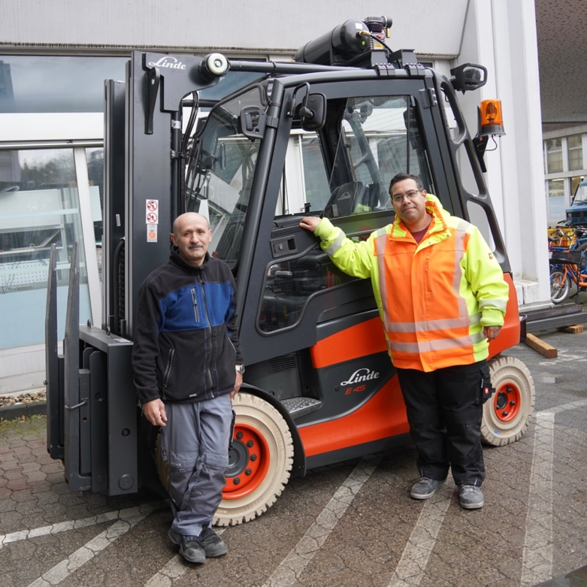
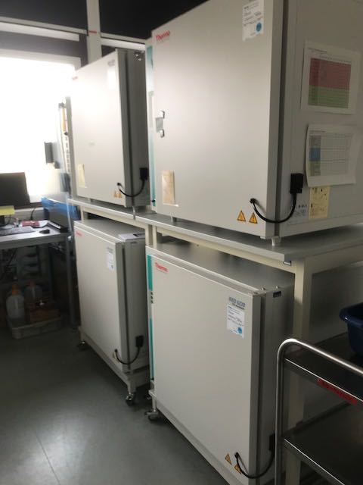
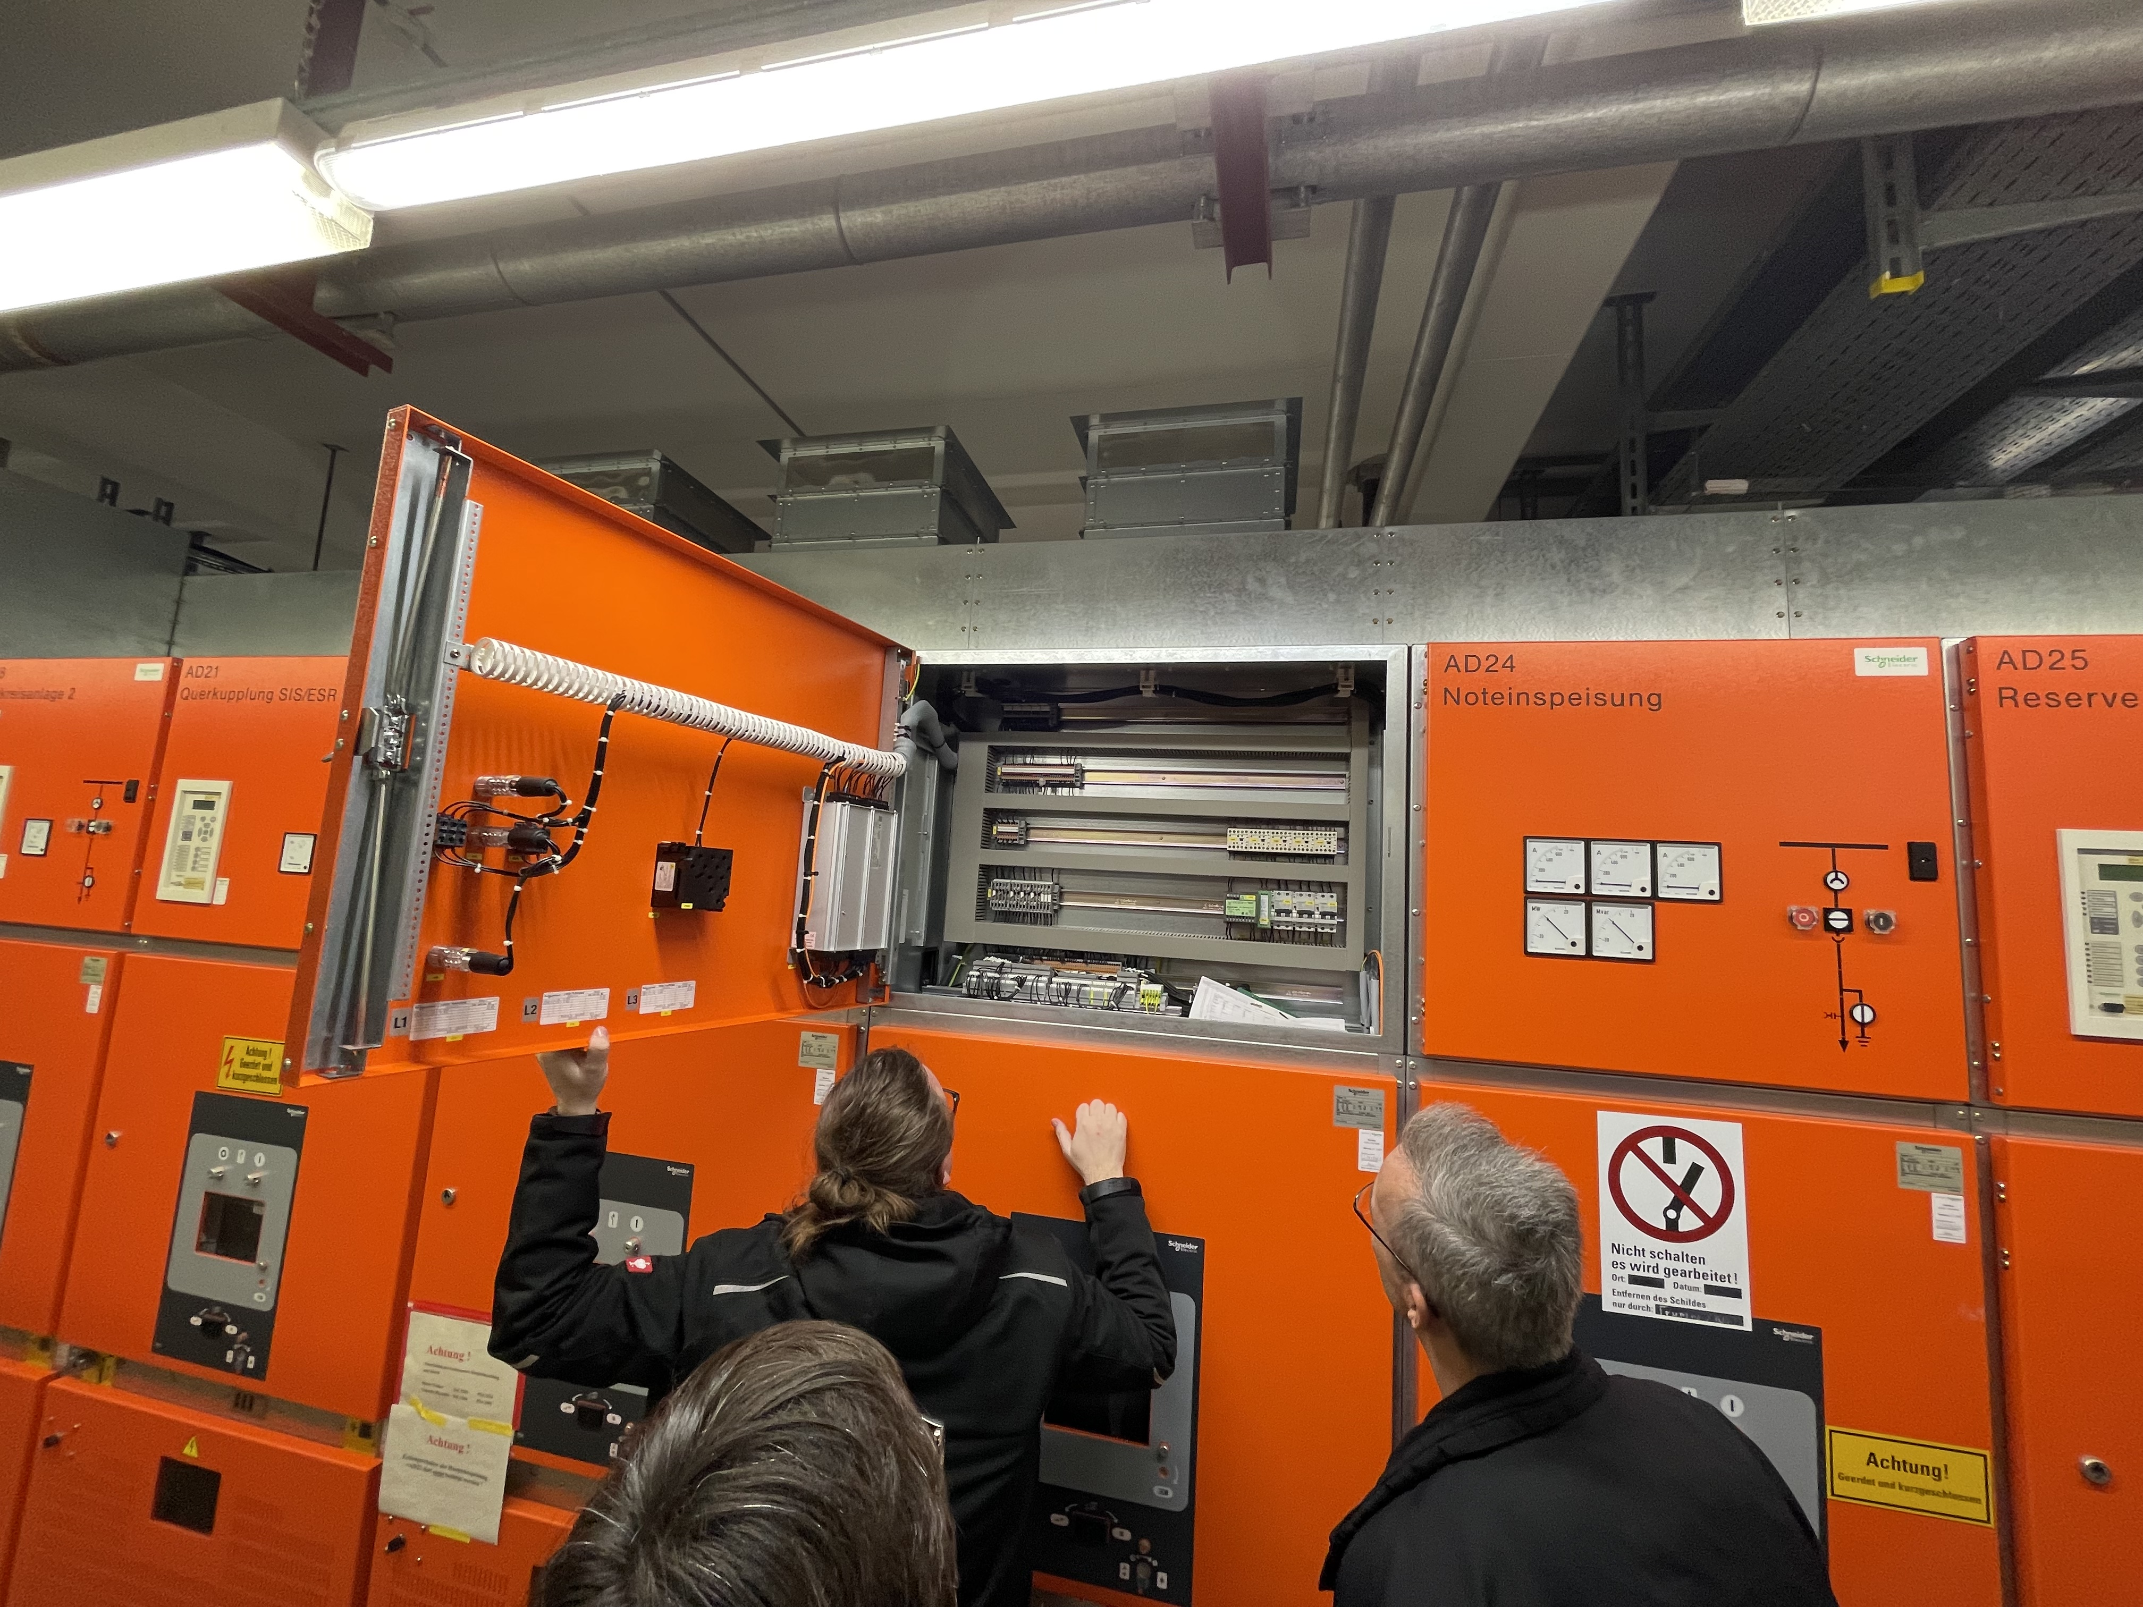
2. Energy management
Energy efficiency measures
Replacement of 140 high-pressure mercury vapor lamps and 1150 outdated lights
  Replacement with suitable LED lights
  2023 until 2024 up to 350 MWh electric energy saved
Replacement of the 18 years old gas-powered forklift truck, with a modern electrically powered version
  daily use
  reduce direct (scope 1) greenhouse gas emissions
Brush cleaning system in cold water production
  increase efficiency by 30-40%
  significantly increase availability
Further measures being implemented in 2024
  over 50 smaller and larger measures have been started or implemented
  from refrigerators and incubators to structural measures on buildings and scientific infrastructure such as cryogenic compressors / buffers

Slide 14
2. Energy management
Energy management system - ISO 50001 Roadmap
Implementation of ISO 50001
Legal requirement
Implementation takes about one year
Parallel upgrade of the measurement technology
Benefits are knowledge gain and potential savings
 | 2024
 | Q2 |  |  |  | Q3 |  |  |  |  |  |  |  |  |  |  |  | Q4
 | 6 |  |  |  | 7 |  |  |  | 8 |  |  |  | 9 |  |  |  | 10 |  |  |  | 11 |  |  |  | 12
Project preparation
Project start
Implementation phase
 | 2025
 | Q1 |  |  |  |  |  |  |  |  |  |  |  | Q2 |  |  |  |  |  |  |  |  |  |  |  | Q3 |  |  |  |  |  |  |  |  |  |  |  | Q4
 | 1 |  |  |  | 2 |  |  |  | 3 |  |  |  | 4 |  |  |  | 5 |  |  |  | 6 |  |  |  | 7 |  |  |  | 8 |  |  |  | 9 |  |  |  | 10 |  |  |  | 11 |  |  |  | 12
Implementation phase
Preparation of the audit
External auditing incl. buffer
EnEfG: Für […] Rechenzentren, die im Eigentum öffentlicher Träger stehen, […] besteht ab dem 1. Januar 2026 die Pflicht zur Validierung oder Zertifizierung des Energiemanagementsystems […]

Slide 15
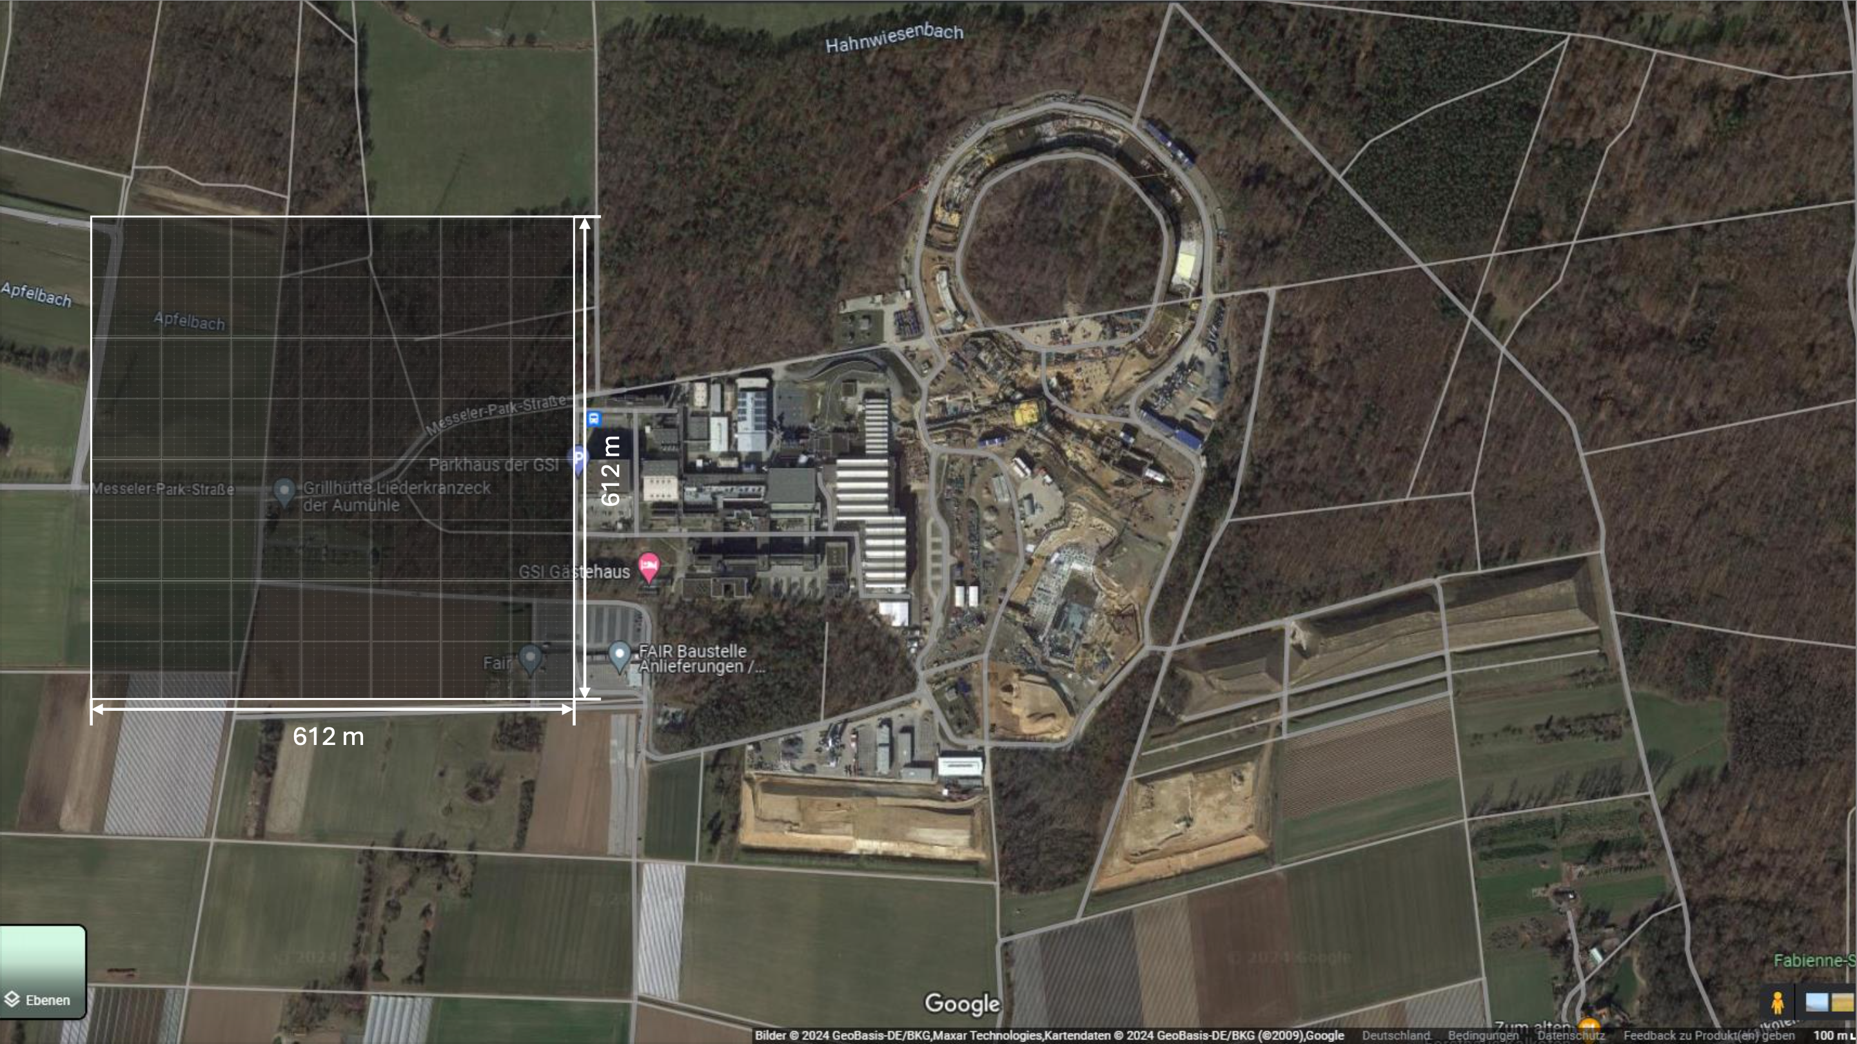
2. Energy management
Potentials for renewable energies
approx. 375,000 m² are required to generate 60 GWh of electrical energy with photovoltaics
Thank you for your attention

Slide 16
Backup
Aufstellung Flächenbedarf PV
  ca. 215 kWh pro m² und Jahr
  60 GWh => 280.000 m² reine Modulfläche
  ca 54.000 kWp zu installierende Leistung
  ca. 375.000 m² inkl. Infrastrukur

