Slide 1
Access Control System TVS
Status
&
Plans for access regulation in 2025
T. Radon

Slide 2
Contents
Introduction / Status
Concrete plan for 2-stage modernization
Requirements for phase 1
Schedule for modernization phase 1
Fault detection and correction
Ad hoc measure
Plans for access control in the 2025 beam time

Slide 3
Introduction / History up to 2022
TVS has been in operation for around 25 years without any significant changes
Risk assessment for the UNILAC area from 2004
carried out by former SIFA, senior UNILAC employee, radiation protection technician
TVS not fail-safe
The TVS does not have a Safety Integrity Level or Performance Level according to EN 61508, EN 61511 or EN ISO 13849
Operation with NT laptops
poor operational safety
Intentions to modernize already existed before 2020
Repeated discussions about the feasibility of modernization
in terms of manpower and budget
in terms of different views/lack of knowledge about the type and manner of a risk analysis to be carried out beforehand

Slide 4
Modernization Requirements
2-stage approach to modernizing the TVS adopted in October 2022 (ACO, SRP, TGF)
Phase 1: Increase operational safety
Phase 2: Complete modernization with regard to personal safety
Decision of TGF: Phase 1 must be completed before the Engineering Run 2023

Slide 5
Specifications for Phase 1
Increase of reliability
The PLC and the controlled safety systems should remain untouched, no significant changes
The TVS server should be updated and kept up to date i.e. hardware update and operating system update (everything else but WinNT)
The safety level during these steps should remain at least the same
Operating options should become more user-friendly
Replacement of keys at the TVS doors
Creation of a password management system
Intensive revision of the operating instructions

Slide 6
Requirements for TVS Password Management
New password management increases the safety level for switching authorizations (no unlimited password duration, no identical passwords in the beam branch)
Passwords should be limited in time and space to one experiment
Only be one active password per beam branch (X, Y, Z, M, ...) at the same time
Option for ARP to intervene in unforeseeable situations
Experiment ends earlier than planned
Emergency situation
Unintended conditions

Slide 7
Timeline TVS – Modernization Phase 1
Implementation phase Software adaptation: Inclusion of additional experimental areas; password management; selection of the server starting from July 2023 by ACO/IND
Test phase until autumn 2023 by IND & ARP
Engineering Beam time Nov 2023 with updated system
End of beamtime
June 2023
Concept development
and risk assessment
Server update
User interface modernization

Slide 8
Interim Status of Modernizations
Phase 1: Completion achieved in autumn 2023 before the start of the Engineering Run
Phase 2: -> Talk by G. Walter

Slide 9
Failure Detection and Correction 1/3
Internal review of the TVS system (July 2023) in advance of the upcoming engineering run revealed errors in the Z branch
in a certain configuration of the control system, beam could have entered the cave despite possible human access to Z6
Various components (wiring, relays, IO cards ...) of the faulty circuit chain were examined.
Defective hardware was ruled out.
External company Jäger, who designed the software for the TVS, was informed.
According to a relatively quick assessment a software error could have caused the problem when the Cave Z7 was separated from the Z branch and software adjustments were performed.
Company Jäger had received a brief written description of the condition and on the tests carried out on the hardware and was asked to check the software.
The assumed error in the software was found and immediately corrected

Slide 10
Failure Detection and Correction 2/3
End of February 2024 (beaming time), inspection tour
Faraday Cup UXCDK6 was not retracted, although the corresponding key switch had been operated
Check of the drive by BEA on-call
Fault was not found despite intensive search
Rad. Prot. Officer of UNILAC stopped beam operation in the X branch
BEA was able to put the drive back into operation the following morning
Beam operation continued during the morning until the SSB arrived
For the rest of the beam time, access control by the TVS for UNILAC operation and experimental operation in EH was not permitted by RPO UNILAC
In parallel door malfunction at Y6 during a search process discovered

Slide 11
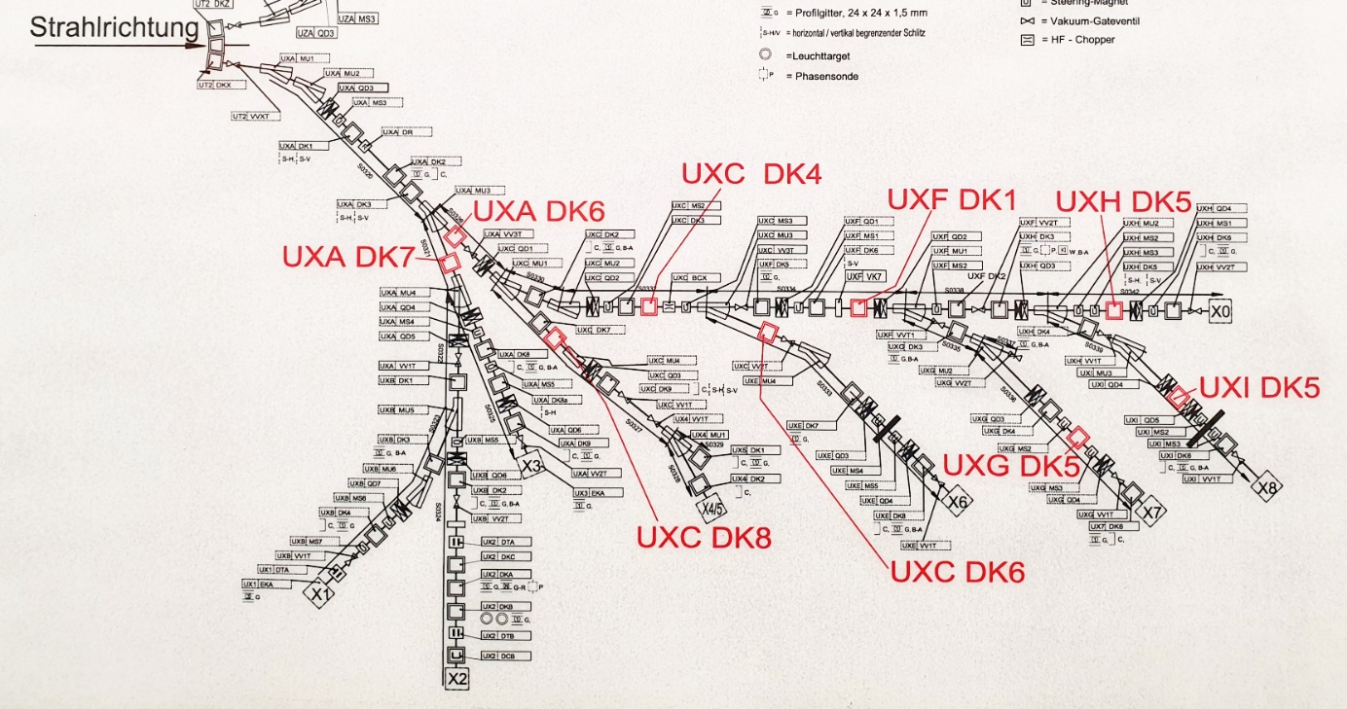
Failure Detection and Correction 3/3
Continuation of beam time with chains and locks at the entrances
Beam cups in front of caves X0, X1-3, X4-5, X6, X7 and X8 were brought into safe position (end position inside) and then the control voltage was removed to rule out a malfunction of the cups.
Establishment of a fixed procedure for access to the caves with the radiation protection shift staff and HKR
Heavy burden for the radiation protection shift staff due to numerous access requests
Slight relief by delegating the access control to SSBs from TASCA for Cave X8

Slide 12
Meeting with Authorities
On May 15, 2024, conversation with Hessian Ministry for Agriculture and Environment (HMLU)
TVS in operation for a long time, no longer state of the art, with specific defects
beam time continuation in the UNLILAC/TK/EH area with chains and padlocks and locked, non-remote-controlled beam cups
In planning: Modernization of the TVS up to state of the art
targeted achievement in 2025.
Interim report to HMLU planned after the start of phase 2

Slide 13
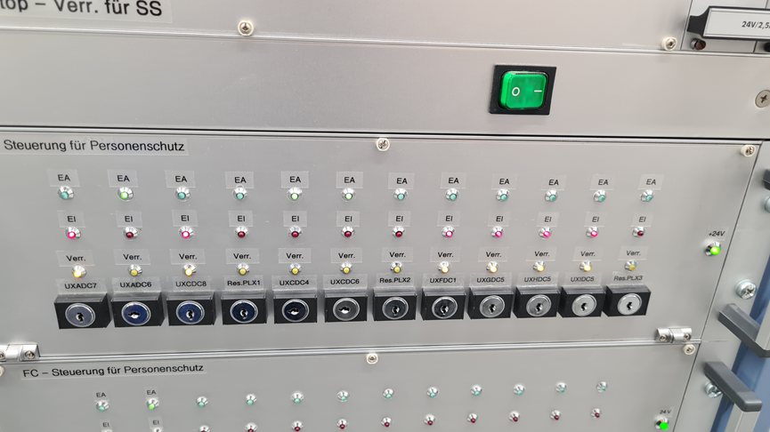
Plans for access control in the 2025 beam time 1/2
Error of the beam cup was NOT displayed on the switch panel
No feedback of the beam cup position available
Installation of the actual readout of the beam cup position on the switch panel at Easter 2024 by BEA
Measure was not accepted by the RPO UNILAC because readout without SIL or PL
beam cup switch panel old and new

Slide 14
Plans for access control in the 2025 beam time 2/2
Upcoming check of TVS components and states
Possibly another external fix for a software error in the control system
Another meeting with the authorities planned
Presentation of the reading of the cup positions an its intended usage
Envisaged additional measures
Mandatory wearing of an active personal dosimeter when entering TVS controlled areas
Specified procedure for entry, observing the personal dosimeter in prescribed steps
Possibly additional local dosimeters at entrances
Possibly video transmission of the switch panel in HKR
Implementation of the beam time with the above measures shown with the approval of the authorities

