Slide 1
TVS - Upgrade
G. Walter, Beam Time Retreat 2024
Agenda:
Overview existing TVS
Planned Upgrade
Rough time scale
Project group

Slide 2
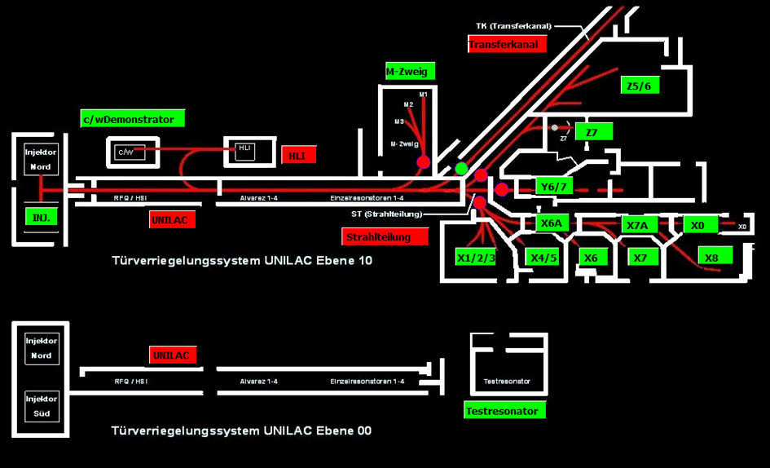
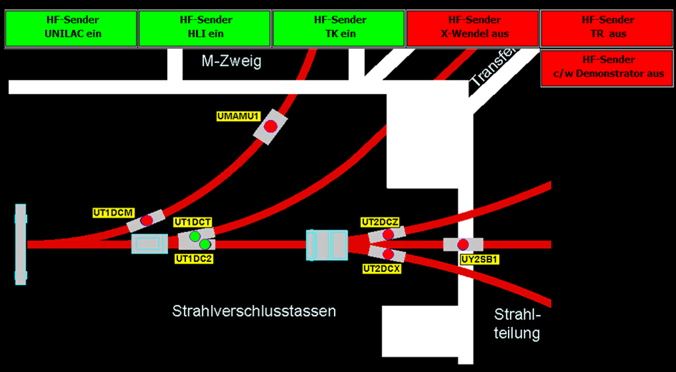
Existing TVS – TürVerriegelungsSystem at Unilac and Experimental Hall EH
Tasks:
  Ensure safe beam operation without any personal injuries – no access with beam in 18 different areas!
  Activate beam interruption in case of trouble/faults – close beamline with cups and switch-off rf power and magnet (M-Zweig).
  Monitor status of radiation protection doors to ensure closure during beam operation in the relevant area.
  Support dedicated personnell during search in related area.
  Allow manual opening of radiation protection doors in case of unallowed or unwanted access of people within related area.
Latest Upgrades: Replacement of WinNT-based
user interface, readout of cup position in/out

Slide 3
Upgrade of TVS
Necessary after about 30 years of operation….and some failures/undefined operation status! New hard- and software necessary, typical operation time of PLC-based „life saving“ systems is max. of 20 years!
Tasks of upgrade are the same as existing one plus:
  Fail-safe use of readout signals of cup positions
  Upgrade Beam Cups (partly too small to shadow entire beam size) - therefore we add 3 additional beam stopper/cups near source and HLI. The positions are already defined.
  If they act as main or redundant cups is still under discussion within the switch-off concept.
  Ensure safe beam operation without any personal injuries – no access with beam in 18 different areas!
  Activate beam interruption in case of trouble/faults – close beamline with cups and switch-off rf power.
  Monitor status of radiation protection doors to ensure closure during beam operation in the relevant area.
  Support SiSt personnell during search in related areas.
  Allow manual opening of radiation protection doors in case of unallowed or unwanted access of people within related areas.

Slide 4
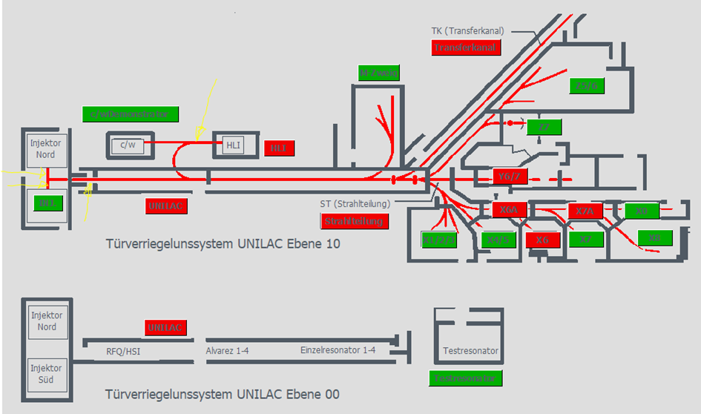
Upgrade of TVS
additional 3
beam stopper
Injector north and south –
2 chambers are available

Slide 5
Upgrade of TVS – Status of Activities
Draft Concept of IKP FZ Jülich in cooperation with ACO is existing.
First draft and starting point of Risk Analysis is done: -> minimum requirement of Safety Integrity Level SIL 2 is defined for all components -> failure rate between 10⁻⁶ and 10⁻⁷ per hour (i.e. 1 failure in roughly 10³-10⁴ years seems feasible) – RA will be worked out in more detail within a small working group, e.g. for cups/beam stops
A first draft version of the PLC Master-Client System is under discussion between Robert Hecker, FZJ and Christine Betz, GSI-FAIR ACO. We we will have an afternoon workshop to go through all details including hardware components next week.
For hardware we will use – wherever reliable and possible – components of FAIR PAS (easier spare parts handling).
Programming and installation – who will do what? – still under discussion!
Therefore:
  -> Planning phase is still ongoing incl. switch-off concept and interfaces (rf, power supplies, etc.)
  -> Plan: First hardware components will be purchased via FZJ until end of 2024
  -> Project team is established – details will be discussed and finalized in smaller working groups to be more effective.

Slide 6
Working Plan – first Draft!!! (reverse order planning)
Just a basic approach for discussion with the project group…
But: Operation of new TVS in Beamtime 2025 is not realistic with
existing personnel resources!

Slide 7
The Executive TVS Project Group
GSI SiSt:
R. Fleissner
Ch. Poeppe
P. Schuffenhauer
T. Radon
IKP, FZJ
O. Felden
R. Hecker
H. Zens
GSI FAIR Commons - ACO:
Ch. Betz
GSI FAIR Commons – BEA:
M. Schwickert
GSI ACC - OIS
G. Walter (Steering Project)
…and many other people participating, like R. Hollinger, F. Maimone, R. Fischer, H. Vormann, U. Scheeler, G. Schreiber,……..
Thank you all
for the good work
and fruitful cooperation!

