Slide 1
Integrated Campus Schedule
Natalya Winters
& Emmanuel Rosi
BTR 12.07.2024

Slide 2
Strategic goals of FAIR & GSI are clearly determined They have a lot of dependencies and impacts
FAIR phase 0
research program
Construction
of FAIR
Impacts?!
FAM:
Campus
development & GAT
Upgrade of existing
accelerators
ICS - BTR 2024

Slide 3
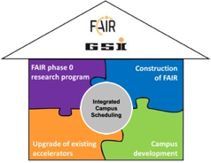
Integrated Campus Scheduling makes dependencies and effects visible and manageable
Objective of ICS Process
Create long term overview of main activities and projects covering all stratectic objectives of campus (FAIR & GSI)
Discuss interfaces, dependencies & new projects
Link plans and consolidate resources needs (TGF) to achieve our strategic goals on time
all new projects where interfaces are expected must be submitted to the ICS team for assessment in advance
Scope & Core Team
FAIR Project
GSI Accelerator & Upgrade Projects
FAIR Phase 0 Research
Commons
Work and Team led by PMO (Dr. Natalya Winters)
ICS - BTR 2024

Slide 4
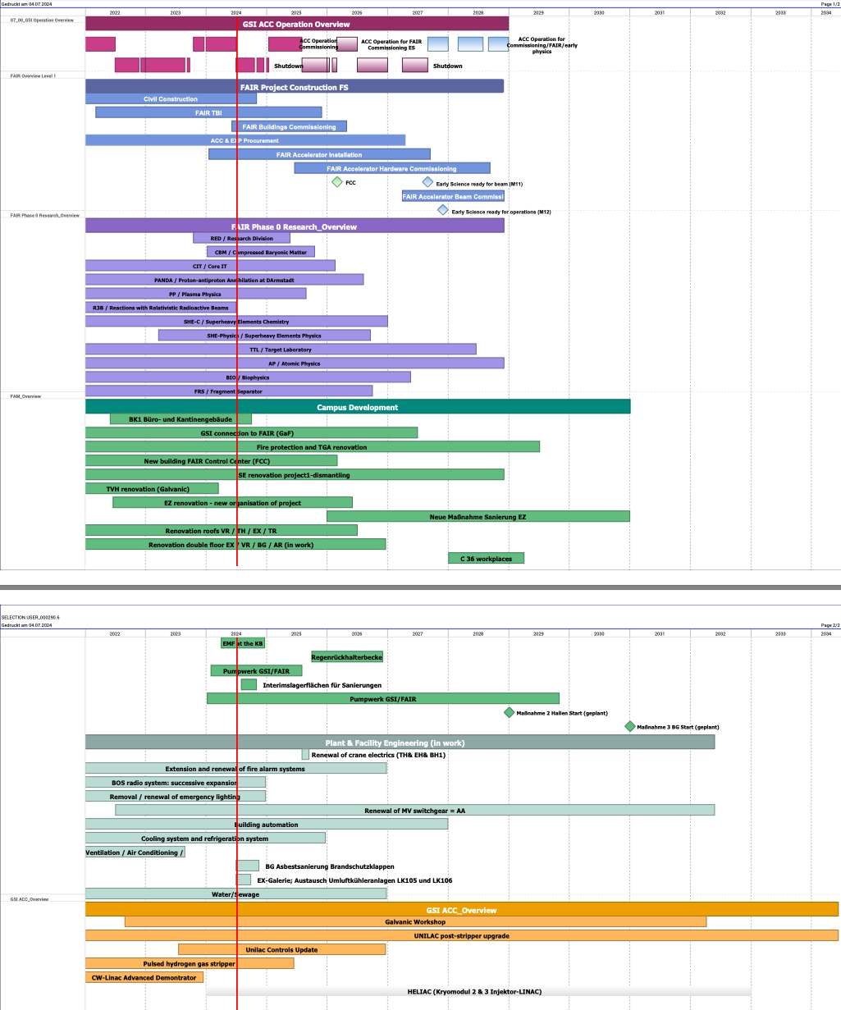
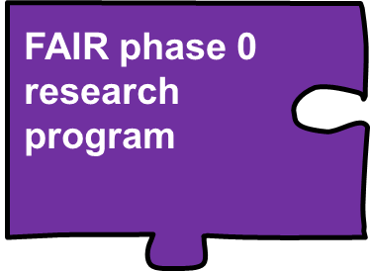
Overall FAIR & GSI Schedule
realization phase
general overview
ICS - BTR 2024

Slide 5
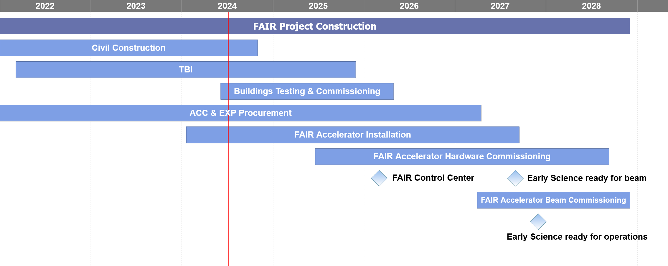
Contribution by FAIR Project
monthly update
FAIR phase 0
research program
everything planned in detail at work package level
Installation planning in re-work
Detailed planning of the commissioning will follow
Construction
of FAIR
ICS - BTR 2024

Slide 6
Contribution by FAIR Phase 0 Research
Projects and activities which involve other GSI departments
Purchases of new equipment
De-commissioning of experimental places
FAIR phase 0
research program
ICS - BTR 2024

Slide 7
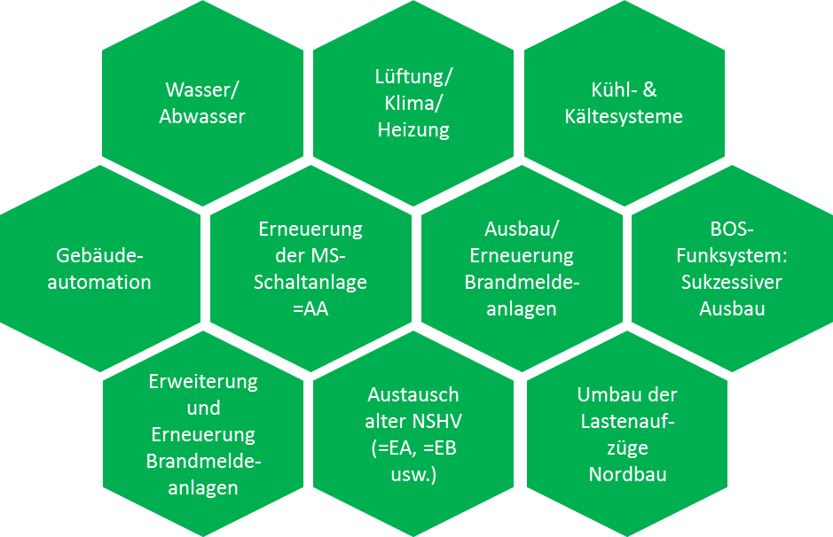
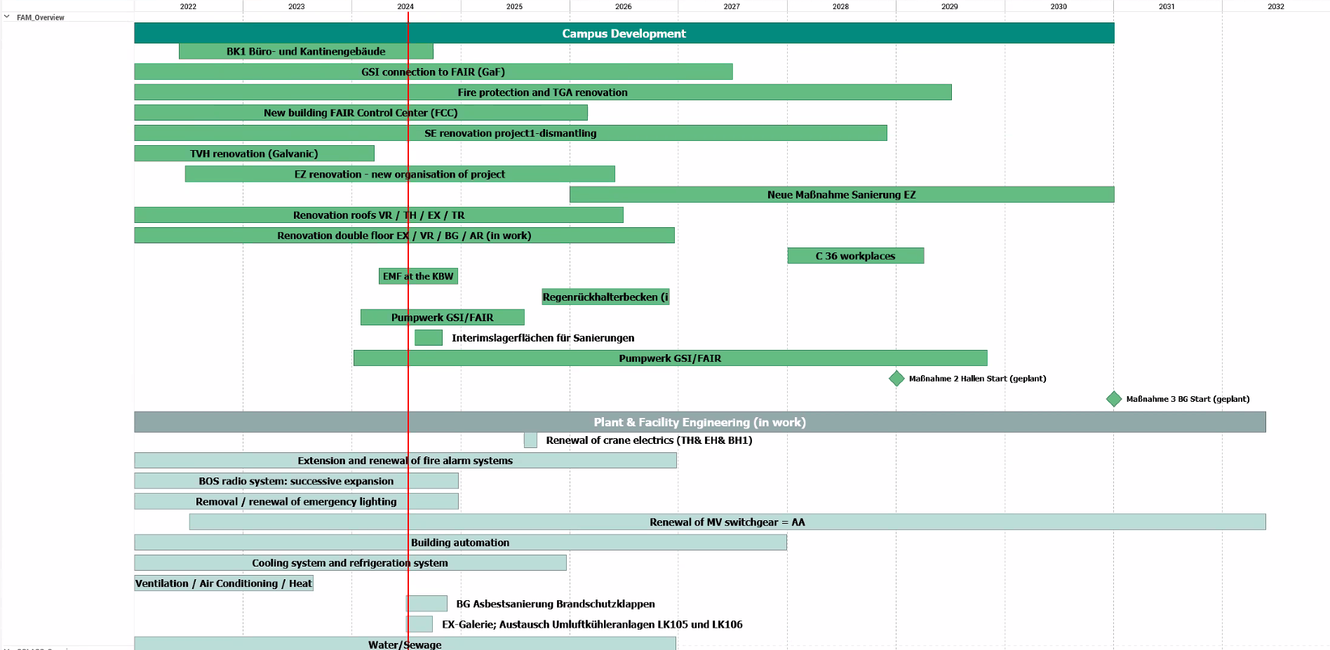
Contribution by Campus Development (CAM) & Plant & Facility Engineering (GAT)
CAM
GAT
Neubauten
Sanierungen
Projektierte Sanierungen
FAIR Neubau
Dachsanierung
Sanierung
Doppelboden
Kranbahnsanierung
2020
FAM:
CAM & GAT
half-yearly update
(Baukoordinierung Gespräche)
ICS - BTR 2024

Slide 8
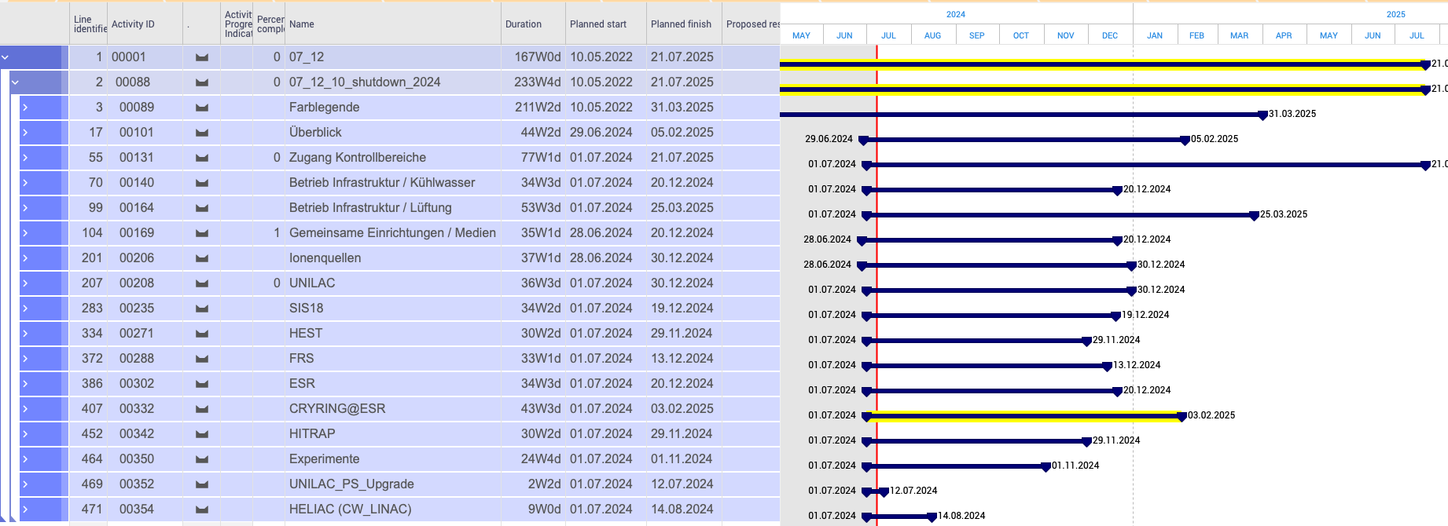
Contribution by GSI Accelerator & Upgrade Projects
Beamtime & shutdown blocks
Shutdown planning
in PLW
with generic resources!
ACC upgrade projects
Upgrade of existing
accelerators
weekly update
partially actual
Quarterly update
ICS - BTR 2024

Slide 9
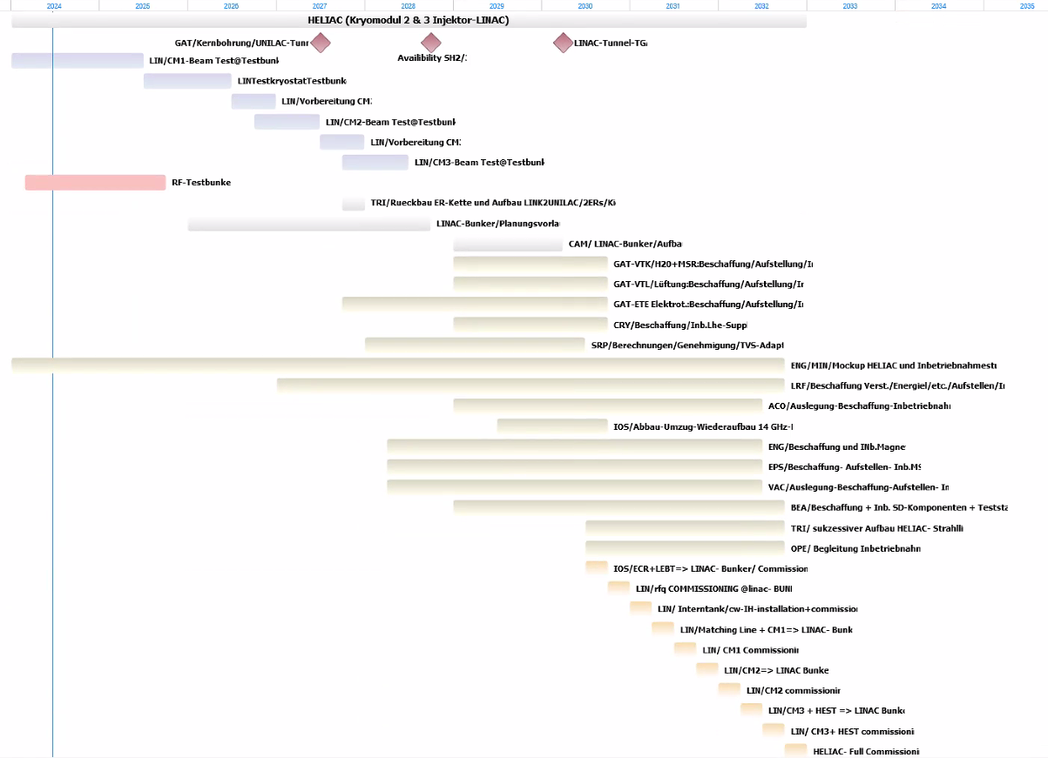
New project analysis: HELIAC
Presentation of the new HELIAC project in 2023 to the ICS team and the departments concerned
Appointment of contact persons by the specialist departments
(Rough) estimate by the specialist departments: FTE/costs/duration (deadlines) /interface
Presentation of the interim results by the HELIAC project management in the same round (March 2024)
Presentation of the planning by the HELIAC project management to the GSI management June 2024
All data is available
a decision on the start of the project will be made in the coming years
ICS - BTR 2024

Slide 10
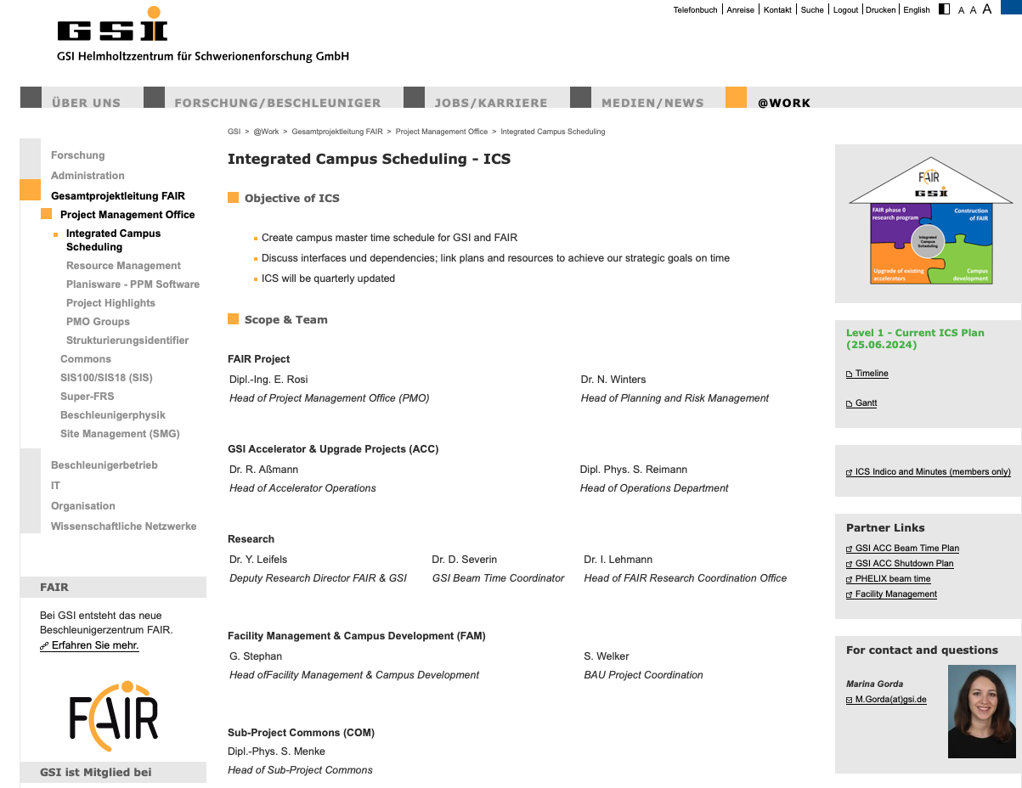
ICS webpage at gsi.de
https://www.gsi.de/work/gesamtprojektleitung_fair/project_management_office/integrated_campus_scheduling
ICS - BTR 2024

Slide 11
Summary – Status – Next Steps
ICS working team meets regularly
ICS Level1 Project Plan published on GSI Webpage
Various important results could be obtained
Example: Galvanic strategy (pLinac / UNILAC) - 2022
Integrated shutdown scenarios (LA-16 Renovation) - 2022
ACC shutdown activity planning - 2024
FCC building completion - 2023
New project analysis: HELIAC - 2024
Open points
Planning quality and completeness (FAIR Resources, GSI ACC planning activities & Procurement activities,)
Next steps
More efficient TGF resources management
Portofolio management improvement
ICS - BTR 2024

Slide 12
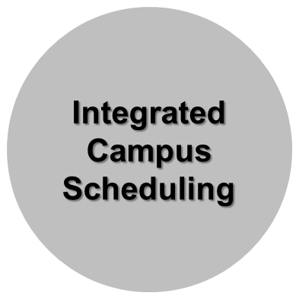
Thank you
special thanks to
Sabine Welker (FAM), Arnaud Le Fevre (Research)
& Marina Gorda (PMO)
FAIR phase 0
research program
Construction
of FAIR
FAM:
Campus
development & GAT
Upgrade of existing
accelerators
ICS - BTR 2024

