Slide 1
7th Beam Time Retreat Shutdown Planning 2024
BEAM TIME RETREAT 2024
M. Klich, M. Müller, Y. Valdau – Shutdown Coordination
11th and 12th July 2024
@ Hotel Jagdschloss Kranichstein

Slide 2
Content
BEAM TIME RETREAT 2024
Planning process
Overview Shutdown
Shutdown’s Framework
Shutdown activities

Slide 3
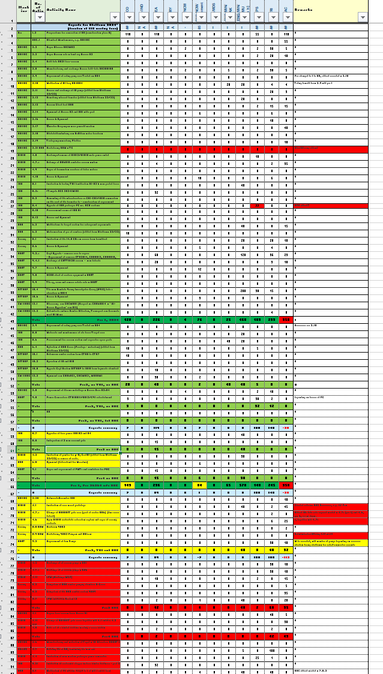
Planning Process
BEAM TIME RETREAT 2024
Collecting activities from Machine Coordinators
Creating Shutdown Activity List
Meetings with Commons departments
Effort estimation
Review of the list taking into account available resources
Distribution of reviewed list with prioritization in Machine Meeting
Resource loaded first draft of shutdown plan

Slide 4
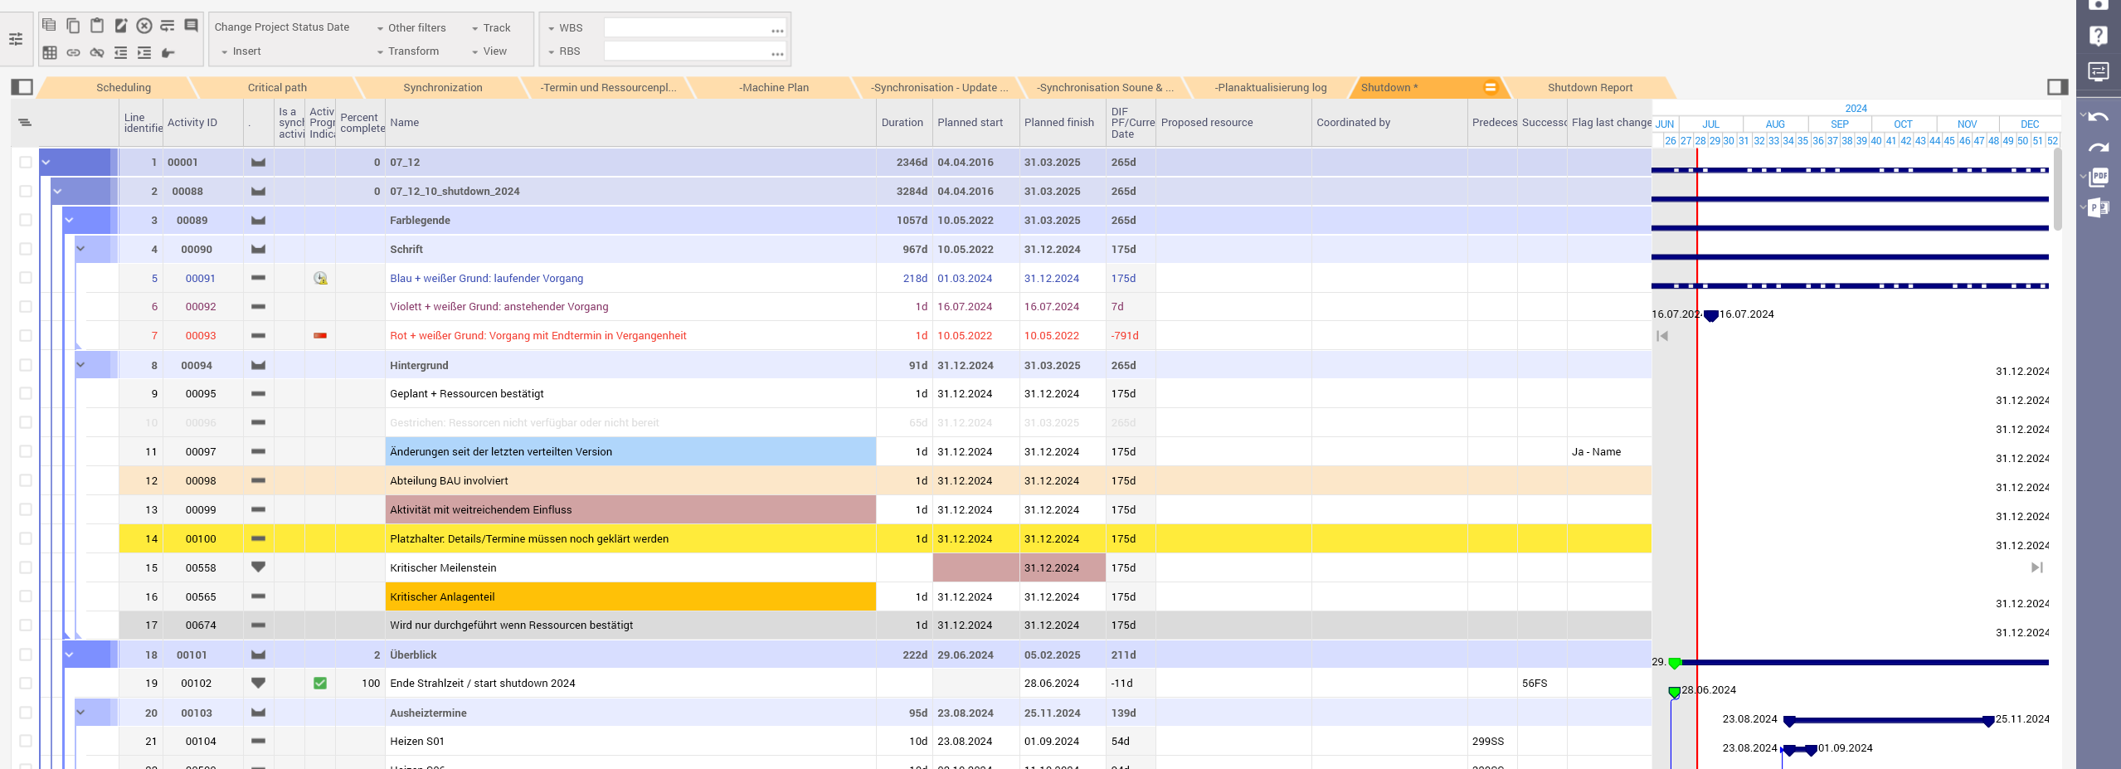
Switch to Planisware
BEAM TIME RETREAT 2024
From Microsoft Project to Planisware Establish new structure | Great support from Project Management Office

Slide 5
Evaluation of Resources
BEAM TIME RETREAT 2024
Shutdown plan resource loaded
List of activities per division
Effort FTE per week

Slide 6
Overview Shutdown
BEAM TIME RETREAT 2024

Slide 7
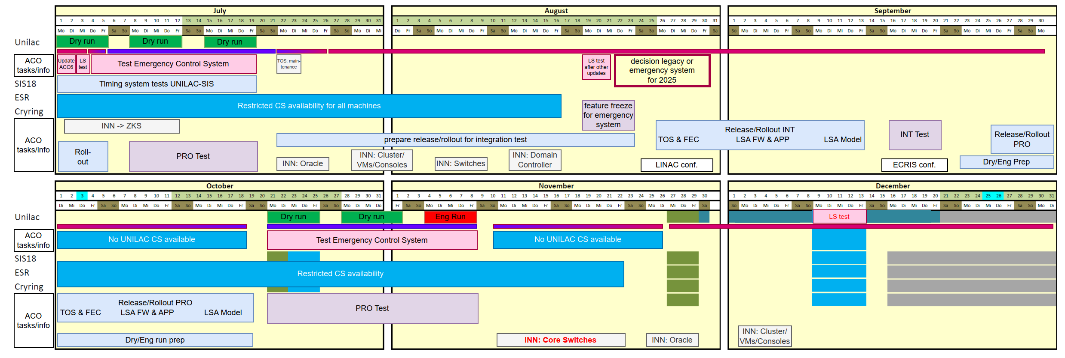
Shutdown’s Framework
BEAM TIME RETREAT 2024
Installation FAIR in parallel
Lack of time
Injector Controls Upgrade Project

Slide 8
Shutdown Activities - Across GSI
BEAM TIME RETREAT 2024
Preparations for renovation of Experimental Hall (EH)
Rebuilding control system KS02
Maintenance of medium voltage switch gear =AE
Exchange/refurbishment fire protection dampers
Survey & Alignment
§88 Test
OPEN: TVS (Tür-Verriegelungs-System)

Slide 9
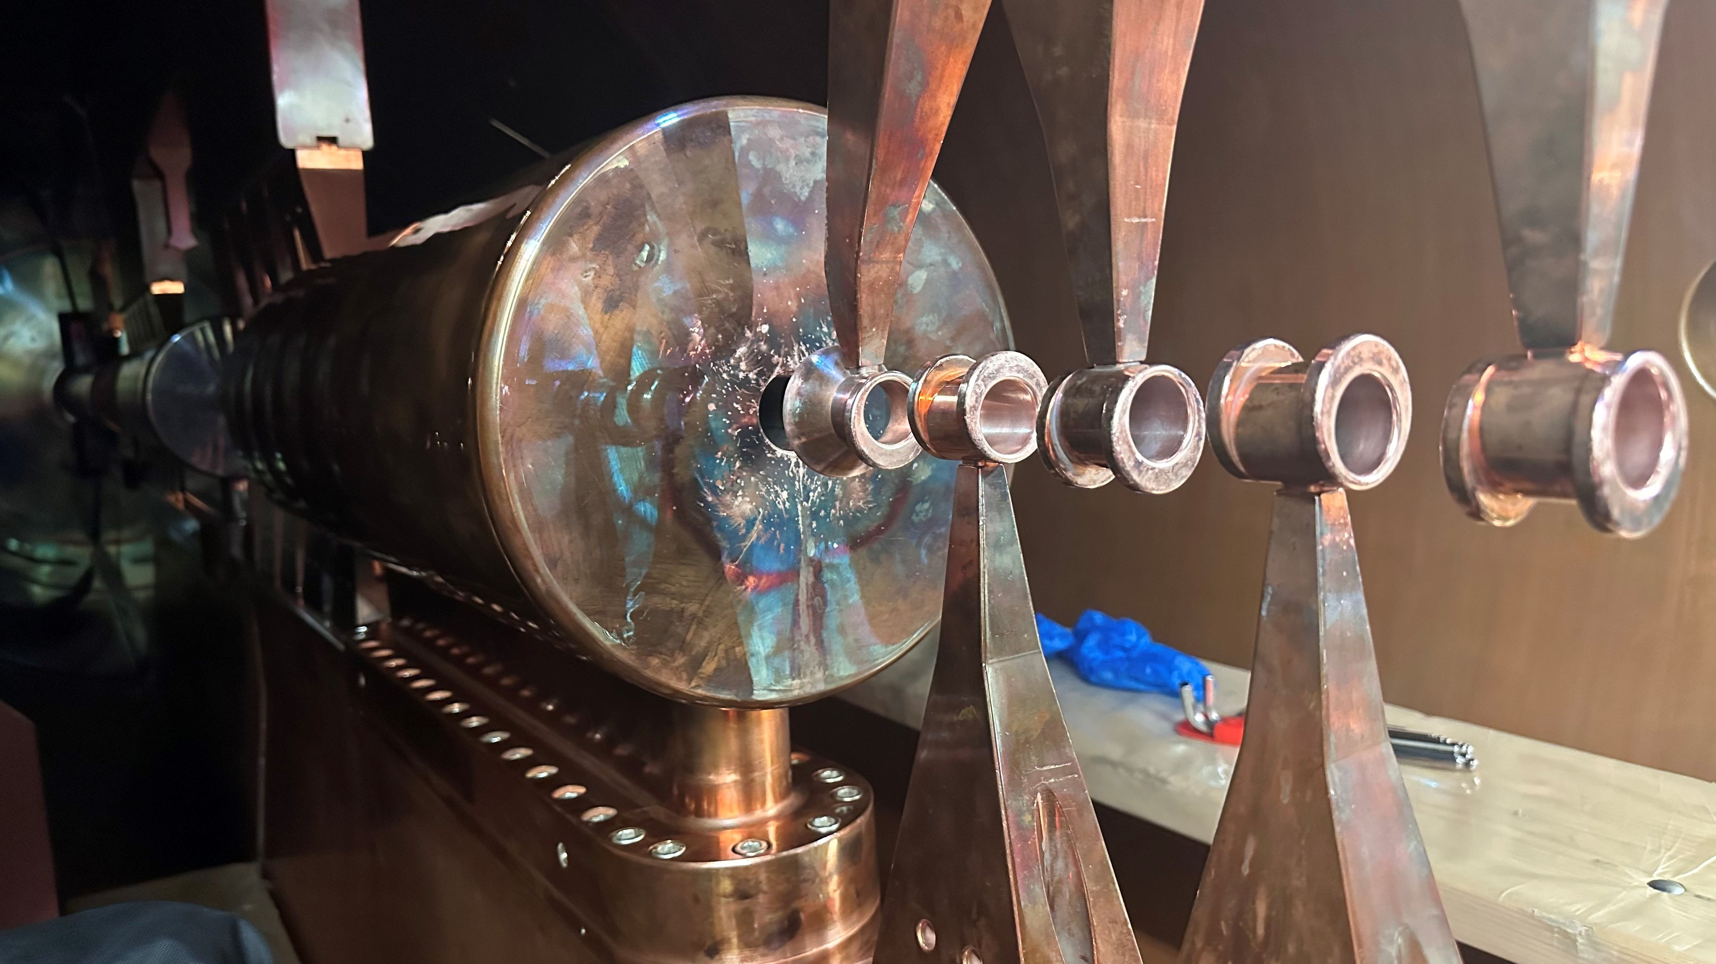
Shutdown Activities - UNILAC
BEAM TIME RETREAT 2024
Water leakage GUH3QT3 (IH1) & repair steerer GUH2MS3
Alvarez A4
Modification of RF loop A4
Replacement leaking pump valve
Alvarez A3
Vacuum leaks in tank cap
Drift tube DR31 fore-vacuum
Alvarez A2
Drift tube DR105
Vacuum leak check BB5
UNILAC Radio Frequency
Pulsed gas stripper
Source: GSI / M. Vossberg

Slide 10
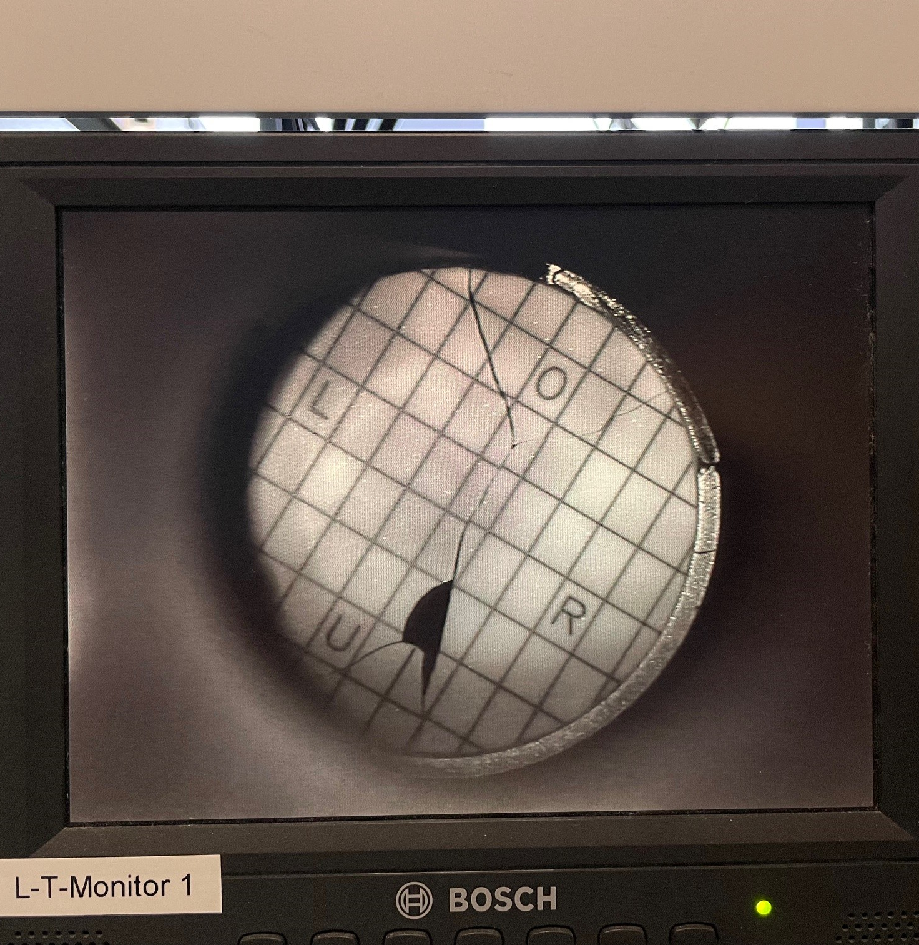
Shutdown Activities - SIS18
BEAM TIME RETREAT 2024
Exchange of GS06DFV scintillator screen window
Maintenance of SIS12/SIS18 mode power switch
NEW: Repair of connector electrostatic extraction septum
If resources are available or with external resources:
Installation of prototype cryo inserts
Open SIS18 electrostatic extraction septum and repair of clearing electrode
Source: GSI / B. Walasek-Höhne

Slide 11
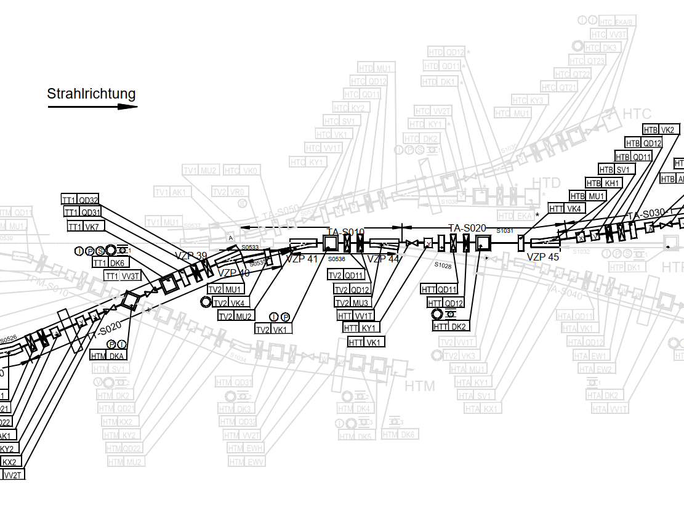
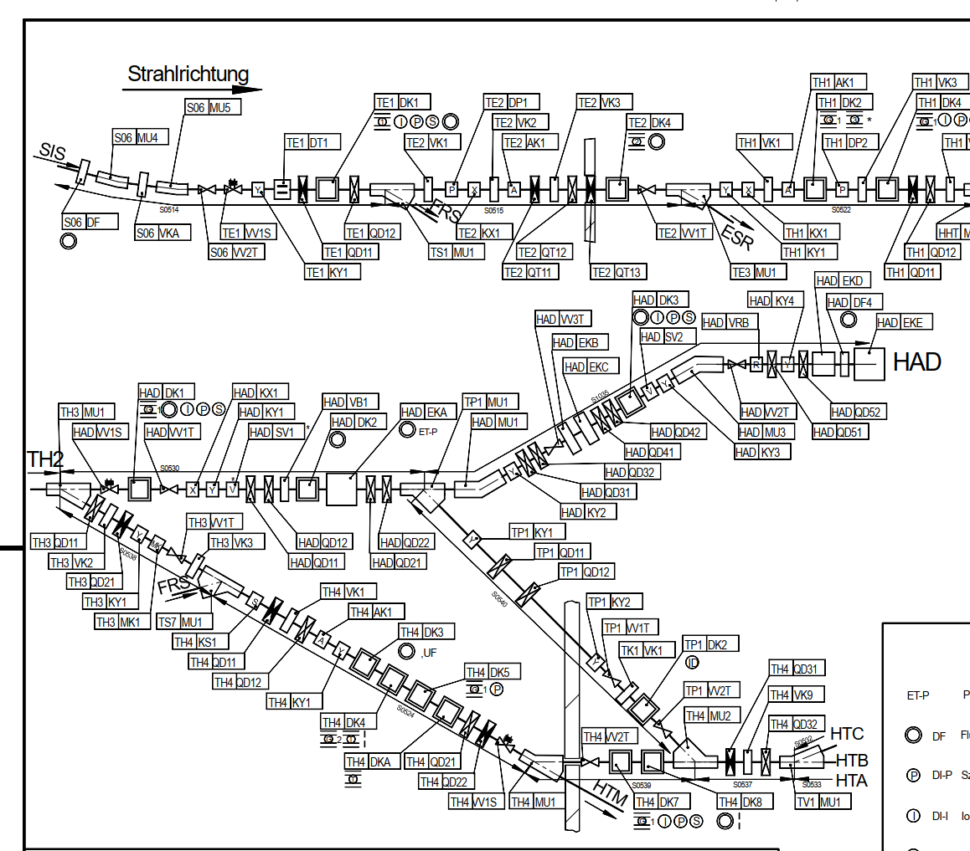
Shutdown Activities - HEST
BEAM TIME RETREAT 2024
Cupid Upgrade
Exchange of GHTTDF2V screen
Power Converters GTE1QD11/QD12/KY1 refurbishment
NEW: Repair TE-Stripper
GHTTDF2
GHADDF2
GHADDF3

Slide 12
Shutdown Activities - Other Machines
BEAM TIME RETREAT 2024
CRYRING@ESR Installation 14.5 GHz ion source E-cooler Experiment preparations | ESR Preparation target area FRS Installation stepper motors control hardware Upgrade quadrupole PC HITRAP Extension control system Investigations IH cavity

Slide 13
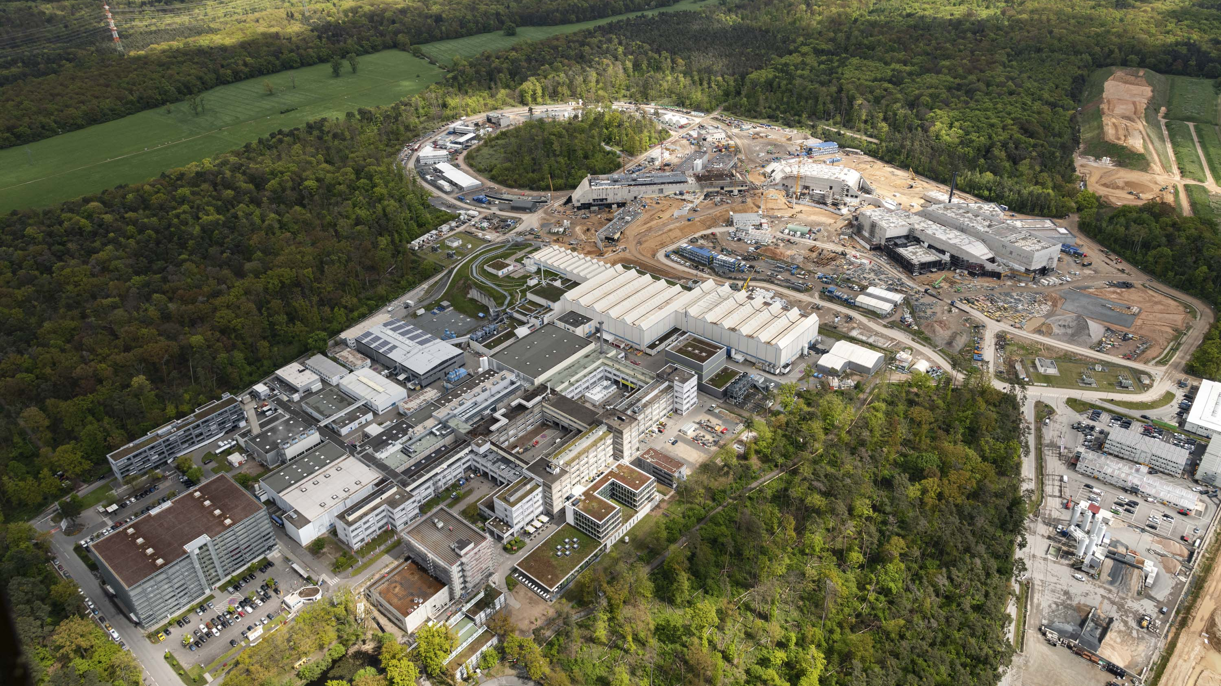
Thank you for your attention!
Source: GSI/FAIR, D. Fehrenz

Slide 14
BEAM TIME RETREAT 2024
Back Up

Slide 15
Maintenance of MV switch gear =AE (1/3)
BEAM TIME RETREAT 2024

Slide 16
Maintenance of MV switch gear =AE (2/3)
BEAM TIME RETREAT 2024

Slide 17
Maintenance of MV switch gear =AE (3/3)
BEAM TIME RETREAT 2024

Slide 18
Exchange/refurbishment fire protection dampers
BEAM TIME RETREAT 2024
(1/7)

Slide 19
Exchange/refurbishment fire protection dampers
BEAM TIME RETREAT 2024
(2/7)

Slide 20
Exchange/refurbishment fire protection dampers
BEAM TIME RETREAT 2024
(3/7)

Slide 21
Exchange/refurbishment fire protection dampers
BEAM TIME RETREAT 2024
(4/7)

Slide 22
Exchange/refurbishment fire protection dampers
BEAM TIME RETREAT 2024
(5/7)

Slide 23
Exchange/refurbishment fire protection dampers
BEAM TIME RETREAT 2024
(6/7)

Slide 24
Exchange/refurbishment fire protection dampers
BEAM TIME RETREAT 2024
(7/7)

Slide 25
Renovation roof BG, TR & EX
BEAM TIME RETREAT 2024

