Slide 1
HEST - Lessons from the beam time 2024 and outlook to 2025
BEAM TIME RETREAT 2024
BEM TIME RETREAT 2023
Christoph Hessler – MK HEST GSI GmbH
11th and 12th July 2024
Kranichstein

Slide 2
Highlights from Beamtime 2024
BEAM TIME RETREAT 2024
BEAM TME RETREAT 2023
Mostly smooth operation of HEST, but not without issues.
Target steering feature in BENNO application has been used regularly for HADES since 2022 and has now been extended and successfully used for HTD.
New TE stripper target installed during Easter break (→ separate slide).
ESR-HTA beamline has been successfully set up and operated for experiment 0095 (→ separate slide).
Re-commissioning after Easter break was done the first time using the sequencer.
Machine studies:
1st direct beam transport from SIS18 to CRYRING entrance.
Commissioning of BPMs in ESR beamline.

Slide 3
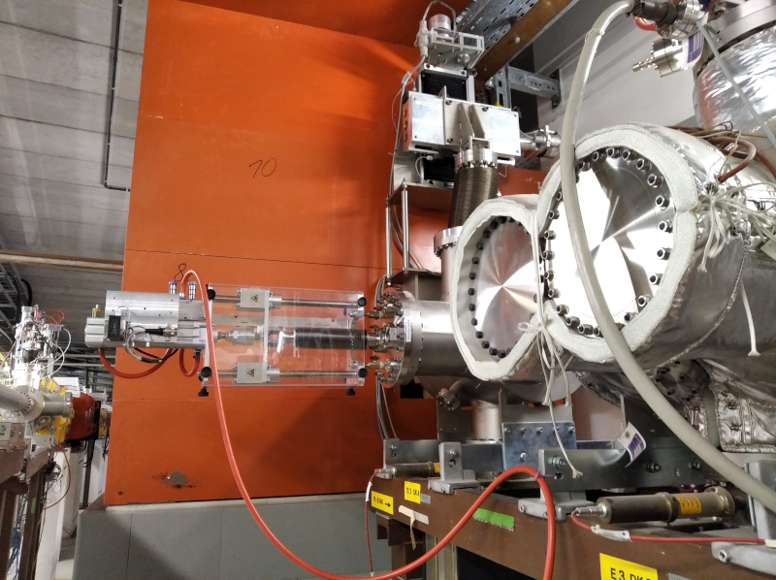
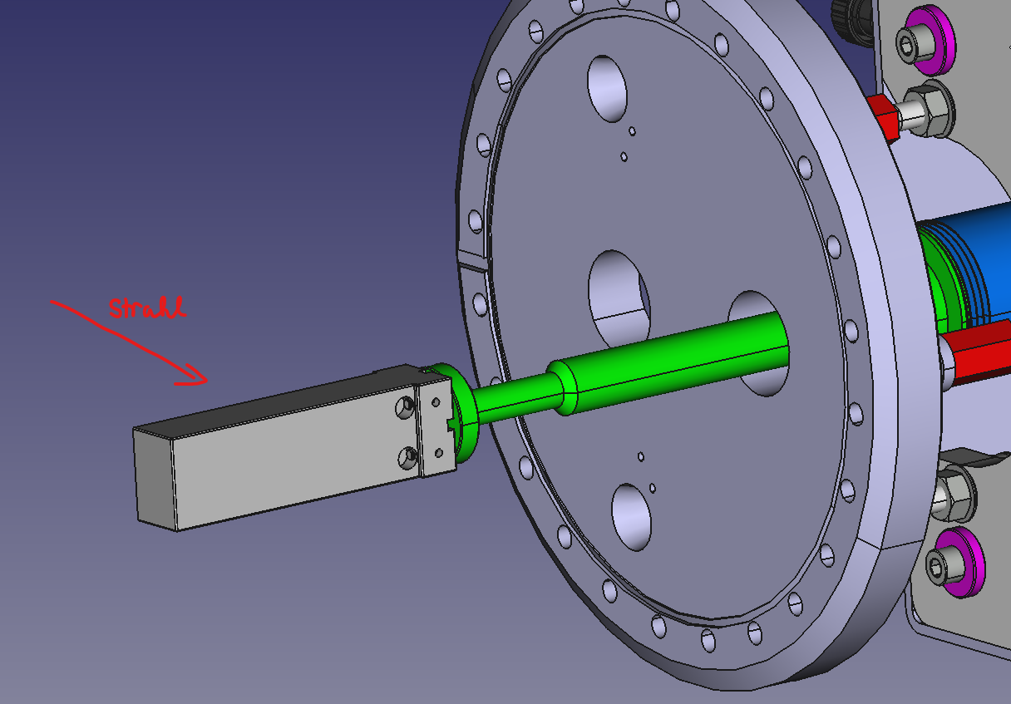
New Target for Isotope Production in TE Line
BEAM TIME RETREAT 2024
BEAM TME RETREAT 2023
Old target drive
New target was required at TE stripper, but knowledge of how to exchange the target has been lost.
Risk to damage the equipment due its age (bellow) and absence of spares.
Safety risk due to installed Be target.
Solution: New Al target has been installed at a separate new drive in front of TE stripper during Easter break.
TE line has been operated successfully with new target.
New target drive
New target
C. Brandau

Slide 4
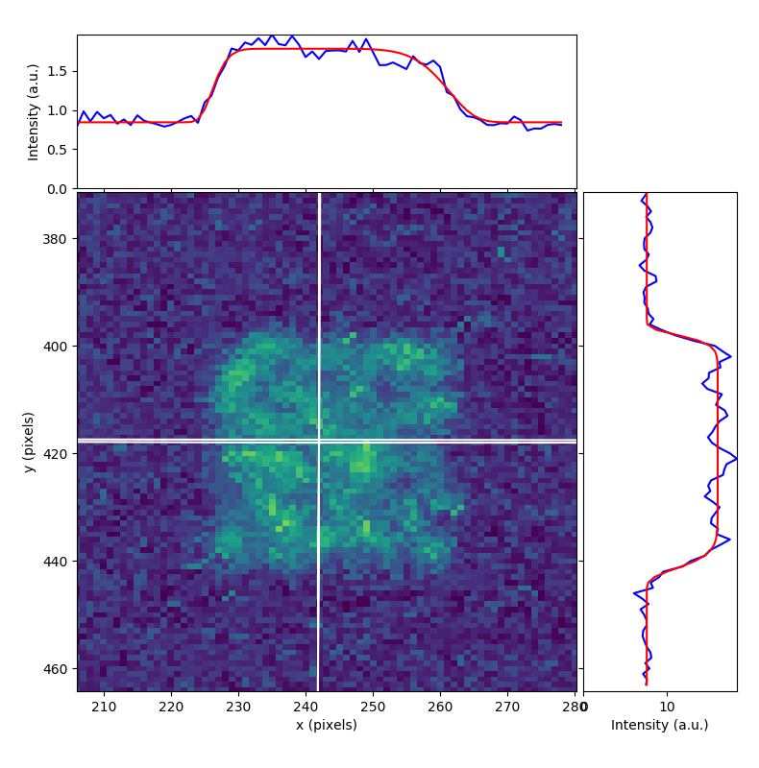
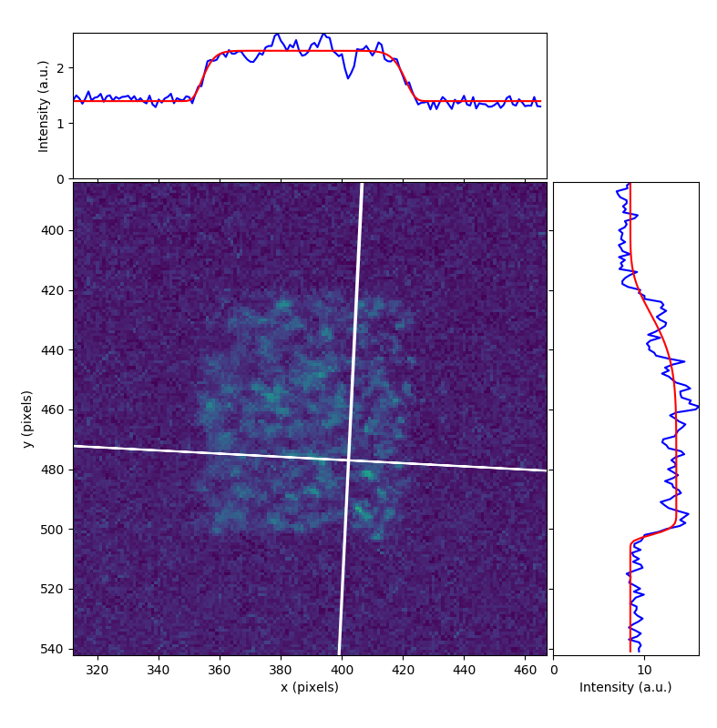
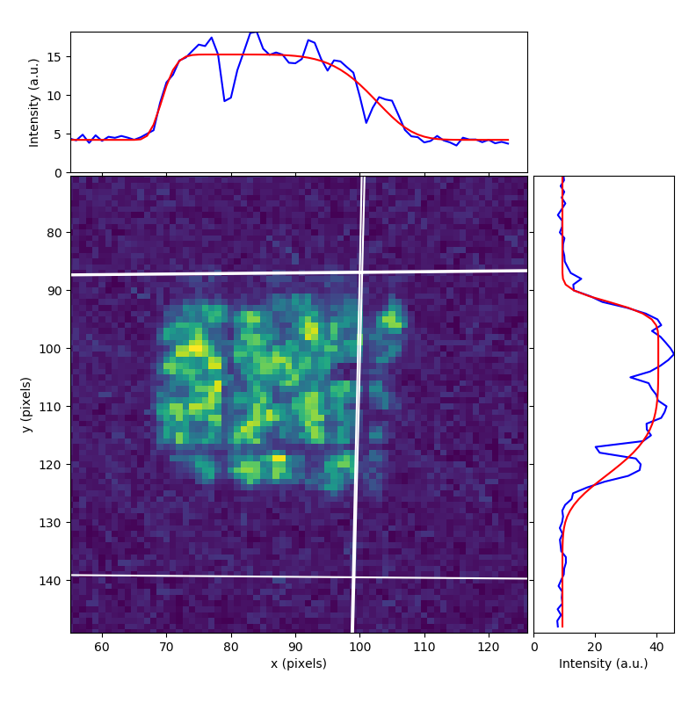
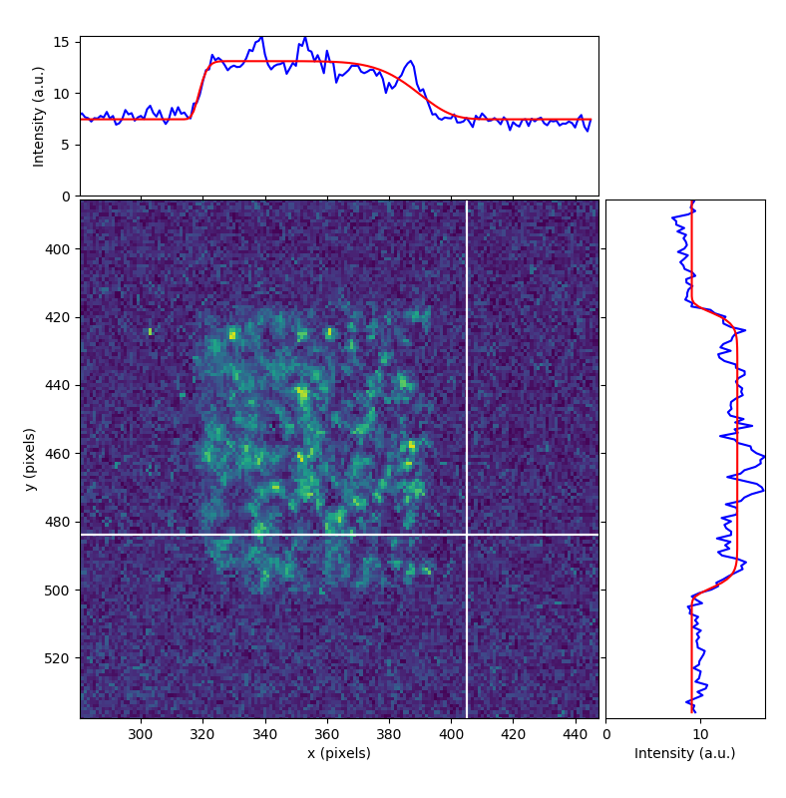
ESR-HTA Beamline Operation
BEAM TIME RETREAT 2024
BEAM TME RETREAT 2023
Beam setup very challenging because experiment requires extremely parallel beam.
Beam has been set up centrally through last 2 quadrupole doublets and not touched anymore (except steering in the spectrometer).
Beam shape cut with slits and measured on 4 different screens:
Estimate of divergence: x’ = (0.033 +/- 0.019) mrad, y’ = -(0.0069 +/- 0.0094) mrad → Fulfills experiment’s requirements (x’, y’ < 0.1 mrad)
More precise divergence values expected from experiment analysis.

Slide 5
Issues during Beamtime 2024
BEAM TIME RETREAT 2024
BEAM TME RETREAT 2023
Failure of fuses of GTS1MU1 power converter, not enough spares were available. → Spares have been ordered, more will be ordered soon. → Spare situation is a general issue at GSI and should be improved.
TE stripper foil (copper) broke during last week of operation. → Possible reason: Too high intensity? → Need to be exchanged in a complicated intervention during shutdown (→ separate slide). → Additional work load during an already very dense shutdown.
HTA was served with fast extracted U beam instead of slow extracted beam during last week of operation (due to electro-static septum non-availability) and screens were used. → This operation mode is not foreseen because it can cause severe damage to BI equipment! → Not clear if equipment has been damaged. Can be checked only with beam. → This operation mode should not be used without consultation of BEA team, so that special precautions can be taken. → Protection, which relies on people remembering things, is insufficient. → Machine protection system is needed to avoid such issues.

Slide 6
Issues during Beamtime 2024
BEAM TIME RETREAT 2024
BEAM TME RETREAT 2023
High radiation level in HHT cave during isotope production at TE stripper, which inhibited access to HHT cave → Was this operation mode foreseen during construction of the facility? → Beamtime schedule should take into account this effect. → Limited addition shielding might be an option (to be checked), but access to HEST equipment and escape routes must be guarantied. → Aim should NOT be to transform TE Stripper to another FRS.
Similar problems in cave C during normal beam setup. → Problem not understood.

Slide 7
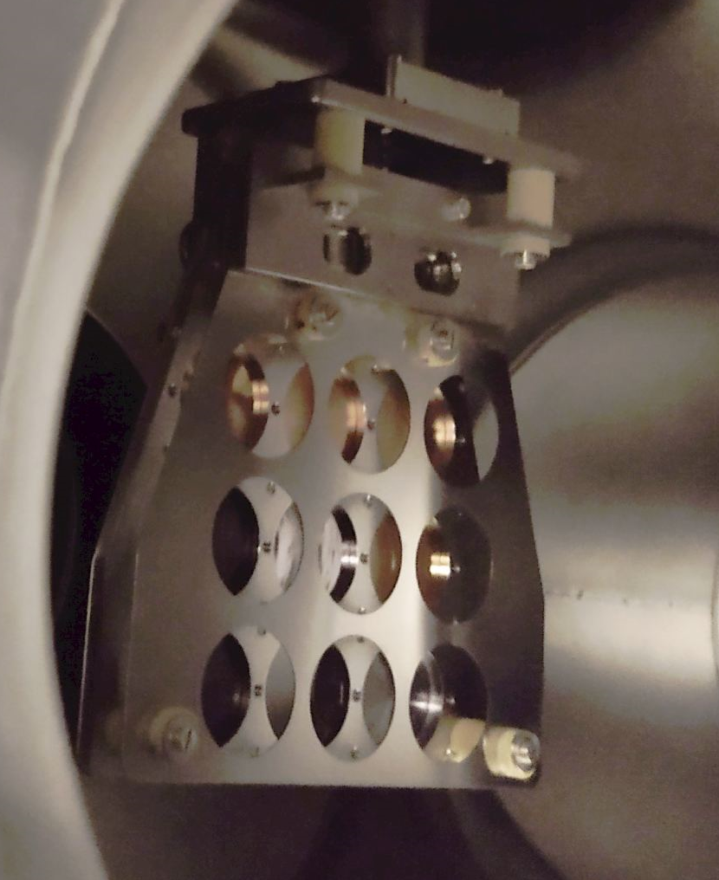
TE Stripper Target Exchange
BEAM TIME RETREAT 2024
BEAM TME RETREAT 2023
Target is required for ESR operation. → No alternative to target exchange.
Risk to damage to the equipment due to its age. → Spare bellows and ceramic isolators have been ordered.
Knowledge of changing the targets has been lost. → Technical drawings have been found. → The whole shutdown is in front of us.
We are in better situation than during last shutdown. Risk is better under control but still not negligible.
Intensity limits have to be defined to avoid equipment damage in the future.
Target holder

Slide 8
Outlook
BEAM TIME RETREAT 2024
BEAM TME RETREAT 2023
Upcoming HADES pion run. → High current tests have been carried out during engineering run, but pion production has not been verified.
Regular cycling of magnets before beam setup.
Regular usage of sequencer.

Slide 9
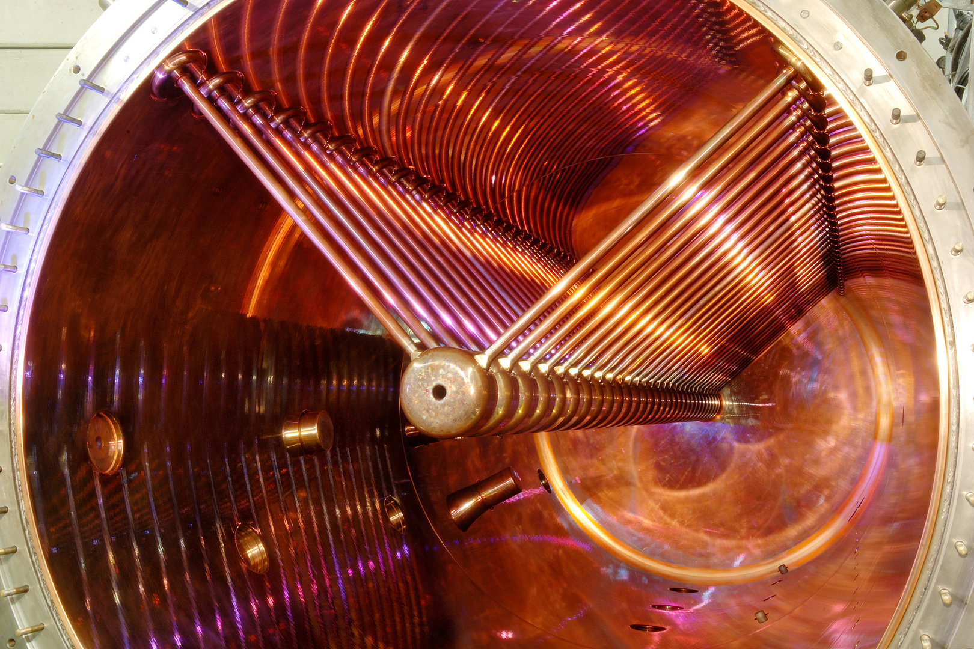
Many thanks to
HEST team, HKR crew,
BEA, EPS, VAC, NCM, ACO, FAIR-DV teams,
SIS, ESR and CRYRING teams,
experiments teams,
… and many others
Thank you for your attention!

