Slide 1
HITRAP
Lessons from the beam time 2024 and outlook to 2025
Zoran Andelkovic
GSI / Accelerator Operations / Decelerator

Slide 2
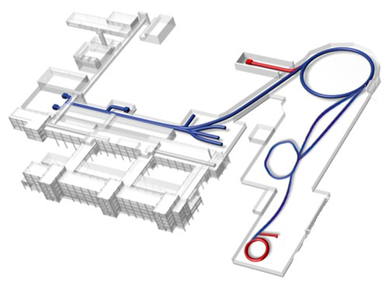
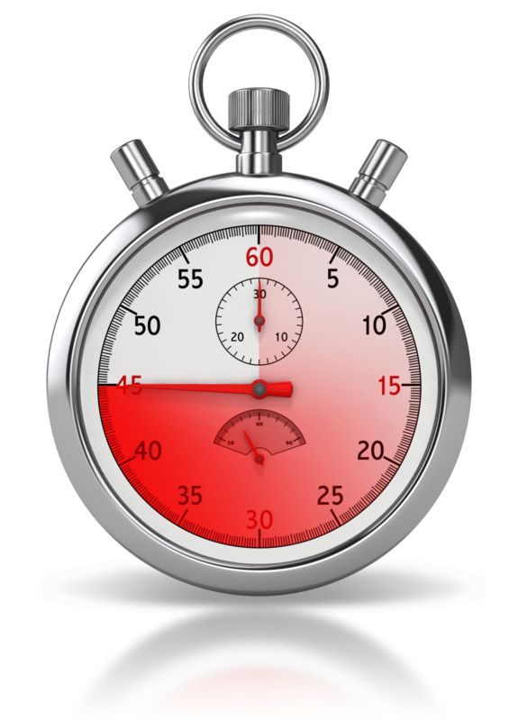
HITRAP facility overview
in units of beamtime:
  beam transport to the trap
  trap operation test run E057
  extraction and mass separation
  E057 with U⁹¹⁺
  …
Goal 10⁵ slow HCI → trap
transport & deceleration
energy separation
trapping, cooling, extraction
Reached so far
✔
2024
✔
✔
2025
?
4.03 MeV/u
4.03 + 0.495 MeV/u
4.03 + 0.495 + 0.006 MeV/u
BB
IH Structure
BB
RF Quadrupole
Trap
Magnet +
0.1 mm
Slit
Detector
Magnet +
0.1 mm
Slit
Detector
Detector
Rep. Rate
45-60 sec.

Slide 3
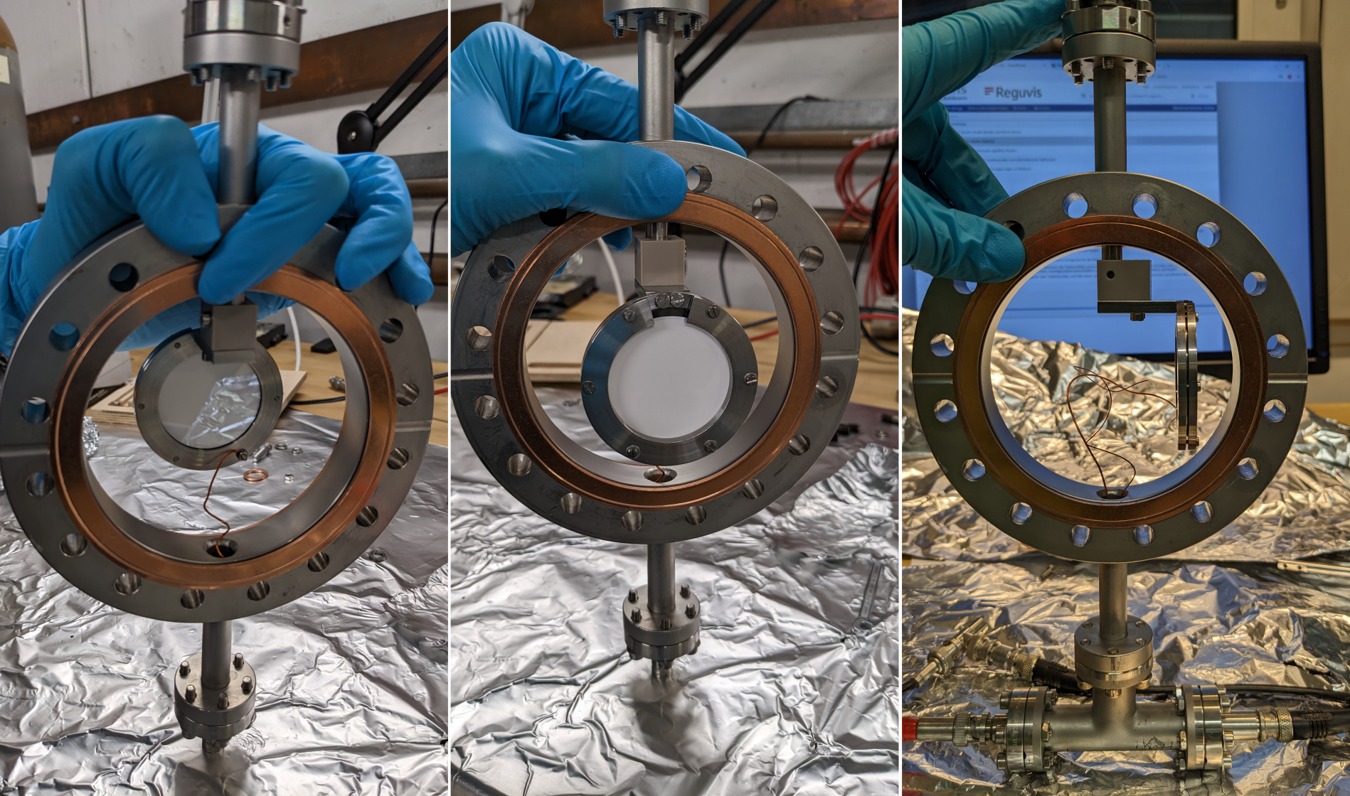
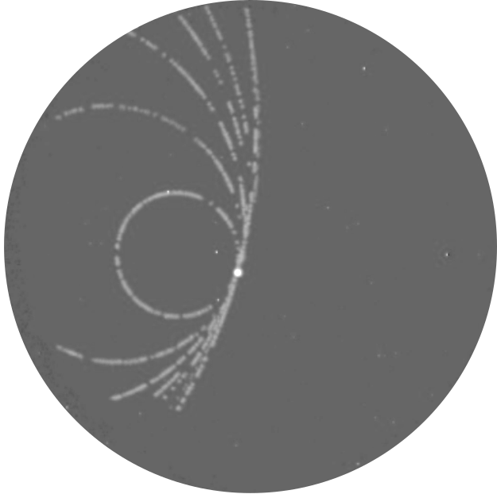
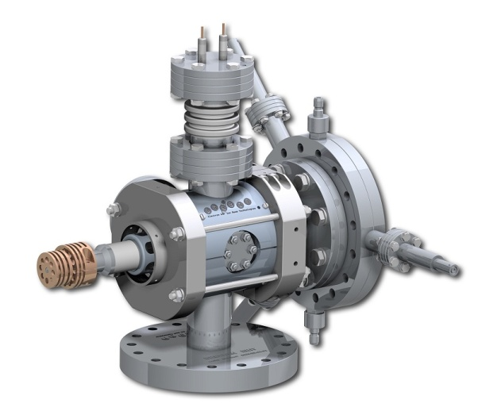
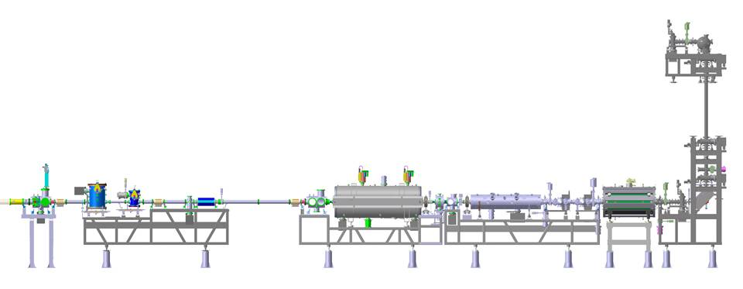
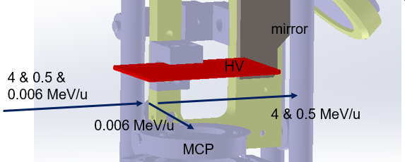
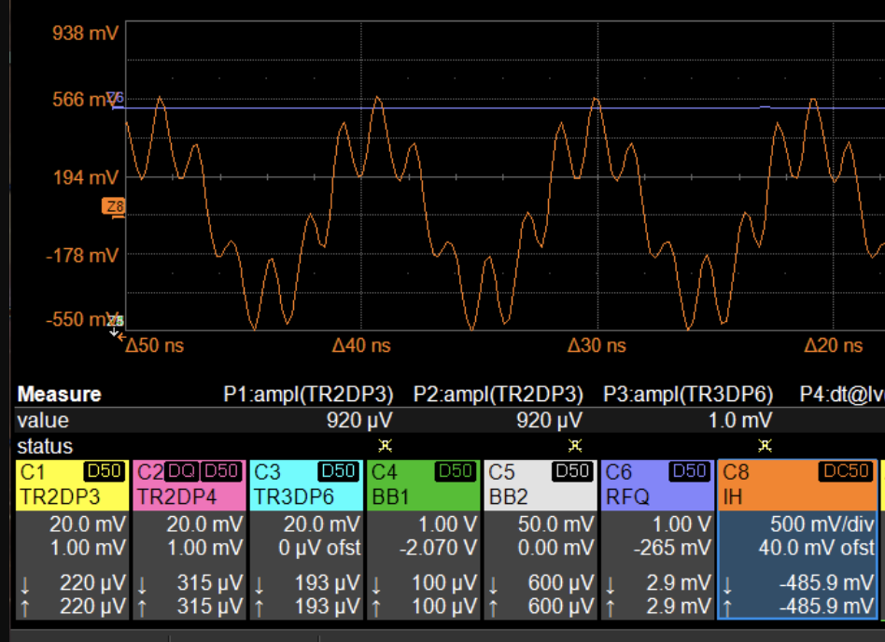
Shutdown work 2023-24
Preparation for beam time ‘24
detector development
e-cooling development
CS expansion to GTR5
stabilization IH amplitude
EBIT
+ GTR7
✔
✔
42mm
✔
GTR1-4
GTR5
GTR6

Slide 4
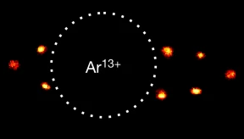
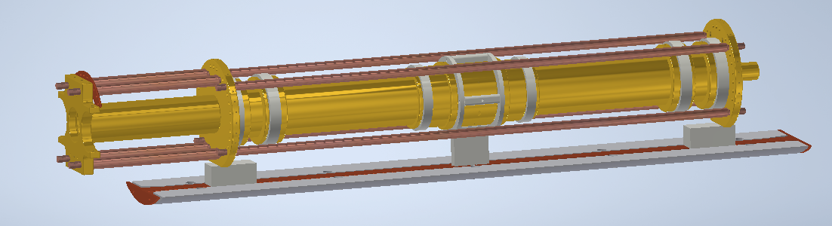
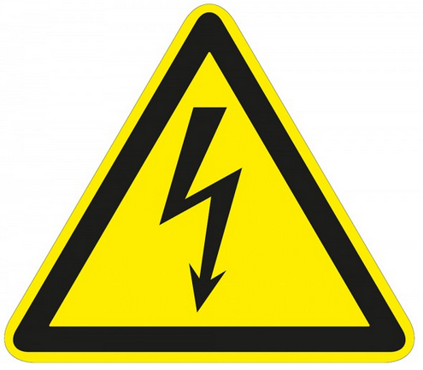
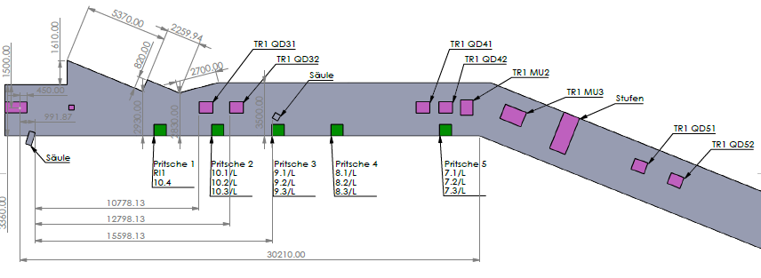


Electron cooling development & Experiments
» like e⁻ cooling in a storage ring at extremely low-E
» an experiment with constant research demand
(now with a generation change of PhD students, TU-DA)
» major progress, first worldwide:
ions electrons cooling online operation
New HYIG with P. Micke @ HITRAP
talk by T. Stöhlker on Thursday
laser lab construction between beam times
preparation for ion delivery from the trap
40 cm
20 kV
6 T
HCI
4 K
e⁻
e⁻
NE14 (ex-reinjection)
new passage through shielding
two new walls
✔
✔
✔

Slide 5
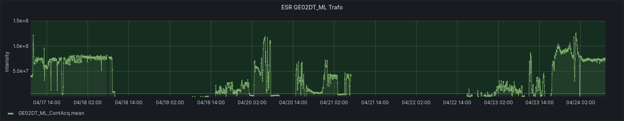
Beamtime overview 2024
16.02 | 17.02 | 18.02 | 19.02 | 20.02 | 21.02 | 22.02 | 23.02 | 23.02 | 24.02 | 25.02 | 26.02 | 27.02
12-C 6+ ( m/q = 2.0 ) |  |  |  |  |  |  | 18-O 8+ ( m/q = 2.25 )
Beam setup (UNILAC + SIS + ESR) |  |  |  |  |  |  | Setup
A total of ca. 4 days with a stable beam
A total of ca. 6 days with a stable beam
15.04 | 16.04 | 17.04 | 18.04 | 19.04 | 20.04 | 21.04 | 22.04 | 23.04 | 24.04 | 25.04 | 26.04 | 27.04 | 28.04
36-Ar 18+ ( m/q = 2.0 )
Setup |  |  | parallel oper. Er |  | unstable |  | setup for parallel oper.
up to 2022: 16 tests (3-7 days, 45 sec / shot)
= ca. 1 (one) hour of operation @ 50 Hz
some problems due to setup & parallel operation
shift to ³⁶Ar helped a lot
overall quote OK
3 on-line tests since recommissioning
…
2022
2023
2024
2025

Slide 6
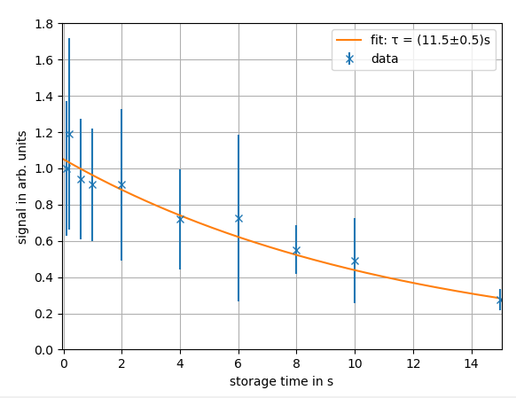
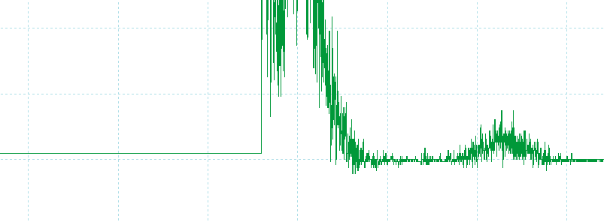
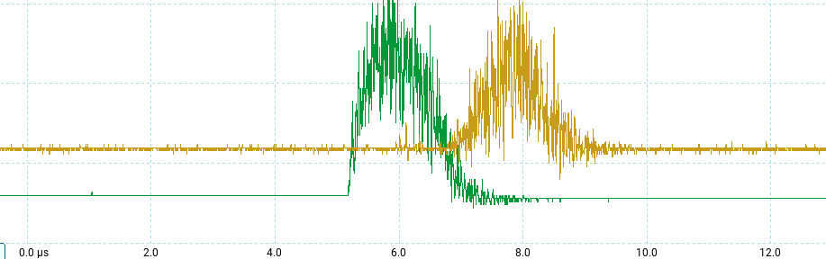
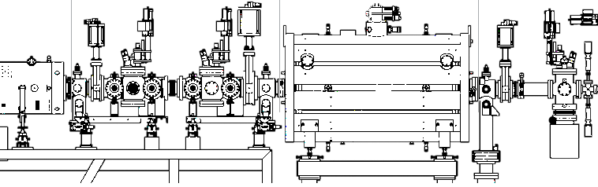




Excellent results 2024
slow ions behind the trap
10⁵ ions ³⁶Ar¹⁸⁺
stopped, stored & extracted
a mix of fast components
6 - 0.5 MeV/u
$$Δt ≈2.73μs$$
$$E≈6.3\frac{keV}{u}$$
slow ions in front of the trap
SUCCESS!
worldwide first time HCI were stopped after production, estimate 10⁴-10⁵ particles
RFQ + beam transport ion trap / B = 6 T

Slide 7
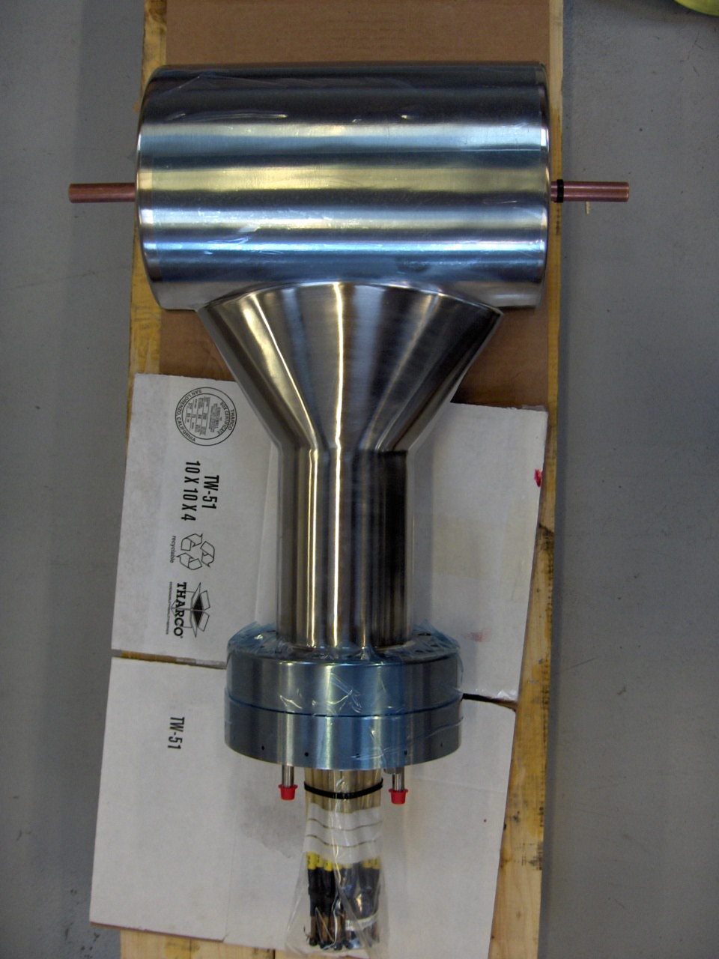
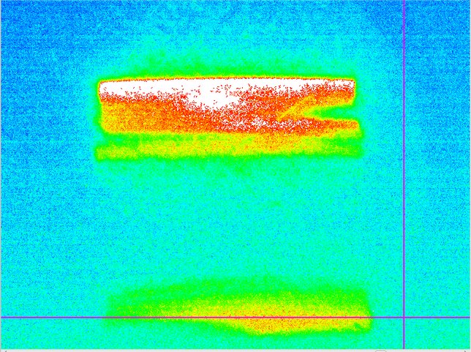
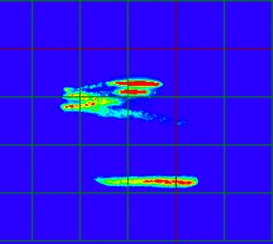
Observed problems
²³⁸U
1
2
¹⁸O
GTR3QT3 (internal IH triplet & steerer)
Feb. 2024
¹⁸O⁸⁺ 7.1 V
(m/q = 2.25)
³⁶Ar
Mar. 2010
⁸⁶Kr³³⁺; 7.85 V
(m/q = 2.61 = ²³⁸U⁹¹⁺)
last shift ca. 200 liters/day
leak from the steerer subunit
intensity loss ca. 85% if switched off

Slide 8
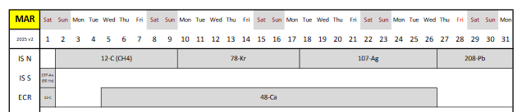
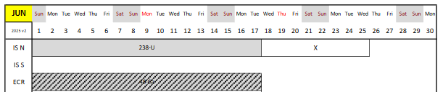

Consequences for the experiments
Achieved in this beam time:
beam transported to the trap
  Prerequisite for E057
ions stored in the trap
  Prerequisite for e⁻ cooling
ions decelerated in the trap
  new HYIG & ERC Advanced Grant
Open issues:
expansion of the control system
  includes mostly FESA + independent operation
reestablish IH Amplitude 8 V
  several action items in the Shutdown Plan 2024
  invest in Solid State amplifiers (ca. 750 k€, 2 years)
  restriction to m/q < 2.20
water leak TR3KX4 (IH triplet & steerer)
  new unit (1 year & ca. 150k€) + mounting time
  temporarily decommission (ca. 85% intensity loss)
setup time and repetition rate
  several beam times per year are essential
  revisit the idea of a local source of 4 MeV/u
with the right conditions, some beams possible in 2025
⁷⁸Kr
(m/q = 2.16)
2025
²³⁸U
(m/q = 2.61)

Slide 9
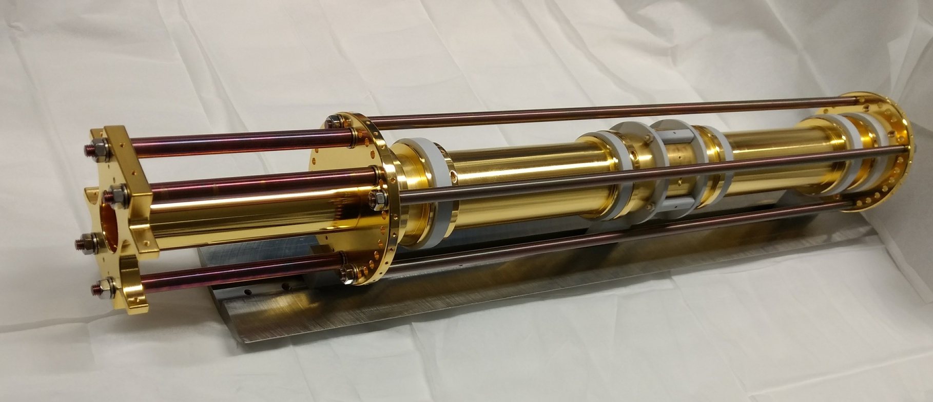
Thank you for listening!
Also thanks to the DEC team and collaborators:
S. Fedotova, W. Geithner, F. Herfurth, J. Ködel, N. Kotovskiy, I. Kraus, K. Mohr, D. Neidherr, D. Racano, S. Rausch, N. Stallkamp, S. Trotsenko, G. Vorobyev, W. Nörtershäuser, D. Zisis

Slide 10
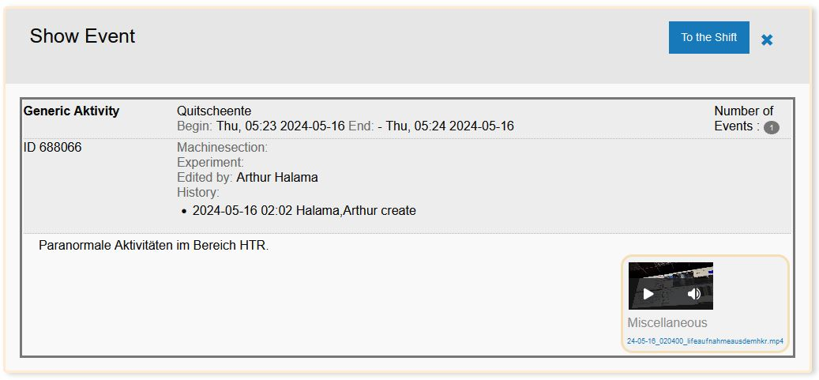
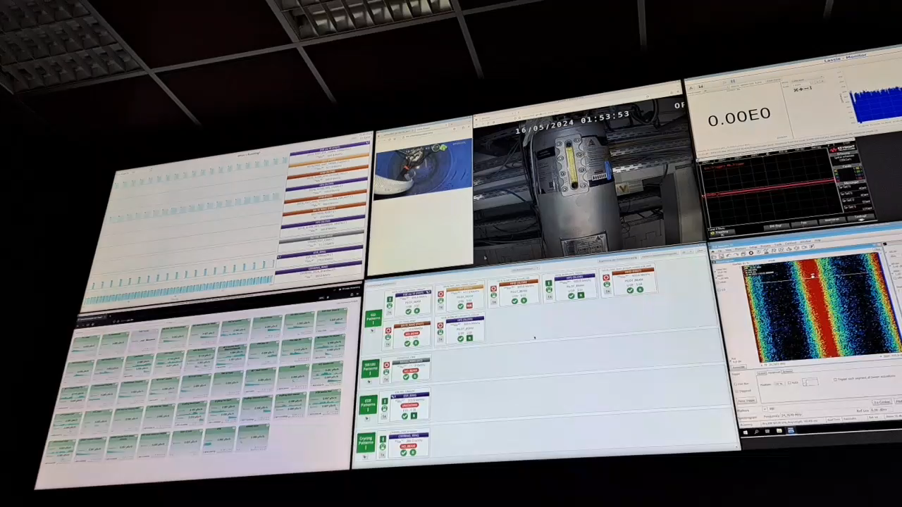
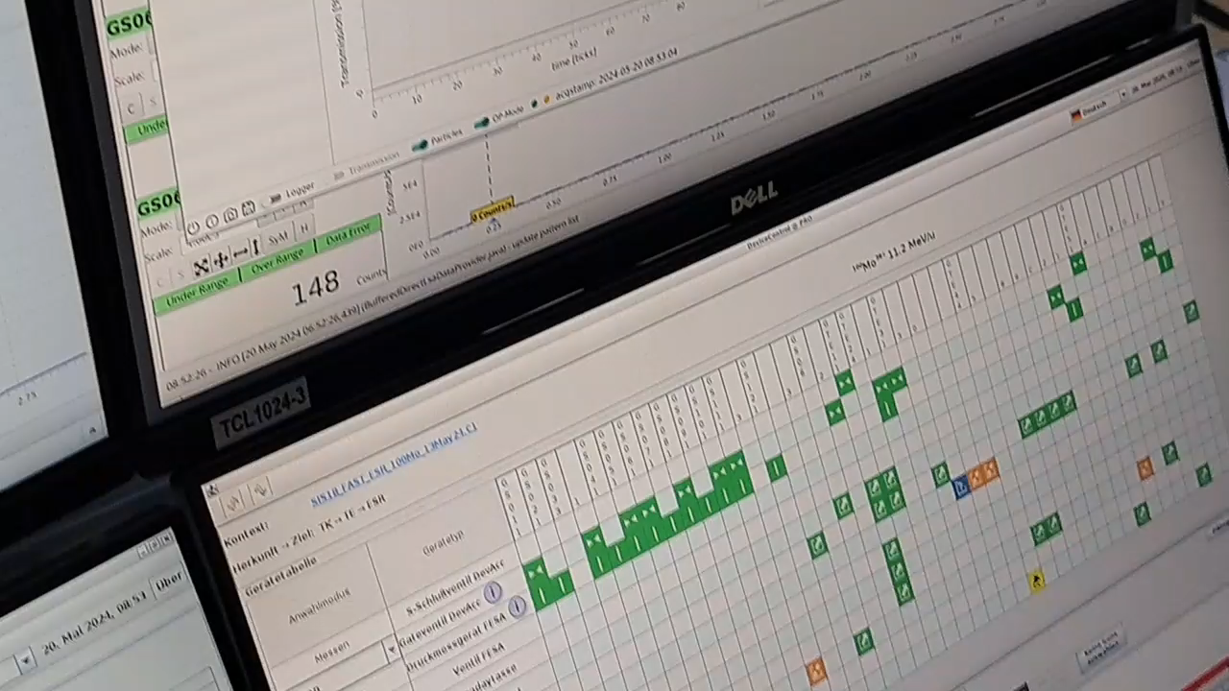
End of beam time fun
so despite all the stress…
… always look at the bright side of life

Slide 11
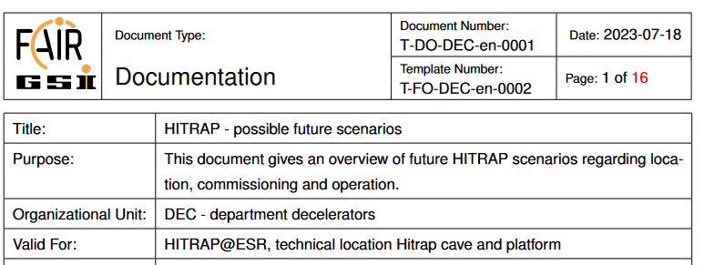
Perspectives
Engineering run 2023
  expand FAIR CS to GTR5
  reach RF amplitudes > 7V
shutdown work 2024
PhD students on cooling trap
further beamtime depends on the schedule and ESR availability
alternative scenarios investigated
  a study report available
a no-fail plan / units of beamtime:
  transport through GTR5
  online cooling; test run E134 with Ar¹⁸⁺
  extraction and mass separation
  E134 with U⁹¹⁺
  multiplexed operation
  single ions for HYIG (optical clocks)
  transport to the 2nd floor
  E130 with Bi⁸²⁺
  …
2024
2025
7, 8
current status: ca. 10⁶ ions @ 6 keV/u
1, 4
2, 5
3, 6

Slide 12
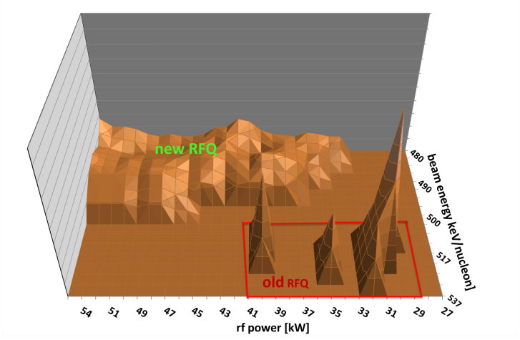

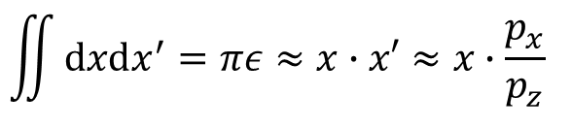
Commissioning experience
Why is a linear decelerator NOT simply a reversed accelerator?
the emittance grows
narrow acceptance
fast beams stay in
low repetition rate
0.5 T perm. Magnet
One-shot energy analyzer
MCP
0.1 mm slit
reconstruction
(2013-14)
Beam
Mirror & CCD
$$\iint{dxdx^{′}=πε≈x∙x′≈x∙\frac{p_{x}}{p_{z}} }$$
if everything OK:
» ca. 5 days for beam setup
» ca. 5 days for experiment
=> minimum two online beams per year for progress
16 On-Line Tests (3-7 days, 45 sec / shot)
= 1 (one) hour of operation @ 50 Hz
45 sec delivery rate:
set one dipole = 20 min
set two dipoles = 20*20 min = 6h
360° RFQ rough scan = 3h
360° RFQ full scan = one shift
2007
…
2014
…
2022

Slide 13
Ion | A/q | IH power / kW | IH Tank / V (extrap.) | RFQ power / kW | RFQ Tank / V (extrap.)
¹⁴N⁷⁺ | 2.00 | 100 | 6.10 | 78 | 6.2
⁵⁸Ni²⁸⁺ | 2.07 | 110 | 6.25 | 96 | 6.7
¹⁸O⁸⁺ | 2.25 | 130 | 6.85 | 105 | (7.0)
⁴⁰Ar¹⁸⁺ | 2.22 | 125 | (6.77) | 100 | (6.9)
²³⁸U⁹¹⁺ | 2.61 | 175 | (7.95) | 150 | (8.1)
⁸⁶Kr³³⁺ | 2.61 | 160 | 7.85 | 150 | (8.1)
abgebremste Ionen gemessen
(extrapolierte Amplitude)

Slide 14
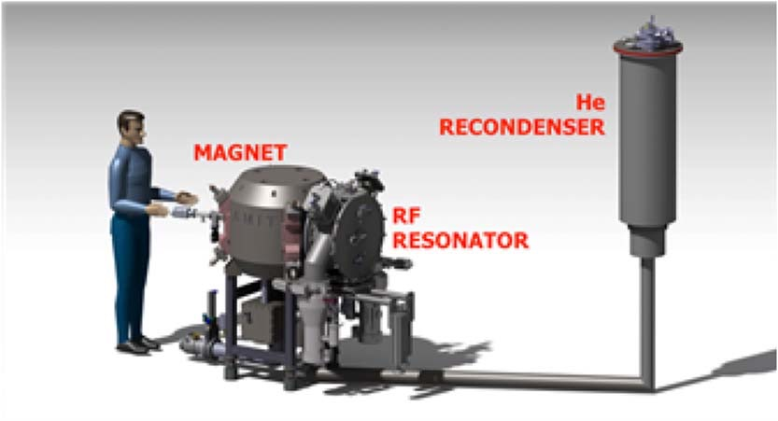
Commissioning alternative I (reduced scope)
1) Can we have “offline” D+ @ 4 MeV/u?
rapid commissioning without GSI beamtime
added bonus: available for other purposes, e.g. machine studies at ESR or HEST
… but cyclotrons or IH setups are costly and have no direct scientific benefit for GSI
EBIT or S-EBIT
Experiments
http://cyclomed.tech
2) Can we reduce the scope of HITRAP?
HITRAP decelerates to 6 keV/u without cooling
EBIT and S-EBIT deliver HCI offline
still needs commissioning
10⁶ cooled U⁹²⁺ not possible, but…
… low intensity experiments possible
… HCI cooling for full scope can still be developed
Development of a superconducting magnet for a compact Cyclotron for radioisotope production.
Luis García-Tabarés, Pablo Abramian, Jesús Calero, José L. Gutiérrez…

