Slide 1
SIS18 – Lessons from beam time 24 and outlook to 25
Jens Stadlmann 7th Beam Time Retreat 11.7.2024

Slide 2
Beam Time 24 general remarks
Overall very successful beam time at SIS18
Highlight talks:
Booster mode improvements (D. Ondreka)
Spill feedback and microspill optimisation, SOS system (P. Niedermeyer R. Singh)
Spill optimization by RF cavity (K. Groß)
Dual beams (R. Hollinger)
Highest Uranium 73+ intensities (W. Barth) (also due to dedicated Uranium setup without different ion in the UNILAC)
Planned Setup times were a big help
I will complain about a few things, but overall the performance was good

Slide 3
Problems with parallel operation
Several times during the beam time we had issues with parallel operation. Caused
by experiments using different ion species behind the SIS or
by experiments using very different energies with the same ion species
The first case will stay a complicated mode of operation. The main problem being the necessity of switching the transfer channel to different rigidities between pulses. Methods to overcome are the “Kainberger Method” and starting the re-tuning at the TK NOT at the SIS if this problem occurs.
The second case is easier to migrate with the “Schornstein” operation. I several cases those “Schonsteine” were not set properly. Maybe we need a nrw software to assist with that at least to monitor if all settings are OK.
Overall setups of parallel operation need strong, HKR-present, coordination.

Slide 4
GOOD: Dedicated setup times
Overall I had the impression the newly introduced dedicated setup times helped a lot to improve the quality of the machine settings
From my point of view it helps a lot to name the contexts in an useful way not just default names.
Setup and “Nachoptimieren” towards the beam dump is very helpful (but was not always done)

Slide 5
Setup problems and unnecessary down time
A few times establish settings had to be redone because machine requirements of the user were not considered during the initial setup.
One example being was the (repeated) setup of a machines with slow ramps despite the experiments were aiming for highest average rates.
The communication by “Mittagssitzung” and “Nachrichten aus der Mittagssitzung” seems not to work anymore. If we want to setup several experiments for days and weeks in advance the requirements (and maybe names of the contexts) have to be accessible at a central “black board” (not the white board in HKR) for all stakeholders.
We (again) had down times due to ferrite RF cavity failures despite the MA ones were ready to operate. Issue was highlighted countless times at different places for years now but still….

Slide 6
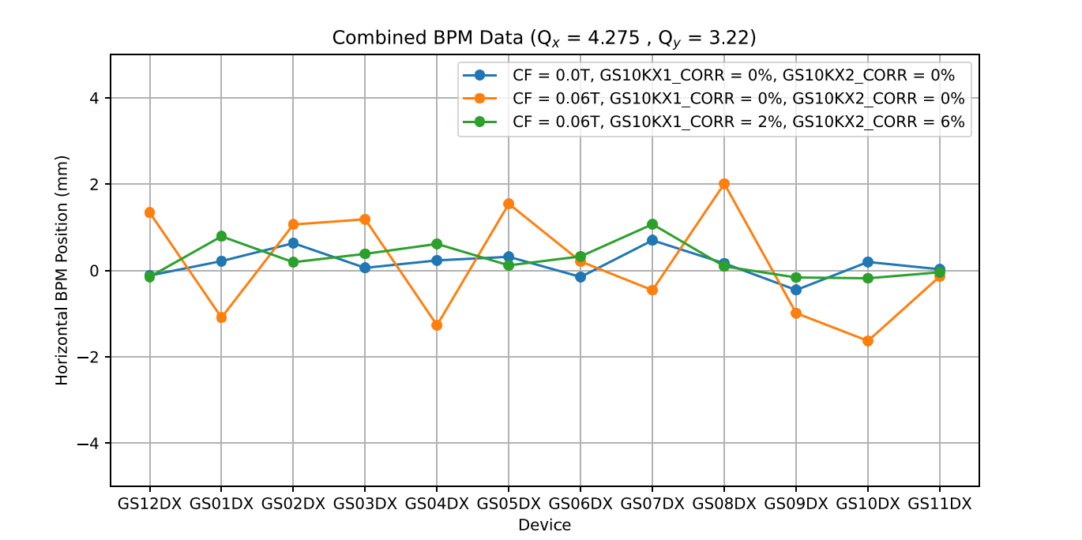
Highlight: Faster setup times and quality of cooled machines
The existing model for the errors introduced by the fields of the electron cooler and their compensation could be significantly improved.
Previously a the setup of a cooled machine, required a complete separate setup of the UNILAC-SIS18 injection.
Due to the improvement the setup times and setup quality were both improved.
SIS18 orbit distortion:
no cooler / cooler old / cooler new
(Y. el-Hayek)

Slide 7
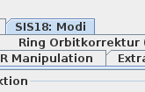
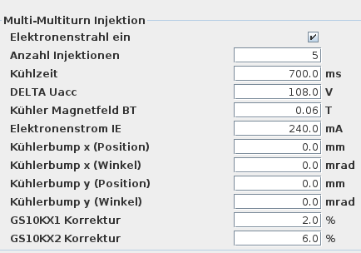
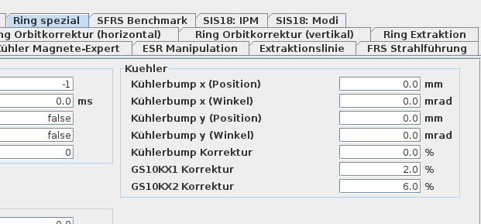
BUT -> those settings were sometimes forgotten in this year’s run. Problem already solved
Lesson learned: Control software was modified already during the beam time 24. Parameters went to “front page”

Slide 8
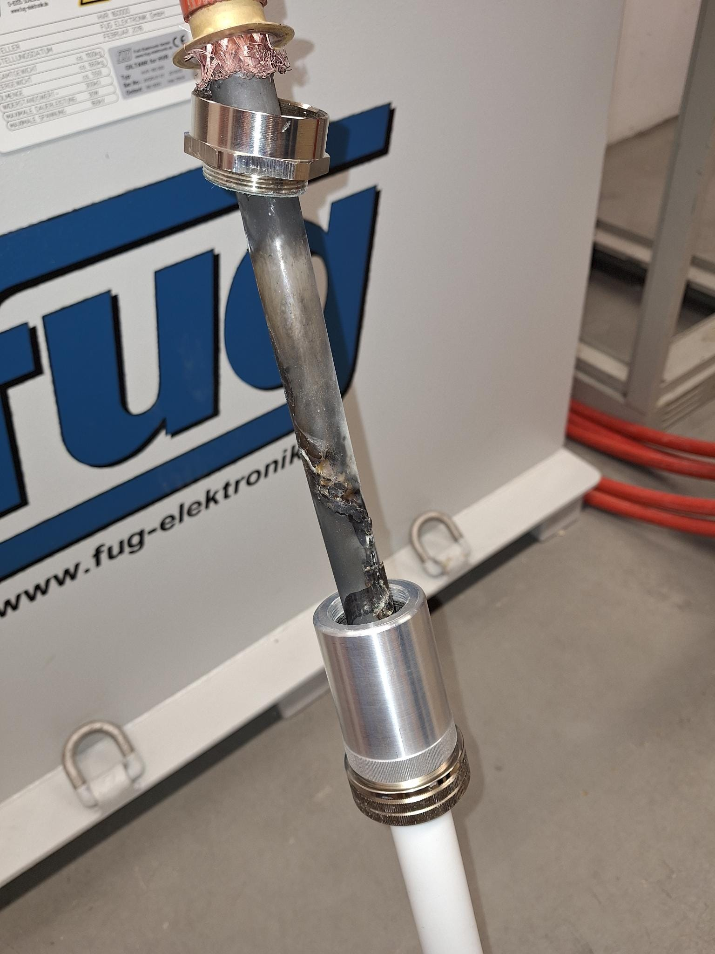
Urgent (Prio 0) needs I: output value monitoring
We need automatic(!) monitoring of device’s output values and alarm generation if those values run out of acceptance corridors.
Our present system allows situations (especially old world, device assess but in general too) where devices are not working at all or with very odd output values without any alarm from the control system.
Most prominent in 24 was the E-Septum But correction magnets, bumpers, all..

Slide 9
Urgent (Prio 0) needs II: trim time improvement
An energy test trim in this beam time was 54,758s:
45,906s Database access
8,852s calculation and data supply to devices
To effectively tune the machine all trims must be < 5s, ideally 1s. Especially if we want to use automatic or AI driven setup routines.
50 s wasted time per trim cost between 250 to 500€. With an estimate of 100 trims per shift and 3 shifts per day during one setup day it sums up to 75000 to 150000 Euro of wasted taxpayers money. That is a serious loss of beamtime The value is millions per year!
Please solve that ! Priority 0!

Slide 10
Conclusion and outlook to 25
Many major improvements were made and led to highlight talks yesterday.
The dedicated setup times help. We can improve with some organisational and software help.
We need automated output value monitoring and faster trim times
The new, still experimental, goodies will be requested in the future. How far can we get with implementation till 25?

