Slide 1
ESR
Lessons from the beam time 2024 and outlook to 2025
Bernd Lorentz
for the ESR operating team
GSI/FAIR Accelerator Beam Time Retreat July 11th and 12th, 2024

Slide 2
Shutdown work Juli 2022 to February 2024
Repair of electron cooler drift tube
Repair of kicker electrodes of stochastic cooling in ESR quadrupole
Replacement of defective pole face winding in one of the ESR dipoles
Repair of ionization profile monitor
Modernization of vaccum system, exchange of (35 year old) ion getter pumps in the arcs, exchange of 2 sector valves.

Slide 3
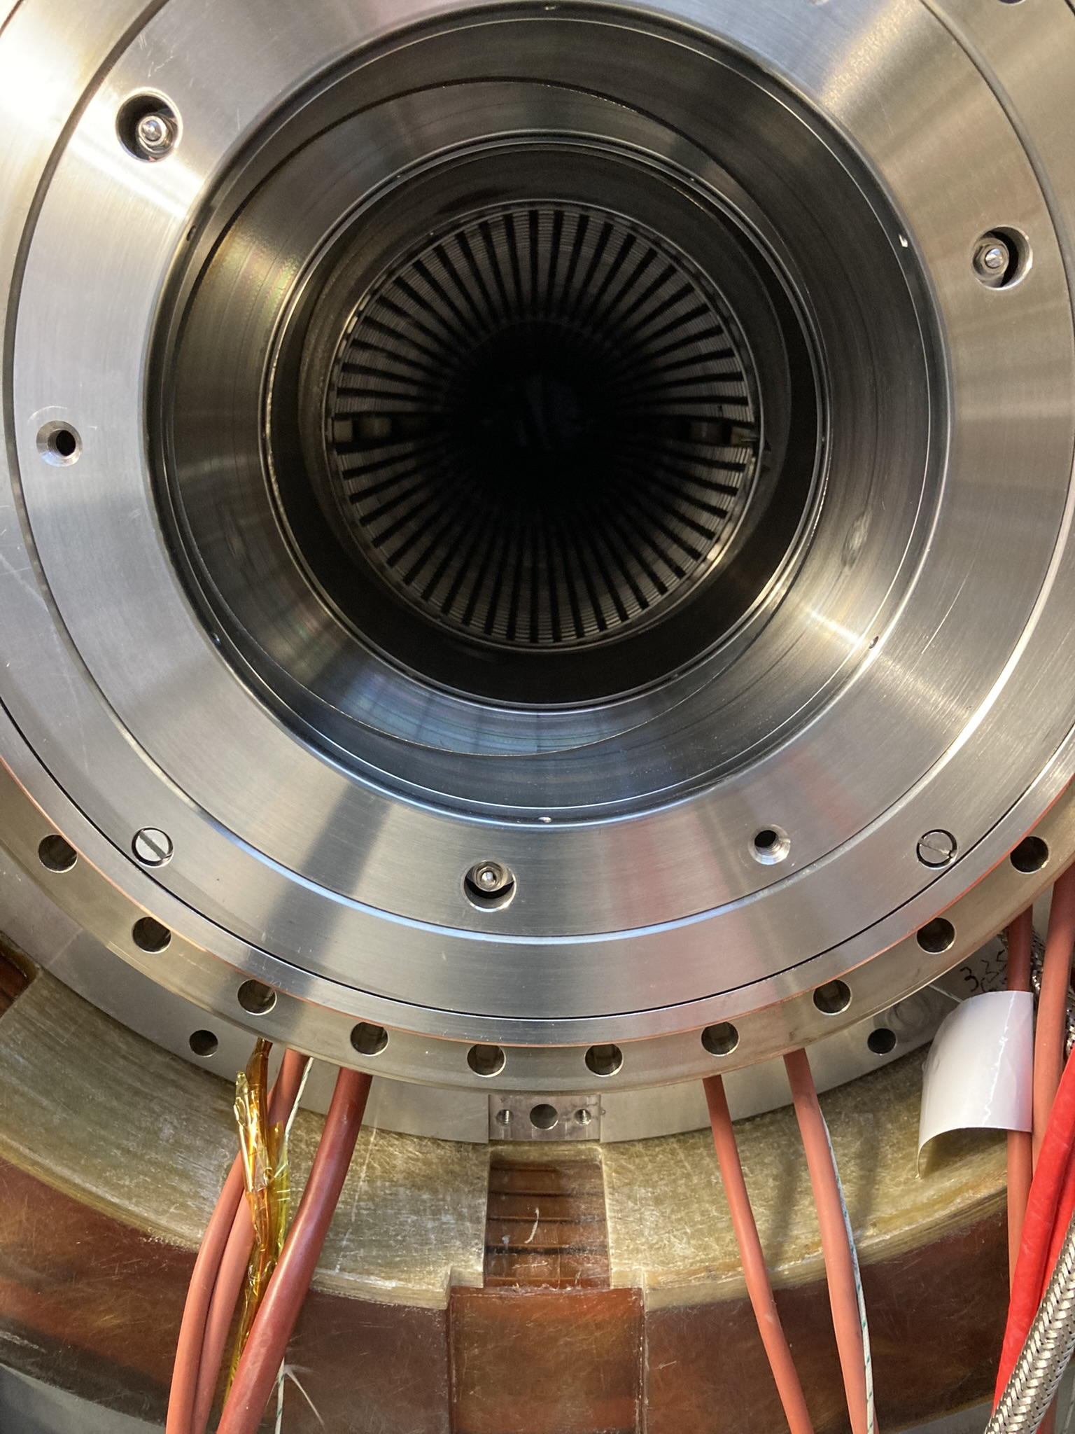
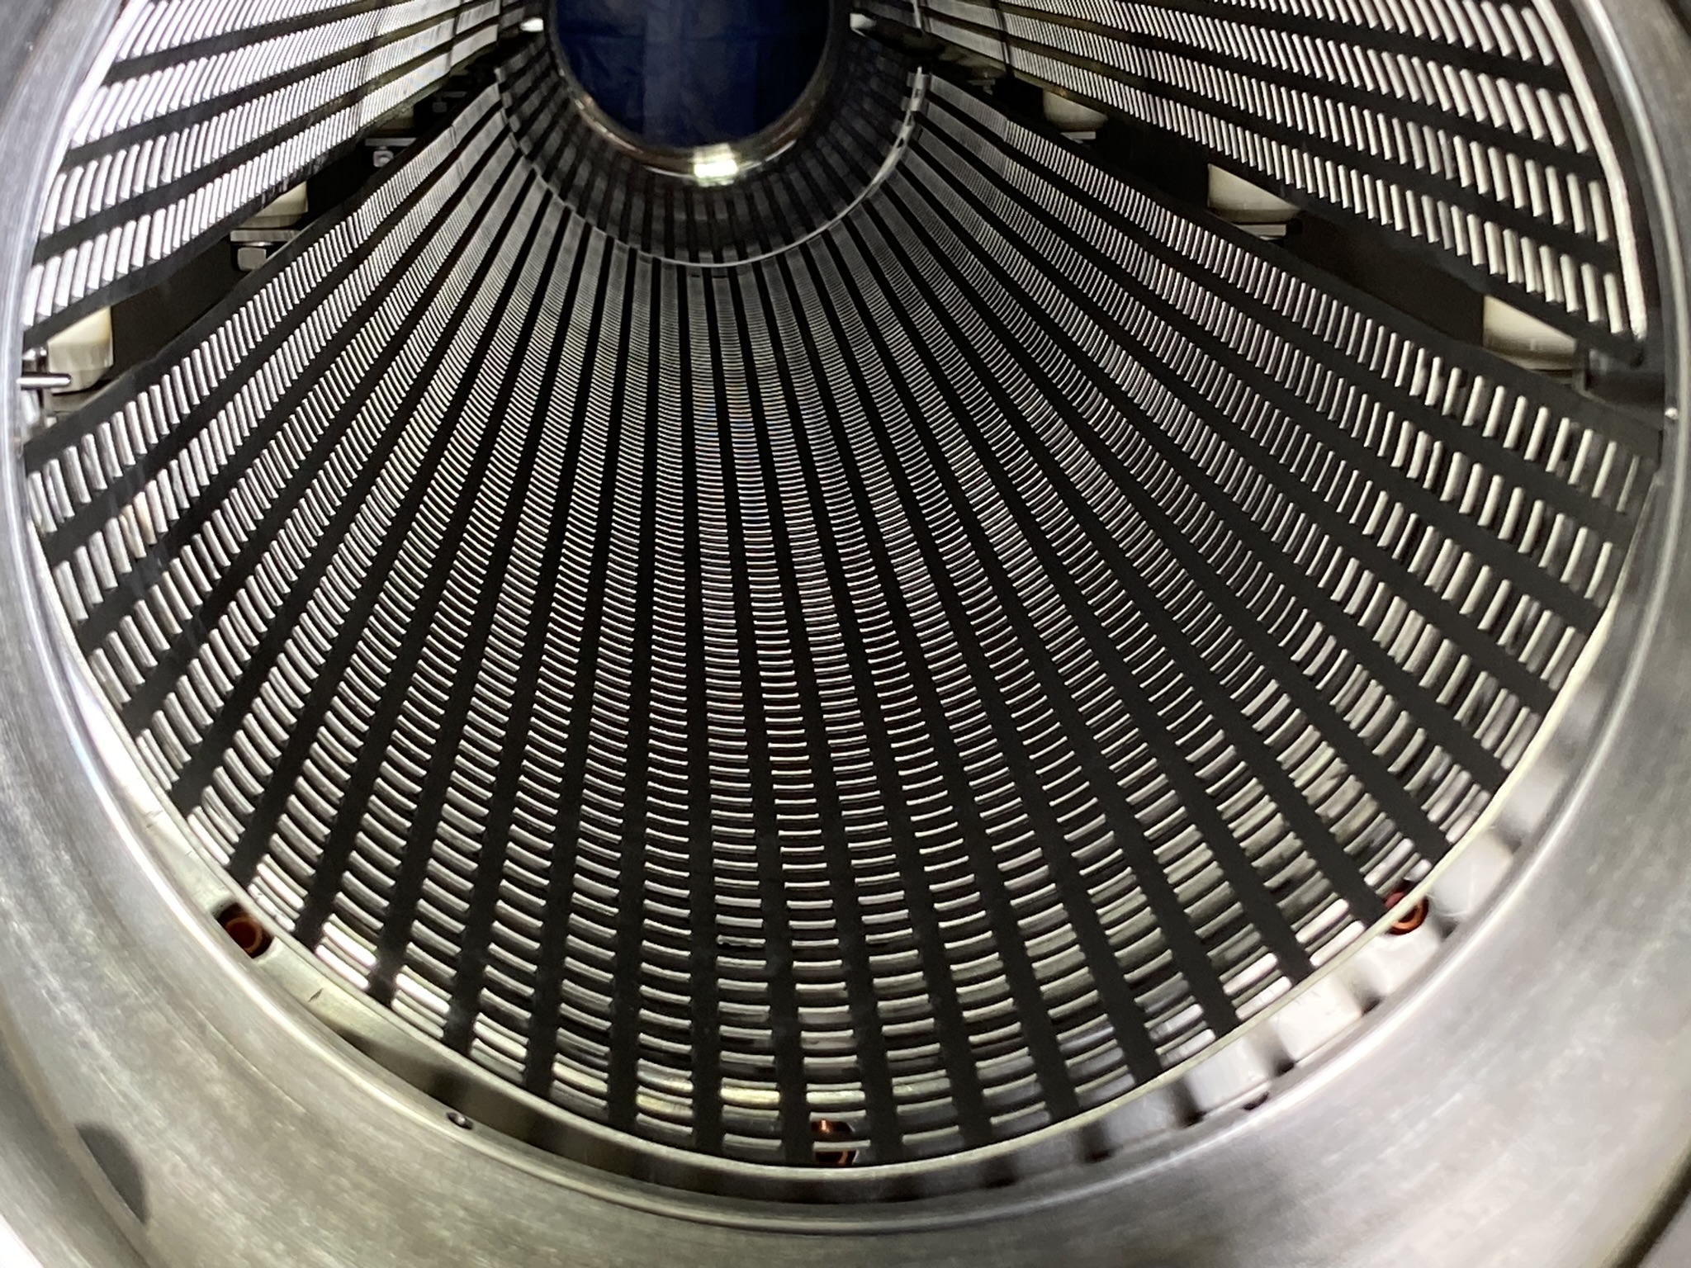
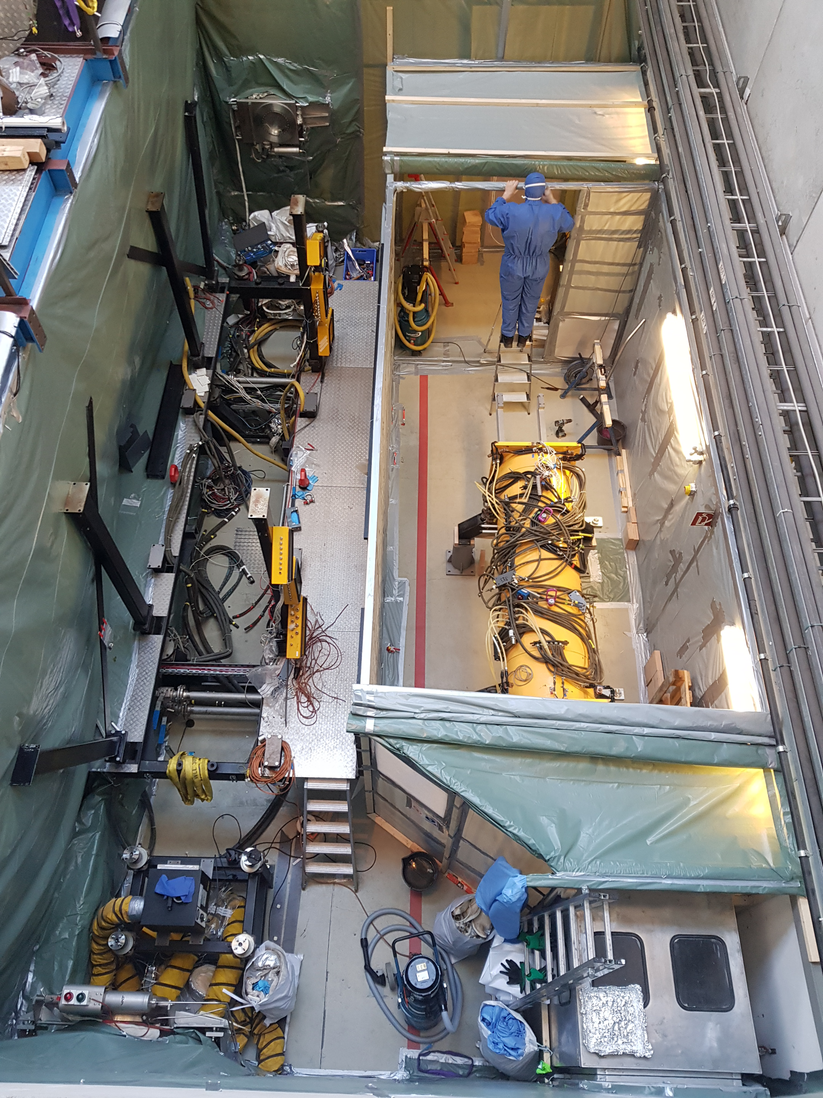
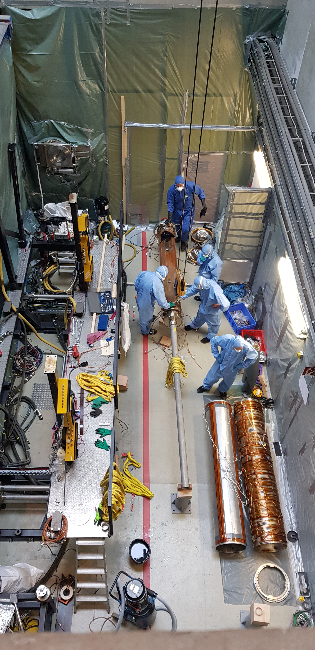
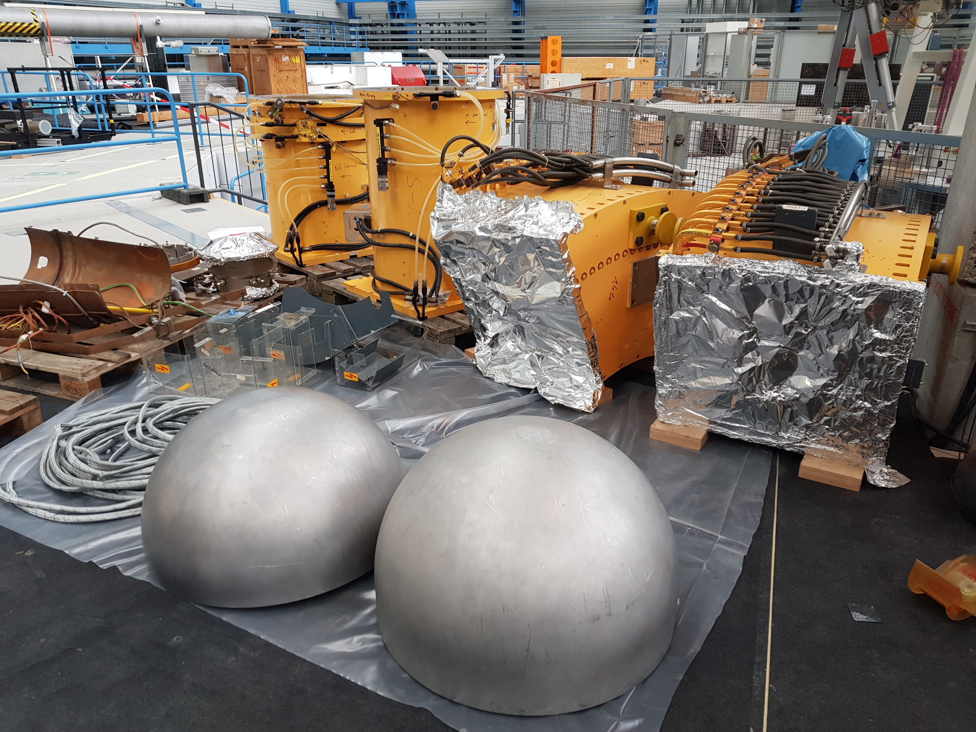
Shutdown work Juli 2022 to February 2024
repair of electron cooler drift tube in the cooling solenoid

Slide 4
Recomissioning without any problems
02/07/2024 all shutdown work finished
electron cooler
  02/09/24 electron cooler HV comissioned and system fully operational
  02/14/24 comissioning with beam
  02/21/24 beam delivered to HITRAP (electron cooled, decelarated, extracted)
stochastic cooling
  end of february 24: recomissioning, all electrodes operational
  June 24: successfull stacking with stochastic cooling
pole face winding operational
ionization profile monitor working
best vacuum conditions for the last 10 years
despite many complications and necessary adjustments in the shutdown schedule:
ALL SHUTDOWN WORK FINISHED IN TIME FOR COMISSIONING WITH BEAM!!
recomissioning without problems, thanks to all involved colleagues

Slide 5
improved vacuum => beam lifetime
deceleration of Ar¹⁸⁺
from 45 to 2.5 MeV/u 05/24
p ≈ 4 × 10⁻¹¹ mbar
Xe⁵⁴⁺
(2014)
(2024)
Ar¹⁸⁺
p ≈ 1 × 10⁻¹⁰ mbar
Be-like ion beam:
03/21 ²⁰⁷Pb⁷⁸⁺ 11 MeV/u : τ ∼16 s <=> 03/24 ¹⁹⁷Au⁷⁵⁺ 12 MeV/u : τ ∼100 s
Ni²⁸⁺
Au⁷⁸⁺

Slide 6
ESR operation in 2024
Chronological:
19.-22.02.: ¹²C⁶⁺ HITRAP (H000), about 1 day setup ESR (decel. and extraction)
23.-29.02.: ¹⁸O⁸⁺ HITRAP (H000), change by scaling without problem
29.02.-07.03.: machine time (recomissioning sto. cooling system) and setup ¹⁹⁷Au⁷⁵⁺
08.-22.03.: ¹⁹⁷Au⁷⁵⁺ CryRing (C025/MAT)
15.-28.04.: ³⁶Ar¹⁸⁺ HITRAP (H000), about 1 day setup ESR (decel. and extraction)
29.04.-03.05.: machine experiments (6 experiments, 8 shifts)
14.-21.05.: ¹⁰⁰Mo⁴²⁺/⁹⁸Mo⁴²⁺/⁹⁸Zr⁴⁰⁺/⁹⁶Sr³⁹⁺ isochronous mode ESR (E018)
23.05-03.06.: U⁸⁹⁺ by charge exchange from U⁹⁰⁺ for HTA (E095), 1 day setup time
04.-07.06.: machine experiments (2 experiments, 4 shifts)
08.-18.06.: ²³⁸U⁹²⁺/²²⁹Th⁸⁹⁺ ESR internal (E052)
19.-28.06.: ²³⁸U⁹² ⁺ ESR internal with deuterium gas jet target (E028)

Slide 7
ESR: internal with isochronous optics, ¹⁰⁰Mo⁴²⁺/⁹⁸Mo⁴²⁺/⁹⁸Zr⁴⁰⁺/⁹⁶Sr³⁹⁺
  no problems, requires significant setup time!
ESR internal ²³⁸U⁹²⁺/²²⁹Th⁸⁹⁺, stacking with stochastic cooling
  this kind of experiments requires LONG setup times!!!
  (setup time went into the experiment time)
  unfortunately cancelled just after start of datataking, because of failure of infrastructure

Slide 8
CryRing
some lengthy discussion about beam size/quality of extracted beam
two days of checking ESR settings, all found to be good, no improvement
finally good conditions found by combined effort of CryRing/ESR teams
(extr. ESR, transfer line, inj. CryRing optimized)
remark: for extraction kick in ESR, the injection kicker is used
=> large orbit distortions all around the ESR required
no electron cooling for extraction setting possible, an increase of emittance
of the beam can not be excluded
(topic in list of ESR upgrade options: ‚Extraction Kicker for CryRing‘)

Slide 9
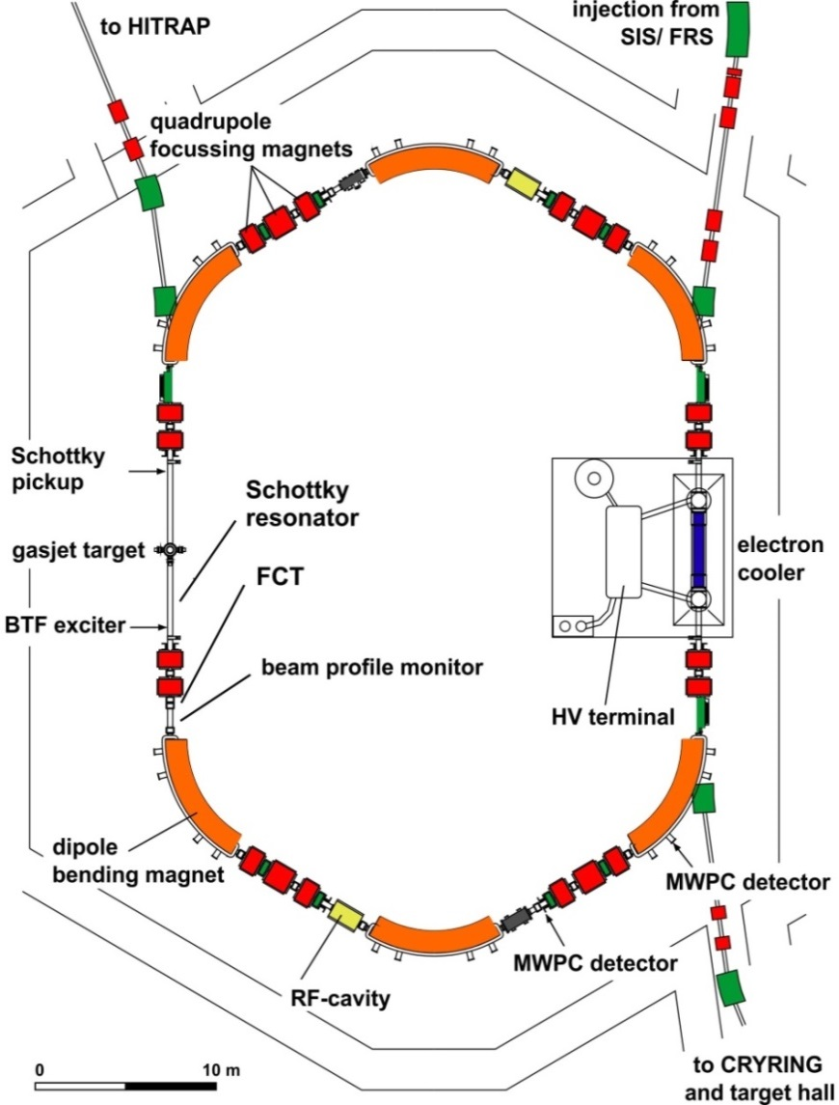
ESR operation modes
injection of cooled beams from SIS18
storage of highly charged ions and secondary beams via TE or FRS
stochastic cooling (400 MeV/u)
electron cooling (3 - 420 MeV/u)
internal gas jet target
deceleration (minumum 3 MeV/u)
fast extraction to HITRAP or CRYRING
charge exchange extraction
accumulation
isochronous optics mode
schottky mass spectrometry of RIBs
slow resonance extraction

Slide 10
ESR operation 2024
ESR operation in 2024 was very successfull!!

Slide 11
ESR operation 2024
ESR operation in 2024 was very successfull!!
LSA and storage ring expert app offers a very flexible operation of the storage ring
  => all experiment requirements can be satisfied (and more)
operation need a deep understanding of the ongoing experiment and setup,
(we still encountered unexpected, surprising behaviour of our actions, caused by the specific settings of subchains)
this is probably just a question of getting used to it, but requires constant checking the result of trims/setup changes. (which is sometimes hard to do during setup of the machine...)
previously reported latencies are significantly reduced, but there are still some trims/setup changes with significant waiting time before activation
the transition of ESR hardware to FAIR standards is not yet completed, the performance is therefore restricted
monitoring the system and error diagnosis is not possible adequately due to the lack of actual values (istwert erfassung!) and archiving and should be given high priority!!!

Slide 12
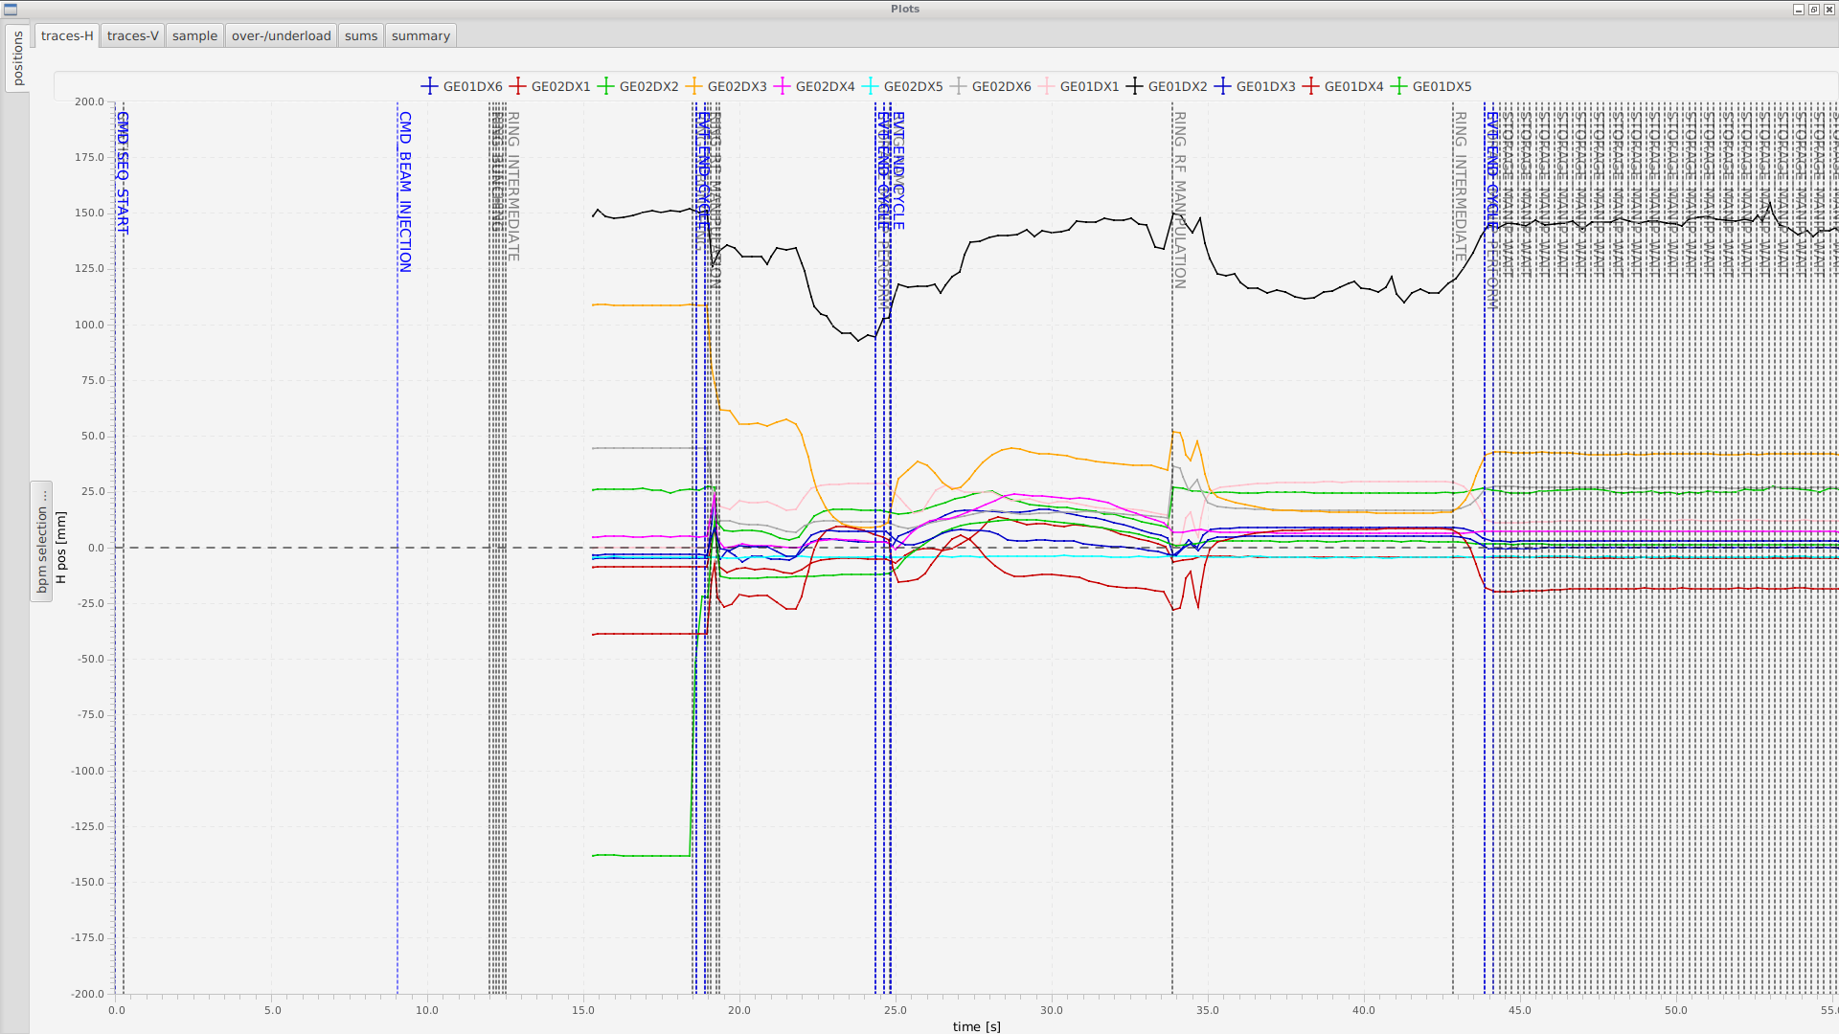
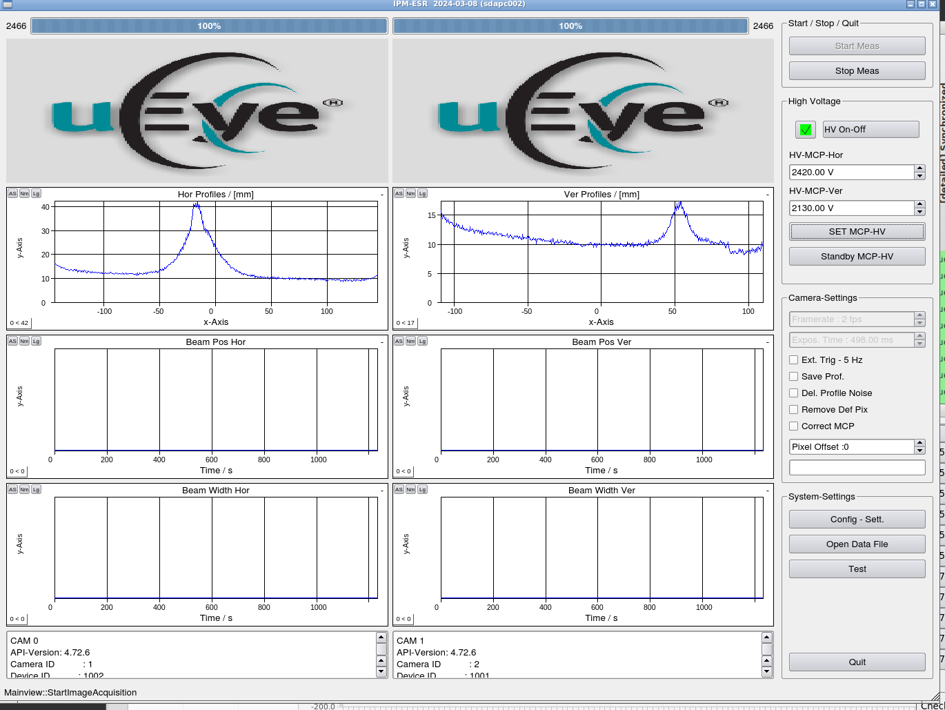
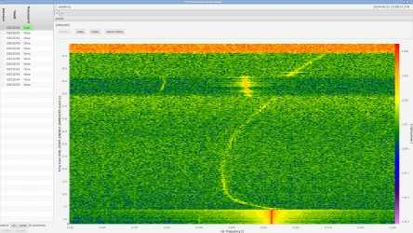
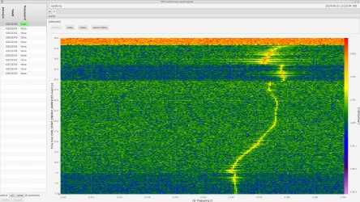
digitization of beam diagnostics
many apps under development and already available,
but still some expert support needed for setup
orbit
and
ipm
tune

Slide 13
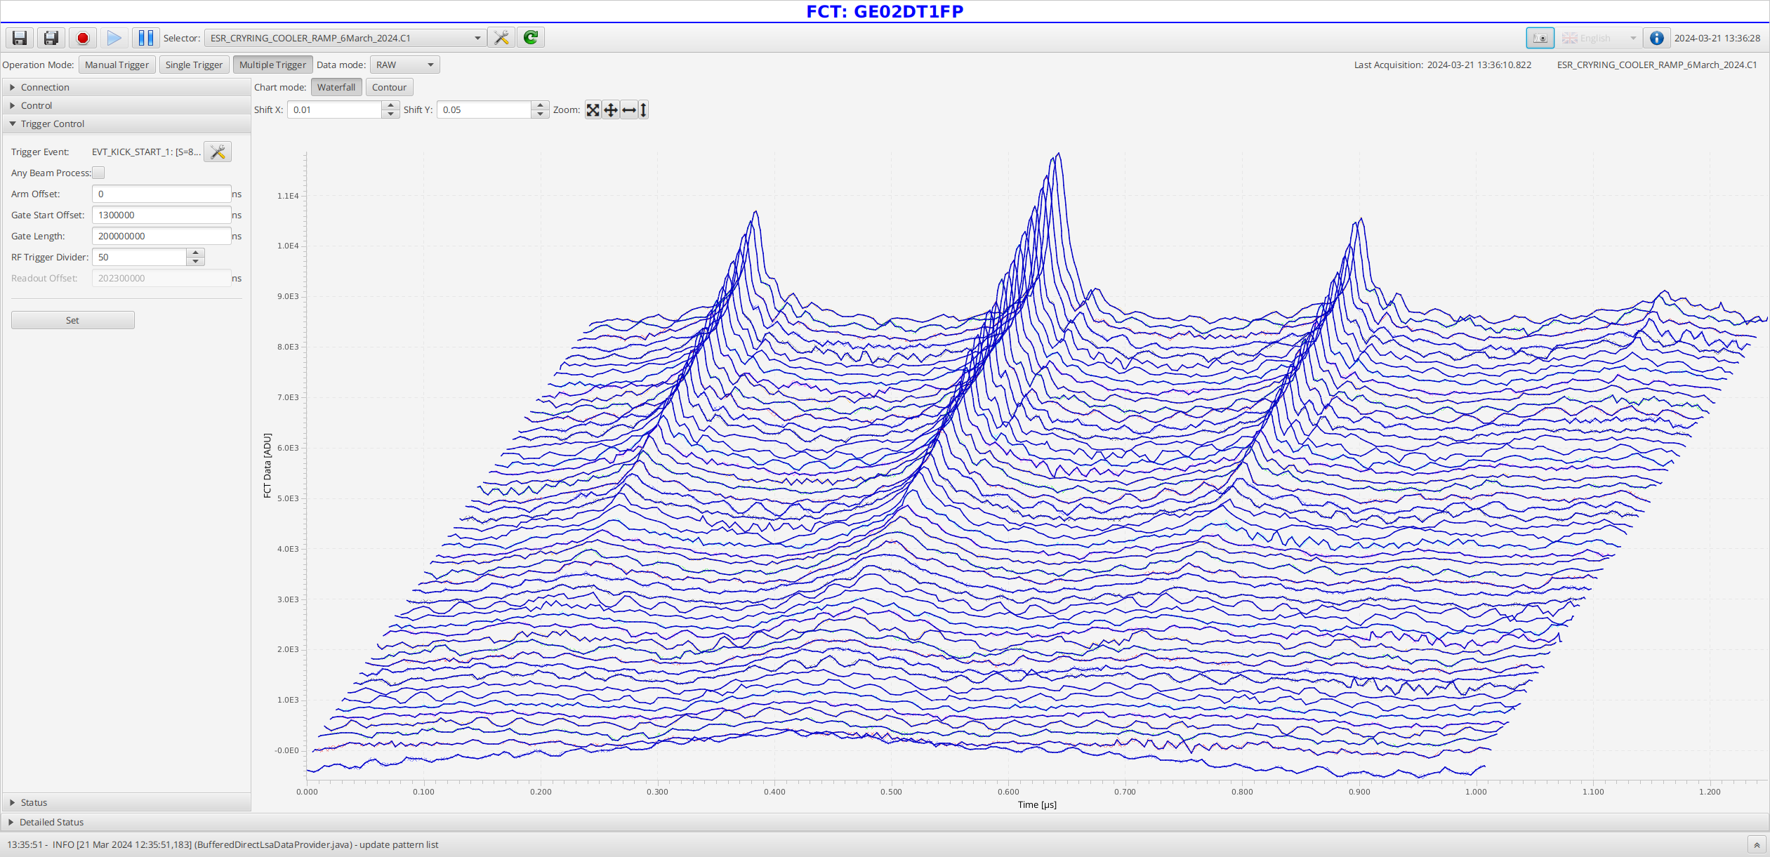
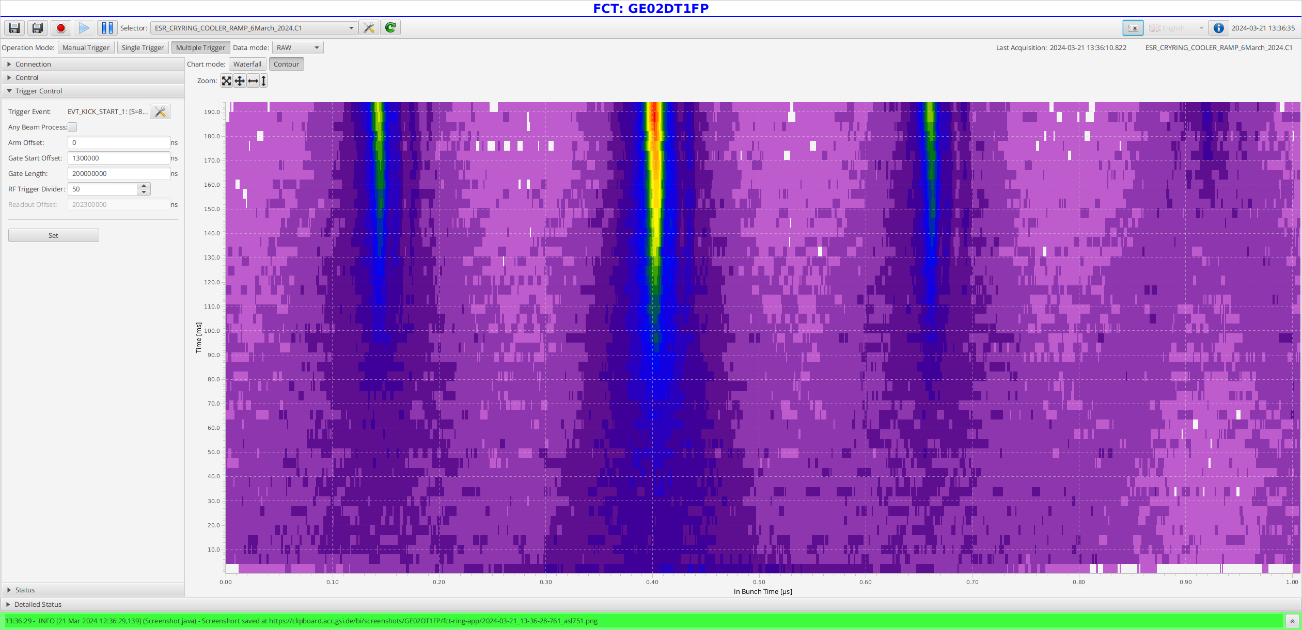
digitization of beam diagnostics
FCT

Slide 14
Outlook to 2025
make more use of available beam diagnostics for machine setup
  (expert support needed and usually available)
  will take some time to setup proper measurements,
  but potentially leads to improved performance
improve understanding of ESR optics
study of deceleration losses (PhD work in progress)
„Online“ optics model
  (no plan how to realize, yet: e.g. within the ESR team, some student,
  some support from Controls, external support....)
NEED FOR MORE SETUP/MACHINE TIME!!

Slide 15
Outlook to 2025
As reported, practically all required operation modes of ESR were successfully executed in 2024
ESR IS READY FOR 2025 BEAMTIME*
*we need a new stripper target in the TE line

Slide 16
Reminder to the experimenters: the shutdown has started
if you need to install, replace equipment please report this asap,
so it can be put in the shutdown planning
Thank you for your attention

Slide 17
Additional transparencies

Slide 18
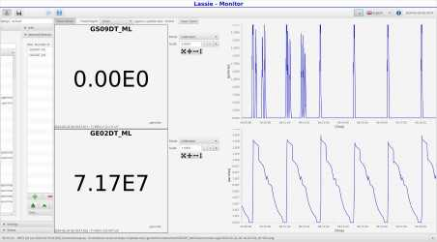
Highlight from 2024 operation
intensity ²³⁸U⁹²⁺ delivered to experiment E028 at 17 MeV/c regularly
over one week+ > 5e7
nominal intensities ²³⁸U
91+/92+ 40 MeV 4E+07
91+/92+ 10 MeV 5E+06

Slide 19
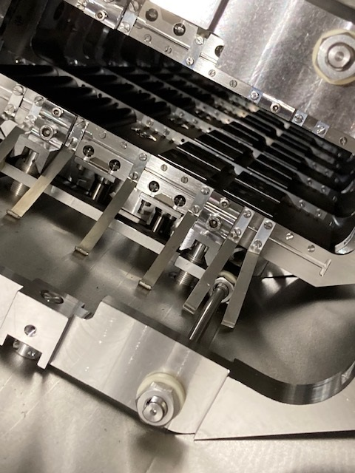
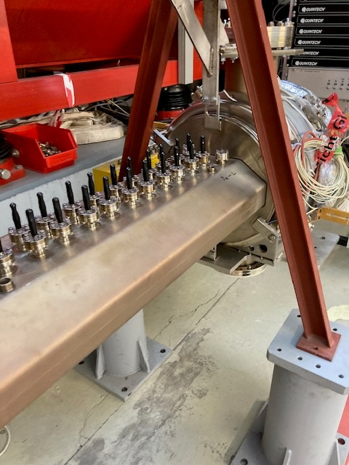
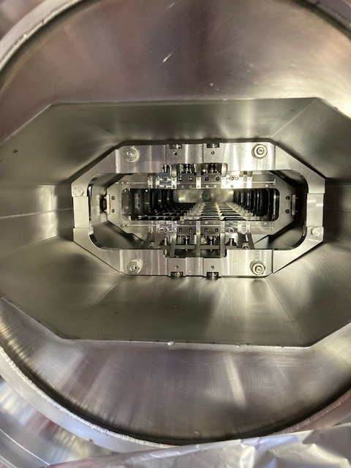
Shutdown work Juli 2022 to February 2024
repair of kicker-electrode of the stochastich cooling in ESR quadrupole

Slide 20
ESR operation in 2024
HITRAP Commissioning: deceleration to 4 MeV/c and fast extraction to HITRAP
¹²C⁶⁺
¹⁸O⁸⁺
³⁶Ar¹⁸⁺
CryRing experiments: deceleration and fast extraction
¹⁹⁷Au⁷⁵⁺
CryRing internal und material research
ESR: internal with isochronous optics, ¹⁰⁰Mo⁴²⁺/⁹⁸Mo⁴²⁺/⁹⁸Zr⁴⁰⁺/⁹⁶Sr³⁹⁺
HTA: ²³⁸U⁸⁹⁺ charge exchange extraction of ²³⁸U⁹⁰⁺
ESR internal ²³⁸U⁹²⁺/²²⁹Th⁸⁹⁺, stacking with stochastic cooling
ESR internal ²³⁸U⁹⁰⁺ with deuterium gasjet target

Slide 21
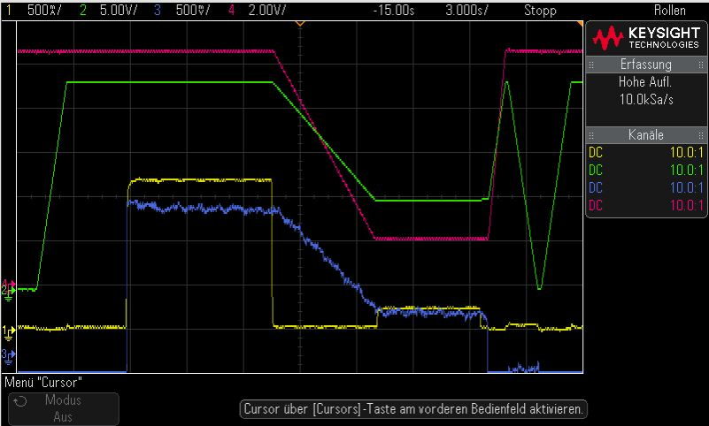
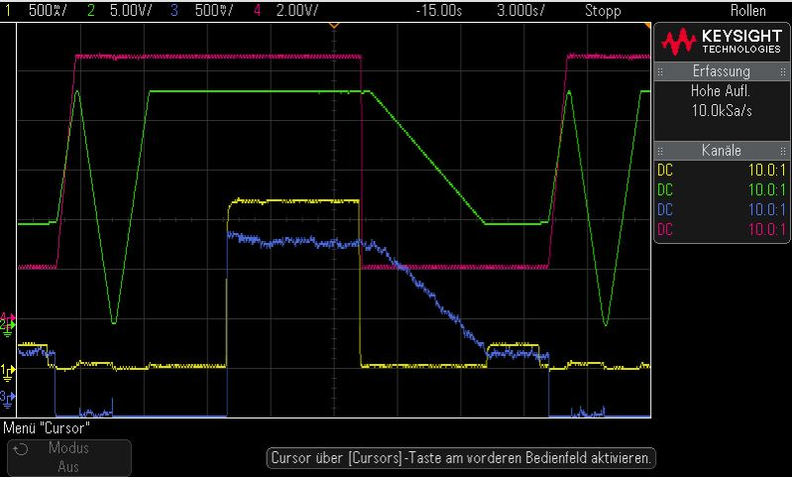
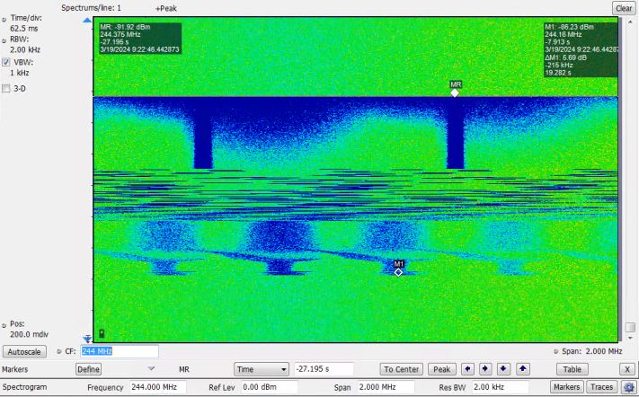
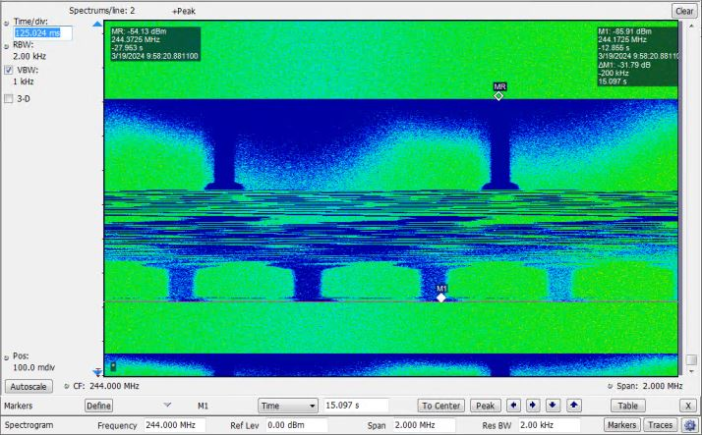
flexibilization of ESR operation
HV ecool
dipole field
Independent ramps for HV ecool and ring magnets
ioncurrent
electron current
reduction of cycle time by avoiding waiting time for HV
45 MeV/u
4 MeV/u

Slide 22
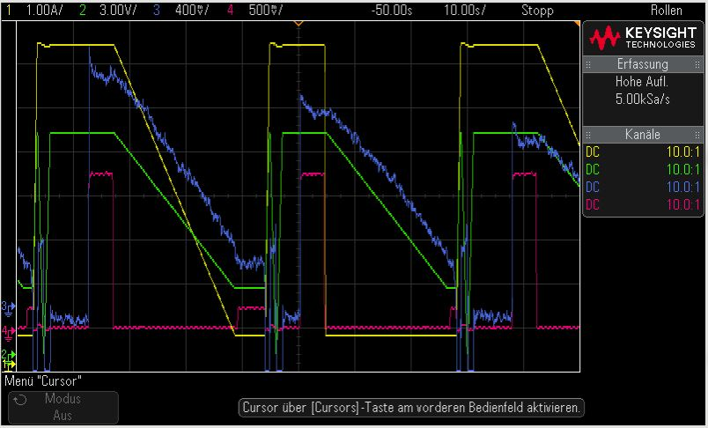
flexibilization of ESR operation
two pairs of coupled pattern:
possibility for storage of different ions (same rigidity, but different velocity)
collissions of co-moving beams
(Ref.: Franzke, NIMB 24/25 (1987))
possibility for parallel operation of ESR for multiple users

Slide 23
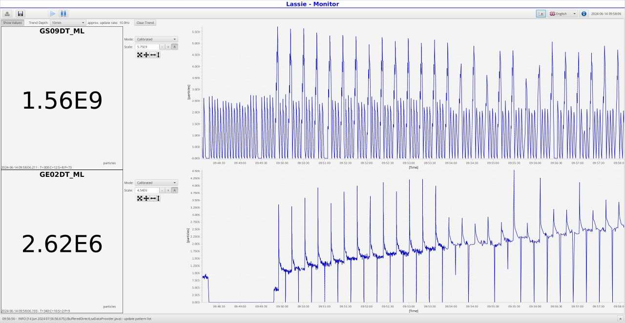

Slide 25
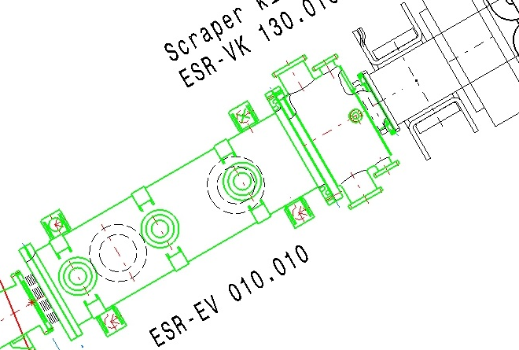
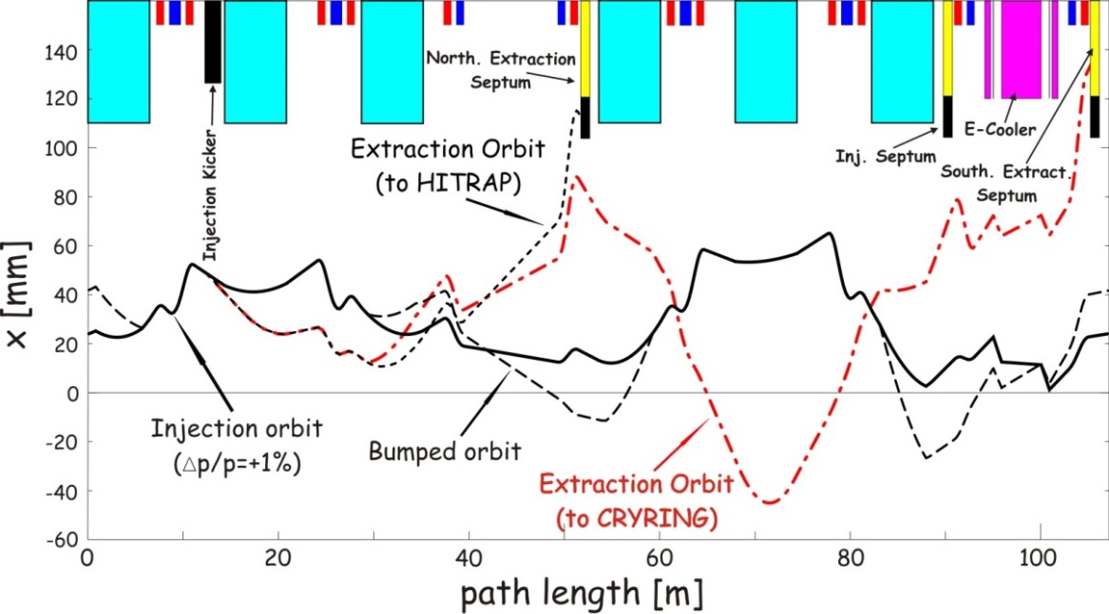
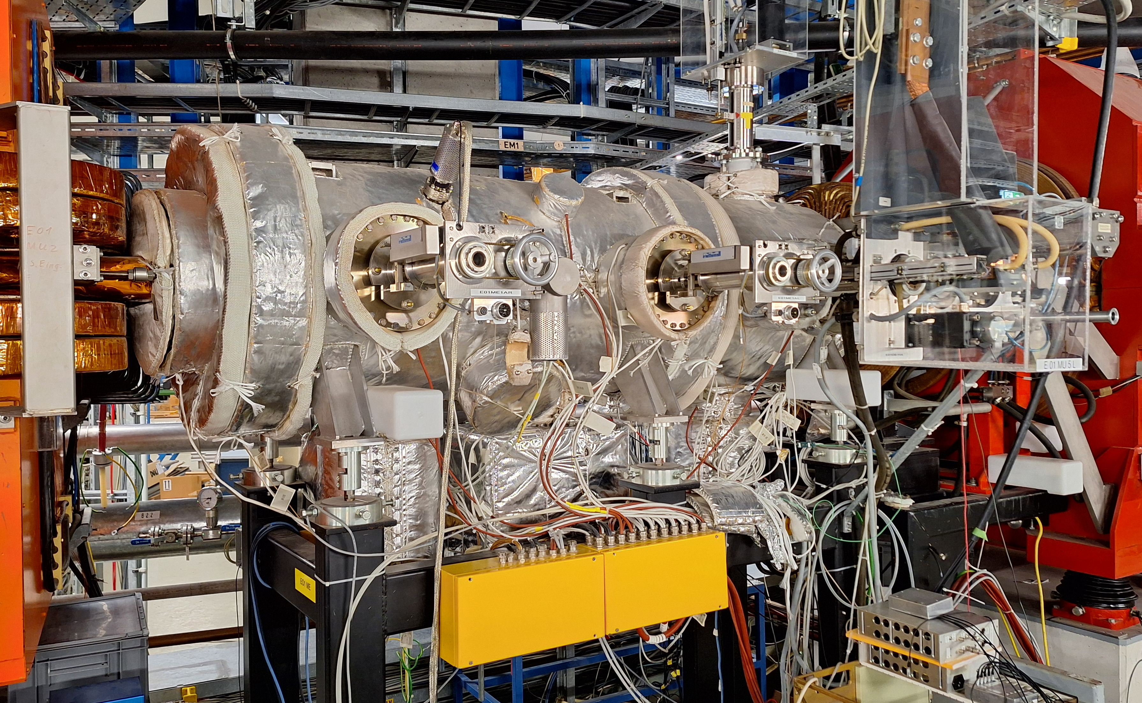
Upgrade Optionen
1 Extraktions-Kicker für CRYRING
aus der Anfangsphase des ESR-CRYRING Projektes (2014):
fast beam extraction from ESR to CRYRING is employing a sophisticated scheme with a distorted closed orbit for the circulating beam before extraction to CRYRING
consequence: no cooling during extraction, risk of unacceptable heating and emittance growth, particularly for highly charged ions
aktuelle Kammer für
langsame Extraktion mit zwei Septa
im Nordbogen
Injektionskicker
S. Litvinov
existierender Kicker
Injektion, Extr. HITRAP
Lösung: dedizierter Extraktionskicker im Norden des ESR, dadurch zusätzlich frei werdender Platz

Slide 26
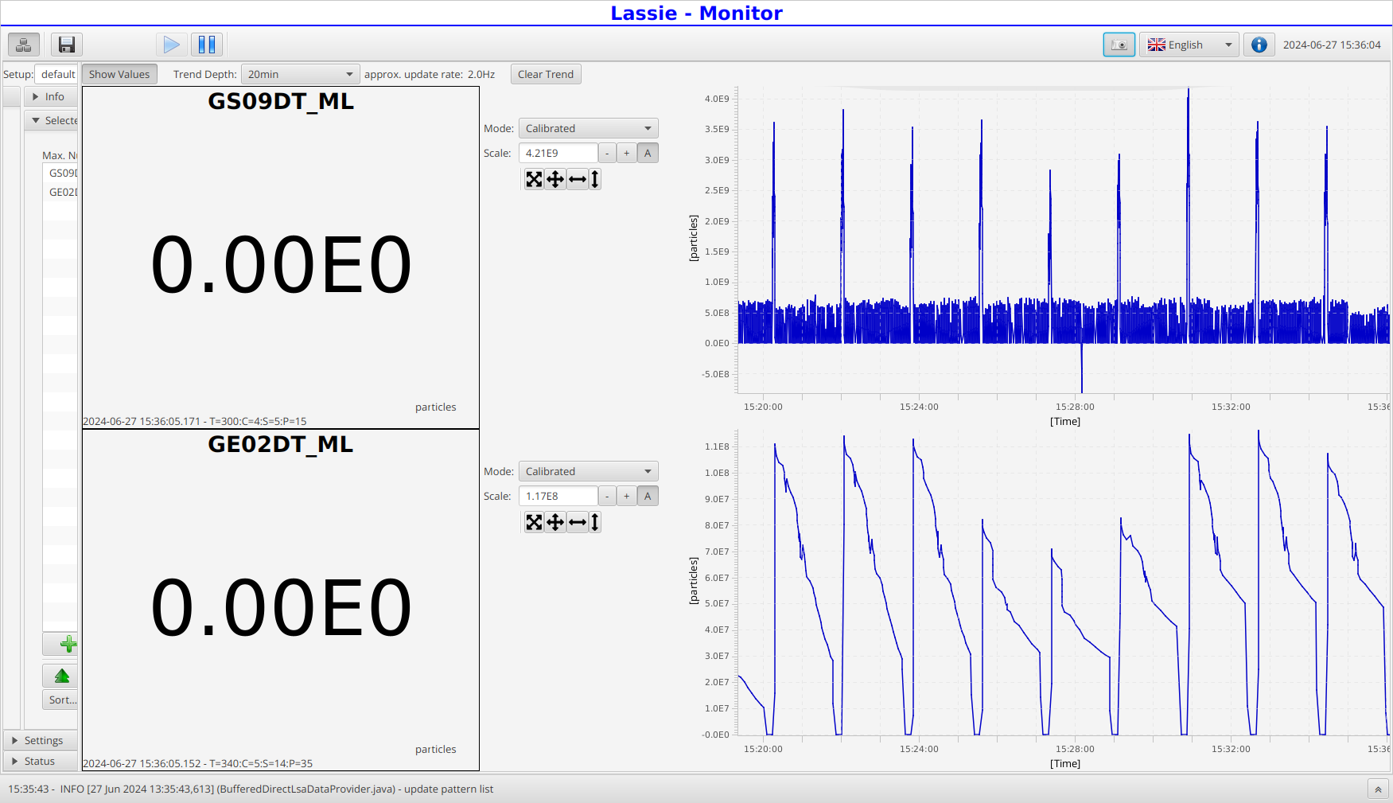
Stripper thema

Slide 27
Aktuelle Upgrades
1 Vakuumverbesserung: vollständiger Ersatz der Ionengetterpumpen
Ersatz der Ti-Sublimatoren durch NEG-Module
weitere Ersatzbeschaffungen sind zu erwarten
neue Hochspannungsgeräte für Elektronenkühler
3 Beschaffung neuer Stromversorgungen
4 Beschaffung von Messgeräten für Remotebetrieb (FCC)
5 Umrüstung aller Geräte auf SCUs erforderlich,
erlaubt flexibleren Betrieb und komplexere Betriebsabläufe (Patterns)
6 Archivierung relevanter Daten sollte mit Priorität verfügbar gemacht werden,
insbesondere auch für die Nutzer

