Slide 1
7th Beam Time Retreat
UNILAC
Lessons from beam time 2024 and outlook to 2025
BEAM TIME RETREAT 2024
BEM TIME RETREAT 2023
Hartmut Vormann – Machine Coordinator UNILAC
11th and 12th July 2024
@ Jagdschloß Kranichstein

Slide 2
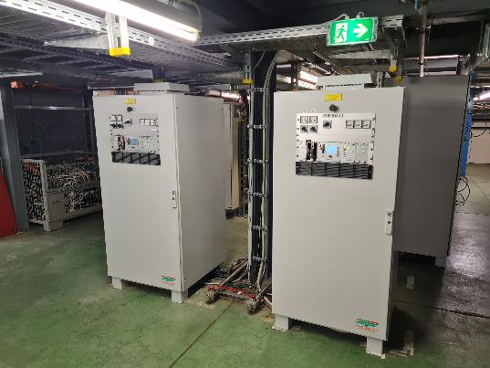
Shutdown 2023
New timing signals for EH users, due to measurement station renovation
Faraday Cup @ TK7 (leak) replaced 20th October 2023 (Spare by BEA)
Faraday Cup @ TK4 (leak) replaced 18th October 2023 (Spare by BEA)
EH-septum/new coil installed: End of September 2023
HSI-LEBT dipoles: New PS
installed;15th January 2024

Slide 3
UNILAC Beamtime Overview
February
  Carbon from CH3, Titanium, Argon/ECR, Oxygen
March
  Gold from PIG (25 Hz) and from MeVVa,
  Easter-Service Period
April
  Iron PIG, Argon/ECR (36Ar HITRAP), Erbium (new!) HFS
  Argon Machine Experiments
May
  Nickel/VARIS, Chrome PIG (52Cr, not 54Cr ECR), Molybdenum (new!)
  Uranium exclusively
June
  Uranium exclusively (H2 gasstripper), Argon for UCW
Feb-15 Alvarez A4 pulse length 9 h
(X6, solved April 3rd)
Feb-22 EH Septa water dropping 24h
(X8, replaced Mar-28)
Feb-28 A4 instable 15h
Mar-18 EH Dipole PS UXAMU1 31h
PS water dropping (X0)
Apr-18 A2A Shortcut Transmitter 30 h
Apr-19/20 36Ar beam jitter at Tkend 15h
(QD11/Erbium )
May-8 beam loss X8, exp valve, 23h
May-31 TK4QD31 water loss, KS01 off 14h
Jun-11 IH1 tube socket shortcut 12 h

Slide 4
Overview - intensities
February
  Carbon from CH3 (1 mA@UH1, 0.4 mA C^{4+/6+}@TK7), Titanium (35 µA@UH1, 40 µA @Y7), Argon/ECR (130µA@UN3, 12 µA@X6, reduced), Oxygen (3 mA@UH1, 1.7 mA@TK7)
March
  Gold from PIG (25 Hz, 20-40 µA@UH1/UT1, source - in smooth operation) and from MeVVa (3 mA@UH1, 200/400µA@TK7),
  Easter - Maintenance Period
April
  Iron PIG (120 µA@UH1, 50 µA@UT1), Argon/ECR (36Ar HITRAP, 120 µA@UN3, 40µA@X6), Erbium (new!, 170Er3+, 23+ Alv, 57+ TK; 1 mA UH1, 400-600 µA UH4, 250 µA TK7) HFS
  Argon Machine Experiments (4-5 mA @TK7)
May
  Nickel/VARIS (3 mA @UH1, 2 mA@UT1, 120 µA@TK7, reduced), Chrome PIG (52Cr, not 54Cr ECR --- 100µA@UR5, 45-60/ 80 µA@UX8), Molybdenum (new!, 400 µA Mo³⁺@UH1, 60 µA@TK7))
  Uranium exclusively
June
  Uranium exclusively (H2 gasstripper; 10 mA@UH1, 10.5 mA@US4, 3.5mA U⁷³⁺@TK7 – „multi charge“ beam), Argon for UCW

Slide 5
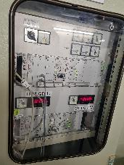
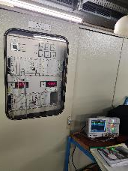
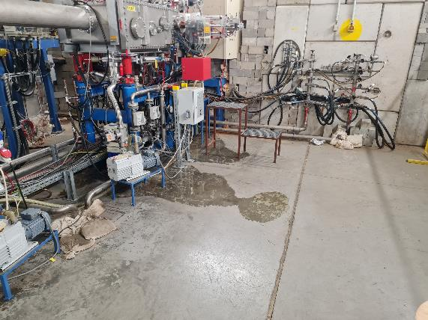
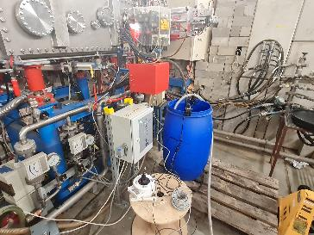
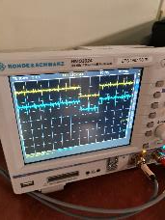
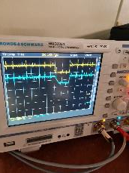
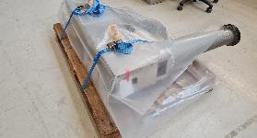
Remarkable events February (C, Ti, Ar, O-beam)
9th Feb: Interlock from ECR ion source microwave SPS
16th Feb: HSI-RFQ ignitron replaced, 3.5 h.
22nd Feb: EH-Septum water leak, automatic pumped barrel, remotely monitored
22nd Feb: Vertical beam jitter (X6 SEM grid), quadrupole GUT1QD11 switch range >0,5 V…
22nd Feb: A4 beam pulse length limited to 300 µs (solved 3rd Apr)
GUT1QD11 beam jitter
EH-Septum, 22nd Feb
new spare part ready 26th Feb

Slide 6
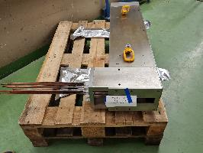
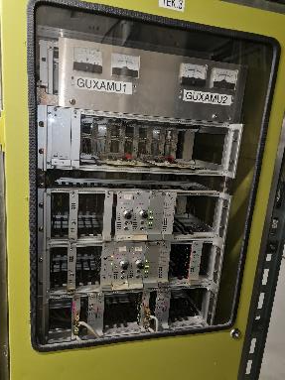
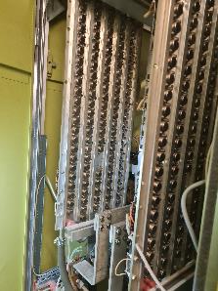
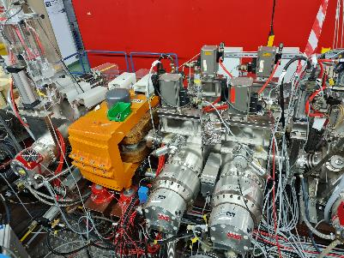
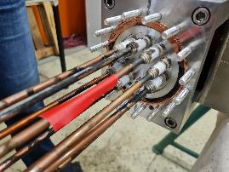
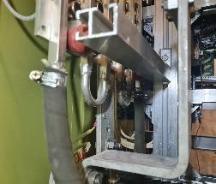
Remarkable events in March 2024 (Gold beam)
20th March: Dipole magnet GUXAMU1 power supply water leak (30 h loss for X0)
25th to 28th March: Easter break:
  GUT2MUX replaced
  Gas stripper valve #1 replaced
Gas stripper section
UXAMU1 Power Supply,
water cooled transistor bank
Damaged UT2MUX

Slide 7
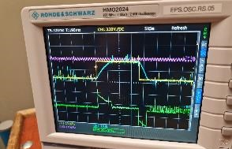
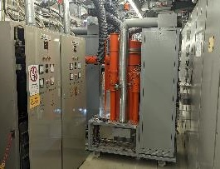
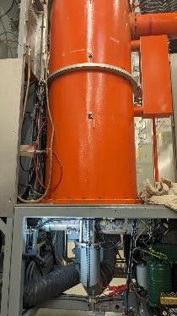
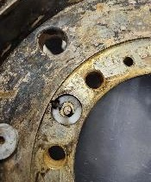
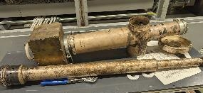
Remarkable events in April (Fe-, Ar-, Er-beam)
20th Apr, also GTK2MU3 causes beam jittering (like QD11); switching coil current from 330 A (Erbium) to 199 A (Ar) problematic.
18th Apr, 9 a.m., failure Alvarez A2A, short circuit of Grid-1 connection of RF tetrode, disassembly of amplifier and tube socket, repair lasts until 19th Apr, 3 p.m. (30 hours)
Power Supply, stability magnet coil current in mixed operation (TK2MU3)
A2A short circuit Grid-1 connection of RF tetrode., Photos courtesy G. Schreiber

Slide 8
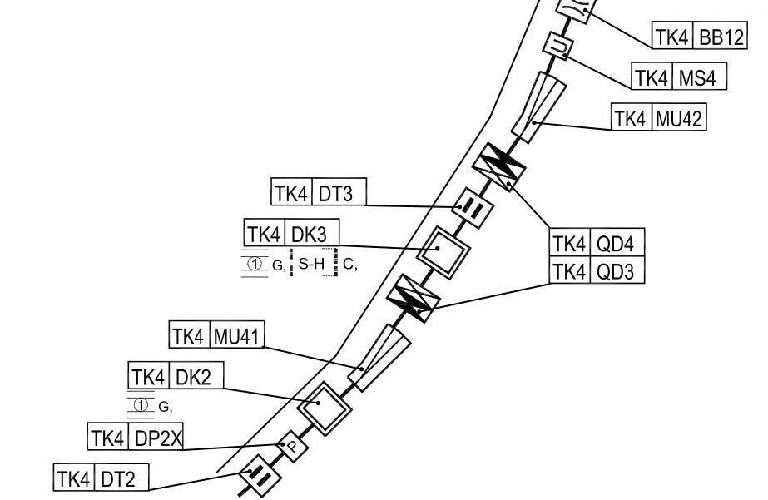
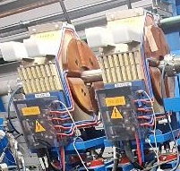
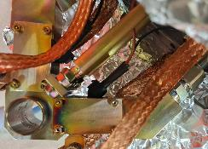
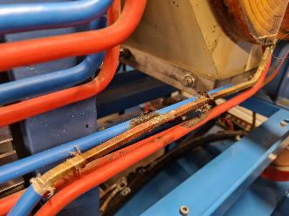
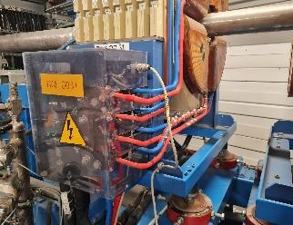
Remarkable events May (Ni-, Cr-, Mo-beam)
7th May: gas stripper valve #2 replaced (7 hours during planned interruption)
31st May („bridge day“, Corpus Christi): water loss GTK4QD31, KS01 switch off (14 hours)
leak copper pipe, brazed and insulated

Slide 9
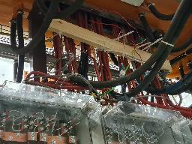
Remarkable events June (U-beam)
IH1-RF-signals
Tube cabinet IH1
TK4-Buncher BB12
  multiple re-start necessary (1.5 h)
  high voltage cable repaired (3 h)
  operation w/o BB12 (at limited beam intensity)
  high voltage cable & HV filter box feedthrough connectors replaced (3 h)
HSI-RFQ
  RF level failure, sparking (ion getter pumps switching off!)
  Operation at reduced RF-amplitude
HSI-IH1
  RF-tube replaced
  tube socket short repaired, anode capacitor replaced (12 h)
  Increased RF power: 1.6 MW, >200 kW reflected!
  RF-voltage reduced (8,57 V => 8,40 V)
  Triplet UH3QT3 water leake
  Supply cables mechanically instable at ramped operation provisionally fixed
UH3QT3-supply
Fotos courtesy G. Schreiber

Slide 10
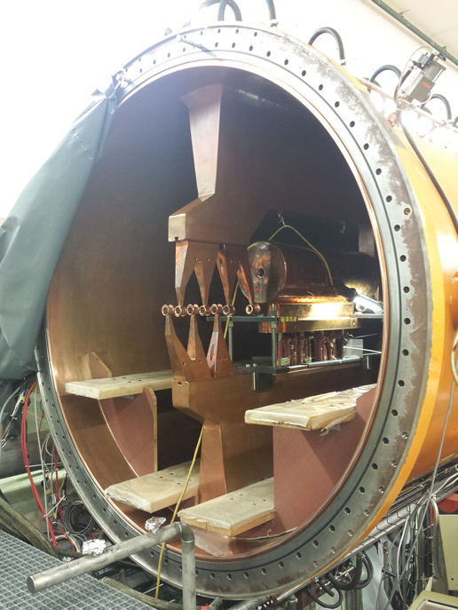
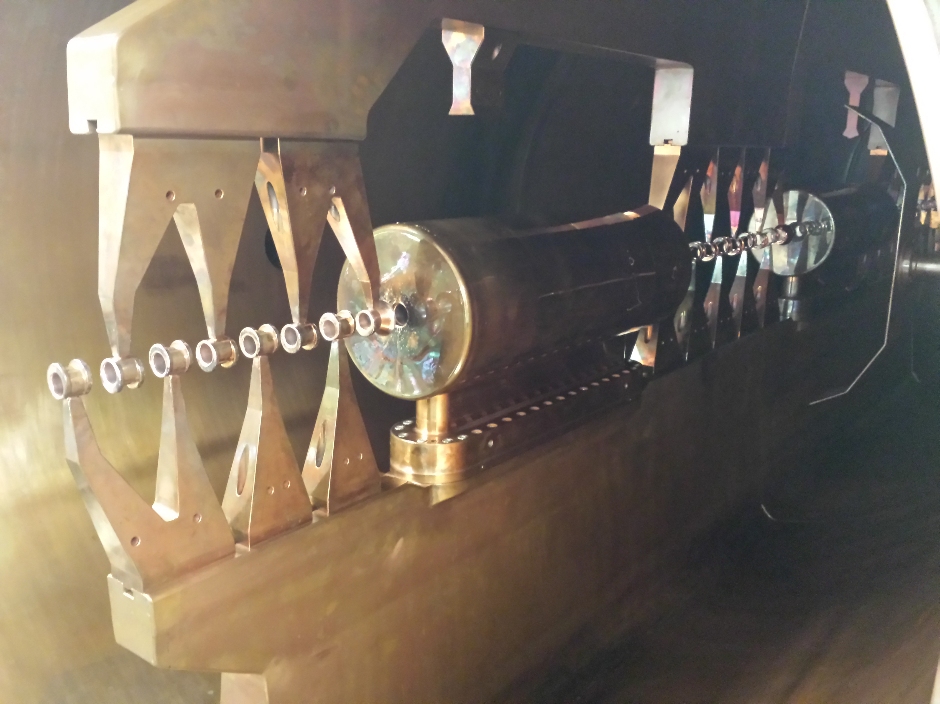
IH1 – opened for triplet repair (2019/2020)

Slide 11
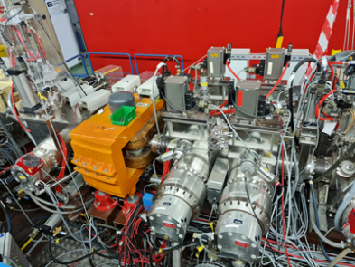
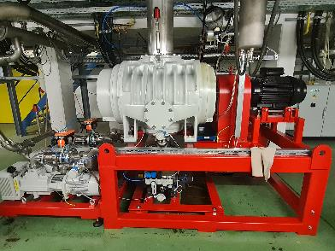
Gasstripper
BEAM TIME RETREAT 2023
BEAM TME RETREAT 2023
Pulsed gas stripper applied for beamtime 2024!
Oil services…
17th mar, roots failure, oil failure, 3 hours (2.5 litres re-filled).
25th-28th Mar, easter shutdown, valve #1 replaced.
11th apr, valve #2 defective, permanent-open; replaced 7th may, incl. oil service (7 hours)
from 8th May on: only valve #2, 550 mbar (=Cr optimized, Ni 250, Mo 400 optimized)
from 22nd May Uranium exclusively, (valve #2, 500 mbar N2, permanent-open – w/o impact
3rd-6th jun H2 stripping gas, valve #1, 6 bar.
5th jun: For PIG-Ar-beam to US3 additionally 5 Hz H2-Gas , vacuum pressure increases and bunchers BB3+4 switch off (vac–threshhold) – machine exp. postponed to N2 gas next day.

Slide 12
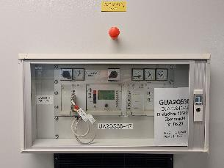
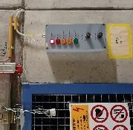
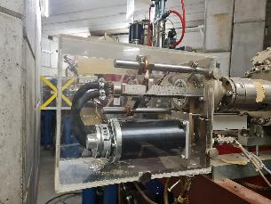
Preconditons and Miscellanious
BEAM TIME RETREAT 2023
BEAM TME RETREAT 2023
A2QS105/106 (QS46/47) out of operation (DR105)
ER1 max 4,5 V, BB4 max. 5,3 V, BB6 max 6 V.
UN3DC2 sudden drive in beam (06th feb), IL µWave…
special regulations EH from rad. safety department, chains and locks…
Scada MCR no ion getter pump switching-on for operators staff
Since 11th Apr: (36Ar8+) HLI RFQ phase jitter, misleading displaying in the MCR RF application
25th Apr, Slit UXADS1HL water leackage, provisionally fixed (2 h)
13th May, 52Cr14+ beam at X8 suddenly dissapeared; reason unclear
A2QS105+106 out of operation
EH Caves, locked, regulations
UXADS1HL water loss

Slide 13
Summary / Conclusions
Increased complexity in mixed mode operation
Hardware failures
  minor impact on overall beam time
  repair measures during scheduled intervention times
  partly repaired instantenously
RF-conditioning campaigns need more carefull collaboration
Beam time has been planned carefully!
UNILAC beam time successfully acomplished!

Slide 14
Outlook
BEAM TIME RETREAT 2023
BEAM TME RETREAT 2023
New HLI-triplet (QT4) in production
  Delivery in Dec. 2024
  Copper coating
  Feb. 2025: 48Ca-beam operation with recent QT4
  Replacement before 2nd Calcium block
Advanced EH dipole chambers-prototype in fabrication
Improved gas stripper operation, featuring pulsed or jet setup
⁵⁴Cr²⁺-beam operation at UNILAC applying PIG is possible
Operation with replaced A2-drift tube (#105)

Slide 15
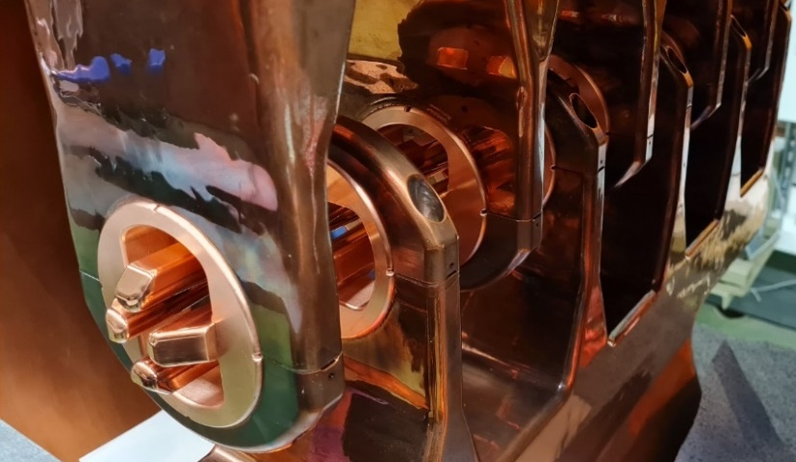
Thank you for your attention!

Slide 16
Attachment

