Slide 1
7th Beam Time Retreat
UNILAC – Lessons from the beam time 2024 and outlook to 2025
BEAM TIME RETREAT 2023
BEM TIME RETREAT 2023
Hartmut Vormann – Machine Coordinator UNILAC
11th and 12th July 2024
@ Jagdschloß Kranichstein

Slide 2
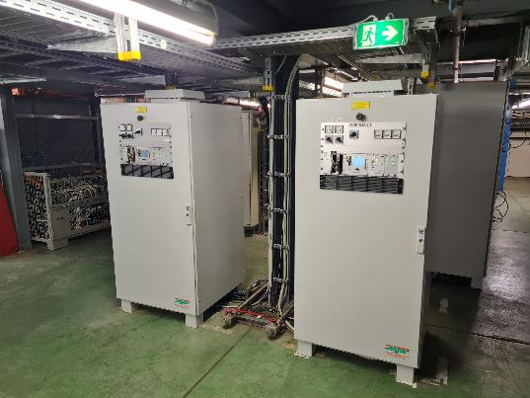
Shutdown 2023
Cables for experiments in EH new, due to measurement station removal
Farady Cup TK7DC3 (leak) replaced 20th October 2023 (Spare by BEA)
Farady Cup TK4DC3 (leak) replaced 18th October 2023 (Spare by BEA)
UT2MUX new coil installed end of September 2023
URMU1/ULMU1 new PS installed 15th January 2024

Slide 3
Overview - main
February
  Carbon from CH3, Titanium, Argon/ECR, Oxygen
March
  Gold from PIG (25 Hz) and from MeVVa,
  Easter-Service Period
April
  Iron PIG, Argon/ECR (36Ar HITRAP), Erbium (new!) HFS
  Argon Machine Experiments
May
  Nickel/VARIS, Chrome PIG (52Cr, not 54Cr ECR), Molybdenum (new!)
  Uranium exclusively
June
  Uranium exclusively (H2 gasstripper), Argon for UCW
Feb-15 Alvarez A4 pulse length 9 h
(X6, solved April 3rd)
Feb-22 EH Septa water dropping 24h
(X8, replaced Mar-28)
Feb-28 A4 instable 15h
Mar-18 EH Dipole PS UXAMU1 31h
PS water dropping (X0)
Apr-18 A2A Shortcut Transmitter 30 h
Apr-19/20 36Ar beam jitter at Tkend 15h
(QD11/Erbium )
May-8 beam loss X8, exp valve, 23h
May-31 TK4QD31 water loss, KS01 off 14h
Jun-11 IH1 tube socket shortcut 12 h

Slide 4
Overview - intensities
February
  Carbon from CH3 (1 mA@UH1, 0.4 mA C^{4+/6+}@TK7), Titanium (35 µA@UH1, 40 µA@Y7), Argon/ECR (130µA@UN3, 12 µA@X6, reduced), Oxygen (3 mA@UH1, 1.7 mA@TK7)
March
  Gold from PIG (25 Hz, 20-40 µA@UH1/UT1, source piano, Exp. reduced 5 µA) and from MeVVa (3 mA@UH1, 200/400µA@TK7),
  Easter - Service Period
April
  Iron PIG (120 µA@UH1, 50 µA@UT1), Argon/ECR (36Ar HITRAP, 120 µA@UN3, 40µA@X6), Erbium (new!, 170Er3+, 23+ Alv, 57+ TK; 1 mA UH1, 400-600 µA UH4, 250 µA TK7) HFS
  Argon Machine Experiments (4-5 mA @TK7)
May
  Nickel/VARIS (3 mA @UH1, 2 mA@UT1, 120 µA@TK7, reduced), Chrome PIG (52Cr, not 54Cr ECR --- 100µA@UL5DT8, 45-60/ 80 µA @UX8DT3), Molybdenum (new!, 400 µA Mo³⁺@UH1, 60 µA@TK7))
  Uranium exclusively
June
  Uranium exclusively (H2 gasstripper; 10 mA@UH1, 1.0/3.5mA U⁷³⁺@TK7 – „multi charge“ beam), Argon for UCW

Slide 5
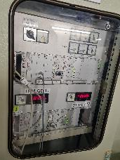
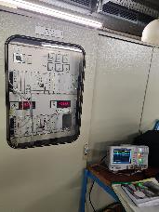
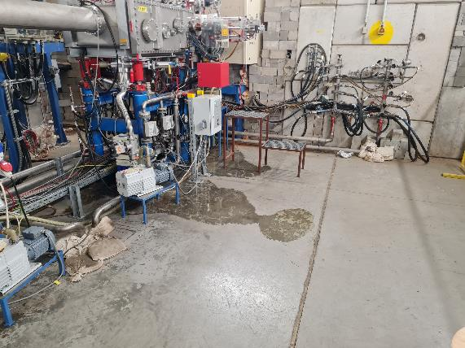
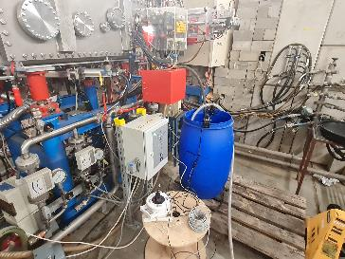
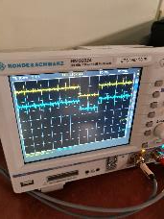
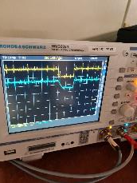
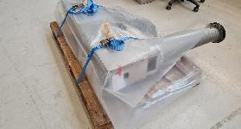
Remarkable events February (C, Ti, Ar, O-beam)
9th Feb: Interlock from ECR ion source microwave SPS
16th Feb: HSI-RFQ ignitron replaced, 3.5 h.
22nd Feb: UT2MUX water loss, automatic pumped bucket, monitored by camera
22nd Feb: Vertical beam jitter (X6 SEM grid), quadrupole UT1QD11 switch range >0,5 V…
22nd Feb: A4 beam pulse length 1 ms not possible (solved 3rd Apr)
UT2MUX, 22nd Feb
UT1QD11 beam jitter
new spare part ready 26th Feb

Slide 6
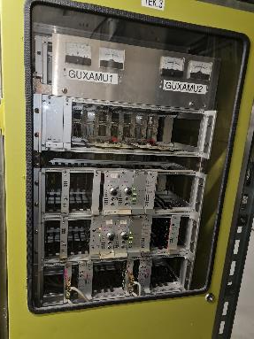
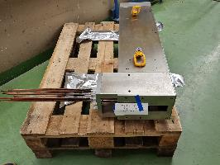
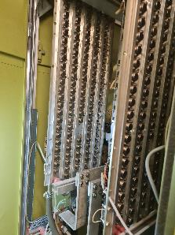
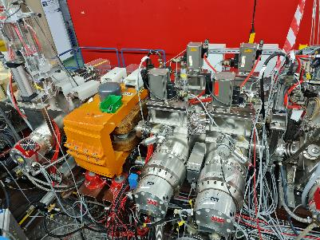
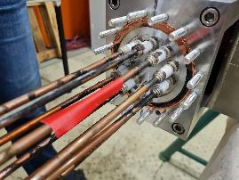
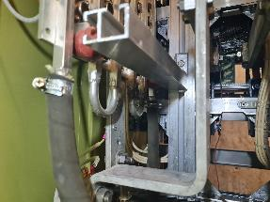
Remarkable events March (Gold beam)
20.3. Dipole magnet UXAMU1 power supply water leak (30 h loss for X0)
25.3.-28.3 Easter break:
  UT2MUX replaced
  Gas stripper valve #1 replaced
Damaged UT2MUX, photos 10th April
UXAMU1 Power Supply,
water cooled transistor bank,
photos 18th March
Gas stripper section, photo 26th March

Slide 7
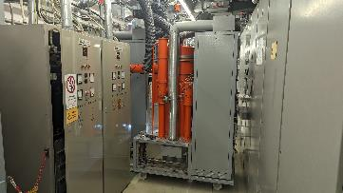
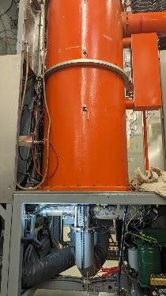
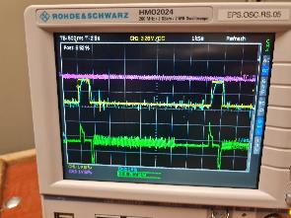
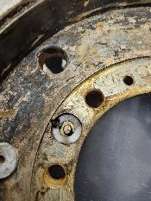
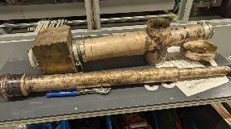
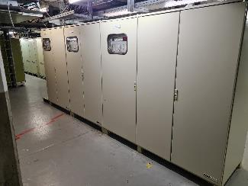
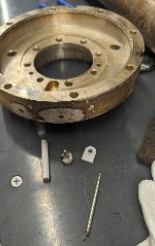
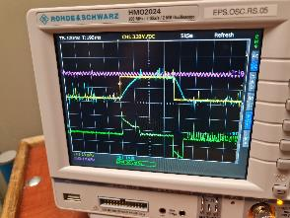
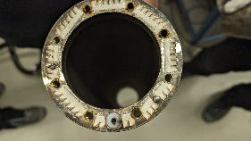
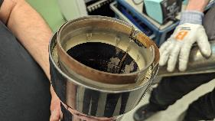
Remarkable events April (Fe, Ar, Erbium-beam)
18th Apr, 9 a.m., failure Alvarez A2A, short circuit of Grid-1 connection of RF tetrode, disassembly of amplifier and tube socket, repair lasts until 19th Apr, 3 p.m. (30 hours)
20th Apr, beam jittering at transfer channel end (36Ar8+), parallel operation with 170Erbium23+ problematic (UT1QD11?)
20th Apr, also TK2MU3 causes beam jittering (like QD11). Switching coil current from 330 A (Erbium) to 199 A (Ar) problematic.
A2A short circuit Grid-1 connection of RF tetrode.
Photos courtesy G. Schreiber
Power Supplies TK1MU1, MU2, TK2MU3 (photo 22nd Apr)

Slide 8
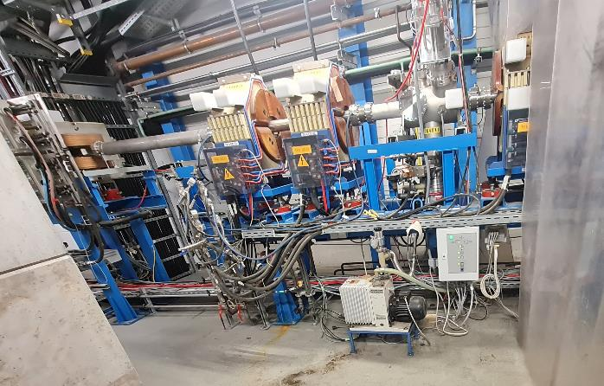
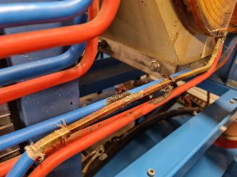
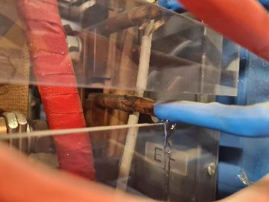
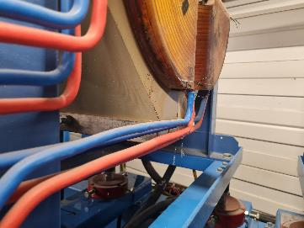
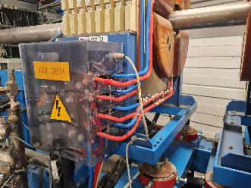
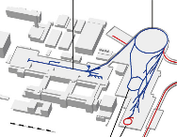
Remarkable events May (Ni, Cr, Molybdenum-beam)
7th May: gas stripper valve #2 replaced (7 hours during planned interruption)
31st May („bridge day“, Corpus Christi): water loss TK4QD31, KS01 switch off (14 hours)
TK4 curve
11.25° dipole
MU41 QD31 QD32 QD4
… …MU42
leak copper pipe…, brazed, … insulated.

Slide 9
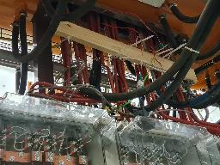
Remarkable events June (U-beam)
6th-10th Jun BB12
  needs multiple switching-on to re-start (1,5 h),
  7th Jun, high voltage cable to tube cabinet shortened (3 h),
  8th Jun, again failure, then operation without BB12 (only low beam intensity requested),
  10th Jun, high voltage cable and HV filter box feedthrough connectors replaced (3 h).
10th Jun (and 3x before), HSI-RFQ, Uranium routine operation: RF level failure, sparking (ion getter pumps switching off!), then: reduce voltage from 7.18 to 7.08 V.
11th Jun, night (2 a.m.), HSI-IH1 RF failure, tube replaced, tube socket short repaired, anode capacitor replaced (12 h). Increased RF power: 1.6 MW, >200 kW reflected!
12th Jun, voltage reduced from 8,568 to 8,403 V.
17th Jun, HSI Quadrupole Triplet UH3QT3 water loss and mechanically instable (wobbeling), provisionally fixed during SIS down (20-kV-filter AEG)
Fotos IH1 courtesy G. Schreiber
RF behaviour IH1
Tube cabinet IH1
UH3QT3

Slide 10
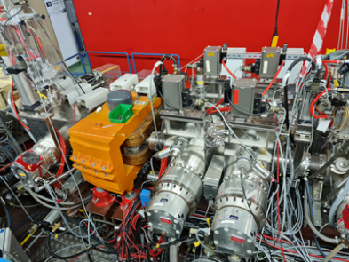
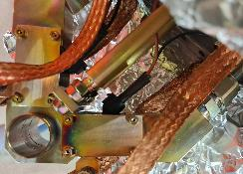
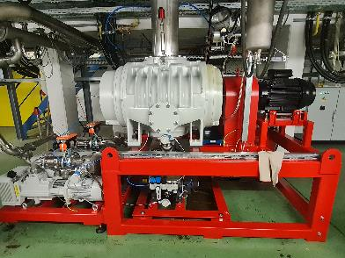
Gasstripper
BEAM TIME RETREAT 2023
BEAM TME RETREAT 2023
Decisison before Christmas: pulsed stripper for beamtime 2024!
Oil services…
17th mar, roots failure, oil failure, 3 hours (2.5 litres re-filled).
25th-28th mar, easter shutdown, valve #1 replaced.
11th apr, valve #2 defective, permanent-open. Replaced 7th may, incl. oil service (7 hours)
from 8th may on: only valve #2, 550 mbar (=Cr optim., Ni 250, Mo 400 optim)
from 22nd may Uranium exclusively, (valve #2, 500 mbar N2, permanent-open - didn’t matter.
3rd-6th jun H2 stripping gas, valve #1, 6 bar.
5th jun: For PIG-Ar-beam to US3 additionally 5 Hz H2-Gas , vacuum pressure increases and bunchers BB3+4 switch off (vac–threshhold) – machine exp. postponed to N2 gas next day.

Slide 11
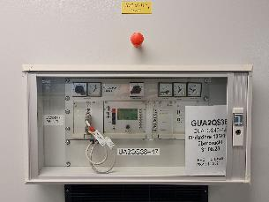
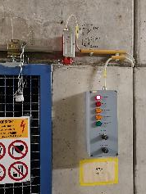
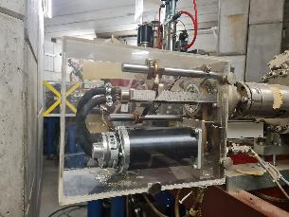
Preconditons and Various
BEAM TIME RETREAT 2023
BEAM TME RETREAT 2023
A2QS105/106 (QS46/47) out of operation (DR105)
ER1 max 4,5 V, BB4 max. 5,3 V, BB6 max 6 V.
UN3DC2 sudden drive in beam (06th feb), IL µWave…
special regulations EH from rad. safety department, chains and locks…
Scada MCR no ion getter pump switching-on for normal operators.
from 11th apr on: (36Ar8+) HLI RFQ phase jitter, misleading displaying in the MCR RF application.
25th apr, Slit/blind UXADS1HL water dripping, provisionally fixed (2 h)
13th may, 52Cr14+ for X8 suddenly lost. Dipole UXAMU1?? – UX8VV2T leak (replaced 14th may)
A2QS105+106 out of operation
UXADS1HL water loss
EH Caves, locked, regulations

Slide 12
Summary / Conclusions
Beam time was planned carefully!
Hardware failures, …some
  – minor influence
  – during planned intervention times
  – or repaired in short time
Less failures from RF department point of view

Slide 13
Outlook to 2025
BEAM TIME RETREAT 2023
BEAM TME RETREAT 2023
UN5QT4, spare part in production,
  Dec. 2024 delivery date (then copper coating),
  Feb. 2025 beam operation 48Ca10+ with defective old QT4 (test!).
  Then replacement if resonable/necessary.
EH dipole chambers..
new power supplies UL/UR quadrupoles?? delivery…
Gas stripper pulsed (valves…) or not pulsed? (Uranium efficiency!)
⁵⁴Chrome from PIG or ECR? (⁵⁴Cr²⁺…)
A2DR105 replaced? (If QS105+106 in operation, then all QS in operation.)

Slide 14
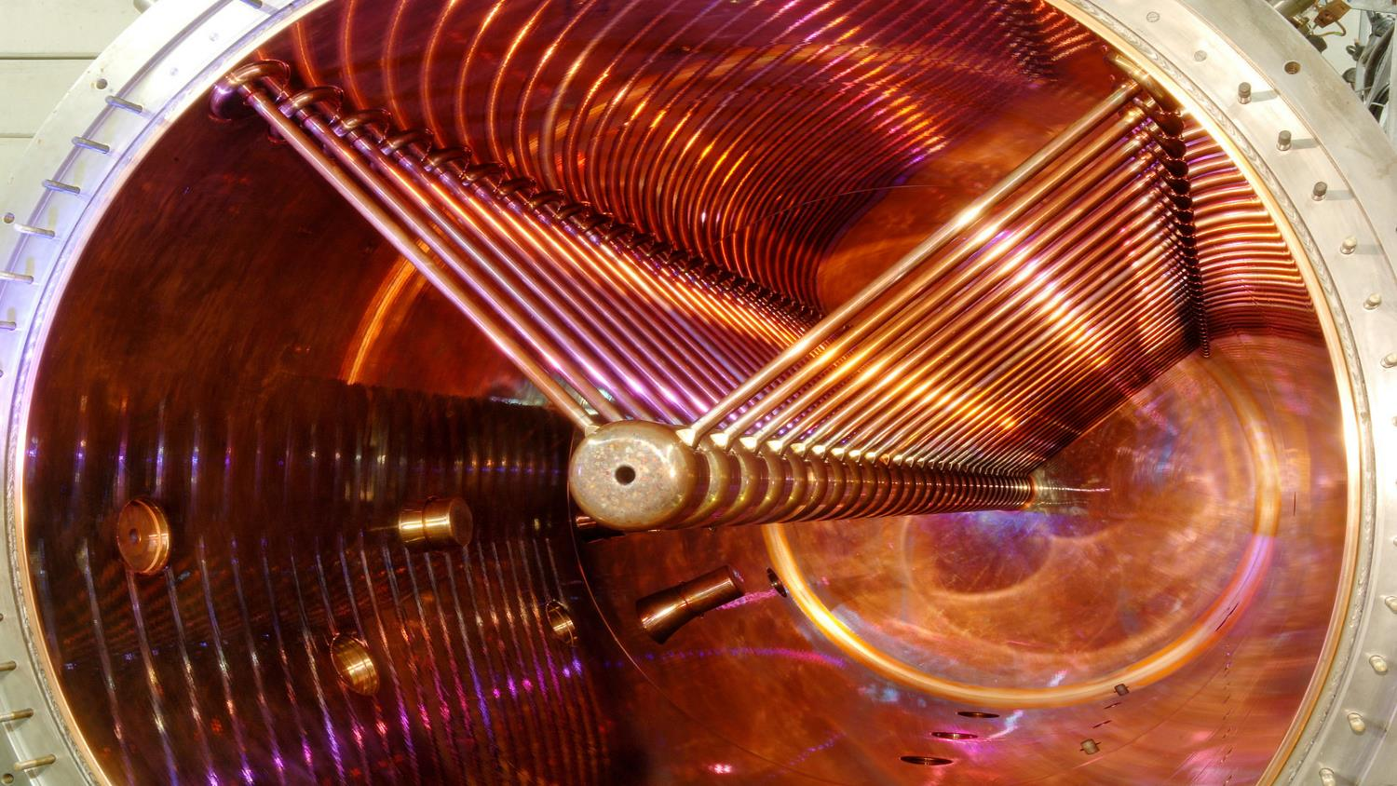
Thank you for your attention!

