Slide 1
Strategic beam time schedule
Stephan Reimann, M. Vossberg
Beam Time Retreat 2024 – Do. 16:30-16:50

Slide 2
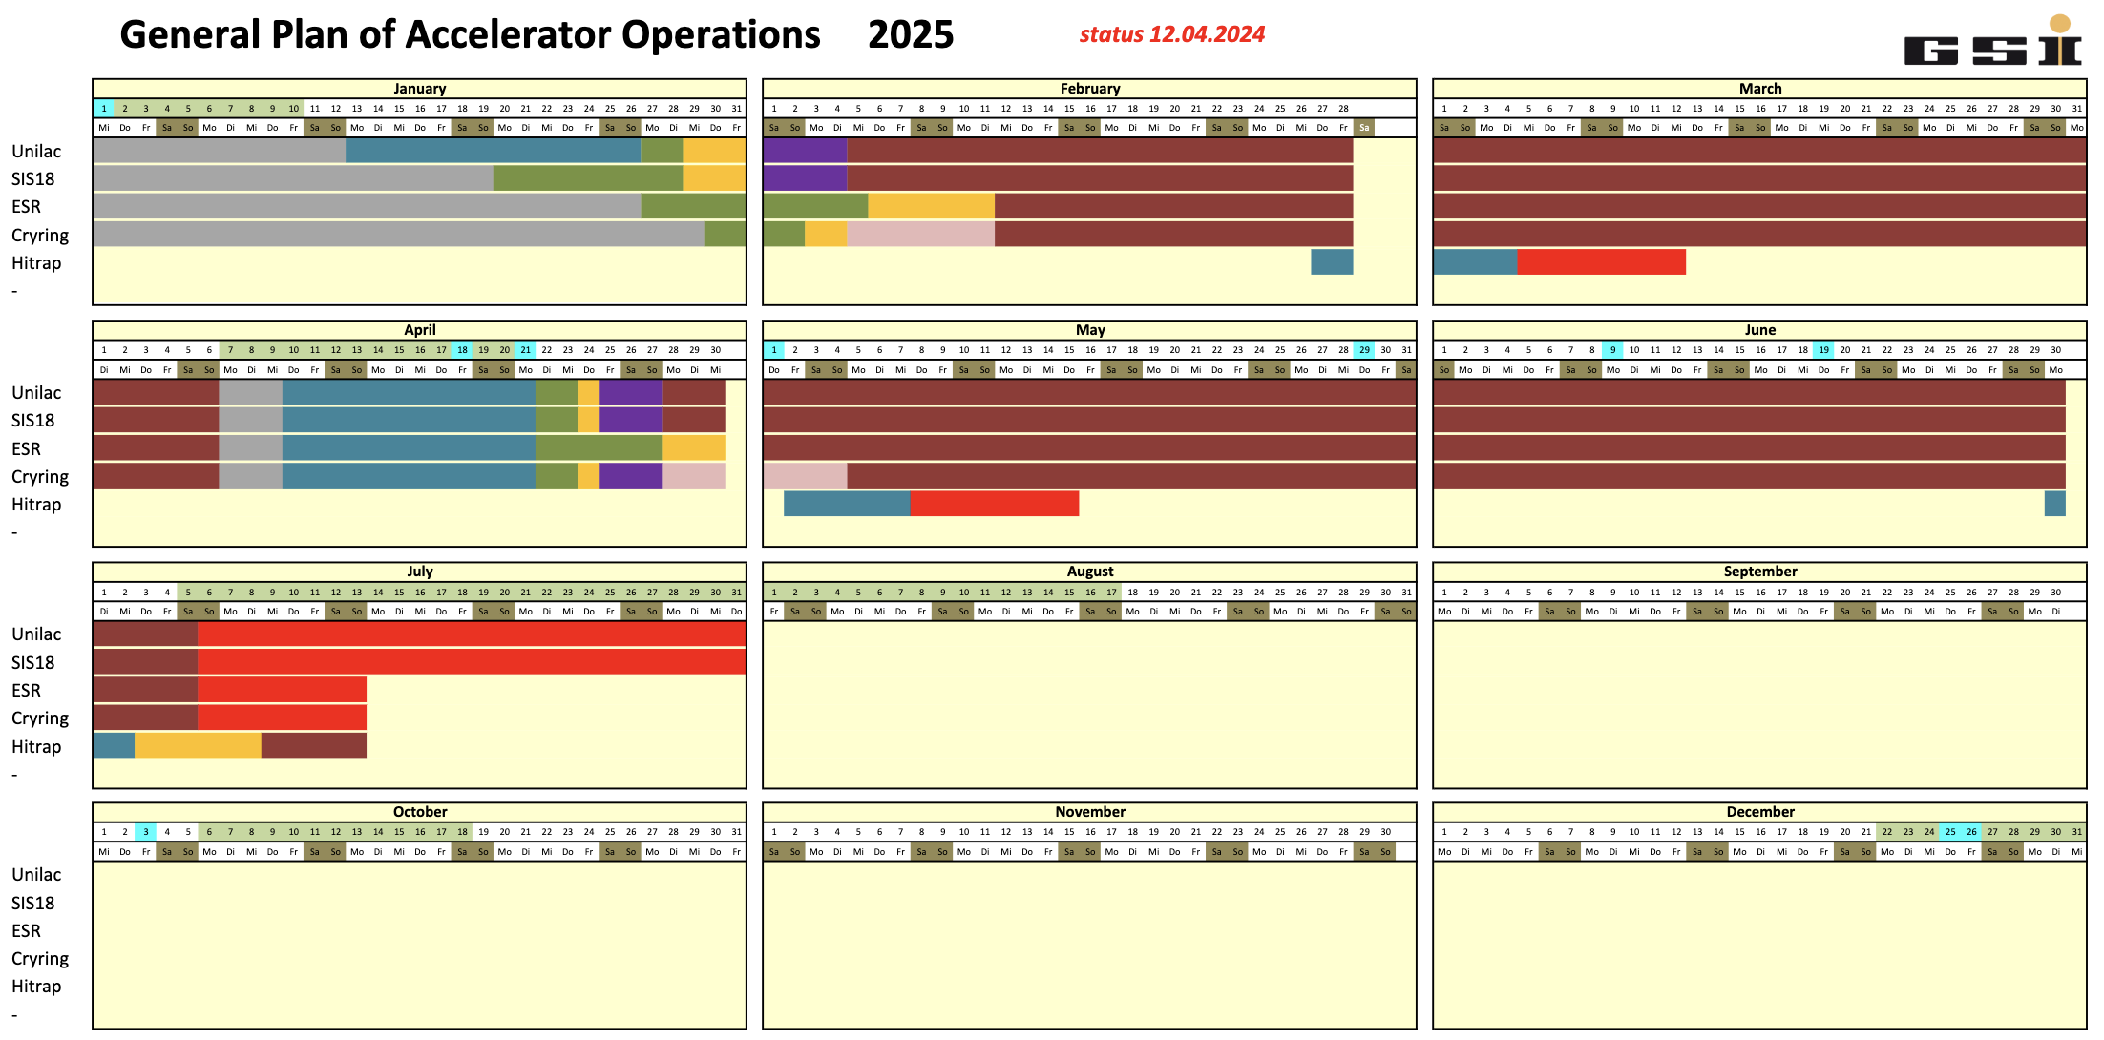
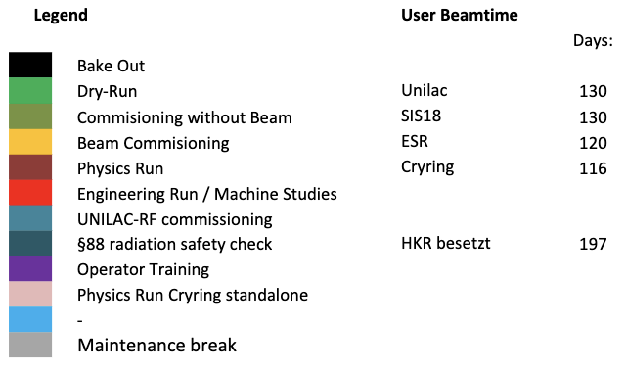
2025

Slide 3
Strategic Schedule – Status Jun. 2024
44
140
0
100

Slide 4
Strategic schedule – FAIR-commissioning perspective
2024 2025 2026 2027 2028
Beam Time
Eng. Run
Beam Time
Beam Time
FCC Construction & Procurement of Interior equipment
FCC - MCR commissioning
operation from FCC
Injector Controls Upgrade: 1st version of new production system
Injector Controls Upgrade: finalization
Controls & BI Digitization UNILAC, SIS18, ESR, Cryring, HEBT
UNILAC operation
with new CS
Cryo 2 Commissioning
HEBT-ES HW-Commissioning
Dry-Runs
SFRS HW-Commissioning
ES Beam Commissioning
Dry-Runs
SFRS Cooldown
HEBT-FS HW-Commissioning
Dry-Runs
SIS100 HW-Commissioning
FS Beam Commissioning
Dry-Runs
SIS100 Cooldown

