Slide 1
Spill Optimization: SIS18 Micro Spill Cavity
Beam Time Retreat
K. Groß, RRF
11.07.2024
Acknowledgments: TRI, BAU, LRF, VAC, ARP, ATP, OPE, SIS100/SIS18, BEA, HADES, mCBM

Slide 2
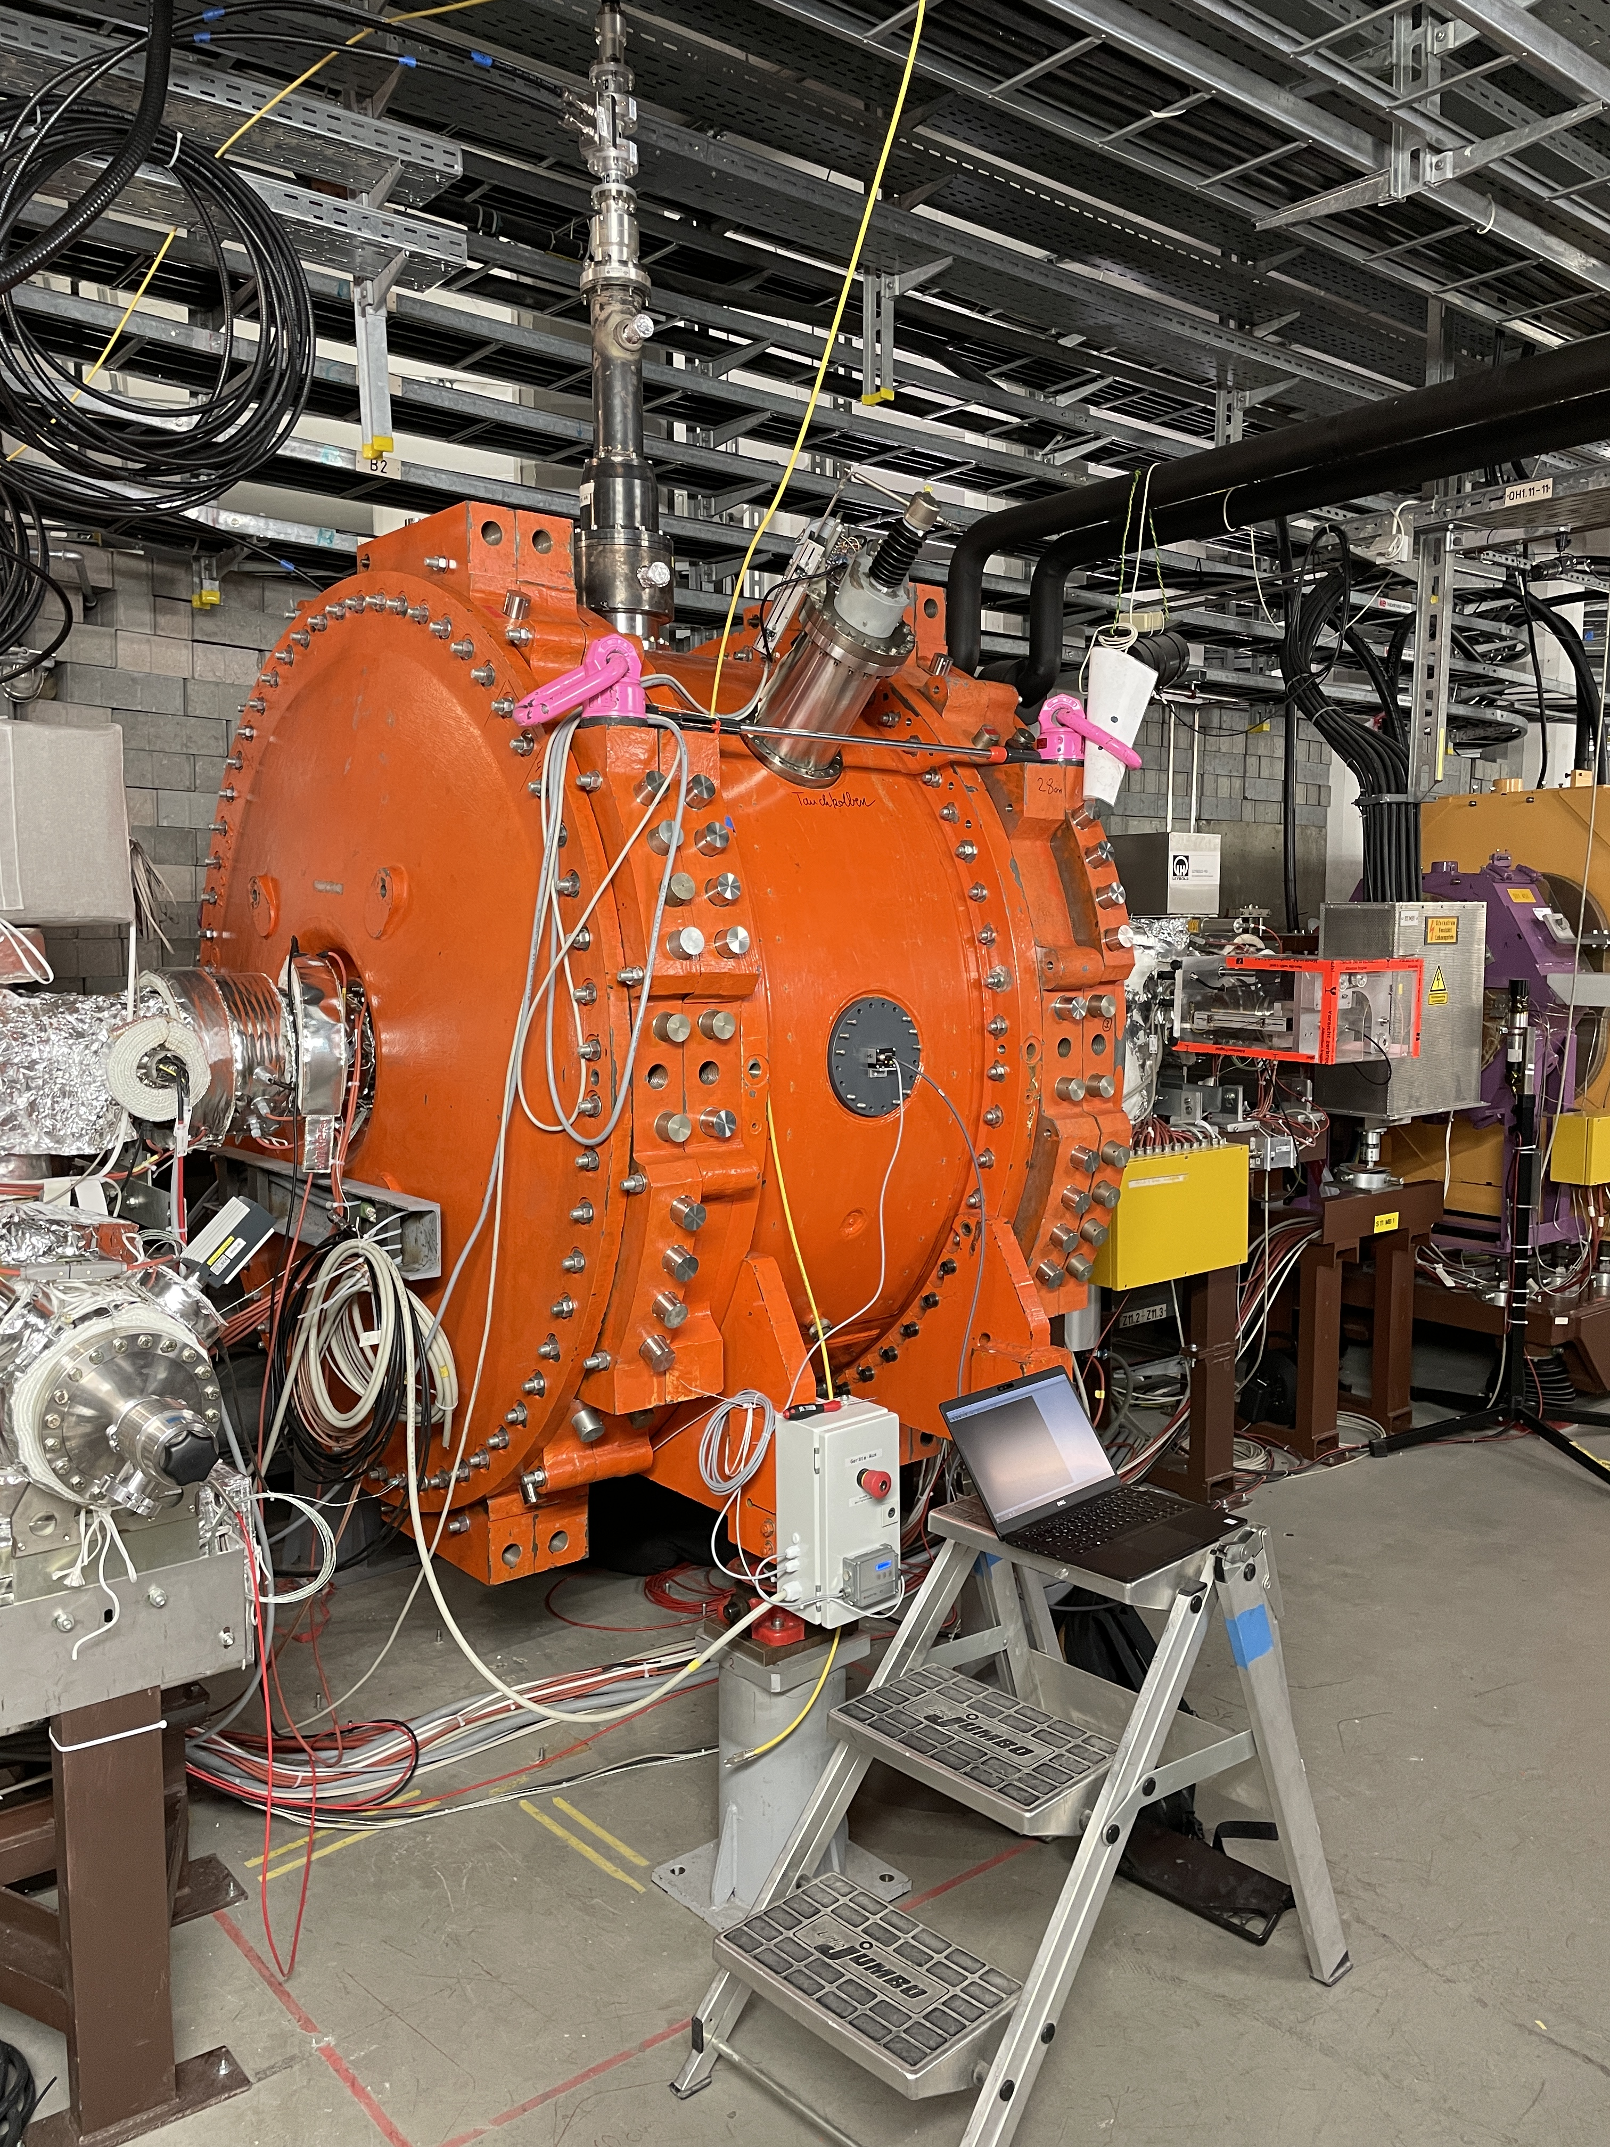
Current Status of Micro Spill Cavity in SIS18
Cavity installed in SIS18 in July 2023
Locally operated (BG 1.016)
Access SIS18 required to remove short-circuit
Impedance without shortcut about 500 kΩ Q ₀ ≈ 5000
Frequency 80.3 to 81.6 MHz (sufficient for all energies with adjustment of harmonic number)
Gap voltage amplitude 1.5 kV without conditioning & warmup (up to 25 kV in test setup)
Conditioning required warming-up & cooling-down time

Slide 3
Experimental Results from Operation with Beam
Dedicated MDE 29.11.2023
Rev. freq. f₀ = 904.8510 kHz
h=4 f_{RF} = 3.6194 MHz
h=90 f_{RF} = 81.4366 MHz
Extraction: Quadrupole-driven 8 seconds
Detector: HHD-CFD
Outline:
Duty Factor
Spectrum
Arrival time with respect to RF
(MDE / Parasitic Operation) HADES 1. / 6.3.2024
Rev. freq. f₀ = 1.1661 MHz
h=4 f_{RF} = 4.664 MHz
h=70 f_{RF} = 81.6283 MHz
Extraction: RF Knock Out with SOS 20 seconds (Noise / Noise++ / 3 Sines)
Detector: multiplicity signal derived from HADES / HHDDI2P
Evaluation based on code by P. Niedermayer, data recorded by T. Milosic and ideas from P. Forck, R. Singh, S. Sorge and J. Yang → Thanks to all!

Slide 4
Experimental Results from Operation with Beam
Dedicated MDE 29.11.2023
Extraction: Quadrupole-driven (without SOS) 8 seconds
Detector: HHD-CFD

Slide 5
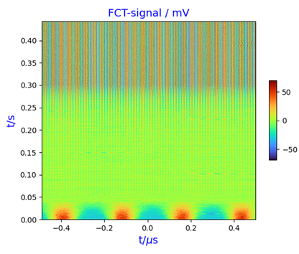
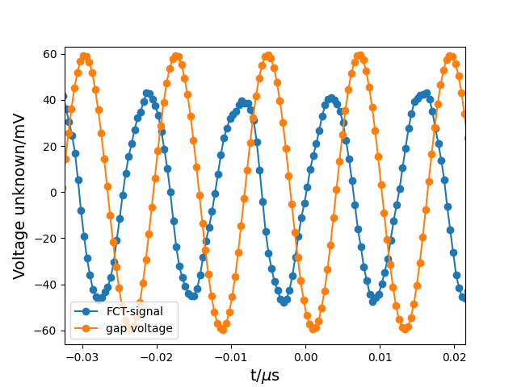
Experimental Results from Operation with Beam Dedicated MDE 29.11.2023
Bunched beam during extraction
Rebunching at h=90
Debunching at h=4

Slide 6
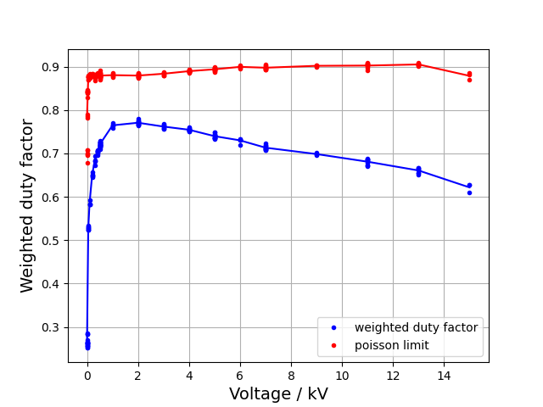
Experimental Results from Operation with Beam Dedicated MDE 29.11.2023
Spill quality / weighted duty factor ($t_{bin}=10$ μs, $t_{av}=10$ ms)
167 spills, 16 voltages
Valid for $t_{bin}<1$ μs
$F_{av}=\frac{\sum_{k}{N_{k}F_{k}}}{\sum_{k}{N_{k}}}$ with $F=\frac{μ^{2}}{μ^{2}+σ^{2}}=\frac{{\left\langle n\right\rangle }^{2}}{\left\langle n^{2}\right\rangle }$ $n$ in $t_{bin}$, $N$ in $t_{av}$
Optimal voltage found at 2 kV is only valid for ¹⁴N⁷⁺ @ 300 MeV/u
Optimum synchrotron tune found at 2 kV is 0.0038
Meaning of optimal synchrotron tune → next MDE / next slide

Slide 7
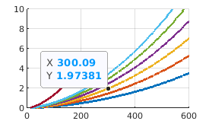
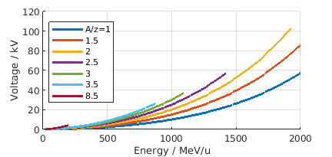
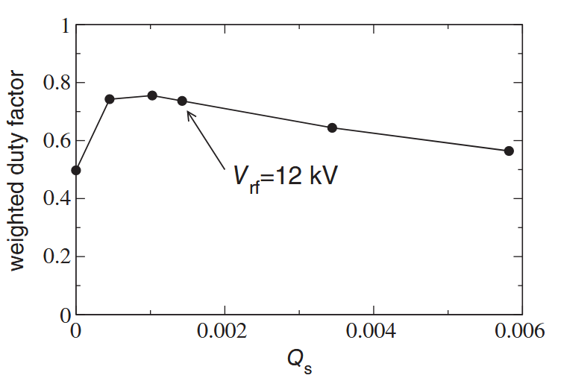
Experimental Results from Operation with Beam Dedicated MDE 29.11.2023 - Outlook
Next MDE – find optimal gap voltage amplitude:
Assumption based on [1] and private communication
Similar synchrotron tune → similar duty factor
Strongest impact
Transverse beam widths
Momentum width
Synchrotron tune
[1] S. Sorge et al, PR AB 26, 014402 (2023)

Slide 8
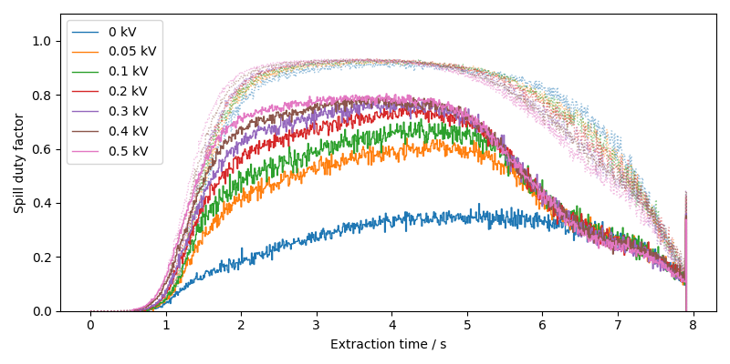
Experimental Results from Operation with Beam Dedicated MDE 29.11.2023
Spill duty factor over time – up to 500 V
Spill duty factor increases with gap voltage

Slide 9
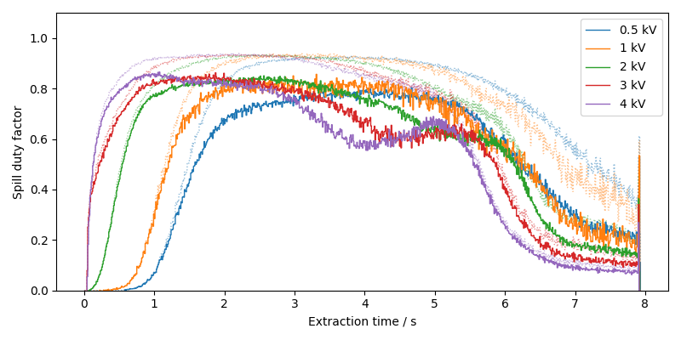
Experimental Results from Operation with Beam Dedicated MDE 29.11.2023
Spill duty factor over time – 500 V to 4 kV
Optimum found at 2 kV
Second local max. for gap voltage > 2 kV

Slide 10
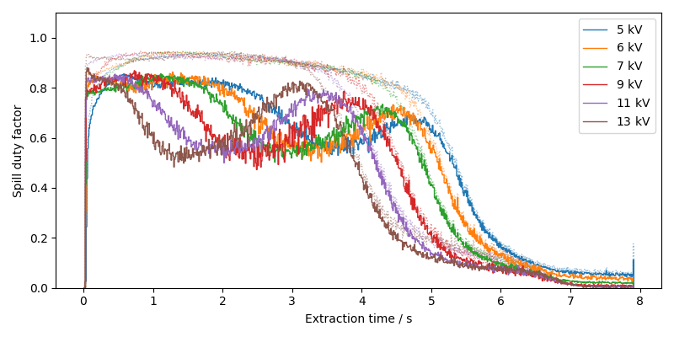
Experimental Results from Operation with Beam Dedicated MDE 29.11.2023
Spill duty factor over time – 5 to 13 kV
Position of second local max. seems to depend on tune shift
Further evaluation necessary

Slide 11
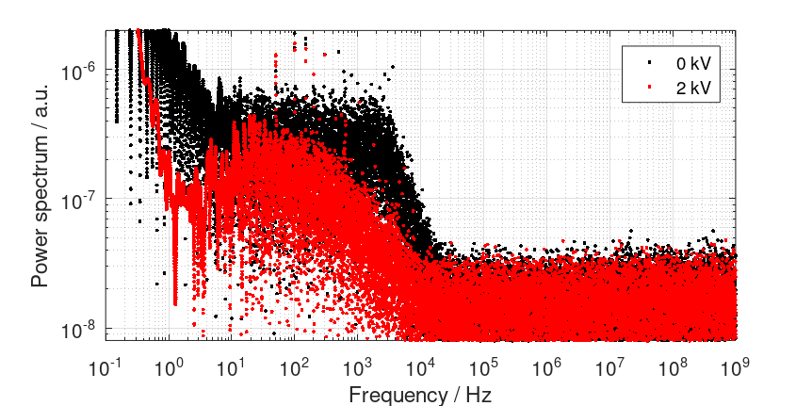
Experimental Results from Operation with Beam Dedicated MDE 29.11.2023
Spectrum of extracted beam
Improvement for all frequencies

Slide 12
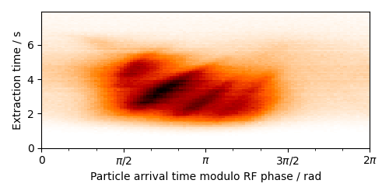
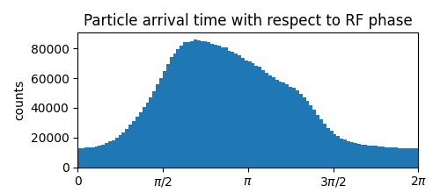
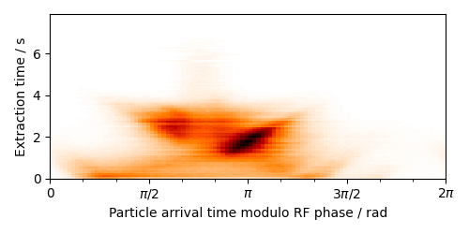
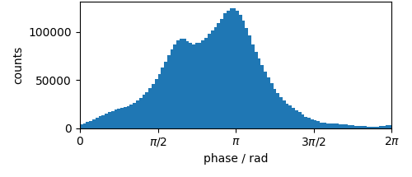
Experimental Results from Operation with Beam Dedicated MDE 29.11.2023
Arrival time with respect to RF phase (12.25 ns) - further evaluation needed
1 kV
13 kV

Slide 13
Experimental Results from Operation with Beam
MDE - HADES 1.3.2024
Extraction: RF Knock Out with SOS (Noise / Noise++) 20 seconds
Detector: multiplicity signal with a jitter of several ns derived from HADES

Slide 14
Experimental Results from Operation with Beam Parasitic Operation HADES Beam Time
Measurements performed by beam diagnostics department (BEA) on 1.3.2024
Best results found with spill optimization system AND micro spill cavity on
settings changed*
*) sextupole amplitude increased
tune adjusted

Slide 15
Experimental Results from Operation with Beam Parasitic Operation HADES Beam Time
Measurements performed by beam diagnostics department (BEA) on 1.3.2024
Best results found with spill optimization system AND micro spill cavity on
settings changed*
*) sextupole amplitude increased
tune adjusted

Slide 16
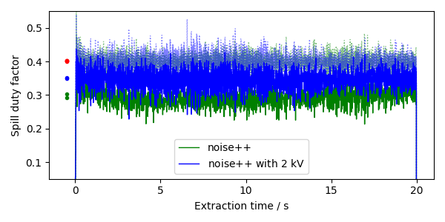
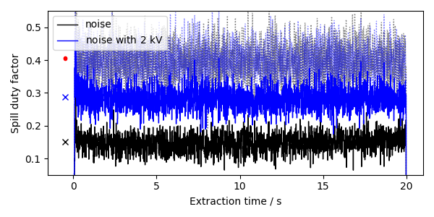
Experimental Results from Operation with Beam Parasitic Operation HADES Beam Time
„noise“ vs. „noise with 2 kV“
Spill duty factor over time
„noise++“ vs. „noise++ with 2 kV“

Slide 17
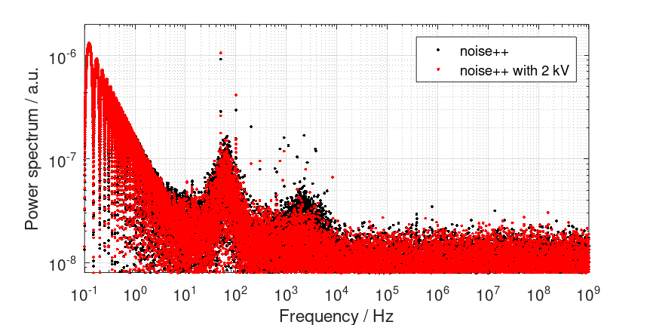
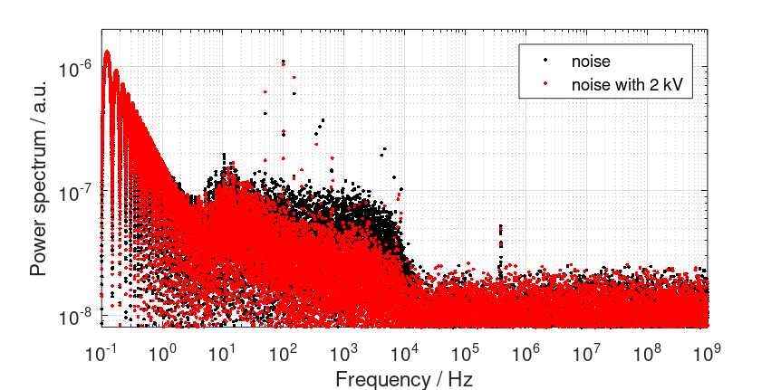
Experimental Results from Operation with Beam Parasitic Operation HADES Beam Time
„noise“ vs. „noise with 2 kV“
Fourier series
„noise++“ vs. „noise++ with 2 kV“

Slide 18
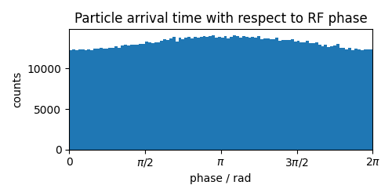
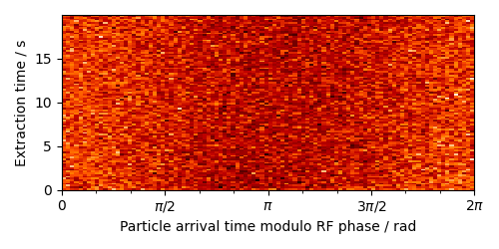
Experimental Results from Operation with Beam Parasitic Operation HADES Beam Time
Measurements performed on 1.3.2024
“noise++ with 2 kV”
multiplicity signal → over time → not “structured”
→ Washed-out due to multiplicity signal with a jitter of several ns
→ Structure (29.11.23) likely due to tune shift (quadrupole-driven extraction)

Slide 19
Experimental Results from Operation with Beam
Parasitic Operation HADES 6.3.2024
Extraction: RF Knock Out with SOS (3 Sines) 20 seconds
Detector: HHDDI2P

Slide 20
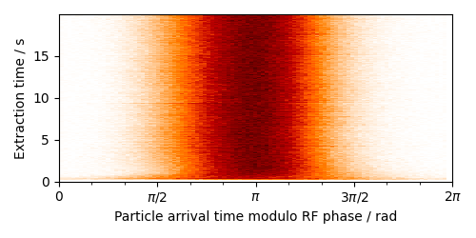
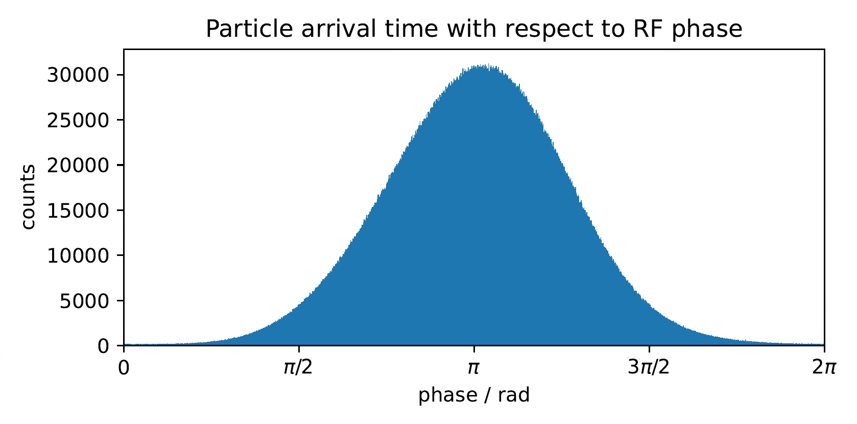
Experimental Results from Operation with Beam Parasitic Operation HADES Beam Time
Measurements performed by beam diagnostics group on 6.3.2024
3 Sines (“+++“) used instead of “noise++“ by SOS
HHDDI2P 10⁷ ions / (20 s ∙ 81.63 MHz) = 0.006 ions
→ Structure (29.11.23) likely due to tune shift (quadrupole-driven extraction)
No further analysis due to different settings in the only measurement with cavity.

Slide 21
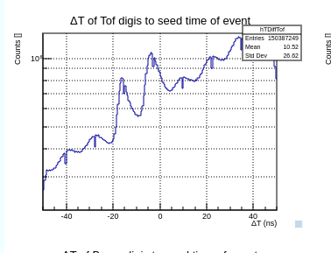
Experimental Results from Operation with Beam Parasitic Operation HADES Beam Time (mCBM, Slow)
time difference TOF-T0 (diamond)
MQ based online analysis by Norbert Herrmann multivariate system of quadratic equations
The RF period of 12.25 ns could be measured at mCBM / HTD during quadrupole-driven slow extraction with cavity on at 1.5 kV

Slide 22
Conclusion and Outlook
Significant improvement in spill quality due to micro spill cavity
Best results with combination of SOS and micro spill cavity
Several further machine experiments necessary
Work in progress to make the cavity usable with less RRF support
Step 1: set amplitude for selected pattern, frequency fixed, read status
Step 2: set frequency and amplitude, remote control (on, off, reset) remote short-circuit (if possible)
Step 3: LSA-model includes results from upcoming MDEs, optimal operational parameters are set automatically
Limited to 1.5 kV (2.25 W) for remote operation in all steps

Slide 23
The End
Thanks
for your attention!
Questions?

Slide 24
Acknowledgements
Development and Commissioning: Accelerator Radiation Protection, Atomic, Quantum & Fundamental Physics, Construction (B. Benz, J. Kalenda), Linac RF (B. Schlitt, G. Schreiber, W. Vinzenz, J. Zappai et al.), Ring RF (R. Balß, B. Breitkreutz, C. Christoph, O. Disser, M. Hardieck, H. Klingbeil, H.G. König, U. Laier, D.E.M. Lens, S. Lux, S. Schäfer, C. Thielmann, T. Winnefeld, B. Zipfel et al.), SIS100/SIS18 (P. Spiller, J. Stadlmann), Transport and Installation (D. Acker, K. Lück, M. Grenz-Gustafson, M. Diebel, K. Kalaitzidis et al.), Vacuum Systems (M.C. Bellachioma, E. Renz, G. Savino)
Spill Measurements: Accelerator Physics (S. Sorge), Beam Instrumentation (P. Boutachkov, O. Chorniy, P. Forck, T. Milosic, P. Niedermayer, R. Singh, J. Yang), SIS100/SIS18, HADES/mCBM (J. Pietraszko, C. Strum, M. Traxler)
Machine Operating and Discussions: (Accelerator) Operation(s) (R. Aßmann, A. Bloch-Späth, C. Böhm, V. Kamerdzhiev, H. Kummerfeldt, F. Lorenz, S. Reimann, Y. Valdau)

Slide 25
Backup Slides
Cavity Development, Operation and Upgrade
Development
Requirement on Frequency
Gap Voltage Calibration
RF Frequency and Harmonic Number
Operation
Conditioning
Temperature Development
Vacuum
High Beam Intensities
Upgrade
Control System
Short-

Slide 26
Requirement on Frequency
J. Pietraszko, “The Hades/CBM physics case requirements”, oral presentation at Slow Extraction Workshop, Darmstadt, Germany, June 2016.

Slide 27
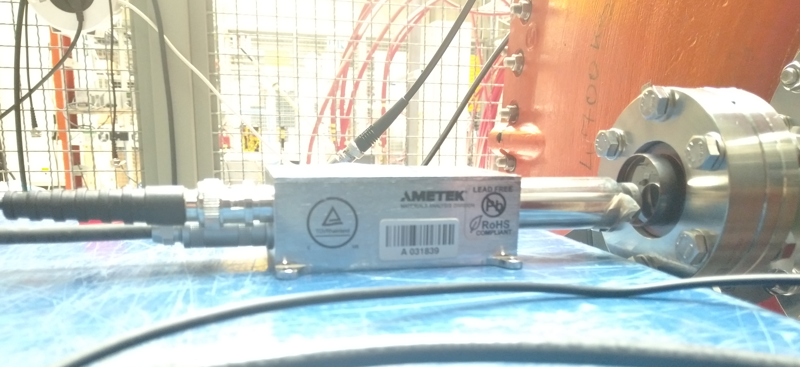
Gap Voltage Calibration

Slide 28
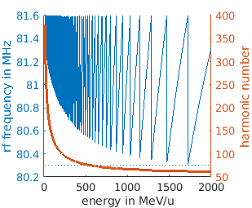
RF Frequency and Harmonic Number
One of several possibilities

Slide 29
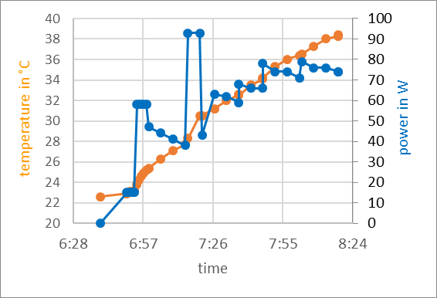
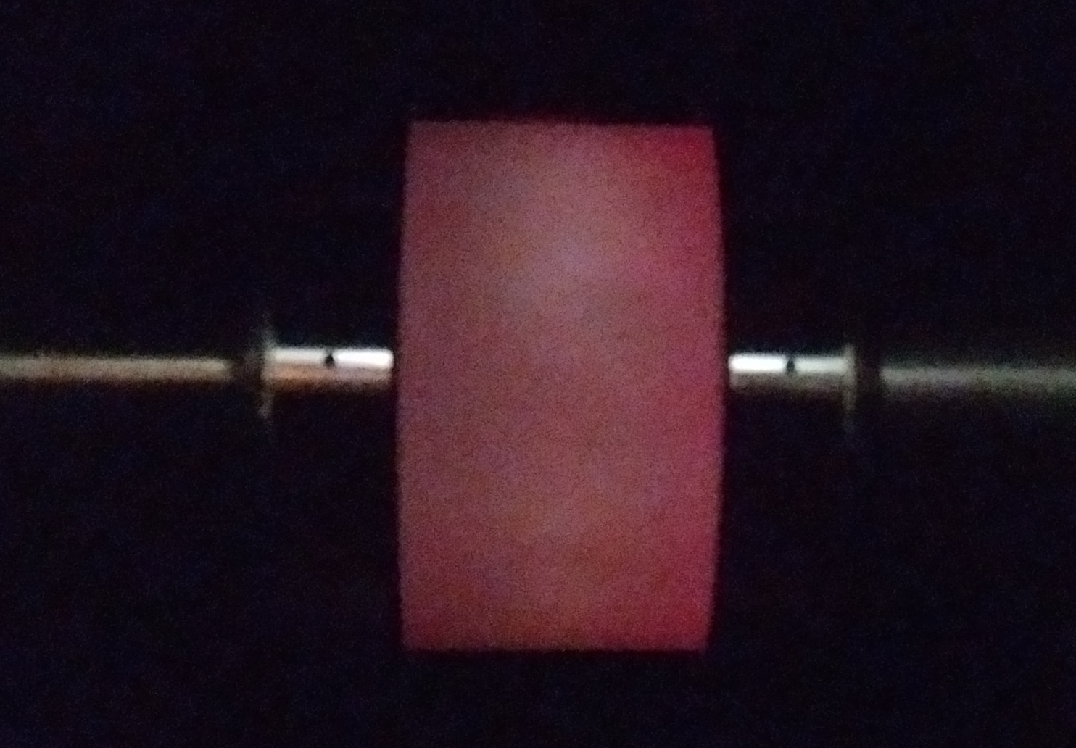
Conditioning
First conditioning in beam time can take 6 – 29 hours and require a power of up to 225 W (15 kV)

Slide 30
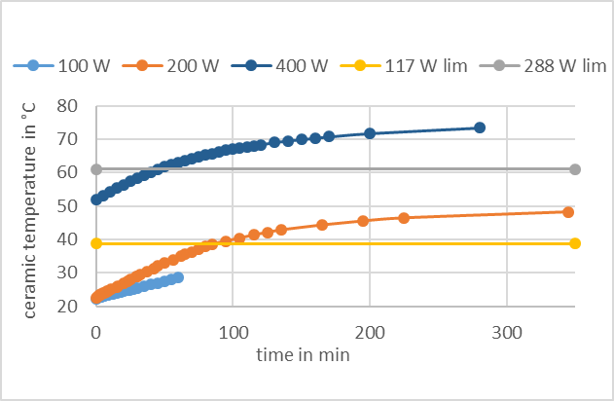
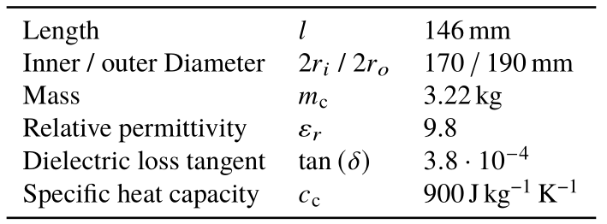
Temperature Development
$$∆θ=\frac{Energy}{m∙900 \frac{J}{kg K}}=\frac{4 W}{3.22 kg∙900\frac{Ws}{kg K}}=0.08 \frac{K}{min}$$
Properties of the ceramic gap

Slide 31
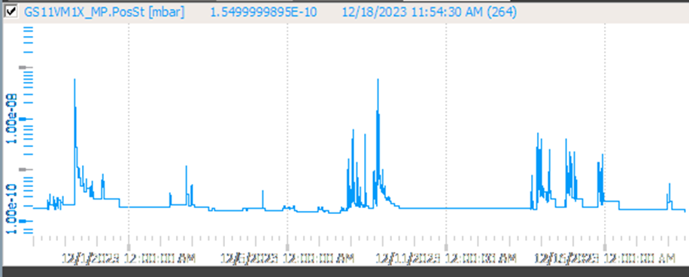
Vacuum
Worst case „ conditioning“ limited in time and similar to high current operation
Vacuum (GS11VM1X) 1.5·10⁻¹⁰
Beam pipe tested as any other beam pipe
Heat out (up to now) limited to ceramic
Vacuum not influenced by operation at 1.5 kV
Only necessary for MDEs with high voltage requirements
Slow conditioning leady to lower peaks in the vacuum pressure
29.11.
8. & 9.12.
13.-16.12.

Slide 32
Vacuum
Only the beam pipe is under vacuum

Slide 33
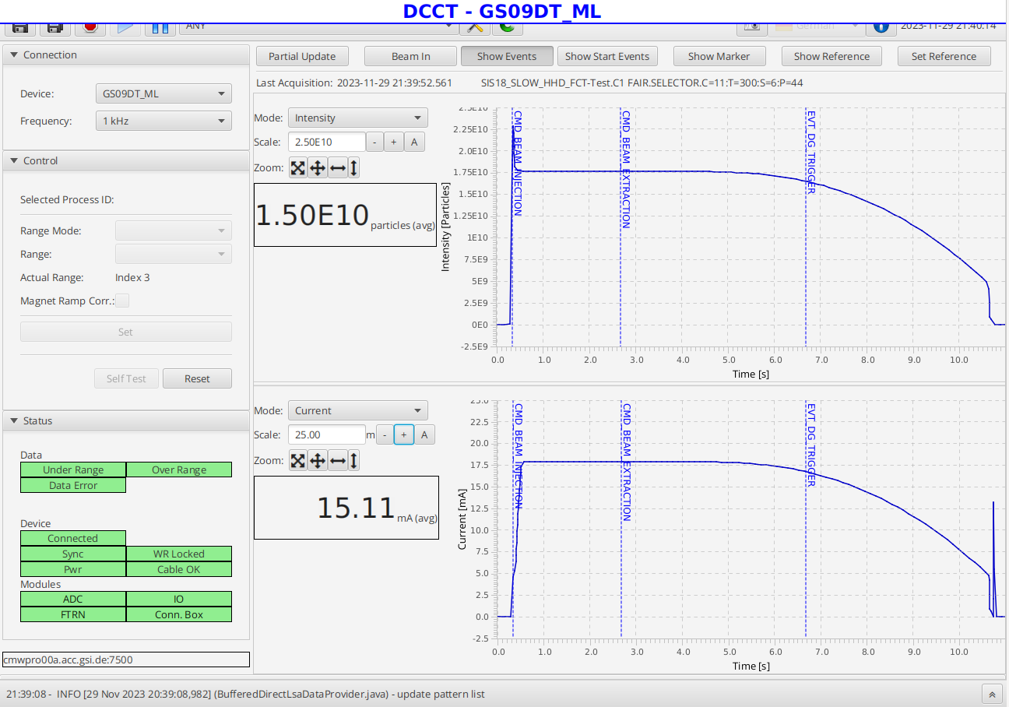
High Beam Intensities
Additional test:
Successful acceleration of 1.5·10¹⁰ particles, 15 mA
Induced voltage was < 100 V

Slide 34
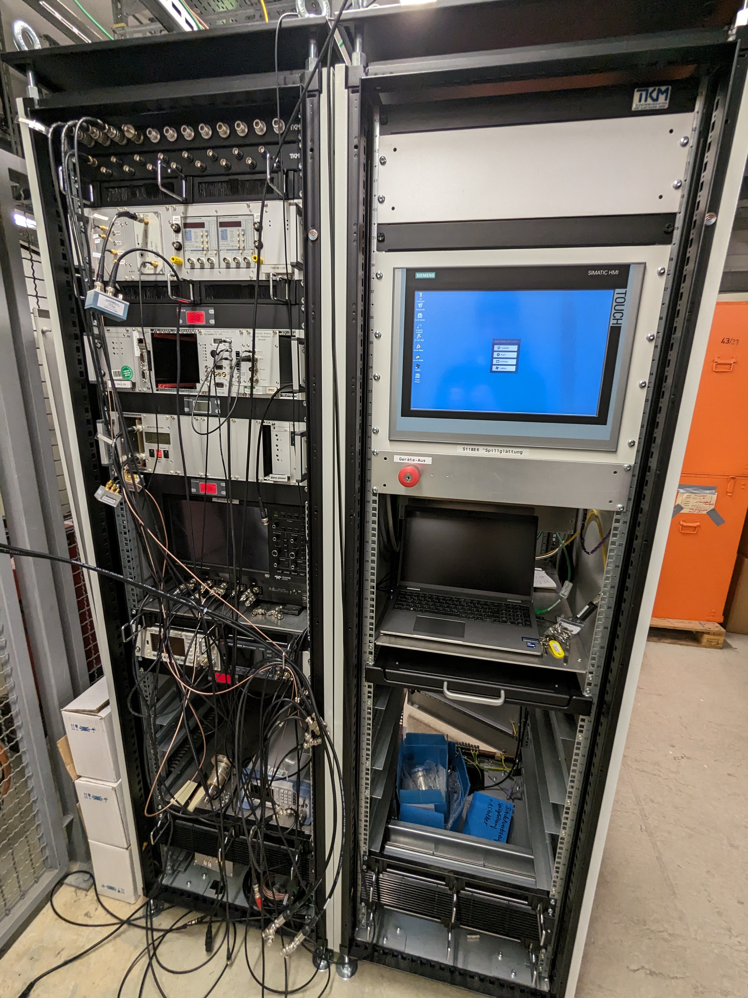
Steps towards Operation from Main Control Room
Ramps and plunger control have to be integrated into control system
PLC for interlock handling to be integrated in control system
Limitation to 1.5 kV for standard operation without conditioning remains
New output- and directional coupler for lower power
Automatic short-circuit needed
not cycle to cycle (impedance applies to all running virt. accel.)
ambitious, evaluation of possibilities (new development of a plunger)

Slide 35
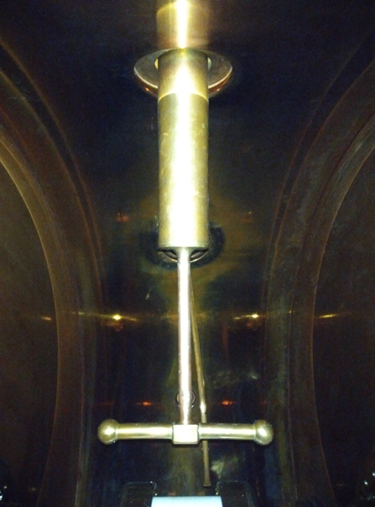
Short Circuit
Construction of a new, small plunger

Slide 36
Research on Current Limitations
Build up test environment / resonator to analyze the problems regarding …
Conditioning / plasma discharge:
Why was it not necessary in the test environment, but is necessary in SIS18?
How does this need depend on the vacuum / environment?
Coating, higher conductivity, better hided welds, …
Temperature rise in the ceramic / dielectric losses:
Measurement on Vacon-Temperature
Measurements on Ceramic Probes
Decision on conditioning in SIS18

Slide 37
Backup Slides
Experimental Results
Results not included in the presentation
RF frequency variation
Time structure of spill
Selected frequencies
Ions and energies
Details of the results included in the presentation
Weighted duty factor for variation of t_{bin} and t_{av}
max / mean duty factor
Spectra
Changed settings

Slide 38
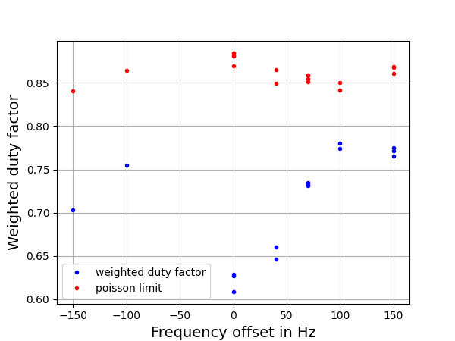
RF Frequency Variation
A shift of 100 Hz means a change in the harmonic number by 0.005 (marked with the bar in the figure – different setup simulation, calculation and measurement)

Slide 39
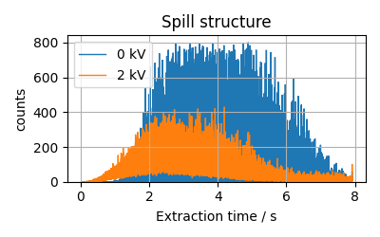
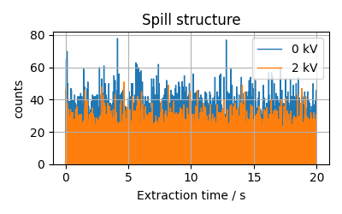
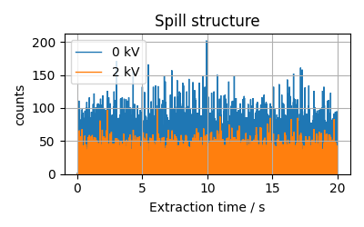
Experimental Results from Operation with Beam Time Structure of Spill
Spill structure – comparison between 0 kV and 2 kV ($t_{bin}=100$ μs)
Quadrupole-driven
RF Knock Out with SOS
„noise++“
„noise” (macro-spill feedback)

Slide 40
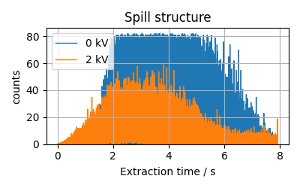
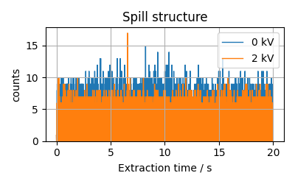
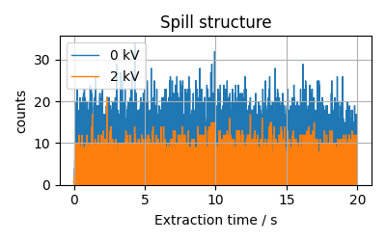
Experimental Results from Operation with Beam Time Structure of Spill
Spill structure – comparison between 0 kV and 2 kV ($t_{bin}=10$ μs)
Quadrupole-driven
RF Knock Out with SOS
„noise++“
„noise” (macro-spill feedback)

Slide 41
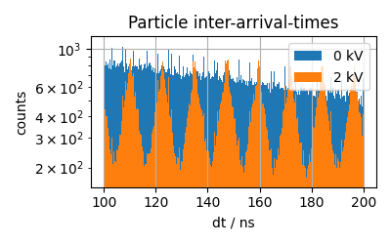
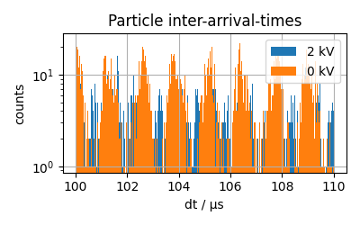
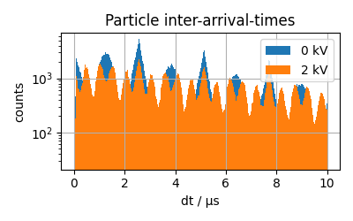
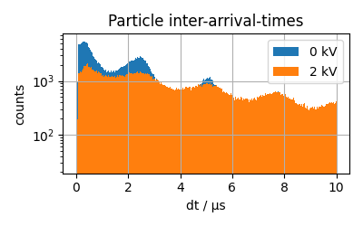
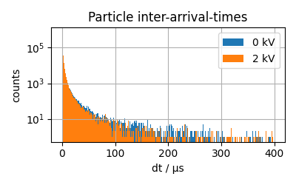
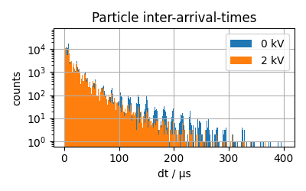
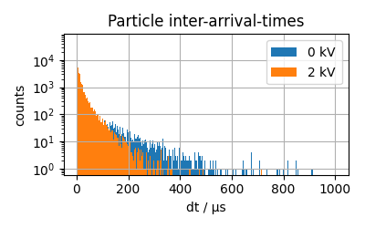
Experimental Results from Operation with Beam Particle inter-arrival-times
Particle inter-arrival-times – comparison between 0 kV and 2 kV
Quadrupole-driven
(80 MHz)
RF Knock Out with SOS
„noise++“ (0.38, 0.76, 1.9 kHz)
„noise” (macro-spill feedback)

Slide 42
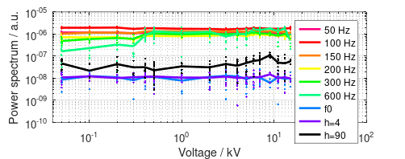
Experimental results from operation with beam Dedicated MDE 29.11.2023 (2 shifts)
No suppression of the dominant harmonics – rausnehmen!

Slide 43
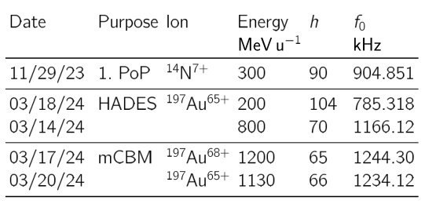
Ions and Energies

Slide 44
Dedicated MDE 29.11.2023 Spill quality / weighted duty factor (¹⁴N⁷⁺ @ 300 MeV/u)
 | t_{bin}=1 μs | t_{bin}=10 μs | t_{bin}=100 μs
t_{av}=1 ms
t_{av}=10 ms
t_{av}=100 ms

Slide 45
Dedicated MDE 29.11.2023 Spill quality / weighted duty factor (¹⁴N⁷⁺ @ 300 MeV/u)
 | t_{bin}=5 μs | t_{bin}=10 μs | t_{bin}=20 μs
t_{av}=5 ms
t_{av}=10 ms
t_{av}=20 ms

Slide 46
Experimental Results from Operation with Beam Dedicated MDE 29.11.2023
Spill quality / weighted duty factor ($t_{bin}=10$ μs, $t_{av}=10$ ms)
167 spills, 16 voltages
Valid for $t_{bin}<1$ μs
$F_{av}=\frac{\sum_{k}{N_{k}F_{k}}}{\sum_{k}{N_{k}}}$ with $F=\frac{max⁡(n)}{\left\langle n\right\rangle }$ $n$ in $t_{bin}$, $N$ in $t_{av}$
Optimal voltage found at 2 kV is only valid for ¹⁴N⁷⁺ @ 300 MeV/u
Optimum synchrotron tune found at 2 kV is 0.0038

Slide 47
Experimental Results from Operation with Beam Parasitic Operation HADES Beam Time
Measurements performed by beam diagnostics department (BEA) on 1.3.2024
Best results found with spill optimization system AND micro spill cavity on
settings changed*
*) sextupole amplitude increased
tune adjusted

Slide 48
Experimental results from operation with beam Dedicated MDE 29.11.2023
Spectrum of extracted beam
Improvement for all frequencies

Slide 49
Experimental results from operation with beam Dedicated MDE 29.11.2023
Spectrum of extracted beam
Improvement for all frequencies

Slide 50
Experimental results from operation with beam Parasitic Operation HADES Beam Time
Fourier series – „noise ++“ vs. „noise ++ with 2 kV“

Slide 51
Experimental results from operation with beam Parasitic Operation HADES Beam Time
Fourier series – „noise ++“ vs. „noise ++ with 2 kV“

Slide 52
Experimental results from operation with beam Parasitic Operation HADES Beam Time
Fourier series – „noise“ vs. „noise with 2 kV“

Slide 53
Experimental results from operation with beam Parasitic Operation HADES Beam Time
Fourier series – „noise“ vs. „noise with 2 kV“

Slide 54
Experimental results from operation with beam Dedicated MDE 29.11.2023
Different Settings

