Slide 1
UNILAC Pulsed Gasstripper
P. Gerhard/PSU
on behalf of the gasstripper team

Slide 2
Outline
Introduction
Progress since 2022
Oil issues
Machine development beam time 2023
Preparation for and experiences from beam time operation 2024
Summary & outlook

Slide 3
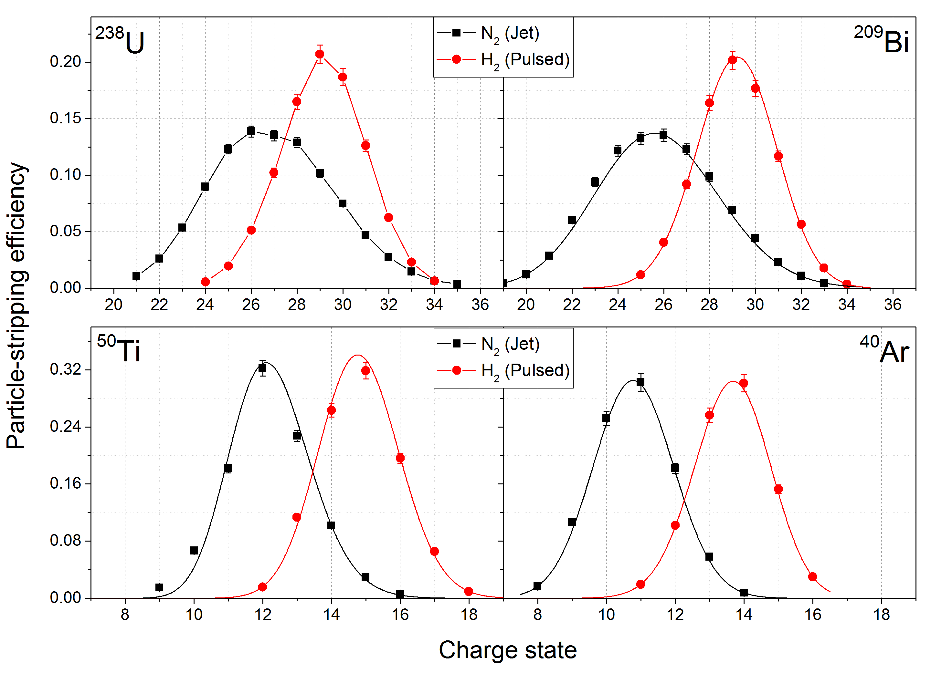
Why do we want to use H₂ instead of N₂?
Measured charge state distributions with highest <q>
Heavy ions (U, Bi):
  more narrow distribution
  increased stripping efficiency
  higher beam intensity
All ions:
  higher average charge state
  less rf power
  higher energy in SIS18
P. Scharrer et al., Proc. LINAC16, TUOP03

Slide 4
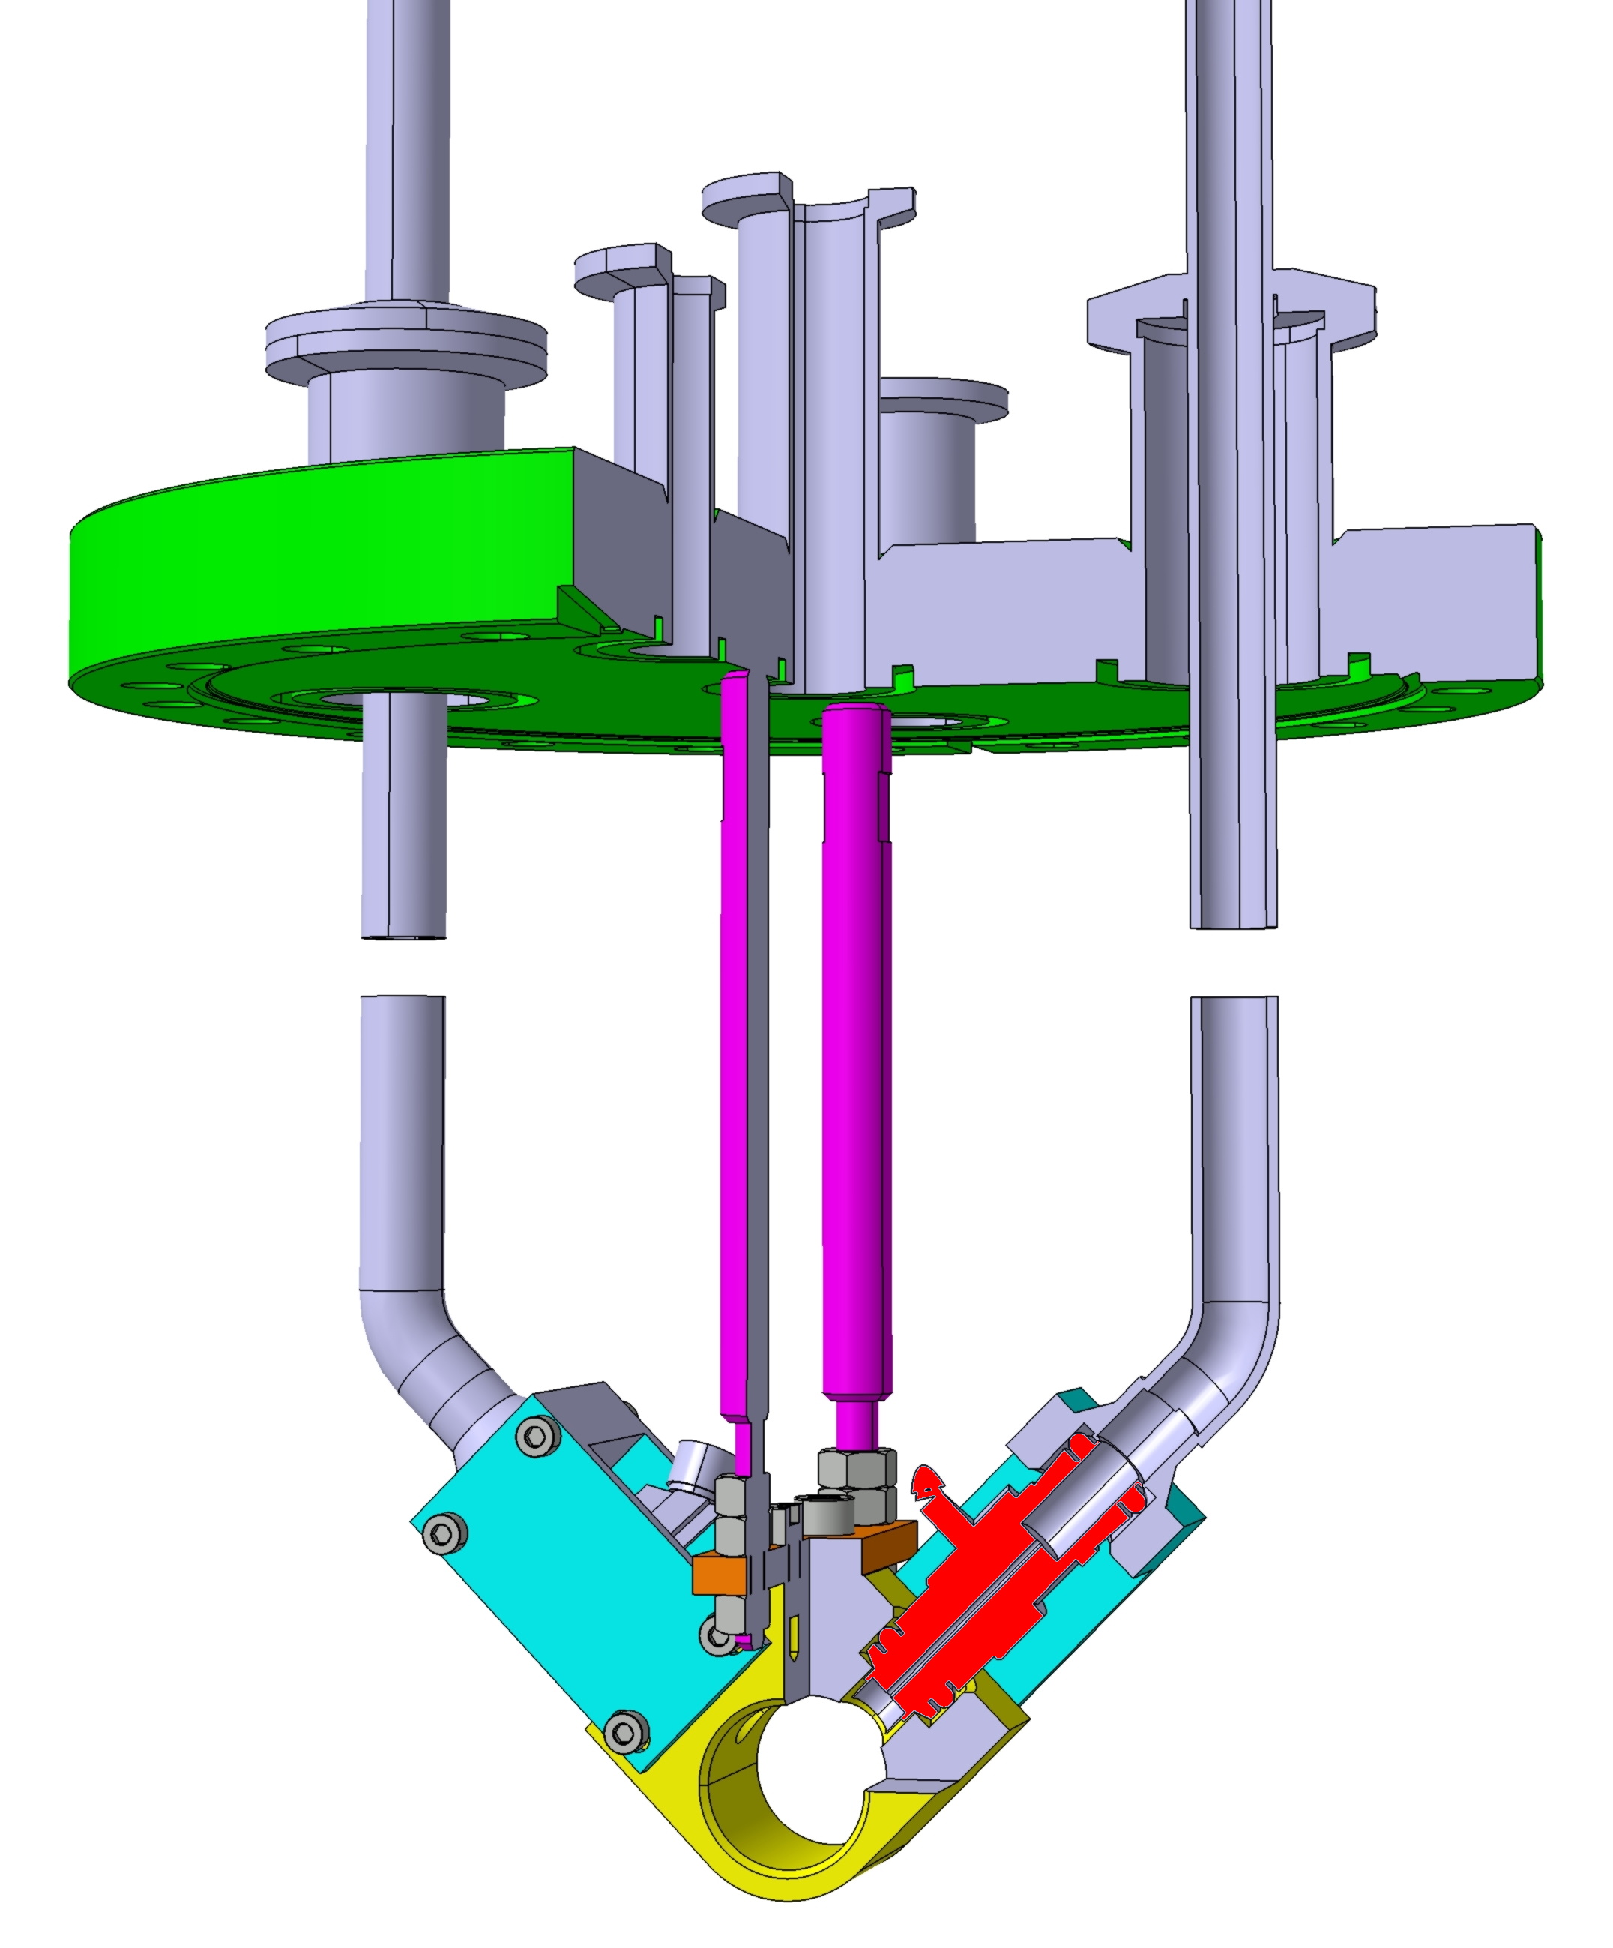
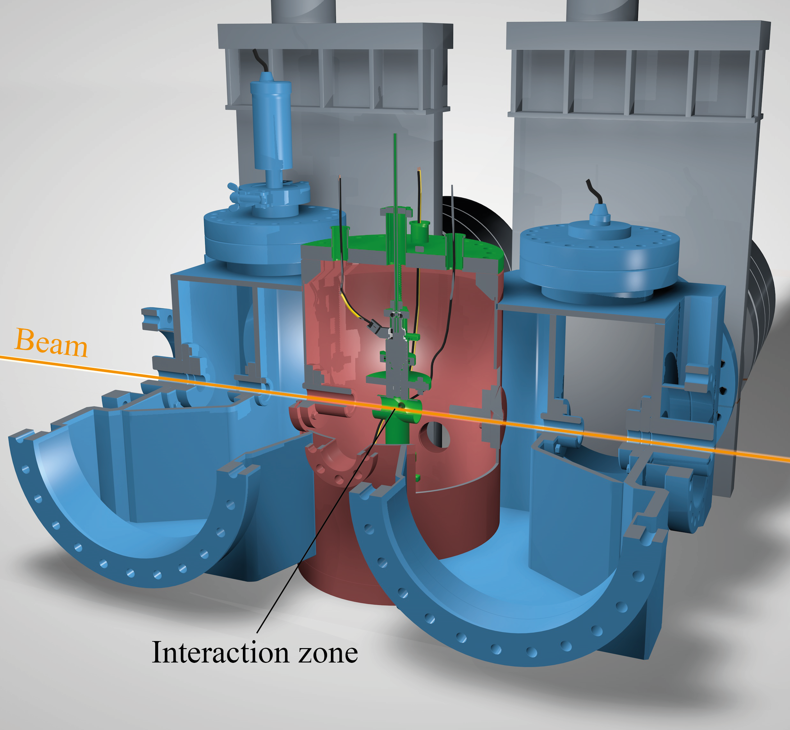
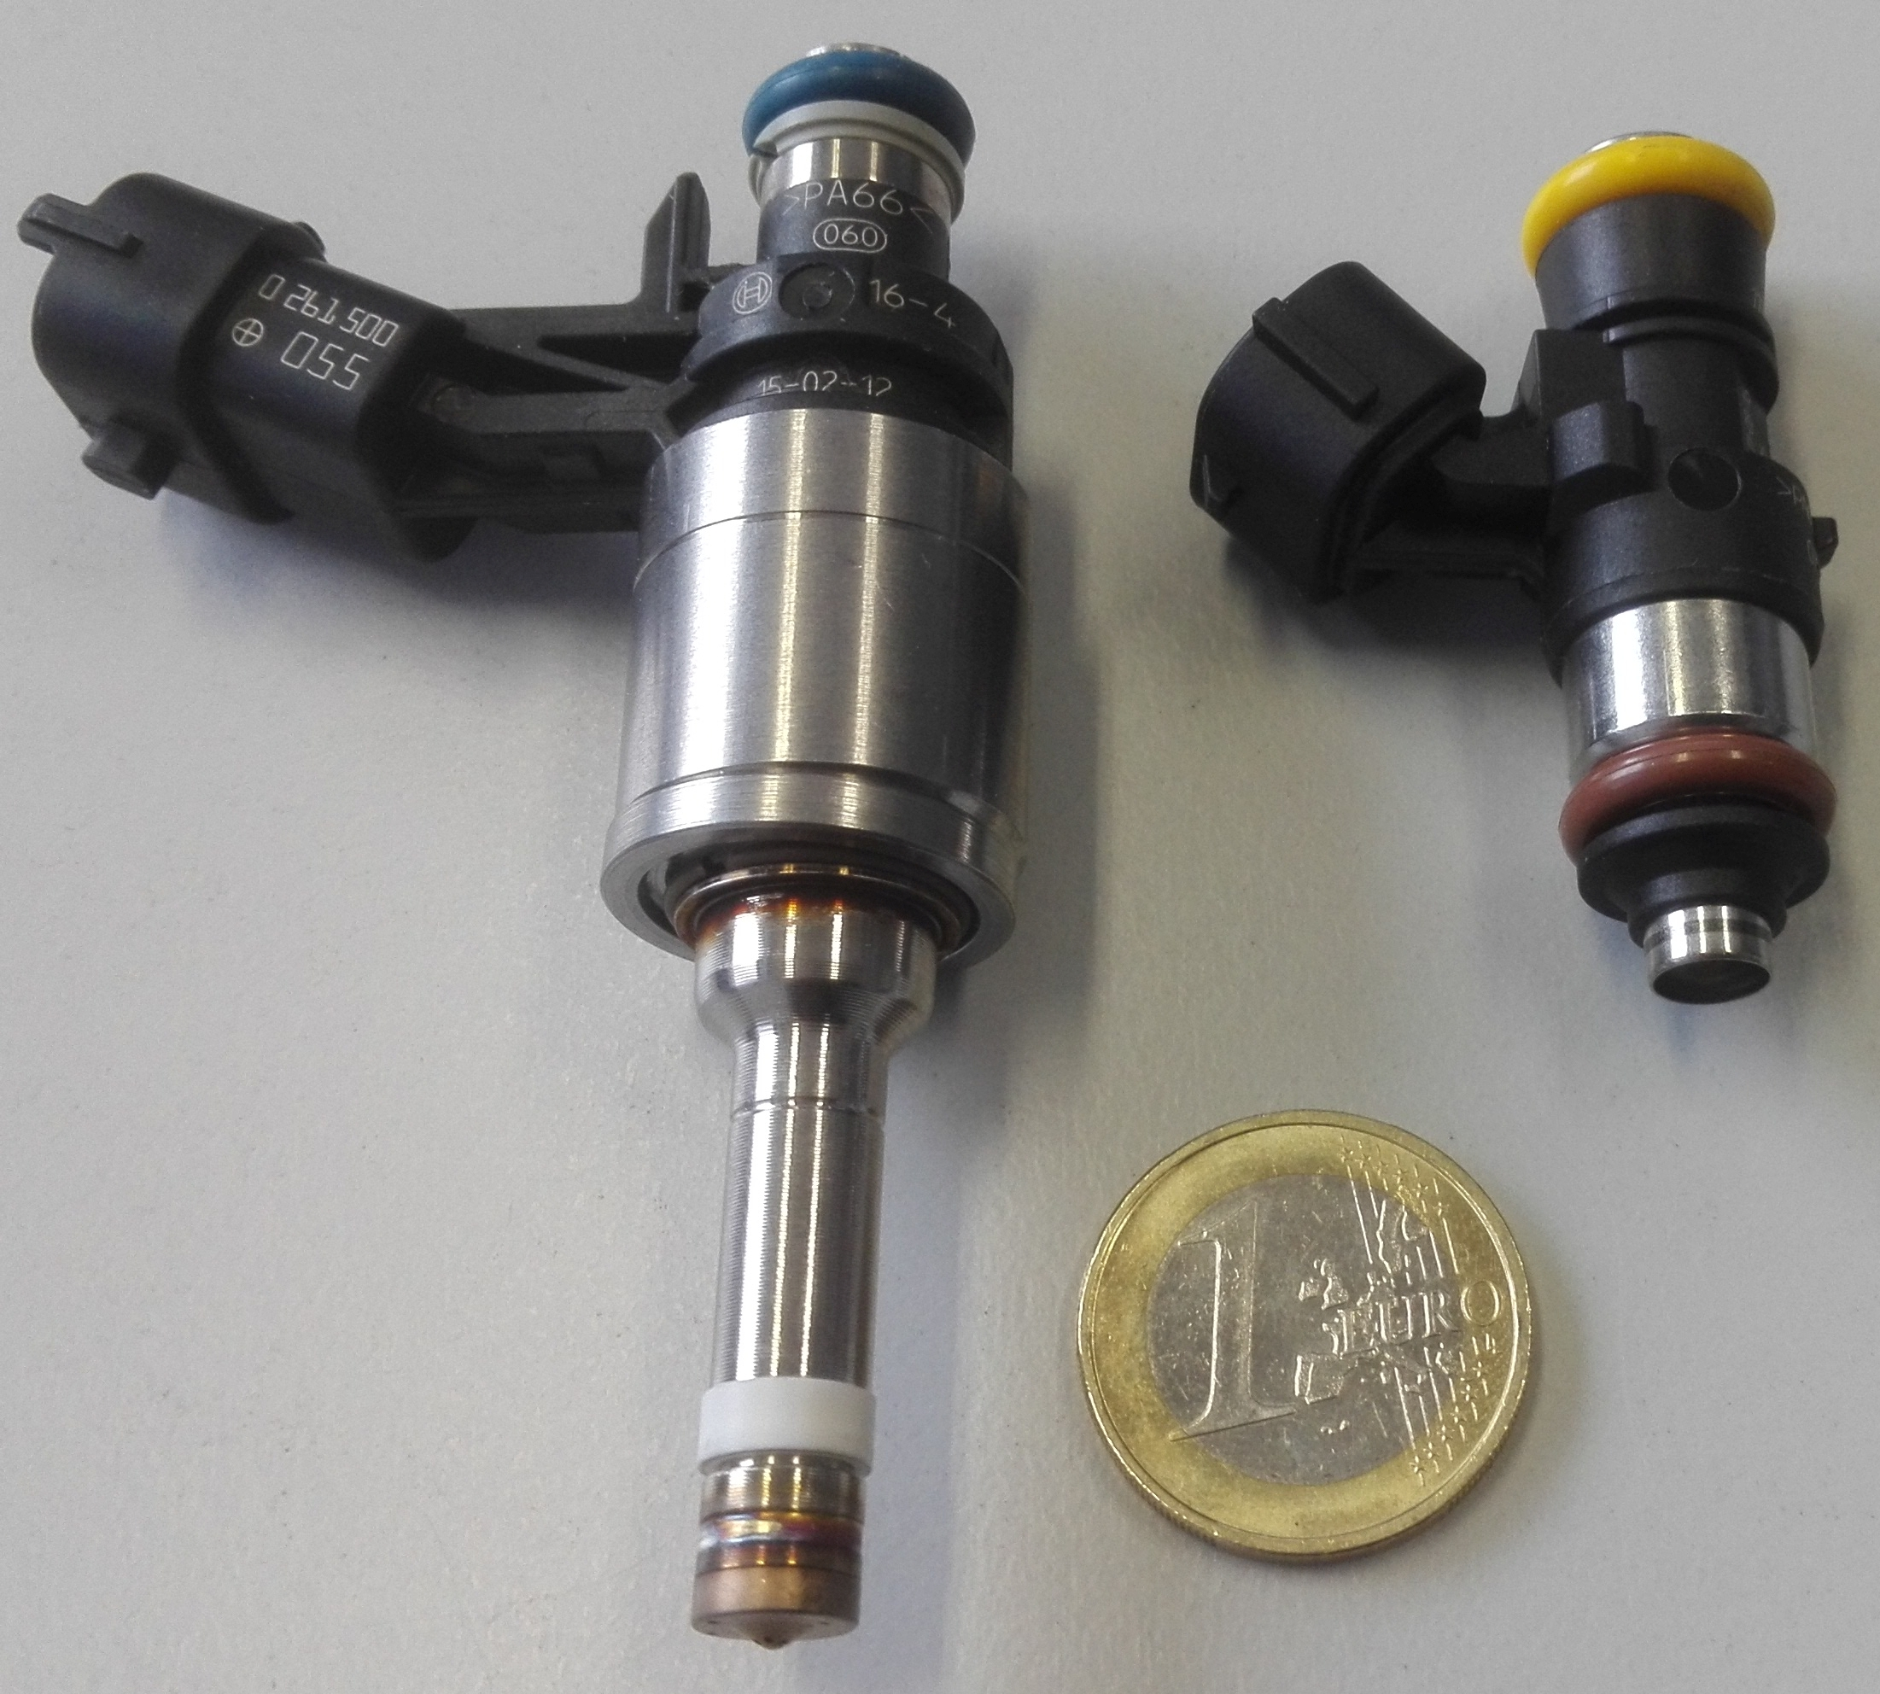
Gas Stripper Chamber and Pulsed Valves Setup
Liquid and gaseous
media valves
gas
supply
Pulsed stripper
setup with
two gas valves
valve
interaction zone

Slide 5
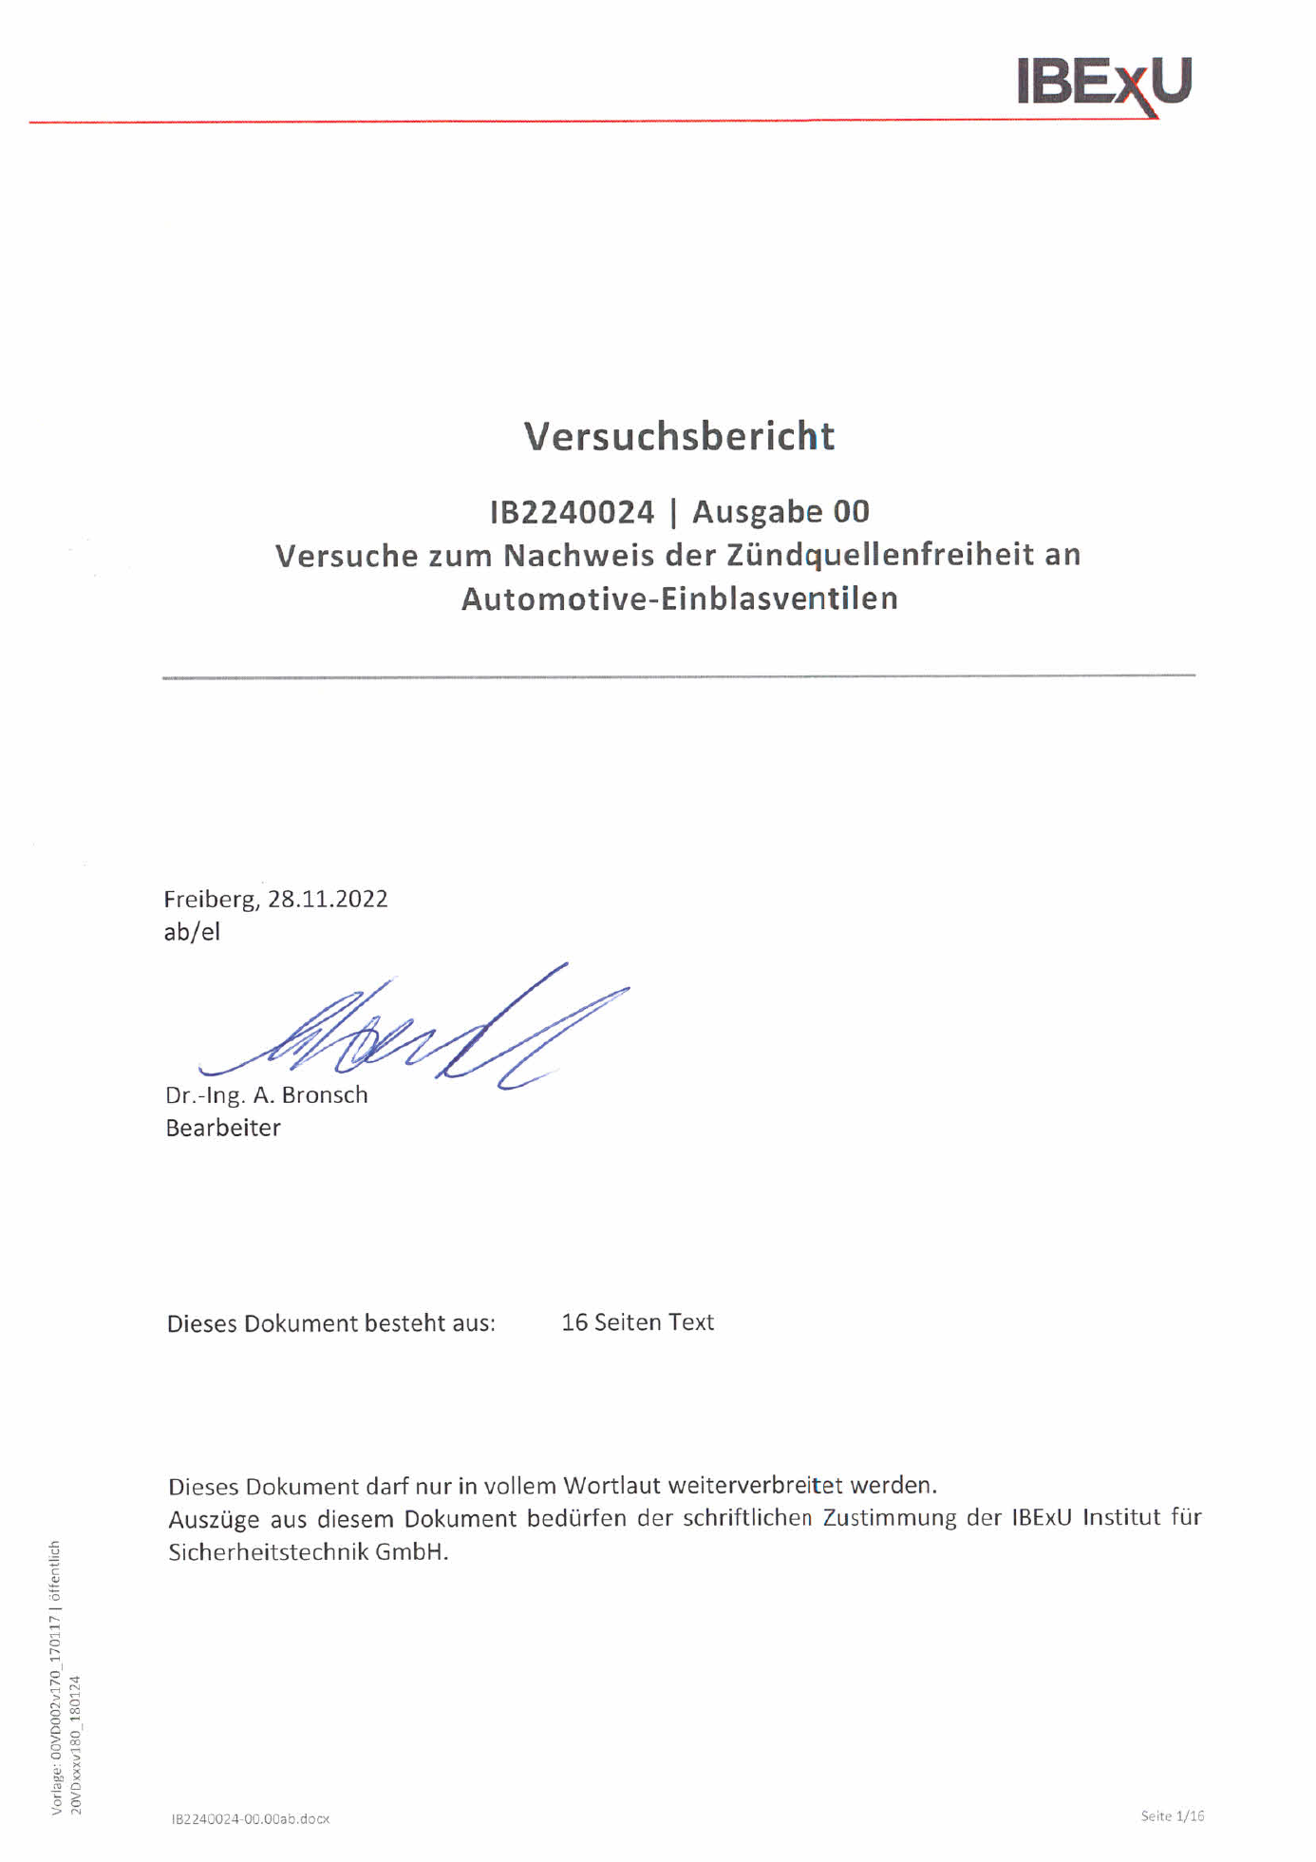
Formal Progress in Safety
Report on the Absence of
Ignition Sources in the Pulsed Valves
Draft Explosion Safety Document

Slide 6
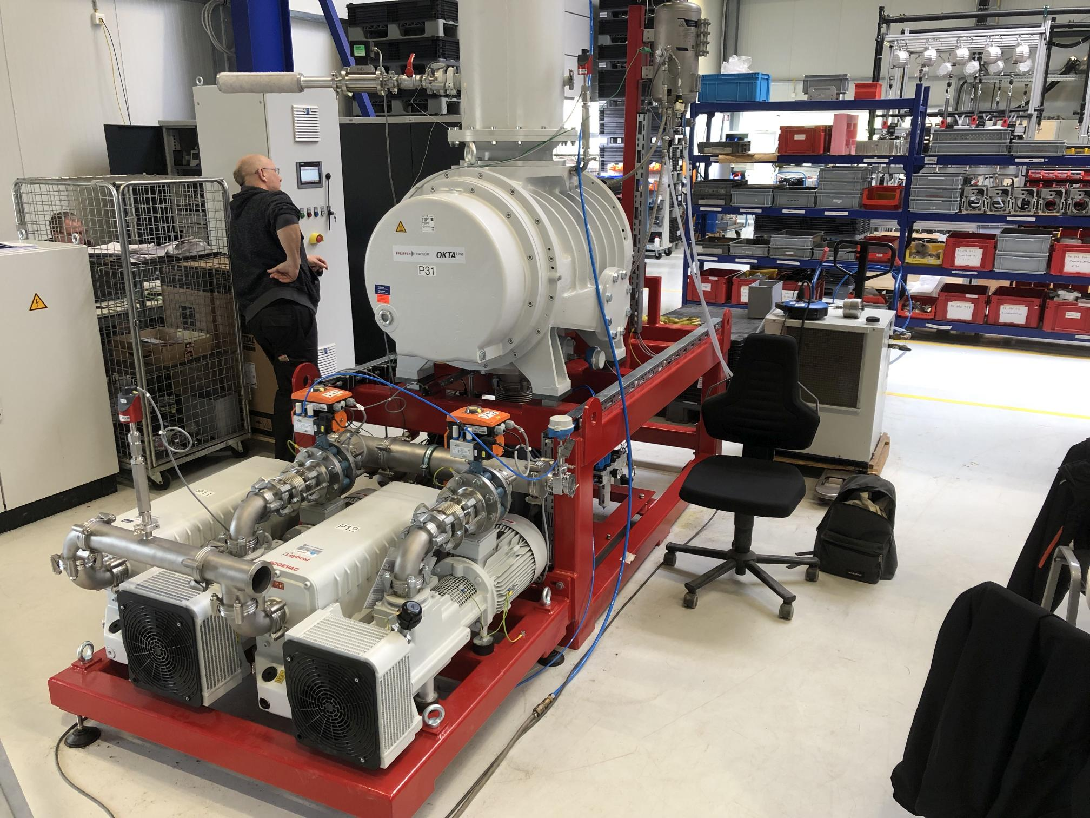
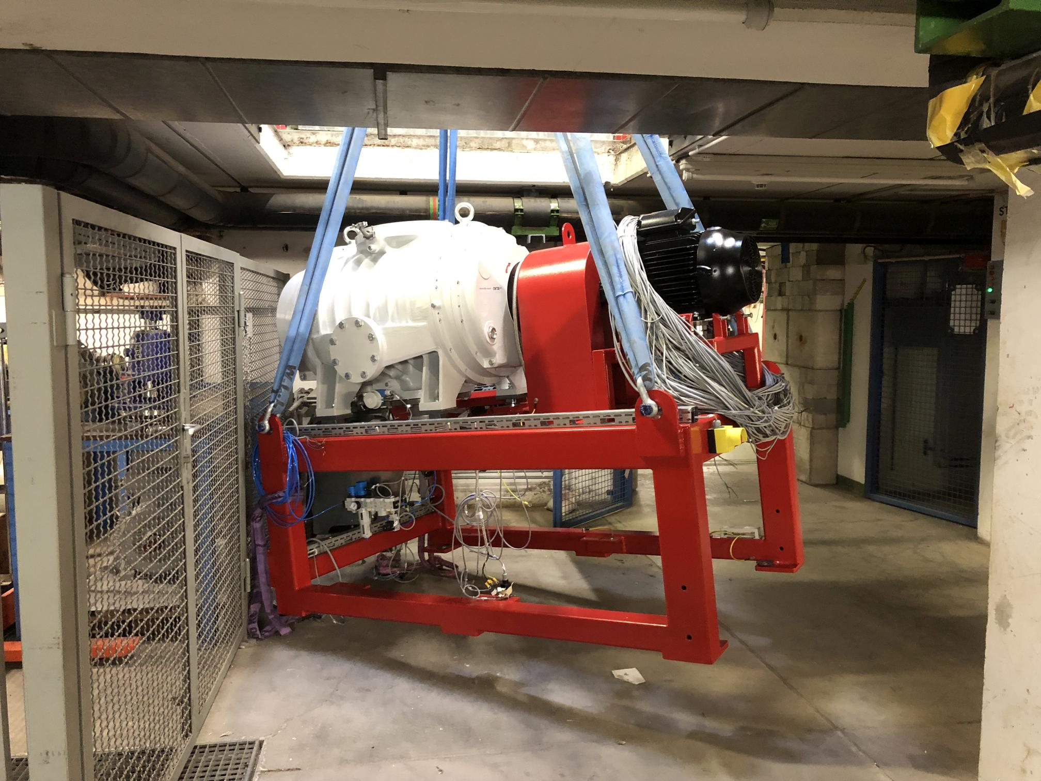
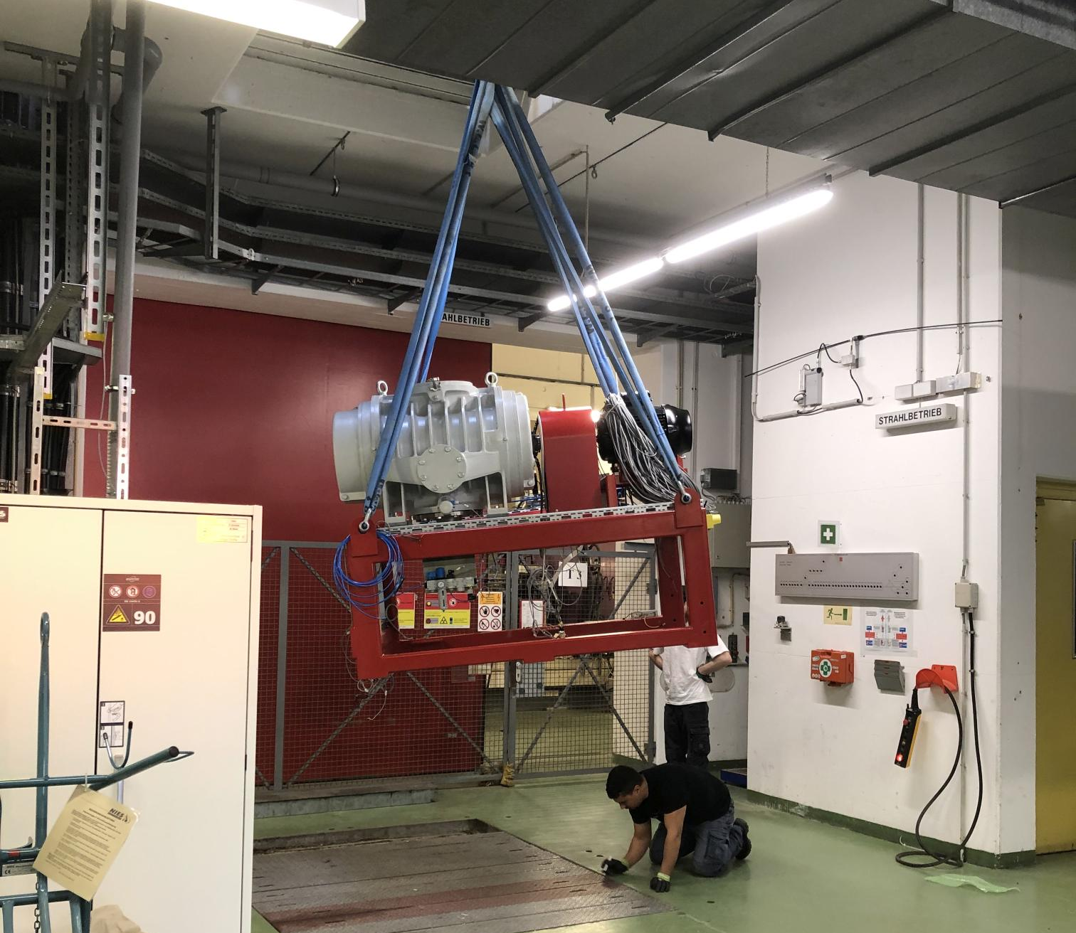
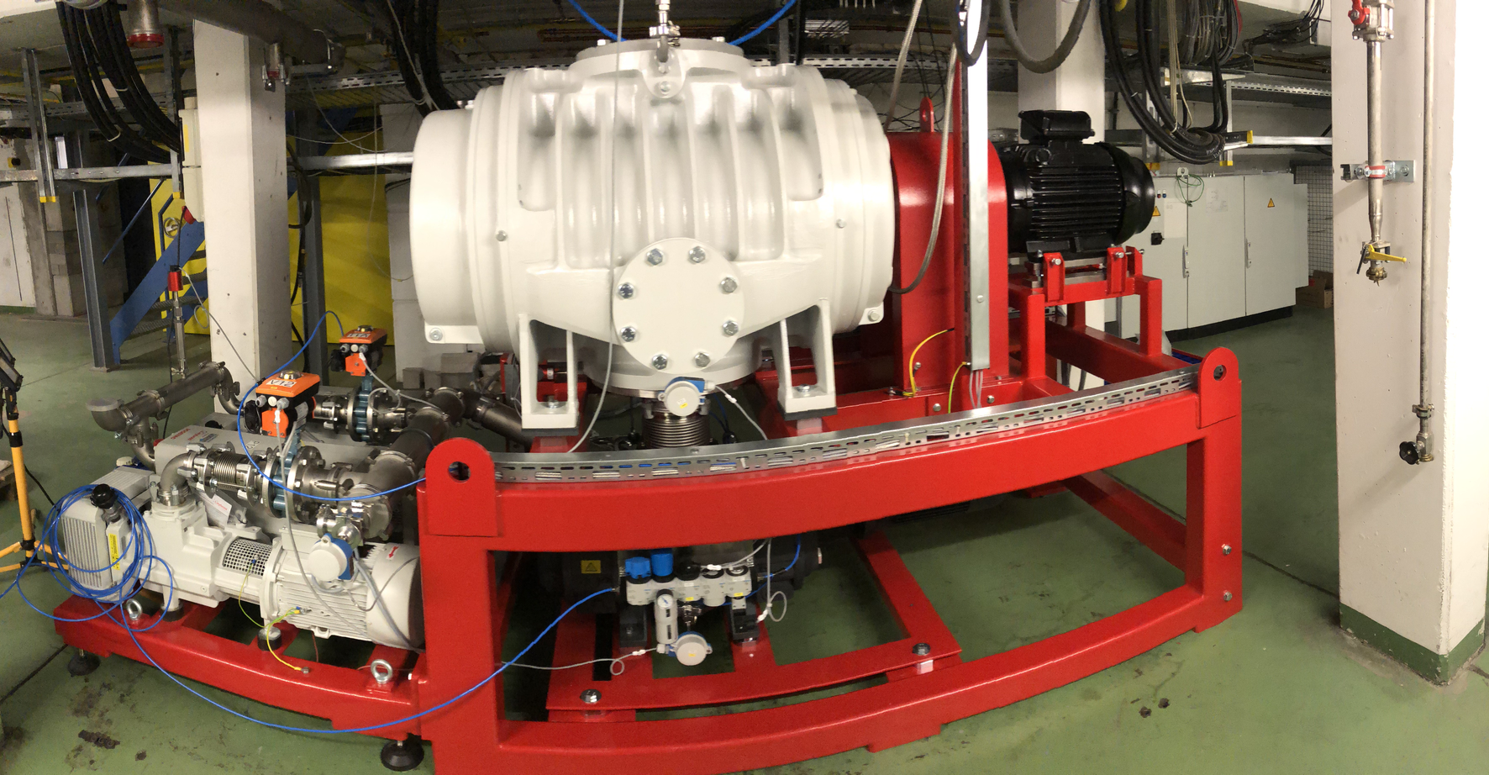
New Explosion Safe Roots Pump Station
Delivery 2.5.23

Slide 7
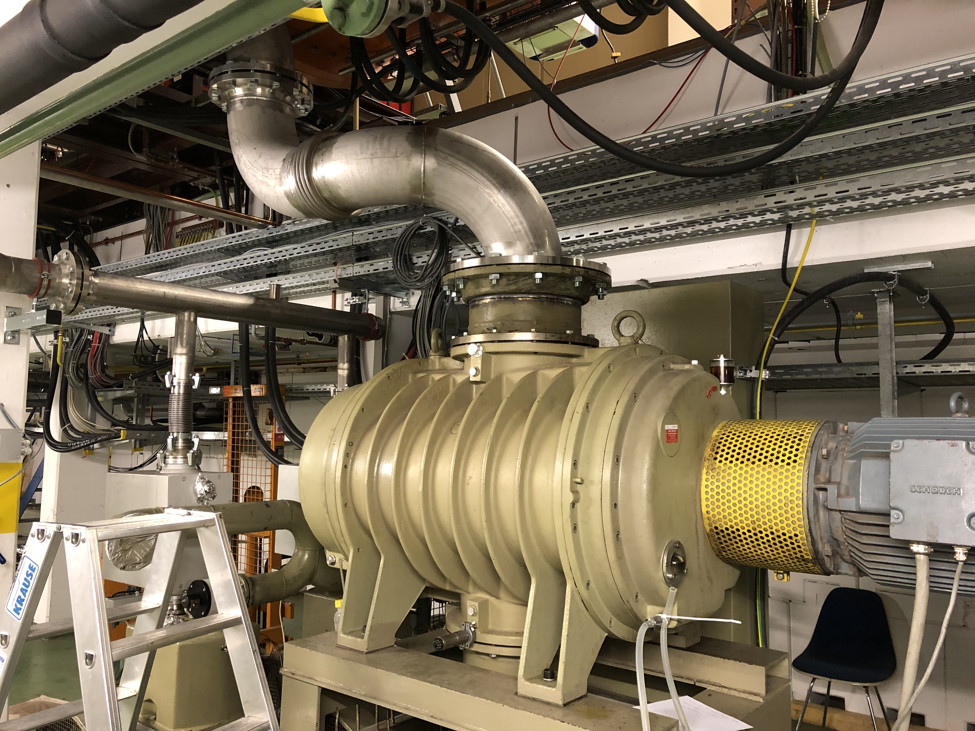
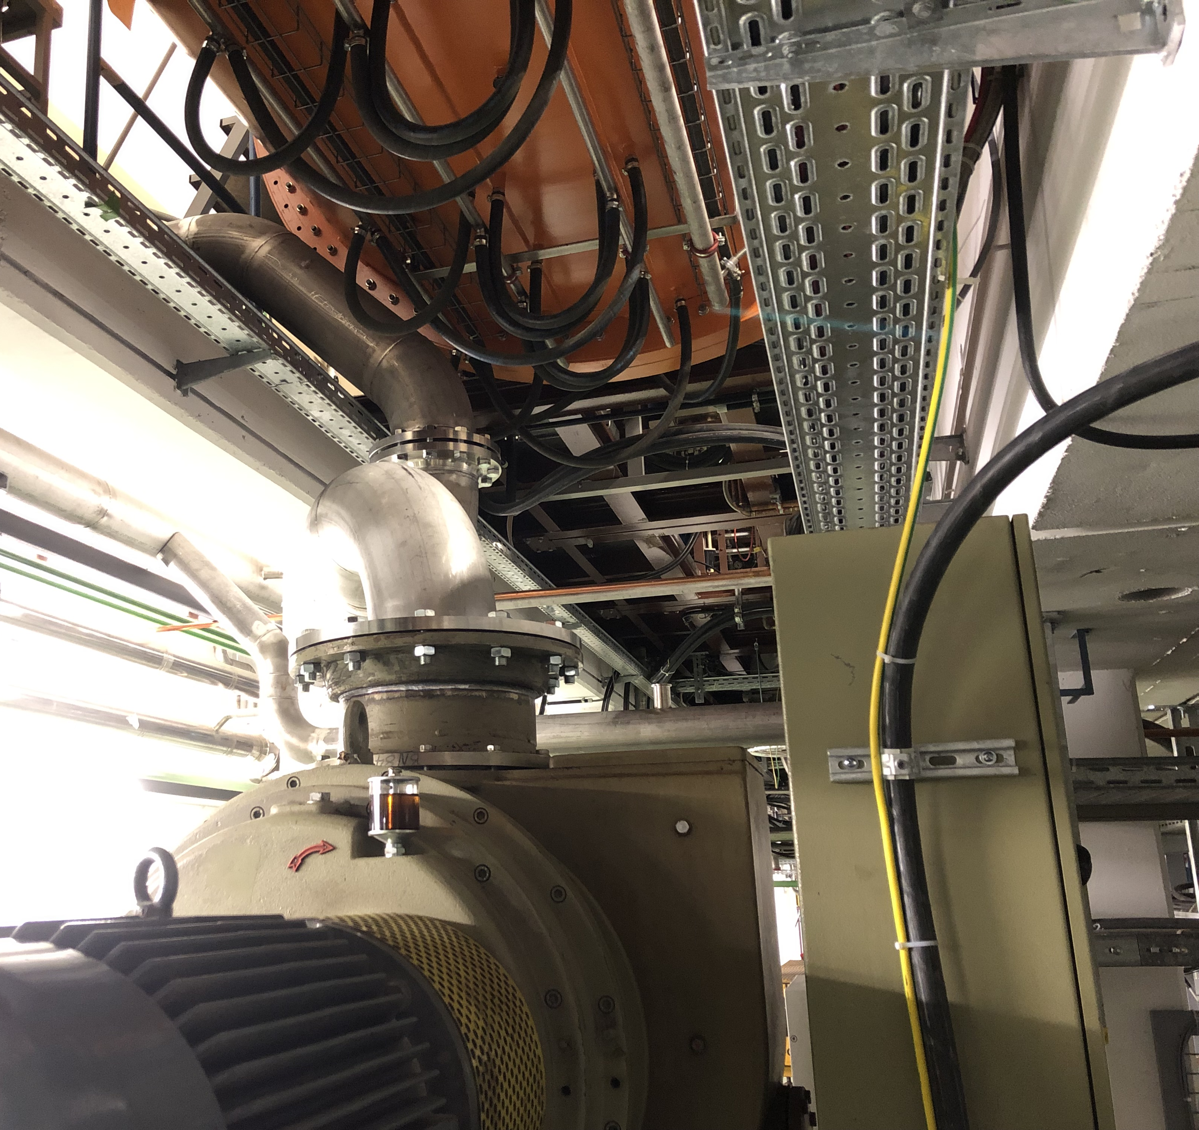
Old Roots Pump Station Moved and Reinstalled

Slide 8
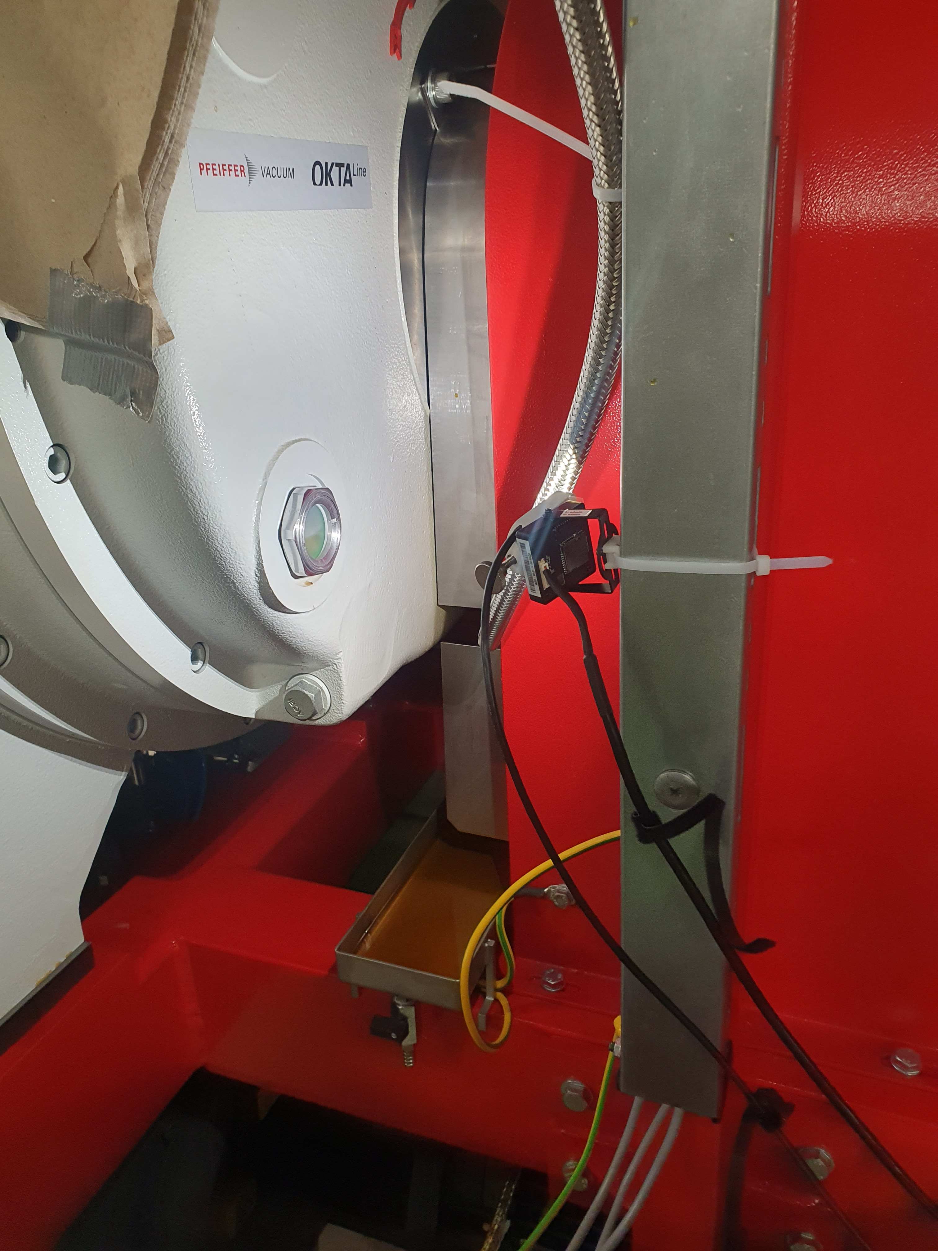
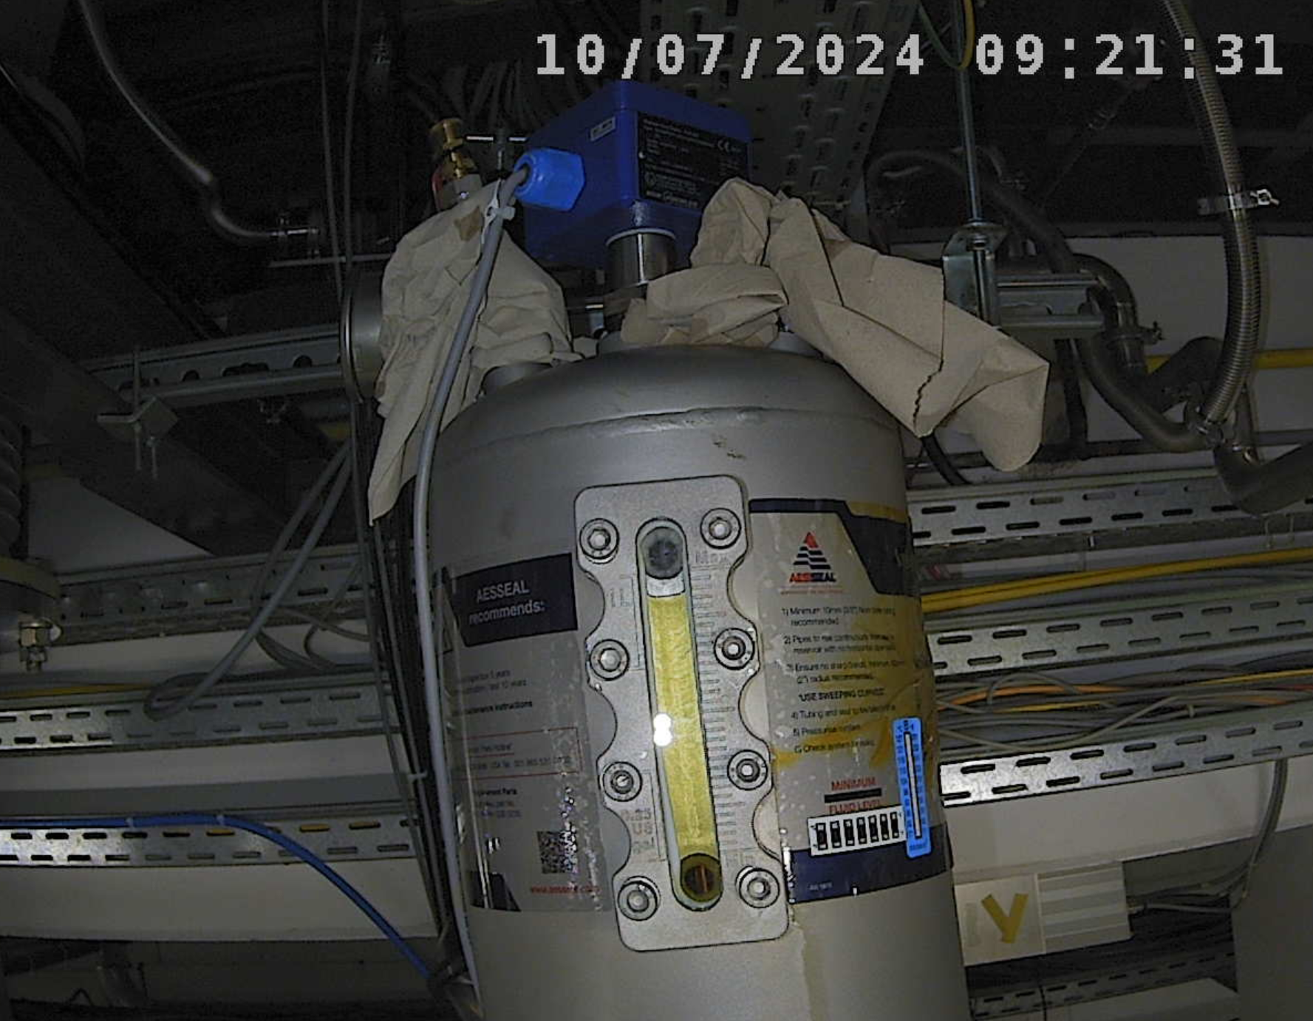
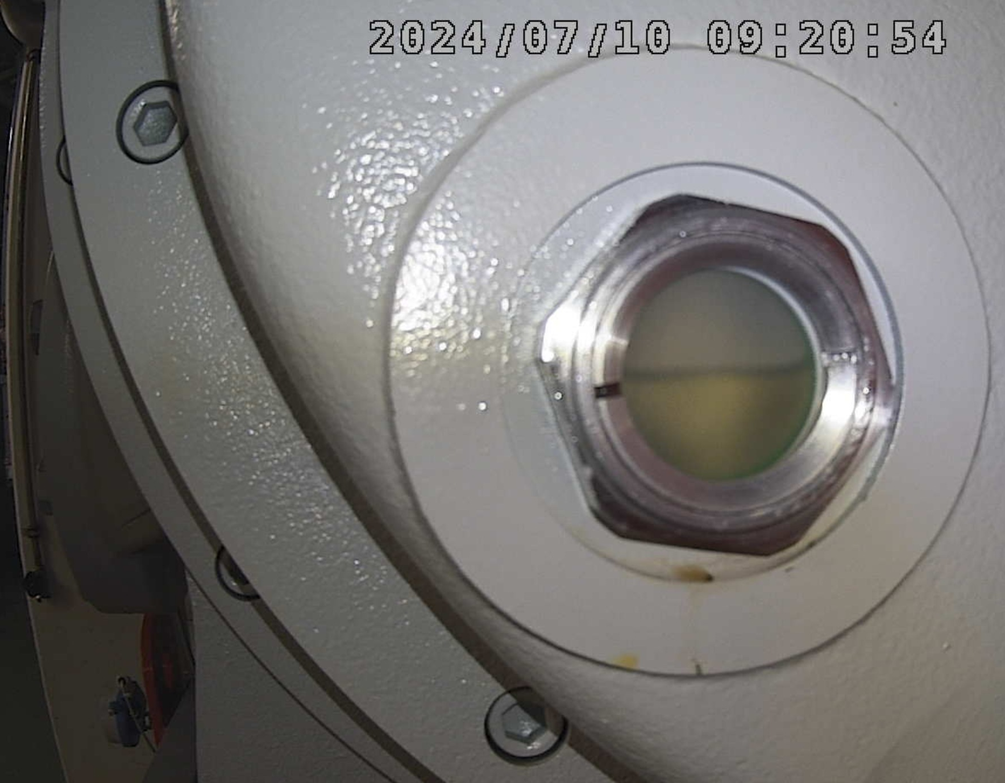
Oil Issues: Consumption and Oil in the Wrong Places
floating
ring seal oil
splash guard
floating ring seal
oil reservoir
roots
pump
oil level
window
of shaft
bearing
floating
ring seal oil
collector pan
pump bearing
oil reservoir

Slide 9
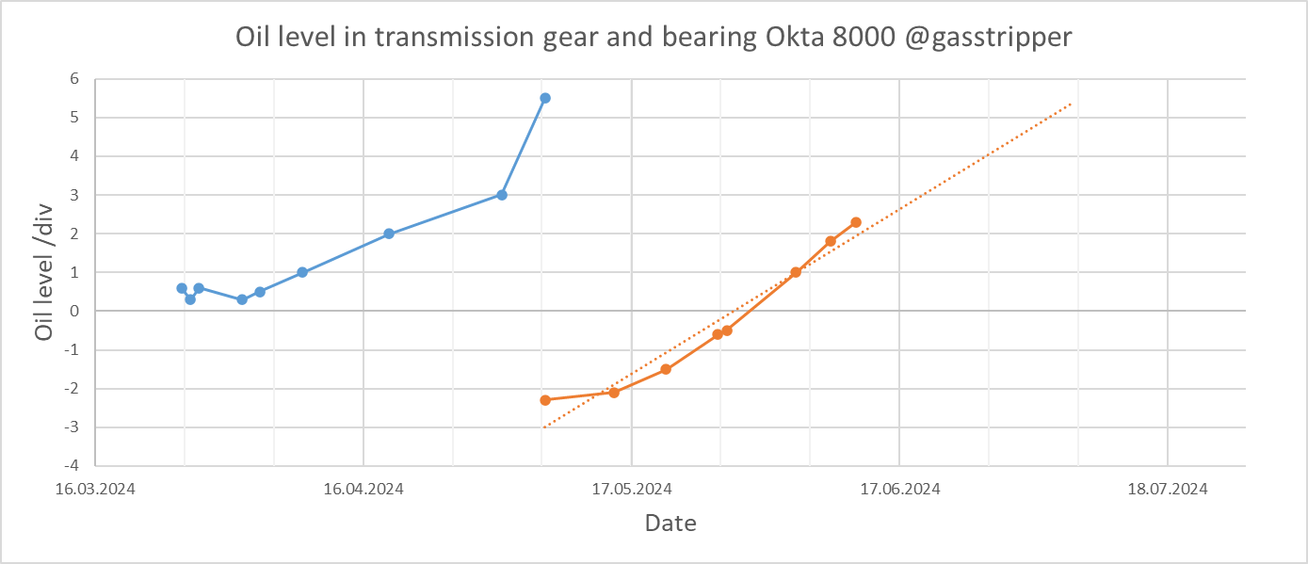
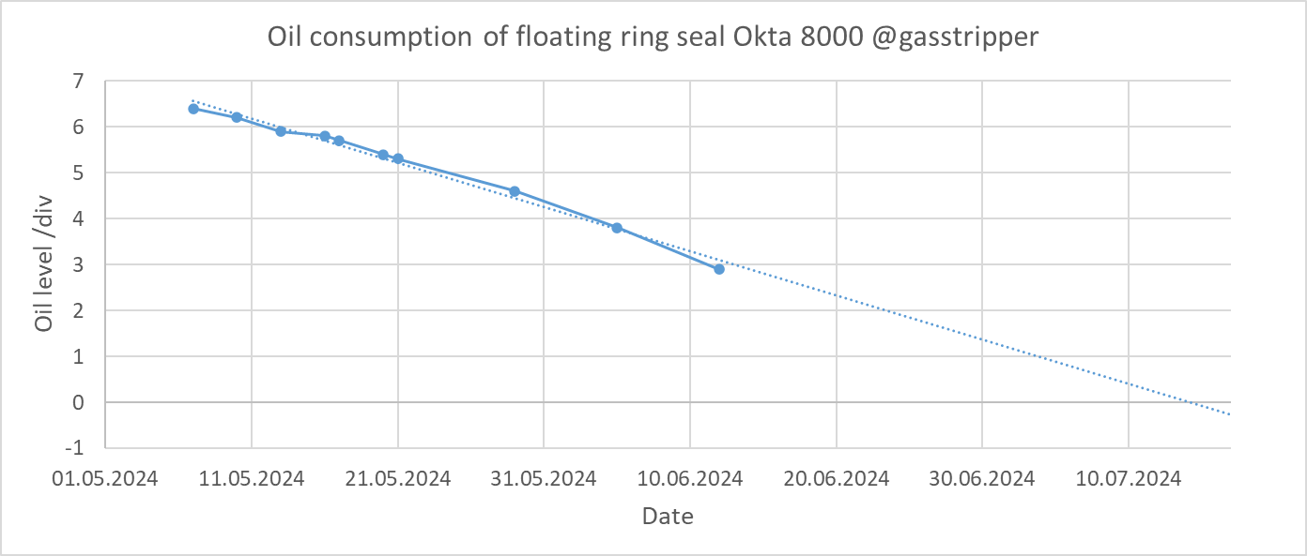
Oil Issues: The Rise and Fall of Oil Levels
Level rise due to oil from the floating ring seal entering the transmission gear and bearing chamber
Time between intervention 1-2 months
Green area = operational range
Time between refills 2-3 months

Slide 10
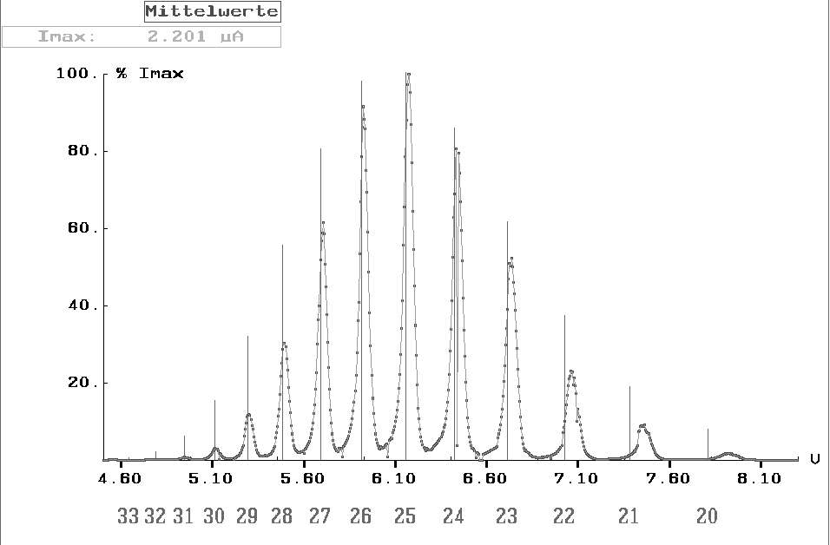
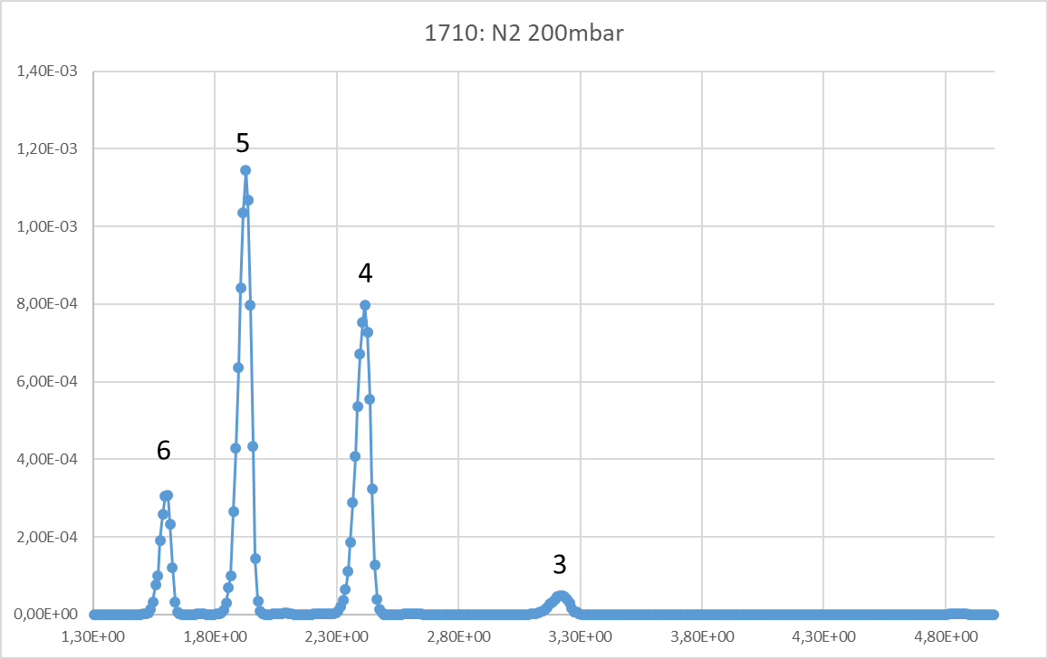
Machine development beamtime November/December 2023
U²⁸⁺ → H₂ stripper operation for SIS18 Booster Mode and other experiments
Pulsed stripper operation with N₂ for other experiments
Collect more data on stripping of [CH₃⇒C, Ar, Fe, Au, U] by [N₂, H₂]
Gather essential operating parameters for light, inter-mediate and heavy ions for specification of gas station
Au^{n+} after
H₂ stripping
C^{n+} after N₂ stripping

Slide 11
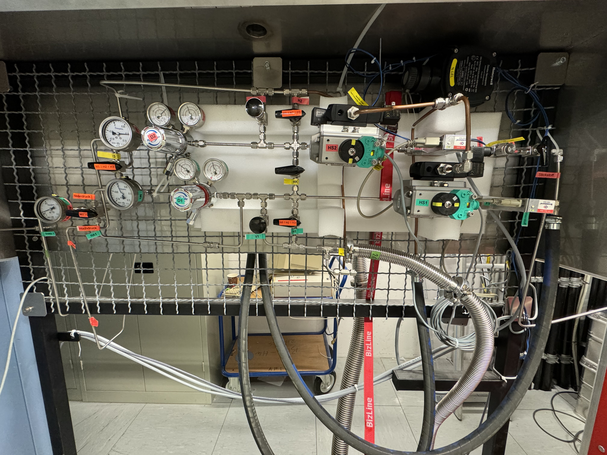
Preparation for beam time operation 2024
new low pressure
regulators
interlock signals
to vacuum controls
N₂ from supply line
split purge line
control air
from supply line
flexible use of
2 injection valves,
bypass line

Slide 12
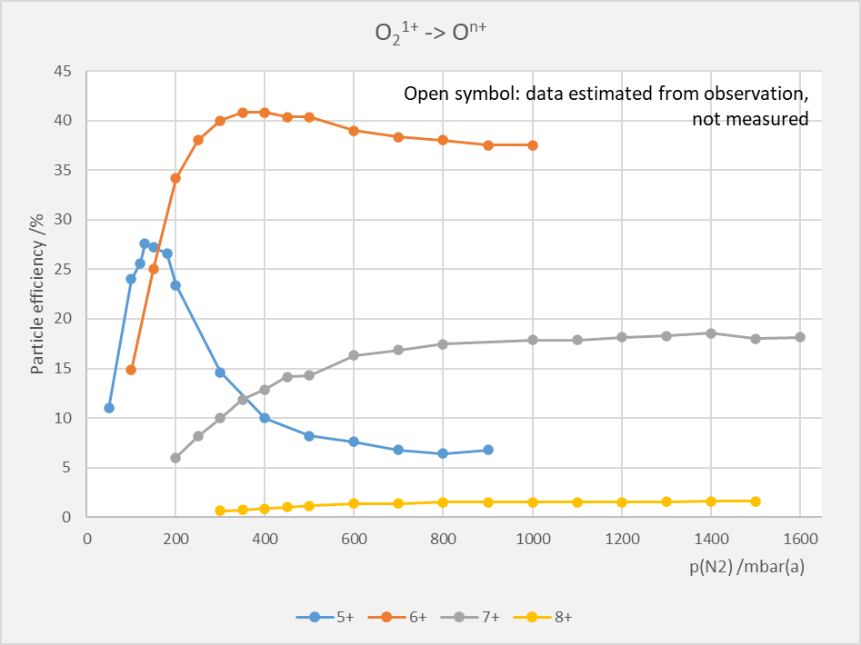
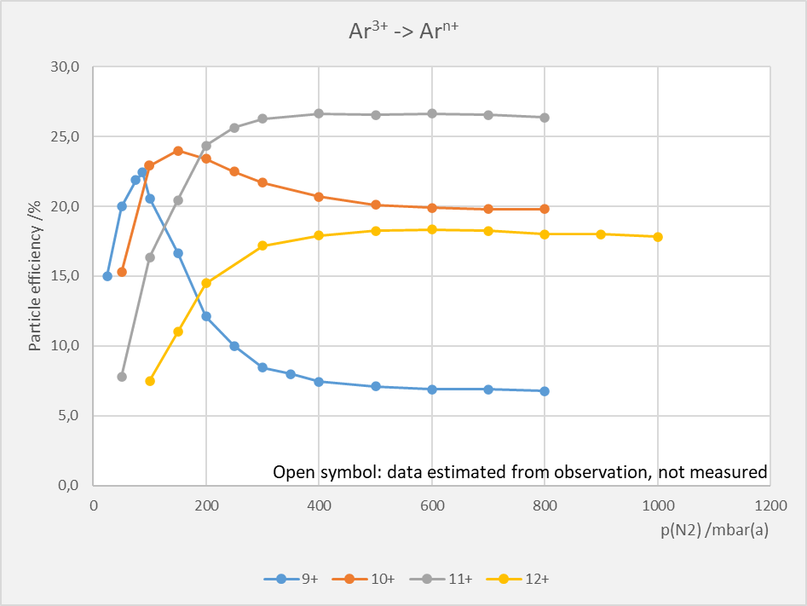
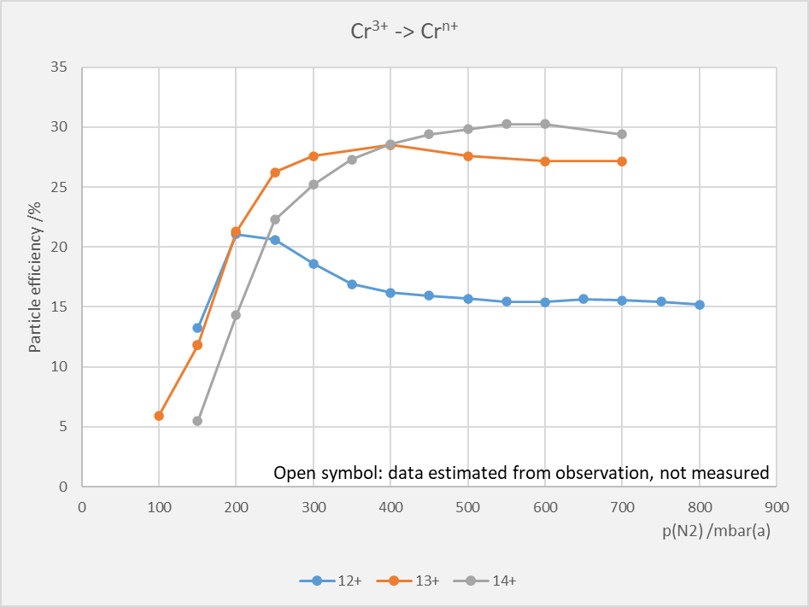
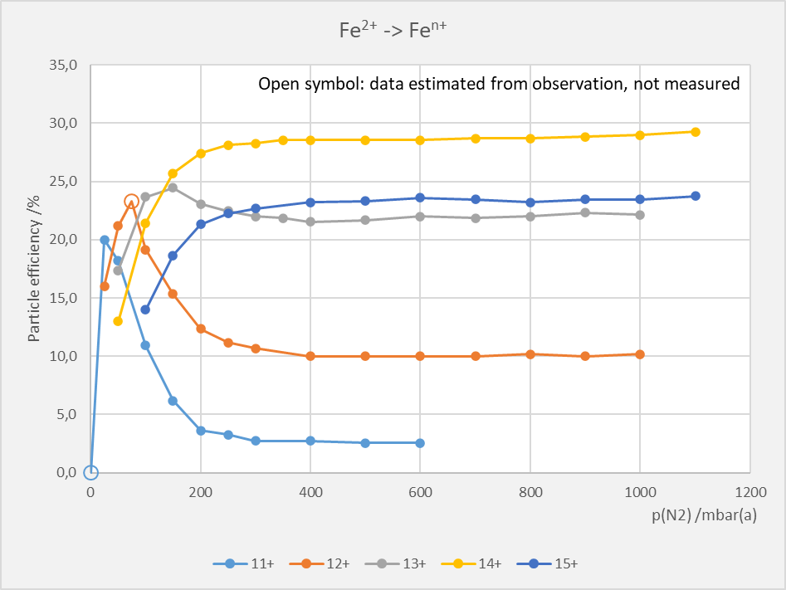
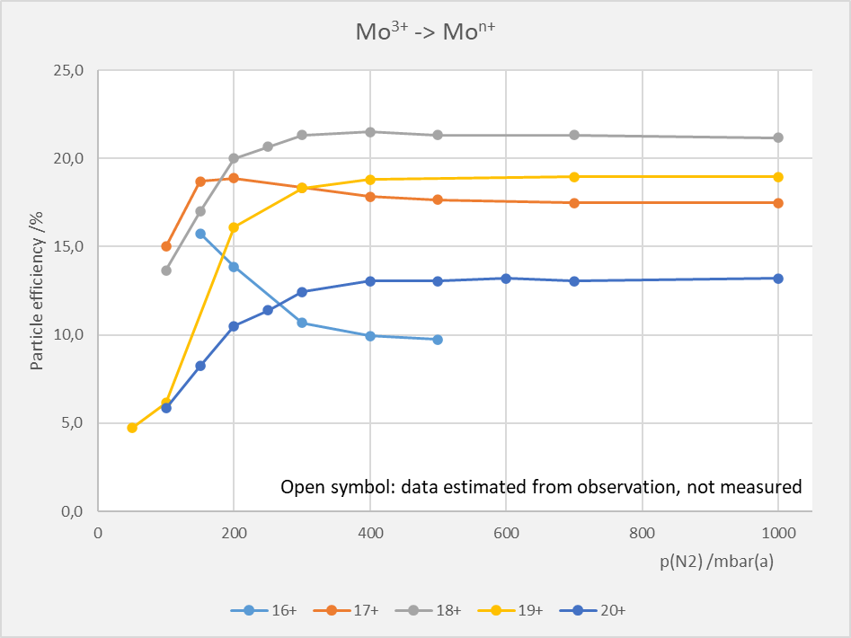
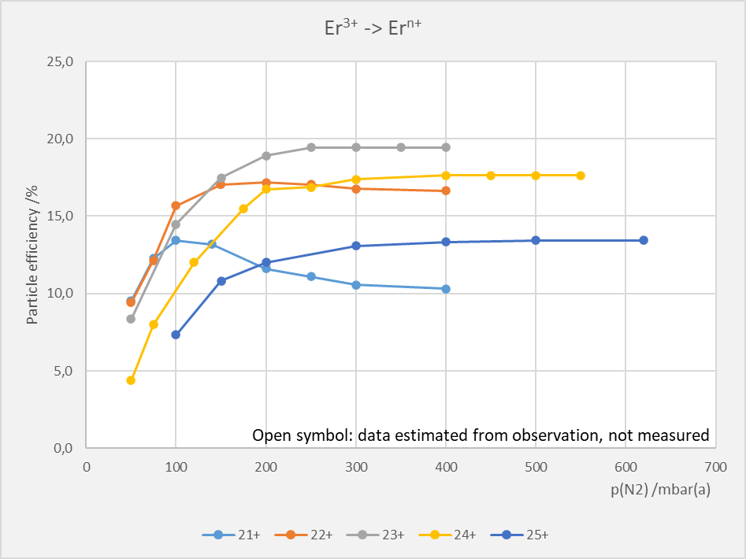
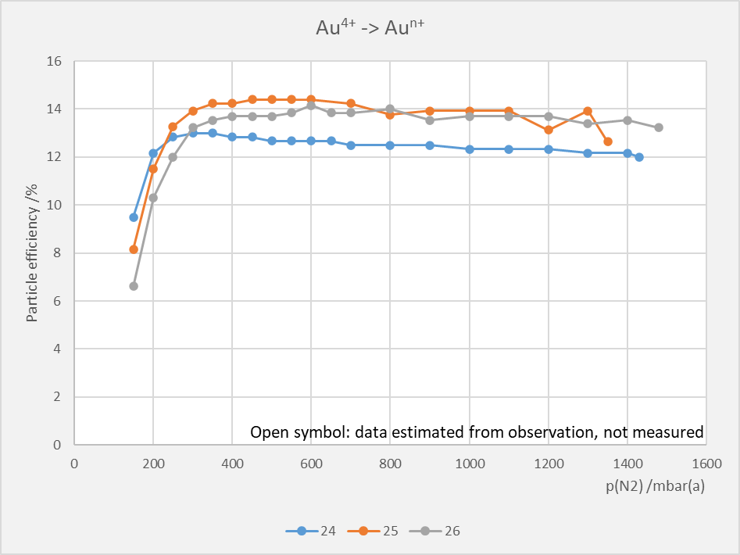
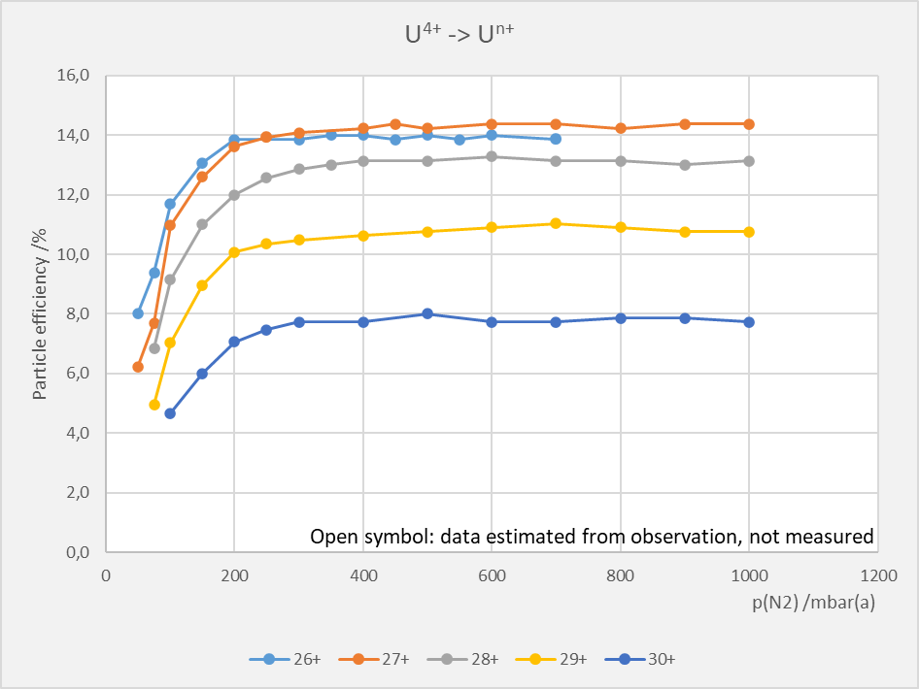
Stripping data collected during beam time
Measured stripping efficiencies of O₂, Ar, Cr, Fe, Mo, Er, Au, U on N₂

Slide 13
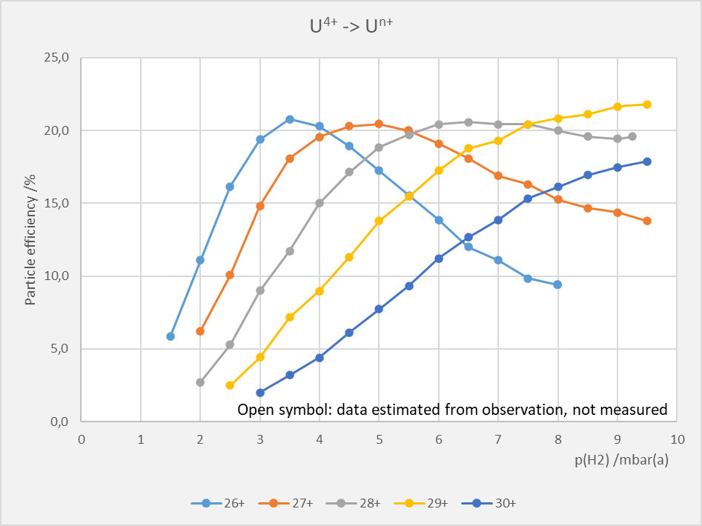
Stripping data collected during beam time
Measured stripping efficiencies of U on N₂ and H₂

Slide 14
Injection Valve Failures
Nominal service life under intended use: 380.000.000 cycles, equivalent to 88 days of 50 Hz operation
Pulsed gas stripper does not comply with intended use in several ways
  different gases, very low gas pressure & flow, higher voltage & current, very high cycle rates over extended periods
3 valves broke premature during beam time 2024
  serial 2-11-08-16 010154 reached 20% of expected service life
    history: delivery 06.2017, used for 5 machine beam times, development, safety tests, SAT roots pump station a. o. since 2018 with N₂ and H₂
    usage: approx. 76.000.000 cycles in total, of which 73.500.000 @50Hz in beam time 2024
  serial 2-11-08-16 005603 reached 20% of expected service life
    history: delivery 06.2017, used for 6 machine beam times, development, safety tests, SAT roots pump station a. o. since 2018 with N₂ and H₂
    usage: usage approx. 77.000.000 cycles in total, of which 8.600.000 @50Hz and 62.600.00 @25Hz in beam time 2024
  serial 2-30-10-17 005056 reached 14% of expected service life
    history: delivery 05.2018, used since 7.5.24 with N₂, unused before 2024
    usage: usage approx. 54.000.000 cycles in total, most of which @50Hz

Slide 15
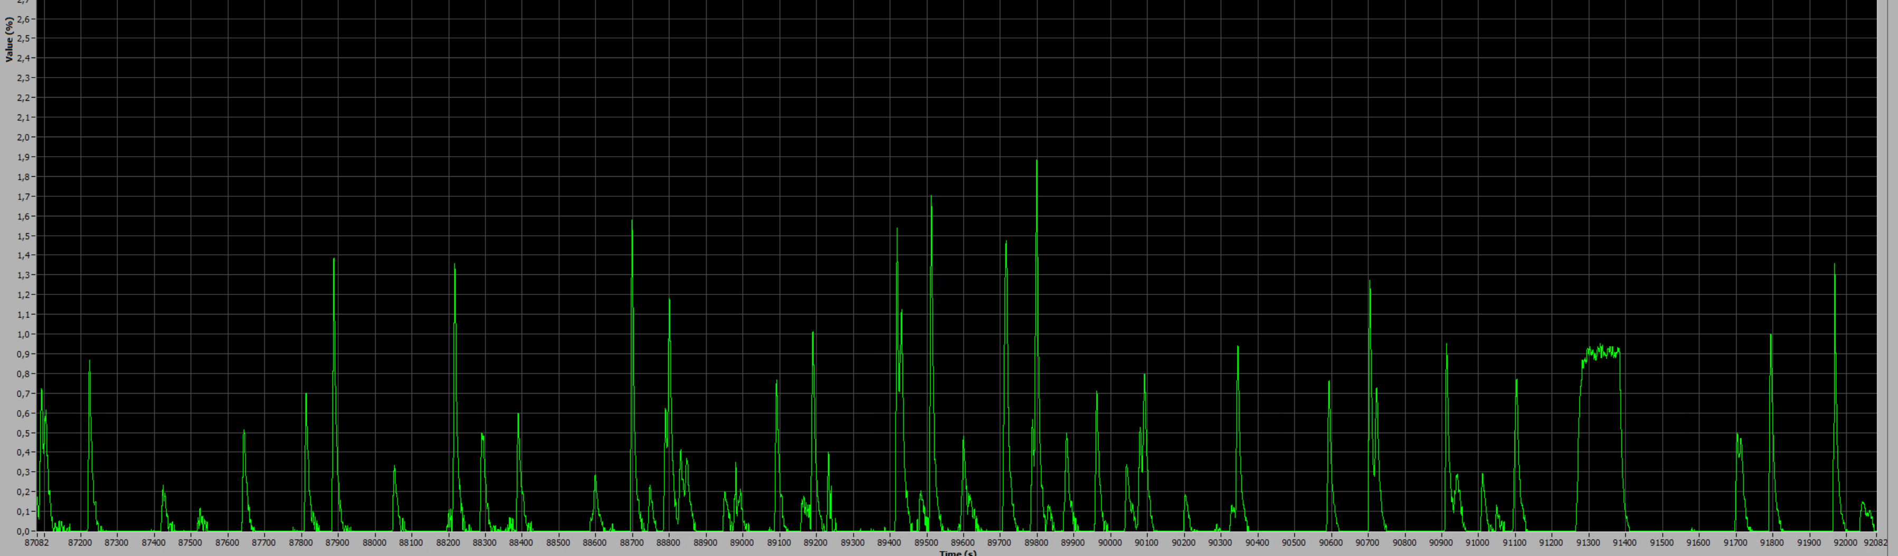
Injection Valve Failure: Mitigation
Added gas flow monitoring as diagnostics
Look into opportunities to operate valves more gentle, closer to intended use, and for alternative ways of operation for high duty cycle beams
Exemplary time series of stripper gas flow
with faulty pulsed injection valve at 1 Hz operation
5000 s

Slide 16
Summary & Outlook
Pulsed gas stripper project is progressing
  Safety concept reviewed by expert companies, proceed with implementation based on this
  Gas alarm system extension completed, commissioned 22.12.2023
  ATEX Roots pump station in operation, remaining issues will be fixed together with manufacturer
  Shutdown 2024: Replacement of 4 Turbopumps for differential pumping stages
  Major remaining parts: Gas control, vacuum exhaust treatment, safety interlock
  Many other small things to do ...
  Commissioning of fully-fledged pulsed gas stripper planned for end of 2025
Provision of 5 months of pulsed stripper operation during user beam time 2024 (unexpected, unplanned, on short notice) and machine beam time 2023
  Lots of data and experience gained
Issues
  Premature failures of injection valves
  Short maintenance intervals of roots pump due to oil issues
  Automated stripper gas pressure control, procurement of gas control

Slide 17
Thank you
for your attention!

Slide 18
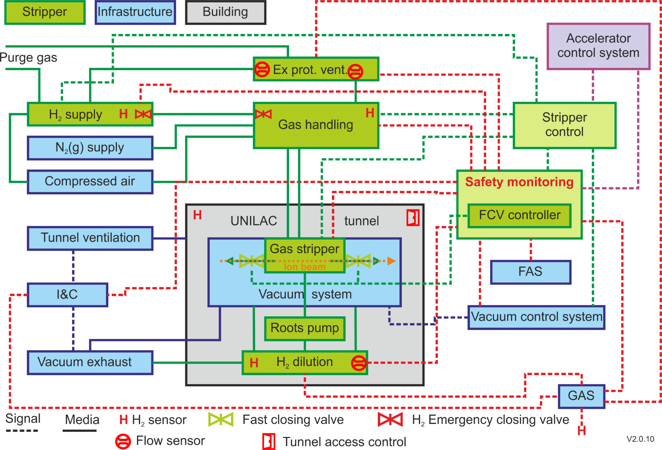
General System Overview

