Slide 1
FAIR Booster Mode
D. Ondreka, SYS
7th Beam Time Retreat, 11 July 2024

Slide 2
Contents
Booster mode
Definition
Topics
Super-cycle development
Hysteresis effects
BD applications and booster mode
Status
Summary and outlook

Slide 3
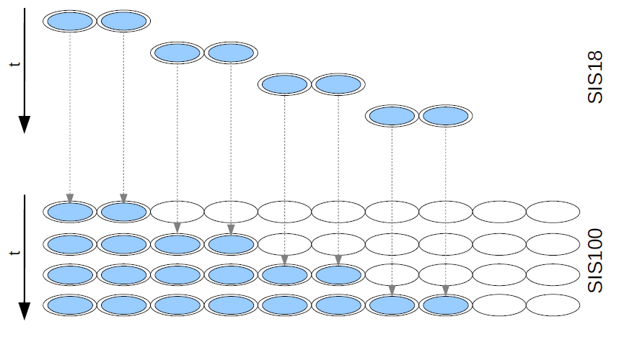
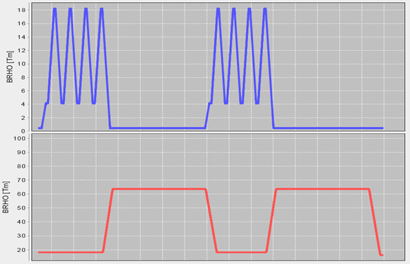
Booster Mode
Goal: reach maximum intensity in SIS100
Longitudinal filling by stacking four SIS18 cycles
Two empty buckets as beam abort gap
Used with any ion species
Fundamental requirements
Fastest possible repetition rate
Direct ramp-down to injection level
Fast extraction only
Repetition rate
Original value: 2.7 Hz for U²⁸⁺ (reference)
Cycle length 370 ms incompatible with 50 Hz
Presently aiming for cycle length 380 ms (2.6 Hz)
Cycle time longer for lighter ions to 18 Tm!
Common misconceptions:
booster mode $⇎$ highest intensities of U²⁸⁺
fastest ramp rate (19 kA/s) $⇏$ booster mode
Stacking scheme for RIB production
SIS18 and SIS100 cycles for RIB production
SIS18
SIS100

Slide 4
Booster Mode: Topics
Beam physics
Acceleration at max. possible ramp rate (19 kA/s)
Strong eddy current effects
Hysteresis effects due to special magnetic cycle
Hardware
AEG power converters
Reaching 19 kA/s on down ramp
Decrease of rounding time: 32 ms → 24 ms ?
MA cavities for H=2
Max. voltage, especially for lighter ions
Machine model
Generation of booster mode cycles
Smallest number of BPs: bunching in INJECTION
Control system
BD applications handling booster mode properly
Ramped front-ends: smaller min. BP length
Coupling with new UNILAC timing system
FAIR patterns: repetition of single booster cycle

Slide 5
Super-Cycle Development
Preferred operation: n-fold repetition of same cycle
May or may not be feasible
Version 1
First successful test with beam (U²⁸⁺, 2022)
Drawback: completely different magnetic hysteresis for first cycle
Version 2
Advantage: same hysteresis for every cycle
Drawback: eddy currents different in first cycle due to UNILAC synchronization
Successfully used (U²⁸⁺, 2023; U⁷³⁺, 2024)
Version 3
Advantage: same hysteresis and eddy currents in every cycle
2 failed test in 2024 (wrong timing graph?)
Error analysis ongoing
May wait for new UNILAC timing system
Version 1 (2022)
UNI sync
Injection
Injection
Injection
Injection
Version 2 (2023)
UNI sync
Injection
Injection
Injection
Injection
Version 3 (2024)
UNI sync
Injection
Injection
Injection
Injection

Slide 6
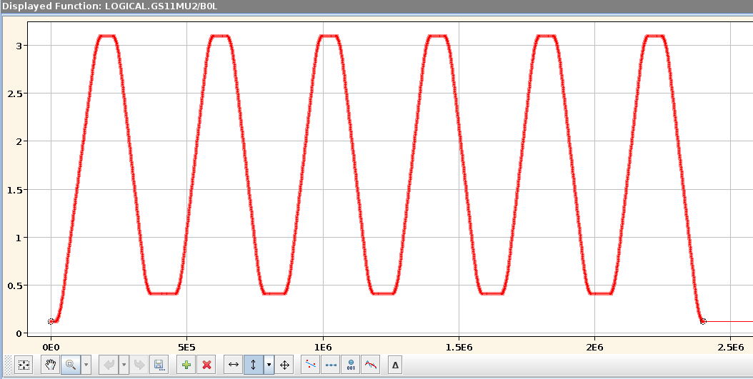
Hysteresis Effects: General
Magnetic field in standard cycle
Different magnetic cycle for booster
Direct ramp-down to injection level to save time
Hysteresis loop significantly smaller
Expected general effects
Larger remnant field at injection
Different shape of excitation curve
Impact on performance
Degradation of injection performance
Increased beam loss at start of ramp
Measured with special U⁷³⁺ booster cycle U⁷³⁺
Injection into 4/5 repetitions for same eddy currents
UNI sync
Injection
Magnetic field in booster cycle (first injection omitted)
UNI sync
Injection
Injection
Injection
Injection
Small losses at start of ramp in standard cycle
High losses at start of ramp in booster cycles

Slide 7
Hysteresis Effects: Dipoles
Larger remnant field at injection
Shift of horizontal orbit towards center
Compensation by adjusting B field at injection
Strong orbit motion at start of ramp
Caused by different shape of B(I) curve
Good news: cycles appear to behave identical!
Observation by monitoring orbit
Orbit application can display all cycles
Data can be exported in binary format
Limitations of present software
No comparison of different cycles
Radial position for same orbit at injection
Cycle | ΔR set value
Booster | 8 mm
Standard | -2 mm
Difference | 10 mm
Horizontal orbit evolution in standard cycle
Horizontal orbit evolution in booster cycles

Slide 8
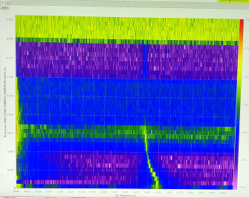
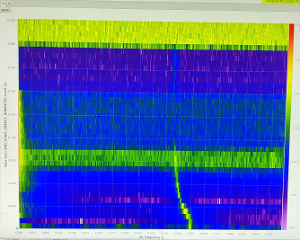
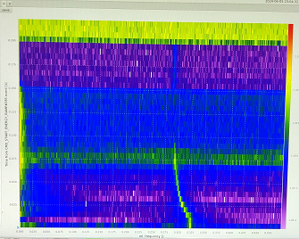
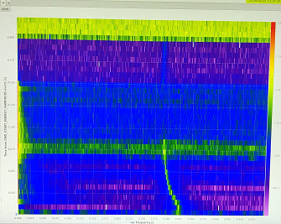
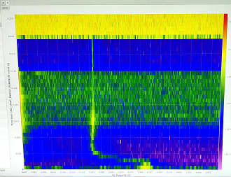
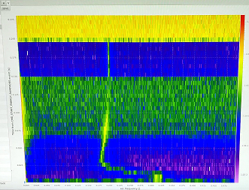
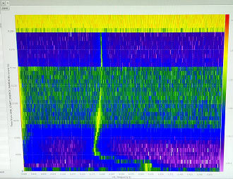
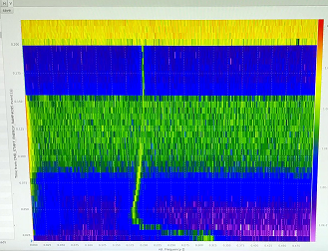
Hysteresis Effects: Quadrupoles
Larger remnant field at injection
Tune shift, esp. large in vertical plane
Compensation by adjusting set tunes
Strong tune motion at start of ramp
Caused by different shape of B’(I) curve
Good news: cycles appear to behave identical!
Observation difficult
Displayed data: snapshots from video recorded on smart phone
Limitations of present software
No comparison of different cycles
No saving data for different cycles
Injection tune set values for U⁷³⁺ for same real tunes
Cycle | Q_{h} set value | Q_{v} set value
Booster | 4.275 | 3.21
Standard | 4.305 | 3.315
Difference | -0.03 | -0.105
Horizontal tune in booster mode with U⁷³⁺ for four successive cycles
#1
#2
#3
#4
Vertical tune in booster mode with U⁷³⁺ for four successive cycles
#1
#2
#3
#4
Different Q_{v} on flattop!

Slide 9
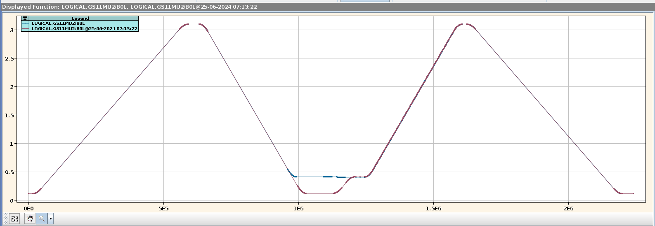
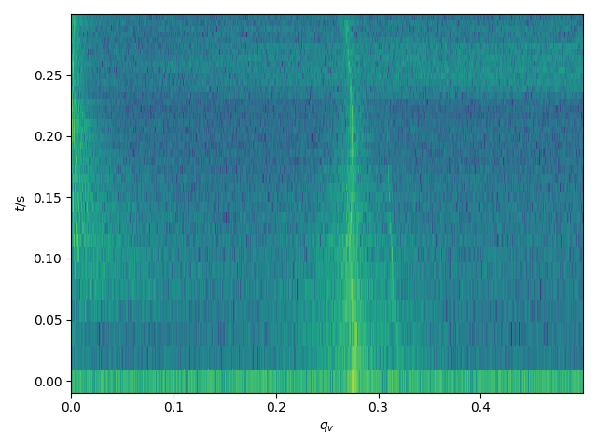
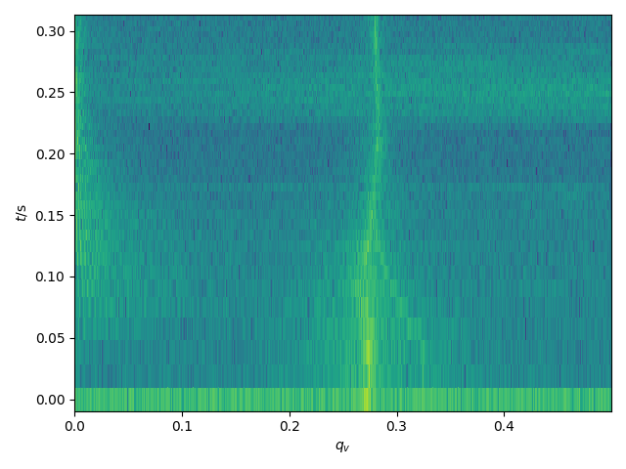
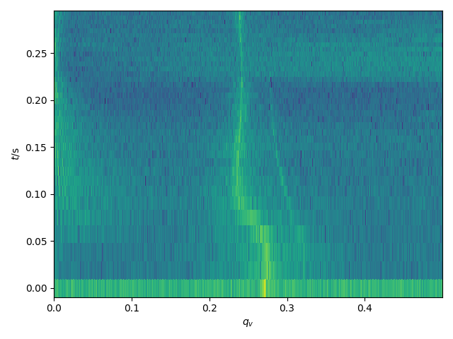
Hysteresis Compensation (I)
Short test during last week of beam time
Made possible due to septum cable failure
U⁷³⁺ booster cycle with single injection used
Goals: measure and demonstrate compensation
Measurement of hysteresis
‘Chimney’ used to change hysteresis loop
Injection offsets compensated by set values
Separately for dipoles and quadrupoles
Data acquired, analysis ongoing
Booster cycle with ‘chimney’ used for hysteresis measurements
Injection
‘Chimney’
Effect of changing hysteresis loop for D-quadrupoles on vertical tune
Standard
B1L = -0.4T
B1L = -0.6T

Slide 10
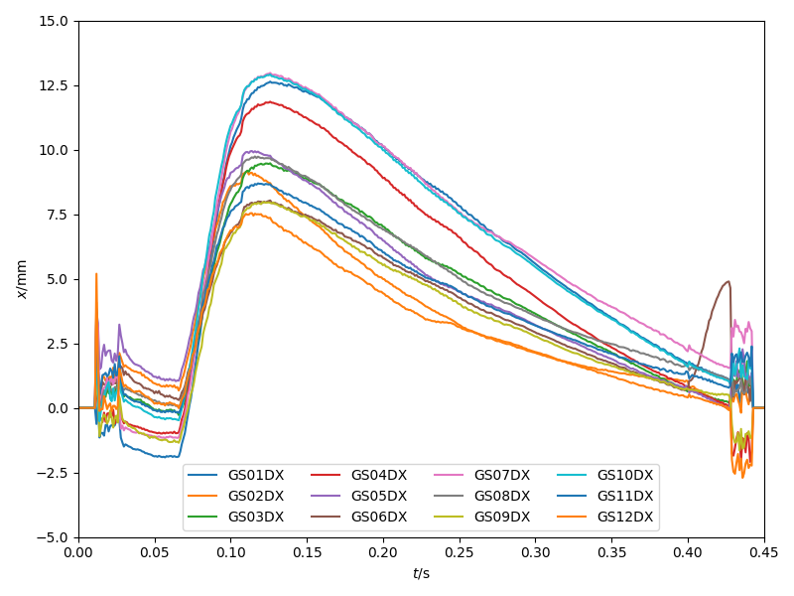
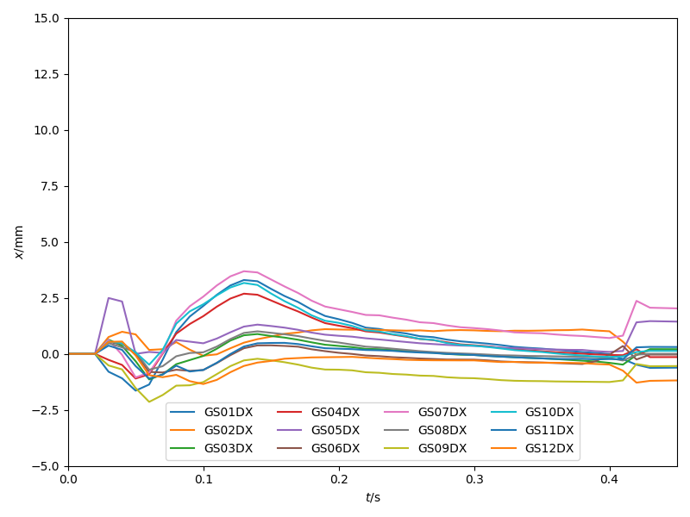
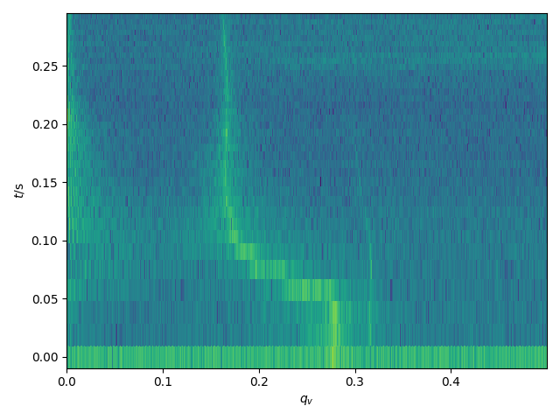
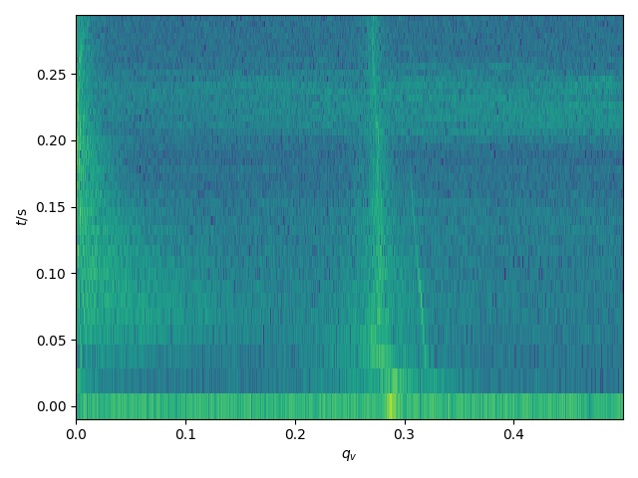
Hysteresis Compensation (II)
Manual correction trim to integral dipole field
Manual correction trim to vertical tune
Measured horizontal orbit
Measured vertical tune
uncompensated
compensated
uncompensated
compensated
Demonstration of dynamic compensation
Manual trims during ramp
Dipole hysteresis → integral field B0L
Quad hysteresis → vertical tune Q_{v}
Software tools required for routine operation
Orbit correction on ramp
Tune correction on ramp

Slide 11
BD applications for booster mode
Non-uniform behavior of existing applications for displaying beam signals
DCT and orbit application
All cycles displayed on single time axis at end of super-cycle
ACT and tune application
Every cycle is displayed when it finishes, erasing the previous one
Saving data of individual cycles may or may not be possible
Goals
Allow operators to focus on and diagnose individual cycles
Allow operators to compare individual cycles
Allow machine physicists to save data of individual cycles
Considerations for implementation
Requirements need to be clarified
Present ‘booster mode light’ may not be identical to final solution
Final booster mode structure will be part of FAIR pattern concept

Slide 12
Status of Topics
Category | Topic | Demonstration | When | Status
Physics | Ramp rate 19 kA/s with U²⁸⁺ | Reached 18.9 kA/s up, 17.6 kA/s down | 12/2023 | up: ok down: p.f.i.
Physics | Investigation of eddy current effects |  |  | open
Physics | Compensation of hysteresis effects | Manual compensation | 06/2024 | demo: ok tools: open
HW | Smaller rounding times for AEG |  |  | open
HW | Max. voltage for MA cavities to 42 kV |  |  | open
Model | Super-cycles with optimal hysteresis | Version 2 successful, version 3 failed | 2022+23 | p.f.i.
Model | Bunching in injection |  |  | open
CS | Adapt BI applications to booster |  |  | open
CS | Smaller min. BP length in FG |  |  | open
CS | Coupling with new UNILAC timing |  |  | open
CS | FAIR patterns: rep. of single cycle |  |  | open
p.f.i. = potential for improvement

Slide 13
Comparison to FAIR Requirements
Booster for U²⁸⁺ | FAIR (50 Hz) | Present status
Ramp rate | 19 kA/s | 18.9 kA/s up, 17.6 kA/s down
Available MA voltage | 42 kV | 39 kV
Cycle time | 380 ms | 400 ms
Repetition rate | 2.63 Hz | 2.50 Hz
Stacking time | 1.14 s | 1.2 s
Present MA cavity voltage appears sufficient up to ~ 5∙10¹⁰ particles
Potential for reducing cycle time to 380 ms
Increasing ramp down rate: 10 ms
Reducing min. BP length from 16 ms to 12 ms: 4 ms
Reducing rounding time from 32 ms to 24 ms: 16 ms
Bunching in injection BP: 16 ms
→ FAIR design parameters for booster with U²⁸⁺ well in reach

Slide 14
Summary and Outlook
Booster mode machine development well advanced
Demonstrated 2.5 Hz operation with U²⁸⁺ (already in 2023)
Hysteresis effects understood and manual compensation demonstrated
Apparently four identical cycles possible with suitable super-cycle
Recommended next steps
Activities in SYS
Booster mode test with a lighter ion, e.g. Ar¹⁰⁺
Investigation of eddy current effects
Merging injection and bunching beam process to save time
Development of hysteresis compensation tool
Light-weight adaptation of BI applications to handle booster mode better

