Slide 1
ERC and other grants: What is needed from the machines?
1

Slide 2
Overview
The presentation will cover the following running grants
ERC advanced grant NECTAR (2020) “Nuclear Reactions at Storage Rings” (CRYRING, ESR)”
Beatriz Jurado, LP2i Bordeaux
ERC consolidator grant LISA (2020): “Lifetime measurements with Solid Active targets” (DESPEC)
Kathrin Wimmer, GSI
ERC starting grant ELDAR (2022) “Elements in the Lives and Death of Stars “ (CRYRING)
Carlo Bruno, U Edinburgh
Helmholtz Young Investigator Group (2023) “Towards frequency metrology of the optical hyperfine structure of highly charged ions using quantum logic” (HITRAP)
Peter Micke, U Jena and HI-Jena
ERC advanced grant HiThor (2024) “Highly Ionized Trapped 229-Thorium: A New Paradigm Towards a Nuclear Clock” (ESR, HITRAP)”
Thomas Stöhlker GSI, HI-Jena, U Jena
ERC advanced grant BARB (2020) “Biomedical Applications of Radioactive ion Beams”
Marco Durante GSI, TU Darmstadt
ERC consolidator grant PROMISE (2024) “Portal Range Monitoring in Mixed Ion Beam Surgery“
Christian Graef GSI, TU Darmstad
2

Slide 3
PI: Beatriz Jurado, LP2i Bordeaux
3

Slide 4
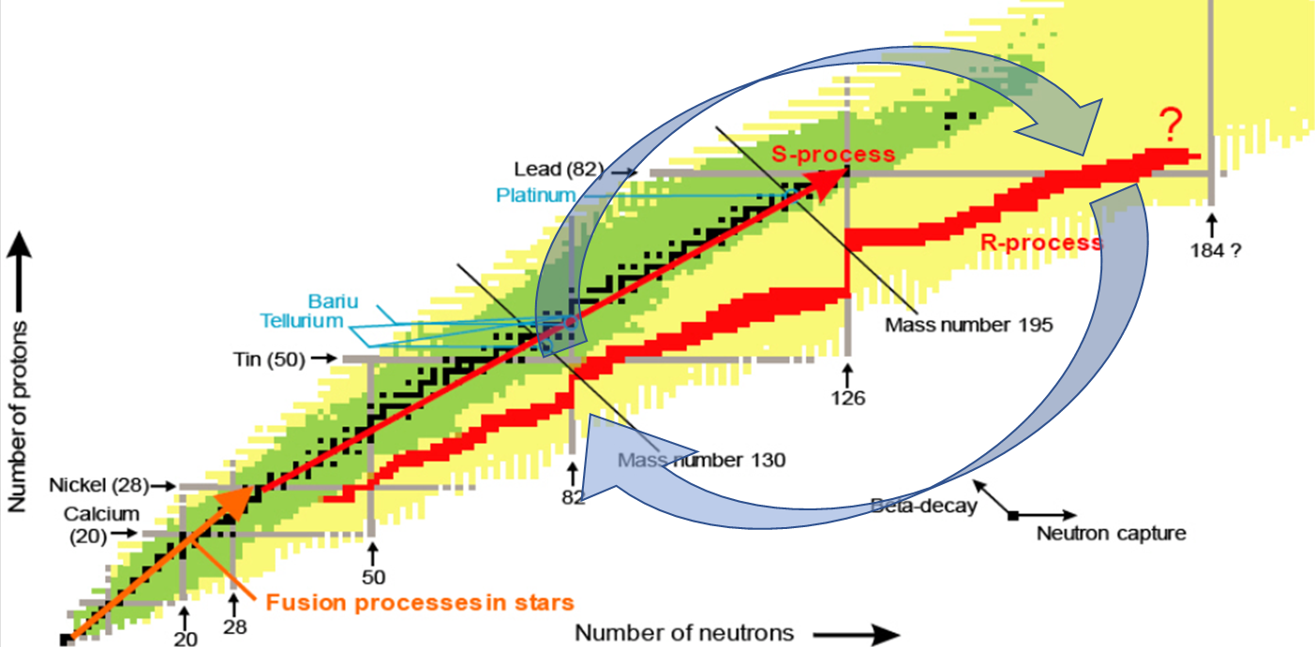
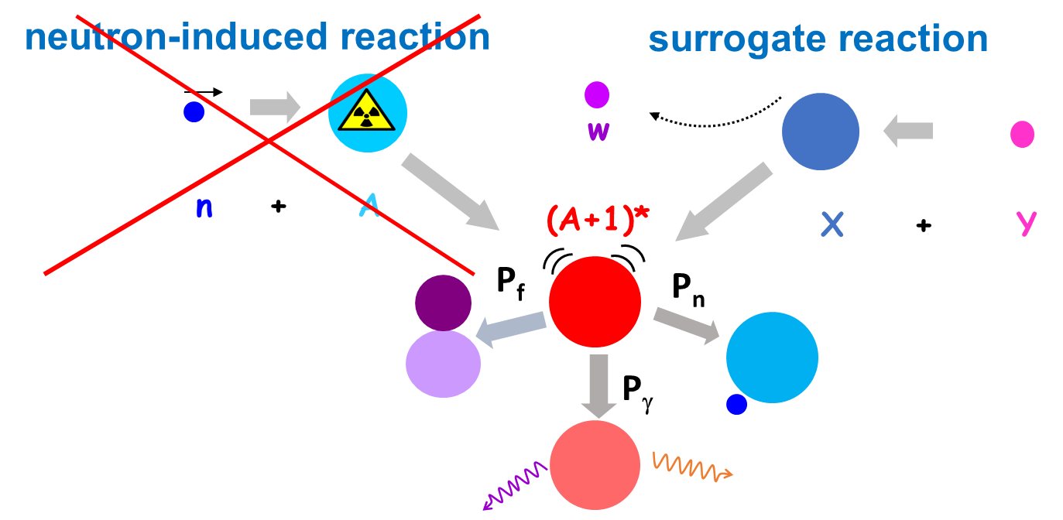
NECTAR - Nuclear rEaCTions At storage Rings
PI: Beatriz Jurado, LP2i Bordeaux
neutron-induced reaction cross sections of short-lived nuclei
Motivation: astrophysics & applications
Experimental method: the surrogate technique in inverse kinematics
challenge: no free neutron targets available
indirect method with stored radioactive beams
surrogate reaction populates the same compound system (CS)
study the energy-dependend decay branchings of CS
fission recycling as the endpoint of the r-process
neutron capture rates for s- & i-process
nuclear applications: technology & safety
measurement of short-lived nuclei is not feasible with traditional methods
unprecedented contraints for n-induced reactions
successful proof-of-principle experiments with stable beams
4

Slide 5
NECTAR - Nuclear rEaCTions At storage Rings
Machine challenges:
Next steps:
highest intensity stable beam from SIS
in-flight production of fragments in FRS
accumulation, storage, cooling and decel. in ESR
new, dedicated reaction chamber at the ESR
new internal gas target (smaller radius ~0.5-1 mm)
1st measurement with radioactive beams
Proposal candidates: (one to be selected for submission to next G-PAC)
i-process (n,γ) reaction
SIS: ¹³⁶Xe⁴⁸⁺ [2e9, 550 MeV/u]
FRS: ¹³⁶Xe + ⁹Be -> ¹³⁵I
ESR: ¹³⁵I⁵³⁺ [1e7, ~20 MeV/u]
s-process (n,γ) reaction
SIS: ²⁰⁸Pb⁶⁷⁺ [1e9, 600 MeV/u]
FRS: ²⁰⁸Pb + ⁹Be -> ²⁰⁵Pb
ESR: ²⁰⁵Pb⁸²⁺ [1e7, ~20 MeV/u]
nuclear applications (n,x)
SIS: ²³⁸U⁷³⁺ [2e9, 600 MeV/u]
FRS: ²³⁸U + ⁹Be -> ²³⁵U
ESR: ²³⁸U⁹²⁺ [1e7, ~20 MeV/u]
Summary
ion | facilities | intensity (stored) | energies (stored) | special | beam time
¹³⁶Xe⁴⁸⁺ | FRS-ESR | highest possible | 10 – 30 MeV/u | D₂ or H₂ target: > 5e13 atoms/cm² | 2 week/42 shifts
²⁰⁸Pb⁶⁷⁺
²³⁸U⁷³⁺
5

Slide 6
LISA: LIfetime measurements with Solid Active targets
PI: Kathrin Wimmer, GSI
6

Slide 7
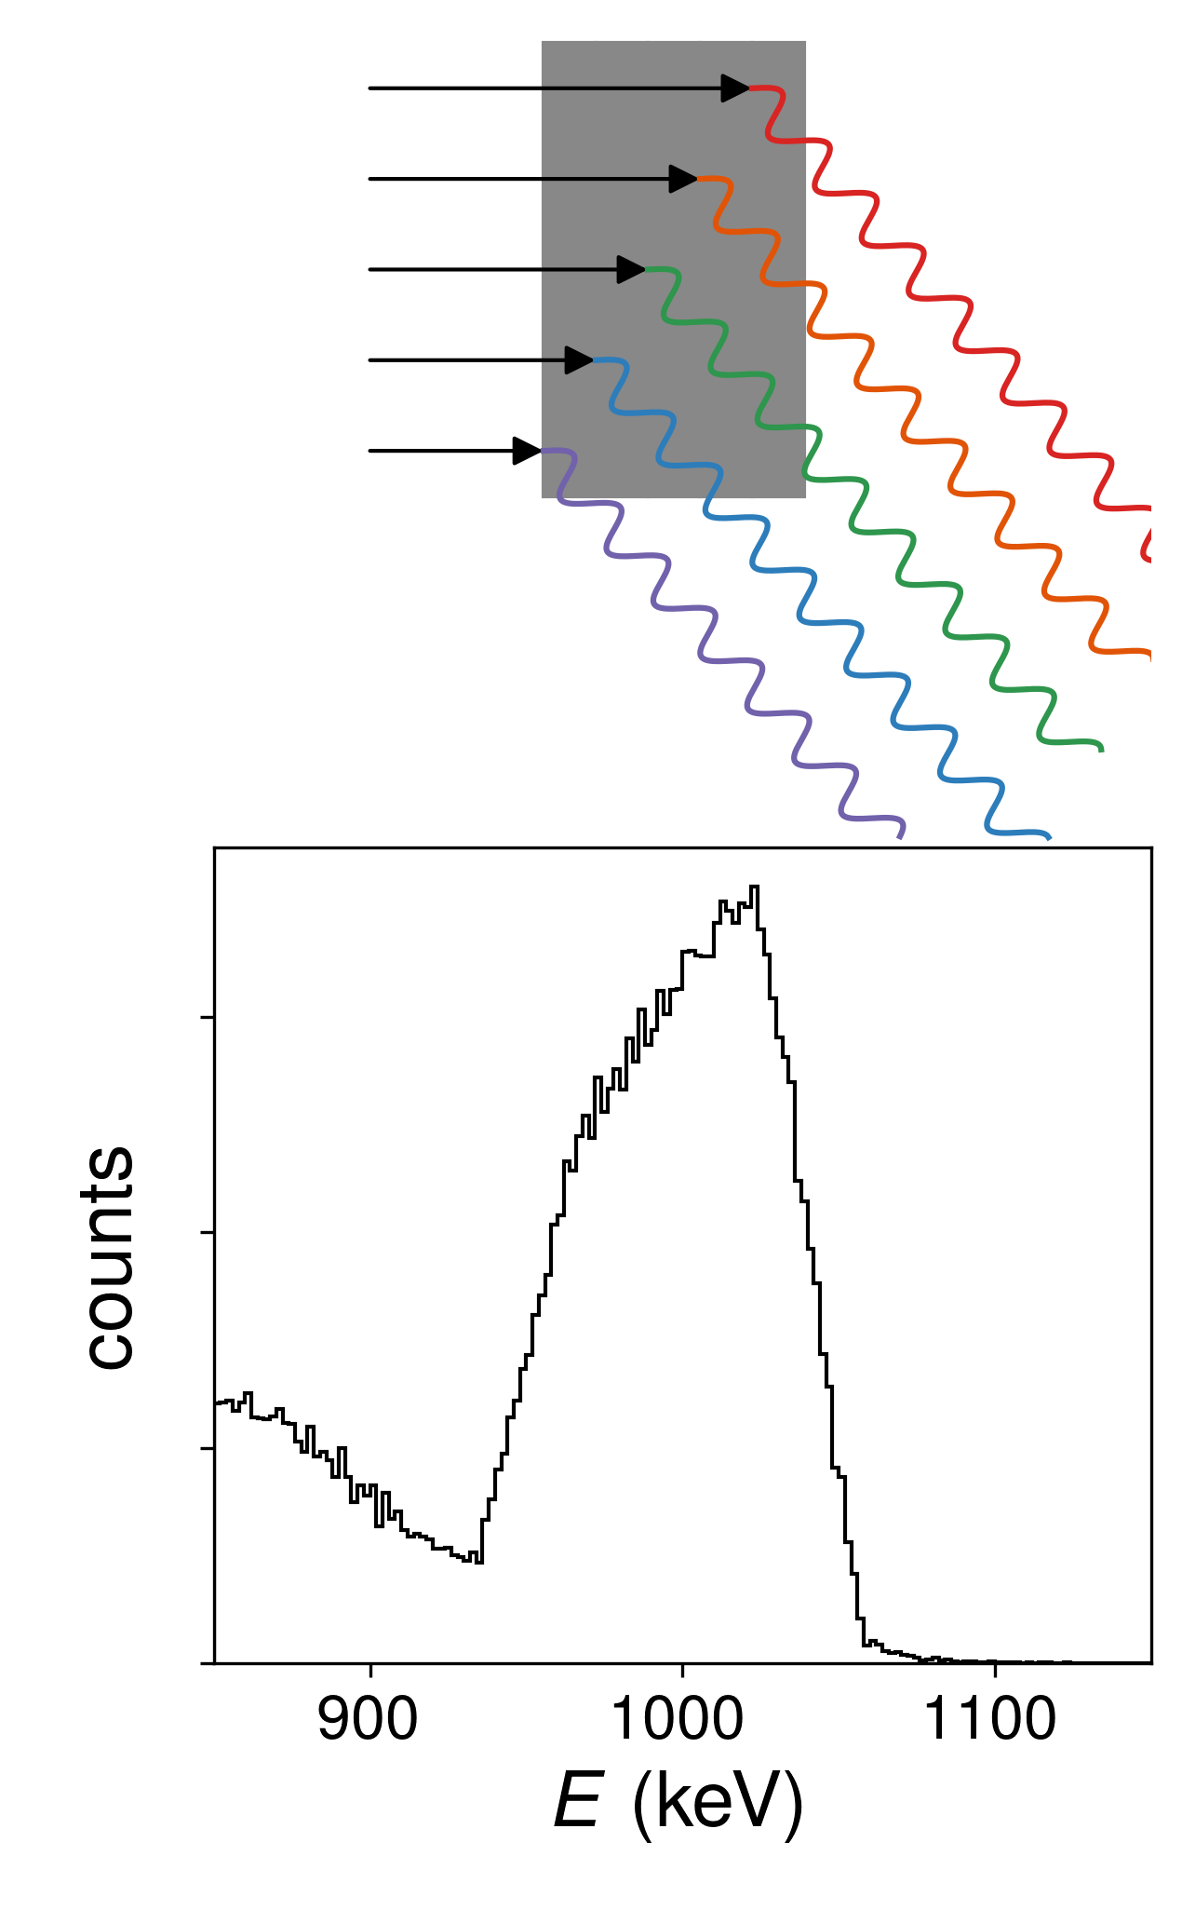
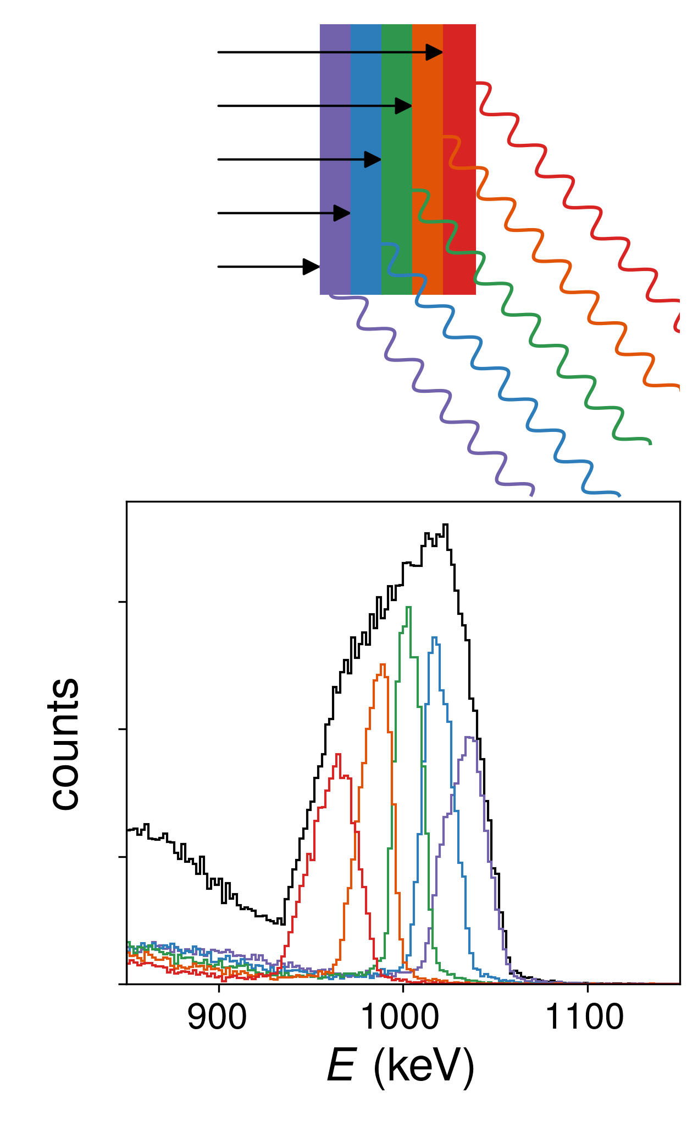
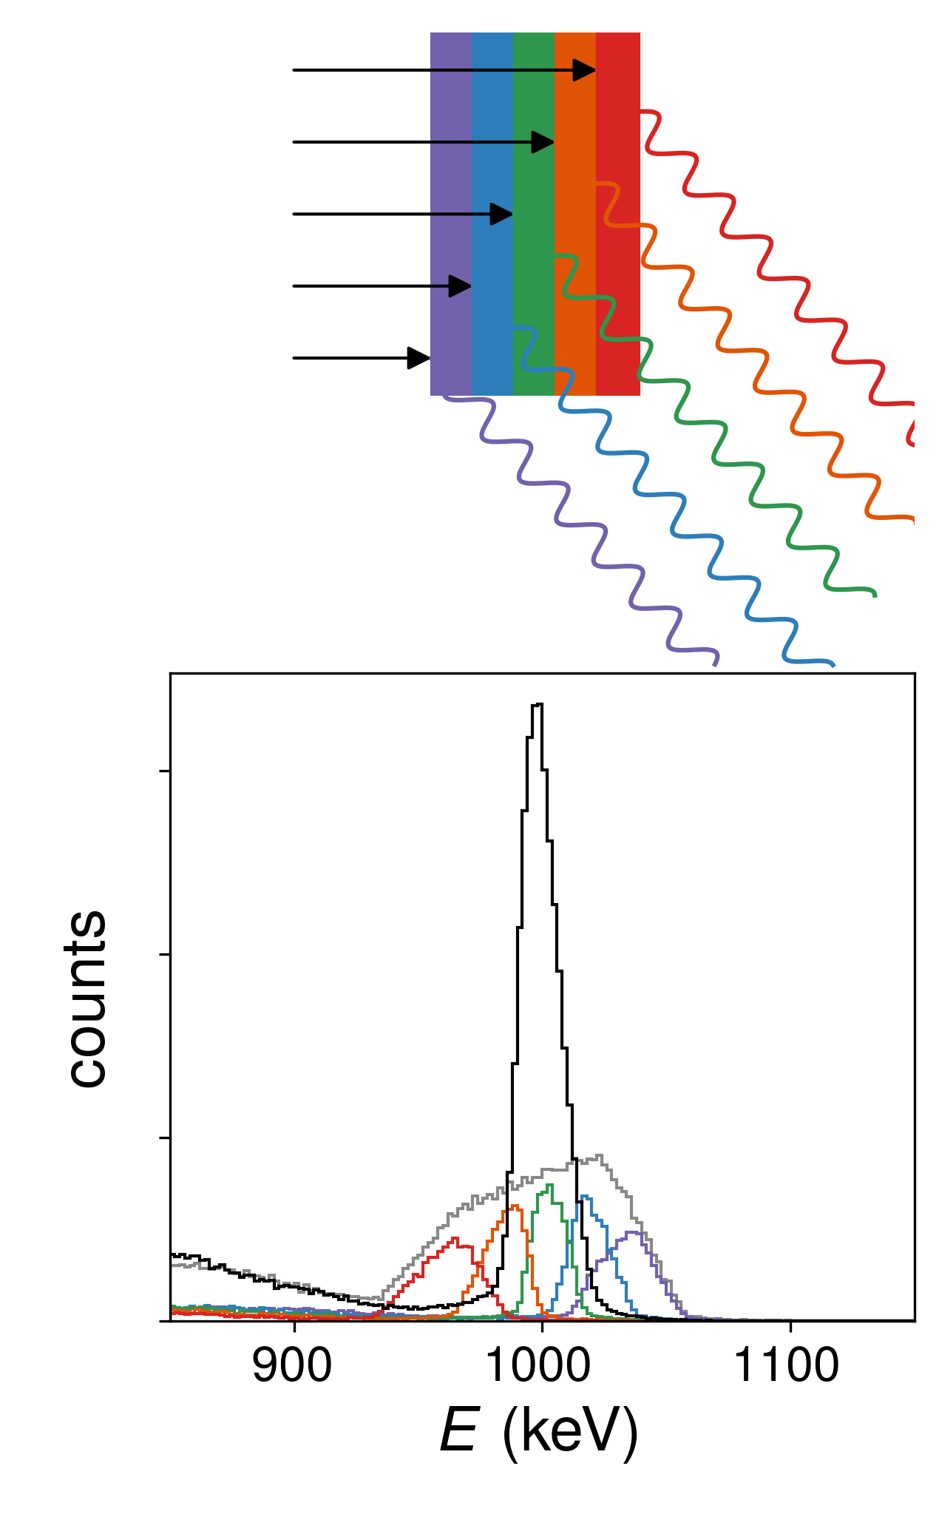
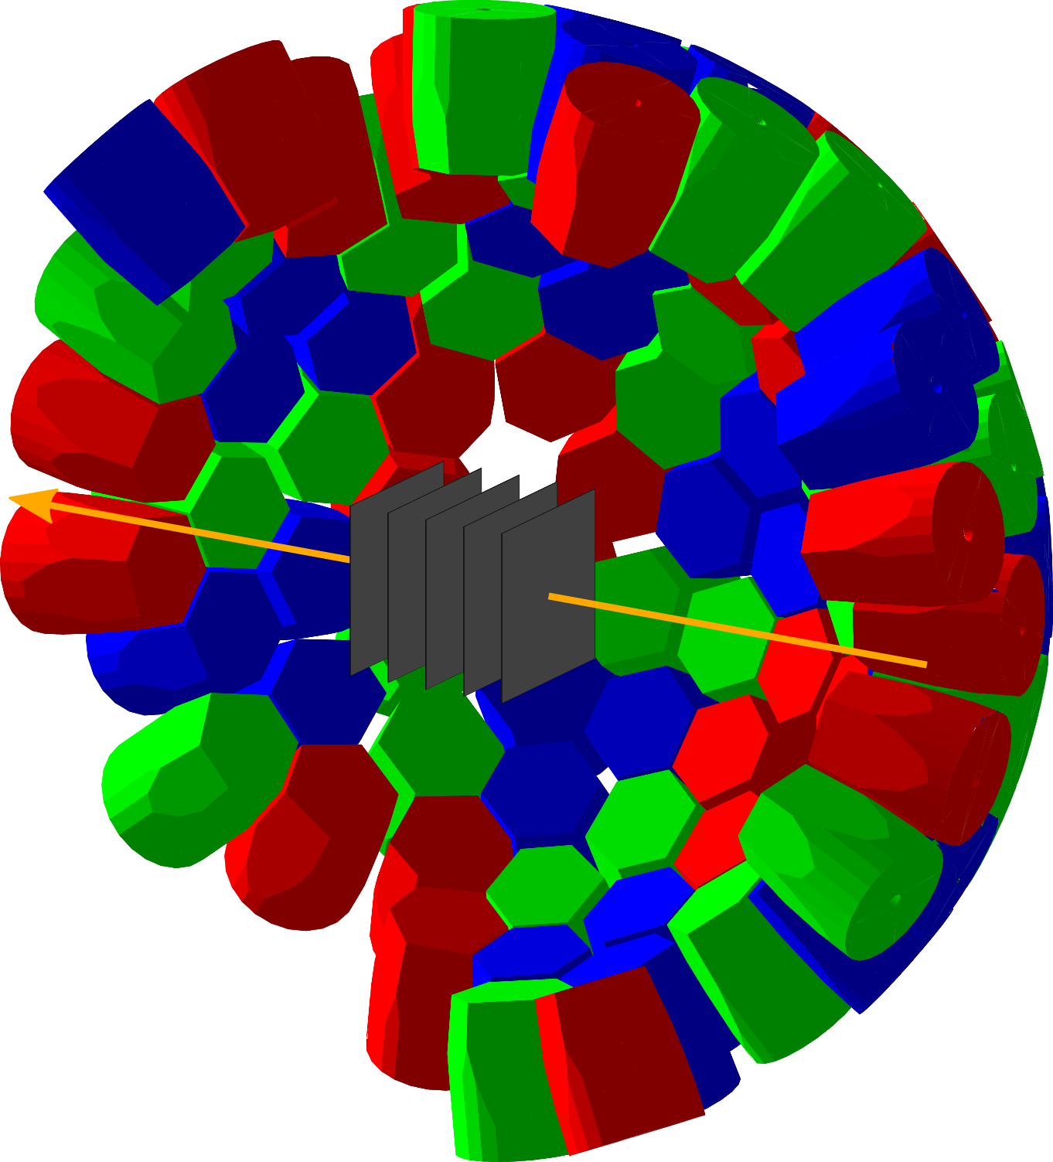
LISA: LIfetime measurements with Solid Active targets
In nuclei, the coexistence of single-particle and collective degrees of freedom in atomic nuclei gives rise to various exotic phenomena.
Where and how collectivity emerges from the single-particle dynamics of protons and neutrons is an open question in nuclear structure physics that will be addressed with LISA in a unique way.
Energy resolution determined by unknown velocity in the target
Several layers of active targets
Event-by-event determination of reaction position → (β,z)
Opens new possibilities for lifetime measurements using AGATA at FAIR:
Evolution of collectivity in Islands of Inversion
Fate of the N = 82 and 126 shell closures
And many more
Compact array of active target detectors inside AGATA
7

Slide 8
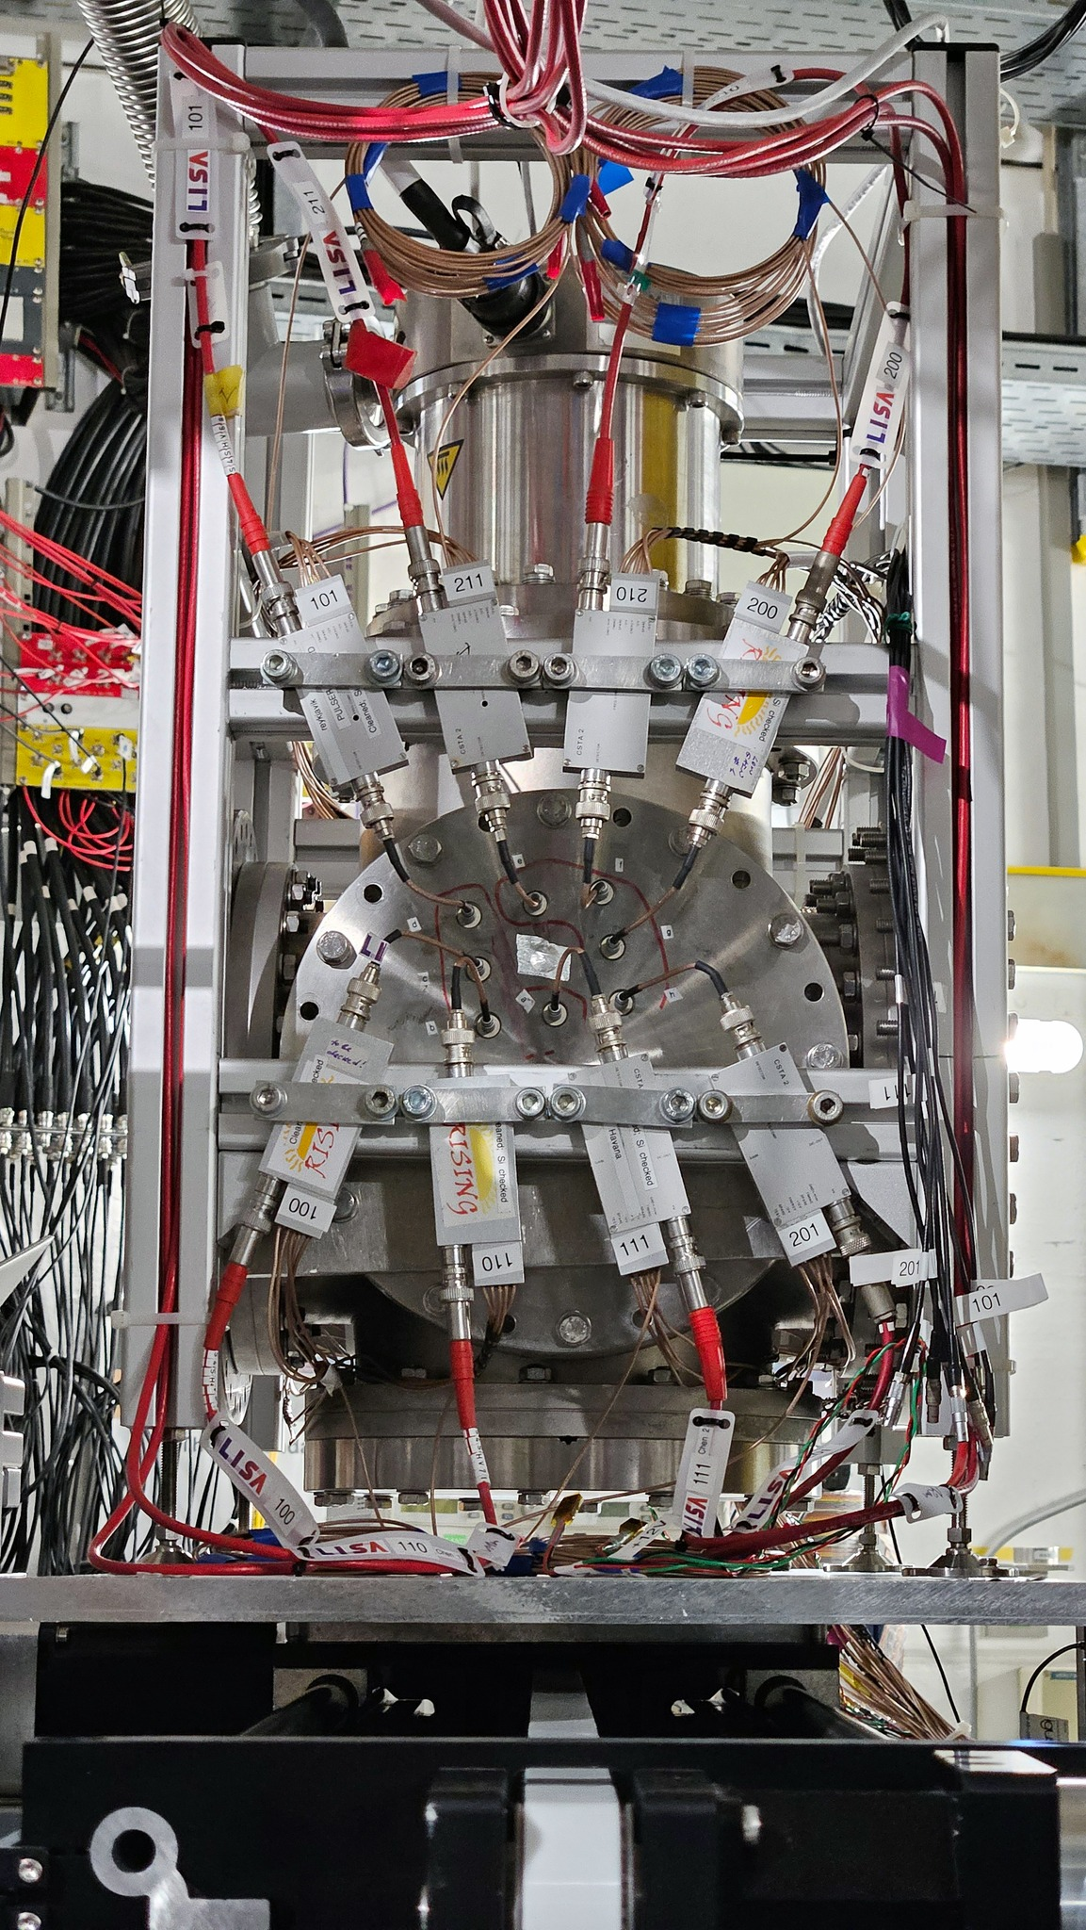
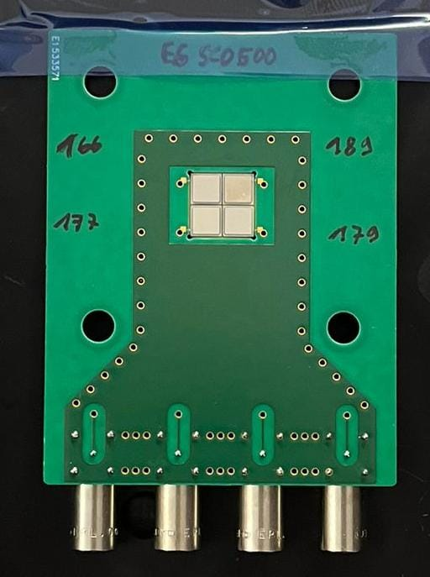
LISA: proof of principle experiments in 2023/24
LISA prototype installed at S2 focal plane of FRS
Projectile fragmentation and fission of primary ¹⁴N, ²³⁸U, and ¹⁰⁰Mo beams
Reaction tag in LISA at S2 ΔE → change in proton number Z
Seondary fragment ID with FRS
Single-crystalline CVD diamond samples (4.5×4.5×0.5 mm³)
Arranged in two 2×2 prototype layers
Pulse shapes for ²³⁸U beam: Fission fragments resolved:
8

Slide 9
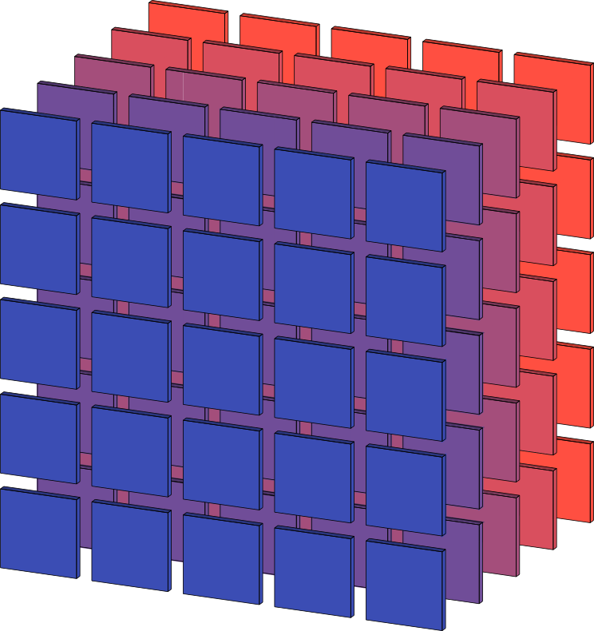
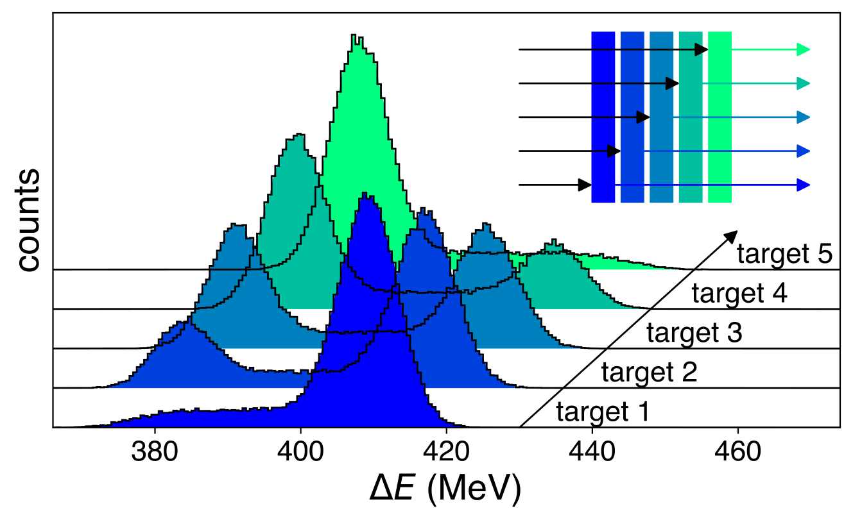
Outlook: 2025 beamtime
Construction of full array: five layers with 5×5 diamonds
Ongoing development of dedicated electronics and readout
Detector characterization and further optimization with sample provider
Automate layer identification and online event selection
Commissioning beam time at GSI April 2025 with full LISA array
Ready for physics experiments from mid 2025
Requirements for 2025/26:
Fragment beam from FRS
few hundred AMeV (LEB energies)
uniform spill structure
PID before LISA, S1-S2 time-of-flight
few days of beam time for physics runs
This project has received funding from the European Research Council (ERC) under the European Union's Horizon 2020 research and innovation programme (grant agreement No 101001561).
9

Slide 10
10

Slide 11
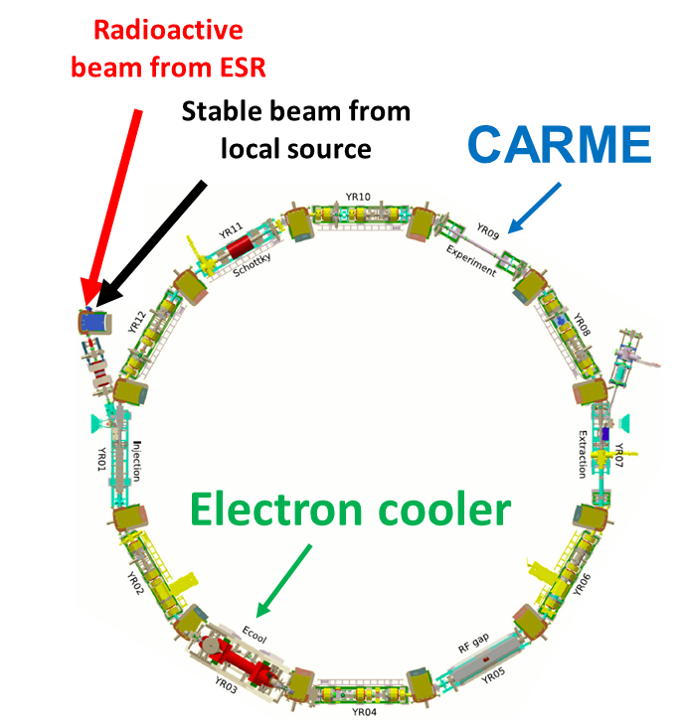
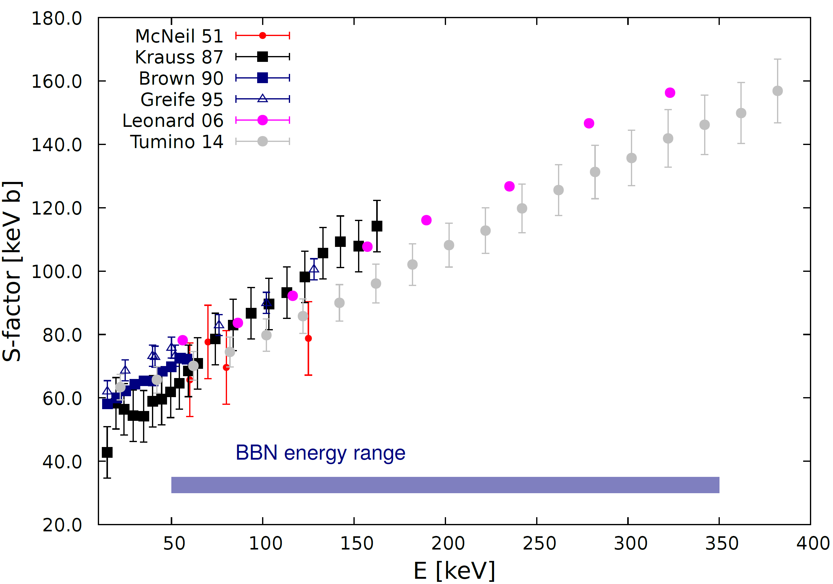
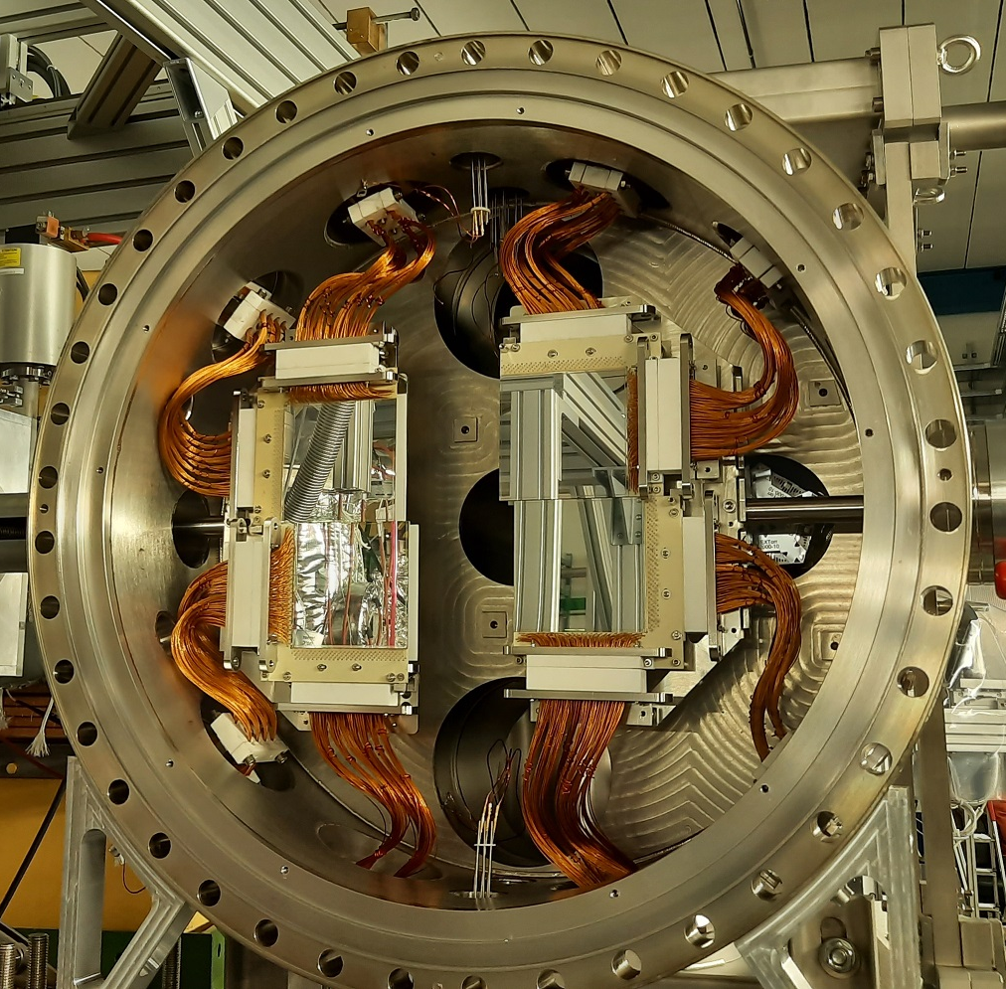
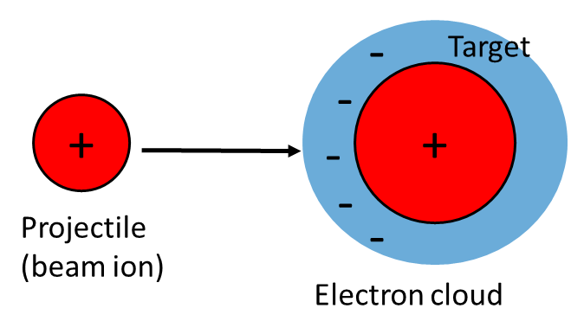
ELDAR – Elements in the Lives and Death of stAR
nuclear reaction measurements with the CARME reaction chamber
Motivation: nuclear astrophysics
Experimental method: detection of reaction products
using CARME in CRYRING
D + D reaction for Big Bang Nucleosynthesis (BBN)
unsatisfying situation of measurements in literature
largest uncertainty in BBN
key test of standard model
CARME - CRYRING Array for Reaction Measurements
large Si detector array
high position & energy resolution
XHV compatible setup
¹⁵N(p,γ) reaction to understand electron screening
long-standing challenge
potential impact on many astrophysical scenarios
key test of a new approach to model electron screening
high purity and luminosities of stored beams in CRYRING
direct detection of reaction products using CARME
ongoing commissioning of CARME and new internal gas target
measurement with radiactive beams
forseen in the future
unrivalled conditions for low-energy nuclear reaction measurements
11

Slide 12
ELDAR – Elements in the Lives and Death of stARs
PI: Carlo Bruno, U Edinburgh
Machine challenges:
Future plans
highest intensity beams from local CRYRING injector
High precision resonance scanning
beam cooling and acceleration in CRYRING
ion-ion reaction studies using CARME and FISIC
radioactive beams via FRS-ESR
Beam time proposals (commissioning runs for CARME):
2025: D+D for Big Bang Nucleosynthesis (accepted proposal)
CRYRING local: ²H¹⁺ [0.1 to 2 MeV/u]
Beam time: 1 week/21 shifts
2025: Electron screening in ¹⁵N(p,αγ)
(accepted proposal)
CRYRING local: ¹⁵N¹⁺ & ¹⁵N⁵⁺ [430 keV/u]
Beam time: 1 week/21 shifts
2026: 2 weeks production run with secondary beams from ESR
(¹⁵O(α, α))
Summary
ion | facilities | intensity (stored) | energies (stored) | special | beam time
D⁺ | CRYRING local | > 5e7 | 0.1 – 2 MeV/u | D₂ target: 5e12 atoms/cm² | 1 week/21 shifts
¹⁵N^{1+/5+} | CRYRING local | > 1e7 (1+) / > 1e6 (5+) | 430 keV/u | H₂ target: 5e11 atoms/cm² | 1 week/21 shifts
12

Slide 13
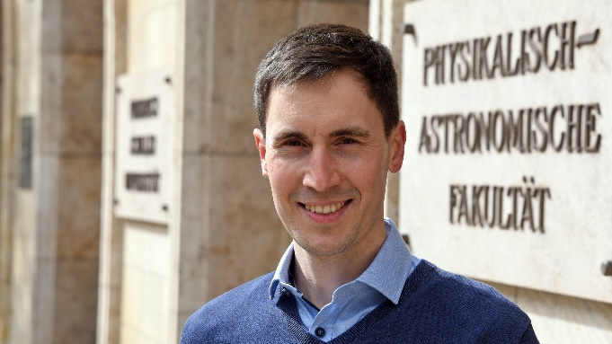
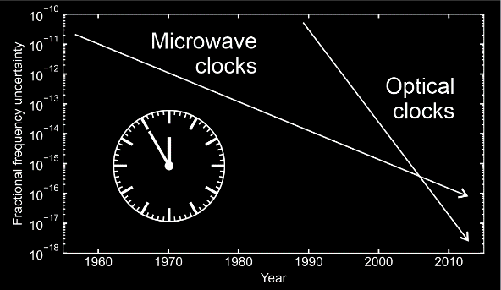
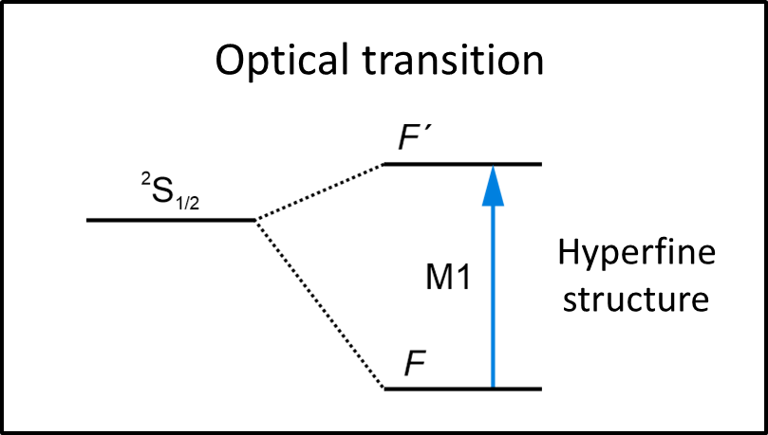
Helmholtz Young Investigator Group: Peter Micke
Quantum logic spectroscopy and a quantum logic clock
August 2023: started at HI-Jena/GSI
February 1st: W1/W2 TT at Friedrich-Schiller-University Jena
Objectives:
Tests of fundamental, atomic, and nuclear physics
Sensitive quantum sensors for beyond Standard Model physics
Optical clocks are the most accurate measuring instruments
13

Slide 14
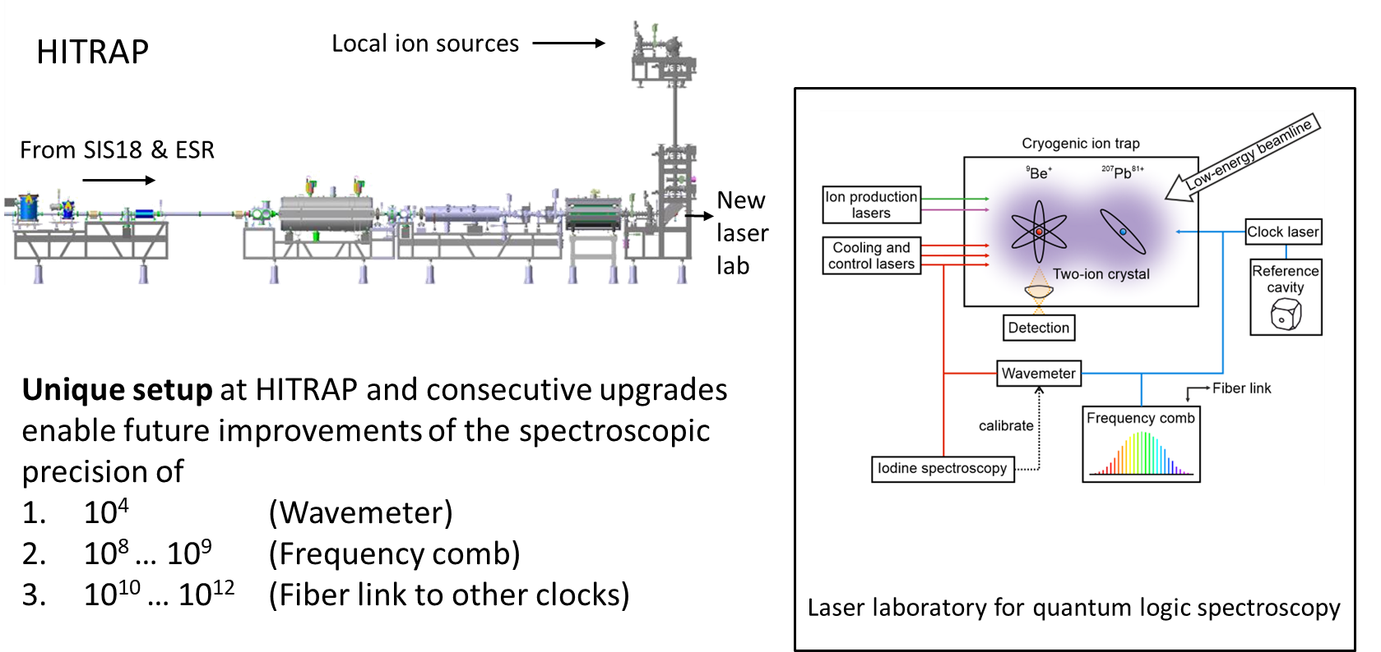
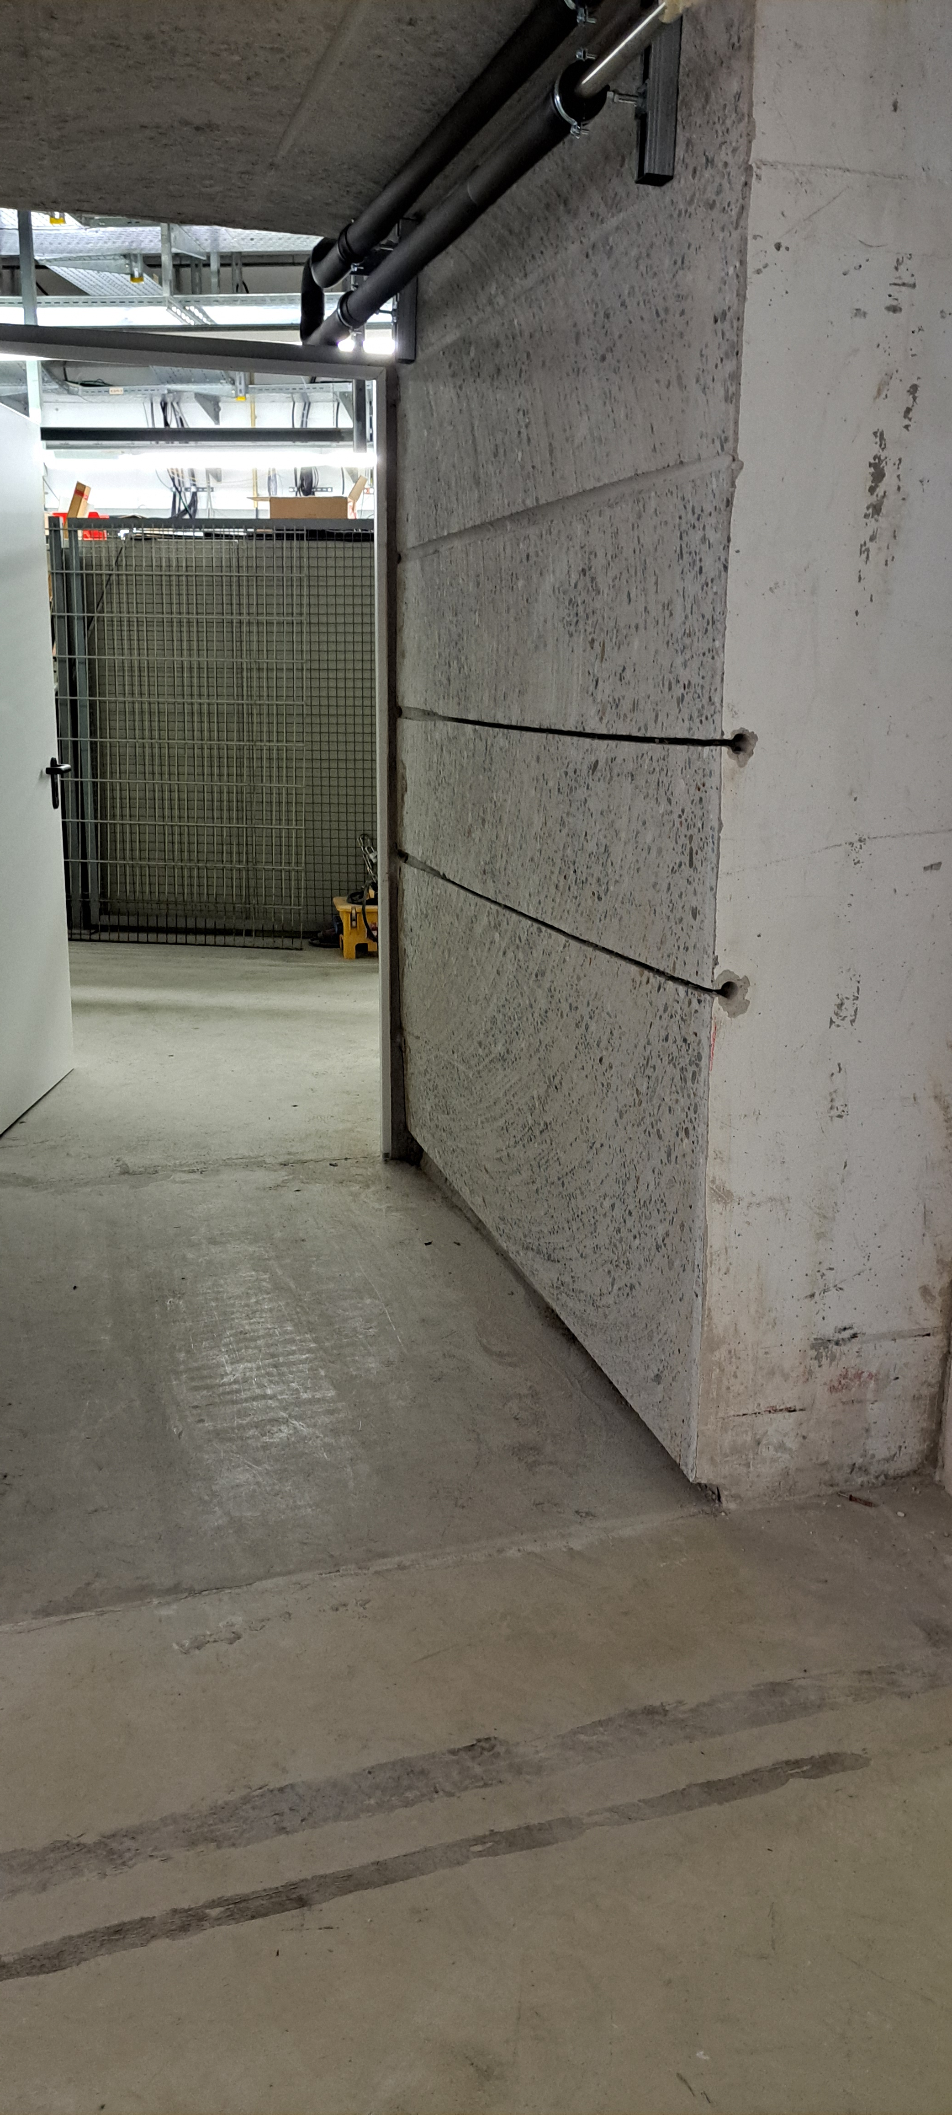
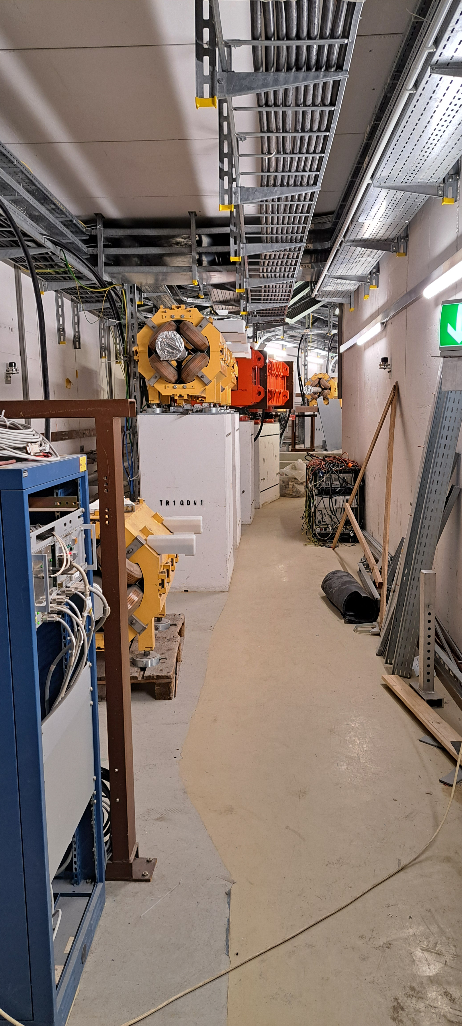
Highly charged ions are great clock references!
Unique platform at HITRAP enables unprecedented measurements of sensitive atomic or even nuclear systems that can serve as clock ions
Optical transitions in heavy highly charged ions
Nuclear transition in thorium ions
Photograph
14

Slide 15
Timeline requirements for HYIG Peter Micke
2023 | Started in August.
2024
2025
2026
2027 | Re-trapping of a hydrogen-like ion (e.g. ²⁰⁷Pb⁸¹⁺ or ²²⁹Th⁸⁹⁺ or other species with $q/m≈0.39$) in the Paul trap and cooling to quantum-mechanical ground state of motion.
2028 | Promised: Demonstration of quantum logic spectroscopy of a heavy highly charged ion, e.g. ²⁰⁷Pb⁸¹⁺ - convenient optical transition with simple Zeeman structure.
Full commissioning of HITRAP with $\sim$ hydrogen-like ions (e.g. ²⁰⁷Pb⁸¹⁺ or ²²⁹Th⁸⁹⁺ or other species with $q/m≈0.39$).
For future project: Primary thorium ion beam strongly desired! Major commissioning of Paul trap experiment can happen with ²²⁹Th⁸⁹⁺ as well.
15

Slide 16
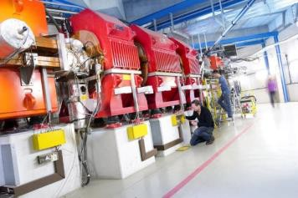
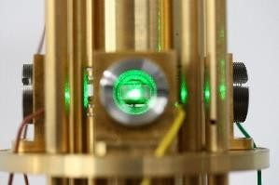
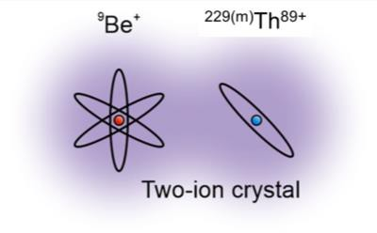
Highly Ionized Trapped 229-Thorium: A New Paradigm Towards a Nuclear Clock”
PI: Thomas Stöhlker
16

Slide 17
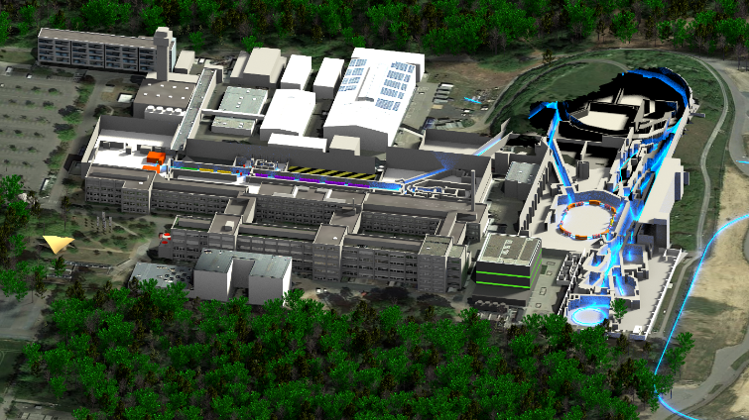
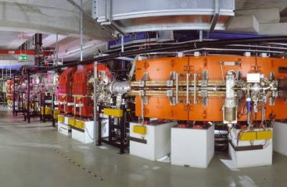
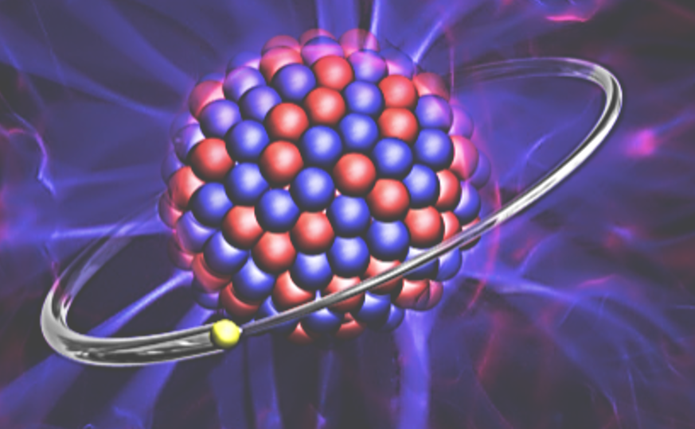
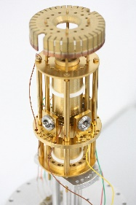
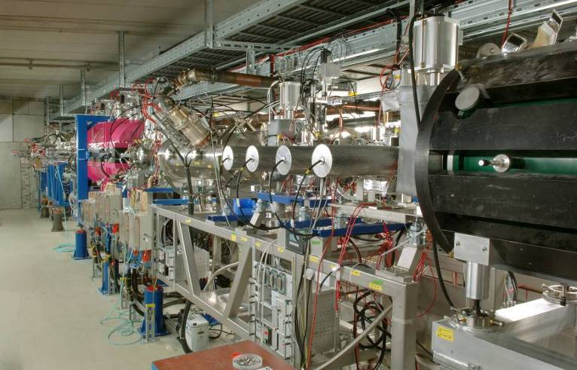
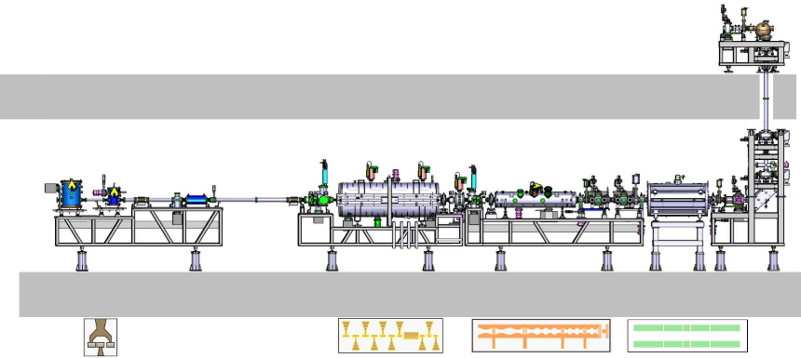
HiThor Can Only be Realized at GSI – One-Electron ²²⁹Th⁸⁹⁺
Ion storage ring and traps at GSI
GSI
²²⁹Th⁸⁹⁺
ESR
Uranium beam
from synchrotron
²²⁹Th production
target
HITRAP
β = 0
ESR
β ≈ 0.7
Worldwide unique !
HITRAP
17
17
Notes:
Worldwide, there is only one facility available where the HiThor experiments can be conducted, namely at GSI Darmstadt, Germany.
For the experiments we use initially a high-energetic uranium beam and produce via fragmentation the desired Thorium 229 isotope with one-electron only.
The cocktail of fragments is injected into the storage ring ESR at about 70% speed of light where the Thorium-229 isotope with one-electron is isolated.
This has already been demonstrated in an experiment in 2022.
The first part of the HiThor experiments will be performed at the ESR but a large part of the HiThor experiment will be performed with ions at rest in the laboratory using precision traps at HITRAP.
For this purpose, the ions are decelerated in the ESR, and extract out of the ring and injected into the decelerator of HITRAP where we finally slow down the ions to rest but preserving the high charge state.
134 Worte1 ½ Minuten

Slide 18
Timeline requirements for HiTHOR
2024 | Started 1st of July
2025
2026
2027
2028 | Precision experiment at SPECTRAP (STEP 1)
2029 | Precision experiment at SPECTRAP (STEP 2) and transfer to Quantum Logic
2025: ESR 229Th89+; proof of NHF
minimum of 10 days of ²³⁸U beams at SIS;
2026: Depending on result in 2025:
minimum of 10 days of ²³⁸U beams at SIS;
2027: Depending on result in 2026:
minimum of 10 days of ²³⁸U beams at SIS;
Full commissioning of HITRAP with heavy ions
Beam time request depends on HITRAP performance
Primary ²³²Th beam would substanially relax the beam time request!
18

Slide 19
BARB AdG 2020-2025 extended to 2026 PI: Marco Durante
19

Slide 20
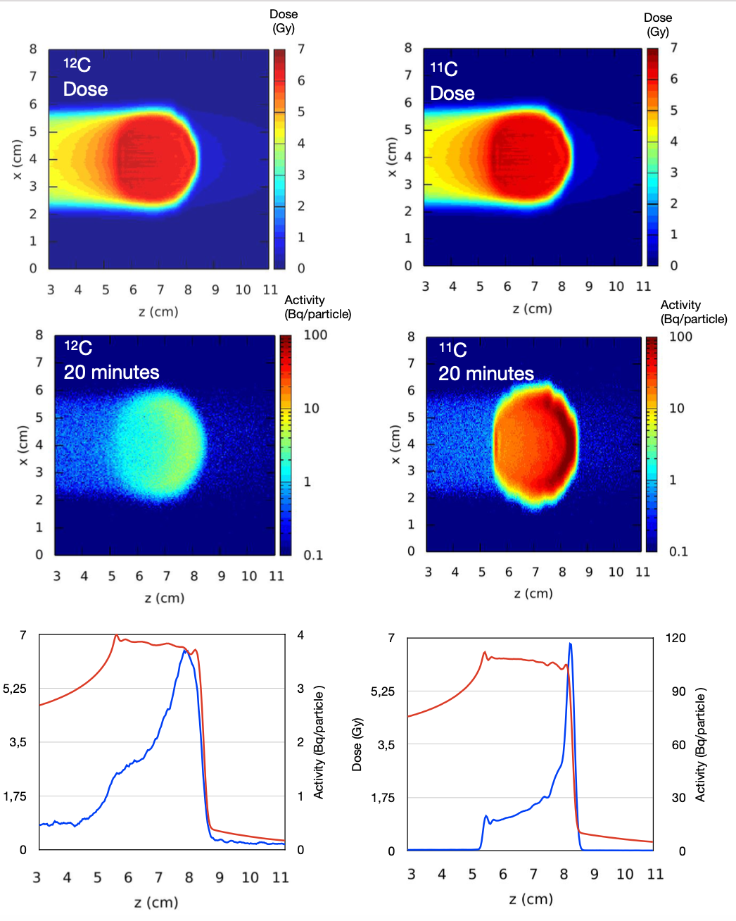
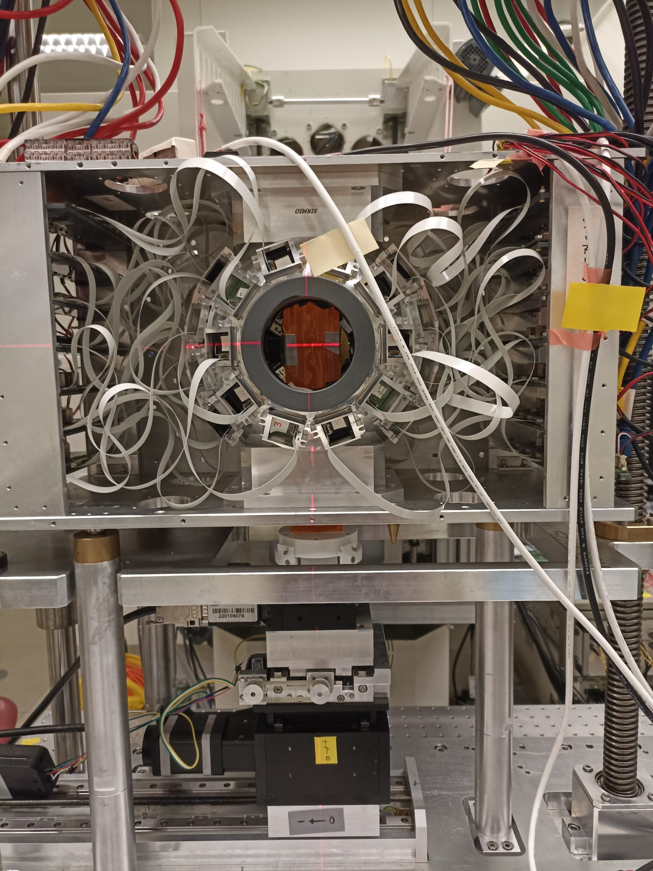
Radioactive Ion Beams (RIB) for simultaneous treatment
and range verification
Respect to conventional PET imaging in heavy ion therapy, RIBs show:
Improved count rate (one order of magnitude larger than for stable ions)
Improved correlation between activity and dose
Reduced washout blur thanks to short lived isotopes
The SIRMIO online PET detector in Cave M
Boscolo et al. Front. Oncol. 2020
20

Slide 21
Request for coming year 2025-2026
First animal results confirm thefeasibility of RIB irradiation with simultanous beam monitoring for tumors very close to oragns at risk
Experiments will continue in Cave M with the beam from FRS using different doses
Crucial is high intensity ¹²C beam to FRS in the oder of 10¹⁰ pps
We also plan to us ¹⁵O (t_{1/2} = 2.04 min) beams in the 2026 final run to complete the scheduled program
18 shifts are planned in 25 and 26
21
Olga Sokol on behalf of the BARB collaboration | PTCOG 62 | Singapore, 12.06.2024

Slide 22
PROMISE (2024) “Portal Range Monitoring in Mixed Ion Beam Surgery“
PI: Christian Graef
22

Slide 23
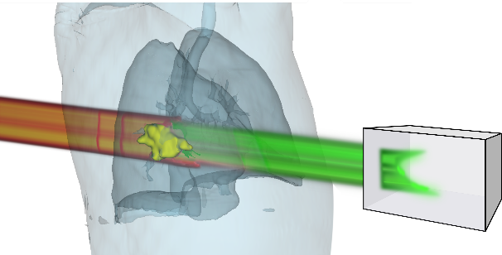
ERC CoG PROMISE: He-C Mixed beam irradiation
Range uncertainty is a major challenge in particle therapy: Sharp dose gradient of Bragg Peak is biggest advantage, but only if known where
Mixed carbon and helium ions for concurrent therapy and monitoring:
~90% carbon for therapy, stops in patient
~10% helium for imaging, with 3x higher range, exits patient for online range inference
Especially useful for moving targets such as lung cancer, where range changes are expected
real-time capable
higher SNR than other methods
low additional imaging dose
¹²C
⁴He
Treatment
Imaging
Funded by the European Union (ERC CoG PROMISE, 101124273). Views and opinions expressed are however those of the author(s) only and do not necessarily reflect those of the European Union or the European Research Council Executive Agency. Neither the European Union nor the granting authority can be held responsible for them.
23

Slide 24
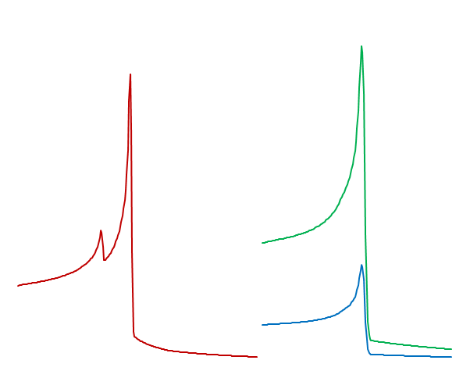
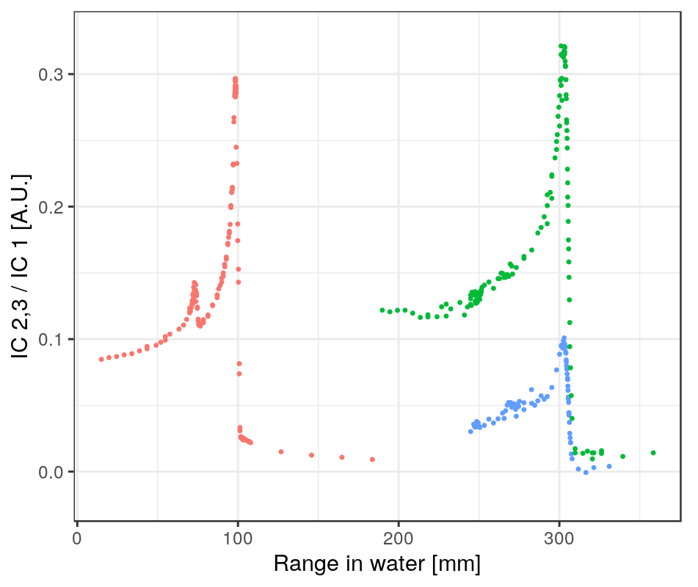
Accelerator requirements
Mixed beam of C and He with same A/Q at therapy energies and intensities
<400 MeV/u; ~5 10⁷ Carbon/s
RFKO extraction – intensity stabilization would be highly favorable
First experimental test successful in Nov 23
worldfirst mixed beam production!
¹²C³⁺ and ⁴He⁺ from ECR, ¹⁶O⁴⁺ contamination
RFKO extraction with adjusted chromaticity
Further requirements
Stable, adjustable intra- and interspill He fraction
interspill was excellent, intraspill acceptable
¹⁶O contamination below threshold of clinical relevance i.e. less than 1-2% variation in target dose
carbon
helium high
oxygen
helium low
24

Slide 25
Beamtime requests for 2025 ff
According to granted proposal, 3-5 days of beam annually
2025: 1-2 days of physics + 1-2 days of machine beam
Program 2025 (for 2 Postdocs in ACC and Biophysics hired in fall of 2024)
Source of 16O contamination
Additional options for multiple injections of separate ions to SIS18
Stable extraction modes including intensity feedback from HTM detectors (of C and He?)
Detector concepts for real-time range detection of He beam: IC stacks, scintillator slabs or block with different optical readout
Program 2026 ff
Develop beam production model for clinical facility, possibly in collab with MedAustron
Develop Medical Physics DAQ and AI-based data processing
Explore clinical use case in patient studies and proof of concept in animal model

Slide 26
Thank you for your attention!

