Slide 1
7th Beam Time Retreat
Highlights @UNILAC 2024
BEAM TIME RETREAT 2024
BEM TIME RETREAT 2023
Content:
Overview
Selected highlights from UNILAC beamtime 2024
Outlook 2025
M. Block GSI, HIM, JGU
on behalf of the UNILAC users
11th and 12st July 2024
@ Jagdhotel Kranichstein
With input from
A. Blazevic, T. Dickel, Ch. Düllmann, J. Khuyagbaatar,
S. Raeder, E. Toimil-Molares, A. Yakushev

Slide 2
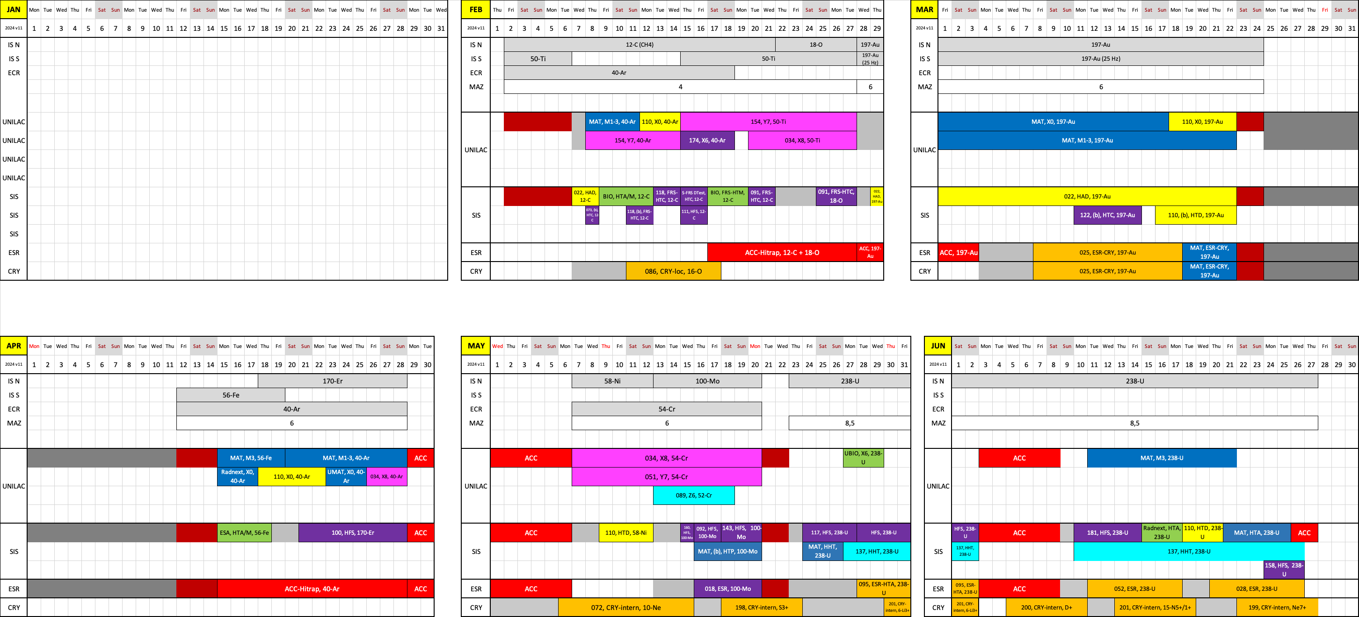
Beamtime schedule 2024 v11

Slide 3
UNILAC – Material Science

Slide 4

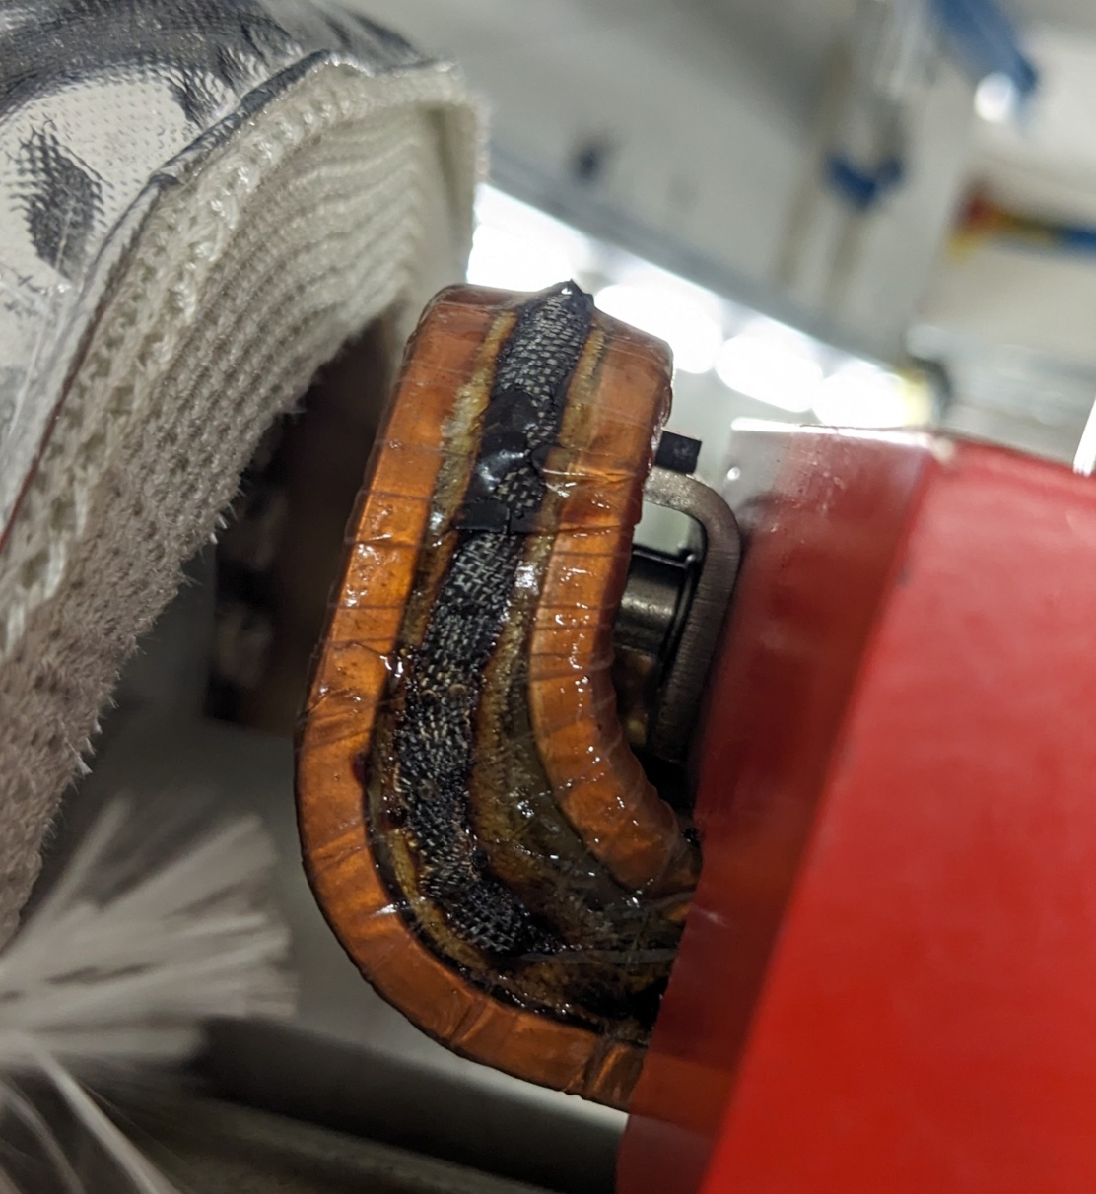

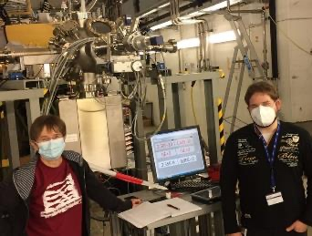
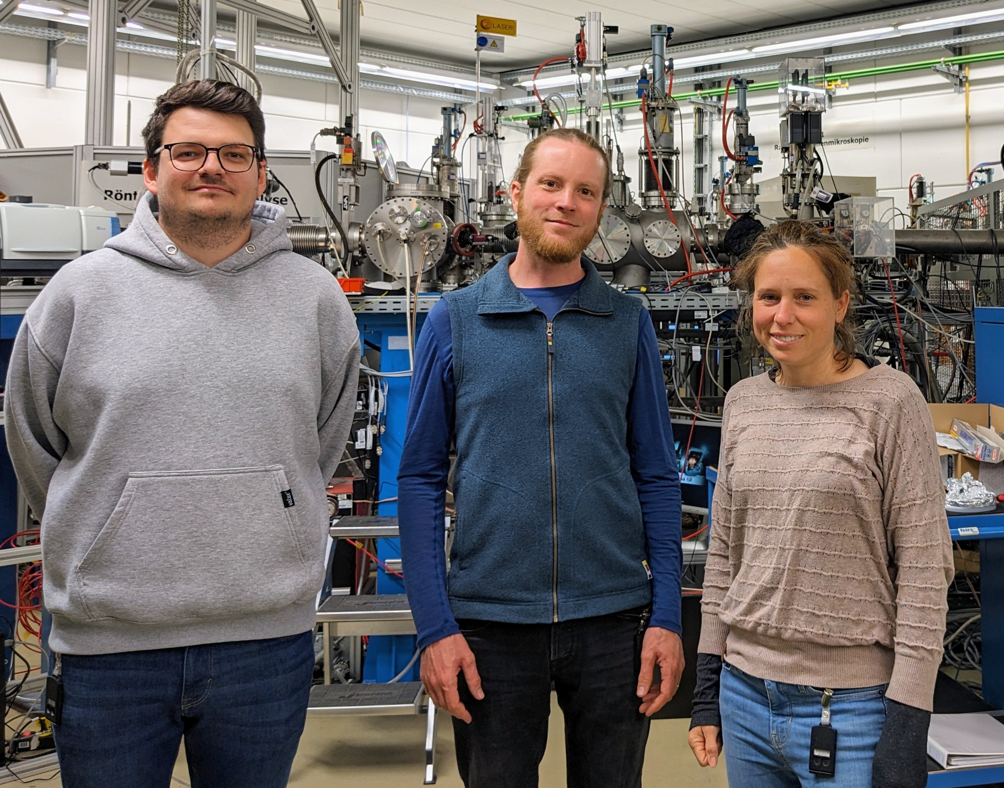
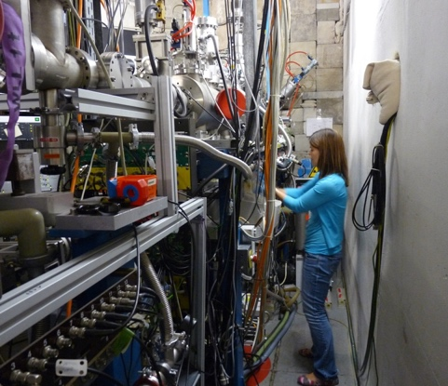
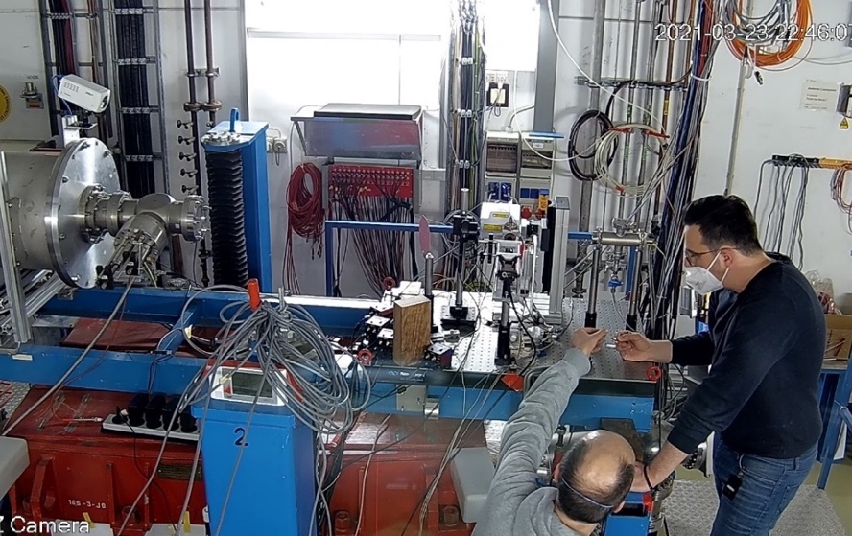

MAT beamtime 2024
CRYRING
MAT station
UNILAC
M-branch
UNILAC
X0
SIS18
Cave A
Extraction magnet failure, broken coil
February to June (Ar, Fe, Au, and U)
June (U)
~50 % of the ~300 shifts granted for 2024/2025 allocated in 2024 (> 50 days operation)
parallel operation of M-branch and X0 is essential and very efficient
~ 40 user groups of the MAT collaboration were served in 2024
various ion species, energies, fluxes (single ion to > 1e9 i/cm²s)
Notes:
We successfully carried out 55% of the total of allocated shifts

Slide 5

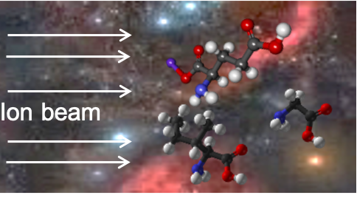
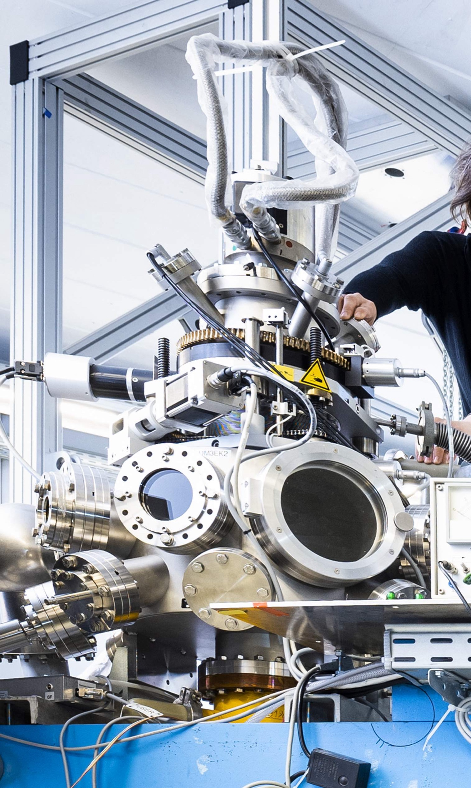
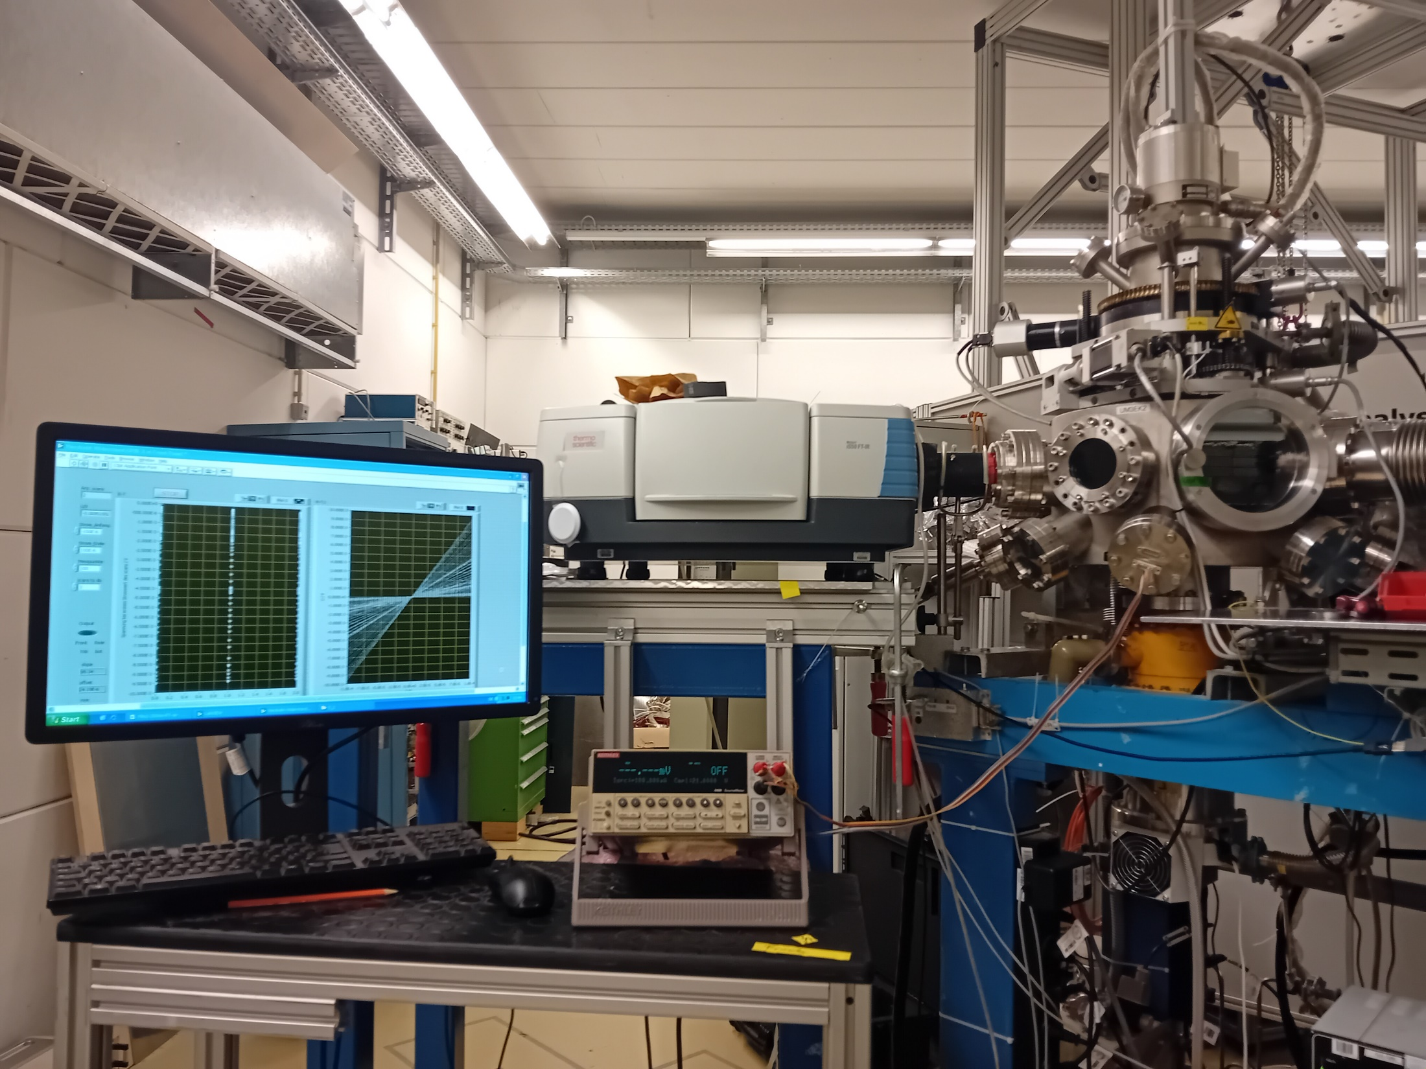
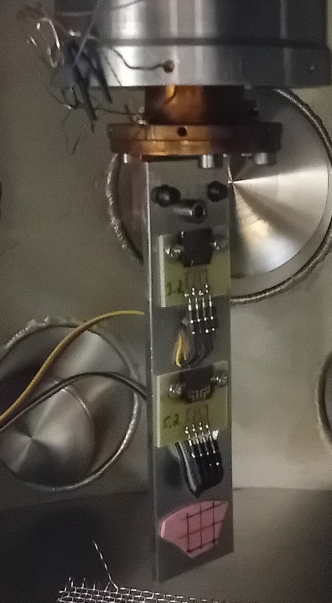


M-branch 2024 selected highlights
Temperature-dependent in-situ resistivity measurements of thin films
Astrochemistry
New setup
In-situ low temperature FTIR on:
Adenine and pyridine samples (GANIL)
Carbonaceous dust analogues (University Paris Saclay and Uni Jena)
Irradiation of oligopeptides with ions of various charge states (Uni Gießen)
Bi films
Irradiation chamber & cryostate
Sourcemeter
Radiation effects and in-situ characterization of a large variety of novel materials
High-entropy alloys
(Uni Münster)
Tailored nanostructures
(Bi, Sb, TiO₂, Bi₂Te₃…(GSI)
Oxides and carbides
(University of Tennessee)
Phase-change materials
Ge₂Sb₂Te₅
(Uni Jena)
Graphene oxide
Minerals

Slide 6
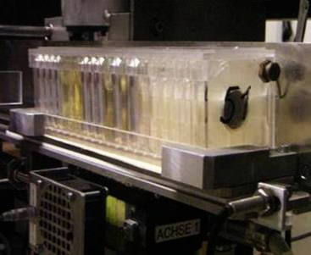
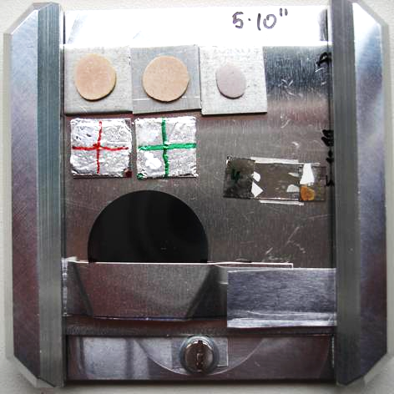
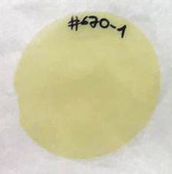
X0 2024
Automatic load-lock system
    up to ~500 samples/h
Defocused beam (5 cm x 5 cm)
Fluence: Single ions up to 1e13 i/cm²
Radiation Effects on Materials and Ion-Track Nanotechnology
All proposals
and
users served
Oxides and carbides
(University of Tennessee)
Ferroelectric devices
(HZAO, Y₂O₃, HZO) (TU Darmstadt)
Thin films, 2D materials and polymers
(KFUPM, PUCRS,…)
Semiconductors
(IMP Lanzhou, IFIN-HH)

Slide 7
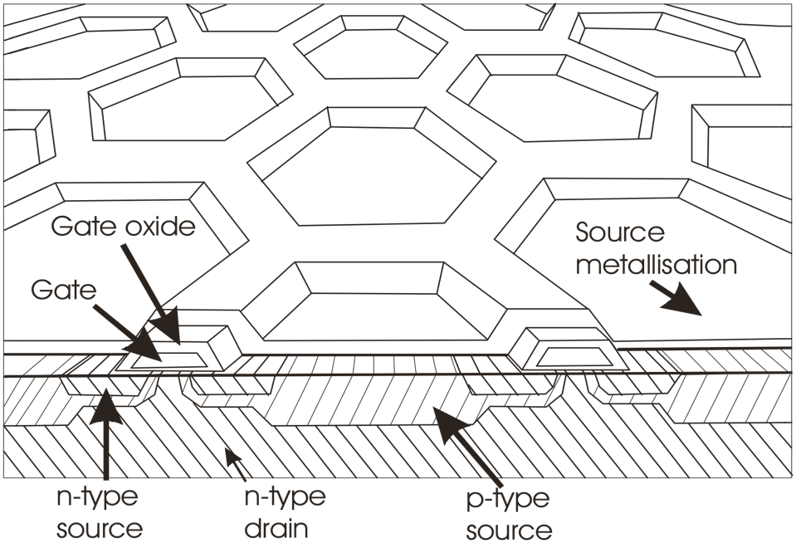
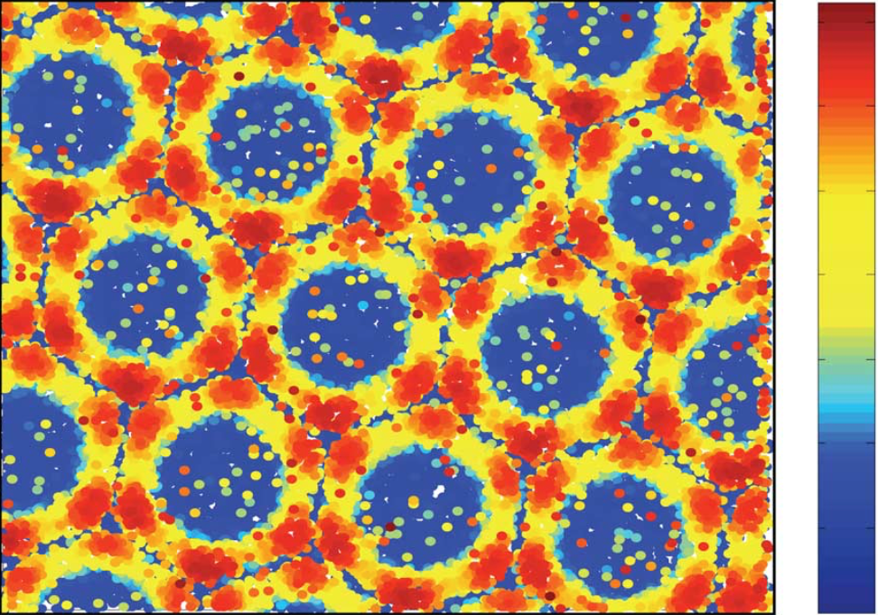
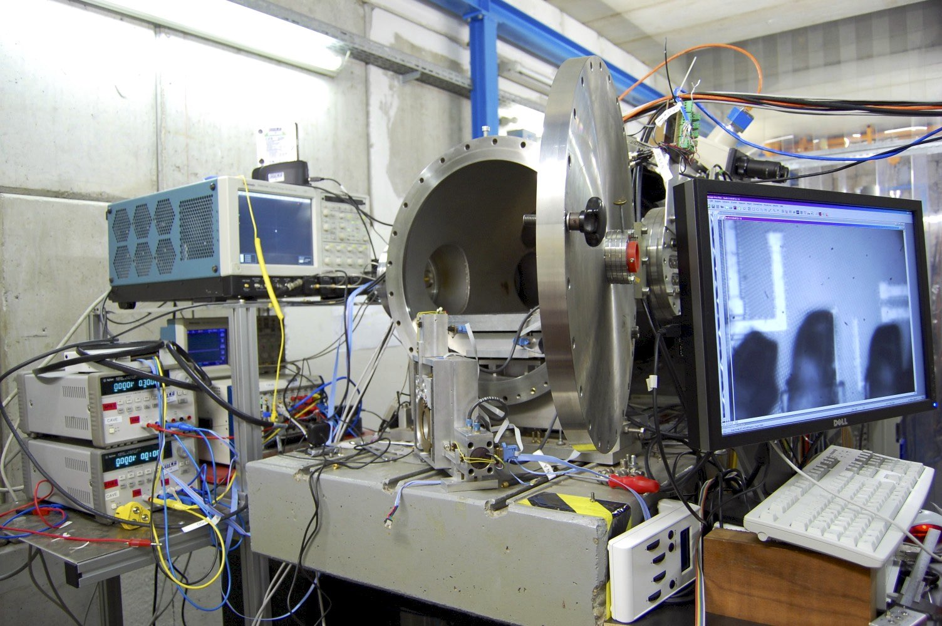
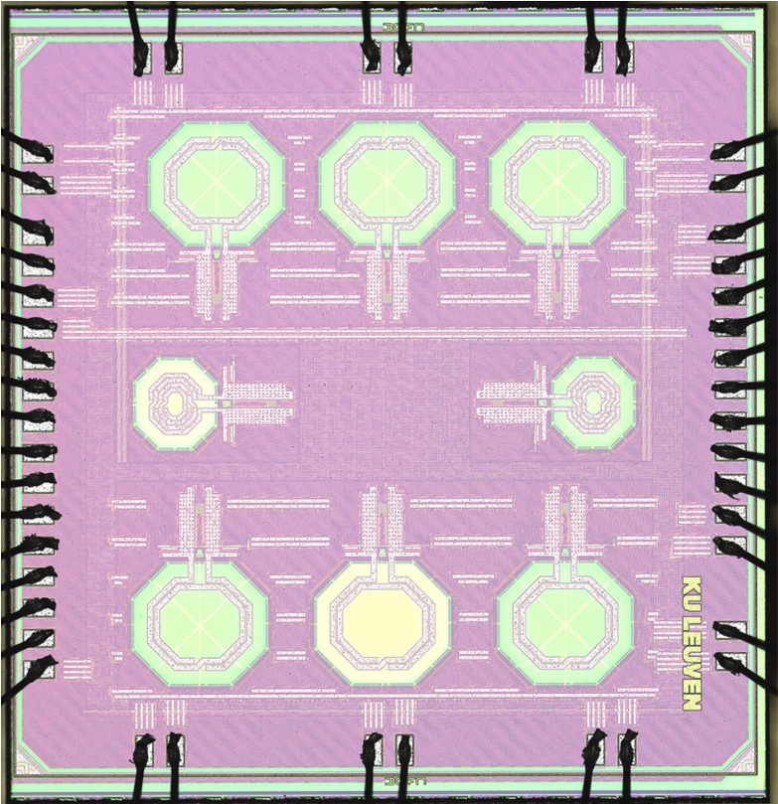
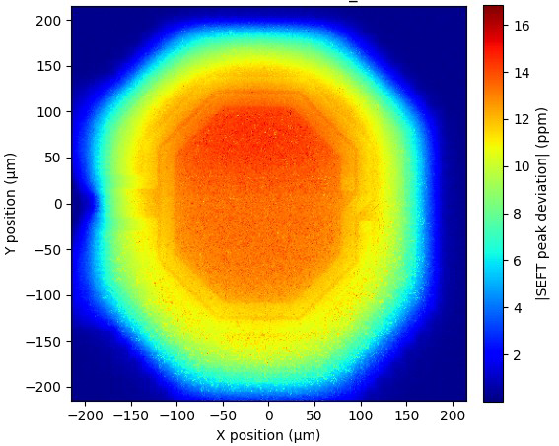
X0 – heavy ion microprobe
Power devices/microcontrollers (Uni Jena, ETH Zürich)
MIMOSIS-2 Sensors (Uni FRA, GSI)
LC-oscillator circuits (CERN, KU Leuven)
danger
Crater produced by single ion
Contact wire
safe
150µm
Recording/monitoring of ion impact maps of single event effects in semiconductor chips
High rates (kHz) and high spatial resolution (~µm)
Needed to understand and mitigate catastrophic failures of space electronics, detectors,...

Slide 8
UNILAC – Superheavy Elements

Slide 9

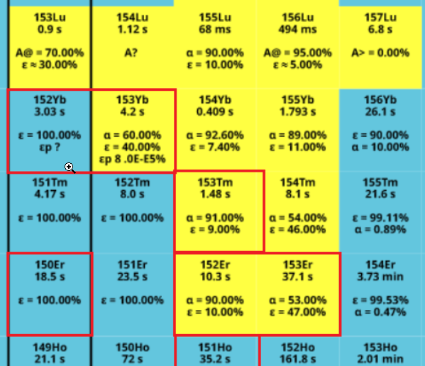
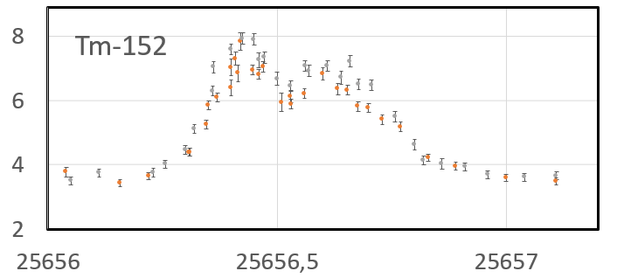
RADRIS – Beamtime 2024
⁵²Cr beam – parasitic (5 Hz, 5 ms) – very high intensity
¹⁰⁷Ag target for production of Lu isotopes
      Test laser ionization of Lu
      Method development
      laser spectroscopy of Tm (Md homologue)
Production
Laser spectroscopy
Tm
351 nm
Detection
25 656.02
4f¹³6s6p J₁=5/2
normalized countrate
389.6 nm
4f¹³6s² J₀=7/2
Wavenumber [cm⁻¹]

Slide 10
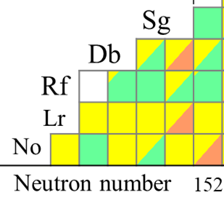
The new sub-μs superheavy nucleus ²⁵²Rf @TASCA
One of the current hot topics: T_{SF}(²⁵²Rf) - ?
Prediction 1: 100 ns: (inaccessible at in-flight separators)
J. Khuyagbaatar et al., Phys. Rev. C. 104, L031303 (2021).
Prediction 2: 0.001 ns: (inaccessible at in-flight separators)
A. Lopez-Martens et al., Phys. Rev. C. 105, L021306 (2022).
CE(^{252m}Rf)
SF(^{252g}Rf)
ER(^{252m}Rf)
Solution: To imply a potential long-lived high-K state
J. Khuyagbaatar, Eur. Phys. J. A 58, 243 (2022).
The new isotope ²⁵²Rf
Experimental campaigns at TASCA
2021: Proposal U328 (J. Khuyagbaatar)
+
2024: 20-28 February (⁵⁰Ti parasitic beam)
Proposal G-22-0034 (A. Yakushev)
J. Khuyagbaatar
Under review with PRL

Slide 11
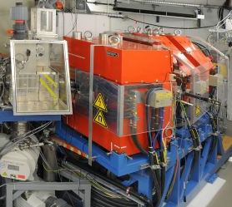
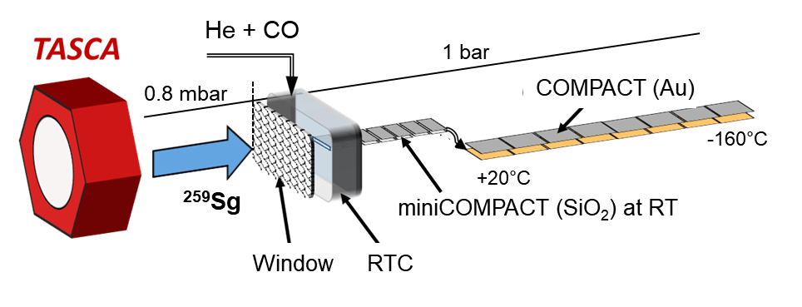
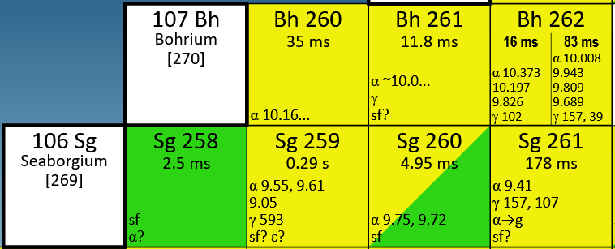
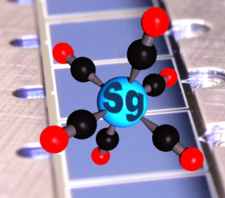
Kinetics studies with superheavy element Sg
Proposal G-22-0034 (Spokesperson A. Yakushev)
Approved: 42 main shifts (⁵⁴Cr beam) for the Sg(CO)₆ studies
> 60 ²⁵⁹Sg nuclei were observed
First successful kinetics study with superheavy element
+110
-100
⁵⁴Cr + ²⁰⁸Pb (2100 pb)
in the chemical reaction between Sg atoms and carbon monoxide
⁵²Cr + ²⁰⁸Pb (320 pb)
Sg⁰ + CO → Sg(CO)_{x} → Sg(CO)₆ , x = 0….5
The lower cross section has been partially compensated by the excellent Cr-52 beam intensity
The intermediate chemical products Sg(CO)_{x} are not volatile,
and thus, they were detected in miniCOMPACT at RT
The volatile Sg(CO)₆ complex was detected in COMPACT
adsorbed at low temperatures
Sg(CO)₆

Slide 12
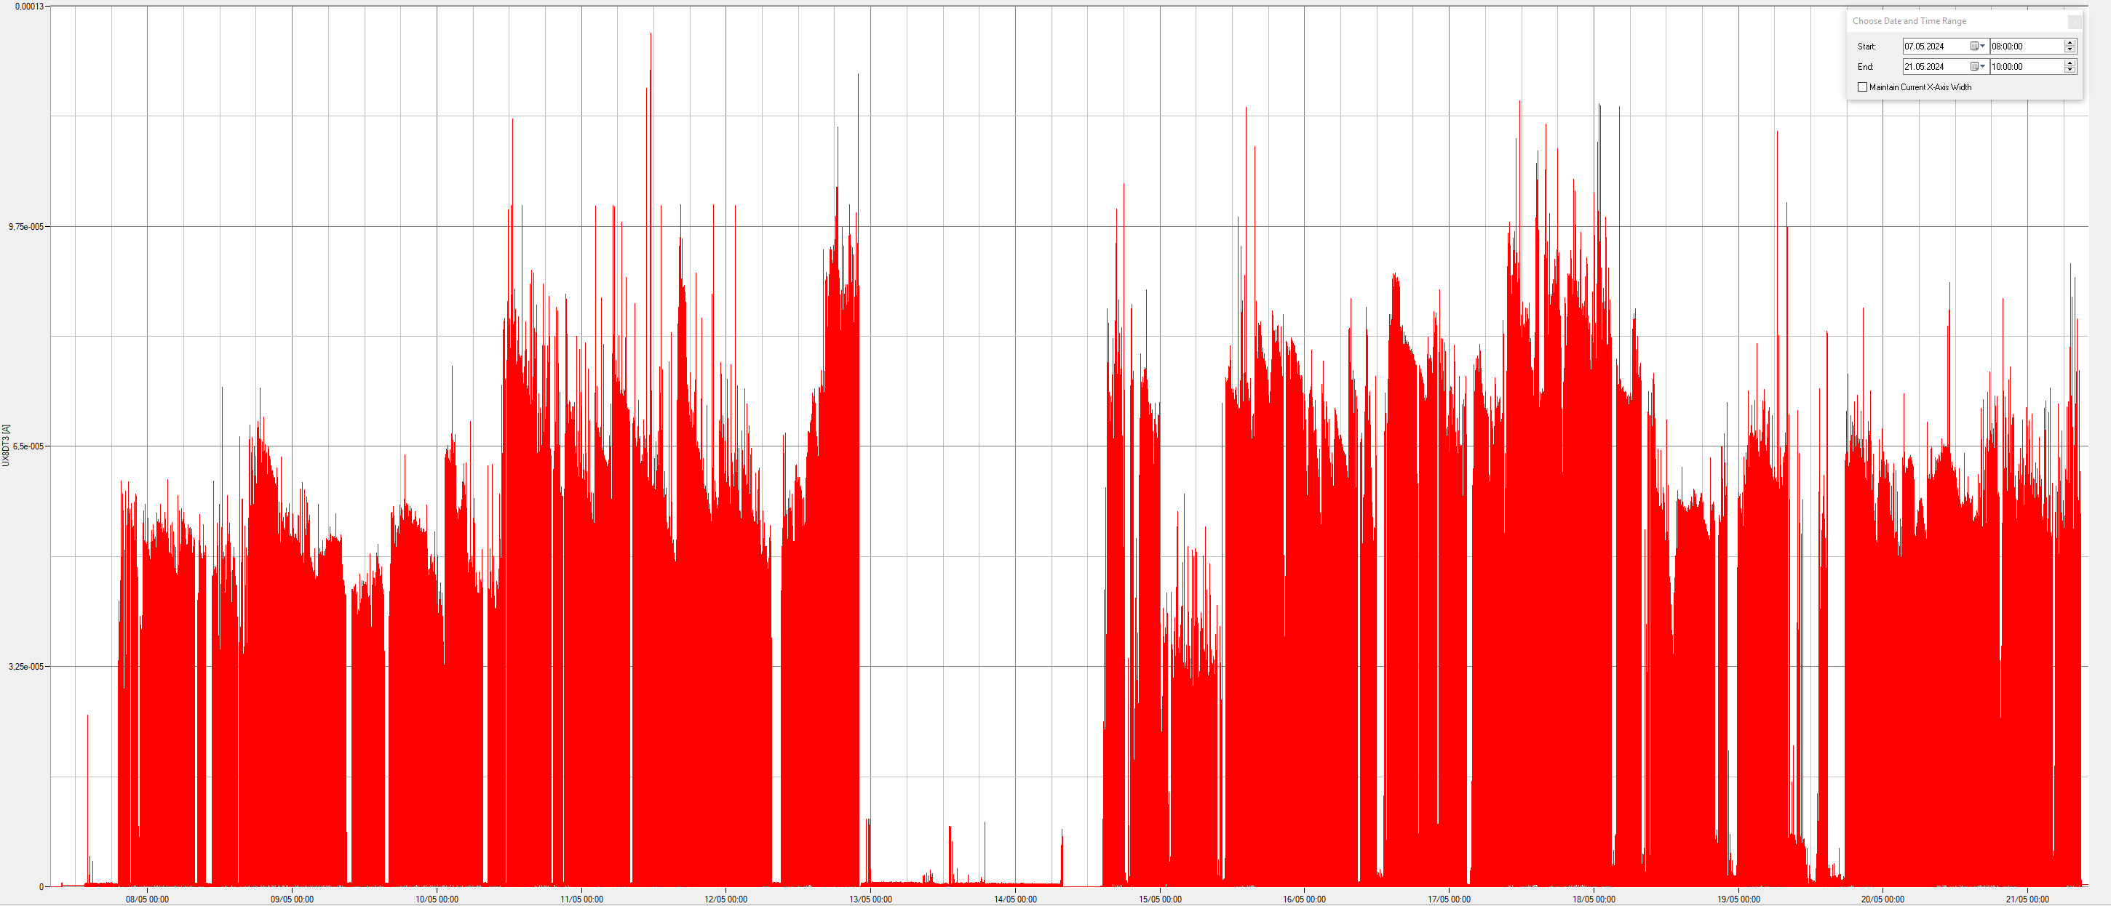
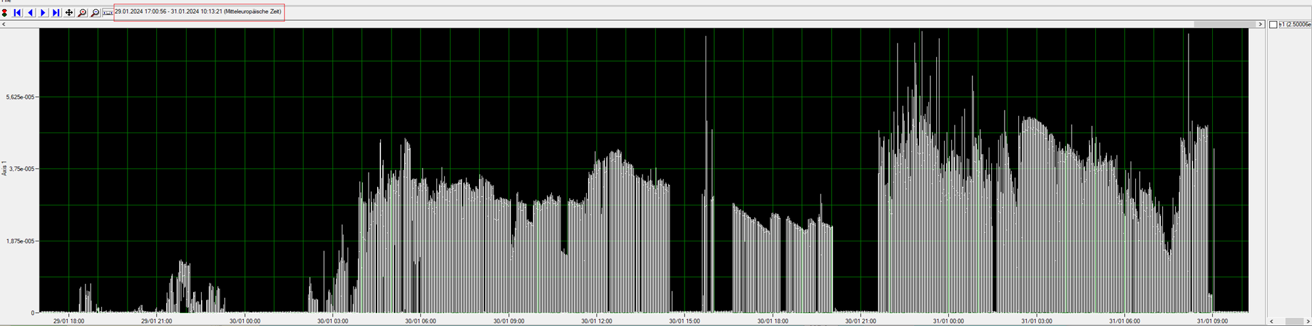
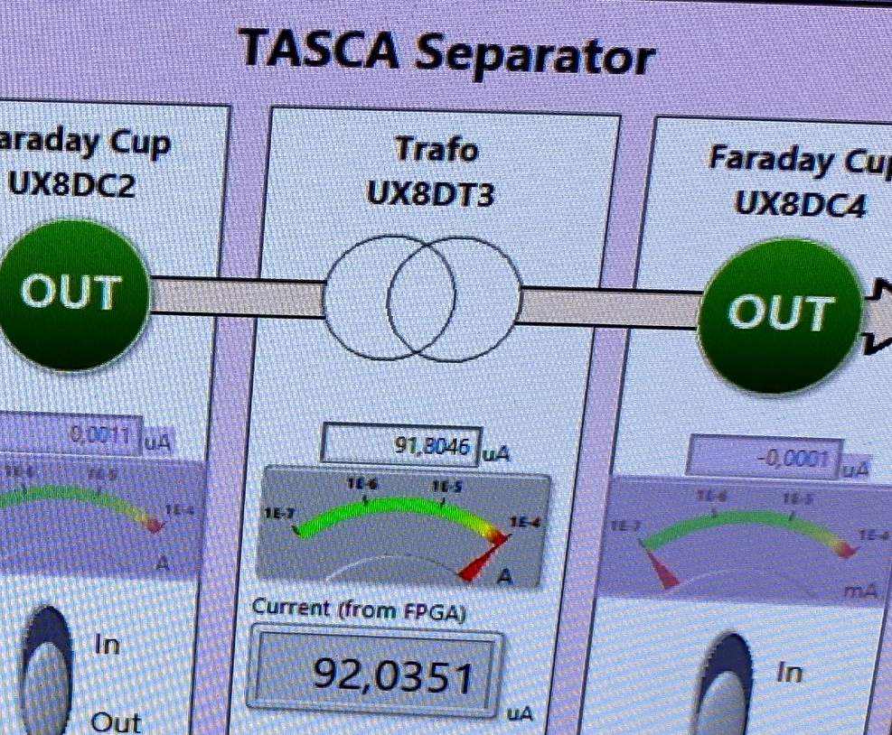
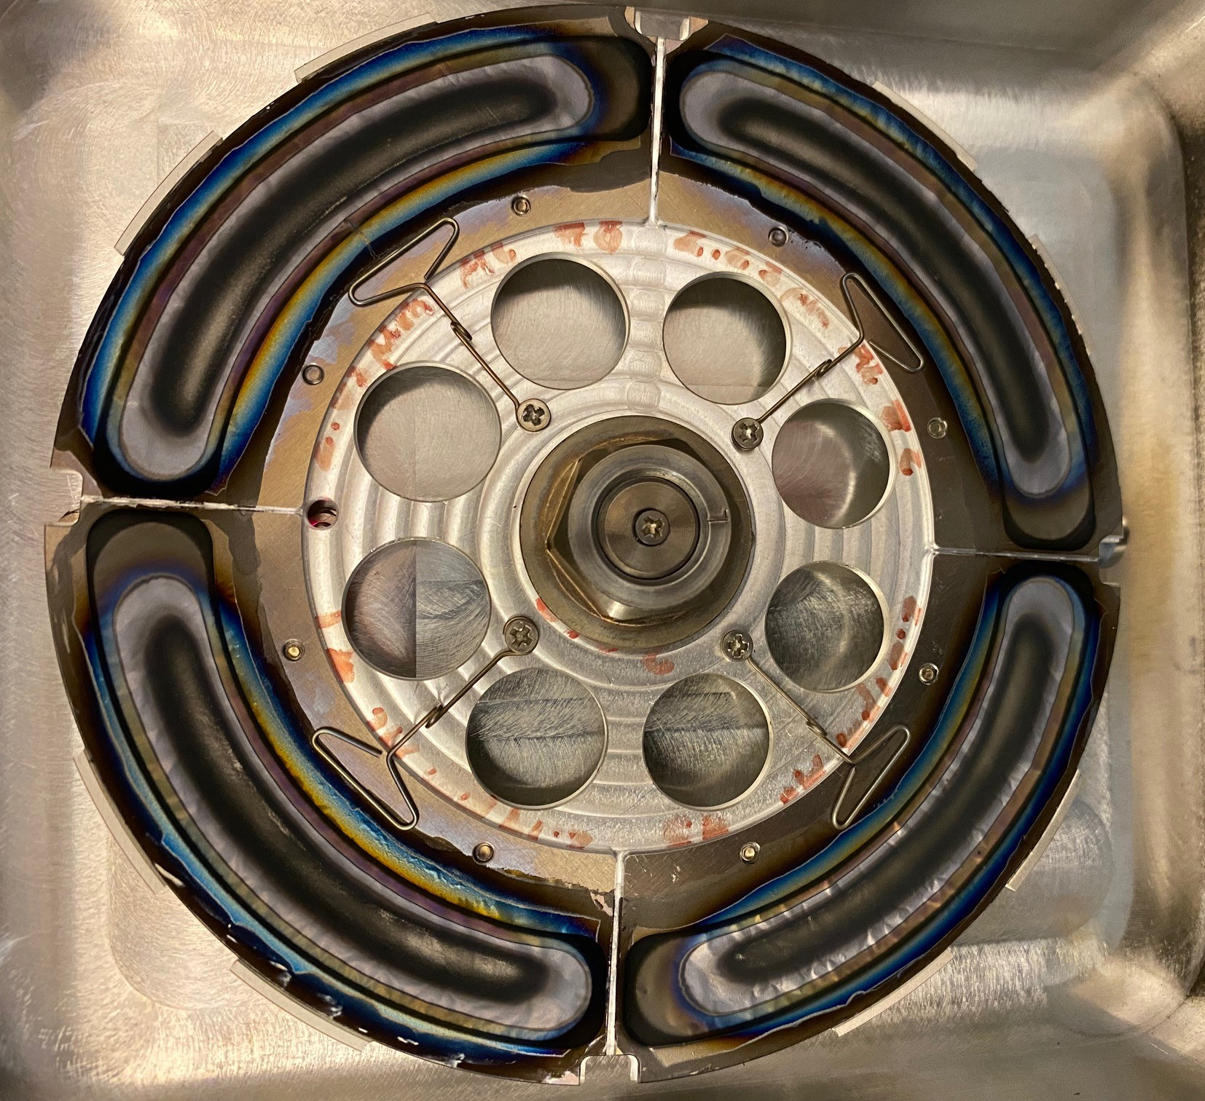
Excellent Cr-52 beam from the Penning source
January 30, 2024:
The first Cr-52 beam test
Experimental run
in May 2024
1pμA
0.6 pμA
08.05 10.05 12.05 14.05 16.05 18.05 20.05
Stable conditions with intensities up to 100 uA
An average beam intensity on target > 1 puA
Average working time for one electrode 2 days
The intensity approaches a limit of target stability

Slide 13
UNILAC – Nustar

Slide 14




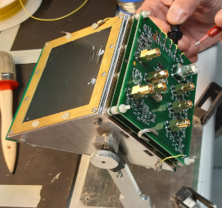
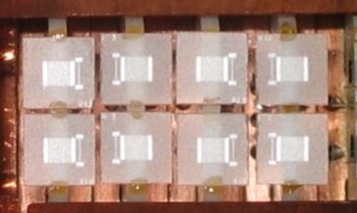
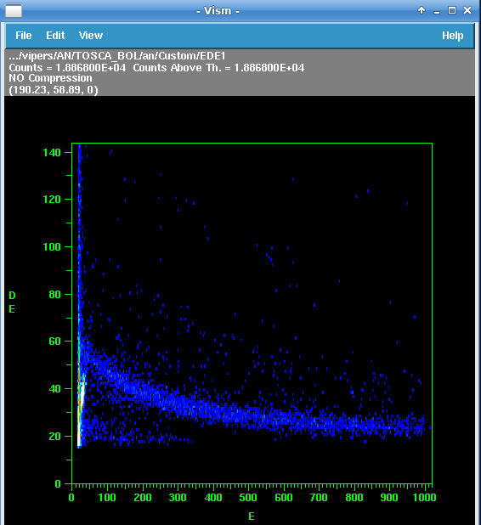




In-beam test of a ToF-ΔE-E method for
MultiNucleon Transfer reactions
Spokespersons/GSI contact: E. Vardaci, S. Kraft-Bermuth / T. Dickel
idea: combine two high-resolution time-of-flight (ToF) detectors with a high-resolution microcalorimeter for the energy detection
9 shifts scheduled for February 2024 with ⁵⁰Ti beam at X6/UNILAC
1st branch ($v_{1}→E_{1}$)
2nd branch ($v_{2}$)
Microcalo-rimeter
($E_{2}\left(Z\right)=E_{1}−δE(Z)$ )
TOF1, v1
Passive absorber ($δE(Z))$
TOF2, v2
S. Kraft-Bermuth et al., Rev. Sc. Inst. 80, 2009
Online Spectra DE/E
TOSCA time-of-flight spectrometer E. Vardaci et al. 2022
Results of beam time in 2024:
Successfull combination of the two detector systems (timing, energy and ToF resolution)
Data analysis ongoing:
A and Z identification by combining two ToFs with the microcalorimeter

Slide 15
UNILAC – Plasma Physics

Slide 16
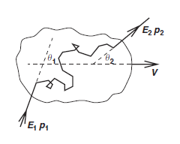
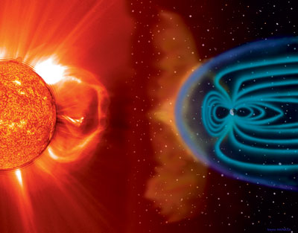
Scientific goals – injection problem
  Want to understand how cosmic rays are accelerated
  Widely accepted mechanism is Fermi acceleration, in which particles must cross shock many times (i.e. already faster than bulk)
  Origin of energetic population is the injection problem
  This pre-acceleration mechanism can be provided by wave-plasma instabilities, such as modified two-stream instability or the lower-hybrid drift instability.
  These instabilities have been suggested to explain observed x-ray excess in cometary knots and supernova remnants interacting with circumstellar clouds (Bingham et al. 2004)
Protheroe (2004)

Slide 17
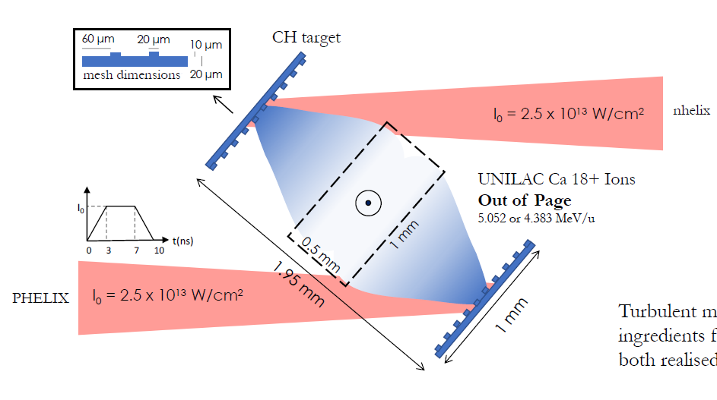
Experimental setup
Front surface illumination of targets with grid structure
Turbulent, magnetised plasma is created in the collision
Ion beam is surrogate for cosmic rays
Signatures of cosmic ray transport in perturbation to energy-spectrum and fluence profile

Slide 18
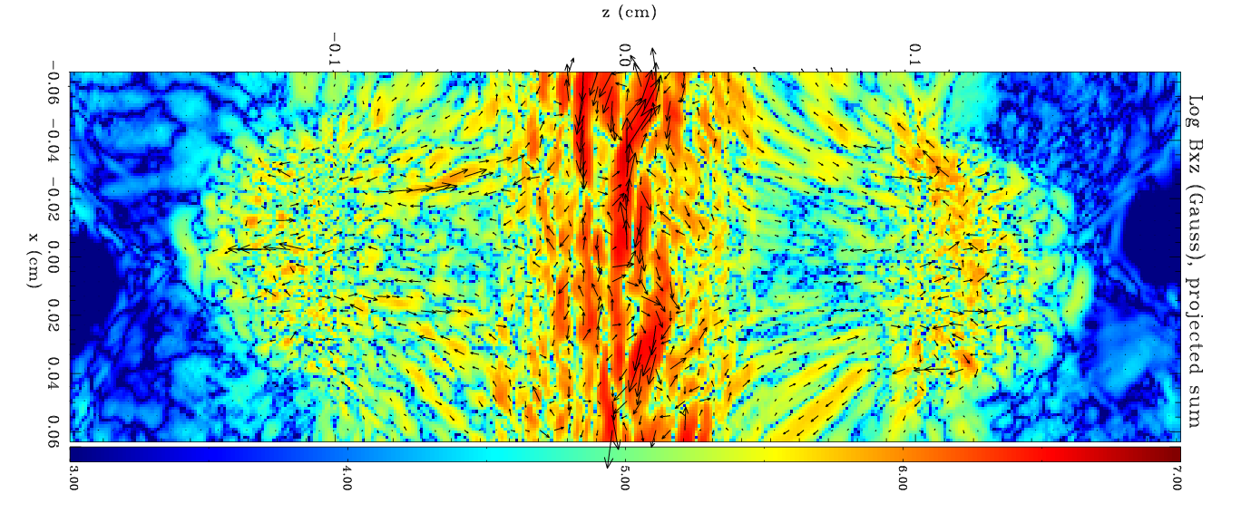
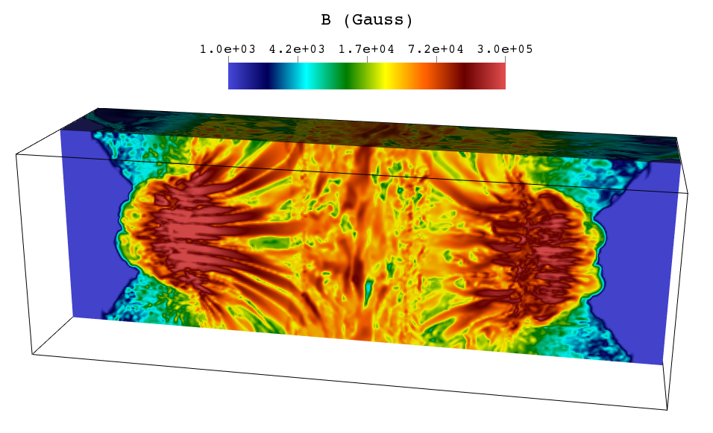
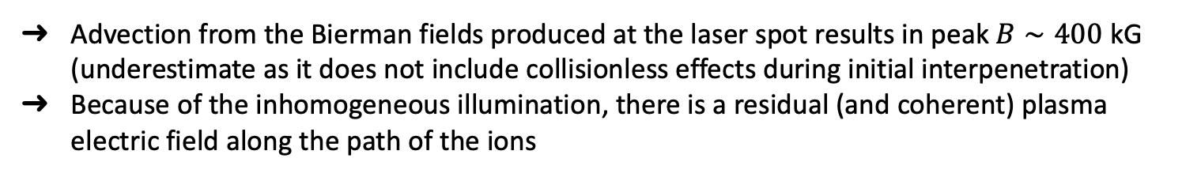
3D MHD simulations (FLASH)
  Advection from the Bierman fields produced at the laser spot results in peak $B∼400$ kG (underestimate as it does not include collisionless effects during initial interpenetration)
  Because of the inhomogeneous illumination, there is a residual (and coherent) plasma electric field along the path of the ions

Slide 19
Summary and Conclusions
BEAM TIME RETREAT 2024
BEAM TME RETREAT 2023
overall beamtime 2024 at UNILAC very successful
about 50% of MAT program 2024/25 completed, more than 40 external user groups served
very high-intensity beams of Ti-50 and Cr-52 served to SHE experiments
increase of physics beamtime crucial to maintain international competitiveness
continuous efforts essential to maintain full capability of UNILAC (high duty factor!) until HELIAC will be operational

Slide 20
Outlook 2025
focus on running all remaining A-rated G-PAC proposals and as many
A⁻-rated proposals as possible, new MAT-PAC call
maximize beam usage by maintaining flexible beam sharing between X0 and M branch as well as between X8 and Y7
high-intensity ⁴⁸Ca beam for SHE program required, delayed repair of UN5QT4 necessitates mitigation actions
high-intensity ⁵⁰Ti beam required for SHE program at Y7
~Ca and U beam with 3.6 - 11.4 MeV/u and (1-4 ms) pulses with
20-50 Hz duty cycle preferred by MAT users

Slide 21
Outlook 2025+
2024
2025
2026
2027
2028
2029
2030
2031
2032
2033
2034
Today
PoF IV
PoF V
FAIR
UNILAC
HELIAC
ES FS /FS+ FAIR MSV
25% d.c. → c.w. .
Maintain full UNILAC capability until HELIAC start
Irrespective of the exact starting year, HELIAC will deliver beams for SHE during PoF V
HELIAC should serve as FAIR injector (with some restrictions) during PSU installation

Slide 22
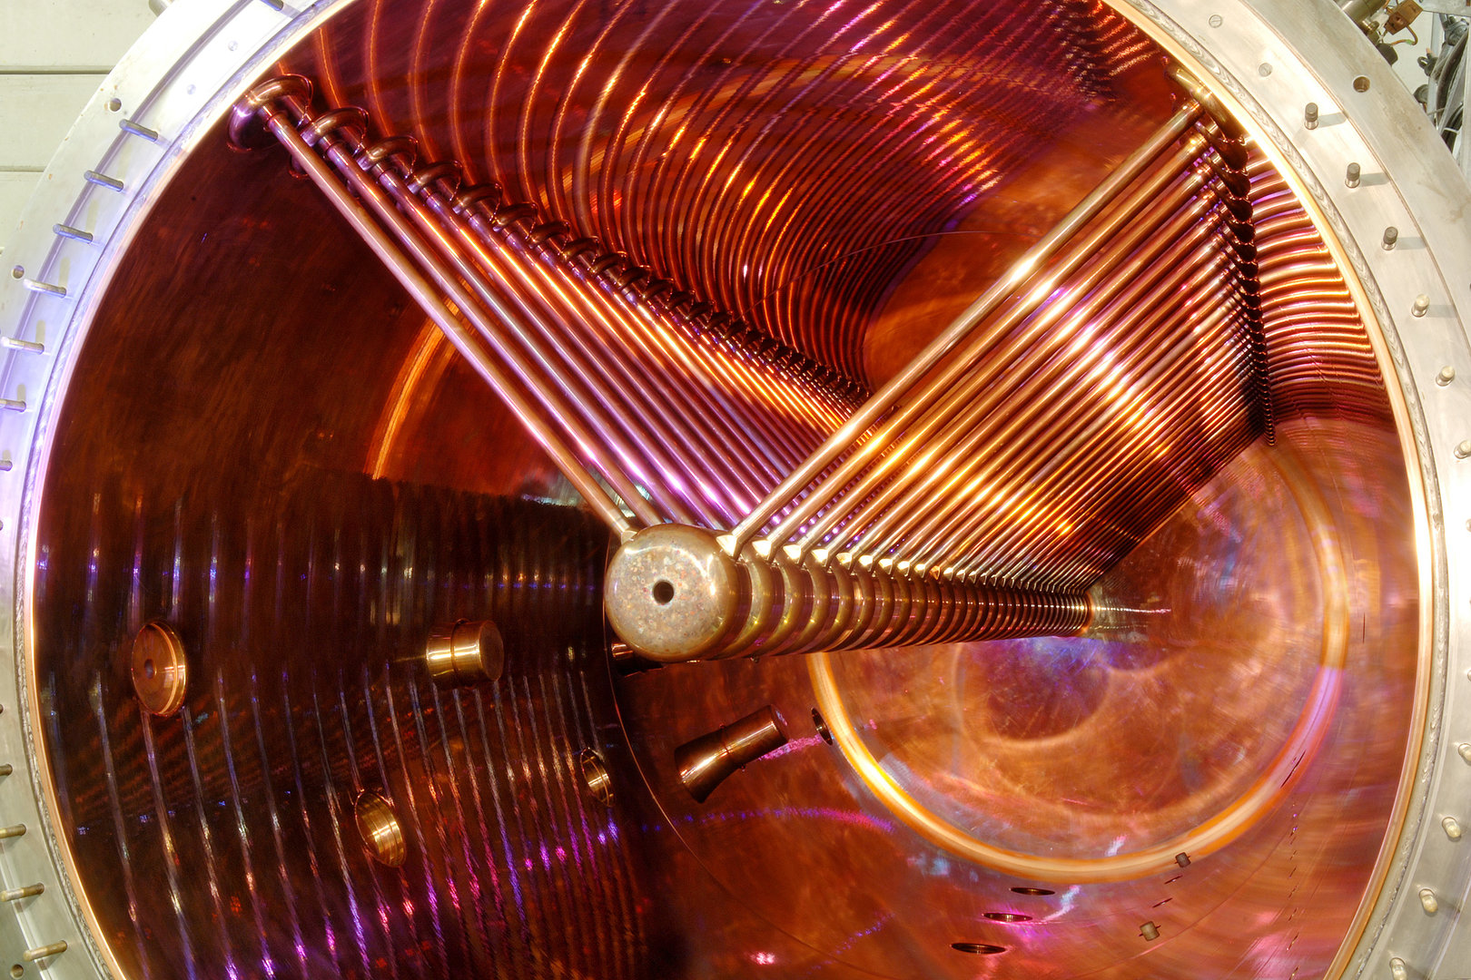
Thank you for your attention!

Slide 23
Conclusions of the Retreat of FAIR/GSI Research
19-21 Jan 2021
Input to the discussion on linear accelerators
The GSI/FAIR research division is concerned about the situation that may occur after the end of operation of the UNILAC linear accelerator according to current planning. On the one hand, at times where SIS100 is in full operation and commissioning of the FAIR facilities and first FAIR experiments with SIS100 are in full swing, an upgrade of the UNILAC will interrupt further beam operation for an extended period of up to two years. On the other hand, this will end the various, highly visible programs that use the long-duty cycle beams in superheavy element research and a significant part of the materials research activities. Both problems are best mitigated by the timely installation of a minimal configuration of a cw-linac (HELIAC) delivering long-duty cycle beams in a configuration that comprises a new (18 GHz) ECR ion source and Low Energy Beam Transport Line, the existing 25%-duty-cycle injector and three accelerator cryomodules and its link to the existing beam transport system behind UNILAC. This configuration will provide heavy ion beams of sufficient energy and duty cycle that can be injected into SIS18 and serve a compelling science program in superheavy element research, except for new element search, and a significant part of the materials research program. A cw-linac configuration with two cryomodules is not a viable option as the resulting beam energy is too low. The minimum configuration cw-linac would not only provide a second heavy-ion injector to increase the operational flexibility but could also serve as backup injector for FAIR commissioning/operation during the installation of the post-stripper upgrade, currently foreseen to start in 2028. Without this three-module based cw-linac, the FAIR experiments cannot be served with heavy-ion beams for about two years limiting experiments in the planned FAIR Phase-1. A fourth module and/or a pre-accelerator would further enhance the capability significantly.

Slide 24
15th GSI/FAIR Joint Scientific Council
22-23 May 2023
Resolutions of 15th JSC Meeting
The JSC is extremely impressed by the progress made with the HELIAC accelerator. It could play an important role in view of its potential use as injector for FAIR.

Slide 25
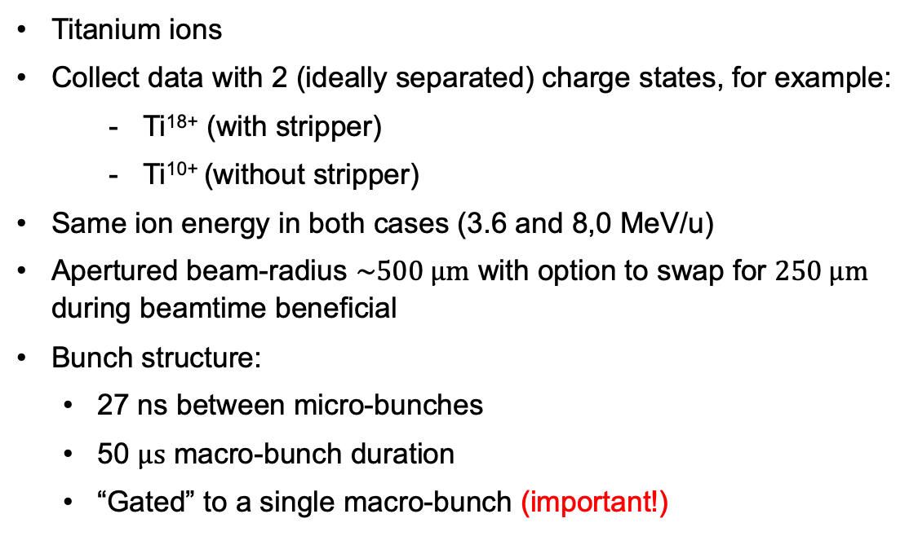
GSI_P-22-00089_TDR (jack.halliday@physics.ox.ac.uk)
Required ion-beam parameters
Titanium ions
Collect data with 2 (ideally separated) charge states, for example:
    Ti¹⁸⁺ (with stripper)
    Ti¹⁰⁺ (without stripper)
Same ion energy in both cases (3.6 and 8,0 MeV/u)
Apertured beam-radius $\sim 500 μm$ with option to swap for $250 μm$
during beamtime beneficial
Bunch structure:
  27 ns between micro-bunches
  50 $μs$ macro-bunch duration
  “Gated” to a single macro-bunch (important!)

Slide 26
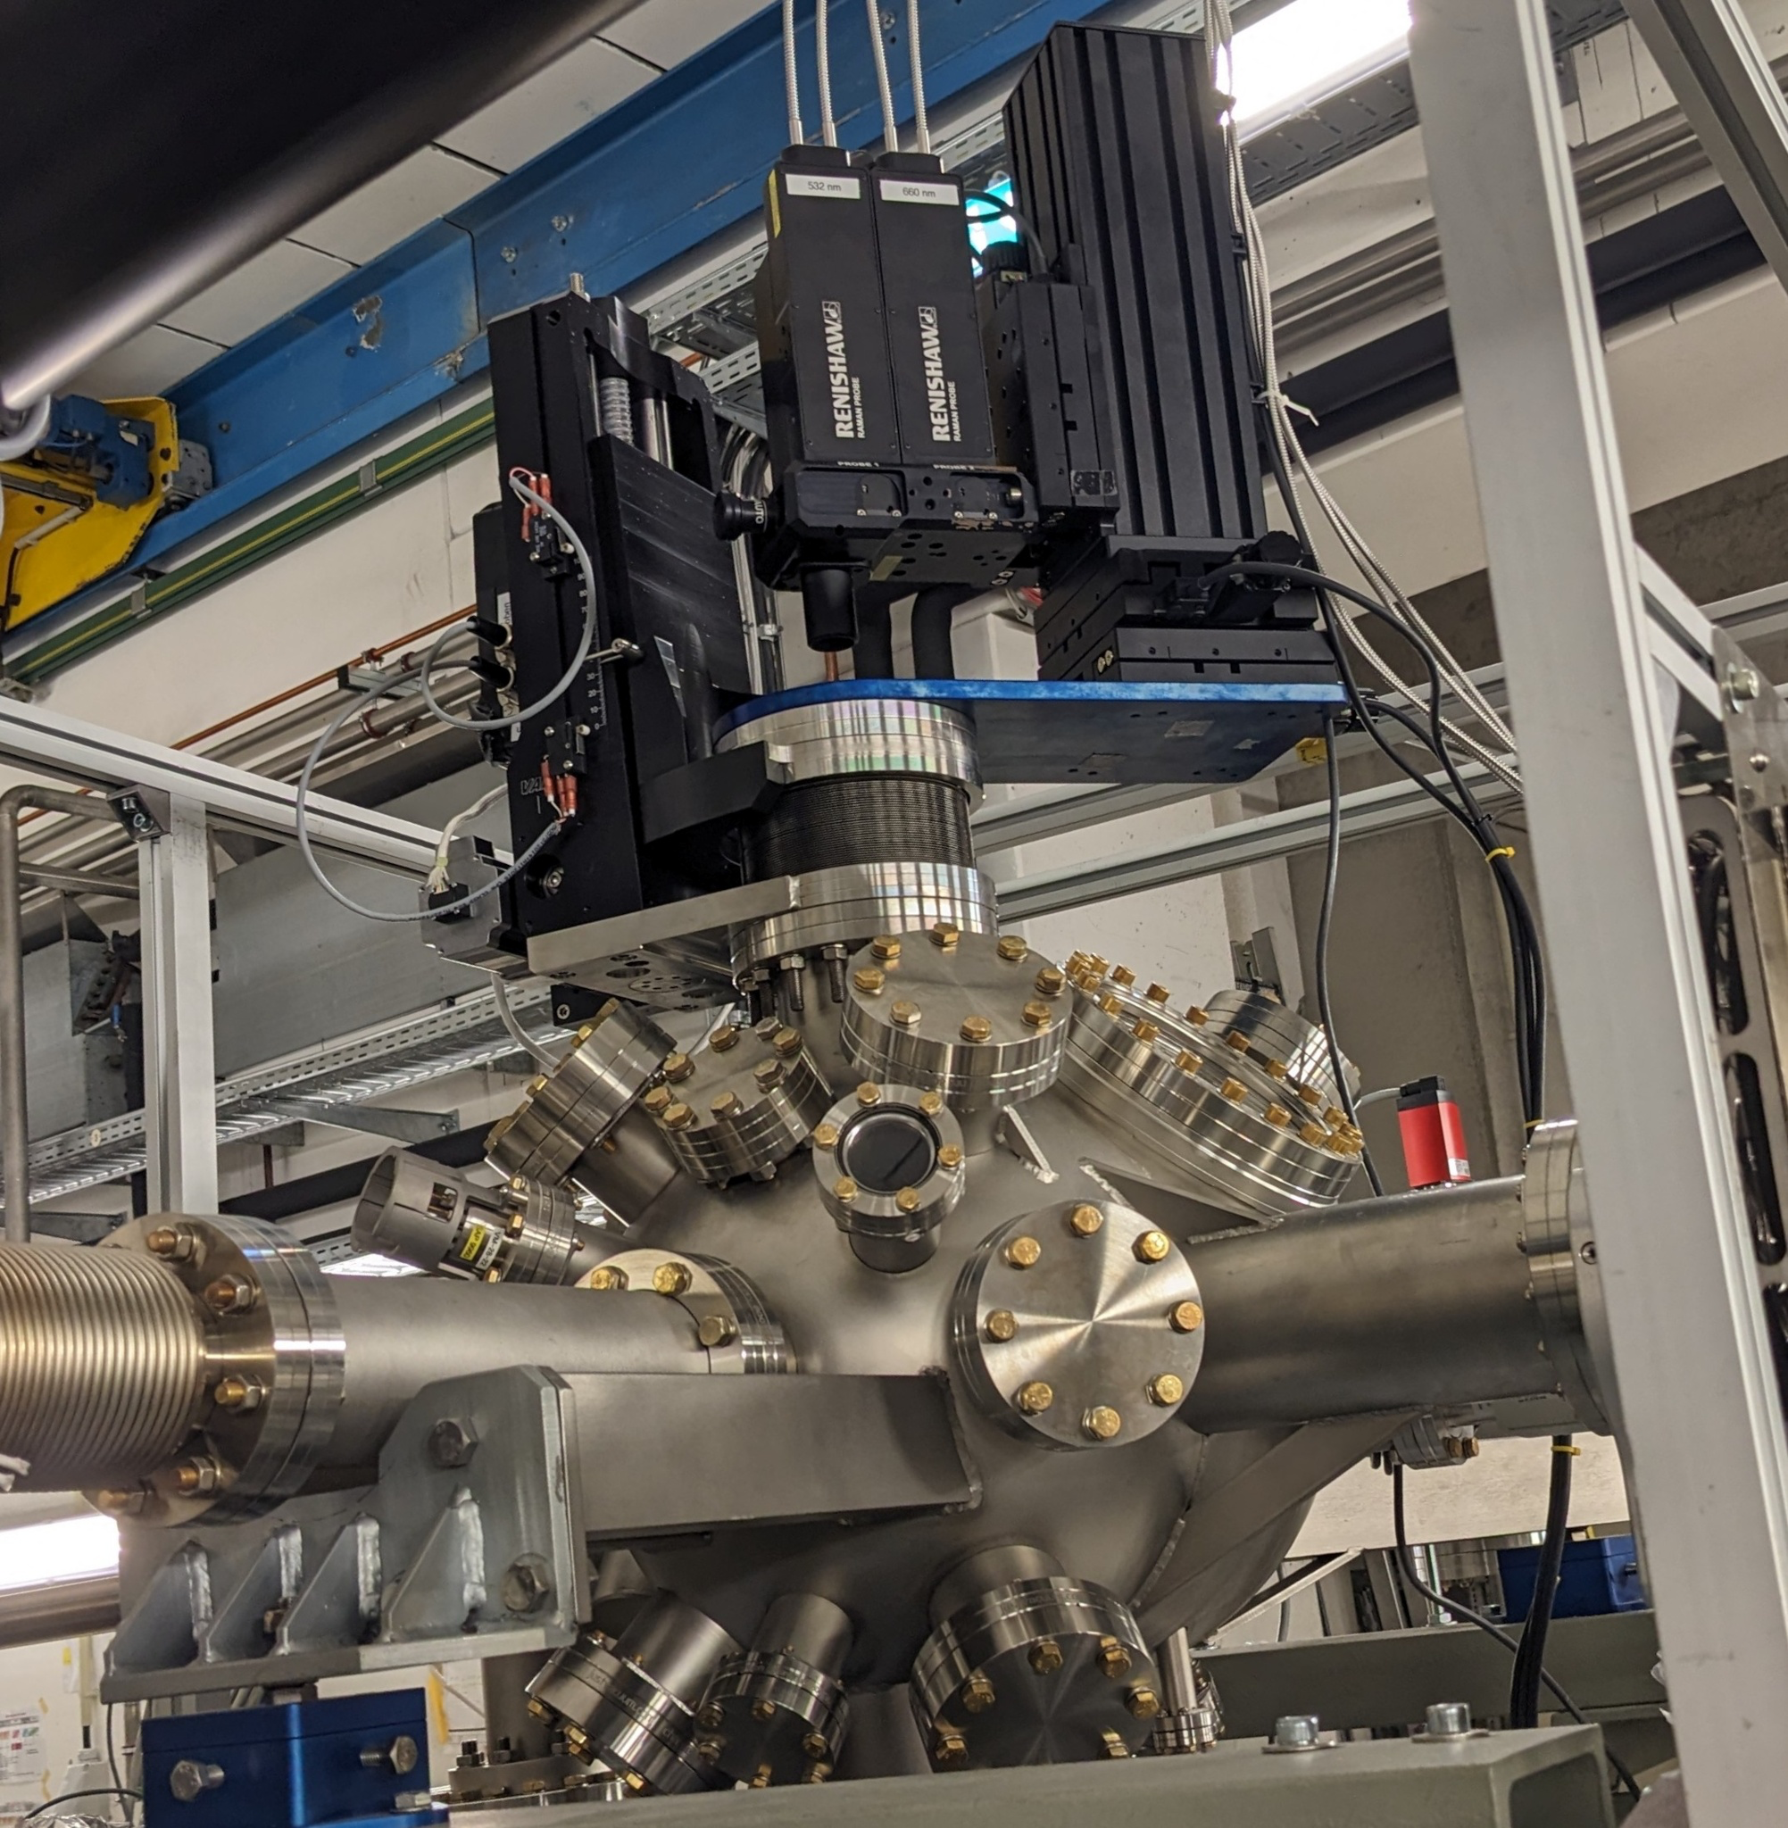
MAT UNILAC 2025 Outlook
CRYRING
MAT station
UNILAC
M-branch
UNILAC
X0
SIS18
Cave A
allocation of remaining shifts (~150)
new MAT PAC Call at the end of 2024 → New users requests also for 2025 beamtime
Ion species between ~Ca and U, energies between 3.6 and 11.4 MeV/u
Long pulses (1-4 ms) and 20-50 Hz duty cycle preferred
Parallel operation of X0 and M-branch
Testing of new controls and setups

