Slide 1
Summary Session 2
Daniel Severin

Slide 2
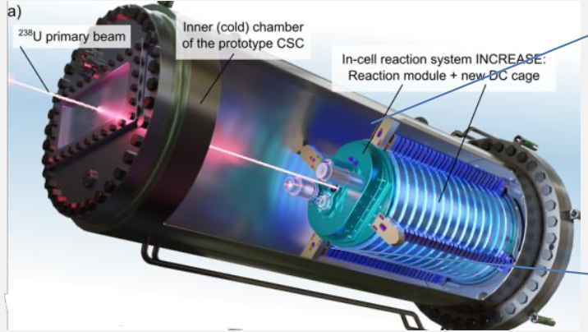
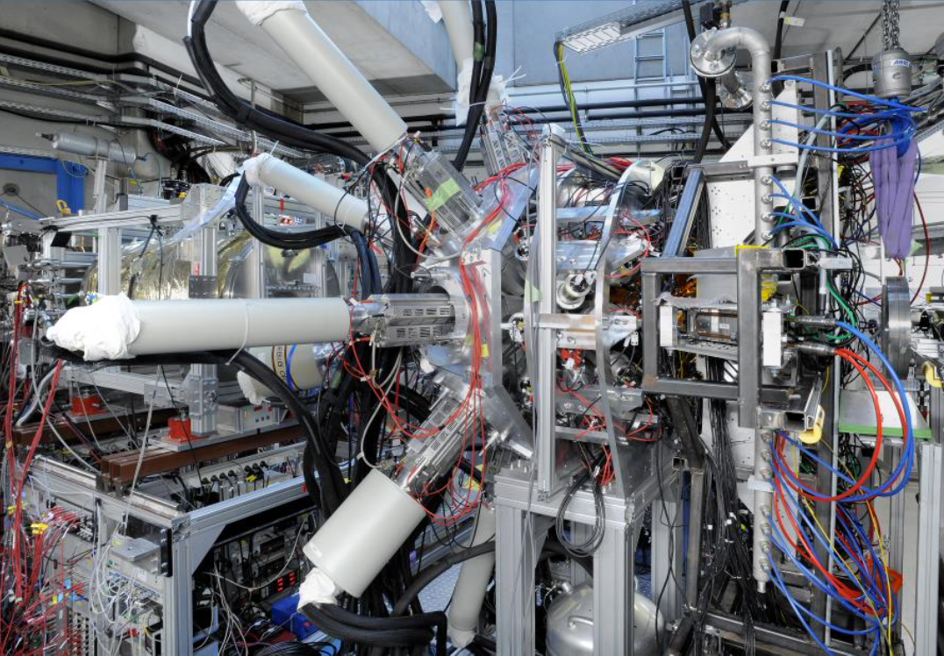
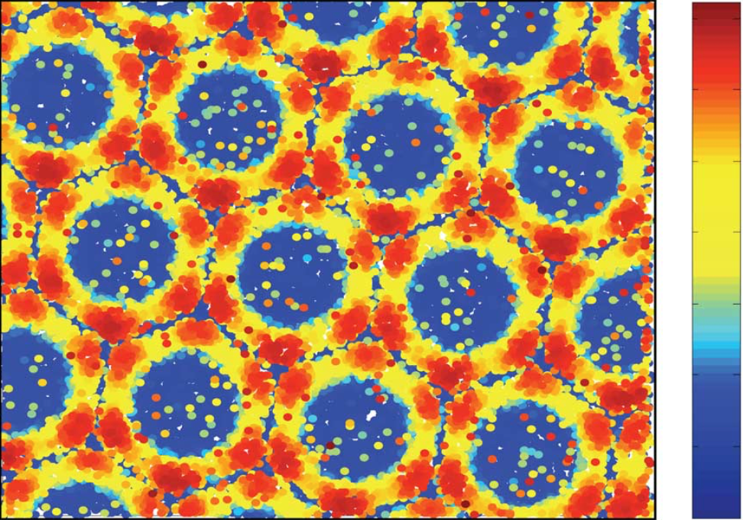
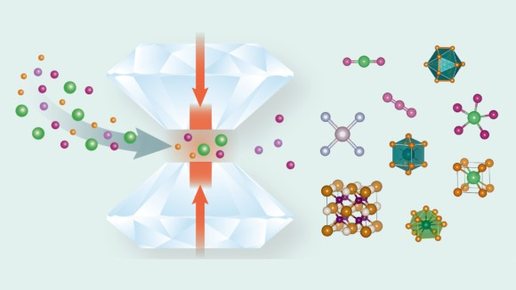
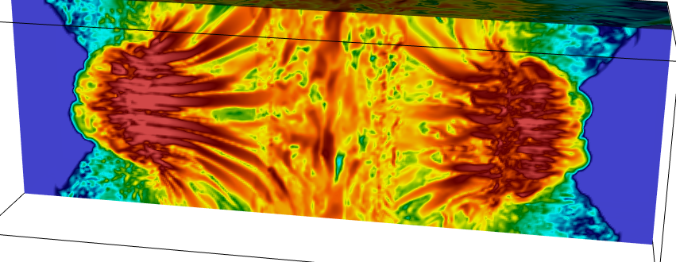
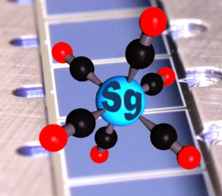
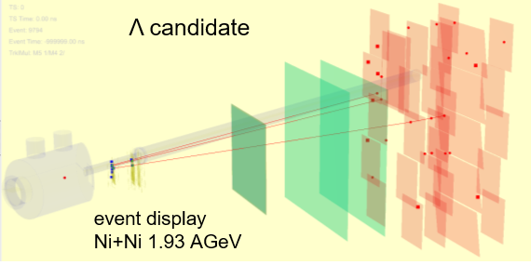
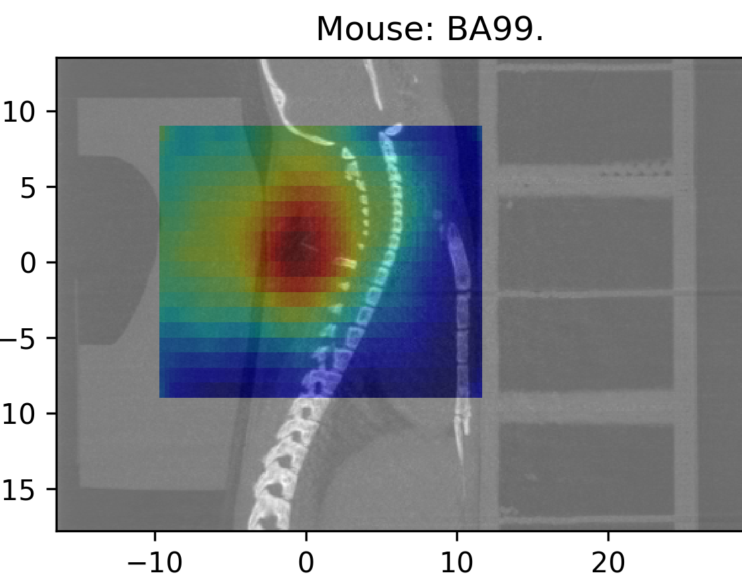
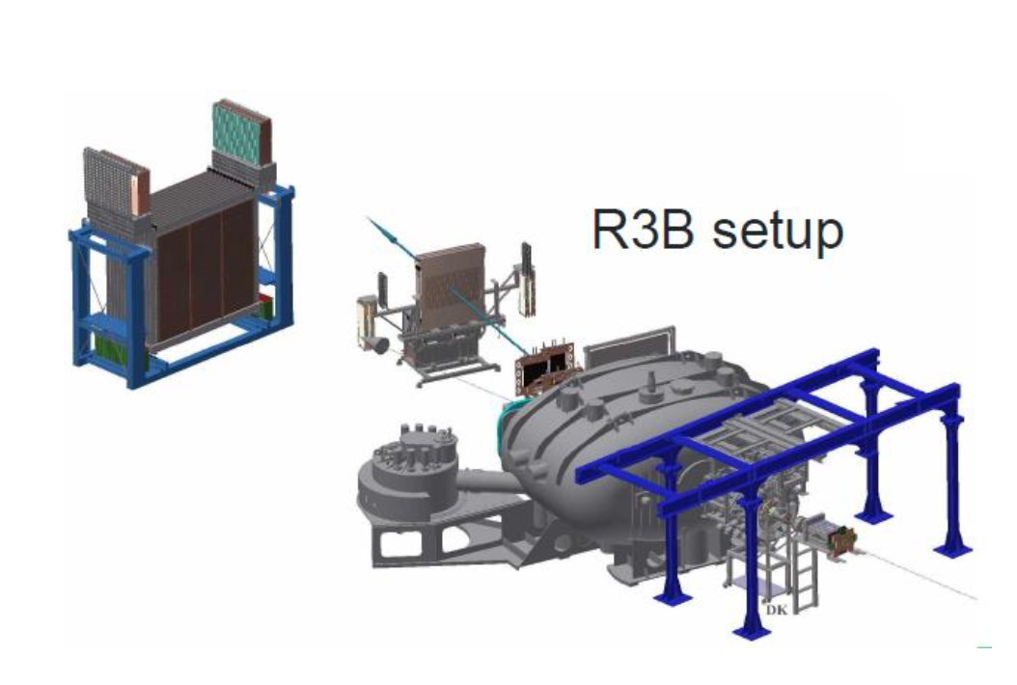
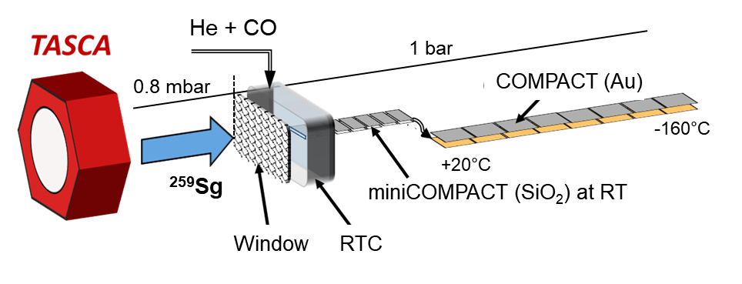
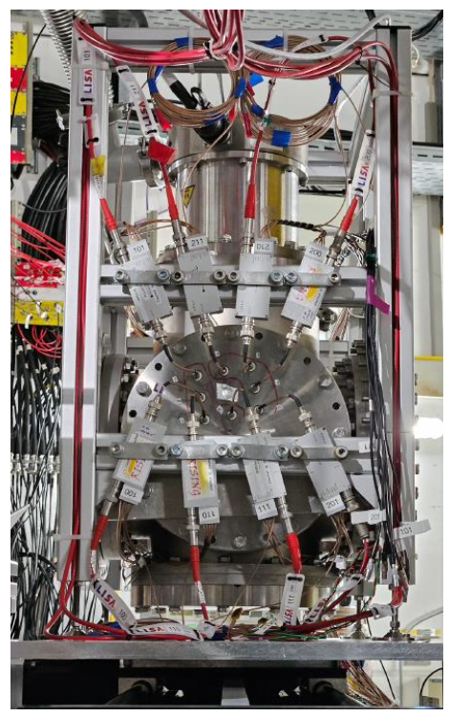
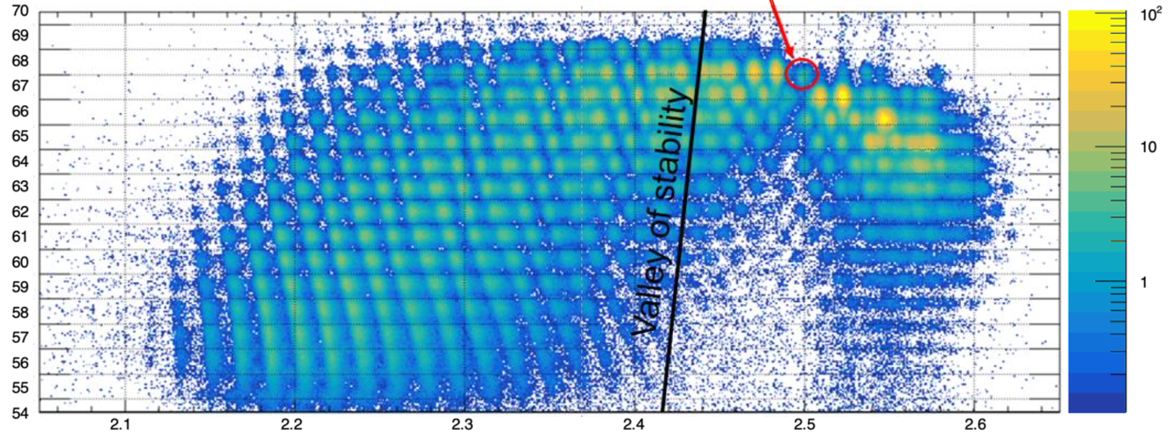
Summary BT2024

Slide 3
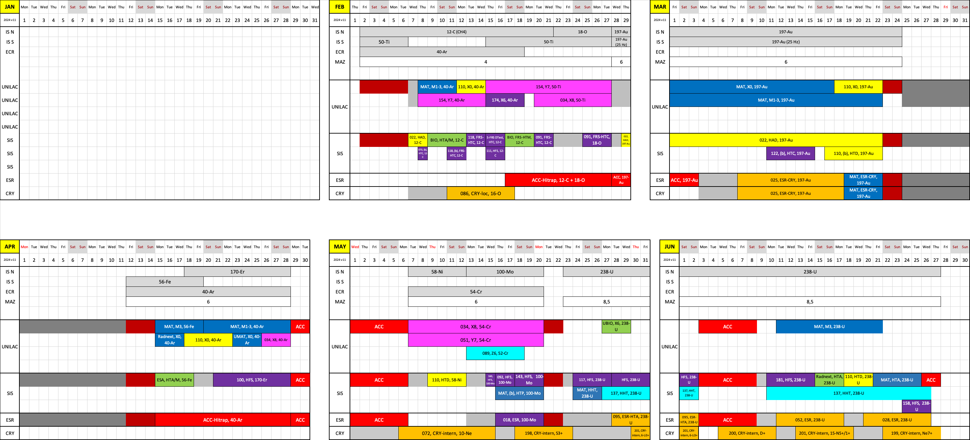
Beamtime 2024
Many thanks for the successful beamtime!!!

Slide 4
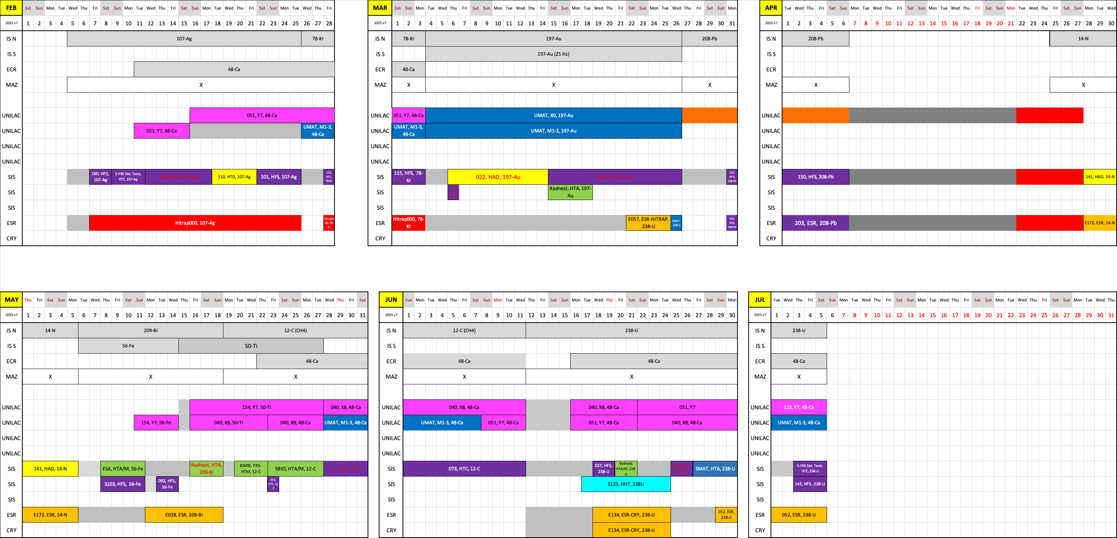
Beamtime 2025
Looking forward to the beamtime 2025

Slide 5


Overview
The presentation will cover the following running grants
ERC advanced grant NECTAR (2020) “Nuclear Reactions at Storage Rings” (CRYRING, ESR)”
Beatriz Jurado, LP2i Bordeaux
ERC consolidator grant LISA (2020): “Lifetime measurements with Solid Active targets” (DESPEC)
Kathrin Wimmer, GSI
ERC starting grant ELDAR (2022) “Elements in the Lives and Death of Stars “ (CRYRING)
Carlo Bruno, U Edinburgh
Helmholtz Young Investigator Group (2023) “Towards frequency metrology of the optical hyperfine structure of highly charged ions using quantum logic” (HITRAP)
Peter Micke, U Jena and HI-Jena
ERC advanced grant HiThor (2024) “Highly Ionized Trapped 229-Thorium: A New Paradigm Towards a Nuclear Clock” (ESR, HITRAP)”
Thomas Stöhlker GSI, HI-Jena, U Jena
ERC advanced grant BARB (2020) “Biomedical Applications of Radioactive ion Beams”
Marco Durante GSI, TU Darmstadt
ERC consolidator grant PROMISE (2024) “Portal Range Monitoring in Mixed Ion Beam Surgery“
Christian Graef GSI, TU Darmstad
5

Slide 6
FAIR/GSI strategic operation scenario towards FAIR
beam time
Acc. Operation total / days
140
Pre-paration works
EH
140+30
renovation
EH
140
renovation
EH
140
200
240
240
240
240
beam time
Physics beam time/ days
100
100+30
50
70
min. 120*
215
215
215
215
Project phases (ES, FS, FS+)
FAIR Installation of Accelerator Components
FAIR Hardware Commissioning
FCC OP ready
UNILAC CS ready
DR
FAIR Beam Commissioning
PCP reached
Facility availability
early science (ES) →
now
included
SIS18 → SFRS → NUSTAR
still
missing
first science (FS) →
SIS100 → SFRS → NUSTAR
first science + (FS+) →
SIS100 –> CBM
UNILAC → EH, SIS18 → TH, EX, FRS, ESR → HITRAP, Cryring
2024
2025
2026
2027
2028
2029
2030
2031
2032
FAIR Phase 0
Early Science
Early Science & First Science+
Science
6

Slide 7
Physics beamtime modes
Mode A
Physics beamtime
- highest priority on physics
- full parallel operation
- full on-call service at any time
Mode B
Best effort operation (BEO)
- priority on physics
- limited parallel operation
- on-call service by arrangement
Mode C
Second priority
- priority on FAIR commissioning
- limited parallel operation
- on-call service by arrangement

Slide 8
Thanks for you attention

