Slide 1
Beam Time 2024 – Report from Strahlzeitkoordinator
Daniel Severin

Slide 2
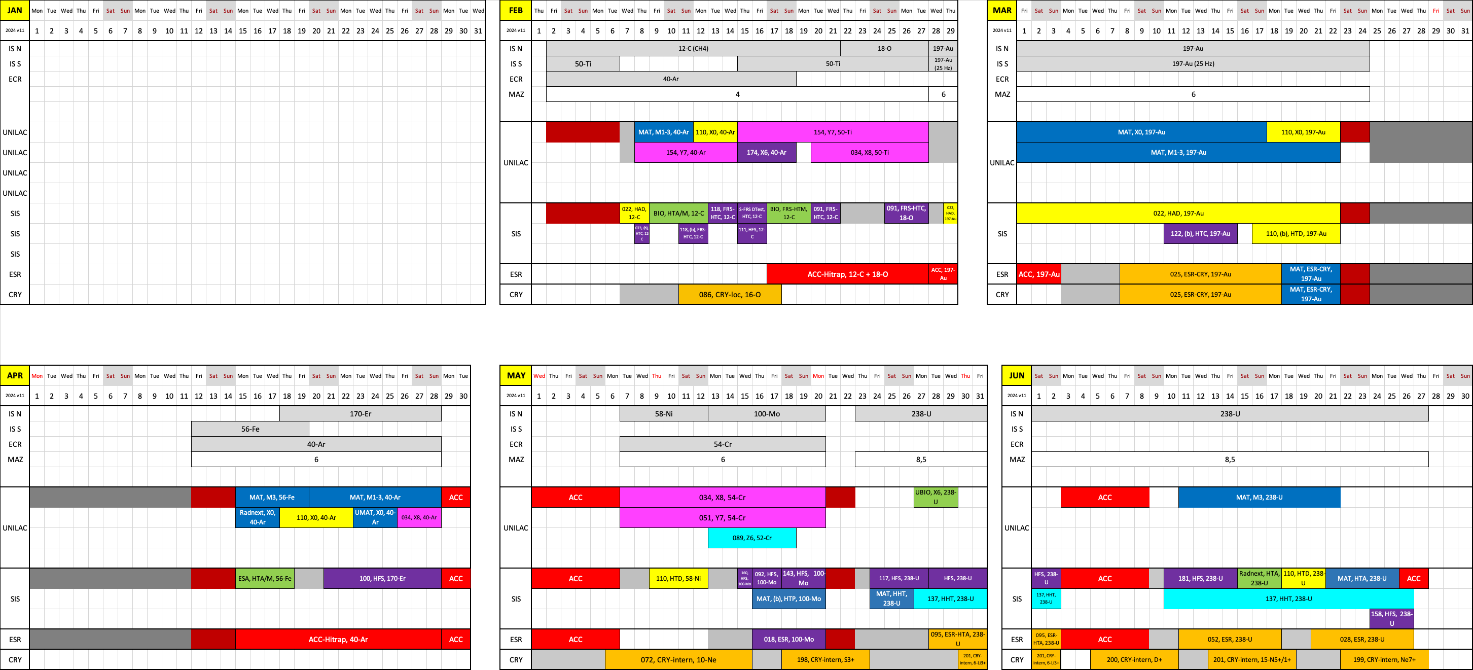
Beamtime 2024
Many thanks for the successful beamtime!!!

Slide 3
Summary BT2024
Ti/Ar + C/O block
SHE/MAT (UNILAC): many adaptions due to failures
R3B: pre-run and commissioning + very flexible phys. run (E091)
BIO + BARB: OK, some failures
Au block
MAT: as usual, stabile and successful
HADES: spill feedback
SPARC ESR-CRY: fast beam setup, good intensity
mCBM: commissioning fast beam setup
R3B (ASY-EOS): good pre-run

Slide 4
Summary BT2024
Ar + Fe/Er block
MAT: 5Hz Fe beam and Ar µ-probe
ESA: successful
BIO: failed (1 day)
Hi/Despec: new Er-beam successful
Cr + Ni/Mo block
SHE-C: 52-Cr (PIG) high intensity
mCBM production test successful
ILIMA/SPARC: sec. beam without FRS at ESR
Hi/Despec: intensive test program

Slide 5
Summary BT2024
U block
MAT/BIO (UNILAC): successful parasitic program
SEC+Hi/Despec: various program at FRS (E181: 2 days failed)
Radnext: failed (3 days)
mCBM: failed (3 days)
PP: HiHex very successful (high pulse intensity)
MAT (SIS): adapted to fast ext. so, successful
SPARC: E095 OK / E052 failed / E028 successful
Cryring intern
very flexible and successful program with 7 experiments

Slide 6
Lessons learned concerning operation & machine
Beam setup
Faster setup times
Initial settings often with support of machine experts
UNILAC/SIS matching
Stable control system
HEST settings reproduceable
Feedback system
Spill structure
Increased stability for parallel operation
Radiation safety
TVS
New challenges at SIS (ESR production target)
Machine stability
Uranium operation at the limit

Slide 7
Lessons learned concerning scheduling
Uranium block as single beam block
No gain (?)
Comparable intensity as parallel operation
Parallel operation
Beam settings for the entire block
Gain during the block
Increased stability
Machine beam block integrated
Physics view: pro: time for setup changes // con: increased failure risk
SIS single user operation (Hades block)
High risk if main experiment fails

Slide 8
Lessons learned summary
It was a successful beamtime!
Even if we had painful failures and lost some experiments (HADES, BIO, Radnext, ESR Th, FRS)
Adaptions as solution still works
UNILAC water leak
Fast extraction for MAT
Focus on avoidable failures

Slide 9
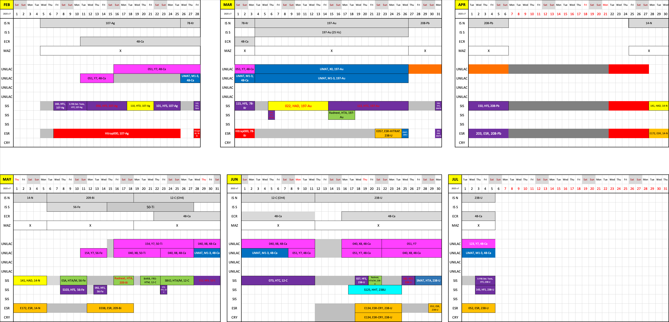
BT 2025

Slide 10
Upcoming challenges
2025 beamtime
Longest block since more than 10 years (130 days physics)
HITRAP strategy: commissioning vs. open for experiments
48-Ca operation from HLI (3 blocks)
Pion run (short)
Fully packed FRS program
2026/27 PAC call
Expectation management

Slide 11
Physics beamtime modes
Mode A
Physics beamtime
- highest priority on physics
- full parallel operation
- full on-call service at any time
Mode B
Best effort operation (BEO)
- priority on physics
- limited parallel operation
- on-call service by arrangement
Mode C
Second priority
- priority on FAIR commissioning
- limited parallel operation
- on-call service by arrangement

Slide 12
FAIR/GSI strategic operation scenario towards FS+
beam time
Acc. Operation total / days
134
44
140
Pre-paration works
EH
140+30
renovation
EH
140
renovation
EH
140
200
240
240
beam time
Physics beam time/ days
107
0
100
100+30
50
70
min. 120*
180
180
engineering-runs
Project phases (ES, FS, FS+)
FAIR Installation of Accelerator Components
FAIR Hardware Commissioning
FCC OP ready
UNILAC CS ready
DR
FAIR Beam Commissioning
PCP reached
Facility availability
now
included
early science (ES) →
SIS18 → SFRS → NUSTAR
still
missing
first science (FS) →
SIS100 → SFRS → NUSTAR
first science + (FS+) →
SIS100 –> CBM
UNILAC → EH, SIS18 → TH, EX, FRS, ESR → HITRAP, Cryring
2022
2023
2024
2025
2026
2027
2028
2029
2030
FAIR Phase 0
Early Science
Early Science & First Science+
12

Slide 13
FAIR/GSI strategic operation scenario towards FAIR
beam time
Acc. Operation total / days
140
Pre-paration works
EH
140+30
renovation
EH
140
renovation
EH
140
200
240
240
240
240
beam time
Physics beam time/ days
100
100+30
50
70
min. 120*
215
215
215
215
Project phases (ES, FS, FS+)
FAIR Installation of Accelerator Components
FAIR Hardware Commissioning
FCC OP ready
UNILAC CS ready
DR
FAIR Beam Commissioning
PCP reached
Facility availability
now
included
early science (ES) →
SIS18 → SFRS → NUSTAR
still
missing
first science (FS) →
SIS100 → SFRS → NUSTAR
first science + (FS+) →
SIS100 –> CBM
UNILAC → EH, SIS18 → TH, EX, FRS, ESR → HITRAP, Cryring
2024
2025
2026
2027
2028
2029
2030
2031
2032
FAIR Phase 0
Early Science
Early Science & First Science+
Science
13

Slide 14
FAIR/GSI strategic operation scenario towards FAIR
beam time
Acc. Operation total / days
140
Pre-paration works
EH
140+30
renovation
EH
140
renovation
EH
140
200
240
240
240
240
beam time
Physics beam time/ days
100
100+30
50
70
min. 120*
215
215
215
215
Project phases (ES, FS, FS+)
FAIR Installation of Accelerator Components
FAIR Hardware Commissioning
FCC OP ready
UNILAC CS ready
DR
FAIR Beam Commissioning
PCP reached
Facility availability
early science (ES) →
now
included
SIS18 → SFRS → NUSTAR
still
missing
first science (FS) →
SIS100 → SFRS → NUSTAR
first science + (FS+) →
SIS100 –> CBM
UNILAC → EH, SIS18 → TH, EX, FRS, ESR → HITRAP, Cryring
2024
2025
2026
2027
2028
2029
2030
2031
2032
FAIR Phase 0
Early Science
Early Science & First Science+
Science
14

Slide 15
Remarks
Mid-term
EH renovation
Parallel FAIR commissioning and physics run
Performance upgrades
Pulsed gas stripper
Spill feedback / µ-spill cavity
Control system (eg. archiving)
etc.
Long-term
UNILAC
HLI vs. Heliac: perspectives for SHE & MAT
HSI (RFQ, super lens, IH): action needed?
FAIR commissioning after PCP

Slide 16
Thanks for you attention

