Slide 1
Report from the past operation period
Stephan Reimann
A. Bloch-Späth, O. Geithner, M. Klich, M. Vossberg
Beam Time Retreat 2024 – Do. 9:45-10:10

Slide 2
Outline
overview of the past operating period
recapitulation engineering run 2023
2024 beamtime statistics
improvements & opportunities

Slide 3
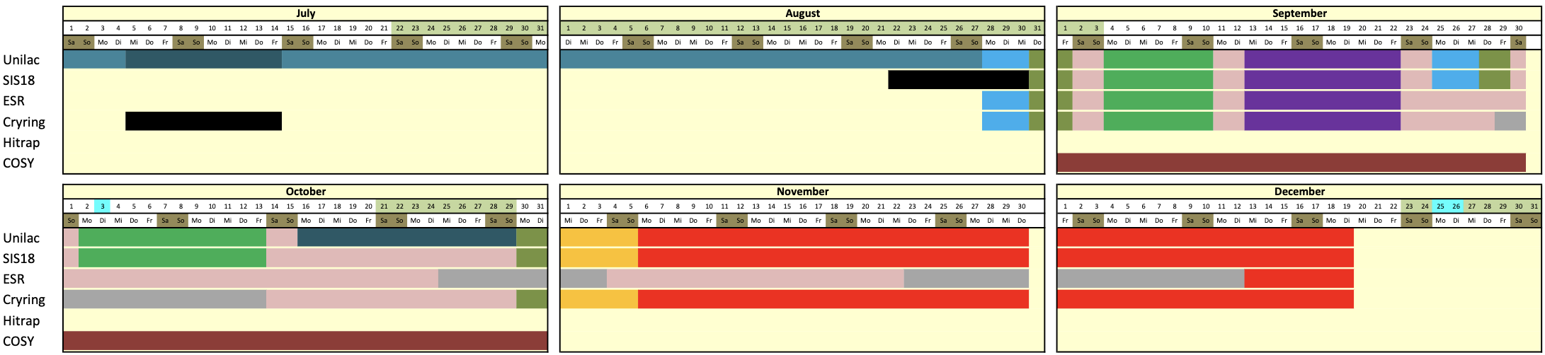
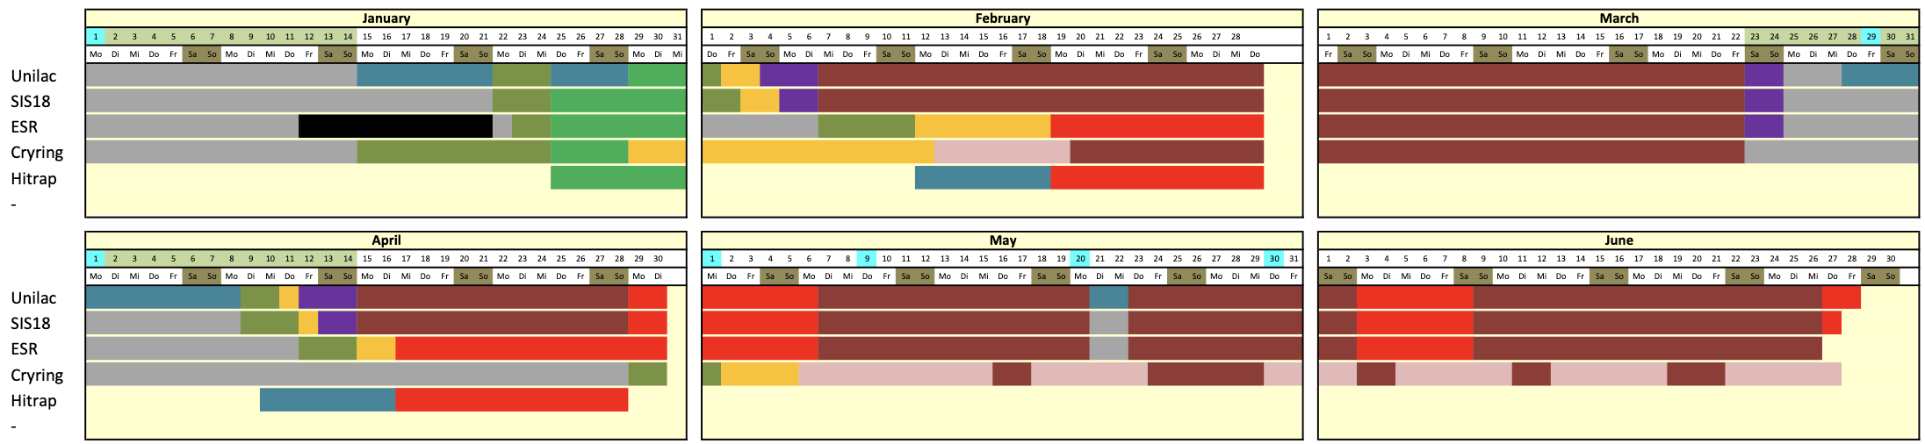
Past Operation Period
2023
engineering run
2024
user beam time

Slide 4
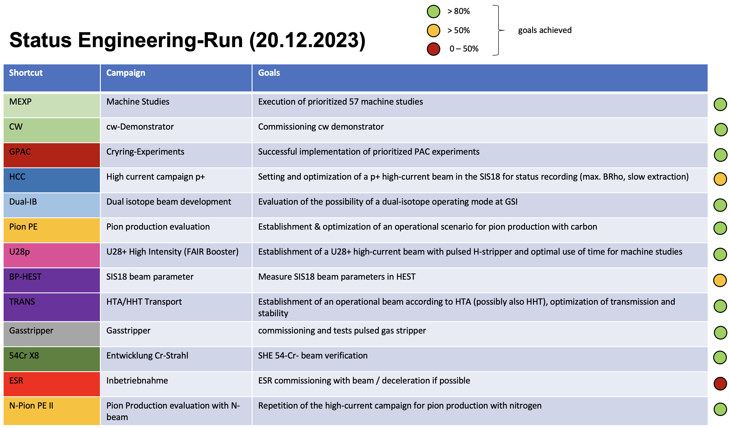
Recapitulation Engineering Run 2023
swiftly organized by campaign coordinators
57 machine studies incl. spill optimization, machine learning, ... have been scheduled
ca. 48 h beam for HHT prior (different ions)
ca. 9h carbon beam for FRS/HTM

Slide 5
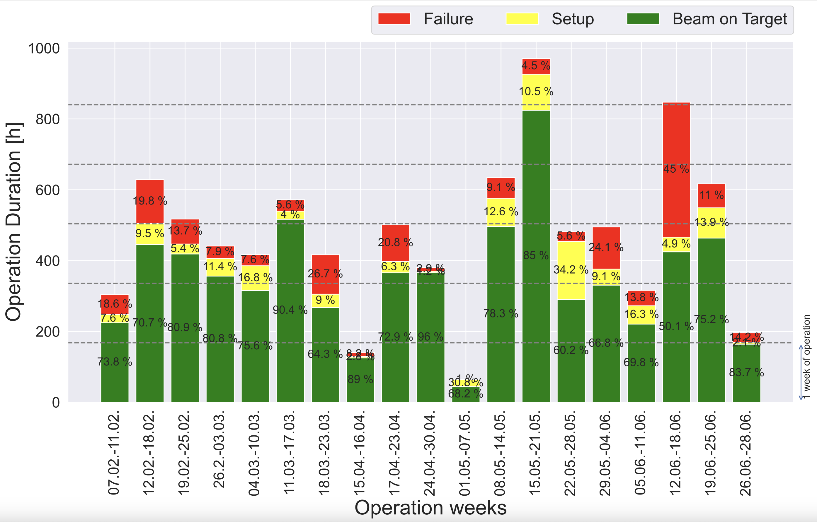
Availability Statistics 2024
average parallel factor: 2.8
Beam Time 2022
beam on target: 74%
average parallel factor: 2.7

Slide 6



Machine Availability
Machine | Availability within chain | Availability for experiments
UNILAC | 92% | 78%
SIS18 | 83%
ESR |  | 80%
HEST | 99% | 90%
Cryring |  | 69%
Availability as part of a chain
Availability for experiments if the machine represents the end of a chain

Slide 7
Top 5 longest single event interruptions 2024

Slide 8
Top 5 longest single event interruptions 2024
+ “hidden” events from machine exp. / eng.-runs / etc.

Slide 9
Top 5 systems that failed most frequently
11h exchange of interface card
15h driver, 6h booster mode
12h anode capacitor, 4h High-voltage cable exchanged
3h Heater card replaced

Slide 10
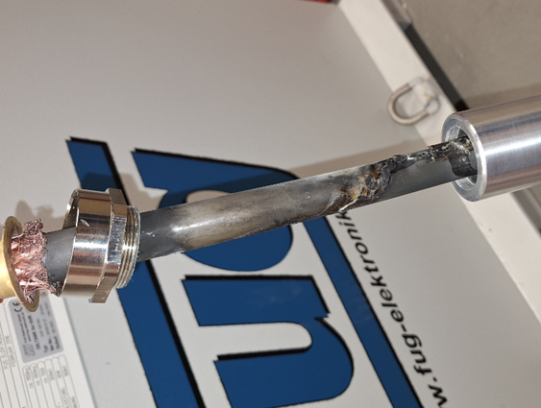
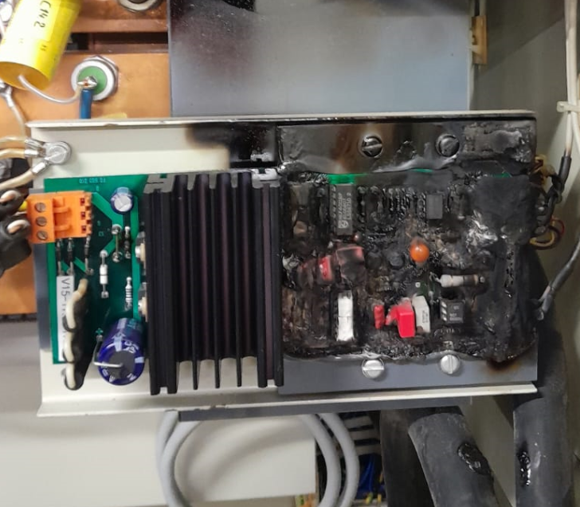
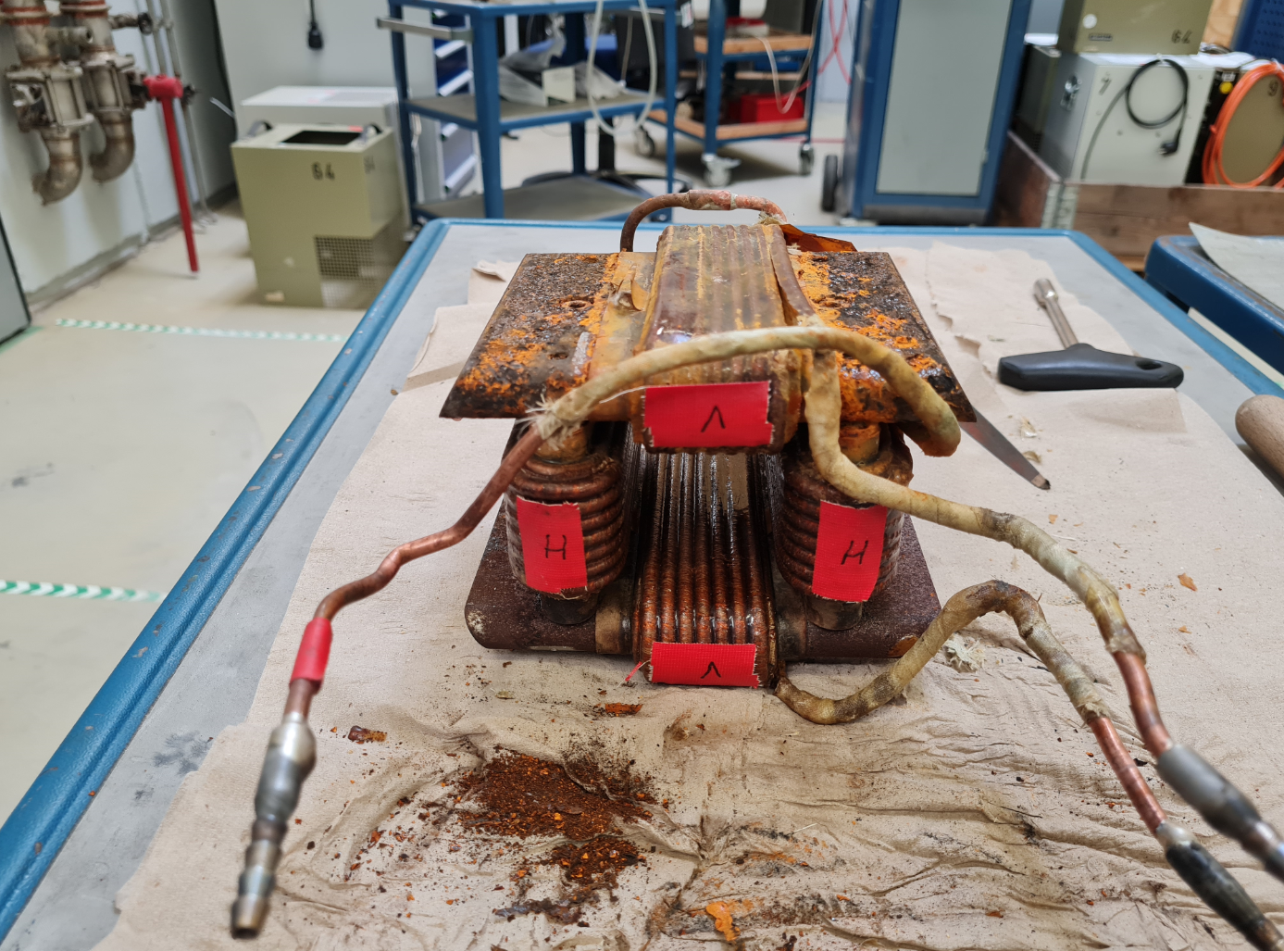
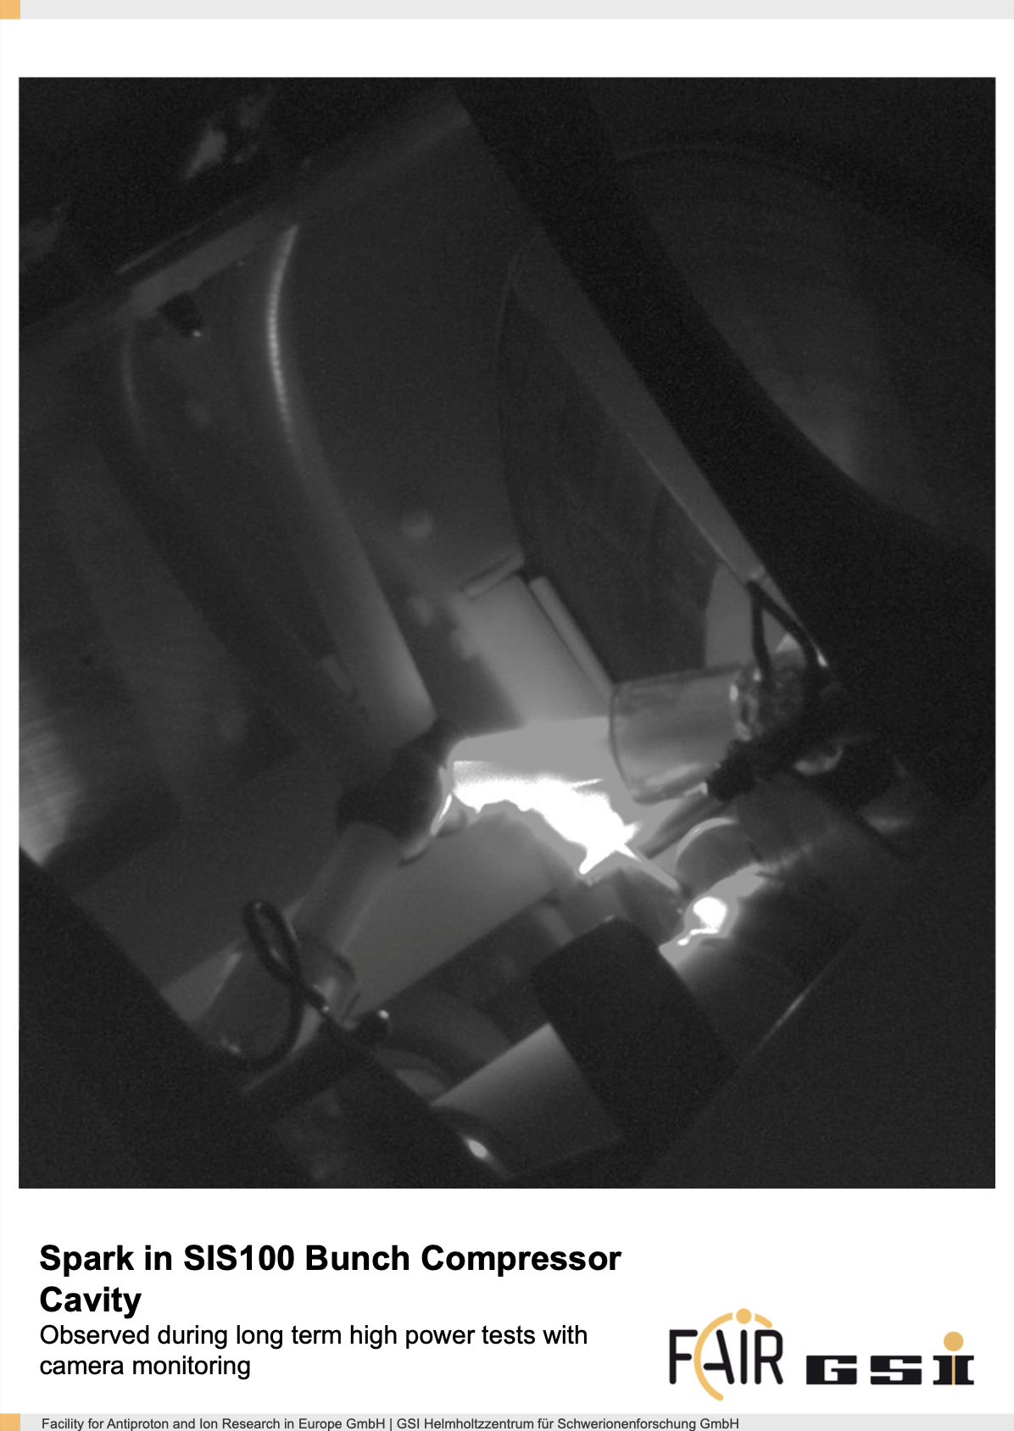
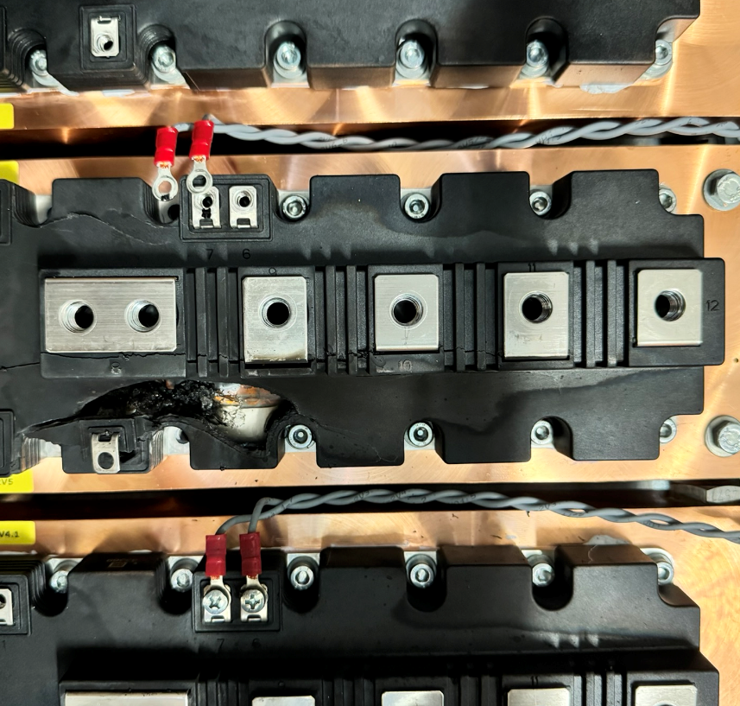
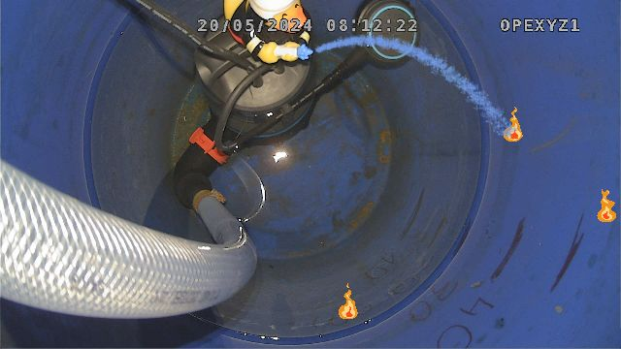
disaster pictures

Slide 11
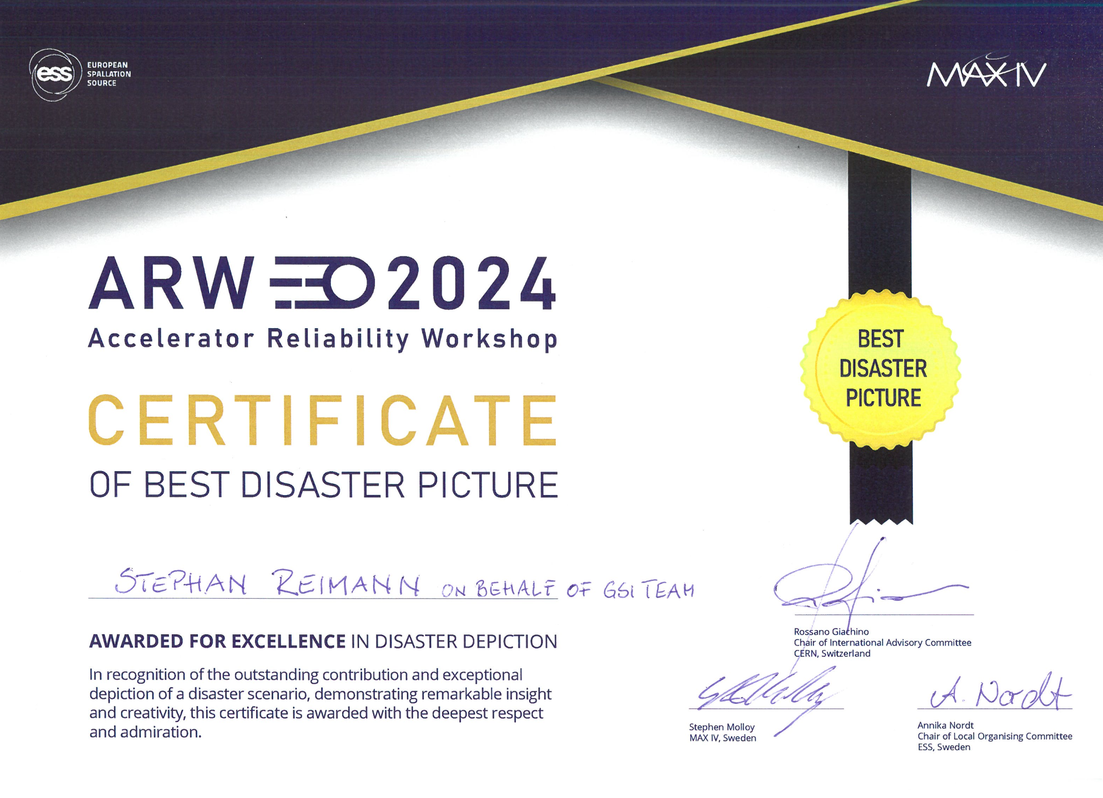
excellence in failure

Slide 12
on-call service most calls (>10) – total 423

Slide 13
on-call service highest integral working time (>24h) – total 748h
92 person days in total

Slide 14
Good Developments
beam time scheduling
  dedicated setup times
  longer blocks with same ions
  improved consideration of parallel operation and compatible experiments
better and more detailed documentation in OLOG
Cryring operation
  improved collaboration between shift crew and machine team
good preparation of SIS18 patterns by machine team
control system has stabilized
very good support by all machine-teams

Slide 15
Opportunities for Improvement
machine study coordination
  1 coordinator instead of 3 → campaign coordination concept from engineering run
operations coordination
  regular check of basic SIS18 settings & experiment data in logbook
communication of machine knowledge (e.g. SIS18 RF-setup, RF-KO, chimney setup, CO)
  operator School Q4 2024
setup of special operating modes at UNILAC
  machine team has been overcharged this year and operations team unlearns skills
  in case there are new concepts, knowledge transfer to operations team must be organized
regular setup of standard operating modes at SIS18 by machine team
  help with preparation and regularly check settings, but don’t do setup unless called
certain controls aspects
  LSA storage, only few devices achieved, digital actual-values, OP optimized UIs, infrastructure data

Slide 16
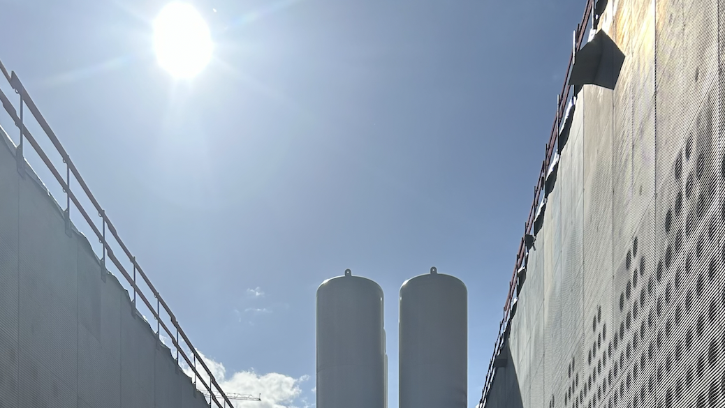
Thanks for the great support during the beam time 2024

